Slide 1
MUSE E-133 | Fall Term 2016 | CRN 15155
Performing the Digital Museum
Susan Hazan
September 6 Museums on the Web The distributed museum; authenticity, originality and clone-ability

Slide 2
MUSE E-133 | Performing the Digital Museum
September 6 Museums on the Web The distributed museum; authenticity, originality and clone-ability
Tate | Broad
Non-places | Places of universal value
Assignment
Louvre | British Museum
Natural History | Jurassic technology
Discussion

Slide 3
What is the world’s most reproduced work of art?
https://www.artsy.net/article/artsy-editorial-this-is-the-most-reproduced-artwork-of-all-time
British sculptor Arnold Machin crafted the effigy almost 50 years ago to appear on the country’s definitive postage stamp. Since then, the Royal Mail has printed some 220 billion stamps bearing copies of Machin’s artwork.

Slide 4
Tate | Broad

Slide 6
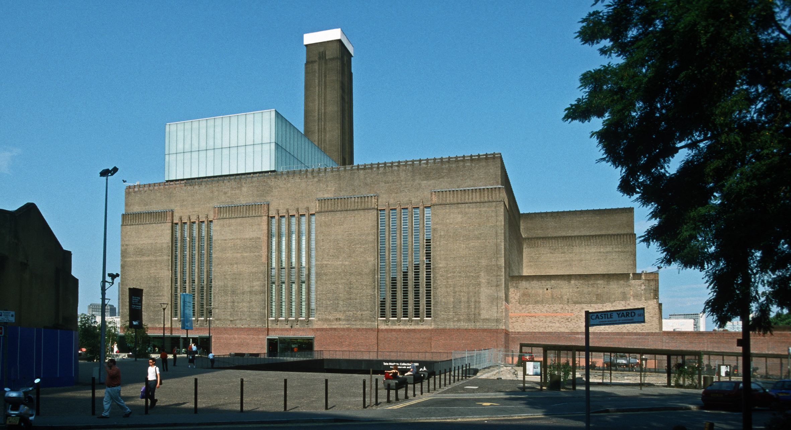

Slide 7
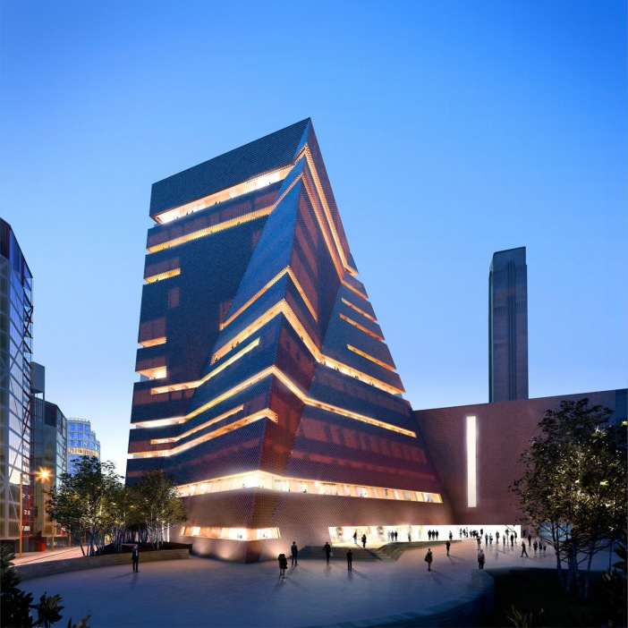
View from the South at dusk
© Hayes Davidson and Herzog & de Meuron

Slide 8
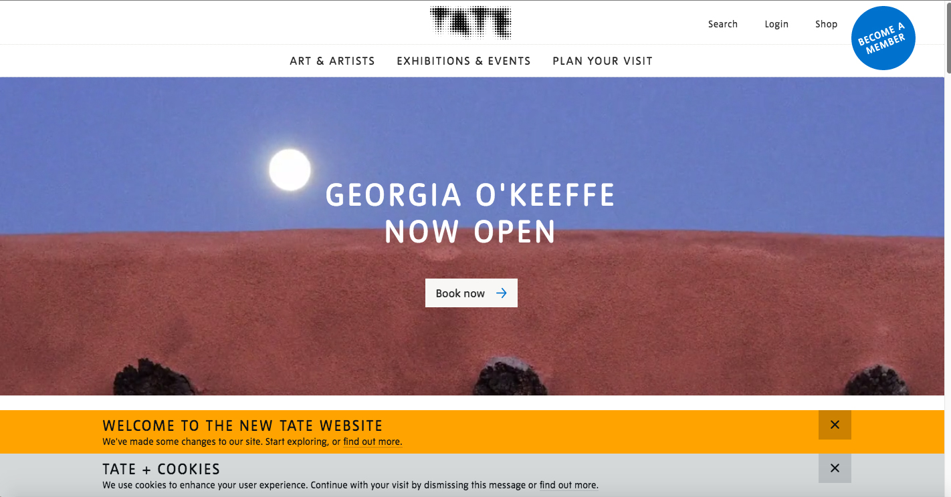

Slide 9
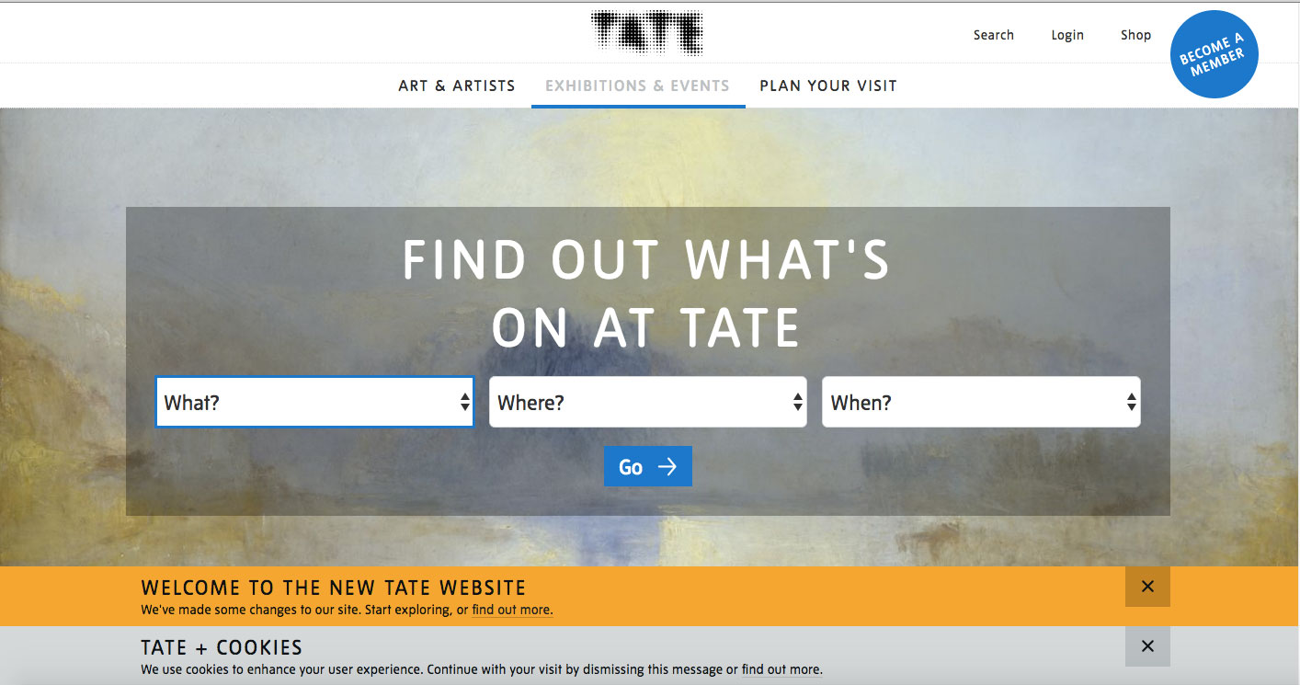

Slide 10
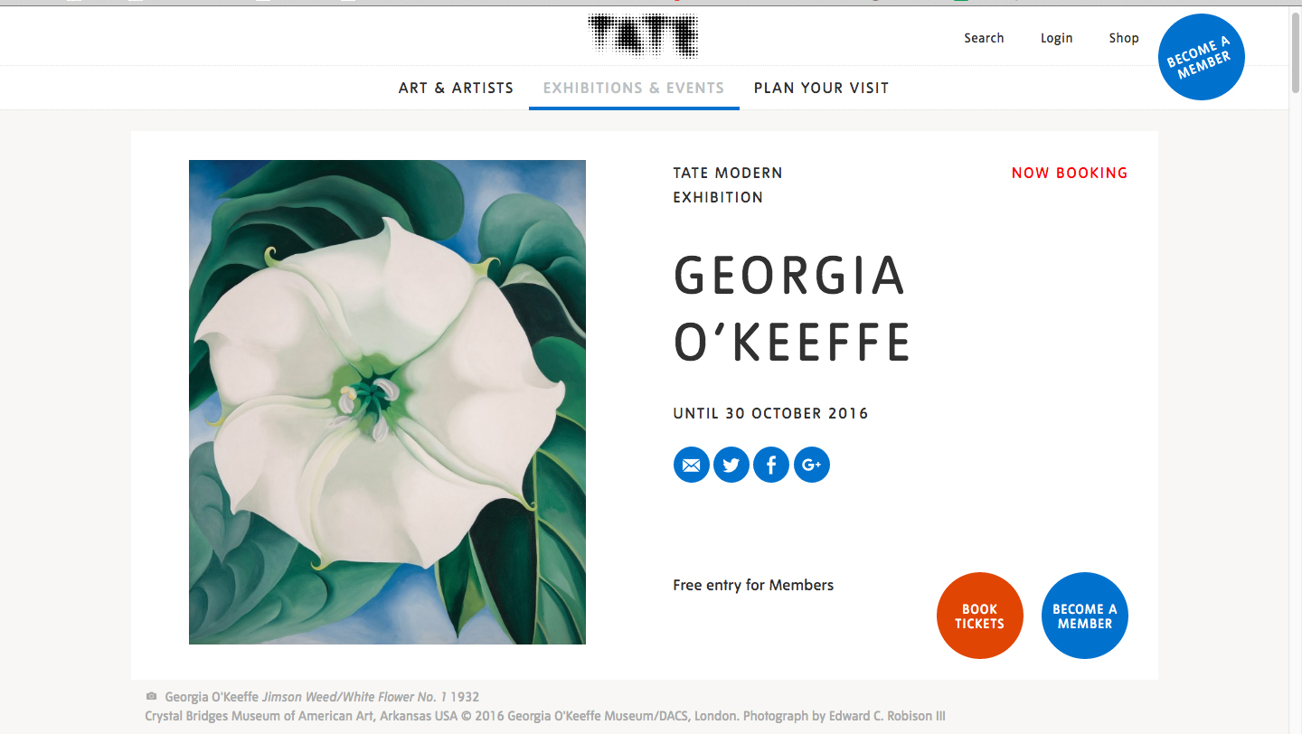
http://www.tate.org.uk/whats-on/tate-modern/exhibition/georgia-okeeffe

Slide 11
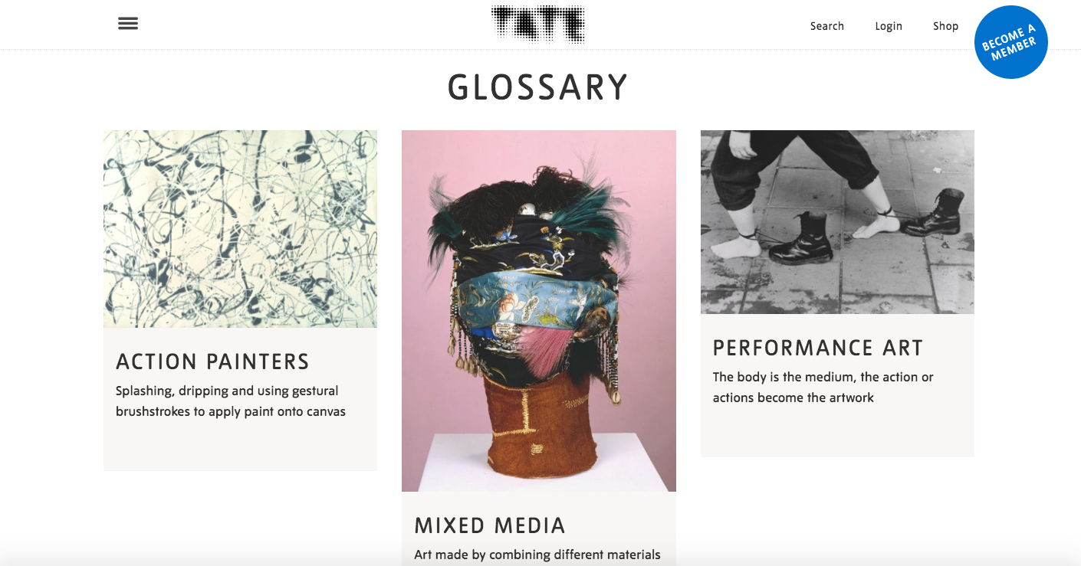

Slide 12
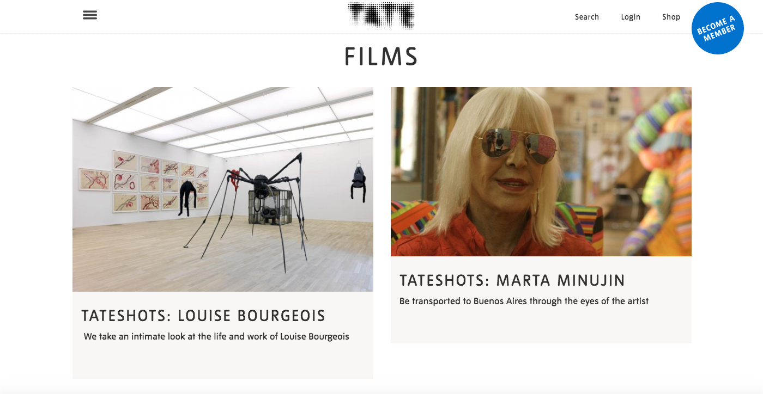

Slide 14
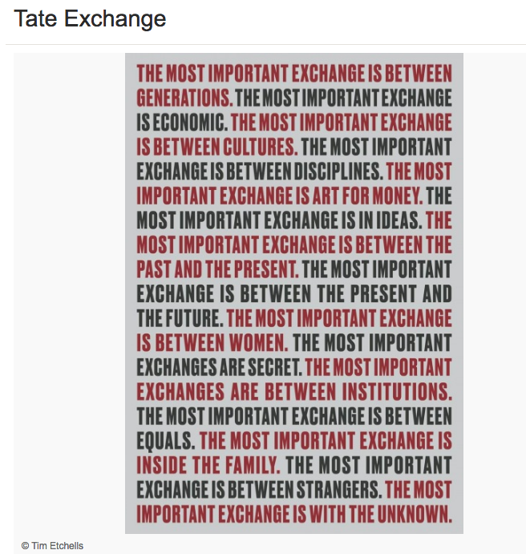

Slide 15
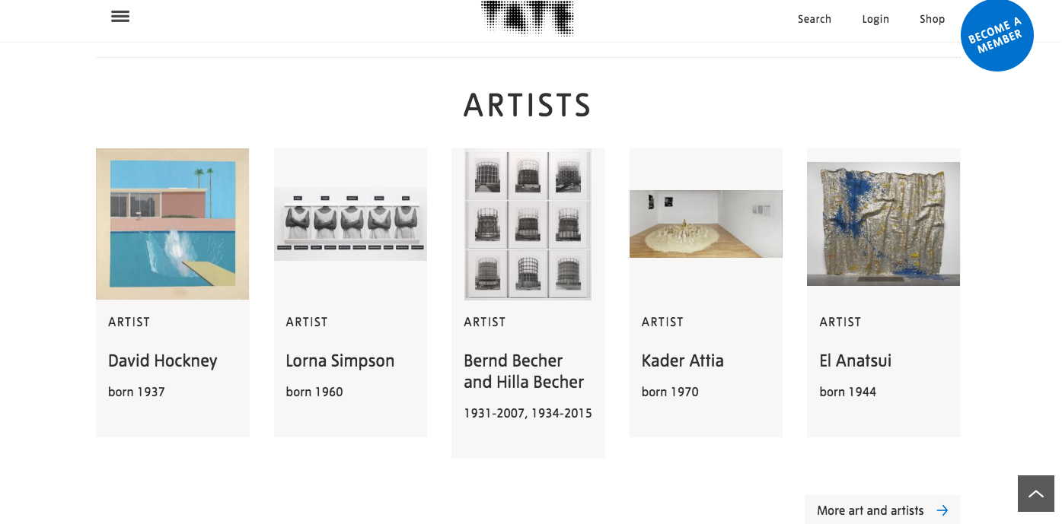

Slide 16
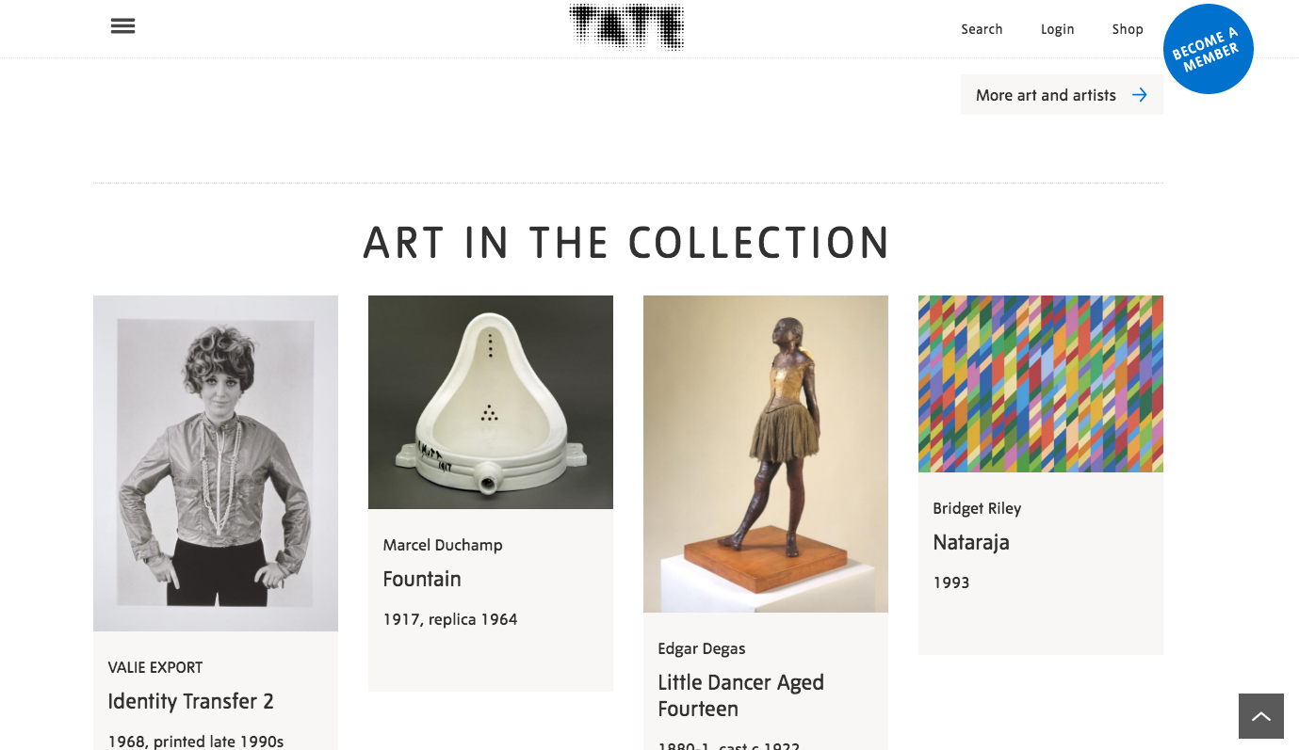

Slide 17
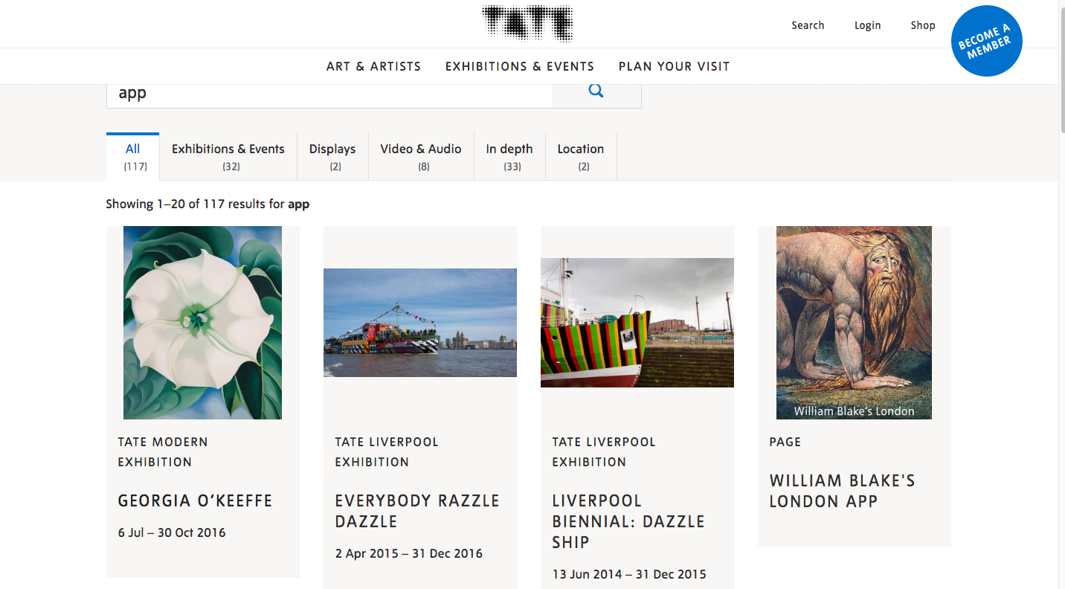
Museum Apps

Slide 19
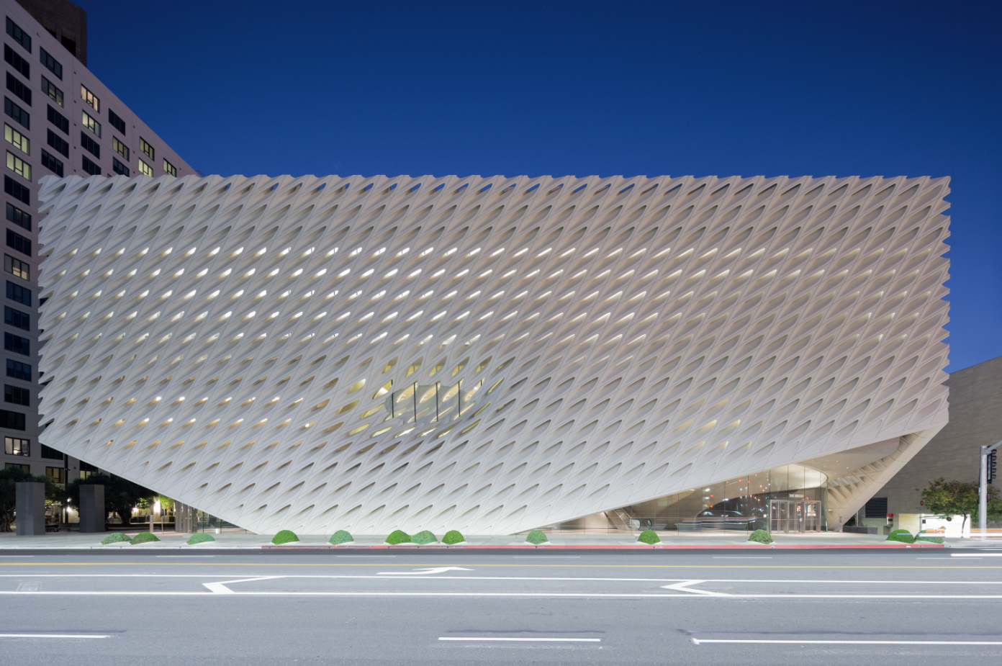

Slide 21
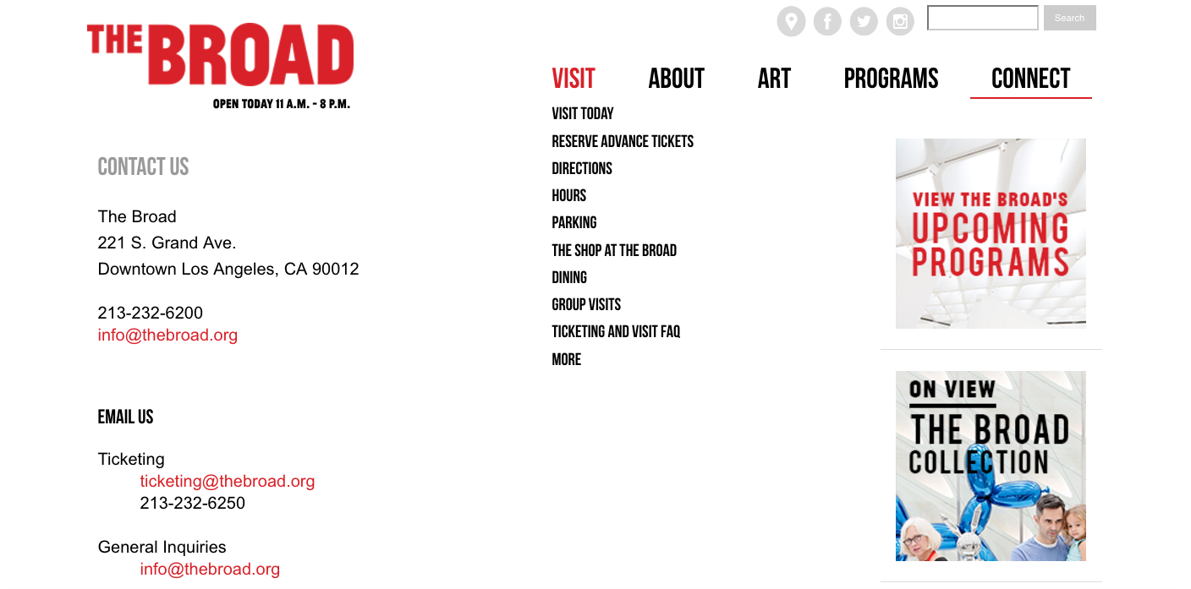

Slide 22
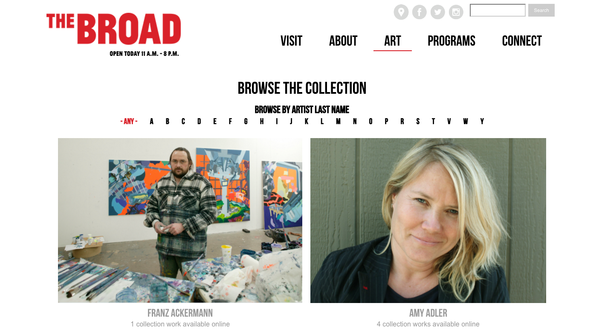

Slide 23
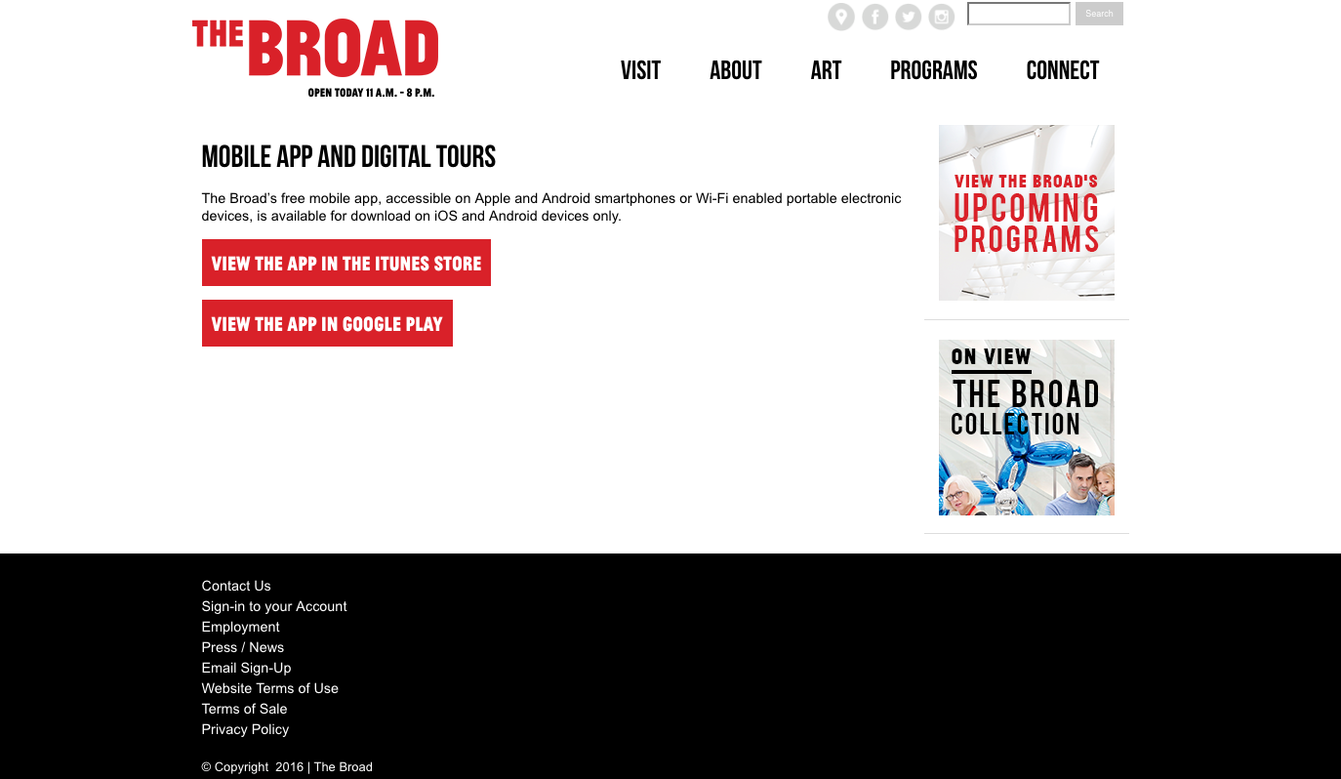
Museum Apps

Slide 24
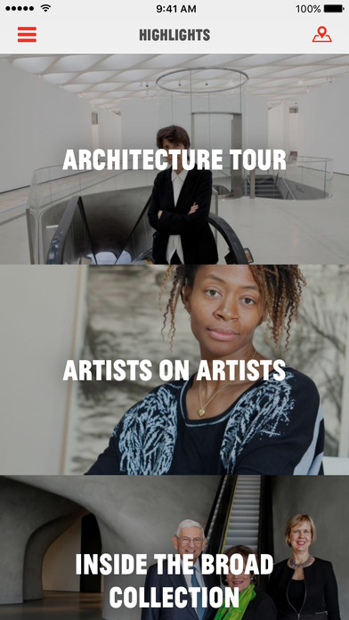
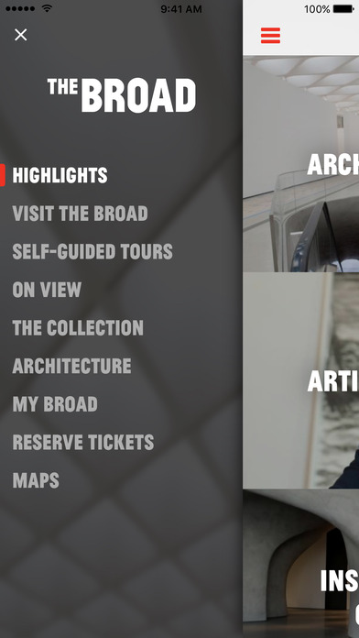

Slide 25
Louvre | British Museum

Slide 26
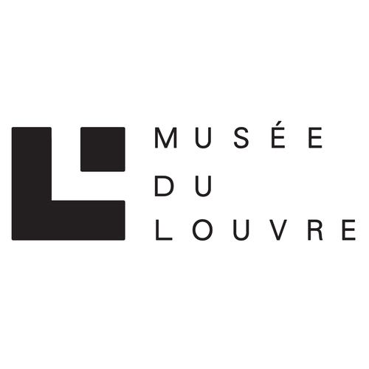

Slide 27
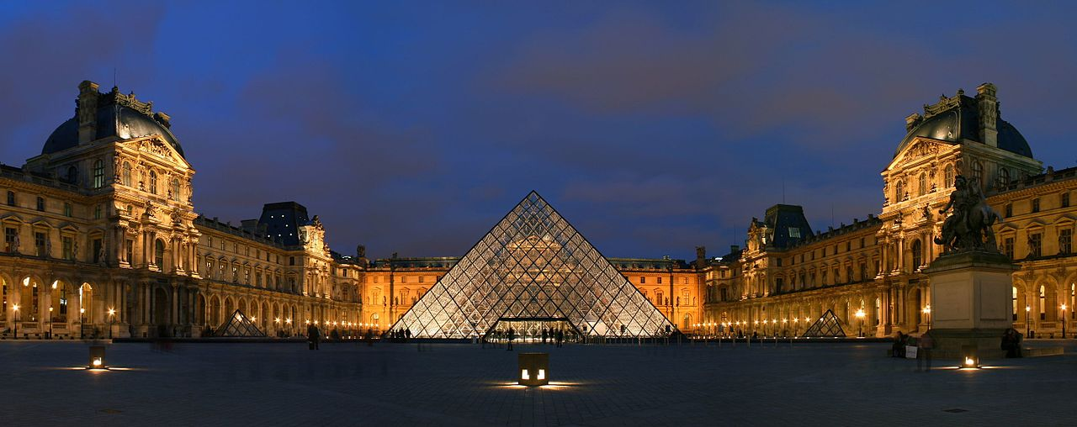
The Louvre with the Louvre Pyramid in the middle, Benh LIEU SONG - Own work, Courtyard of the Museum of Louvre, and its pyramid. This picture is a panorama made from stitching three pictures with Hugin, File:Louvre 2007 02 24 c.jpg, Created: 24 February 2007

Slide 30
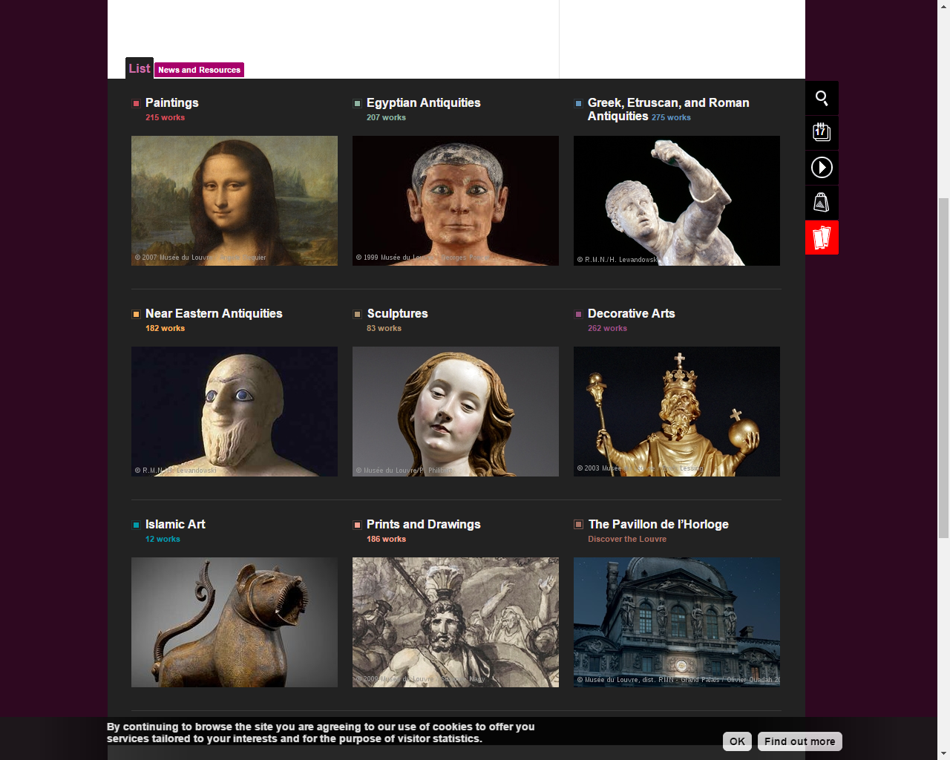

Slide 31
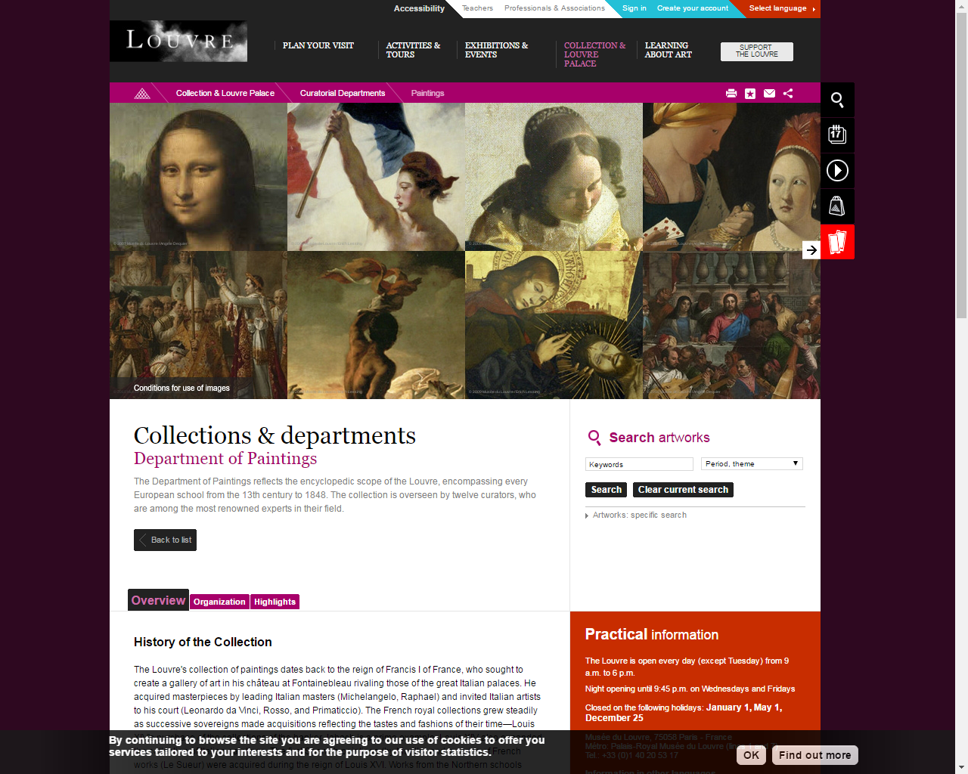

Slide 32
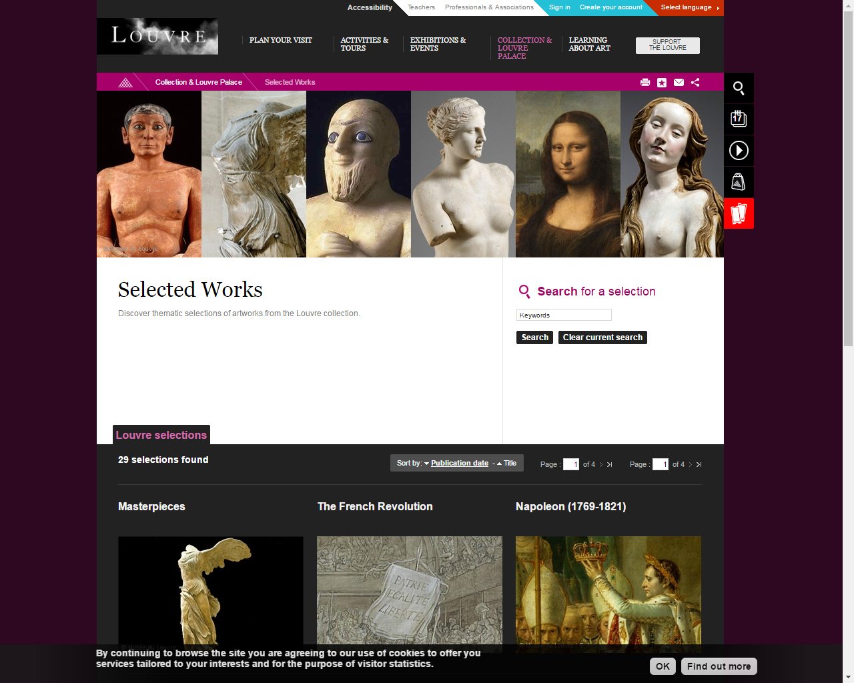

Slide 33
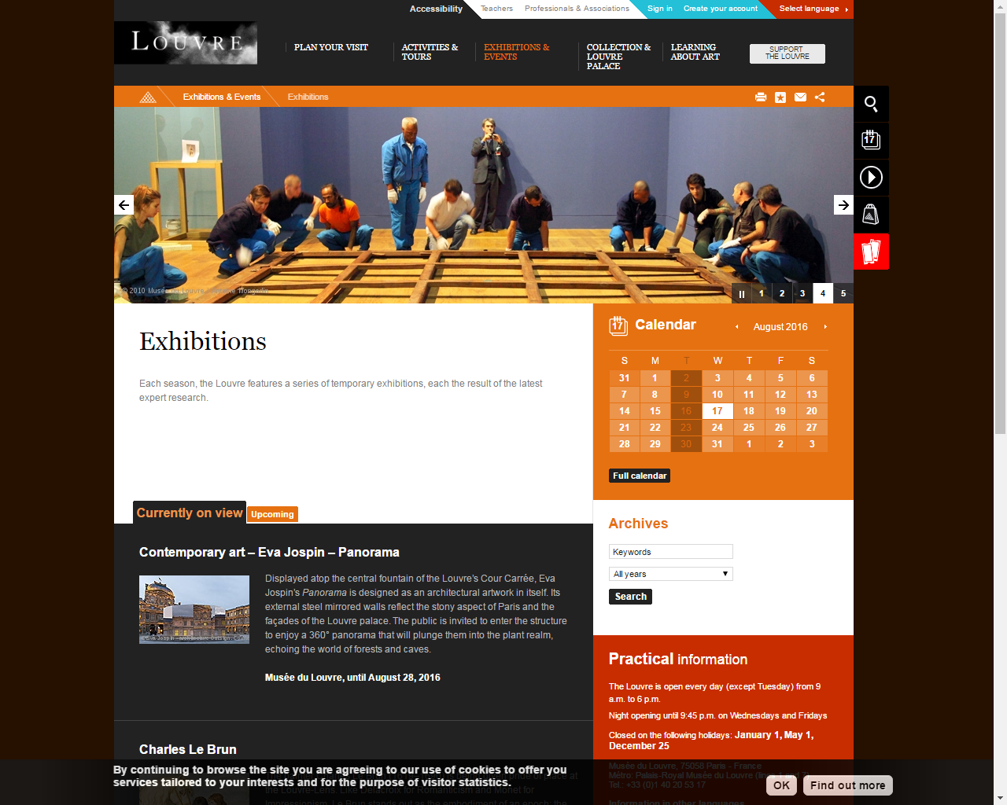

Slide 34
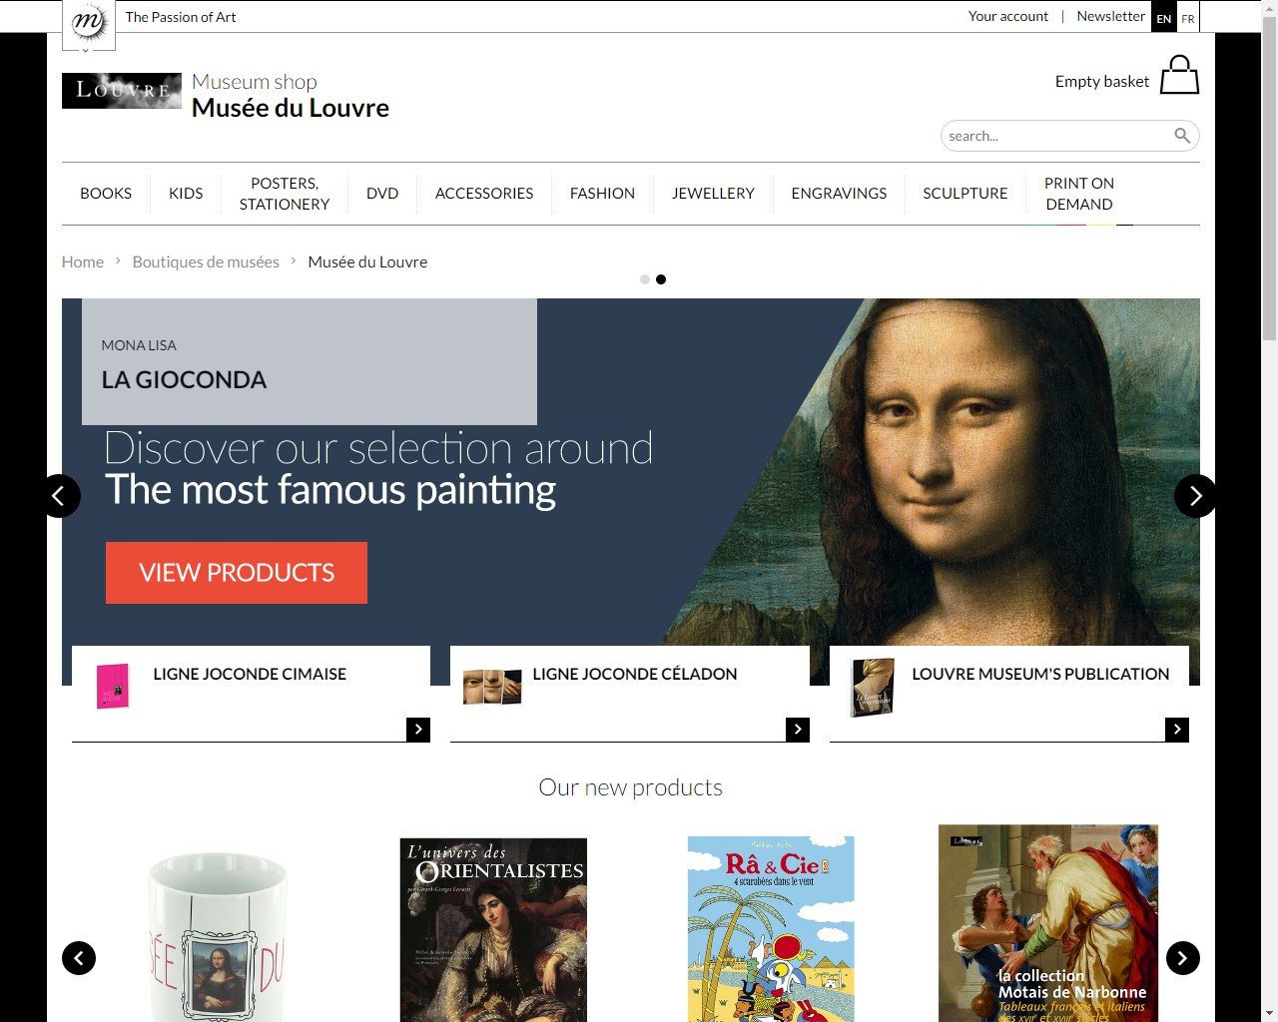

Slide 36
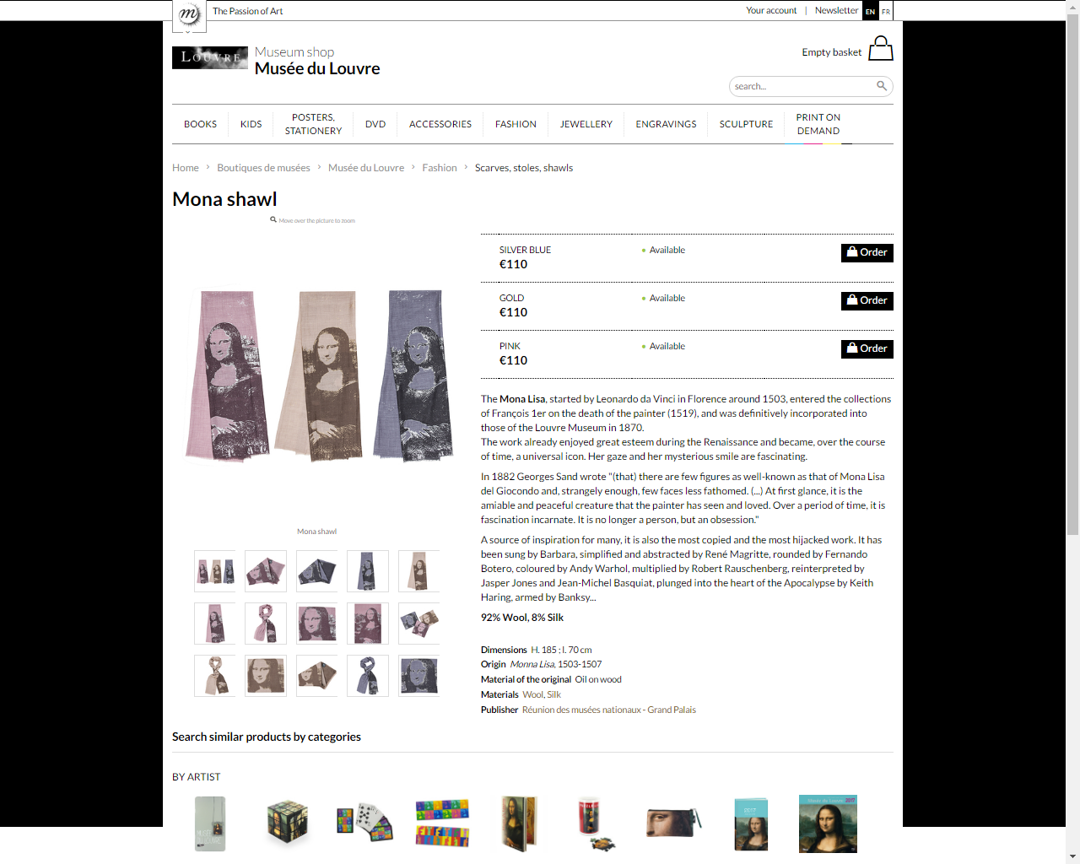

Slide 37
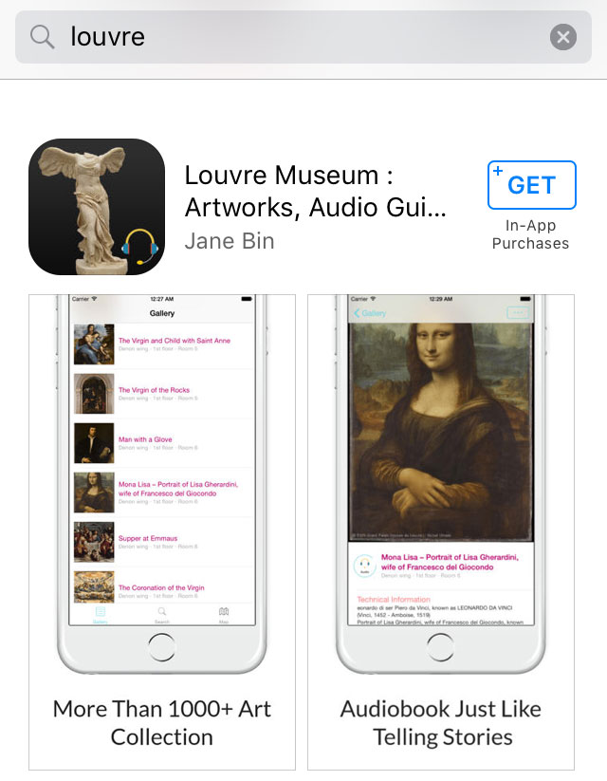
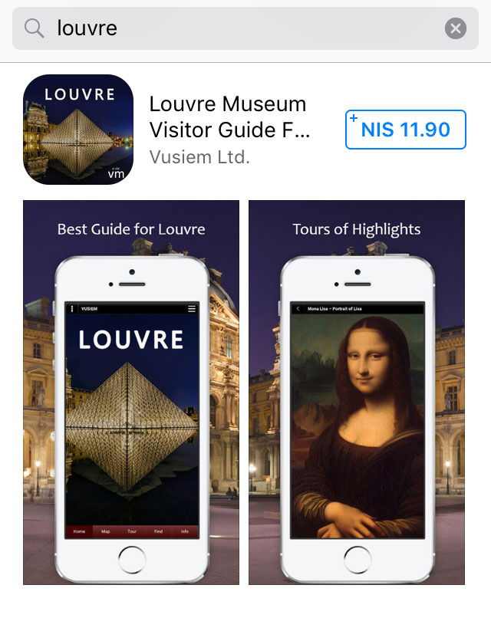
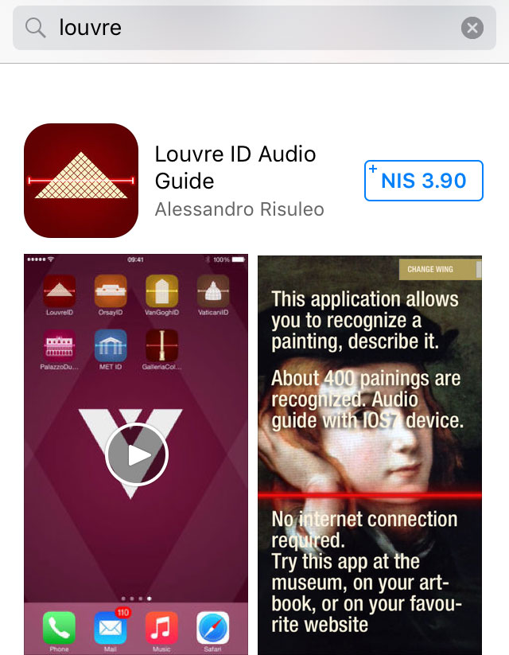
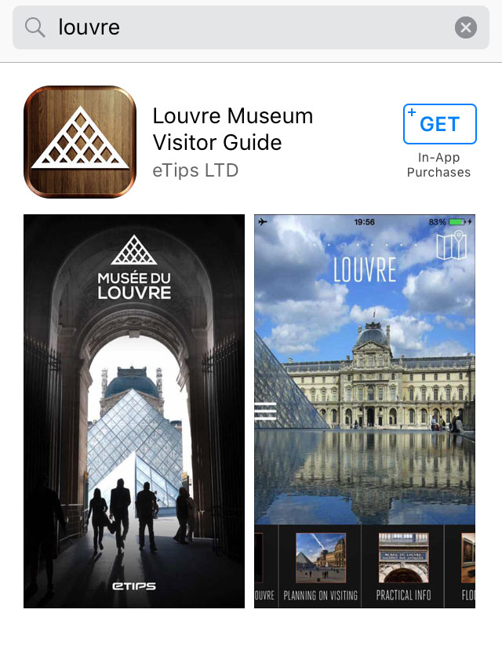
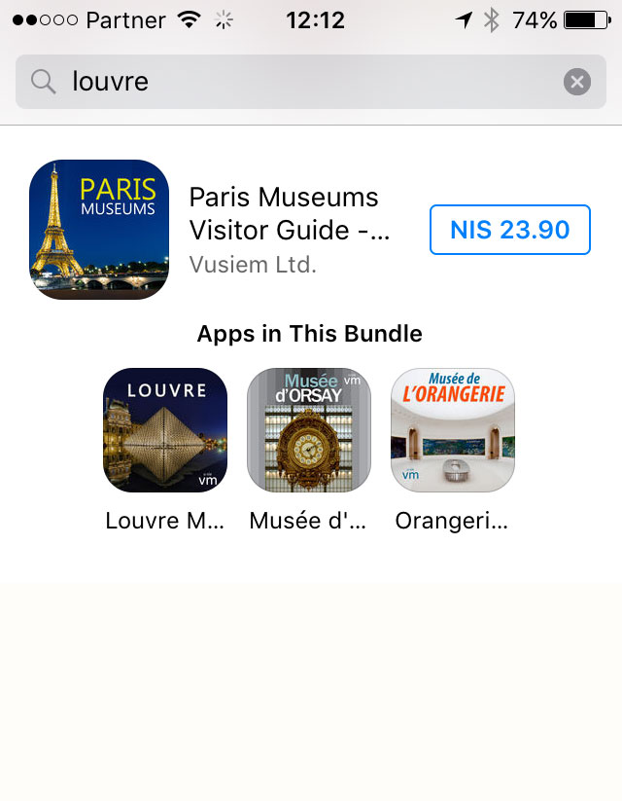
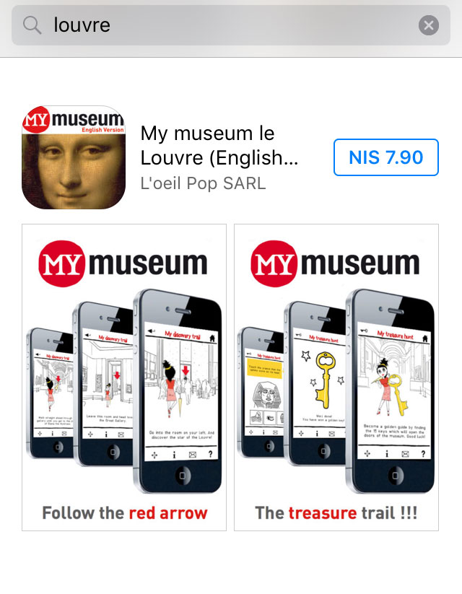
Museum Apps

Slide 38
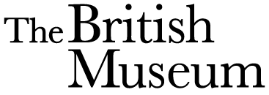

Slide 39
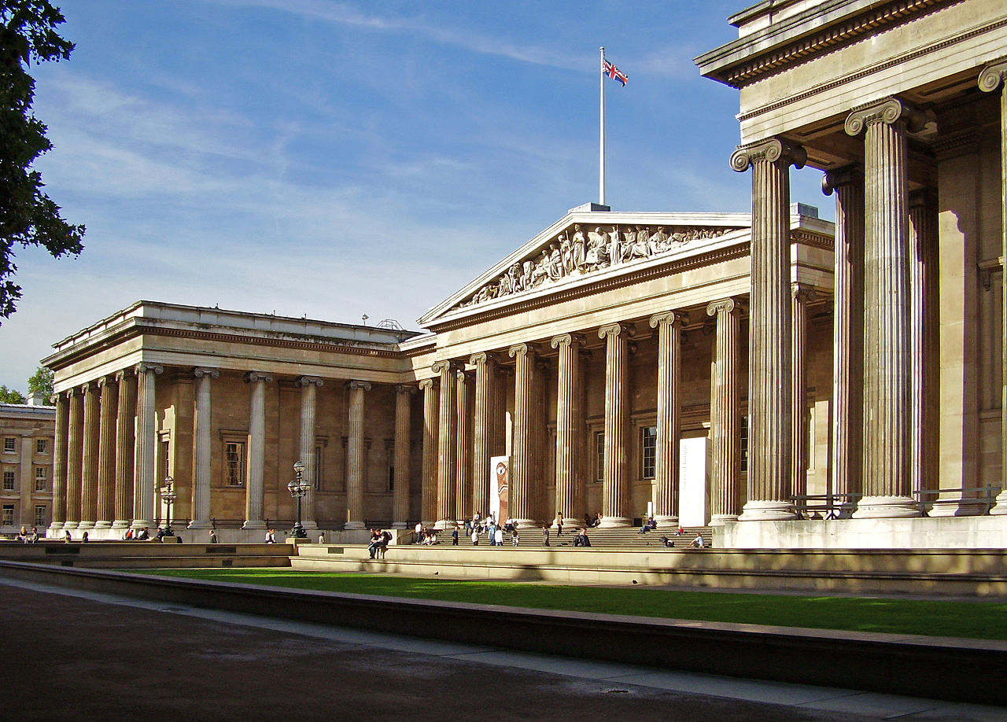
Façade of the British Museum, Ham - Own work, File:British Museum from NE 2.JPG, Uploaded: 4 May 2013

Slide 40
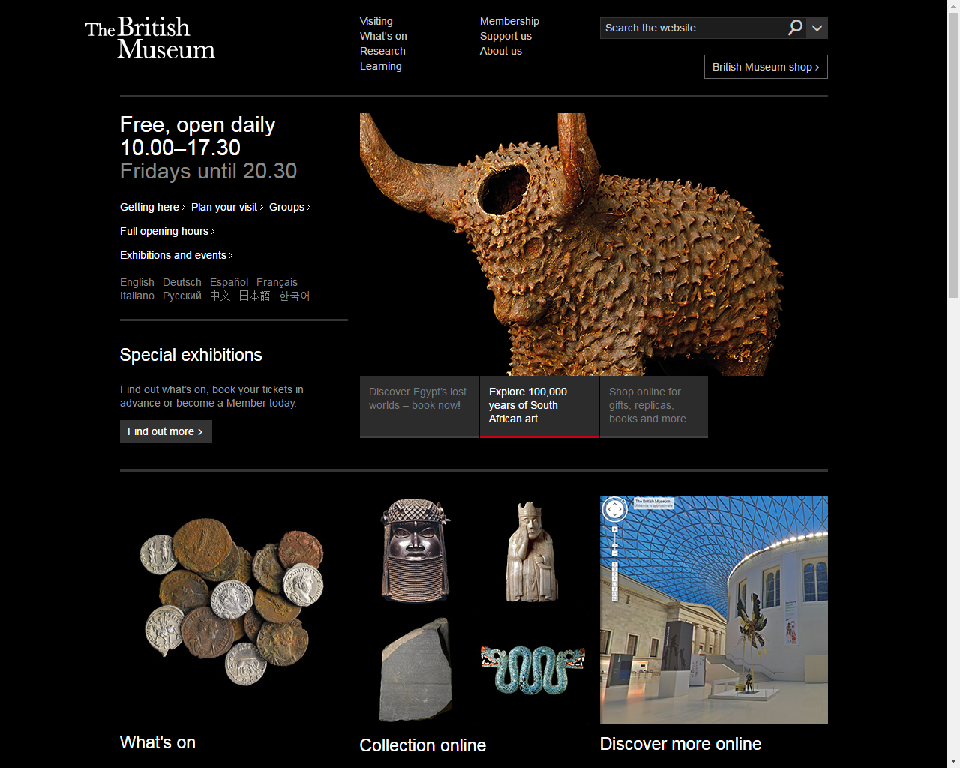

Slide 41
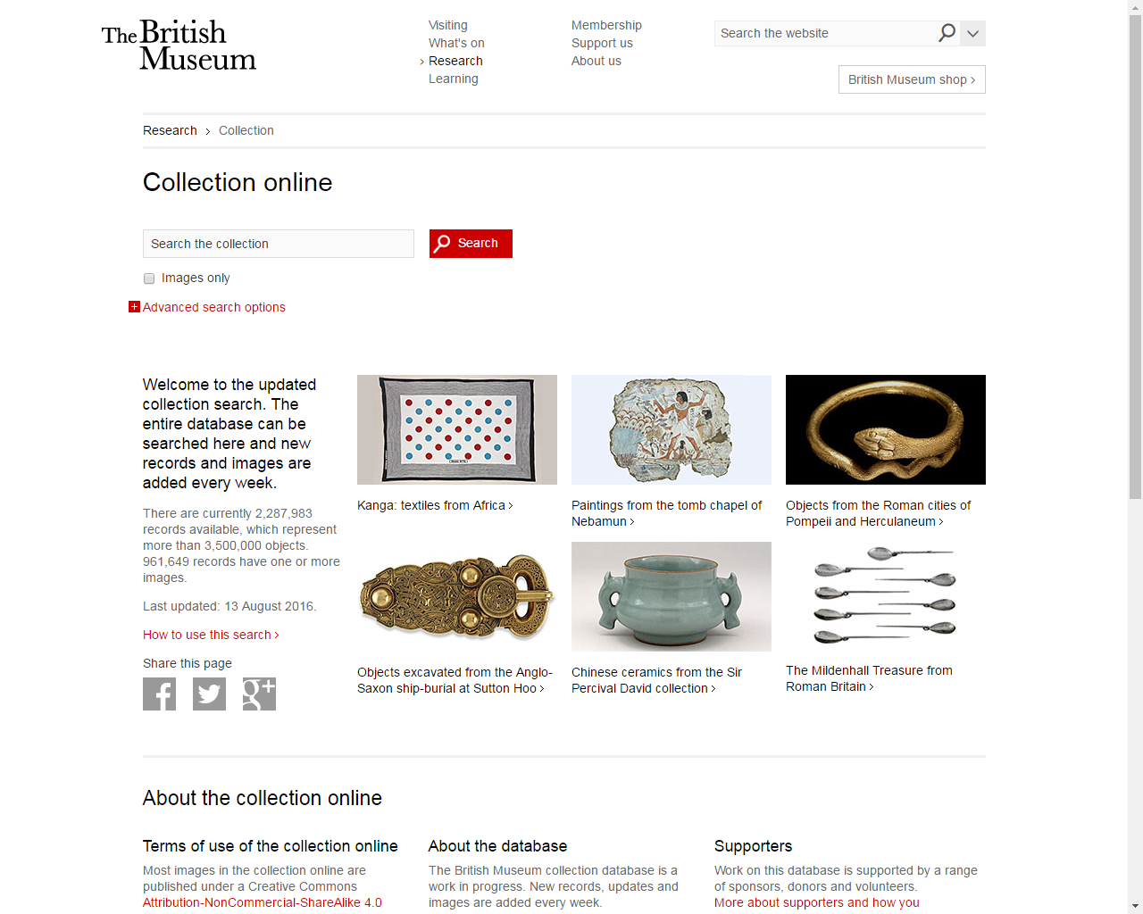
British Museum collection
The entire database can be searched and new records and images are added every week.
There are currently 2,288,990 records available, which represent more than 3,500,000 objects. 961,649 records have one or more images.

Slide 42
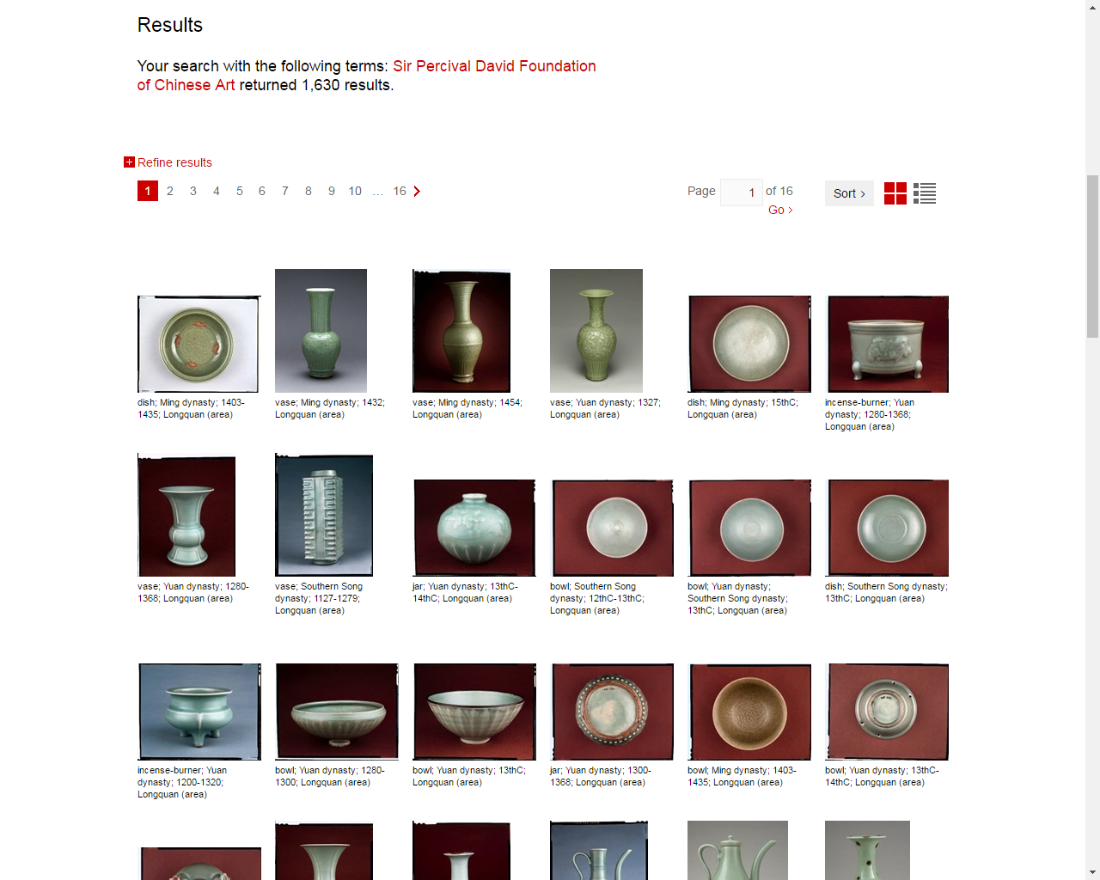

Slide 43
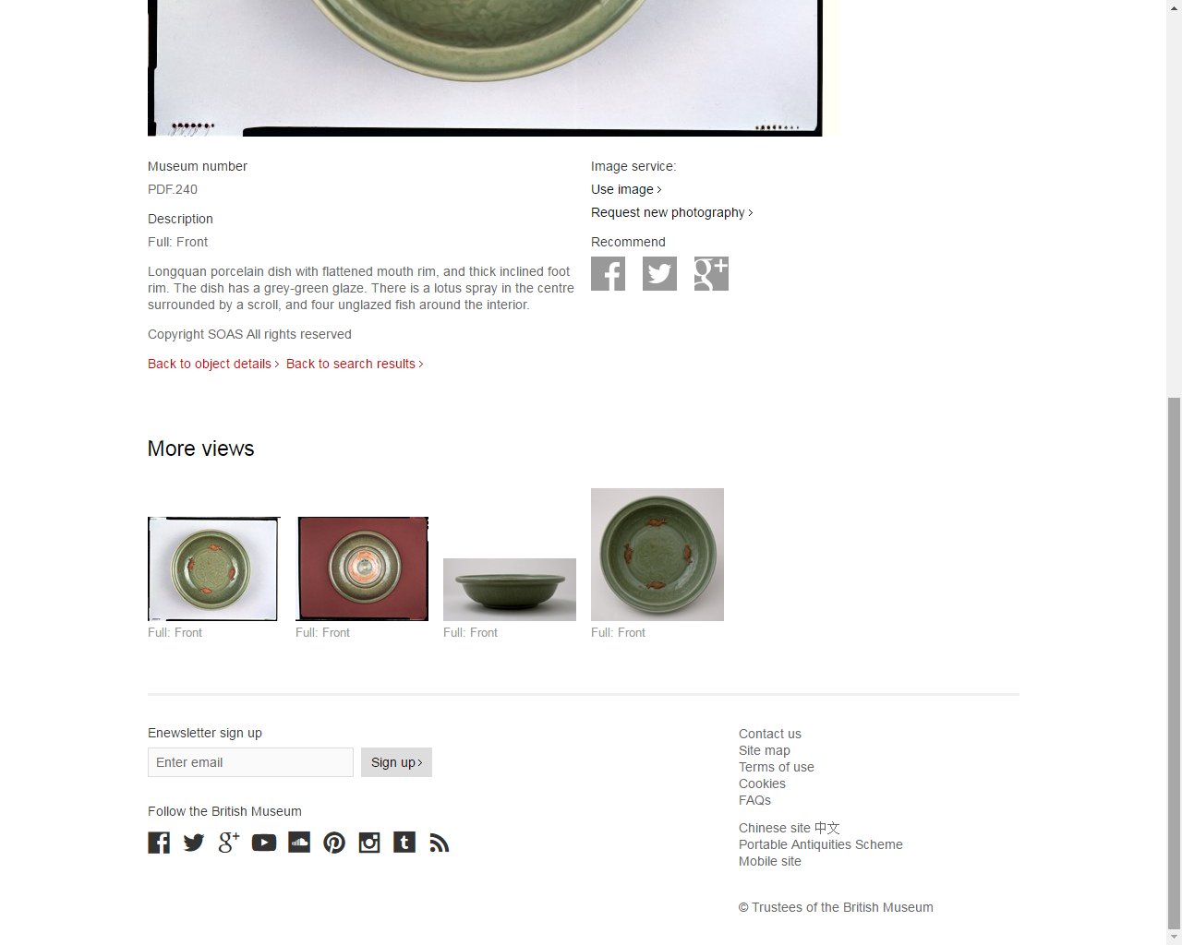
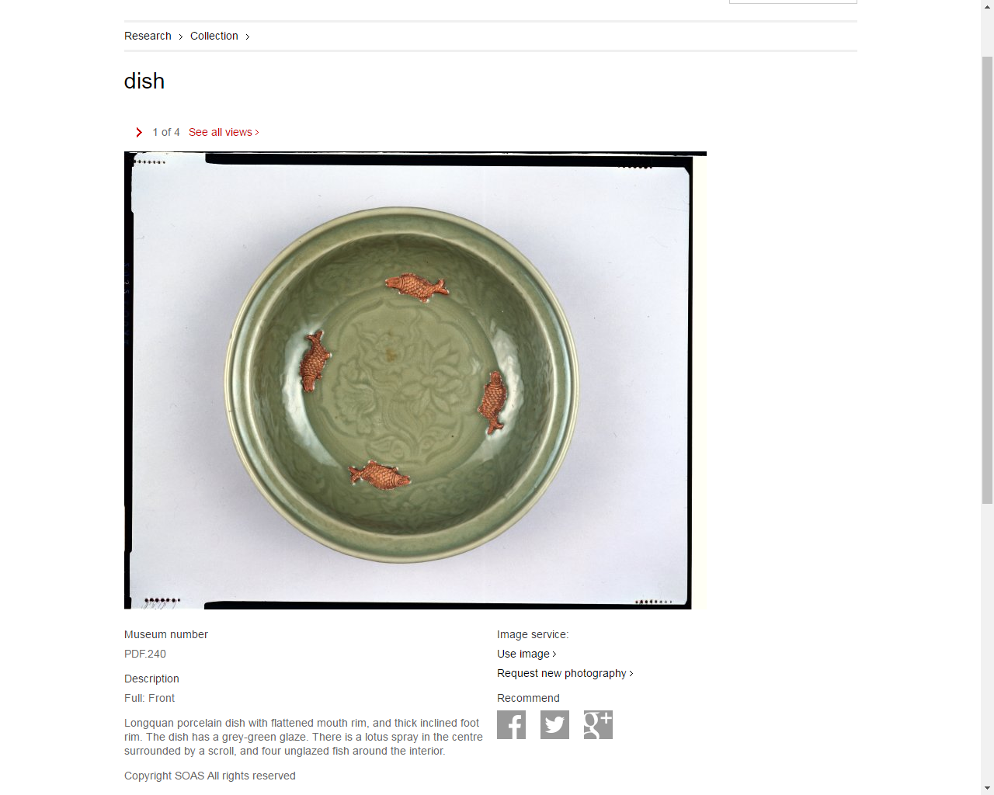

Slide 46
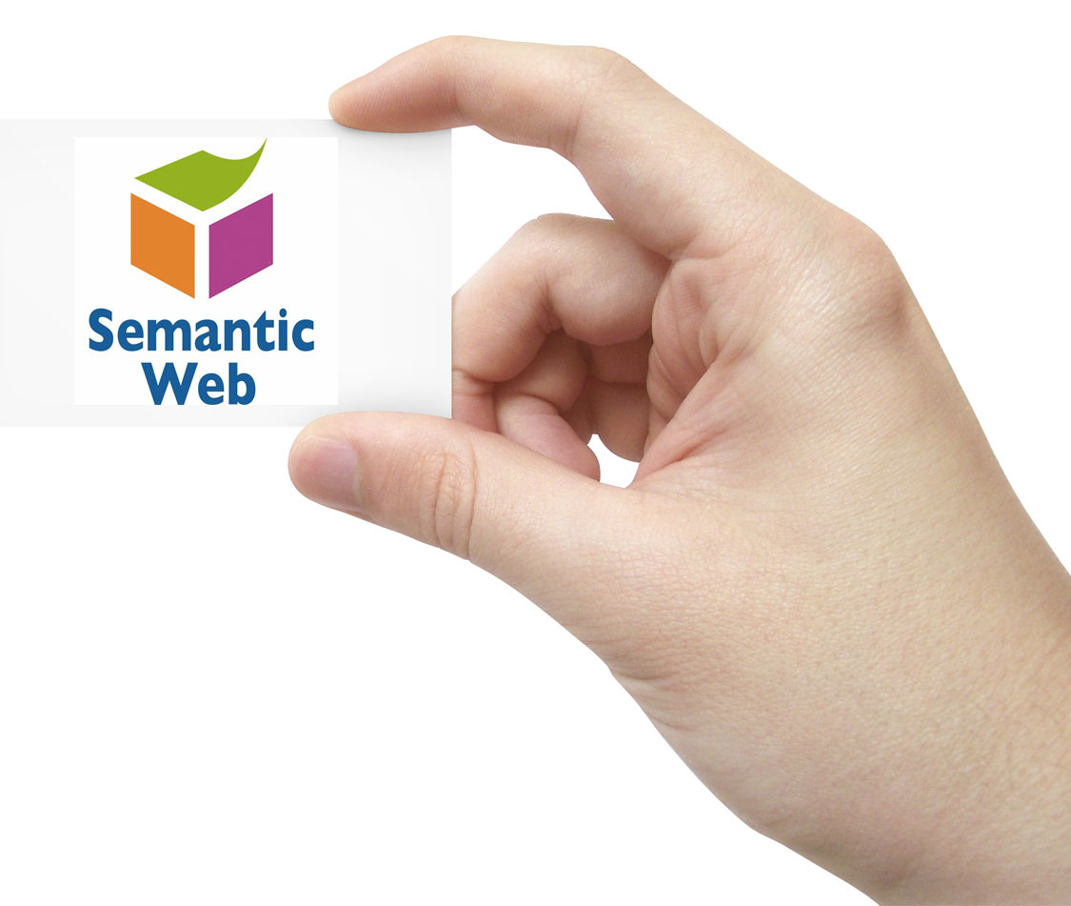
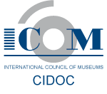
Semantic web version
British Museum collection data is available in the W3C open data standard, RDF, joining and relating to a growing body of linked data published around the world.
Powered by the CIDOC Conceptual Reference Model and SPARQL 1.1
http://collection.britishmuseum.org/
https://www.w3.org/standards/semanticweb

Slide 47
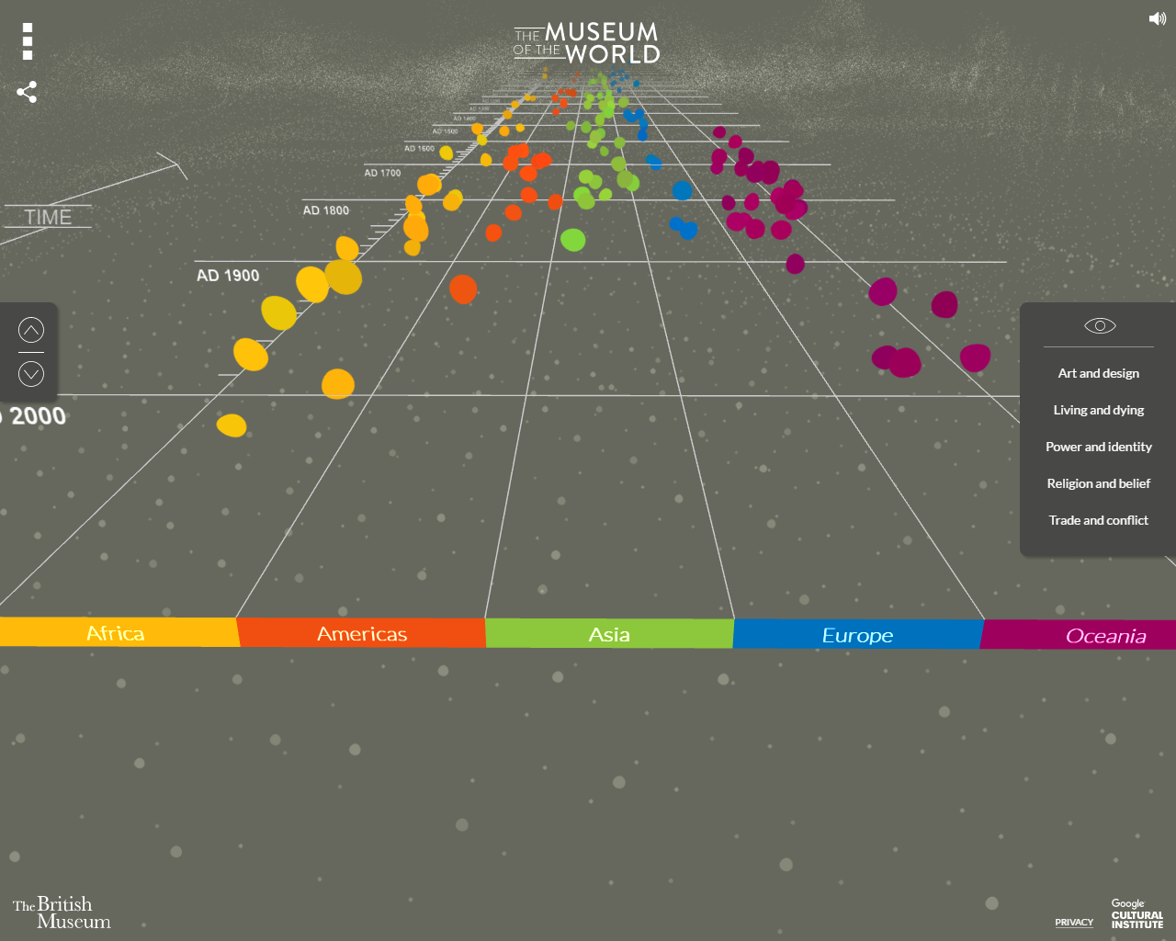

Slide 48
The Museum of the World is an interactive experience, featuring some of the most fascinating objects in human history.
Discover British Museum objects from prehistory to the present using the most advanced WebGL (Web Graphics Library) technology available.
Jump back in time, listen to curators share their insights, and connect objects across time and space.

Slide 49
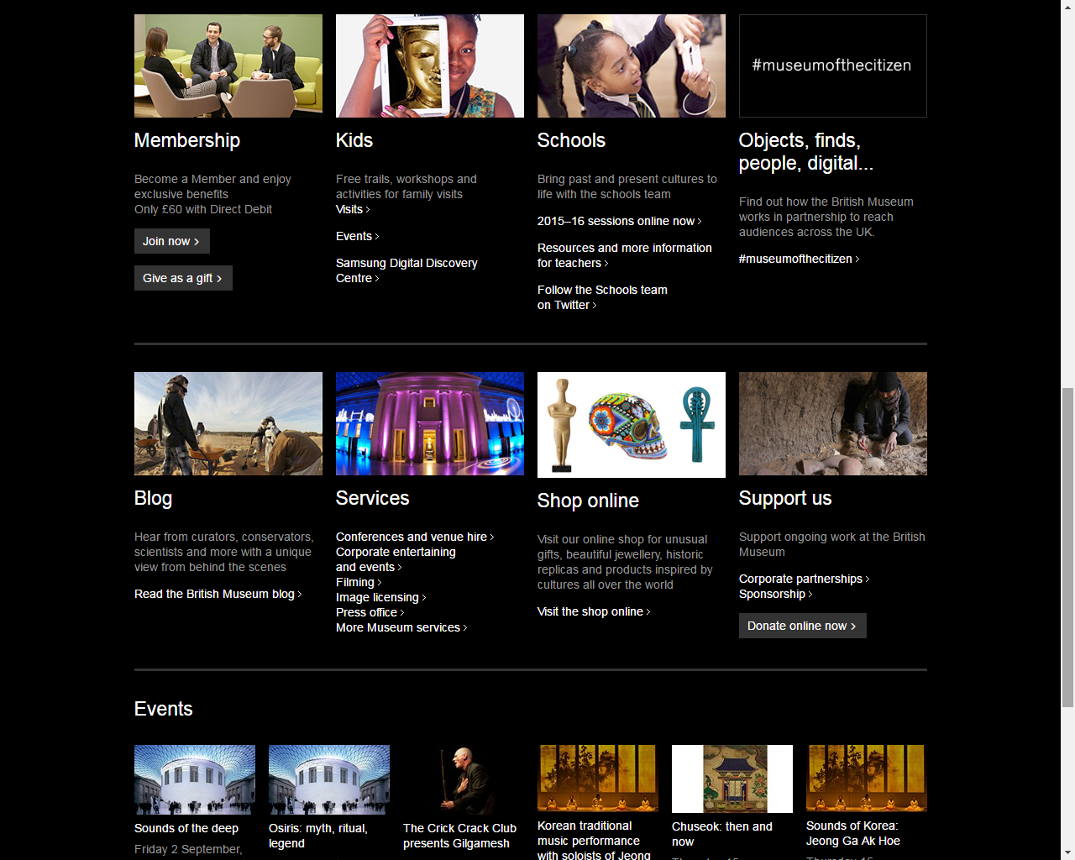

Slide 50
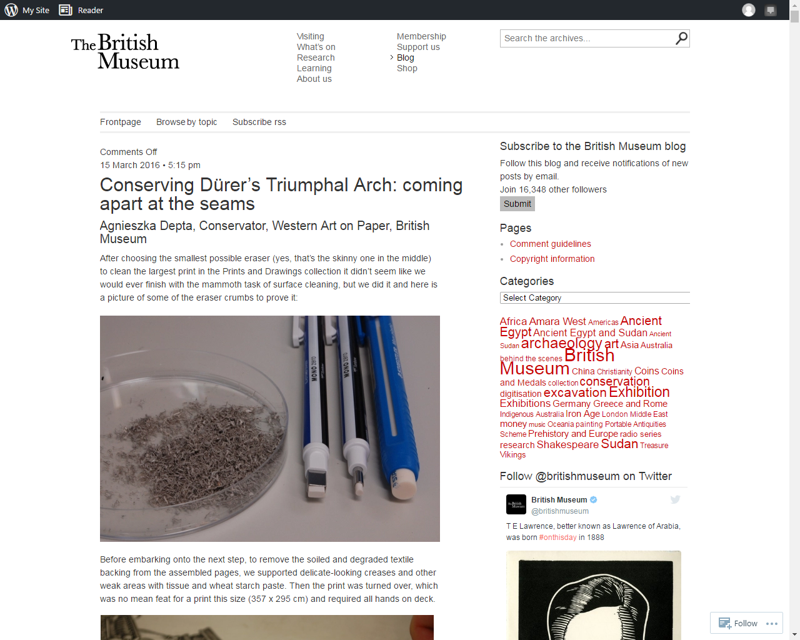

Slide 51
Performing the (Digital) Museum

Slide 52
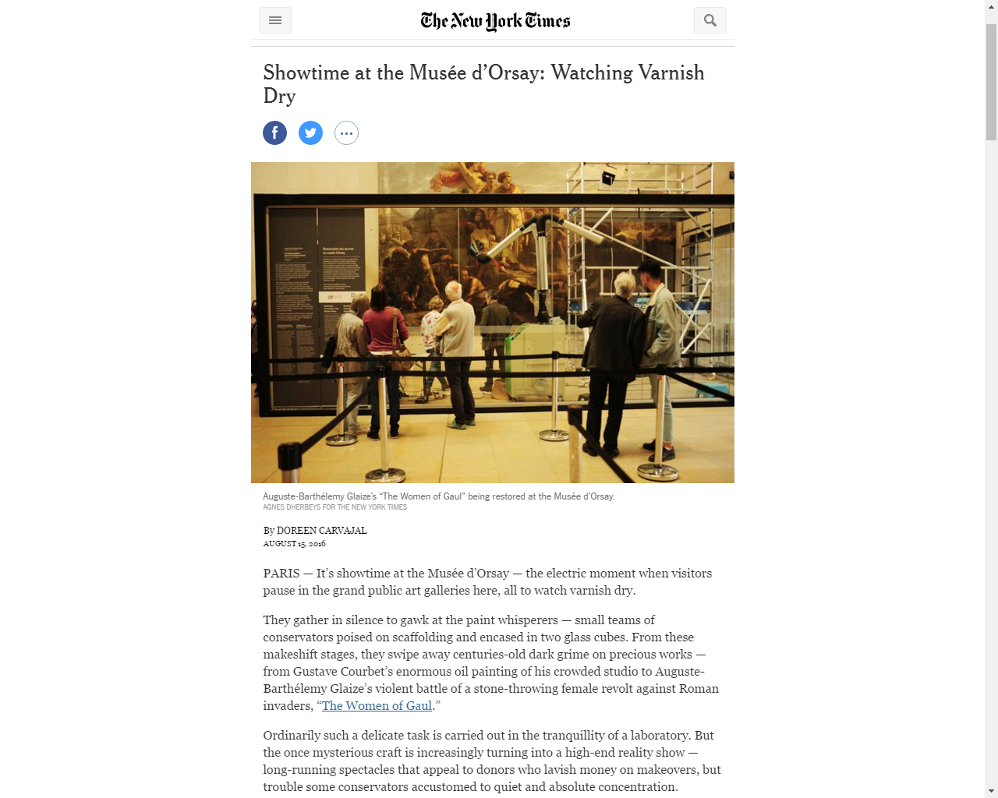

Slide 53
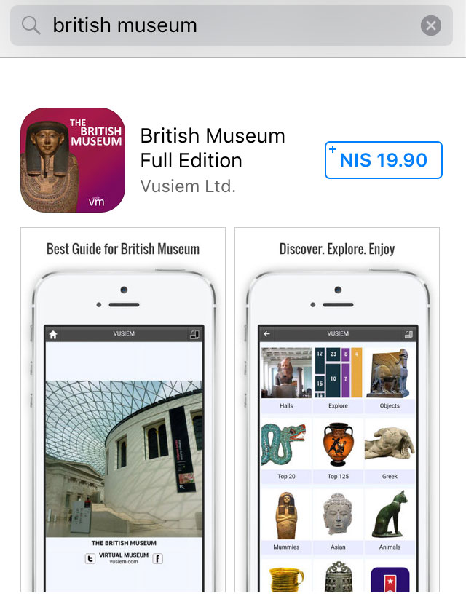
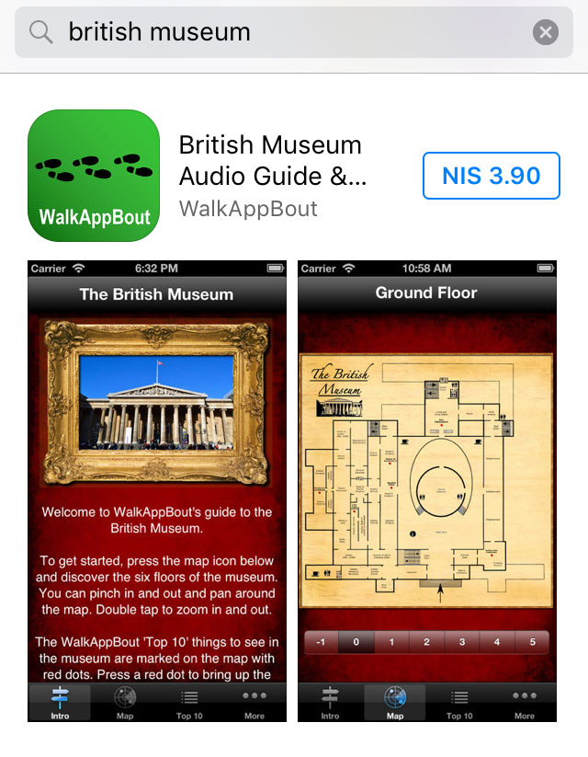
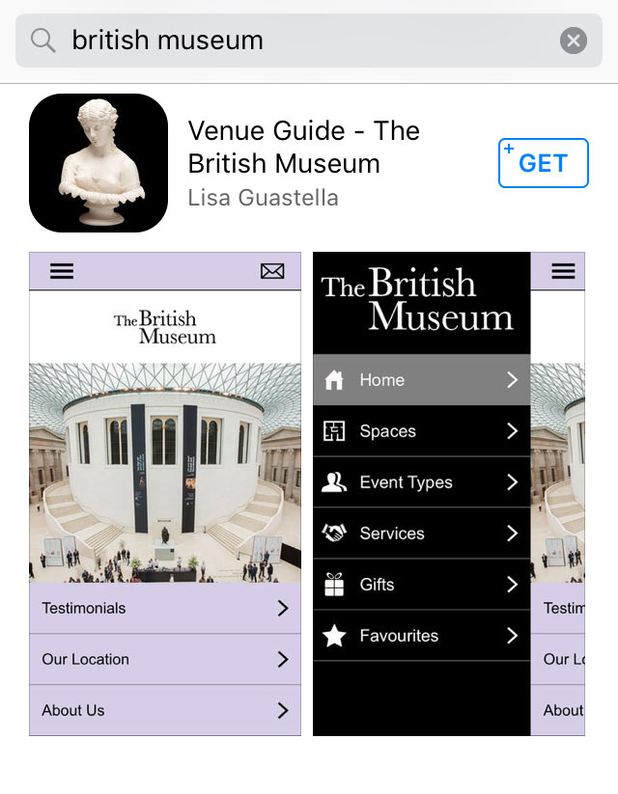
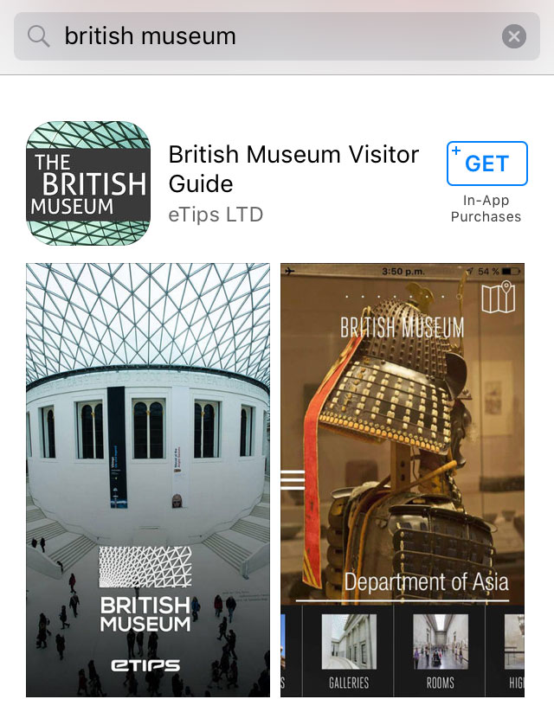
Museum Apps

Slide 54
Natural History | Jurassic technology

Slide 56
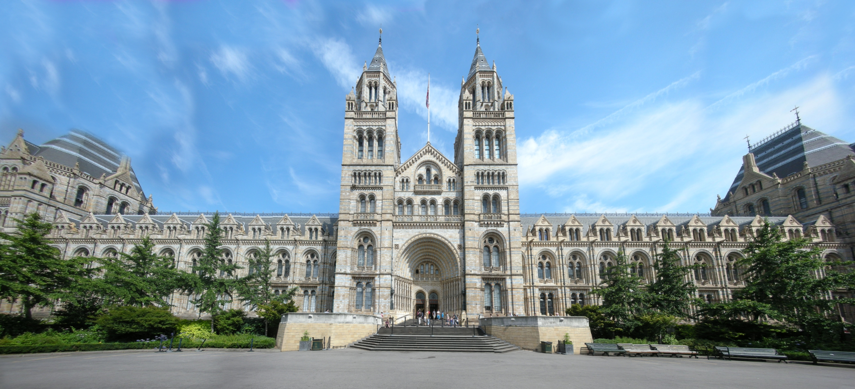
Front view of the Natural History Museum in London, UK. This panorama image was composed of 12 individual images and stiched using the nona engine with Hugin. Some of the sky was recreated during post processing with The Gimp to create a rectanglar image. Author, StephantomWikipedia:GLAM/Natural History Museum and Science Museum

Slide 57
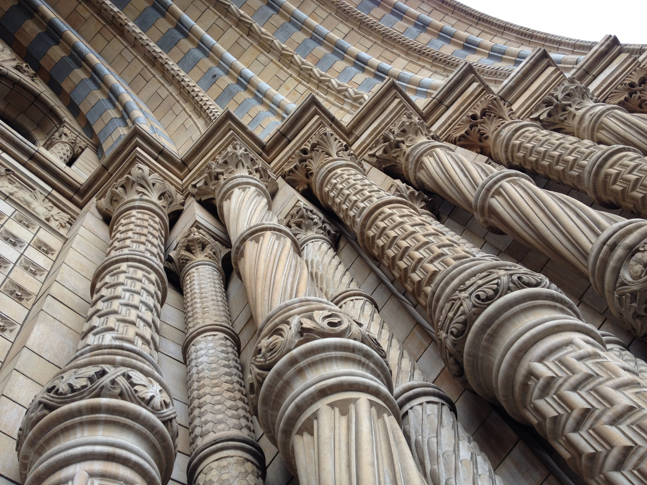
Copyright © 2011 – 2016 Boundary Space Ltd

Slide 64
Take part
Citizen science
Identify nature
Centre for UK Biodiversity
Volunteer
Training
Wildlife Photographer of the Year Competition
http://www.nhm.ac.uk/our-science.html#sthash.ULT7ws4U.dpuf

Slide 66
Visitors App
Deep Sea ID
Tree indentification
Museum Apps
Leafsnap
Dinosaurs

Slide 68
Museum of Jurassic Technology
Trippy Food blog on the Museum

Slide 69
CONTRIBUTIONS FROM THE MUSEUM OF JURASSIC TECHNOLOGY
COLLECTIONS AND EXHIBITIONS

Slide 70
MEGOLAPONERA FOETENS STINK ANT OF THE CAMEROON OF WEST CENTRAL AFRICA

Slide 71
MJT mice on toast and mice pie
Mice on toast and mice pie cures bed-wetting, incontinence and stuttering. This exhibit is referenced in the subtitle of Weschler's book about the museum, Wikimedia, Common, Sgerbic

Slide 72
Mr. Wilson's Cabinet of Wonder: Pronged Ants, Horned Humans, Mice on Toast, and Other Marvels of Jurassic Technology
Lawrence Weschler, 1996
Primarily about the Museum of Jurassic Technology and, more broadly, the history and role of museums

Slide 73
Cabinet of Curiosities
A corner of a cabinet, painted by Frans II Francken in 1636 reveals the range of connoisseurship a Baroque-era virtuoso might evince
https://en.wikipedia.org/wiki/Cabinet_of_curiosities#/media/File:Frans_Francken_(II),_Kunst-_und_Rarit%C3%A4tenkammer_(1636).jpg

Slide 74
Cabinet of Curiosities
An early eighteenth-century German Schrank with a traditional display of corals(Naturkundenmuseum Berlin)
https://en.wikipedia.org/wiki/Cabinet_of_curiosities#/media/File:Berlin_Naturkundemuseum_Korallen.jpg

Slide 75
Cabinet of Curiosities
Ashmolean Museum Oxford European Ceramics Gallery 2014 Sarah Casey

Slide 76
Museum of Jurassic Technology on Pinterest

Slide 77
ESTAR(SER), through the good offices of The Society for the Diffusion of Useful Information, is pleased to announce the 2016 “Joint Symposium”:
Inquiries into the Order of the Third Bird
Saturday, September 10th
Doors open at 2:30 p.m. for a viewing of the Exhibition;
program begins at 3:30 p.m.; closing reception, 6:00 p.m.
All attendees will be permitted to exit and re-enter throughout the afternoon.
$10 admission (includes exhibition catalog); reservations required.
Foshay Masonic Lodge
9635 Venice Blvd, Culver City, 90232
Please join ESTAR(SER) for an afternoon of close attention to matters of attention — and more particularly to the history of the attentional activities of that ever-fugitive body known as the Tertia Avis or “Order of the Third Bird.” Participants will have an unprecedented opportunity to examine objects and documents from the remarkable “W-Cache” of Bird-related sources; a set of formal presentations by several distinguished ESTAR(SER) scholars will inform the public about the progress of current research. Some collective experimentation is expected. All are welcome. About ESTAR(SER): The Esthetical Society for Transcendental and Applied Realization (now incorporating the Society of Esthetic Realizers) is an established body of private, independent scholars who work collaboratively to recover, scrutinize, and (where relevant) draw attention to the historicity of the Order of the Third Bird.
The Museum of Jurassic Technology 9341 Venice Blvd Culver City, CA 90232, US

Slide 78
About "The Order of the Third Bird"
Please note the venue: This program will not take place at the Museum of Jurassic Technology. It will be held at the Foshay Masonic Lodge, two blocks west of the Museum on Venice Blvd.

Slide 80
MEGOLAPONERA FOETENS STINK ANT OF THE CAMEROON OF WEST CENTRAL AFRICA

Slide 81
Non-places | Places of universal value

Slide 82
Non-places | Places of universal value
Heritages places can thus be defined – without reference to their specific components – as focal points of reflection, commemoration, and debate about the values of the past in contemporary society.
Heritage places: Evolving conceptions and changing forms Neil Silverman
https://www.academia.edu/10029989/Heritage_places_Evolving_conceptions_and_changing_forms?auto=view&campaign=weekly_digest
Augé, M. (1995) Non-places: An Introduction to an Anthropology of Supermodernity, J. Howe (trans.), London: Verso.

Slide 83
European Space Agency’s First Artist in Residence Is Building a Temple for the Moon
ARTSY EDITORIAL, BY ABIGAIL CAIN
AUG 13TH, 2016 1:00 PM
Spanish artist Jorge Mañes Rubio

Slide 84
Non-places | Places of universal value
World Heritage List

Slide 85
Non-places | Places of universal value
To be included on the World Heritage List, sites must be of outstanding universal value and meet at least one out of ten selection criteria.
(i) to represent a masterpiece of human creative genius;
(ii) to exhibit an important interchange of human values, over a span of time or within a cultural area of the world, on developments in architecture or technology, monumental arts, town-planning or landscape design;
(iii) to bear a unique or at least exceptional testimony to a cultural tradition or to a civilization which is living or which has disappeared;
(iv) to be an outstanding example of a type of building, architectural or technological ensemble or landscape which illustrates (a) significant stage(s) in human history;
(v) to be an outstanding example of a traditional human settlement, land-use, or sea-use which is representative of a culture (or cultures), or human interaction with the environment especially when it has become vulnerable under the impact of irreversible change;
(vi) to be directly or tangibly associated with events or living traditions, with ideas, or with beliefs, with artistic and literary works of outstanding universal significance. (The Committee considers that this criterion should preferably be used in conjunction with other criteria);
(vii) to contain superlative natural phenomena or areas of exceptional natural beauty and aesthetic importance;
(viii) to be outstanding examples representing major stages of earth's history, including the record of life, significant on-going geological processes in the development of landforms, or significant geomorphic or physiographic features;
(ix) to be outstanding examples representing significant on-going ecological and biological processes in the evolution and development of terrestrial, fresh water, coastal and marine ecosystems and communities of plants and animals;
(x) to contain the most important and significant natural habitats for in-situ conservation of biological diversity, including those containing threatened species of outstanding universal value from the point of view of science or conservation.

Slide 86
Non-places | Places of universal value
Your Culture or Mine?
Disrupting the Universal
The display of cultural heritage in the museum makes the divisions of sub-cultures and para-cultures highly visible, therefore legitimising some kinds of cultural affiliation, while presenting other kinds of cultural practice as exotic or alien.
Cognitive dissonance
Male figurine (Chalcolithic Period, 4500BCE – 3500 BCE)

Slide 87
MUSE E-133 | Performing the Digital Museum
September 6 Museums on the Web | The distributed museum; authenticity, originality and clone-ability
Assignment 1
Research 2 different museum websites and compare them while evaluating from the following perspectives:
Institutional voice; authoritative or informal
End user experience
Content, rich or shallow; limited versus complex
Write succinctly (2-3 pages) double-spacing, size 12 font, 1 inch margin
Submit images, screenshots separately
Due: Sep 20 at 11:59pm

Slide 88
MUSE E-133 | Performing the Digital Museum
Links - September 6 Museums on the Web | The distributed museum; authenticity, originality and clone-ability
https://www.artsy.net/article/artsy-editorial-this-is-the-most-reproduced-artwork-of-all-time
Tate http://www.tate.org.uk/
Tate Exchange http://www.tate.org.uk/visit/tate-modern/new-tate-modern/art/tate-exchange
The Broad http://www.thebroad.org/
Louvre http://www.louvre.fr
The British Museum (BM) http://www.britishmuseum.org
CIDOC CRM collection.britishmuseum.org
Semantic Web https://www.w3.org/standards/semanticweb/
The Museum of the World https://britishmuseum.withgoogle.com
British Museum Blog - The conservation of Dürer’s Triumphal Arch https://blog.britishmuseum.org
Showtime at the Musée d’Orsay: Watching Varnish Dry - NYTimes.com
http://mobile.nytimes.com/2016/08/16/arts/design/showtime-at-the-musee-dorsay-watching-varnish-dry.html
The Natural History Museum, London http://www.nhm.ac.uk
The Museum of Jurassic Technology, Los Angeles, California http://www.mjt.org
Introduction and background http://www.mjt.org/intro/genborch.htm
Where Outlandish Meets Landish, Edward Rothstein JAN. 9, 2012, New York Times
http://www.nytimes.com/2012/01/10/arts/design/museum-of-jurrasic-technology-shows-its-wild-side-review.html?_r=0
Cabinet of Wonders, Running Carrot (runswithcarrots, blog) https://runswithcarrots.wordpress.com/2011/04/05/cabinet-of-wonders
NHM Data Portal http://data.nhm.ac.uk/?_ga=1.238016387.2090504359.1471150606
Discussion
Heritage places: Evolving conceptions and changing forms Neil Silverman https://www.academia.edu/10029989/Heritage_places_Evolving_conceptions_and_changing_for
Augé, M. (1995) Non-places: An Introduction to an Anthropology of Supermodernity, J. Howe (trans.), London: Verso.
European Space Agency’s First Artist in Residence Is Building a Temple for the MoonARTSY EDITORIAL ABIGAIL CAIN, AUG 13TH, 2016 1:00 PM https://www.artsy.net/article/artsy-editorial-this-artist-is-working-with-the-european-space-agency-to-put-a-temple-on-the-moon
World Heritage List http://whc.unesco.org/en/list
Disrupting the Universal Male figurine, Unknown Chalcolithic Period, 4500BCE - Chalcolithic Period, 3500 BCE https://www.google.com/culturalinstitute/beta/u/0/asset/male-figurine/iwE4uH9CVx_ihw

Slide 89
MUSE E-133 | Performing the Digital Museum
Contact
shazan@imj.org.il
Skype – shazan22
Jerusalem time zone – currently UTC/GMT +2 hours

Slide 90
Paul Klee 1879, Munchenbuchsee, Switzerland – 1940, Muralto, Switzerland Angelus Novus 1920 Oil transfer and watercolor on paper
© Israel Museum http://www.imj.org.il/imagine/collections/item.asp?itemNum=199799

