Slide 1
MUSE E-133 | Fall Term 2016 | CRN 15155
Performing the Digital Museum
September 13 Swiping and tapping | Museums on the smartphone; apps and more apps

Slide 2
MUSE E-133 | Performing the Digital Museum
September 13 Swiping and tapping | Museums on the smartphone; apps and more apps
Follow me Rijks | Follow Me SFMOMA
Play with me MOMA | MET and ARTLAB
Responsive | Mobile
Discussion
Assignment
Preview to GAP

Slide 3
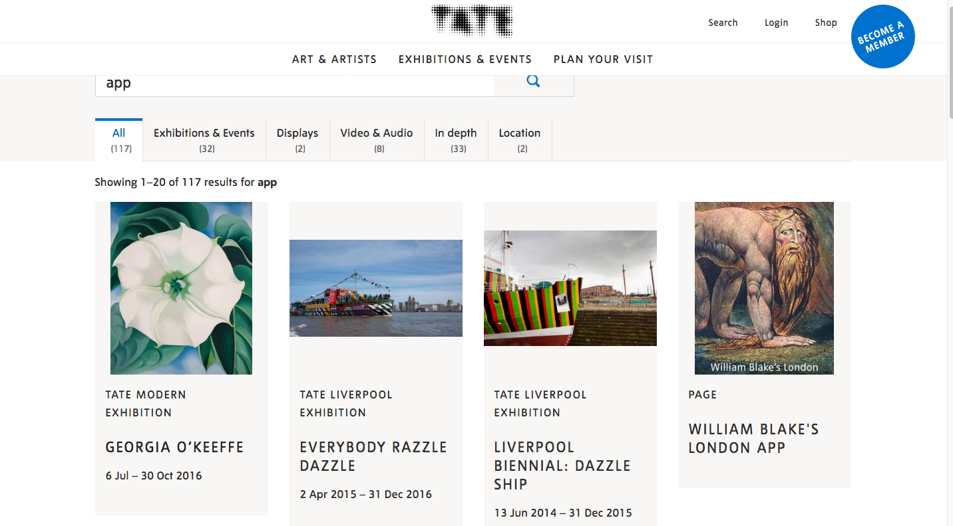
Museum Apps

Slide 4
Museum Apps

Slide 5
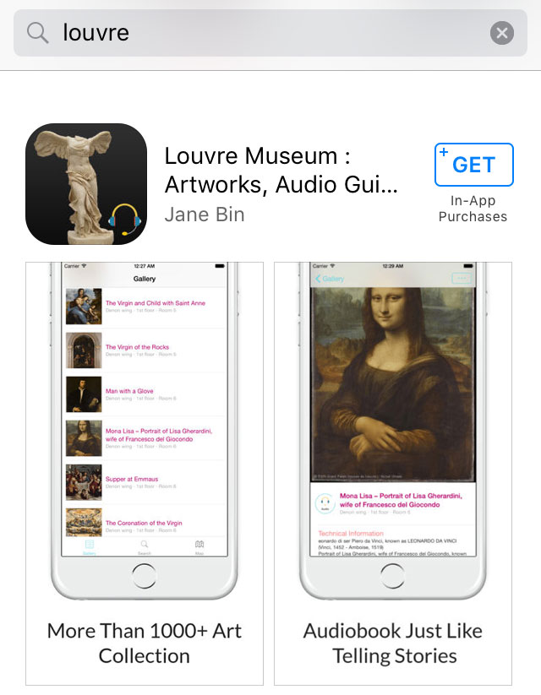
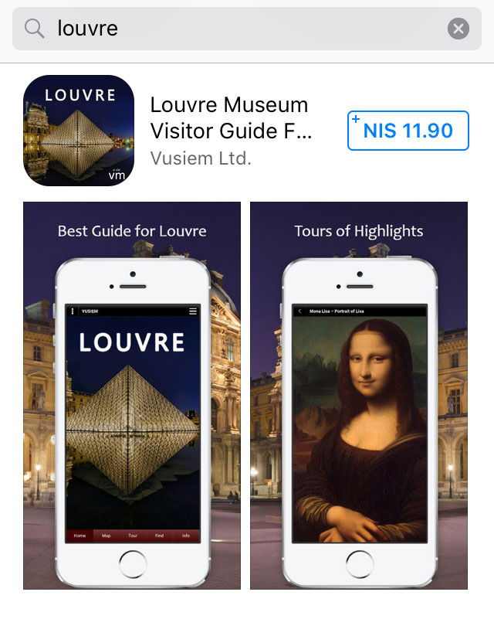
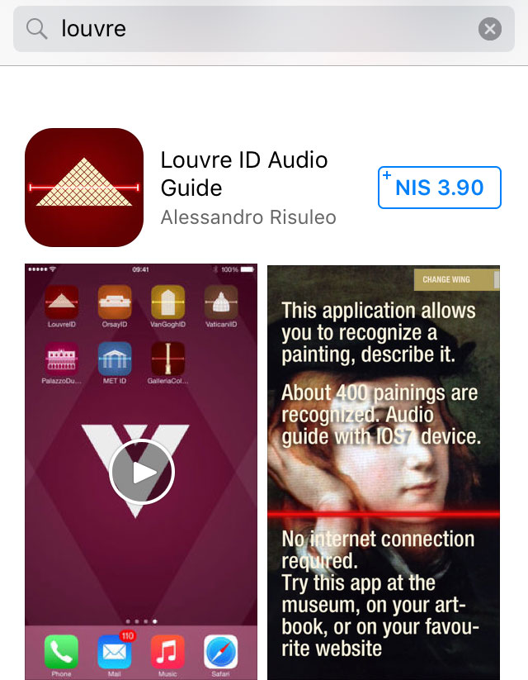
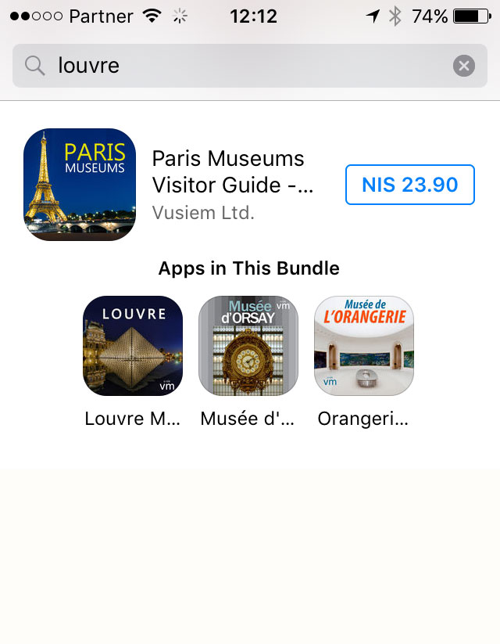
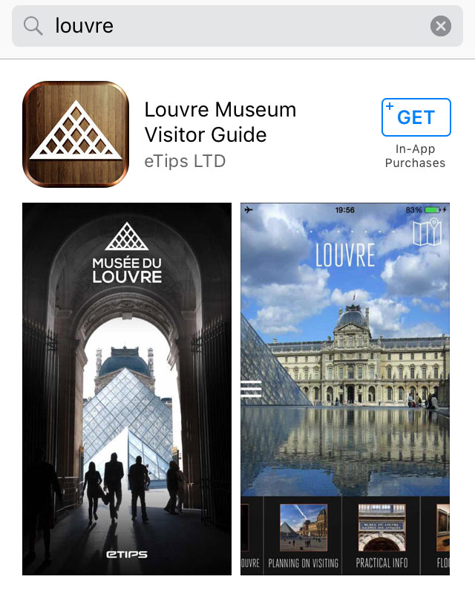
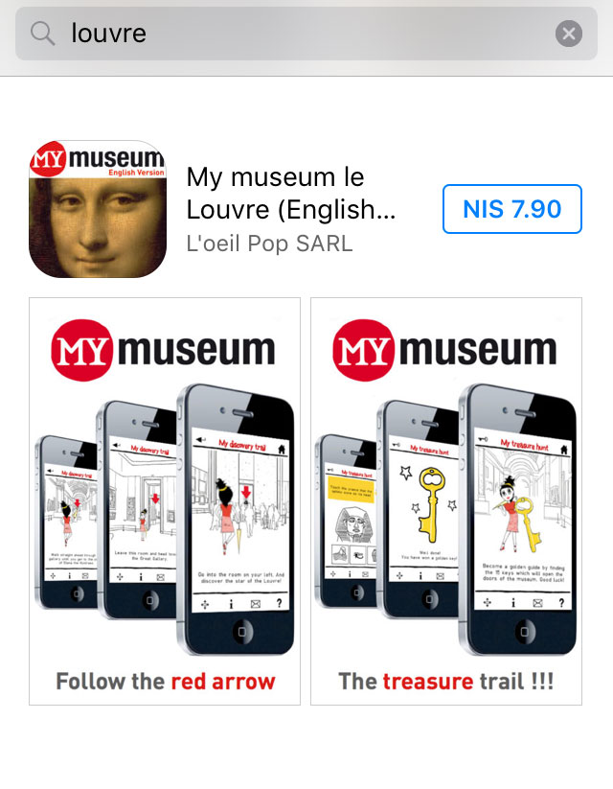
Museum Apps

Slide 6
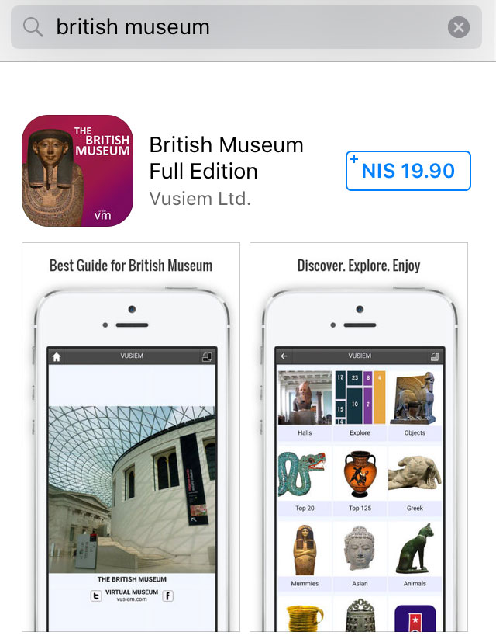
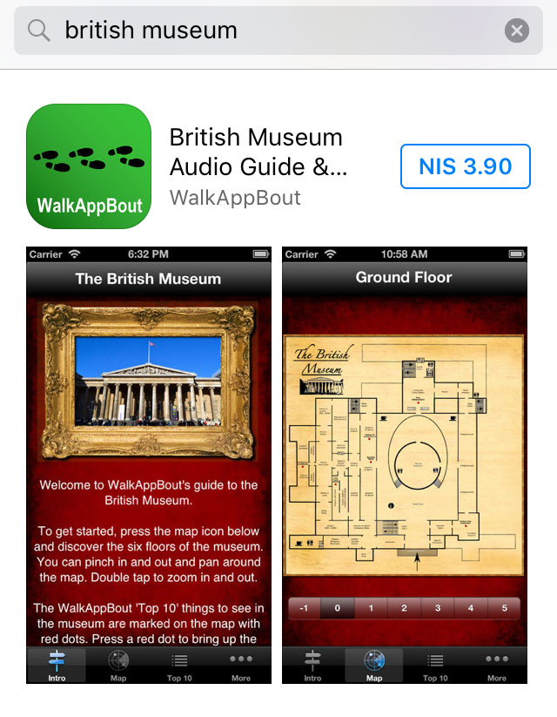
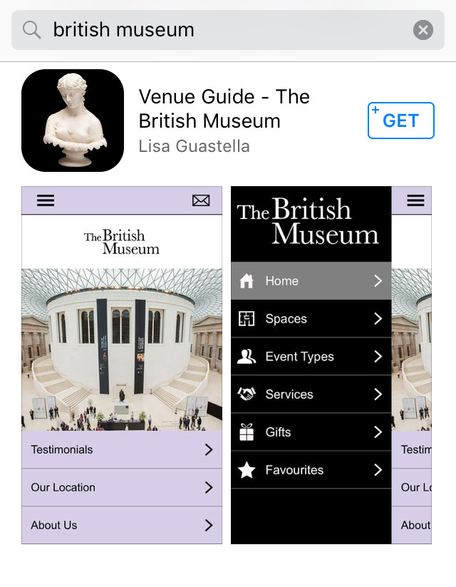
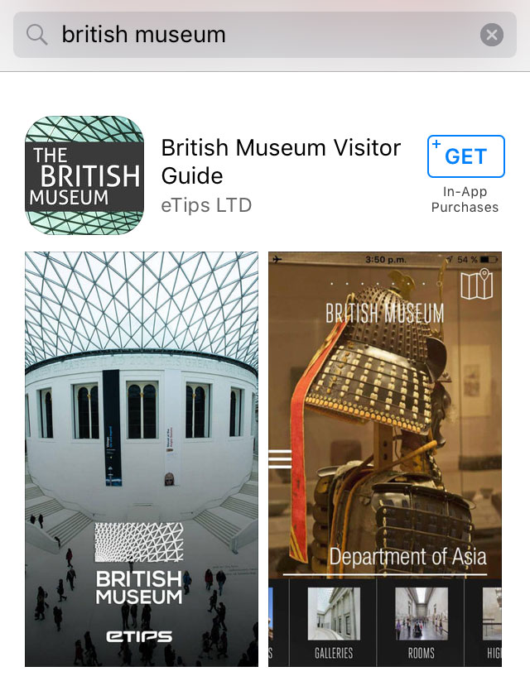
Museum Apps

Slide 7
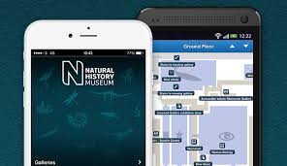
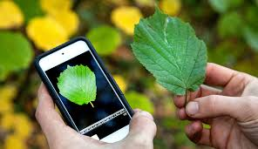
Visitors App
Deep Sea ID
Tree indentification
Museum Apps
Leafsnap
Dinosaurs

Slide 10
Rijksmuseum – 2013
Explore the Rijksmuseum in Amsterdam in your pocket. Definitely a must for those studying art, mainly from the 17th and 18th centuries, or art lovers. This beautiful app allows you to explore 100 top works of art in the this world famous museum. Featuring works of art, like the Night Watch, The Fall, Rembrandt as Shepard, Venus and Adonis plus many more pieces all brought to your iPhone and iPad in one app. Features - introduction about the Rijksmuseum and all necessary information - 100 works in the Rijksmuseum - slide show feature - browse art by artist - zoom in and pan - no need for 3G or Wifi in the app The Rijksmuseum art viewing app is educational and visually enjoyable, so download the app and find out for yourself!

Slide 12
SELF PORTRAIT, WIDE-EYED
1630 etching 51 x 46mm. Rijksmuseum, Amsterdam

Slide 13
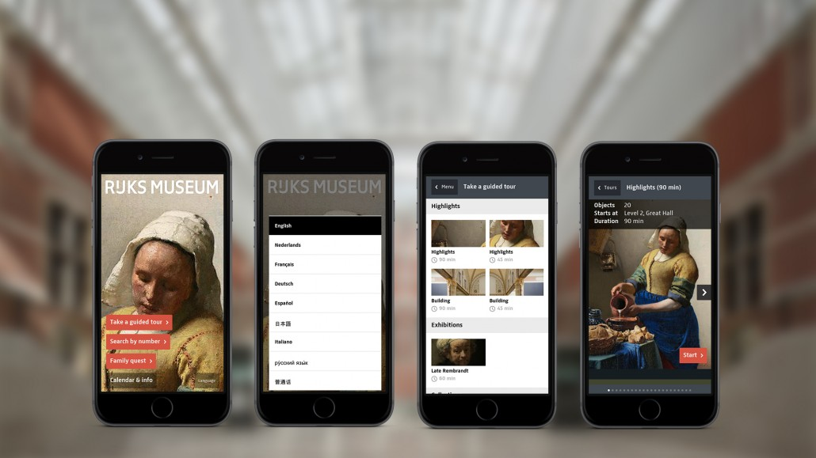
Rijksmuseum - 2014
Design and Development Kiss the Frog, Concept Northernlight, Version 2.9.1 Simple user interface, 225 magic window videos, 3D audio soundscapes, 120 VIP’s and expert interviews, 4400 information layers, Nine languages
“We designed the Rijksmuseum app around a simple principle: see more. With the Rijksmuseum app your smartphone is transformed into a magnifying glass, a set of binoculars, a time machine, an infrared scanner, a sketch pad, or a magic wand.
Its 3D-audio clips allow visitors to navigate through experiences and every tour offers the option to collect a digital souvenir”.

Slide 14
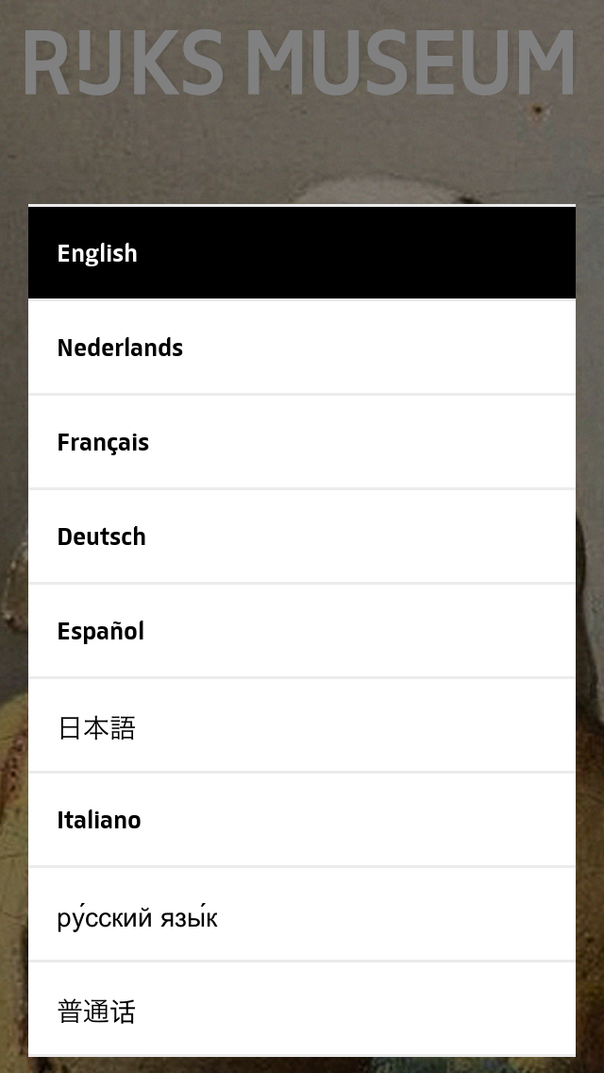
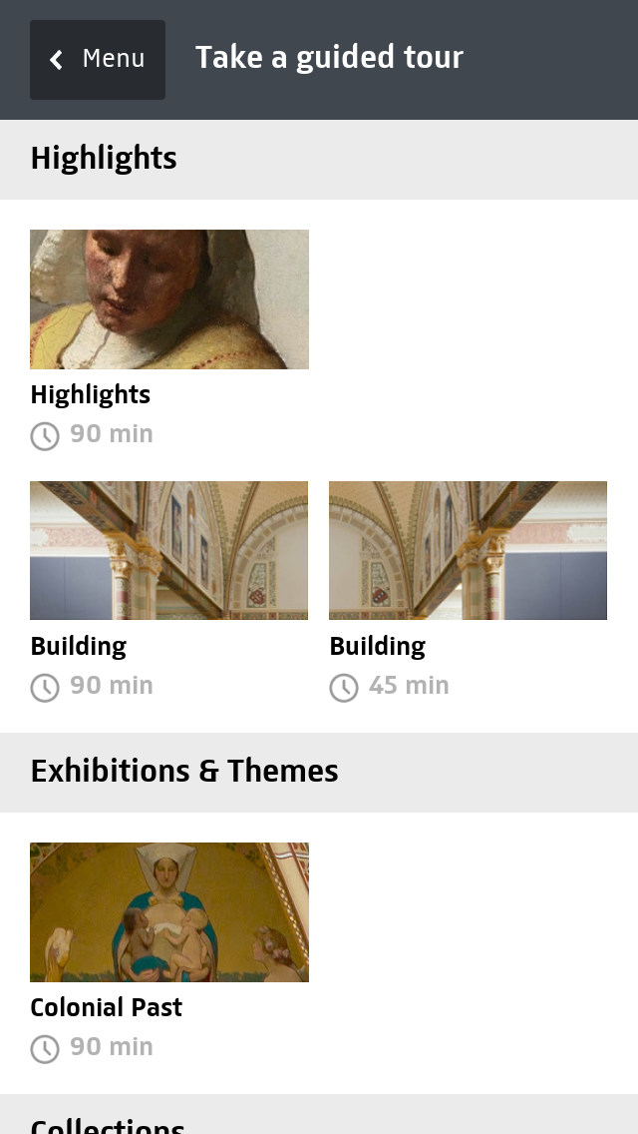

Slide 15
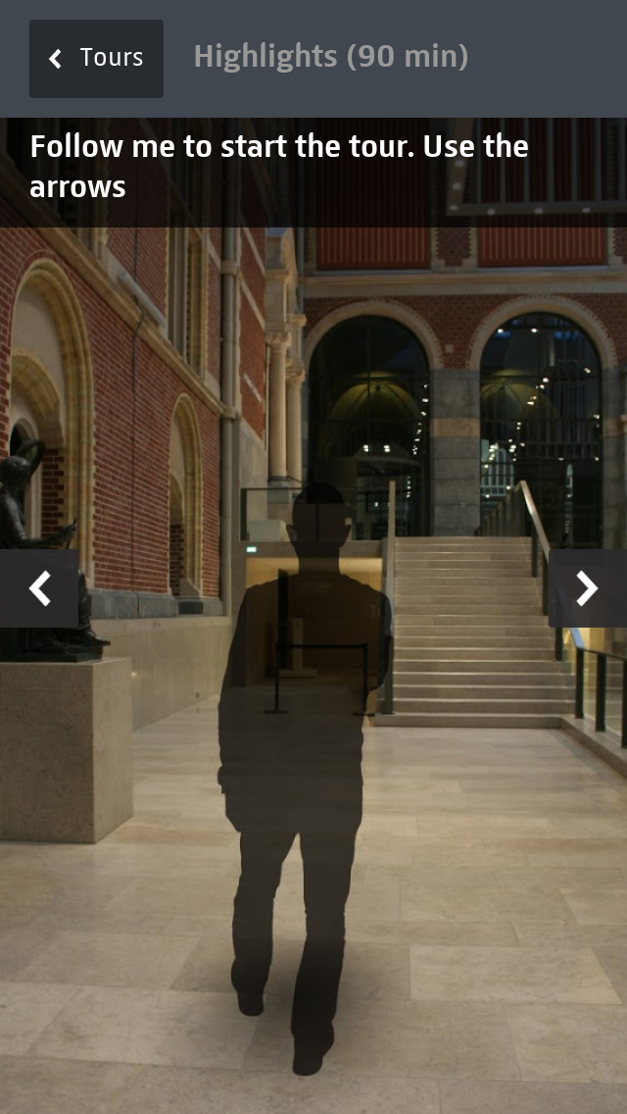
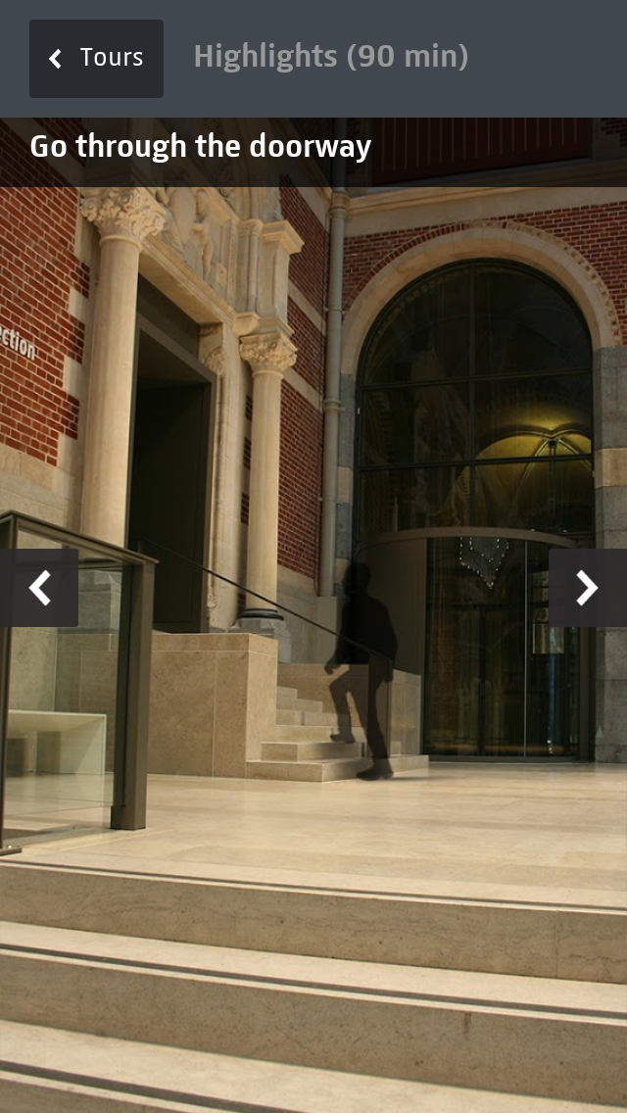

Slide 16
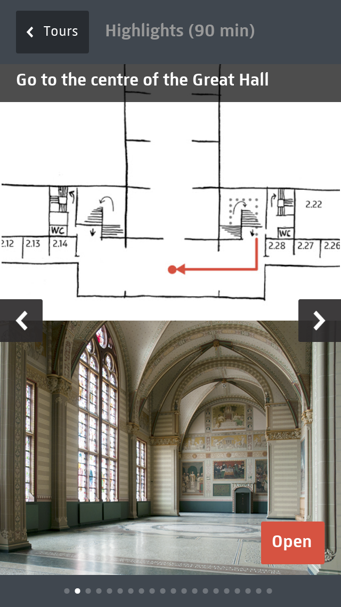
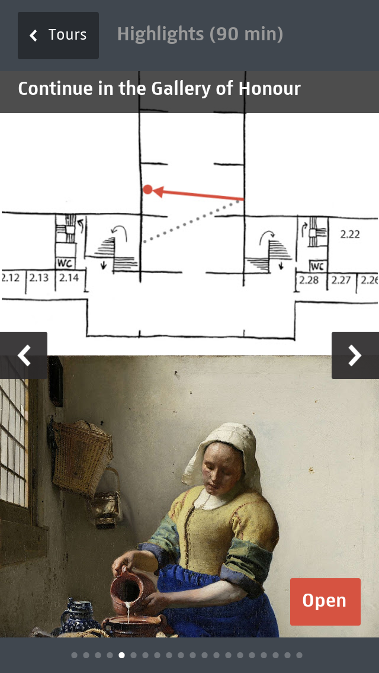

Slide 17
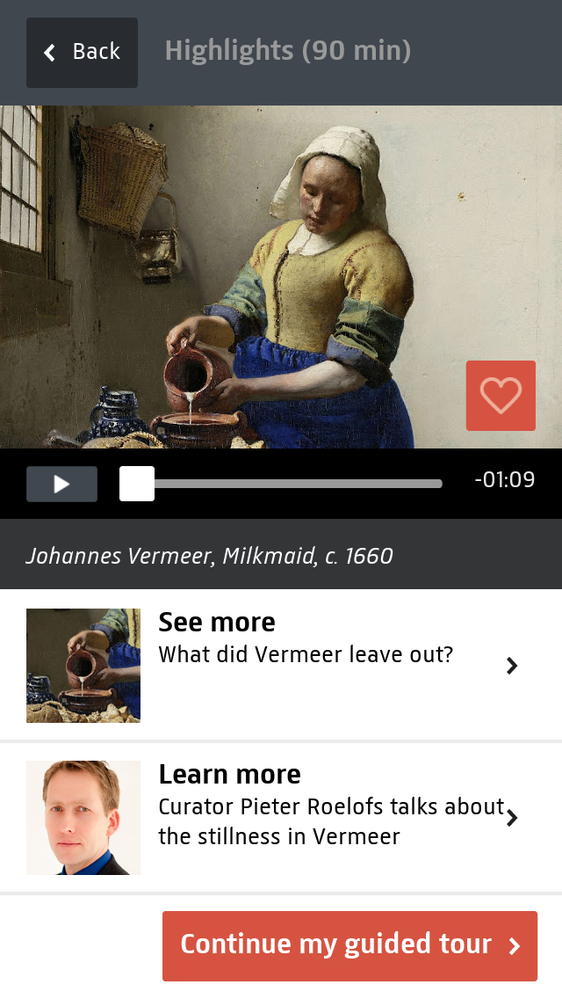
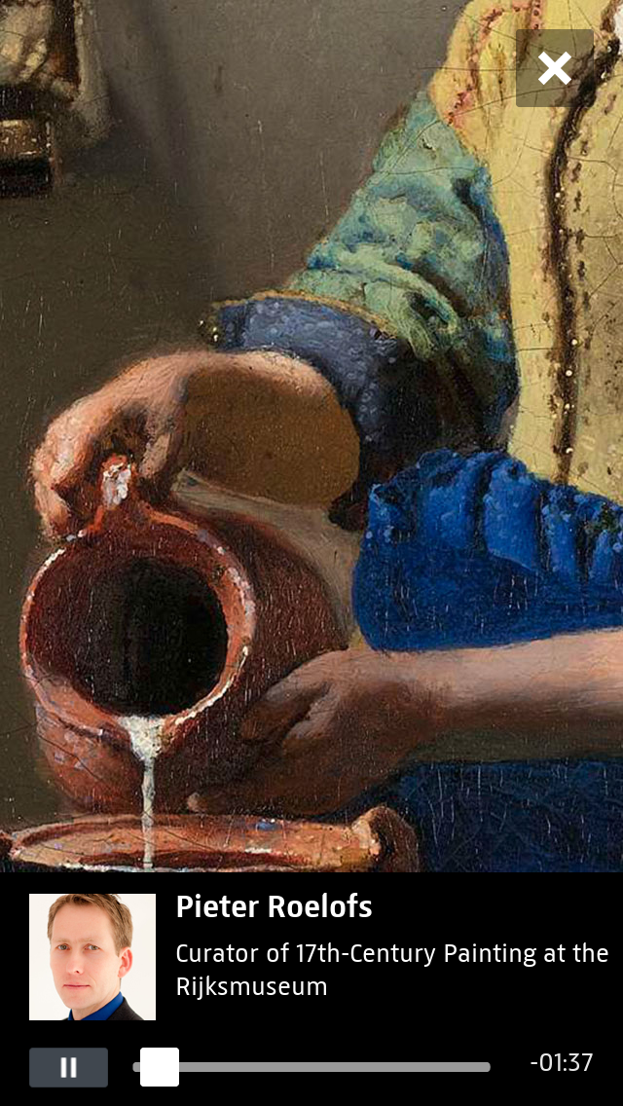

Slide 18
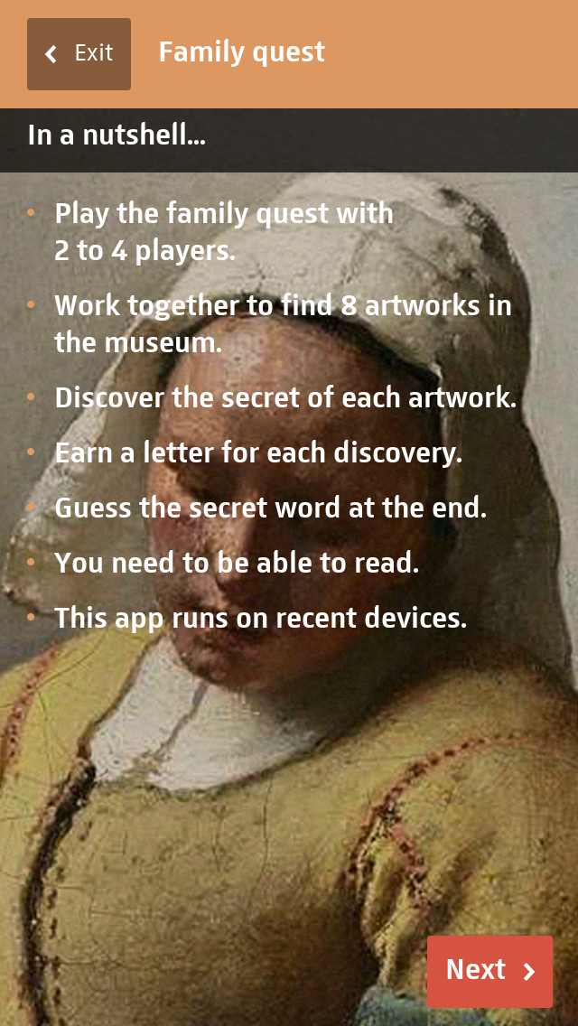
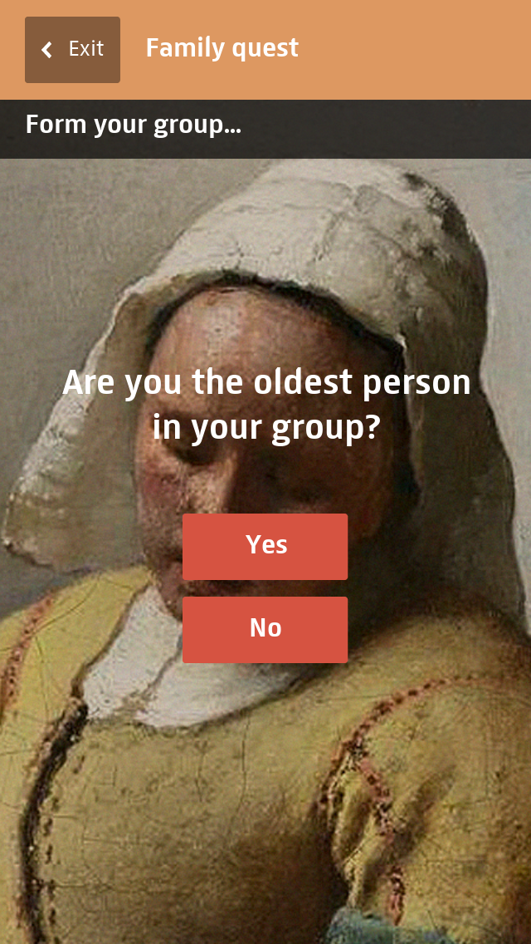

Slide 19
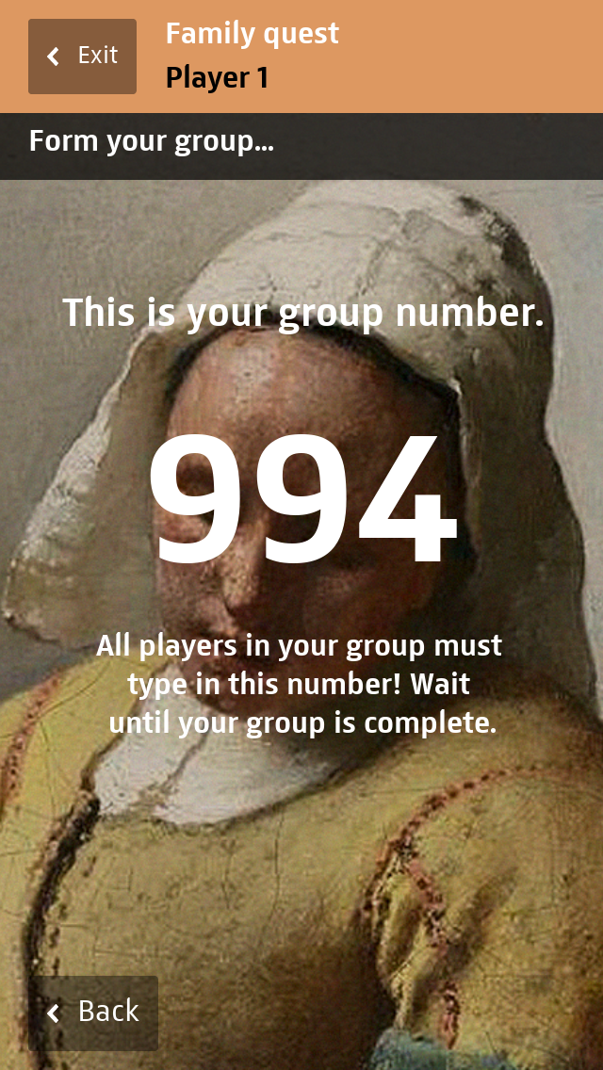
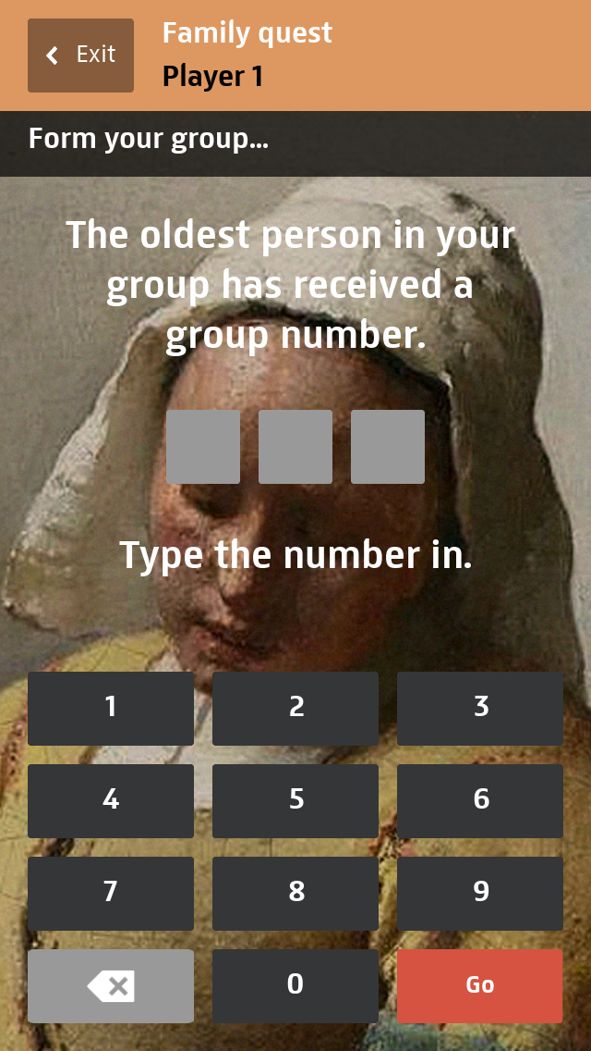

Slide 20
Published on 15 Sep 2014
The Rijksmuseum multimedia tour now also includes a family game. An exciting group game inviting you to solve eight fascinating Rijksmuseum mysteries. It takes about 1 hour and if you succeed, there’s another surprise waiting at the end of the tour.
https://www.youtube.com/watch?v=RA_He9vRddw

Slide 21
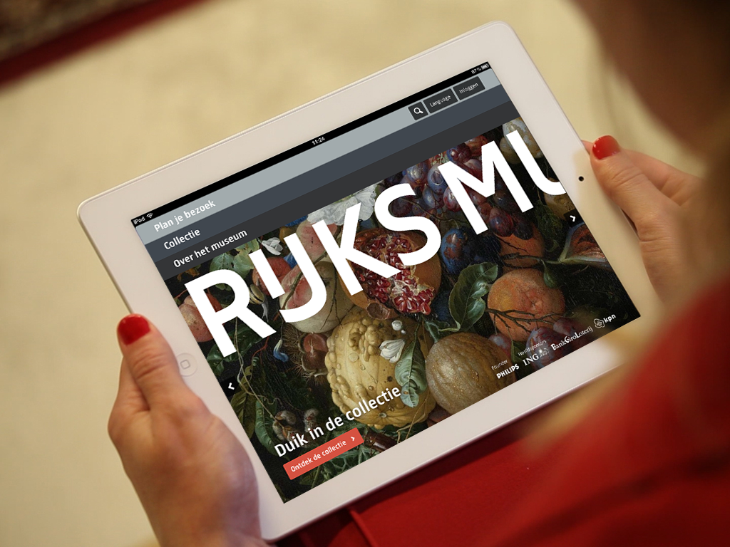

Slide 22
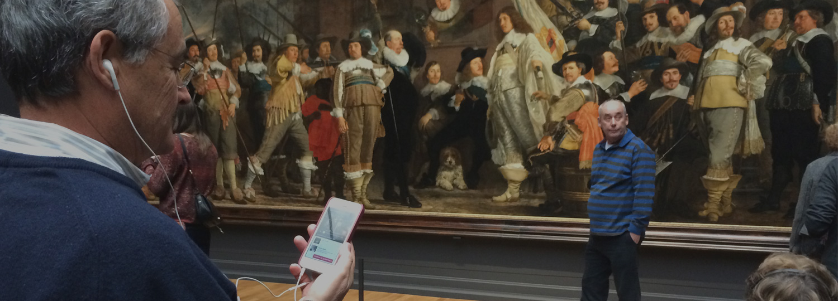
Touching Rembrandt’s Night Watch at the Rijksmuseum, Valsplat

Slide 25
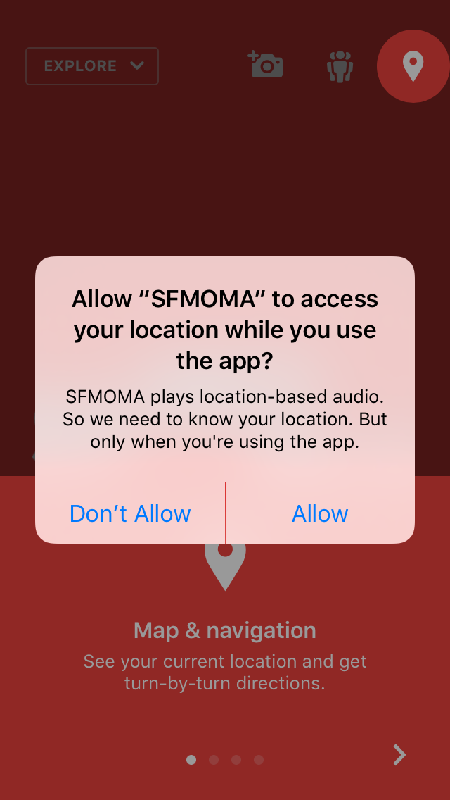
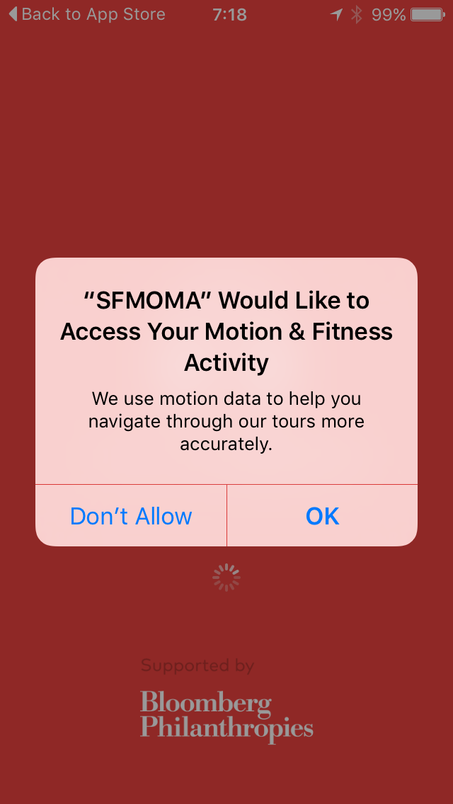

Slide 26
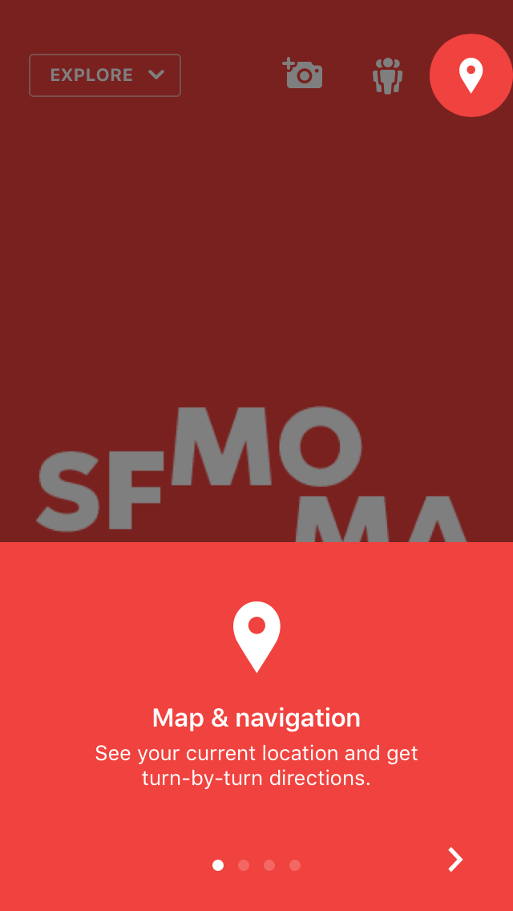
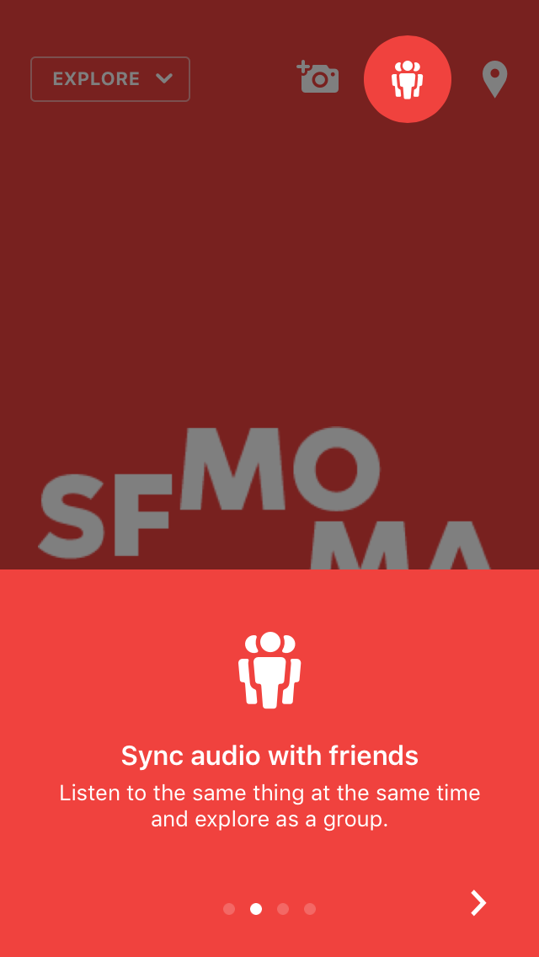

Slide 27
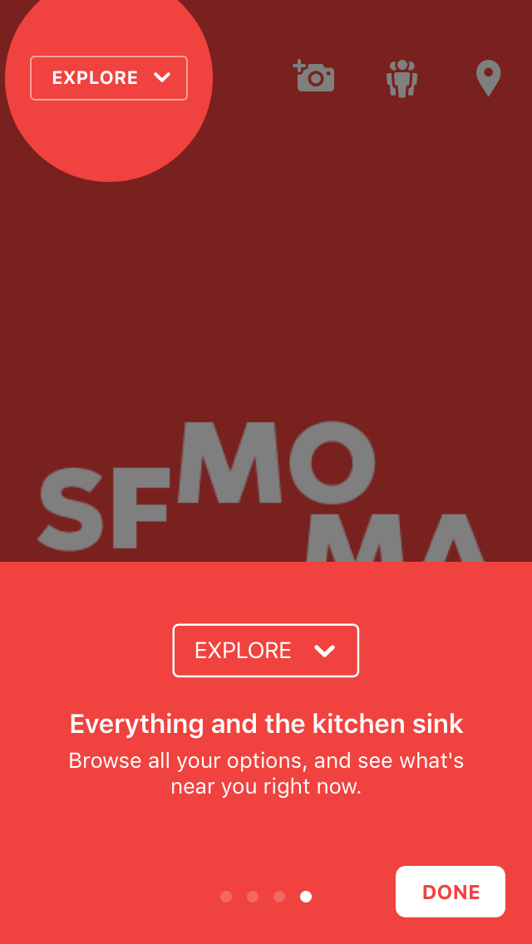
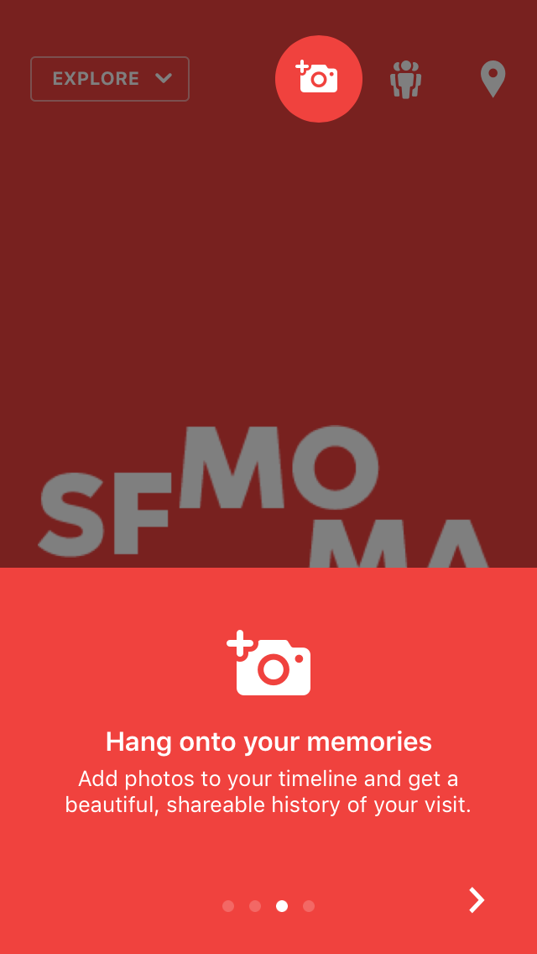

Slide 28
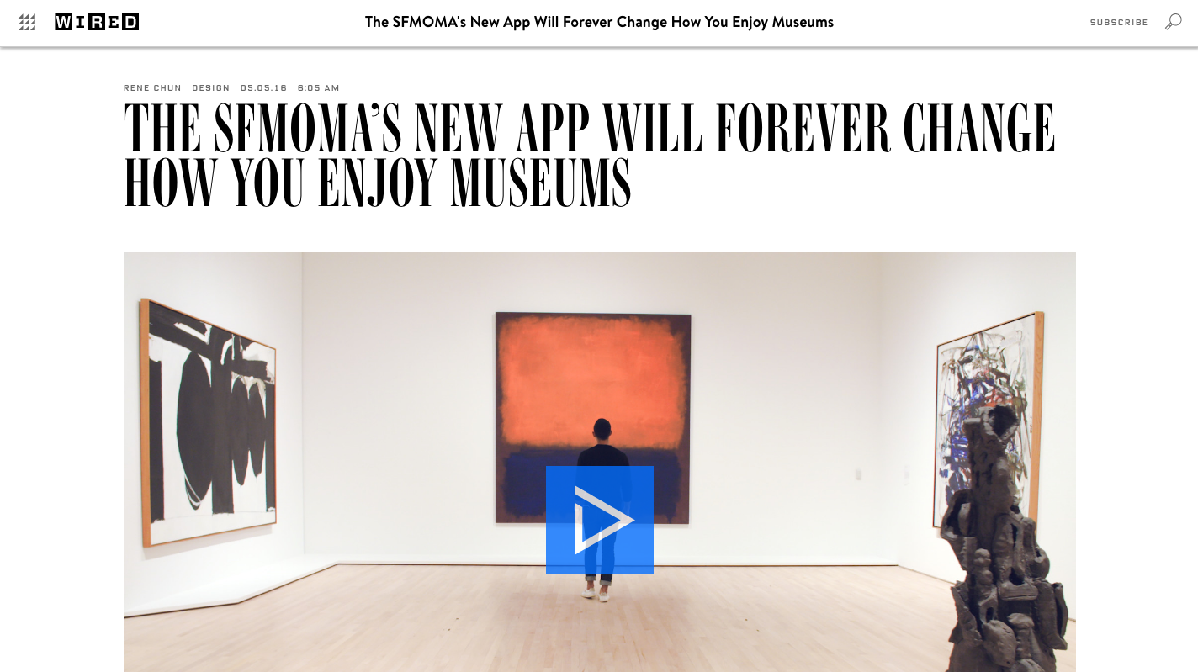
SFMOMA's new app uses the museum's Wi-Fi to keep tabs on where you are and where you're going—and adjusts its immersive audio tours accordingly, WIRED, RENE CHUN | 05.05.16
http://www.wired.com/2016/05/sfmoma-audio-tour-app/

Slide 29
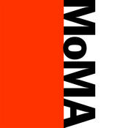

Slide 31
With the MoMA App, you can take The Museum of Modern Art wherever you go.
Tours: Hear from a wide range of artists, curators, and others about works in the collection and many special exhibitions.
My Collections: Create collections of your favorite media, images, and artworks.
Camera: Snap and share your MoMA experience.
Calendar: Browse current and upcoming exhibitions, events, and film screenings.
Directory & Map: Locate artworks and Museum facilities.
Search: Find a specific artist, artwork, calendar listing, or audio commentary.
Visit: Find information including hours, admission, and directions to help you plan your visit.
Share: Share your favorite audio, artworks, events, and photos via email, text, Facebook, or Twitter.
The MoMA App requires an Internet connection.

Slide 32
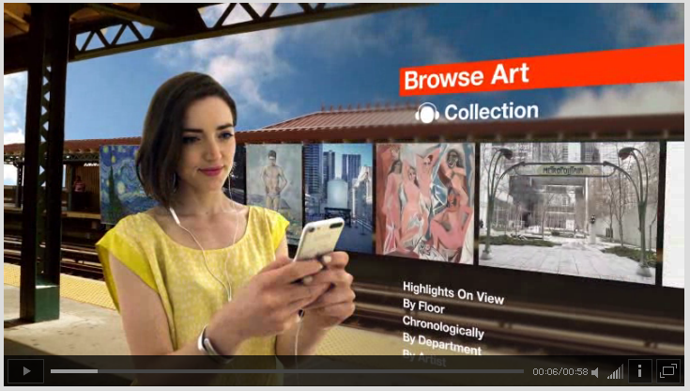
https://www.moma.org/explore/mobile/iphoneapp

Slide 33
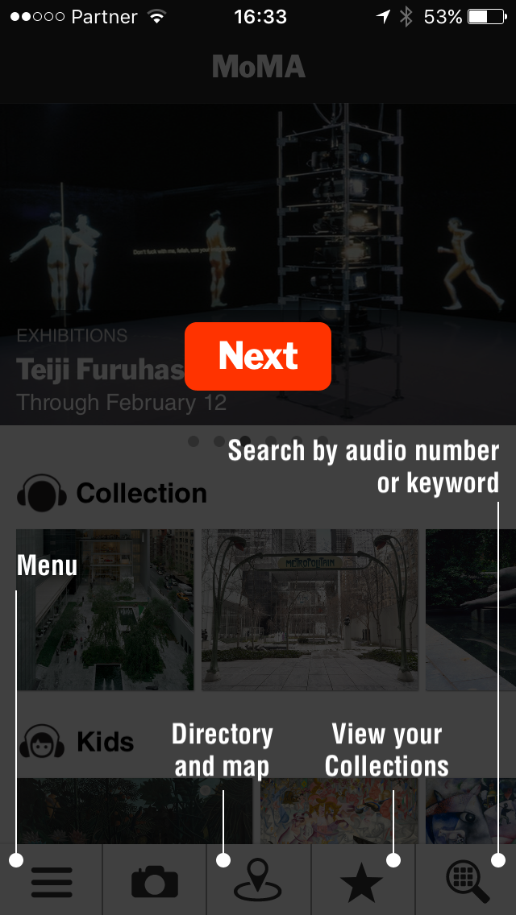
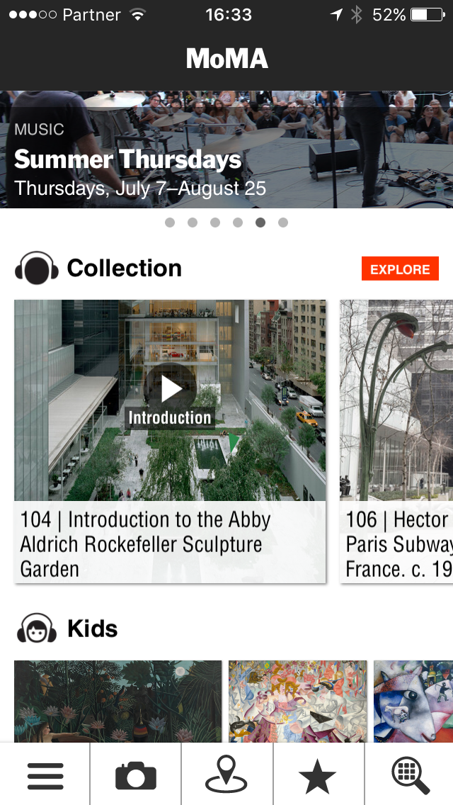

Slide 35
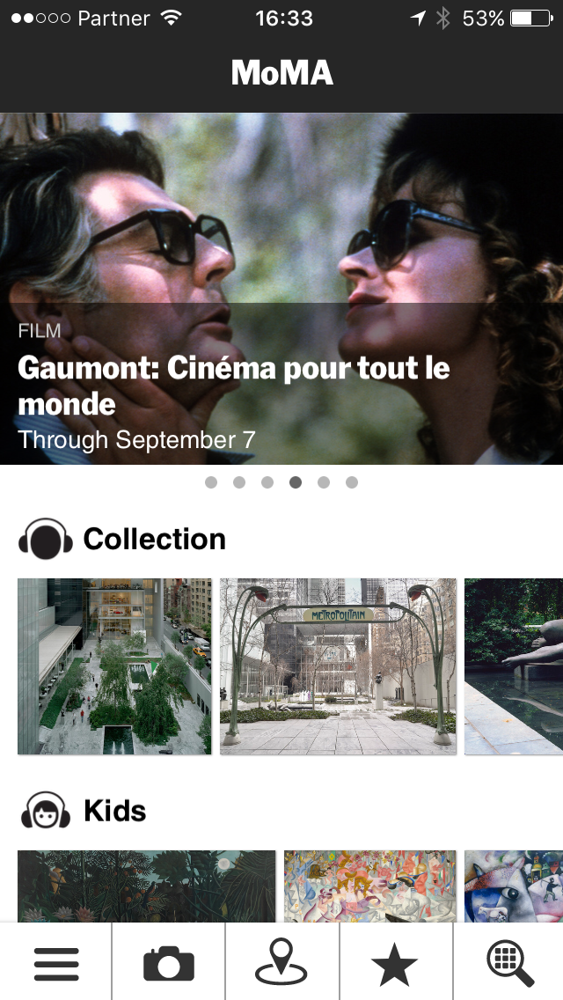

Slide 36
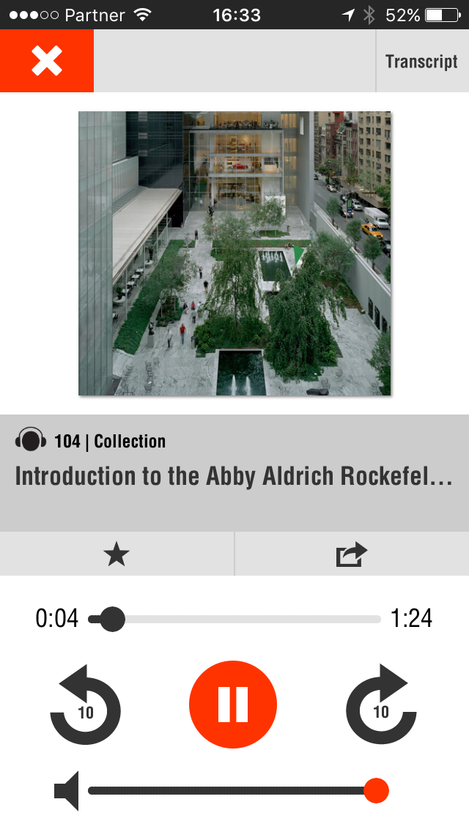
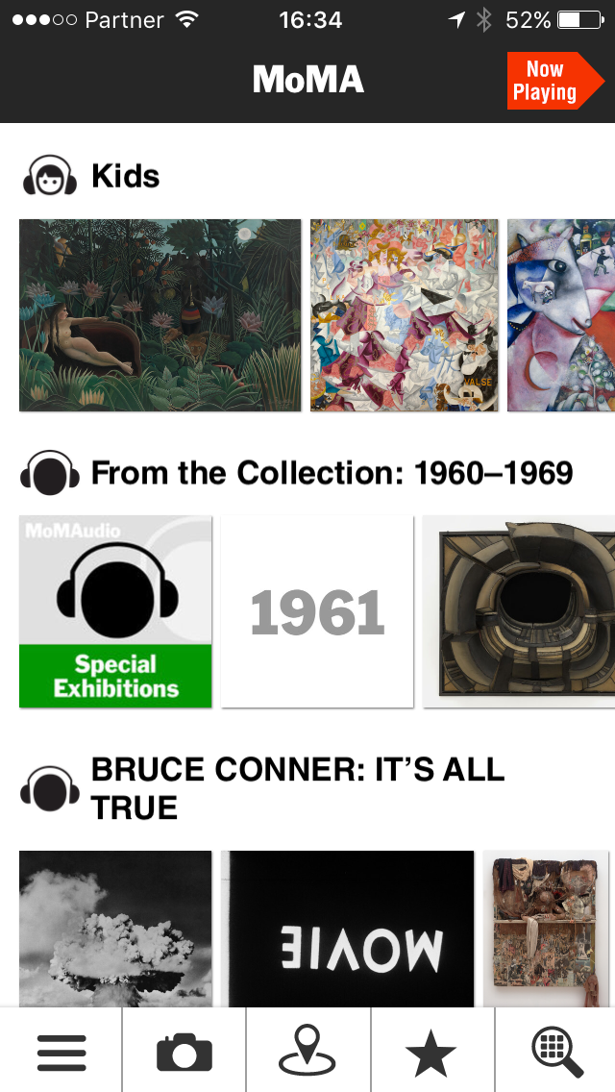

Slide 39
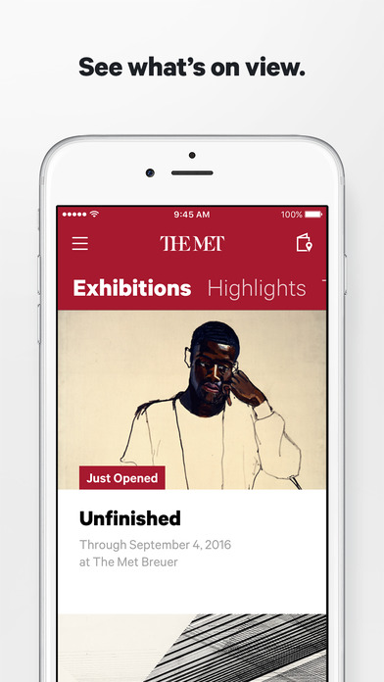
The Met — The Official App of The Metropolitan Museum of Art in NYC
By The Metropolitan Museum of Art
View More by This Developer
Open iTunes to buy and download apps.
Description
Whether you’re new to the Met or a passionate Member, coming as a family or just looking for something different, start here. The app is the easiest way to see what’s happening at the Met every day—wherever you are. "Beautifully designed … A rich, accessible experience" - The New York Times “A great starting point for visiting.” – iLounge “Something we can’t help but love.” – Huffington Post Features: * Map of the Museum and ability to pin the location of events, exhibitions, and artworks * Recommendations on what to see, from artworks to architecture * Full listings of our exhibitions, events, and how to visit the Museum's three locations * A special section for Met Members with upcoming events and opportunities * Ability to save your favorite art, events, and exhibitions—and add them to your calendar * The Met app is optimized for use with iOS Accessibility features—VoiceOver, Zoom, Larger Text, etc. The Met app is made possible through the support of Bloomberg Philanthropies.
...More
The Metropolitan Museum of Art Web SiteThe Met — The Official App of The Metropolitan Museum of Art in NYC Support
What's New in Version 1.3.2
• Videos: watch the exhibition trailers before you visit • Notifications: get in-app messages about exhibition openings and other timely information

Slide 40
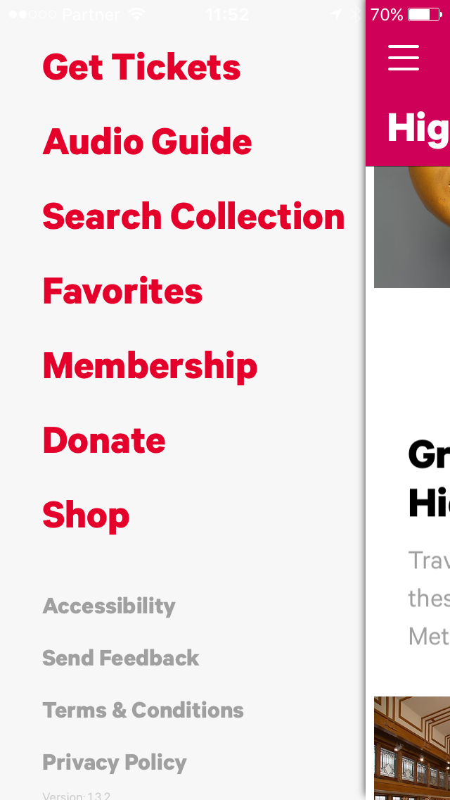
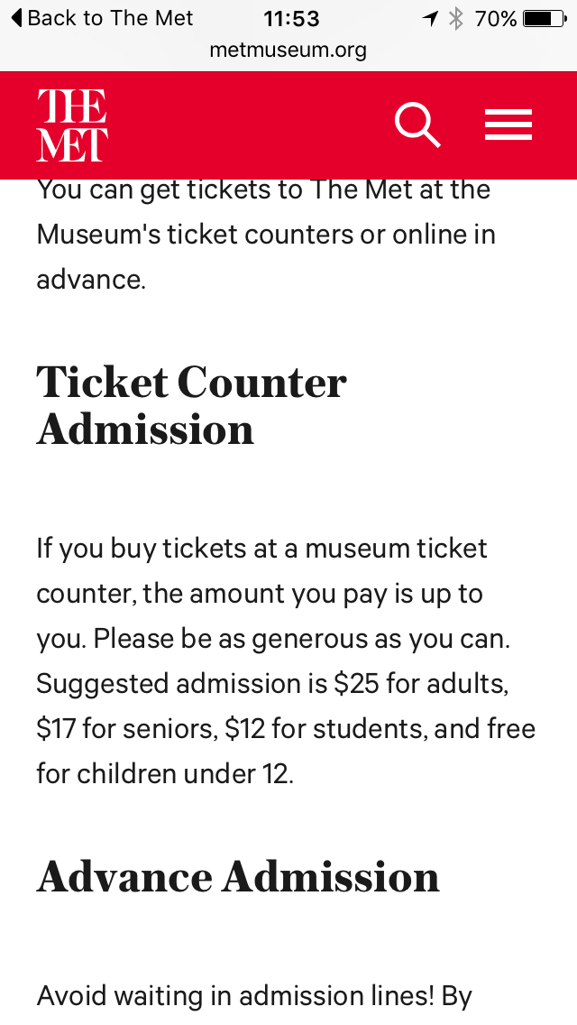
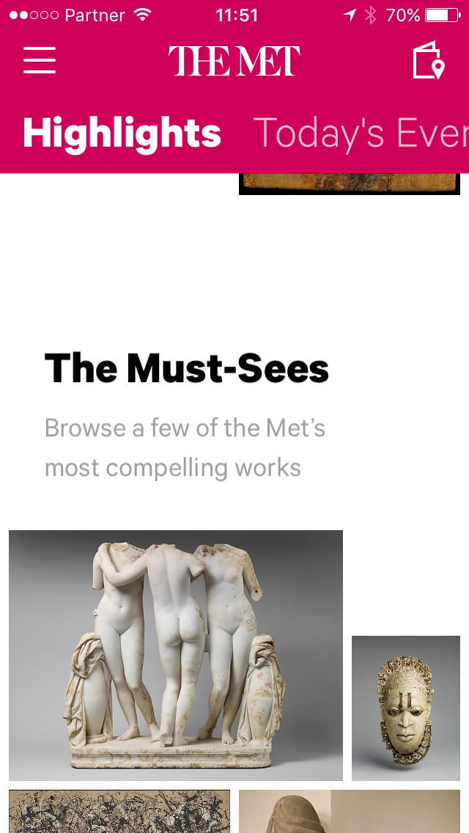

Slide 41
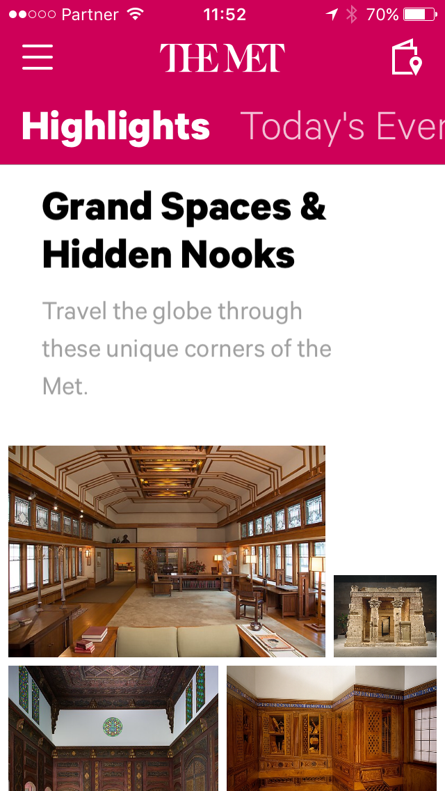
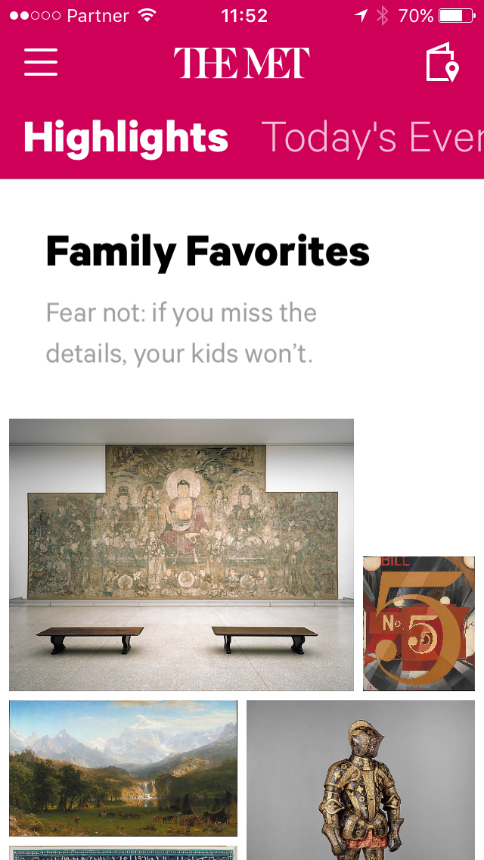
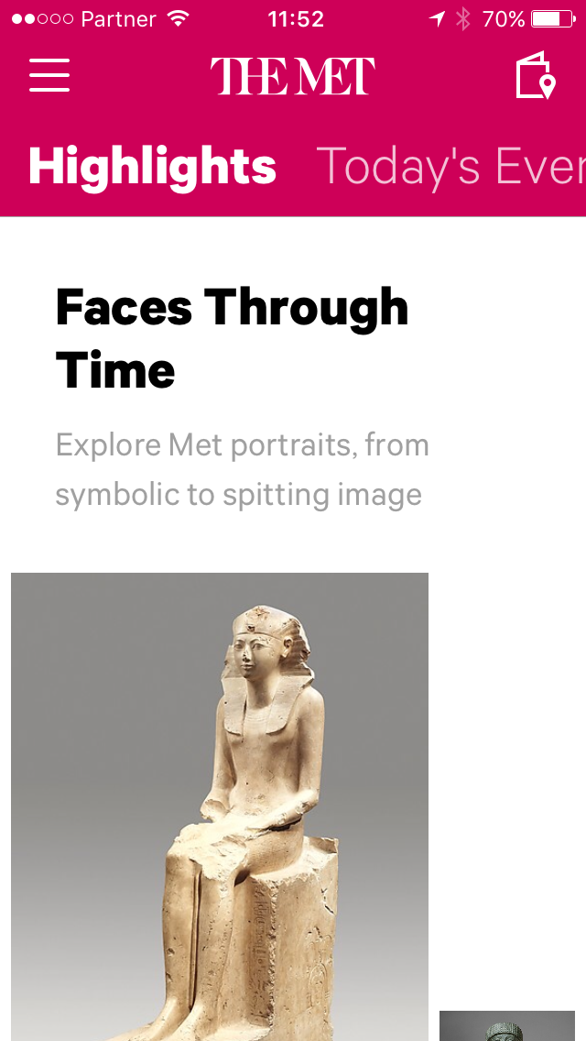

Slide 42
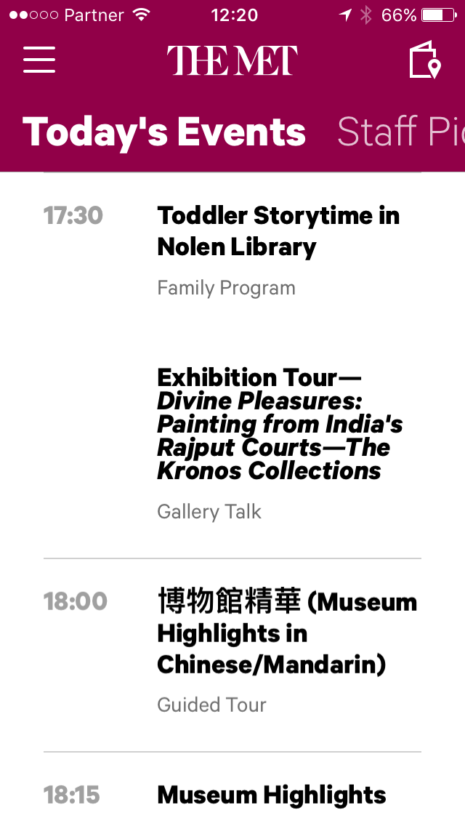

Slide 51
Cognitive dissonance

Slide 53
iPad
ARTLAB MOMA, Museum of Modern Art
https://itunes.apple.com/us/app/moma-art-lab/id529886963?mt=8

Slide 54
The Department of Advertising and Graphic Design is The Museum of Modern Art’s in-house design studio.
http://momadesignstudio.org/Art-Lab-App
Project: Art Lab App Project Team: Allegra Burnette / H.Y. Ingrid Chou / Julia Hoffmann (creative direction), H.Y. Ingrid Chou (art direction, design) About: iPad app inspired by the onsite labs in MoMA's Education Center (Line Lab, Shape Lab, Material Lab, MoMA Art Lab: People) Photos: Jason Brownrigg Awards & Press: 2012 Parent's Choice Award 2012 HOW Interactive Design Merit Award 2013 Webby Award (Education & Reference) Featured in the art chapter of iPad Apps for Kids, elected one of the "10 Favorite Kid Apps" Featured on artinfo.com, hyperallergic.com, and in USA Today as one of the top five apps for creative kids Featured as "App of the Day" on gizmodo.com Featured in iPad Apps for Kids for Dummies by Jinny Gudmundsen: "...MoMA Art Lab creates one of the most creative and inspiring experiences that I've encountered since the iTunes Store opened. The tools are easy to use and produce fascinating artwork. The six activities based on the work of real artists make brilliant use of the iPad. "Best for: Kids and adults, regardless of whether they're interested in art. Actually, this is a great app to explore for kids who don't like art. It makes modern art accessible. "An overwhelming number of art creation apps are in the iTunes Store, in part because the iPad offers such an intuitive way to make art. With just the touch of the finger to the screen, kids can start to create. I selected this app as one of my Ten Favorite Kid Apps because it does more than simply encourage artistic creation. This app changes the way kids look at art..."
iPad

Slide 55
http://momadesignstudio.org/Art-Lab-App

Slide 56
iPad
http://momadesignstudio.org/Art-Lab-App

Slide 57
iPad

Slide 58
iPad

Slide 59
iPad

Slide 60
iPad

Slide 61
iPad

Slide 62
iPad

Slide 63
iPad

Slide 64
iPad

Slide 65
iPad

Slide 66
iPad

Slide 67
8 Rue de Londres 75009 Paris France

Slide 68
8 Rue de Londres 75009 Paris France

Slide 74
MUSE E-133 | Performing the Digital Museum
September 13 Swiping and tapping | Museums on the smartphone; apps and more apps
Discussion – Mobile or PC

Slide 75
Responsive design

Slide 76
Responsive web design
Responsive design
https://en.wikipedia.org/wiki/Responsive_web_design

Slide 77
StatCounter Global Stats http://gs.statcounter.com§

Slide 78
Mobile Apps vs. Mobile Web: Do You Have to Choose? April 25, 2016Posted By Ajay Kapur
http://www.business.com/mobile-marketing/mobile-apps-vs-mobile-web-do-you-have-to-choose/
The Biggest Brands Have It Made
Mobile apps represent a small fraction of the total mobile revenue for all but a handful of the biggest brands.
Amazon has more app revenue than mobile web revenue. Walmart is getting close to parity. Most are not even close. Why? Benedict Evans summed it up most succinctly: “Do people want to put your icon on their home screen?” The answer for most brands is, “no.”

Slide 79
What is Mobilegwddon and the Google Mobile Friendly Update
http://searchengineland.com/library/google/google-mobile-friendly-upd

Slide 80
Visitor-first, mobile-first: Designing a visitor-centric mobile experience
Marty Spellerberg, Spellerberg Associates, USA, Elise Granata, Santa Cruz Museum of Art & History, USA, Sarah Wambold, Clyfford Still Museum, USA
http://mw2016.museumsandtheweb.com/paper/visitor-first-mobile-first-designing-a-visitor-centric-mobile-experience/

Slide 81
MUSE E-133 | Performing the Digital Museum
September 13 Swiping and tapping | Museums on the smartphone; apps and more apps
Assignment
Research 2 different museum mobile apps and compare them while evaluating from the following perspectives:
Institutional voice, authoritative or informal
End user experience
Content, rich or shallow; limited versus complex
Write succinctly (2-3 pages) double-spacing, size 12 font, 1 inch margin Submit images, screenshots separately
Due: 2-3 pages | Due Oct 25

Slide 82
MUSE E-133 | Performing the Digital Museum
September 13 Swiping and tapping | Museums on the smartphone; apps and more apps
Links
Rijks
https://itunes.apple.com/en/app/rijksmuseum/id621307961?mt=8
https://play.google.com/store/apps/details?id=nl.rijksmuseum.mmt&hl=en
SFMOMA
https://itunes.apple.com/us/app/sfmoma/id1109182982?mt=8
* Not yet in Google play
Metropoloitan Museum
https://itunes.apple.com/us/app/met-official-app-metropolitan/id910622872?mt=8
https://play.google.com/store/apps/details?id=org.metmuseum.android.met&hl=en
ARTLAB MOMA, Museum of Modern Art
https://itunes.apple.com/us/app/moma-art-lab/id529886963?mt=8
Google Cultural Institute https://www.google.com/culturalinstitute/about
Discussion
Responsive web design
https://en.wikipedia.org/wiki/Responsive_web_design
StatCounter Global Stats
http://gs.statcounter.com/#desktop+mobile+tablet-comparison-US-monthly-201508-201607
Mobile Apps vs. Mobile Web: Do You Have to Choose? April 25, 2016Posted Ajay Kapur
http://www.business.com/mobile-marketing/mobile-apps-vs-mobile-web-do-you-have-to-choose/
What is Mobilegwddon and the Google Mobile Friendly Update
http://searchengineland.com/library/google/google-mobile-friendly-upd
Visitor-first, mobile-first: Designing a visitor-centric mobile experience
Marty Spellerberg, Spellerberg Associates, USA, Elise Granata, Santa Cruz Museum of Art & History, USA, Sarah Wambold, Clyfford Still Museum, USA
http://mw2016.museumsandtheweb.com/paper/visitor-first-mobile-first-designing-a-visitor-centric-mobile-experience/

Slide 83
MUSE E-133 | Performing the Digital Museum
Contact
shazan@imj.org.il
Skype – shazan22
Jerusalem time zone – currently UTC/GMT +2 hours

Slide 84
By Victor Grigas - Own work, CC BY-SA 4.0, https://commons.wikimedia.org/w/index.php?curid=40250423

