Slide 1
Micro-credentials in Action
The Friday Institute’s Approach
Mary Ann Wolf, PhD

Slide 2
Effective Professional Learning Is:
Intensive, ongoing, job-embedded, & connected.
Focused on student learning.
Focused on teaching specific curriculum content.
Aligned with school improvement priorities & goals.
Focused on building strong working relationships among teachers.
(Darling-Hammond, Learning Forward, 2009)

Slide 3
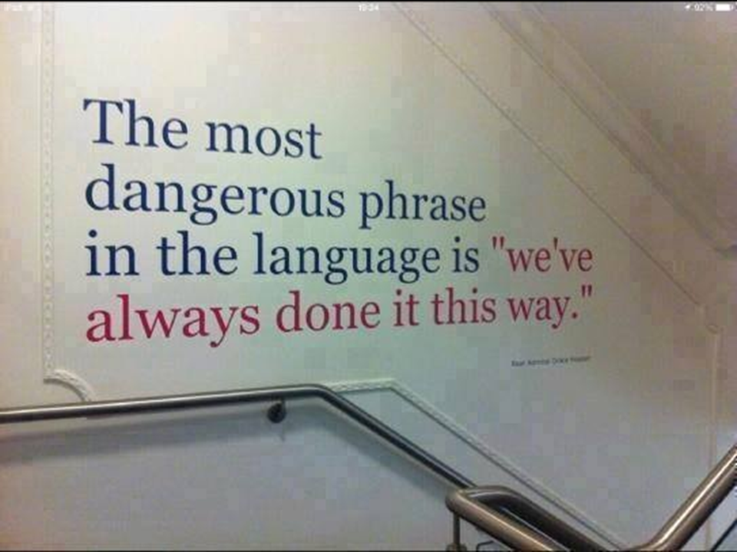

Slide 4
Notes:
MA - Unlearn...

Slide 5
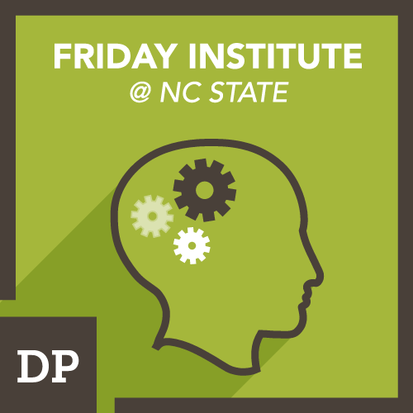
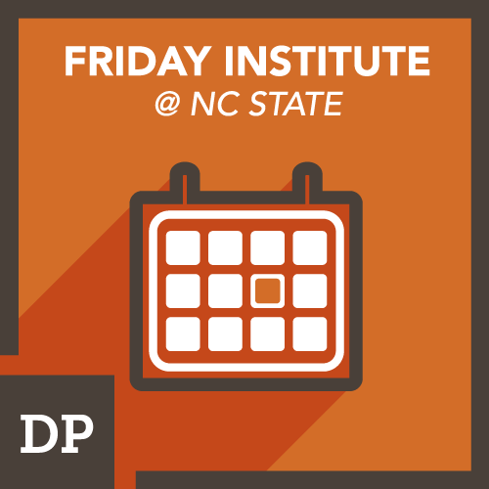
What are micro-credentials?
Badges represent a broader movement in education from recognizing seat time as a measure of completion to competency based professional learning. Rather than requiring educators attend a certain number of hours of professional learning experiences, badging requires educators to demonstrate mastery of a certain number of skills.

Slide 6
Our approach
Micro-credentials to supplement our professional learning opportunities, including our MOOCs for Educators and face-to-face sessions
26 micro-credentials on:
Learning Differences (6)
Fractions Foundations (8)
Using the SAMR model in the classroom (4)
Teaching Statistics (8)

Slide 7
Our design elements
While developing micro-credentials, the Friday Institute considers several design elements:
Self-directed
Job-Embedded
Competency-Based
Research-Based

Slide 8
Sample Submissions

Slide 9
Sample 1: Fair Sharing
The Fair Sharing stack is comprised of four micro-credentials:
Apply Understanding
Conduct a Student Interview
Build a Plan
Try it Today

Slide 10
Sample 1: Fair Sharing
In my student interview, my student struggled to identify how the number of equal pieces that the object was divided into related to the name of the fraction. The student interview influenced the lesson because if I had not done the interview, I would not have known that this misconception existed and would not have emphasized the role the denominator and numerator played in the creation of a fraction.
I would also like to note that my district did a pre-test for this skill and the students that I interviewed had all answered the question about numerator and denominator correctly. I think that the interview was a much better judge of mastery and I plan to use this more often.

Slide 11
Full lesson plan available here

Slide 13
Sample 2: Learning Differences
The submission is part of the Executive Function stack which is comprised of 5 micro-credentials:
Demonstrate Understanding
Partner With Students
Create a Learner Profile
Try it Tomorrow
Connect with Others

Slide 14
Sample 2: Learning Differences
“The student I chose is in the fifth grade and has difficulty with impulse control. He is very intelligent and thrives on lists and learning new things; however, his impulse control can get in the way of achieving his goals. Also, fifth grade is a crucial age to work with to help students prepare for middle school. I am working with him using a curriculum called Hunter and His Amazing Remote Control. Each session focuses on a different button on the remote control and each button represents an executive function to work on . For example, the Fast Forward button helps with self-monitoring and looking ahead. [...] The Play button is the heart of student agency allowing them to be in control… To further teach the menu button (emotional control), we did an activity where the student tried to guess the feeling on each page based on facial expressions and then write about times when he felt those feelings.”

Slide 15
Sample 3: Learning Differences
“In using the curriculum to build executive function, the most commonly used strategy that I incorporate is role play. This allows my student to practice the skills in a therapeutic environment where he feels safe, heard, and understood. The student practiced asking questions on a difficult assignment like he would in class. To practice emotional control, I would antagonize him like a fellow student might do in his class, and my student would practice standing up for himself in a calm assertive way. [...]”

Slide 16
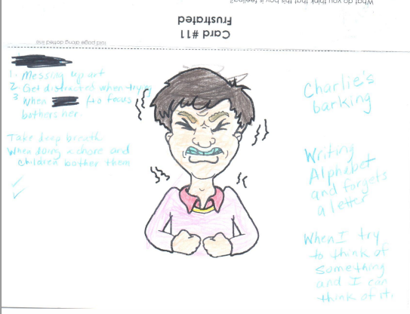

Slide 17
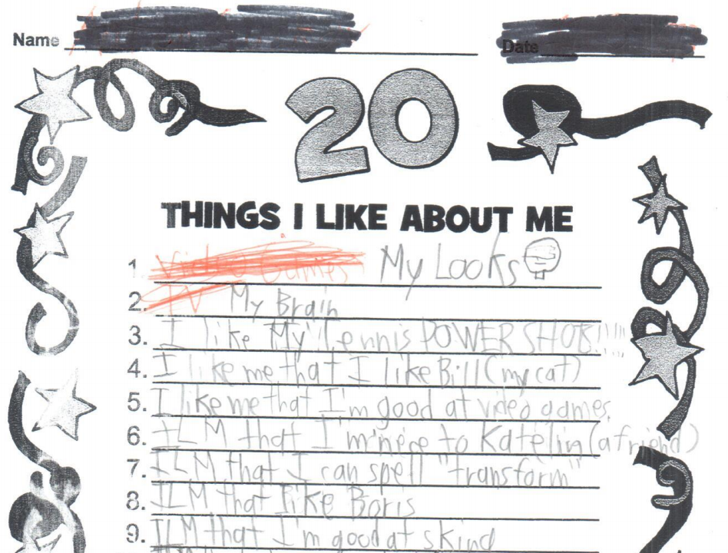

Slide 18
Micro-Credentials in States & Districts
North Carolina: Micro-credentialing and State Policy Working Group, CEU Equivalencies
Arkansas: Teacher Inducation Focus
Washington: Growth Mindset
Surry County and New Hanover County, NC: Focus on Digital Learning

Slide 19
Micro-Credentials for Pre-Service
Brigham Young University
Penn State University
Digital Promise (pre-service and in-service)

Slide 20
Personal Mastery
90%
80-90%
80-90%
Skills into Classrooms
10-20%
5-10%
5%
5%
5%
Research and Theory
Research, Theory, and Demonstrations
Research, Theory, Demonstrations, and Practice
Research, Theory,
Demonstrations,
and Practice + Coaching/Mentoring
Source: Joyce & Showers (1995, 2002)

Slide 21
Discussion Questions
How could micro-credentials support or encourage personalization of professional learning experiences (pre-service or in-service)?
How might a school, district, state, or university utilize micro-credentials?
Questions from you!

Slide 22
Mary Ann Wolf, PhD
mawolf@ncsu.edu

