Slide 1
BST281: Genomic Data Manipulation
Curtis Huttenhower (chuttenh@hsph.harvard.edu)
Eric Franzosa (franzosa@hsph.harvard.edu)
http://huttenhower.sph.harvard.edu/bst281

Slide 2
BST281: Genomic Data Manipulation
Provide the conceptual understanding and technical tools to do high-quality quantitative biology research.
Overview of molecular assays, data, and analysis techniques.
Ways to generate and obtain data, best practices for analysis.
A little bit of statistics, a lot of computational techniques.
No prior knowledge assumed, although it definitely doesn’t hurt.
Python as a tool, but it’s just that – a tool, and only one representative.
DNA sequencing, RNA-seq and microarrays, proteomics, epigenetics, knockout and synthetic genetics, biological networks, metagenomics, comparative genomics and phylogenetics.

Slide 3
Course overview
Location
Lectures: MW 3:30-5:20 Kresge LL6
Labs: M 5:30-7:20 FXB G11
Mandatory during problem sets, first ~3/4 of class.
Instructors
Curtis Huttenhower chuttenh@hsph.harvard.edu
Office hours: M 10:00-11:00, SPH1 413
Eric Franzosa franzosa@hsph.harvard.edu
Office hours: M 10:00-11:00, SPH1 412
TA
Xue Zou xuz943@mail.harvard.edu
Office hours: W 12:30-1:30, CLSB 11021

Slide 4
Course web site
http://huttenhower.sph.harvard.edu/bst281
Redirects to standard Canvas site.
If you aren’t on Canvas that’s fine – email TA now / ASAP to register.
Contains the entire calendar of topics and activities throughout the course.
All assignments and grades will be posted and submitted here.
All assignments will be submitted as text files including Python and written material.
Plus group presentations and analysis packages for journal club and final project.
Includes course announcements and discussion board.
Please use the latter to discuss the course and questions…
…but be cognizant of the collaboration policy – more on that later.

Slide 5
Course structure
Four main components:
Quantitative biology and ’omics.
Computational tools (Python).
Current research (journal club) midterm, and final project.
Two books:
Practical Computing for Biologists, Haddock and Dunn: mostly for the first 1/3.
Bioinformatics and Functional Genomics, Pevsner: mostly for the second 1/3.
Six biweekly problem sets:
Assigned every other Monday.
Due by end-of-day (midnight) next week’s Friday (~two weeks).
Most material provided in slides (one per class segment).
Plus a one-page summary of each class: takeaways, textbook readings, literature.

Slide 6
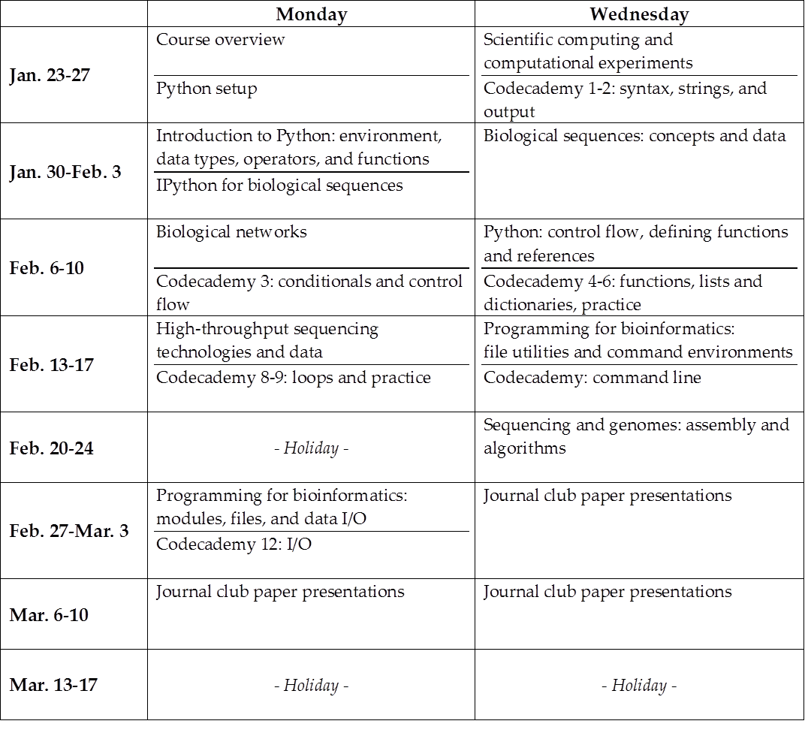
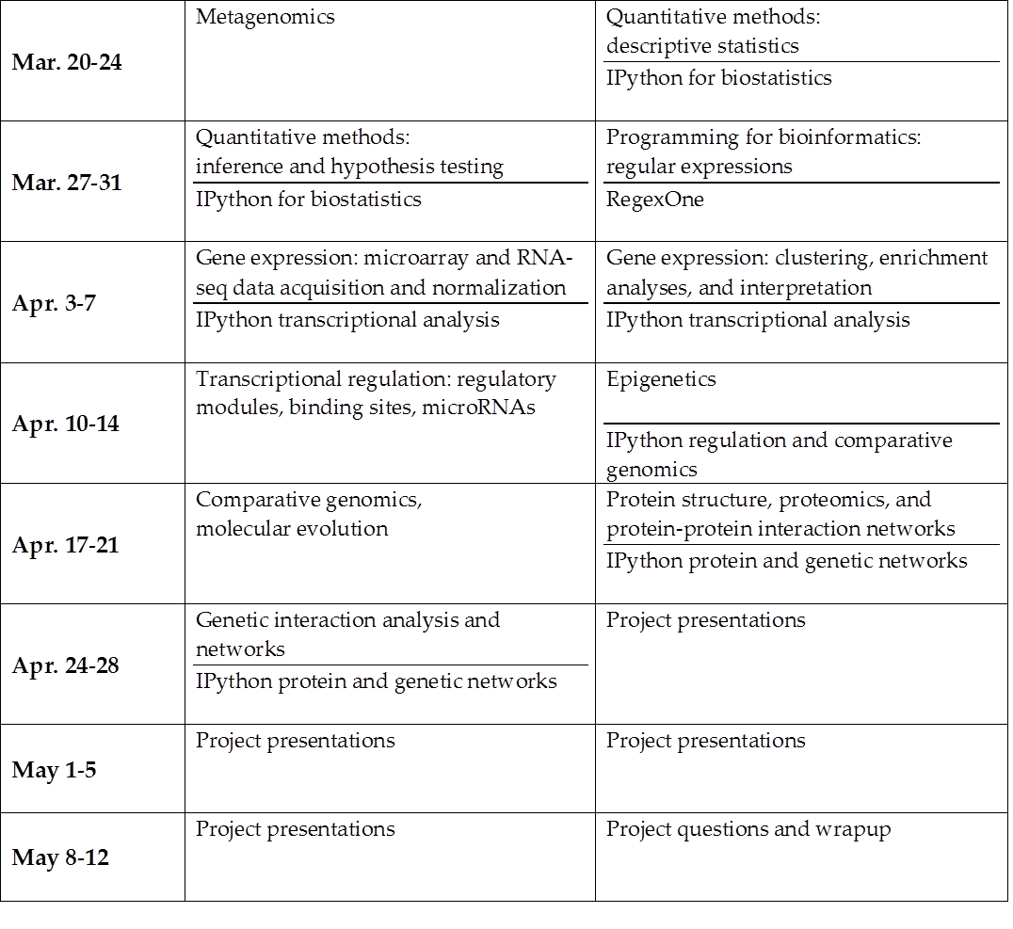
Course structure

Slide 7
Class structure
Two two-hour sessions each week, plus lab
Each session comprises at least two segments, with a ~5-10min break in between
Breaks are intended to be halfway ~4:20 – if I miss them, please remind me!
Lectures are meant to be interactive – a conversation, not a speech!
Please interrupt, ask questions, and feel free to direct discussion topics.
Particularly when they touch on your own areas of research.
Please bring your laptops to class if at all possible.
If not, let one of us know after class.

Slide 8
Lab structure
Mandatory while problem sets are outstanding.
Optional but time and space still available during midterm / final projects.
Assignments will be returned ~one week after submission.
Each lab includes, in priority order:
If an assignment just came back, review and discussion.
Examples and discussion related to the currently outstanding problem set.
Particularly for the technical details of programming.
Continuation of in-class analysis activities.
Additional lecture material or demonstrations from class topics.
Free time for individual or small group work on assignments / projects.

Slide 9
Journal clubs and final projects
Midterm journal clubs and final projects are both group activities.
2-5 people per group, 3-4 recommended.
Do not have to be the same groups.
Journal clubs:
Select a high-impact and/or recent publication that’s heavy on quantitative biology.
Propose and get signoff from us.
Present and submit, as a group, a ~30min summary and discussion, plus questions.
Final projects:
Generate a ~1-2 paragraph proposal for an appropriately-scoped ‘omics analysis.
Using your own research data is fair game.
Iterate, get signoff, and carry out the analysis.
Present ~45min overview and discussion, plus questions.
Submit presentation, data and code package, and…
…individual extended abstract writeups: 2-4 pages, including 1-2 figures, plus references.

Slide 10
Assignment and collaboration policies
Late submissions lose points geometrically:
10% the first day, 25% the second, 60% the third, 100% the fourth.
Extensions are generally fine if requested at least one day in advance.
Problem set structure and scoring is indicated within each assignment.
On problem sets, please use common sense for collaboration:
Neither specific code nor text for written answers may be shared.
Do not show them to each other, even within group members.
If you want to ask about specific code, send it privately to the TA.
All problem sets are submitted individually and checked for duplication.
However, we encourage discussion of questions about problem sets:
These may (and should!) be posted on the course web discussion board.
Feel free to address questions, without sharing the specifics of individual answers.

Slide 11
Summary
http://huttenhower.sph.harvard.edu/bst281
MW 3:30-5:20, plus lab
Curtis, Eric, and Xue
Tools and concepts for high-quality quantitative biology research.
Learn standard ‘omics analysis techniques and tools to create your own.
Python programming from scratch, quantitative concepts, and bioinformatics.
Two sessions each week, plus lab.
Sessions are a mix of lectures and activities, labs are homework and technical details.
Six biweekly problem sets, group journal club and final project.

