Slide 1
Biological Sequences: Concepts & Data
Curtis Huttenhower (chuttenh@hsph.harvard.edu)
Eric Franzosa (franzosa@hsph.harvard.edu)
http://huttenhower.sph.harvard.edu/bst281

Slide 2
Summary
Biopolymers and the central dogma
Sequences as data & the FASTA file format
Sequence homology
Sequence alignment
BLAST as a homology search method
Dissecting a BLAST result
Sequence databases

Slide 3
Biopolymers

Slide 4
Polymers & biopolymers
Polymer (n): a substance that has a molecular structure consisting chiefly or entirely of a large number of similar units bonded together.
Biopolymer (n): a polymeric substance occurring in living organisms, e.g., a protein, cellulose, or DNA.

Slide 5
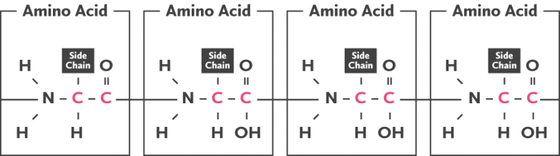
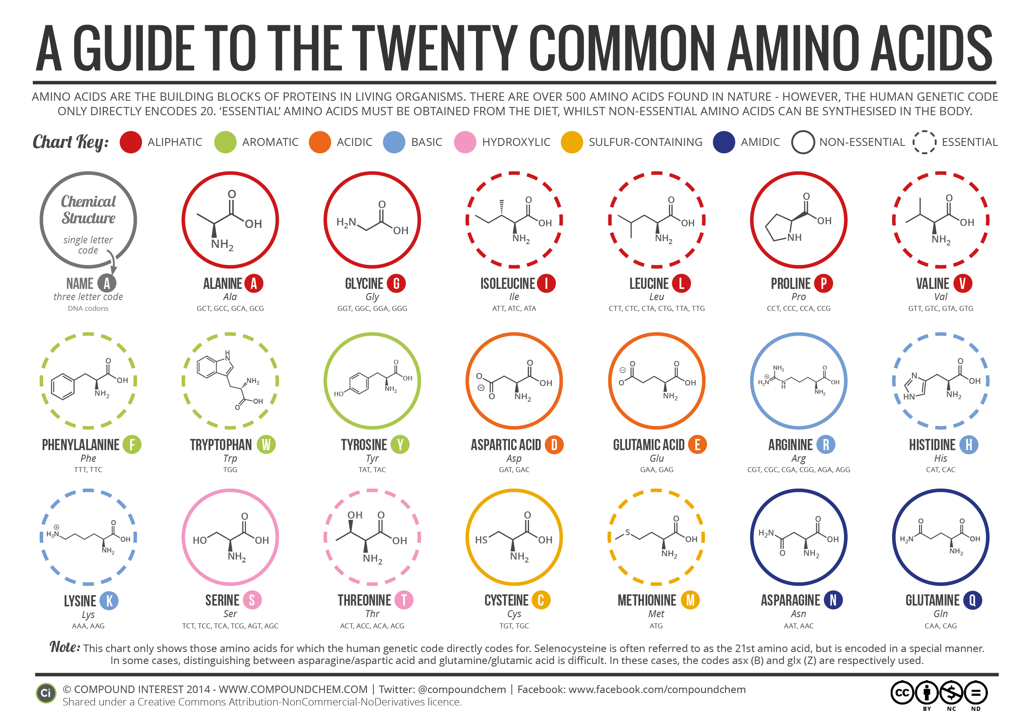
Information-carrying biopolymers
(N)ucleic (A)cids
Polypeptides (protein primary seq.)
(D)eoxyribo(N)(A)
(R)ibo(N)(A)
1/30/2017

Slide 6
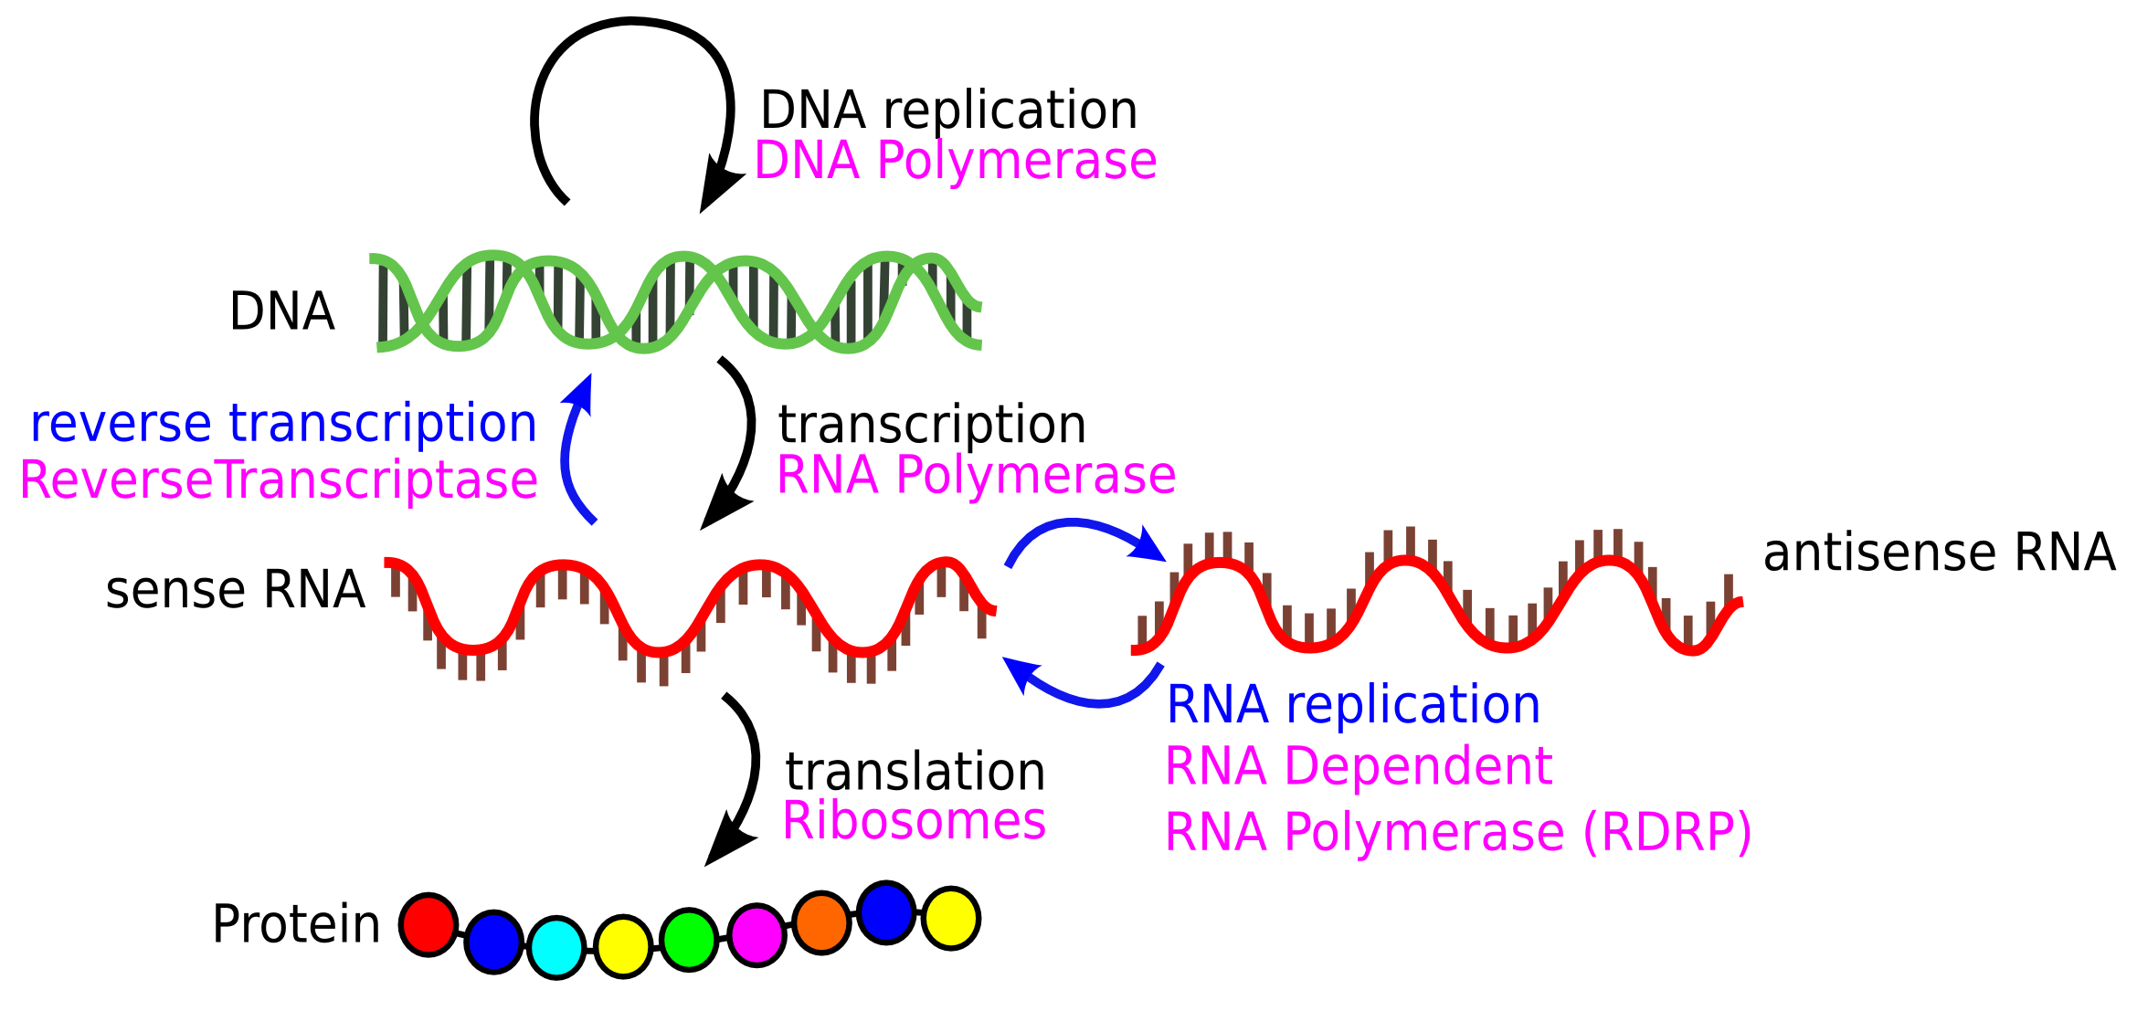
Information flow in the central dogma: molecular view

Slide 7
Information flow in the central dogma: data view
DNA sequence: (+)(sense)(5’-3’)(Watson) strand
5’ | GCT | GGA | GCA | CCA | GGA | CAA | GAT | GGA | 3’
DNA sequence: (-)(antisense)(3’-5’)(Crick) strand
3’ | CGA | CCT | CGT | GGT | CCT | GTT | CTA | CCT | 5’
RNA sequence: transcript
5’ | GCU | GGA | GCA | CCA | GGA | CAA | GAU | GGA | 3’
Protein translation (3-letter amino acid codes)
N- | Ala | Gly | Ala | Pro | Gly | Gln | Asp | Gly | -C
Protein translation (1-letter amino acid codes)
N- | A | G | A | P | G | Q | D | G | -C

Slide 8
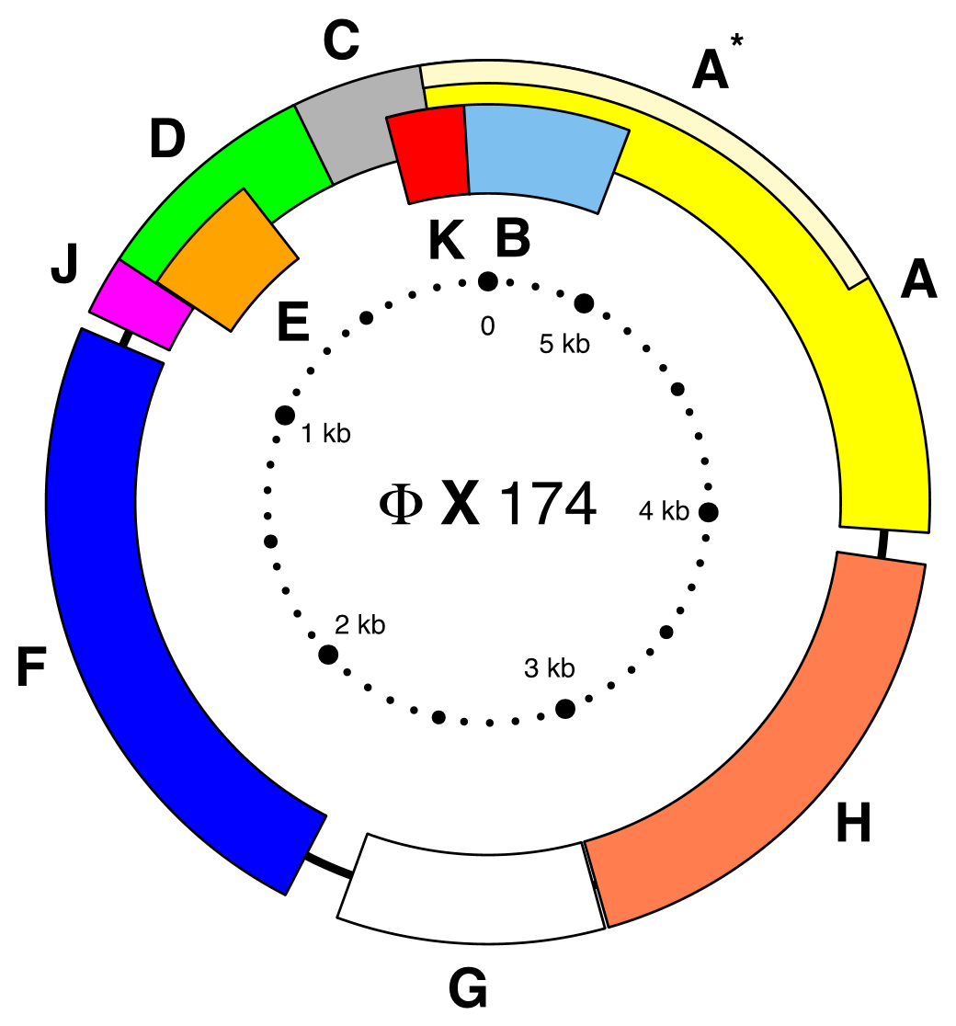
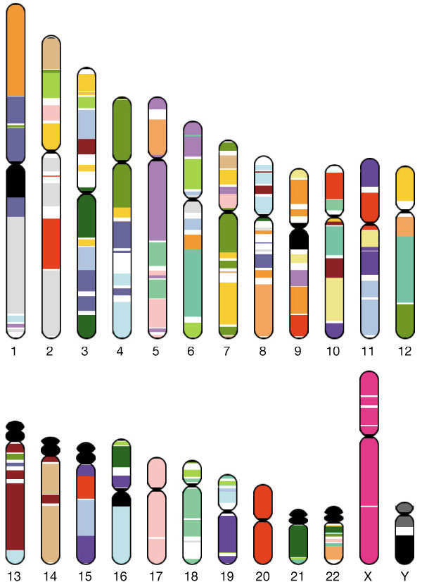
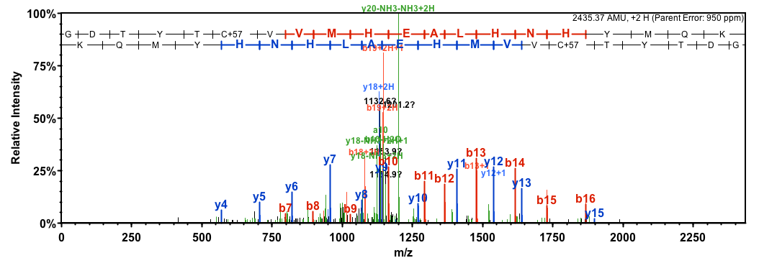
Generating novel sequence data: by experiment
Genomics (DNA-seq)
de novo transcriptomics (RNA-seq)
Phy X 174
Sequenced 1977
5,386 nucleotides
Proteomics (mass spectrometry)
Human genome
“Sequenced” Feb. 2001
24 chromosomes (molecules)
~3 billion nucleotides

Slide 9
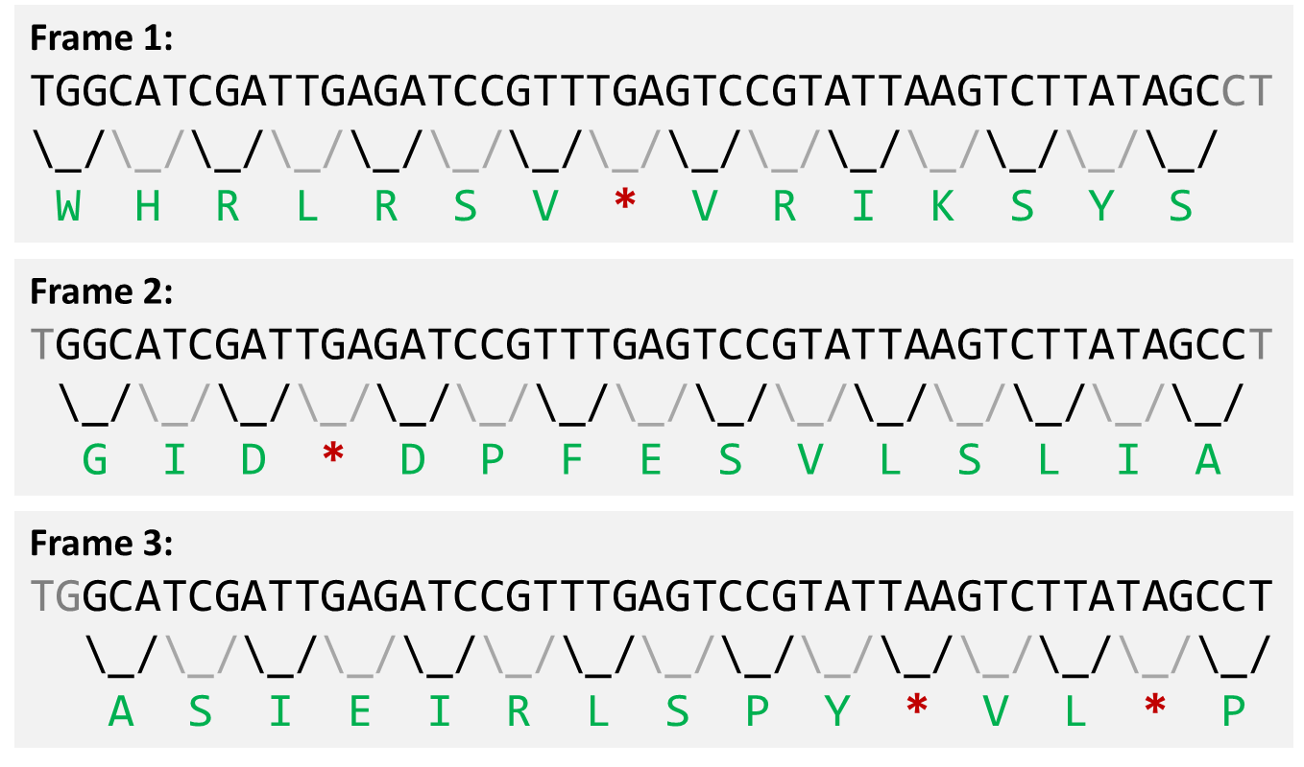
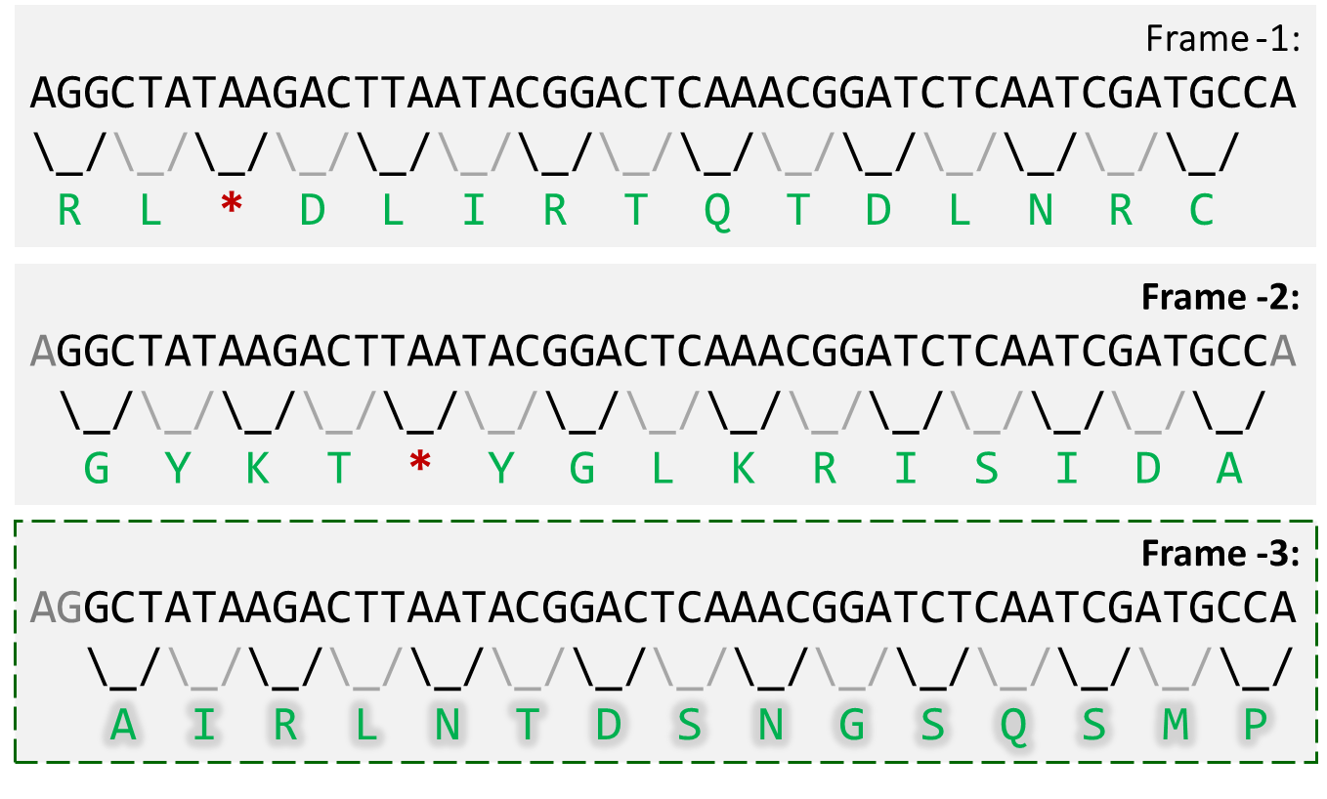
Generating novel sequence data: in silico
Much of the transcript (gene) and protein sequence data we have today comes from looking for coding sequences (open reading frames, ORFs) in genomes:
Genes can be encoded on the reverse strand as well!

Slide 10
Preview of future topics
Sequencing details (M04)
Genome assembly and annotation (W05)
RNA expression and transcriptomics (M10)
Protein structure and proteomics (W12)

Slide 11
FASTA files

Slide 12
FASTA files represent sequence data
Invented for use with the FASTA software in 1985
FASTA software is antiquated, but the data format remains
Should be pronounced “fast-A”, but “fast-ah” more common
One-line headers (sequence descriptions) start with “>”
Sequence information follows
>Header1
...sequence1...
>Header2
...sequence2...
>Header3
...sequence3...

Slide 13
FASTA files represent sequence data
Sequence portion is whitespace insensitive
Often lines of 70-80 characters, sometimes in blocks of 10
>HEADER1
AGCATTCGATAGCATTCGATAGCATTCGATAGCATTCGATAGCATTCGATAGCATTCGATAGCATTCGAT
AGCATTCGATAGCATTCGATAGCATTCGATAGCATTCGATAGCATTCGATAGCATTCGATAGCATTCGAT
AGCATTCGATAGCATTCGATAGCATTCGATAGCATTCGA
>HEADER2
AGCATTCGATAGCATTCGATAGCATTCGATAGCATTCGATAGCATTCGATAGCATTCGATAGCATTCGAT
AGCATTCGATAGCATTCGATAGCATTCGATAGCATTCGATAGCATTCGATAGCATTCGATAGCATTCGAT
AGCATTCGATAGCATTCG
Headers often contain multiple piped (“|”) fields
First field suggests database-of-origin; here, sp=swissprot
>sp|P04637|P53_HUMAN Cellular tumor antigen p53 OS=Homo sapiens GN=TP53 PE=1 SV=4
...
>sp|P49615|CDK5_MOUSE Cyclin-dependent-like kinase 5 OS=Mus musculus GN=Cdk5 PE=1 SV=1
...

Slide 14
FASTA file extensions
.fasta, .fas
Generic extensions
.fnt
Generic nucleotide sequence
.ffn
Protein-coding DNA sequence (e.g. ORFs)
.frn
RNA-coding sequences
.faa
Generic protein sequence

Slide 15
Sequence homology

Slide 16
Biological sequence analysis
Comparing biological sequences to quantify their similarity is one of the most fundamental concepts in biological data analysis
Sequence similarity implies common evolutionary history
Comparative genomics, phylogenetics (M10)
Sequence similarity implies related molecular function
Annotation transfer, functional profiling (W05, M07)
Sequence similarity implies point of origin
Sequence mapping (ubiquitous)

Slide 17
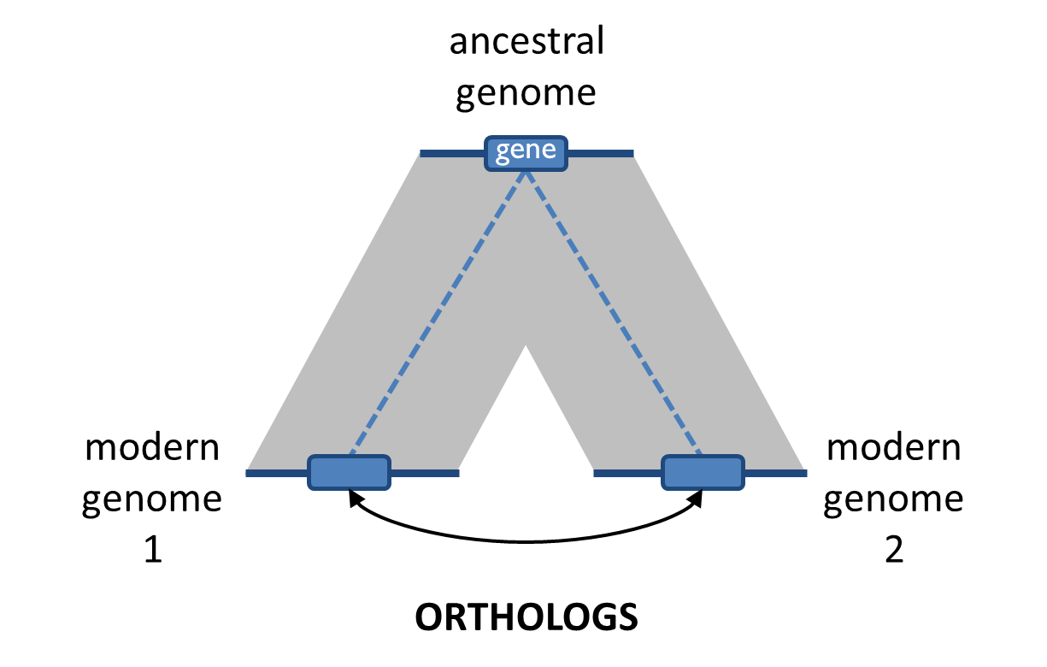
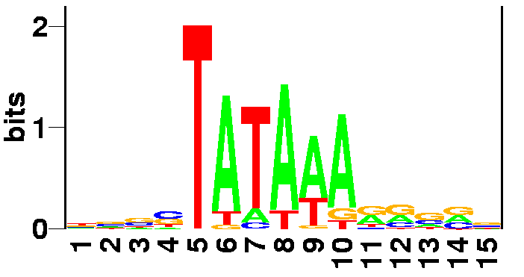
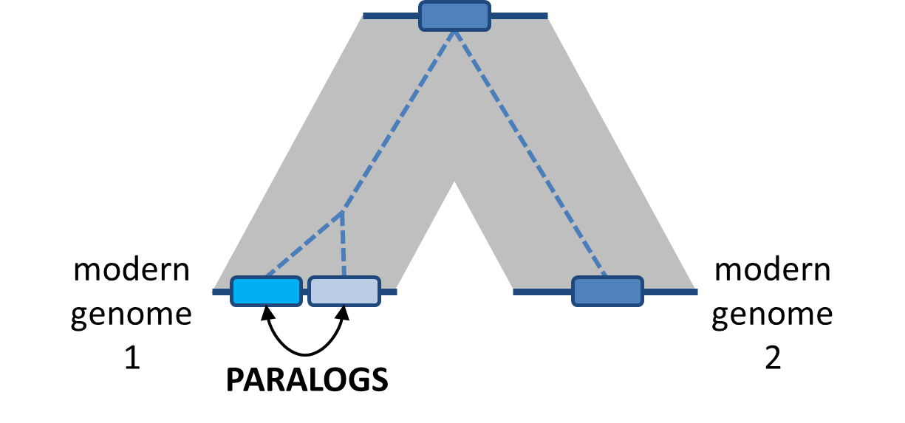
How does sequence similarity arise?
Convergent evolution / sequence “analogy”
Mostly applies to short sequences (motifs)
Divergent evolution / sequence homology
Most common cause of sequence similarity
gene
gene
gene
gene
gene

Slide 18
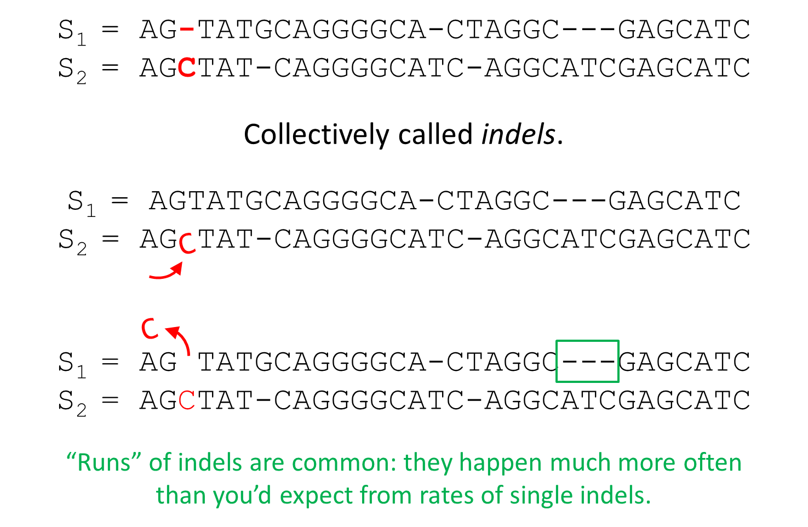
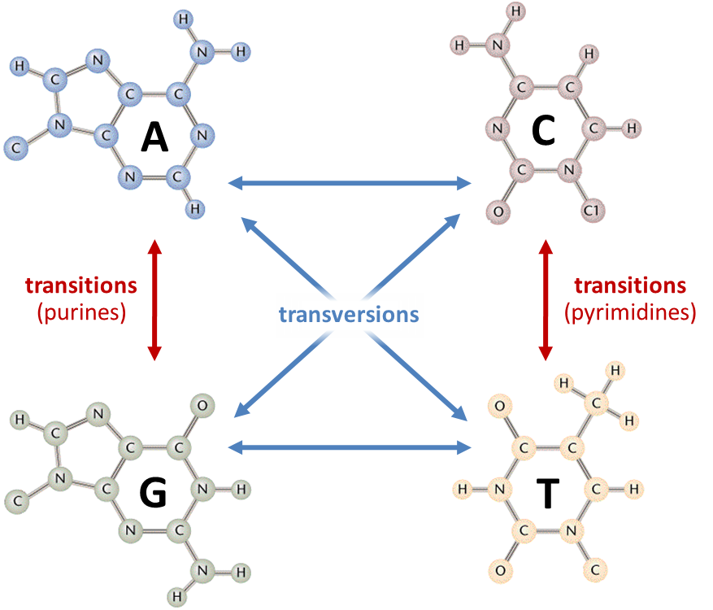
How sequence differences arise: DNA

Slide 19
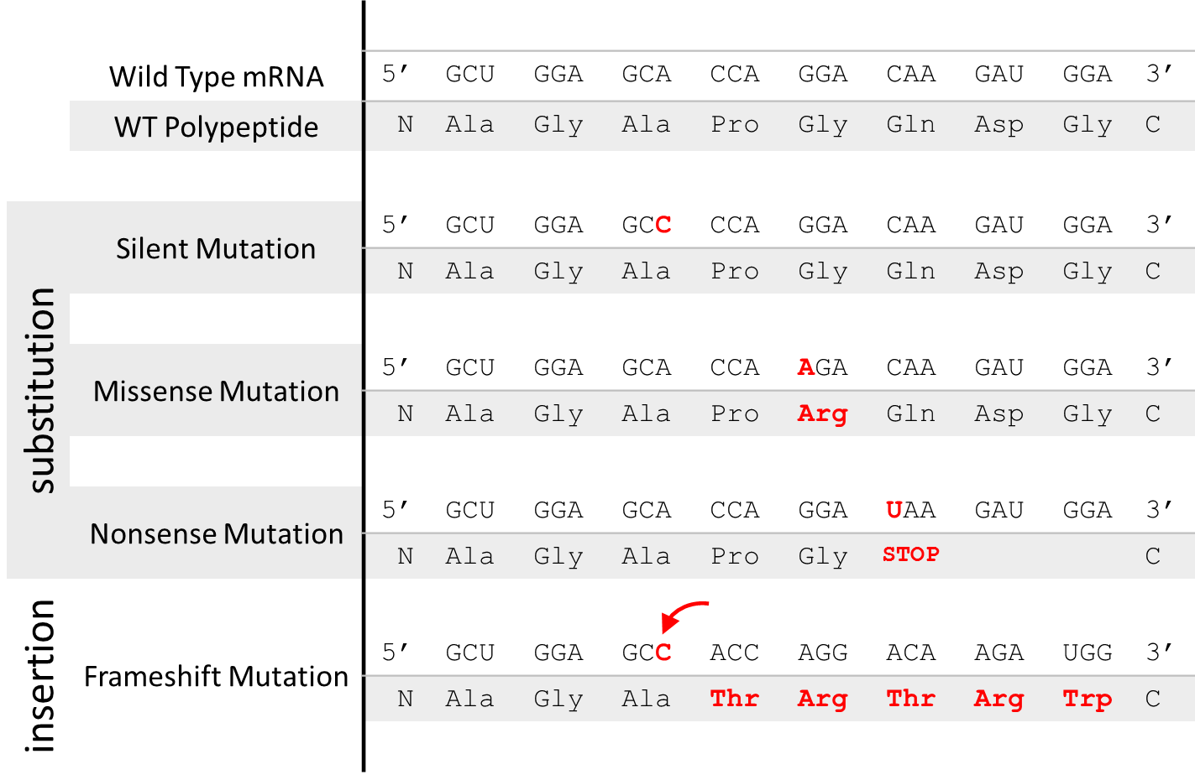
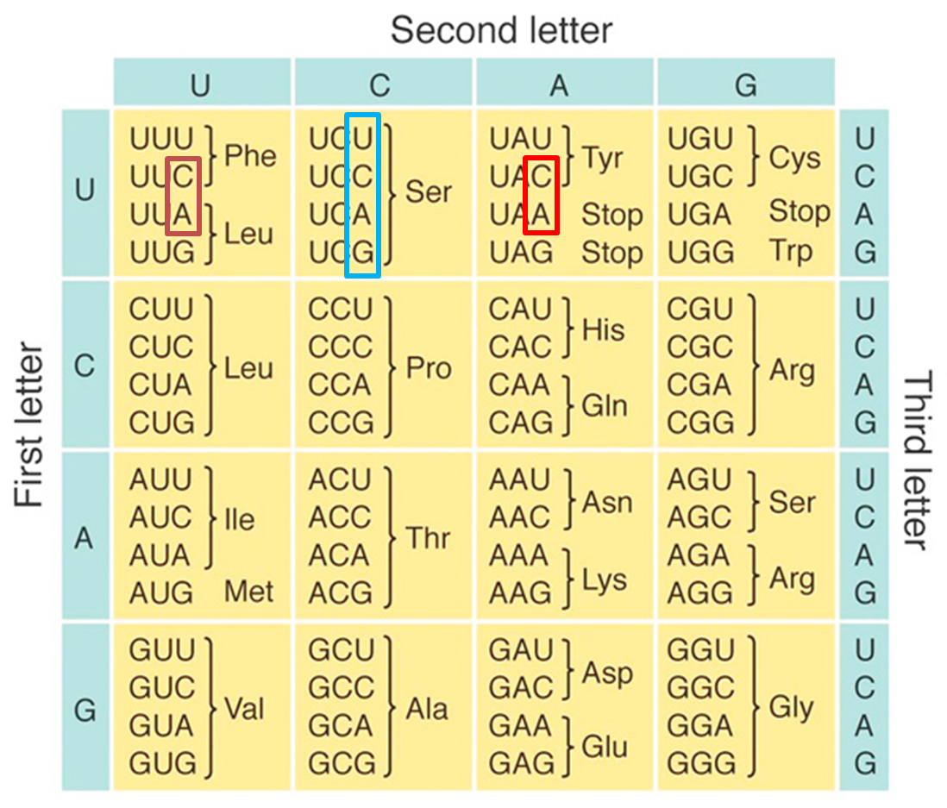
How sequence differences arise: Proteins
Degeneracy in the genetic code causes protein sequence similarity to “decay” more slowly than DNA sequence

Slide 20
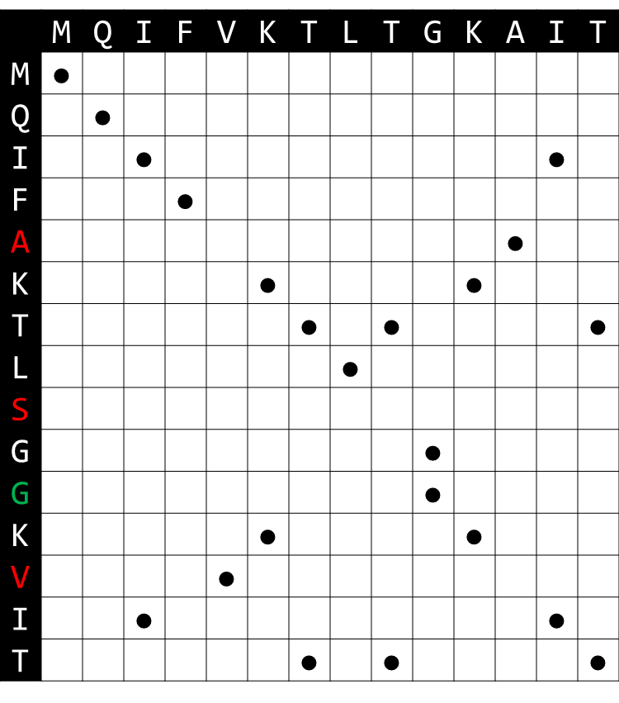
Quantifying sequence similarity by alignment
Dot plots compare a first sequence (cols) to a second sequence (rows)
A dot indicates an identical position
Diagonals indicate runs of identical positions (support for homology)
A “jump” indicates an insertion in one sequence OR deletion from the other
MQIFVKTLT-GKAIT
|||| ||| || ||
MQIFAKTLSGGKVIT

Slide 21
Sequence alignment

Slide 22
Quantifying sequence similarity by alignment
Dot plots are a good tool for visualizing sequence homology, but they are impractical for actually building alignments
The number of possible alignments for two sequences grows very rapidly (250M options for two sequences of length 12):
mathmaticks
++++ +
mathematics
math-maticks
++++ +++++
mathematics
math-maticks
++++ +++++ +
mathematic-s

Slide 23
Global alignment
 | X_{i} | → | 0 |  | 1 |  | 2 |  | 3 |  | 4 |  | 5 |  | 6 |  | 7
Y_{j} |  |  | – |  | G |  | A |  | T |  | T |  | A |  | C |  | A
↓
0 | –
 |  |  |  | ↖
1 | G
 |  |  |  |  |  | ↖
2 | A |  |  |  |  |  |  | ←
 |  |  |  |  |  |  |  |  |  | ↖
3 | T
 |  |  |  |  |  |  |  |  |  |  |  | ↖
4 | A
 |  |  |  |  |  |  |  |  |  |  |  |  |  | ↖
5 | G
 |  |  |  |  |  |  |  |  |  |  |  |  |  |  |  | ↖
6 | A
Consider two DNA sequences:
GATTACA GATAGA
An alignment is a path in this grid
 |  |  |  |  | G |  | A |  | T |  | T |  | A |  | C |  | A
 |  |  |  |  | | |  | | |  |  |  | | |  | | |  |  |  | |
 |  |  |  |  | G |  | A |  | – |  | T |  | A |  | G |  | A

Slide 24
Global alignment
 | X_{i} | → | 0 |  | 1 |  | 2 |  | 3 |  | 4 |  | 5 |  | 6 |  | 7
Y_{j} |  |  | – |  | G |  | A |  | T |  | T |  | A |  | C |  | A
↓
0 | –
 |  |  |  | ↖
1 | G |  |  |  |  | ← |  | ←
 |  |  |  |  |  |  |  |  |  | ↖
2 | A
 |  |  |  |  |  |  |  |  |  |  |  | ↖
3 | T
 |  |  |  |  |  |  |  |  |  |  |  |  |  | ↖
4 | A
 |  |  |  |  |  |  |  |  |  |  |  |  |  |  | ↑
5 | G
 |  |  |  |  |  |  |  |  |  |  |  |  |  |  |  | ↖
6 | A
Consider two DNA sequences:
GATTACA GATAGA
An alignment is a path in this grid
Another alignment path that is not as good (qualitatively)
 |  |  | G |  | A |  | T |  | T |  | A |  | C |  | - |  | A
 |  |  | | |  |  |  |  |  |  |  | | |  |  |  |  |  | |
 |  |  | G |  | – |  | – |  | A |  | T |  | A |  | G |  | A

Slide 25
Alignment scoring
 | X_{i} | → | 0 |  | 1 |  | 2 |  | 3 |  | 4 |  | 5 |  | 6 |  | 7
Y_{j} |  |  | – |  | G |  | A |  | T |  | T |  | A |  | C |  | A
↓
0 | – |  | 0
 |  |  |  | ↖
1 | G |  |  |  | 1
 |  |  |  |  |  | ↖
2 | A |  |  |  |  |  | 2 | ← | 1
 |  |  |  |  |  |  |  |  |  | ↖
3 | T |  |  |  |  |  |  |  |  |  | 2
 |  |  |  |  |  |  |  |  |  |  |  | ↖
4 | A |  |  |  |  |  |  |  |  |  |  |  | 3
 |  |  |  |  |  |  |  |  |  |  |  |  |  | ↖
5 | G |  |  |  |  |  |  |  |  |  |  |  |  |  | 3
 |  |  |  |  |  |  |  |  |  |  |  |  |  |  |  | ↖
6 | A |  |  |  |  |  |  |  |  |  |  |  |  |  |  |  | 4
Let a “match” add 1 to the score…
Let a “mismatch” add 0 to the score…
Let an indel/gap subtract 1 from the score (reflects indels being less common than substitutions)
Our original alignment has a score of four
 |  |  |  |  | G |  | A |  | T |  | T |  | A |  | C |  | A
 |  |  |  |  | +1 |  | +1 |  | -1 |  | +1 |  | +1 |  | +0 |  | +1
 |  |  |  |  | G |  | A |  | – |  | T |  | A |  | G |  | A
Total = 4

Slide 26
Alignment scoring
 | X_{i} | → | 0 |  | 1 |  | 2 |  | 3 |  | 4 |  | 5 |  | 6 |  | 7
Y_{j} |  |  | – |  | G |  | A |  | T |  | T |  | A |  | C |  | A
↓
0 | – |  | 0
 |  |  |  | ↖
1 | G |  |  |  | 1 | ← | 0 | ← | -1
 |  |  |  |  |  |  |  |  |  | ↖
2 | A |  |  |  |  |  |  |  |  |  | -1
 |  |  |  |  |  |  |  |  |  |  |  | ↖
3 | T |  |  |  |  |  |  |  |  |  |  |  | -1
 |  |  |  |  |  |  |  |  |  |  |  |  |  | ↖
4 | A |  |  |  |  |  |  |  |  |  |  |  |  |  | -1
 |  |  |  |  |  |  |  |  |  |  |  |  |  |  | ↑
5 | G |  |  |  |  |  |  |  |  |  |  |  |  |  | -2
 |  |  |  |  |  |  |  |  |  |  |  |  |  |  |  | ↖
6 | A |  |  |  |  |  |  |  |  |  |  |  |  |  |  |  | -1
Let a “match” add 1 to the score…
Let a “mismatch” add 0 to the score…
Let an indel/gap subtract 1 from the score (reflects indels being less common than substitutions)
The alternate alignment is quantitatively worse
 |  |  | G |  | A |  | T |  | T |  | A |  | C |  | - |  | A
 |  |  | +1 |  | -1 |  | -1 |  | +0 |  | +0 |  | +0 |  | -1 |  | +1
 |  |  | G |  | – |  | – |  | A |  | T |  | A |  | G |  | A
Total = -1

Slide 27
Finding the best alignment
Based on these ideas…
Represent alignment as a path
Scoring alignment “steps” according to biological realism
We then “construct” the best, full alignment using shorter, previously constructed alignments
We’ll skip the details (Needleman–Wunsch Algorithm, 1970)
Part of a family of computing problems (dynamic programming), another of which is shortest/quickest path (Google Maps)

Slide 28
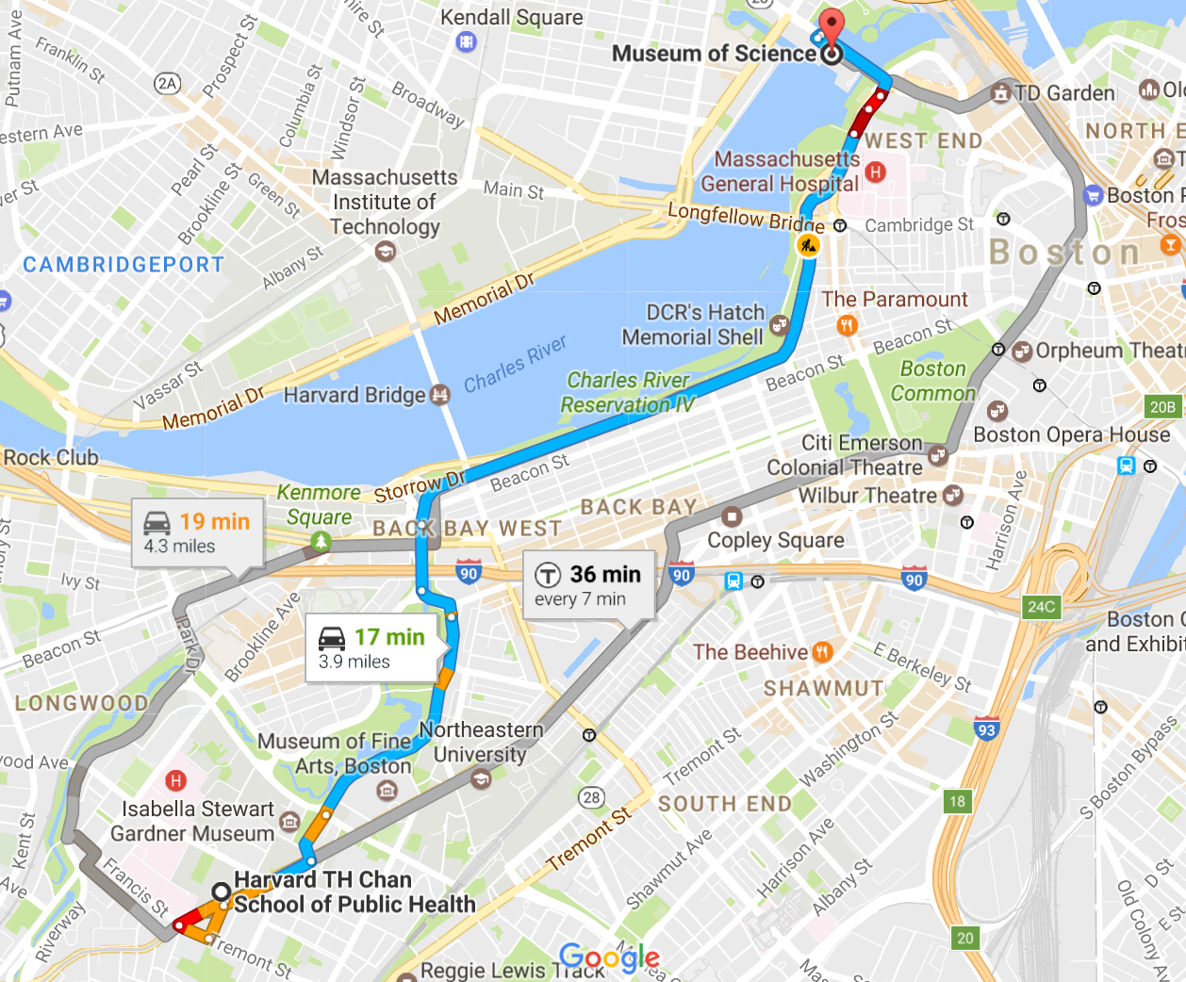
Finding the best alignment

Slide 29
Alignment strategies
Global alignment
Semi-global alignment
Local alignment
Must use all of both sequences
Punishes gain/loss of information at the ends of sequences
Can ignore the ends of one of the two sequences
Helpful when aligning very short sequences (e.g. reads) to long sequences (e.g. genomes)
Can ignore the ends of both sequences
Do sequences share a homologous region?
Most common strategy
Smith-Waterman algorithm

Slide 30
Advanced alignment scoring: amino acid similarity
Not all mismatches are equally “bad”

Slide 31
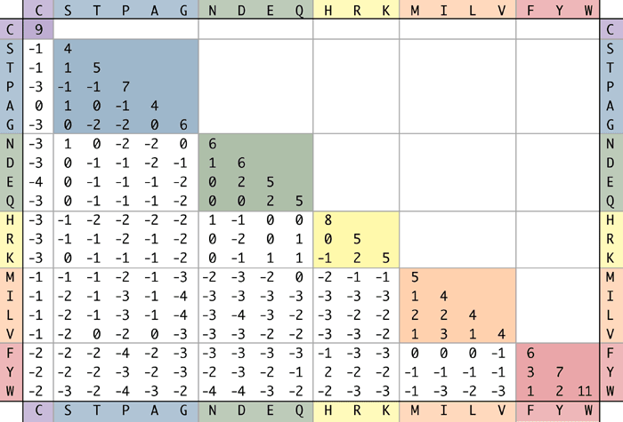
Advanced alignment scoring: amino acid similarity
BLOSUM62 scores weight AA pairs based on evolutionary similarity
(which tends to mirror biochemical similarity)
(i,j) entry reflects the log likelihood of AA_{i} aligning to AA_{j} in two sequences that are 62% identical

Slide 32
Advanced alignment scoring: affine gap scoring
Unlike point substitutions, insertions and deletions often happen in chunks:
Penalizing each individual gap as a separate event is overly harsh
Instead, use a large, negative “gap open” penalty (e.g. -4) and a smaller negative gap extension penalty (e.g. -1); this is called “affine gap scoring”
AGGAC-----TAGGCATATGGGGGACT
AGGACGCATCTAGGCATATG---GACT
-4 + -4 + -4 + -4 + -4 versus -4 + -1 + -1 + -1 + -1
AGGAC-----TAGGCATATGGGGGACT
AGGACGCATCTAGGCATATG---GACT
-4 + -4 + -4 versus -4 + -1 + -1

Slide 33
BLAST

Slide 34
Alignment versus homology search
For two given sequences, pairwise alignment quantifies their similarity and provides an optimal alignment
A more common problem is, for a given sequence (query), can you find homologous sequences in a sequence database?
On which chromosome does my gene reside?
Which species have a copy of my gene?
Is a subsequence of my gene found in other genes?
Repeated, pairwise alignment is not an efficient solution here:
D₁
D₂
D₃
D₄
D₅
Query

Slide 35
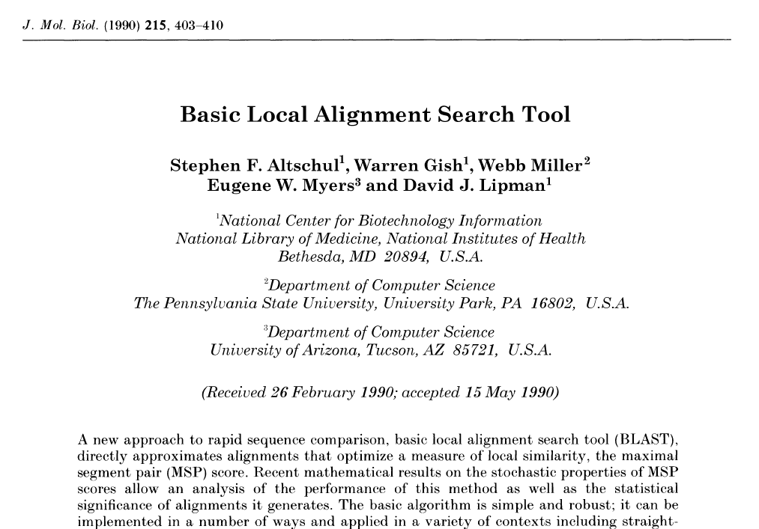
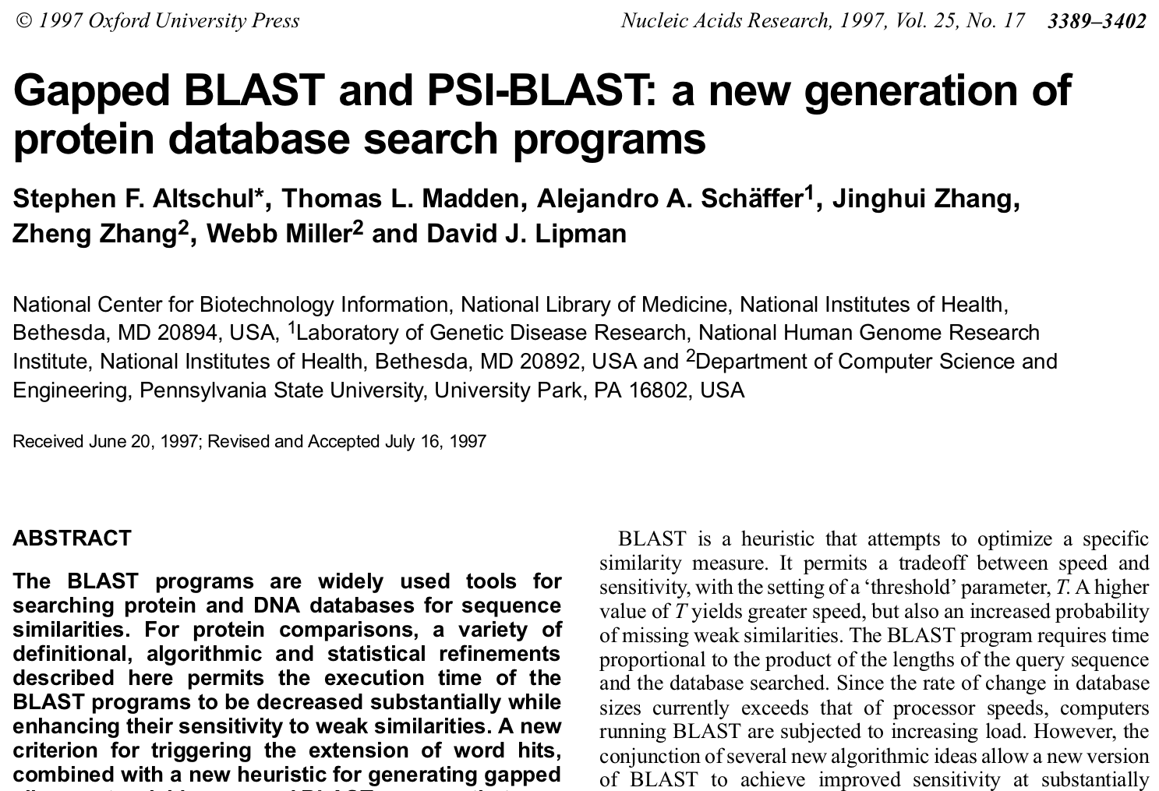
Enter BLAST: the Basic Local Alignment Search Tool
>60K Citations since 1990
>60K Citations since 1997

Slide 36
BLAST as a heuristic method
The Needleman-Wunsch (global sequence alignment) algorithm is guaranteed to find the optimal alignment between two sequences
Repeated NW will find all optimal alignments between a query and a database (but this takes a very long time)
In contrast, BLAST is a heuristic algorithm
Heuristic algorithms use “common sense” ideas to find a good, but not necessarily optimal, solution to a problem, typically in less time than the optimal approach (and often in cases where the “optimal” approach is not feasible)
BLAST aims to find database sequences that are homologous to a query sequence, but isn’t guaranteed to find all such sequences, nor is it guaranteed to find the best (most similar) sequences
But in practice its answers are very good

Slide 37
BLAST as a heuristic method
The BLAST heuristic: a pair of sequences that are destined to align well tend to contain short, gapless regions of high identity
These regions are called alignment “seeds”
MQIFVKTLT-GKAIT
|||| ||| || ||
MQIFAKTLSGGKVIT
Break query into “words” (substrings of length k)
Find database sequences with a matching word (seed match)
Extend from the seed match to check for good alignment

Slide 38
The BLAST algorithm
MGALEDVAL
Query sequence
MGA
GAL
ALE
LED
EDV
DVA
VAL
Divided into k=3 words
Database sequence 1
Database sequence 2
Database sequence 3
XXXXXXXXXXXXX
XXXXXLEDXXXXX
XXMGALEDVVLXX
---+++---
+++++++-+
don’t consider aligning to a database seq. w/o a seed match
MGALEDVAL
MGALEDVAL
Extending this seed suggests that a strong alignment is not likely
Extending this seed identifies a good alignment
Break query into “words” (substrings of length k)
Find database sequences with a matching word (seed match)
Extend from the seed match to check for good alignment

Slide 39
Why BLAST is fast
We can pre-process the database (once!) to locate and store the positions of all possible words
DICTIONARY
Key | Value (List of Positions)
‘AAA’ | [12, 37, 151, 1608]
‘AAC’ | [77, 103, 909, 454, 1020, 667]
‘AAD’ | [ ]
…
‘LED’ | [1024, 2657]
…
“Dictionary lookup” of the words from our query is very fast
Cataloging/organizing a database for later search is called “indexing”
Indexing saves time on all subsequent searches: worth the effort!
d₁
d₂
d₃
d₄
d₅

Slide 40
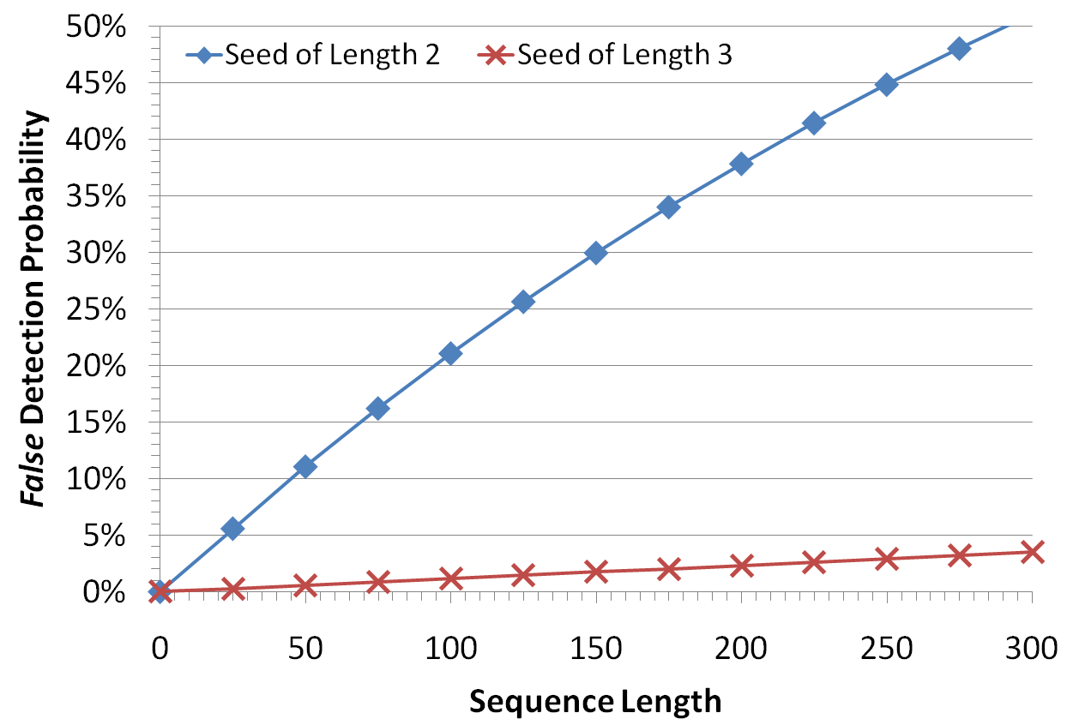
Why BLAST is fast
*Random protein alignment modeled as having 5% identity (1 in 20 matches)
Most database sequences that are evolutionarily unrelated to our query will not contain a seed match
As word size grows, the chance of a random match shrinks
Database sequences without a matching word are skipped

Slide 41
Why BLAST is heuristic
Sequences related to our query are not guaranteed to contain a seed match, which will result in false negatives:
These two sequences have 50% identity and many k=3 seeds:
VGKQLEDGRTIPPDQQRLIFTLHLVLRLRGLSDYNIQKES
|||||||||| ||||||||||
VGKQLEDGRTXXXXXXXXXXXXXXXXXXXXLSDYNIQKES
These two sequences also have 50% identity but no k=3 seeds:
IPPDQQRLIFVGKQLEDGRTLSDYNIQKESTLHLVLRLRG
| | | | | | | | | | | | | | | | | | | |
IXPXQXRXIXVXKXLXDXRXLXDXNXQXEXTXHXVXRXRX

Slide 42
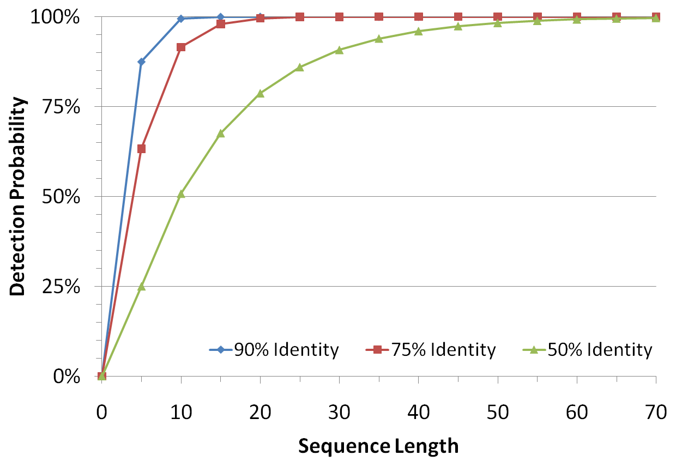
Why BLAST is heuristic
Seed hit probability varies…
directly with alignment length
inversely with seed length
inversely with alignment identity
Seed length can be tuned when running BLAST (uncommon)
Defaults balance speed with detection probability
In practice, results are very good, despite no guarantee of optimality
*For seeds of length k=3

Slide 43
BLAST flavors
BLAST is available online at https://blast.ncbi.nlm.nih.gov/Blast.cgi
Can also download and run locally
A variety of different online/offline programs exist:
Program | Query type / preprocessing | Database type / preprocessing | When to use it
blastp | protein | protein | find homologous proteins
blastn | nucleotide | nucleotide | non-coding DNA search, large-scale (e.g. contig vs. genome) search
blastx | nucleotide (translated in 6 reading frames) | protein | establish coding potential/protein products of novel DNA/RNA
tblastn | protein | nucleotide (translated in 6 reading frames) | identify a protein of interest in a novel genome; uncommon
tblastx | nucleotide (translated in 6 reading frames) | nucleotide (translated in 6 reading frames) | identify remote homology in highly diverged coding sequence; uncommon

Slide 44
BLAST output

Slide 45
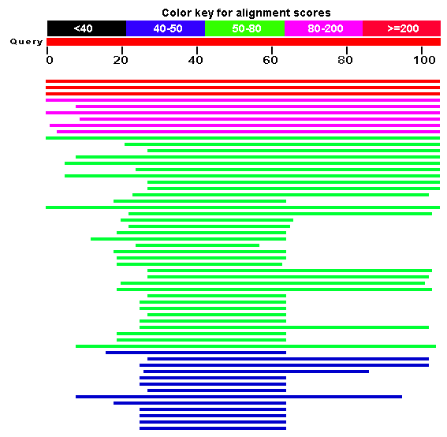
Interpreting BLAST output
Online BLAST produces some nice graphical output, but more often we’re interested in machine-readable (tabular) text
We’ll examine some of these fields/statistics in the context of a hybrid BLAST output (human-readable text)

Slide 46
Interpreting BLAST output
Alignment of the query sequence to the “subject” (database) sequence; generally excluded from tabular output
Start and end coordinates of the alignment within the query and subject sequences; these define “coverage”: i.e. how local vs. global the alignment is

Slide 47
Interpreting BLAST output
# and % of “identities” (positions that are the same between query and database); a measure of evolutionary divergence
# and % of “similarities” (different but “similar” amino acids); only applies to protein-level alignments

Slide 48
Interpreting BLAST output
Expectation- or E-value: the # of alignments at least this strong expected by chance (given score & database size)
A measure of the statistical significance of an alignment
Small E-values can be interpreted similarly to P-values

Slide 49
Interpreting BLAST hits (protein query / database)
 | HIGH identity | LOW identity
HIGH coverage | Your query*; Population variants; Close homologs | Distant homologs, pseudogenes
LOW coverage | Shared domain | Shared domain; false positive?
|| ||||| ||||
| || |

Slide 50
Sequence databases

Slide 51
Sequence databases: common features
Browse sequence data online
Download sequence data
FTP access?
Search data with embedded BLAST implementations
Database versioning
Sequence versioning?
Systematic identifiers for sequences and regions
Differ between databases
The “ID-mapping” problem

Slide 52
http://www.ncbi.nlm.nih.gov/genbank
NCBI comprehensive nucleotide sequence database
If you sequence a new genome, it ends up here (with optional annotation)

Slide 53
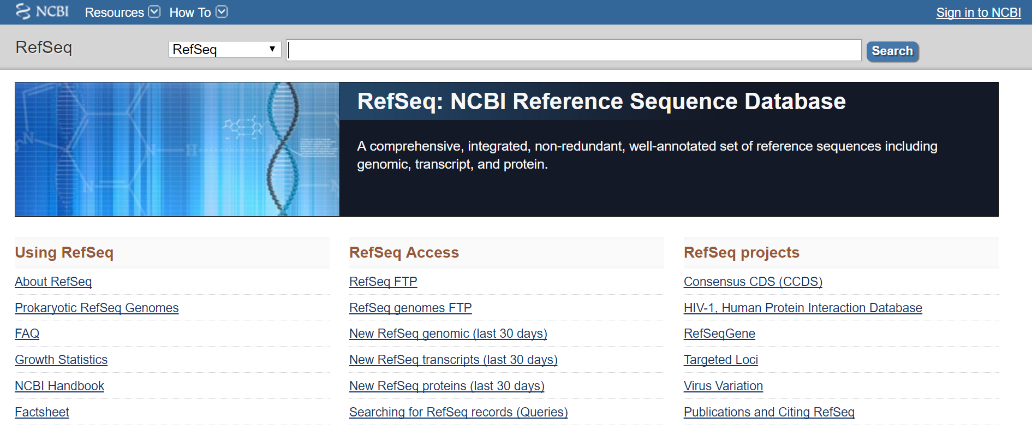
http://www.ncbi.nlm.nih.gov/refseq
NCBI curated sequence database
Non-redundant and versioned genomes, genes, proteins

Slide 54
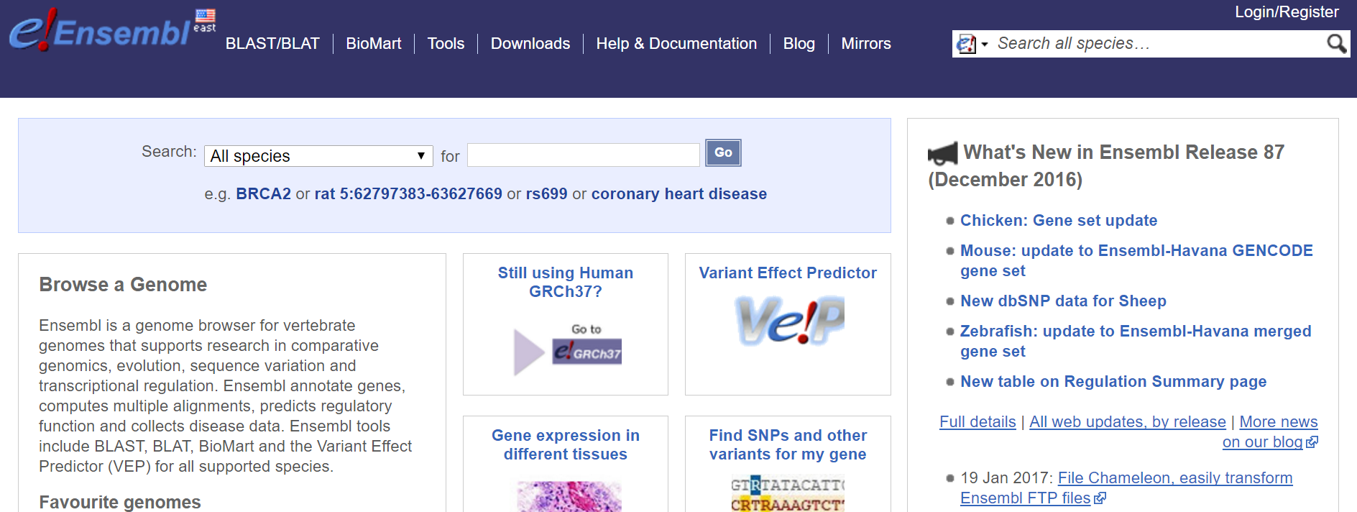
http://ensembl.org
EMBL-EBI sequence database and exploration site
BioMart provides a programmatic interface to ensembl

Slide 55
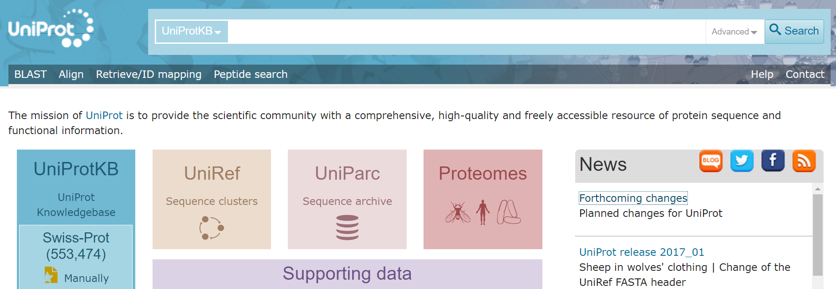
http://uniprot.org
EMBL-EBI protein sequence database
All known protein sequences, nicely organized and annotated

Slide 56
Summary
Biopolymers and the central dogma
Sequences as data & the FASTA file format
Sequence homology
Sequence alignment
BLAST as a homology search method
Dissecting a BLAST result
Sequence databases

