Slide 1
Sequencing technologies
Curtis Huttenhower (chuttenh@hsph.harvard.edu)
Eric Franzosa (franzosa@hsph.harvard.edu)
http://huttenhower.sph.harvard.edu/bst281
Slide elements courtesy of:
Oliver Hofmann
Cathy Ball

Slide 2
Midterm: journal club
Sign up for a journal club presentation by end of day Wednesday!
Email instructional team with:
Group members (2-5, names + CCed).
Paper to present.
~2-4 sentence justification.
Recent and/or high-impact quantitative biology.
Date of presentation (March 1, 6, 8).
3-4 presentations / day.
First come, first served.
20 minute presentation + 5 minutes questions.
All group members must present.
Background, overview/results, methods, discussion/interpretation, questions.

Slide 3
In the old days…

Slide 4
Sequencing by radiolabeled synthesis
Template (Crick)
very low concentration of ddNTPs compared to dNTPs
Watsons
A nested series of DNA fragments ending in the base specified by the terminator-ddNTP
Expose gel to x-ray film (to make an “auto-radiogram”)
Recombinant DNA: Genes and Genomes. 3rd Edition (Dec06). WH Freeman Press.

Slide 5
You took radiation safety training, right?
CAAGTGTCTTAAC
Wouldn’t it be nice if this were…
Smaller?
Less noisy?
In one lane?
Not radioactive???

Slide 6
Sequencing by fluorescently labeled synthesis
Lane signal
(Real fluorescent signals from a lane/capillary are much uglier than this).
A bunch of magic to boost signal/noise, correct for dye-effects, mobility differences, etc, generates the ‘final’ trace (for each capillary of the run)
Trace
Recombinant DNA: Genes and Genomes. 3rd Edition (Dec06). WH Freeman Press.

Slide 7
Sanger sequencing
ugly over here
ugly over there
Base Caller (Phred)
... 44 45 46 47 48 49 50 51 52 53 54 55 ... 718 719 720 ...
... N A G C G T T C C G C G ... A N N ...
... 0 3 20 25 40 88 95 99 99 99 99 99 ... 10 0 0 ...
Quality score = -10 * log(probability of error)
For Q20, probability of error = 1/100
For Q99, probability of error ~10⁻¹⁰

Slide 8
How to make the nails fit the hammer
Sanger sequencing only maintains quality up to ~1knt or so.
Why?
What can we do about it?
Hierarchical Shotgun Approach
DNA
Fragments (cells / clones)
Scaffolds
Contigs
Reads
GCAATGAAATATGTTCTTGTAATTTAAGCTGACACTCCTAATTTAGCTCTTGTCCTCTACTGAGTCTACCTAATTATATGTATGGATTGACTTGG
AGCTCTTGTCCTCTACTGAGTCTACCTAATTATATGTATGGATTGACTTGGTGTTTTCTCTTTTTCTTAAATAGTAATGCAGAAAGCCTGGAGAGAGAG
GCAATGAAATATGTTCTTGTAATTTAAGCTGACACTCCTAATTTAGCTCTTGTCCTCTACTGAGTCTACCTAATTATATGTATGGATTGACTTGGTGTTTTCTCTTTTTCTTAAATAGTAATGCAGAAAGCCTGGAGAGAGAG
Assembly

Slide 9
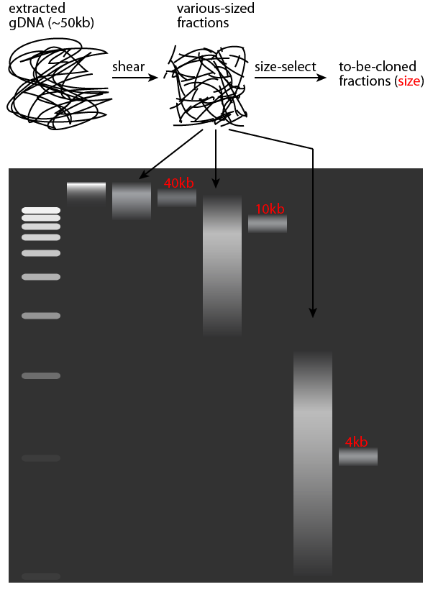
Shotgun sequencing
Full-length DNA
Originally, cloned plasmid linker (why?) (no longer used)
sequencing primer
sequencing primer
"forward read"
"reverse read"

Slide 10
Un-shotgunning: assembly
Scaffold
Contig
gap
Contig
NNNNNN
number of N's in sequence = estimated size

Slide 11
Library insert sizes
Read length
Insert size
Short inserts = local assembly
Long inserts = repeat jumping = global assembly

Slide 12
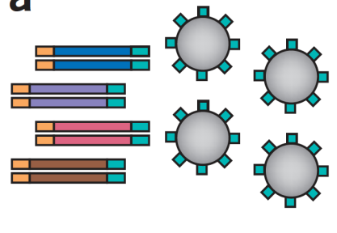
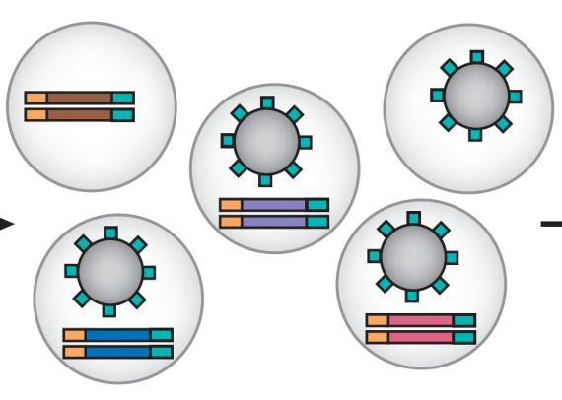
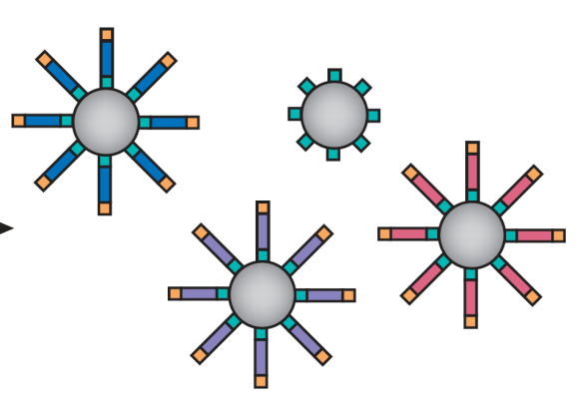
Making it go faster, step one: pyrosequencing
Adaptor DNA adapter ends plus beads
454 was the first “high-throughput” or “next-generation” sequencing technology.
Still sequencing by synthesis.
Leveraged beads + plates from microarrays.
PCR, not cloning (why?)
~Millions of reads, ~hundreds of nt, ~hours / run.
Pyrosequencing: reactions labeled using luminescence.
Make water-in-oil emulsion
~ 1 DNA molecule and 1 bead per droplet
Emulsion PCR
Most beads with with multiple copies of individual DNA molecules

Slide 13
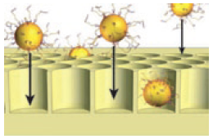
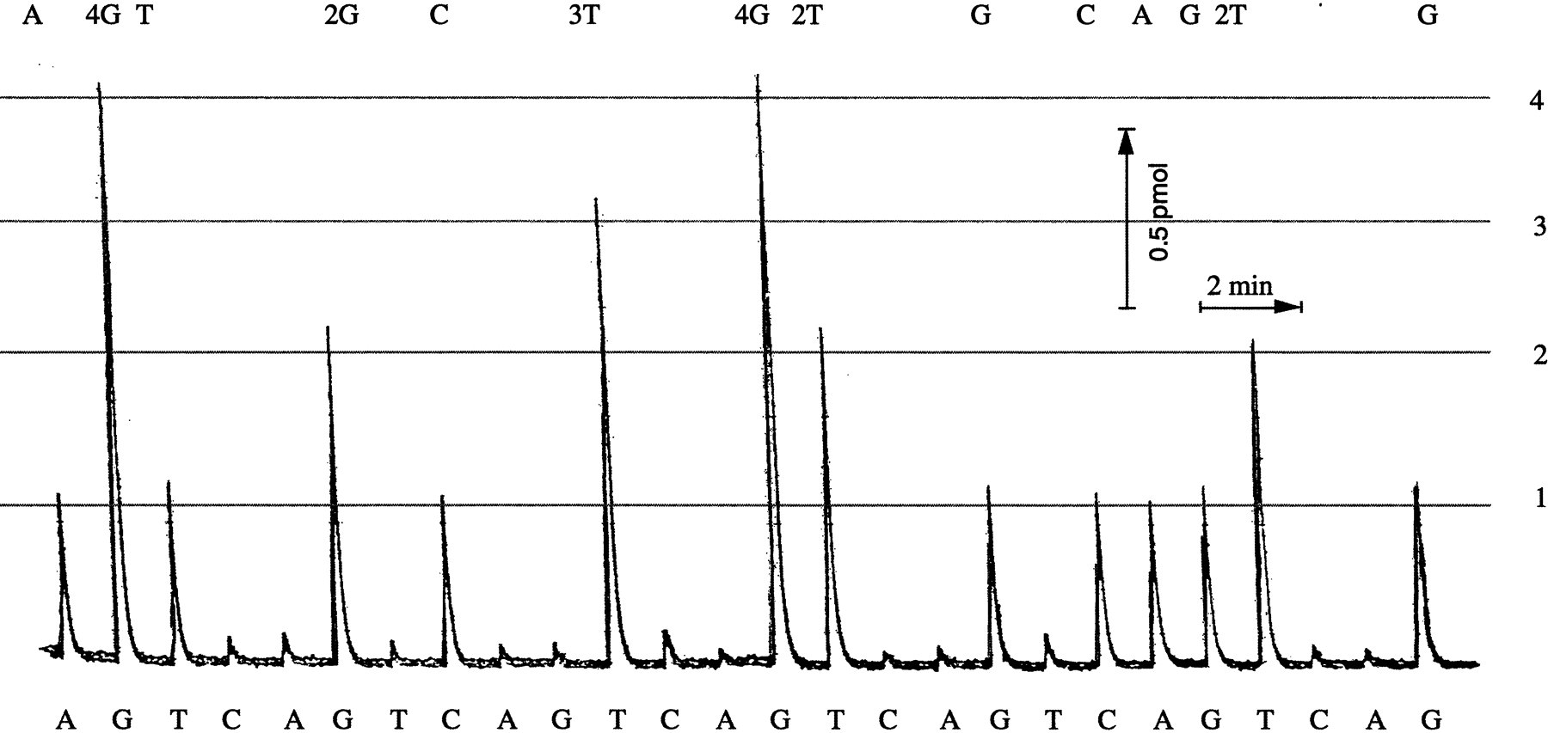
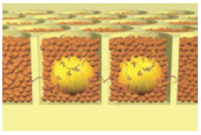
454 sequencing
Beads loaded into wells
Enzymes added
Sequencing gives off light

Slide 14
454 might be dead, but their marketing lives on

Slide 15
Making it go faster, step two: Illumina
3’
5’
DNA (0.1-1.0 ug)
A
G
C
T
A
G
C
T
T
C
A
C
G
G
A
T
A
A
T
C
C
C
G
C
G
A
T
T
Sample preparation
(fragmentation + ligation)
C
Cluster growth (“polonies”)
G
A
T
5’
Sequencing (fluorescence)
1
2
3
4
5
6
7
8
9
T G C T A C G A T …
Image acquisition
Base calling

Slide 16
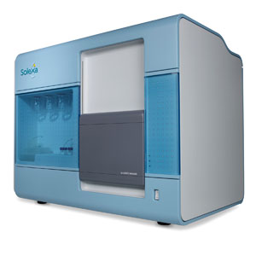
Why use one capillary when you can use millions?
250+ Million Clusters
Per Flow Cell
20 Microns
100 Microns

Slide 17
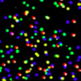
Why use one million when you can use eight (or more)?
Reagents flowed in here
Image for each channel is actually tiled (four images per panel, one for each color)
Out to waste

Slide 18
High-throughput sequencing error profiles
De-phasing
Degradation
Crosstalk

Slide 19
Illumina sequencing: how it really works

Slide 20
Making reads longer, step one: Pacific Biosciences
Single Molecule Real Time (SMRT) sequencing
Still light: gridded fluorescent reaction readout
Eid 2009

Slide 21
Making reads longer, step two: Oxford Nanopore
MIT Technology Review 2012

Slide 22
High-throughput sequencing: 2011
Platform | Read length | Gnt / run | Time / run | Cost / run | Error rate
Sanger | 1000 | 0.0001 | 1 hour | $10k | 0.001%
454 | 300 | 45 | 10 hours |  | 1%
Illumina | 75-100 | 18-35 | 2 days |  | 0.1%
SOLiD | 50 | 30-50 | 5 days
Helicos | 30 | 37

Slide 23
High-throughput sequencing: 2013
Platform | Read length | Gnt / run | Time / run | Cost / run | Error rate
Sanger | 1000 | 0.0001 | 1 hour | $10k | 0.001%
454 | 700-1000 | 10 | 1 day | $5-10k | 1%
Illumina HiSeq | 100-200 | 500-750 | 1 week | $20-25k | 0.1%
SOLiD
Helicos
Illumina MiSeq | 150-250 | 1-2 | 1 day | $1k | 0.1%
Ion Torrent | 200-400 | 1 | 2 hours | $0.5-1k | 1%
Pac Bio | 500-1500 | 0.1-0.5 | 2 hours | $2k | 15%

Slide 24
High-throughput sequencing: 2017
Platform | Read length | Gnt / run | Time / run | Cost / run | Error rate
Sanger | 1000 | 0.0001 | 1 hour | $10k | 0.001%
454
Illumina HiSeq | 100-200 | 1500 | 1 week | $15k | 0.1%
SOLiD
Helicos
Illumina MiSeq | 150-300 | 15 | 1 day | $1k | 0.1%
Ion Torrent
Pac Bio | 10000-50000 | 1-5 | 0.5-1 day | $5k | 0.1-1%
Illumina NxSeq | 100-150 | 120 | 1 day | $10k | 0.1%
Nanopore | 1000-10000 | 0.1 | 1-2 days | $0.5-1k | 1-10%

Slide 25
Summary
Sequencing is free!
Ok, well, not quite, but close…
Many different technologies, but…
All descended from radiolabeled southern blots.
Most use sequencing by synthesis.
All rely on shotgun sequencing.
Although read length is increasing quickly.
All produce reads with characteristic errors.
Short + error-prone reads dictate analysis strategies – more next!

