Slide 1

‘Meta-analysis of Host Response Networks Identifies a Common Core in Tuberculosis’
Sambarey A, Devaprasad A, Baloni P, Mishra M, Mohan A, Tyagi P, Singh A, Akshata JS, Sultana R, Buggi S and Chandra N.
Systems Biology and Applications (2017)3:4.
By Jonny Batty & Ibrahim Diakite
Notes:
10 minutes; 5 minutes for questions

Slide 2
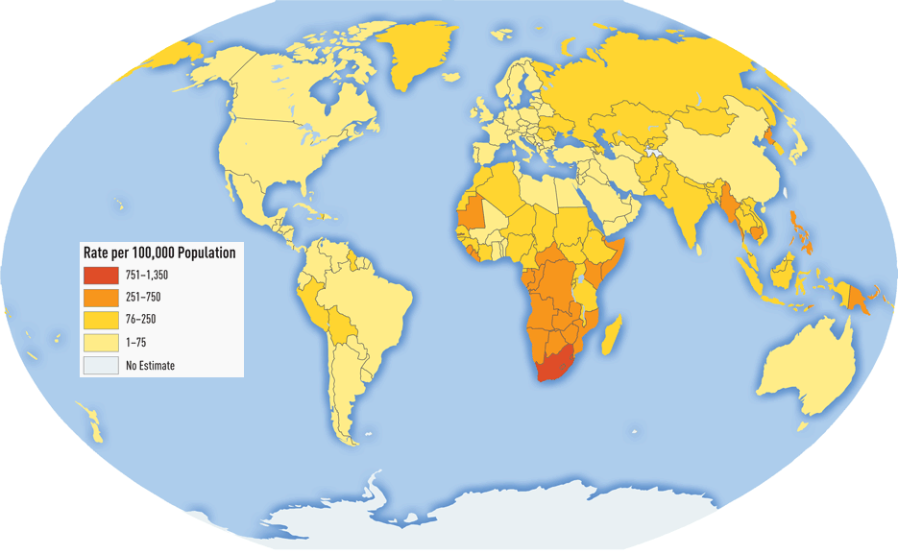
1 | Background
TB continues to pose a public health challenge; > 1 million deaths per year.
Causative agent is M. tuberculosis; infection may be active or latent.
Complex dynamics between the host immune system and mycobacteria determine disease phenotype.
Many host factors are deterministic:
  Genetic polymorphisms
  Innate and adaptive immune response
  Metabolic pathways
Perturbations in underlying, complex and interdependent molecular networks may explain the TB disease phenotype.
A systems-based approach is vital.
WHO Tuberculosis Database, 2014.
Notes:
And rarely will an alteration in a single gene or
gene product directly result in disease. Disease states are in fact
representations of perturbations in the underlying complex
interdependent molecular networks. It is thus important to adopt
a systems approach to address this fundamental complexity.

Slide 3
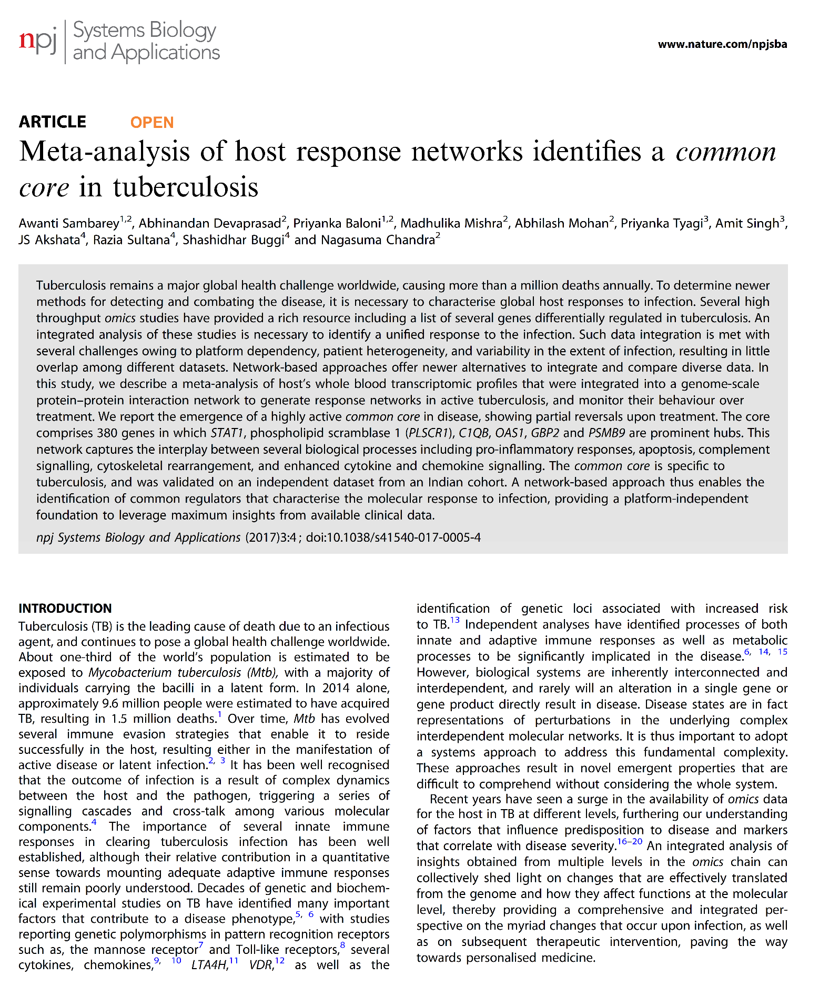
2 | Article Selection
Why we selected THIS paper…
Application and expansion of theory learned in class
Use of publicly-accessible, ‘open’ -omics data resource (GEO)
Network-based analysis to capture systems-level effects
Full disclosure of analysis / computational pipeline (GitHub)
Journal Metrics
Nature Partner Journal
Open-access, online only
Launched in 2015; no IF available
Objectives:
To identify host-response networks in TB, using an a priori hypothesis-free approach, using whole blood expression profiles of TB-infected and non-infected individuals.
To evaluate changes in such networks in response to treatment.
To evaluate the specificity of these networks, through comparison with conceptually-similar disease types.
Sambarey et al., npj Systems Biology and Applications (2017)3:4

Slide 4
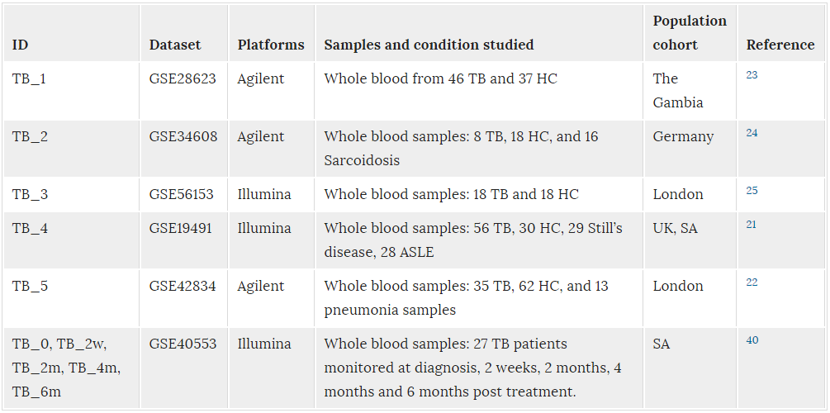


3 | Methodology
Samples and Data
5 gene expression microarray datasets; whole-blood from TB vs. age-matched HCs.
All data available from NCBI Gene Expression Omnibus (GEO)
Platform-specific normalisation (R; limma / lumi), quantile normalisation, log2 transformation.
Table 1 |
*HC = healthy controls

Slide 5
3 | Methodology / Results
Part 1: Identification of differentially-expressed genes across studies.
Genes with expression values with ≥ 2-fold difference (TB vs. HC) differentially expressed.
Hierarchical clustering (R, hclust, PCC with Euclidean distance).
Gene set enrichment using functional annotation data (Panther ontology, EnrichR)
Identification of differentially-expressed gene sets by functional class (TB vs. HC)
5-way Venn diagrams of consistent differential gene / functional class expression:
Notes:
Whole blood transcriptomic profiles from tuberculosis patients and corresponding healthy controls were normalised and integrated into a curated human Protein–Protein Interaction Network (hPPiN) to generate condition-specific networks, from which highest activity ‘response networks’ were identified. A comparison of these networks led to the identification of a common core highly active in disease. The significance of this common core was assessed on an independent microarray dataset generated for the Indian Cohort, and its specificity to tuberculosis was determined by monitoring its variation over treatment as well as by comparing similar response networks generated for other inflammatory diseases Sarcoidosis, Pneumonia, Still’s disease and SLE, collectively termed as OD

Slide 6
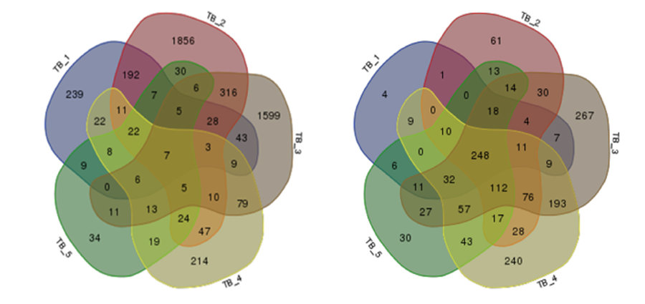
3 | Methodology / Results
(a) Gene expression
(b) Functional class

Slide 7
3 | Methodology / Results
Part 2: identification of a ‘Common Core’ gene network.
Construction of hPPiN: annotated, protein-protein interaction network.
Interactions mined from STRING 10, SigaLink 2.0, BioGRID, others.
Contains 17,062 proteins (nodes) and 208,759 interactions (edges).
  Unidirectional (168,237) - ‘activation’, ‘inhibition’, ‘phosphorylation’, ‘proteolysis’, etc.
  Bidirectional (40,522) - physical binding.
Protein 1
Interaction 1,2
Protein 2
Weight ∝ 1/node weights
Weight ∝ to gene 1 expression
Weight ∝ to gene 2 expression
Pairwise shortest paths calculated by Dijkstra’a algorithm (94,886,628).
The lower the path cost, the higher the pathway activity.
Identification of paths in 99.5th % (highest activity). Comparison of TB vs. HC.

Slide 8
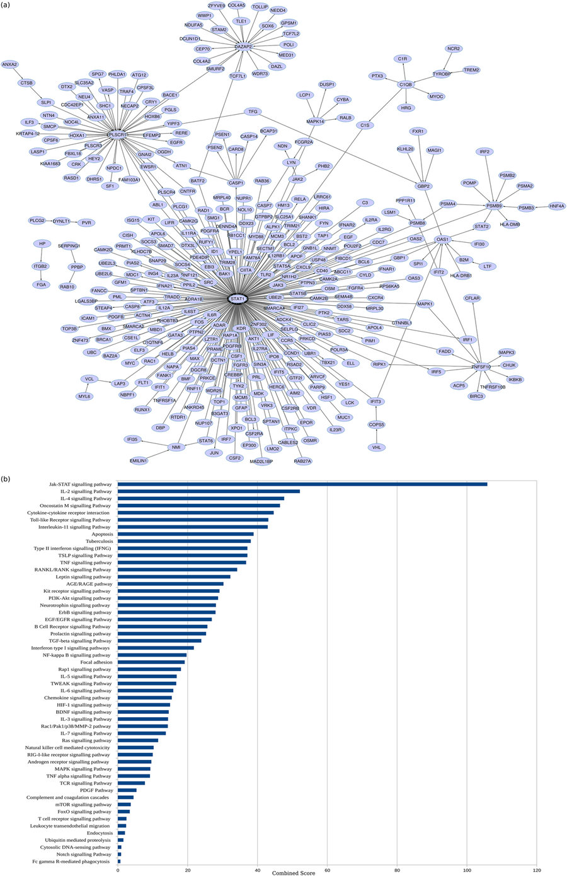
3 | Methodology / Results
The ‘Common Core’ (CC)
≥ 99.5th percentile activity in TB but not HC
Hub 1
Hub 2
380 nodes
467 edges
Permutation-based selections (10⁵): CC observed in 6%

Slide 9
3 | Methodology / Results
Biological Processes Enriched in the CC:
JAK-STAT and pro-inflammatory signalling pathways (IL2, IL11, IL3, IL6. IL5, TNF-α, IFN-γ)

Slide 10
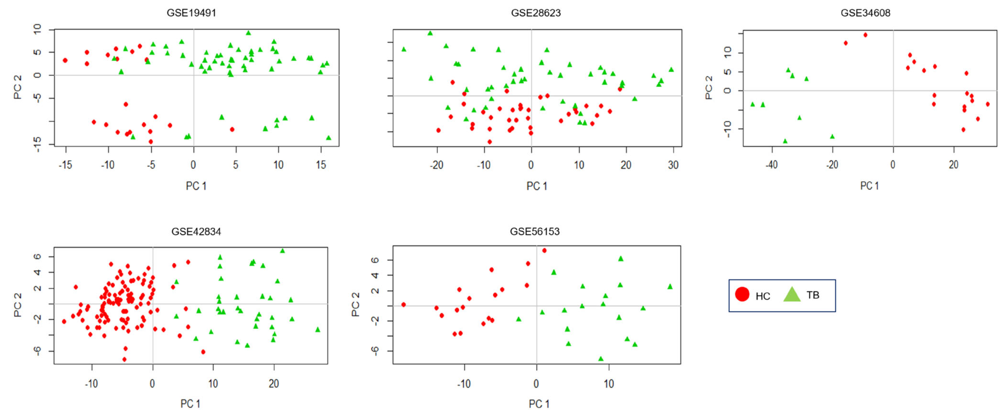
3 | Methodology / Results
The CC distinguishes between diseased / healthy samples:
2D PCA of expression values of CC genes, across all 5 samples. Reasonable separation.
Also validated in independent population: large overlap (291 of 380 genes), same hubs.

Slide 11
3 | Methodology / Results
Part 3: Changes to the CC on anti-TB treatment
Networks constructed using same methodology from whole blood samples at:
  Diagnosis (TB_0) pre-treatment.
  2 weeks (TB_2w) post-treatment.
  2 months (TB_2m) post-treatment.
  6 months (TB_6m) post-treatment.
  12 months (TB_12m) post-treatment.
CC observed at TB_0. Relative to this network:
  Change in network topology observed within 2 weeks.
  STAT1 no longer had a central role (? Reduction in inflammatory response).
  Other decreases in inflammatory pathways (e.g. complement).
CC gradually disappears with time; strengthen observation that core is infection-induced response in the host.

Slide 12
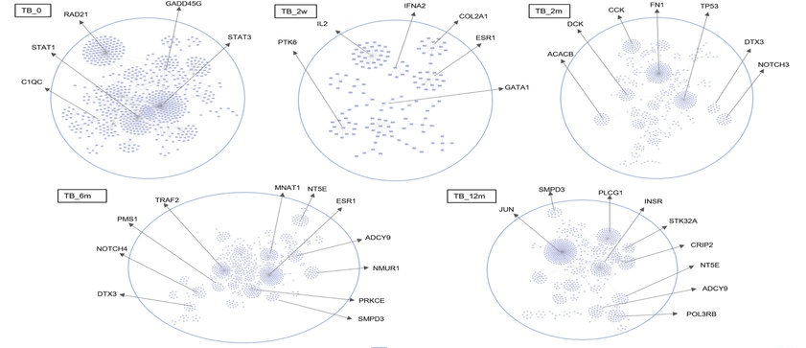
3 | Methodology / Results
Changes to the CC on anti-TB treatment:

Slide 13
3 | Methodology / Results
Part 4: Specificity of the ‘common core’ to TB.
Networks constructed using same methodology, from whole blood samples from patients with:
  Pneumonia
  Sarcoidosis
  Systematic Lupus Erythmatosus (SLE)
  Still’s disease
18 paths overlap between TB and pneumonia (STAT1, PLSCR1 hub)
Other networks show little-to-no overlap with common core of TB; largely specific

Slide 14
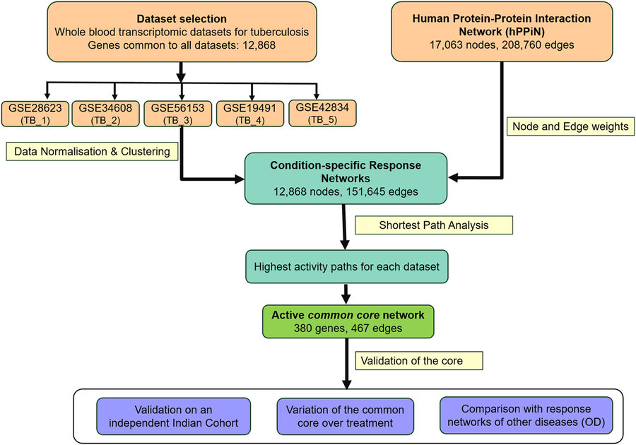
3 | Methodology / Results
Summary schema:
Notes:
Workflow adopted in this study. Whole blood transcriptomic profiles from tuberculosis patients and corresponding healthy controls were normalised and integrated into a curated human Protein–Protein Interaction Network (hPPiN) to generate condition-specific networks, from which highest activity ‘response networks’ were identified. A comparison of these networks led to the identification of a common core highly active in disease. The significance of this common core was assessed on an independent microarray dataset generated for the Indian Cohort, and its specificity to tuberculosis was determined by monitoring its variation over treatment as well as by comparing similar response networks generated for other inflammatory diseases Sarcoidosis, Pneumonia, Still’s disease and SLE, collectively termed as OD

Slide 15
4 | Article Critique (I)
Strengths
Open-access reporting, availability of analytic workflow - enables reproducibility.
Repurposing of open-access data in order to derive (potential) biological insight.
Hypothesis-generating approach.
Weaknesses
Meta-analysis of heterogenous gene expression platforms (Agilent, Illumina)
  Increase in signal ‘noise’
  Inclusion of different genes on each platform: analysis limited to intersection
Few formal tests of hypotheses
  Inclusion of 99.5th percentile (i.e. top 0.05 genes) does not constitute statistical significance.
  Permutation-based tests used to poor effect; no a priori determinant of threshold.
Inconsistent findings across 5 studies analysed; questionable validation
Lack of integration with other TB literature.

Slide 16
5 | Conclusions
Conclusions
Meta-analysis of whole blood transcriptional profiling studies demonstrates consistent differential regulation of only 7 genes in TB-infected patients, vs. healthy controls.
Gene set enrichment and network-based analysis identifies a commonly upregulated network of inflammation-associated genes, specific to TB, that diminish with curative therapy (the ‘common core’).
Future Directions and Implications
‘Traditional’ biological investigation of the significance of the leading pathways.
  E.g. JAK-STAT knockout / knock-down in TB models.
If ‘common core’ robustly validated, implications for:
  Pathophysiology of mycobacterial-host response
  Novel diagnostics of TB, able to stratify active vs. latent vs. previous infection

Slide 17
5 | References
Dijkstra, E. W. A note on two problems in connexion with graphs. Numerische Mathematik. 1: 269–271 (1959).
Moreau, Y. et al. Comparison and meta-analysis of microarray data: from the bench to the computer desk. Trends Genet. 19, 570 (2003).
Bloom, C. I. et al. Transcriptional blood signatures distinguish pulmonary tuberculosis, pulmonary sarcoidosis, pneumonias and lung cancers. PLoS One 8, e70630 (2013).
Maertzdorf, J. et al. Functional correlations of pathogenesis-driven gene expression signatures in tuberculosis. PLoS One 6, e26938 (2011).
Maertzdorf, J. et al. Common patterns and disease-related signatures in tuberculosis and sarcoidosis. Proc. Natl. Acad. Sci. USA 109, 7853 (2012).
Blankley, S. et al. The application of transcriptional blood signatures to enhance our understanding of the host response to infection: the example of tuberculosis. Philos. Trans. R. Soc. Lond. B Biol. Sci. 369, 20130427 (2014).
Cliff, J. M. et al. The human immune response to tuberculosis and its treatment: a view from the blood. Immunol. Rev. 264, 88 (2015).

Slide 18
The End.
Any questions?

