Slide 1
Samantha, Greg, Eddie, Joanna

Slide 2
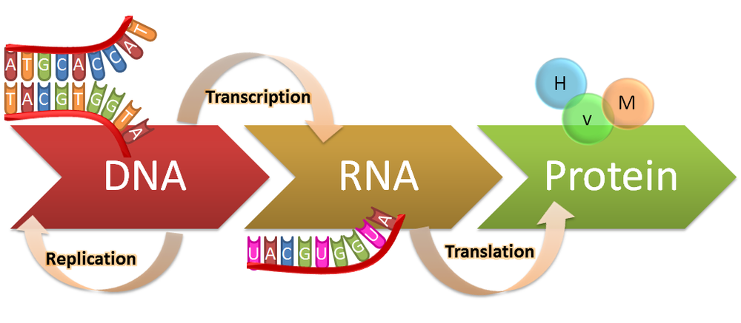
Why is this important?
Notes:
Central dogma of biology
Transcriptomics is a fundamental part of this
Lets us understand what genes are being transcribed→ leads to phenotypes such as diseases and manifestations
Important for practically everything- cancer, infectious disease, plants, animals, etc

Slide 3
Notes:
RNA seq did exist before this paper
Very low throughput
Hard to tell where expression is coming from (example in a blood cell- monocytes vs lymphocytes etc)
Biological problem- great to tell what’s being transcribed but it would be more useful to know where exactly its coming from

Slide 4
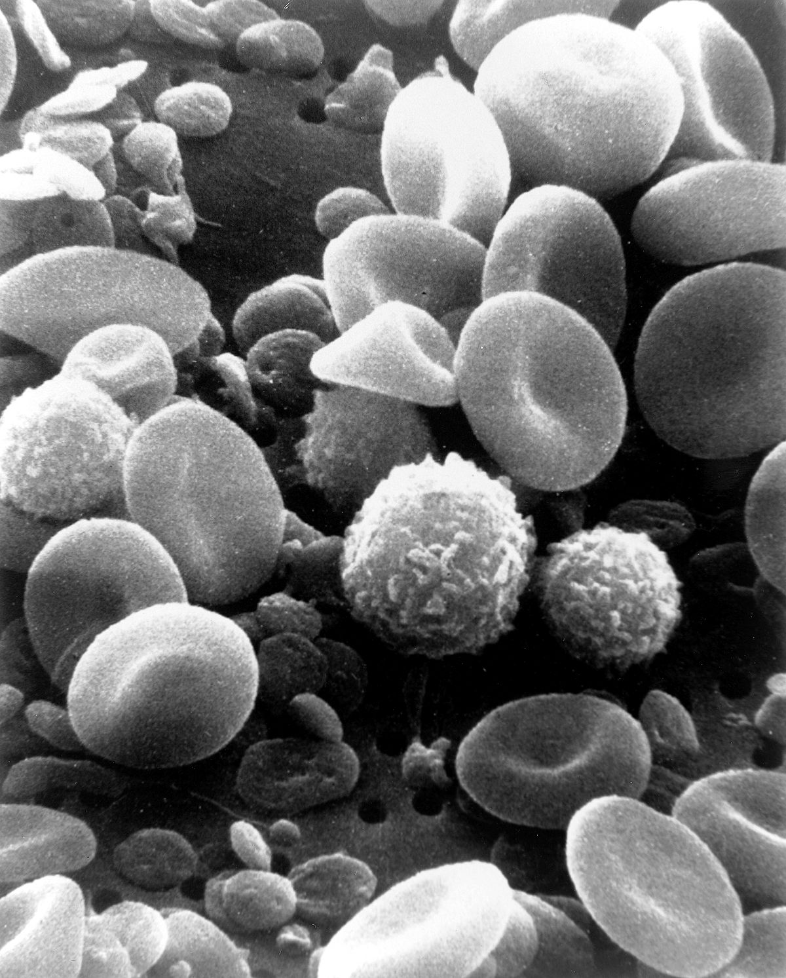
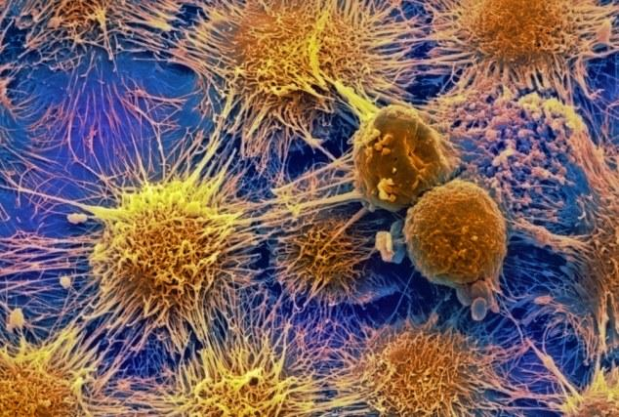
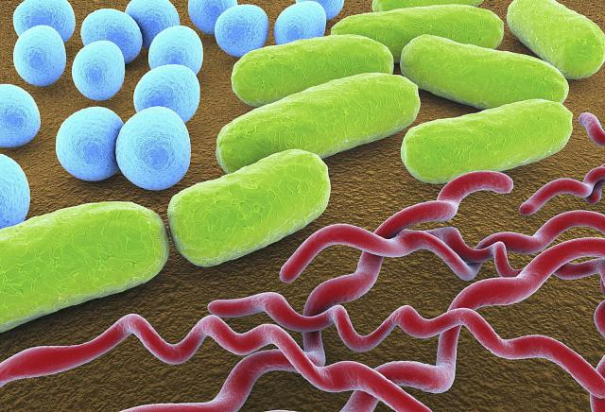
Single Cell Analysis
Notes:
Hard to tell where expression is coming from
So many different cell types
To solve a lot of biological problems, really need to understand transcriptomics at the single cell level
The authors of this paper were hoping to tackle this problem and develop a high throughput technique for single cell RNA seq

Slide 5
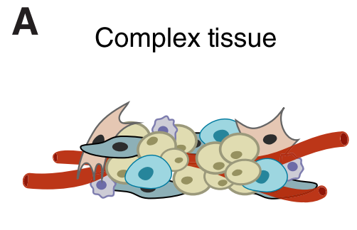
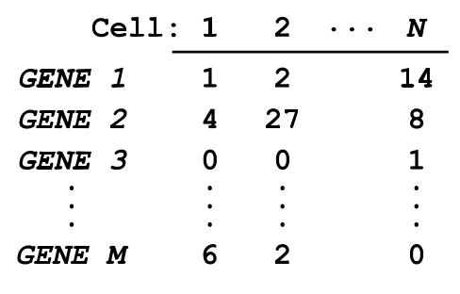
Single Cell RNA-seq: Start to Finish
Some considerations:
Ensure high-quality data
Achieve high transcript capture
Eliminate bias towards certain cells or genes
Don’t bankrupt your lab

Slide 6
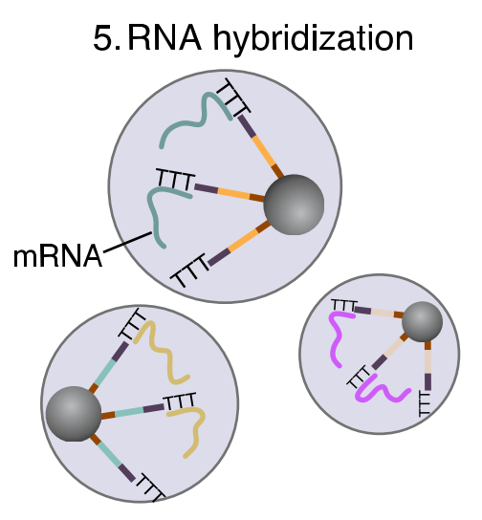
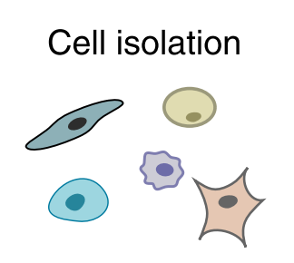
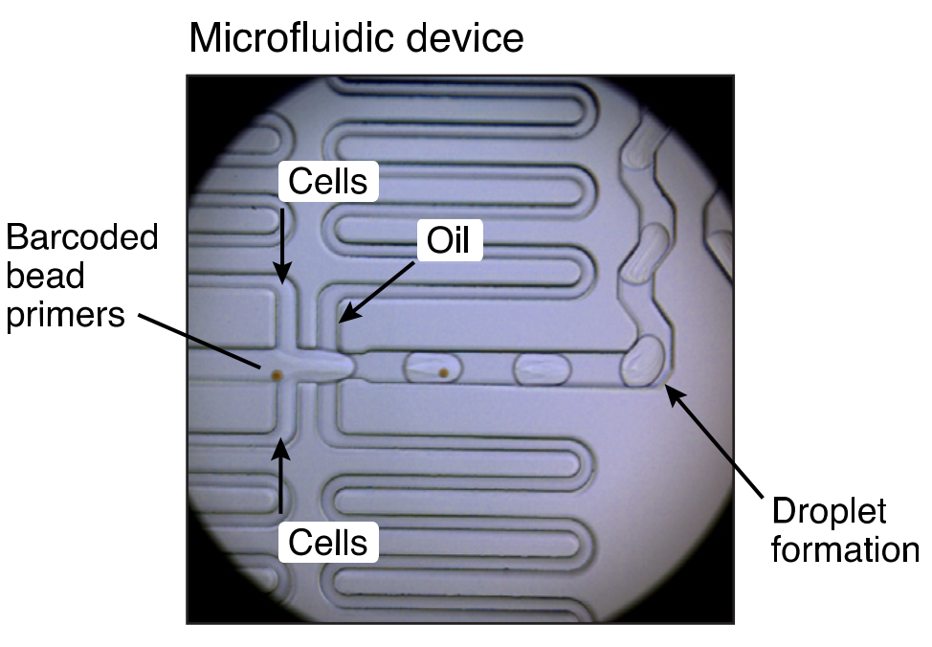
Solution: Drop-seq
aka The Miracle of Microfluidics
Rapid
cell lysis

Slide 7
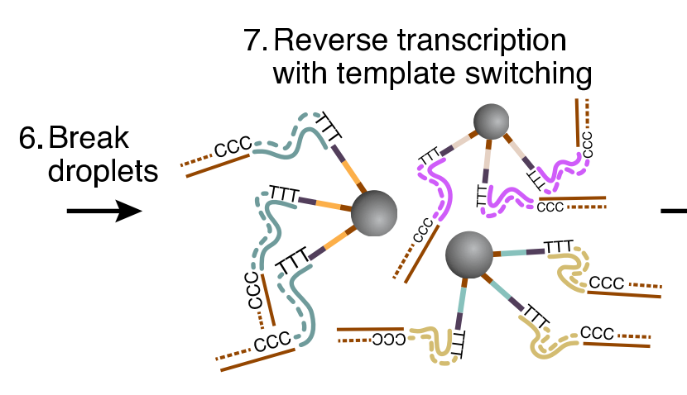
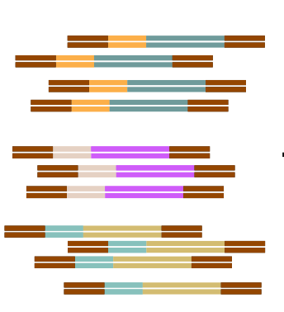
Drop-seq (continued)
PCR
Illumina Sequencing
PCR Handle
Bead Barcode
UMI
(dT)²⁷
PCR Handle
Bead Barcode
UMI
(dT)²⁷
PCR Handle
Bead Barcode
UMI
(dT)²⁷
PCR Handle
Bead Barcode
UMI
(dT)²⁷

Slide 8
Drop-seq (continued)
PCR
Illumina Sequencing
PCR Handle
Bead Barcode
UMI
(dT)²⁷

Slide 9
Drop-seq (continued)
PCR
Illumina Sequencing
mRNA molecule
AAAAAAAAAAA
CTGGCTGAT
cDNA molecule
TTT
GACCGACTA
PCR Handle
AAAAAAAAAAA
CUGGCUGAU
mRNA molecule

Slide 10
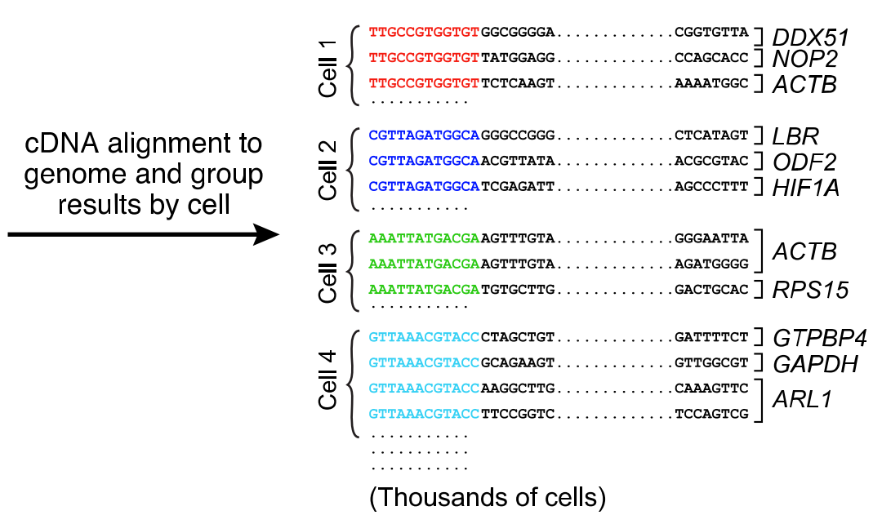
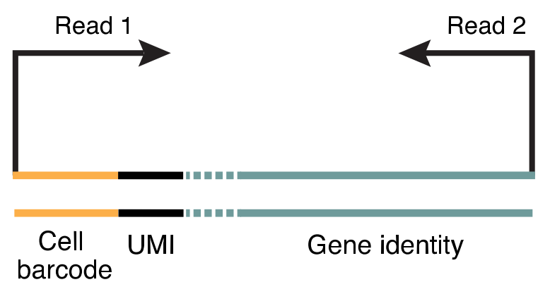
Creating the Matrix
Filtering the Data
Remove:
“Cells” with very few mRNAs
“Cells” with too much of one mRNA
etc...

Slide 11
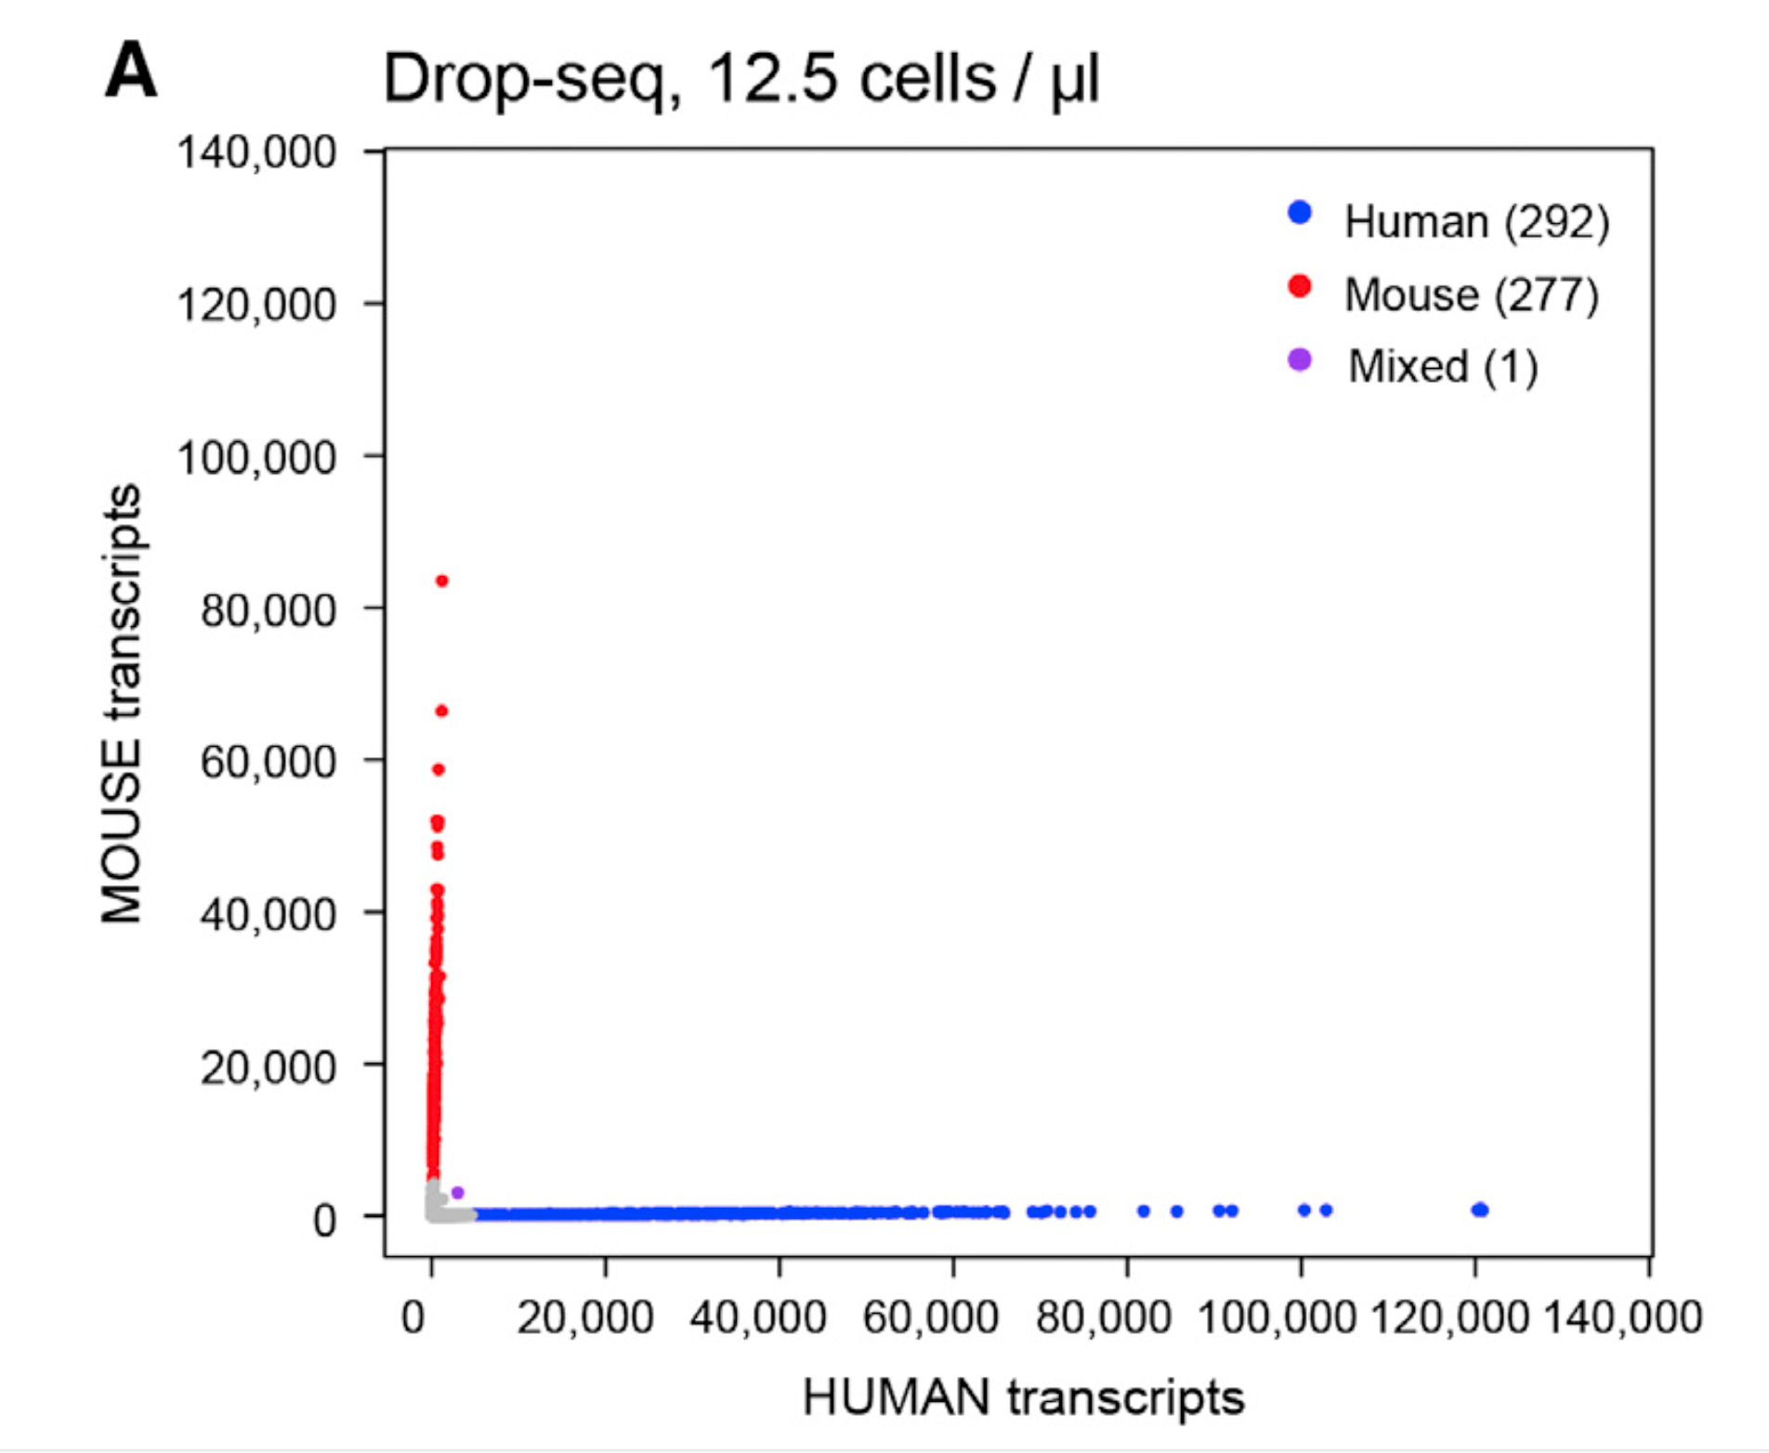
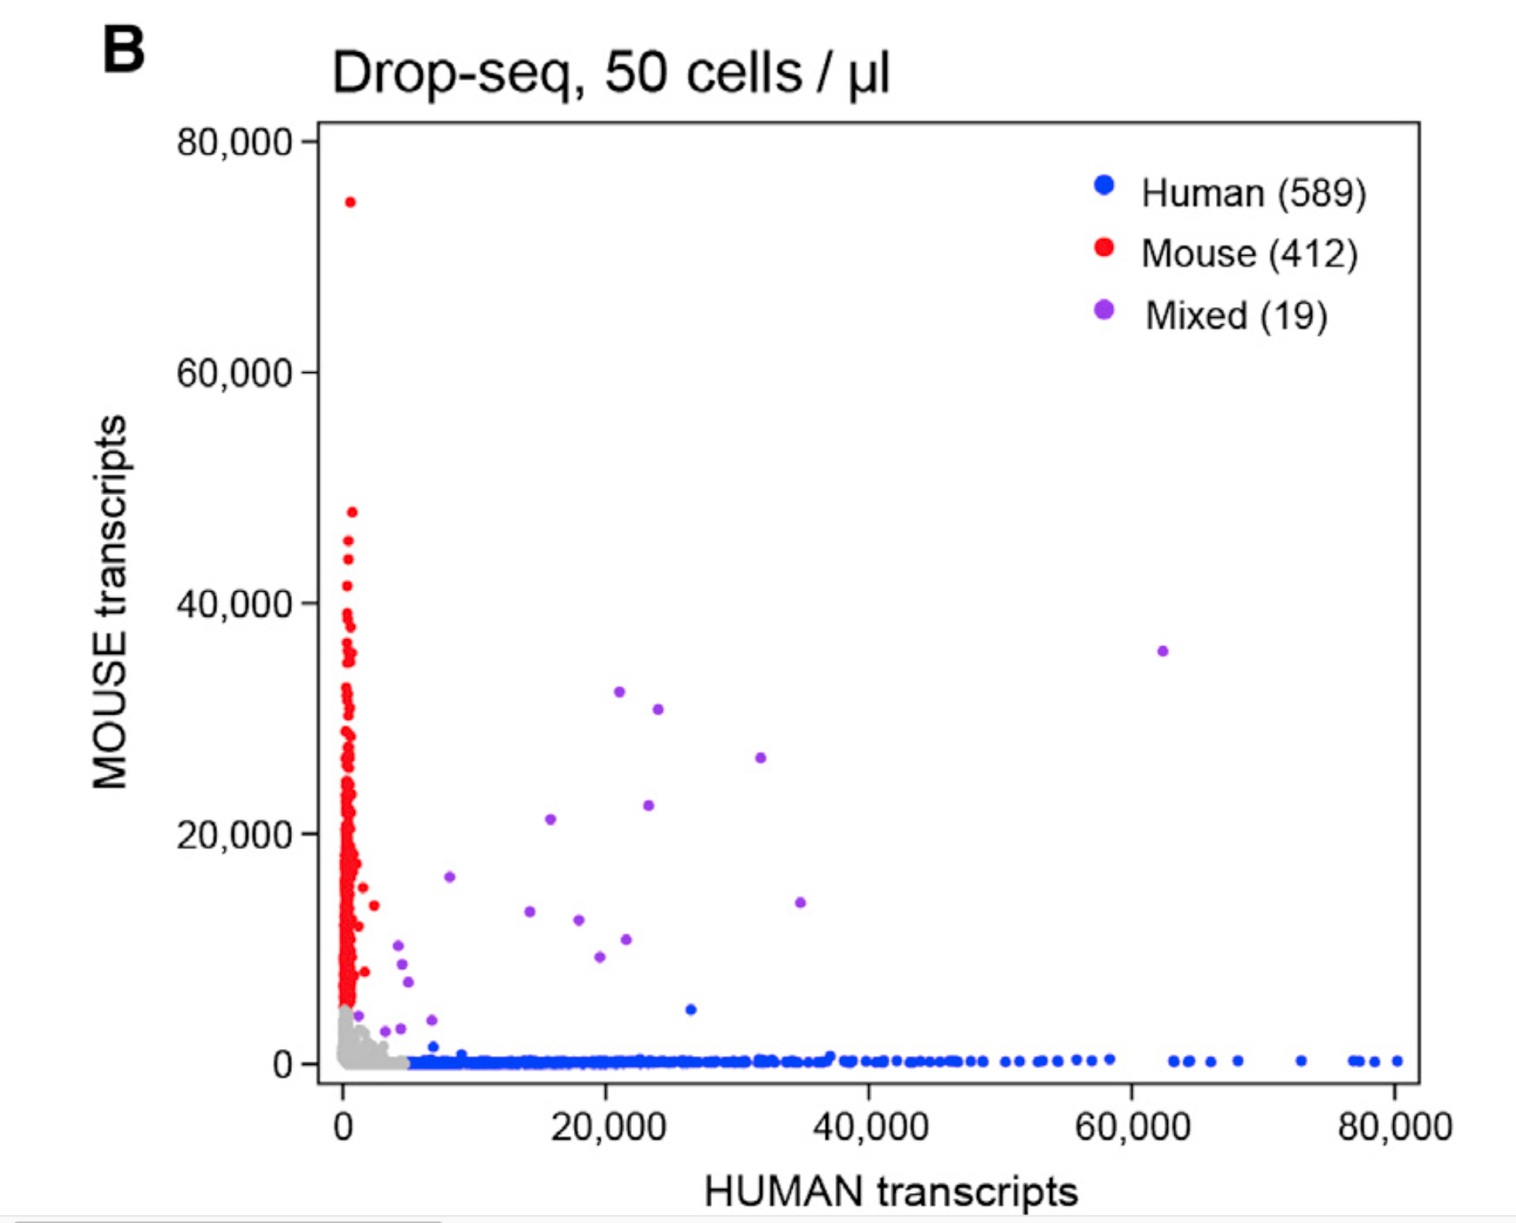
The Single-Cell Accuracy and Sensitivity of Drop- Seq Libraries
Human (HEK)
Drop-seq Analysis
Mixed Cells
Mouse (3T3)

Slide 12
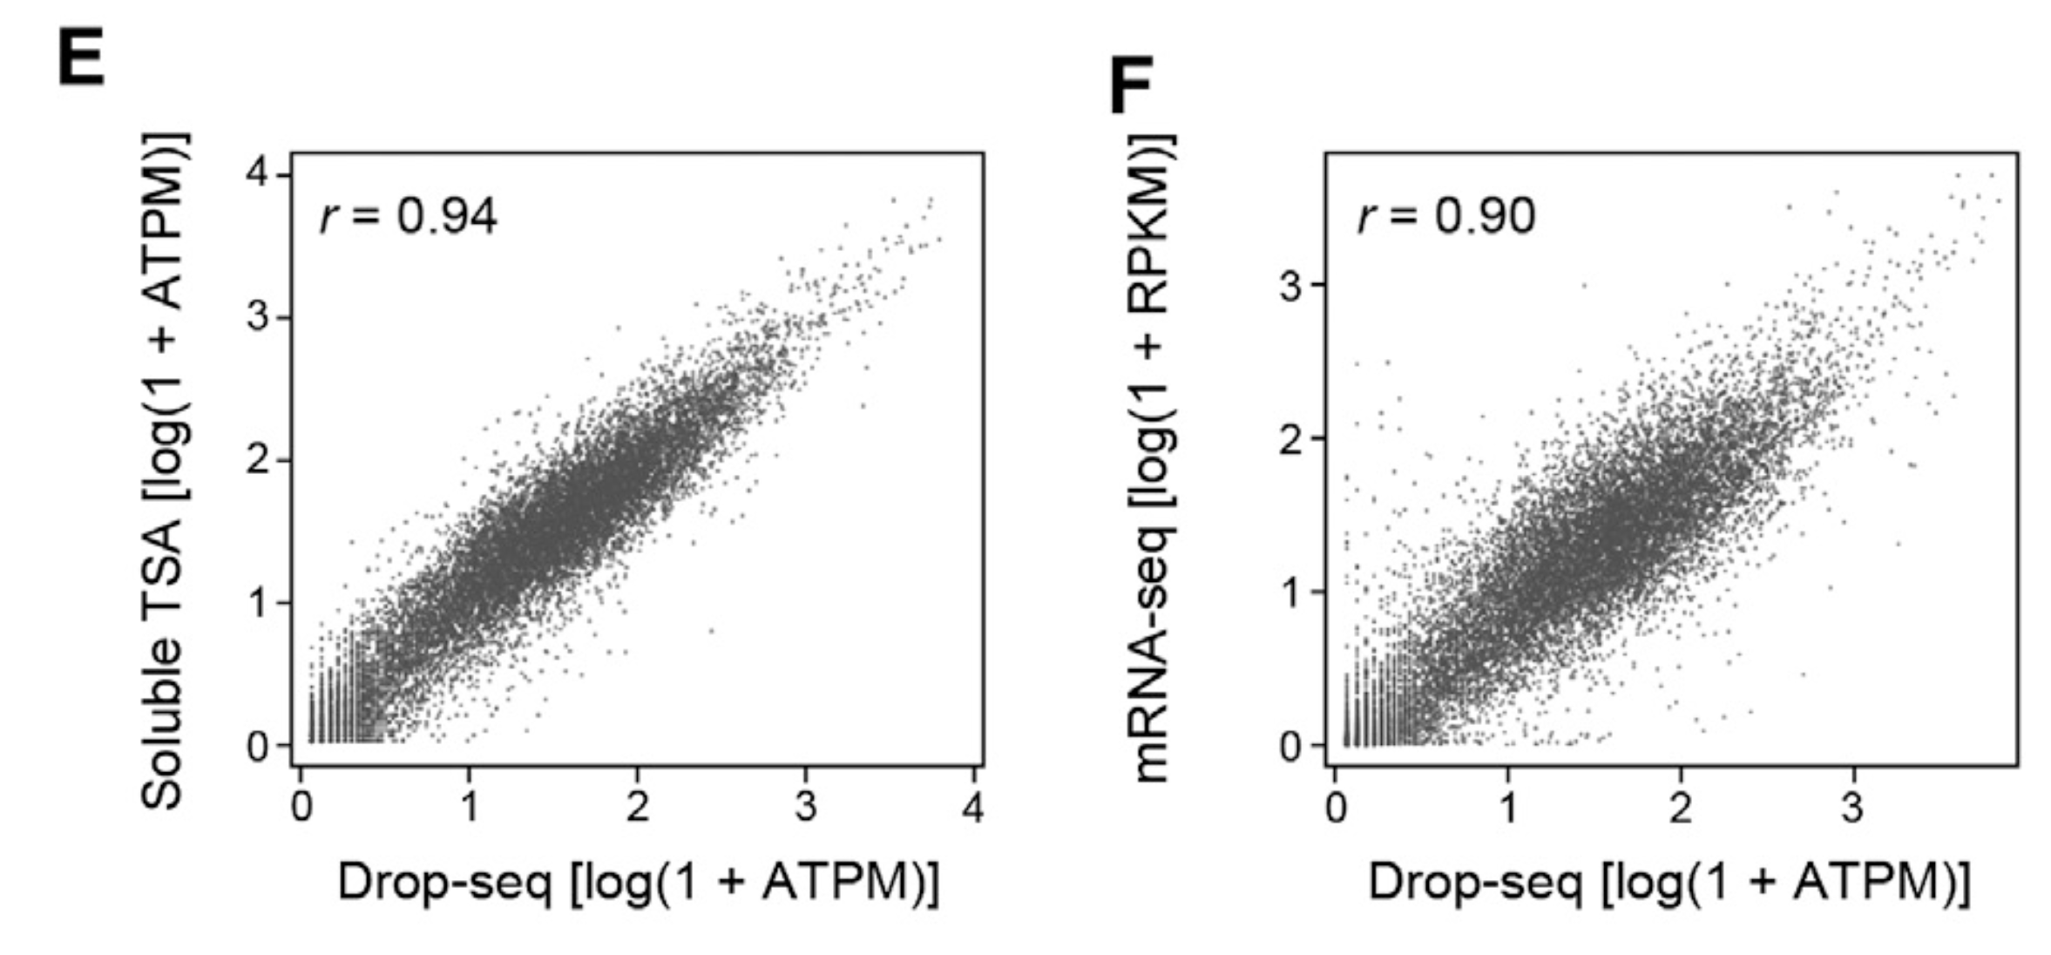
Correlation Between Gene Expression Measurements in Drop-Seq and non-single-cell RNA-Seq Methods

Slide 13
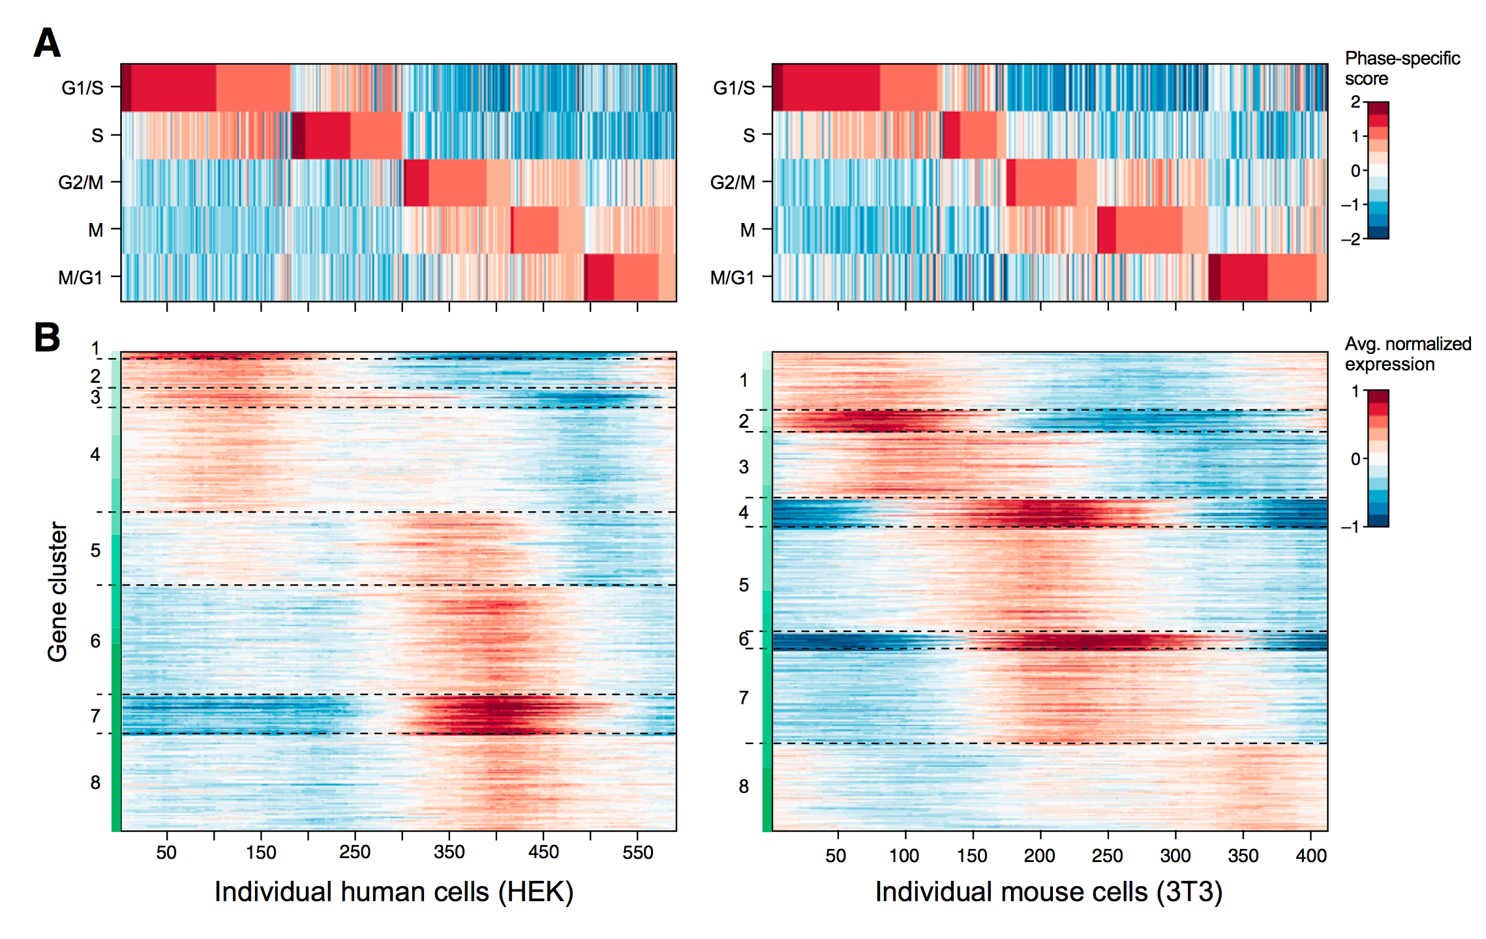
Cell States: Drop-Seq Analysis of the Cell Cycle

Slide 14
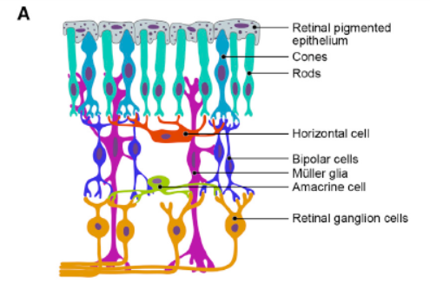
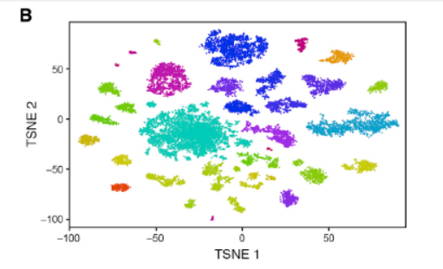
Reconstruction of retinal cell types from single-cell transcription profiles

Slide 15
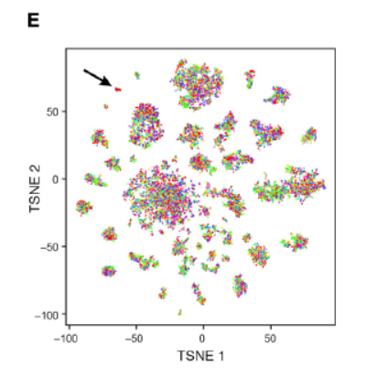
Reconstruction of retinal cell types from single-cell transcription profiles

Slide 16
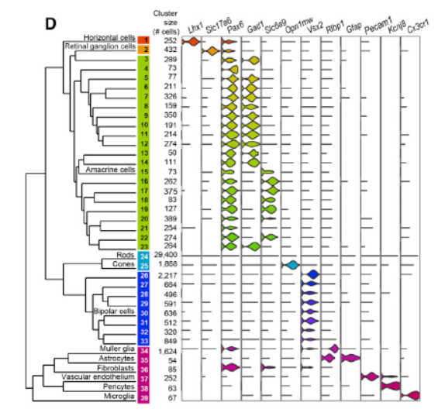
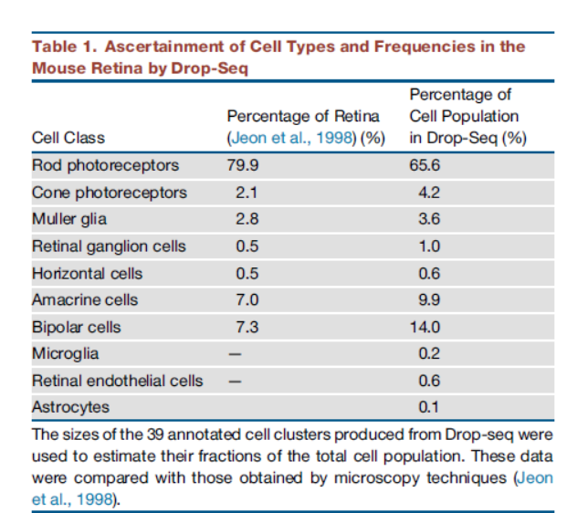
39 cell populations inferred from analysis matched to known retinal cell types

Slide 17
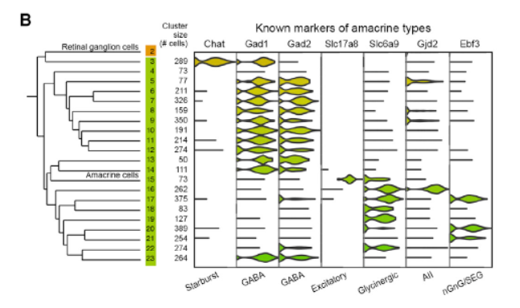
Identification of known amacrine cell types among clusters

Slide 18
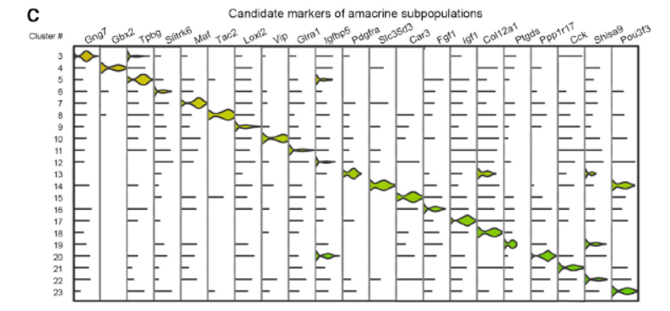
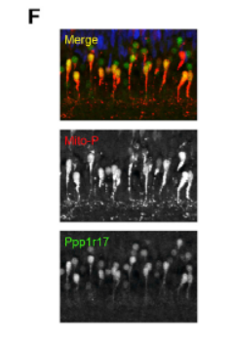
Nomination of novel candidate markers for each of the 21 amacrine cell populations
Notes:
Background: Majority of amacrine cell types lack defining molecular markers
C- looking for markers of distinct for different amacrine cell populations
Able to find markers for most of them
F- know one marker distinguishes 2 cell types, able to label these and visualize
Validation of PPP1R17 (green) as marker for an amacrine sub population
Staining of retina- CFP(red) in both nGnG amacrines and type 1 bipolars
Marker of bipolar neurons(blue)
Overlapping (red and green) supports Drop seq identification of PPP1R17 expression in nGnG amacrine neurons

Slide 19
Conclusion
High throughput
Lots of controls
Identified distinct subsets of amacrine cells
Retina is incredibly complex
Notes:
High throughput → useful for many areas of biology
Controls→ we talked about a lot, assure confidence in the results that they saw
Retina is complex→ this is definitely an accomplishment that would not have been possible before

Slide 20
Questions?

Slide 21
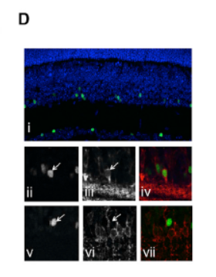
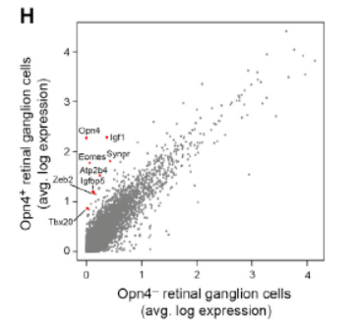
Extra

Slide 22
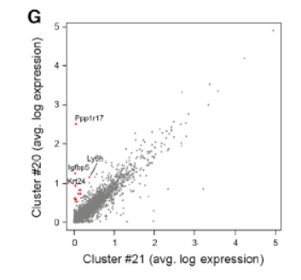
Extra

