Slide 1
A Network of Conserved Synthetic Lethal Interactions for Exploration of Precision Cancer Therapy
Rohith Srivas, John Paul Shen,
Chih Cheng Yang, ..., Pedro Aza-Blanc, Robert W. Sobol, Trey Ideker
Conor Foley, Isabelle Mieling, Alex Wu, Yongling Ye, Nancy Zhang

Slide 2
Introduction/Overview
Changes in Tumor Genome
Gain of Function in Oncogenes
Loss of Function in Tumor Suppressor Genes (TSGs)

Slide 3
Introduction/Overview
Changes in Tumor Genome
Gain of Function in Oncogenes
Loss of Function in Tumor Suppressor Genes (TSGs)
Effectively able to target
Not currently feasible to restore the function of TSGs
Notes:
Rather than directly target the tumor suppressor genes.. Introduce synthetic lethal interactions.

Slide 4
Synthetic Lethal Interactions
Gene A
Gene B
…
Gene X
Gene Y
Gene Z
…
Selective Cell Death
TSG
Notes:
Idea of a synthetic lethal interaction
+1 if target genes are already druggable with FDA-approved drugs

Slide 5
Ex: Olaparib Targets PARP1
Gene A
PARP1
…
Gene X
Gene Y
Gene Z
…
Selective Cell Death in BRCA1 -/- or BRCA2 -/- cells
BRCA1/BRCA2

Slide 6
Find More of these Interactions
Statistically analyze tumor genomes, find pairs that are seldom co-mutated in same tumor
Systematically test in human cell lines, with siRNA + drugs, or CRISPR
Screen a population of cancer cell lines against directed knockdowns
First, find such interactions in yeast.
Then, use results from yeast mapping to design screens for TSG-DT pairs in human cancer cell lines.

Slide 7
Yeast?
Technology exists to measure genetic interactions
Large scale
Unbiased manner
Minimal off-target effects
Can be assured that conserved interactions exist
A number of TSGs implicated in human cancer first described in yeast
Notes:
Insert the technology used here? (microbio methods)

Slide 8
Outline
Build network of TSG-DT pairs in yeast, and then in humans: Alex
Examine conservation of these two networks and interesting network features: Kelvin
Validate novel interactions in vivo, explore implications for clinical translation: Isabelle
Discussion and Critiques: Conor
Notes:
Now that we have the gene-gene pairs,

Slide 9
Selection of Conserved Tumor Suppressor & Druggable Genes
{ Tumor Suppressor Genes }
> Clinically relevant yeast orthologs: n = 111
{ Drug Target Genes }
> Druggable with FDA-approved treatments: m = 956
>Yeast orthologs: m = 433
111 tumor suppressor genes x 433 target genes ≈ 43,000 gene-gene pairs 43, 505 gene-gene pairs x 4 environments ≈ 169,000 interactions to test
Notes:
First, define a set of TSGs
Compiled a list of 129 genes known/suspected to harbor loss of function cancer driver mutations for which there are yeast orthologs.
Make sure they are clinically relevant: “on average, 73% and 36% of >6k tumors analyzed in Cancer Genome Atlas have somatic mutation or copy number loss in at least one of these TSGs, significantly higher than picking a random gene.
111 yeast orthologs also enriched for functional roles similar to their human counterparts. So pick these 111 TSGs
Next, define a set of DTs
List of human genes known or predicted to be druggable
Prioritized 956 genes -> 433 yeast orthologs chosen to cover broad range of functional representations.
There’s a discrepancy in these numbers and the data they provide in their supplemental figures, but anyway, they report to test 43,505 gene-gene pairs.

Slide 10
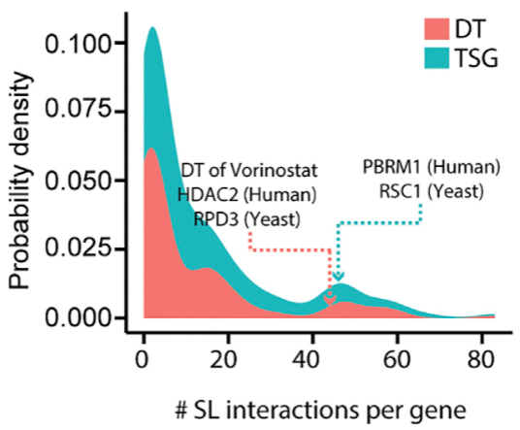
A TSG-DT Genetic Interaction Map in Yeast
Synthetic genetic arrays (SGAs) to test 43,505 gene pairs
Identified 1,420 synthetic lethal pairs in S. cerevisiae

Slide 11
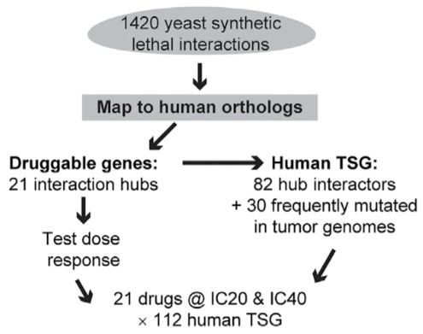
Chemo-genetic Interaction Mapping in Human Cancer Cells
Tumor suppressor-drug interaction screen: HeLa (cervical cancer)
Controls:
Drug (DMSO)
TSG (non-silencing siRNA)
127 synthetic lethal pairs

Slide 12
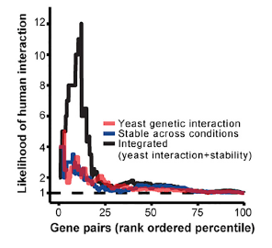
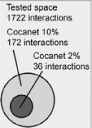
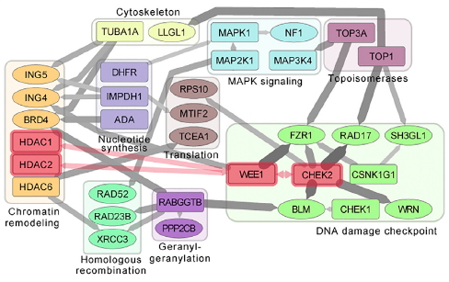
A Conserved Synthetic Lethal Interaction Network
1.General conservation of SL interaction network was observed between yeast and human
2. Specific conserved cancer interaction network identification shared in both species
Notes:
After generating the network resources in both yeast and human cancer cells, the author was trying to predict the interactions in humans by the interactions in the yeast.
Firstly, the authors identified the conservation of synthetic lethal interaction between the two species. Gene pairs with SL interaction in humans shows significantly more negative scores in the yeast compared to all remaining gene pairs. In turn, Prior SL interaction observation in yeast (i.e., gene pairs among the top 10% ranked by S score) increased the likelihood of human genetic interaction by approximately 3-fold.
Based on this general conservation, the authors further tried to identify the conservation pattern of more specific and stronger SL interactions narrowing down to the interactions with top 10% and 2% rank product scores in both species respectively. The vast majority of these interactions were identified for the first time whereas 14 of them were characterized before. CoCaNet10 included conserved interactions among 59 TSGs and 23 drug targets. The most stringent CoCaNet2 also captured the strongest conserved interactions.

Slide 13
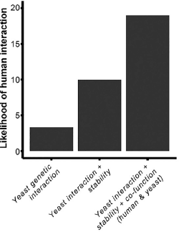
Incidence of Human Interaction is Informed by Context Stability and Co-function
Observed interactions in Yeast with certain network features can predict the interaction in HeLa cells
2. LS scoring based on yeast interaction, context stability, co-functionality shows the potentiality of identifying the SL interaction
Notes:
Several features of the networks are worth noticing, the interaction not only occurs in yeast but is stable across environmental contexts led to an increase in the likelihood of human interaction up to 9-fold from baseline. a gene pair functions in the same biological process (yeast and human GO terms) increased the likelihood of human interaction to 19-fold. The authors were making predictions of SL interactions on Human Hela cells by training regression model of four features, which are yeast interaction, context stability, yeast co-function, and human co-function. Training data was from the chemo-genetic screen. The model was used in over 100,000 genes with the feature information available. it is believed to be useful for identifying potential synthetic lethal interactions in a human gene space orders of magnitude larger than that what can be experimentally tested with current technology.

Slide 14
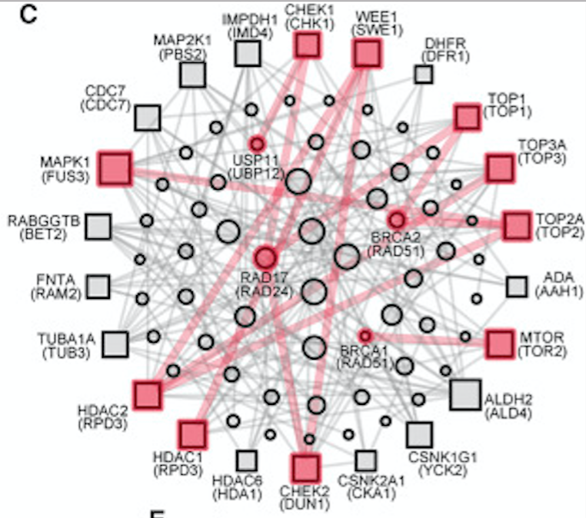
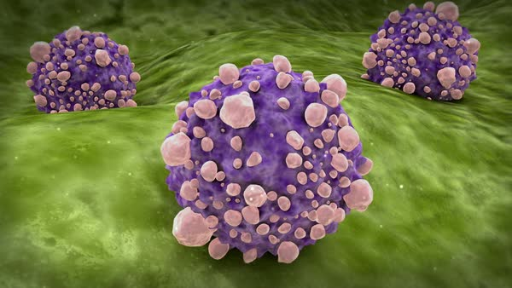
FDA-approved Drugs
Selective killing of tumor cells
Network of tumor-
suppressor interactions
Stocktrek Images
Notes:
As mentioned, cancer therapeutics have not been able to restore the function of mutated or deleted tumor suppressor genes in the clinical setting
Therefore, this study could have vas implications in the clinical setting if the interactions can be validated and repeated
The next step is to validate these novel interactions in cell survival assays

Slide 15
Validation of Novel Interactions in
Cell Survival Assays
RAD17
Deletion & mutation in ~5% of prostate, ovarian, pancreatic & stomach cancers
5 conserved synthetic sick/lethal interactions
2 targeted by FDA-approved drugs, 3 by molecules in clinical development
XRCC3
Deletion in ~4% of bladder & pancreatic cancers
7 conserved synthetic sick/lethal interactions
Glioblastoma cell line
2 FDA-approved drugs, 1 clinical development
10/12 interactions associated with decrease
in tumor cell survival in 2 cell lines
Notes:
cultured tumor cells using the interaction neighborhoods of RAD17 and XRCC3, 2 tumor suppressor genes involved in the repair of DNA damage
In order to validate these interactions, they examined the combination of chemical inhibitors targeting each of these interactors with a gene knockdowns to see whether the reduction in cell growth they observed translated to a reduction of survival in individual tumor cell
For RAD17, they observed that here was significant reduction in colony formation
For XRCC they wanted to see whether these interactions would generalize to human cell lines other than HeLa so they used a glioblastoma cell line
5/7 were associated with a negative effect on survival in this cell line
Together these showed that of 12 interactions examined, 10 could be readily associated with a specific decrease in tumor cell clonal survival, spanning 2 cell line backgrounds

Slide 16
Implications for Clinical Translation of Synthetic Lethal Interactions
Explore interactions in clinical outcomes of cancer patients:
2,000 breast cancer patients
Jerby-Arnon et al. (2014) scoring method, ISL : ‘induced synthetic lethality’
Patients with highest scores had significantly longer survival times relative to patients with lowest scores (p = 6x10⁻⁴)
Synthetic sick/lethal interactions in CoCaNet relevant to clinical response of human tumors via survival analysis
Notes:
to gauge the clinical relevance of the CoCaNet, the authors explored the association of these interactions with differences in clinical outcomes of cancer patients
it has been shown in previous studies that patients with tumors for which both genes of a synthetic sick interaction are under-expressed tend toward longer survival times
The authors explored this idea using the Jerby-Arnon et al. scoring method
~2,000 breast cancer patients waere scored by couting the number of synthetic sick/lethal interactions in CoCaNet10 for which both genes were underexpresed in the patient’s tumor versus their normal tissued
They compared the survival of the top 10% of scores and the lowest 10% of scres
Findings showed that highest score patients had significantly longer survival times relative to non-ISL patients (p = 6x10^-4)
Method to statistically infer synthetic lethality interactions from cancer genomic data from clinically samples
Synthetic lethality occurs when the inhibition of two genes is lethal while the inhibition of each single gene is not. It can be harnessed to selectively treat cancer by identifying inactive genes in a given cancer and targeting their synthetic lethal (SL) partners. The DAISY:
DAISY is an approach for statistically inferring SL interactions from cancer genomic data of both cell lines and clinical samples. DAISY applies three statistical inference procedures, each tailored to specific cancer data sets.
The first inference strategy, termed genomic survival of the fittest (SoF), is based on the observation that cancer cells that have lost two SL-paired genes do not survive, they are strongly selected against.
The second inference strategy, shRNA-based functional examination, is based on the notion that the knock down of a synthetically lethal gene is lethal to cancer cells where its SL partner is inactive
The third procedure, pairwise gene coexpression, is based on the notion that SL pairs tend to participate in closely related biological processes and hence are likely to be coexpressed
This is consistent with the idea that decreased function of both genes promoted synthetic sickness, cuasing the tumor to be less robust and leading to improved patient outcomes
10% of the cases with the highest scores were marked as having potential ‘induced syntehtic lethality’
Greatest contribution to increased survival was from SL interaction of BLM and CHEK1 and BLM and CHEK2

Slide 17
Claims
“As clinical genomic sequencing becomes more common, the synthetic-lethal maps provided by CoCaNetHuman, CoCaNet2/10, and CoCaNetX may become increasingly valuable tools to understand exceptional responses to therapy…Our analysis highlights several ways in which cross-species data may continue to be quite valuable…in preparation for more challenging interaction screens in humans. “
Notes:
This quote (direct attention towards, but don’t read aloud) captures the essence of what the authors are claiming to have done. However, it is an overstatement. Firstly, these networks did not appreciably reduce the test space in advance of human trials. They started with 169,000 potential interactions of interest, and only reduced it down to a prioritized 10e5 or at least 100,000; not even an order of magnitude lower. Secondly, their validation is in part lacking. As (Isabelle?) mentioned, 10 out of 12 tested interactions were associated with decreases in tumor cells. There are issues with this; first, the 12 chosen interactions were not identified as being chosen for any quantitative reason, e.g. being the top scoring interactions, but were seemingly chosen somewhat arbitrarily. In addition, some of these were not novel interactions, but had been studied more extensively previously in the literature. Thus far, throughout all of its citations, this paper has only been credited with uncovering one novel synthetically lethal relationship [1].

Slide 18
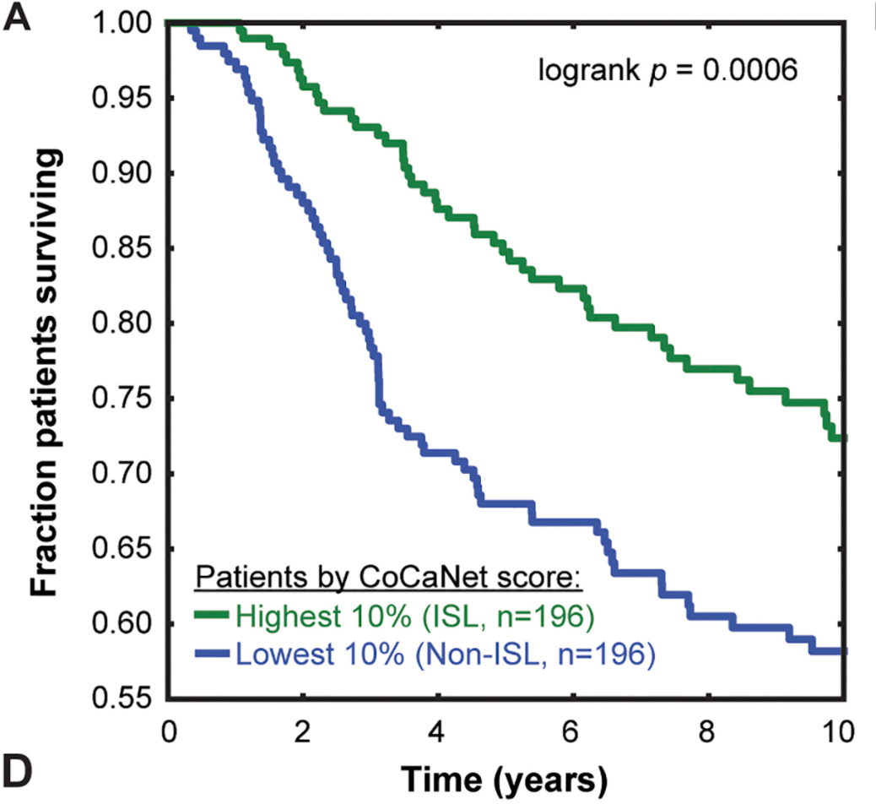
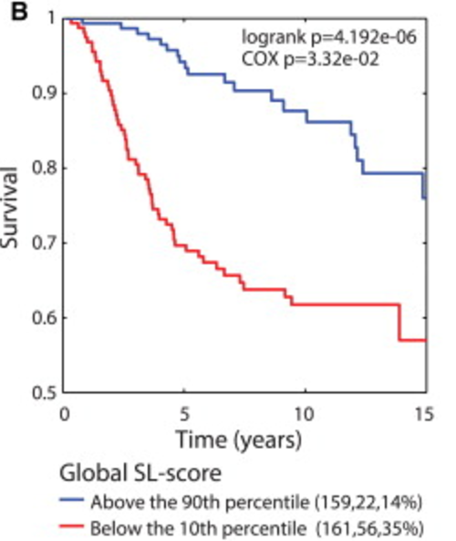
METABRIC Survival Comparison
Notes:
(Isabelle?) also talked about the survival comparisons of those with the top 10% ISL scores versus the bottom 10% ISL scores using Jerby Arnon scoring. On the left, we have the diagram from this paper, constructed using the gene interaction networks presented in this paper. On the right, we have a figure from the Jerby Arnon paper, which does the same thing for a different set of computationally derived synthetic lethal interactions. It is hard to say that the methodology of identifying interactions presented in this paper was better than existing methods, i.e. Jerby Anon’s method.

Slide 19
Summary
Goal: Address loss of function in TSG’s by identifying synthetic lethal interactions
Novel approach: use yeast as a model organism to analyze TSG-DT pairs, translate to humans with network features
Results:
43,505 gene-gene pairs used to create networks of conserved synthetic lethal interactions
127 experimentally identified and quantified interactions applied to networks to prioritize ~10⁵ combinations for follow-up
Some validation success
Notes:
cancer therapeutics have not been able to restore the function of mutated or deleted tumor suppressor genes in the clinical setting
interactions associated with decrease
in tumor cell survival in 2 cell lines

Slide 20
References
•Ali, R., Rakha, E.A., Madhusudan, S. and Bryant, H.E., 2016. DNA damage repair in breast cancer and its therapeutic implications. Pathology.
•Jerby-Arnon, L., Pfetzer, N., Waldman, Y.Y., McGarry, L., James, D., Shanks, E., Seashore-Ludlow, B., Weinstock, A., Geiger, T., Clemons, P.A. and Gottlieb, E., 2014. Predicting cancer-specific vulnerability via data-driven detection of synthetic lethality. Cell, 158(5), pp.1199-1209.

Slide 21
Thank you!

