Slide 1
Cell-free DNA comprises an in vivo nucleosome footprint that informs its tissues-of-origin
By: Snyder MW, Kircher M, Hill A, Daza RM, and Shendure J.
Cell. 2016 164(0), 57-68.
Presenters: Andrew Goldfarb, Kaylyn Williamson, Soun Lee
BST281 Journal Club
March 8, 2017

Slide 2
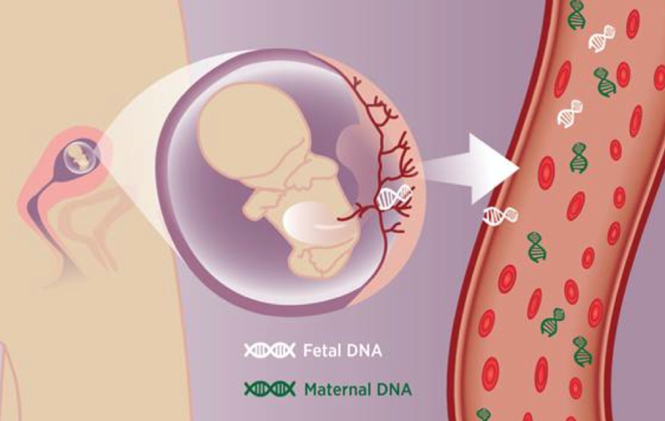
Background
Cell-free DNA
Very low concentration in plasma
Main source: apoptosis of normal cells of the hematopoietic lineage
Clinical applications of cfDNA
Pregnancy (2008)
Cancer (2014)
Limitation → requirement for genetic differences

Slide 3
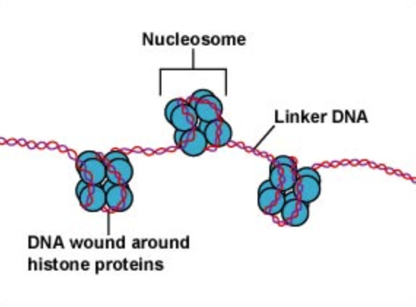
Background
Nucleosome position differs among cell types
Previous observation:
Overwhelmingly short (167 bp)

Slide 4
Hypothesis
Given:
Apoptosis ⇒ DNA fragmentation ⇒ biased protection (nucleosomes, TFs)
Hypothesize:
Deep sequencing of cfDNA can: (1) predict in vivo nucleosome positioning,
(2) epigenetically distinguish cell types

Slide 5
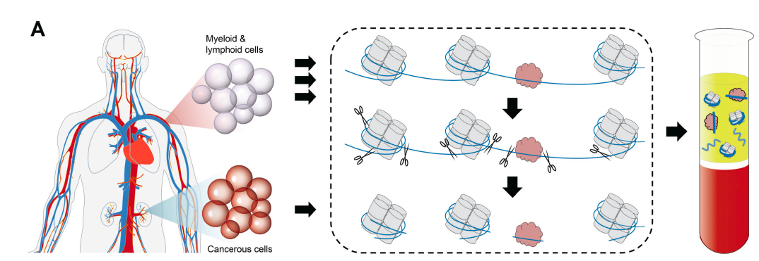
cfDNA Extraction and Nucleosome Positioning Methods Development
Samples: Pooled healthy donor plasma- BH01
Individual healthy donor plasma IH01, IH02
cfDNA was purified from plasma using Qiagen QiaAMP Circulating Nucleic Acids Kit
Libraries prepared using ThruPLEX DNA-seq kit (end repair, ligation, PCR amplification)
Sequenced to 96-105 fold coverage (1.5-1.6 billion fragments) on Illumina HiSeq 2000 or Next Seq 500
Figure 1
Notes:
The major hypothesis of this paper is that cfDNA found in circulating body fluids such as blood plasma, is protected from nuclease digestion by nucleosomes and TFs and that this can give us a pattern of nucleosome position. cfDNA in healthy individuals predominantly comes from myeloid and lymphoid cell lines undergoing apoptosis (which is a normal process) while in certain disease states, such as cancer, a larger contribution could be from tumor cells undergoing apoptosis or necrosis.
To be able to address their hypothesis: first need to determine whether cfDNA is likely to be nucleosome bound.
The authors developed a method for extracting, and sequencing the cfDNA fragments.

Slide 6
Fragment length and dinucleotide composition as evidence for nucleosome protected cfDNA
Conventional library preparation:
Removes 5’ and 3’ overhangs which may obscure cleavage sites
Single-stranded library preparation:
Developed for damaged or ancient DNA. No end repair so better preserves nicked ends.
Figure 1
Peak size 167 bp- chromatosome (nucleosome and linker histone)
Notes:
After sequencing, data was analyzed for average fragment length and position relative to the center of the 167 bp fragment (well positioned nucleosomes).
Supports model that cfDNA fragments are protected by nucleosome core particle and linker histone.
Additional smaller peaks 10.4 bp apart could be explained by additional nicking or cleavage occurring in relation to the helical pitch of nucleosome bound DNA.
Analysis to look at dinucleotide composition of the fragments. Confirms earlier findings of bias against AT dinucleotides at the dyad. NCP symmetrically positioned with respect to the chromatosome.
The authors had some concern that conventional library preparation will bias the results away from short damaged dsDNA molecules which is what we are actually looking for. Single stranded cfDNA library developed for damaged or ancient DNA samples in which no end repair is done. Instead they ligate adapters to single stranded (heat denatured) DNA, use polymerase to fill in the other strand and blunt end ligation to add a second adapter. This way they don’t miss the end points of fragments. 3-base pair offset. Again see a peak at 167 bp, with 10.4 bp periodicity and they do pick up larger percentage of small fragments but the peak size remains the same with a 3 bp offset which they suggest is due to no end repair.

Slide 7
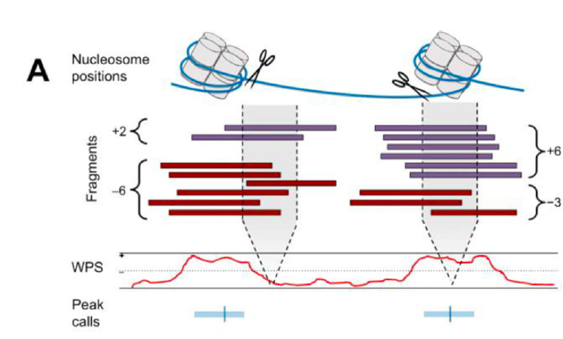
Determining nucleosome positions from cfDNA fragmentation patterns
Computational Methods:
Calculate a per-base Windowed Protection Score (WPS):
# of fragments completely spanning a 120 bp window - # of fragments with endpoints within the window
Larger WPS → indicates increased protection of DNA from digestion
Smaller WPS → indicates DNA is unprotected and thus not bound by nucleosomes or TFs.
Heuristic peak calling method → Adjusted WPS to local median of 0. Segmented into 50-150 bp regions, if WPS is above 0, call peak as maximum-sum contiguous window above median.
Figure 2
Notes:
Can they determine the local position of nucleosomes in tissues from the distribution of aligned fragment endpoints. Fragments should cluster adjacent to NCP boundaries but be depleted from the NCP itself
Peak calls identify contiguous regions of elevated WPS

Slide 8
Validation of methods:
WPS and peak calling correlate with position of nucleosomes from previous in vitro reports
CH01- pooled and resequenced libraries from BH01, IH01, IH02 with 231-fold coverage
Figure 2
Notes:
Validation of WPS and peak calling analysis. Strongly positioned nucleosomes at well-studied alpha satellite. Nucleosome calls from CH01 and two published arrays are shown to correlate fairly well.
CH01- combined and resequenced all samples with coverage of 231 fold (3.8G fragments). This gave higher WPS scores, better coverage, and approached saturation. Distance between peaks is 185 bp with low variance (consistent with nucleosome repeat length in mammalian cells.

Slide 9
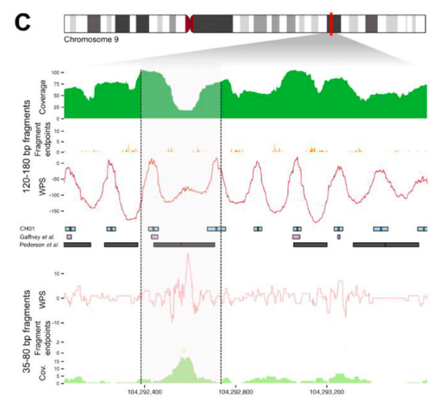
Short fragments of cfDNA correspond to TF protected regions
- Short windowed (16bp) S-WPS to identify transcription factor (TF) protected cfDNA fragments at sites of DNAse hypersensitivity (DHS).
Figure 2
Notes:
Previous studies of DNaseI hypersensitivity patterns identified two dominant classes of fragments: longer fragments associated with cleavage between nucleosomes, and shorter fragments associated with cleavage adjacent to transcription factor binding sites (TFBS). Partitioned sequence reads from pooled sample on the basis of inferred fragment length and recalculated the WPS using long fragments and short fragments.

Slide 10
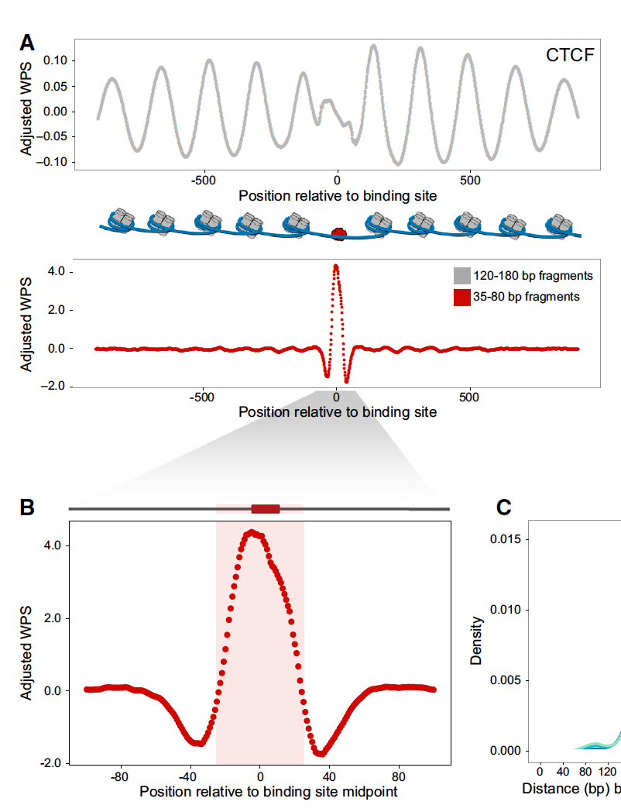
Short cfDNA fragments harbor footprints of transcription factors
L-WPS
CTCF - a transcriptional repressor that promotes nucleosome formation
S-WPS
TF binding can be detected by cfDNA
Figure 4

Slide 11
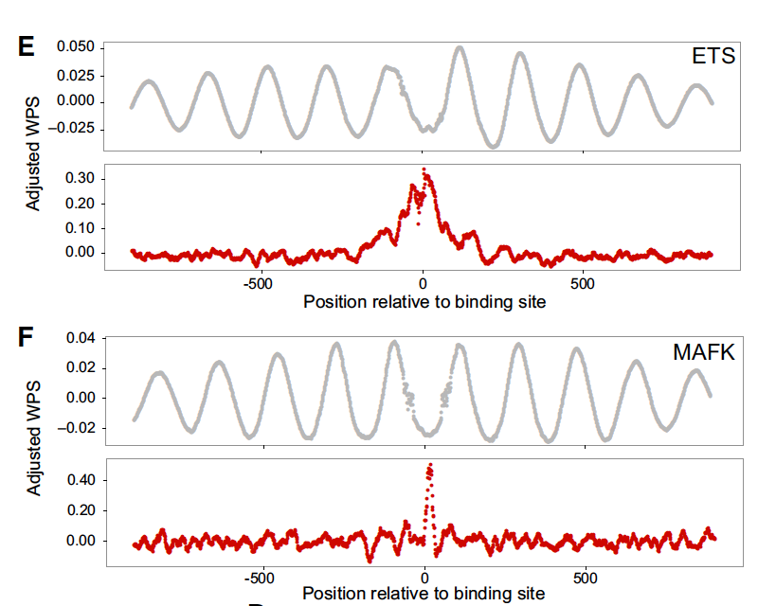
Short cfDNA fragments harbor footprints of transcription factors
Confirmed by two other TFs: ETS and MAFK
Conclusion: cfDNA directly footprints TF binding sites
Figure 4

Slide 12
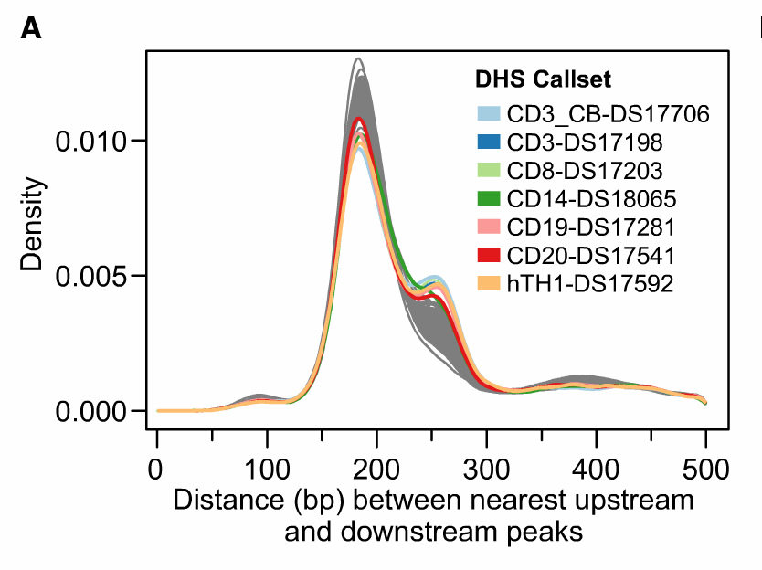
Nucleosome Position Correlation with DHS sites
Nucleosomes within DHS sites shows Peaks at 187 bp and 260 bp
Figure 5
Notes:
DHS assay has been conventionally used to map nucleosome positions...expect peaks w/in DHS sites
Looking at DHS sites from 116 callsets
Show peak at same 187 bp distance same as previously observed
Small peaks: lymphoid and myeloid origins

Slide 13
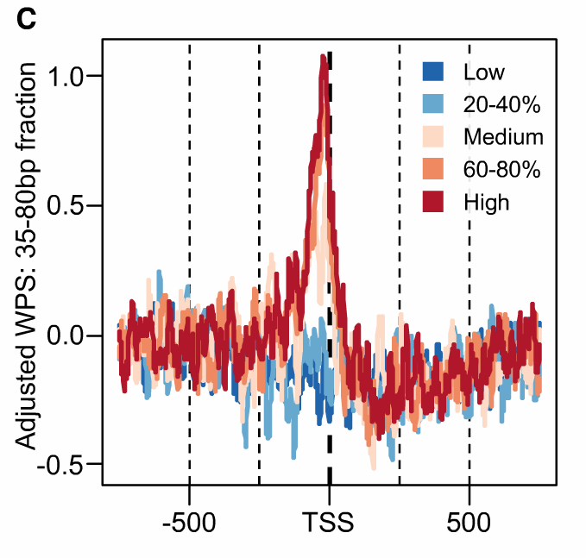
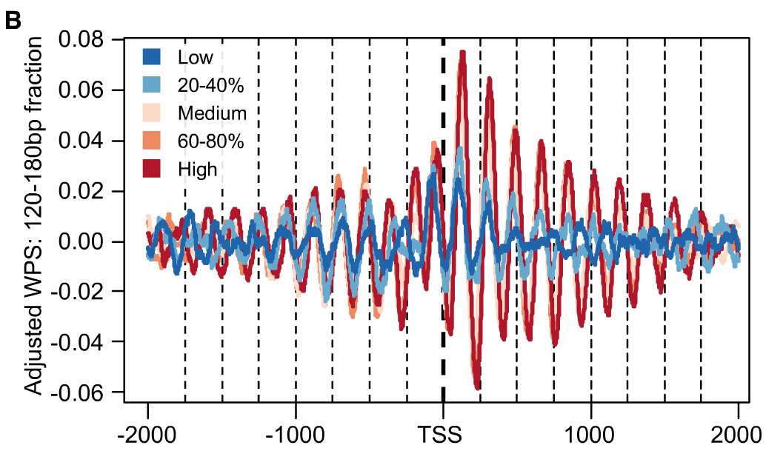
WPS Peaks Correlate with Expression Levels from Lymphoid Cell Line
Figure 5
Notes:
B. stratify WPS based on Lymphoid cell line expression data. High expression -> stronger peaks right after TSS
C. high WPS peak at TSS correlate with high expression level
cfDNA nucleosome occupancies correlate with expression observed in different cell types → strategy can inform the cell type of origin

Slide 14
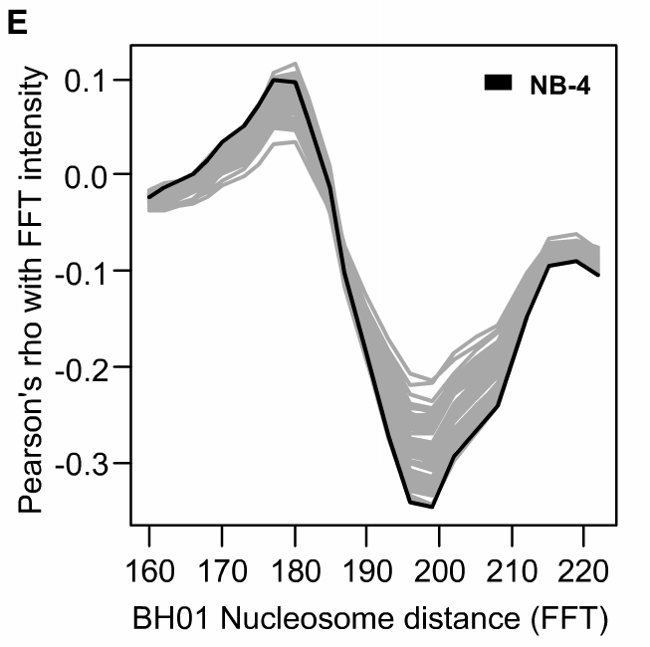
Expression Correlation Scores & Nucleosome Distance
Figure 5
Notes:
76 expression datasets
To deconvolve multiple contributions, intensities from fast Fourier transformation (FFT) quantified the specific frequency contributions in the long fragment WPS for 10 kb windows downstream of each TSS.

Slide 15
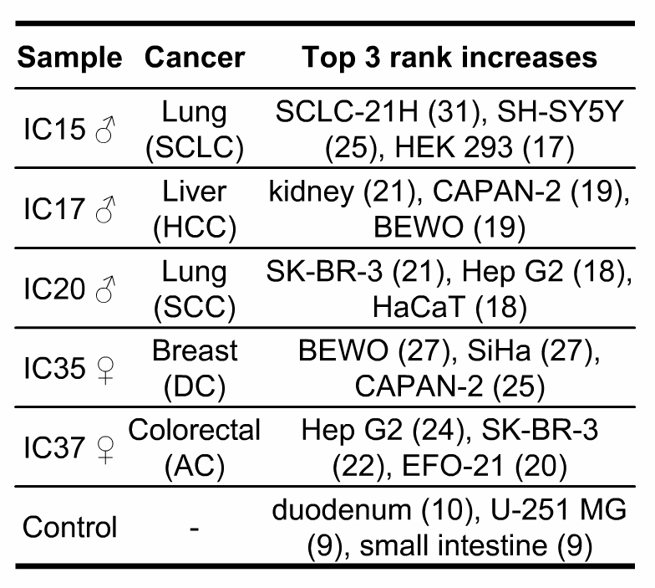
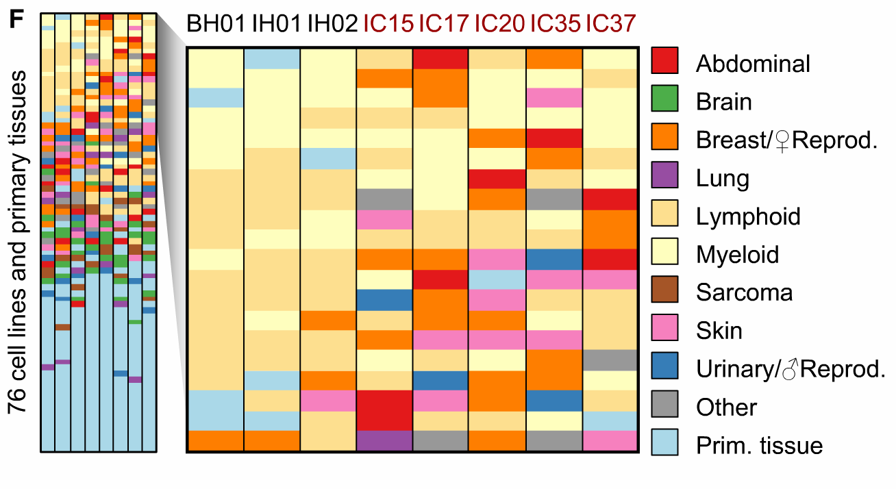
Top Hits for Cell Type Correlation
Figure 5
Notes:
FFT Intensity 193-199 bp
SCLC-21H: lung carcinoma, SH-SY5Y: bone marrow from neuroblastoma, hek292: kidney
CAPAN-2: human pancreatic ductal adenocarcinoma, BEWO: human Choriocarcinoma (uterus)
skBR3: adenocarcinoma, HepG2: liver cancer

Slide 16
Discussion
Used fragments from endogenous physiological processes, unlike in vitro MNase digestion with variations
Demonstrated the interplay between nucleosome positioning and expression patterns in cfDNA
Showed as proof-of-concept that cell types can be predicted from cfDNA nucleosome positions
May be used as a non-invasive technique to classify cancer types
May be applicable to other diseases: myocardial infarction, stroke, and autoimmune disorders
cfRNA and DNA methylation
Notes:
Not meant as a replacement of mutation-based monitoring of circulating tumor DNA.

Slide 17
Limitations
Future Directions
Small sample size (n=8)
Used individuals w/ large burdens of tumor derived DNA
Used expression data sets as reference comparison for various cell type of origin prediction
Heterogenous cell type contribution in small amount
Requires deep coverage
Build a collection of nucleosome positioning maps from different cell types and tissues to use as reference data sets for sample identification instead of expression data
Expand to larger cohort of patient samples
Determine a way to analyze data with lower coverage requirement, cost prohibitive as a diagnostic tool as it is.

Slide 18
Questions

Slide 19
Peak Calling
Supp Figure 1

