Slide 1
Genome-wide association analysis of more than 120,000 individuals identifies 15 new susceptibility loci for breast cancer
Michailidou et al. Nature Genetics 47.4 (2015): 373-380
Fangyuan Hong, Xinan Wang, Qiuhao Zhang, Yuxi Liu

Slide 2
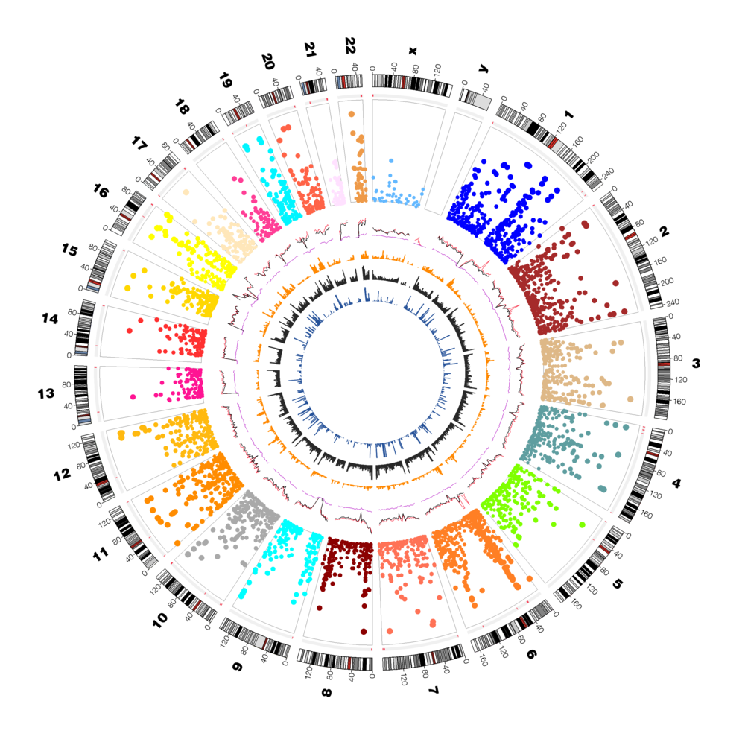
Outline
Background
Previous studies
Methods
Results
Discussions & Critiques
https://www.whi.org/Stories/Genome%20Wide%20Association%20Studies%20(GWAS).aspx

Slide 3
Background
Breast cancer susceptibility largely “polygenic” (Easton et al. 2007)
Rare variants in the DNA repair genes include BRCA1, BRCA2, PALB2, ATM and CHEK2
Observed patterns of familial aggregation, estimates of the inherited component of the disease are uncertain
Breast cancer is about twice as common in the first-degree relatives of women with the disease as in the general population (Hunter et al. 2007)
Estrogen, known as one of the most common types of receptors to fuel most breast cancer growth are both test negative and test positive in this study (detect 8 loci with P<5 x 10^-8)
Notes:
Breast cancer susceptibility is largely ‘polygenic’, i.e. susceptibility is conferred by a large number of common loci each with a small effect on breast cancer risk.
The tumor suppressor genes BRCA1 and BRCA2, were identified in 1990 that account for a substantial proportion of early-onset breast cancer, but a much smaller proportion of late-onset disease. However, the majority of multiple case breast cancer families do not segregate to identify further major breast cancer genes.
Such studies have identified variants in the DNA repair genes CHEK2, ATM, BRIP1 and PALB2 that confer an approximately twofold risk of breast cancer, but these variants are rare in the population.

Slide 4
Previous studies
Estimated 7 million common SNPs in the human genome (with minor allele frequency, MAF > 5%), neighboring polymorphisms strongly correlated (LD) with each other
Study has shown that a common coding variant in CASP8 is associated with a moderate reduction in breast cancer risk (Easton DF, et al. 2007)
Have identified common variants in 79 loci associated with breast cancer, explaining ~14% of the familial risk of the disease
Notes:
As linkage studies lack power to detect alleles with moderate effects on risk, large case-control association studies are required.
GWAS and large scale replication studies have identified common variants in 79 loci associated with breast cancer, explaining ~14% of the familial risk of the disease, residual genetic variance is likely due to variants conferring more moderate risks
Another study identified two SNPs (rs4415084 and rs10941679) on 5p12 that confer risk, preferentially for estrogen receptor (ER)-positive tumors (P=2.5x10^-12 for rs10941679), signal in FGFR2 was found to associate specifically with ER-positive breast cancer (Stacey SN, et al. 2008)

Slide 5
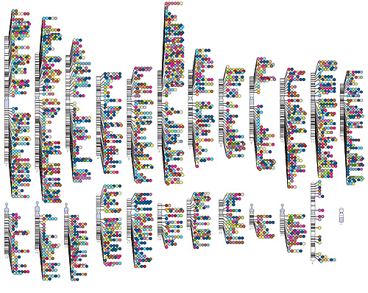
GWAS
Genome-wide association study or GWAS measures and analyzes DNA sequence variations from across the human genome
To identify genetic risk factors for diseases common in the population
Make predictions about who is at risk and to identify the biological underpinnings of disease susceptibility for developing new treatment
Rare variants studied well, quantify effects of common variants
https://www.genome.gov/27554296/current-uses-of-and-future-directions-for-the-gwas-catalog/

Slide 6
Methods
Genotyping 211,155 markers on iCOGS array
Imputation ~11 million SNPs using 1000 Genome Project
Association Analysis & Loci Selection From 7000+ SNPs to 15 loci
Testing SNP Effect Association with ER+/- and age
Identification ChIP-Seq & ENCODE
Notes:
Let’s take a brief look at the flowchart of the study. First, they use the customized iCOG array to genotype around 210000 markers. After that, they impute to 11 million SNPs based on 1000 genome project reference panel. Then genetic association analysis was conducted using p-value equals to 5 x 10-8 as a threshold to get 7000 potential SNPs associated. After a sequence of further selection based on r-square, p-value, odds ratio, imputation quality, etc. They determined the 15 new susceptibility loci for breast cancer. Finally, they used ChIP-Seq and ENCODE to identify the function of the loci.

Slide 7
Genotyping 211,155 markers on iCOGS array
Imputation ~11 million SNPs using 1000 Genome Project
Association Analysis & Loci Selection From 7000+ SNPs to 15 loci
Testing SNP Effect Association with ER+/- and age
Identification ChIP-Seq & ENCODE
Notes:
Let’s take a brief look at the flowchart of the study. First, they use the customized iCOG array to genotype around 210000 markers. After that, they impute to 11 million SNPs based on 1000 genome project reference panel. Then genetic association analysis was conducted using p-value equals to 5 x 10-8 as a threshold to get 7000 potential SNPs associated. After a sequence of further selection based on r-square, p-value, odds ratio, imputation quality, etc. They determined the 15 new susceptibility loci for breast cancer. Finally, they used ChIP-Seq and ENCODE to identify the function of the loci.

Slide 8
iCOGS Array
Associated with breast cancer susceptibility or survival in previous GWAS, including those specific to particular subgroups (for example, BRCA1 and BRCA2 mutation carriers)
Fine mapping genomic regions of interest to breast cancers
Associated with breast cancer-related quantitative traits
In selected candidate genes or pathways

Slide 9
Genotyping 211,155 markers on iCOGS array
Imputation ~11 million SNPs using 1000 Genome Project
Association Analysis & Loci Selection From 7000+ SNPs to 15 loci
Testing SNP Effect Association with ER+/- and age
Identification ChIP-Seq & ENCODE
Notes:
Let’s take a brief look at the flowchart of the study. First, they use the customized iCOG array to genotype around 210000 markers. After that, they impute to 11 million SNPs based on 1000 genome project reference panel. Then genetic association analysis was conducted using p-value equals to 5 x 10-8 as a threshold to get 7000 potential SNPs associated. After a sequence of further selection based on r-square, p-value, odds ratio, imputation quality, etc. They determined the 15 new susceptibility loci for breast cancer. Finally, they used ChIP-Seq and ENCODE to identify the function of the loci.

Slide 10
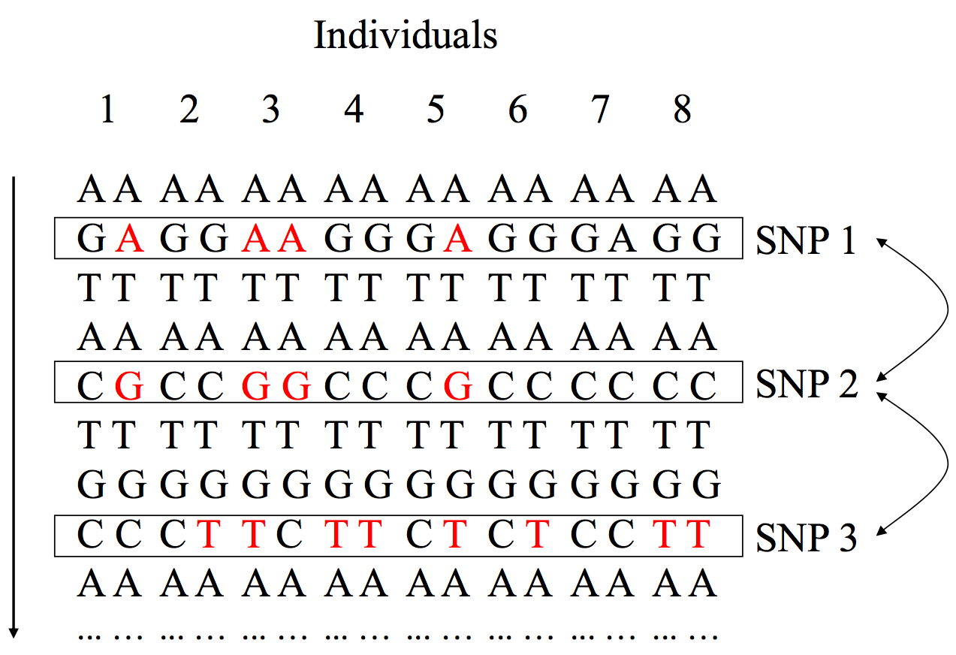
Background - Linkage Disequilibrium (LD) & Tag SNP
SNP1 & SNP2 in perfect LD
r²=1
SNP2 & SNP3 NOT in LD
r²=0
SNP1 and SNP2 are perfectly correlated
Notes:
Before we get into the study, let’s get some basic idea of the key concepts used in this study first.
LD stands for linkage disequilibrium and it measures the correlations between genotypes of nearby markers
Here we can see each row represents a SNP, and each two column numbered represents an individual. In the case of SNP1 and SNP2, every time we have an A at SNP1, we could also have a G at SNP2. In this case, we call SNP1 and SNP2 are in perfect LD and r square equals to 1. However, SNP2 and SNP3 are not in LD.
Increase power to detect disease association at untyped causal SNP
imputed causal SNP may have stronger association than tag SNP

Slide 11
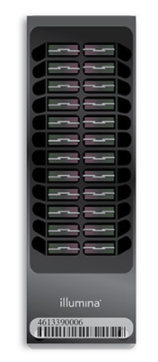
Background - Linkage Disequilibrium (LD) & Tag SNP
Genotype SNP2 in cases and controls
If SNP2 affects disease risk, then SNP1 will also be associated
Tag SNPs for each other
Notes:
Now let’s put it into practice. Say here we have cases and controls. And the numbers 1 and 0 here means whether getting the risk allele or not. As we can see, SNP1 and 2 are in perfect LD, so if only SNP2 is on the array, and we can only genotype SNP2. Then If SNP2 affects disease risk, then SNP1 will also be associated. They can be tag SNPs for each other.

Slide 12
Background - Linkage Disequilibrium (LD) & Tag SNP
Genotype SNP1 in cases and controls
If SNP1 affects disease risk, then SNP3 will also be associated
Notes:
Also, here we can see SNP1 and SNP3 are in partial LD and r2 is 0.7. So if we genotype SNP1 and If SNP1 affects disease risk, then SNP3 will also be associated.

Slide 13
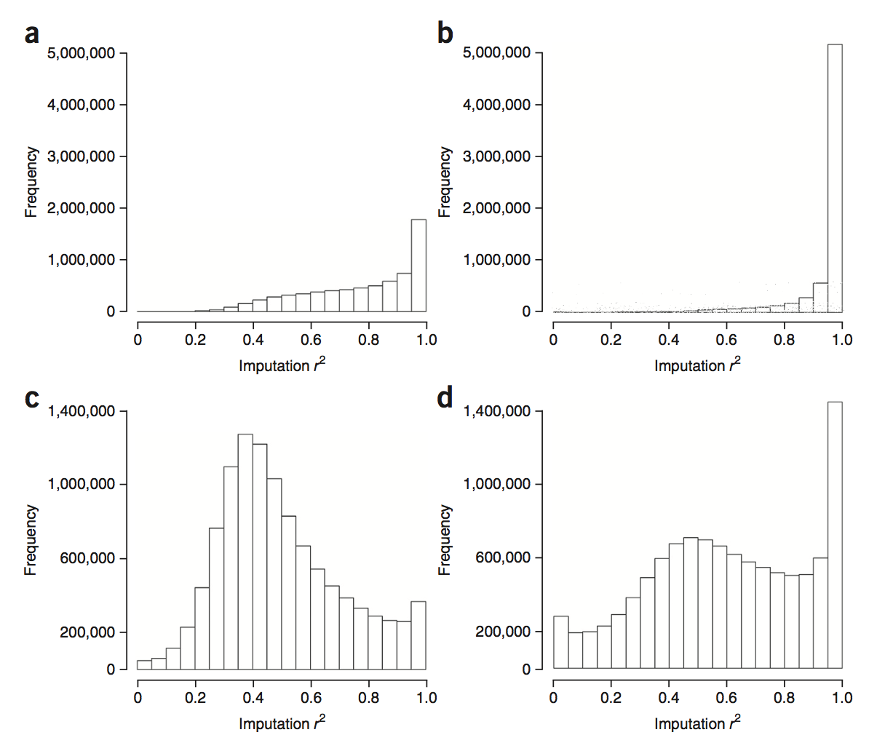
Imputation -1000 Genome Project Reference panel
Threshold
r² >0.3
MAF>0.005
Results
88% were imputed from the iCOGS array with r² >0.5, vs. 99% of variants for UK2
37% were imputed on the iCOGS platform with r² >0.9, vs. 85% for UK2
overall imputation quality was poorer than from a standard GWAS array, majority of the common SNPs are covered using iCOGS array
Imputation quality decreased with decreasing allele frequency
iCOGS
MAF>0.05
UK2
MAF>0.05
iCOGS MAF<0.05
UK2
MAF<0.05
Notes:
So based on LD, they impute the 210000 markers to 11 millions SNPs based on r square>0.3 and minor allele frequency >0.005

Slide 14
Genotyping 211,155 markers on iCOGS array
Imputation ~11 million SNPs using 1000 Genome Project
Association Analysis & Loci Selection From 7000+ SNPs to 15 loci
Testing SNP Effect Association with ER+/- and age
Identification ChIP-Seq & ENCODE
Notes:
Let’s take a brief look at the flowchart of the study. First, they use the customized iCOG array to genotype around 210000 markers. After that, they impute to 11 million SNPs based on 1000 genome project reference panel. Then genetic association analysis was conducted using p-value equals to 5 x 10-8 as a threshold to get 7000 potential SNPs associated. After a sequence of further selection based on r-square, p-value, odds ratio, imputation quality, etc. They determined the 15 new susceptibility loci for breast cancer. Finally, they used ChIP-Seq and ENCODE to identify the function of the loci.

Slide 15
Genotyping 211,155 markers on iCOGS array
7000 SNPs log OR (P < 5×10⁻⁸)
Imputation ~11 million SNPs using 1000 Genome Project
314 SNPs in 27 regions Removing regions around previously identified associated variants
Association Analysis & Loci Selection From 7000+ SNPs to 15 loci
18 regions Adjustment for previously known SNP, r²
Testing SNP Effect Association with ER+/- and age
15 new loci Re-imputation without pre-phasing
Identification ChIP-Seq & ENCODE
Notes:
Let’s take a brief look at the flowchart of the study. First, they use the customized iCOG array to genotype around 210000 markers. After that, they impute to 11 million SNPs based on 1000 genome project reference panel. Then genetic association analysis was conducted using p-value equals to 5 x 10-8 as a threshold to get 7000 potential SNPs associated. After a sequence of further selection based on r-square, p-value, odds ratio, imputation quality, etc. They determined the 15 new susceptibility loci for breast cancer. Finally, they used ChIP-Seq and ENCODE to identify the function of the loci.

Slide 16
Genotyping 211,155 markers on iCOGS array
7000 SNPs log OR (P < 5×10⁻⁸)
Imputation ~11 million SNPs using 1000 Genome Project
314 SNPs in 27 regions Removing regions around previously identified associated variants
Association Analysis & Loci Selection From 7000+ SNPs to 15 loci
18 regions Adjustment for previously known SNP, r²
Testing SNP Effect Association with ER+/- and age
15 new loci Re-imputation without pre-phasing
Identification ChIP-Seq & ENCODE
Notes:
Let’s take a brief look at the flowchart of the study. First, they use the customized iCOG array to genotype around 210000 markers. After that, they impute to 11 million SNPs based on 1000 genome project reference panel. Then genetic association analysis was conducted using p-value equals to 5 x 10-8 as a threshold to get 7000 potential SNPs associated. After a sequence of further selection based on r-square, p-value, odds ratio, imputation quality, etc. They determined the 15 new susceptibility loci for breast cancer. Finally, they used ChIP-Seq and ENCODE to identify the function of the loci.

Slide 17
Genetic Association Analysis
Removed variants within 500kb of associated variants previously established
314 variants from 27 regions
Notes:
To assess the evidence for additional susceptibility loci, variants within 500kb of variants previously established to be associated with breast cancer in women of European ancestry were removed. Here is the Manhattan Plots for the strength of genetic association with Y-axis is (-log10P) and X-axis is chromosomal position, Red horizontal line corresponds to the P=5x10-8, and each dot represents a single variant so the dots above the line may have significant association with breast cancer (blue horizontal line corresponds to P=10-5.) They got 314 variants from 27 regions

Slide 18
Genotyping 211,155 markers on iCOGS array
7000 SNPs log OR (P < 5×10⁻⁸)
Imputation ~11 million SNPs using 1000 Genome Project
314 SNPs in 27 regions Removing regions around previously identified associated variants
Association Analysis & Loci Selection From 7000+ SNPs to 15 loci
18 regions Adjustment for previously known SNP, r²
Testing SNP Effect Association with ER+/- and age
15 new loci Re-imputation without pre-phasing
Identification ChIP-Seq & ENCODE
Notes:
Let’s take a brief look at the flowchart of the study. First, they use the customized iCOG array to genotype around 210000 markers. After that, they impute to 11 million SNPs based on 1000 genome project reference panel. Then genetic association analysis was conducted using p-value equals to 5 x 10-8 as a threshold to get 7000 potential SNPs associated. After a sequence of further selection based on r-square, p-value, odds ratio, imputation quality, etc. They determined the 15 new susceptibility loci for breast cancer. Finally, they used ChIP-Seq and ENCODE to identify the function of the loci.

Slide 19
Genotyping 211,155 markers on iCOGS array
7000 SNPs log OR (P < 5×10⁻⁸)
Imputation ~11 million SNPs using 1000 Genome Project
314 SNPs in 27 regions Removing regions around previously identified associated variants
Association Analysis & Loci Selection From 7000+ SNPs to 15 loci
18 regions Adjustment for previously known SNP, r²
Testing SNP Effect Association with ER+/- and age
15 new loci Re-imputation without pre-phasing
Identification ChIP-Seq & ENCODE
Notes:
Let’s take a brief look at the flowchart of the study. First, they use the customized iCOG array to genotype around 210000 markers. After that, they impute to 11 million SNPs based on 1000 genome project reference panel. Then genetic association analysis was conducted using p-value equals to 5 x 10-8 as a threshold to get 7000 potential SNPs associated. After a sequence of further selection based on r-square, p-value, odds ratio, imputation quality, etc. They determined the 15 new susceptibility loci for breast cancer. Finally, they used ChIP-Seq and ENCODE to identify the function of the loci.

Slide 20
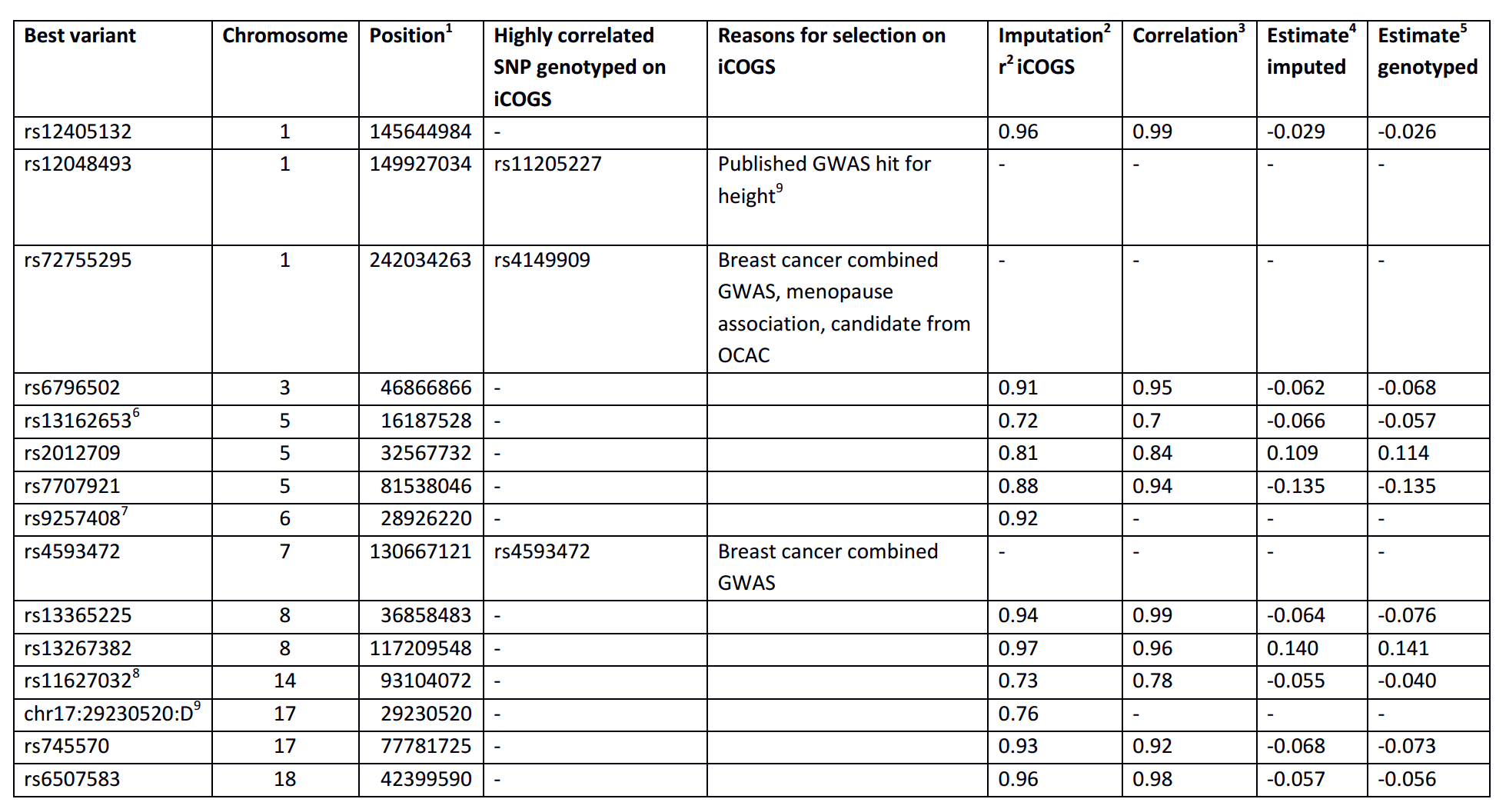
Confirm imputation quality

Slide 21
Confirm imputation quality

Slide 22
Genotyping 211,155 markers on iCOGS array
Imputation ~11 million SNPs using 1000 Genome Project
Association Analysis & Loci Selection From 7000+ SNPs to 15 loci
Testing SNP Effect Association with ER+/- and age
Identification ChIP-Seq & ENCODE
Notes:
Let’s take a brief look at the flowchart of the study. First, they use the customized iCOG array to genotype around 210000 markers. After that, they impute to 11 million SNPs based on 1000 genome project reference panel. Then genetic association analysis was conducted using p-value equals to 5 x 10-8 as a threshold to get 7000 potential SNPs associated. After a sequence of further selection based on r-square, p-value, odds ratio, imputation quality, etc. They determined the 15 new susceptibility loci for breast cancer. Finally, they used ChIP-Seq and ENCODE to identify the function of the loci.

Slide 23
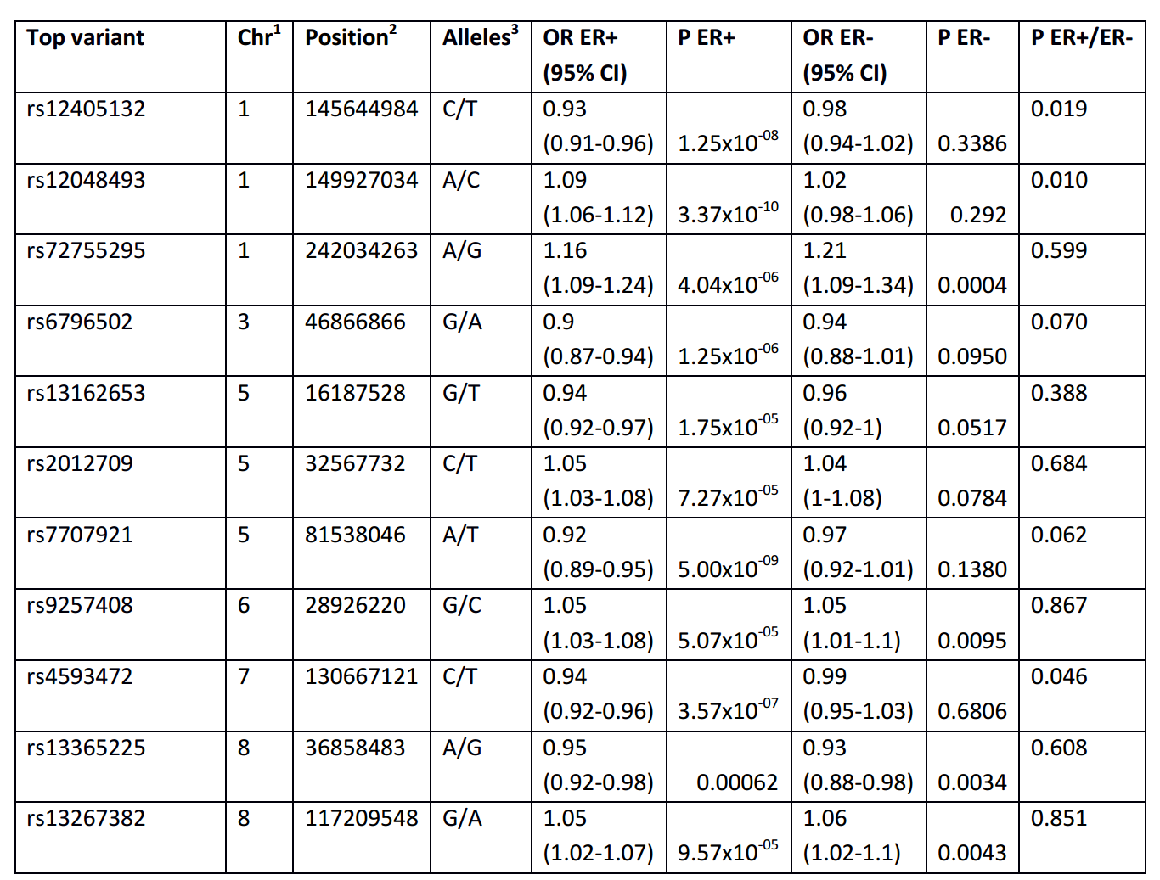
Per-allele ORs for ER+ vs. ER-

Slide 24
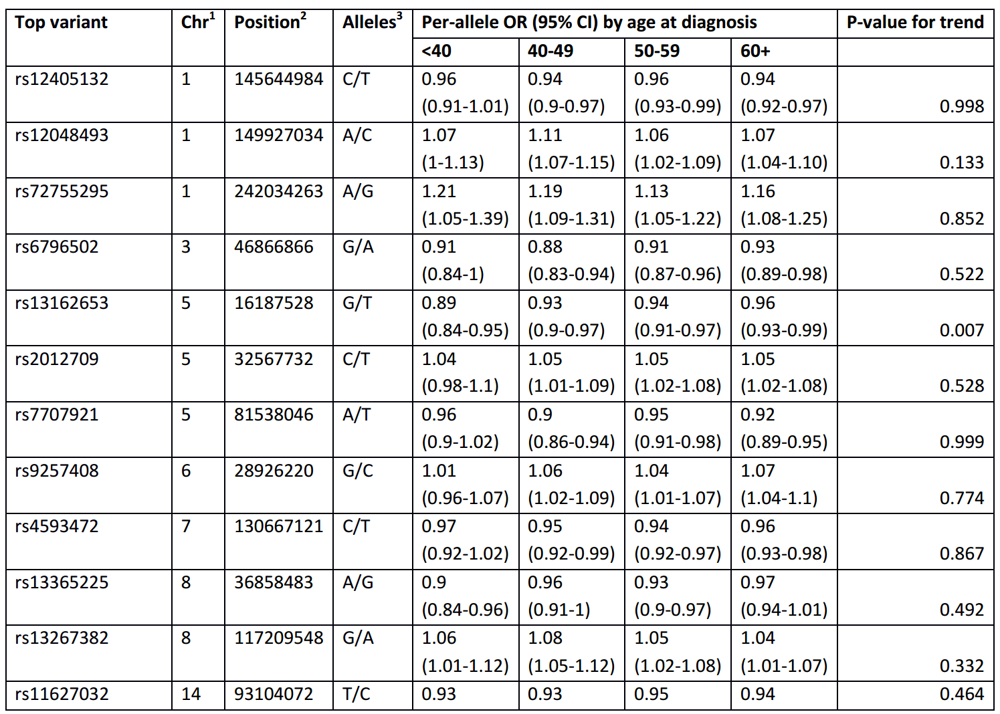
Per-allele ORs by age

Slide 25
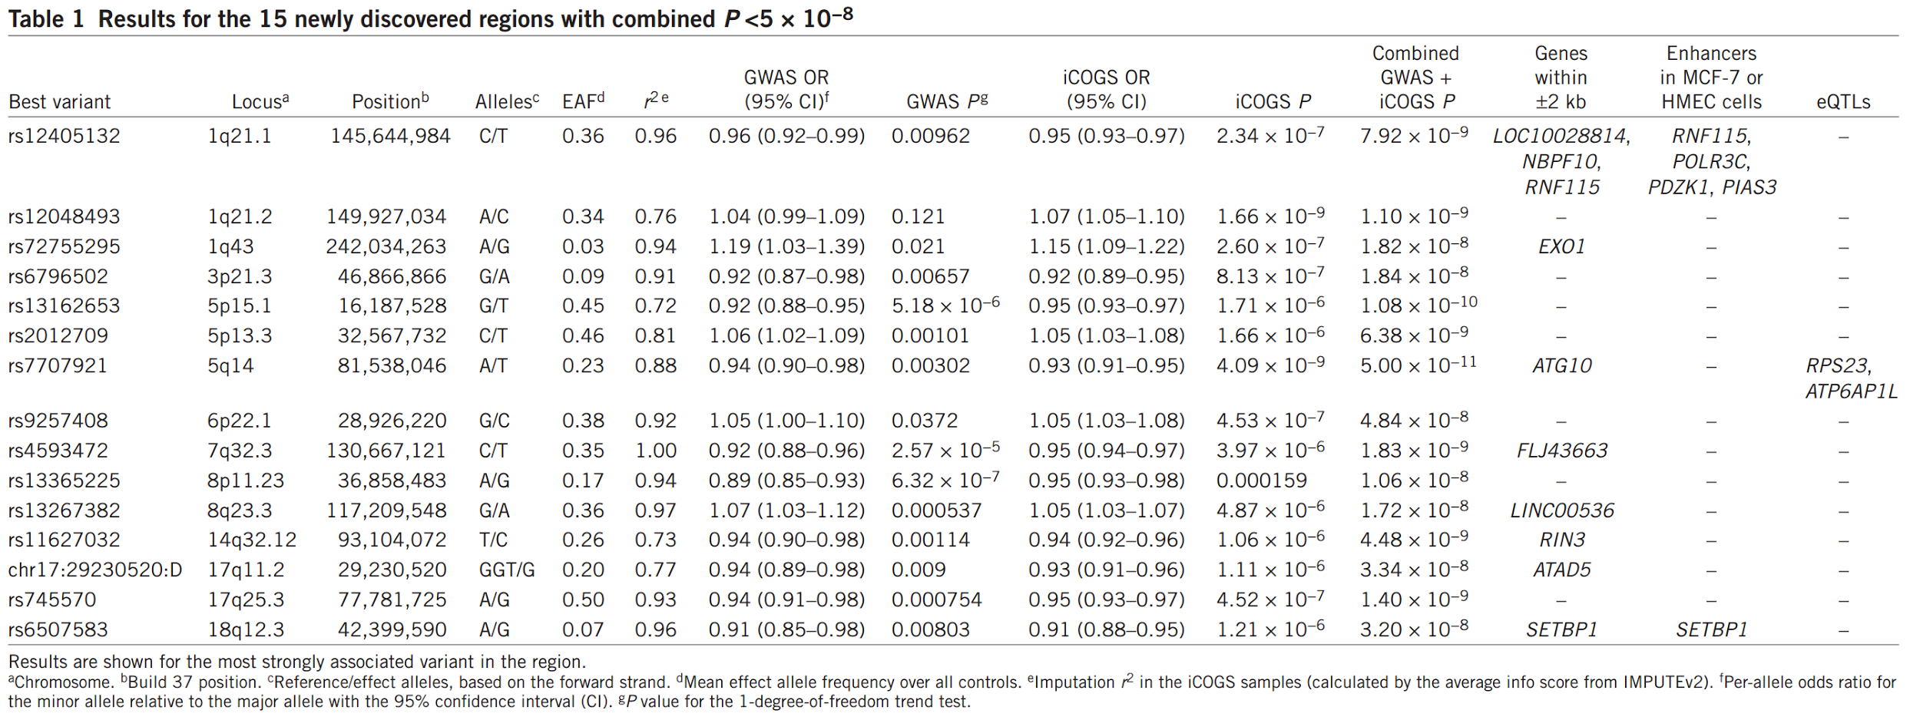
Summary results

Slide 26
Genotyping 211,155 markers on iCOGS array
Imputation ~11 million SNPs using 1000 Genome Project
Association Analysis & Loci Selection From 7000+ SNPs to 15 loci
Testing SNP Effect Association with ER+/- and age
Identification ChIP-Seq & ENCODE
Notes:
Let’s take a brief look at the flowchart of the study. First, they use the customized iCOG array to genotype around 210000 markers. After that, they impute to 11 million SNPs based on 1000 genome project reference panel. Then genetic association analysis was conducted using p-value equals to 5 x 10-8 as a threshold to get 7000 potential SNPs associated. After a sequence of further selection based on r-square, p-value, odds ratio, imputation quality, etc. They determined the 15 new susceptibility loci for breast cancer. Finally, they used ChIP-Seq and ENCODE to identify the function of the loci.

Slide 27
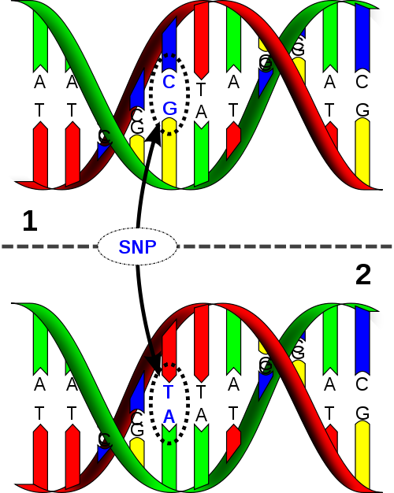
Potentially Causal Variants and Genes
15 new loci associated with breast cancer
522 variants - a set of potentially causal variants
Gene-coding elements:
rs72755295, rs4149909 (EXO1)
Regulatory elements:
rs12405132 (RNF115, PDZK1)
rs6507583 (SETBP1)
eQTLs:
rs7707921 (RPS23, ATP6AP1L)

Slide 28
Gene-coding elements
rs72755295
Lies in an intron of EXO1
Strongly correlated with only one other variant rs4149909
EXO1
Encodes exonuclease 1, which involves in mismatch repair
rs4149909
Codes for an amino acid substitution (AAS) in EXO1
Likely to be deleterious (CADD score: 33)

Slide 29
Regulatory elements
Enhancer elements in mammary cell line
Encyclopedia of DNA elements (ENCODE)
Chromatin Immunoprecipitation and Sequencing (ChIP-Seq)
Potential gene targets
ENCODE chromatin interaction analysis
Paired-end tag (ChIA-PET) chromatin interaction
rs12405132 at 1q21.1 and rs6507583 at 18q12.3
Overlapped with putative enhancer sequences
Promoter interactions

Slide 30
rs12405132 at 1q21.1
Potential interacting genes: RNF115, PDZK1, POLR3C, PIAS3
RNF115
Encodes an E3 ubiquitin ligase RING finger protein that is overexpressed in ER-positive breast cancers
PDZK1
Encodes a scaffold protein that connects plasma membrane proteins and regulatory components, regulating their surface expression in epithelial cell apical domains, and has been proposed to act as an oncogene in breast cancer.

Slide 31
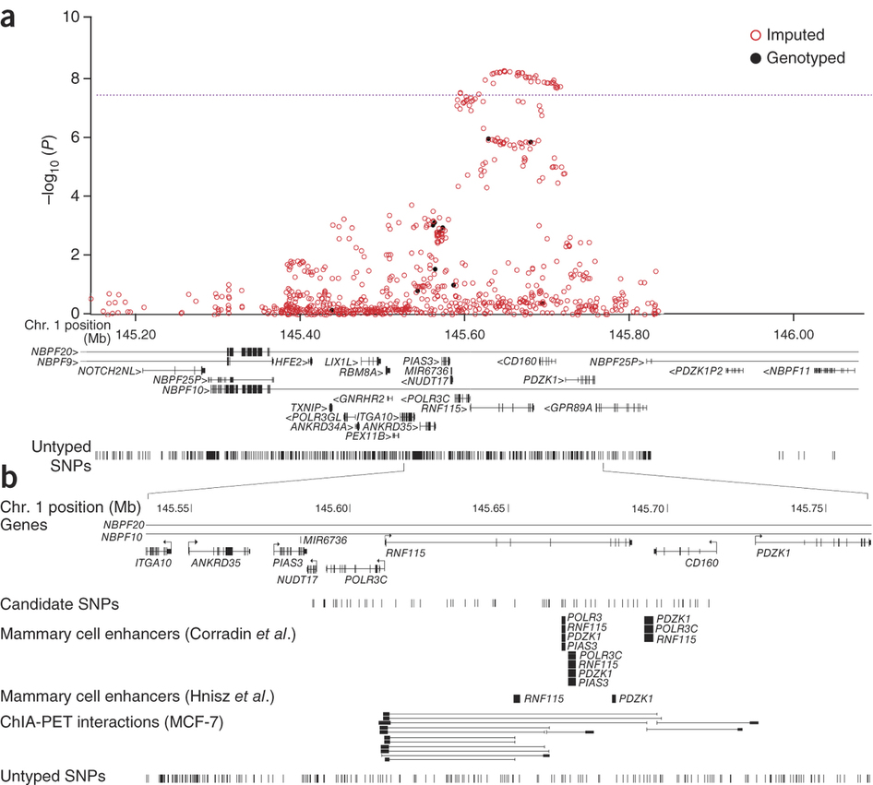
rs12405132 at 1q21.1
RNF115
Encodes an E3 ubiquitin ligase RING finger protein that is overexpressed in ER-positive breast cancers
PDZK1
Encodes a scaffold protein that connects plasma membrane proteins and regulatory components, regulating their surface expression in epithelial cell apical domains, and has been proposed to act as an oncogene in breast cancer.

Slide 32
rs6507583 at 18q12.3
Correlated SNPs lie in regions interacting with the promoter of SETBP1
SETBP1
Encodes a protein that binds the SET nuclear oncoprotein, which is involved in DNA replication.

Slide 33
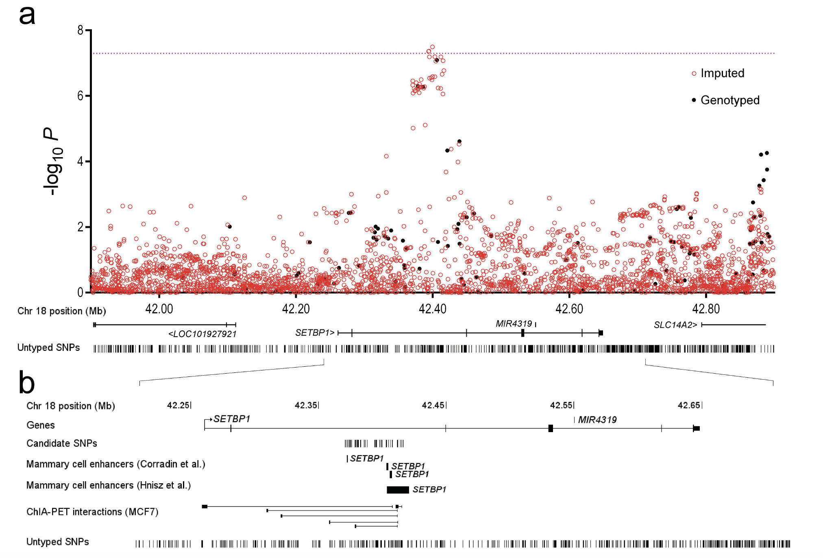
rs6507583 at 18q12.3
SETBP1
Encodes a protein that binds the SET nuclear oncoprotein, which is involved in DNA replication.

Slide 34
eQTLs
Expression quantitative trait loci (eQTLs)
Associations between the 15 new loci and expression of neighboring genes
Breast tumors and normal breast tissues
Data from The Cancer Genome Atlas (TCGA)
rs7707921
Strongly associated with RPS23 expression in all tissues
Weakly associated with ATP6AP1L expression (P=5.6×10⁻⁵ in breast tumors, P=0.066 in normal tissue)
RPS23: encodes ribosomal protein S23 that is a component of the 40S subunit
ATP6AP1L: a paralog of ATP6AP1, which encodes the S1 subunit of the enzyme V-type proton ATPase

Slide 35
Discussion
Pros
Large scale replication study incorporating previous GWAS dataset
Clear evidence between SNPs and related genes
Explain further ~2% of the two-fold risk of breast cancer
Cons
Imputation quality of iCOGS is poorer than standard GWAS array
Notes:
Inclusion of these additional loci in polygenic risk scores will improve the ability to discriminate between individuals at high and low risk, potentially improving breast cancer screening and prevention.

Slide 36
Future Directions & Critiques
Perform a larger association study
Based on a higher quality array
Conduct on other ancestries
Enrich with cases with a positive family history of the disease (compare GWAS and linkage analysis (Hunter et al. 2007)
Notes:
Although there may be further susceptibility variants with comparably associated effects that were not well imputed, the identification of many additional loci will require larger association studies
A GWAS is often enriched with cases with a positive family history of the disease, in order to maximize the opportunity to detect inherited causal variants (Hunter et al. 2007)

Slide 37
References
Bush, William S., and Jason H. Moore. "Genome-wide association studies." PLoS Comput Biol 8.12 (2012): e1002822.
Hunter, David J., et al. "A genome-wide association study identifies alleles in FGFR2 associated with risk of sporadic postmenopausal breast cancer." Nature genetics 39.7 (2007): 870-874.
Michailidou, Kyriaki, et al. "Genome-wide association analysis of more than 120,000 individuals identifies 15 new susceptibility loci for breast cancer." Nature genetics 47.4 (2015): 373-380.
Stacey, Simon N., et al. "Common variants on chromosome 5p12 confer susceptibility to estrogen receptor–positive breast cancer." Nature genetics 40.6 (2008): 703-706.
Zheng, Wei, et al. "Genome-wide association study identifies a new breast cancer susceptibility locus at 6q25. 1." Nature genetics 41.3 (2009): 324-328.

Slide 38
Thanks!

Slide 39
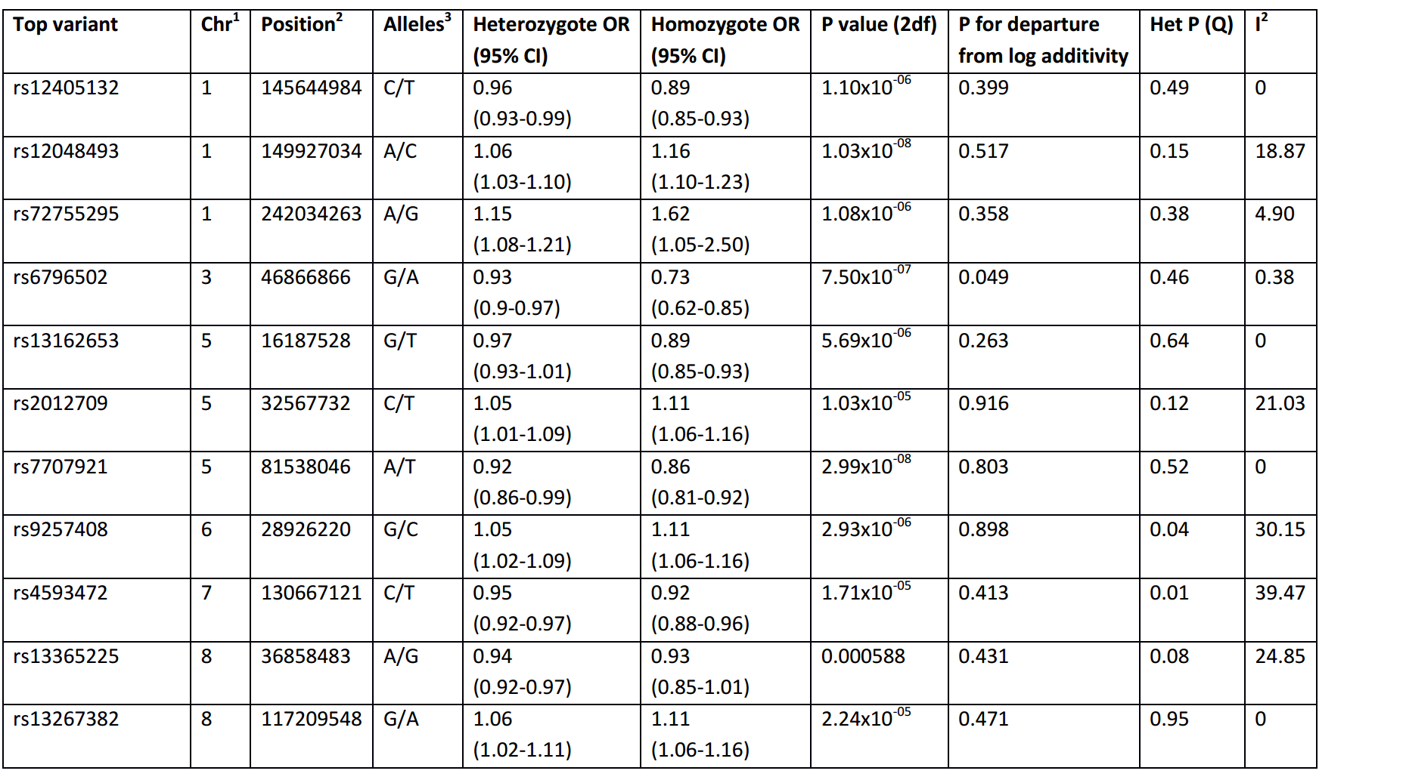
Supplement
homogeneity

