Slide 1
Bio 281 Journal Club March 8, 2017 Kathy Lee-Sarwar, Alberta Wang, Amit Joshi

Slide 2
Introduction Methods / Results Discussion

Slide 3
Introduction Methods / Results Discussion

Slide 4
Gut microbial changes are associated with a growing number of diseases, including polygenic diseases.
Slide modified from Julian Marchesi

Slide 5
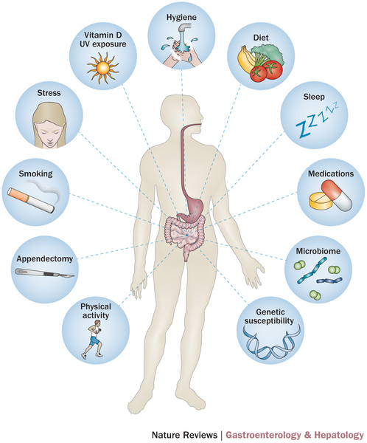
Open questions regarding the role of genetics in microbial community composition
Is gut dysbiosis a consequence or cause of polygenic disease?
To what extent is the gut microbiome is genetically determined?
How much do we have to personalize microbial-based treatments?
Ananthakrishnan A
Nat Rev Gastr & Hep 2015.

Slide 6
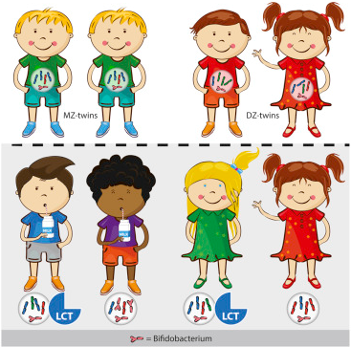
Prior studies (focusing on those conducted in humans)
Monozygotic twins have more similar microbiomes than dizygotic twins.
Single candidate genes influence the human gut microbiome.
Human Microbiome Project: associations between genetic variants & microbiome composition.
Goodrich JK, Cell 2014.
Goodrich JK, Cell Host Microbe 2016.
Blekhman R, Genome Biol 2014.
Notes:
LCT encodes the lactase enzyme, which is expressed in the GI tract and acts to hydrolyze lactose, the sugar found in dairy products. Intriguingly, Bifidobacterium can metabolize lactose, and reports show that some strains prefer lactose to glucose [51]. Since genetic variants in and around LCT are directly linked to lactase persistence [52], it is likely that the variants we observed dictate an individual’s consumption of milk products, which in turn may regulate the abundance of Bifidobacterium in the GI tract.

Slide 7
Objective: Determine the association between human genetic variation and the composition of the microbiota.

Slide 8
Introduction Methods / Results Discussion

Slide 9
Nature Genetics Vol 48, No 11: 3 genetic analyses of the human gut microbiome
 | Turpin W, et al. | Bonder MJ, et al. | Wang J, et al.
Cohort Size | 1,098 / 463 | 984 / 425 / 105 | 1,115 / 914
Ancestry | 100% Caucasian | Dutch population cohorts | European ancestry
Microbial sequencing method | 16S sequencing using Illumina MiSeq | Metagenomic sequencing using Illumina HiSeq | 16S sequencing using Illumina MiSeq
Genotyping platform | Illumina HumanCoreExome-12v1.1 chip, Immunochip | Illumina HumanCytoSNP-12 Beadchhip, HumanCoreExome-12v1.1, Immunochip | Affymetrix 6.0 & Axiom, Illumina 550k, Immunochip, Metabochip & Omni Express Exome

Slide 10
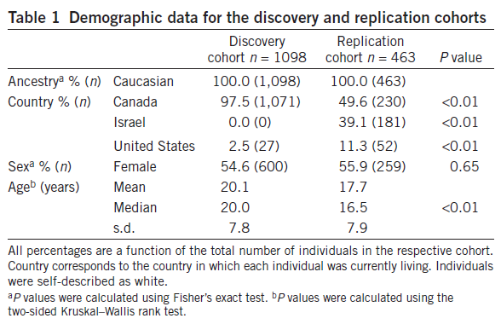
Genetic Environmental Microbial Project to study healthy 1st degree relatives of subjects with Crohn’s disease
Subjects excluded if:
Antibiotics in prior 3 months
History or symptoms of intestinal disease
Notes:
Age range 6 to 35 years of age

Slide 11
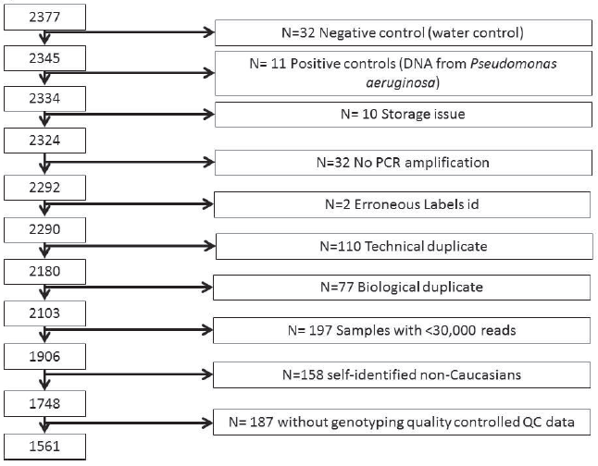
Microbial taxonomic profiling quality control
*Technical Duplicate
Repeated measurements of the same sample.
Purpose: assess random noise
associated with protocols or equipment.
*
**Biological Duplicate
Measurements of multiple samples from the same subject.
Purpose: assess noise from random
biological variation.
**
Notes:
All stool DNA extraction performed in a single facility to reduce batch effects from between-facility variation
OTUs with prevalence of < 5% were removed from analysis

Slide 12
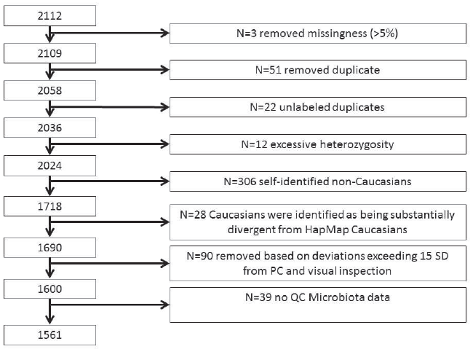
Genotyping quality control
Illumina HumanCoreExome chip & Immunochip
Filtered out SNPs:
>5% missingness
On a list of commonly misgenotyped variants
508,915 SNPs analyzed
Imputation from 1000 Genomes Project, SNP2HLA
Notes:
51 were known duplicates and 22 had high genetic similarity to other samples suggesting they were duplicates.
Those with excess heterozygosity were > 3sd from mean
Merged data for a subset of SNPs with HapMap data and removed subjects that differed from HapMap Caucasions on MDS plots.
Did PCA on the genotyping data and 90 outliers were removed

Slide 13
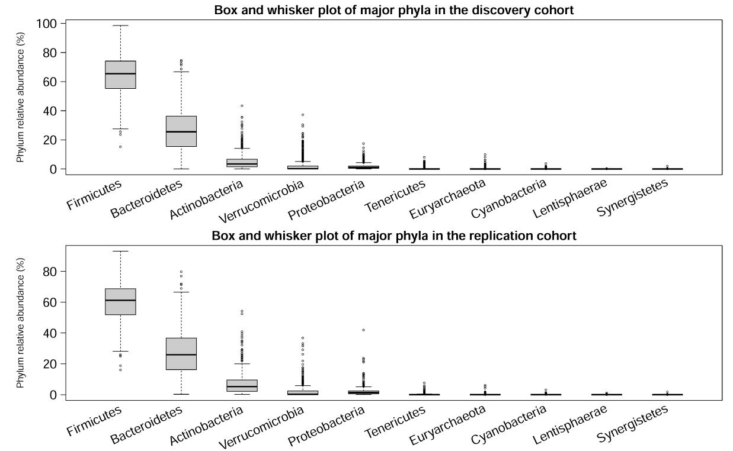
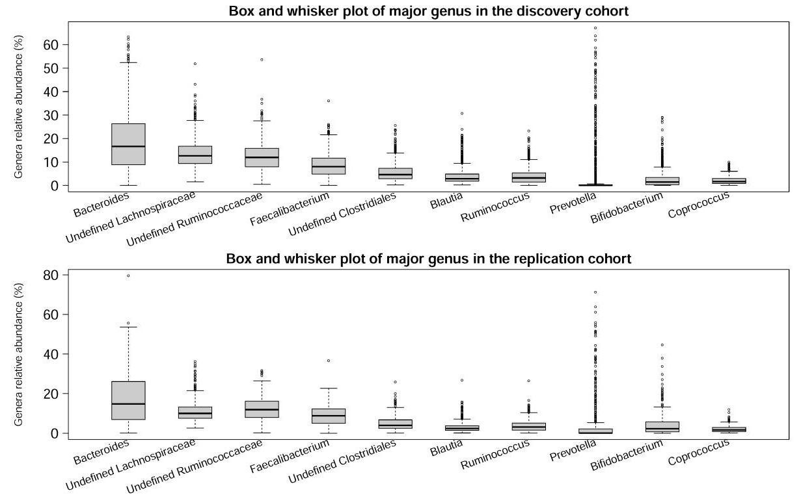
Major taxa were similar in the discovery and replication cohorts
Notes:
(1) Box and whisker plots of major phyla on the left, and major genus on the right – show that major taxa were similar in the discovery and replication cohorts across taxonomic ranks.
(2) 9 of 127 genera were found in all subjects, and the remaining 118 were variable
(3) Consistent with the idea of a core stable microbiome that coexists with highly variable bacterial taxa in the human gut microbiome.

Slide 14
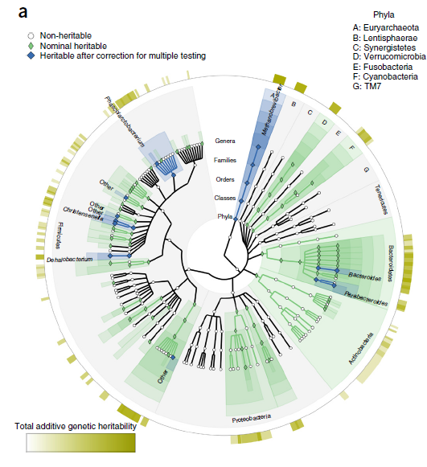
Heritability analysis of microbiota
Polygenic heritability: Proportion of population variance in the gut microbiota that can be explained by additive genetic variation (narrow sense).
Analyzed heritability in a subset of 270 related individuals from 123 families
Assessed polygenic heritability from the phylum to the genus level in 249 bacterial taxa
Bacterial relative abundance values were inverse normal transformed
Notes:
This is a cladogram, in which the central dot represents kingdom, and each successive circle moving outward is one step lower phylogenetically. You can see the various branches of the phylogenetic tree in the figure.
The green shading represents a heritability higher than 25% and p-value less than 0.05. Of the 249 bacterial taxa, 94 were nominally significant which is much higher than you would expect by chance.
The blue shading represents taxa that survived multiple comparisons correction at P-value less than 4.13x10⁻⁴. The most notable of these are methanobrevibacter and phascolarctobacterium.
13 or 26 previously discovered heritable taxa were also replicated in this study.

Slide 15
GWAS of bacterial taxa
GEE framework to test for association between 3.7M SNPs and each of the 166 non-redundant microbial taxonomic level
Account for familial clustering
Flexible to model specification and does not rely on fully parametric assumptions, which are not met in the case of bacterial taxa
Adjusted for age, sex and top 3 PCs
Models
<5% zero values: log normal model on the log of the relative abundance for non-zero counts
>15% zero values – 2 part log normal fitting
logistic model on the absence/ presence of the taxon and
Additive genetic model on the log of the relative abundance for non-zero counts
5-15% zerio values: Model selection criterion between the two models above using quasi-likelihood (QIC)
Multiple comparisons corrections
Genome-wide significance threshold – 5x10⁻⁸
Study wide significance (166 GWASes) – 4.13x10⁻¹⁰

Slide 16
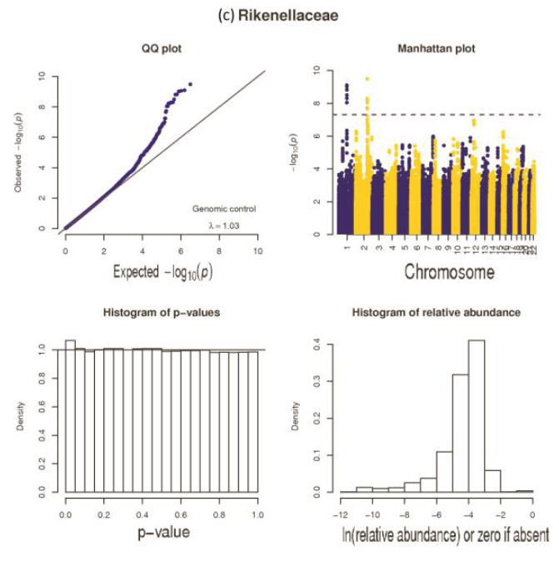
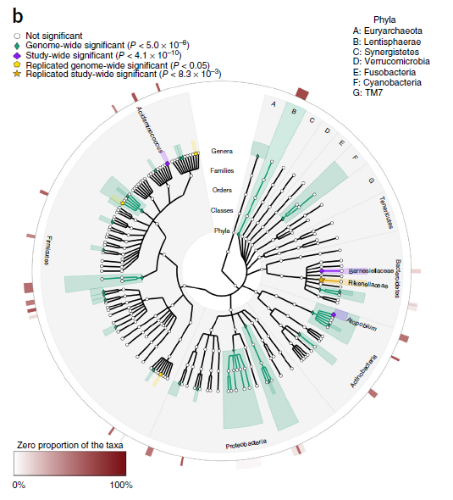
GWAS of bacterial taxa

Slide 17
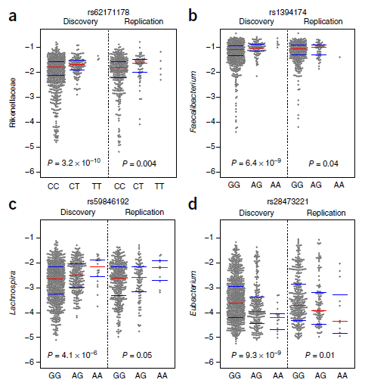
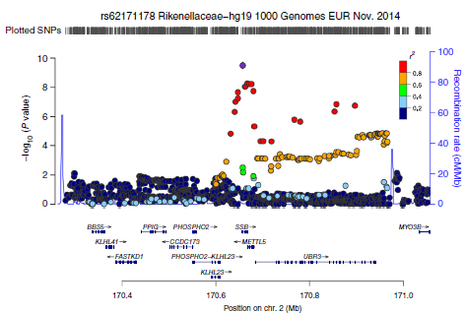
Replicated GWAS-significant associations

Slide 18
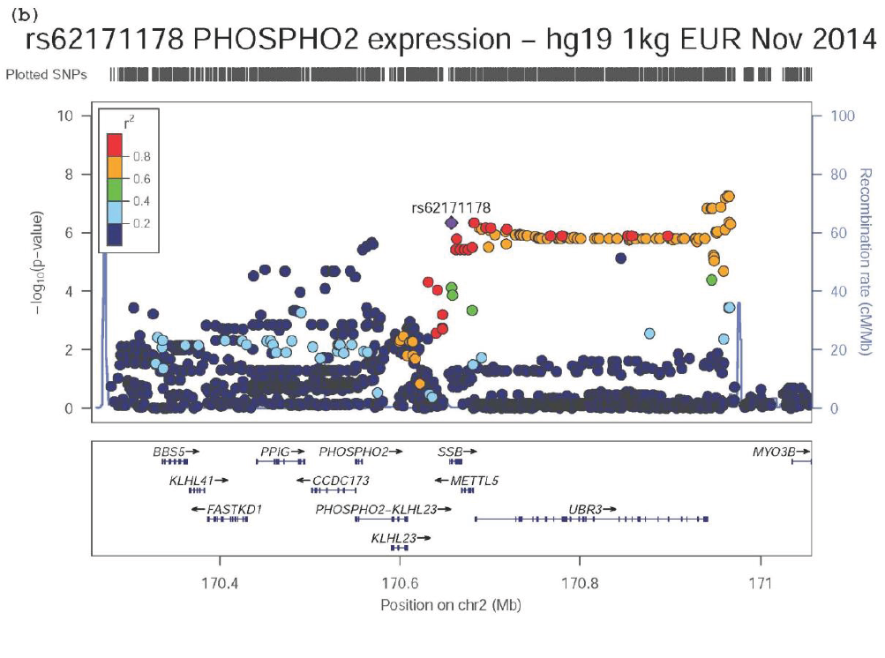
rs62171178 is eQTL for PHOSPHO2 expression in the stomach

Slide 19
Introduction Methods / Results Discussion

Slide 20
Discussion of Main Findings
Using a discovery cohort of 1098 individuals:
Among 270 related individuals, 32% of microbiota are heritable
“Core microbiome” that coexists with a highly variable bacterial taxa in the human gut microbiome
3 dominant bacteria phyla: Firmicutes, Bacteroidetes, Actinobacteria
Notes:
Much of what they found confirms current knowledge about the gut microbiome
##########
Among 270 related individuals from 123 families, 94 of 249 total bacteria taxa (32% of microbiota)
Firmicutes (64%), Bacteroidetes (27%), Actinobacteria (5%)
Replication cohort had 463 individuals

Slide 21
Summary of GWAS
58 SNPs were associated with 33 bacterial taxa
6 associations remained significant after correction for multiple testing
1 association replicated (rs62171178)
Carriers of minor allele (T) at rs62171178 located within SSB (Sjögren syndrome antigen B) had an increased abundance of Rikenellaceae
rs62171178 is also in high LD with METTL5 (methyltransferase like 5) &
UBR3 (ubiquitin-protein ligase 3)
Notes:
rs62171178 located on chr 2q31.1
SSB – Sjögren syndrome antigen B; involved in RNA metabolism
METTL5 – methyltransferase like 5; involved in RNA metabolism and protein and rRNA methylation
UBR3 –ubiquitin-protein ligase E3 component; ubiquitin-protein ligase E3; polymorphisms in the ubiquitin-proteasome pathway might trigger a modification of immune regulation, which potentially may result in certain bacterial taxa differing in their presence or abundance across individuals
##########
33 SNPs across 18 heritable bacterial taxa
25 SNPs across 15 non-heritable bacterial taxa
Total of 58 SNPs across 33 bacterial taxa
Discovery cohort enriched for subjects from Canada
Replication cohort enriched for subjects from Israel and US

Slide 22
Conclusions
Host genetic polymorphisms influence the composition of the microbiota
Polymorphism in rs62171178 is associated with relative abundance in gut Rikenellaceae
rs62171178 maps to 3 genes
Significance of these gene associations unknown
rs62171178 is also associated with PHOSPHO2 expression in the stomach
Relationship with Rikenellaceae abundance needs to be determined
Notes:
rs62171178 located on chr 2q31.1
PHOSPHO2 – pyridoxal phosphate phosphatase

Slide 23
Strengths
Results were replicated in a replication cohort
Replication cohort had a younger median age
Age can influence the microbiome yet results still replicated
Balance of males & females
Notes:
Age is known to contribute variability to the microbiome
Median age in discovery 20.0 years vs replication 16.5 years

Slide 24
Limitations: Cohort
Discovery & replication cohorts were both of all White European ancestries
“Healthy cohorts” but 1st-degree relatives of subjects with Crohn’s disease
Found evidence of heritability of microbial dysbiosis (MD) index
MD index not associated with SNPs on GWAS (perhaps due to small sample size)
Not generalizable across populations
Notes:
MD index is the “microbial dysbiosis” index which is a measure of the altered microbe composition suggested to be specific to the diagnosis of Crohn’s disease

Slide 25
Limitations: Methods & Results
Used 16s ribosomal DNA sequencing vs metagenomic sequencing
Derived heritability estimates from related individuals (n = 270) vs. non-related (n = 951)
Relatively small sample sizes of cohorts for 166 GWASes
Finding of SNP association and eQTL needs further validation
Notes:
16s DNA sequencing does not allow the level the granularity as metagenomic sequencing
Deriving heritability estimates from related individuals and mostly sibilings in this case inflated the genetic component because the environmental component of heritability is reduced in the case of sibilings due to shared environment. Furthermore, they could have derived heritability estimates from a larger sample size of non-related individuals, and replicated it in their replication cohort.
##########
Sample size: 1098 in discovery and 463 in replication
(270 related individuals from 123 families)

Slide 26
Implications & Future Directions
Study confirms previous findings that host genetics influences intestinal microbiota
Further studies needed to determine the association between rs62171178 and the 3 genes it maps to: SSB, METTL5, UBR3
Future studies needed to determine the relationship between gut PHOSPHO2 expression and Rikenellaceae abundance
Notes:
Complements previous findings that host genetics influences intestinal microbiota

