Slide 1
Quantitative Methods: Descriptive Statistics
Curtis Huttenhower (chuttenh@hsph.harvard.edu)
Jason Lloyd-Price (jasonlp@broadinstitute.org)
http://huttenhower.sph.harvard.edu/bst281

Slide 2
Topics
Why quantitative methods
Simple descriptive statistics
Comparing data
Basics of probability

Slide 3
A simple experiment
Create a 5000 x 15 matrix of random values
Genes and samples
Find gene most correlated with Age
Does this gene truly predict longevity?
Feature | Sample1 | Sample2 | Sample3 | Sample4
Age | 0.150953 | 0.821741 | 0.158316 | 0.898557
Gene1 | 0.801808 | 0.491848 | 0.608064 | 0.583391
Gene2 | 0.146415 | 0.922903 | 0.547641 | 0.344042
Gene3 | 0.219748 | 0.844069 | 0.39559 | 0.314302
Gene4 | 0.613934 | 0.685797 | 0.512878 | 0.986288
Gene5 | 0.322305 | 0.149985 | 0.106558 | 0.659032
Gene6 | 0.667529 | 0.508563 | 0.57018 | 0.803856
Feature | Sample1 | Sample2 | Sample3 | Sample4
Age | =RAND()
Gene1
Gene2
Gene3
Gene4
Gene5
Gene6
…
…
Pearson correlation = 0.81

Slide 4
Descriptive and inferential statistics
Descriptive statistics summarize information already present in data
Visualizations like boxplots, histograms, etc.
Summary measures like averages, standard deviation, median, etc.
Inferential statistics use a sample of data to make predictions about larger populations or about unobserved/future trends
Any measurements made in the presence of noise or variation
Generalizations from a sample to a population
Confidence intervals, hypothesis tests, etc.
Comparisons made between datasets
Comparisons, correlations, regress, etc.

Slide 5
Categorical, ordinal, and continuous data
Categorical values take one of a discrete set of unordered values
A tissue type: blood/skin/lung/GI/etc.
Ordinal values take one of a discrete set of ordered values
Counts or rank orders
Rarely analyzed differently than continuous values
Continuous values take one value from an ordered numerical scale
Times, frequencies, ratios, percentages, abundances, etc.

Slide 6
Simple descriptive statistics
A statistic is any single value that summarizes an entire dataset
Parametric summary statistics
Typically used to describe “well-behaved” data that is approximately normally-distributed
I.e. continuous, symmetric, thin-tailed
Closeness needed for “approximately” depends on application
Average = Mean = μ = Σx/n

Slide 7
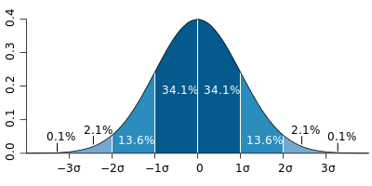
Simple descriptive statistics
Standard deviation = √Variance = σ = √(Σx²/n-μ²) (population)
Beware the difference between population and sample standard deviation
√(Σ(x-μ)²/(n-1)) or √(n/(n-1))(Σx²/n-μ²) (sample)
Data expressed as z-scores are relative to a dataset's mean and σ
z = (x-μ)/σ
99%
95%
2/3

Slide 8
Nonparametric statistics
Can be used to describe any data regardless of distribution
Median = m = x[|x|/2] = midpoint of dataset
Percentile = p(y) = x[y|x|] = data point y% of the way "through" dataset
Quartiles = 25th, 50th, and 75th percentiles = {p(0.25), p(0.5), p(0.75)}
Also quintiles, deciles, etc.
Inter-quartile range = IQR = p(0.75) - p(0.25)
Difference upper and lower quartiles

Slide 9
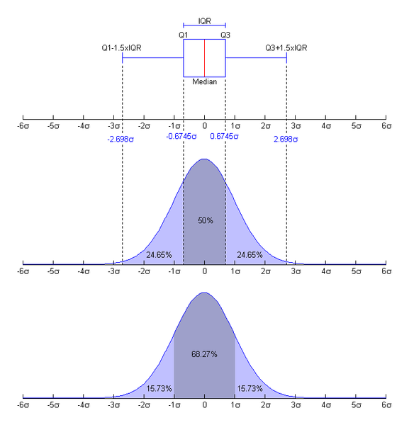
Nonparametric statistics
Fences = bounds on "usual" range of data
Upper fence lies above the 75th percentile p(0.75), lower fence below 25th percentile p(0.25)
Inner fences are 1.5 inter-quartile ranges above/below, outer fences 3 IQRs
Provide a good way to detect outliers
<LIF or >UIF is unusual, <LOF or >UOF is extremely unlikely

Slide 10
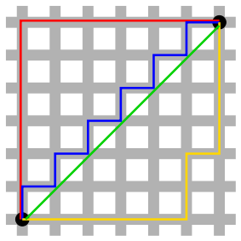
Comparing data: Distances
Larger means less similar
Euclidean = e = √Σ(x-y)²
Also the L2 norm
Straight line distance; amplifies outliers
In the range [0, ∞]
Manhattan = m = Σ|x-y|
Also the L1 norm
Grid or absolute distance
In the range [0, ∞]

Slide 11
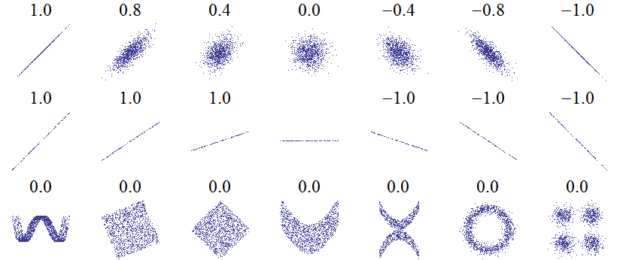
Comparing data: Correlations
Larger means more similar
Pearson = ρ = Σ((x-μ_{x})(y-μ_{y}))/(√Σ(x-μ_{x})²√Σ(y-μ_{y})²)
Location and scale invariant, but assumes normal distribution
In the range [-1, 1]
Cosine = c = Σ(xy)/(√Σx²√Σy²)
Also uncentered Pearson
Scale but not location invariant
In the range [-1, 1]

Slide 12
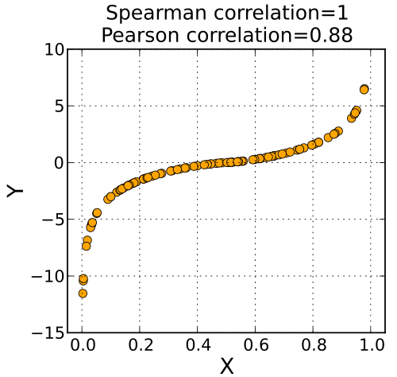
Comparing data: Correlations
Spearman = r = Pearson correlation of ranks (ties ranked identically)
Assesses monotonicity
Nonparametric measure of similarity of trend
Location and scale invariant
In the range [-1, 1]

Slide 13
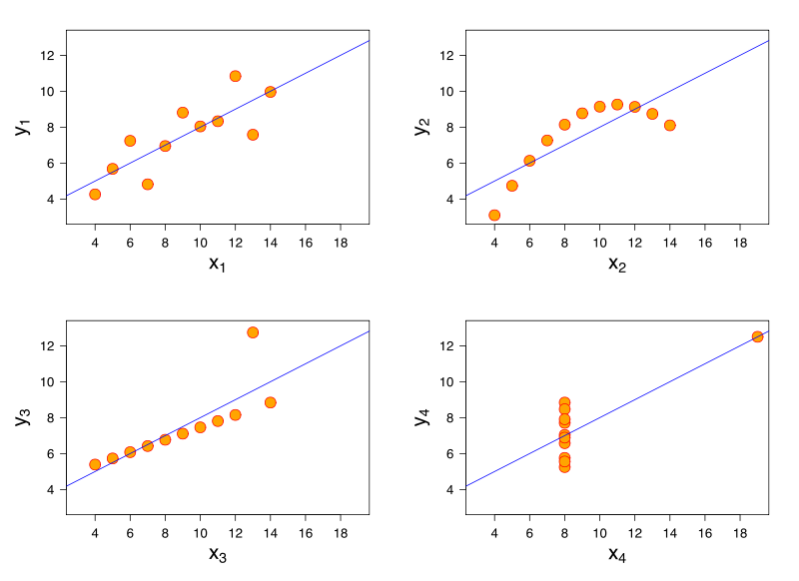
Beware of summary statistics
Anscombe’s quartet
Manually constructed in 1973 by Francis Anscombe at Yale
Four pairs of datasets with
Equal means
9 for x and 7.5 for y
Equal standard deviations
11 for x and 4.1 for y
Identical Pearson correlations (0.816)
Yet completely different relationships
Understand and visualize your data before summarizing them

Slide 14
Probability: Basic definitions
Experiment: anything that produces a non-deterministic result
Coin flip, die roll, item count, concentration measurement, distance measurement...
Sample space: the set of all possible outcomes for a particular experiment, finite or infinite, discrete or continuous
{H, T}, {1, 2, 3, 4, 5, 6}, {0, 1, 2, 3, ...}, {0, 0.1, 0.001, 0.02, 3.14159, ...}
Event: any subset of a sample space
{}, {H}, {1, 3, 5}, {0, 1, 2}, [0, 3)
Probability: for an event E, the limit of n(E)/n as n grows large

Slide 15
Probability: Kolmogorov axioms
One definition of "probability" that matches reality
For any event E, P(E)≥0
"Probability" is a non-negative real number
For any sample space S, P(S)=1
The "probability" of all outcomes for an experiment must total 1
For disjoint events E∩F={}, P(E∪F)=P(E)+P(F)
For two mutually exclusive events that share no outcomes...
The "probability" of either happening equals the summed "probability" of each happening independently

Slide 16
Probability: Kolmogorov axioms
Three Kolmogorov axioms
For any event E, P(E) ≥ 0
For any sample space S, P(S)=1
For disjoint events E∩F = {}, P(E∪F) = P(E) + P(F)
P({}) = 0
Every experiment must have some outcome
P(E) ≤ P(F) if E ⊆ F
The probability of more events happening must be at least as great as fewer events
0 ≤ P(E) ≤ 1 for any event E

Slide 17
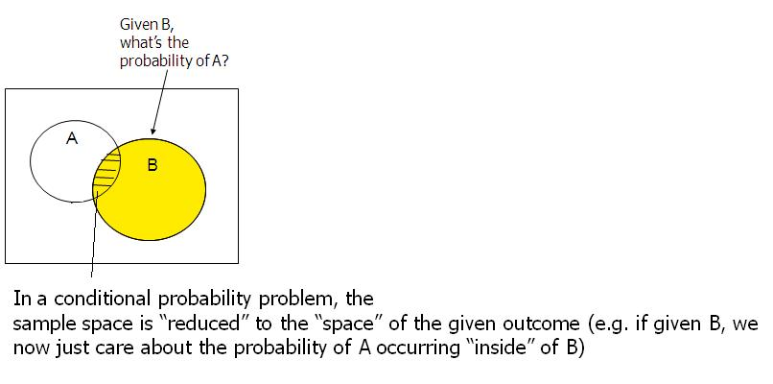
Conditional Probability
The probability of an event given that another event has already occurred
The probability of event F given that the sample space S has been reduced to E⊆S
Denoted P(F|E) and defined as P(E∩F)/P(E)

Slide 18
Bayes’ theorem
P(F|E) = P(E|F)P(F)/P(E)
True since P(F|E) = P(E∩F)/P(E) and P(E∩F) = P(F∩E) = P(E|F)P(F)
Provides a means of calculating a conditional probability based on the inverse of its condition
Typically described in terms of prior, posterior, and support
P(F) is the prior probability of F occurring at all in the first place, "before" anything else
P(F|E) is the posterior probability of F occurring "after" E has occurred
P(E|F)/P(E) is the support E provides for F

Slide 19
Bayes’ theorem: Poker
Pick a card, any card!
Probability of drawing a jack given that you've drawn a face card?
Probability of drawing a face card given that you've drawn a jack?
Pick three cards: probability of drawing (exactly) a pair of aces given that you've drawn (exactly) a pair?

Slide 20
Summary
Descriptive statistics summarize datasets
Parametric statistics (mean, standard deviation, z-scores)
Assumes the data is “well-behaved”
Nonparametric statistics (median, percentiles, interquartile range)
Uses rank information – no distribution assumption
Comparing datasets
Distances (Euclidean, Manhattan)
Correlations (Pearson, Cosine, Spearman)
Visualize your data!
Histograms, scatterplots, boxplots, etc.
Introduction to probability
Thinking in terms of sets of outcomes; Kolmogorov axioms
Conditional probability and Bayes’ theorem

