Slide 1
Inference and Hypothesis Testing
Curtis Huttenhower (chuttenh@hsph.harvard.edu)
Jason Lloyd-Price (jasonlp@broadinstitute.org)
http://huttenhower.sph.harvard.edu/bst281

Slide 2
Topics
Basic idea
Test statistics and p-values
Performance evaluation
Repeated tests and high-dimensional data

Slide 3
Example
Eric has dark hair
On the phone: The lecturer for BST 281 has blond hair
⇒ The lecturer is not Eric

Slide 4
Example
Adult chickens weigh 6.2 ± 0.8 lb
On the phone: This weighs 10 lb
⇒ This is probably not a chicken
Test statistic: weight
Null distribution
Null hypothesis: this is a chicken
Observation
p-value

Slide 5
Null distributions
The null hypothesis is the statement tested for possible rejection
Usually that the results are due to chance
I.e. there is no effect/bias/relationship/etc.
E.g. There is no bias towards Heads/Tails, “this is a chicken”
Denoted H₀
Alternate hypothesis is everything else
The null distribution is the distribution of the test statistic if the null hypothesis is true
E.g. binomial distribution, known distribution of chicken weights
For test statistic T: P(T = t | H₀)

Slide 6
p-values
The p-value is the probability of observing an equal or more extreme value of the test statistic than observed, assuming the null hypothesis
For test statistic T, this is P(T ≥ t | H₀)
Quantifies “surprise”
Lower -> observation is more unlikely -> more surprised
When the null hypothesis is true, p-values have a uniform distribution
p-values < α are considered “significant”
I.e. reject the null hypothesis
α is the fraction of tests that will be significant when the null hypothesis is true
Usually 0.05 or 0.01

Slide 7
z-test
If the test statistic is normally-distributed under the null
z = (x - µ) / σ
Chicken example:
Adult chickens weigh 6.2 ± 0.8 lb
Observed mass is 10 lb
z = (10 – 6.2) / 0.8 = 4.75
P(|z| ≥ 4.75 | This is a chicken) = 2.03 × 10⁻⁶

Slide 8
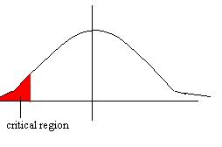
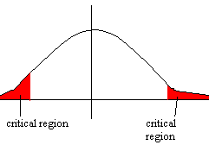
One-tail and two-tail tests
What observations are considered “extreme”?
One-sided/one-tail tests test whether the test statistic is higher or lower than chance
H₀ : μ≥μ₀, H_{A} : μ<μ₀
Two-sided/two-tail tests test whether the test statistic is equal to
H₀ : μ=μ₀, H_{A} : μ≠μ₀

Slide 9
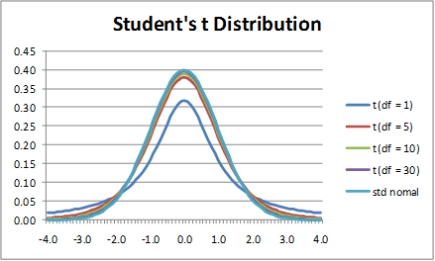
Simple parametric tests
When the population mean + standard deviation are unknown
Data is still assumed normal
Null distribution is “Student’s t” distribution
t-test
Testing Pearson correlations
Usually H₀ : ρ=0, H_{A} : ρ≠0
tanh⁻¹(ρ) ∼ Normal
-> z-test
Often make very strong assumptions about the data

Slide 10
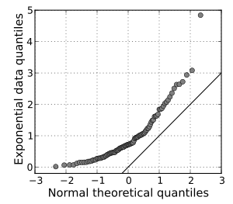
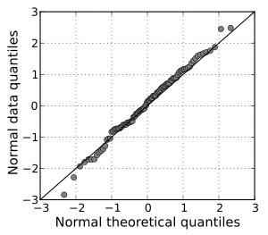
Nonparametric tests
Test statistic is insensitive to the distribution (e.g. by rank transform)
“Non-parametric t-test”: Mann-Whitney U test
Cost is decreased sensitivity
Permutation test
p-value is calculated by repeated randomizations of the data
Cost is a significant increase in computation time
Can also be used to test how well your test statistic fits a specific assumption
Quantile-Quantile (Q-Q) plot

Slide 11
Performance evaluation
How do you assess the accuracy of a hypothesis test?
Compare with data for which the answer is known: Gold standard
Negatives: null hypothesis should not be rejected (drawn from H₀)
Positives: null hypothesis expected to be rejected (drawn from H_{A})
Perform the test on the gold standard data. Possible outcomes:
 | H₀ True | H₀ False
H₀ Not Rejected | True Negative | False Negative (Type II)
H₀ Rejected | False Positive (Type I) | True Positive

Slide 12
Performance evaluation
Probability of incorrect call
False positive rate: FPR = P(reject H₀ | H₀)
False negative rate: FNR = P(!reject H₀ | H_{A})
Power: probability of detecting a true effect
P(reject H₀ | H_{A})
Also called recall, true positive rate (TPR), sensitivity
Precision: probability a detected effect is true
P(H_{A} | reject H₀)
Specificity: probability an undetected effect is false
P(!reject H₀ | H₀)
Also true negative rate (TNR)
 | H₀ | H_{A}
H₀ Not Rejected | TN | FN
H₀ Rejected | FP | TP

Slide 13
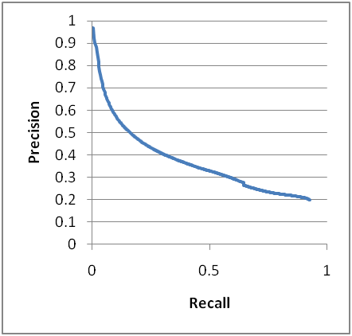
Precision/recall plots (PR)
Most tests have a parameter that adjusts their sensitivity
E.g. α
Precision vs recall
Upper-right is good

Slide 14
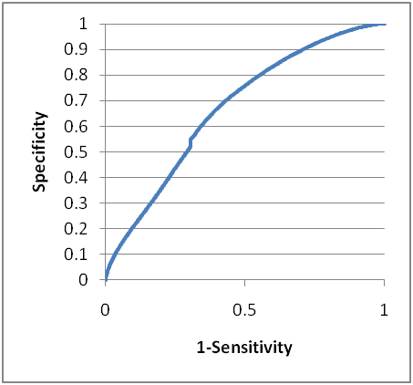
Receiver Operating Characteristic (ROC)
Sensitivity/specificity plots
TPR vs FPR
Upper left is good
Well-defined behavior when guessing
Area Under the Curve (AUC)
Perfect = 1
Random = 0.5
Perfectly wrong = 0

Slide 15
Testing many hypotheses
Recall that under the null hypothesis, p-values follow a uniform distribution in [0, 1]
Probability of rejecting of α, even if there’s no biological effect
Consider 20,000 genes measured at once by microarray/RNA-seq
Test each gene for differences
How many false positive are expected?
What can we do?
Can change the test statistic to “maximum difference over the dataset”
Null hypothesis: “no effect for any of the features”
Can instead “adjust” the p-value to account for multiple hypothesis testing

Slide 16
Multiple hypothesis correction
Bonferroni correction
Multiply p-values by the number of tests
Very strict/conservative
Control False Discovery Rate (FDR)
% of tests expected to “fail” by chance
FDR q-value = (# tests) * (p-value) / (p-value rank)

Slide 17
A simple experiment
Create a 5000 x 15 matrix of random values
Genes and samples
Find gene most correlated with Age
Does this gene truly predict longevity?
Feature | Sample1 | Sample2 | Sample3 | Sample4
Age | 0.150953 | 0.821741 | 0.158316 | 0.898557
Gene1 | 0.801808 | 0.491848 | 0.608064 | 0.583391
Gene2 | 0.146415 | 0.922903 | 0.547641 | 0.344042
Gene3 | 0.219748 | 0.844069 | 0.39559 | 0.314302
Gene4 | 0.613934 | 0.685797 | 0.512878 | 0.986288
Gene5 | 0.322305 | 0.149985 | 0.106558 | 0.659032
Gene6 | 0.667529 | 0.508563 | 0.57018 | 0.803856
Feature | Sample1 | Sample2 | Sample3 | Sample4
Age | =RAND()
Gene1
Gene2
Gene3
Gene4
Gene5
Gene6
…
…
Pearson correlation = 0.81
p-value = 0.000252
q-value = 1

Slide 18
Statistical significance vs biological significance
Statistically significant ⇏ biologically significant
Something can be statistically significant, but biologically irrelevant
E.g. when sample size is very large or uncertainty is very low
Not statistically significant ⇏ not biologically significant
Especially when sample size is small
“There is no difference at the effect size we’re powered to test”

Slide 19
Accepting the null
Consider:
Adult chickens weigh 6.2 ± 0.8 lb
On the phone: This weighs 6.1 lb
⇒ This is a chicken
Equivalent to a high p-value
“Guilty” vs “not guilty”

Slide 20
Summary
Test statistics, null hypothesis and distribution, and p-values
Performance evaluation
False positive/negative rates, power, precision and specificity
Precision/recall plots
Receiver-Operator Characteristic (ROC) and the Area Under the Curve (AUC)
Repeated tests and high-dimensional data
Bonferroni and FDR corrections

