Slide 1
Gene expression analyses
Curtis Huttenhower (chuttenh@hsph.harvard.edu)
Eric Franzosa (franzosa@hsph.harvard.edu)
http://huttenhower.sph.harvard.edu/bst281
Slide elements courtesy of:
Amy Caudy
Gavin Sherlock
Matt Hibbs
Florian Markowetz
Olga Troyanskaya

Slide 2
What to do with your gene expression data?
Supervised analyses
Differential expression (class comparison)
Biomarkery discovery (class prediction)
Unsupervised analyses
Clustering (class discovery)
Ordination
Coexpression (network construction)

Slide 3
Supervised analyses
Learning from examples: classification.
Given data from healthy and sick people, diagnose the next person walking in.
Given a list of genes that carry out some biological process, find more.
Given a subnetwork of interacting genes, add others to the same network.
Generalize known structure to new data.
Given training data with known labels, predict new labels.
Inference problem!

Slide 4
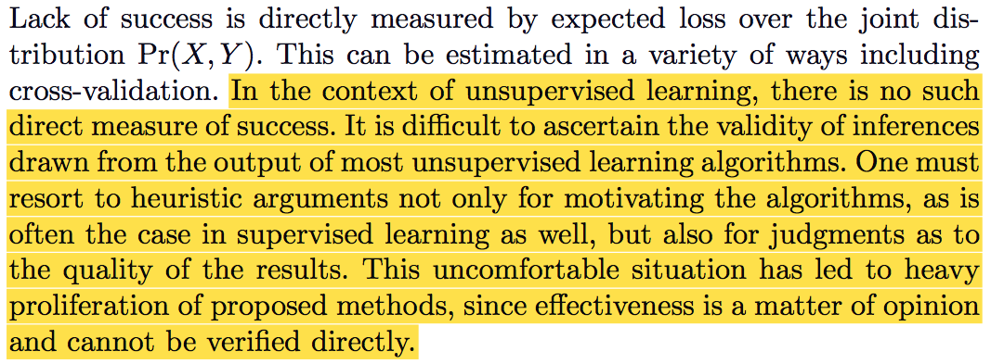
Unsupervised analyses
Pattern finding: clustering.
Are there groups of genes that behave similarly under many conditions?
Are there groups of patients more like each other within a heterogeneous disease?
What are the major patterns of variation in genes / pathways, across many conditions?
Exploratory analysis to identify structures of potential interest.
No right answer – analyzer beware!
Elements of Statistical Learning: “In supervised learning, the goal is to predict the value of an outcome measure based on a number of input measures; in unsupervised learning, there is no outcome measure, and the goal is to describe the associations and patterns among a set of input measures.”

Slide 5
An unsupervised example: clustering

Slide 6
A supervised example: classification
Class 1: cats
Class 2: dogs

Slide 7
A biological example: expression matrix analysis
Unsupervised
Conditions →
Given n samples, what groups exist within them?
Clustering
← Genes
Cases
Controls
New, unlabeled samples
Given n samples in k (in this case two) labeled groups and m unlabeled, what labels should they have?
Supervised
Classification

Slide 8
Supervised analyses

Slide 9
Typical supervised transcriptomic analyses
I have a bunch of gene expression profiles (columns in a matrix)…
They all come from two (or more) different conditions of interest. Which genes are differentially expressed among these conditions?
I know some of the conditions are particularly interesting. Which other conditions (in this matrix or others) are have similar expression profiles?
I have a bunch of genes across expression conditions (rows in a matrix)…
I know which ones are involved in a pathway of interest. Which other genes are predicted to have the same function?
I know some of the regulatory targets of my favorite transcription factor. Which other genes are predicted to have the same regulatory patterns?

Slide 10
Differential expression
Identifying genes differentially transcribed among labeled sample sets.
Always a fancy t-test!
Or ANOVA, for >2 classes.
How fancy depends on your exact null model, covariates, repeated measures.
Wilcoxon = rank-based t-test = simplest.
SAM = Significance Analysis for Microarrays = moderated (permutation-based) t-test = still pretty simple.
limma = Linear Models for Microarrays = multivariate models.
With empirical Bayes significance assessment.
Allows multiple covariates, random effects (somewhat).
These all work for microarrays or RNA-seq, but…

Slide 11
Differential expression for RNA-seq
DESeq = Differential Exp. for Seq. = parametric negative binomial.
Count model specifically for RNA-seq experiments.
Allows multiple covariates, but not random effects.
EdgeR = empirical Bayes negative binomial.
Allows multiple covariates, but not random effects.
Cuffdiff = differential exp. in Cufflinks = same idea, isoform aware.
Ditto.
There are not a lot of differences left between these methods.
Differed more in the exact assumptions made by their earlier models.
Have since converged.

Slide 12
Differential expression outputs
Gene | p-value (nominal) | q-value (FDR) | Effect size
G1 | 0.001 | 0.01 | 1
G2 | 0.01 | 0.05 | 2
G3 | 0.05 | 0.1 | 0.5
G4 | 0.1 | 0.3 | 0.1
…
Brian Haas

Slide 13
Differential expression gotchas
If you cluster only genes that are differential, you will find clusters!
If you ordinate only genes that are differential, you will find clusters!

Slide 14
Interpreting differential gene lists
Gene set overlap:
Given a fixed set of genes that “are” differential…
…and a reference set of characterized gene sets / pathways to test…
…which overlaps between “hits” and “pathways” are significant?
Hypergeometric or Fisher’s Exact test:
Given:
N = total features (genes) assayed.
M = total genes in target pathway.
n = genes in your fixed set.
x = overlap between fixed set and pathway.
Bethany Crane

Slide 15
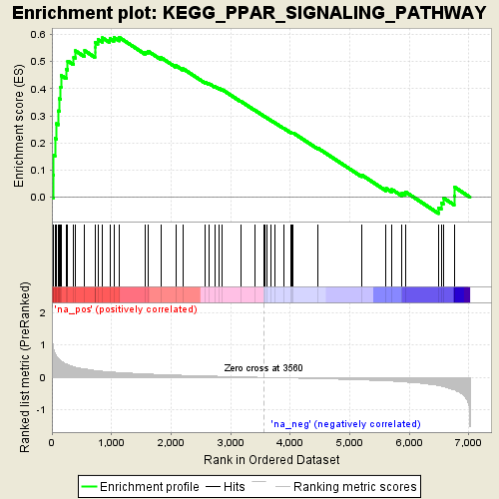
Interpreting differential gene lists
Gene set enrichment:
Given a ranked list of “how” differential each gene is (p-value / t-score / etc.)…
…and a reference set of characterized gene sets / pathways to test…
…which “pathways’” genes are “surprisingly” high in the ranking?
Kolmogorov-Smirnov test (modified) for uniform distribution.

Slide 16
Interpreting differential gene lists
Gene set search:
Given a fixed set of genes that “are” differential…
…and a reference network, typically weighted…
…which subnetwork is “near” the target genes?
Network search problem:
Given some genes to search for…
…find them and their “most interesting” neighborhood within one or more pre-existing networks.

Slide 17
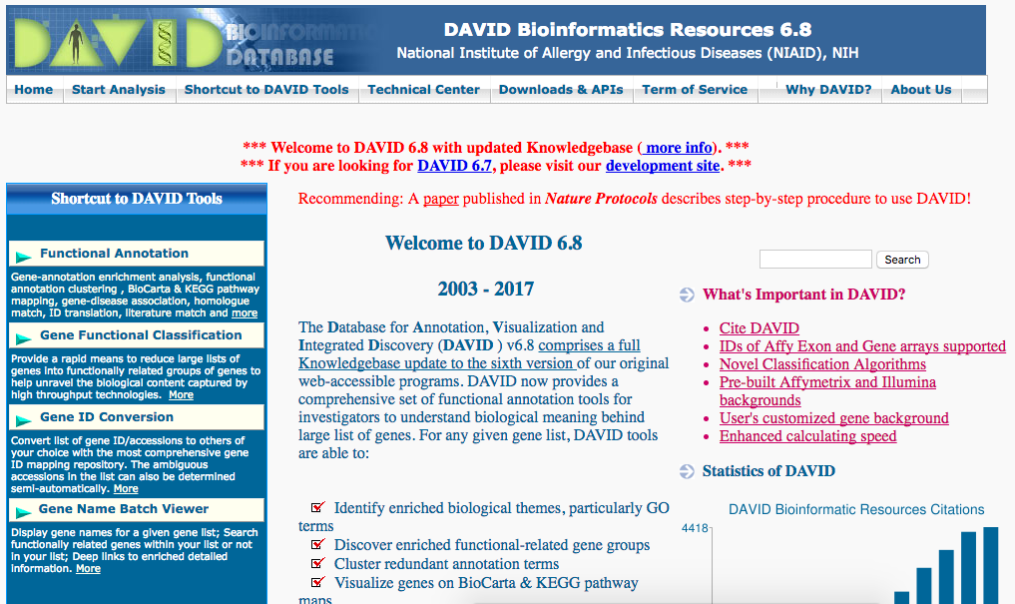
Interpreting differential gene lists
Gene set overlap:
GOrilla, DAVID, AmiGO, Ontologizer…
Gene set enrichment:
GSEA, GSAT, GSA…
Gene network search:
GeneMANIA, IMP, STRING, iHOP…

Slide 18
Supervised classification terminology
Given a labeled training set…
Of either samples (columns = experiments) or features (rows = genes / transcripts)…
Build a classifier or machine learner or model…
That generalizes well when predicting…
Labels for a new, not previously observed test set…
That may require tuning parameters…
That still have good evaluation performance when generalized to…
A completely held out validation set.

Slide 19
Classifying samples
Expression of gene 2
Expression of gene 1

Slide 20
Classifying samples
Which of these options is ”better”?
A
B
And what does “better” mean for a supervised learner?
C
D

Slide 21
Classifying samples
Not a sharp knife, but a…
FAT PLANE

Slide 22
Supervised classifiers: support vector machines (SVMs)
Data points closest to separating hyperplane
= support vectors
Maximal margin
separating hyperplane

Slide 23
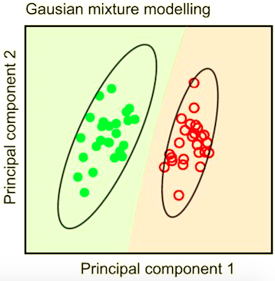
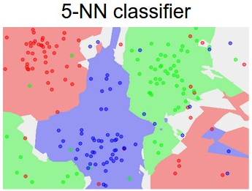
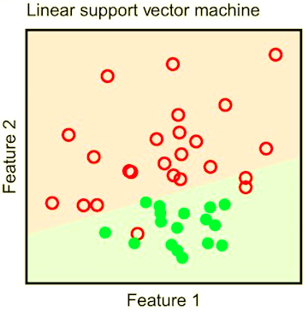
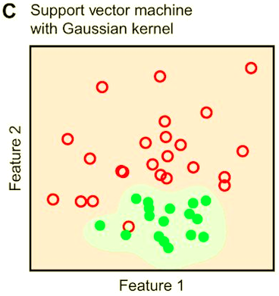
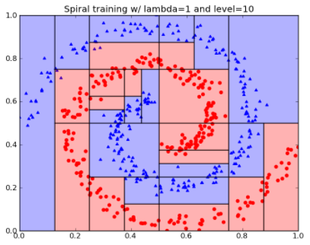
Supervised classifiers
Decision tree

Slide 24
Supervised classifiers: proportional hazards
Cox regression: biomarker discovery specifically for multiple classes with a survival (time-to-event) outcome.
Identify genes differential among classes.
Build a supervised classification model from them.
Evaluate it by separation between survival curves.

Slide 25
Classifier evaluation
Training error: how well do we do on the data we trained the classifier on?
But how well will we do in the future, on new data?
Test error: How well does the classifier generalize?
Same classifier (= line)
New data from same classes
The classifier will usually perform worse than before:
Test error > training error

Slide 26
Classifier evaluation: cross-validation
Training error
Train classifier and test it
Also leave-one-out cross-validation (LOOCV), good for highly heterogeneous data.
Test error
Train %
Test %
K-fold Cross-validation
Step 1.
Train
Train
Test
And the bootstrap, which generates training sets by sampling with replacement.
Here for
K=3
Step 2.
Train
Test
Train
Step 3.
Test
Train
Train

Slide 27
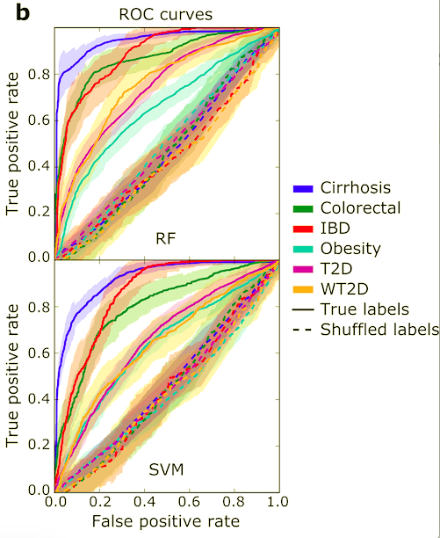
Classifier evaluation
Pasolli et al, PLoS CB 2016
https://en.wikipedia.org/wiki/Evaluation_of_binary_classifiers

Slide 28
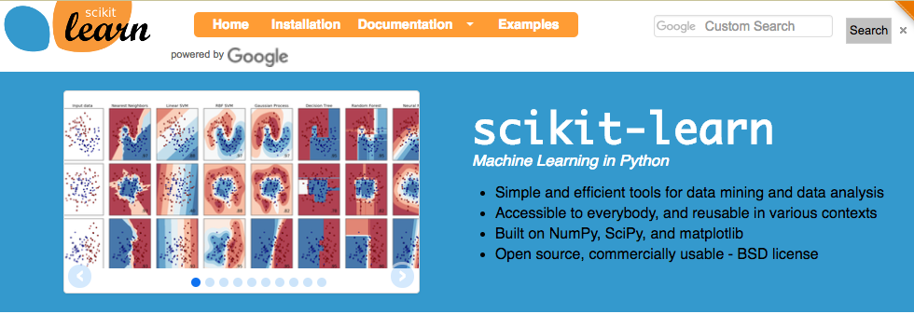
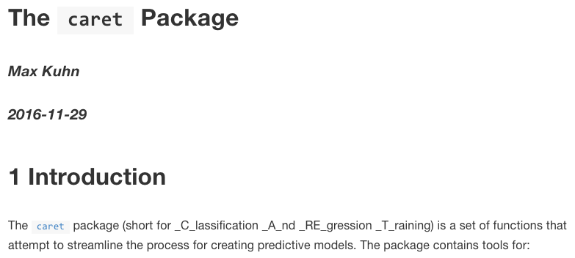
Yet more supervised classifiers
Neural networks (“deep learning”).
Bayesian methods.
Include naïve Bayes models.
Regression (logistic for classification).
Boosting.
Weighted combinations of weak learners.
Random forests.
Resampled combinations of decision trees.
Discriminant analysis (e.g. linear = LDA).
…

Slide 29
Deep thoughts on supervised transcriptomics
Anything you can do to samples, you can do to genes.
And vice versa - classification, clustering, etc.
Be very cognizant of the effects of QC and batches.
Although they’re worse for unsupervised analyses!
High dimensionality makes many analyses highly variable.
If 1,000 genes out of 10,000 are equally good, which one does your learner pick?
A significant p-value (or q-value) is not interesting in isolation.
If your null model is wrong, it’s meaningless.
If your effect size is too small, it’s meaningless.
Your model WILL overfit.
Past results are never (quite) an indication of future performance.

Slide 30
Unsupervised analyses

Slide 31
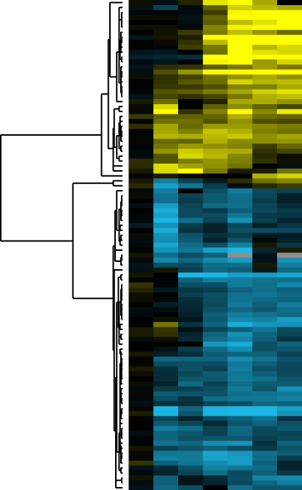
Unsupervised analyses are all about visualization
They show you all the patterns in your data, even ones you didn’t know about before!
They show you all the patterns in your data, even ones that don’t actually exist!
Seeing something in an unsupervised analysis doesn’t make it significant.
Not seeing something in an unsupervised analysis doesn’t make it not significant.
But they do provide great summary visualizations of data (sub) sets.

Slide 32
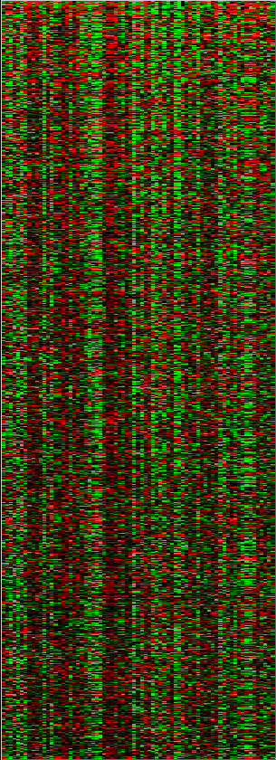
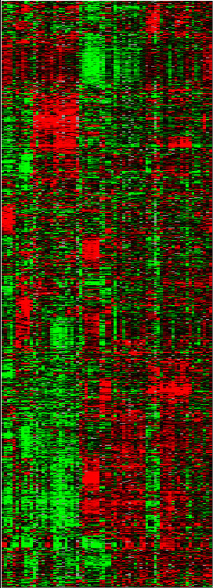
Unsupervised analyses: clustering
Identify subsets of samples (columns) or genes (rows) that are related by some measure.
May or may not be discrete, separable clusters (communities).
May or may not involve full-length vectors (biclustering).
Given a matrix, reorder at least one (possibly both) axes so that similar vectors are grouped together.
This is typically done independently for the two axes, if at all.
Roughly equivalent to first axis of variation from a PCA.

Slide 33
Clustering techniques
Similarity measures:
How do you define (dis)similar?
Euclidean distance (L2).
Pearson correlation.
Spearman correlation.
Manhattan distance (L1).
Kendall’s tau.
Mutual information.
Bray-Curtis.
…
Algorithms:
How do you group similar features?
Hierarchical.
K-means.
K-medoids.
WGCNA.
Self-organizing maps (SOMs).
Mixture models.
…

Slide 34
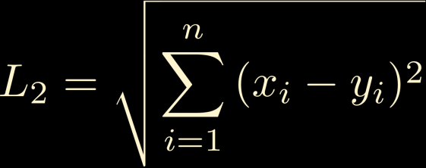
Clustering techniques: similarity measures
Consider the interpretation of your (dis)similarity score.
Pearson Correlation
Euclidean Distance
Spearman Correlation

Slide 35
Hierarchical clustering
Imposes a pair-wise hierarchical structure on all data.
Simple, flexible, good for visualization.
Agglomerative algorithm:
Calculate all pair-wise similarities.
Join the closest pair.
Calculate the new pair’s distance to all other features.
Rinse and repeat until all features joined.

Slide 36
Hierarchical clustering

Slide 37
Hierarchical clustering

Slide 38
Hierarchical clustering

Slide 39
Hierarchical clustering

Slide 40
Hierarchical clustering

Slide 41
Hierarchical clustering

Slide 42
Hierarchical clustering: linkage
Single linkage
Nearest Neighbor
•
•
+
•
•
•
This method produces long chains which form straggly clusters.
•
•
•
+
•
•

Slide 43
Hierarchical clustering: linkage
Complete linkage
Furthest Neighbor
•
•
+
•
•
This method tends to produce very tight clusters of similar patterns
•
•
•
•
+
•
•

Slide 44
Hierarchical clustering: linkage
Average linkage
Average (only shown for two cases)
•
•
+
•
The red and blue ‘+’ signs mark the centroids of the two clusters.
•
•
•
•
•
+
•
•

Slide 45
Hierarchical clustering: linkage
Centroid linkage
•
Centroid
(or medoid)
•
+
•
The red and blue ‘+’ signs mark the centroids of the two clusters.
•
•
•
•
•
+
•
•

Slide 46
Hierarchical clustering: pros and cons
Simple! And fast!
Clusters everything, whether it should be or not.
Can be hard to identify discrete, separable clusters.
Within-cluster order not easily defined.
That is, ((AB)C) vs. (C(AB)).
Highly dependent on (dis)similarity measure.
Although that’s true for any unsupervised analysis.
Only really sensitive to largest patterns in the dataset.
Genes assigned based on variation across all samples.
Thus weighted by the number of columns supporting a pattern.

Slide 47
K-means clustering
Groups features into a pre-defined number of non-overlapping partitions.
K-means algorithm:
Input k, the number of clusters.
Randomly initialize each with a seed (typically a random feature).
Calculate a representative for each cluster.
Using one of the linkage methods described above.
Assign each feature to the most similar cluster.
Rinse and repeat until convergence.
No, or very little, change in cluster assignments between iterations.

Slide 48
K-means clustering

Slide 49
K-means clustering

Slide 50
K-means clustering

Slide 51
K-means clustering: pros and cons
Simple! And fast!
You’ll get k clusters, whether they exist or not.
Must set k ahead of time.
Although there are systematic ways of evaluating this.
Each feature belongs to exactly one cluster.
Highly dependent on (dis)similarity measure.
Although that’s true for any unsupervised analysis.
Only really sensitive to largest patterns in the dataset.
Genes assigned based on variation across all samples.
Thus weighted by the number of columns supporting a pattern.

Slide 52
Other clustering algorithms
Fuzzy clustering / mixture modeling.
Features can belong to multiple clusters, optionally probabilistically.
Partial clustering.
One “unclustered” cluster is special.
Clustering with resampling / bootstrapping / jackknifing / etc.
Assigns some measure of confidence to cluster splits.
Spring models.
Not dissimilar to NMDS/t-SNE/PCA/dimensionality reduction.
Network clustering.
Community discovery / dense subnetworks.
Equivalent to block model of pairwise (dis)similarity matrix.

Slide 53
Cluster quality evaluation
VERY HARD!
Easy to get wildly different answers from different quality measures / clusterings.
Figure of merit.
Remove one sample at a time; what’s its probability of being re-classified to its same, original cluster?
Prediction strength.
In a bootstrap / cross-validation, what is the probability that each pair of samples falls in the same cluster?
Silhouette width.
(average distance between features within a cluster) / (avg. between clusters)
Cophenetic correlation.
How closely do pairwise distances in the clustered tree / groups mimic those in the original high-dimensional space?

Slide 54
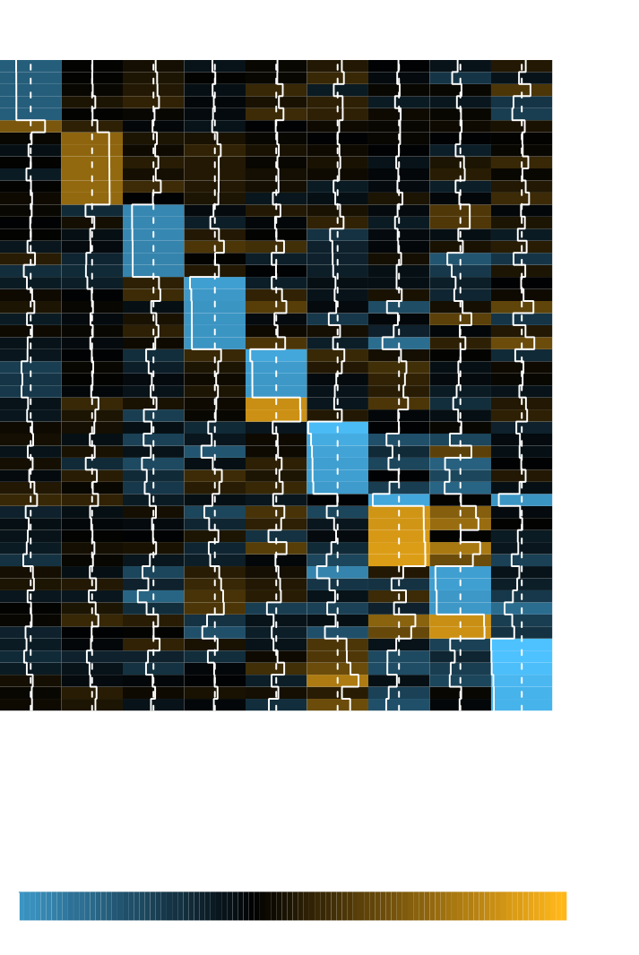
Ordination
Loading vectors, indicating how much each feature contributes to each pattern.
X
U
Σ
V^{t}
=
“Eigen-” or singular values
“Eigen-genes”
Original
Data matrix
“Eigen-conditions”
Scree plot, indicating the percent variance captured by each pattern.

Slide 55
Ordination
PCA

Slide 56
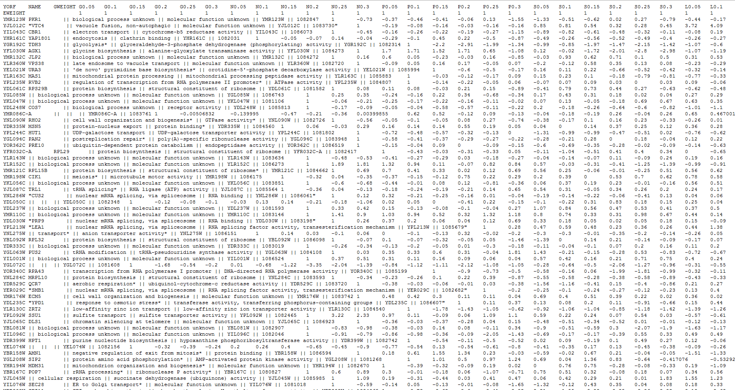
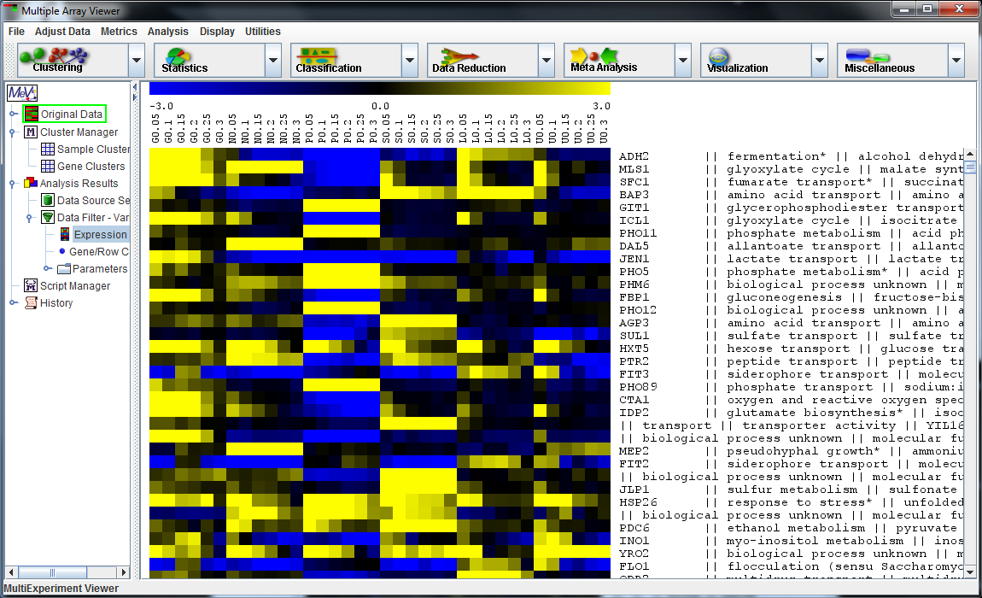
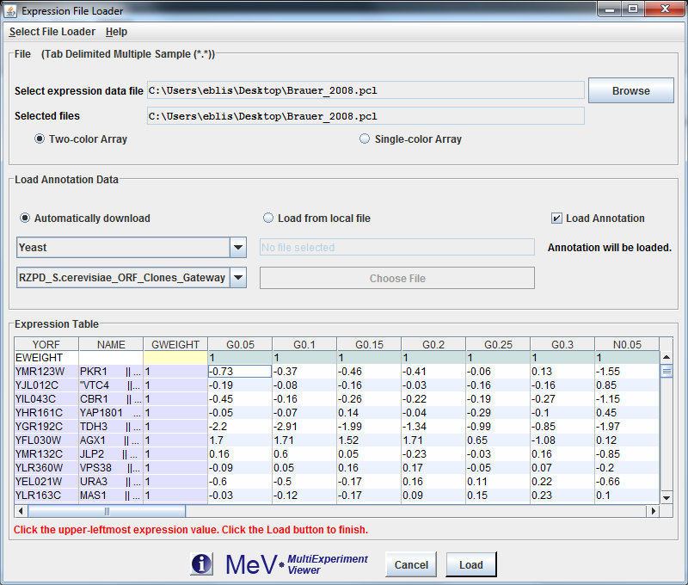
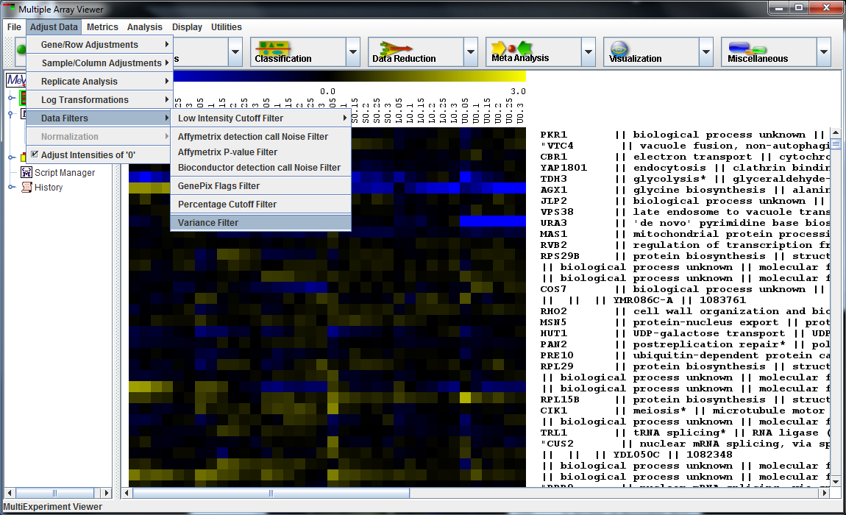
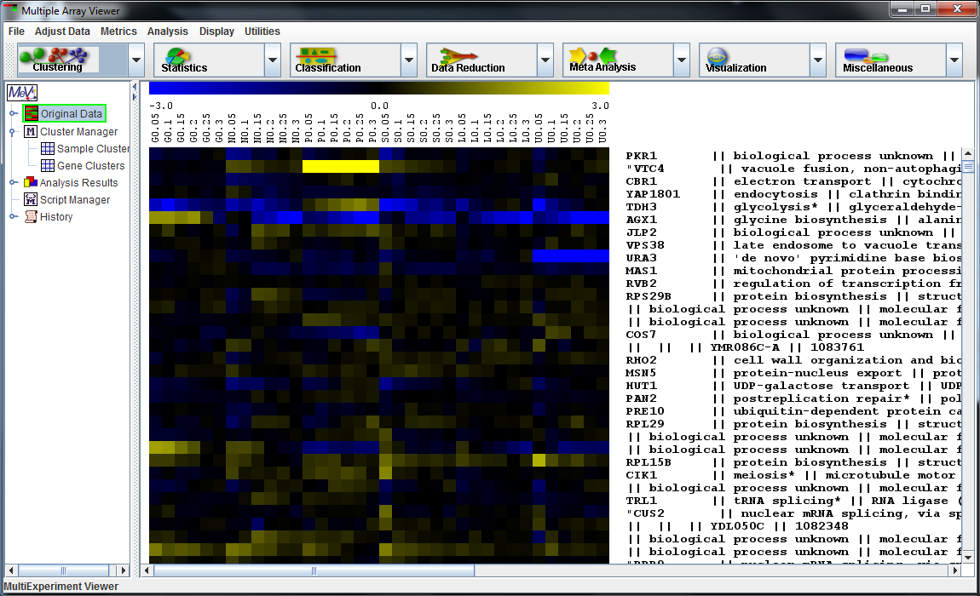
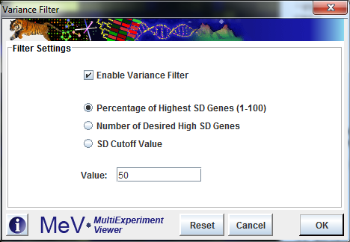
A fun transcriptomics environment: MeV
mev.tm4.org

Slide 57
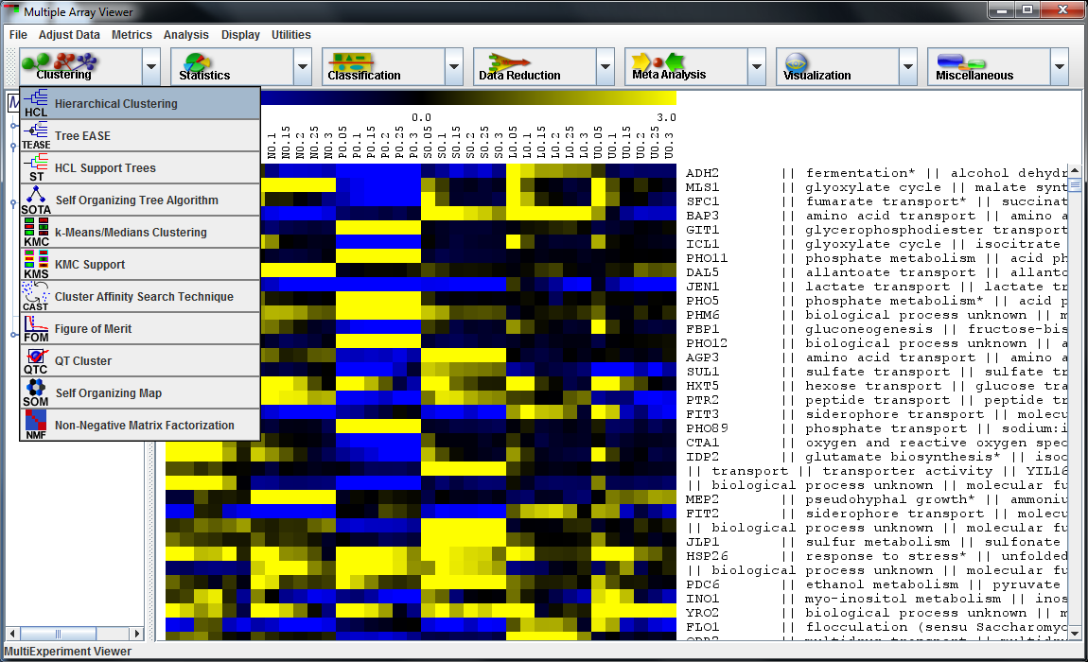
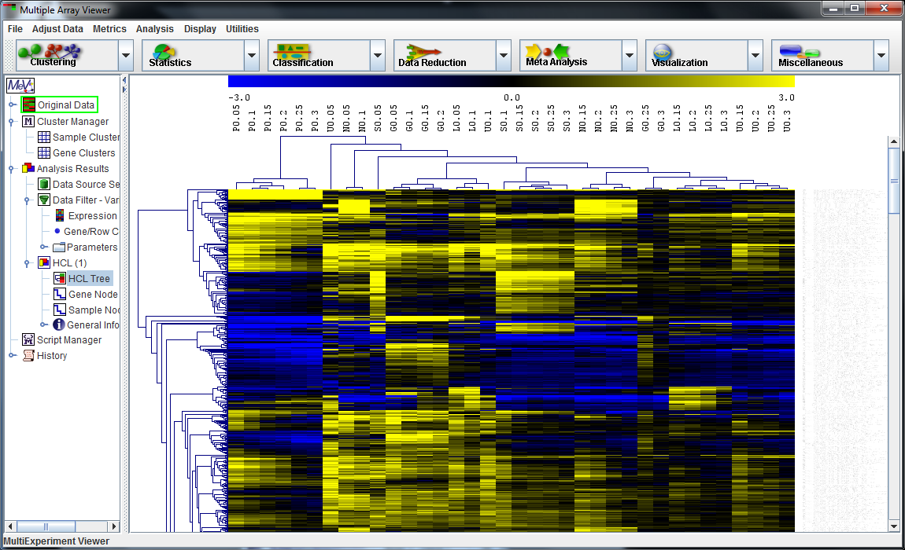
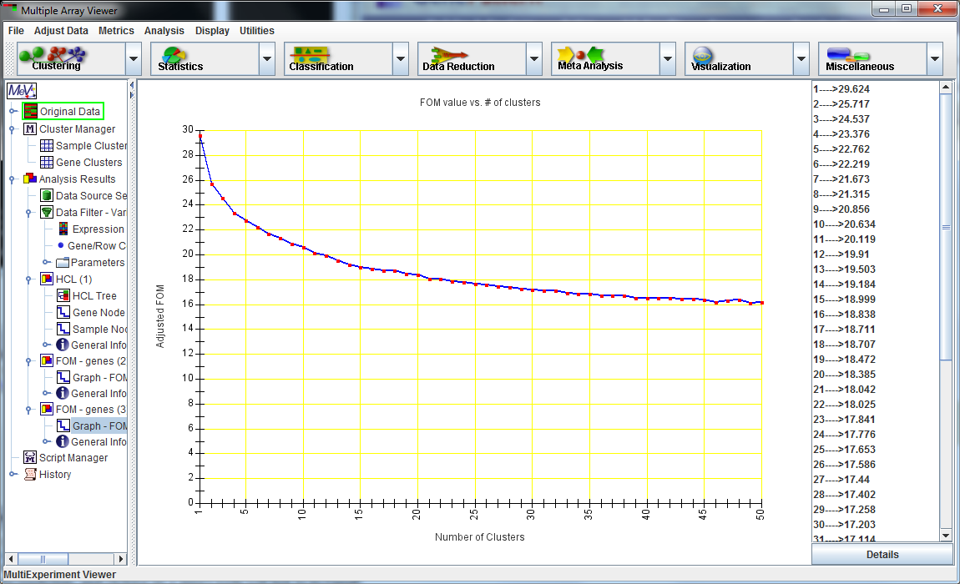
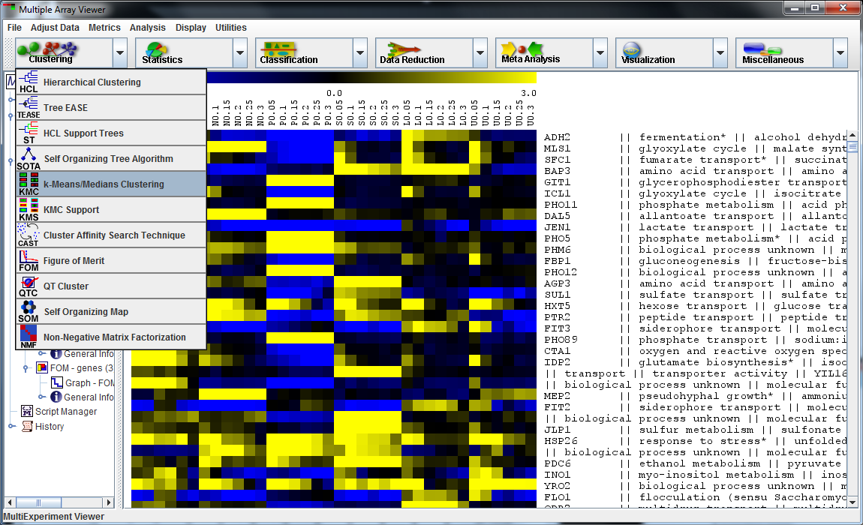
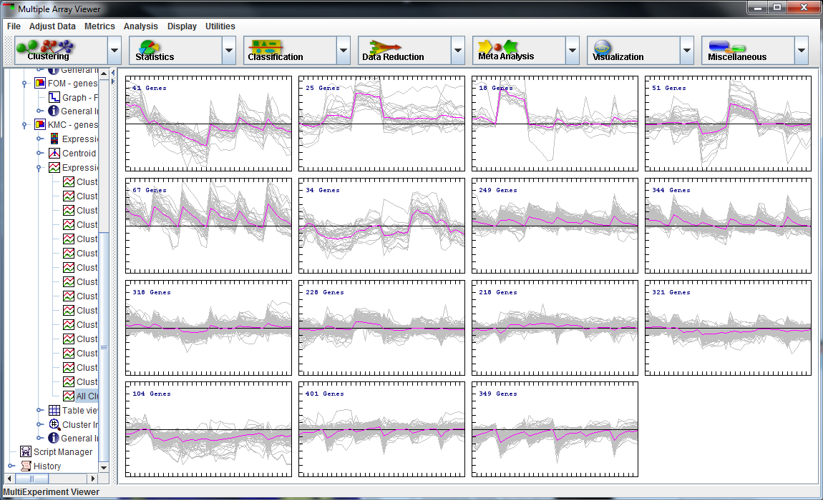
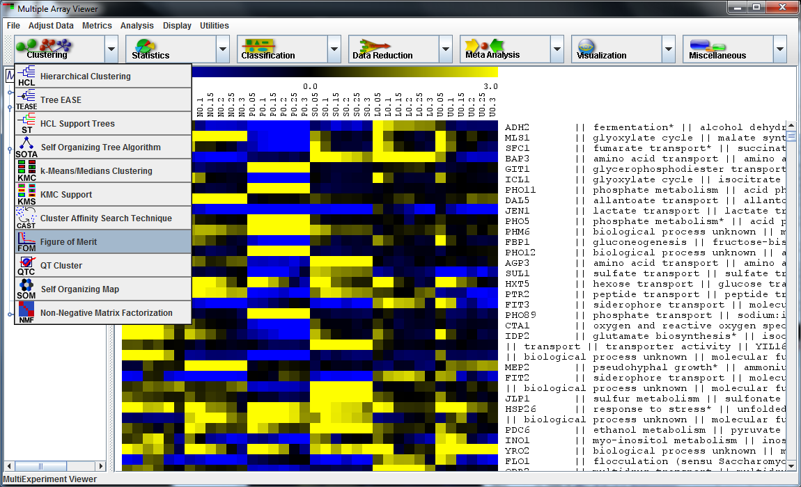
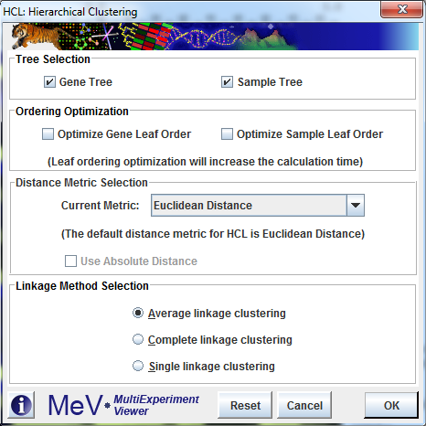
A fun transcriptomics environment: MeV
mev.tm4.org

Slide 58
Summary
Supervised transcriptomics: class comparison and prediction.
Differential expression: fancy t-tests.
Interpreting gene lists by overlap or enrichment with characterized sets / pathways.
Gene function prediction or sample phenotype prediction.
Supervised machine learning: SVMs, kNN, decision trees, etc. etc. etc.
Evaluation by cross-validation etc. – beware overfitting!
Unsupervised transcriptomics: class discovery.
Hierarchical clustering.
K-means clustering.
Linkage methods and (dis)similarity scores.
Cluster quality evaluation.
Ordination.

