Slide 1
Comparative Genomics
Curtis Huttenhower (chuttenh@hsph.harvard.edu)
Eric Franzosa (franzosa@hsph.harvard.edu)
http://huttenhower.sph.harvard.edu/bst281

Slide 2
Summary
Introduction to molecular evolution
Detecting sequence conservation and evolutionary constraint
Constructing phylogenetic trees
Multiple sequence alignment
Other topics in comparative genomics

Slide 3
Summary
Introduction to molecular evolution
Detecting sequence conservation and evolutionary constraint
Constructing phylogenetic trees
Multiple sequence alignment
Other topics in comparative genomics

Slide 4
What evolution is
Biological systems replicate
Replication introduces variation
Some variants replicate more

Slide 5
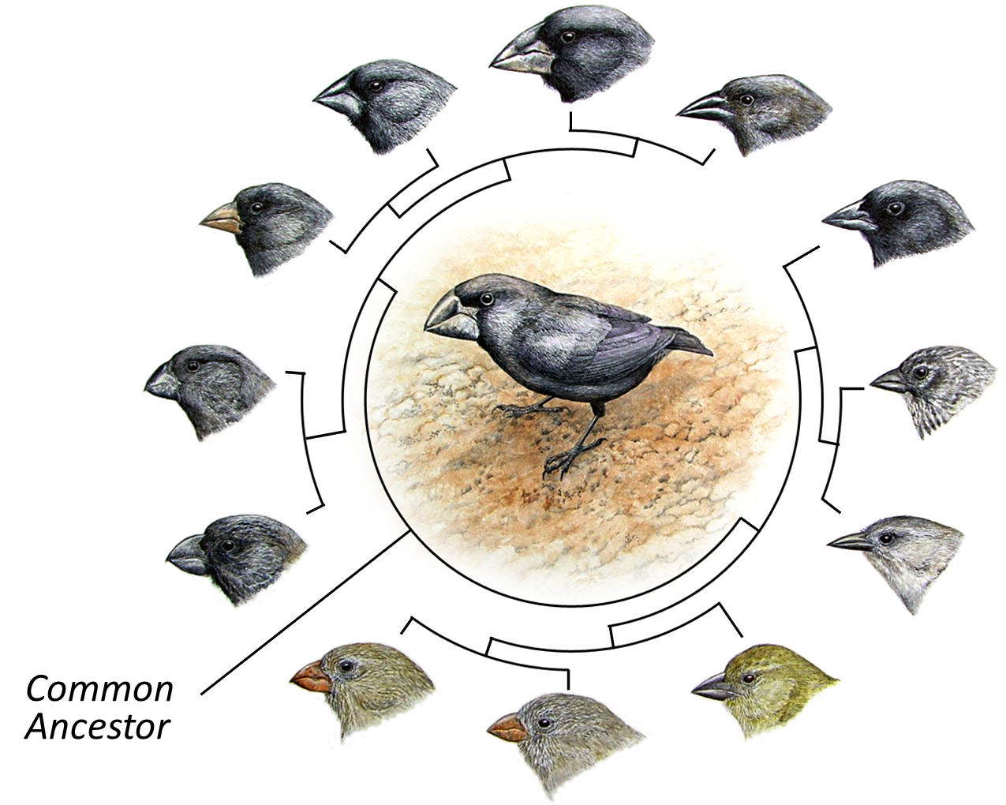
We observe variation in phenotype

Slide 6
Underlying such changes are differences in genotype
Many changes in genotype are deleterious, resulting in less-fit organisms
Some changes are adaptive, resulting in more-fit organisms
gene
% of pop.
w/ variant
% of pop.
w/ variant
time
time
gene
gene
% of pop.
w/ variant
gene
Changes in genotype may also be “neutral,” producing no change in the phenotype
time
time

Slide 7
Summary
Quick overview of molecular evolution
Detecting sequence conservation and evolutionary constraint
Constructing phylogenetic trees
Multiple sequence alignment
Other topics in comparative genomics

Slide 8
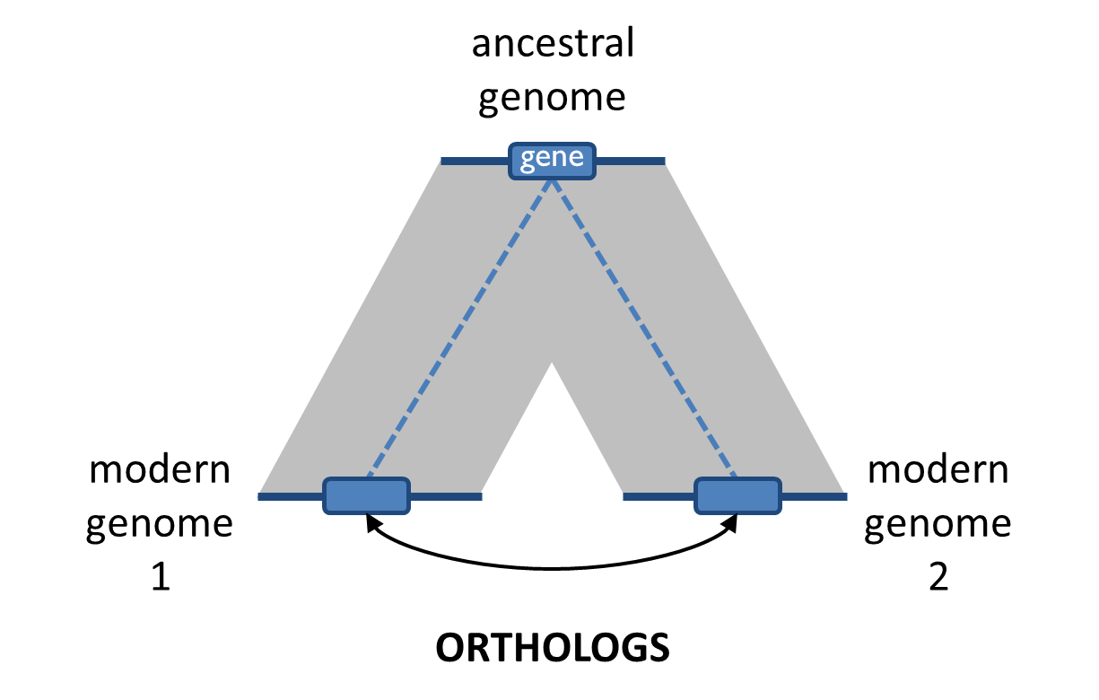
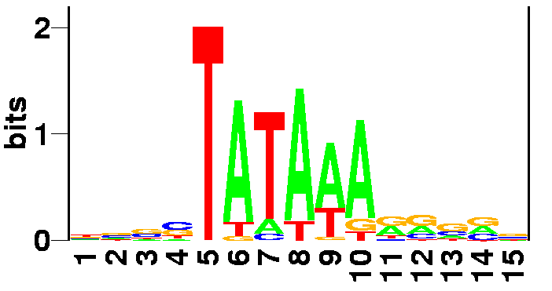
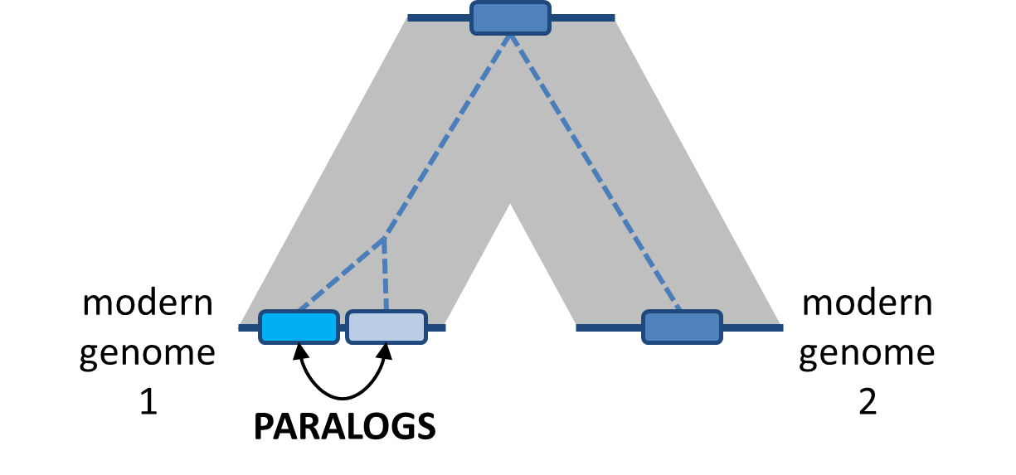
How does sequence similarity arise? (Review)
Convergent evolution / sequence “analogy”
Mostly applies to short sequences (motifs)
Divergent evolution / sequence homology
Most common cause of sequence similarity
gene
gene
gene
gene
gene

Slide 9
Alignment scoring (Review)
 | X_{i} | → | 0 |  | 1 |  | 2 |  | 3 |  | 4 |  | 5 |  | 6 |  | 7
Y_{j} |  |  | – |  | G |  | A |  | T |  | T |  | A |  | C |  | A
↓
0 | – |  | 0
 |  |  |  | ↖
1 | G |  |  |  | 1
 |  |  |  |  |  | ↖
2 | A |  |  |  |  |  | 2 | ← | 1
 |  |  |  |  |  |  |  |  |  | ↖
3 | T |  |  |  |  |  |  |  |  |  | 2
 |  |  |  |  |  |  |  |  |  |  |  | ↖
4 | A |  |  |  |  |  |  |  |  |  |  |  | 3
 |  |  |  |  |  |  |  |  |  |  |  |  |  | ↖
5 | G |  |  |  |  |  |  |  |  |  |  |  |  |  | 3
 |  |  |  |  |  |  |  |  |  |  |  |  |  |  |  | ↖
6 | A |  |  |  |  |  |  |  |  |  |  |  |  |  |  |  | 4
Let a “match” add 1 to the score…
Let a “mismatch” add 0 to the score…
Let an indel/gap subtract 1 from the score (reflects indels being less common than substitutions)
Our original alignment has a score of four
 |  |  |  |  | G |  | A |  | T |  | T |  | A |  | C |  | A
 |  |  |  |  | +1 |  | +1 |  | -1 |  | +1 |  | +1 |  | +0 |  | +1
 |  |  |  |  | G |  | A |  | – |  | T |  | A |  | G |  | A
Total = 4

Slide 10
Signs of selection in genome evolution
???
gene
ancestral genome
mutation
Selection
(bad mutations aren’t reproduced as much)
modern genome 1
comparison reveals
constrained elements e.g. genes
modern genome 2

Slide 11
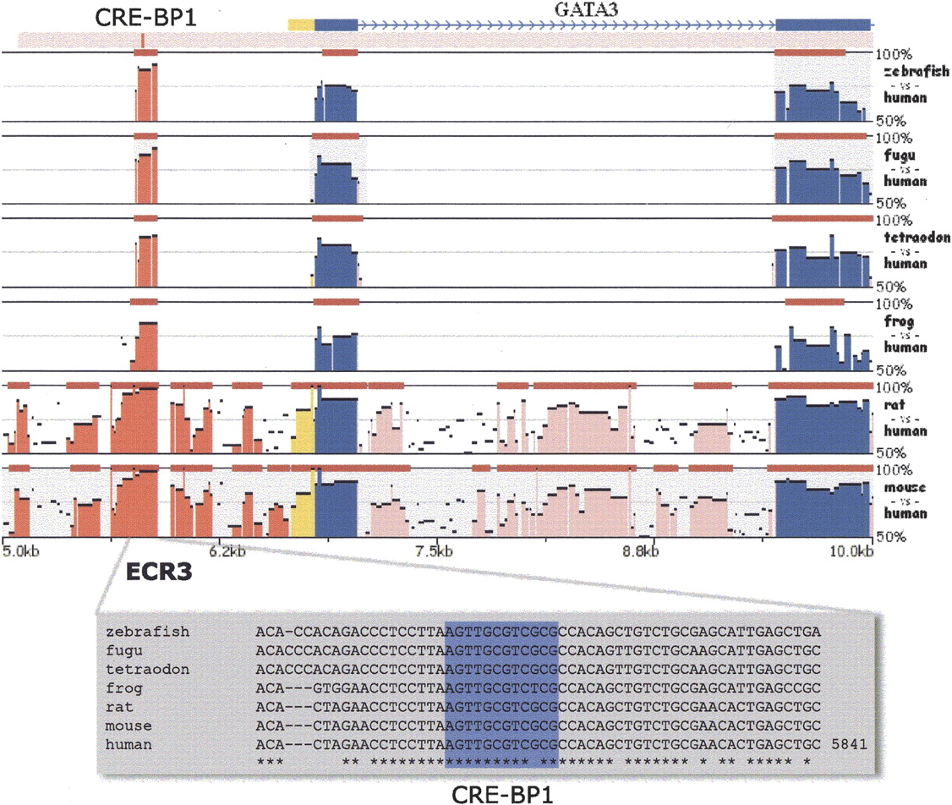
Signs of selection in genome evolution: ENCODE
Ovcharenko, I. et al. Genome Res. 2005 Jan;15(1):184-94

Slide 12
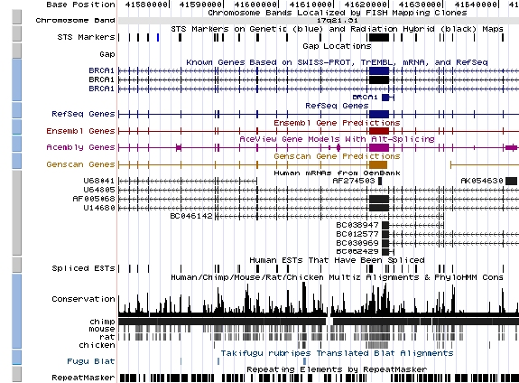
UCSC Genome Browser: Conservation tracks

Slide 13
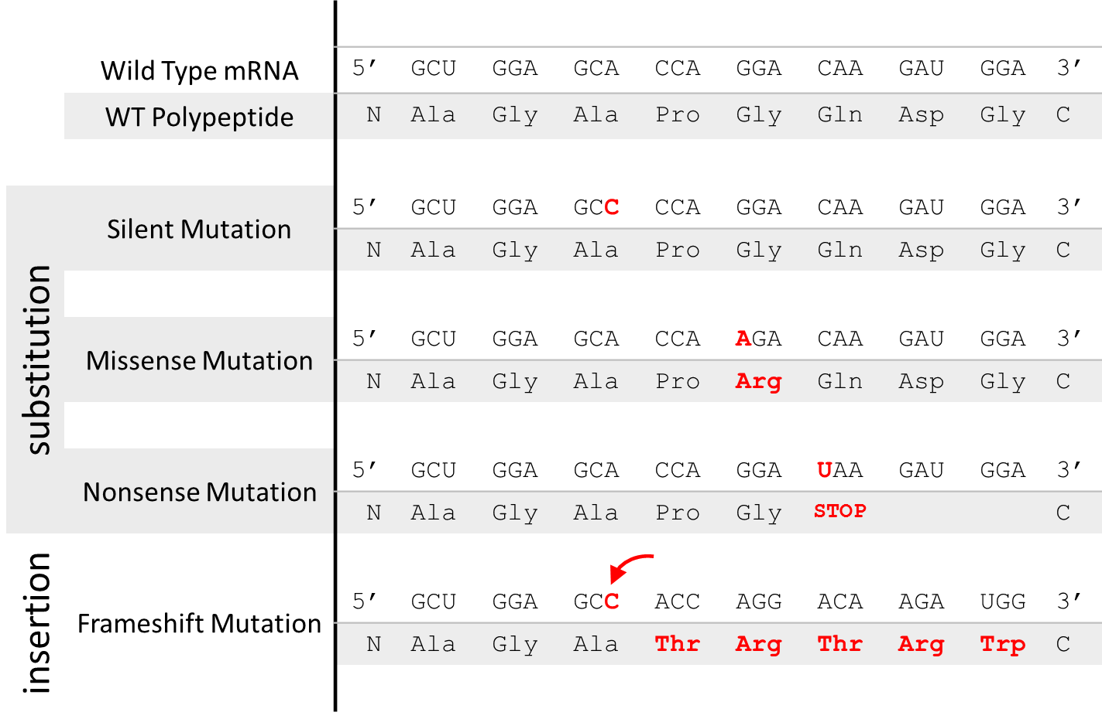
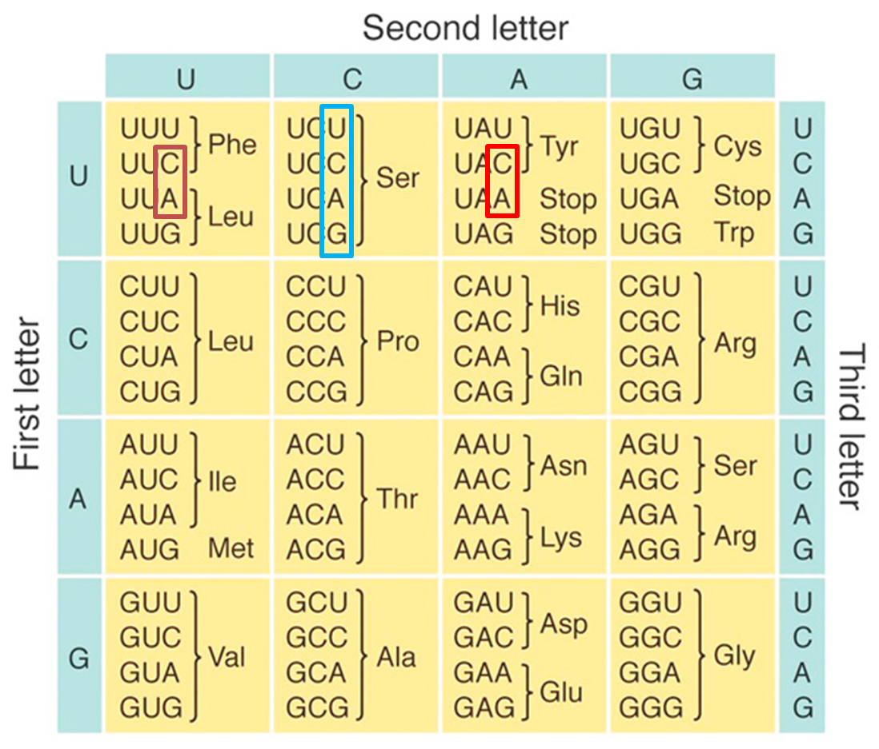
How sequence differences arise: Proteins (Review)
Degeneracy in the genetic code causes protein sequence similarity to “decay” more slowly than DNA sequence

Slide 14
Normalized rate of protein evolution: the dN/dS ratio
CDS 1
CDS 2
CDS 3
Rates of N/S mutation similar, varies by locus
*mutation
6:6
4:4
2:2
S fixation rate (dS) varies with mutation rate and drift
fixation
1:3
1:2
1:1
N fixation rate (dN)
varies with mutation rate, drift, and fitness
evolutionary rate
LOW
MEDIUM
HIGH
selective constraint
HIGH
MEDIUM
LOW
Ratio (dN/dS) isolates fitness effect
*Non-synonymous (changes amino acid) vs. Synonymous (silent)

Slide 15
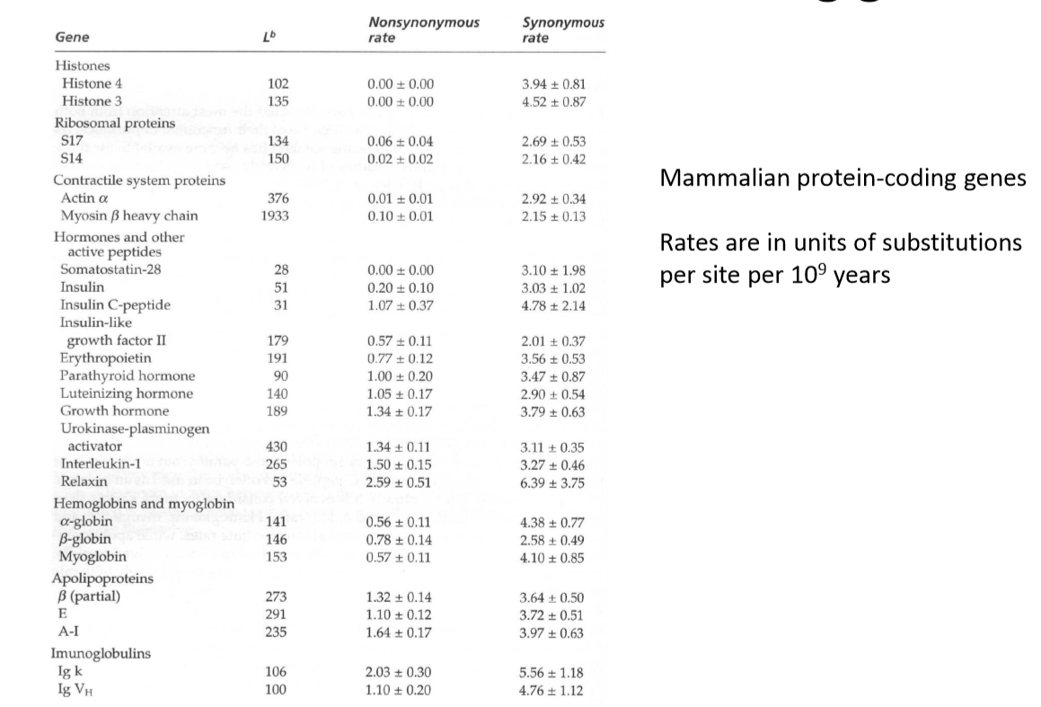
dN/dS

Slide 16
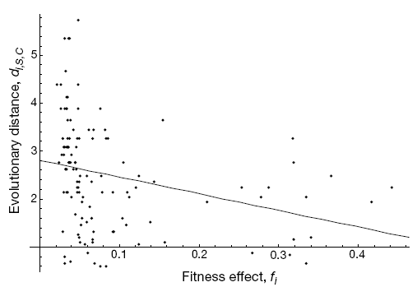
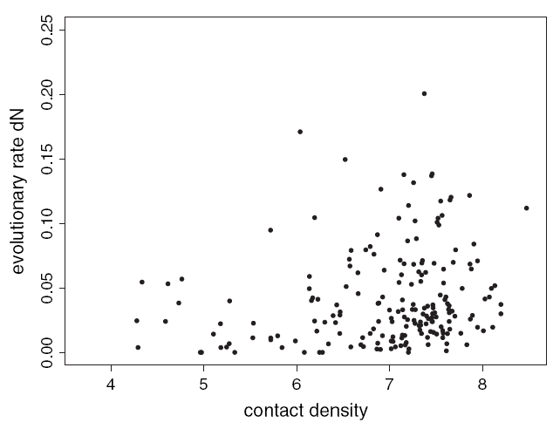
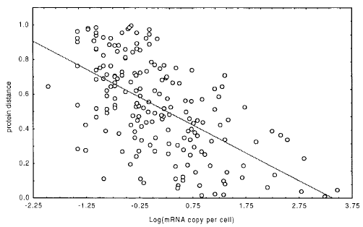
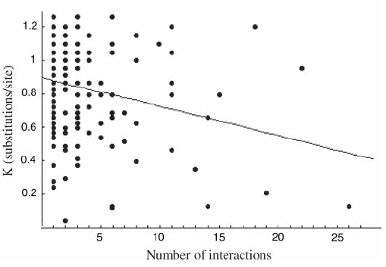
Global determinants of protein evolutionary rate (ER)
ER ∝ (fitness effect)⁻¹
Hirsh et al., Nature, 2001
ER ∝ contact density
Bloom et al., Mol Biol Evol, 2006
ER ∝ (expression)⁻¹
Pal et al., Genetics, 2001
ER ∝ (# of interactors)⁻¹
Fraser et al., Science, 2002

Slide 17
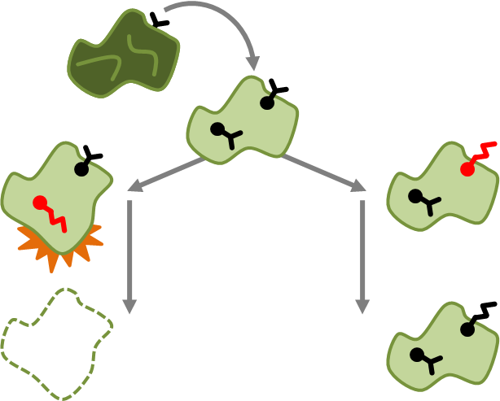
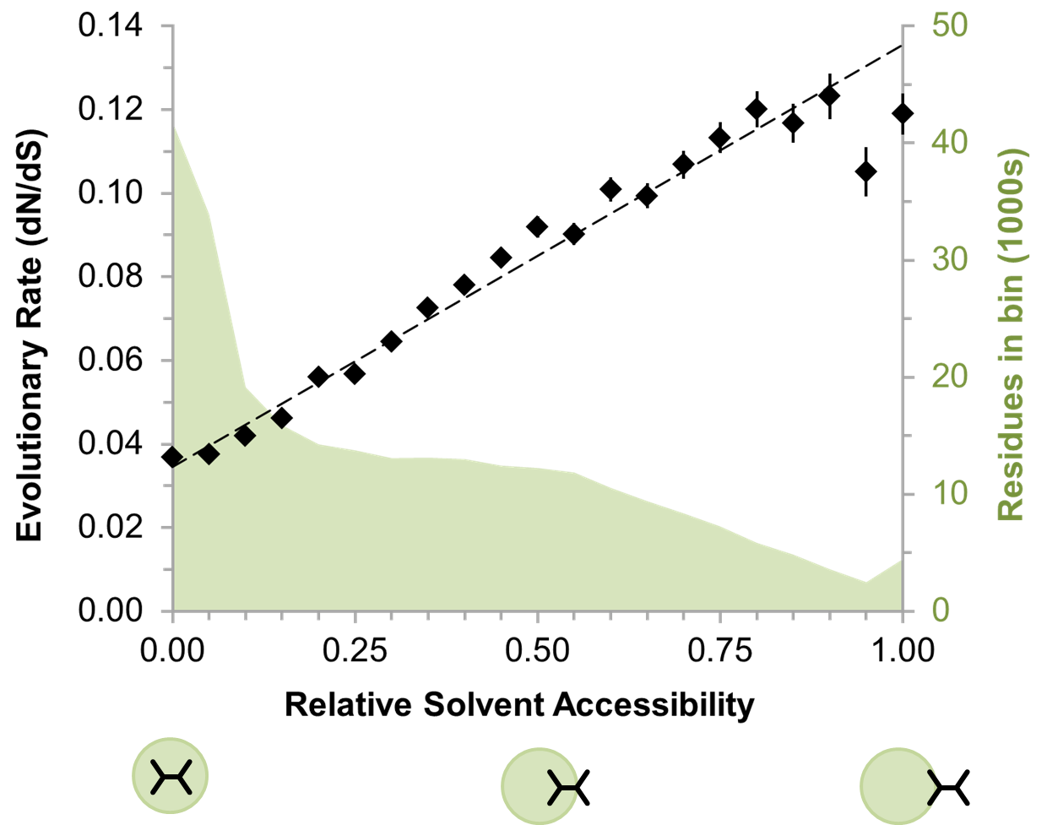
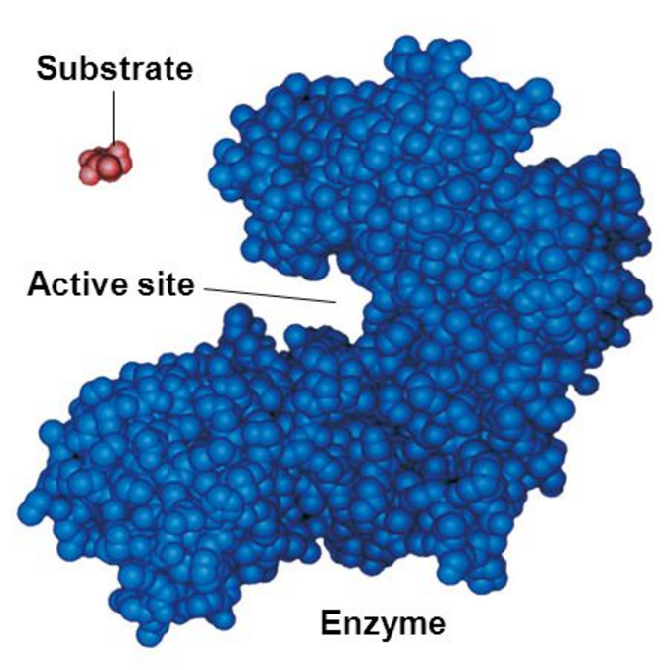
Structure-evolution relationships: dN/dS at individual sites
Interfaces and active sites break the rules!
dN/dS > 1 at a site is a sign of positive selection (adaptation in action)

Slide 18
Summary
Introduction to molecular evolution
Detecting sequence conservation and evolutionary constraint
Constructing phylogenetic trees
Multiple sequence alignment
Other topics in comparative genomics

Slide 19
How would we build a tree like this?

Slide 20
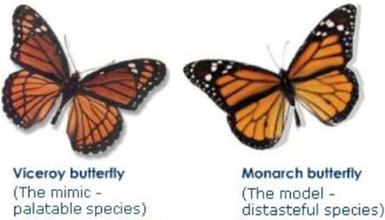
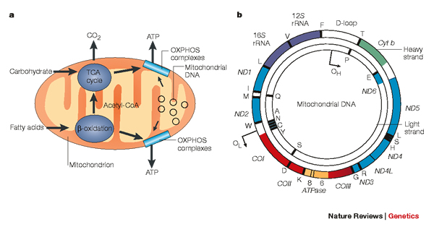
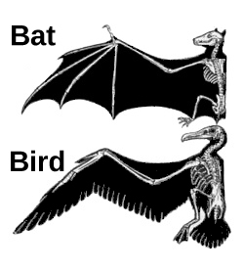
How would we build a tree like this?
In the old days, we built trees by comparing phenotypes
Can you guess some problems with this approach?
Convergent Evolution/
Biomimicry
Today trees are built based on genotype information, e.g. mitochondrial DNA sequences

Slide 21
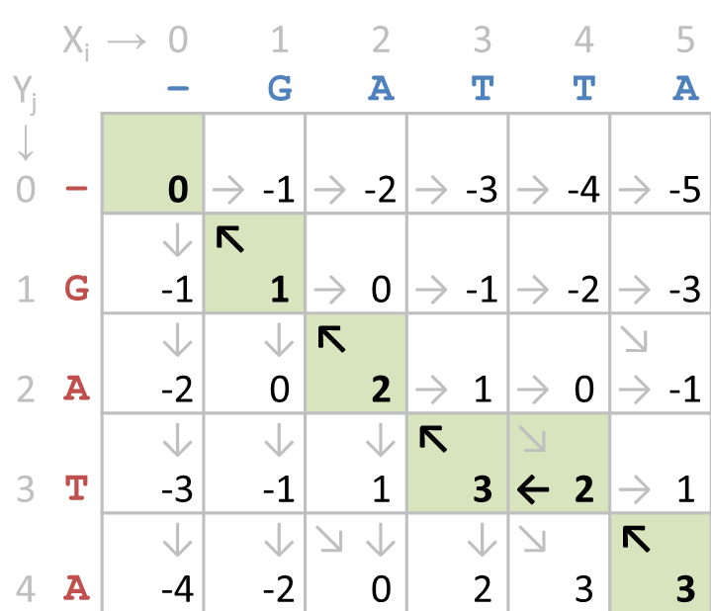
How would we build a tree like this?
A
CGGGG-GGTGCGACTATTC--A
B
CAGGACTATGCGACTAATCTGA
C
CAGGACTATGCAACTAATCTGA
D
CAGGACTATGCAACTAATCTGA
E
TGGGACTATGCGACTATTCTGA
Use the alignment techniques from before to compare each pair of sequences…

Slide 22
Methods for building phylogenetic trees
Distance-based
Examples: UPGMA, Neighbor-Joining
Pros: Very fast, identify tree topology directly
Cons: Require (possibly wrong) simplifying assumptions
Multiple-Sequence Alignment (MSA) Based
Examples: Maximum Parsimony, Maximum Likelihood
Pros: Fewer assumptions, more accurate
Cons: Much slower, must sample possible tree topologies

Slide 23
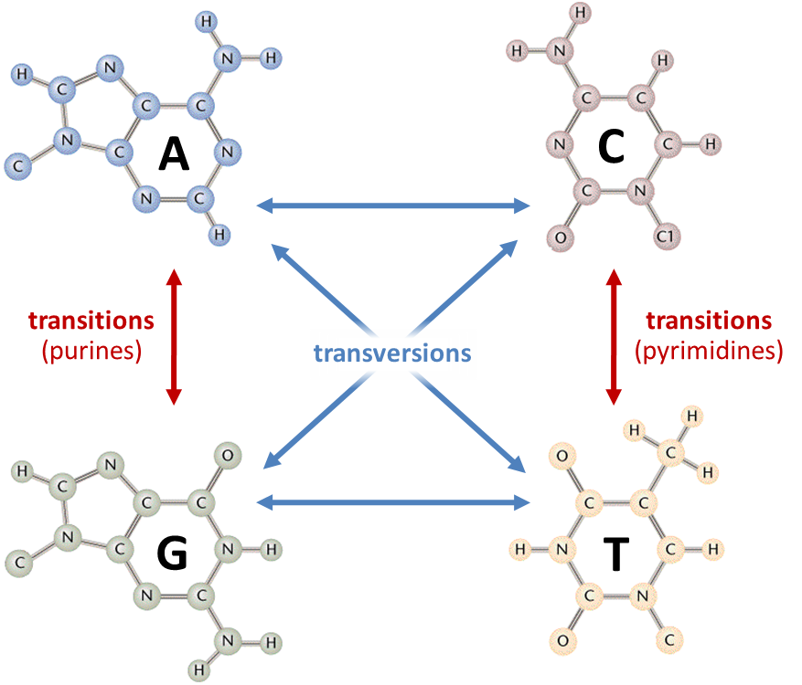
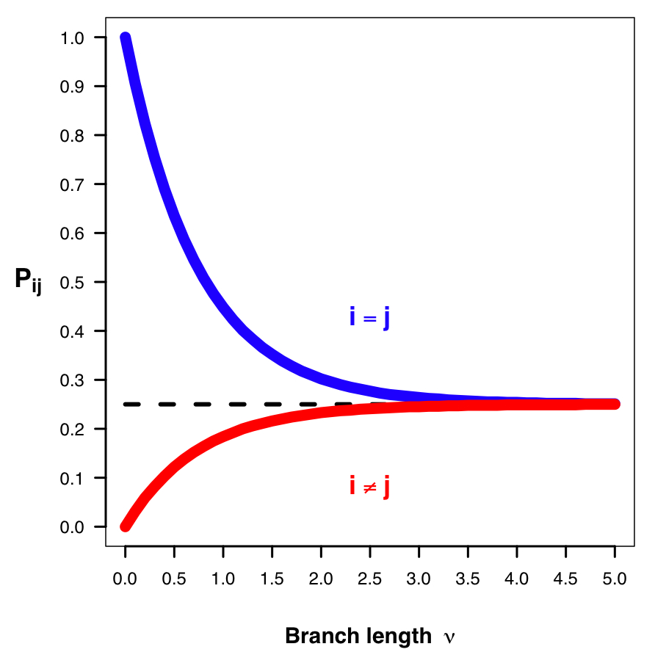
From sequence similarity to distance
G | A | G | C | T | A | C | G | G | A
G | A | C | C | A | A | - | T | G | A
+1 | +1 | 0 | +1 | 0 | +1 | -1 | 0 | +1 | +1
Alignments usually focus on similarity,
trees usually focus on distance.
0 | 0 | +1 | 0 | +1 | 0 | +2 | +1 | 0 | 0
Raw distance adjusted by evolutionary models...
Account for multiple hits per site
Account for approach to randomness
Account for non-equivalent changes

Slide 24
Building a tree from distances: UPGMA
Unweighted Pair Group Method with Arithmetic mean
(Most complicated name, most straightforward method)

Slide 25
Building a tree from distances: UPGMA
d | A | B | C | D | E
A | 0 | 8 | 4 | 6 | 8
B |  | 0 | 8 | 8 | 4
C |  |  | 0 | 6 | 8
D |  |  |  | 0 | 8
E |  |  |  |  | 0
Start with distance table, d, and each species as a “leaf” node
B
E
D
A
C

Slide 26
Building a tree from distances: UPGMA
d | A | B | C | D | E
A | 0 | 8 | 4 | 6 | 8
B |  | 0 | 8 | 8 | 4
C |  |  | 0 | 6 | 8
D |  |  |  | 0 | 8
E |  |  |  |  | 0
Find the two closest nodes i and j, separated by distance d(i, j).
Hang the two nodes from a new node, k, at height d(i, j)/2.
F
2
2
B
E
D
A
C

Slide 27
Building a tree from distances: UPGMA
d | A | B | C | D | E | F
A | 0 | 8 | 4 | 6 | 8 | -
B |  | 0 | 8 | 8 | 4 | 8
C |  |  | 0 | 6 | 8 | -
D |  |  |  | 0 | 8 | 6
E |  |  |  |  | 0 | 8
F |  |  |  |  |  | 0
Add the new node k to the distance table; its distance to each other node h is the average of i and j’s distances to h.
F
2
2
B
E
D
A
C
This is the “arithmetic mean” in the UPGMA acronym

Slide 28
Building a tree from distances: UPGMA
d | B | D | E | F
B | 0 | 8 | 4 | 8
D |  | 0 | 8 | 6
E |  |  | 0 | 8
F |  |  |  | 0
Delete i and j from the distance table.
F
2
2
B
E
D
A
C

Slide 29
Building a tree from distances: UPGMA
d | B | D | E | F | G
B | 0 | 8 | 4 | 8 | -
D |  | 0 | 8 | 4 | 8
E |  |  | 0 | 8 | -
F |  |  |  | 0 | 8
G |  |  |  |  | 0
G
F
2
2
2
2
B
E
D
A
C
Rinse and repeat.

Slide 30
Building a tree from distances: UPGMA
d | D | F | G
D | 0 | 4 | 8
F |  | 0 | 8
G |  |  | 0
G
F
2
2
2
2
B
E
D
A
C
Rinse and repeat.

Slide 31
Building a tree from distances: UPGMA
d | D | F | G | H
D | 0 | 4 | 8 | -
F |  | 0 | 8 | -
G |  |  | 0 | 8
H |  |  |  | 0
H
1
G
3
F
2
2
2
2
B
E
D
A
C
Rinse and repeat.

Slide 32
Building a tree from distances: UPGMA
d | G | H
G | 0 | 8
H |  | 0
H
1
G
3
F
2
2
2
2
B
E
D
A
C
Rinse and repeat.

Slide 33
Building a tree from distances: UPGMA
d | G | H | I
G | 0 | 8 | -
H |  | 0 | -
I |  |  | 0
I
1
2
H
1
G
3
F
2
2
2
2
B
E
D
A
C
Rinse and repeat.

Slide 34
Building a tree from distances: UPGMA
d | A | B | C | D | E
A | 0 | 8 | 4 | 6 | 8
B |  | 0 | 8 | 8 | 4
C |  |  | 0 | 6 | 8
D |  |  |  | 0 | 8
E |  |  |  |  | 0
I
1
2
H
1
G
3
F
2
2
2
2
B
E
D
A
C
Distances in the tree reflect the original distances.

Slide 35
Problems with UPGMA
Assumes a molecular clock, i.e.
Distance between taxa is directly proportional
to the time since their divergence.
This is often not the case. Why?
C
B
D
B
C
D
A
A
A perfectly reasonable tree
UPGMA gets it wrong

Slide 36
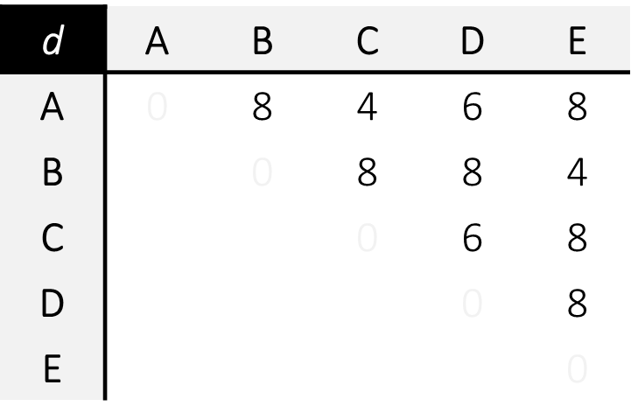
Neighbor-joining is a better distance-based method
Neighbor-joining (NJ) still assumes that distances are additive,
but does not assume a molecular clock
A
E
A
E
B
D
y
x
C
D
C
B
The idea: Iteratively pull out pairs of nodes that keep the total branch length of the tree as small as possible (but not necessarily the closest nodes).
Note that the length of the x-y branch above was previously duplicated across
distances A-B, A-D, A-E, C-B, C-D, and C-E

Slide 37
Nifty (if tedious) NJ arithmetic...
3
3
3
1
1
1
4
4
4
y
x
y
x
y
x
2
2
2
5
5
5
3
3
3
1
1
1
4
4
4
y
x
y
x
y
x
2
2
2
5
5
5

Slide 38
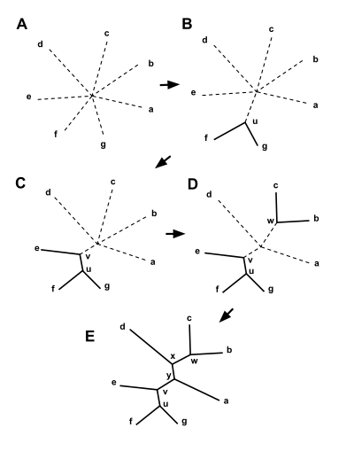
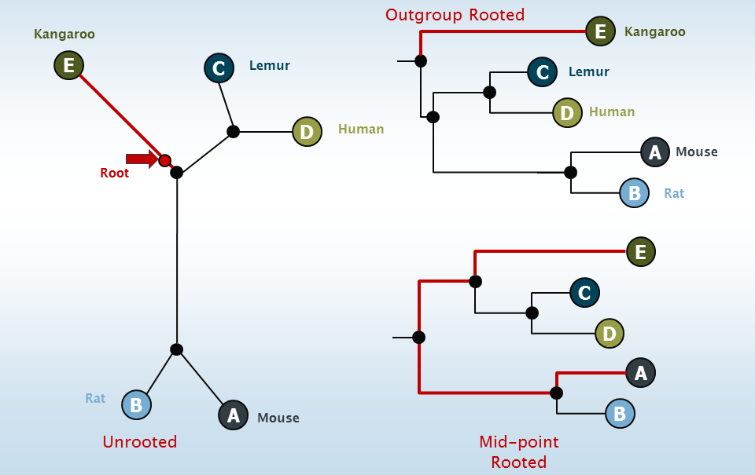
Neighbor-joining trees are unrooted by default

Slide 39
Maximum parsimony
S₁ | = | A | G | A | A | A | A | A | T | A | A
S₂ | = | G | G | A | A | A | A | A | T | A | A
S₃ | = | A | A | A | A | T | A | A | C | T | T
S₄ | = | A | T | C | T | T | G | A | T | C | C
Maximum parsimony (MP) looks for a tree that can explain the differences among your sequences using the smallest possible number of mutations.
Need a multiple sequence alignment (MSA) rather than a bunch of pairwise sequence alignments (more on this later)

Slide 40
Maximum parsimony
S₁ | = | A | G | A | A | A | A | A | T | A | A
S₂ | = | G | G | A | A | A | A | A | T | A | A
S₃ | = | A | A | A | A | T | A | A | C | T | T
S₄ | = | A | T | C | T | T | G | A | T | C | C
Consider all possible trees:
S₁
S₃
S₁
S₂
S₁
S₂
S₂
S₄
S₃
S₄
S₄
S₃

Slide 41
Maximum parsimony
S₁ | = | A | G | A | A | A | A | A | T | A | A
S₂ | = | G | G | A | A | A | A | A | T | A | A
S₃ | = | A | A | A | A | T | A | A | C | T | T
S₄ | = | A | T | C | T | T | G | A | T | C | C
Count changes at this site required by each tree.
S₁
S₃
S₁
S₂
S₁
S₂
1
change
1
change
1
change
A
A
A
G
A
G
A
A
A
A
A
A
G
A
A
A
A
A
S₂
S₄
S₃
S₄
S₄
S₃

Slide 42
Maximum parsimony
S₁ | = | A | G | A | A | A | A | A | T | A | A
S₂ | = | G | G | A | A | A | A | A | T | A | A
S₃ | = | A | A | A | A | T | A | A | C | T | T
S₄ | = | A | T | C | T | T | G | A | T | C | C
This site is uninformative. All trees look equally good.
S₁
S₃
S₁
S₂
S₁
S₂
2
change
2
change
2
change
G
A
G
G
G
G
G
T
G
G
G
G
G
T
A
T
T
A
S₂
S₄
S₃
S₄
S₄
S₃

Slide 43
Maximum parsimony
S₁ | = | A | G | A | A | A | A | A | T | A | A
S₂ | = | G | G | A | A | A | A | A | T | A | A
S₃ | = | A | A | A | A | T | A | A | C | T | T
S₄ | = | A | T | C | T | T | G | A | T | C | C
This site is informative: The first tree is more parsimonious.
S₁
S₃
S₁
S₂
S₁
S₂
1
change
2
change
2
change
A
T
A
A
A
A
A
T
A
A
A
A
A
T
T
T
T
A
S₂
S₄
S₃
S₄
S₄
S₃

Slide 44
Maximum parsimony
S₁ | = | A | G | A | A | A | A | A | T | A | A
S₂ | = | G | G | A | A | A | A | A | T | A | A
S₃ | = | A | A | A | A | T | A | A | C | T | T
S₄ | = | A | T | C | T | T | G | A | T | C | C
 |  | 1 | 2 | 1 | 1 | 1 | 1 | 0 | 1 | 2 | 2
S₁
S₃
This tree can explain the four sequences with 12 mutations, the most parsimonious solution.
S₂
S₄

Slide 45
Maximum parsimony
The number of trees gets very big very fast.
Taxa | Rooted Trees | Unrooted Trees
3 | 3 | 1
5 | 105 | 15
10 | 3.4 × 10⁷ | 2.0 × 10⁶
20 | 8.2 × 10²¹ | 2.2 × 10²⁰
N | (2N-3)!! | (2N-5)!!
N!! = N × (N – 2) × (N – 4) × (N – 6) × …

Slide 46
Maximum likelihood
Similar in spirit to maximum parsimony
Instead of the “cheapest” tree, we’ll take the most likely one
Cost( change 1 ) + Cost( Change 2 ) becomes Pr( Change 1 ) × Pr( Change 2 )
Can model different rates of evolution on different sites/branches
Relies on tricks to speed up the search
E.g. eliminating (pruning) trees that are unlikely to be correct
Bayesian probabilistic approaches here as well
Today’s software for tree-building largely focused on these approaches
RAxML
PhyML
MrBayes
FastTree

Slide 47
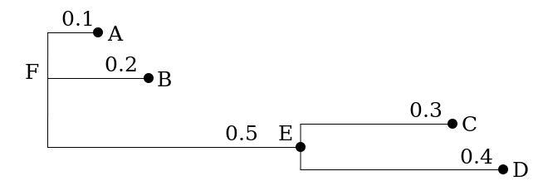
Storing tree data: the Newick format
(A:0.1,B:0.2,(C:0.3,D:0.4):0.5);

Slide 48
Challenges in building species trees
Need the right resolution for the species in question
Myoglobin too similar among primates to resolve them well
Need an ortholog in each species of interest
No myoglobin in yeast, for example
Some common single-locus phylogenetic markers
16S rRNA (gene) for bacteria
Internal Transcribed Spacer (ITS) sequence for fungi
mtDNA for resolving primates/human populations

Slide 49
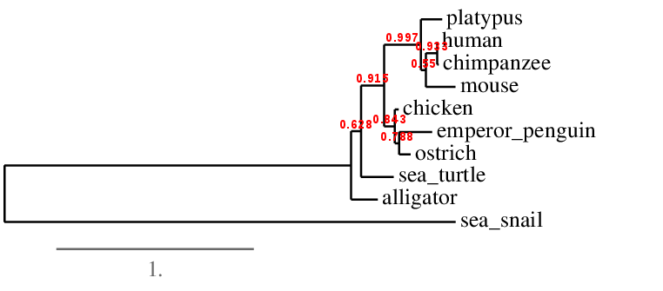
Challenges in building species trees
Not all genes produce the same species tree
Lateral gene transfer violates the assumptions of the tree
Often helpful to use multiple genes
AMPHORA/PhyloPhlAn sets for prokaryotes
Can concatenate real genes into a single super-gene and analyze...
...or build a separate tree for each gene and “average”
E. coli
Myoglobin tree

Slide 50
Summary
Quick overview of molecular evolution
Detecting sequence conservation and evolutionary constraint
Constructing phylogenetic trees
Multiple sequence alignment
Other topics in comparative genomics

Slide 51
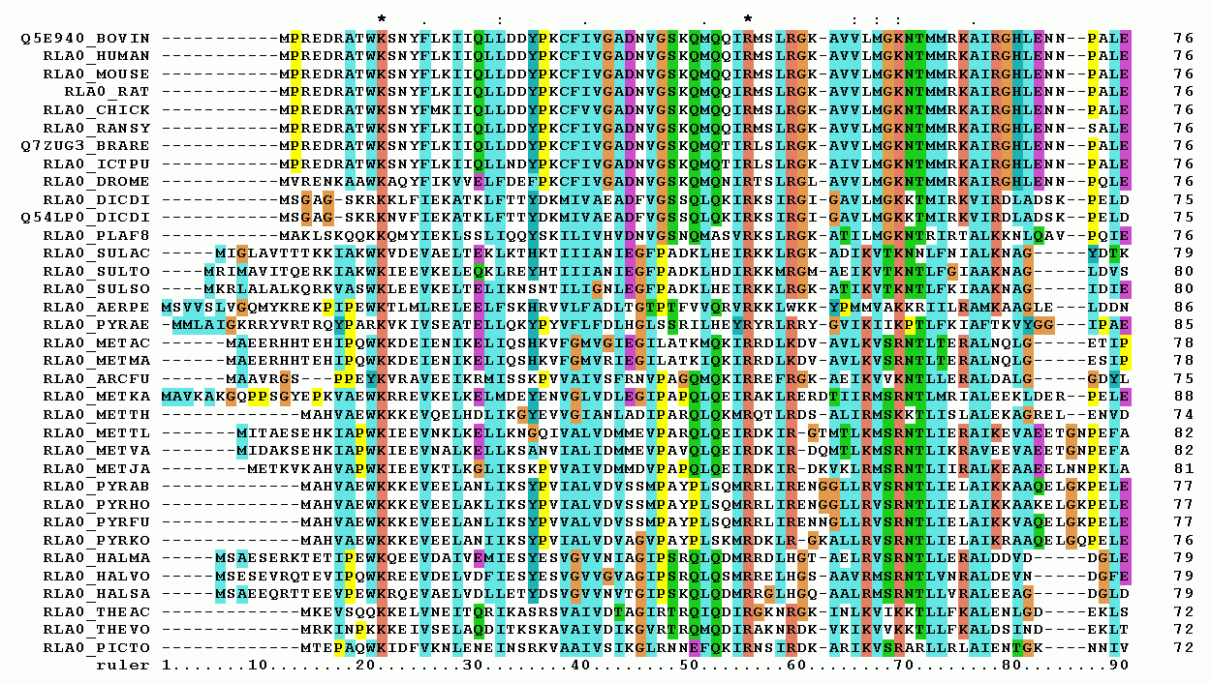
Example of a multiple sequence alignment (MSA)
The goal of MSA is to line up homologous positions (nucleotide sides or amino acids) across three or more evolutionarily related genes/loci

Slide 52
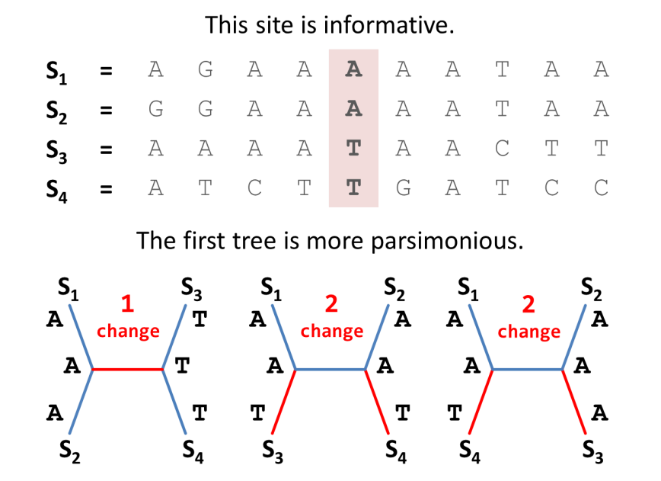
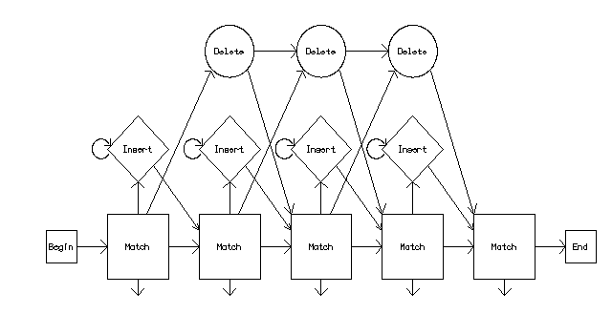
Uses of MSA
Input for maximum parsimony and maximum likelihood tree-building.
Building models for protein families
(highlight important positions and find new members)

Slide 53
Recall how we find the best alignment of 2 sequences
(X₀, Y₀)
Seq X
To align X = FIT and Y = FLIT
at each point in the alignment we must check 3 options for each cell in the alignment grid.
Seq Y
Match or
mismatch
Gap #1
Gap #2
(X_{i}, Y_{j})
X
Y
X
-
-
Y
F | - | I | T
F | L | I | T

Slide 54
The same idea applies to larger #s of sequences...
(X₀, Y₀, Z₀)
Seq X
To align X = FIT and Y = FLIT and Z = FRET we must check 7 options in each cell of the alignment cube.
Seq Z
Seq Y
Match or
mismatch
Gap #1
Gap #2
X
Y
Z
X
Y
-
X
-
Z
(X_{i}, Y_{j}, Z_{k})
gap #3
gap #4
Gap #5
gap #6
F | - | I | T
F | L | I | T
F | R | E | T
-
Y
Z
-
-
Z
X
-
-
-
Y
-

Slide 55
The same idea applies to larger #s of sequences...
Match or
mismatch
X
Y
Z
Gap #1
Gap #2
Gap #3
X
Y
-
X
-
Z
-
Y
Z
Gap #4
Gap #5
Gap #6
-
-
Z
X
-
-
-
Y
-

Slide 56
...but quickly becomes computationally infeasible
The number of total operations grows as L^{N} × (2^{N} – 1)
(L = sequence length, N = # of sequences)
L ~ 90
N ~ 30
This method needs >10⁶⁷ comparisons to build the alignment...

Slide 57
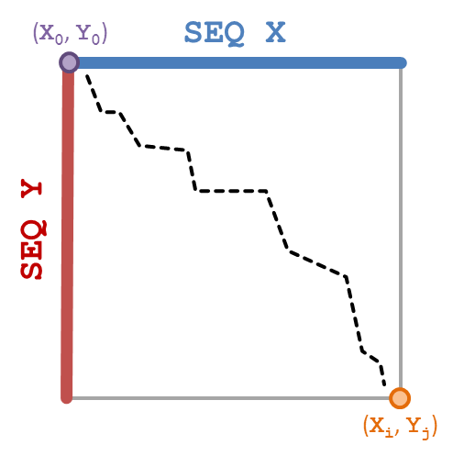
Actual methods are variants on progressive MSA
Use iterative pairwise alignments to build the full alignment of all sequences.
PIEKSAVTL
DIRKSAITAL
DIRKSALYAL
YEEKSITAL
YEEKSTAL
First do all pairwise alignments, then use the resulting distance information to build a (distance-based) tree.

Slide 58
Actual methods are variants on progressive MSA
PIEKSAVTL
DIRKSAITAL
DIRKSALYAL
YEEKSITAL
YEEKSITAL
YEEKSTAL
YEEKS-TAL
Order of alignment is determined by the tree structure
(align more closely related groups first).

Slide 59
Actual methods are variants on progressive MSA
PIEKSAVTL
DIRKSAITAL
DIRKSAITAL
DIRKSALYAL
DIRKSALYAL
YEEKSITAL
YEEKS-TAL
Order of alignment is determined by the tree structure
(align more closely related groups first).

Slide 60
Actual methods are variants on progressive MSA
PIEKSAVTL
PIEKSAVT-L
DIRKSAITAL
DIRKSAITAL
DIRKSALYAL
DIRKSALYAL
YEEKSITAL
YEEKS-TAL
Order of alignment is determined by the tree structure
(align more closely related groups first).

Slide 61
Aligning alignments
AAAAATTCCCCC
AAAAATTCCCCC AAAAA--CCCCC AAAAA--CCCCC
AAAAACCCCC
AAAAACCCCC
When “gapping” an alignment, each sequence receives a gap
F | - | I₁ | T
F | L | I₂ | T
F | R | - | Y
F | R | E | T
+36 | -2 | -5 | 9
= |  |  | 38
I₁ | I₁ | I₁ | I₂ | I₂ | -
I₂ | - | E | - | E | E
+4 | -1 | -3 | -1 | -3 | -1
= |  |  |  |  | -5
Matches and mistmatches are scored with a sum of all pairwise scores

Slide 62
Actual methods are variants on progressive MSA
PIEKSAVT-L
PIEKSAVT-L
DIRKSAITAL
DIRKSAITAL
DIRKSALYAL
DIRKSALYAL
YEEKSITAL
YEEKS-ITAL
YEEKS-TAL
YEEKS--TAL
Order of alignment is determined by the tree structure
(align more closely related groups first).

Slide 63
Issues with progressive MSA
This approach still requires a lot of comparisons, but it is feasible (the exact approach was not).
PIEKSAVT-L
DIRKSAITAL
This produces a good MSA, but it’s not guaranteed to be the best one (heuristic!)
DIRKSALYAL
YEEKS-ITAL
YEEKS--TAL
The CLUSTAL algorithm follows this approach, using a neighbor joining tree to guide the alignments.

Slide 64
Issues with progressive MSA
“Once a gap, always a gap!”
Choices that worked well in a pairwise alignment may prove poor for the MSA, but there is no going back with this approach.
DIRKSAITAL
DIRKSALYAL
PIEKSAVT-L
YEEKSIT-AL
YEEKS-T-AL
The MUSCLE algorithm re-evaluates earlier alignment decisions to mitigate these problems.

Slide 65
Summary
Introduction to molecular evolution
Detecting sequence conservation and evolutionary constraint
Constructing phylogenetic trees
Multiple sequence alignment
Other topics in comparative genomics

Slide 66
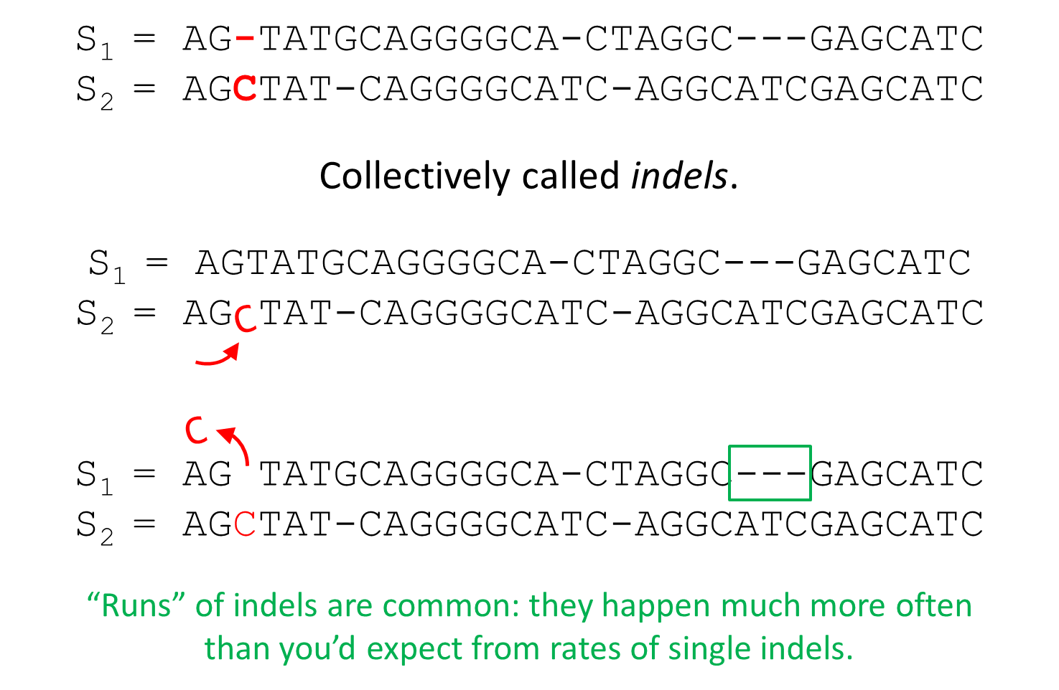
So far we’ve been focusing on point mutations...

Slide 67
Point mutations distinguish modern-day orthologs
ancestral
genome
gene
modern
genome
1
modern
genome
2
ORTHOLOGS
Descend directly from ancestral gene in the ancestral species; they tend to carry out the same function.

Slide 68
Gene duplication is a common, larger-scale change
ancestral
genome
gene
modern
genome
1
modern
genome
2
PARALOGS
Result from gene duplication; one or both may diverge from the ancestral gene’s function.

Slide 69
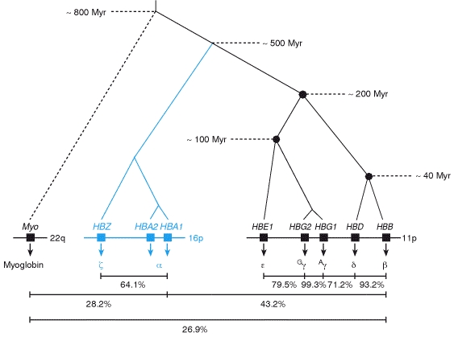
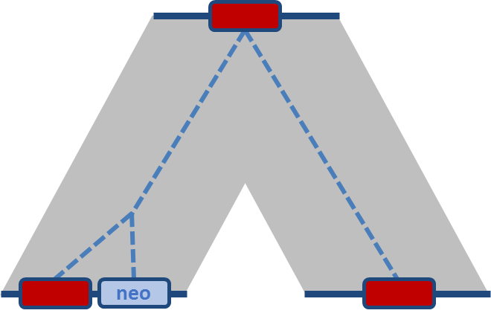
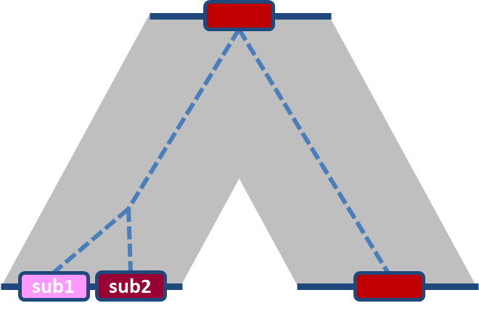
Gene duplication results in expansion of gene families
Expansion of the haemoglobin family
Neofunctionalization
One of the copies takes on a new function
Subfunctionalization
Each “daughter” takes on a specialized function
Number of UNCHANGED positions ^

Slide 70
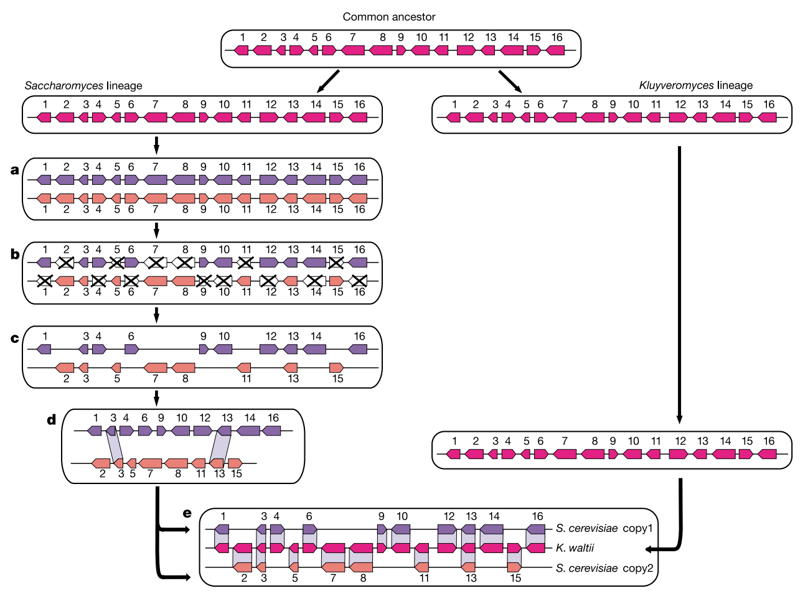
Entire genomes can also duplicate (as in yeast)
Kellis et al. Nature 428, 617-624 (2004)

Slide 71
New genes can enter a genome “laterally”
ancestral
genome
gene
XENOLOG
modern
genome
1
modern
genome
2
Are not related by descent (reproduction),
giving rise to the term
“lateral (or horizontal) gene transfer.”

Slide 72
Genes can be lost (deleted) or shuffled
Genes (arrows) can be lost or shuffled.
1
2
3
deleted
1
3

Slide 73
Chunks of genome can be inverted
Rotate
Mirror

Slide 74
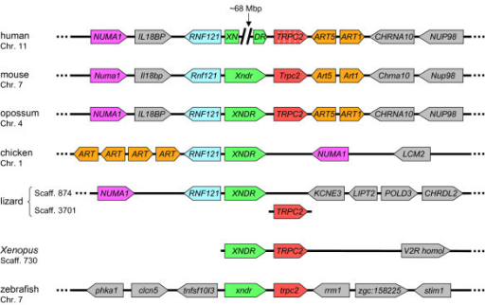
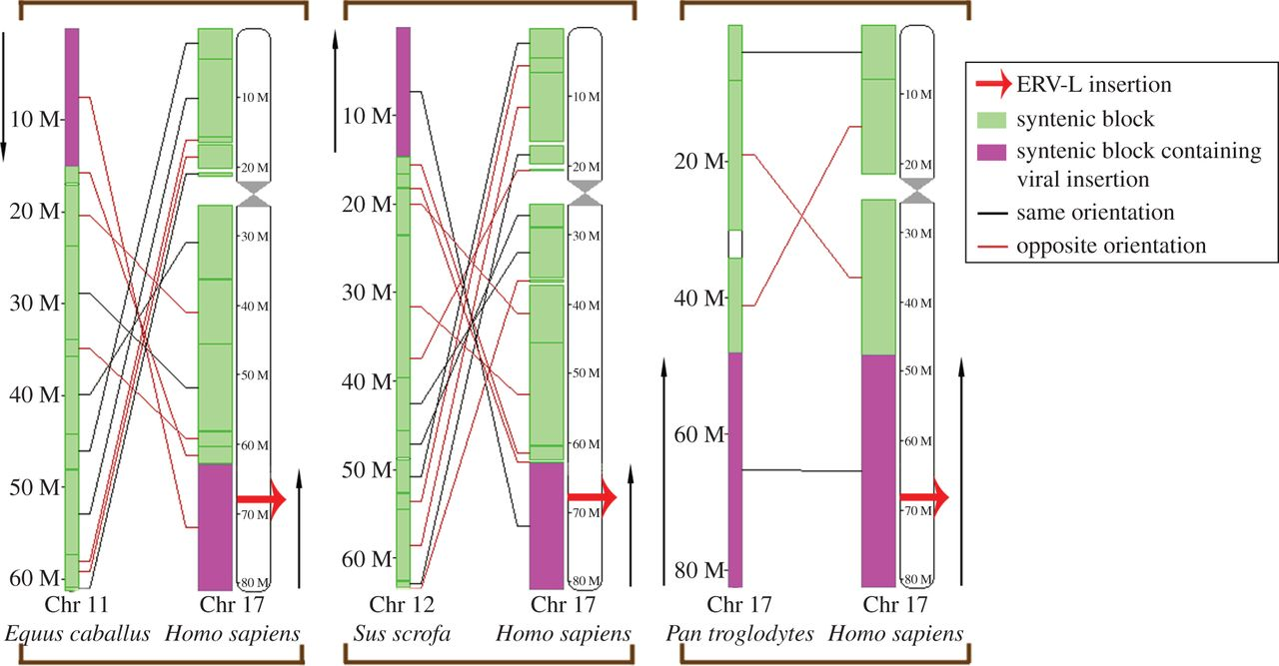
Synteny
Large-scale changes can result in genomes with similar contents (e.g. genes) occurring in very different orders
Such ordering is referred to as synteny
Synteny of a block of genes across vertebrates
Synteny of larger chromosomal pieces in mammals

Slide 75
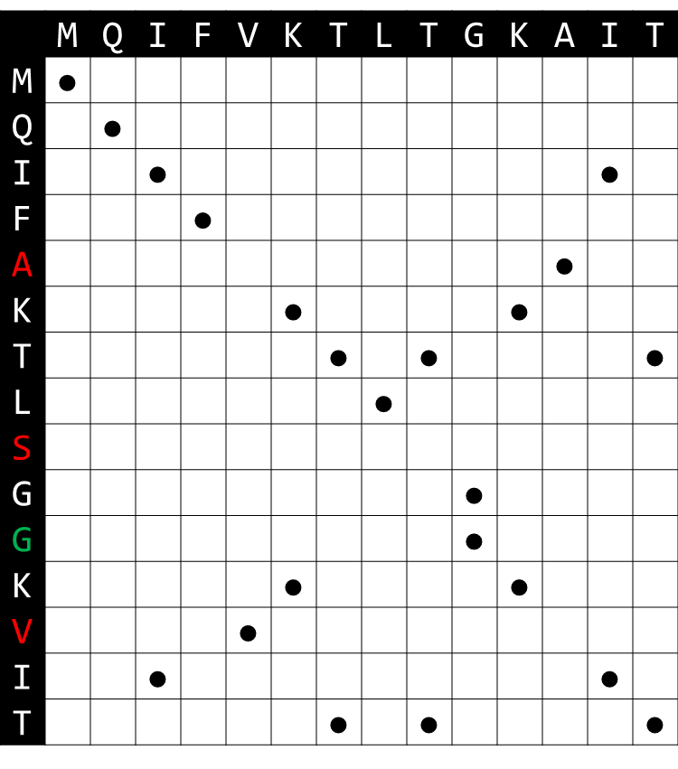
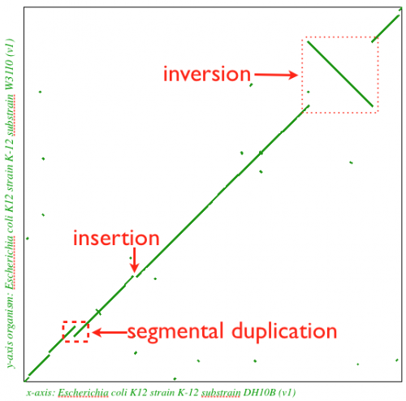
Recall the dot plot...
Very handy for visualizing large-scale changes in genomes
Not as useful as alignment for comparing shorter sequences (genes/proteins)
MUMMER is a piece of software for
performing syntenic analysis

Slide 76
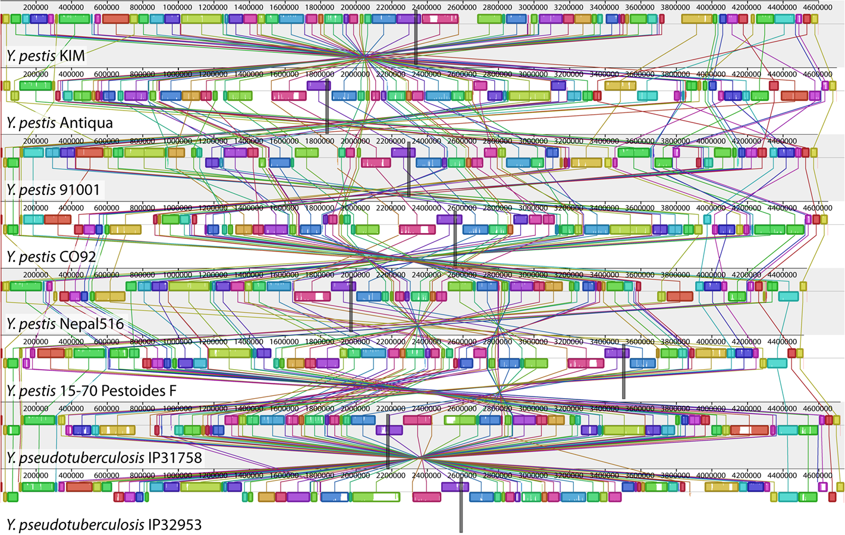
Syntenic analysis of Yersinia genomes in Mauve

Slide 77
Summary
Introduction to molecular evolution
Detecting sequence conservation and evolutionary constraint
Constructing phylogenetic trees
Multiple sequence alignment
Other topics in comparative genomics

