Slide 1
Computational tools setup: Codecademy, Python, and Jupyter
Curtis Huttenhower (chuttenh@hsph.harvard.edu)
Eric Franzosa (franzosa@hsph.harvard.edu)
http://huttenhower.sph.harvard.edu/bst281

Slide 2
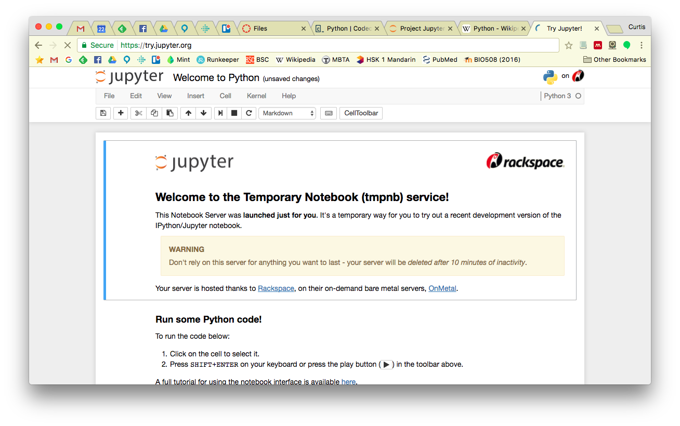
Learning computational tools for quantitative biology
Python: interpreted, imperative, memory-managed language wt. large library.
Codecademy: great learners’ web site
https://www.codecademy.com
Provides documentation, tutorial, runs code, and evaluates progress, all online.
Command line Python scripts and editing
Each program is its own text file, executed and with input/output on the command line.
Best for “real” research – will be used heavily in lab and for all problem sets.
Jupyter (formerly IPython Notebook)
http://jupyter.org
Graphical interface to running small pieces of Python interactively.
Great for documenting specific activities, research or otherwise.

Slide 3
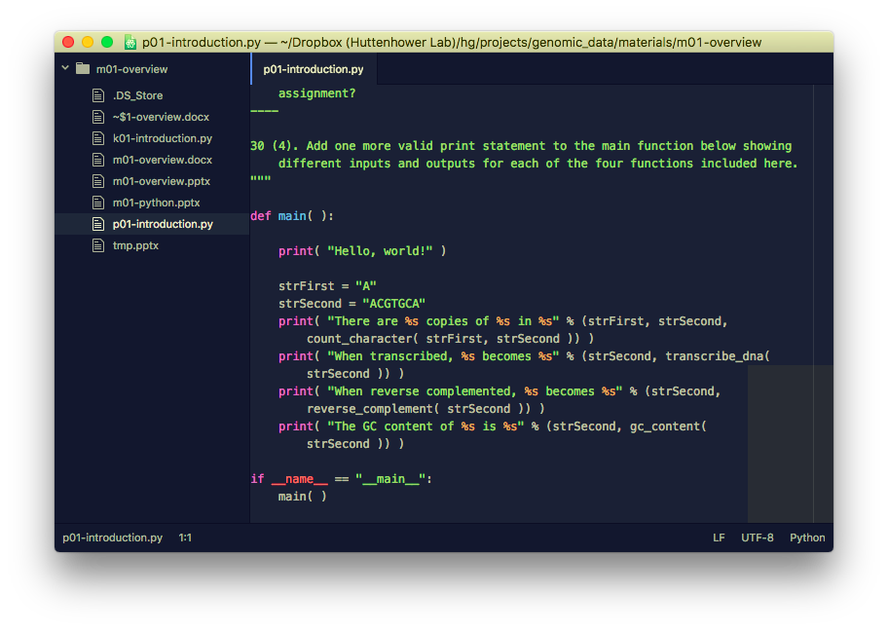
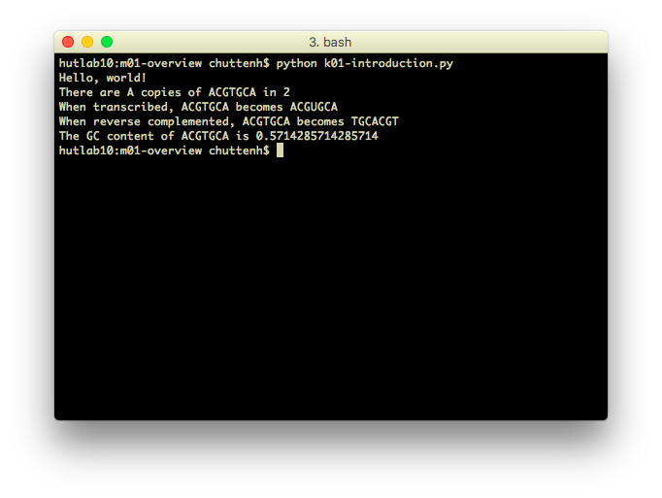
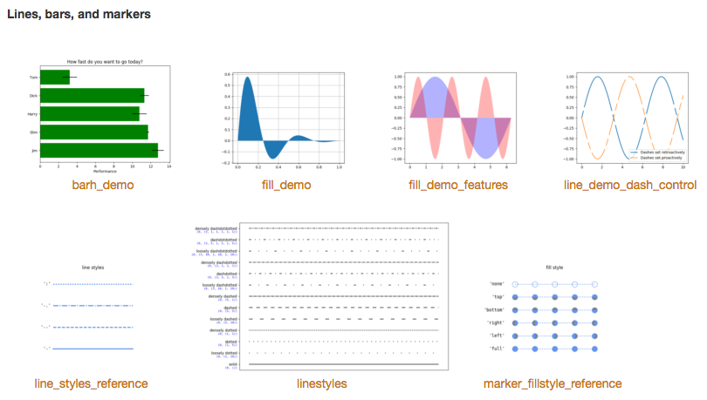
Python
Simple, clean programming language:
Easy to learn.
Widely used (in computational biology and otherwise).
Lots of tools already built in.
Provides an environment that:
Helps you think about data.
Can quickly get simple tasks done.
Like what?
Download lots of data at once.
Change and match formats.
Quality control or filter data.
Generate reports and visualizations.
Perform statistical tests reproducibly.

Slide 4
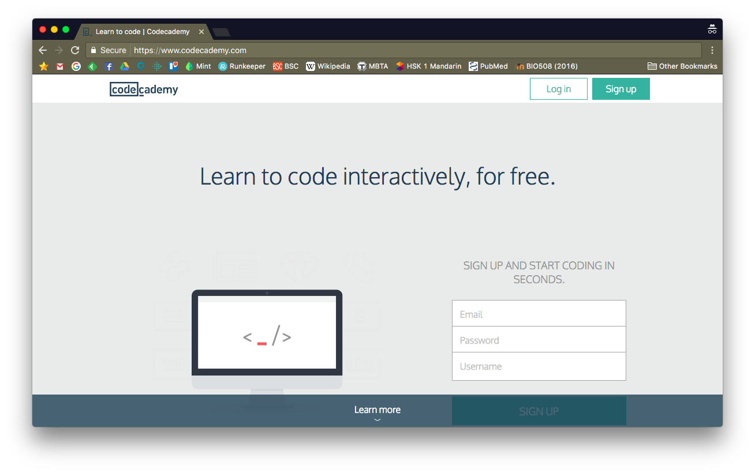
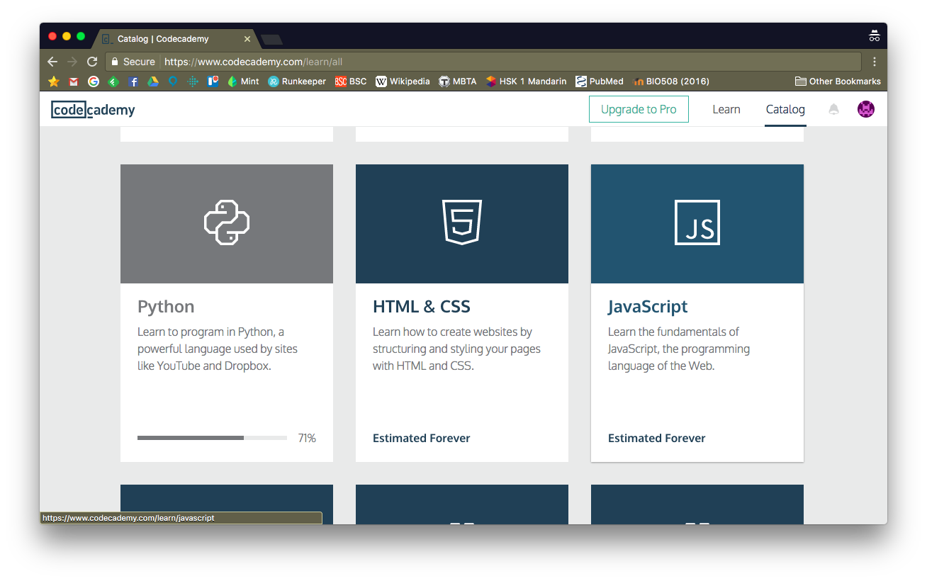
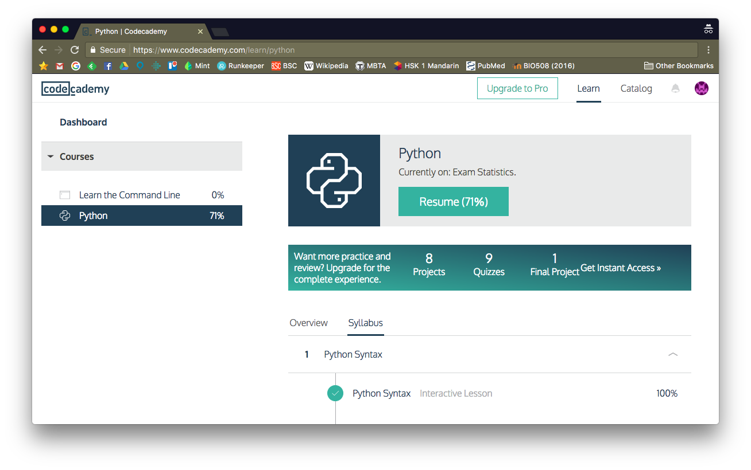
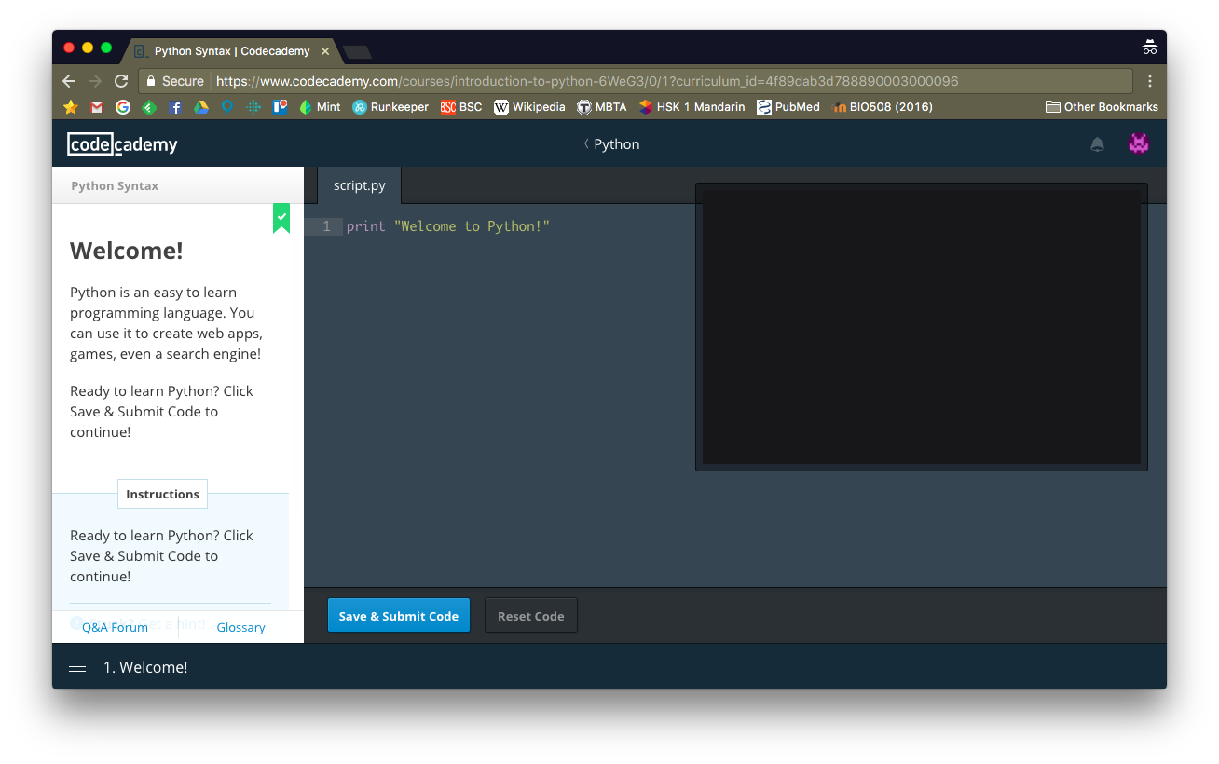
Codecademy

Slide 5
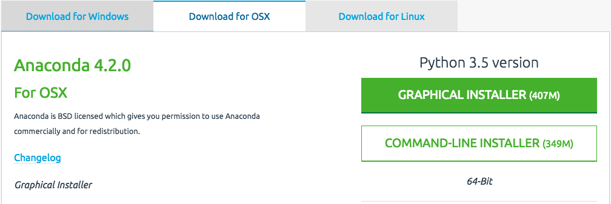
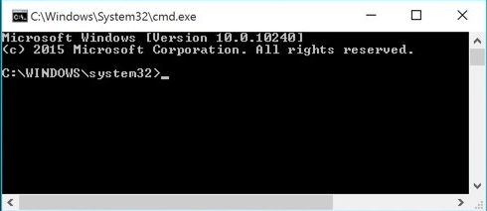
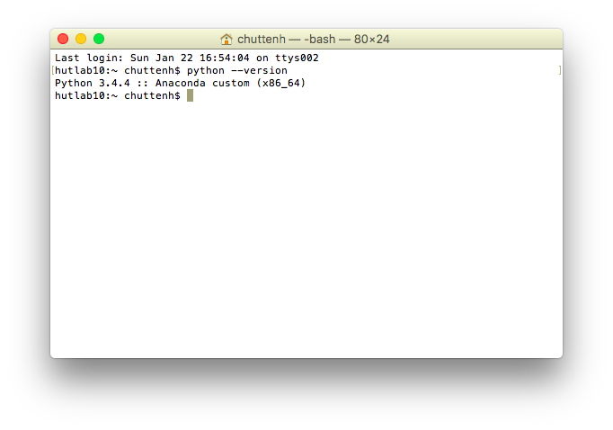
Command line Python
Skip if you already have a working Python 3.
Otherwise, we’ll install one using Anaconda:
https://docs.continuum.io/anaconda/install
Make sure to use Python 3, not 2.
After installation, start a terminal:
macOS: Applications → Utilities → Terminal
Windows 10: Start → All apps → Windows System → Command Prompt
Equivalent in earlier Windows: Start → Programs → Accessories → Command Prompt
Type python --version and press Return.
Lab: more command line syntax and the Python-aware editor Brackets.

Slide 6
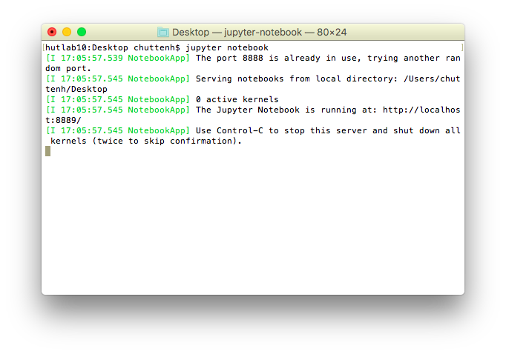
Jupyter
Jupyter (formerly IPython Notebook): web-based graphical interface to interactively run, visualize, and document Python snippets.
In a terminal, type jupyter notebook and press Return.
In the resulting web page, select New → Notebooks: Python 3.
Type exactly print( "Hello, world!" ) and press Shift-Return.
If the result doesn’t look like this, grab someone for help.

Slide 7
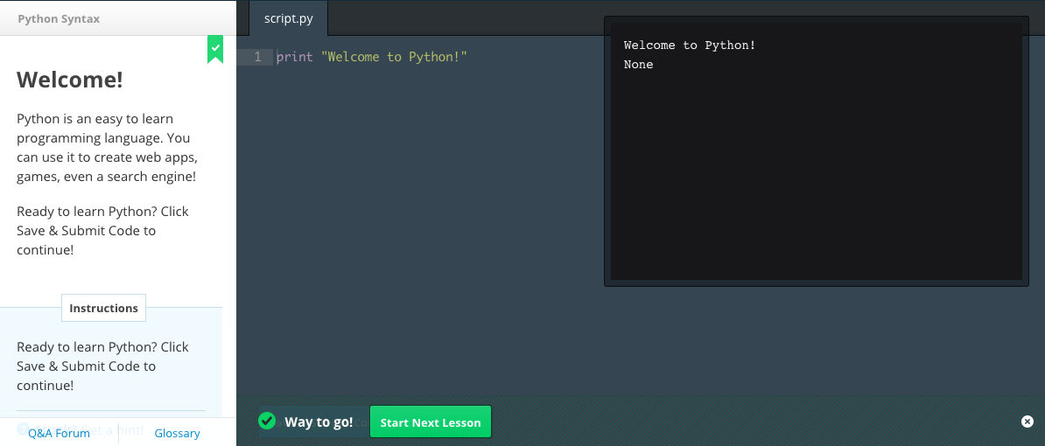
Next steps
Codecademy
Create account, log in, start Python, and run only the very first module (“Welcome!”)
Python
Install Python 3 using Anaconda.
Run python --version from the command line.
Jupyter
Run jupyter notebook from the command line.
Create a new Python notebook and run a print command.

Slide 8
Summary
Python: simple language for learning computing concepts.
Good for data manipulation and analysis.
Large library of existing tools for biological data.
Most important interface is from the command line.
Each program is a text file, run using the command line terminal.
We’ll use this for all problem sets and labs.
Codecademy web service for learning Python syntax.
Plus other computing tools later.
Jupyter.
Graphical interface for documenting and visualizing snippets of Python.

