Slide 1
Codecademy Python 1-2: basic syntax, strings, and output
Curtis Huttenhower (chuttenh@hsph.harvard.edu)
Eric Franzosa (franzosa@hsph.harvard.edu)
http://huttenhower.sph.harvard.edu/bst281

Slide 2
Programming
Controlled language that tells the computer how to do work for us.
Computers are dumb – must be very precise.
Otherwise very much like learning a spoken language: useful for explaining yourself.
Allows us to manipulate data in a controlled, flexible way.
Just like a textbook does the same for information communication between people.
Who’s done some programming before (not including the HMS bootcamp?)
Who’s specifically experienced with Python?
In our context, it’s often “just” a tool, but it’s one with which it’s necessary to be fluent.
Pipetting isn’t research, but it’s impossible to do many types of research without understanding it and doing it efficiently and accurately.

Slide 3
Python
Interpreted language (not compiled).
Your programs are plain text files (not Word etc.) that describe data and instructions.
An interpreter reads them in, figures out what they mean, and (hopefully) does it.
Any programming language has a specific syntax.
Formatting conventions that allow the computer to read it precisely.
This includes capitalization, whitespace, indentation, symbols, operators, names…
Handful of important concepts that we’ll see soon:
Data, which can be stored in different locations using different types.
Instructions, which manipulate data and come in several forms.
Operators, which are simple instructions typically abbreviated using punctuation.
Functions, which are complex instructions typically given a specific name.
Keywords, other instructions built into the language.
Always read and think hard about error messages.
They can be hard to understand, but they usually tell you what went wrong!

Slide 4
Storing information: data and data types
Data are typically stored in variables, which are essentially named buckets.
The bucket contains the data, it’s not the data itself!
variable_name = "value"
In general, data must be of a specific type.
You can add two numbers, or concatenate two strings…
…but you can’t add a number to a string, or concatenate two numbers.
Many built-in data types in Python, but the simplest are:
Strings = sequences of characters surrounded by quotes: "This is a string."
Integers = positive or negative whole numbers: 12345
Floats = numbers with a decimal place: 12.345
Booleans = binary values, True or False: True

Slide 5
Manipulating information: instructions and functions
Functions are the most important type of instruction.
Operators and keywords tend to be special but very specific.
A function is exactly like a recipe or a protocol:
It takes zero or more inputs, of different types (called arguments or parameters).
It produces zero or more results (referred to as a return value).
There’s a difference between running a function and writing one.
Just like a recipe – having it in the book doesn’t actually do anything until you run it.
In Python, a function is called by writing its name followed by parentheses and arguments.
function_name( )
function_name( argument1, argument2, argument3 )
argument1.function_name( argument2, argument3 )
New functions are written using the def keyword – more on that later…

Slide 6
Syntax and formatting
Python loves whitespace – you can’t see it, but the computer can.
In general, whitespace within a line doesn’t matter.
Within a line: just spaces.
At the end of a line: newlines and/or carriage returns, doesn’t matter.
Whitespace at the beginning of a line matters.
At the beginning of a line, spaces or tabs – either fine, but must be consistent (I recommend tabs).
Indentation in Python indicates blocks:
A block is a group of instructions associated with a particular environment.
Within a function, within a conditional, within a loop – keep an eye out for these later.
A side comment: external code can be included using import.
External code like this in Python is called a module – more on that later.

Slide 7
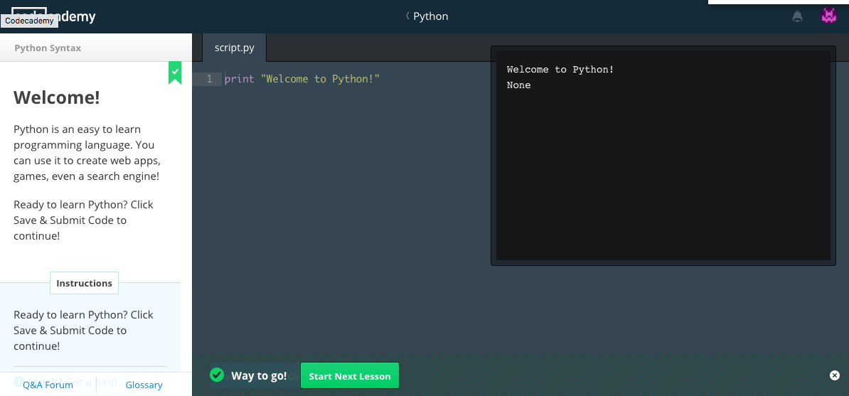
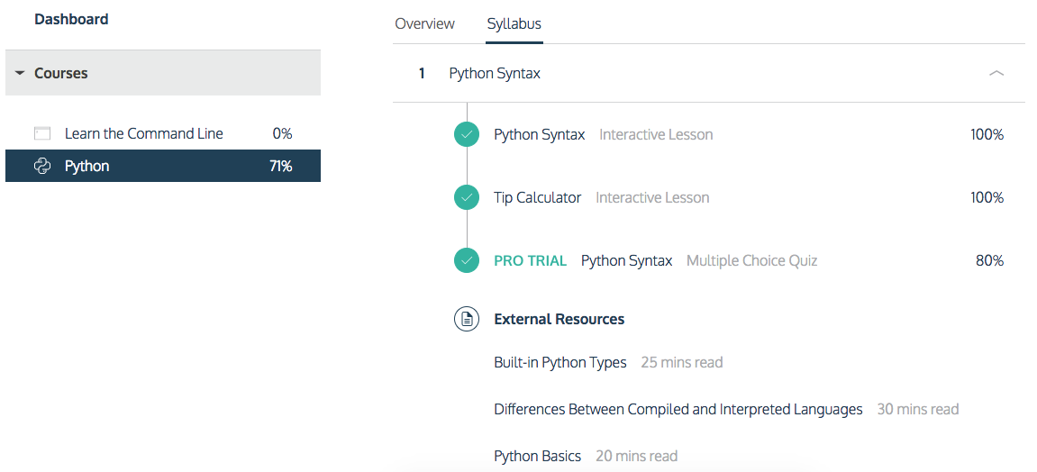
Codecademy
Load it up and do modules 1-2.
Check out the “External Resources” links as needed.
You can press Command- or Control-Return to execute code.
And use the circled X in the lower right if you need to rerun it.
Do take the sample “Python Syntax” quiz from the first module, it’s useful!

Slide 8
Concluding thoughts
Strings can use ' or " equivalently.
'this' is the same as "this".
I’ll always use double quotes for si.mplicity + visibility.
Tired of retyping variable names when using arithmetic operators?
iNumber = iNumber + 1
Be constructively lazy! Use assignment operators instead: iNumber += 1
Available for all basic operators, e.g. dFloat /= 2
What are those funny variable names? Hungarian notation.
Helps you (not the computer) keep track of what’s in a variable.
String = str, int = i, float = d (for double), boolean = f (for flag)
You’ll see others as they come along…
Need some help? Read the docs!
http://docs.python.org

Slide 9
Summary
Programming gets research done for you!
Python is one controlled language that can be used to instruct the computer.
Interpreted in a particular syntax describing data and instructions.
Instructions = functions, operators, keywords.
1 + 2 and function( arguments )
Data = strings, integers, floats, booleans, and more to come.
Stored in variables, which are named buckets.

