Slide 1
Data input and output in Python
Curtis Huttenhower (chuttenh@hsph.harvard.edu)
Eric Franzosa (franzosa@hsph.harvard.edu)
http://huttenhower.sph.harvard.edu/bst281

Slide 2
Topics
Namespaces, modules, and import
Input and output in Python
Input and output from the command line

Slide 3
Namespaces and modules
Python groups all variable names into namespaces or environments.
We've seen this earlier for local environment blocks in functions
Each Python file is also a module that likewise groups its own variables.
Unlike functions, variables within modules are accessible using the dot operator .
This is the same dot operator that targets functions.
In this case, it targets a name to a namespace
Local variables (including functions) are referred to by name: aiSomeList
Variables/functions in a module are targeted:
someModule.aiSomeList
someModule.someFunction( )

Slide 4
Import
You can specify which modules are targetable using the import command.
e.g. import someModule would let you run the commands above.
This is similar to taking a someModule.py file and pasting it into your current file.
But Python preserves the local environment by using the . operator.
Python provides a bunch of built-in functions as modules you can import:
http://docs.python.org
Keeping these in an enclosed namespace helps to keep the environment clean by preventing name litter.
abs is a global function; you can't safely write your own function named abs.
The function random to generate a random number lives in the module random.
Thus it can only be called using import random and then random.random( )
This lets you create your own local def random( ) function with impunity.

Slide 5
import sys
The sys module is easily the most-used Python module.
Provides functions and values that let your programs interface with the outside world.
Hence "sys" for system: it links programs to the system on which they're running.
The variable sys.argv holds a list of command line arguments (as strings).
You can provide additional arguments to your script:
python script.py one 2 three
sys.argv[0] is always the file name of your Python script
Thus above, sys.argv = ["script.py", "one", "2", "three"]
And len( sys.argv ) - 1 is the number of additional arguments provided.

Slide 6
import sys
Example: factorial.py
import sys
def factorial( iN ):
iRet = 1
for i in range( 1, iN + 1 ):
iRet *= i
return iRet
print( factorial( int(sys.argv[ 1 ]) ) )
Running:
python factorial.py 5 → 120
python factorial.py 10 → 3628800
Now you don't have to edit the code itself to generate new information!

Slide 7
Input and output streams
This is a limited way to get data in and out, though…
We can do better!
IO = Input and Output
All Python IO is performed using streams:
Virtual cursors that move through input or write output.
Input streams return data at current position and advance when read:
strInput = istm.read( )
Output streams act like print, write data to current position and advance:
ostm.write( strOutput )

Slide 8
Input streams
istm
istm
This is
a
text file.
strIn = istm.read( 5 )
This is
a
text file.
strIn = "This "

Slide 9
Output streams
ostm
This is
ostm.write( "\na\ntest." )
This is
a
test.
ostm

Slide 10
sys.stdin and sys.stdout
Two built-in input and output streams: standard in and out.
By default, standard output is printed to the screen (exactly like print).
By default, standard input is typed on the keyboard.
They can be used like any other (e.g. file) input/output streams:
sys.stdout.write( "What is your name?\n" )
strName = sys.stdin.readline( )
sys.stdout.write(”Hello, %s\n" % strName )
Unlike print, write does not append a newline!
Otherwise, they’re exactly the same – print is a write to stdout!

Slide 11
Standard input and output redirects
The real power of stdio lies in redirects.
Allows any file to be “hooked up” to standard in, or out, instead of the defaults.
Managed entirely by the system and Python, no work needed from you!
Just use < to provide an input filename, > to provide an output filename.
For example, to randomly subset 10% of lines from a file in subset.py:
import random
import sys
for strLine in sys.stdin:
if random.random( ) < 0.1:
sys.stdout.write( strLine )
Then run:
python subset.py < complete_input_file.txt > subsetted_output_file.txt

Slide 12
sys.stderr
Final built-in output stream is standard error.
Made to immediately report printed output to console; great for debugging!
Will be printed to the screen even if standard output is redirected.
For example, if demo.py contains:
sys.stdout.write( "This will be stored in a file." )
sys.stderr.write( "This will be shown on screen." )
Then after running:
python demo.py > demo.txt
The file will contain the first string, and the screen will display the second.
You can redirect stderr separately using 2> if you really want to…

Slide 13
Some gotchas
Note that by default, writing to an output stream overwrites the target.
This is a great way to delete files by mistake!
This is true both for open and for > redirects.
Beware of line endings (EOLs) – they are a constant pain.
Macs use carriage returns, \r.
Linux uses newlines, \n.
Windows uses both, \r\n.
Python in text IO mode will attempt to guess the right one(s), but…
Text mode will not work for non-text files, and vice versa.
It doesn’t always guess right.
If in doubt, use \n alone.
Don’t forget to .close or .flush output streams.
“Normal” output streams can buffer their output indefinitely.
This means that print / write / etc. do not always show up if things go wrong.
stderr is special and unbuffered so you can immediately see requested output.

Slide 14
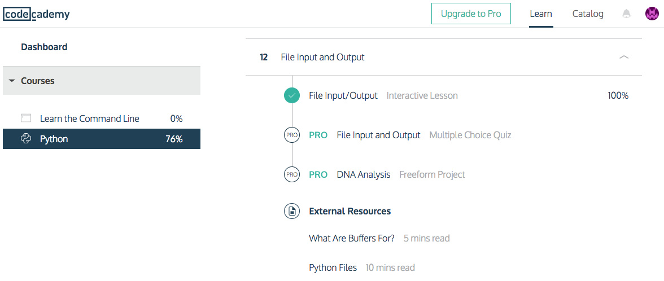
Codecademy 12: File input and output
Two bugs in this one!
In “Reading between the lines,” add at top:
ostm = open( "text.txt", "w" )
ostm.write( "a\nb\nc\n" )
ostm.close( )
In “Case closed,” you must not use a space in .closed().

Slide 15
Summary
Namespace = group of variables in the same module.
Accessed using the import command.
Lots and lots built in: see http://docs.python.org.
File IO = input and output
Performed in Python (and many languages) using streams.
Virtual cursors that read or write from a location and advance.
Don’t forget to handle end-of-line characters in input and output.
import sys
sys.argv
sys.stdin, sys.stdout, and sys.stderr
./script.py < input.txt > output.txt
istm = open( "file.txt", "r" )
strInput = istm.readline( )
ostm = open( "file.txt", "w" )
ostm.write( strOutput )
i/ostm.close( )
for strLine in open( "file.txt", "r" ):
…
import csv
for astrLine in csv.reader( istm, csv.excel_tab ):
…
with csv.writer( ostm, csv.excel_tab) as csvw:
csvw.writerow( [strOne, iTwo, dThree] )

