Slide 1
File utilities and command environments
Curtis Huttenhower (chuttenh@hsph.harvard.edu)
Eric Franzosa (franzosa@hsph.harvard.edu)
http://huttenhower.sph.harvard.edu/bst281

Slide 2
The unix and linux (*nix) philosophy
Work at the command line (terminal)
Manipulate data as text, often with tab-delimited rows
Build/use programs that perform specific tasks very well
Chain together programs to perform complex tasks
“Chaining” involves passing data as STDIN/STDOUT streams

Slide 3
The command line and you
Being comfortable on the command line is helpful for data analysis/coding
Command line tools save you from reinventing the wheel
The data analysis programming trifecta:
Command line experience
A utility language for data manipulation (e.g. Python)
A statistical analysis and graphics language (e.g. R, though Python works too)
The command line is a 90/10 learning process:
90% of the data questions you’ll encounter can be answered with 10% of the command line functionality (which you can master in a few weeks)
The rest you pick up bit-by-bit over your career

Slide 4
Using command-line tools
If you’re on a mac (or Linux), you have all of these built-in
Not available by default in Windows command prompt, but a few options:
Cygwin (mini-Linux that runs as a terminal program on Windows)
Windows 10 Bash shell (experimental)
GOW (Gnu on Windows) lightweight Cygwin alternative
Installs ~100 basic linux programs for use in the default Windows Command Prompt
This is what I use

Slide 5
*nix utilities: man
What does it do?
Displays a “manual” page for another tool, detailing expected input data and optional flags
Usage
$ man less
Options | What does it do?
Q | [within program] Exits the current man page

Slide 6
*nix utilities: man
LESS(1) General Commands Manual LESS(1)
NAME
less - opposite of more
SYNOPSIS
less -?
less --help
less -V
less --version
less [-[+]aABcCdeEfFgGiIJKLmMnNqQrRsSuUVwWX~]
[-b space] [-h lines] [-j line] [-k keyfile]
[-{oO} logfile] [-p pattern] [-P prompt] [-t tag]
[-T tagsfile] [-x tab,...] [-y lines] [-[z] lines]
[-# shift] [+[+]cmd] [--] [filename]...
(See the OPTIONS section for alternate option syntax with long option names.)
DESCRIPTION
Less is a program similar to more (1), but it has many more features. Less does not have to read the entire input file before starting, so with large
input files it starts up faster than text editors like vi (1). Less uses termcap (or terminfo on some systems), so it can run on a variety of terminals.
There is even limited support for hardcopy terminals. (On a hardcopy terminal, lines which should be printed at the top of the screen are prefixed with a
caret.)
Commands are based on both more and vi. Commands may be preceded by a decimal number, called N in the descriptions below. The number is used by some com‐
mands, as indicated.
COMMANDS
In the following descriptions, ^X means control-X. ESC stands for the ESCAPE key; for example ESC-v means the two character sequence "ESCAPE", then "v".
h or H Help: display a summary of these commands. If you forget all the other commands, remember this one.
SPACE or ^V or f or ^F
Scroll forward N lines, default one window (see option -z below). If N is more than the screen size, only the final screenful is displayed. Warn‐
ing: some systems use ^V as a special literalization character.
z Like SPACE, but if N is specified, it becomes the new window size.

Slide 7
*nix utilities: ls
What does it do?
List files in the current directory
Usage
$ ls # list all files in current directory
$ ls *.txt # list all text files
Options | What does it do?
-l | List file details
-h | Human-readable file sizes (e.g. 3.3MB vs. 3354123)
 | Lots of build in sorting options (size, type, last update, etc.)

Slide 8
*nix utilities: rm
What does it do?
Deletes (removes) a file PERMANENTLY
Usage
$ rm my_file
Options | What does it do?
-r | Force-remove a directory (will fail by default)
-i | Confirm each deletion event

Slide 9
*nix utilities: cp
What does it do?
Copy a file
Usage
$ cp my_file my_copy
Options | What does it do?
-i | Warn before overwriting a file
-r | Copy recursively (needed for copying directories)

Slide 10
*nix utilities: mv
What does it do?
Move a file to a new location (or rename a file)
Usage
$ mv my_file MY_FILE # rename my_file as MY_FILE
$ my /my_dir/my_file . # move file “here” (.)
Options | What does it do?
-i | Warn before overwriting a file

Slide 11
Path syntax
$ is used to indicate the start of a command (your prompt may look different)
$ command
/ is the root of the file system (C:\ on Windows, typically; note the backslash)
$ ls /
A subdirectory of the root directory
$ ls /my_dir/
. refers to the current directory
$ wc -l ./my_file.txt $ cp /my_dir/my_file.txt . # copy file “here”
.. refers to the parent directory
$ mv ../my_file.txt .

Slide 12
*nix utilities: cat
What does it do?
Dumps files on disk to STDOUT (for feeding into another program)
Usage
$ cat my_file # lines of file scroll over screen
$ cat my_file | program # lines of file enter program as STDIN
$ cat *.txt | program # concatenate all text files as STDIN

Slide 13
*nix utilities: less
What does it do?
View a file or data stream with navigation options
Usage
$ less my_file
$ cat *.txt | less # ‘less’ is often used at the end of a chain
Options | What does it do?
-S | Don’t wrap long lines
←↑→↓ | Arrow keys to navigate in file (PageUp, PageDown, Home, End work too)
/ | [in program] Search for text, use n and N to see next/previous matches

Slide 14
*nix utilities: grep
What does it do?
Isolate lines of a data stream (file or STDIN) that match a pattern
Usage
$ grep pattern my_file
$ cat *.txt | grep pattern
Options | What does it do?
-P | Richer pattern options (regular expressions); more on these in a later lecture
-v | Isolate lines that DO NOT match the pattern (invert the match)
-i | Case-insensitive match
-f | Specify a file of patterns to match (slow if there are lots of options)

Slide 15
*nix utilities: cut
What does it do?
Isolate tab-delimited columns of a data stream. First column is #1 (not #0 as in Python).
Usage
$ cut -f2 my_file # isolate the 2nd column of the file
$ cut -f2,3 my_file # isolate columns 2 and 3
$ cut -f2-5 my_file # isolate columns 2 THROUGH 5
$ cut -f3- my_file # isolate columns 3 to END (python [2:] slice)
Options | What does it do?
-f | Select columns (fields)
-t‘char’ | Break columns on the specified character instead of tab, e.g. -t‘,’ for .csv file

Slide 16
*nix utilities: sort
What does it do?
Sort the lines of a data stream (alphabetically)
Usage
$ sort my_file
Options | What does it do?
-r | Reverse the sort
-k N | Sort on the value of WHITESPACE-delimited column N
-t‘char’ | Specify the delimiter character (e.g. -t‘\t’ for tab)
-n | Perform a numeric sort (otherwise 10 comes before 2)

Slide 17
*nix utilities: uniq
What does it do?
Isolate the unique ADJACENT lines of a data stream
Usage
$ sort my_file | uniq # w/o sorting, non-adjacent repeats missed
Options | What does it do?
-c | Count the occurrence of each unique line

Slide 18
*nix utilities: wc
What does it do?
Counts the lines, words, and characters of a data stream
Usage
$ wc my_file
Options | What does it do?
-l | Only report line count (faster, and often all you want)
-w | Only report word count
-c | Only report character count

Slide 19
*nix utilities: head/tail
What does it do?
Stream the first/last (tail/head) lines of a data stream (default 10)
Usage
$ head my_file
$ head -n 100 my_file | tail # Stream lines 91-100
Options | What does it do?
-n N | Stream N lines instead of default 10

Slide 20
*nix utilities: column
What does it do?
“Normalize” the widths of column entries (Excelify your data)
Usage
$ column -t my_file
Options | What does it do?
-s‘char’ | Specify the delimiter character (e.g. -s‘\t’ for tab); default = any whitespace

Slide 21
*nix utilities: sed
What does it do?
Edit a data stream, most often used for find/replace operations
Usage
$ sed “s/find/replace/g” my_file
$ sed “s/apple/banana/g” my_file # replace all instances of “apple” with “banana”
Options | What does it do?
-i | Edit file “in place” (use with caution)
 | “find” can be a regular expression, and “replace” can use captured elements of the pattern (this will make more sense after our regular expressions lecture).

Slide 22
Chaining programs
Most programs read from STDIN and write to STDOUT
To start a chain:
cat *.txt
Useful for processing multiple files, changing the first command in the chain
grep “Hello” my_file.txt
Read file as first argument
grep “Hello” < my_file.txt
Another way to provide a single file as STDIN
Use the pipe ‘|’ to direct STDOUT of program N as STDIN of program N+1
grep “Hello” my_file.txt | sort
Can do this repeatedly
grep “Hello” my_file.txt | sort | uniq | wc -l
Dump the results to a file (OVERWRITES!)
grep “Hello” my_file.txt | sort | uniq | wc -l > hello_count.txt

Slide 23
*nix utilities: diff
What does it do?
Compare two TEXT files and display differing lines
Usage
$ diff my_file1 my_file2

Slide 24
Chaining programs
patient_data.tsv
UNIQUE_ID | SUBJECT_NAME | SUBJECT_ZIP
134245 | Smith, John | 02135
102135 | Doe, Jon | 02134
... | ... | ...
What does this do?
$ cut -f3 patient_data.tsv | grep “02135” | wc -l
What does this do?
$ cut -f3 patient_data.tsv | sort | uniq | wc -l
What does this do?
$ sed “s/, Jon/, John/g” patient_data.tsv | grep “, John” | wc -l

Slide 25
Chaining programs
Consider hmp2012_metadata.tsv
(Simplified) metadata for Human Microbiome Project samples
Each sample comes from a body site of a particular subject at a given visit
Questions:
How many unique subjects? Body sites?
What are the six most commonly sampled body sites?
How many “Retroauricular_crease” (ear) samples, ignoring left/right distinction?
How many subjects contributed more than 10 samples?
How many (subject, body site) pairs were sampled 3 times?
Are there any technical replicates?
Unique samples with same (subject, body site, visit) triple

Slide 26
Chaining programs (solutions)
How many unique subjects?
cut -f2 hmp2012_metadata.tsv | grep -v "SUBJECT_ID" | sort | uniq | wc -l
ans = 103
How many unique body sites?
cut -f4 hmp2012_metadata.tsv | grep -v “BODY_SITE" | sort | uniq | wc -l
ans = 16
What are the six most commonly sampled body sites?
cut -f4 hmp2012_metadata.tsv | sort | uniq -c | sort | tail -n 6
ans = Posterior_fornix, Anterior_nares, Buccal_mucosa, Supragingival_plaque, Tongue_dorsum, Stool
How many “Retroauricular_crease” (ear) samples, ignoring left/right distinction?
cut -f4 hmp2012_metadata.tsv | sed "s/^[LR]_//g" | sort | uniq -c
27

Slide 27
Chaining programs (solutions, cont.)
How many subjects contributed more than 10 samples?
cut -f2 hmp2012_metadata.tsv | sort | uniq -c | sort | tail -22
ans = 21
How many (subject, body site) pairs were sampled 3 times?
cut -f2,4 hmp2012_metadata.tsv | sort | uniq -c | sort | tail -16
ans = 15 (including pairs sampled >3 times)
Are there any technical replicates?
cut -f2,3,4 hmp2012_metadata.tsv | sort | uniq -c | sort
ans = yes

Slide 28
Calling command-line tools in Python: subprocess
import subprocess
subprocess.call( “ls -l | wc -l”, shell=True )
Runs the given command
Output goes to the screen when command is FINISHED
subprocess.check_output( “ls -l | wc -l”, shell=True )
Runs the given command
Output returned as a STRING when command is FINISHED
Can then be manipulated in Python
Multiline output delimited by “\n”
subprocess.Popen( ) for more advanced options
Provides a “handle” to the process that you can interact with (like a file handle)
E.g. live-stream output rather than waiting for process to finish

Slide 29
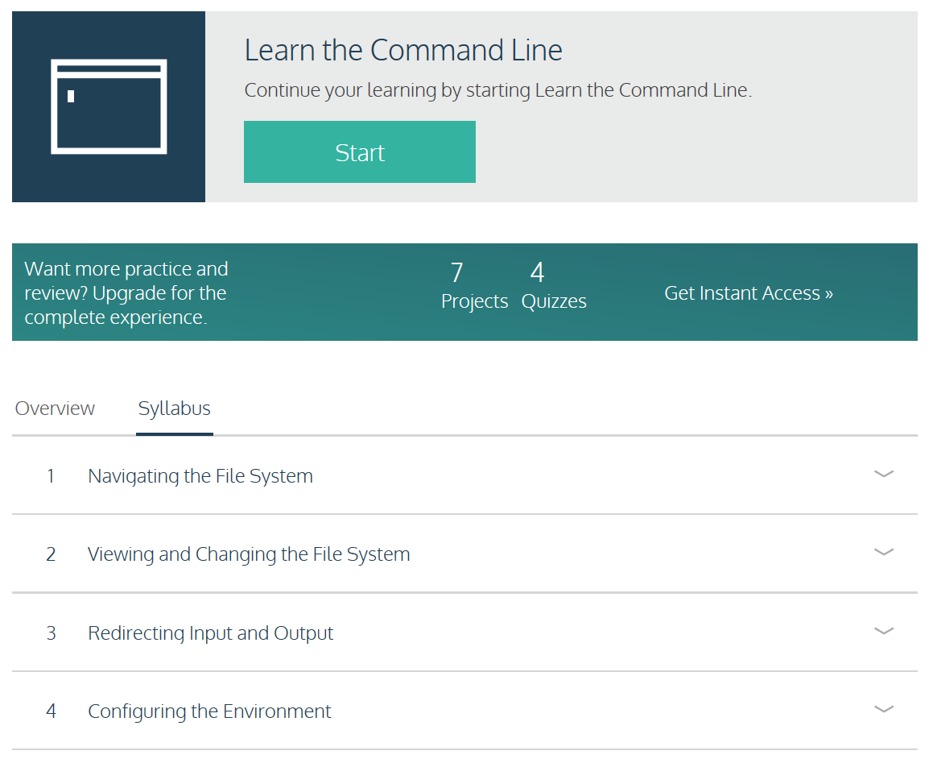
https://www.codecademy.com/learn/learn-the-command-line

