Slide 1
Quantitative Methods: Descriptive Statistics
Curtis Huttenhower (chuttenh@hsph.harvard.edu)
Eric Franzosa (franzosa@broadinstitute.org)
http://huttenhower.sph.harvard.edu/bst281

Slide 2
Topics
Why quantitative methods
Simple descriptive statistics
Descriptive statistics for paired data (comparisons)
Basics of probability

Slide 3
A simple experiment
Create a 5,000 x 15 matrix of random values
"Genes" and "samples"
Find gene most correlated with "Age"
Does this gene truly predict longevity?
Feature | Sample1 | Sample2 | Sample3 | Sample4
Age | 0.150953 | 0.821741 | 0.158316 | 0.898557
Gene1 | 0.801808 | 0.491848 | 0.608064 | 0.583391
Gene2 | 0.146415 | 0.922903 | 0.547641 | 0.344042
Gene3 | 0.219748 | 0.844069 | 0.39559 | 0.314302
Gene4 | 0.613934 | 0.685797 | 0.512878 | 0.986288
Gene5 | 0.322305 | 0.149985 | 0.106558 | 0.659032
Gene6 | 0.667529 | 0.508563 | 0.57018 | 0.803856
Feature | Sample1 | Sample2 | Sample3 | Sample4
Age | =RAND()
Gene1
Gene2
Gene3
Gene4
Gene5
Gene6
…
…
Pearson correlation = 0.81

Slide 4
Descriptive and inferential statistics
Descriptive statistics summarize information already present in data
Visualizations like boxplots, histograms, etc.
Summary measures like averages, standard deviation, median, etc.
Inferential statistics use a sample of data to make predictions about larger populations or about unobserved/future trends
Any measurements made in the presence of noise or variation
Generalizations from a sample to a population
Confidence intervals, hypothesis tests, etc.
Comparisons made between datasets
Comparisons, correlations, regress, etc.

Slide 5
Statistics describe different types of data
Categorical values take one of a discrete set of unordered values
A tissue type: blood/skin/lung/GI/etc.
Ordinal values take one of a discrete set of ordered values
Counts or rank orders
Often (but not always) analyzed in the same way as continuous values
Continuous values take one value from an ordered numerical scale
Times, frequencies, ratios, percentages, abundances, etc.

Slide 6
Simple descriptive statistics
A statistic is any single value that summarizes an entire dataset
Parametric summary statistics
Typically used to describe "well-behaved" data that are approximately normally-distributed
i.e. continuous, symmetric, thin-tailed, no outliers
Closeness needed for "approximately" depends on application
Average = Mean = μ = Σx/n

Slide 7
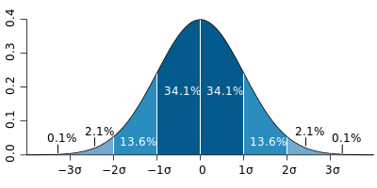



Simple descriptive statistics
$$\sqrt{\frac{\sum{x^{2}}}{n−μ^{2}}}$$
Standard deviation = √Variance = σ = √(Σx²/n-μ²) = (population)
Beware the difference between population and sample standard deviation
or (sample) Why?
Data expressed as z-scores are relative to a dataset's mean and σ
z = (x-μ)/σ
$$\sqrt{\frac{\sum{{(x−μ)}^{2}}}{n−1}}$$
$$\sqrt{\frac{n}{n−1}∙\frac{\sum{x^{2}}}{n−μ^{2}}}$$
99%
95%
2/3

Slide 8
Nonparametric statistics
Can be used to describe any data regardless of distribution
No free lunch: they're less sensitive to false and real signals
Fewer false positives, but potentially fewer true positives, too
Median = m = x[|x|/2] = midpoint of dataset
Percentile = p(y) = x[y|x|] = data point y% of the way "through" dataset
Quartiles = 25th, 50th, and 75th percentiles = {p(0.25), p(0.5), p(0.75)}
Also quintiles, deciles, etc.
Inter-quartile range = IQR = p(0.75) - p(0.25)
Difference between upper and lower quartiles

Slide 9
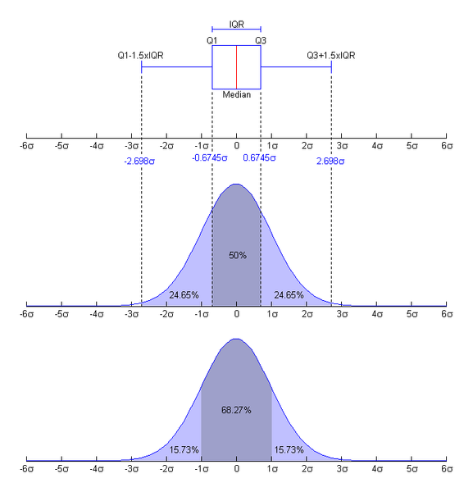
Nonparametric statistics
Deal better with outliers
Fences = bounds on "usual" range of data
Upper fence lies above the 75th percentile p(0.75), lower fence below 25th percentile p(0.25)
Inner fences are 1.5 inter-quartile ranges above/below, outer fences 3 IQRs
Provide a good way to detect outliers
<LIF or >UIF is unusual, <LOF or >UOF is extremely unlikely
*
*
*

Slide 10
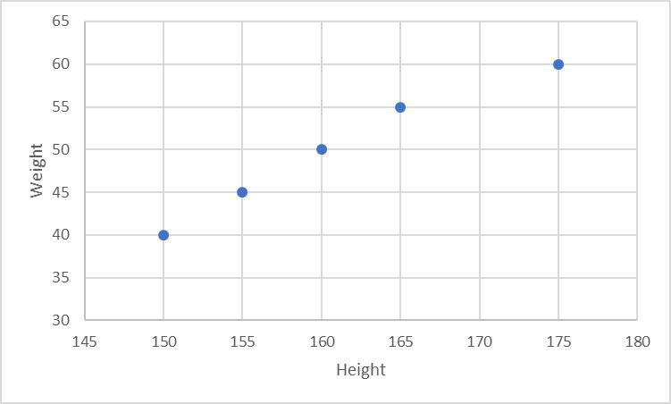
Statistics for paired data: comparisons
What about experiments that result in more than one measurement?
Paired? Multidimensional?
Subject | S1 | S2 | S3 | S4 | S5 | …
Height | 150 | 155 | 160 | 165 | 175 | …
Weight | 40 | 45 | 50 | 55 | 60 | …
Height | 150 | 155 | 160 | 165 | 175
161
Can we generate a "joint" statistic that summarizes something about the "similarity" of two sets of measurements?
Mean
Weight | 40 | 45 | 50 | 55 | 60
50

Slide 11
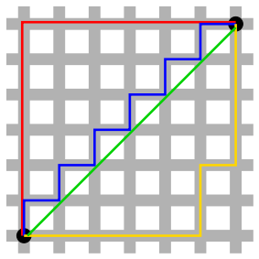
Comparing data: Distances
Appropriate for paired data with the same units
Larger means less similar
Euclidean = e = √Σ(x-y)²
Also the L2 norm
Straight line distance; amplifies outliers
In the range [0, ∞]
Manhattan = m = Σ|x-y|
Also the L1 norm
Grid or absolute distance
In the range [0, ∞]
Indicates how close measurements are in an "absolute" sense

Slide 12
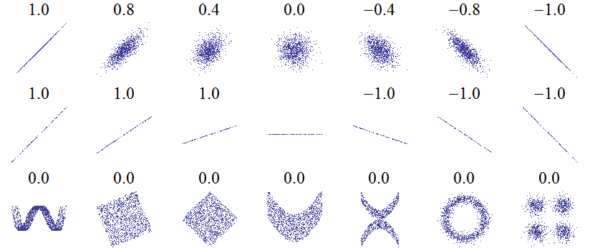
Comparing data: Correlations
Appropriate for "well-behaved" measurements with any units
Can have baked-in parametric assumptions…
Larger means more similar
Pearson = ρ = Σ((x-μ_{x})(y-μ_{y}))/(√Σ(x-μ_{x})²√Σ(y-μ_{y})²)
Location and scale invariant, but assumes normal distribution
In the range [-1, 1]
Cosine = c = Σ(xy)/(√Σx²√Σy²)
Also "uncentered Pearson"
Scale but not location invariant
In the range [-1, 1]
Indicates how much measurements covary around their means.

Slide 13
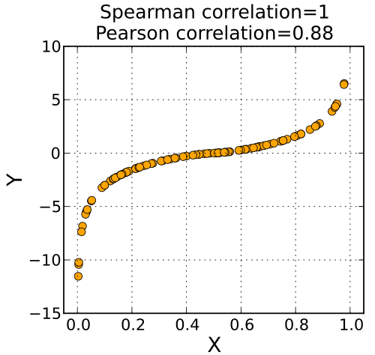
Comparing data: Correlations
Spearman = r = Pearson correlation of ranks (ties ranked identically)
Assesses monotonicity
Nonparametric measure of similarity of trend
Location and scale invariant
In the range [-1, 1]
Indicates whether measurements increase at the same time
Also see Kendall's tau; even more lenient…

Slide 14
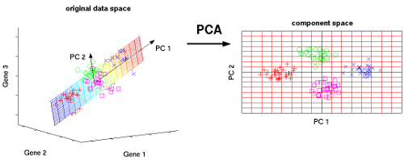
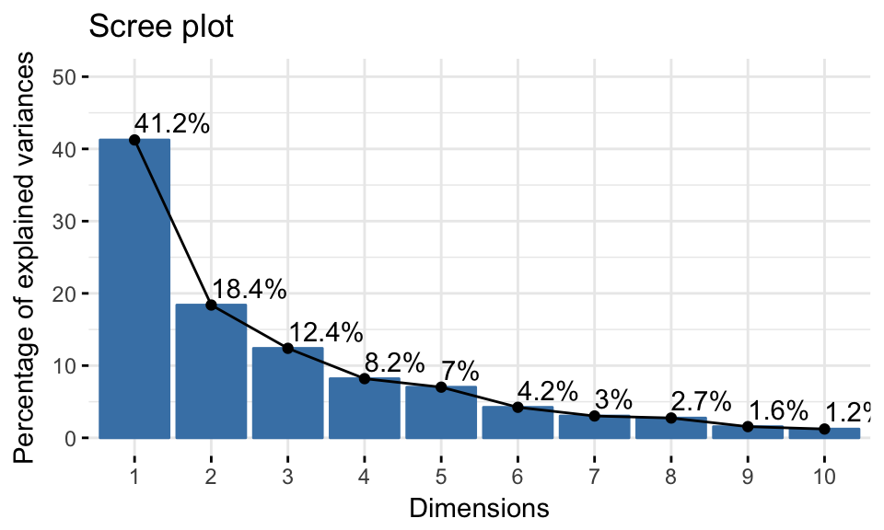
An interesting aside: statistics for high-dimensional data
What about experiments that result in more than one measurement?
Paired? Multidimensional?
Subject | S1 | S2 | S3 | S4 | S5 | …
Height | 150 | 155 | 160 | 165 | 175 | …
Weight | 40 | 45 | 50 | 55 | 60 | …
Age | 16 | 18 | 20 | 22 | 24 | …
Speed | 8 | 8.5 | 9 | 9.5 | 10 | …
… |  |  |  |  |  | …
(18%)
(41%)
http://www.nlpca.org/pca_principal_component_analysis.html

Slide 15
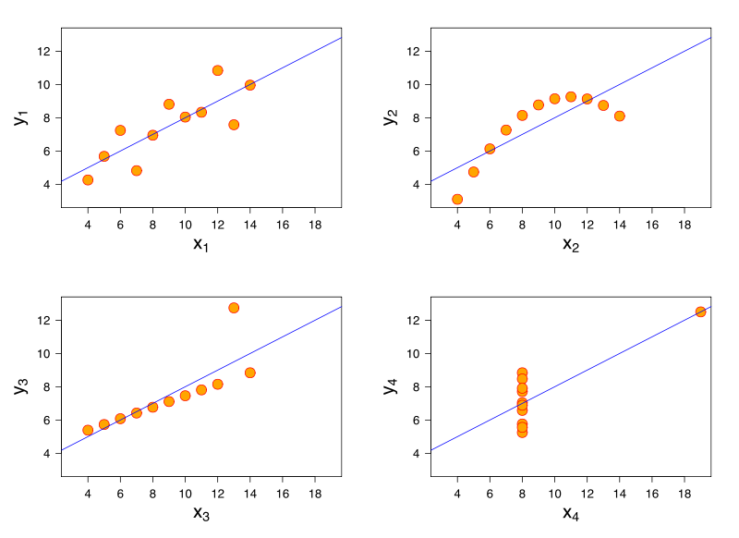
Beware of summary statistics
Anscombe's quartet
Manually constructed in 1973 by Francis Anscombe at Yale
Four pairs of datasets with
Equal means
9 for x and 7.5 for y
Equal standard deviations
11 for x and 4.1 for y
Identical Pearson correlations (0.816)
Yet completely different relationships
Understand and visualize your data before summarizing them

Slide 17
Probability: Basic definitions
Experiment: anything that produces a non-deterministic result
Coin flip, die roll, item count, concentration measurement, distance measurement...
Sample space: the set of all possible outcomes for a particular experiment, finite or infinite, discrete or continuous
{H, T}, {1, 2, 3, 4, 5, 6}, {0, 1, 2, 3, ...}, {0, 0.1, 0.001, 0.02, 3.14159, ...}
Event: any subset of a sample space
{}, {H}, {1, 3, 5}, {0, 1, 2}, [0, 3)
Probability: for an event E, the limit of n(E)/n as n grows large

Slide 18
Probability: Kolmogorov axioms
One definition of "probability" that matches reality
For any event E, P(E)≥0
"Probability" is a non-negative real number
For any sample space S, P(S)=1
The "probability" of an outcome being in the sample space must be 1
For disjoint events E∩F={}, P(E∪F)=P(E)+P(F)
For two mutually exclusive events that share no outcomes...
The "probability" of either happening equals the summed "probability" of each happening independently

Slide 19
Probability: Kolmogorov axioms
Three Kolmogorov axioms
For any event E, P(E) ≥ 0
For any sample space S, P(S)=1
For disjoint events E∩F = {}, P(E∪F) = P(E) + P(F)
P({}) = 0
Every experiment must have some outcome
P(E) ≤ P(F) if E ⊆ F
The probability of more events happening must be at least as great as fewer events
0 ≤ P(E) ≤ 1 for any event E

Slide 20
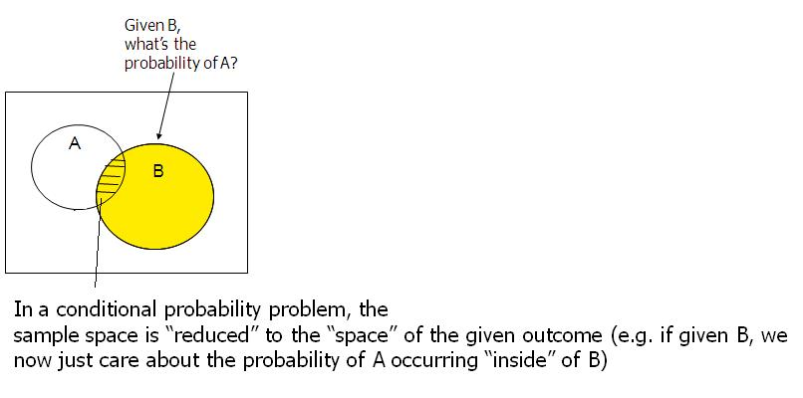
Conditional Probability
The probability of an event given that another event has "already" occurred
The probability of event F given that the sample space S has been reduced to E⊆S
Not necessarily a temporal "already," but can be!
Instead a "knowledge" already, i.e. "is known to have occurred"
Denoted P(F|E) and defined as P(E∩F)/P(E)

Slide 21
Bayes' theorem
P(F|E) = P(E|F)P(F)/P(E)
Provides a means of calculating a conditional probability based on the probability of the "old" event, rather than the "new" event
Typically described in terms of prior, posterior, and support
P(F) is the prior probability of F occurring at all in the first place, "before" anything else
P(F|E) is the posterior probability of F occurring "after" E has occurred
P(E|F)/P(E) is the support E provides for F
Why is this true?

Slide 22
Bayes' theorem: Poker
Pick a card, any card!
Probability of drawing a jack given that you've drawn a face card?
Probability of drawing a face card given that you've drawn a jack?
Pick three cards: probability of drawing (exactly) a pair of aces given that you've drawn (exactly) a pair?

Slide 23
Summary
Descriptive statistics summarize data
Parametric statistics (mean, standard deviation, z-scores)
Assumes the data are "well-behaved"
Nonparametric statistics (median, percentiles, interquartile range)
Uses rank information - no distribution assumption
Comparing datasets
Distances (Euclidean, Manhattan)
Correlations (Pearson, Cosine, Spearman)
Visualize your data!
Histograms, scatterplots, boxplots, etc.
Introduction to probability
Thinking in terms of sets of outcomes; Kolmogorov axioms
Conditional probability and Bayes' theorem

