Slide 1
Epigenetics
Curtis Huttenhower (chuttenh@hsph.harvard.edu)
Eric Franzosa (franzosa@hsph.harvard.edu)
http://huttenhower.sph.harvard.edu/bst281
Slide elements courtesy of:
Shirley Liu
GC Yuan

Slide 2
Final project
Sign up for a final project slot by end of day next Monday!
  Leave time to iterate – rare that first proposed project is accepted without revision.
Email instructional team with:
  Group members (2-5, names + CCed) – can, but doesn’t have to be, same as midterm.
  1-2 paragraph summary of proposed project.
  Date of presentation (April 25, 30, May 2, 7).
    ~3 presentations / day; first come, first served.
Any analysis project incorporating quantitative biomolecular data analysis.
  Scope must be appropriate for number of people and time – not too much, too little.
  Can be drawn from current research.
  Will submit group presentation and code+data package, individual 2-4 page writeup.
    Must include 1-2 figures and appropriate references; aim for 2 pages + citations (and overflow).
30 minute presentation + 5 minutes questions.
  All group members must present.
  Background/motivation, data, methods, results, discussion, questions/next steps.

Slide 3
Epigenetics
Nucleosomes and histones.
  Nucleosome positioning.
  Histone modifications.
DNA methylation.
Chromatin capture.
  3C, 4C, 5C, Hi-C, ChIA-PET…

Slide 4
Epigenetics: a brief primer
Changes in phenotype not caused by changes in genotype.
  Technically, lots of things are epigenetic.
Typically refers to persistent structural changes in DNA storage, not sequence.
  Often, but not always, over multiple cell divisions – sometimes in offspring.
  How DNA is packed, accessible (or not), expressed, etc.
boundless.com

Slide 5
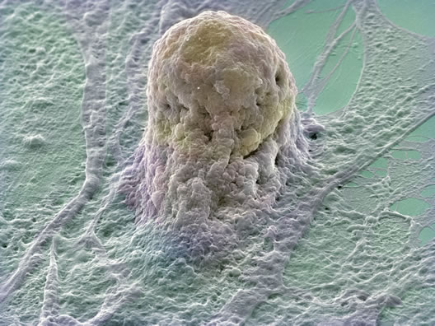
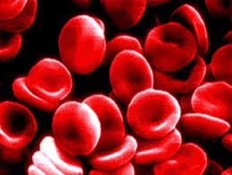
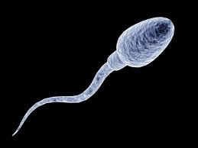
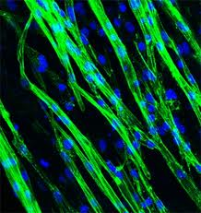
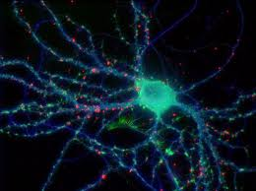
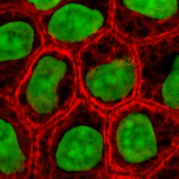
Epigenetic phenotypes
Cell type differentiation – same genome!
Imprinting – some of this can reach offspring.
wallace.genetics.uga.edu

Slide 6
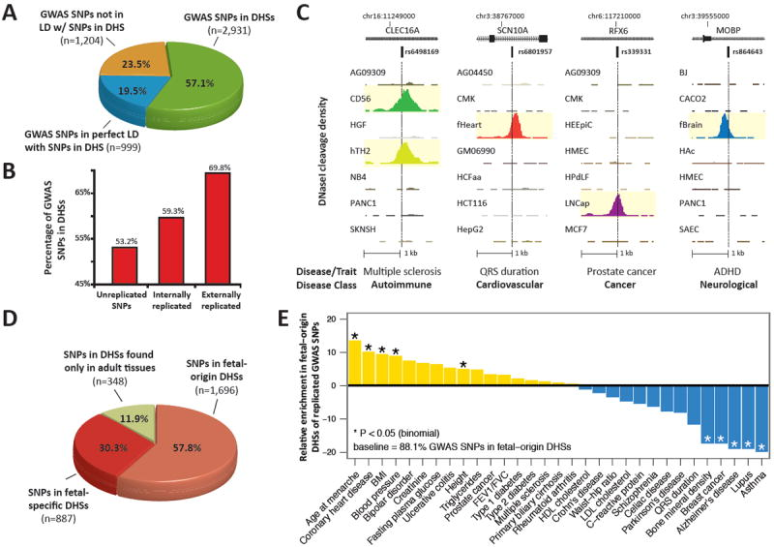
Epigenetic phenotypes
DHS =
DNAse Hypersensitive Site = exposed DNA
Maurano Science 2012

Slide 7
Nucleosomes and histones
Felsenfeld and Groudine 2003

Slide 8
Nucleosomes influence regulation by placement
Bell NRG 2011

Slide 9
Nucleosomes influence regulation by modifications
Bell NRG 2011

Slide 10
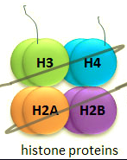
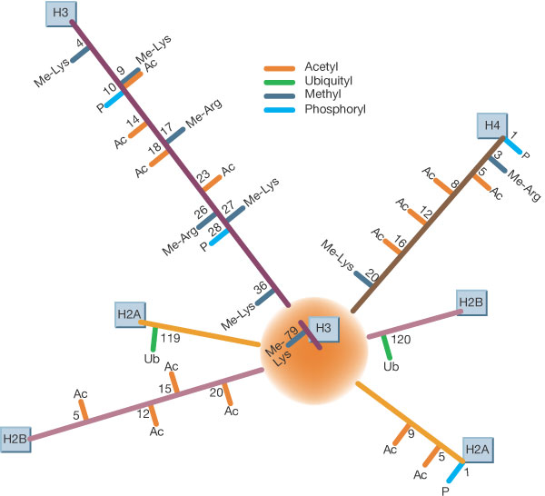
Nucleosomes influence regulation by modifications
Felsenfeld and Groudine 2003

Slide 11

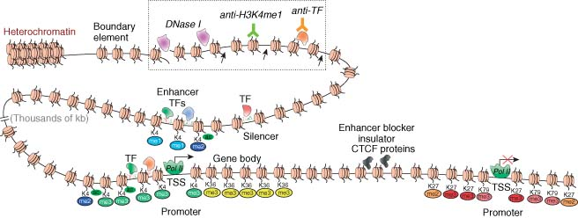
Nucleosomes influence regulation
TF
ACATGT
RNA
Modifications can change placement.
Or change conformational structure.
Or directly modify TF recruitment.

Slide 12
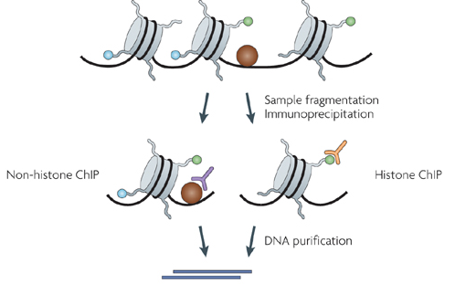
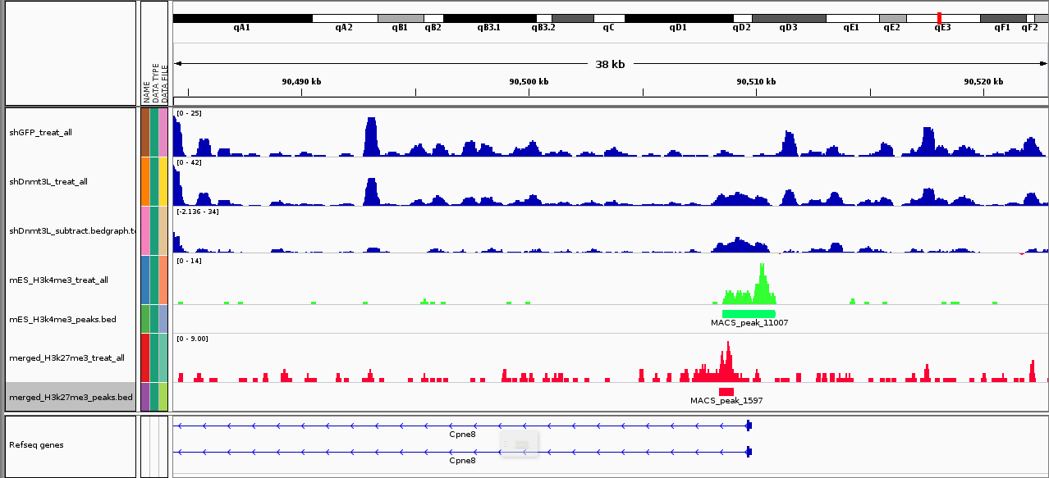
Assaying nucleosome positions by ChIP-*
biocluster.ucr.edu
Felsenfeld 2003

Slide 13
Modeling nucleosome positions
Segal 2006

Slide 14
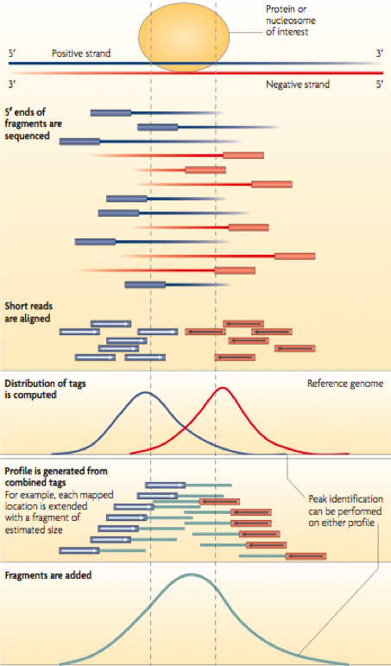
Identifying nucleosome positions
MACS (MACS2) – Liu Lab
Peakseq – Gerstein Lab
SPP – Park Lab
GEM – Gifford Lab
E-Range – Wold Lab
Peak Finder
SICER – Peng Lab
T-Picr – Pachter Lab
biocluster.ucr.edu
Park NRG 2009

Slide 15
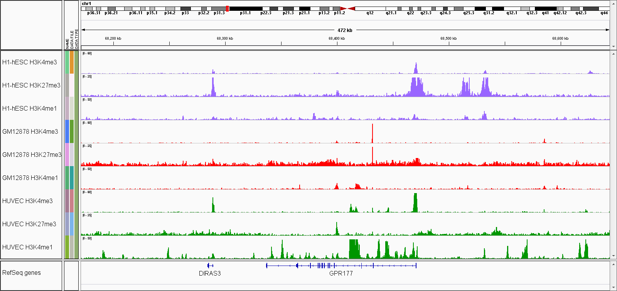
Integrating histone modification patterns
Transcription
Repression
Stem cell
Lymphocyte
Endothelial
Wnt receptor

Slide 16

Integrating histone modification patterns
ChromHMM (Ernst&Kellis); Segway (Hoffman&Noble).
Both are based on hidden Markov models (HMM).
chromatin state
histone mark intensities
Assumptions
Markov property:
Independent obs:

Slide 17
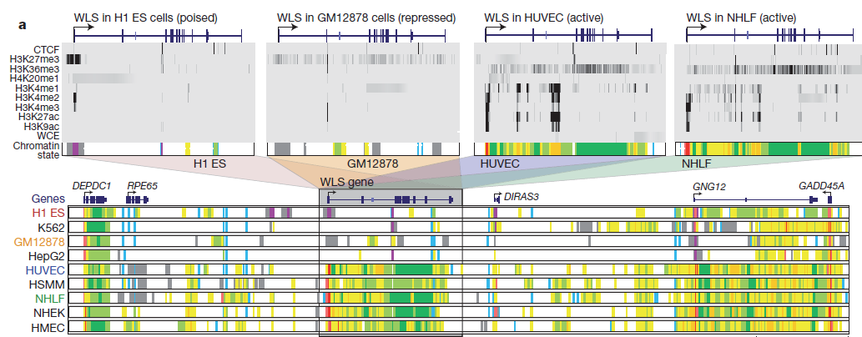
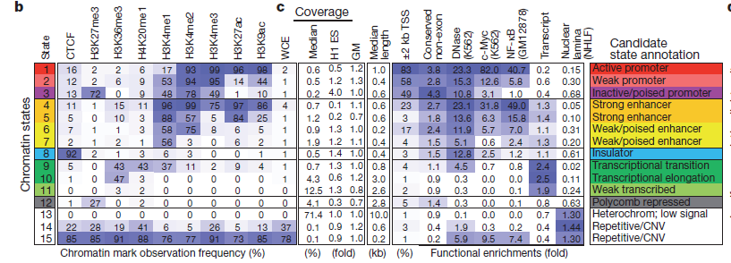
Integrating histone modification patterns
Ernst Nature 2011

Slide 18
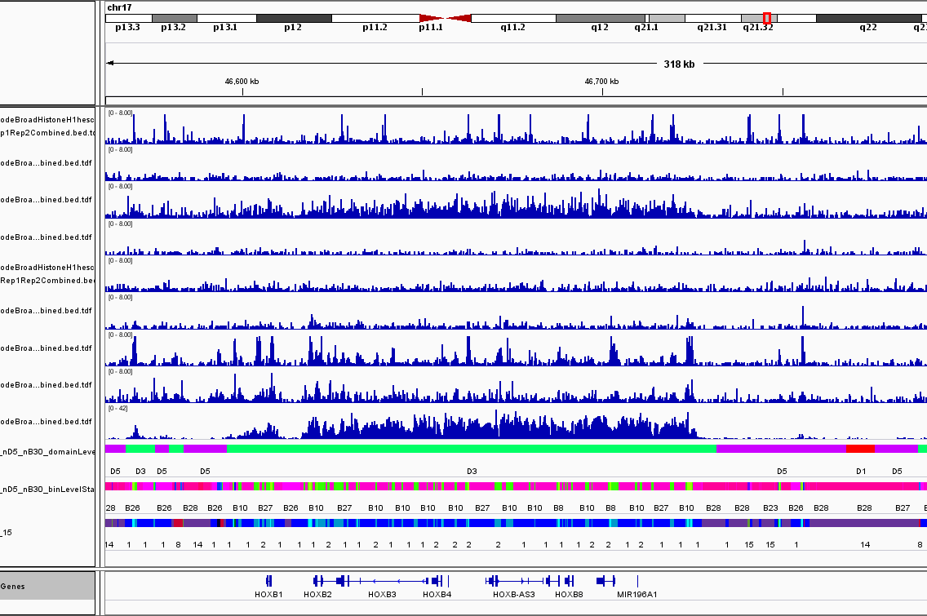
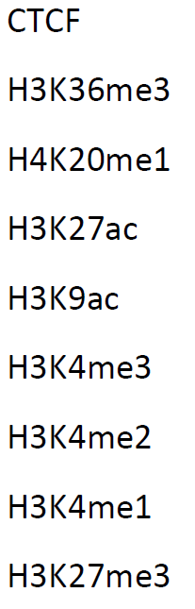
Chromatin domains
Dom
Nuc
HHMM
chromHMM

Slide 19
DNA methylation
Mariuswalter

Slide 20
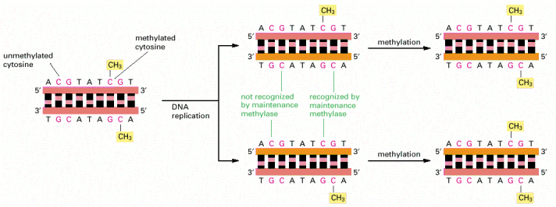
Heritable repression through DNA methylation
Occurs at CpG dinucleotides.
Maintained during replication.
Alberts MBC

Slide 21
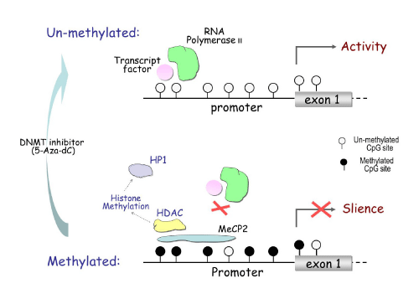
Heritable repression through DNA methylation

Slide 22
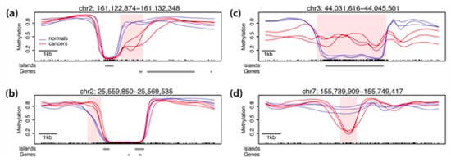
Methylation phenotypes
Dynamic during cell type differentiation
Aberrant during cancer
Irizarry NatureG 2009

Slide 23
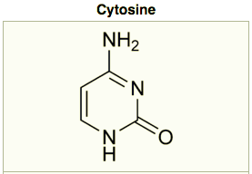
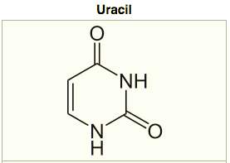
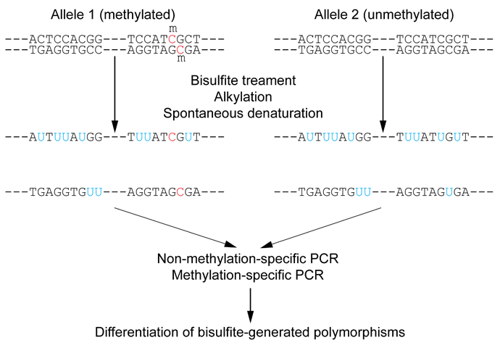
Assaying methylation
(Reduced representation) bisulfite sequencing (RRBS).
  Chemically convert unmethylated C to U (RNA version of T).
  Sequence the original and converted sequences and look for differences.
  When “reduced,” PCR-enrich for CpG-rich genomic regions first – more efficient.
Methylated DNA immunoprecipitation
(MeDIP).
  ChIP-*, but antibodies against methyl-C
  instead.
Endonuclease digestion
  Digest by methylation-sensitive, sequence-
  specific enzymes.
  Then sequence to see where cuts are.

Slide 24
Analyzing differential methylation
Hebestreit Bioinformatics 2013
QC.
Mapping.
Smoothing.
Testing (hierarchical).

Slide 25
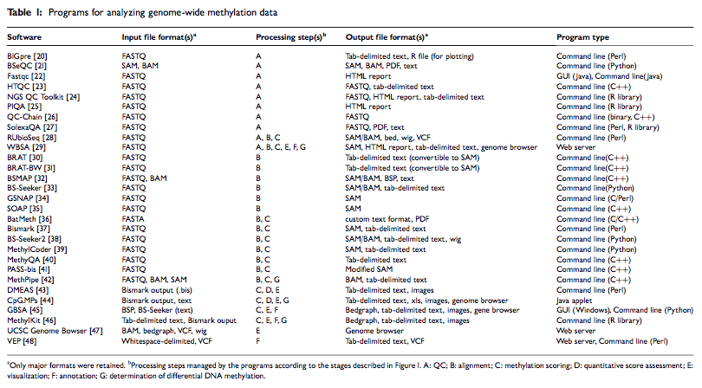
Analyzing differential methylation
Adusumali BiB 2014

Slide 26
Chromatin capture

Slide 27
CCCCCCCCCC
3C: Chromosome conformation capture (single locus pair).
  Cross-link DNA, fragment, ligate with tagged primers, unlink,
  PCR, quantify.
4C: Chromosome conformation capture-on-chip (one locus
to many).
  Cross-link DNA, fragment, circularize with tagged primers,
  unlink, PCR, quantify.
5C: Chromosome conformation capture carbon copy
(genome-wide).
  Cross-link DNA, fragment, ligate with universal primers,
  unlink, PCR, sequence.
Hi-C: Chromosome conformation capture carbon copy
(genome-wide).
  Cross-link DNA, fragment, ligate with biotinylated primers,
  sequence.

Slide 28
Distal chromatin contact mapping
Lieberman-Aiden Science 2009

Slide 29
ChIA-PET: Chromatin Interaction Analysis by Paired-End Tags
Fullwood Nature 2009
Hi-C + ChIP for your TF/protein of interest

Slide 30
Yes, they work for single cells too
Nagano Nature 2013
10 manually isolated T cells
Local (domain) structure preserved, global (inter-domain) structure variable.

Slide 31
Summary
Epigenetic changes are important.
  Phenotypes induced by non-sequence mechanisms.
  Sometimes also heritable.
Nucleosome positioning.
  Packs DNA into (in)accessible regions, blocks TF recruitment.
Histone modifications.
  Of the four main proteins, plus variants, side chains can be modified.
  Changes chromatin structure, activates, represses, recruits, etc.
DNA methylation at CpGs.
  Transcriptional repressive marker that’s preserved through replication.
Chromatin capture.
  Sequencing assays that link distal, contacting sequence elements.

