Slide 1
Proteins: Proteomics, Families, & Folds
Curtis Huttenhower (chuttenh@hsph.harvard.edu)
Eric Franzosa (franzosa@hsph.harvard.edu)
http://huttenhower.sph.harvard.edu/bst281
Some slides borrowed from Jignesh Parikh and Michael Levitt

Slide 2
Final Project
proposal feedback

Slide 3
Any issues with Final Project presentation schedule?

Slide 4
Final Project packets due
11:59pm Weds May 9, 2017
(three weeks from today)

Slide 5
How would people feel about NOT having a 6th homework?

Slide 6
Final Grades:
15% journal club presentation
25% final project (including presentation)

Slide 7
Proteins: Proteomics, Families, & Folds
Curtis Huttenhower (chuttenh@hsph.harvard.edu)
Eric Franzosa (franzosa@hsph.harvard.edu)
http://huttenhower.sph.harvard.edu/bst281
Some slides borrowed from Jignesh Parikh and Michael Levitt

Slide 8
Summary
Shotgun proteomics
Protein families and domains
Protein structure determination
Protein structure databases

Slide 9
Shotgun Proteomics

Slide 10
Proteins often defined & quantified from DNA/RNA
DNA sequence: (+)(sense)(5’-3’)(Watson) strand
5’ | GCT | GGA | GCA | CCA | GGA | CAA | GAT | GGA | 3’
DNA sequence: (-)(antisense)(3’-5’)(Crick) strand
3’ | CGA | CCT | CGT | GGT | CCT | GTT | CTA | CCT | 5’
RNA sequence: transcript
5’ | GCU | GGA | GCA | CCA | GGA | CAA | GAU | GGA | 3’
Protein translation (3-letter amino acid codes)
N- | Ala | Gly | Ala | Pro | Gly | Gln | Asp | Gly | -C
Protein translation (1-letter amino acid codes)
N- | A | G | A | P | G | Q | D | G | -C

Slide 11
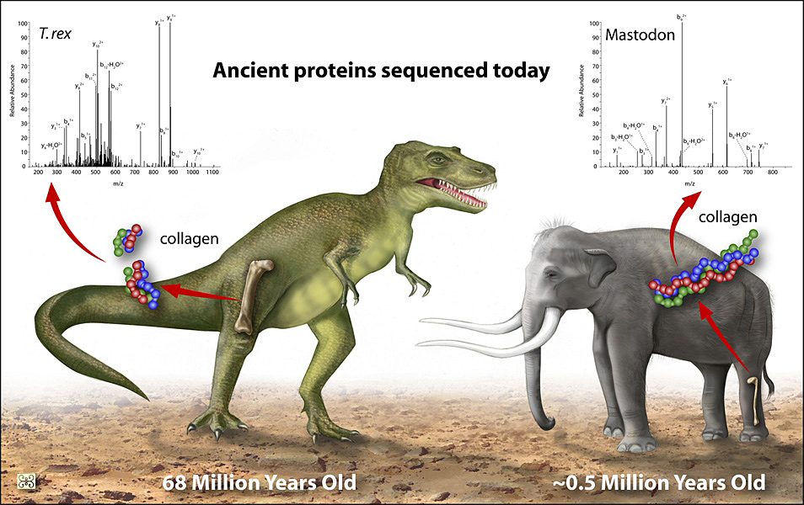
Problems with defining proteins from DNA (genomes)
A reasonable-looking open reading frame (ORF) might not be real
Can’t see post-translational modifications (e.g. phosphorylated version)
Genomic DNA may not be readily available

Slide 12
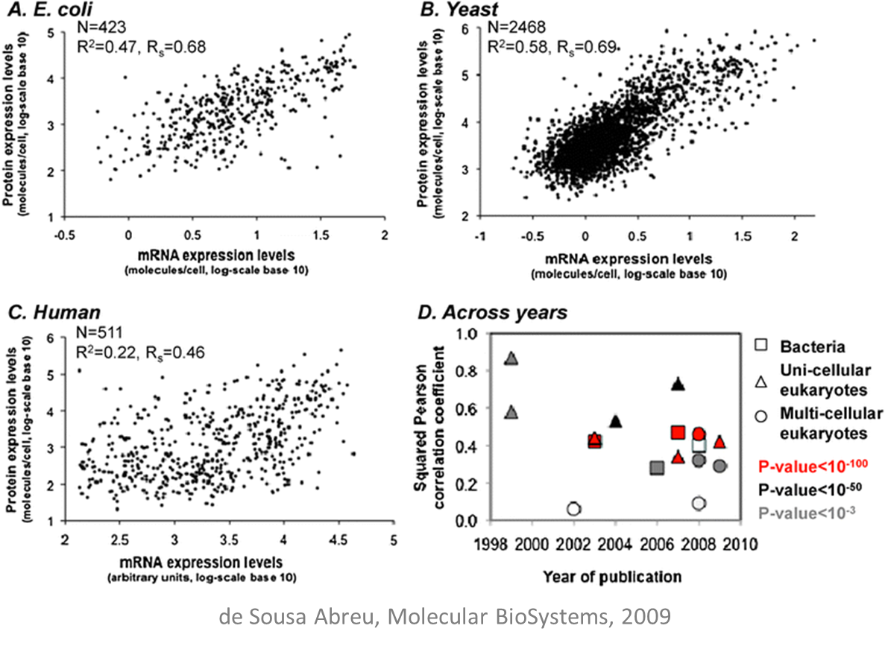
Problems with quantifying proteins from RNA
RNA/protein correlations are good (very significant) but not perfect
A protein with a long half-life can accumulate via very low-level transcription/translation
A protein with a short half-life may be rare in the cell despite strong transcription/translation

Slide 13
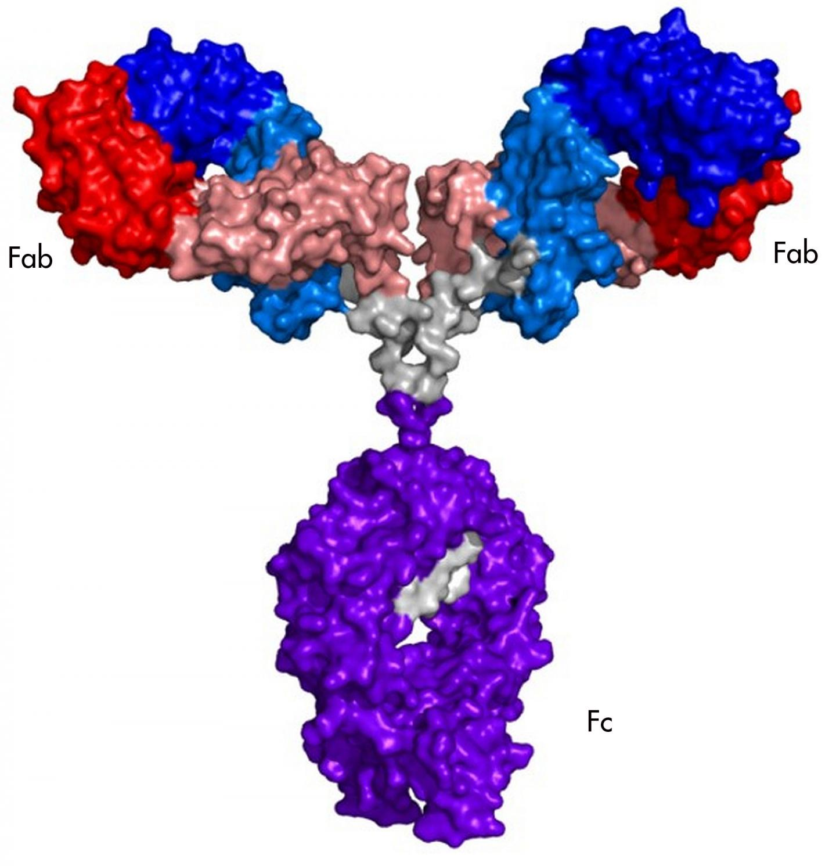
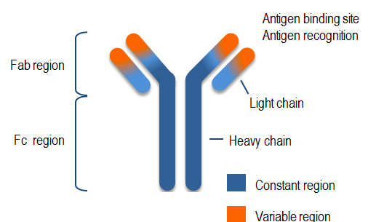
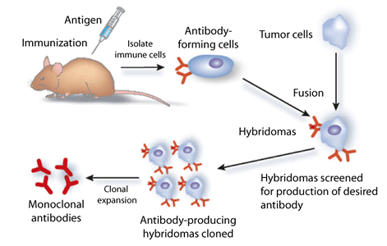
Direct methods for protein quantification
The tendency for DNA/RNA to self-hybridize (e.g. to primers, chips) is manipulated to great effect in DNA/RNA sequencing/quantification
Not so easy with proteins
Detection/quantification by binding requires a protein-specific antibody
Antibody protein
structure
Antibody schematic
structure
Making a monoclonal antibody

Slide 14
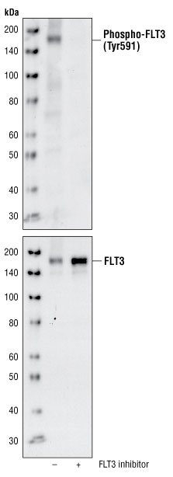
Protein detection/quantification: Western Blot
Specific protein detected by Western Blot
  protein + radiolabeled antibody
Strong evidence for a particular protein
Low-throughput
Protein and protein-state specific
  Can have antibodies specific to, say, protein X phosphorylated at a particular amino acid site

Slide 15
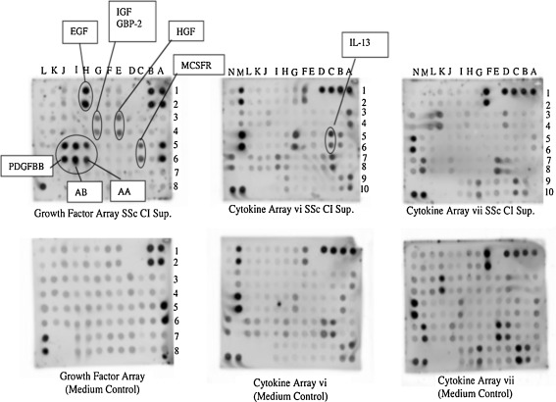
Protein detection/quantification: Arrays
Microarray logic for a protein sample
Requires antibody for each protein
  Often domain-specific sets
Non-specific binding and cross-hybridization issues (just like transcript/RNA arrays)
Can analyze similarly to microarrays

Slide 16
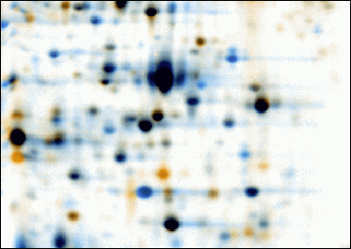


Protein detection/quantification: 2D gels
Use two distinct properties of a protein (e.g. size, pH) to stratify the members of a sample
Compare to reference states of known proteins for identification
Stain with YFA/D/R/etc.
Bioinformatic challenges?
Image alignment: warping
(commercial, see Berth 2007; MELANIE)
Spot quantification
Database search (Make2D-DB/WORLD-2DPAGE)
SDS-PAGE (kDa)
pH/isoelectric point (zero charge)

Slide 17
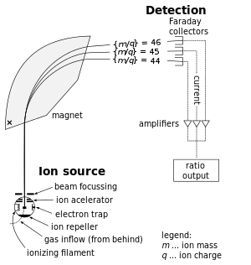
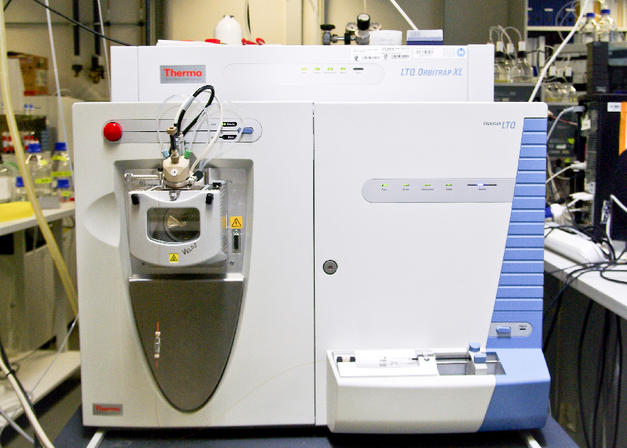
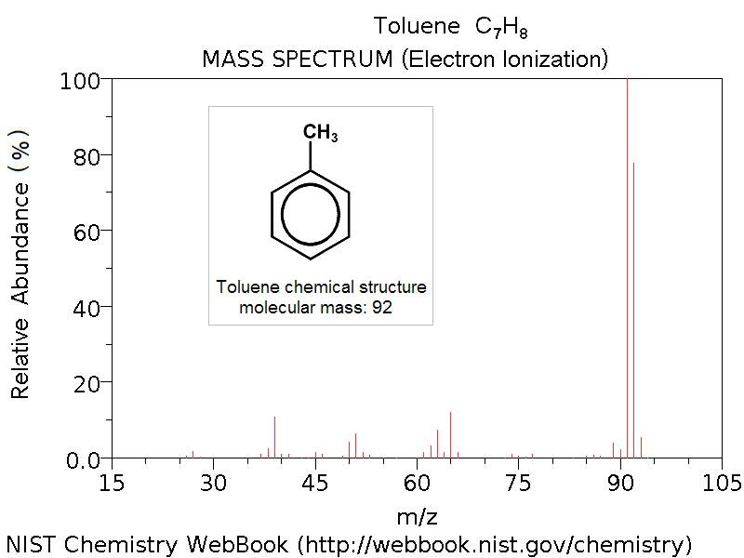
Mass spectrometry
Particles in a magnetic field will follow trajectories determined by their mass and charge
Given where a particle impacts a detector, we can work out its mass/charge ratio (m/z)
In a pure sample, m/z for “whole” molecule plus fragments can help us work out its identity

Slide 18
Tandem mass spectrometry (MS/MS) proteomics
Proteins are too big and too variable to be identified directly by MS
1st phase of MS isolates a pool
of a specific peptide
That specific peptide is then shattered
2nd phase of MS determines the
masses of the fragments/ions
Break down protein into
shorter peptides
Trypsin, for example,
cleaves proteins at
[KR][^P]
Infer peptide sequence from
differences in mass between ions
Try to connect peptides to known proteins/protein families
Process one or a few proteins
at a time
Complex protein mixture

Slide 19
Tandem mass spectrometry (MS/MS) proteomics
Sequence of a single protein, isolated by
liquid chromatography
P E P T I D E K G A H I K P L K S H I L A R S L A
P E P T I D E K|G A H I K P L K|S H I L A R|S L A
Trypsin digest
P E P T I D E K
Single peptide fragment (many copies) isolated during MS-1
b ions: N-terminal fragments
y ions: C-terminal fragments
m/z
98.06
227.10
324.16
425.20
538.29
653.31
782.36
m/z
147.11
276.16
391.18
504.27
605.31
702.37
831.41
Peptide is shattered at
inter-residue bonds
b1
P
y1
K
b2
PE
y2
EK
Each break produces an
N-terminal ion (b) and
a C-terminal ion (y)
b3
PEP
y3
DEK
b4
PEPT
y4
IDEK
Masses of b- and y- ions
determined during MS-2
b5
PEPTI
y5
TIDEK
b6
PEPTID
y6
PTIDEK
b7
PEPTIDE
y7
EPTIDEK

Slide 20
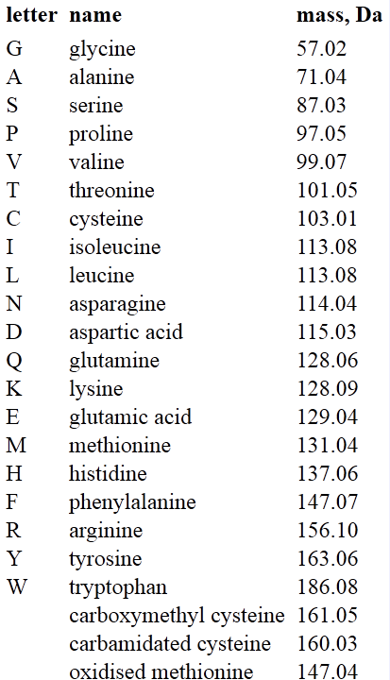
Tandem mass spectrometry (MS/MS) proteomics
Sequence of a single protein, isolated by
liquid chromatography
P E P T I D E K G A H I K P L K S H I L A R S L A
P E P T I D E K|G A H I K P L K|S H I L A R|S L A
Trypsin digest
P E P T I D E K
Single peptide fragment (many copies) isolated during MS-1
b ions: N-terminal fragments
m/z
98.06
227.10
324.16
425.20
538.29
653.31
782.36
Peptide is shattered at
inter-residue bonds
b1
P
Mass of proline (+ proton)
b2
PE
Mass of proline + glutamate
delta = 129.04
Each break produces an
N-terminal ion (b) and
a C-terminal ion (y)
b3
PEP
b4
PEPT
Masses of b- and y- ions
determined during MS-2
b5
PEPTI
b6
PEPTID
b7
PEPTIDE

Slide 21
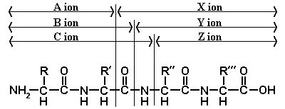
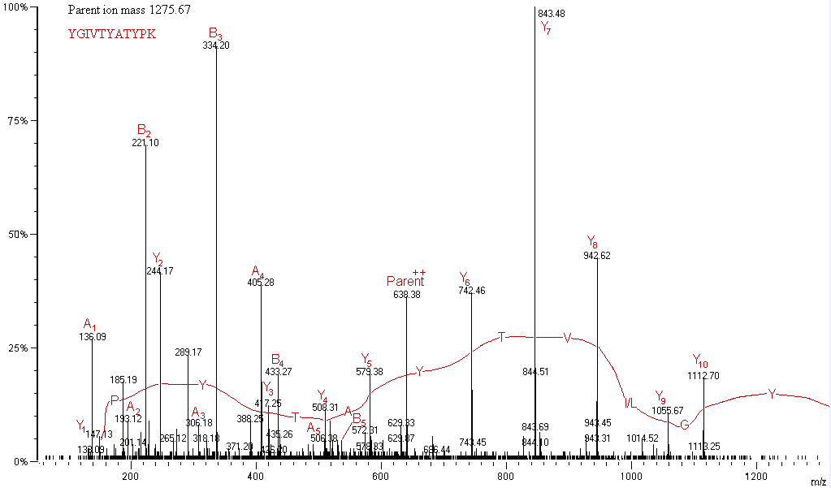
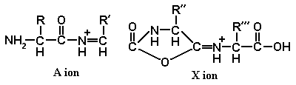
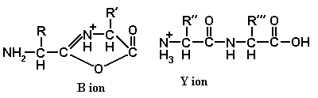
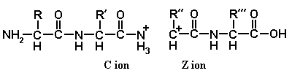
Tandem mass spectrometry (MS/MS) proteomics
B/Y ions correspond to
broken peptide bonds;
other breaks possible
http://www.weddslist.com/ms/tandem.html

Slide 22
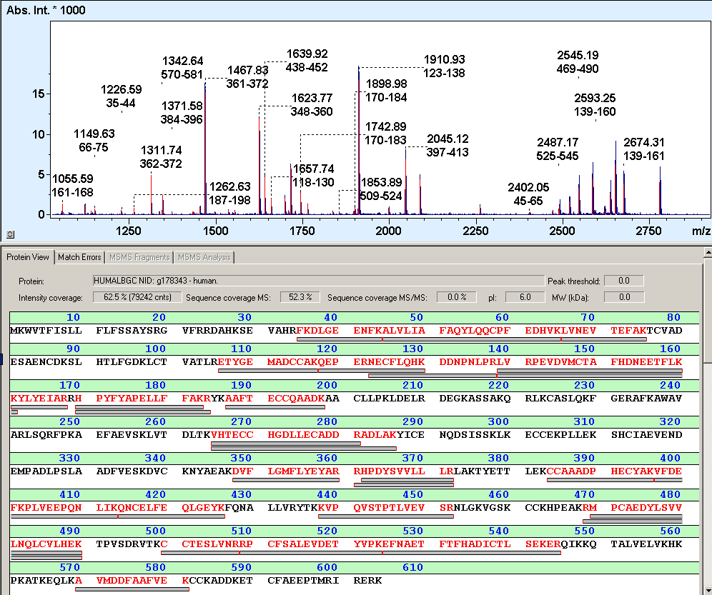
Tandem mass spectrometry (MS/MS) proteomics
End results are spectra for each peptide fragment
  And approximate abundances
Given a reference proteome, can generate theoretical spectra and compare
Can also reconstruct sequences from spectra de novo (harder)
Commercial software
  Mascot + SEQUEST
  SORCERER
  Proteome Discoverer
  ProteinPilot
Open options
  MSight
  OMSSA

Slide 23
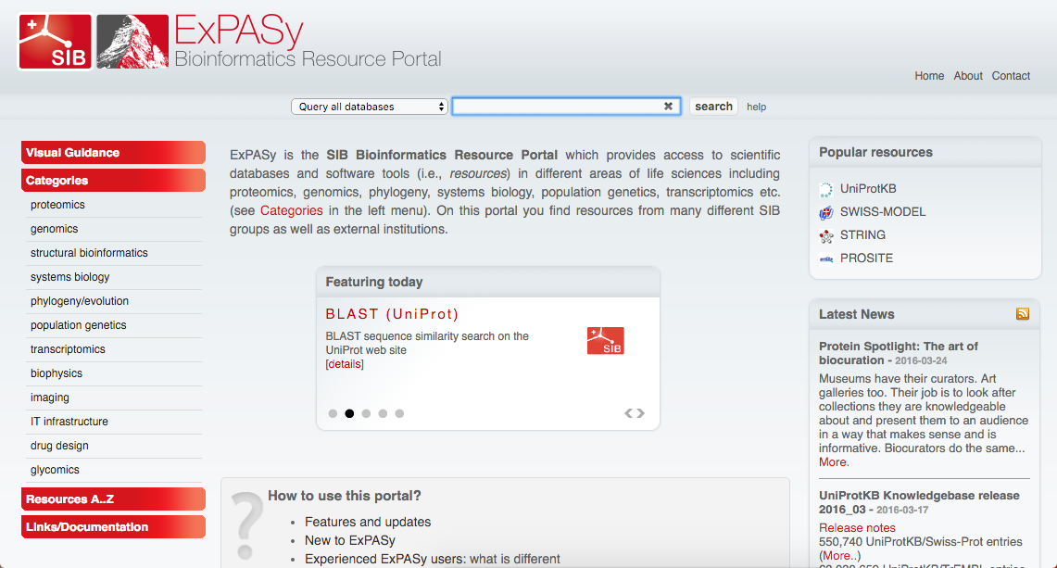
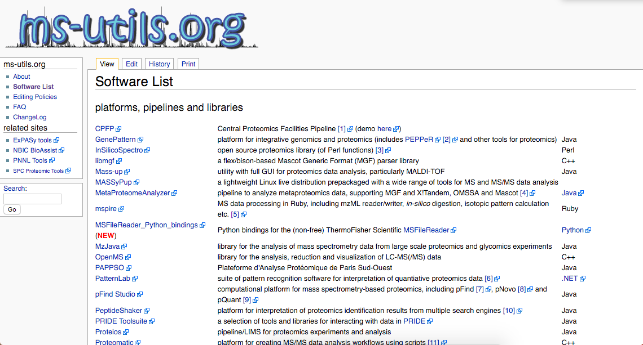

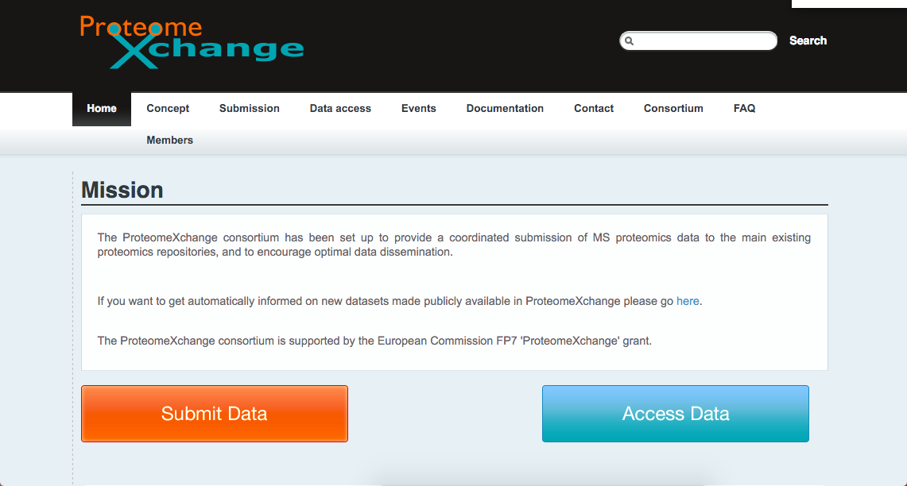
Proteomics resources
www.expasy.org
www.ms-utils.org
www.hupo.org
proteomexchange.org

Slide 24
Protein families
& domains

Slide 25
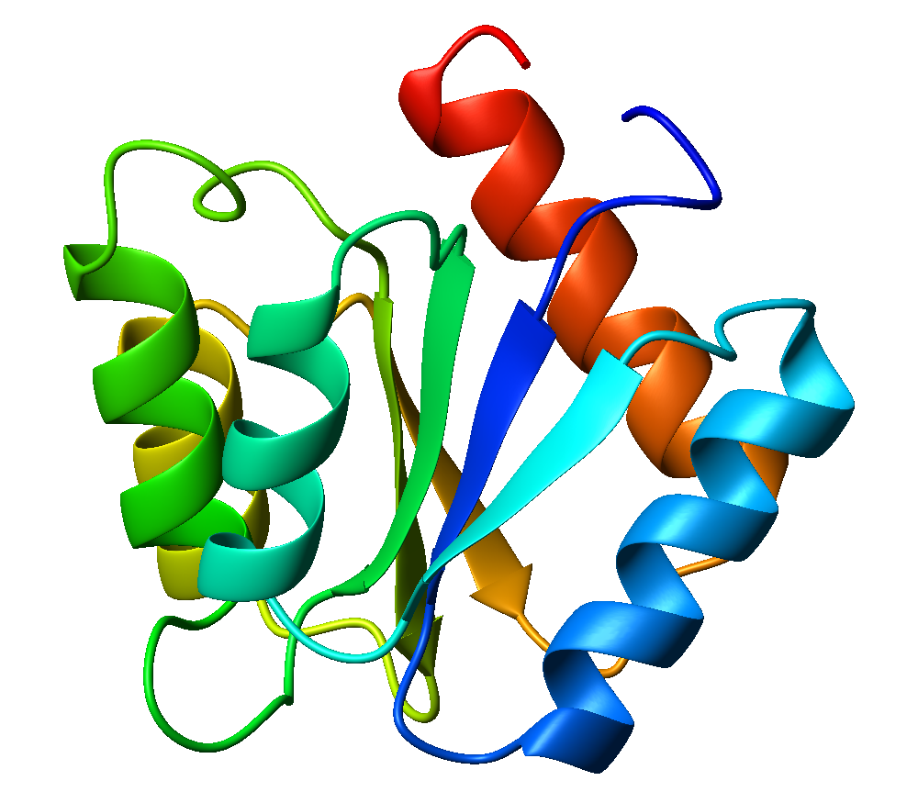
Sequence-function-structure relationships
A
A
B
C
B
C
A
B
C
A
B
C
conserved
residue
conserved chemistry
(e.g. hydrophobic)
variable
X
X
Y
Z
Y
X
Y
Z
a specific
protein fold
Z
X
Y
Z
function shaped by
fold + small tweaks
many compatible
sequences

Slide 26
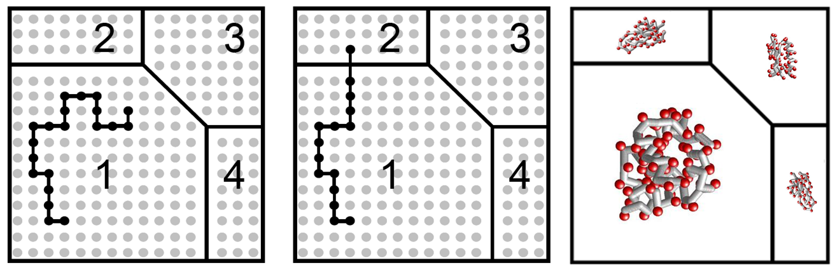
Genotype-phenotype mapping
A structure/function (phenotype) is a set of possible sequences (genotypes)
Evolution can wander around inside the set without changing phenotype
  Neutral evolution, hence spaces sometimes called “neutral networks”
Function changes when we wander into a new phenotype

Slide 27
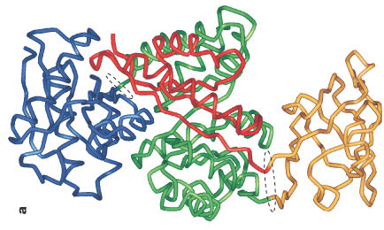
Defining protein families, domains, and folds
Set of globally similar coding sequences
  Homology fades quickly, not ideal
ATG AAA CTA GCT Gene Sequence TAG CTG CGT TAA
Set of globally similar protein sequences
  COGs, UniRef
MPVWELAHVVCI Protein Sequence KLPAHVTAHCVHVAG
Protein structures/folds
  Not always related by descent
  Similarity not always obvious at the sequence level (even when related by descent)
  CATH, SCOP
Set of conserved protein subsequences
  Domains: independently folding and functioning units; related by descent
  Motifs: smaller; convergent evol. possible
Domain
Domain
Domain
Domain

Slide 28
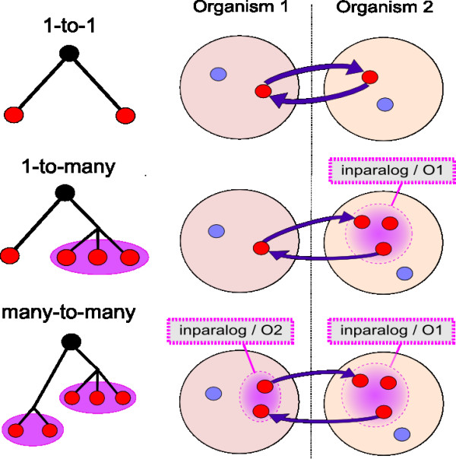
Protein families: COGs
Clusters of Orthologous Groups
Based on the notion of the reciprocal best BLAST hit (RBBH)
  Gene a in Genome A is the closest match to gene b in Genome B
  Gene b in Genome B is the closest match to gene a in Genome A
COGs = triangles of mutually best-hitting genes
Original set (1997) for bacteria
  Extended to Eukaryotes (KOGs, 2003)
  Archaea (arCOGs, 2007)
  Phages (POGs, 2011)
  Others
COGs grouped into functional super-classes by letter
  e.g. “A” = “RNA processing and modification”

Slide 29
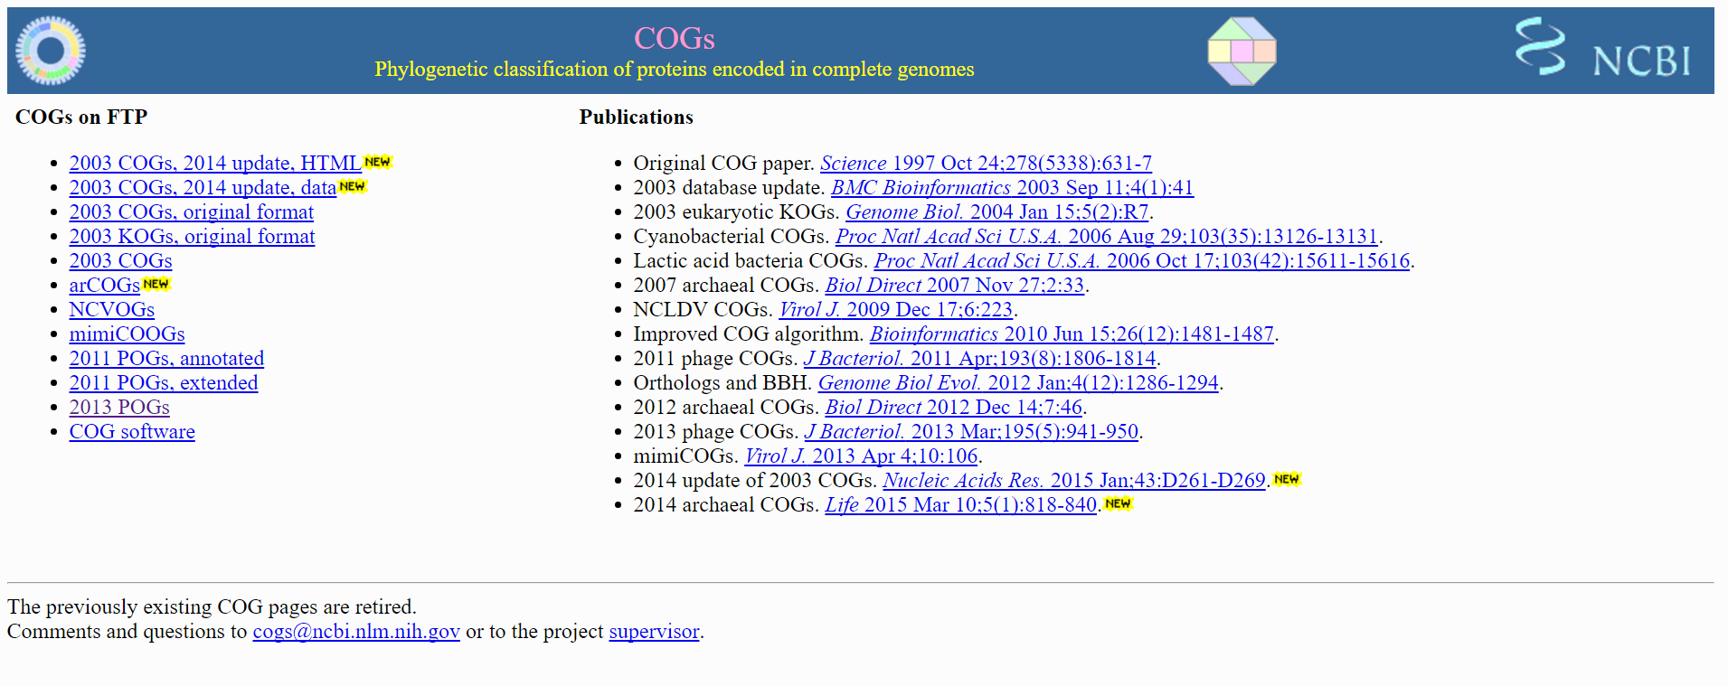
Protein families: COGs
https://www.ncbi.nlm.nih.gov/COG/

Slide 30
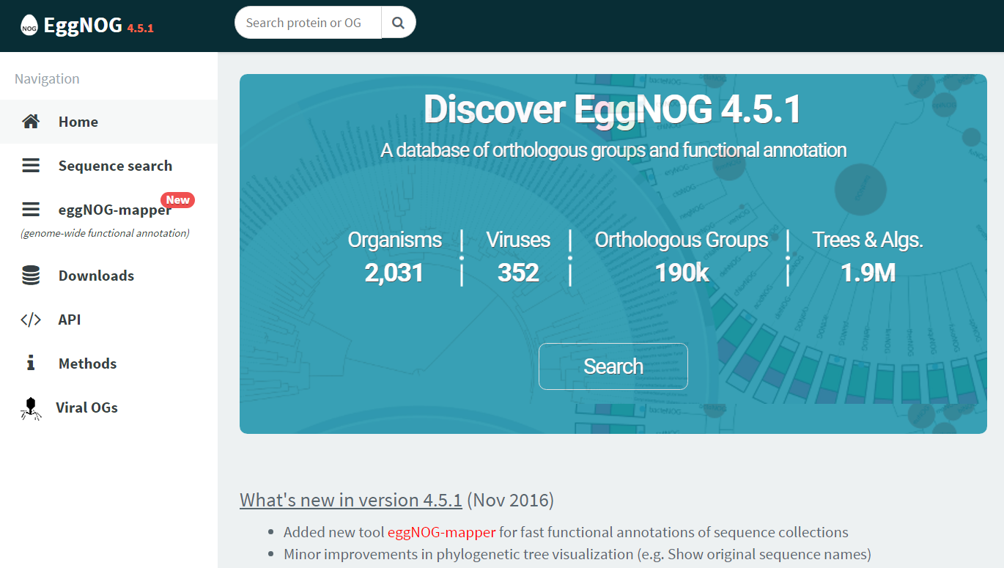
Protein families: eggNOG
http://eggnogdb.embl.de
eggNOG expands the COG concept and is better maintained
  evolutionary genealogy of genes: Non-supervised Orthologous Groups
http://eggnogdb.embl.de

Slide 31
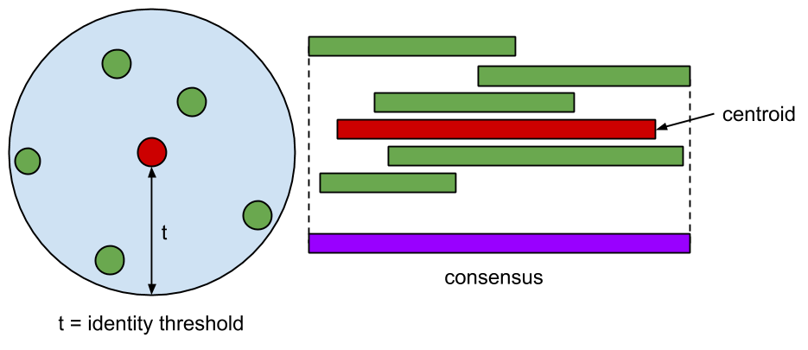
Protein families: UniRef
One, big clustering of all proteins in UniProt
UniRef100
  Sequence-unique proteins
  Best-annotated member chosen as representative
UniRef90
  UniRef100 representatives clustered at 90% sequence identity, 80% coverage
UniRef50
  UniRef90 representatives clustered at 50% sequence identity, 80% coverage
Pros
  Comprehensive, non-redundant, well-annotated, continuously updated
Cons
  Continuously updated (centroids can change)

Slide 32
Protein families: UniRef
Like building a UPGMA tree of all protein sequences and cutting
Methods for clustering proteins efficiently: CD-HIT, UCLUST
Representatives
B
A
UniRef50 (50% identity)
Representatives
B
D
A
UniRef90 (90% identity)
B
E
D
A
C
UniRef100 (sequence unique)
B
B
E
D
D
A
C
UniProt

Slide 33
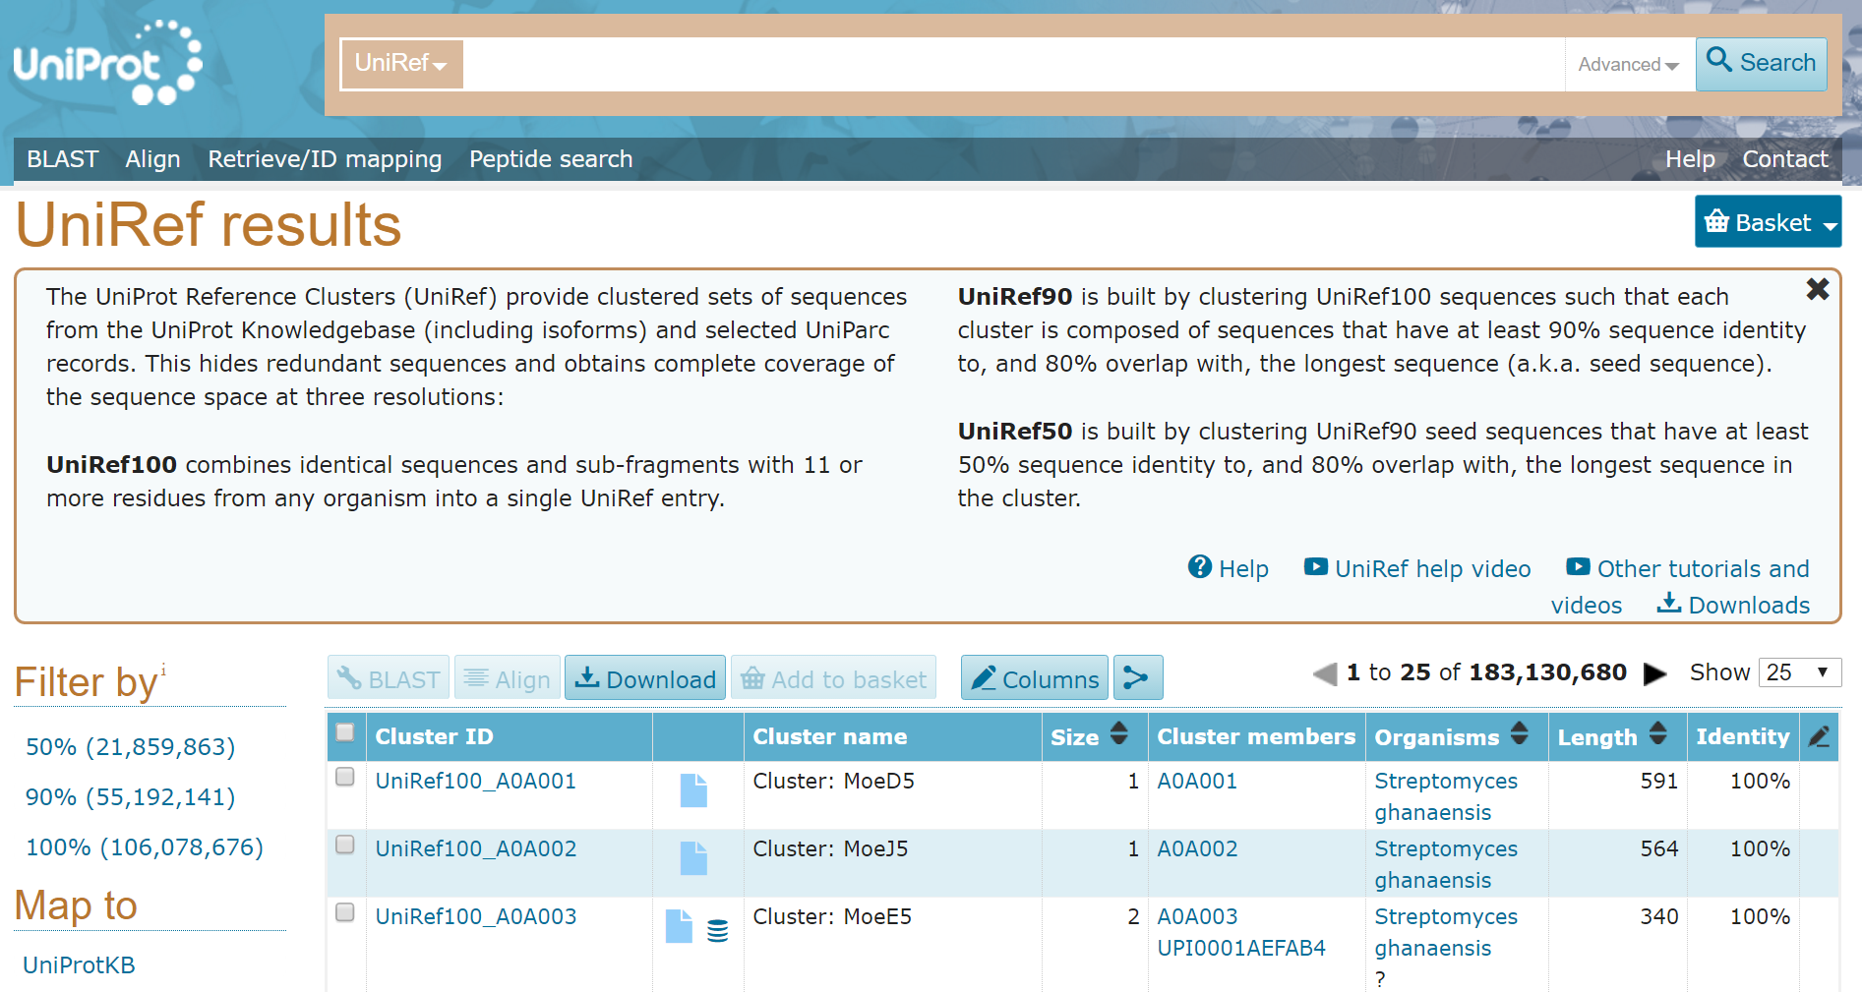
Protein families: UniRef
http://www.uniprot.org/uniref/

Slide 34
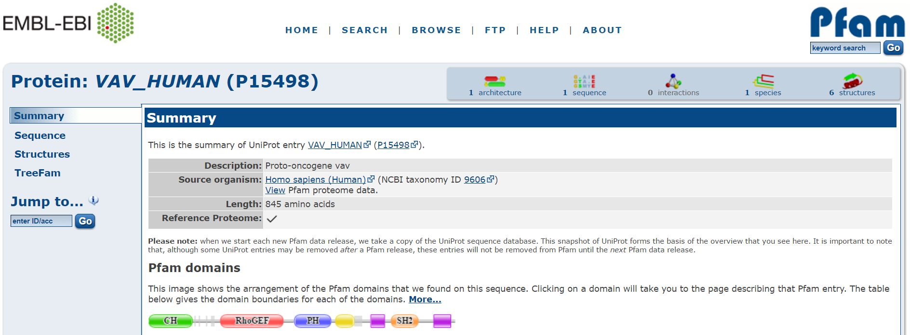
Protein domains: Pfam
http://pfam.xfam.org/
Pfam is a collection of sequence-level protein domains
Based on unsupervised clustering, like UniRef
Unlike UniRef, a Pfam domain doesn’t have to explain an entire protein
  In fact, many proteins are composed of two or more Pfam domains (an “architecture”)

Slide 35
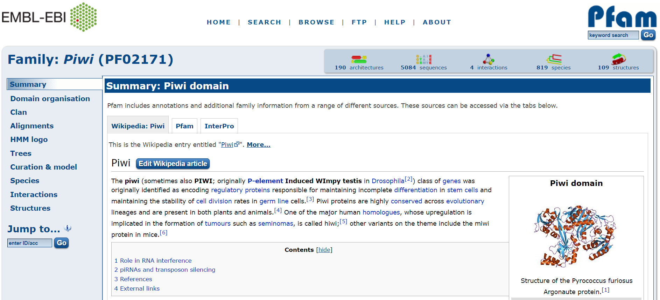
Protein domains: Pfam
Currently around 16K distinct Pfam domains
New domains are discovered much less frequently than protein sequences
New domain architectures somewhere in the middle

Slide 36
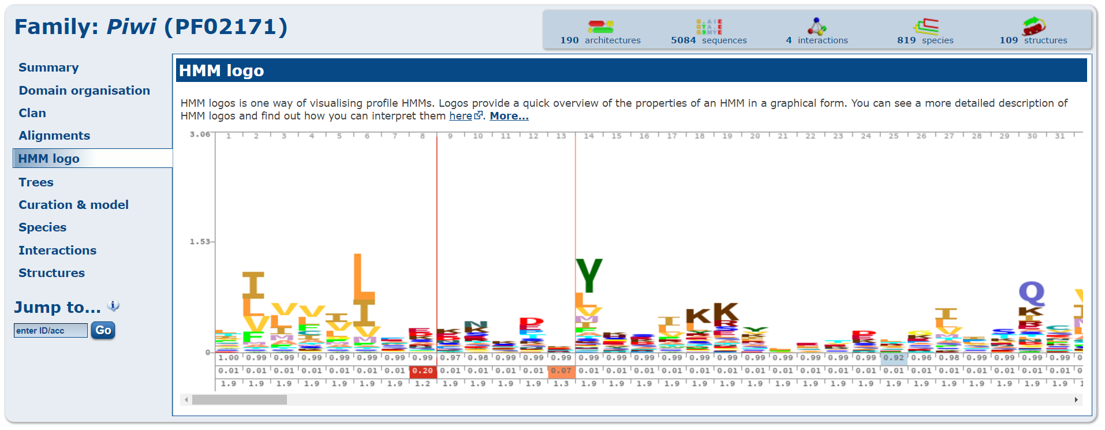
Protein domains: Pfam
Each domain is characterized by a multiple alignment of compatible sequences, sequence logo, and profile HMM (more on this later)

Slide 37
Protein domains: Pfam
The organization of Pfam is particularly useful
  Easy to link Pfams to species
  Easy to link Pfams to functions
  Easy to link Pfams to 3D structures
  Pairs of Pfam domains that interact with each other (domain-domain interaction)
Pfam HMMs makes it easy to find Pfams in newly sequenced collections of proteins, even those that are distantly diverged from known sequences
Other similar systems exist, though I usually default to Pfam
  PANTHER
  PROSITE
  SMART
  SUPERFAMILY
  TIGRFAMs

Slide 38
Protein Structure
Determination

Slide 39
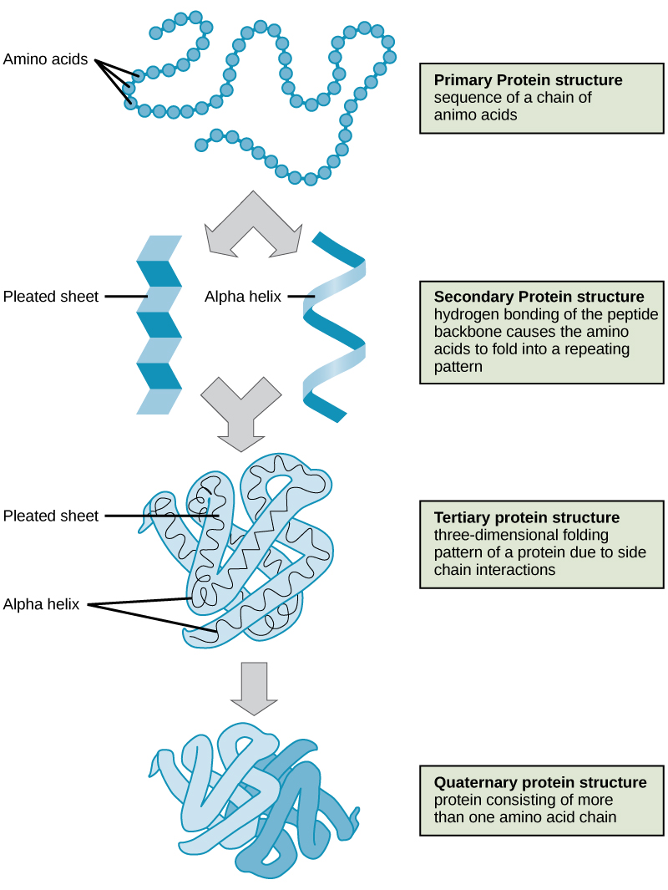
Protein structure
Primary structure (amino acid sequence)
  Infer from genome sequencing
  Profile directly from MS-MS experiments
Secondary structure (local conformation)
  Reasonably easy to predict from primary sequence
  HMMs strike again!
Tertiary structure (non-local folding)
  X-ray crystallography
  Nuclear Magnetic Resonance (NMR)
  Ab initio protein-folding
Quaternary structure (protein-protein interaction)
  Tertiary methods for 2+ proteins
  PPI detection methods (e.g. yeast two-hybrid) sort of...

Slide 40
Protein structure
Primary structure (amino acid sequence)
  Infer from genome sequencing
  Profile directly from MS-MS experiments
Secondary structure (local conformation)
  Reasonably easy to predict from primary sequence
  HMMs strike again!
Tertiary structure (non-local folding)
  X-ray crystallography
  Nuclear Magnetic Resonance (NMR)
  Ab initio protein-folding
Quaternary structure (protein-protein interaction)
  Tertiary methods for 2+ proteins
  PPI detection methods (e.g. yeast two-hybrid) sort of...

Slide 41
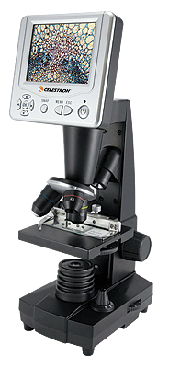
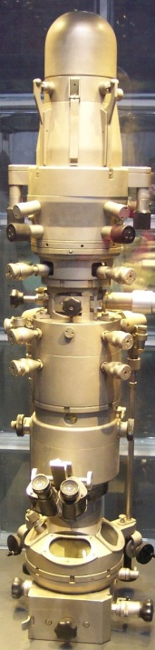
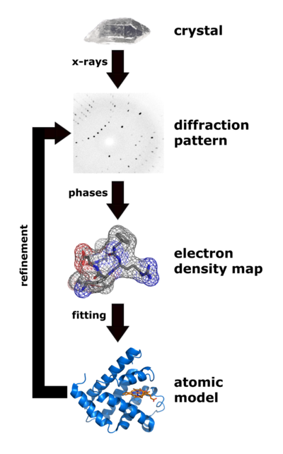
Can you build a microscope powerful enough to see a protein?
Optical Microscope
10³x magnification
μm resolution
Electron Microscope
10⁶x magnification
nm resolution
X-Ray Diffraction
10⁸x magnification
Å resolution

Slide 42
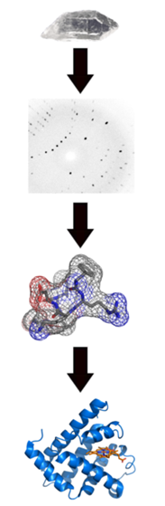
X-ray crystallography: overview
Make crystal from protein molecules
Bombard with x-rays
Record diffraction patterns
Apply some fancy math
Infer 3D electron density map
Refine with known sequence
Finished protein structure

Slide 43
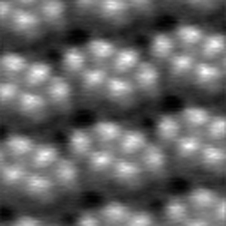
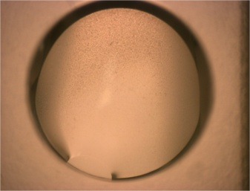
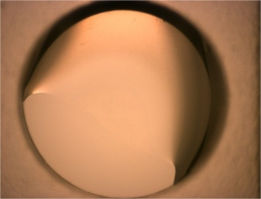
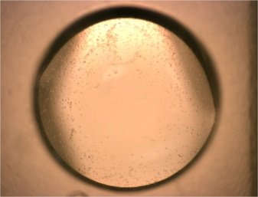
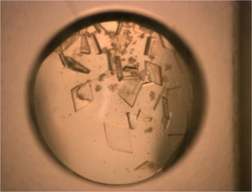
X-ray crystallography: making protein crystals
Generate lots of pure protein
Find a buffer solution where the protein is stable
Bring the solution to supersaturation
Nucleation events seed crystal formation
Crystal lattice visualized by atomic force microscopy.

Slide 44
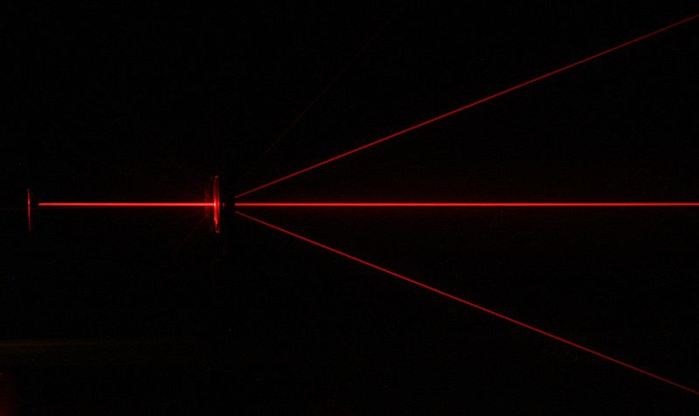
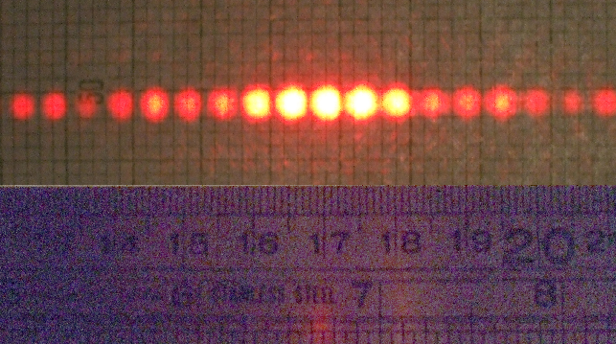
X-ray crystallography: Diffraction
Diffraction refers to the tendency of a wave to spread out as it passes through small openings.
The spreading waves interact, resulting in patterns of constructive and destructive interference.

Slide 45
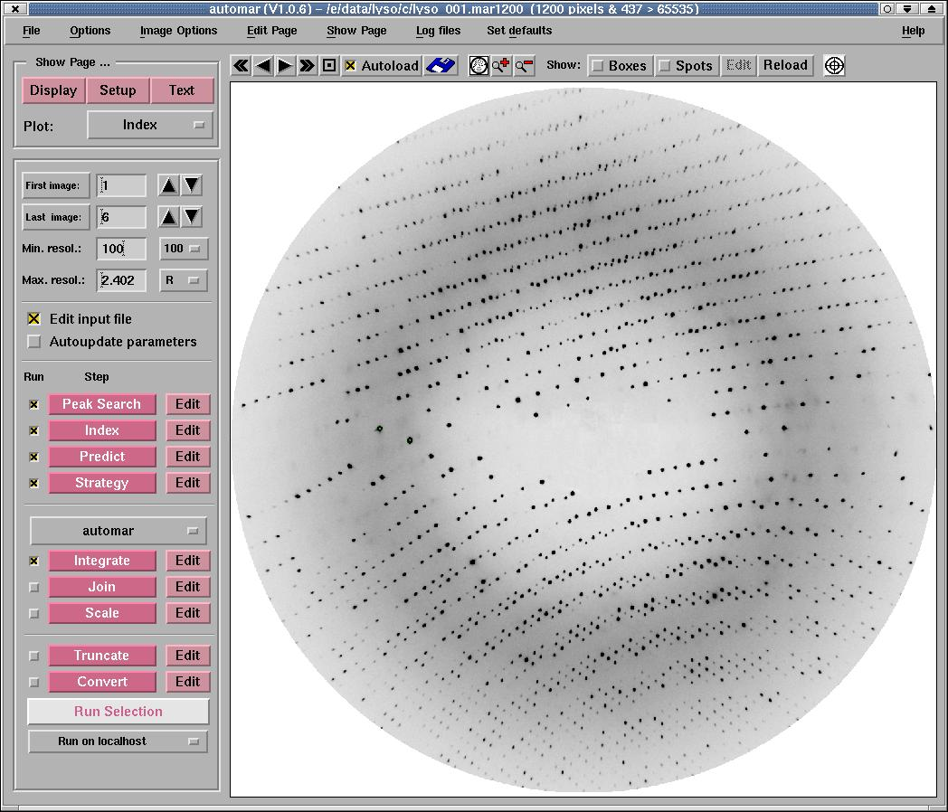
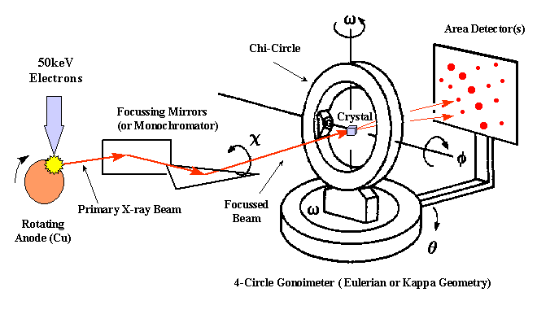
X-ray crystallography: Diffraction
X-rays interact with atomic lattice to form a 3D diffraction pattern
Rotating the crystal captures different slices

Slide 46
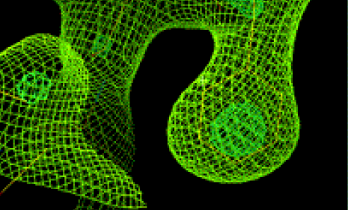
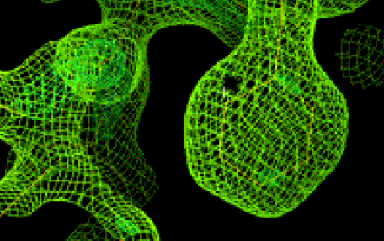
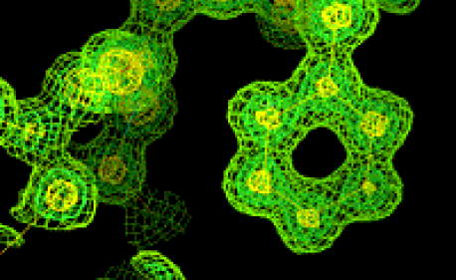
X-ray crystallography: Diffraction
We backtrack from the diffraction pattern to produce an electron density map (electrons scattered the x-rays).
Electron Density Map
3 Å resolution
Electron Density Map
2 Å resolution
Electron Density Map
1 Å resolution

Slide 47
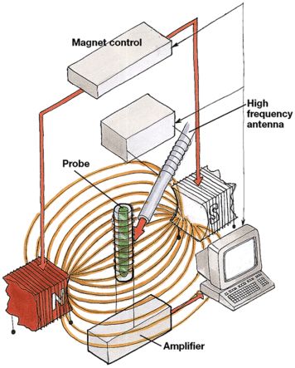



Nuclear Magnetic Resonance (NMR) spectroscopy
Certain atomic nuclei behave as little magnets
Line them up with powerful magnetic fields
Apply electromagnetic pulses, causing nuclei to resonate
Resonance produces measurable currents
Resonance frequency is environment specific
Infer position of one atom relative to others → structure

Slide 48
Methods comparison
X-Ray Crystallography:
  Most common method
  Potential for very high resolution
  No theoretical size limit
  Requires crystal (can be difficult to make)
  Static protein configuration, sometimes non-biological
NMR Spectroscopy:
  Has a theoretical size limit (100 kD; Myoglobin = 16.7 kD)
  Can probe dynamic processes

Slide 49


Protein folding: From sequence to structure
Protein primary structure is defined entirely by sequence:
Most of the time, this is all the information nature needs to make the final 3D structure (folding is spontaneous)

Slide 50



Protein folding: Driving forces
Anfinsen’s dogma (a.k.a. the thermodynamic hypothesis):
The native fold represents a free energy minimum for the polypeptide chain and its environment.
(Note: systems tend toward lower energy states.)
Apples fall.
Springs push back.
Opposites attract.

Slide 51


Protein folding: Driving forces
Bonds have spring-like properties
Atoms attract and repel
They stretch…
Electrostatic
forces
They bend…
van der Waals forces,
hydrogen bonds
They twist…

Slide 52


Protein folding: Driving forces
A solution rearranges to maximize favorable water-water contacts (hydrogen bonds).
Hydrophobic residues cluster (forming the protein core), surrounded by surface hydrophilic residues.

Slide 53


ab initio protein folding
Model every atom as a movable object in space.
Small Protein
Small Protein + Water
# of atoms:
304
# of atoms:
304 + 7,377 = 7,681

Slide 54



ab initio protein folding
Start with a random coil
Advance time in discrete steps
Update atomic forces, positions, and velocities
If your model is accurate, then a real fold should emerge
Very computationally demanding…
…but it can work! (real vs. predicted)

Slide 55



Knowledge-based folding
Fragment libraries:
Build up a full protein from small pieces of known structure (the LEGO approach)
Homology modeling:
If seq. A is very similar to seq. B, and seq. B’s structure is known, then seq. A’s structure will be very similar
Threading:
Determine if seq. A is compatible with the
structure of seq. B, even if seq. A and seq. B
aren’t obviously homologous (twilight zone)

Slide 56

The Protein Data Bank (PDB)
Mirrors of PDB data (I tend to favor this one, http://www.rcsb.org/pdb)
Great educational info about
protein structure
Cool art by David S. Goodsell

Slide 57

The Protein Data Bank: Example Entry
Annotations
Unique ID
Raw data
Method & resolution
Multiple static views, plus a variety of movable 3D options
Citation. Often one structure per paper. This is hard work!

Slide 58




View of 1FZY from the PDB

Slide 59
The Protein Data Bank: Raw Data
A couple of different formats (PDB, mmCIF, XML)
All are focused on specifying the identities and locations of atoms
In a structure of
more than one
peptide subunit, the subunits units are referred to as chains
(and lettered)
chain
symbol
residue
type
residue
#
atom
type
atom
#
(x, y, z) coordinate
Very common to have gaps (missing atoms/residues) due to disordered regions with uncertain position
(e.g. loops)
A ASP 30 N 221 23.694 11.762 7.111
A ASP 30 CA 222 23.808 10.408 6.579
A ASP 30 C 223 22.639 10.070 5.665
A ASP 30 O 224 21.664 10.818 5.579
A ASP 30 CB 225 23.815 9.400 7.709
A ASP 30 CG 226 22.563 9.478 8.517
A ASP 30 OD1 227 22.545 10.216 9.521
A ASP 30 OD2 228 21.578 8.833 8.116
A ILE 31 N 229 22.738 8.914 5.015
A ILE 31 CA 230 21.692 8.454 4.117
A ILE 31 C 231 21.072 7.127 4.539
A ILE 31 O 232 20.366 6.491 3.750
A ILE 31 CB 233 22.213 8.346 2.649
A
B

Slide 60
Databases of protein folds
Group together protein structures based on similar properties and shapes
Similar in spirit to what Pfam (and friends) do for sequences
Some computational alignment, also a lot of eye-balling

Slide 61

CATH
www.cathdb.info
Part manual*/part automated** clustering of proteins and protein structures by fold
Class*
  Broad architectural similarities
  e.g. “mostly alpha helix”
Architecture*
  Similar folding units
  Not necessarily related through evolution
Topology**
  Structural/functional evidence of divergent evolution
  Not necessarily obvious sequence homologs
Homology**
  Sequence homologs

Slide 62

SCOP (and SCOP2)
http://scop.mrc-lmb.cam.ac.uk/scop
http://scop2.mrc-lmb.cam.ac.uk
Structural Classification Of Proteins
Manual curation of proteins into hierarchy based on appearance

Slide 63

https://fold.it/portal/

Slide 64
Extras

Slide 65
Hidden Markov Models

Slide 66


Hidden Markov Models (HMMs)
A Markov model is a sequence of states that we transition through over time
The likelihood of where we’ll transition to depends only on the state we’re in
  No long-term memory
Let’s use the weather as an example...

Slide 67

Hidden Markov Models (HMMs)
Imagine that if it is sunny today, there is an 80% chance of sun tomorrow, and a 20% chance of clouds.
Similarly, if it is cloudy today, there is a 50% chance of clouds tomorrow, and a 50% chance of sun.
80%
50%
20%
50%
Today
Tomorrow
Today
Tomorrow

Slide 68

Hidden Markov Models (HMMs)
The same probabilities will take us from tomorrow into the day after tomorrow, and so forth...
This allows us to simulate a sequence of states

Slide 69

Hidden Markov Models (HMMs)
In a Hidden Markov Model, we don’t get to see the states directly
Instead, states emit information (symbols) and the frequency of these emissions varies with the state

Slide 70

Hidden Markov Models (HMMs)
The same scenario represented as a HMM
Given a sequence of tosses, we can evaluate the probability that it came from a certain sequence of states:
Emissions (flips): HTHH
States: FFBB
P(Sequence) = (0.50)(0.90)(0.50)(0.10)(0.75)(0.90)(0.75) = 0.011

Slide 71
Hidden Markov Models (HMMs)
The same scenario represented as a HMM
More importantly, given a sequence of emissions, we can compute the most likely sequence of states to have produced it
  In other words, given my flips, do you think I cheated you?
Ignoring the details, but it’s easier than enumerating all possible options!

Slide 72
HMM application: Finding CpG islands
CpG sites can be methylated as a means of gene regulation
Regions enriched for CpGs (CpG islands) tend to occur near genes
A HMM for gene-finding considers a genome as a sequence of emissions
A sequence enriched for CpGs suggests that we are in the “near gene” state
near
gene
not near
gene
AA | AC | AG | AT
CA | CC | CG | CT
GA | GC | GG | GT
TA | TC | TG | TT
AA | AC | AG | AT
CA | CC | CG | CT
GA | GC | GG | GT
TA | TC | TG | TT

Slide 73
Finding CpG islands
We “learn” transition and emission probabilities from known genes/genomes
Then apply the model to new genomes to predict gene-coding regions
genome
gene
gene
gene
near
gene
not near
gene
AA | AC | AG | AT
CA | CC | CG | CT
GA | GC | GG | GT
TA | TC | TG | TT
AA | AC | AG | AT
CA | CC | CG | CT
GA | GC | GG | GT
TA | TC | TG | TT

Slide 74
Pfam HMMs
A Pfam domain MSA can be represented as a Hidden Markov Model
Each position in the alignment is a state (extra states for insertions/deletions)
Observed amino acids frequencies are the emission probabilities

Slide 75


Pfam HMMs
Each position is also associated with...
  A deletion state (allowing us to skip any individual position)
  An insertion state (that we can stay in to account for extra sequence)
Apply Pfam HMMs to a new protein to annotate its domain architecture
  Enabled by a tool called HMMER
http://hmmer.org/

