Slide 1
Cytoscape Tutorial
Curtis Huttenhower (chuttenh@hsph.harvard.edu)
Eric Franzosa (franzosa@hsph.harvard.edu)
http://huttenhower.sph.harvard.edu/bst281

Slide 2
Introduction
Cytoscape is a powerful tool for viewing/analyzing network data
http://www.cytoscape.org/ ← website
https://github.com/cytoscape/cytoscape-tutorials/wiki ← guides
Miriam Posner created a wonderful tutorial for Cytoscape 3.0
https://github.com/miriamposner/cytoscape_tutorials
However it is focused on early African-American silent film, not biology
Mapping actors to movies
You can complete the film tutorial if interested
Alternatively you can substitute some pre-prepared biological data…

Slide 3
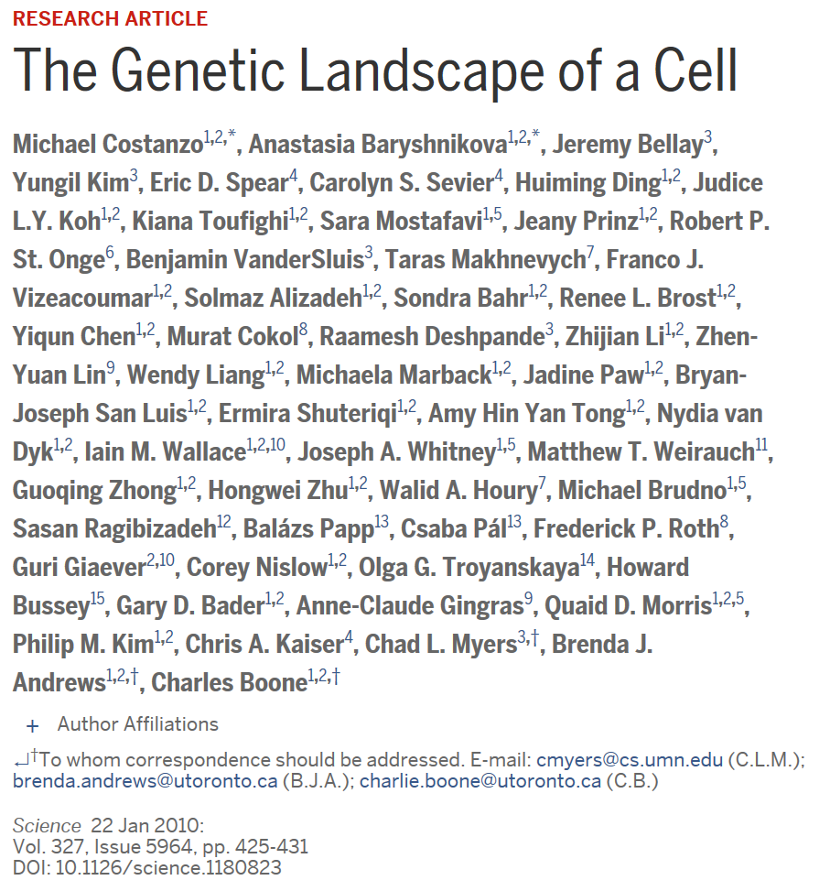
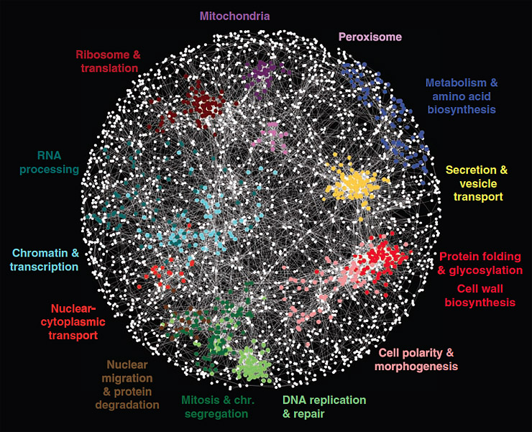
Constanzo et al. 2016: Update to 2010 dataset/work

Slide 4
How I produced the biological data (you don’t need to do this!)
Downloaded all yeast interaction data from BioGRID
https://thebiogrid.org/
Filtered Constanzo et al. 2016 genetic interactions by Pubmed ID (27708008)
>300K genetic interactions
Too many for tutorial purposes
Additionally filtered interactions that had been seen in 4+ other studies
Very, very high-confidence genetic interactions
~2,200 interactions among ~900 yeast proteins
Downloaded list of yeast kinases from https://yeastkinome.org/
This allows us to divide our nodes into two types: “kinase” and “not kinase”
This replaces the “actor” vs. “film” node annotations from the film demo
Note: all of our nodes are genes, so (unlike actors+films) the biological network won’t be “bimodal”
Uploaded biological data files (edges+node properties) to Canvas as .csv files

Slide 5
Tutorial Steps (you do need to do this)
(Update to Java 8 if needed)
http://www.oracle.com/technetwork/java/javase/downloads/jre8-downloads-2133155.html
Install Cytoscape 3
http://www.cytoscape.org/
Download the biological data files from Canvas
yeast_confirmed_genetic_edges.csv
yeast_confirmed_genetic_nodes.csv
Follow the Cytoscape tutorial at
https://github.com/miriamposner/cytoscape_tutorials
Actor/film files are available there if you choose to do that version

Slide 6
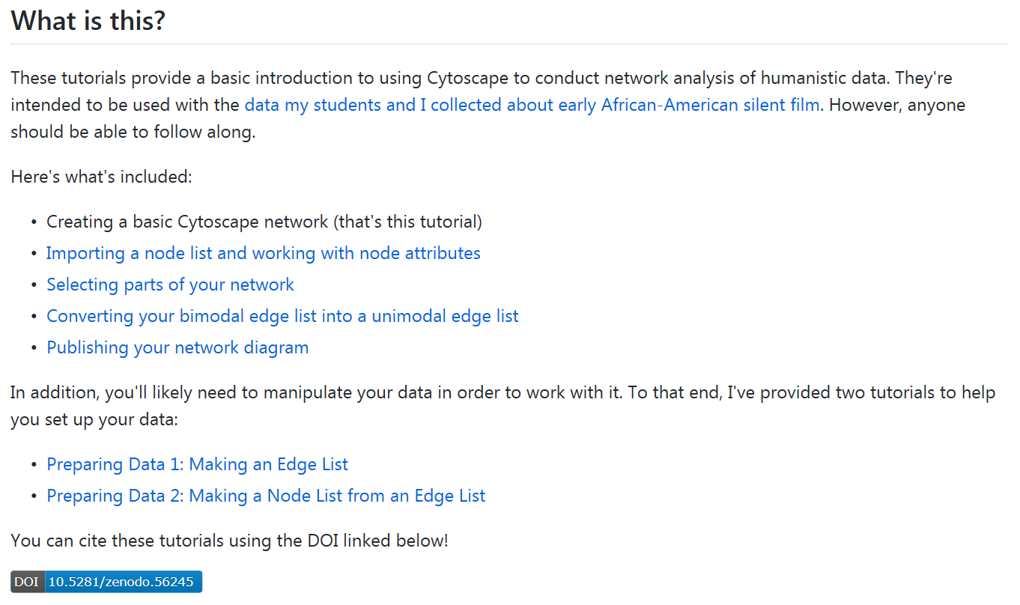
Elements of the tutorial
Do
Do
Do
Skip
Do
Look over
Look over

Slide 7
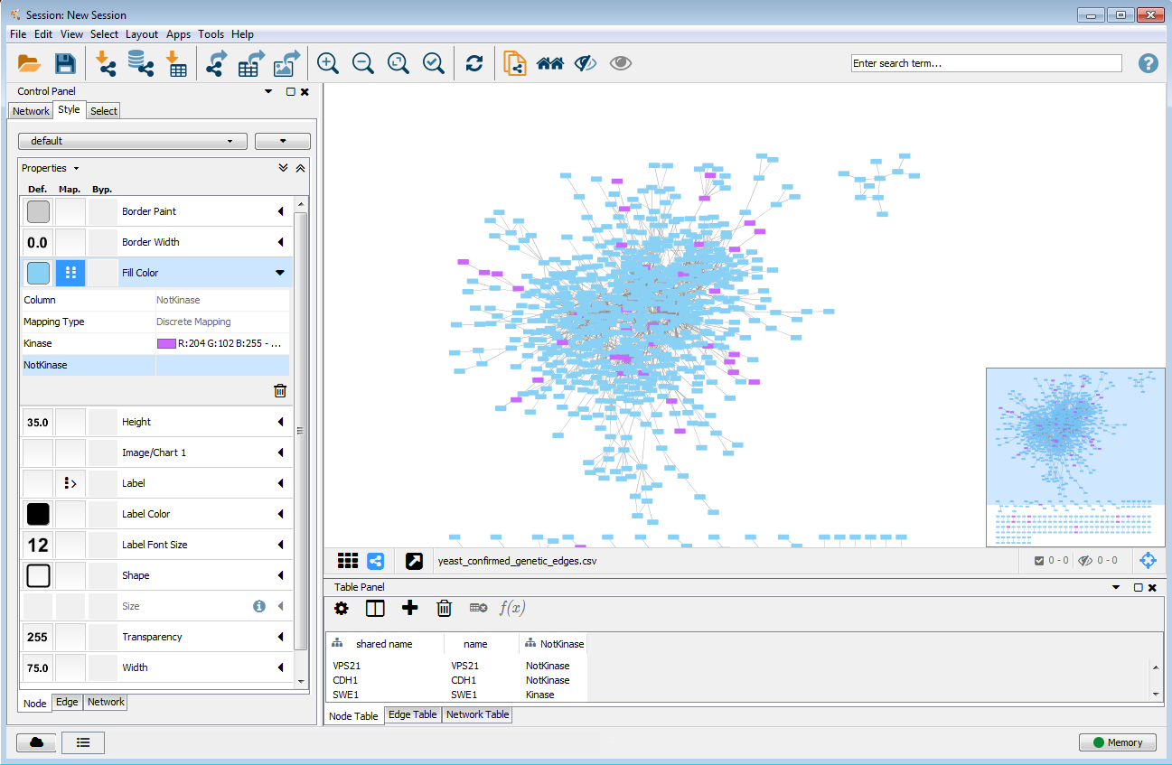
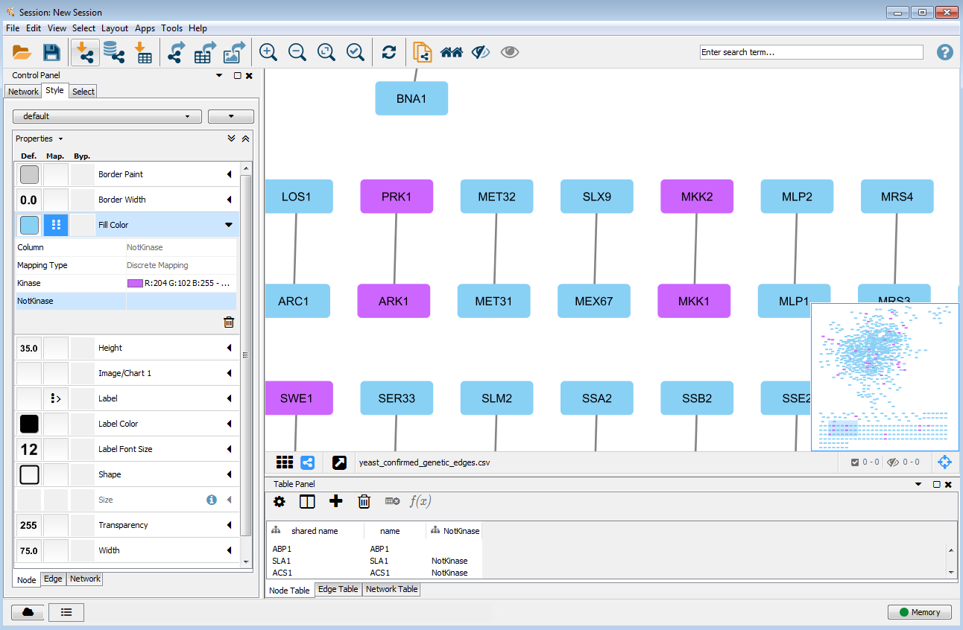
What we’re aiming for…

