Slide 1
CSCI E-12
Fundamentals of Web Site Development
Validation, HTML5, and Tables

Slide 2
Introduction
Michael D. Hilborn
But you can call me “Mike”
Contact:
Discussion board on course web site
Canvas inbox
Last resort: hilborn@fas.harvard.edu

Slide 3
Format of Section
Focused on the fundamentals that you will need to know for your assignments
First 30 minutes devoted to an overview of the previous lecture’s important topics
Final 30 minutes (possibly beyond) devoted to hands-on help with assignments
But how the section runs is ultimately up to all of us

Slide 4
How You Can Help
Attend the previous week’s lecture
Read the previous week’s recommended materials
Read through (and hopefully) start the current assignment
Come prepared with questions

Slide 5
Today’s Agenda
Quick review of last week
Validating Web Pages
Structure, Style, & Function
Some HTML Markup
Tables

Slide 6
Quick Review of Last Section
You learned about your web toolkit
Web Client (browser), Web Server, Text Editor, SSH Client, FTP Client, WWW
You learned about HTML
You learned about using HTML to write web pages
Best of all, you published your own web page!
But we didn’t validate the web page, so…

Slide 7
Let’s Validate Your HTML!
Why validate your web page?
Ensures that it adheres to web standards
Why do we care about standards?
Accessibility for people
Accessibility for computers
Browsers
Search engines
Mobile devices
Stability (forward/backward compatible)

Slide 8
How Do You Validate?
First, make certain you have a Document Type Definition (DTD) at the top of your HTML
This informs the browser or validator what kind of markup you are using
The browser renders according to the DTD’s rules
The validator checks against the DTD’s rules
Current DTDs
HTML 5
XHTML 1.1
XHTML 1.0 Strict
XHTML 1.0 Transitional
HTML 4.01 Strict
HTML 4.01 Transitional
Tip: Why not try for XHTML 1.1, then validate for HTML 5?
I like these

Slide 9
Choose A DTD And Cut-n-Paste It
HTML 5
<!DOCTYPE html>
XHTML 1.1
<!DOCTYPE html PUBLIC "-//W3C//DTD XHTML 1.1//EN" "http://www.w3.org/TR/xhtml11/DTD/xhtml11.dtd">
XHTML 1.0 Strict
<!DOCTYPE html PUBLIC "-//W3C//DTD XHTML 1.0 Strict//EN" "http://www.w3.org/TR/xhtml1/DTD/xhtml1-strict.dtd">
XHTML 1.0 Transitional
<!DOCTYPE html PUBLIC "-//W3C//DTD XHTML 1.0 Transitional//EN" "http://www.w3.org/TR/xhtml1/DTD/xhtml1-transitional.dtd">
I like this!

Slide 10
Choose A DTD And Cut-n-Paste It
HTML 4.01 Strict
<!DOCTYPE html PUBLIC "-//W3C//DTD HTML 4.01//EN" "http://www.w3.org/TR/html4/strict.dtd">
HTML 4.01 Transitional
<!DOCTYPE html PUBLIC "-//W3C//DTD HTML 4.01 Transitional//EN" "http://www.w3.org/TR/html4/loose.dtd”>
HTML 4.01 Frameset
<!DOCTYPE html PUBLIC "-//W3C//DTD HTML 4.01 Frameset//EN" "http://www.w3.org/TR/html4/frameset.dtd">

Slide 11
How Do You Validate?
After you select a DTD and write your HTML, go to a validator…
http://validator.w3.org/nu/

Slide 12
Structure, Style, & Function… Oh My!
We are here
HTML
CSS
JavaScript
Remember: Good web page design means the three are separate, but work together

Slide 13
Structure: HTML Markup
<!DOCTYPE html>
<html>
<head>
<meta charset="utf-8" />
<title>Jabberwocky</title>
</head>
<body>
<p>
`Twas brillig, and the slithy toves
<br />
Did gyre and gimble in the wabe:
<br />
All mimsy were the borogoves,
<br />
And the mome raths outgrabe.
</p>
<p>
"Beware the Jabberwock, my son!
<br /> The jaws that bite,
the claws that catch!
<br /> Beware the Jubjub bird, and shun
<br />
The frumious Bandersnatch!”
</p>
</body>
</html>
Heading elements
Block level elements
Inline elements
Anchor (link) element
Image element
Lists
Tables
Forms

Slide 14
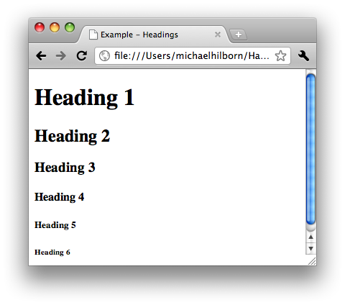
Heading Elements
<h1>Heading 1</h1>
<h2>Heading 2</h2>
<h3>Heading 3</h3>
<h4>Heading 4</h4>
<h5>Heading 5</h5>
<h6>Heading 6</h6>

Slide 15
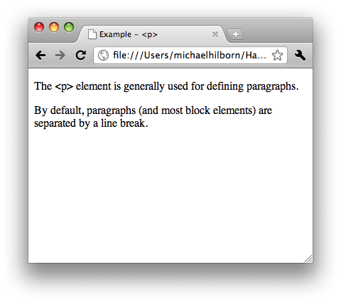
Block level elements: <p>
<p>
The &lt;p&gt; element is generally used for defining paragraphs.
</p>
<p>
By default, paragraphs (and most block elements) are separated by a line break.
</p>

Slide 16
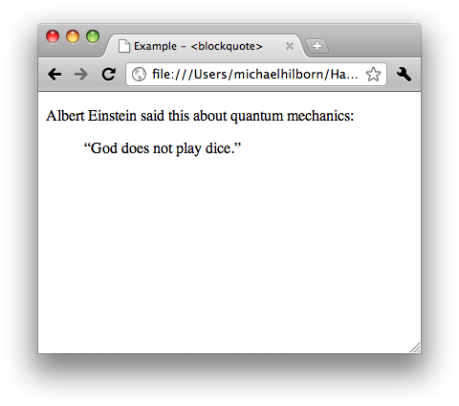
Block level elements: <blockquote>
<p>
Albert Einstein said this about quantum mechanics:
</p>
<blockquote>
“God does not play dice.”
</blockquote>

Slide 17
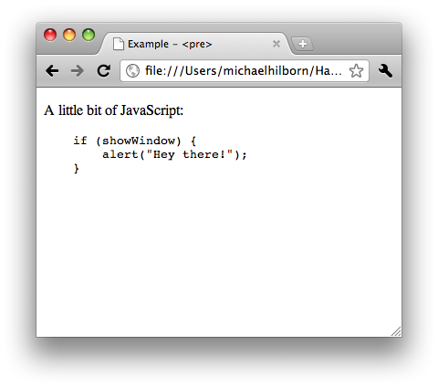
Block level elements: <pre>
<p>
A little bit of JavaScript:
</p>
<pre>
if (showWindow) {
alert("Hey there!");
}
</pre>

Slide 18
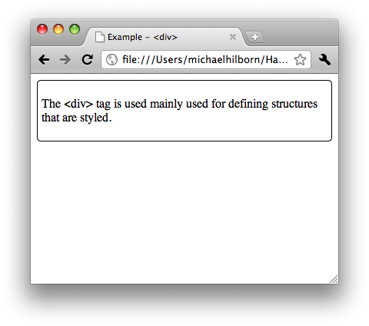
Block level elements: <div>
<div style=“border: thin solid black; padding: 5px; -webkit-border-radius: 5px”>
<p>
The &lt;div&gt; tag is mainly used for defining structures that are styled.
</p>
</div>

Slide 19
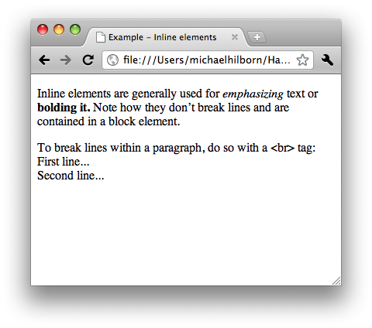
Inline elements: <em>, <strong>, <br />
<p>
Inline elements are generally used for <em>emphasizing</em> text or <strong>bolding it.</strong> Note how they don’t break lines and are contained in a block element.
</p>
<p>
To break lines within a paragraph, do so with a &lt;br&gt; tag:
<br />
First line...
<br />
Second line...
</p>

Slide 20
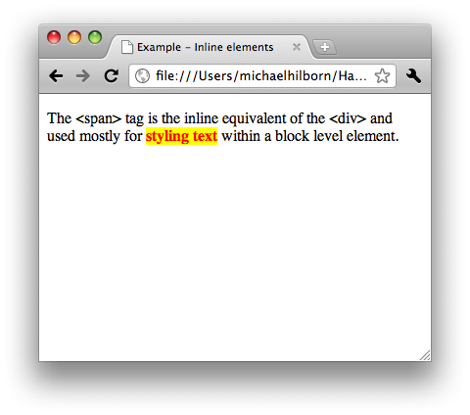
Inline elements: <span>
<p>
The &lt;span&gt; tag is the inline equivalent of the &lt;div&gt; and used mostly for <span style="background-color: yellow; color: red; font-weight: bold;">styling text</span> within a block level element.
</p>

Slide 21
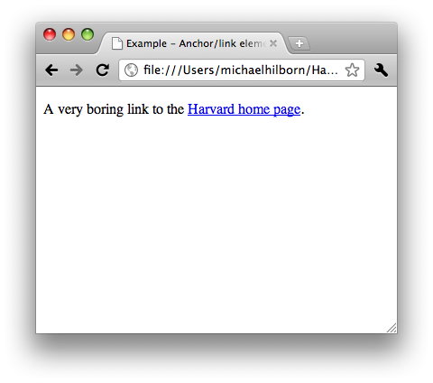
Anchor/Link Element: <a>
<p>
A very boring link to the <a href="http://www.harvard.edu">Harvard home page</a>.
</p>

Slide 22
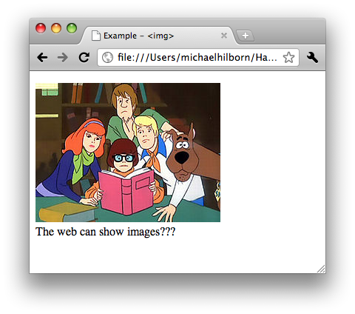
Image Element: <img />
<p>
<img src="images/scooby-doo.jpg" alt="Scooby Doo" />
<br />
The web can show images???
</p>

Slide 23
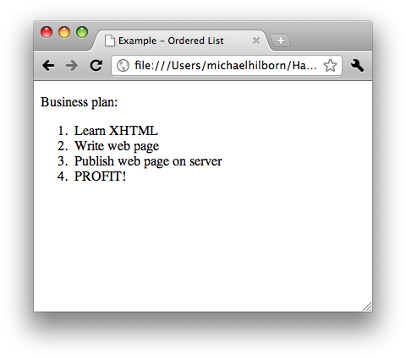
Lists: Ordered List (<ol>, <li>)
<p>
Business plan:
</p>
<ol>
<li>Learn XHTML</li>
<li>Write web page</li>
<li>Publish web page on server</li>
<li>PROFIT!</li>
</ol>

Slide 24
Lists: Unordered List (<ul>, <li>)
<p>
Business plan:
</p>
<ul>
<li>Learn XHTML</li>
<li>Write web page</li>
<li>Publish web page on server</li>
<li>PROFIT!</li>
</ul>

Slide 25
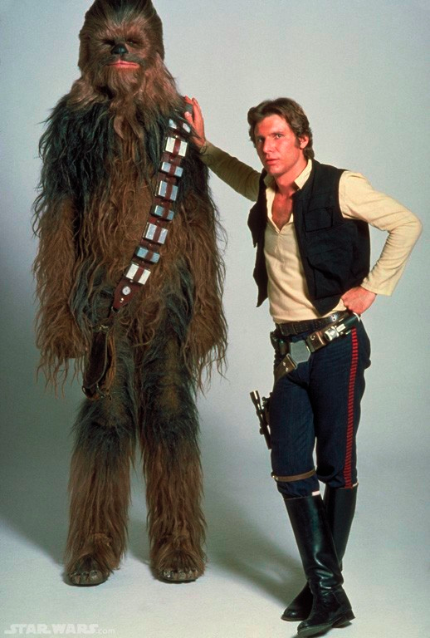
Lots of Elements Out There
Don’t panic!
You’ll get to a know a bunch and you’ll become best friends.
http://www.w3schools.com/tags/
<!--...--> <!DOCTYPE> <a> <abbr> <acronym> <address> <applet> <area /> <b> <base /> <basefont /> <bdo> <big> <blockquote> <body> <br /> <button> <caption> <center> <cite> <code> <col /> <colgroup> <dd> <del> <dfn> <dir> <div> <dl> <dt> <em> <fieldset> <font> <form> <frame /> <frameset> <h1> <h2> <h3> <h4> <h5> <h6> <head> <hr /> <html> <i> <iframe> <img /> <input /> <ins> <isindex> <kbd> <label> <legend> <li> <link /> <map> <menu> <meta /> <noframes> <noscript> <object> <ol> <optgroup> <option> <p> <param /> <pre> <q> <s> <samp> <script> <select> <small> <span> <strike> <strong> <style> <sub> <sup> <table> <tbody> <td> <textarea> <tfoot> <th> <thead> <title> <tr> <tt> <u> <ul> <var> <xmp>

Slide 26
Tables
Great for displaying tabular data
Even better for laying out pages!
WRONG!
WRONG!
WRONG!
Tables should be used for tabular data ONLY!

Slide 27
Anatomy of a Table
<table>
<caption>Sci-Fi movie trilogies</caption>
<thead>
<tr>
<th scope="col">Trilogy</th>
<th scope="col">First Movie</th>
<th scope="col">Second Movie</th>
<th scope="col">Third Movie</th>
</tr>
</thead>
<tfoot>
<tr>
<td colspan="4">Data compiled from a geek's memory</td>
</tr>
</tfoot>
<tbody>
<tr>
<th scope="row">Star Wars</th>
<td>A New Hope</td>
<td>The Empire Strikes Back</td>
<td>The Return of the Jedi</td>
</tr>
<tr>
<th scope="row">Matrix</th>
<td>The Matrix</td>
<td>The Matrix Reloaded</td>
<td>The Matrix Revolutions</td>
</tr>
</tbody>
</table>

Slide 28
Anatomy of a Table
<table>
<caption>Sci-Fi movie trilogies</caption>
<thead>
<tr>
<th scope="col">Trilogy</th>
<th scope="col">First Movie</th>
<th scope="col">Second Movie</th>
<th scope="col">Third Movie</th>
</tr>
</thead>
<tfoot>
<tr>
<td colspan="4">Data compiled from a geek's memory</td>
</tr>
</tfoot>
<tbody>
<tr>
<th scope="row">Star Wars</td>
<td>A New Hope</td>
<td>The Empire Strikes Back</td>
<td>The Return of the Jedi</td>
</tr>
<tr>
<th scope="row">Matrix</td>
<td>The Matrix</td>
<td>The Matrix Reloaded</td>
<td>The Matrix Revolutions</td>
</tr>
</tbody>
</table>
The table itself (<table>…</table>)

Slide 29
Anatomy of a Table
<table>
<caption>Sci-Fi movie trilogies</caption>
<thead>
<tr>
<th scope="col">Trilogy</th>
<th scope="col">First Movie</th>
<th scope="col">Second Movie</th>
<th scope="col">Third Movie</th>
</tr>
</thead>
<tfoot>
<tr>
<td colspan="4">Data compiled from a geek's memory</td>
</tr>
</tfoot>
<tbody>
<tr>
<th scope="row">Star Wars</th>
<td>A New Hope</td>
<td>The Empire Strikes Back</td>
<td>The Return of the Jedi</td>
</tr>
<tr>
<th scope="row">Matrix</th>
<td>The Matrix</td>
<td>The Matrix Reloaded</td>
<td>The Matrix Revolutions</td>
</tr>
</tbody>
</table>
The table itself (<table>…</table>)
A caption (<caption>…</caption>)

Slide 30
Anatomy of a Table
<table>
<caption>Sci-Fi movie trilogies</caption>
<thead>
<tr>
<th scope="col">Trilogy</th>
<th scope="col">First Movie</th>
<th scope="col">Second Movie</th>
<th scope="col">Third Movie</th>
</tr>
</thead>
<tfoot>
<tr>
<td colspan="4">Data compiled from a geek's memory</td>
</tr>
</tfoot>
<tbody>
<tr>
<th scope="row">Star Wars</th>
<td>A New Hope</td>
<td>The Empire Strikes Back</td>
<td>The Return of the Jedi</td>
</tr>
<tr>
<th scope="row">Matrix</th>
<td>The Matrix</td>
<td>The Matrix Reloaded</td>
<td>The Matrix Revolutions</td>
</tr>
</tbody>
</table>
The table itself (<table>…</table>)
A caption (<caption>…</caption>)
Header (<thead>…</thead>)

Slide 31
Anatomy of a Table
<table>
<caption>Sci-Fi movie trilogies</caption>
<thead>
<tr>
<th scope="col">Trilogy</th>
<th scope="col">First Movie</th>
<th scope="col">Second Movie</th>
<th scope="col">Third Movie</th>
</tr>
</thead>
<tfoot>
<tr>
<td colspan="4">Data compiled from a geek's memory</td>
</tr>
</tfoot>
<tbody>
<tr>
<th scope="row">Star Wars</th>
<td>A New Hope</td>
<td>The Empire Strikes Back</td>
<td>The Return of the Jedi</td>
</tr>
<tr>
<th scope="row">Matrix</th>
<td>The Matrix</td>
<td>The Matrix Reloaded</td>
<td>The Matrix Revolutions</td>
</tr>
</tbody>
</table>
The table itself (<table>…</table>)
A caption (<caption>…</caption>)
Header (<thead>…</thead>)
Footer (<tfoot>…</tfoot>)

Slide 32
Anatomy of a Table
<table>
<caption>Sci-Fi movie trilogies</caption>
<thead>
<tr>
<th scope="col">Trilogy</th>
<th scope="col">First Movie</th>
<th scope="col">Second Movie</th>
<th scope="col">Third Movie</th>
</tr>
</thead>
<tfoot>
<tr>
<td colspan="4">Data compiled from a geek's memory</td>
</tr>
</tfoot>
<tbody>
<tr>
<th scope="row">Star Wars</th>
<td>A New Hope</td>
<td>The Empire Strikes Back</td>
<td>The Return of the Jedi</td>
</tr>
<tr>
<th scope="row">Matrix</th>
<td>The Matrix</td>
<td>The Matrix Reloaded</td>
<td>The Matrix Revolutions</td>
</tr>
</tbody>
</table>
The table itself (<table>…</table>)
A caption (<caption>…</caption>)
Header (<thead>…</thead>)
Footer (<tfoot>…</tfoot>)
Body (<tbody>…</tbody>)

Slide 33
Anatomy of a Table
<table>
<caption>Sci-Fi movie trilogies</caption>
<thead>
<tr>
<th scope="col">Trilogy</th>
<th scope="col">First Movie</th>
<th scope="col">Second Movie</th>
<th scope="col">Third Movie</th>
</tr>
</thead>
<tfoot>
<tr>
<td colspan="4">Data compiled from a geek's memory</td>
</tr>
</tfoot>
<tbody>
<tr>
<th scope="row">Star Wars</th>
<td>A New Hope</td>
<td>The Empire Strikes Back</td>
<td>The Return of the Jedi</td>
</tr>
<tr>
<th scope="row">Matrix</th>
<td>The Matrix</td>
<td>The Matrix Reloaded</td>
<td>The Matrix Revolutions</td>
</tr>
</tbody>
</table>
The table itself (<table>…</table>)
A caption (<caption>…</caption>)
Header (<thead>…</thead>)
Footer (<tfoot>…</tfoot>)
Body (<tbody>…</tbody>)
Rows (<tr>…</tr>)

Slide 34
Anatomy of a Table
<table>
<caption>Sci-Fi movie trilogies</caption>
<thead>
<tr>
<th scope="col">Trilogy</th>
<th scope="col">First Movie</th>
<th scope="col">Second Movie</th>
<th scope="col">Third Movie</th>
</tr>
</thead>
<tfoot>
<tr>
<td colspan="4">Data compiled from a geek's memory</td>
</tr>
</tfoot>
<tbody>
<tr>
<th scope="row">Star Wars</th>
<td>A New Hope</td>
<td>The Empire Strikes Back</td>
<td>The Return of the Jedi</td>
</tr>
<tr>
<th scope="row">Matrix</th>
<td>The Matrix</td>
<td>The Matrix Reloaded</td>
<td>The Matrix Revolutions</td>
</tr>
</tbody>
</table>
The table itself (<table>…</table>)
A caption (<caption>…</caption>)
Header (<thead>…</thead>)
Footer (<tfoot>…</tfoot>)
Body (<tbody>…</tbody>)
Rows (<tr>…</tr>)
Data cells (<td>…</td>)

Slide 35
Anatomy of a Table
<table>
<caption>Sci-Fi movie trilogies</caption>
<thead>
<tr>
<th scope="col">Trilogy</th>
<th scope="col">First Movie</th>
<th scope="col">Second Movie</th>
<th scope="col">Third Movie</th>
</tr>
</thead>
<tfoot>
<tr>
<td colspan="4">Data compiled from a geek's memory</td>
</tr>
</tfoot>
<tbody>
<tr>
<th scope="row">Star Wars</th>
<td>A New Hope</td>
<td>The Empire Strikes Back</td>
<td>The Return of the Jedi</td>
</tr>
<tr>
<th scope="row">Matrix</th>
<td>The Matrix</td>
<td>The Matrix Reloaded</td>
<td>The Matrix Revolutions</td>
</tr>
</tbody>
</table>
The table itself (<table>…</table>)
A caption (<caption>…</caption>)
Header (<thead>…</thead>)
Footer (<tfoot>…</tfoot>)
Body (<tbody>…</tbody>)
Rows (<tr>…</tr>)
Data cells (<td>…</td>)
Attributes
colspan, rowspan

Slide 36
Anatomy of a Table
<table>
<caption>Sci-Fi movie trilogies</caption>
<thead>
<tr>
<th scope="col">Trilogy</th>
<th scope="col">First Movie</th>
<th scope="col">Second Movie</th>
<th scope="col">Third Movie</th>
</tr>
</thead>
<tfoot>
<tr>
<td colspan="4">Data compiled from a geek's memory</td>
</tr>
</tfoot>
<tbody>
<tr>
<th>Star Wars</th>
<td>A New Hope</td>
<td>The Empire Strikes Back</td>
<td>The Return of the Jedi</td>
</tr>
<tr>
<th>Matrix</th>
<td>The Matrix</td>
<td>The Matrix Reloaded</td>
<td>The Matrix Revolutions</td>
</tr>
</tbody>
</table>
The table itself (<table>…</table>)
A caption (<caption>…</caption>)
Header (<thead>…</thead>)
Footer (<tfoot>…</tfoot>)
Body (<tbody>…</tbody>)
Rows (<tr>…</tr>)
Data cells (<td>…</td>)
Attributes
colspan, rowspan
scope

Slide 37
Bookmark This!
W3C Validator: http://validator.w3.org/nu/
HTML markup: http://www.w3schools.com/tags/
HTML tables: http://www.w3schools.com/html/html_tables.asp
<col> and <colgroup>: http://htmldog.com/guides/htmladvanced/tables/
Tutorial on accessible tables: http://jimthatcher.com/webcourse9.htm

