Slide 1
Version Control and Git
Kevin Bonham, PhD
2 Oct, 2018

Slide 2
Learning Objectives
After completing this lesson, you will be able to:
Recognize git jargon (repo, commit, stage, push, pull, branch etc.)
Initialize and commit to a local git repository
Use git branches to make changes to working code without losing the current state
Clone a remote repository, make a change, and then start a pull request.

Slide 3
But first!

Slide 4
Version Control

Slide 5
Version control is a system for tracking the state of files and / or folders
my_presentation_draft.pptx
my_presentation_v1_eric_notes.pptx
my_presentation_v1.pptx
my_presentation_garbage.pptx
my_presentation_v1_edits.pptx
my_presentation_v2.pptx
my_presentation_v3.pptx

Slide 6
What if you have multiple files?
my_app/
├ run.py ----------
|
|
|
├ my_functions.py -
|
|
├ my_variables.py -
from my_functions import print_name
from my_variables import my_name
print_name(my_name)
def print_name(a_name):
print(“My name is”, a_name)
my_name = "Kevin"

Slide 7
What if you have multiple files?
my_app/
├ run.py ----------
|
|
|
├ my_functions.py -
|
|
├ my_variables.py -
from my_functions import print_name
from my_variables import user_name
print_name(user_name)
def print_name(a_name):
print(“Your name is”, a_name)
user_name = input("What is your name? ")

Slide 8
What if you have multiple files?
my_app/
├ run_v2.py ----------
|
|
|
├ my_functions_v2.py -
|
|
├ my_variables_v2.py -
from my_functions_v2 import print_name
from my_variables_v2 import user_name
print_name(user_name)
def print_name(a_name):
print(“Your name is”, a_name)
user_name = input("What is your name? ")

Slide 9
What if you’re collaborating?
my_app/
├ run.py ----------
|
|
|
├ my_functions.py -
|
|
├ my_variables.py -
from my_functions import print_name
from my_variables import my_name
print_name(my_name)
def print_name(a_name):
print(“My name is”, a_name)
my_name = “Eric"

Slide 10
Why not use web drive like gdrive or dropbox?
Changes to files are often co-dependent
simultaneous coding is… problematic
Explicit versioning
Changes can “break” code in ways text can’t be broken
Ability to take multiple development paths

Slide 11
Version Control Systems (VCS)

Slide 12
A version control system:
Explicitly tracks the state of files and folders
Keeps a record of changes to files and folders
Without requiring name changes
Enables moving forward and backward in time

Slide 13
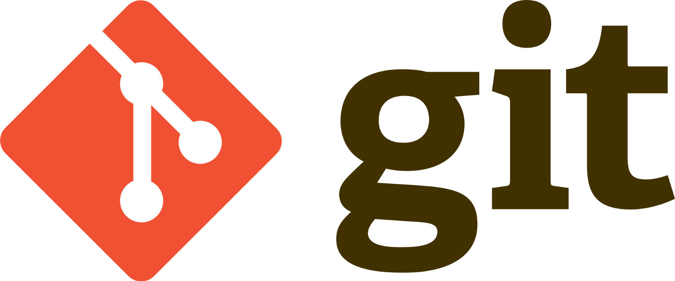
is a Distributed Version Control System (DVCS)

Slide 14
Git has a lot of jargon
Repository (repo): a git-enabled folder
Sometimes refers to all locations (remotes and locals) of a particular fork
Commit: an snapshot of code
Branch: a particular history of commits (multiple branches can exist in the same repo)
Merge: When two branches are joined together and any conflicts are dealt with

Slide 15
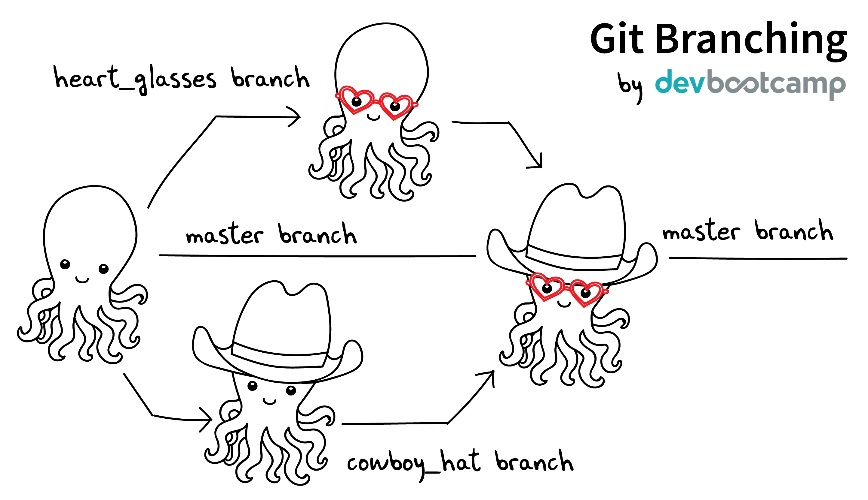

Slide 16
git ≠ github
Github (and gitlab and bitbucket) is a place for hosting a “remote” repository
Also adds collaboration features
git is powerful even if used only on your local machine
But… get free private repos on github with your .edu address (or use gitlab / bitbucket)

Slide 17
Install git
Mac:
https://brew.sh/
Copy install code (on the webpage)
/usr/bin/ruby -e "$(curl -fsSL https://raw.githubusercontent.com/Homebrew/install/master/install)”
$ brew install git
Windows:
https://gitforwindows.org/

Slide 18
Clone the exercise repo
$ git clone https://github.com/kescobo/bst273_lecture09.git
Cloning into 'bst273_lecture09'...
remote: Enumerating objects: 11, done.remote: Counting objects: 100% (11/11), done.
remote: Compressing objects: 100% (9/9), done.
remote: Total 11 (delta 1), reused 11 (delta 1), pack-reused 0
Unpacking objects: 100% (11/11), done.

