Slide 1
IID209: Microbial Communities and the Human Microbiome
Wendy Garrett (wgarrett@hsph.harvard.edu)
Curtis Huttenhower (chuttenh@hsph.harvard.edu)
http://huttenhower.sph.harvard.edu/iid209

Slide 2
IID209: Microbial Communities and the Human Microbiome
Introduction to microbial community theory and analysis methods generally.
And the human microbiome and health specifically.
History of microbial community studies.
Ecology, microbiology, and immunology of the human microbiome.
Methods for microbial community research.
Experimental: in vitro, gnotobiotics, in vivo.
Quantitative: bioinformatics, statistics.
Microbial community disease relevance, population studies, public health.
No particular prerequisites, just general familiarity with molecular/microbiology and very basic computational skills.

Slide 3
Course overview
Location
Lectures: MW 2:00-3:30 Kresge 201
Instructors
Wendy Garrett wgarrett@hsph.harvard.edu
Office hours: By appointment, SPH1 9th
Curtis Huttenhower chuttenh@hsph.harvard.edu
Office hours: F 10:00-11:00, SPH1 413
TA
Sydney Lavoie sydneylavoie@fas.harvard.edu

Slide 4
Course web site
Canvas or http://huttenhower.sph.harvard.edu/iid209
Redirects to standard Canvas site.
If you aren’t on Canvas that’s fine – email TA now / ASAP to register.
Contains the entire calendar of topics and activities throughout the course.
All assignments and grades will be posted and submitted here.
Plus group presentations and analysis packages for journal club and final project.
In addition to in-class "clicker" polls – ungraded but recorded (attendance!)
Includes course announcements and discussion board.
Please use the latter to discuss the course and questions…
…but be cognizant of the collaboration policy – more on that later.

Slide 5
Course structure
Three main components:
Lectures, readings, and in-class activities.
Problem sets (3x).
Final project.
Textbook:
Bacteriology of Humans: An Ecological Perspective, Wilson
It’s a bit dated, but comprehensive and engaging for its age.
Three ~biweekly problem sets:
Assigned every other Monday.
Due by end-of-day (midnight) next week’s Friday (~two weeks).
Most material provided in slides (one per class segment).
Plus textbook readings and especially literature.

Slide 6
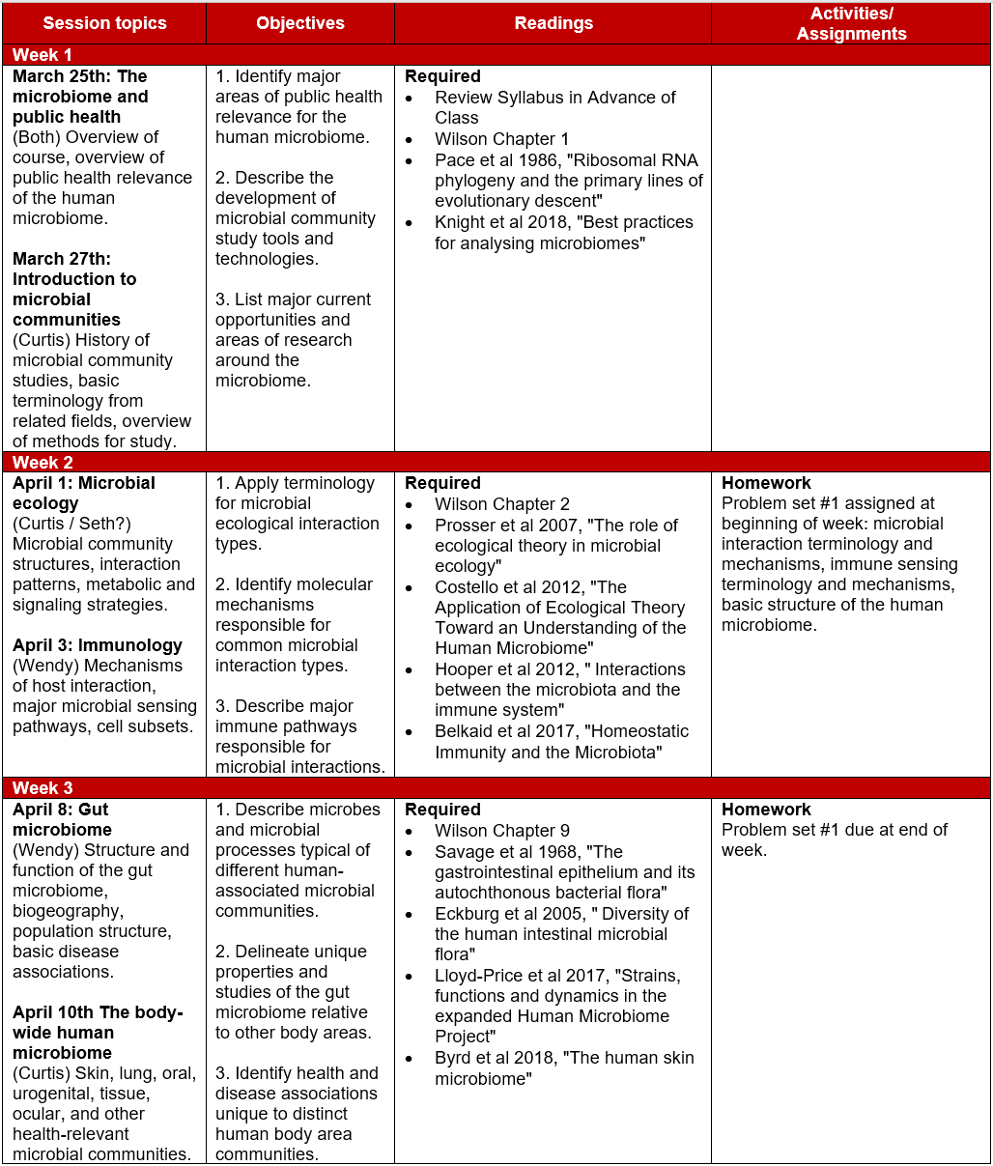
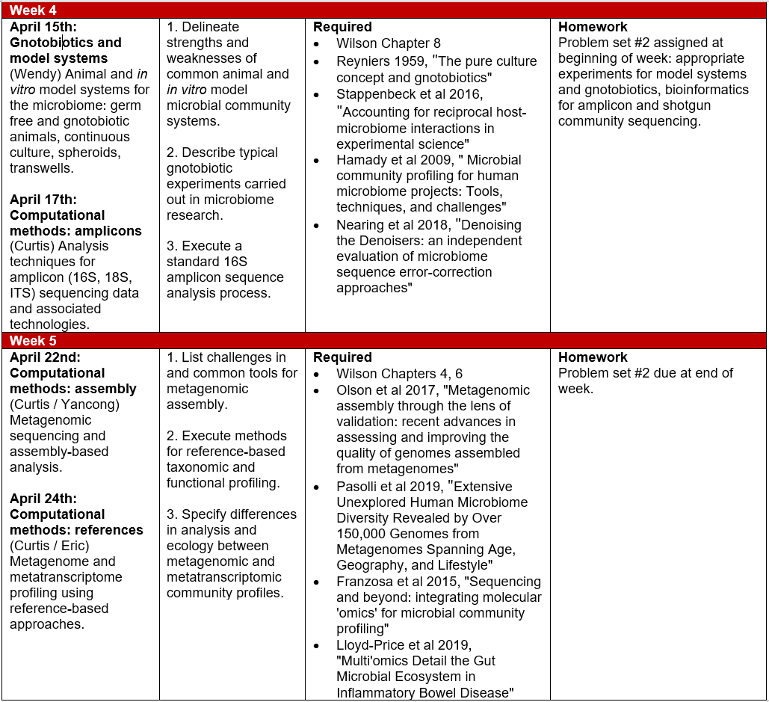
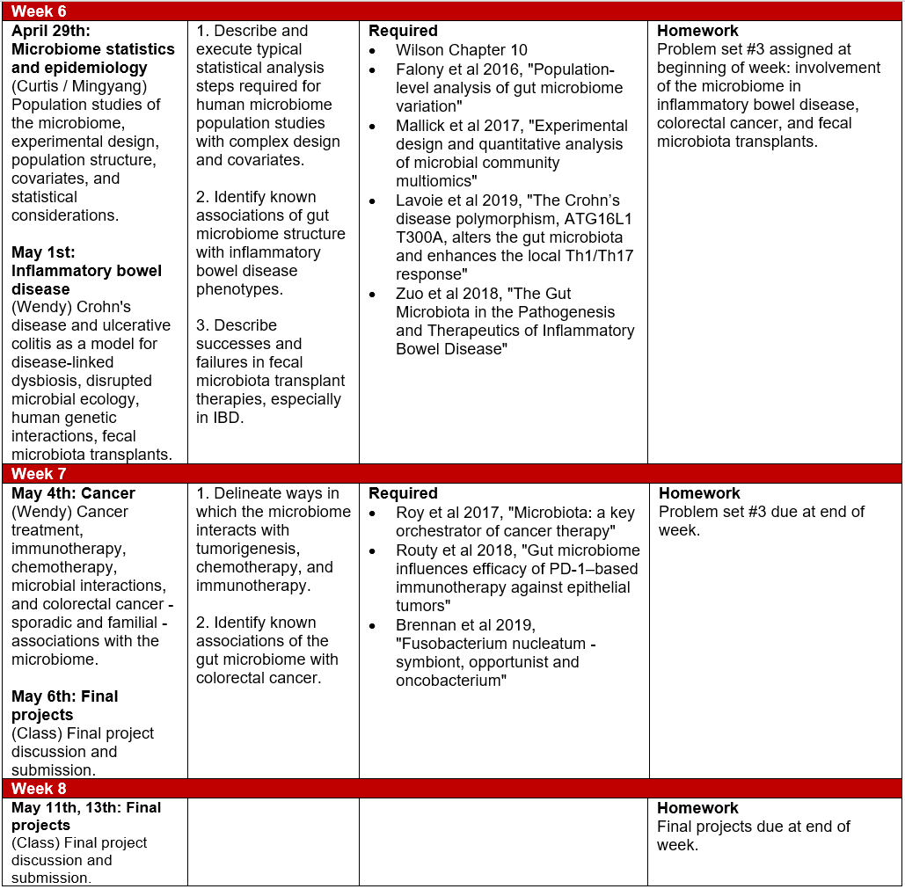
Course structure

Slide 7
Class structure
Two 90-minute sessions each week
Each session comprises two segments, with a ~5-10min break in between
Breaks are intended to be halfway ~4:30 – if I miss them, please remind us!
Many classes will have a group or interactive activity in the last ~1/3, in which case break’s a bit later.
Lectures are meant to be interactive – a conversation, not a speech!
Please interrupt, ask questions, and feel free to direct discussion topics.
Particularly when they touch on your own areas of research.
Please bring your laptops to class if at all possible.
If not, let one of us know after class.
Will be used for activities, polls.

Slide 8
Poll structure
Canvas quizzes, clicker-style.
Results are ungraded and only displayed anonymously.
However, responses are logged – which tells us who's here.
Can be submitted either through the web site or their (not-too-bad) app.
Let's try it out and get some background on the group:
M01.1 Introductions

Slide 9
Problem sets and final projects
Problem sets are typically short answer writing.
Largely based on literature material, occasionally on the textbook.
Critical thinking, thoughtful conclusions and critiques, domain knowledge.
Final projects are group activities.
2-4 people per group.
Final projects:
Generate a ~1-2 paragraph proposal for an appropriately-scoped ‘omics analysis.
Using your own research data is fair game.
Iterate, get signoff, and carry out the analysis.
Present ~45min (I think?) overview and discussion, plus questions.
Submit presentation, data and analysis package, and…
…individual extended abstract writeups: 2-4 pages, including 1-2 figures, plus references.

Slide 10
Assignment and collaboration policies
Late submissions lose points geometrically:
10% the first day, 25% the second, 60% the third, 100% the fourth.
Extensions are generally fine if requested at least one day in advance.
Problem set structure and scoring is indicated within each assignment.
On problem sets, please use common sense for collaboration:
Specific text for written answers should not be shared.
Do not show them to each other, even within group members.
If you want to ask about specific text, send it privately to the TA.
All problem sets are submitted individually.
However, we encourage discussion of questions about problem sets:
These may (and should!) be posted on the course web discussion board.
Feel free to address questions, without sharing the specifics of individual answers.

Slide 11
Summary
http://huttenhower.sph.harvard.edu/iid209
MW 2:00-3:30
Wendy, Curtis, and Syd
Microbial community theory and methods, with a focus on human microbiome function, mechanisms, health, and population biology.
Combination of microbial ecology, microbiology, immunology, bioinformatics, translational applications, and epidemiology.
Two sessions each week.
Sessions are a mix of lectures and activities.
Three biweekly problem sets, group final project.
What would you like to get out of the course?

