Slide 1
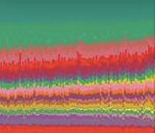
IID 209 Lecture #7: Model systems for microbiome studies
Nature 486, 207–214. 2012
LEARNING OBJECTIVES
Delineate strengths and weaknesses of model systems
Describe typical experiments carried out in microbiome research
http://www.emergtoplifesci.org/content/1/4/385

Slide 2
Outline
Bioreactors
Polarized cell cultures
Gut-on-a-chip
Organoids & spheroids
Animals & husbandry
Hyperbiotics.com

Slide 3
Bioreactors
Enable the controlled study of microbial behavior so that in replicate experiments, consistent samples are produced and measurements of parameters (biomass, metabolic activity, cell number and resistance to chemical or physical challenge) can be made.
Reactor systems can be set up to control many experimental variables:
Chemical variables:
Nutrient type (carbon sources: sugars, proteins, lipids, ….)
Nutrient concentration
pH
Inorganic components, (nitrogen and sulfur source etc.)
Dissolved Oxygen
Growth Inhibitors (antimetabolites, antibiotics, disinfectants)
Physical variables
Temperature
Fluid shear stress
Surface composition and texture
Residence time
Biological variables
Organism type (pure or mixed culture)
Organism concentration
https://www.cs.montana.edu/webworks/projects/stevesbook/contents/contents.html
https://doi.org/10.1016/j.ymeth.2018.08.003

Slide 4
What types of questions can you begin to address with bioreactors
Questions about biological interaction between different biological organisms
Types of Interaction
Mutualism (benefits both)
Cooperation (same idea but more general)
Predation (one benefits, other is actively targeted)
Parasitism (one benefits, detrimental to other)
Amensalism (neither affected)
Competition (both are actively targeted)
How interactions are implemented
Metabolically: ‘a’ needs something ‘b’ makes
Signaling / regulation: quorum sensing
Biochemical warfare: antibiotics, bacteriocins
Spatial interaction/competition
https://www.cs.montana.edu/webworks/projects/stevesbook/contents/chapters/chapter008/section002/blue/page004.html

Slide 5
Types of Bioreactors
Bioreactors | Batch Cultures | Twin-vessel single-stage chemostat | MiniBioReactor Arrays | Three-stage continuous culture system
Inoculum Simulates | Fecal Samples Colon | Fecal Samples Distal Colon | Fecal Samples Distal Colon | Fecal Samples Prox., Transverse, Distal Colon
Pros | Easy to maintain Closed systems/less risk of contamination Reduces operating cost High-throughput | Reproducibility Long period of cultures Perturbation studies Simultaneous control can be monitored | Small processing volumes Reduced cost per run Small processing volumes Reduced cost per run | Simulates proximal, transversal and distal colon Allows sampling at different zones
Cons | Short Culture Periods Nutrients Decrease Over Time Limited Amount of Growth Media Waste Product Build-up | Risk of contamination due to daily operation Anatomy of intestine not mimicked Long operation increase cost/run | Risk of contamination Stable cell growth can fail during the sampling protocol Inhibition of growth by excess end products | No simulation of digestion or absorption of nutrients Risk of contamination
Characklis and Marshall. Biofilms, 1990. John Wiley and Son, Inc. New York.
https://doi.org/10.1016/j.ymeth.2018.08.003
https://www.ncbi.nlm.nih.gov/pmc/articles/PMC3815277/ (SHIME and M-SHIME)
Notes:
Described by Monod and Novick & Szilard in 1950
Batch bioreactors are closed system vessels with defined volumes of enriched media
Short term & study of fermentative end products, as no nutrient replenishment
detailed characterization of planktonic and biofilm reproducibility, diver- sity, and response to perturbation.
Continuous culture using Continuous Flow Stirred Tank Reactor (chemostats)
whether planktonic and biofilm communities were (i) reproducible and stable over time, (ii) had distinct microbial compositions, and (iii) had varying responses to antibiotic
First, the simulator of the human intestinal microbial ecosystem (SHIME) (Van den Abbeele et al. 2012) is a model of the small and large intestines that contains stable and functional microbial communities similar to those found in the human (Joly et al. 2013). It is one of the earliest types of linked continuous culture systems that mimic the human digestive tract microbiome by controlling compartmentalization, nutrient availability, pH, and other environmental conditions. Another version of the SHIME model is the mucosal SHIME (M-SHIME); it permits the study of mucosa-associated microorganisms (Van den Abbeele et al. 2012). A simpler model is the minibioreactor array, which, unlike the SHIME model, is amenable to high-throughput screening, although it does not model multiple regions of the gastrointestinal tract (Auchtung et al. 2015).

Slide 6
Experiments….
Hyperbiotics.com
And…what’s missing?

Slide 7
Outline
Bioreactors
Polarized cell cultures
Gut-on-a-chip
Organoids & spheroids
Animals and husbandry
Hyperbiotics.com

Slide 8
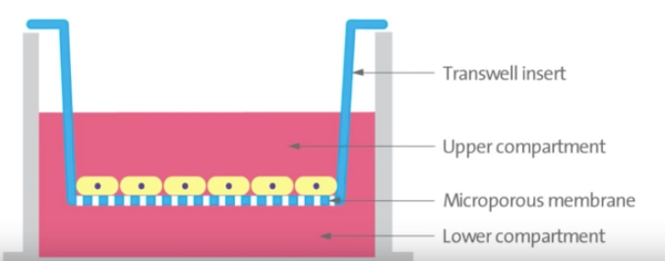
Polarized Cell Cultures: Study of the epithelial barrier
Cell polarity is the asymmetric organization of several cellular components.
Cell polarity maintains a barrier within the gut epithelium
Cell polarity is essential, in vivo, for the full expression of functional properties of tissues and organs.
Human polarizable colonic epithelial cell lines: Caco2-BBe, HCT-8, HT29, SKCO-15, T84
https://www.youtube.com/watch?v=qShNJowtd_8

Slide 9
Pros of Polarized Epithelial Monolayers
Can be generated from primary of immortalized gut cells on transwell membranes and other scaffolds.
Microbes can be added to apical surface
The epithelium can be studied
Permeability
Transmembrane resistance
Active Transport
Absorption
Excretion
Amenable to a number of expression assays
Miniaturization enables microfluidic manipulations
Environmental Chemicals, the Human Microbiome, and Health Risk
A Research Strategy (2018). https://www.nap.edu/catalog/24960/environmental-chemicals-the-human-microbiome-and-health-risk-a-research
https://www.pnas.org/content/106/27/11143

Slide 10
Cons of Polarized Epithelial Monolayers
Lack of secondary epithelial structures, such as villi and crypts
Absence of additional epithelial-cell and other subtypes*
Goblet, enteroendocrine, stromal cells and immune cells
Lack of mucus layers between host and microbial cells
Difficult to incorporate multiorganism microbial-community components
Environmental Chemicals, the Human Microbiome, and Health Risk
A Research Strategy (2018). https://www.nap.edu/catalog/24960/environmental-chemicals-the-human-microbiome-and-health-risk-a-research
https://www.pnas.org/content/106/27/11143

Slide 11
Experiments….
Hyperbiotics.com

Slide 12
Gut-on-a-chip
Gut-on-a-chip (GOC) technology uses microfluidic platforms to grow intestinal epithelial cells and mimic the movement of fluids through the gut (Kim and Ingber 2013)
GOC enables formation of intestinal-tissue structures with specialized cell types, such as absorptive, goblet, enteroendocrine, and Paneth cells.
GOC structures exhibit barrier properties, including mucosal linings and peristaltic motion.
Continuous movement of fluids can enable persistent microbial microcolonization as a continuous-culture system (Kim et al. 2012, 2016).
DOI: 10.1039/c2lc40074j
Notes:
we describe a biomimetic ‘human gut-on-a-chip’ microdevice composed of two microfluidic channels separated by a porous flexible membrane coated with extracellular matrix (ECM) and lined by human intestinal epithelial (Caco-2) cells that mimics the complex structure and physiology of living intestine. The gut microenvironment is recreated by flowing fluid at a low rate (30 mL h!1 ) producing low shear stress (0.02 dyne cm!2 ) over the microchannels, and by exerting cyclic strain (10%; 0.15 Hz) that mimics physiological peristaltic motions. Under these conditions, a columnar epithelium develops that polarizes rapidly, spontaneously grows into folds that recapitulate the structure of intestinal villi, and forms a high integrity barrier to small molecules that better mimics whole intestine than cells in cultured in static Transwell models. In addition, a normal intestinal microbe (Lactobacillus rhamnosus GG) can be successfully co-cultured for extended periods (>1 week) on the luminal surface of the cultured epithelium without compromising epithelial cell viability, and this actually improves barrier function as previously observed in humans. Thus, this gut-on-a-chip recapitulates multiple dynamic physical and functional features of human intestine that are critical for its function within a controlled microfluidic environment that is amenable for transport, absorption, and toxicity studies, and hence it should have great value for drug testing as well as development of novel intestinal disease models

Slide 13
Cons of Gut on a Chip lots of iterations (so know what is actually on the Chip)
Only incorporate limited components of the 4-layered intestinal wall, and these missing features might play a significant role in some disorders.
No smooth muscle cells
Poor modeling to date of the enteric nervous system
Immune system often not incorporated
Polydimethylsiloxane (PDMS) which is used in microfluidic organ devices adsorbs many small and hydrophobic molecules which may prove problematic for studying microbial metabolites and drugs.
Expensive and requires a fair degree of specialized expertise

Slide 14
Experiments….
Hyperbiotics.com

Slide 15
Organoid Culture System
Organ culture of intestinal tissue was first described in 1969 by Browning and Trier
Hans Clever's lab developed a method for isolating intestinal crypts from the small or large intestine of mice and propagating LGR5⁺ stem cells from mice that can be continuously passaged and propagated (Sato et al., 2009), termed intestinal organoids
In 2014 Yin et al., reported methods to direct the differentiation of LGR5⁺ stem cells to become specific cell type (i.e., enterocytes, goblet cells, stem cells, enteroendocrine cells)
Human and mouse intestinal organoids have been used to study host-microbe, host-MAMP, and host-microbial metabolites interactions.

Slide 16
Intestinal organoids and spheroids
https://www.ncbi.nlm.nih.gov/pmc/articles/PMC6240795/

Slide 17
Cons on Intestinal Organoids Cultures
The 3D-architecture of organoids causes their polarity to be “inside-out” where the lumen is contained in the center of the spherical structure making it a challenge to carry out studies of host and microbe
There are now methods to flip them inside-out
Methods to introduce microbes, microbial metabolites and ligands such as microinjection are time consuming, require expertise, and are low through put
There are now methods to create 2-D monolayers out of these organoids facilitating exposure studies
These cultures lack immune, neuronal, and stromal cells
Investigators are working on add-back experiments
Culture system can be expensive (source of growth factor), requires expertise, and concerns about lab-to-lab variability

Slide 18
Experiments….
Hyperbiotics.com

Slide 19
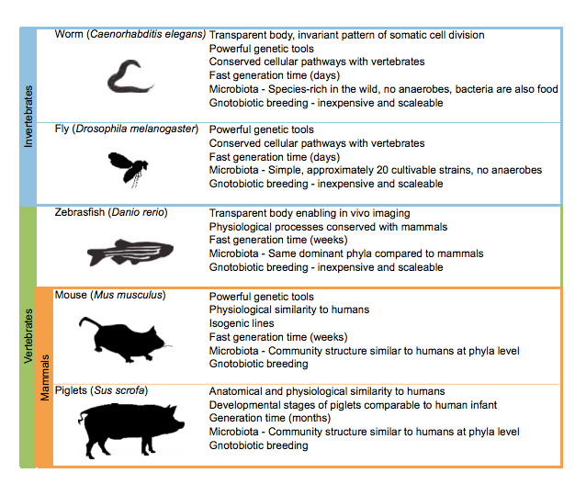
Animal Models & husbandry– the work-horses of microbiome studies
Leulier et al. 2017

Slide 20
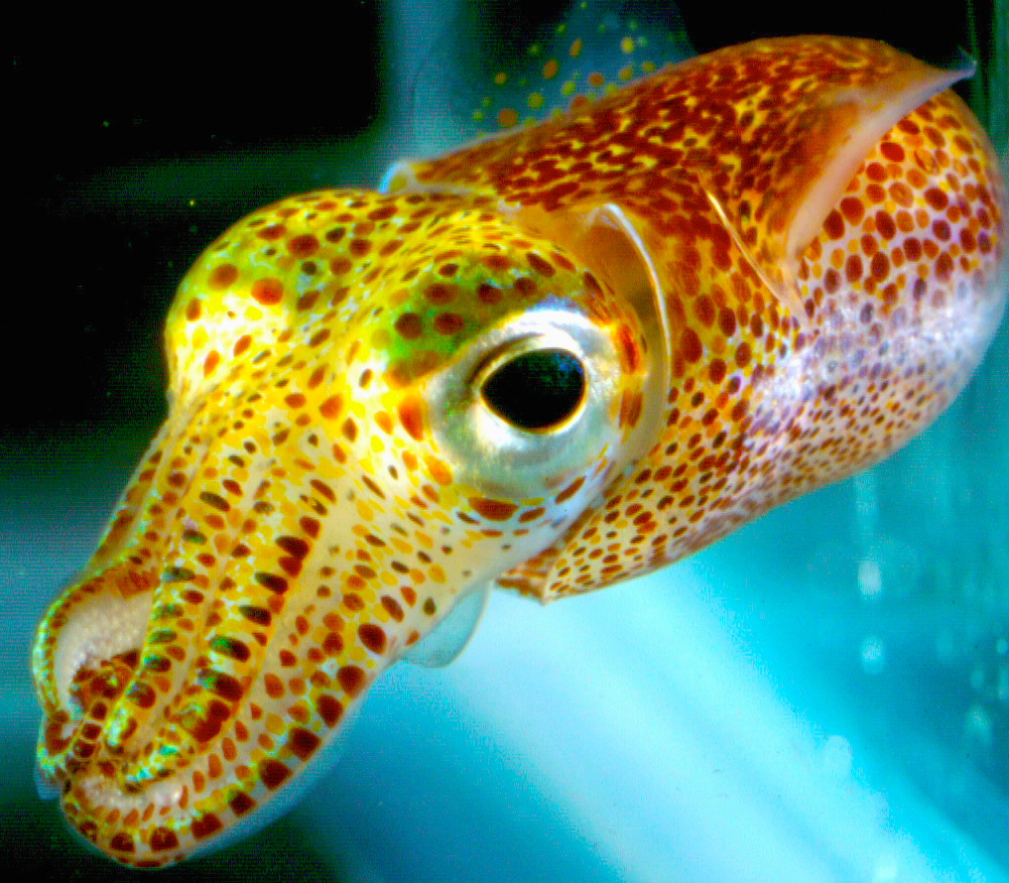
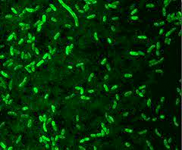
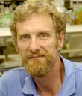
Euprymna scolpes and Vibrio fischeri
M. McFall-Ngai
E. ‘Ned’ Ruby

Slide 21
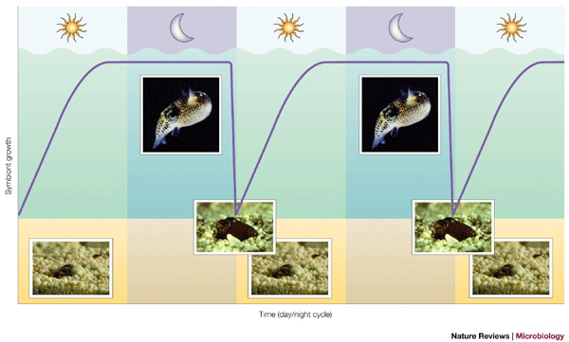
The daily rhythms of the Hawaiian bobtail squid and V. fischeri

Slide 22
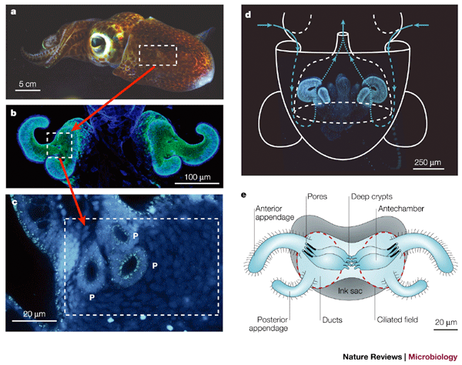
The light organ of Euprymna scolpes

Slide 23
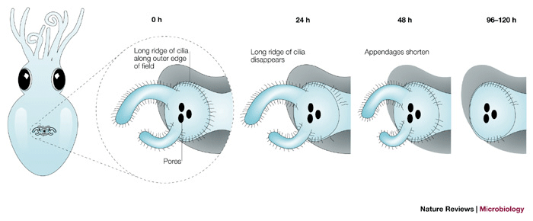
The light organ and 0-120 hrs post-hatching a carefully orchestrated symbiosis

Slide 24
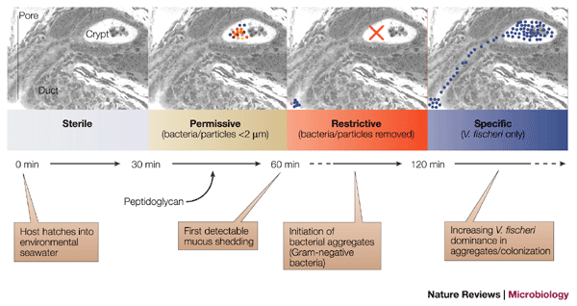
A selective symbiosis

Slide 25
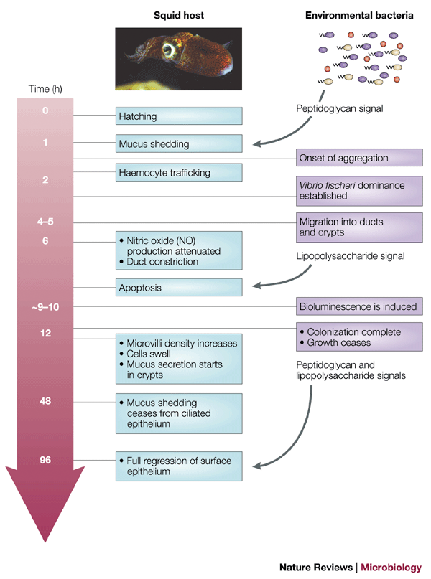
A carefully orchestrated symbiosis

Slide 26
Experiments….
Hyperbiotics.com

Slide 27
Field Trip….

