Slide 1
IID 209 Lecture #11: Crohn's disease & ulcerative colitis as a model for disease-linked dysbiosis, disrupted microbial ecology, human genetic-microbe interactions & fecal microbiota transplants (FMT).
LEARNING OBJECTIVES
Identify known associations of the gut microbiome with inflammatory bowel disease phenotypes.
Describe FMT therapies and reflect upon successes and failures
https://www.healthline.com/health-news/new-drug-treatment-for-ibd

Slide 2
Outline
Introduction to Inflammatory Bowel Disease (IBD)
IBD: a model for disease-linked dysbiosis
Microbial ecology disruption
Microbial community structure alterations
Microbial community functional changes
Host genetic & microbe interactions
FMT
Field Trip: ‘IBD’ mouse model
Hyperbiotics.com

Slide 3
An Introduction to Inflammatory Bowel Disease
Chronic, relapsing disorders of the GI tract characterized by exaggerated immune responses
to microbiota-derived components in a genetically predisposed individuals and influenced
by environmental factors. IBD afflicts >3.1 million people in the U.S.
Genetic Predisposition
Environmental Factors
Microbiota
Immune Response

Slide 4
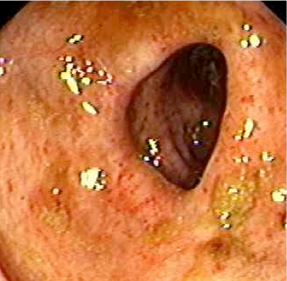
Ulcerative Colitis
Incidence: | 11/100,000
Onset: | Between ages 15-30 or 60-80
Ethnicity: | Ashkenazi Jewish>Non-Jewish Caucasian>African American>Latino>Asian
Pathology: | Mucosal disease. Rectum-->Colon. Altered crypt architecture.
Notes:
T-bet is on human chrosome 17 and mu chromosome 11

Slide 5
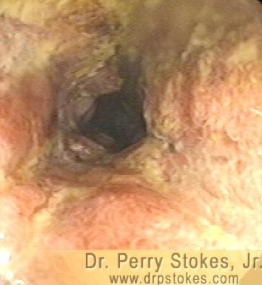
Crohn’s Disease
Incidence: | 7/100,000
Onset: | Between ages 15-30 or 60-80
Ethnicity: | Ashkenazi Jewish>Non-Jewish Caucasian>African American>Latino>Asian
Pathology: | Can affect any part of the GI tract from the mouth to the anus. Most commonly affects the last part of the small intestine and parts of the large intestine. Often involves the entire bowel wall.

Slide 6
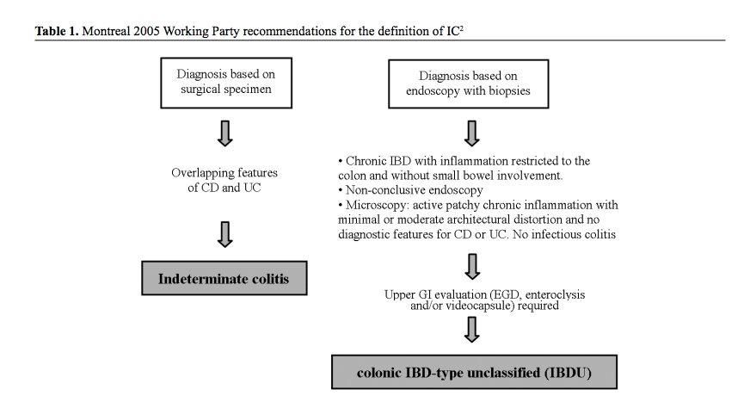
IBD: not as clear-cut as UC and CD
IC and IBD-U
ANNALS OF GASTROENTEROLOGY 2008, 21(3):173-179

Slide 7
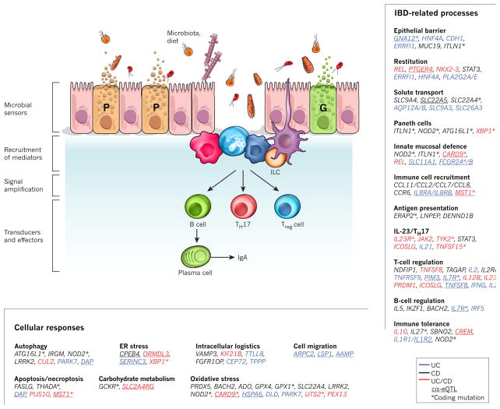
IBD and its ‘complex genetic architecture’ mendelian genetics, polygenic, common genetic variants (GWAS), rare and ultra-rare genetic variants
https://www.cell.com/trends/genetics/comments/S0168-9525(17)30106-3

Slide 8
Outline
Introduction to Inflammatory Bowel Disease (IBD)
IBD: a model for disease-linked dysbiosis
Microbial ecology disruption
Microbial community structure alterations
Microbial community functional changes
Host genetic & microbe interactions
FMT
Field Trip: mouse model
Hyperbiotics.com

Slide 9
IBD: A Model for Disease-Linked Dysbiosis*
Dysbiosis?
A physician-novelist, Elliott Furney used both “eubiosis” and “dysbiosis” in a science fiction
account related to eugenics
C. Arthur Scheunert used the phrase “Dysbiose der Darmflora” in the 1920s regarding
intestinal “flora” and bone inflammation in horses
Helmut Haenel brought the word closer to the modern
concept of an ‘imbalanced’ or ‘altered’ microbiota associated
with negative health status
https://mbio.asm.org/content/8/5/e01492-17

Slide 10
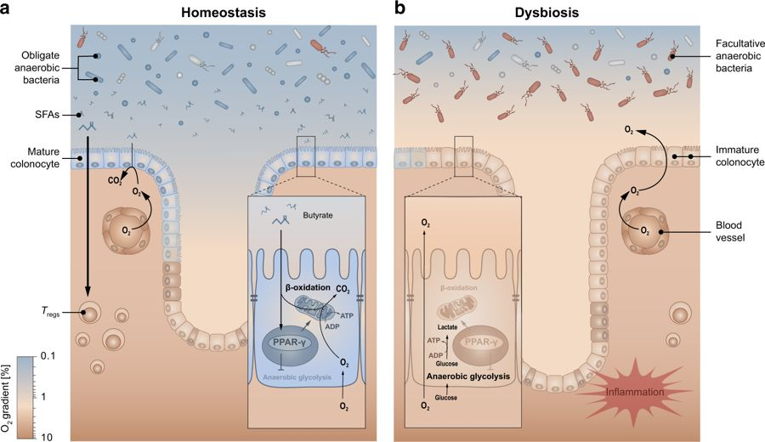
The host keeps control over the colonic ecosystem by limiting respiratory electron acceptors availability to maintain anaerobiosis
Bindloss et al., 2018, Nature

Slide 11
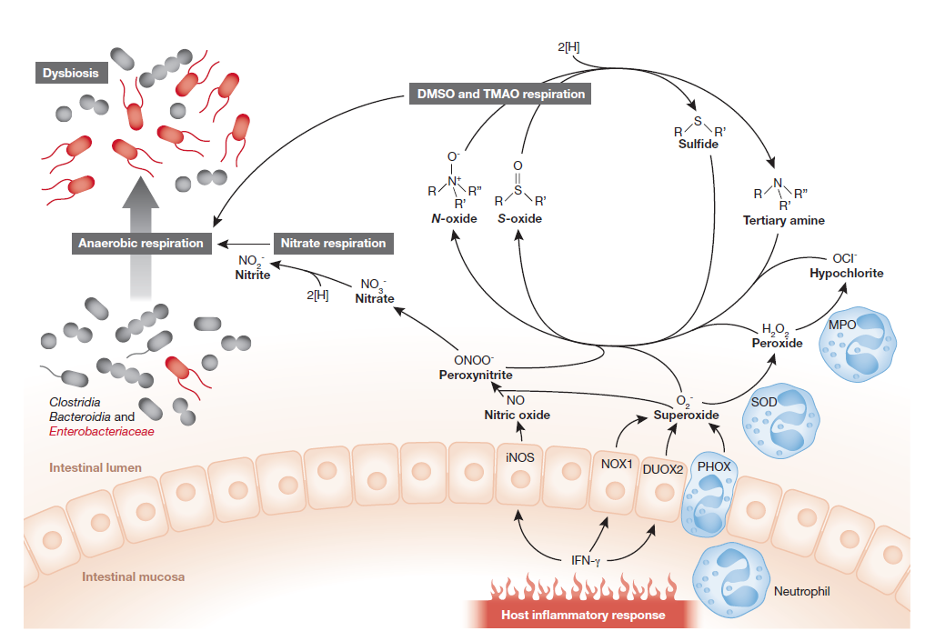
Molecular Model of Dysbiosis: The electron acceptor perspective
doi: 10.1038/embor.2013.27

Slide 12
IBD: A Model for Disease-Linked Dysbiosis
Dysbiosis
Microbial community diversity (alpha)
Microbial community structure
Microbial community function
Biogeography
https://doi.org/10.1371/journal.pone.0202587.g004

Slide 13
IBD: A Model for Disease-Linked Dysbiosis
Dysbiosis
Microbial community diversity
Microbial community structure
Microbial community function
Biogeography
CD
CD
Cell Host & Microbe 2014 15, 382-392DOI: (10.1016/j.chom.2014.02.005)
Cell Host & Microbe 2017 21, 603-610.e3DOI: (10.1016/j.chom.2017.04.010)

Slide 14
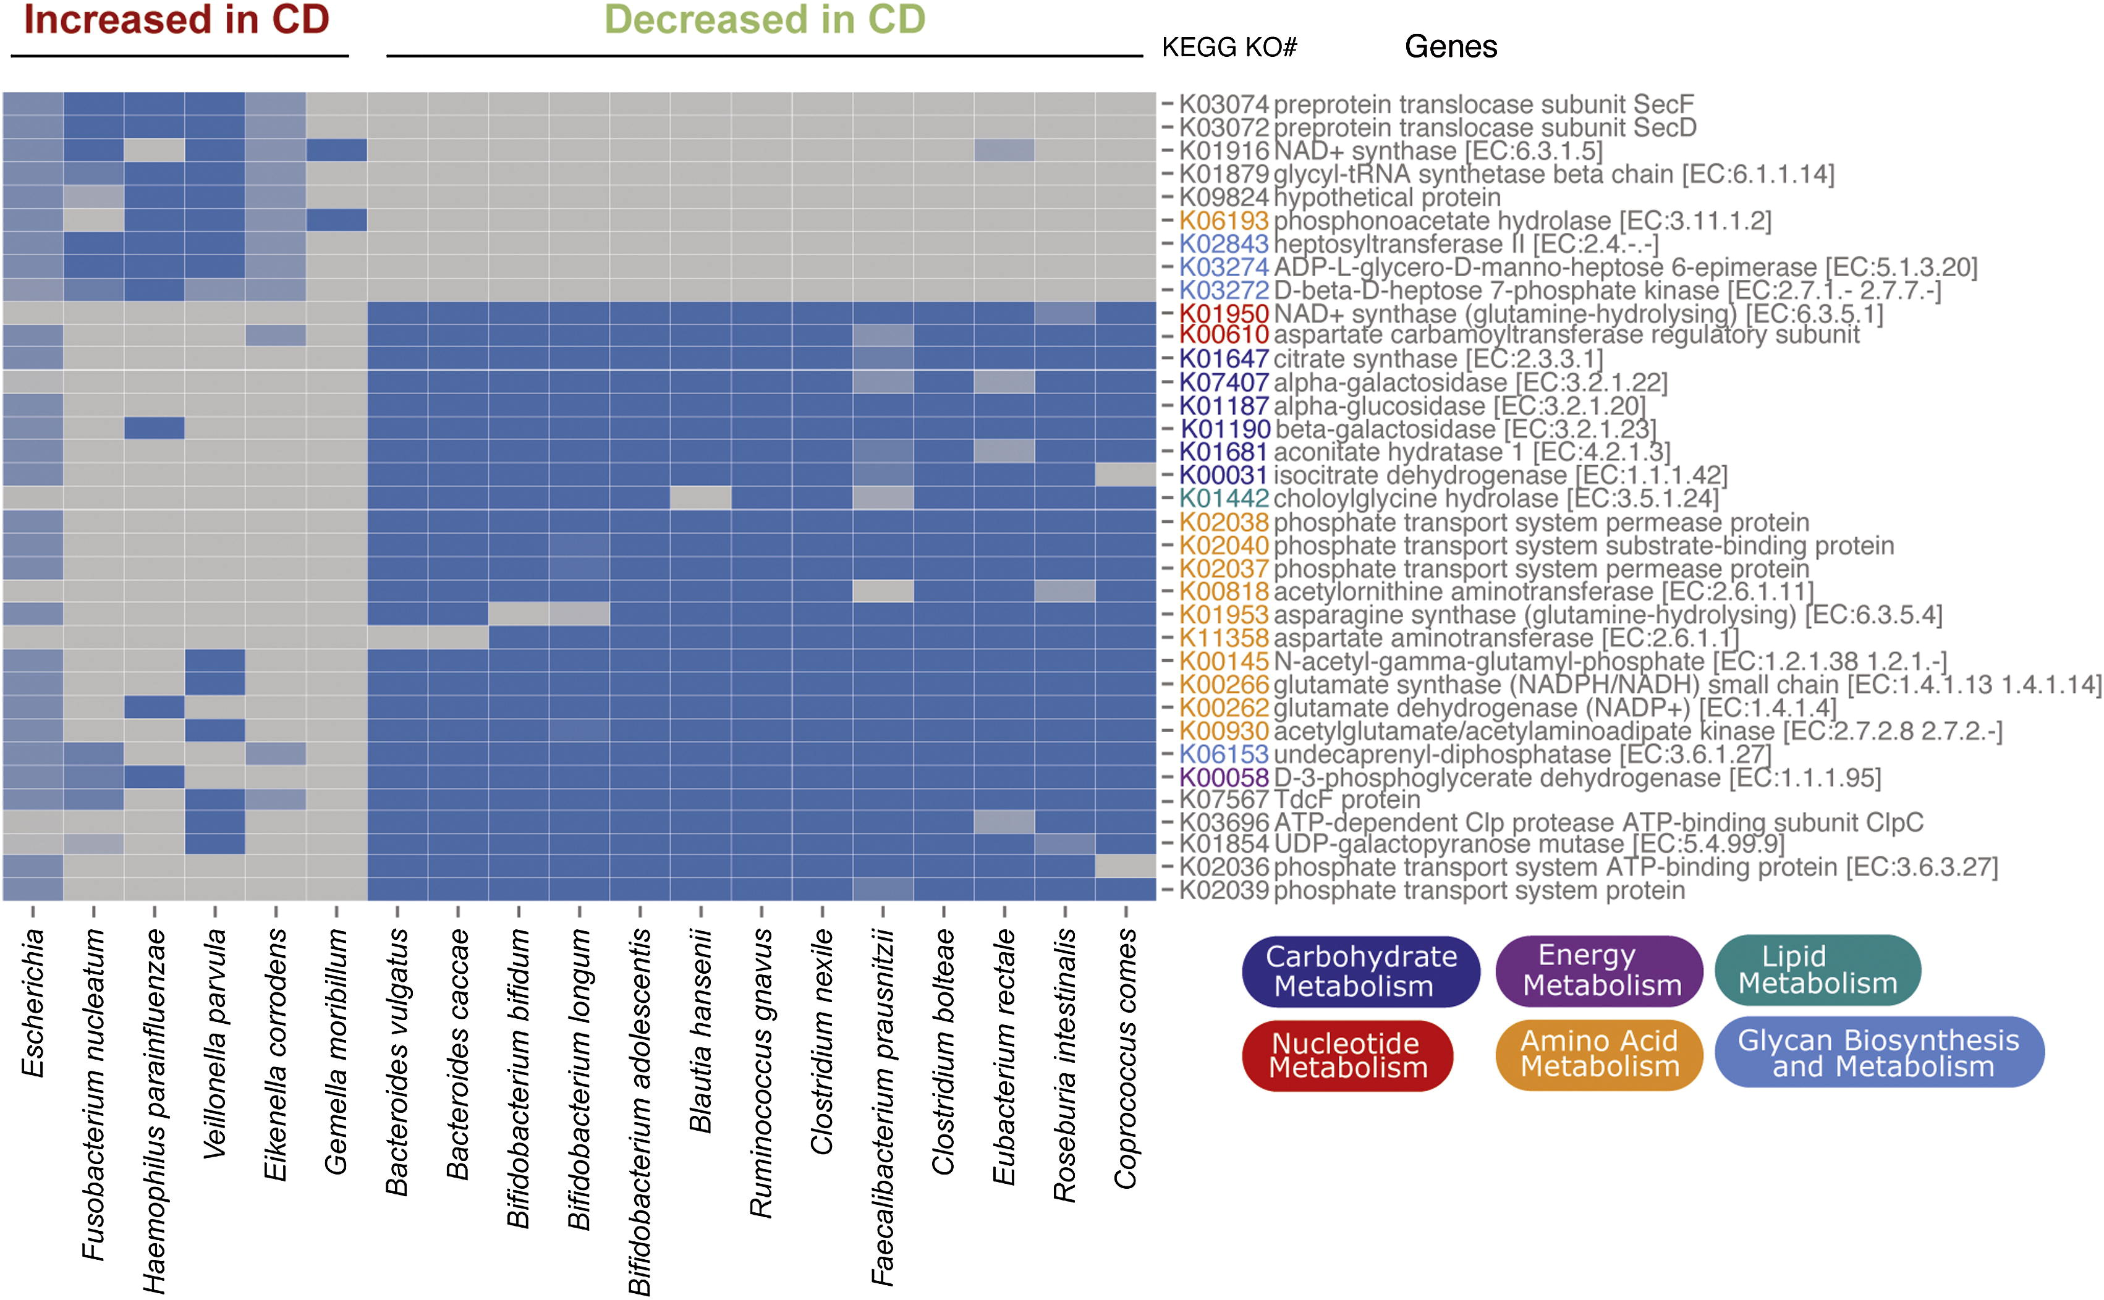
IBD: A Model for Disease-Linked Dysbiosis
Dysbiosis
Microbial community diversity
Microbial community structure
Microbial community functional potential
Biogeography
Cell Host & Microbe 2014 15, 382-392DOI: (10.1016/j.chom.2014.02.005)

Slide 15
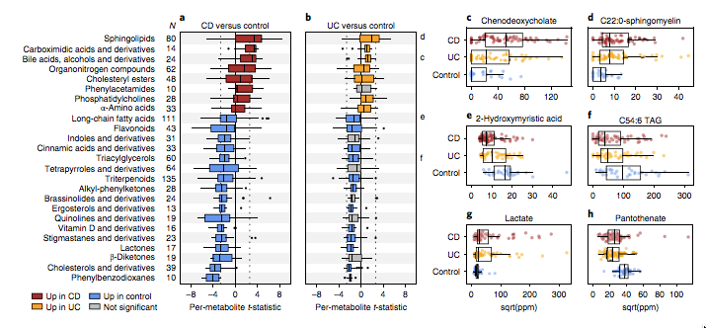
IBD: A Model for Disease-Linked Dysbiosis
Dysbiosis
Microbial community diversity
Microbial community structure
Microbial community function
Biogeography
https://www.nature.com/articles/s41564-018-0306-4

Slide 16
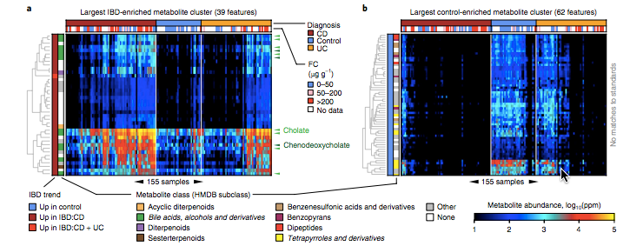
IBD: A Model for Disease-Linked Dysbiosis
Dysbiosis
Microbial community diversity
Microbial community structure
Microbial community function
Biogeography
https://www.nature.com/articles/s41564-018-0306-4

Slide 17
IBD: A Model for Disease-Linked Dysbiosis
and an Opportunity for……
Diagnostics
A Dysbiosis Score*
Prognosis/Response Prediction**
Disease Monitoring
Therapeutics
*https://www.nature.com/articles/s41564-018-0306-4
**https://doi.org/10.1016/j.chom.2017.04.010

Slide 18
Outline
Introduction to Inflammatory Bowel Disease (IBD)
IBD: a model for disease-linked dysbiosis
Microbial ecology disruption
Microbial community structure alterations
Microbial community functional changes
Host genetic & microbe interactions
FMT
Field Trip: mouse model
Hyperbiotics.com

Slide 19
The common IBD risk allele T300A and how it affects gut inflammation

Slide 20
Does T300A affect the microbial community structure?
Perhaps, under ‘homeostatic’ conditions.
https://elifesciences.org/articles/39982

Slide 21
Does T300A affect microbiota structure under inflammatory conditions*
https://elifesciences.org/articles/39982

Slide 22
Does the presence of the T300A allele directly influence the microbiota?
Yes, T300A alters gut microbiota composition in GF mice associated with human stool.
https://elifesciences.org/articles/39982

Slide 23
Before any ‘IBD’, B. ovatus selectively increases IBD-associated pathogenic T cells in gnotobiotic mice
https://elifesciences.org/articles/39982

Slide 24
Outline
Introduction to Inflammatory Bowel Disease (IBD)
IBD: a model for disease-linked dysbiosis
Microbial ecology disruption
Microbial community structure alterations
Microbial community functional changes
Host genetic & microbe interactions
FMT
Field Trip: mouse model
Hyperbiotics.com

Slide 25
FMT: Its Not so Brief History over Time
4th Century: Human fecal suspension for food poisoning or severe diarrhea
16th -17th Century: yellow soup to treat diarrheal illnesses
1900s: Transfaunation by veterinarians
1958: FMT in patient with pseudo-membranous enterocolitis
1983: FMT enema in 65 yo woman with Clostridium difficile colitis
1991: FMT Via NG tube
2000s: FMT via Colonoscopy
http://protomag.com/articles/bright-future-feces-cure
https://health.ucsd.edu/medinfo/nursing/Documents/PPT2017/Fecal%20Microbiota%20Transplantation%20for%20GUTS%20Sept%202017.pptx

Slide 26
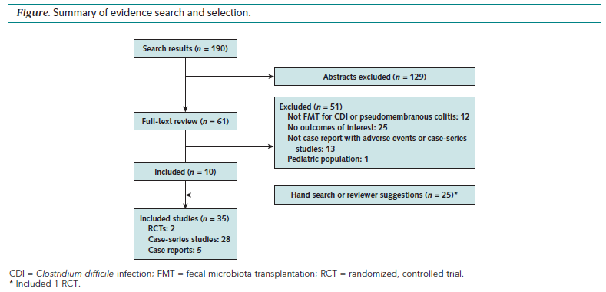
Drekonja D, et al. FMT for Clostridum difficile: A Systematic Review. Ann Intern Med May, 2015; 162:630. Minneapolis VAMC.
https://health.ucsd.edu/medinfo/nursing/Documents/PPT2017/Fecal%20Microbiota%20Transplantation%20for%20GUTS%20Sept%202017.pptx

Slide 27
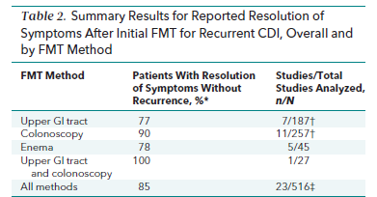
Potential transmission of infectious agents contained in the stool. Case reports of norovirus GE, E.coli and polymicrobial bacteremia, flare of quiescent UC, herpes zoster after FMT.
Drekonja D, et al. FMT for Clostridium difficile Infection: A Systematic Review
(1980- Jan,2015). Ann Intern Med 2015; 162:630. Minneapolis VAMC.
https://health.ucsd.edu/medinfo/nursing/Documents/PPT2017/Fecal%20Microbiota%20Transplantation%20for%20GUTS%20Sept%202017.pptx

Slide 28
FMT Via Colonoscopy
Pros
Cons
Greater area of recolonization as compared to enema
Greater capacity to inhibit spore formation proximal to the splenic flexure.
Deliver the microbiota to the distal small bowel where
C. difficile can reside.
26 patients: 92% symptom free
Avg follow-up of 10.7 months
Kelly et al. J Clin Gastroenterol..2012 Feb; 46(2):145-9
RCT of 46 patients: received full course vanco then
- donor stool (cure rate: 92%) or autologous stool (63%) or
- placebo
Kelly et al. Ann Intern Med. 2016;165(9):609.
Transient and mild
Post-enema symptoms:
Abdominal gurgling, gas, and noise
Colonoscopy complications
HOW TO IN BRIEF:
200-300 g of donor stool suspended in 200-300 mL of normal saline
homogenize briefly (2 min) give via enema within 10 minutes or then infuse via colonoscopy into terminal ileum
*retain for at least 6 hours (loperamide pretreatment) and then follow a high fiber diet
https://health.ucsd.edu/medinfo/nursing/Documents/PPT2017/Fecal%20Microbiota%20Transplantation%20for%20GUTS%20Sept%202017.pptx
Notes:
R

Slide 29
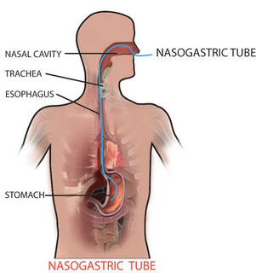
NGT FMT: Preparation and Method
Patient and stool preparation is similar.
PPI (omeprazole 20 mg) evening before and morning of the instillation to decrease gastric acid
NG or NJ tube is placed.
The positioning is confirmed by x-ray and Gastrografin follow-through
A single instillation of 25 to 30 g of stool diluted in 50 mL of saline.
******Risks of aspiration with nasogastric tube******
https://health.ucsd.edu/medinfo/nursing/Documents/PPT2017/Fecal%20Microbiota%20Transplantation%20for%20GUTS%20Sept%202017.pptx

Slide 30
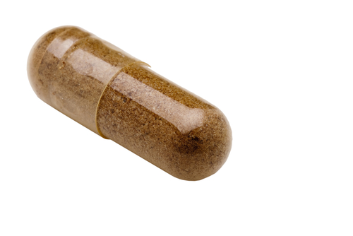
FMT Via Pill
A fecal suspension in normal saline using a commercial blender.
Concentrated by centrifugation and resuspended in saline at one-tenth the volume.
Pipetted into size 0 capsules (650 µL), closed and then sealed in size 00 capsules.
Acid resistant capsules were stored frozen at −80°C (−112°F). 1-2 hours prior to administration, they were transferred to −20°C, then transported on dry ice.
30 capsules contained sieved, concentrated material derived from a mean of 48 g of fecal matter.
Youngster et al. JAMA. 2014;312(17):1772-1778. Division of Infectious Diseases, Massachusetts General Hospital.
https://health.ucsd.edu/medinfo/nursing/Documents/PPT2017/Fecal%20Microbiota%20Transplantation%20for%20GUTS%20Sept%202017.pptx

Slide 31
FMT Via Pill
20 patients
Total 30 frozen FMT capsules (2 consecutive days).
Diarrhea resolved in 14 of 20 patients with single treatment and 4 of 6 nonresponders who were retreated.
No serious adverse events within six months follow-up.
Larger studies are needed and in process.
Youngster et al. JAMA 2014
https://health.ucsd.edu/medinfo/nursing/Documents/PPT2017/Fecal%20Microbiota%20Transplantation%20for%20GUTS%20Sept%202017.pptx

Slide 32
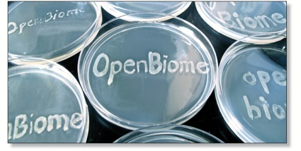
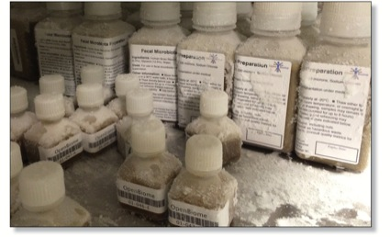
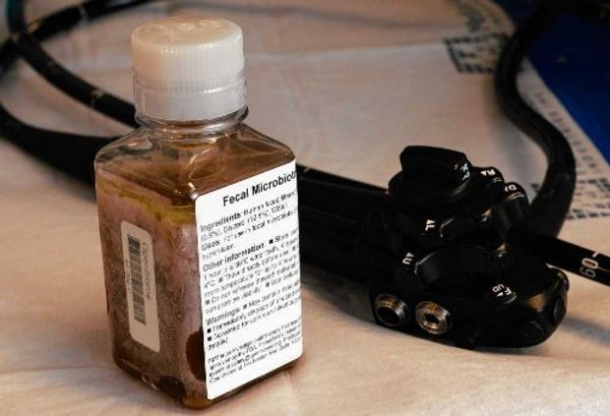
The Present - OpenBiome
Non-profit organization established in 2012
Increased the accessibility and ease of FMT
Donors: young adults screened and tested every 60 days.
Three products:
FMP250 : 250mL fecal microbiota preparation for lower delivery (colonoscopy, enema). FMP30 : 30mL fecal microbiota preparation for upper delivery.
FMT Capsule G3 (30 frozen capsules consumed within 90 min)
https://health.ucsd.edu/medinfo/nursing/Documents/PPT2017/Fecal%20Microbiota%20Transplantation%20for%20GUTS%20Sept%202017.pptx

Slide 33
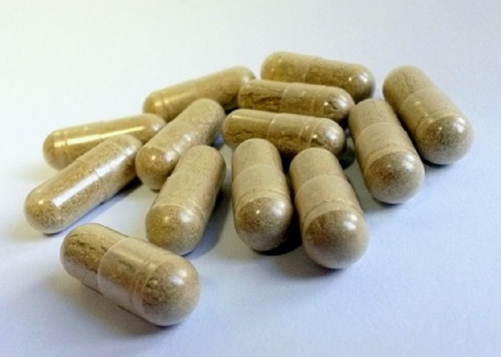
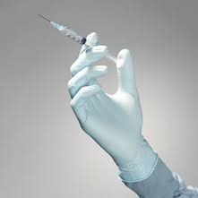
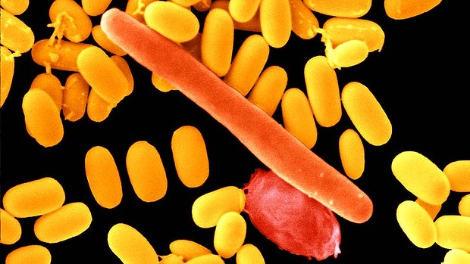
The Future
Clinical trial of FMT in progress for IBD in progress
https://health.ucsd.edu/medinfo/nursing/Documents/PPT2017/Fecal%20Microbiota%20Transplantation%20for%20GUTS%20Sept%202017.pptx

Slide 34
Field Trip…. Colitis mouse models

