Slide 1
IID 209 Lecture #13:
Colon Cancer & the Microbiome
LEARNING OBJECTIVES
1. Delineate ways in which the microbiome interacts with tumorigenesis, chemotherapy, and immunotherapy.
2. Identify known associations of the gut microbiome with colorectal cancer.
https://www.healthline.com/health-news/new-drug-treatment-for-ibd

Slide 2
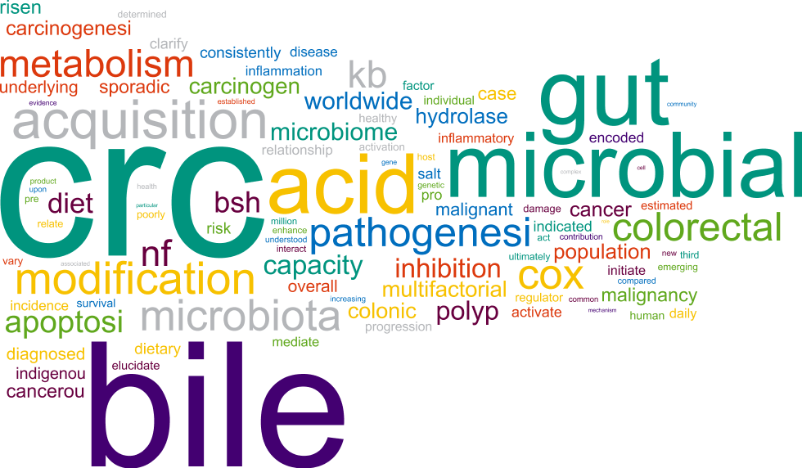
Cancer and the Microbiota

Slide 3
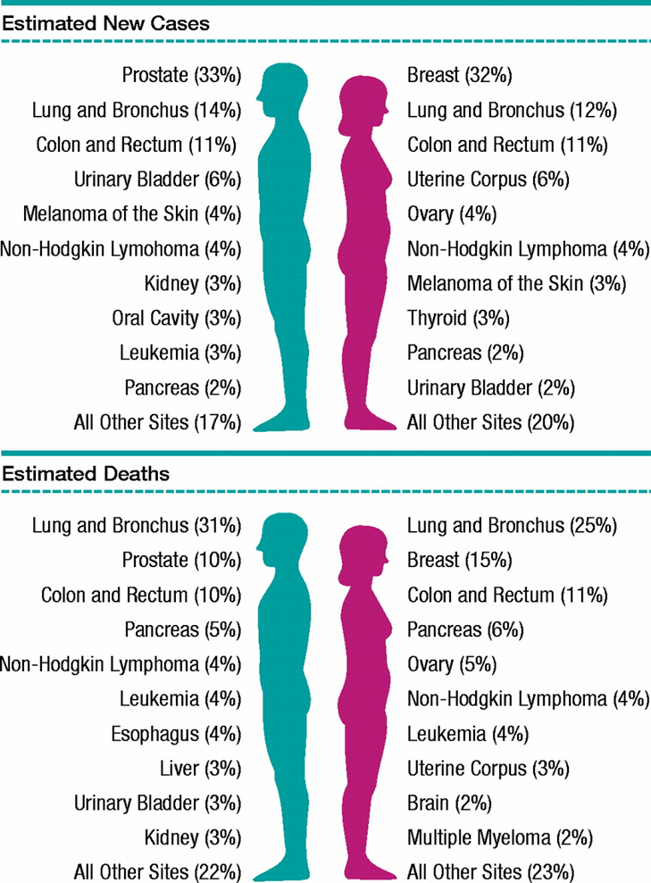
Cancers by Type in U.S.
from American Cancer Society

Slide 4
Cancer is a Genetic Disease
Somatic mutations occur in most cancers.
Inherited germline mutations occur in rare familial cancer syndromes.
Increases in mutation rate or genomic instability increase frequency of cancer.
Aneuploidy is a hallmark of cancer cells.

Slide 5

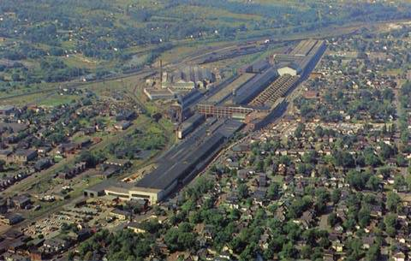

So what causes those human cancer mutations
Chemical Exposure
  Tobacco smoke
  Environmental (PCBs)
  Occupational (coal tar, asbestos, aniline dye)
  Diet
  Radiation (UV, ionizing)
Infection
  Viruses (EBV, hepatitis B, papilloma)
Inherited familial cancer syndromes

Slide 6
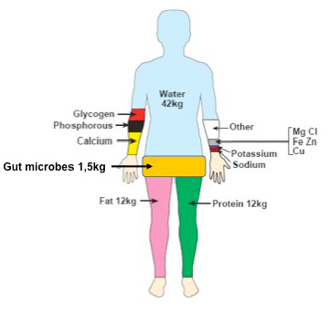
Cancer is a Complex Genetic Disease
What factors influence tumor?
  Susceptibility
  Initiation
  Progression

Slide 7
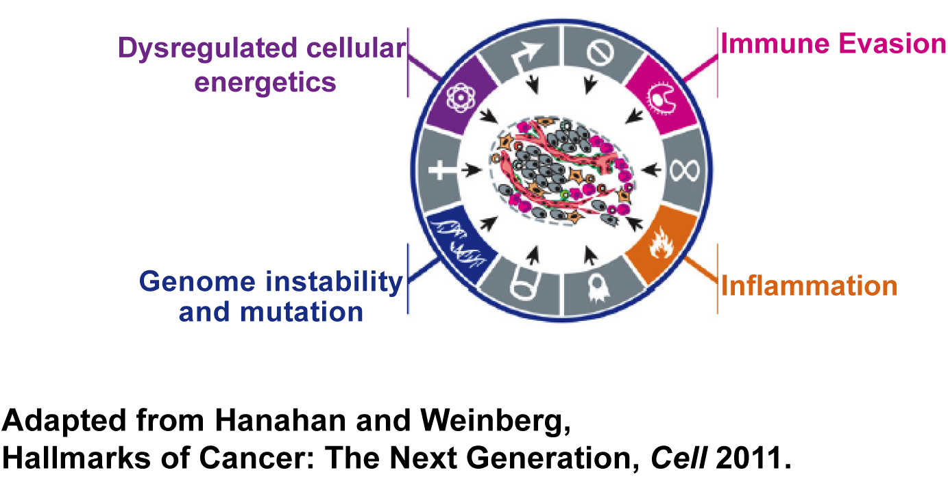
Cell Intrinsic and Extrinsic Hallmarks of Cancers

Slide 8
Hallmarks of Cancer or Bacteria?
Metabolism

Slide 9
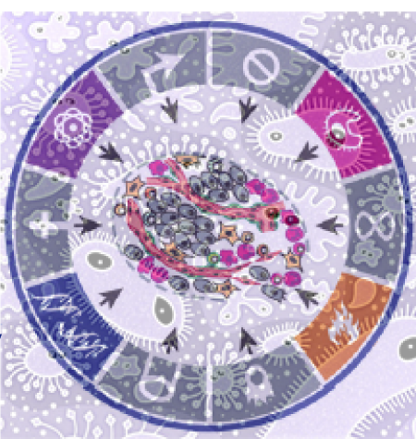
There are numerous well-established associations
between microbes and cancers
H. pylori
Gastric MALT & adenocarcinoma
KSHV
Kaposi’s sarcoma
HPV 16, 18, 31, 35
Cervical cancer
Anal cancer
Head & Neck cancer
HCV
Hepatocellular carcinoma
EBV
Lymphoma
Schistosoma haematobium
Bladder SCC

Slide 10
A framework to keep in mind
Epidemiology
Immunological Response
Experimental Disease Reproduction
Biological Plausibility
Elimination or modification of agent prevents disease

Slide 11
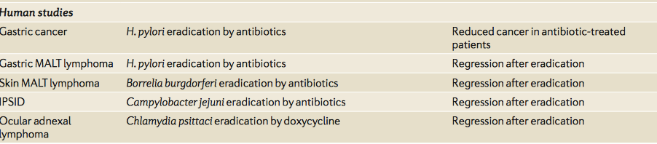
What other cancers in humans are associated with bacteria?

Slide 12
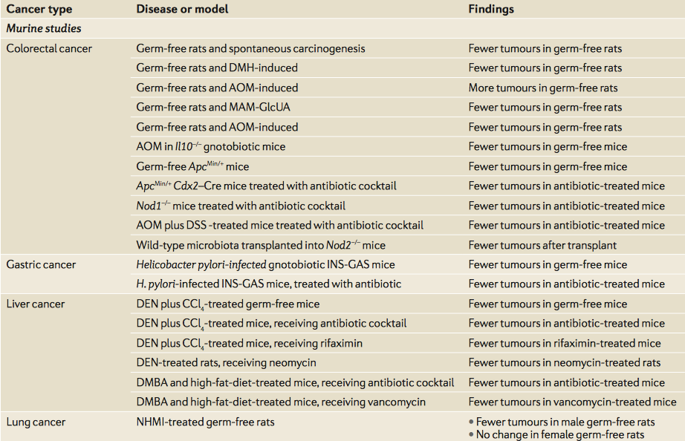
What about ‘mouse’ cancers?

Slide 13
Cancer and the Gut Microbiota

Slide 14
REDUCTIONIST APPROACHES:
Five bacteria to consider and counting….
Escherichia coli
Enterotoxigenic Bacteroides fragilis
Fusobacterium nucleatum
Bifidobacteria spp.
Akkermansia muciniphila

Slide 15
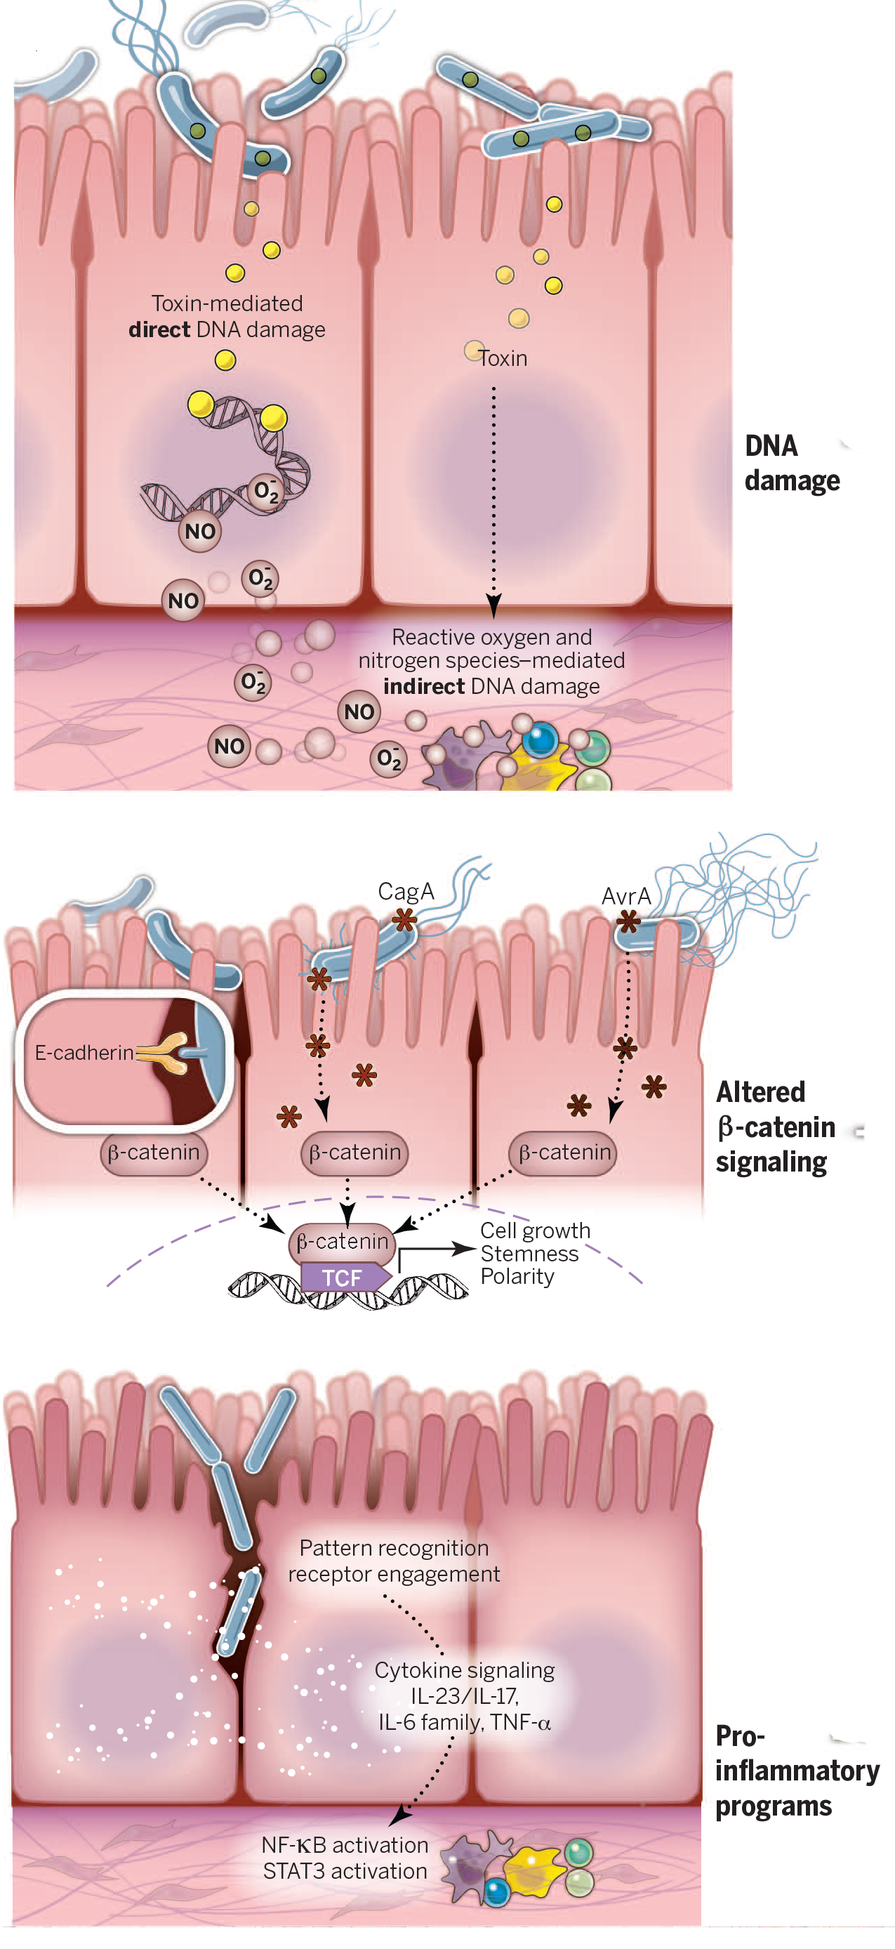
DNA Damage
Pro-inflammatory Signals
Altered β-catenin signaling

Slide 16
DNA Damage

Slide 17
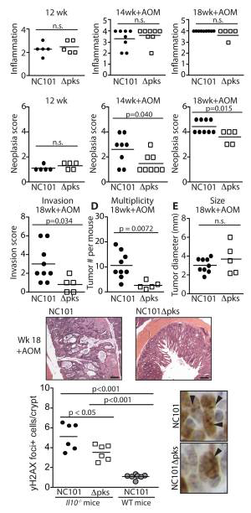
E. coli expressing a pathogenicity island including a toxin called colibactin enhance tumorigenesis
Arthur et al. 2012. Science

Slide 18
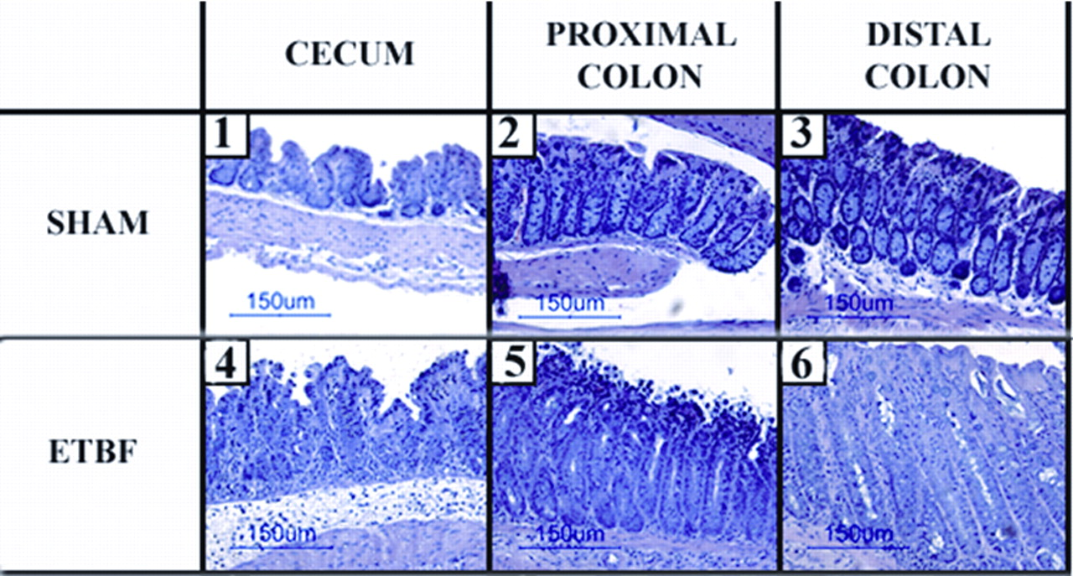
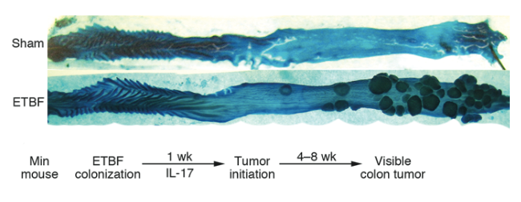
Enterotoxigenic Bacteroides fragilis induces colitis (with persistently elevated mucosal Il-17) and enhances colonic tumor number in APC/^{Min+} mice
Wild type mice
Min mice
Wu et al (Sears Lab). Nature Medicine. 2009

Slide 19
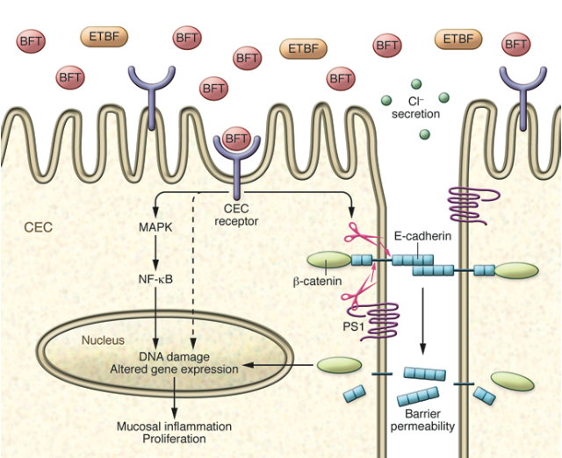
Bft and carcinogenesis

Slide 20
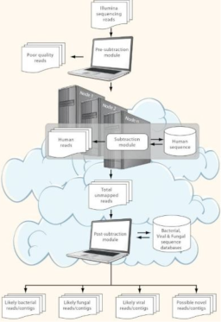
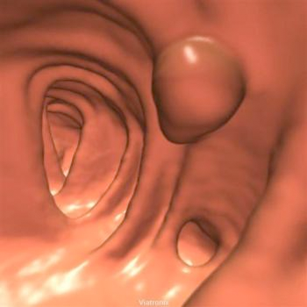
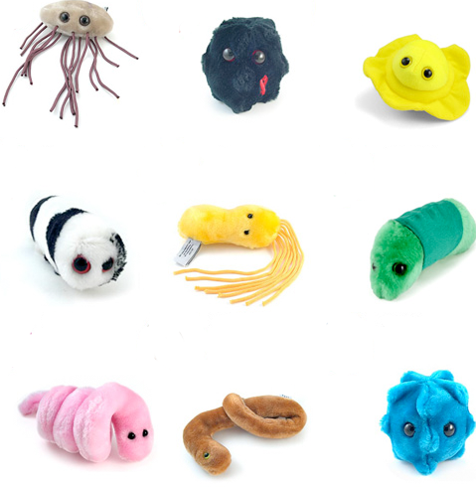
Mining Cancer Genomes for Microbial Signatures
PathSeq
Colorectal cancer
Kostic AD et al. 2011 Nature Biotechnology

Slide 21
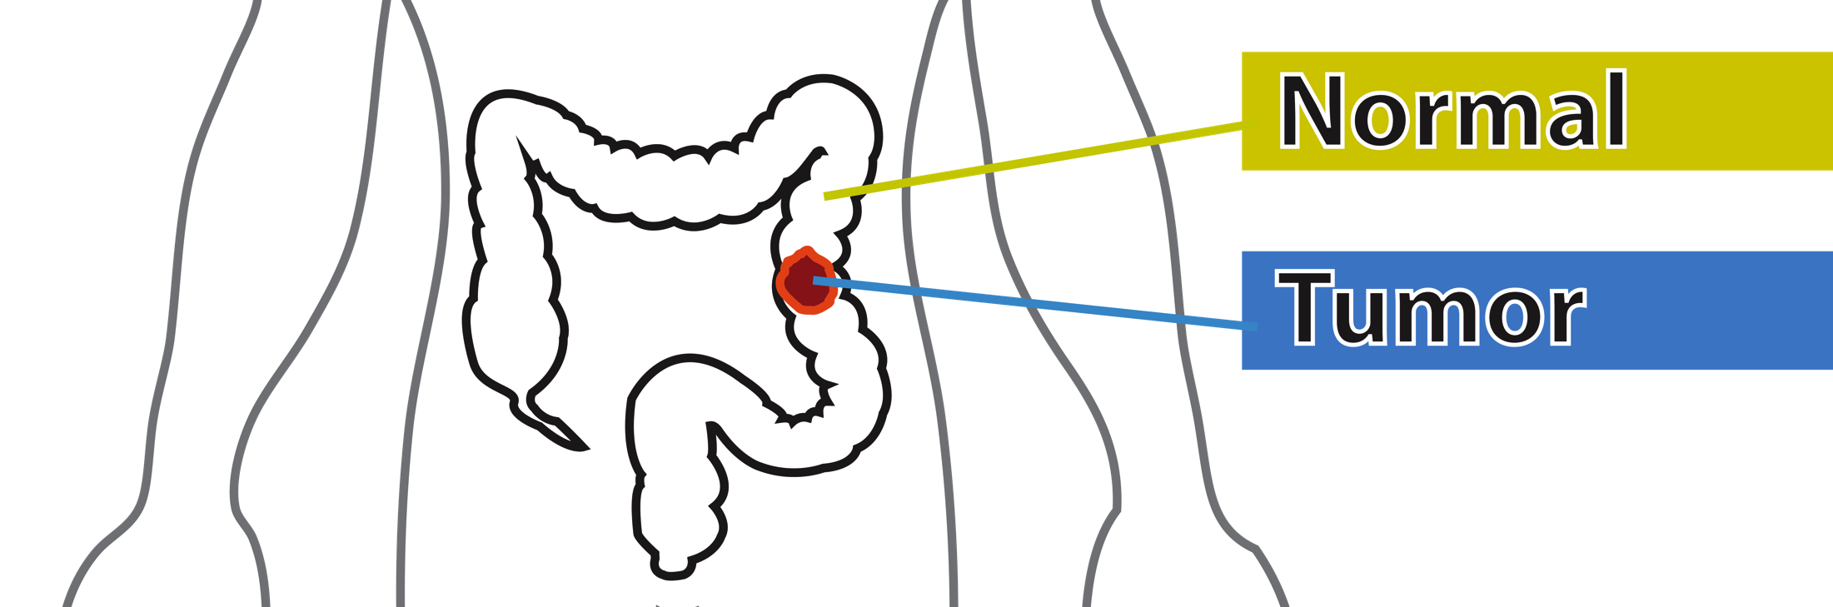
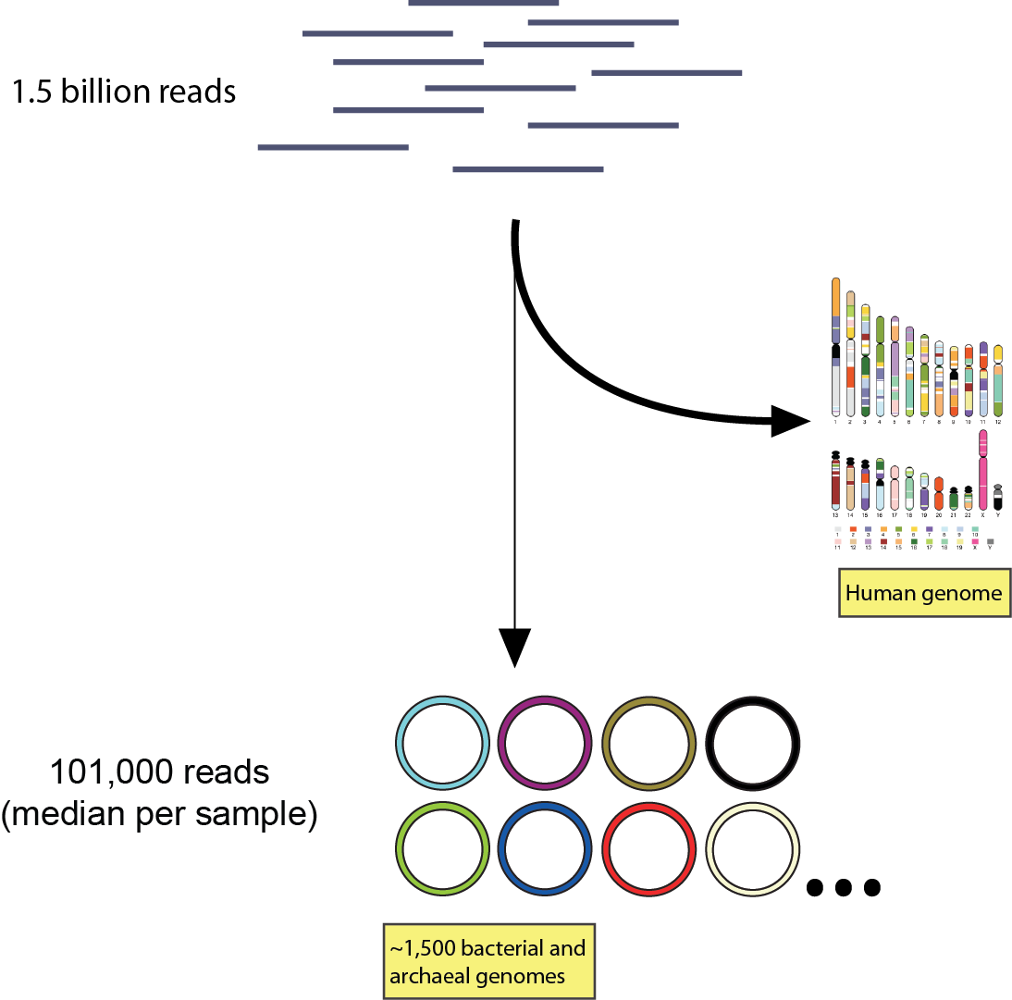
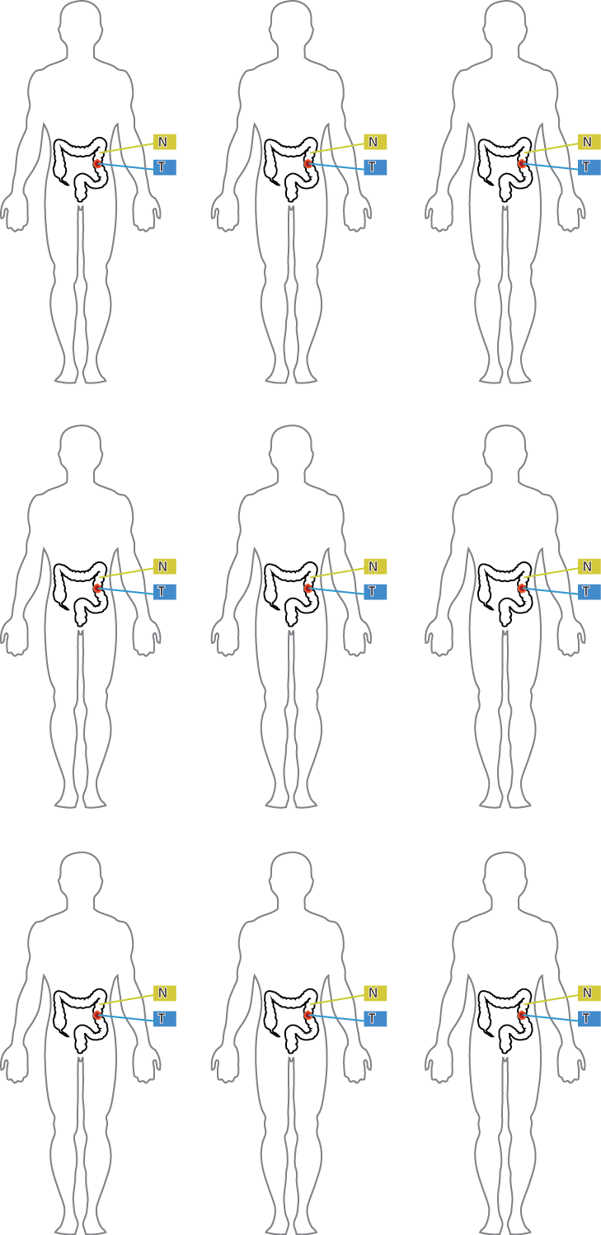

PathSeq
Alex Kostic

Slide 22
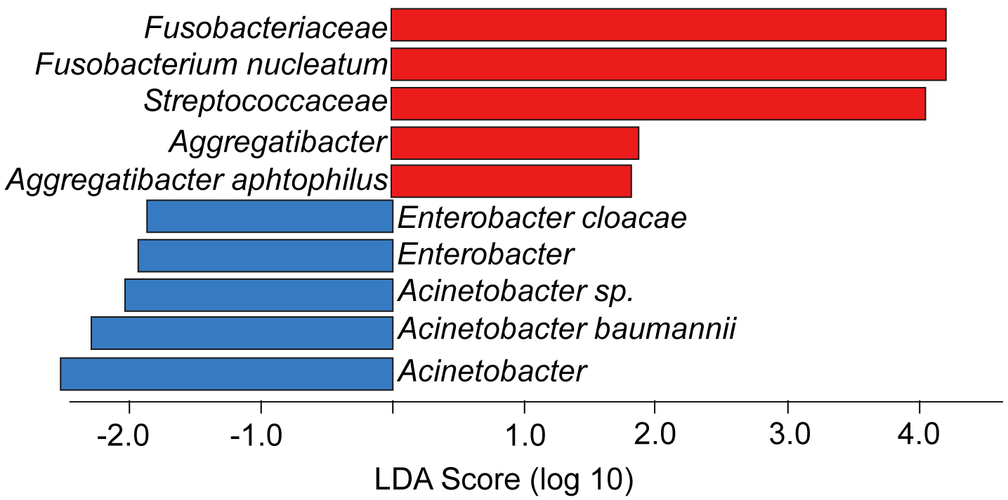
LEfSe analysis of PathSeq filtered
whole genome sequence colonic tissue from
9 tumor-normal pairs
Decreased in tumors
Enriched in tumors
Kostic AD et al. 2012. Genome Research

Slide 23
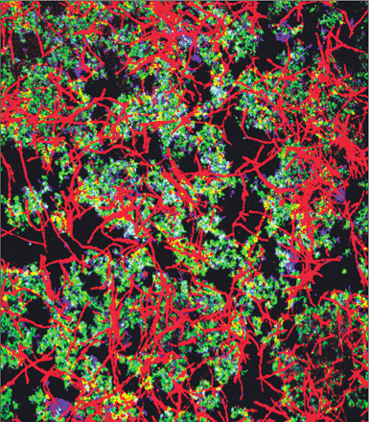
Fusobacterium nucleatum
ASM (c) 2009

Slide 24
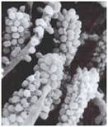
Does a Fusobacterium-colorectal (CRC) association explain long standing observations about Streptococcus gallolyticus (bovis) and CRC

Slide 25
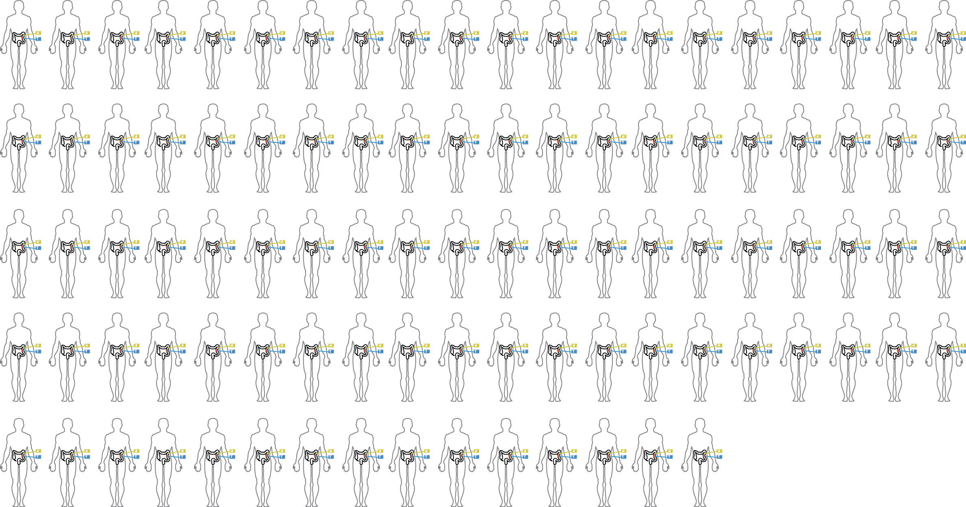

Slide 26
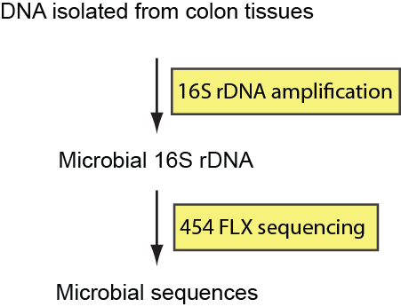
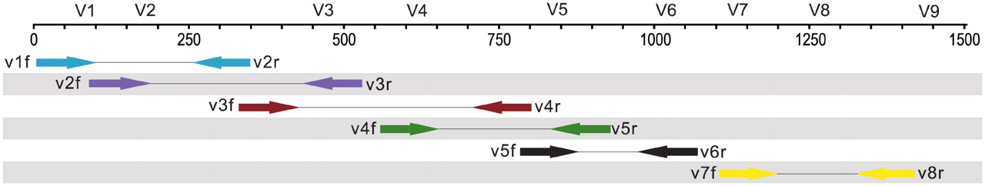
16S rRNA gene sequencing

Slide 27
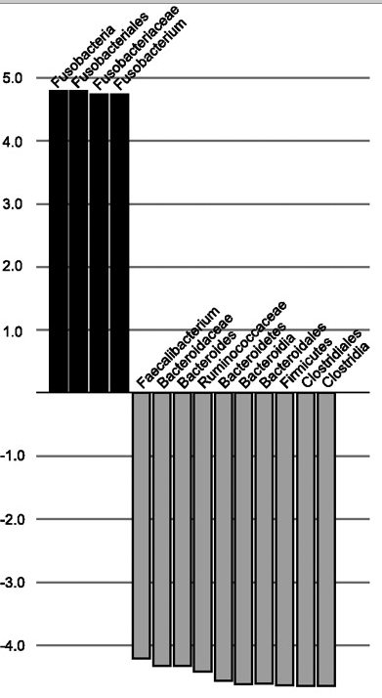
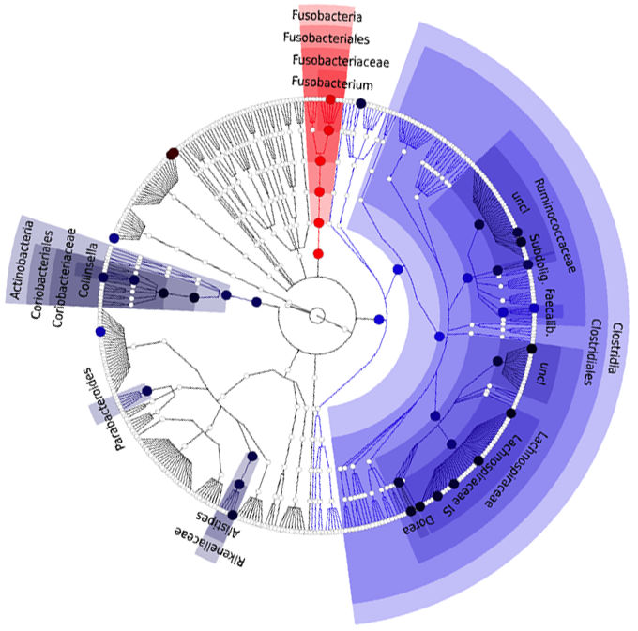
LEfSe analysis of a 16S rRNA metagenomic survey of 95 tumor-normal pairs demonstrates an enrichment of Fusobacterium in tumor tissue
Enriched in tumor
Enriched in normal
TUMOR
LDA score (log10)
NORMAL

Slide 28
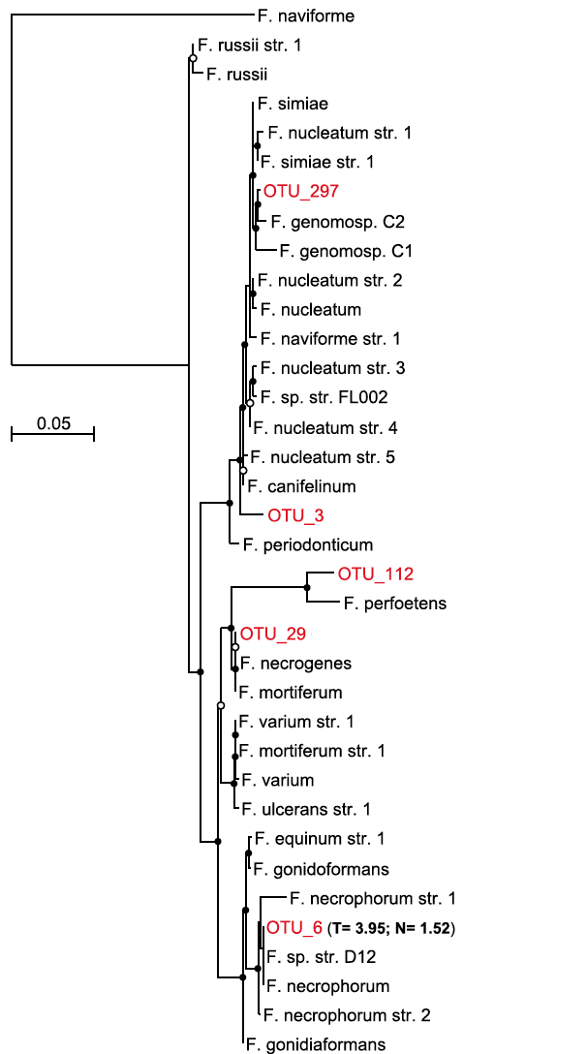
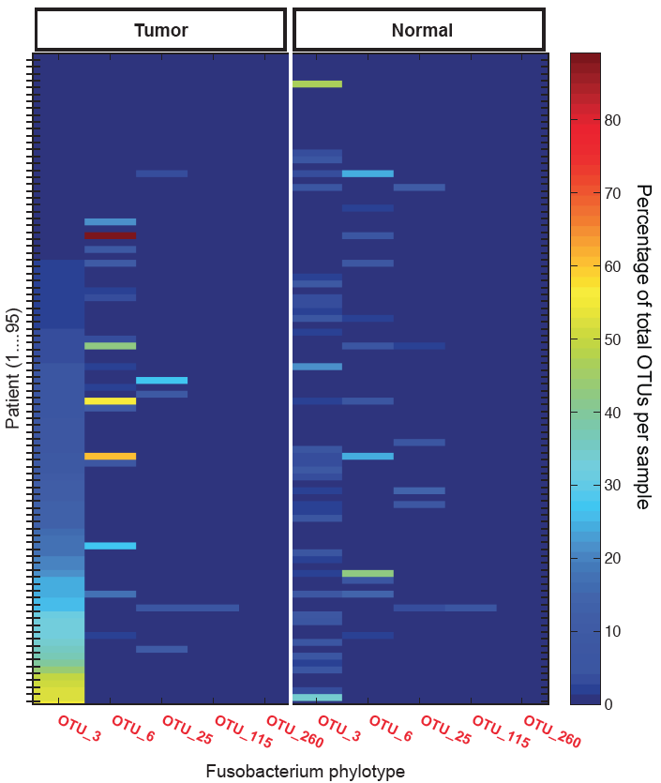
Fusobacterium nucleatum are specifically enriched and some patient’s tumors are dominated by fusobacterium

Slide 29
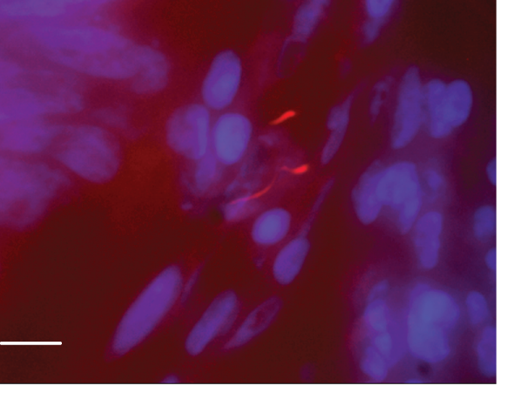
Fusobacterium spp. can be visualized using FISH and are
enriched in colorectal cancer tumors.
DAPI
16S rRNA FUSO

Slide 30
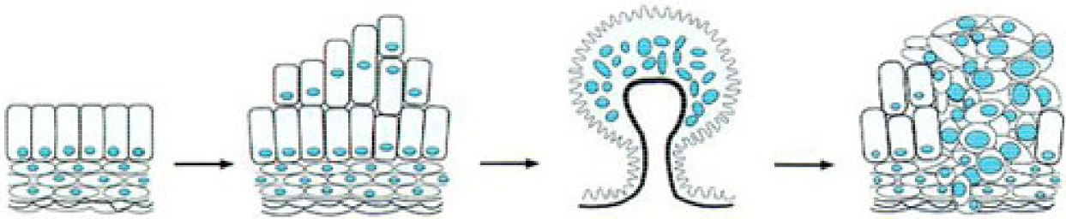
Colorectal cancers develop via a progressive series of discrete histologic & genetic alterations
Normal colon
Hyper-proliferative
epithelium
Adenoma
Carcinoma
Notes:
REDO

Slide 31
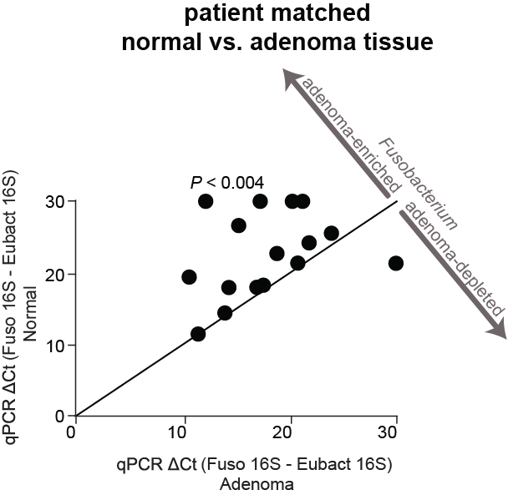
Fusobacterium is enriched in adenoma versus adjacent normal tissue

Slide 32
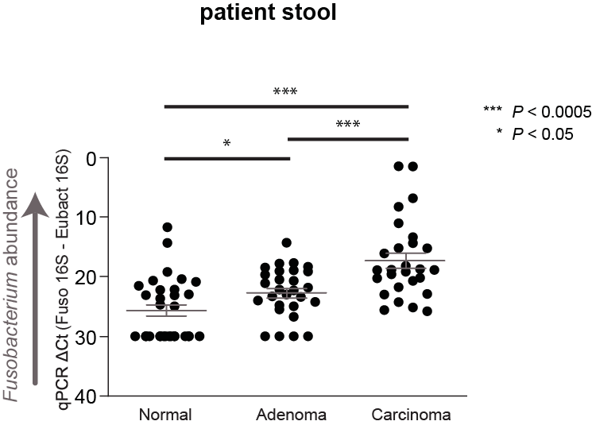
Fusobacterium is detected at a higher abundance in stool from CRC and adenoma cases than from healthy controls

Slide 33
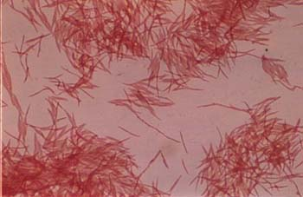
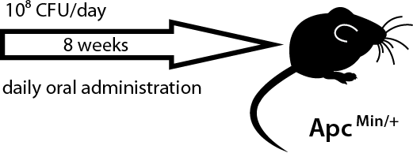

Approaching causality using mouse models
Alex Kostic
Eunyoung Chun
Kostic et al. 2013. Cell Host & Microbe.

Slide 34
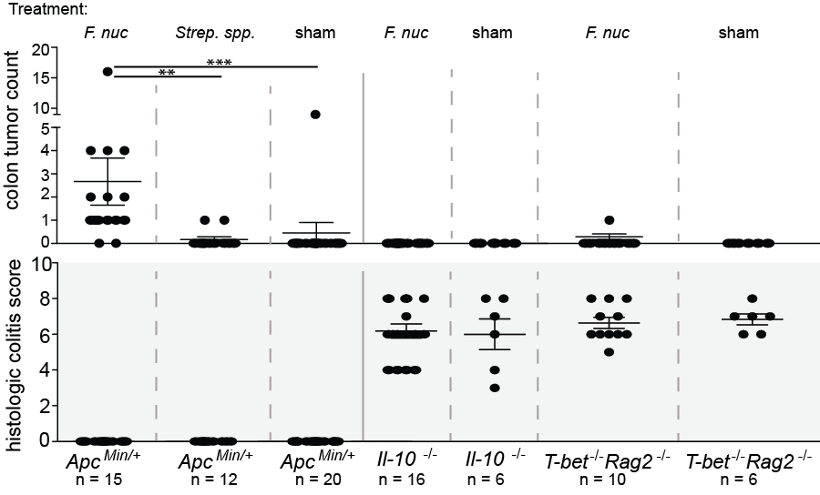
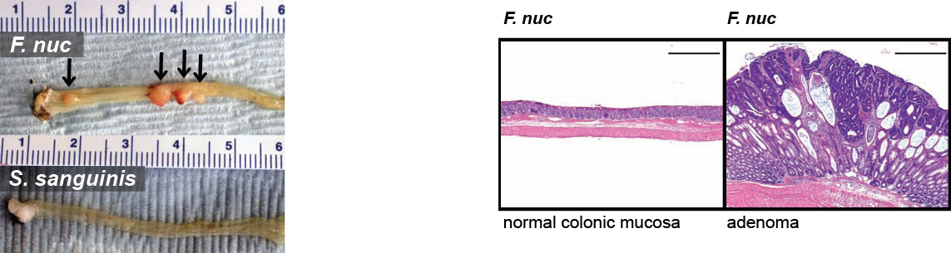
Fusobacterium nucleatum promotes intestinal tumorigenesis

Slide 35
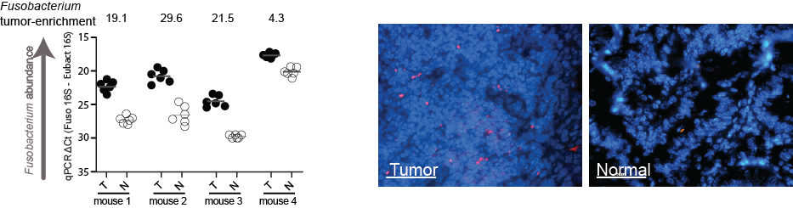
F. nucleatum is enriched in tumor tissues of Apc^{Min/+} mice

Slide 36
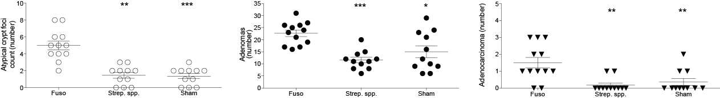
F. nucleatum promotes intestinal tumorigenesis
Hyper-proliferative
epithelium
Adenoma
Carcinoma

Slide 37
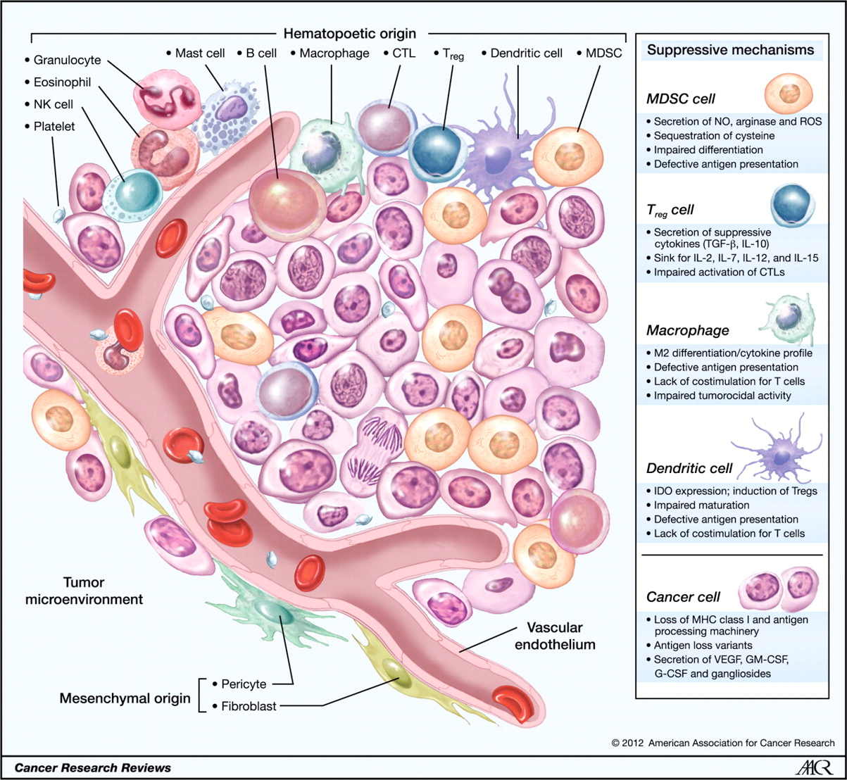
The tumor microenvironment is host to a diversity of immune cells that promote tumor growth and spread

Slide 38
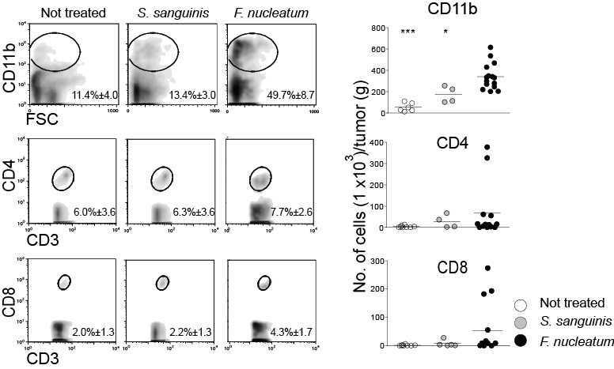
F. nucleatum selectively expands myeloid-derived immune cells

Slide 39
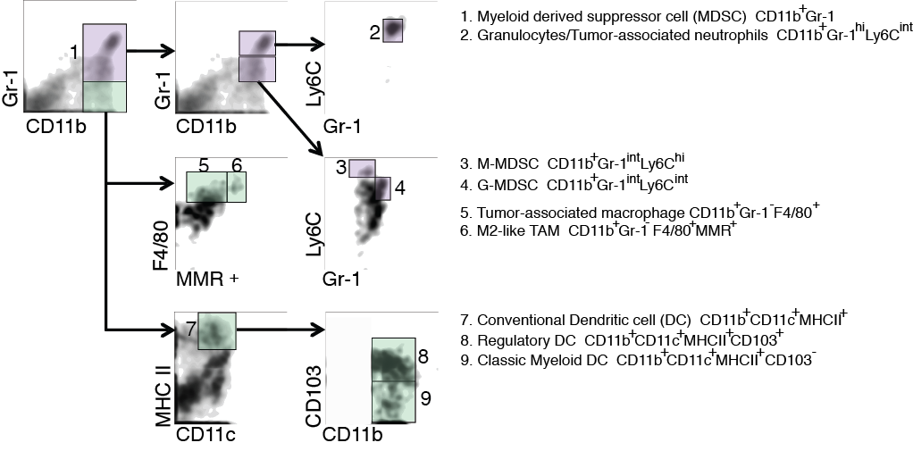
F. nucleatum selectively expands myeloid-derived immune cells

Slide 40
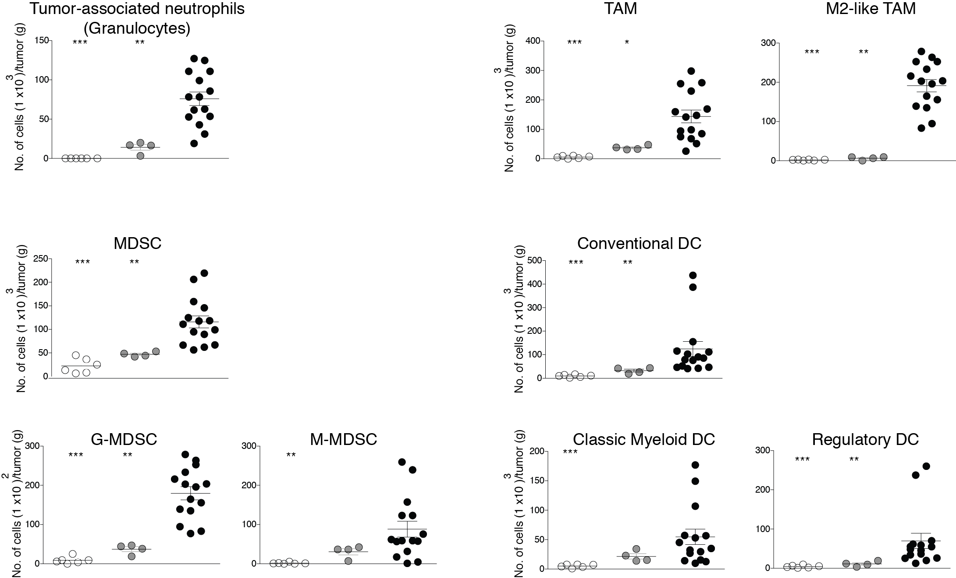
F. nucleatum selectively expands myeloid-derived immune cells

Slide 41
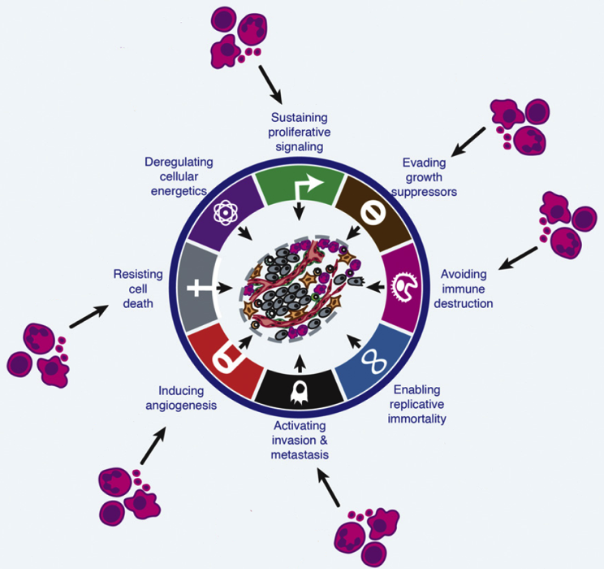
Many myeloid cell subsets promote the hallmarks of carcinogenesis
Adapted from Hanahan and Coussens, Cancer Cell 2012

Slide 42


Slide 43
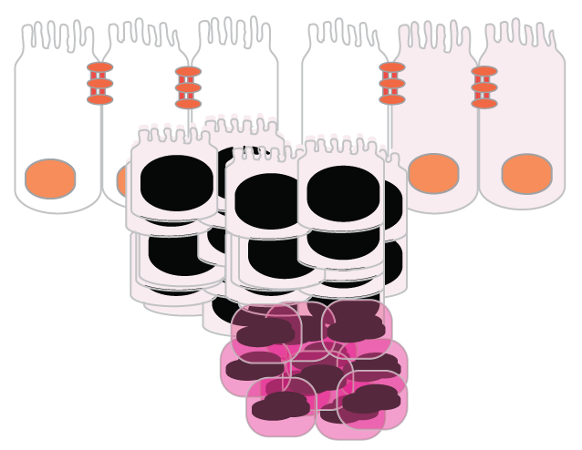

133 Colon Tumors
RNA-Seq analysis: Colorectal cancer
transcriptomic signatures
Microbial
Relative Abundance
Microbial
Metatranscriptome
Host Transcriptome

Slide 44
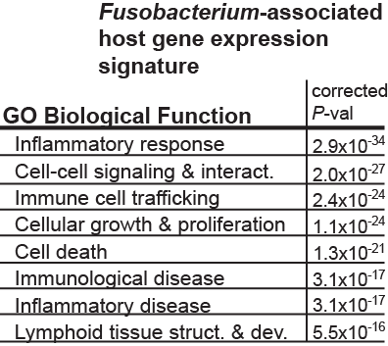
There is a distinctive immune-inflammatory Fusobacterium-associated host gene expression signature in the human RNASeq colon cancer data

Slide 45
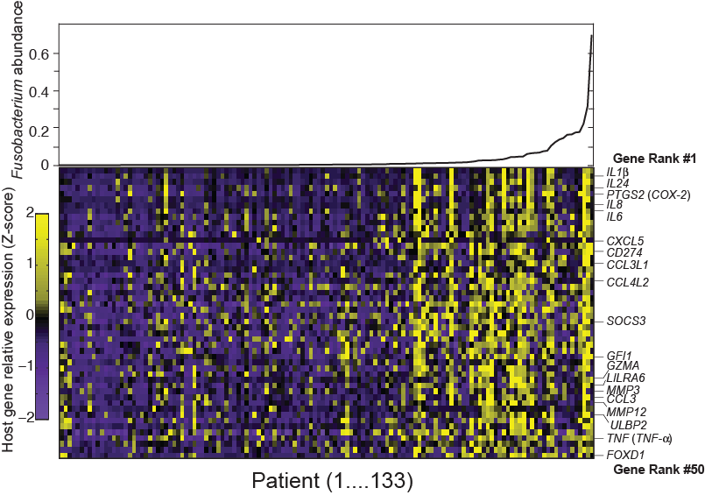
A Fusobacterium-associated human colorectal cancer gene signature

Slide 47
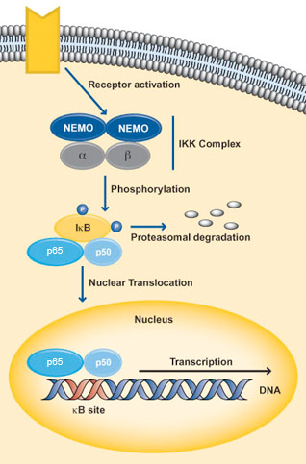
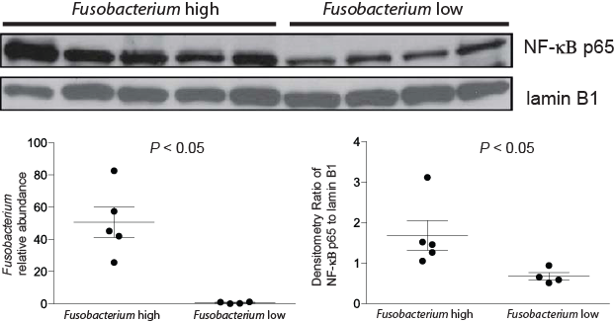
Fusobacterium abundant colon cancers have an increased level of NF-κβ activation
Adapted from abcam.com

Slide 48
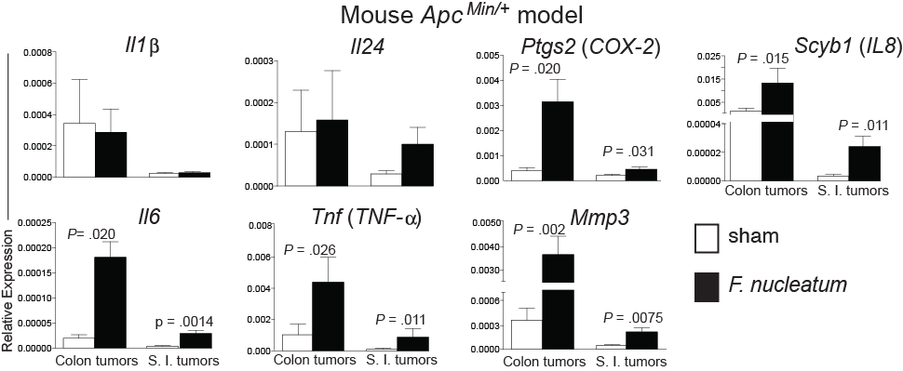
Fusobacterium induces a host expression profile shared between humans and mouse

Slide 49


Bacteria and Cancer
‘Live and Let Live’ Hypothesis
Image adapted from
Elsevier Press, Immunity 2015
Create a immune microenvironment that is permissive for microbe and tumor
  Recruit and recondition immune cell types. Ccl2, Chun et al 2015 Cell Reports
Inhibit Immune Cell Mediated Killing of Bacteria. Fap2 and TIGIT
  Protein-Protein Interactions, Gur et al 2015 Immunity

Slide 50

F. nucleatum clinical tumor isolates differ in their ability to suppress NK-cytotoxicity
Chamutal Gur
Collaboration with Mandelboim & Bachrach Labs
Hebrew University of Jerusalem
Gur et al. Immunity 2015

Slide 51
Screening of a library of F. nucleatum 23726 identified two clones that did not impair NK cytotoxicity
Killing %

Slide 52

Sequencing of the F. nucleatum clones identified fap2, an adhesin, as the disrupted gene and numerous NK cell clone studies identified TIGIT as fap2’s binding partner

Slide 53

TIGIT is expressed in human colon tumors and expressed on human colon cancer tumor infiltrating lymphocytes
TIGIT
CD3
CD4
CD56 and NKp46
CD8
TIGIT

Slide 54


Slide 56

The many CRC microbiome configurations
Nagatsu et al. Nat Commun. 2015 Oct 30

Slide 57

What studies need to be carried out for cancer microbiome studies
Thomas and Jobin. 2016.

Slide 58

The Gut Microbiota and Cancer leveraging the microbiome for cancer care

Slide 59

Paluck and Coussens. Cell 2016 164, 1233-1247DOI: (10.1016/j.cell.2016.01.049)

Slide 60

Bacteria as ‘facilitators’ of cancer therapy efficacy
Cisplatinum Oxaliplatinum | TBI | Cytoxan | CpG | Anti-CTLA4 | Anti-PDL1
+ L. acidophilus - F. nucleatum | Gram-negatives | E. hirae L. johnsonii Barnesiella intestinihominis | A. shahii | B. fragilis B. theta Burkholderales | B. breve B. longum B. adolescentis

Slide 61
Checkpoint…what?
https://gut.bmj.com/content/67/11/2056

Slide 62

Differences in melanoma outgrowth and tumor-specific immune responses between C57BL/6 JAX and TAC mice are eliminated when mice are cohoused.
Sivan et al. Science 2015;350:1084-1089
Notes:
Differences in melanoma outgrowth and tumor-specific immune responses between C57BL/6 JAX and TAC mice are eliminated when mice are cohoused. (A) B16.SIY tumor growth kinetics in newly arrived JAX and TAC mice. (B) IFN-γ enzyme-linked immunospot assay (ELISPOT) in tumor-bearing JAX and TAC mice 7 days after tumor inoculation. (C) Mean size of IFN-γ spots (10⁻³ mm²). (D) Percentage of SIY⁺ T cells of total CD8⁺ T cells within the tumor of JAX and TAC mice as determined by flow cytometry 21 days after tumor inoculation. Representative plots (left), quantification (right). (E) B16.SIY tumor growth kinetics in JAX and TAC mice cohoused for 3 weeks before tumor inoculation. (F) Number of IFN-γ spots/10⁶ splenocytes in tumor-bearing JAX and TAC mice cohoused for 3 weeks before tumor inoculation. (G) Mean size of IFN-γ spots (10⁻³ mm²). (H) Percentage of SIY⁺ T cells of total CD8⁺ T cells within the tumor of JAX and TAC mice cohoused for 3 weeks before tumor inoculation. Means ± SEM combined from six independent experiments, analyzed by two-way analysis of variance (ANOVA) with Sidak’s correction for multiple comparisons (A) and (E), or individual mice with means ± SEM combined from four (B), (C), (F), (G) or three (D) and (H) independent experiments, analyzed by Student’s t test; five mice per group per experiment; *P < 0.005, **P < 0.01; NS, not significant.

Slide 63

Oral administration of JAX fecal material to TAC mice enhances spontaneous antitumor immunity and response to αPD-L1 mAb therapy.
Sivan et al. Science 2015;350:1084-1089
Notes:
Oral administration of JAX fecal material to TAC mice enhances spontaneous antitumor immunity and response to αPD-L1 mAb therapy. (A) B16.SIY tumor growth in newly arrived TAC mice, TAC and JAX mice orally gavaged with phosphate-buffered saline or TAC or JAX fecal material before tumor implantation. (B) Number of IFN-γ spots × mean spot size (10⁻³ mm²), determined by ELISPOT 7 days after tumor inoculation. (C) Percentage of SIY⁺ CD8⁺ T cells within the tumor of TAC and JAX mice treated as in (A), 21 days after tumor inoculation. Representative plots (left), quantification (right). (D) B16.SIY tumor growth in TAC mice, untreated or treated with JAX fecal material 7 and 14 days after tumor implantation, αPD-L1 mAb 7, 10, 13, and 16 days after tumor implantation, or both regimens. (E) IFN-γ ELISPOT assessed 5 days after start of treatment. (F) Percentage of tumor-infiltrating SIY⁺ CD8⁺ T cells, determined by flow cytometry 14 days after start of treatment. (G) B16.SIY tumor growth kinetics in TAC and JAX mice, untreated or treated with αPD-L1 mAb 7, 10, 13, and 16 days after tumor implantation. Means ± SEM analyzed by two-way analysis of variance (ANOVA) with Dunnett’s (A) or Tukey’s (D) and (G) correction for multiple comparisons; or individual mice with means ± SEM analyzed by one-way ANOVA with Holm-Sidak correction for multiple comparisons (B), (C), (E), and (F); data are representative of (A) to (C), (F), and (G) or combined from (D) and (E) two to four independent experiments; five mice per group per experiment; *P < 0.05, **P < 0.01, ****P < 0.0001; NS, not significant.

Slide 64

Direct administration of Bifidobacterium to TAC recipients with established tumors improves tumor-specific immunity and response to αPD-L1 mAb therapy.
Sivan et al. Science 2015;350:1084-1089
Notes:
Direct administration of Bifidobacterium to TAC recipients with established tumors improves tumor-specific immunity and response to αPD-L1 mAb therapy. (A) Principal coordinate analysis plot of bacterial β-diversity over time in groups treated as in Fig. 2A, each group is made up of at least two cages, three or four mice per cage; data represent three independent experiments; **P < 0.01, ***P < 0.001 (ANOSIM). (B) Phylogenetic analysis of taxa that are of significantly different abundance in newly arrived JAX versus TAC mice FDR < 0.05 (nonparametric t test); bars represent log-transformed fold changes, inner circle, log₁₀(10); middle circle, log₁₀(100); outer circle, log₁₀(1000). (C) Heat map showing relative abundance over time of significantly altered genus-level taxa in JAX-fed TAC mice FDR < 0.05 (nonparametric t test); columns depict individual mice; each time point shows mice from two separate cages, three or four mice per cage. (D) Correlation plot of relative abundance of Bifidobacterium OTU_681370 in fecal material obtained from groups, as in (A), 14 days after arrival and frequency of SIY⁺ CD8⁺ T cells in tumor; P = 1.4 × 10⁻⁵, FDR = 0.0002, correlation R² = 0.86 (univariate regression). (E) B16.SIY tumor growth kinetics in TAC mice, untreated or treated with Bifidobacterium 7 and 14 days after tumor implantation, αPD-L1 mAb 7, 10, 13, and 16 days after tumor implantation, or both regimens. (F) IFN-γ ELISPOT assessed 5 days after start of treatment. (G) Percentage of tumor-infiltrating SIY⁺ CD8⁺ T cells, determined by flow cytometry 14 days after start of treatment. Means ± SEM analyzed by two-way ANOVA with Tukey’s correction (E) or individual mice with means ± SEM analyzed by one-way ANOVA with Holm-Sidak correction (F) and (G), and are combined from two independent experiments; five mice per group per experiment: *P < 0.05, ***P < 0.001, ****P < 0.0001.

Slide 65

DCs isolated from JAX & Bifidobacterium-fed TAC mice show increased expression of genes associated with antitumor immunity & heightened capability for T cell activation.
Sivan et al. Science 2015;350:1084-1089
Notes:
Dendritic cells isolated from JAX and Bifidobacterium-fed TAC mice show increased expression of genes associated with antitumor immunity and heightened capability for T cell activation. (A) Quantification of IFN-γ mean fluorescence intensity (MFI) of 2C CD8⁺ T cells in the tumor-draining lymph node (left) and spleen (right) of TAC, JAX, and Bifidobacterium-fed TAC mice on day 7 after adoptive transfer. (B) Percentage of MHC Class II^{hi} DCs in tumors isolated from TAC, JAX, and Bifidobacterium-fed TAC mice 40 hours after tumor implantation as assessed by flow cytometry. Data in (A) and (B) show individual mice with means ± SEM, analyzed by one-way ANOVA with Holm-Sidak correction; representative of two to four independent experiments, eight or nine mice per group per experiment: *P < 0.05, **P < 0.01, ****P < 0.0001. (C) Enriched biological pathways and functions found within the subset of elevated genes in JAX and Bifidobacterium-treated TAC-derived DCs relative to untreated TAC DCs isolated from tumors 40 hours after tumor inoculation, as assessed by DAVID pathway analysis. Red bars indicate the percentage of genes in a pathway up-regulated in DCs isolated from JAX and Bifidobacterium-fed TAC mice. Blue line indicates P values calculated by Fisher’s exact test. (D) Heat map of key antitumor immunity genes in DCs isolated from JAX, Bifidobacterium-treated TAC or untreated TAC mice. Mean fold-change for each gene transcript is shown on the right. (E) Quantification of IFN-γ⁺ 2C TCR Tg CD8⁺ T cells stimulated in vitro with DCs purified from peripheral lymphoid tissues of naïve TAC, JAX, and Bifidobacterium-treated TAC mice in the presence of different concentrations of SIY peptide. Analyses in (C) to (E) were performed on data combined from two independent experiments, five mice pooled per group per experiment. (E) Technical replicates of pooled samples from each experiment separately and were analyzed by fitting a linear mixed model, with Bonferroni correction for multiple comparisons: *P < 0.05, ****P < 0.0001.

Slide 66
How does this work?
Can this be translated to humans?
DON’T KNOW
NOT SURE….
?

Slide 67
What do we now know about microbes and
how they make cancer therapies via
host-microbe interactions?

Slide 68
What do we now know about microbes and
how they contribute to cancer therapy efficacy?
What experimental questions should we ask?
How should we approach such questions?

Slide 69


Slide 70

Antibiotics compromise the efficacy of PD-1 blockade in mouse tumor models and cancer patients.
Routy et al. Science 2018;359:91-97
Notes:
Antibiotics compromise the efficacy of PD-1 blockade in mouse tumor models and cancer patients. (A) Tumor growth kinetics of RET melanoma (left) and MCA-205 sarcoma in mice (right) treated with four injections of PD-1 (clone RMP1-14) mAb (αPD-1) or isotype control mAb (Iso Ctrl) in the presence or absence of broad-spectrum antibiotics (ATB). Data are means ± SEM of tumor sizes for 10 to 12 mice per group. (B) Survival curves of RET-bearing mice (left) and MCA-205–bearing mice (right) treated with PD-1 mAb combined with CTLA-4 mAbs. Each line represents one survival curve for each group of five mice from two or three independent experiments. *P < 0.05, **P < 0.01, ***P < 0.001 [analysis of variance (ANOVA) and log-rank (Mantel-Cox) analysis]; ns, not significant. (C to E) Kaplan-Meier estimates for progression-free survival (PFS) or overall survival (OS) of cancer patients. (C) All cancer patients (n = 249); (D) patients with advanced non–small cell lung cancer (NSCLC, n = 140, fig. S1A; fig. S1D for the validation cohort); (E) renal cell carcinoma (RCC, n = 67, fig. S1B). [See fig. S1C and tables S1 to S6 for data on patients with urothelial carcinoma (n = 42) treated with PD-1/PD-L1 mAb who did or did not receive ATB.] The points represent data censored at the last time the patient was known to be alive and without progression. P values are shown [log-rank (Mantel-Cox) analysis].

Slide 71

Metagenomic analysis of fecal samples predicts response at 3 months of PD-1 mAb treatment in cancer patients.
Routy et al. Science 2018;359:91-97
Notes:
Metagenomic analysis of fecal samples predicts response at 3 months of PD-1 mAb treatment in cancer patients. (A) Shotgun sequencing of fecal samples at diagnosis with representation of gene and MGS counts for all cancer patients according to clinical outcome (PFS at 6 months). Data are means ± SEM of counts for patients experiencing PFS shorter or longer than 6 months. Gene or MGS richness did not predict PFS at 3 months. (B and C) Shotgun sequencing of fecal samples at diagnosis with representation of the relative abundance of each MGS in responders (R) (partial response or stable disease) over nonresponders (NR) (progression or death) defined using the best clinical response according to RECIST1.1 criteria (B) or PFS at 3 months (C) and the corresponding P value on the entire cohort of n = 100 (60 NSCLC and 40 RCC) patients (B) and excluding those who took ATB (C) (fig. S5B), n = 78 (42 R, 36 NR); see also fig. S5A for all patients. T0 samples were analyzed; when not available, T1 specimens were used, as there was no statistical difference between T0 and T1 (fig. S3A). (D) Frequency of patients with detectable A. muciniphila in their feces according to PR (partial response), SD (stable disease), or PD (progressive disease) clinical status, as assessed by metagenomics and analyzed by Cochran-Armitage test. (E and F) Circulating memory T cell immune responses directed against commensals detected during PD-1 blockade and evaluation of the time to progression. (E) Heat map of the P values for each cytokine and each commensal, segregating NSCLC+RCC patients’ PFS according to the median value of cytokine production of the whole cohort. Significant P values (<0.05, Student t test) are indicated with an asterisk for the relevant commensals. (F) Univariate analysis and Kaplan-Meier curves showing PFS for peripheral blood memory Th1 and Tc1 immune responses directed against A. muciniphila and E. hirae 13144, respectively. See fig. S9 for PFS curves for nonspecific T cell receptor–driven cytokine release. (G) Culturomics-based analyses of fecal samples in 16 R and 16 NR NSCLC patients (defined as the best clinical outcome) before therapy, each commensal colony having been identified by mass spectrometry. Colored bars show relative frequencies of each commensal in all fecal cultures in R over NR patients, with P values of the difference shown at the right.

Slide 72

Fecal microbiota transplantation (FMT) of stool samples from NSCLC and RCC patients into mice dictates outcome after PD-1 blockade.
Routy et al. Science 2018;359:91-97
Notes:
Fecal microbiota transplantation (FMT) of stool samples from NSCLC and RCC patients into mice dictates outcome after PD-1 blockade. (A) Experimental setting: FMT was performed in germ-free recipients or after 3 days of ATB in SPF mice. Two weeks later, MCA-205 sarcoma cells were inoculated and PD-1 mAb was injected intraperitoneally every 3 days starting on D+5. (B) Representative MCA-205 tumor growth curves after FMT from NSCLC patients into germ-free (left) or ATB-treated mice (right) during therapy with PD-1 mAb. (C) Means ± SEM of tumor sizes after Iso Ctrl mAb (left) or after PD1 mAb (center and right) in MCA-205–bearing, SPF-reared mice treated with ATB and then receiving FMT from eight NSCLC patients (n = 4 NR, n = 4 R) before PD1 mAb. Pooled data from all patients (left and center) or individual patients (right) are shown; each fecal sample was transferred into five mice per group. (D and E) Flow cytometry analysis of CXCR3 (D) or PD-L1 (E) expression on tumor-infiltrating lymphocytes (TILs) (D) or CD3⁺CD4⁺ splenocytes (E) in 38 and 80 animals, respectively, analyzed at killing times corresponding to those in (C). (F) Monitoring of RENCA progression via bioluminescence imaging of luciferase activity in ATB-treated mice (n = 133) after FMT with feces from three R and four NR RCC patients and treated with a combination of PD-1 and CTLA-4 mAbs. All experiments included five to seven mice per group and were performed at least twice in similar conditions yielding similar results. Data are means ± SEM. *P < 0.05, **P < 0.01, ***P < 0.001 (ANOVA and Student t test). Dx, last IVIS (bioluminescent imaging) measurement; D0, day of randomization.

Slide 73

Biological importance of A. muciniphila during anticancer PD-1 blockade treatment.
Routy et al. Science 2018;359:91-97
Notes:
Biological importance of A. muciniphila during anticancer PD-1 blockade treatment. (A and B) ATB-induced dysbiosis was restored by oral administration of A. muciniphila (Akkermansia) alone or combined with Enterococcus hirae 13144 (E. hirae) to recipient mice receiving PD-1 mAb. Commensals and PD-1 mAb regimens were administered five times every 3 days against RET melanomas (A) and four times in luciferase-expressing orthotopic LLC non–small cell lung cancers treated, or not, with radiotherapy plus PD-1 mAb (B). (C) Means ± SEM of tumor sizes at time of killing in mice exhibiting NR FMT-induced dysbiosis and compensated with A. muciniphila alone or combined with E. hirae (also refer to fig. S12) or control bacteria (fig. S13) during PD-1 mAb–based therapy. Each color represents one NR donor of feces transferred into five mice per group. (D and E) Flow cytometry analysis of CCR9 and CXCR3 expression in mLN-residing CD4⁺ TCM at 48 hours (D) and at D+17 among the tumor-infiltrating lymphocytes (TILs) (E) after the first injection of PD-1 mAb in ATB-treated animals compensated with a mixture of A. muciniphila and E. hirae. Data are pooled from two independent experiments composed of five to seven mice per group; each symbol represents one mouse. (F and G) Immunohistochemical determination of CD4 and FoxP3 infiltrates in D+10-treated tumor beds [representative micrograph in (F)] calculated by image analyzer for the experimental setting described in Fig. 3C and calculation of the ratios between these two values on the whole tumor sample [(G), left]; Spearman correlation between CD4/FoxP3 ratios and tumor size at the time of killing [(G), right]. (H) Effects of neutralizing IL-12p40 mAb on the anticancer efficacy of PD-1 inhibition alone (left) or combined with Akkermansia (right). Data are means ± SEM of tumor sizes at killing; each symbol represents one tumor and each group comprises five mice. One representative experiment out of four is shown. *P < 0.05, **P < 0.01, ***P < 0.001 (ANOVA and Student t test). Dx, last IVIS measurement; D0, day of randomization.

