Slide 1
BST281: Genomic Data Manipulation
Curtis Huttenhower (chuttenh@hsph.harvard.edu)
Eric Franzosa (franzosa@hsph.harvard.edu)
http://huttenhower.sph.harvard.edu/bst281

Slide 2
BST281: Genomic Data Manipulation
Provide the conceptual understanding and technical tools to do high-quality quantitative biology research.
Overview of molecular assays, data, and analysis techniques.
Ways to generate and obtain data, best practices for analysis.
A little bit of statistics, a little more computational techniques.
Basic comfort with Python and the command line is assumed.
Take BST273 Introduction to Programming if needed as a prerequisite.
First lab or two will cover some reminders if needed.
DNA sequencing, RNA-seq and microarrays, proteomics, metabolomics, GWAS, epigenetics, knockout and synthetic genetics, biological networks, metagenomics, comparative genomics and phylogenetics.

Slide 3
Course overview
Location
Lectures: MW 3:45-5:15 FXB G11
Labs: R 3:45-5:15 FXB G03
Labs are optional but recommended, will cover material recap and problem set guidance.
Instructors
Curtis Huttenhower chuttenh@hsph.harvard.edu
Office hours: W 10:00-11:00, SPH1 413
Eric Franzosa franzosa@hsph.harvard.edu
Office hours: W 10:00-11:00, SPH1 413
TA
Mike MacArthur macarthur@g.harvard.edu
Office hours: F 9:30-10:30, FXB second floor atrium

Slide 4
Course web site
http://huttenhower.sph.harvard.edu/bst281
Redirects to standard Canvas site.
If you aren’t on Canvas, or are on the wrong (BIOSTAT) canvas that’s fine – email TA now / ASAP to register.
Contains the entire calendar of topics and activities throughout the course.
All assignments and grades will be posted and submitted here.
All assignments will be submitted as text files including Python and written material.
Plus group presentations and analysis packages for journal club and final project.
In addition to in-class "clicker" polls – ungraded but recorded (attendance!)
Includes course announcements and discussion board.
Please use the latter to discuss the course and questions…
…but be cognizant of the collaboration policy – more on that later.

Slide 5
Course structure
Three main components:
Quantitative biology and ’omics lectures.
Current research (journal club) midterm.
Final project.
Two books:
Introduction to Genomics, Lesk
Bioinformatics and Functional Genomics, Pevsner
Interspersed throughout the first ~3/4 of course (lectures).
Six biweekly problem sets:
Assigned every other Monday.
Due by end-of-day (midnight) next week’s Friday (~two weeks).
Most material provided in slides (one per class segment).
Plus a one-page summary of each class: takeaways, textbook readings, literature.

Slide 6
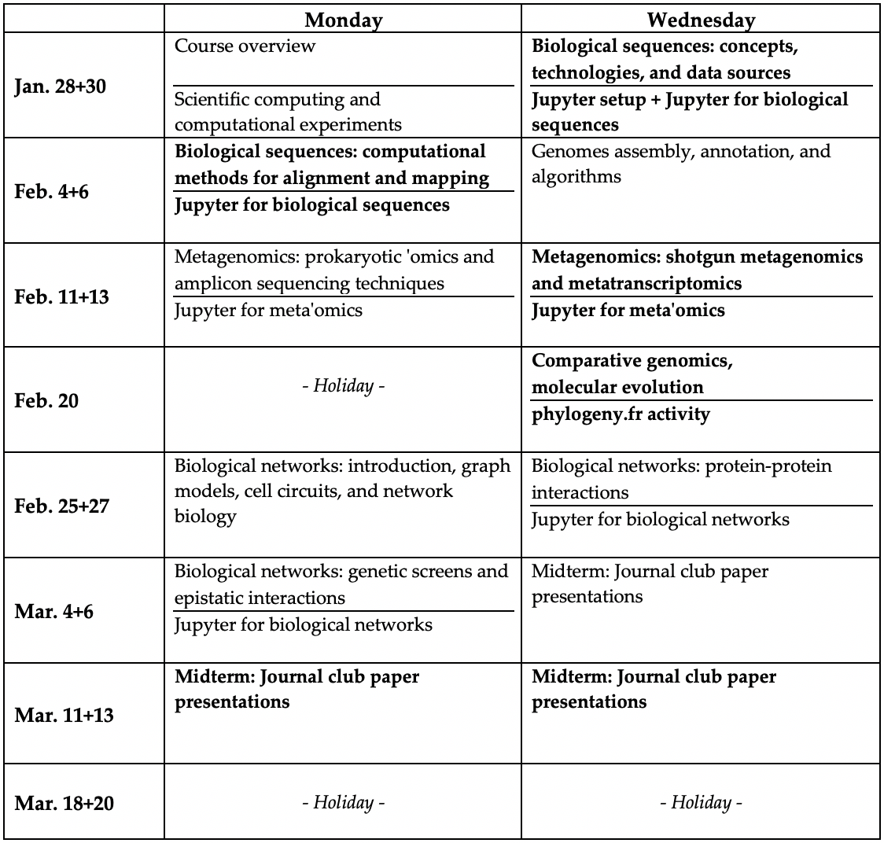
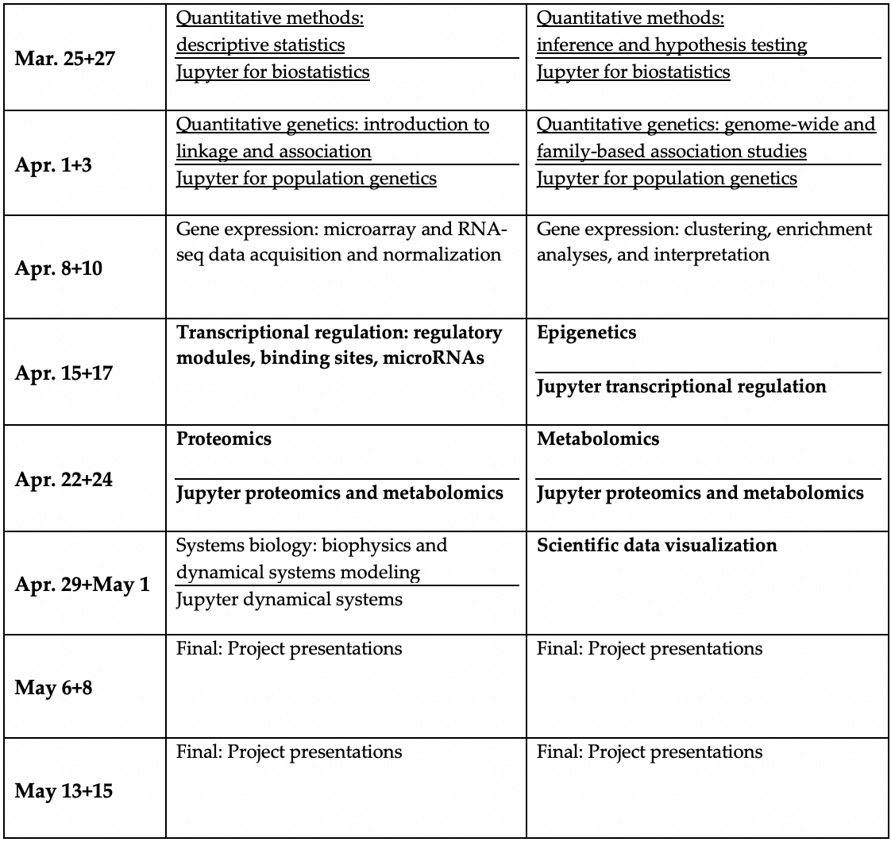
Course structure

Slide 7
Class structure
Two 90-minute sessions each week, plus lab
Each session comprises two segments, with a ~5-10min break in between
Breaks are intended to be halfway ~4:30 – if I miss them, please remind me!
Lectures are meant to be interactive – a conversation, not a speech!
Please interrupt, ask questions, and feel free to direct discussion topics.
Particularly when they touch on your own areas of research.
Please bring your laptops to class if at all possible.
If not, let one of us know after class.
Will be used for activities, polls.

Slide 8
Poll structure
Canvas quizzes, clicker-style.
Results are ungraded and only displayed anonymously.
However, responses are logged – which tells us who's here.
Can be submitted either through the web site or their (not-too-bad) app.
Let's try it out and get some background on the group:
M01.1 Introductions

Slide 9
Lab structure
Optional but highly recommended for problem sets especially.
Time and space are reserved for group prep during midterm / final projects.
Assignments will be returned ~one week after submission.
Each lab includes, in priority order:
If an assignment just came back, review and discussion.
Examples and discussion related to the currently outstanding problem set.
Particularly for the technical details of programming.
Continuation of in-class analysis activities.
Additional lecture material or demonstrations from class topics.
Free time for individual or small group work on assignments / projects.

Slide 10
Journal clubs and final projects
Midterm journal clubs and final projects are both group activities.
2-5 people per group, 3-4 recommended.
Do not have to be the same groups (but can be).
Journal clubs:
Select a high-impact and/or recent publication that’s heavy on quantitative biology.
Propose and get signoff from us.
Present and submit, as a group, a ~30min summary and discussion, plus questions.
Final projects:
Generate a ~1-2 paragraph proposal for an appropriately-scoped ‘omics analysis.
Using your own research data is fair game.
Iterate, get signoff, and carry out the analysis.
Present ~45min overview and discussion, plus questions.
Submit presentation, data and code package, and…
…individual extended abstract writeups: 2-4 pages, including 1-2 figures, plus references.

Slide 11
Assignment and collaboration policies
Late submissions lose points geometrically:
10% the first day, 25% the second, 60% the third, 100% the fourth.
Extensions are generally fine if requested at least one day in advance.
Problem set structure and scoring is indicated within each assignment.
On problem sets, please use common sense for collaboration:
Neither specific code nor text for written answers may be shared.
Do not show them to each other, even within group members.
If you want to ask about specific code, send it privately to the TA.
All problem sets are submitted individually and checked for duplication.
However, we encourage discussion of questions about problem sets:
These may (and should!) be posted on the course web discussion board.
Feel free to address questions, without sharing the specifics of individual answers.

Slide 12
Summary
http://huttenhower.sph.harvard.edu/bst281
MW 3:45-5:15, plus lab
Curtis, Eric, and Mike
Tools and concepts for high-quality quantitative biology research.
Learn standard ‘omics analysis techniques and tools to create your own.
Quantitative concepts and bioinformatics, including public computational tools and methods to make your own in Python.
Two sessions each week, plus lab.
Sessions are a mix of lectures and activities, labs are homework and technical details.
Six biweekly problem sets, group journal club and final project.

Slide 13
Computational experiments and concepts in quantitative biology
Curtis Huttenhower (chuttenh@hsph.harvard.edu)
Eric Franzosa (franzosa@hsph.harvard.edu)
http://huttenhower.sph.harvard.edu/bst281

Slide 14
Quantitative biology
Umbrella term for biological research that requires some data nuance.
Probably sexy to call it, “biological data science,” these days…
Computational biology and bioinformatics
I’ll use these terms roughly interchangeably.
In some cases, the former = more biology, the latter = more computing.
Includes a wide range of topics:
Biostatistics
Knowing what methods are appropriate for different mathematical settings.
Quantitative thinking – understanding what data can and can’t tell you.
And when (not) to believe it!
Sequence analysis
Computational infrastructure
Protein secondary and tertiary structure – crystallography
MS and NMR interpretation – proteomics and metabolomics
Network analysis
Image analysis
Quantitative genetics
Comparative genomics and phylogenetics

Slide 15
Everything I need to know about the history of bioinformatics, I learned from this one slide
Originally meant biophysics (or more what we call systems biology now).
In 1970s and mostly 80s, evolved to mean sequence analysis.
Early impetus = storing and searching DNA and amino acid sequences.
Rapidly evolved into comparative genomics and phylogenetics.
Shotgun sequencing strategies in the 1990s drove computational genomics.
Assembly and annotation.
Human Genome Project put a focus on algorithms.
Microarrays in the late 90s and early 2000s drove data mining.
Experimental design, signal processing, machine learning.
Network biology emerged from transcriptional regulatory analysis.
Statistical genetics in the mid-2000s motivated quantitative techniques.
Followed by a wave of epigenetics, and we're currently mid-single cell.
Data repositories and sharing (PDB dates back to the early 1970s).

Slide 16
Computing in support of biological experiments
One of the most basic roles of bioinformatics is support and automation.
For those with limited programming experience: what’s something you’d like a computer to do for you?
For those with experience: what’s something clever you convinced a computer to do for you?
For everyone: what’s the best computing trick you’ve seen in the biological literature?
businessinsider.com

Slide 17
Computational experiments
More important: computing allows you to express and test biological hypotheses that you couldn’t otherwise.
Remember, a hypothesis is something you think might be true about the universe.
Are birds closely related to dinosaurs?
How many unique microbes are in your gut?
Do yeast cells deactivate translation when starved?
Does low-dose aspirin lower colorectal cancer risk?
A laboratory experiment starts with one or more specimens, runs some procedures on them, and yields an observation that’s simpler and clearer than the original system.
A computational experiment starts with some data, runs a program or test on them, and yields an output that’s simpler and clearer than the original system.
xkcd.com

Slide 18
Best practices for computational experiments
Treat computational experiments like you would lab or field experiments.
Document everything (more on this later).
Consider design beforehand, not afterward.
What samples data will be appropriate? Where will you get them? How many?
How complicated will the analysis be? How much you time? How much machine time?
Which result(s) will support your hypothesis? Can you reliably detect them?
Be constructively skeptical.
Could a particular result be due to an outlier / artifact / error?
Could something going wrong generate an apparently interesting result? If everything goes right, could it still generate an uninteresting result?
If it looks too good to be true, it probably is.
Make sure every step is positively and negatively controlled (more later!)
Look at raw data every step of the way with your plain old eyes.

Slide 19
Look at the data!
It can be easy to treat computational experiments as a big black box.
Start with some raw experimental or epidemiological data.
Write a big, long, complicated analysis pipeline.
Run it once, get a result, write a paper.
Never run a computational experiment without visually inspecting the data that go into and come out of every step.
The computer might not be seeing the data you think it is.
And it definitely might not be producing the data you think it should!
For that matter, never run a computational experiment all in one step – make it modular!
For analysis processes that are too large to “see,” there are many solutions:
Use only the first small fragment of your real data.
Generate a small, synthetic input specific to each step.
Use a random subset of the available data.

Slide 20
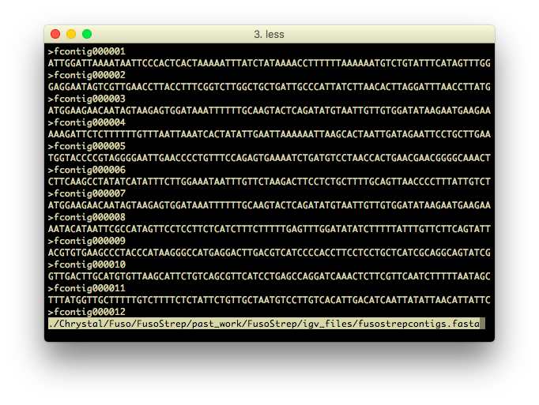
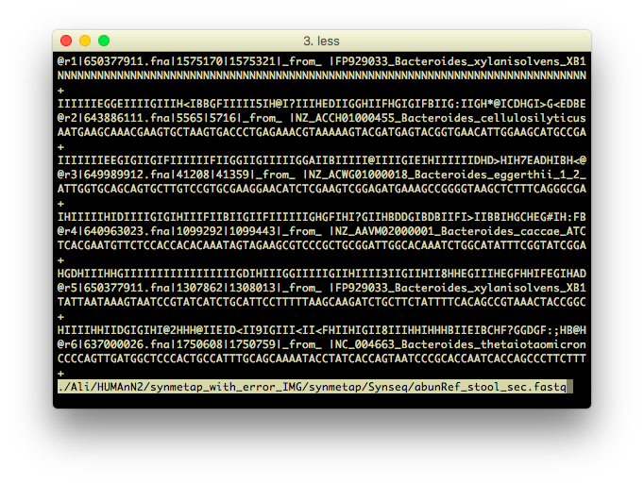
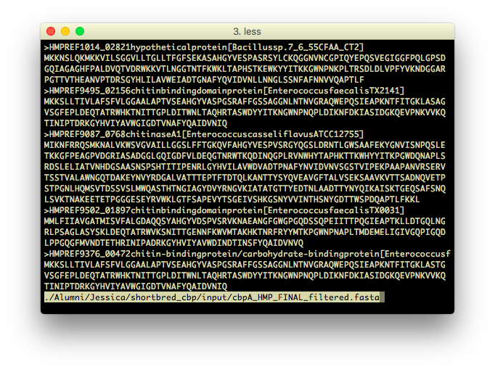
Look at the data!
Sczesnak CHM 2011

Slide 21
Computational positive and negative controls
You would never run or believe a lab experiment without controls – why do it on the computer?
In bioinformatics, also referred to as tests.
Unit tests control an individual analysis step.
Integration tests, often simulations, control an end-to-end process.
Regression tests ensure that nothing breaks when you change something.
Positive control: input data for which you can expect a specific result.
Suppose I knock down the FBN gene in Drosophila. If I then run an RNA-seq and build a computing pipeline to test for differential expression, FBN should be down.
Suppose I build a new genome assembler. If I create fake reads from an assembled genome in silico and assemble them, I should get the original genome back.
Negative control: input data for which you expect a null result.
If I knock down FBN and test for differential expression, actin or GAPDH (housekeeping genes) are unlikely to be affected.
If I build an assembler and feed it completely random reads, or designedly non-overlapping ones, it’s unlikely to output large contigs.

Slide 22
An example: metabolic profiling
You just sequenced a microbe! What pathways are present in its genome?
How might you modularize the computational analysis?
How might you positively and negatively control each step?
And the whole pipeline?
And look at the data at each step?

Slide 23
Documentation
Your past self is your own worst enemy.
Not to mention the relationship between your current self and future lab members.
No complex process makes sense without documentation.
Document your day-to-day computational activities.
Exploratory analyses, one-off tests, quick visualizations.
Use common sense to determine thoroughness – electronic lab notebook.
Describe your data.
Original inputs and important generated data products.
Who made them, what are they, where are they stored, when were they updated, how were they generated.
Document your analysis pipelines and code.

Slide 24
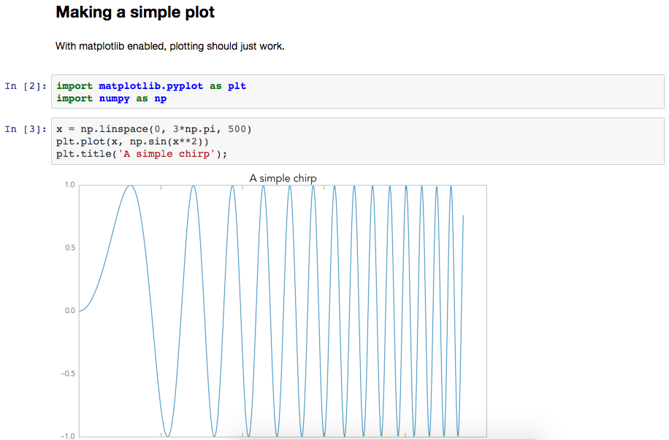
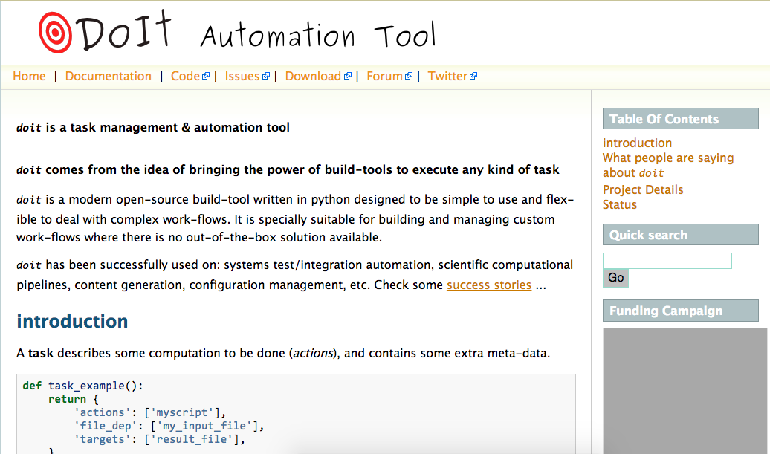
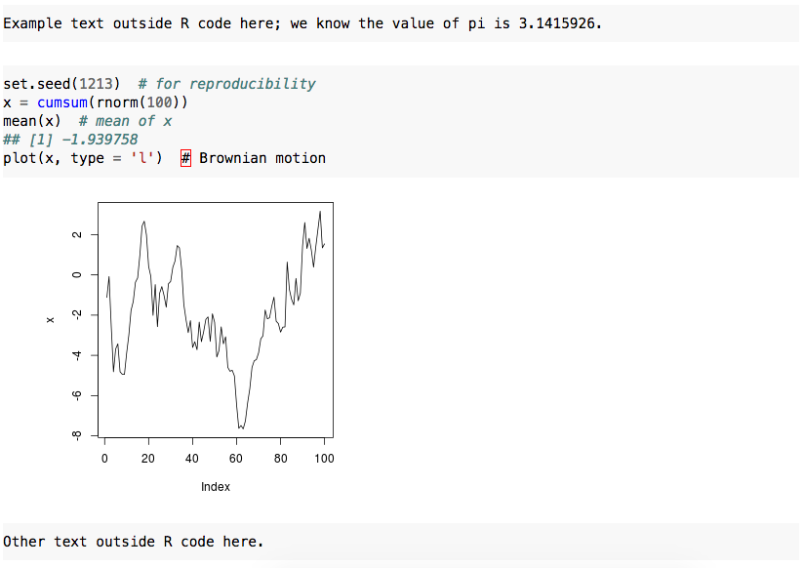
Electronic lab notebooks and literate programming
At the least, use a tool like Evernote or Keep.
But if you want to get fancy, may tools enable literate programming.
Mixing documentation and code so that what you see is what you get.
Jupyter
knitr
doit

Slide 25
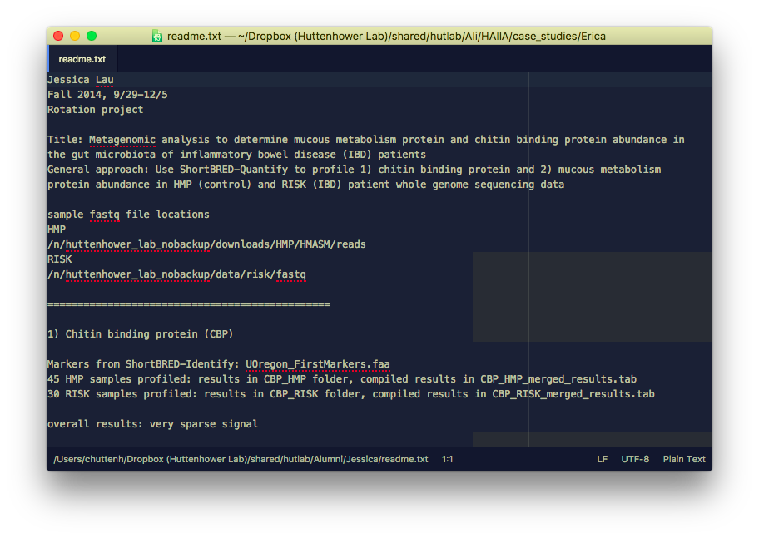
Documenting data
Least standardized aspect – can be as simple as a readme.txt file.
Contact information for responsible individual.
List of most important files.
Plain text descriptions of what they are.
Information on where they came from.
Links out for other info or papers.
What else – who’s been bitten by missing information?

Slide 26
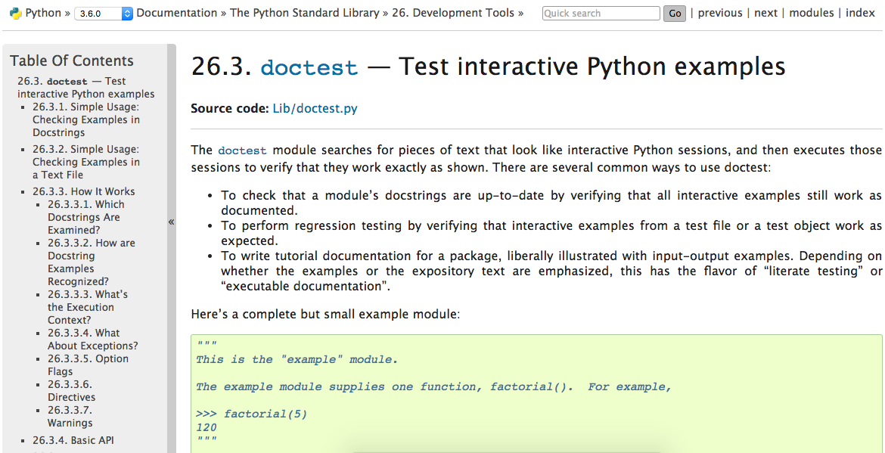
Documenting analyses
doctest
Typically done by “commenting your code.”
(Almost) every programming language can format text that you see but the computer doesn’t.
We’ll use Python’s over the course of the semester.
Lowest bar:
Provide a header at the top of any code file just like a dataset’s readme.
Anywhere you do something complicated during the analysis, write a sentence or two explaining why.
But if you want to get fancy…
Sphinx

Slide 27
Computational project management
Keep your lab bench bioinformatics workspace organized!
Use a consistent directory structure.
Follow file naming conventions.
Date-stamp (or revision control) as appropriate.
I highly recommend formal revision control (git/hg) if you’re up to it.
type_project-subproject_date.ext
grant_r01-microbiome_10-12-14.docx
16-06-18_powercalc_r21-cohort.py
project
input
src
tmp
output
etc
doc
Driver script + readme
Immutable external / raw data
Processing code
Results that can be regenerated
Results that you care about
Configuration / options / parameters
Thorough documentation

Slide 28
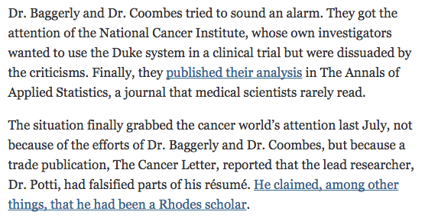
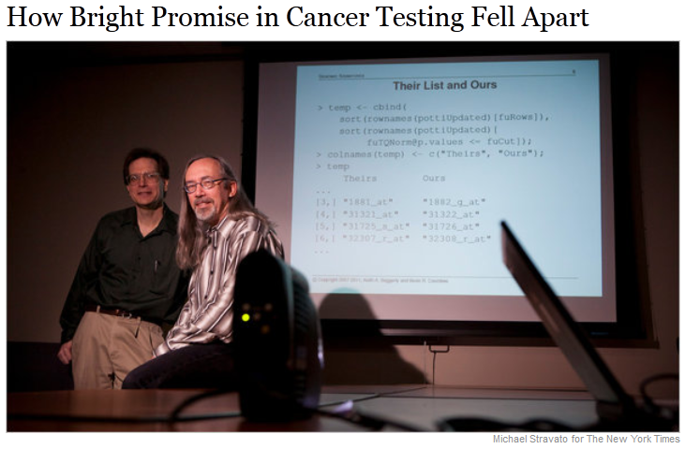
Reproducibility
Potti A, Dressman HK, Bild A, Riedel RF, Chan G, Sayer R, Cragun J, Cottrill H, Kelley MJ, Petersen R, Harpole D, Marks J, Berchuck A, Ginsburg GS, Febbo P, Lancaster J, Nevins JR. Genomic signatures to guide the use of chemotherapeutics. Nat Med. 2006 Nov;12(11):1294-300
Baggerly, K. & Coombes, K. Deriving chemosensitivity from cell lines: Forensic bioinformatics and reproducible research in high-throughput biology. The Annals of Applied Statistics 3, 1309-1334 (2009).
Subramanian, J. & Simon, R. Gene Expression-Based Prognostic Signatures in Lung Cancer: Ready for Clinical Use? J. Natl. Cancer Inst. 102, 464-474 (2010).
Koscielny, S. Why Most Gene Expression Signatures of Tumors Have Not Been Useful in the Clinic. Science Translational Medicine 2, 14ps12-14ps12 (2010).
Evolution of Translational Omics: Lessons Learned and the Path Forward. (National Academies Press, 2012).
Potti A, Dressman HK, Bild A, Riedel RF, Chan G, Sayer R, Cragun J, Cottrill H, Kelley MJ, Petersen R, Harpole D, Marks J, Berchuck A, Ginsburg GS, Febbo P, Lancaster J, Nevins JR. Retraction: Genomic signatures to guide the use of chemotherapeutics. Nat Med. 2011 Jan;17(1):135
July 7, 2011
Keith Baggerly
Kevin Coombes

Slide 29
Summary
Computational biology…
…provides techniques in support of biological experiments.
…enables new computational experiments.
Treat computational experiments like laboratory experiments.
Be constructively skeptical and look at the data every step of the way.
Positive and negative controls.
Your future self, the scientific community, and the rest of the world deserve it.
Document activities, data, and code.
Keep your workspace organized.
Many of these problems are already solved: use existing computational tools and resources to support your work!

