Slide 1
Biological Sequences: Concepts & Data
Curtis Huttenhower (chuttenh@hsph.harvard.edu)
Eric Franzosa (franzosa@hsph.harvard.edu)
http://huttenhower.sph.harvard.edu/bst281

Slide 2
Announcements
Let us know if there are any pending registration issues
If auditing, email to be added as a guest on the website
Start on the first homework earlier not later
Lab tomorrow for help with computational setup
Thursday, 3:45-5:15, FXB G03

Slide 3
Summary
Biological sequences vs. sequence-based quantification
Biopolymers and the central dogma
Sequencing technologies
Sequence data formats
Sequence databases

Slide 4
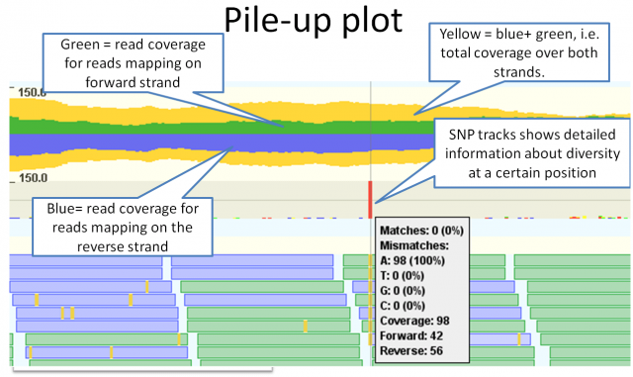
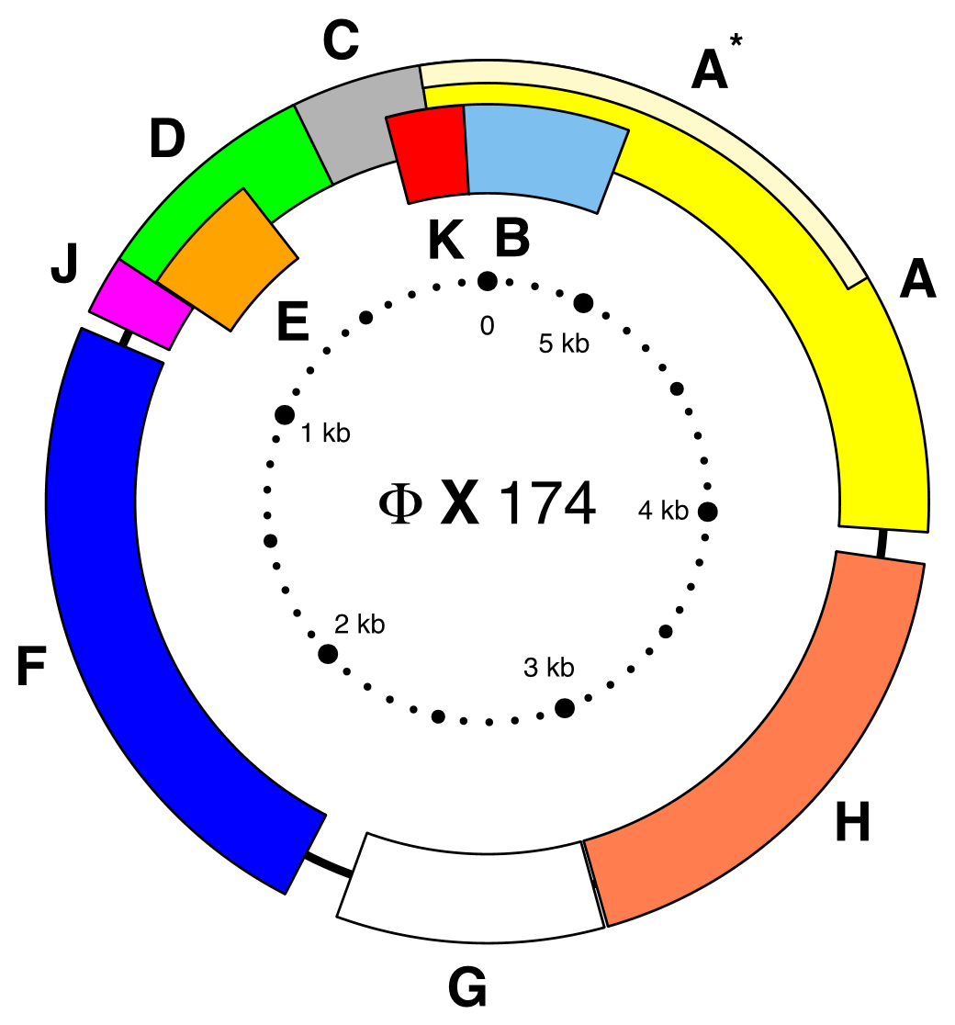
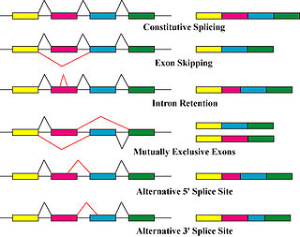
The dual role of biological sequences
Defining biological entities
Quantifying biological entities/states
Genomes
Transcripts
Genes
Motifs
RNA-Seq, ChIP-Seq, Hi-Seq, metagenome-Seq,
and many, many others….
(see https://liorpachter.wordpress.com/seq/ for an annotated compendium)
Protein families

Slide 5
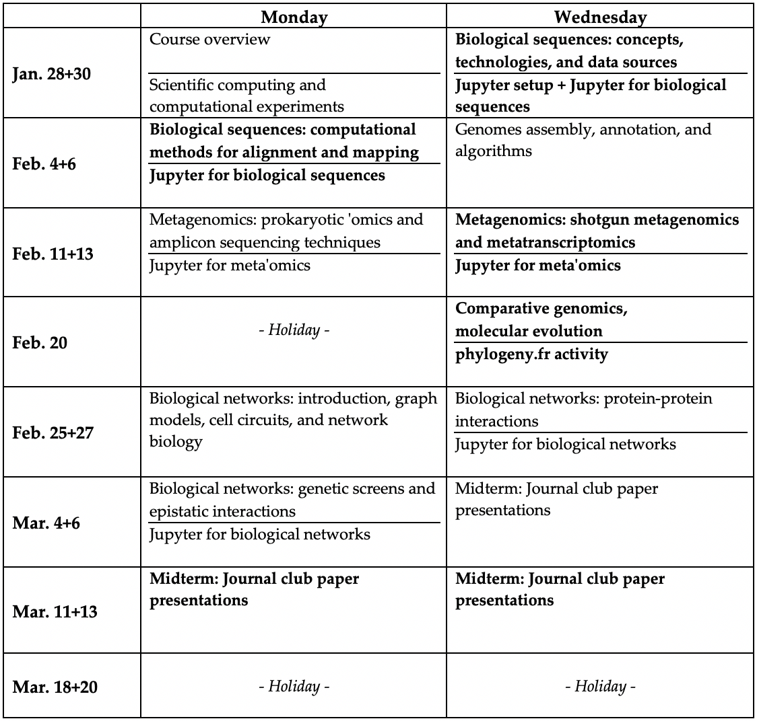
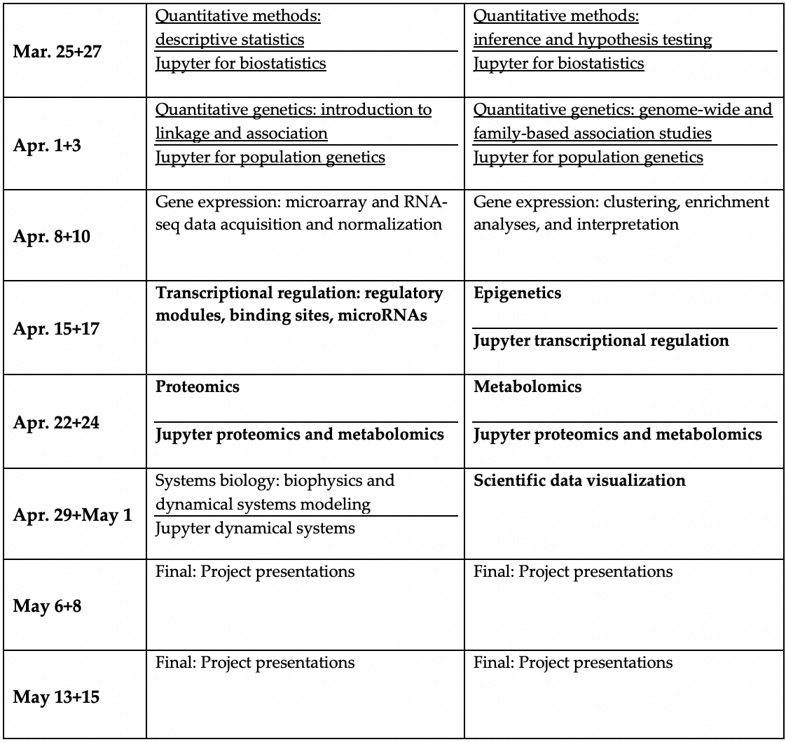
Course structure
sequence as biology
sequence as proxy/tool
no sequence

Slide 6
Biopolymers &
The Central Dogma

Slide 7
Polymers & biopolymers
Polymer (n): a substance that has a molecular structure consisting chiefly or entirely of a large number of similar units bonded together.
Biopolymer (n): a polymeric substance occurring in living organisms, e.g., a protein, cellulose, or DNA.

Slide 8
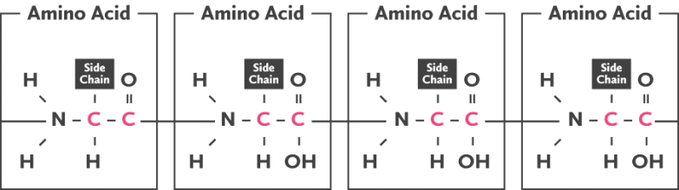
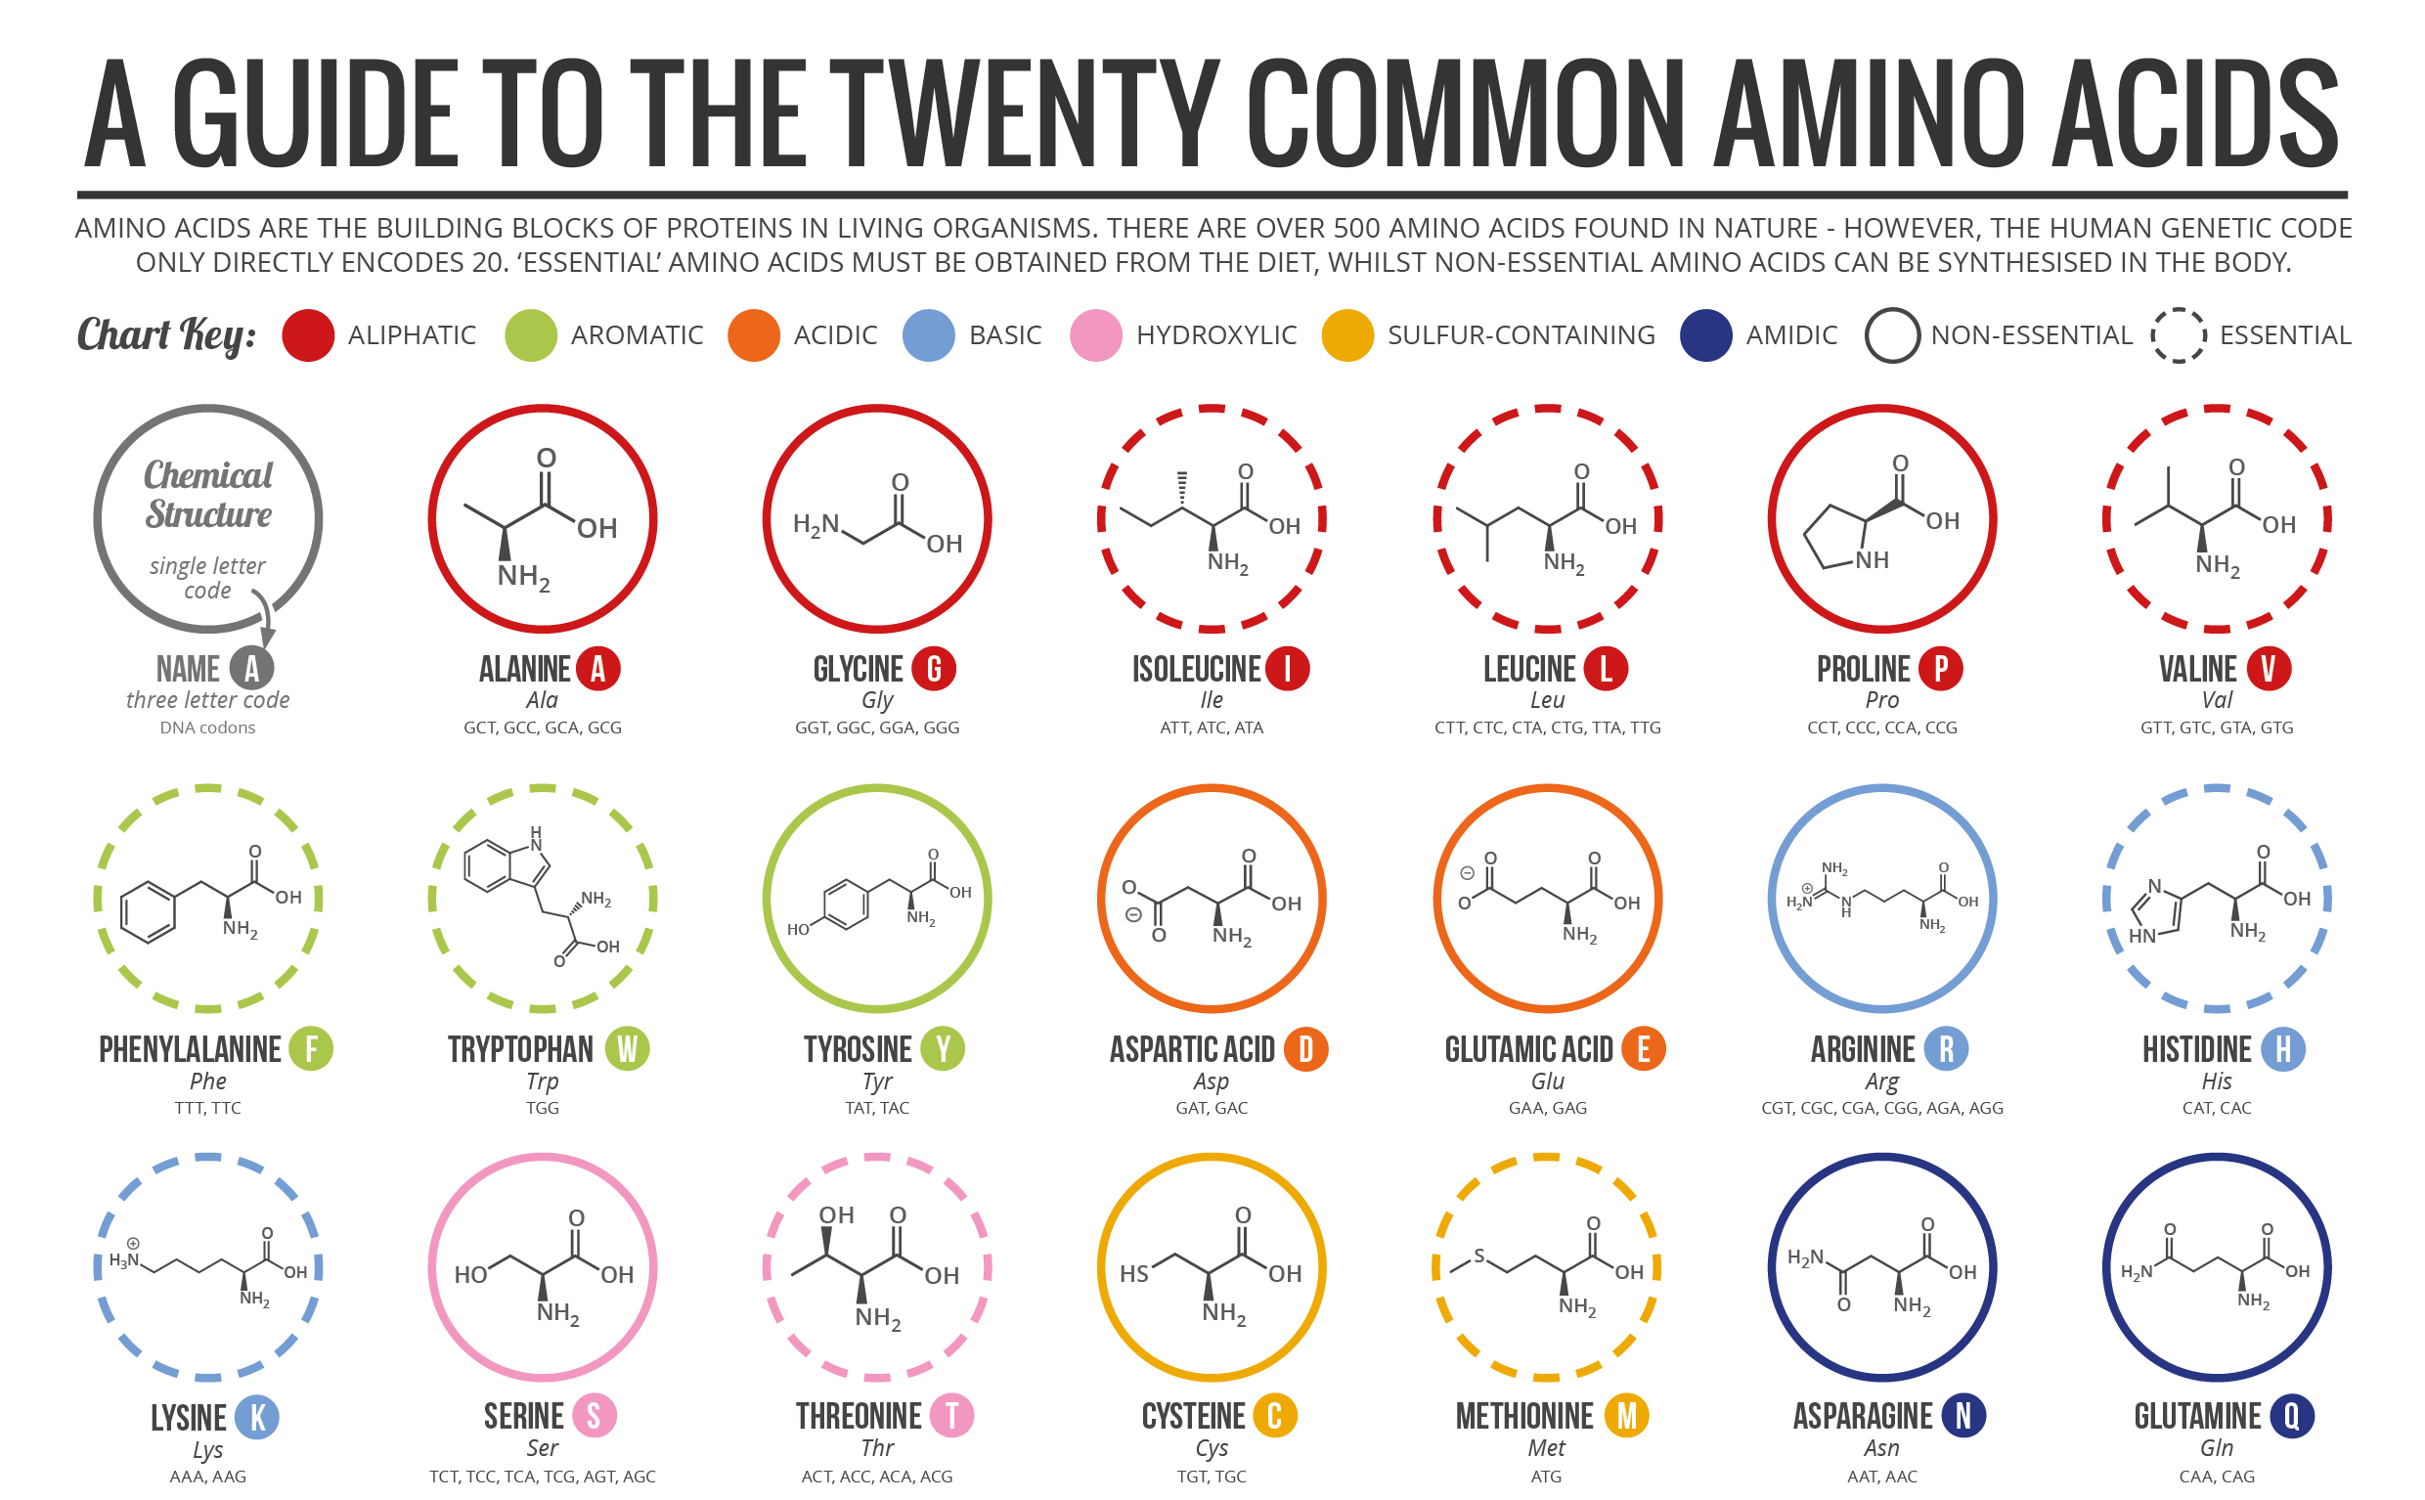
Information-carrying biopolymers
(N)ucleic (A)cids
Polypeptides (protein primary seq.)
(D)eoxyribo(N)(A)
(R)ibo(N)(A)
1/30/2019

Slide 9
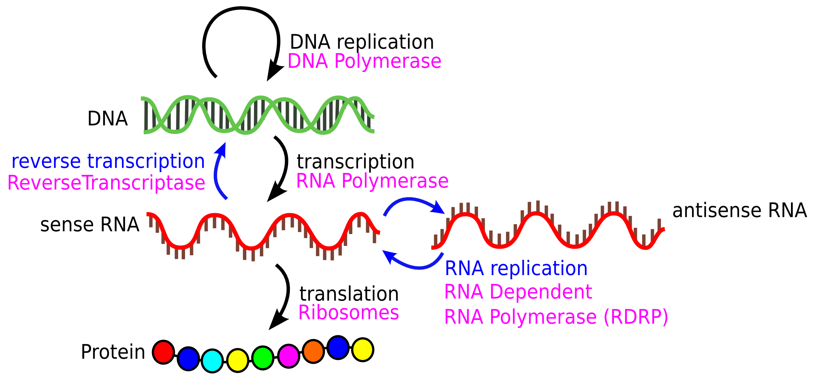
Information flow in The Central Dogma: molecules

Slide 10
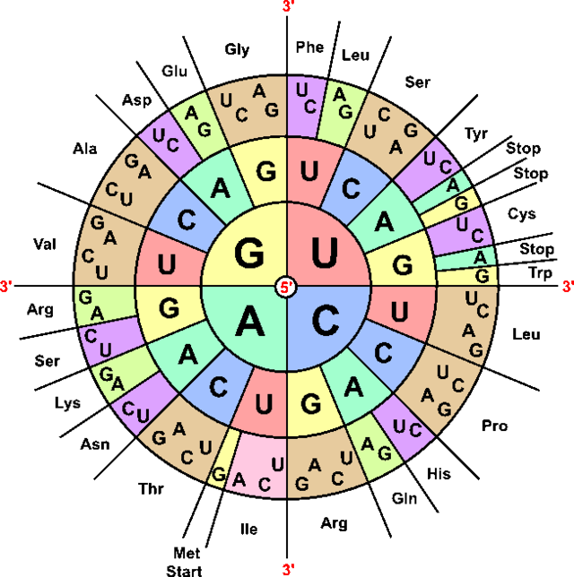
Information flow in The Central Dogma: data
DNA sequence: + a.k.a. sense a.k.a. 5’-3’ a.k.a. Watson strand
5’ | GCT | GGA | GCA | CCA | GGA | CAA | GAT | GGA | 3’
DNA sequence: - a.k.a. antisense a.k.a. 3’-5’ a.k.a. Crick strand
3’ | CGA | CCT | CGT | GGT | CCT | GTT | CTA | CCT | 5’
RNA sequence: transcript
5’ | GCU | GGA | GCA | CCA | GGA | CAA | GAU | GGA | 3’
Protein translation (3-letter amino acid codes)
N- | Ala | Gly | Ala | Pro | Gly | Gln | Asp | Gly | -C
Protein translation (1-letter amino acid codes)
N- | A | G | A | P | G | Q | D | G | -C

Slide 11
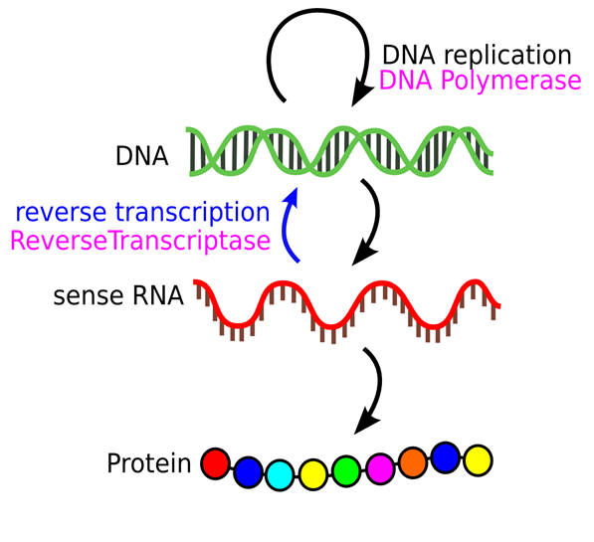
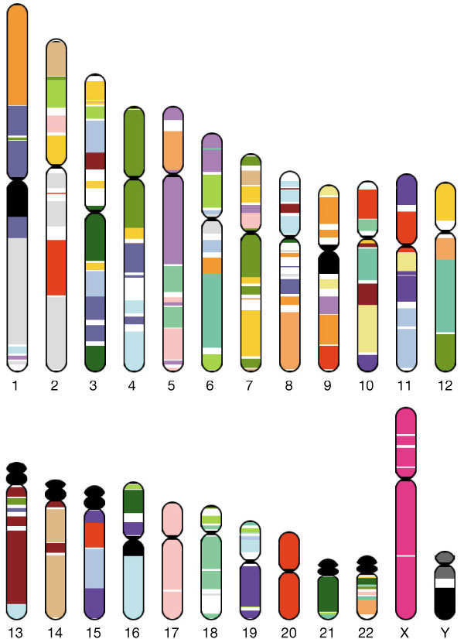
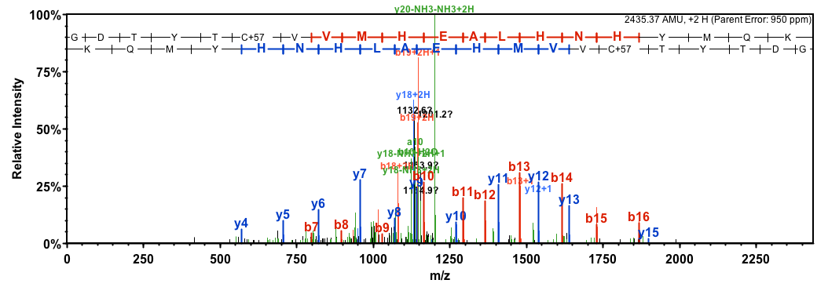
Where does sequence data come from?
DNA sequencing technology uses the biological machinery of DNA replication to read out short sequences (100s of nts)
Assemble short, random DNA pieces to recover biological structures, e.g. genes, chromosomes, and genomes
“shotgun sequencing”
Human genome
“Sequenced” Feb. 2001
24 chromosomes
~3 billion nucleotides
Phy X 174
Sequenced 1977
5,386 nucleotides
No way!
Sequence and assemble RNA transcripts by converting to DNA first!
No biological mechanism for protein → DNA, so we have to roll our own sequencing (mass spectrometry)

Slide 12
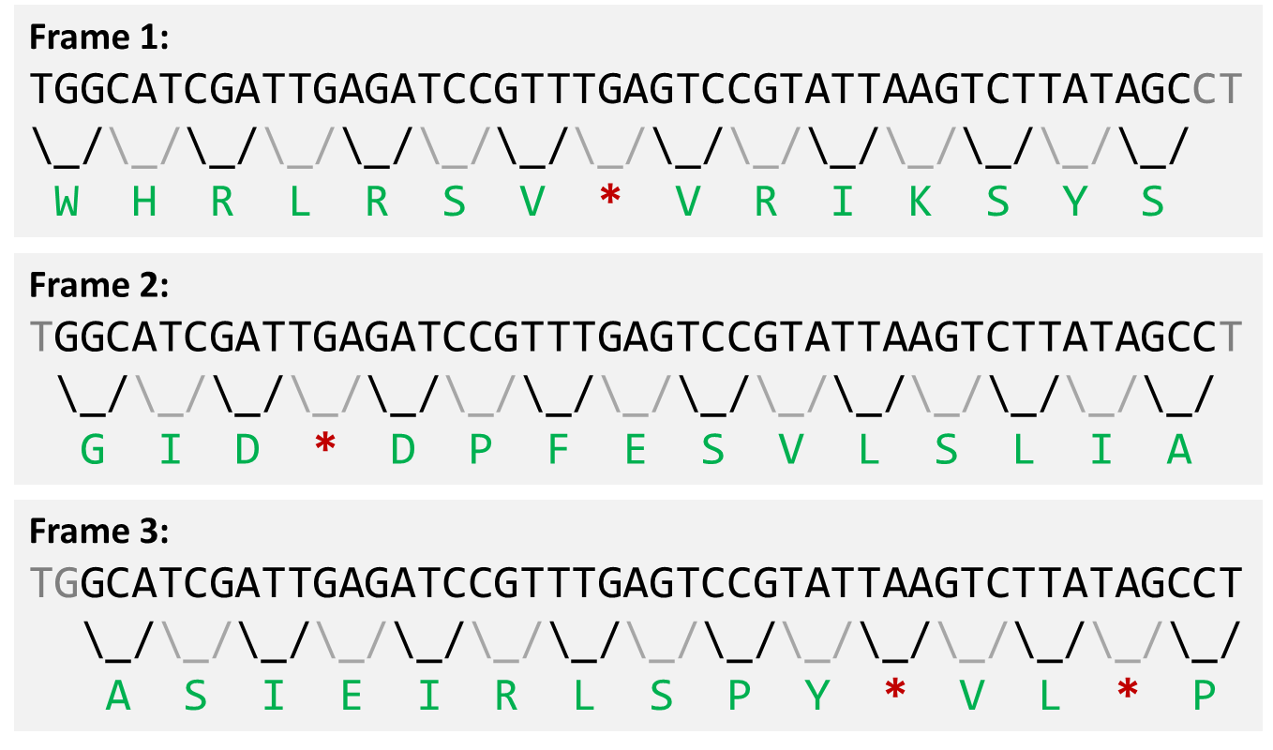
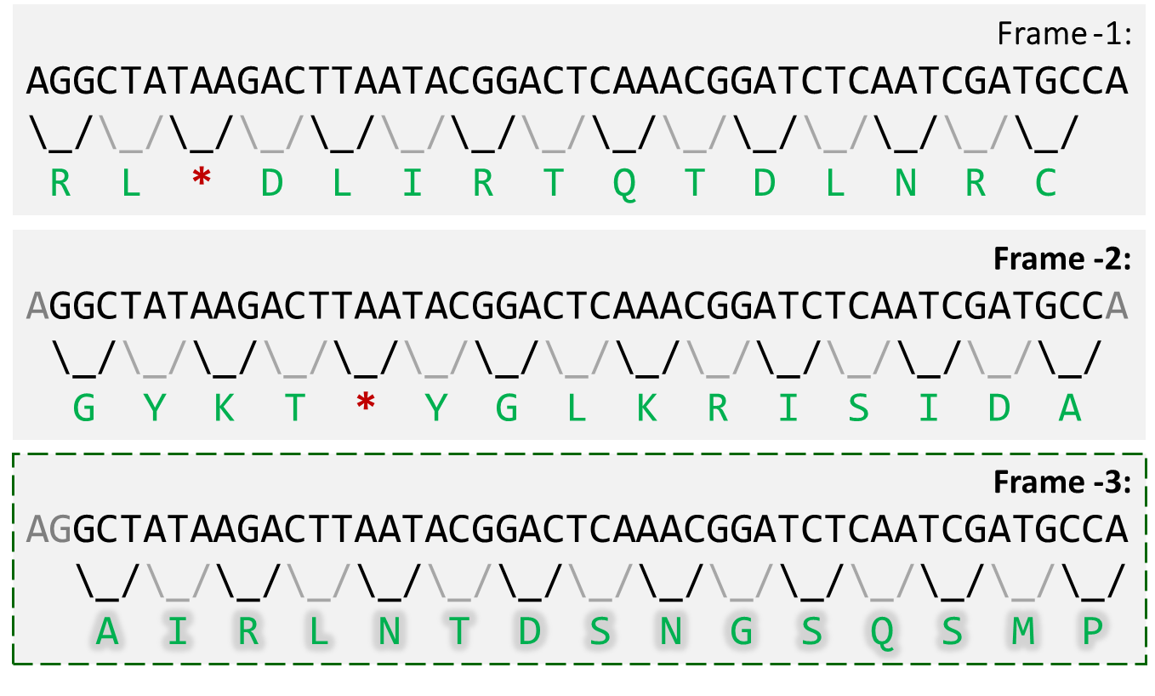
Another approach for finding protein sequences
Much of the transcript (gene) and protein sequence data we have today comes from looking for coding sequences (open reading frames, ORFs) in genomes:
Genes can be encoded on the reverse strand as well!

Slide 13
DNA sequencing
technology

Slide 14
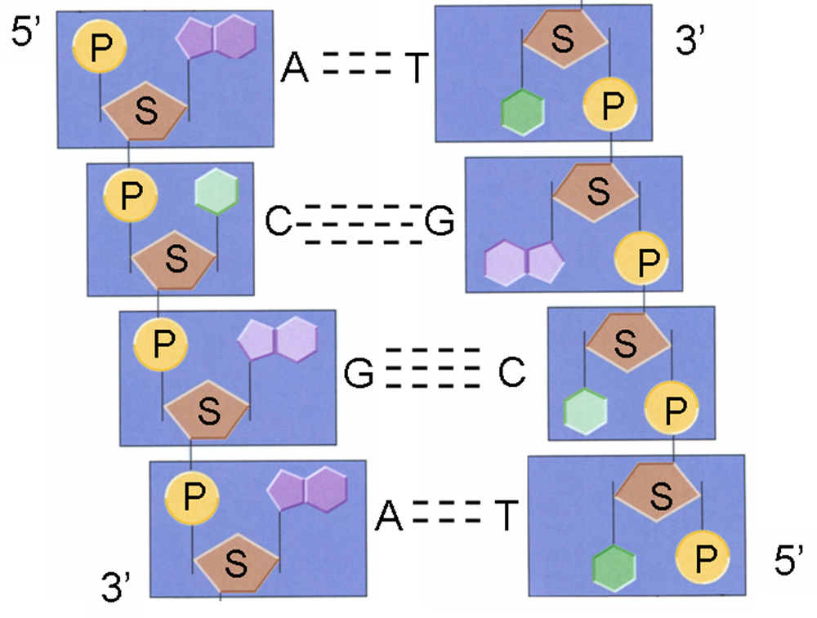
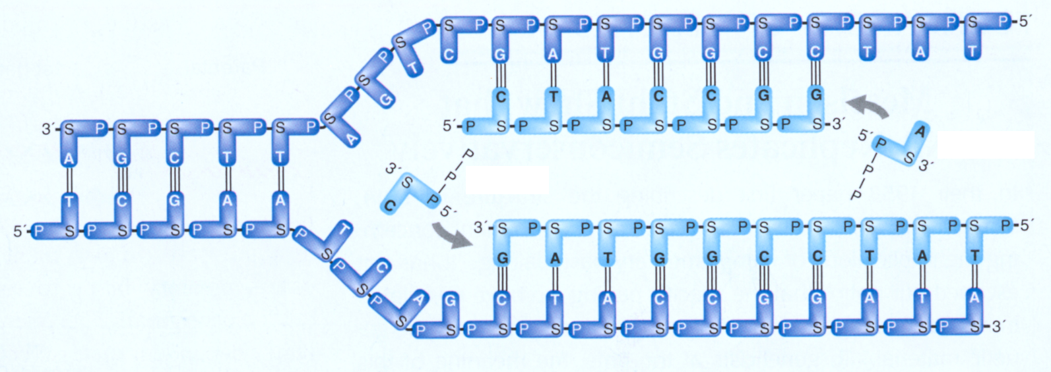
A review of DNA replication
The most common DNA sequencing methods are “sequencing by synthesis”
They take advantage of DNA’s built-in replication mechanism:
DNA consists of two antiparallel chains of the of the A, C, G, T nucleotides
During DNA replication, each chain serves as the template for a new chain
Chains grow in the 5’ → 3’ direction

Slide 15
Sanger sequencing
Developed by Frederick Sanger and colleagues in 1977
Still used today as a gold standard sequence determination
Generates sequences in the 300 - 1000 nt range, though 500 more typical
Based on the idea of chain termination
DNA replication in the presence of modified nucleotides randomly halts extension
3’-CGAGTCCTTAGGCATACA-5’
Deoxynucleotides (normal nucleotides)
5’- -3’
GCTCAGGAATCCGTATGT
3’-CGAGTCCTTAGGCATACA-5’
5’- -3’
GCTCAGGAAT
Dideoxynucleotides (ddA, ddT, ddC, ddG)
ddT

Slide 16
Sanger sequencing
Start from a population of your DNA of interest
Start sequencing from a radio-labeled primer
The population of replicating DNA molecules will terminate at each T position
Producing labeled fragments of different sizes that will separate on a gel
3’-CGAGTCCTTAGGCATACA-5’
tag
GCTCAG
GAAT
3’-CGAGTCCTTAGGCATACA-5’
tag
GCTCAG
GAATCCGT
decreasing size
3’-CGAGTCCTTAGGCATACA-5’
tag
GCTCAG
GAATCCGTAT
3’-CGAGTCCTTAGGCATACA-5’
tag
GCTCAG
GAATCCGTATGT

Slide 17
Sanger sequencing
GTAC
Repeat this process for each nucleotide type
Relative band ordering reveals the DNA sequence!
5’
G
A
A
T
C
C
G
decreasing size
T
A
T
G
T
ddT
ddC
ddA
ddG
Real example!
The sequence is: 5’-GAATCCGTATGT-3’

Slide 18
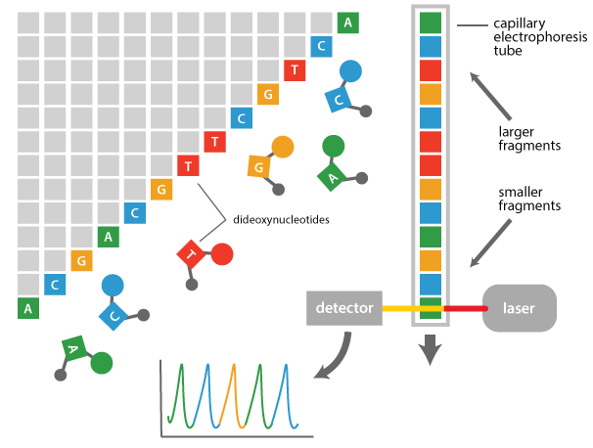
Sanger sequencing
Modern Sanger approaches use pools of terminating nucleotides labeled with fluorescent tags (no more radioactive labeling)
Labeled fragments for all four types of terminations are produced in a single reaction, size-separated in a capillary tube, and identified electronically
intensity
time

Slide 19
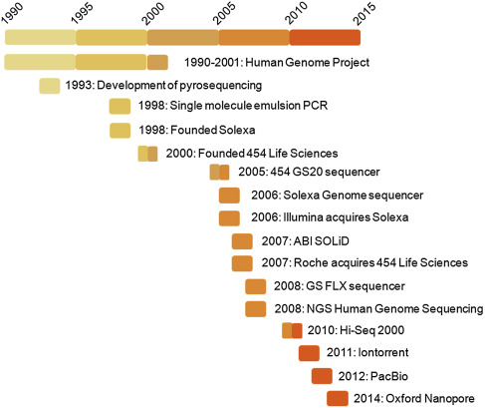
“Next” Generation Sequencing (NGS)
Next-generation sequencing (NGS) term coined to refer to Sanger descendants
Better to call them “high-throughput sequencing” (HTSeq) these days
Emphasis on increasing scale and decreasing cost per nucleotide
Many technologies have come and gone
We’ll focus on the extant ones

Slide 20
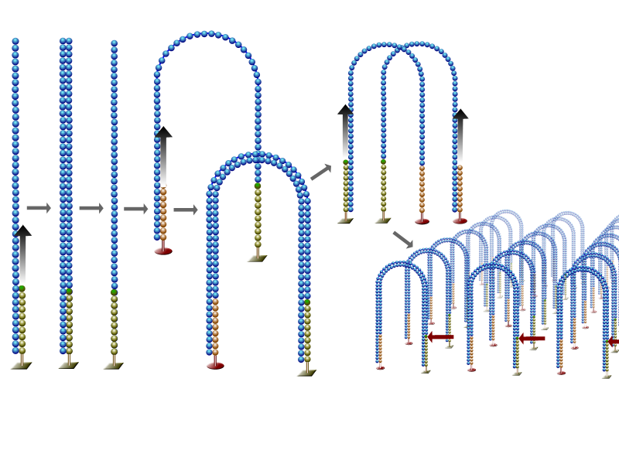
Illumina sequencing
Illumina is the reigning monarch of high-throughput sequencing
Several platforms (instruments): MiSeq, HiSeq, NextSeq, NovaSeq
Like Sanger sequencing, based on sequencing by synthesis
DNA fragments anchor to flow cell surface
Illumina HiSeq flow cell
Fragments are locally replicated through bridge amplification, yielding clusters (“polonies”) of the same sequence
Bridge Amplification

Slide 21
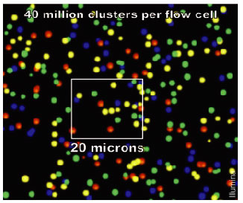
Illumina sequencing
A
C
G
A
G
C
T
T
T
T
T
Sequencing occurs simultaneously for all clusters (one pictured)
DNA synthesis allowed to occur one-nucleotide-at-a-time…
…using reversible, fluorescent chain terminating nucleotides
All fragments are extended by the same nucleotide (here “T”)
A photometer reads out a fluorescent signal from this cluster indicating that an “T” has been attached
Zooming out, the cluster appears as a green glowing dot.
Each cluster’s color indicates the current added nucleotide.
Image software tracks the developing sequence for 10s of millions of clusters

Slide 22
Illumina sequencing
Can’t extend
Can extend
T
T
T
T
T
T
T
T
G
G
G
A chemical transformation then removes the chain-terminating property of the leading nucleotides…
And the process repeats
This time, a “G” nucleotide is added to each fragment in the cluster of fragments
Our cluster glows yellow in this extension, indicating the addition of a “G” nucleotide
And so on and so forth…

Slide 23
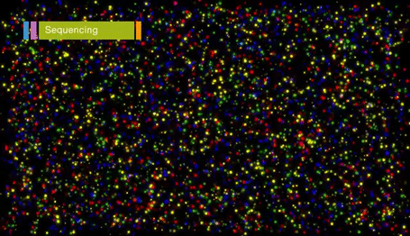
Illumina sequencing

Slide 24
Illumina sequencing
This process sequences 100-200 nts from 3’ end of one DNA fragment strand
The entire process (bridge amplification and sequencing) is then repeated for the other strand of the fragment in each cluster
This produces pairs of reads for each fragment
First Read (100 nts)
Double-stranded DNA fragment (300 nts)
Second Read (100 nts)
First stage
Second stage

Slide 25
Long-read sequencing
Pacific Biosciences (PacBio)
Single Molecule Real Time (SMRT) sequencing
Also sequencing by synthesis, but removes amplification/stepwise approach
Purchased by Illumina in 2018 for $1.2 Billion
Oxford Nanopore
Sequence read as strand passes through tiny pore
NOT sequencing by synthesis

Slide 26
High-throughput sequencing stats
*Gnt = Giganucleotide = 10⁹ (1 billion) nucleotides = 1/3 of human genome
Platform | Read length | *Gnt / run | Time / run | Cost / run | Error rate
Sanger | 1,000 | 0.0001 | 1 hour | $10k | 0.001%
Illumina HiSeq | 100-200 | 1500 | 1 week | $10k | 0.1%
Illumina MiSeq | 150-300 | 15 | 1 day | $1k | 0.1%
Illumina Next | 100-150 | 120 | 1 day | $5-10k | 0.1%
Illumina Nova | 100-200 | 200-5,000 | 1-2 days | $15k | 0.1%
PacBio | 10,000-50,000 | 1-5 | 0.5-1 day | $5k | 0.1-1%
Nanopore | 1,000-10,000 | 0.1 | 1-2 days | $0.5-1k | 1-10%
These days, DNA sequencing is “free” compared to other research costs
If you can solve a problem with short DNA reads, it will be easy and cheap
Long reads still suffer from high error rates

Slide 27
Storing sequence data

Slide 28
FASTA files store biological sequences (e.g. genes, genomes)
One-line headers starting with “>”, followed by 1+ lines of sequence
Sequence lines are “whitespace insensitive”
Can be in blocks, wrapped over lines, or all on one line
One-letter codes for DNA/RNA/protein residues
Sequences can be any length
From reads (10s of nts), to genes (100s of nts/aas), to chromosomes (100Ks of nts)
>sp|P04637|P53_HUMAN Cellular tumor antigen p53 OS=Homo sapiens GN=TP53 PE=1 SV=4
MEEPQSDPSVEPPLSQETFSDLWKLLPENNVLSPLPSQAMDDLMLSPDDIEQWFTEDPGP
DEAPRMPEAAPPVAPAPAAPTPAAPAPAPSWPLSSSVPSQKTYQGSYGFRLGFLHSGTAK
SVTCTYSPALNKMFCQLAKTCPVQLWVDSTPPPGTRVRAMAIYKQSQHMTEVVRRCPHHE
RCSDSDGLAPPQHLIRVEGNLRVEYLDDRNTFRHSVVVPYEPPEVGSDCTTIHYNYMCNS
SCMGGMNRRPILTIITLEDSSGNLLGRNSFEVRVCACPGRDRRTEEENLRKKGEPHHELP
PGSTKRALPNNTSSSPQPKKKPLDGEYFTLQIRGRERFEMFRELNEALELKDAQAGKEPG
GSRAHSSHLKSKKGQSTSRHKKLMFKTEGPDSD

Slide 29
FASTA files store biological sequences (e.g. genes, genomes)
A new header (“>”) signals the start of a new sequence
No limit to the number of headers/sequences per file
Headers are free-form, but often divided into piped (“|”) fields
Different databases will enforce different header formats
These are UniProt protein headers
>sp|P04637|P53_HUMAN Cellular tumor antigen p53 OS=Homo sapiens GN=TP53 PE=1 SV=4
MEEPQSDPSVEPPLSQETFSDLWKLLPENNVLSPLPSQAMDDLMLSPDDIEQWFTEDPGP
DEAPRMPEAAPPVAPAPAAPTPAAPAPAPSWPLSSSVPSQKTYQGSYGFRLGFLHSGTAK
SVTCTYSPALNKMFCQLAKTCPVQLWVDSTPPPGTRVRAMAIYKQSQHMTEVVRRCPHHE
RCSDSDGLAPPQHLIRVEGNLRVEYLDDRNTFRHSVVVPYEPPEVGSDCTTIHYNYMCNS
SCMGGMNRRPILTIITLEDSSGNLLGRNSFEVRVCACPGRDRRTEEENLRKKGEPHHELP
PGSTKRALPNNTSSSPQPKKKPLDGEYFTLQIRGRERFEMFRELNEALELKDAQAGKEPG
GSRAHSSHLKSKKGQSTSRHKKLMFKTEGPDSD
>sp|P49615|CDK5_MOUSE Cyclin-dependent-like kinase 5 OS=Mus musculus GN=Cdk5 PE=1 SV=1
MQKYEKLEKIGEGTYGTVFKAKNRETHEIVALKRVRLDDDDEGVPSSALREICLLKELKHKNIVRLHDVLHSDKKLTLVFE...

Slide 30
FASTQ files store raw sequence data (including quality)
@SEQ_ID
GATTTGGGGTTCAAAGCAGTATCGATCAAATAGTAAATCCATTTGTTCAACTCACAGTTT
+
!''*((((***+))%%%++)(%%%%).1***-+*''))**55CCF>>>>>>CCCCCCC65
Four lines per sequence (typically a single read)
“@” followed by a sequence identifier
Complete nucleotide sequence
“+” (optionally repeat the identifier)
Per-nucleotide quality scores (encoded)

Slide 31
FASTQ files store raw sequence data (including quality)
Quality scores reflect the sequencer’s confidence in nucleotide calls
Higher quality ← Exactly one strong signal (e.g. “definitely a T”)
Lower quality ← Weak or mixed signals (e.g. “no idea” OR “could be A or T”)
Defined (Phred score) as a function of the probability P of being wrong:
Q = -10 log₁₀ P
Q = 10 → P = 0.1 → 90% correct
Q = 30 → P = 0.001 → 99.9% correct
Quality tends to drop off toward the end of a sequence

Slide 32
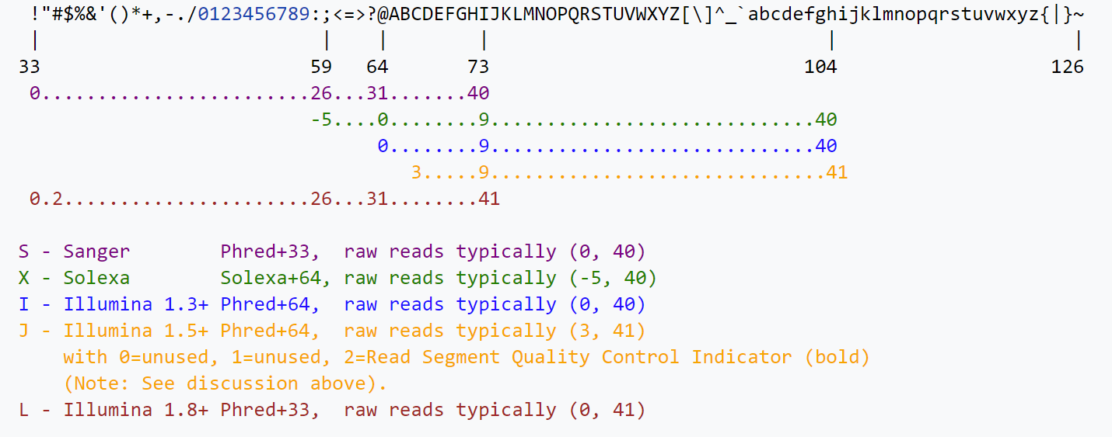
FASTQ files store raw sequence data (including quality)
Numerical Q scores (which may have 2 digits) are converted to ASCII characters to maintain alignment with single-character nucleotides
@SEQ_ID
GATTTGGGGTT
+
!''*((((***

Slide 33
FASTQ files represent sequence data and quality
@071112_SLXA-EAS1_s_7:5:1:817:345#0/1
GGGTGATGGCCGCTGCCGATGGCGTCAAATCCCACC
+
IIIIIIIIIIIIIIIIIIIIIIIIIIIIII9IG9IC
@071112_SLXA-EAS1_s_7:5:1:801:338#0/1
GTTCAGGGATACGACGTTTGTATTTTAAGAATCTGA
+
IIIIIIIIIIIIIIIIIIIIIIIIIIIIIIII6IBI
@071112_SLXA-EAS1_s_7:5:1:817:345#0/1
AAGTTACCCTTAACAACTTAAGGGTTTTCAAATAGA
+
IIIIIIIIIIIIIIIIIIIIDIIIIIII>IIIIII/
@071112_SLXA-EAS1_s_7:5:1:801:338#0/1
AGCAGAAGTCGATGATAATACGCGTCGTTTTATCAT
+
IIIIIIIIIIIIIIIIIIIIIIGII>IIIII-I)8I
Here’s an example of a FASTQ file containing four reads
The quality here is fairly high
I → Q = 40 → P = 0.0001

Slide 34
FASTQ files store raw sequence data (including quality)
FASTQ headers from a given instrument often follow a pattern
This is the pattern for Illumina sequences
@HWUSI-EAS100R:6:73:941:1973#0/1
HWUSI-EAS100R | The unique instrument name
6 | Flowcell lane
73 | Tile number within the flowcell
941 | 'x'-coordinate of the cluster within the tile
1973 | 'y'-coordinate of the cluster within the tile
#0 | index number for a multiplexed sample (0 for no indexing)
/1 | the member of a pair, /1 or /2 (paired-end or mate-pair reads only )
Paired reads are often divided into two “parallel” files per sample

Slide 35
Sequence databases

Slide 36
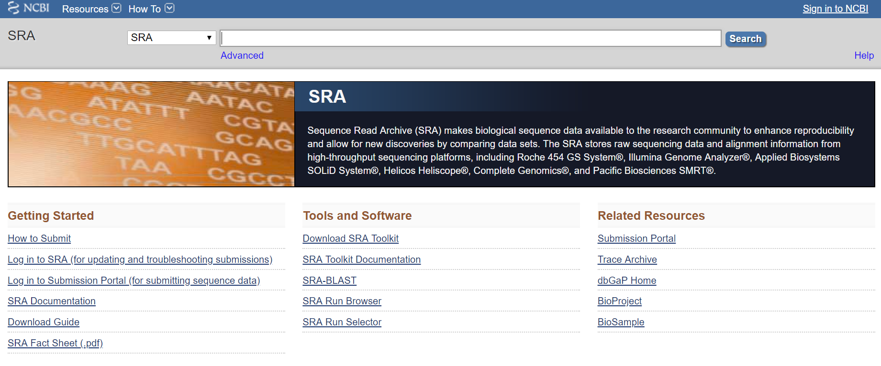
http://www.ncbi.nlm.nih.gov/sra
NCBI SRA (Sequence Read Archive) is a central hub for raw sequence data
Studies deposit their reads here for others to use

Slide 37
Databases for biological sequences (e.g. genes, genomes)
Let you browse sequence data + annotations online
Let you download data in pieces or en masse
FTP access?
Typically embed homology-based search tools (e.g. BLAST)
Query the database using another sequence
Are versioned (individual sequences + database)
E.g. UniProt has a monthly release named like 2019_01
Use systematic identifiers for sequences
Differ between databases, leading to the “ID-mapping” problem
E.g. human CDK1 is P06493 at UniProt and AK291939 in GenBank

Slide 38
http://www.ncbi.nlm.nih.gov/genbank
NCBI comprehensive nucleotide sequence database
If you sequence a new genome, it ends up here (with optional annotation)

Slide 39
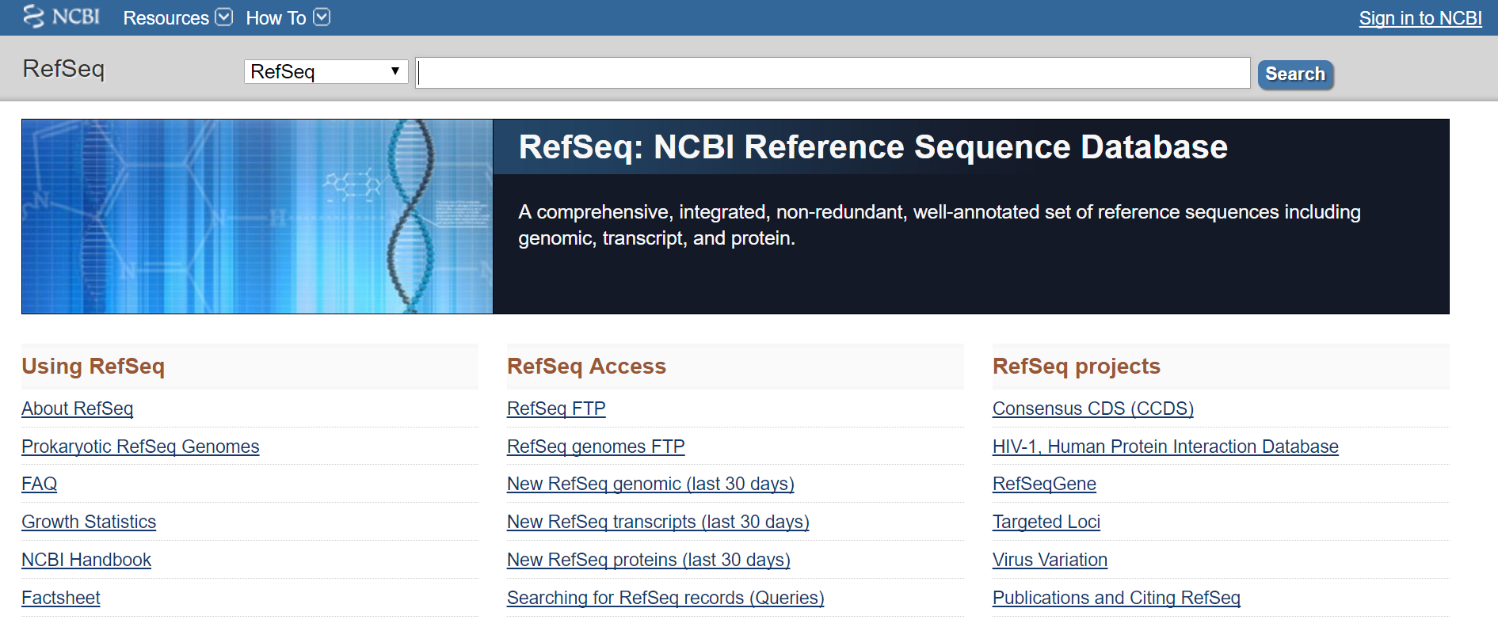
http://www.ncbi.nlm.nih.gov/refseq
NCBI curated sequence database
Non-redundant and versioned genomes, genes, proteins

Slide 40
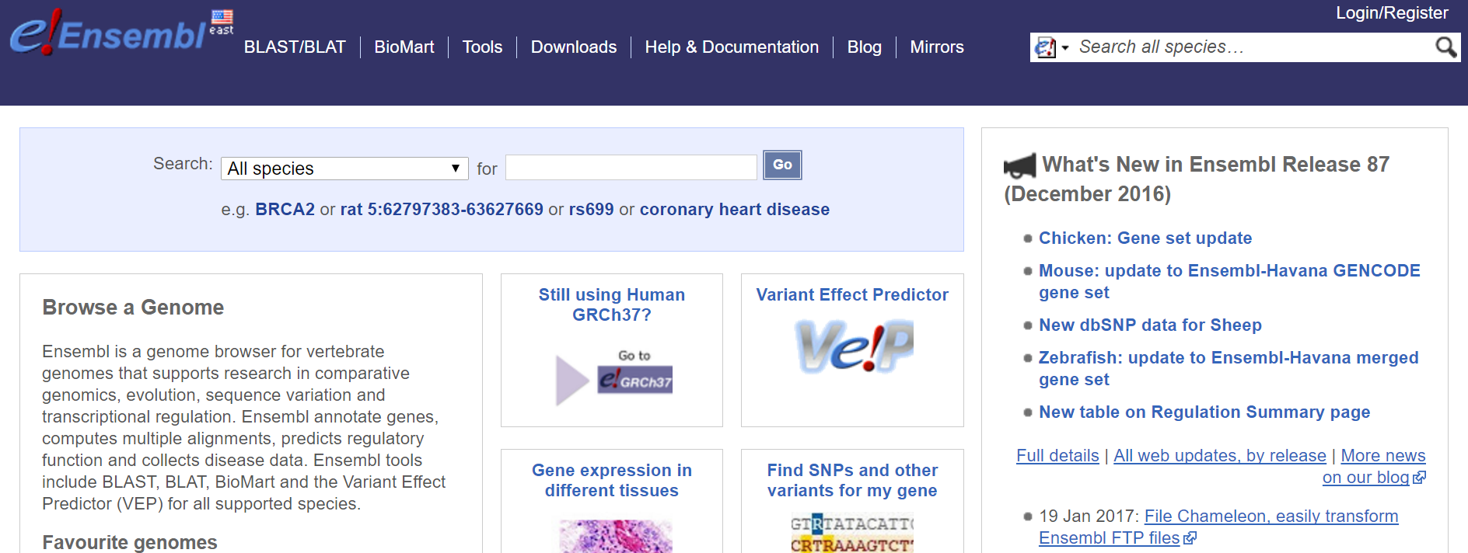
http://ensembl.org
EMBL-EBI sequence database and exploration site
BioMart provides a programmatic interface to ensembl

Slide 41
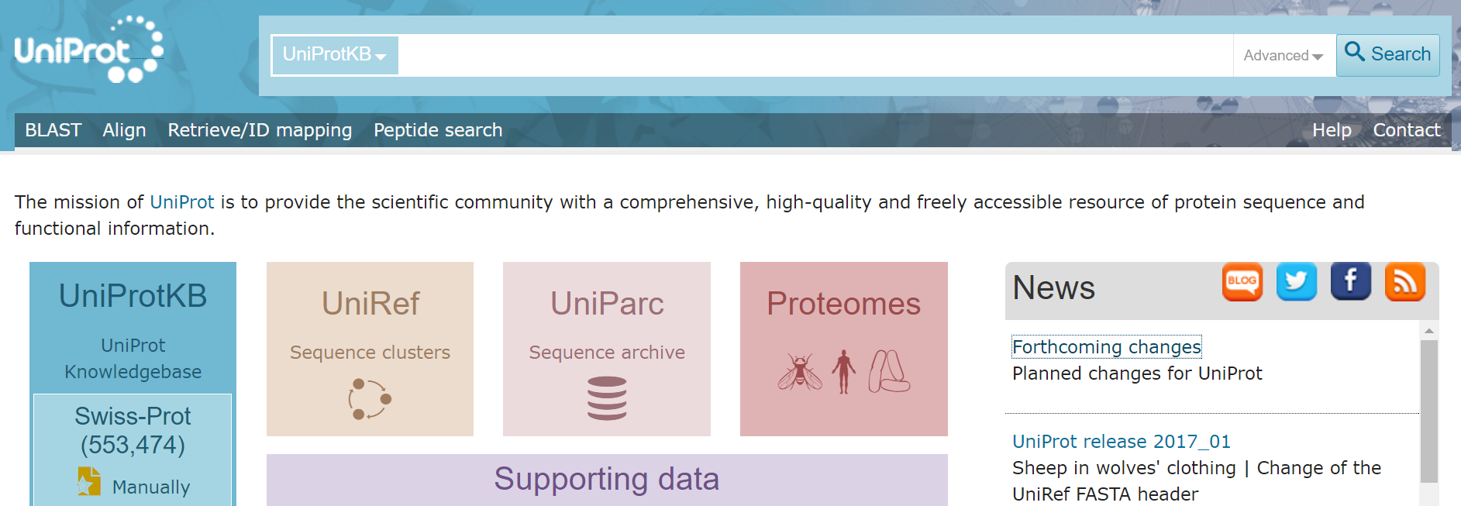
http://uniprot.org
EMBL-EBI protein sequence database
All known protein sequences, nicely organized and annotated

Slide 42
Summary
Biological sequences vs. sequence-based quantification
Biopolymers and the central dogma
Sequencing technologies
Sequence data formats
Sequence databases

Slide 43
Extra slides

Slide 44
High-throughput sequencing: 2011
Platform | Read length | Gnt / run | Time / run | Cost / run | Error rate
Sanger | 1000 | 0.0001 | 1 hour | $10k | 0.001%
454 | 300 | 45 | 10 hours |  | 1%
Illumina | 75-100 | 18-35 | 2 days |  | 0.1%
SOLiD | 50 | 30-50 | 5 days
Helicos | 30 | 37

Slide 45
High-throughput sequencing: 2013
Platform | Read length | Gnt / run | Time / run | Cost / run | Error rate
Sanger | 1000 | 0.0001 | 1 hour | $10k | 0.001%
454 | 700-1000 | 10 | 1 day | $5-10k | 1%
Illumina HiSeq | 100-200 | 500-750 | 1 week | $20-25k | 0.1%
SOLiD
Helicos
Illumina MiSeq | 150-250 | 1-2 | 1 day | $1k | 0.1%
Ion Torrent | 200-400 | 1 | 2 hours | $0.5-1k | 1%
Pac Bio | 500-1500 | 0.1-0.5 | 2 hours | $2k | 15%

Slide 46
High-throughput sequencing: 2017
Platform | Read length | Gnt / run | Time / run | Cost / run | Error rate
Sanger | 1000 | 0.0001 | 1 hour | $10k | 0.001%
454
Illumina HiSeq | 100-200 | 1500 | 1 week | $15k | 0.1%
SOLiD
Helicos
Illumina MiSeq | 150-300 | 15 | 1 day | $1k | 0.1%
Ion Torrent
Pac Bio | 10000-50000 | 1-5 | 0.5-1 day | $5k | 0.1-1%
Illumina Next | 100-150 | 120 | 1 day | $10k | 0.1%
Nanopore | 1000-10000 | 0.1 | 1-2 days | $0.5-1k | 1-10%

Slide 47
High-throughput sequencing: 2018
Platform | Read length | Gnt / run | Time / run | Cost / run | Error rate
Sanger | 1000 | 0.0001 | 1 hour | $10k | 0.001%
454
Illumina HiSeq | 100-200 | 1500 | 1 week | $10k | 0.1%
SOLiD
Helicos
Illumina MiSeq | 150-300 | 15 | 1 day | $1k | 0.1%
Ion Torrent
Pac Bio | 10000-50000 | 1-5 | 0.5-1 day | $5k | 0.1-1%
Illumina Next | 100-150 | 120 | 1 day | $5-10k | 0.1%
Nanopore | 1000-10000 | 0.1 | 1-2 days | $0.5-1k | 1-10%
Illumina Nova | 100-200 | 200-5000 | 1-2 days | $15k | 0.1%

Slide 48
FASTA file extensions
.fasta, .fas
Generic extensions
.fnt
Generic nucleotide sequence
.ffn
Protein-coding DNA sequence (e.g. ORFs)
.frn
RNA-coding sequences
.faa
Generic protein sequence
File extensions are a convenience for you, the user, and Operating Systems (OS).
They hint at the contents of a file, and may help the OS pick a program for opening it.
File extensions do not enforce the content of a file (I can name a FASTA file seq.mp3 and a music file song.fasta).

