Slide 1
Sequence alignment (and related topics)
Curtis Huttenhower (chuttenh@hsph.harvard.edu)
Eric Franzosa (franzosa@hsph.harvard.edu)
http://huttenhower.sph.harvard.edu/bst281

Slide 2
Announcements
Any questions about the announced changes to homeworks?
Class remains devoted to the theory and practice of genomic data analysis
No Python coding for assignments
We will still explore Python coding in activities / lab
Can take BST 273 (intro. to programming) in the Fall if you want more Python
Current homework due next Monday instead of this Friday
HW2+ will return to “Monday → Friday of the next week” schedule
Bring questions to office hours (Weds AM) and lab (Thurs PM)
No changes to midterm journal club or final projects

Slide 3
Summary
Why care about sequence comparison?
Finding optimal sequence alignments
Homology-based search with BLAST
Aligning short reads
Mapping sequences without alignment
Interpreting alignment data

Slide 4
Comparing biological sequences

Slide 5
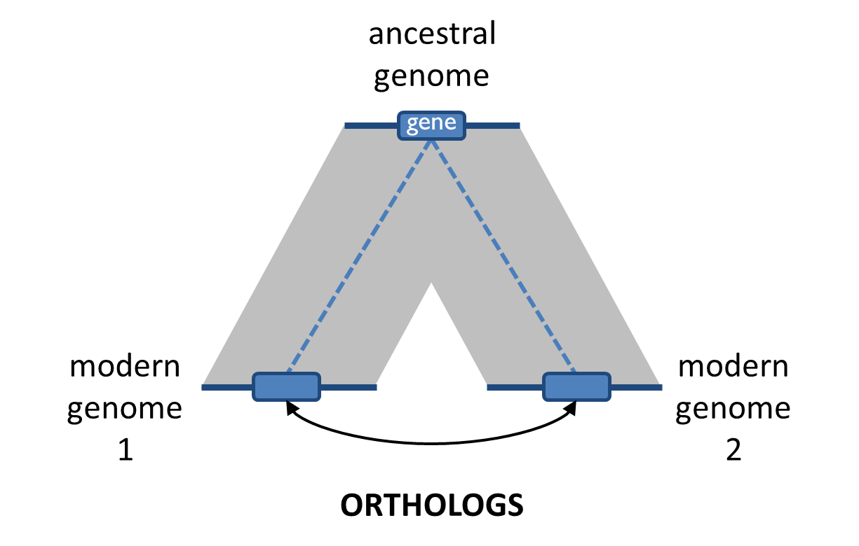
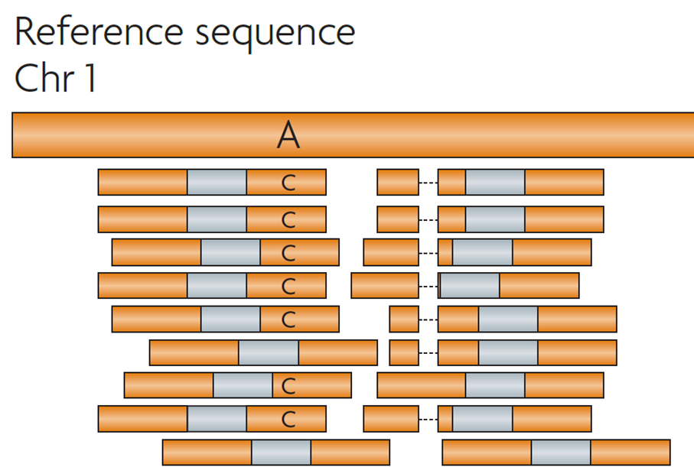
Comparing biological sequences
G |  | A |  | T |  | T |  | A |  | C |  | A
| |  | | |  |  |  | | |  | | |  |  |  | |
G |  | A |  | – |  | T |  | A |  | G |  | A
One of the most ubiquitous and important methods in biological data analysis
A sequence alignment is a mapping between two sequences’ homologous sites
Seq. similarity implies an evolutionary relationship (comparative genomics, phylogenetics)
Seq. similarity suggests functional similarity (function prediction, annotation transfer)
Seq. similarity suggests a point of origin (read mapping for quantification)

Slide 6
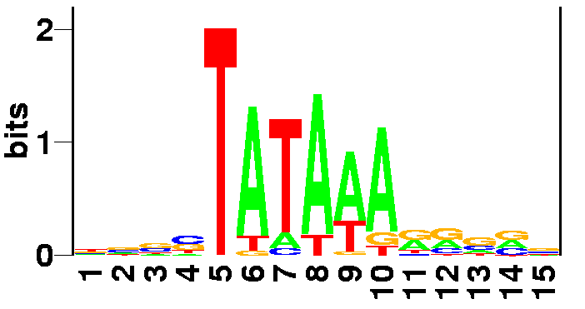
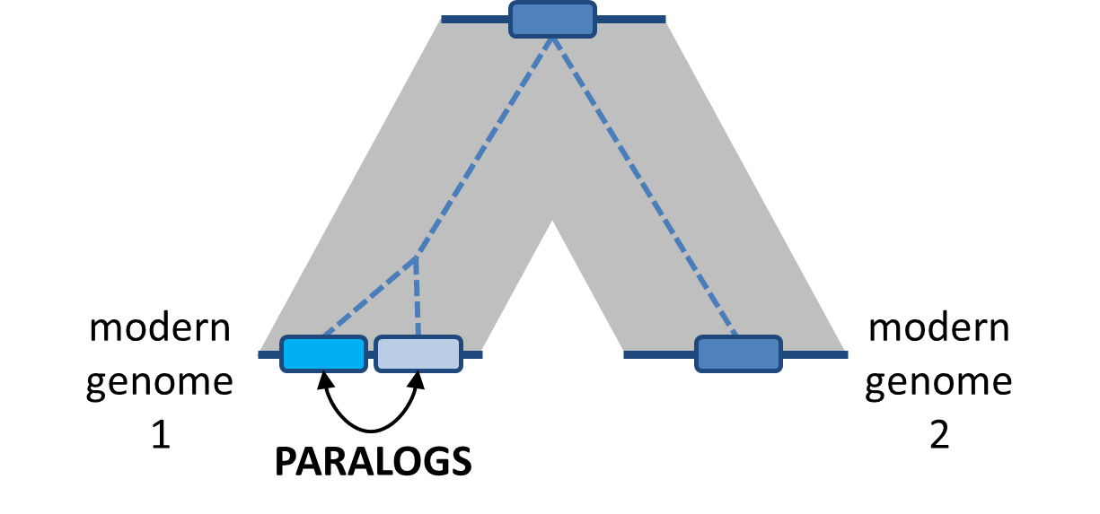
How does sequence similarity arise?
Convergent evolution / sequence “analogy”
Mostly applies to short sequences (motifs)
Divergent evolution / sequence homology
Most common cause of sequence similarity
gene
gene
gene
gene
gene

Slide 7
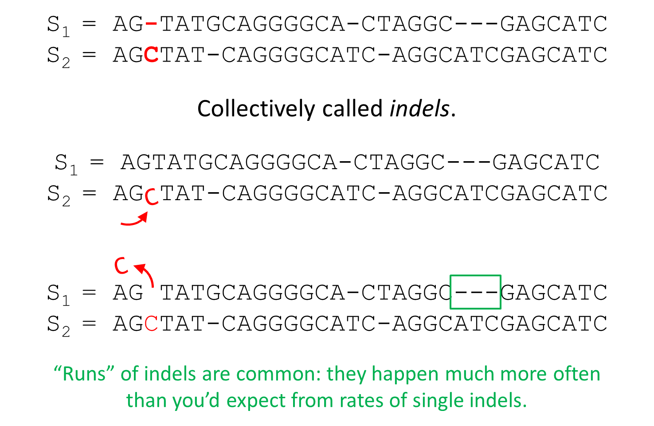
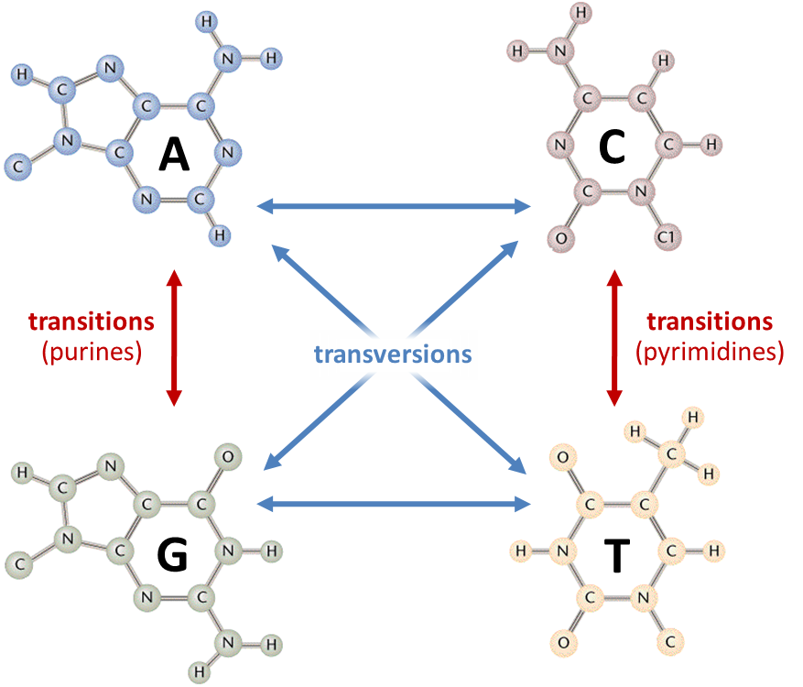
How sequence differences arise: DNA

Slide 8
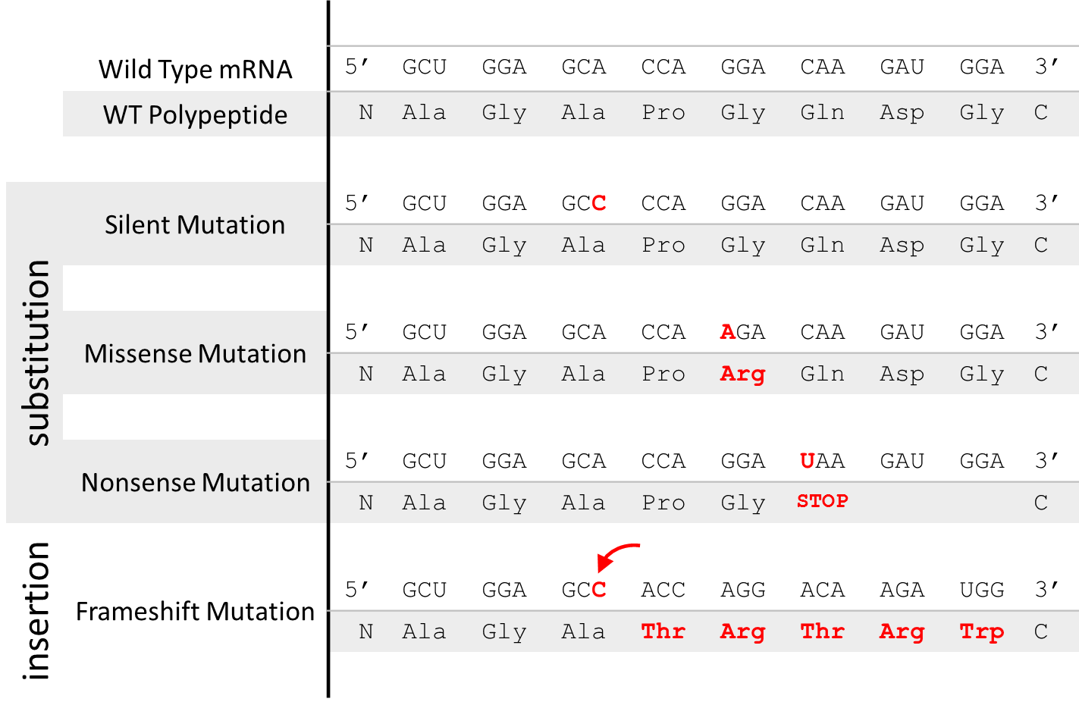
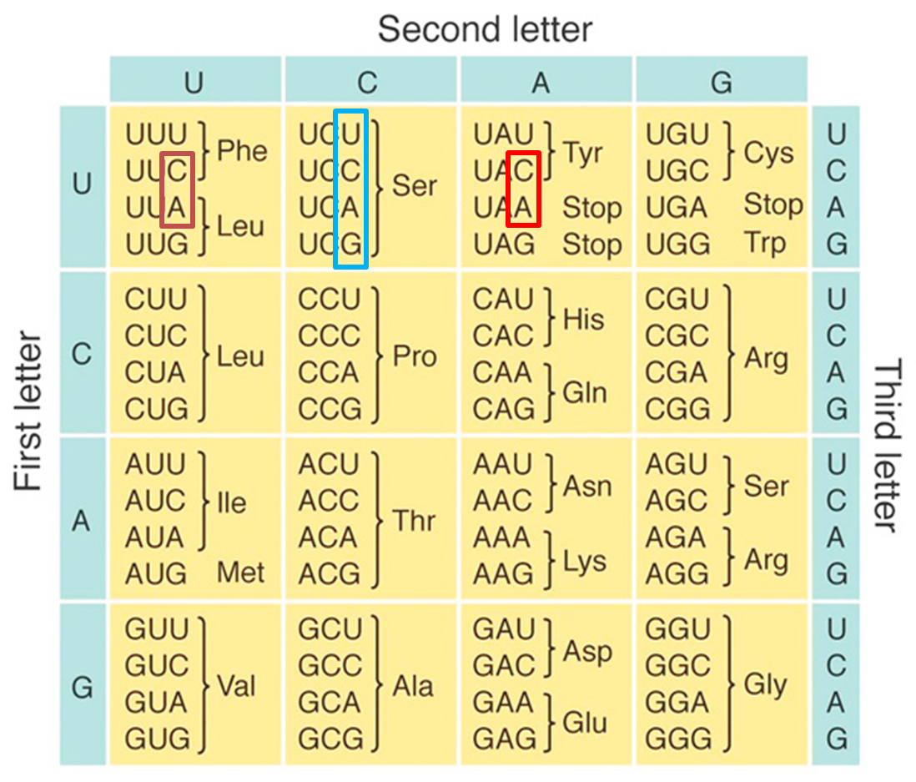
How sequence differences arise: Proteins
Degeneracy in the genetic code causes protein sequence similarity to “decay” more slowly than DNA sequence

Slide 9
Sequence alignment

Slide 10
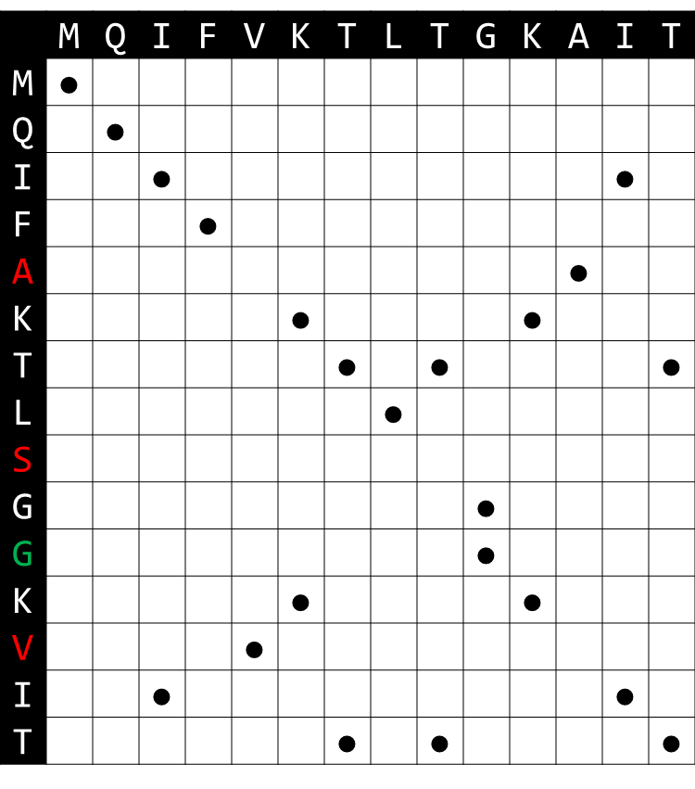
Quantifying sequence similarity by alignment
Dot plots compare a first sequence (cols) to a second sequence (rows)
A dot indicates an identical position
Diagonals indicate runs of identical positions (support for homology)
A “jump” indicates an insertion in one sequence OR deletion from the other

Slide 11
Quantifying sequence similarity by alignment
A sequence alignment is a mapping of positions in one sequence to another
Represented by a path in the dot plot matrix from bottom right to upper left
The best alignment/path balances:
Matches (good)
Unfavorable mismatches (bad)
Gaps (bad)
MQIFVKTLT-GKAIT
|||| ||| || ||
MQIFAKTLSGGKVIT

Slide 12
Quantifying sequence similarity by alignment
Consider an alternative path and the corresponding alignment:
New alignment is objectively worse:
Fewer matches (9 vs. 11)
More gaps (5 vs. 1)
MQIFVKTLTG---KAIT
|||| | | | ||
MQIFAK--TLSGGKVIT
MQIFVKTLT-GKAIT
|||| ||| || ||
MQIFAKTLSGGKVIT

Slide 13
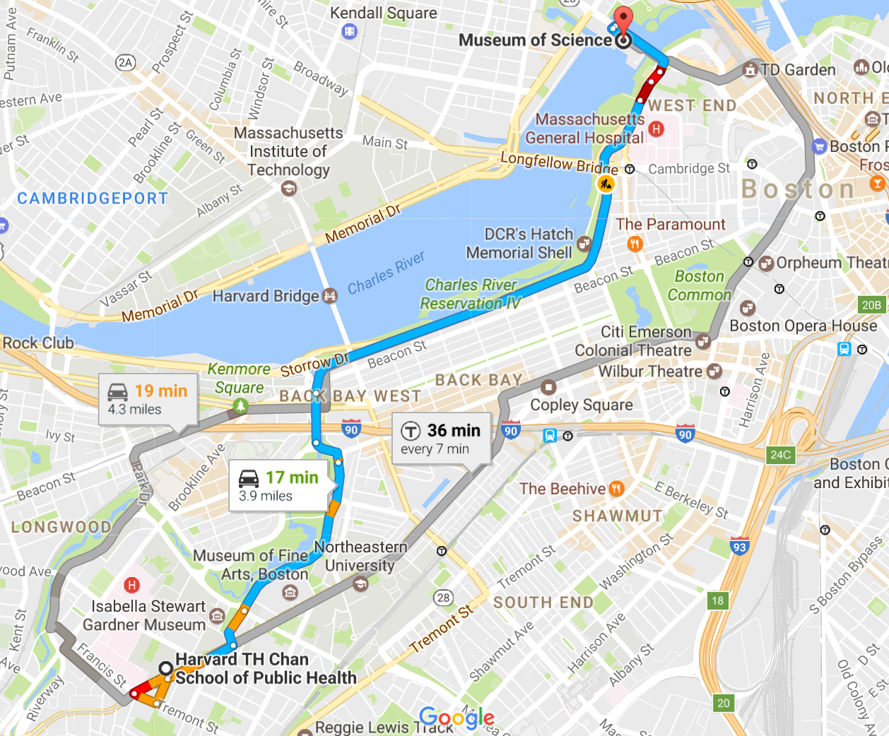
Quantifying sequence similarity by alignment
Finding the best alignment is equivalent to finding the best “path”
Possible using a family of algorithms called dynamic programming
Basic idea: build longer alignments/paths by extending shorter alignments/paths with locally optimal steps
Similar to Google Maps routing
(More details on this at the end of the slide deck, if interested)

Slide 14
Alignment strategies
Global alignment
Semi-global alignment
Local alignment
Must use all of both sequences
Punishes gain/loss of information at the ends of sequences
Can ignore the ends of one of the two sequences
Helpful when aligning very short sequences (e.g. reads) to long sequences (e.g. genomes)
Can ignore the ends of both sequences
Do sequences share a homologous region?
Most common strategy

Slide 15
Homology-based search with BLAST

Slide 16
But first, let’s do today’s Canvas poll
(ask me for the passphrase)

Slide 17
Alignment versus search
For two given sequences, pairwise alignment quantifies their similarity and provides an optimal alignment
A more common problem is, for a given sequence (query), can you find homologous sequences in a sequence database?
On which chromosome does my gene reside?
Which species have a copy of my gene?
Is a subsequence of my gene found in other genes?
Repeated, pairwise alignment is not an efficient solution here:
D₁
D₂
D₃
D₄
D₅
Query

Slide 18
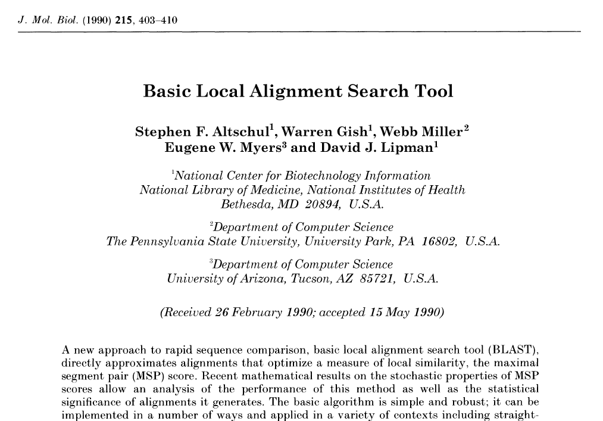
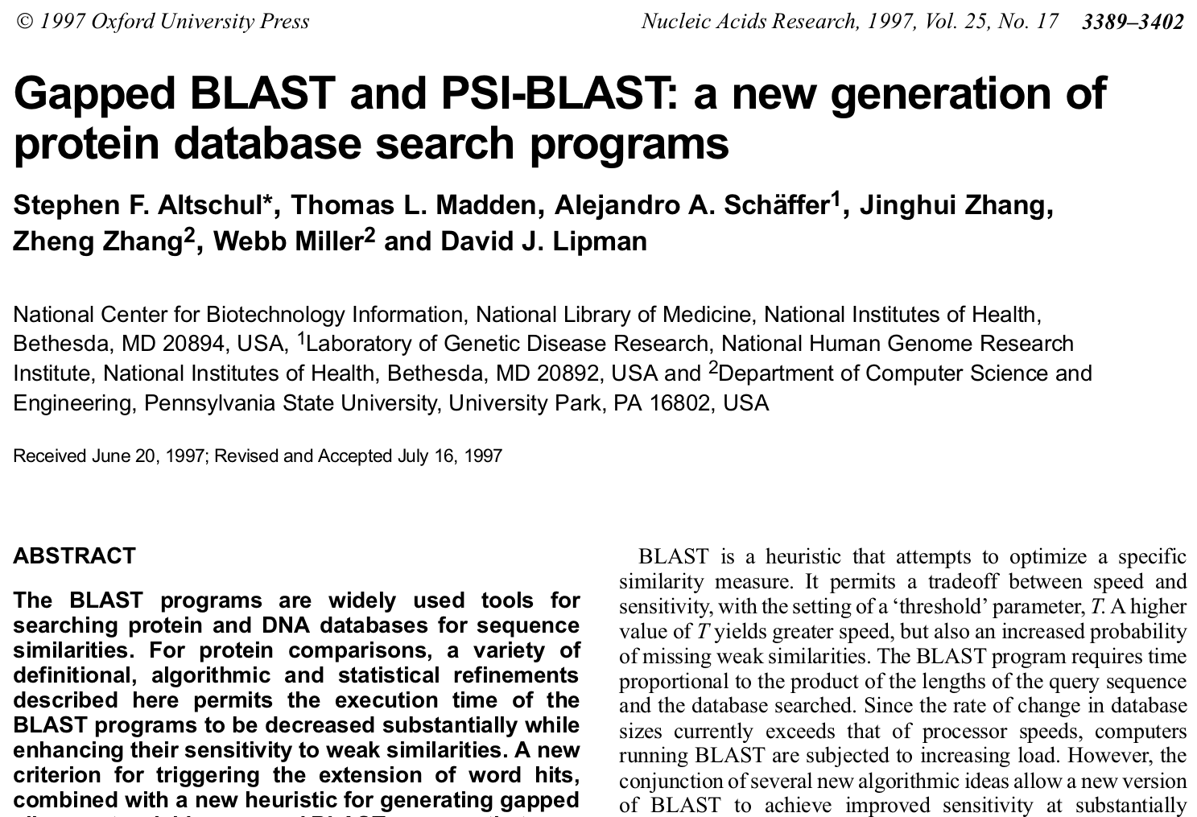
Enter BLAST: the Basic Local Alignment Search Tool
>60K Citations since 1990
>60K Citations since 1997

Slide 19
BLAST as a heuristic method
Dynamic programming (DP) is guaranteed to find the optimal alignment between two sequences
Repeated DP will find all optimal alignments between a query and a database (but this takes a very long time)
In contrast, BLAST is a heuristic algorithm
Heuristic algorithms use “common sense” ideas to find a good, but not necessarily optimal, solution to a problem, typically in less time than the optimal approach (and often in cases where the “optimal” approach is not feasible)
BLAST aims to find database sequences that are homologous to a query sequence, but isn’t guaranteed to find all such sequences, nor is it guaranteed to find the best (most similar) sequences
But in practice its answers are very good

Slide 20
BLAST as a heuristic method
The BLAST heuristic: a pair of sequences that are destined to align well tend to contain short, gap-free regions of high similarity
These regions are called alignment “seeds”
Conversely, most unrelated sequences will lack alignment seeds
MQIFVKTLT-GKAIT
|||| ||| || ||
MQIFAKTLSGGKVIT

Slide 21
The BLAST algorithm: seed and extend
MGALEDVAL
Query sequence
MGA
GAL
ALE
LED
EDV
DVA
VAL
Divided into k=3 words
Database sequence 1
Database sequence 2
Database sequence 3
XXXXXXXXXXXXX
XXXXXLEDXXXXX
XXMGALEDVVLXX
---+++---
+++++++-+
don’t consider aligning to a database seq. w/o a seed match
MGALEDVAL
MGALEDVAL
Extending this seed suggests that a strong alignment is not likely
Extending this seed identifies a good alignment
Break query into “words” (substrings of length k, also called k-mers)
Find database sequences with a matching word (seed match)
Extend from the seed match to check for good alignment

Slide 22
Why BLAST is fast (1): indexing
We can pre-process the database (once!) to locate and store the positions of all possible words
“Dictionary lookup” (hashing) of words from our query is very fast
Cataloging/organizing a database for later search is called “indexing”
Indexing saves time on all subsequent searches: worth the effort!
A common step of most mapping programs
DICTIONARY
Key | Value (List of Positions)
‘AAA’ | [12, 37, 151, 1608]
‘AAC’ | [77, 103, 909, 454, 1020, 667]
‘AAD’ | [ ]
…
‘LED’ | [1024, 2657]
…
d₁
d₂
d₃
d₄
d₅

Slide 23
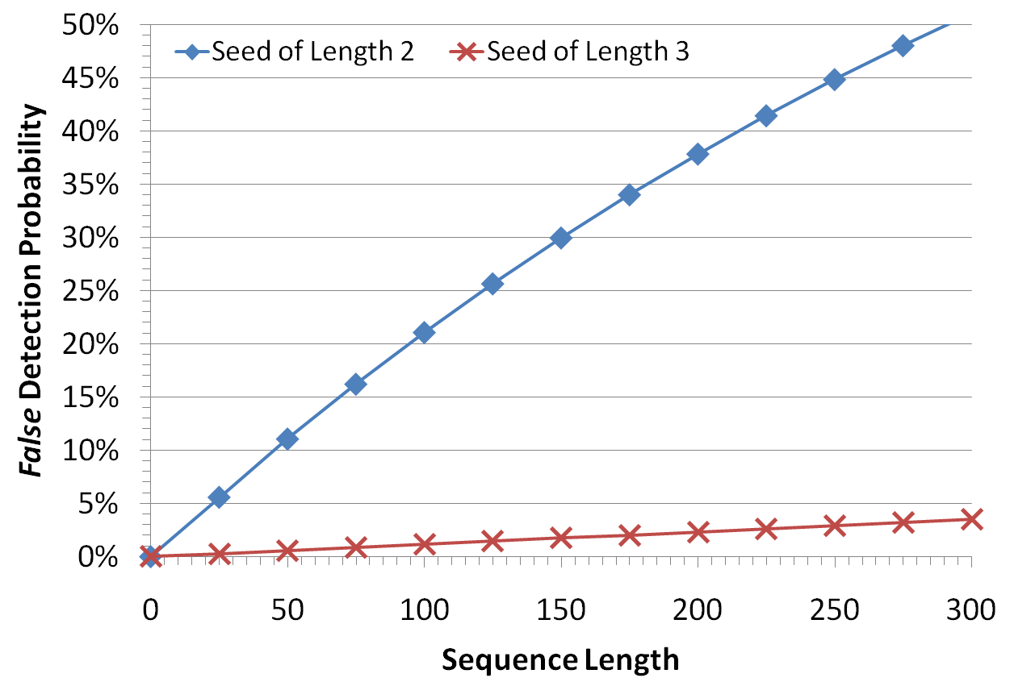
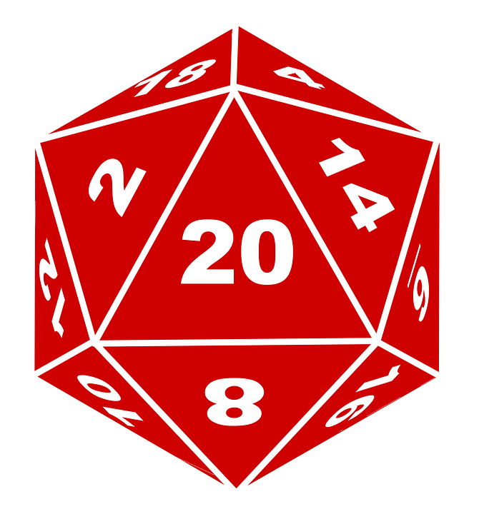
Why BLAST is fast (2): random seeds are rare
Most sequences that are unrelated to our query will NOT contain a seed match
As word size grows, the chance of a random match shrinks
Database sequences without a matching word are ignored
~1% chance that a 100-residue protein contains a k=3 seed match at random
*Random protein alignment modeled as having 5% identity (1 in 20 matches)

Slide 24
Why BLAST is heuristic
Sequences related to our query are not guaranteed to contain a seed match, which will result in false negatives:
These two sequences have 50% identity and several k=3 seeds:
GLSLLYQNSLDLLDLVQTGPERGQIFRETDIKIVKRQPHR
| | | || | | ||| | | ||||| |||
GXSXXYXNSXDXLXLVQXXXEXGXXXXETDIKXXKRQXXX
These two sequences also have 50% identity but no k=3 seeds:
IPPDQQRLIFVGKQLEDGRTLSDYNIQKESTLHLVLRLRG
| | | | | | | | | | | | | | | | | | | |
IXPXQXRXIXVXKXLXDXRXLXDXNXQXEXTXHXVXRXRX

Slide 25
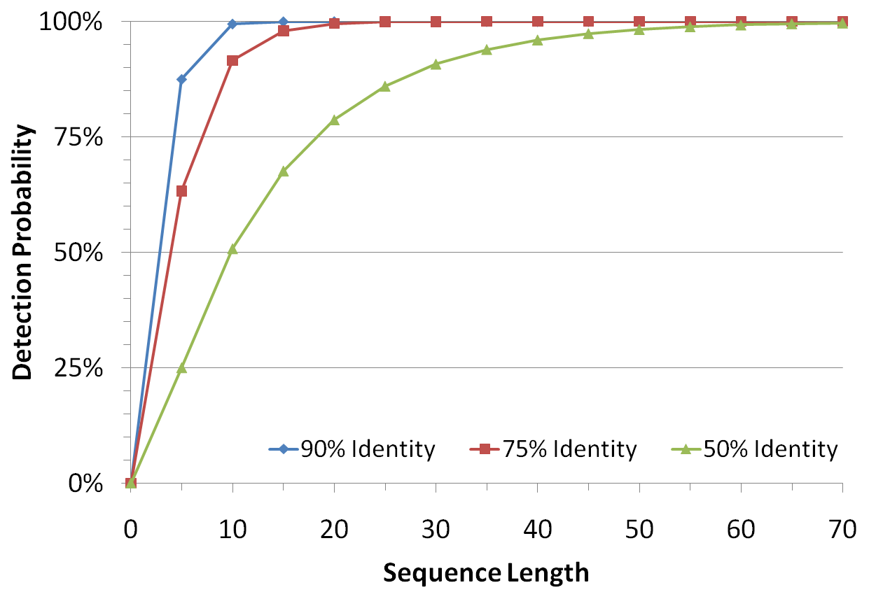
Why BLAST is heuristic
*For seeds of length k=3
Seed hit probability varies…
directly with alignment length
inversely with seed length
inversely with alignment identity
Seed length can be tuned when running BLAST (uncommon)
Defaults balance speed with detection probability
In practice, results are very good, despite no guarantee of optimality
Looking for seeds in 50% identical sequences is like looking for runs of heads in a sequence of coin tosses. What’s the chance of seeing “HHH” in 10 flips?

Slide 26
BLAST flavors
BLAST is available online at https://blast.ncbi.nlm.nih.gov/Blast.cgi
Can also download and run locally
A variety of different online/offline programs exist:
Program | Query type / preprocessing | Database type / preprocessing | When to use it (examples)
blastp | protein | protein | find homologous proteins
blastn | nucleotide | nucleotide | non-coding DNA search, large-scale (e.g. contig vs. genome) search
blastx | nucleotide (translated in 6 reading frames) | protein | establish coding potential/protein products of novel DNA/RNA
tblastn | protein | nucleotide (translated in 6 reading frames) | identify a protein of interest in a novel genome; uncommon
tblastx | nucleotide (translated in 6 reading frames) | nucleotide (translated in 6 reading frames) | identify remote homology in highly diverged coding sequence; uncommon

Slide 27
BLAST descendants
Lots of them!
Offer trade-offs in speed, memory use, sensitivity, specificity
People still use “regular old BLAST” a lot
BLAT
Faster alignment at high identity
DIAMOND/MMSeqs2
Faster alignment for DNA vs. protein (translated search)
USEARCH
Fairly general BLAST replacement; commercial software
VSEARCH
Free implementation of the above, but no protein support

Slide 28
Interpreting
BLAST output

Slide 29
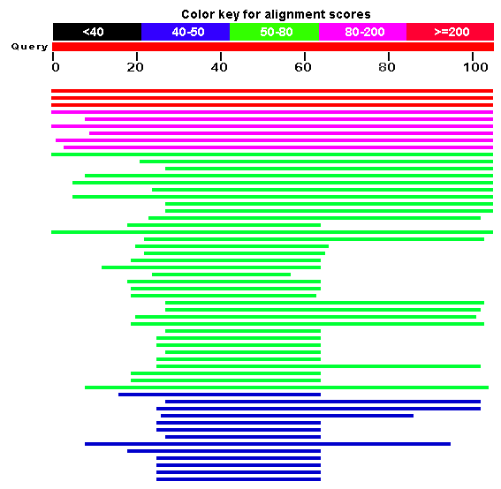
Interpreting BLAST output
Online BLAST produces some nice graphical output, but more often we’re interested in machine-readable (tabular) text
We’ll examine some of these fields/statistics in the context of a hybrid BLAST output (human-readable text)

Slide 30
Interpreting BLAST output: % identity
# and % of “identities” (positions that are the same between query and database); a measure of evolutionary divergence
# and % of “similarities” (different but “similar” amino acids); only applies to protein-level alignments

Slide 31
Interpreting BLAST output: coverage
Alignment of the query sequence to the “subject” (database) sequence; generally excluded from tabular output
Start and end coordinates of the alignment within the query and subject sequences; these define “coverage”: i.e. how local vs. global the alignment is

Slide 32
Interpreting BLAST output: coverage
$$Coverage= \frac{Stop −Start+1}{Length}$$
Start=1
Stop=400
subject (database) sequence
Len=400
Good query coverage, good subject coverage
(Ex. Close homolog in database, or query itself)
locally aligned region
query sequence
Len=400
Start=1
Stop=400
Start=100
Stop=300
subject (database) sequence
Len=400
Fair query coverage, fair subject coverage
(Ex. a shared domain)
locally aligned region
query sequence
Len=400
Start=50
Stop=250
Start=5
Stop=205
subject (database) sequence
Len=400
Good query coverage, fair subject coverage
(Ex. query is a fragment of database sequence)
locally aligned region
query sequence
Len=200
Start=1
Stop=200
Start=1
Stop=200
subject sequence
Len=200
Fair query coverage, good subject coverage
(Ex. query is a fusion of two database sequences)
locally aligned region
query sequence
Len=400
Start=200
Stop=395

Slide 33
Interpreting BLAST output: E-value
Expectation- or E-value: the # of alignments at least this strong expected by chance (given score & database size)
A measure of the statistical significance of an alignment
Small E-values can be interpreted similarly to P-values

Slide 34
Tabular BLAST output
Tabular BLAST output (one row per alignment) is easier to parse
Note, potentially >1 alignment (row) per query!
From the command line, "-outfmt 6" generates tabular data
Default fields (columns) listed below, but can be customized
1. | qseqid | query (e.g., gene) sequence id
2. | sseqid | subject (e.g., reference genome) sequence id
3. | pident | percentage of identical matches
4. | length | alignment length
5. | mismatch | number of mismatches
6. | gapopen | number of gap openings
7. | qstart | start of alignment in query
8. | qend | end of alignment in query
9. | sstart | start of alignment in subject
10. | send | end of alignment in subject
11. | evalue | expect value
12. | bitscore | bit score

Slide 35
Aligning short reads

Slide 36
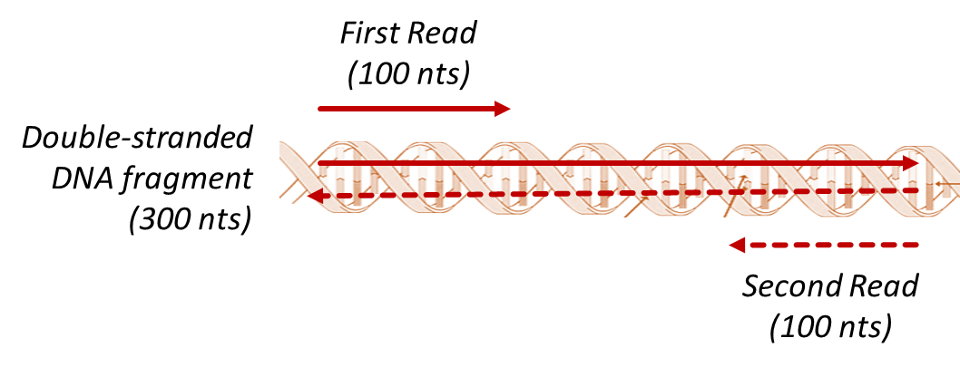
Special considerations for short-read alignment
Usually aligning to a known reference (e.g. human genome) for quantification purposes
Expect entire read to align with few point differences (SNVs?)
Paired reads should align very close to one another
Have to be SUPER efficient: millions of reads (queries) per sample!

Slide 37
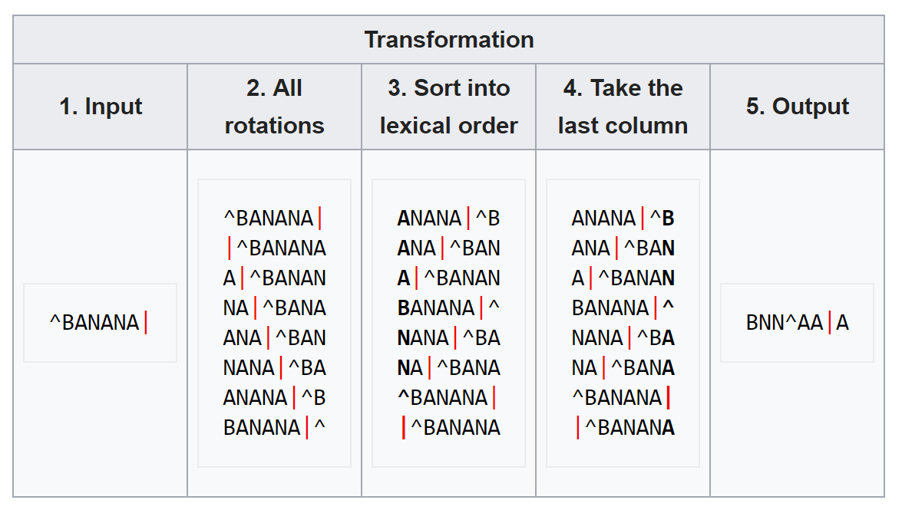
Burrows–Wheeler Transform (BWT)
One way to speed up alignment is to hold the entire database in computer memory (RAM)
BWT facilitates database compression (uses less RAM) while preserving sequence
This is another aspect of doing upstream work on a database (indexing) to make search faster
The Burrows-Wheeler Transform finds all rotations of a sequence (e.g. ABC → BCA and CAB), sorts them, and stores the last column of the rotations as a new sequence.
Here, ^ and | mark the start and end of the original sequence.

Slide 38
Burrows–Wheeler Transform (BWT)
Sorted sequence rotations help us find alignment seeds
Suffix-based search
Is “NAN” in the sequence?
Yes, right here!
Is “FAN” in the sequence?
No, we’d see it here
BWT is a basis for many powerful short-read aligners
bowtie (now bowtie2)
bwa (now bwa-mem)
The Burrows-Wheeler Transform finds all rotations of a sequence (e.g. ABC → BCA and CAB), sorts them, and stores the last column of the rotations as a new sequence.
Here, ^ and | mark the start and end of the original sequence.

Slide 39
Sequence Alignment Map (SAM) format
Standard results format for alignments of short reads
Starts with set of headers for the database sequences (e.g. chromosomes)
@SQ Chromosome1 LN:74656
@SQ Chromosome2 LN:74205
Followed by alignments of individual reads
Tabbed rows, similar to BLAST with "-outfmt 6“
Usually 0 or 1 alignments per read
Read pairs (if input) occur consecutively in raw SAM output
Query Name | Bit Flag | Subject Name | Subject Start | MAPQ | CIGAR | RNEXT | PNEXT | TLEN | Sequence | Quality Scores

Slide 40
Sequence Alignment Map (SAM) format
“Code” to describe things that went right/wrong, e.g. did paired read align to same database sequence?
Shorthand description of alignment (tracks matches, insertions, deletions);
e.g. 50M1D50M
Key pieces of info (like BLAST): who are you, what did you hit, and where
Sequence and quality strings from FASTQ repeated here
Likelihood that read is in the right place
(different from E-value)
Query Name | Bit Flag | Subject Name | Subject Start | MAPQ | CIGAR | RNEXT | PNEXT | TLEN | Sequence | Quality Scores
 |  | * | * | * | * | ← These fields are * if read unaligned

Slide 41
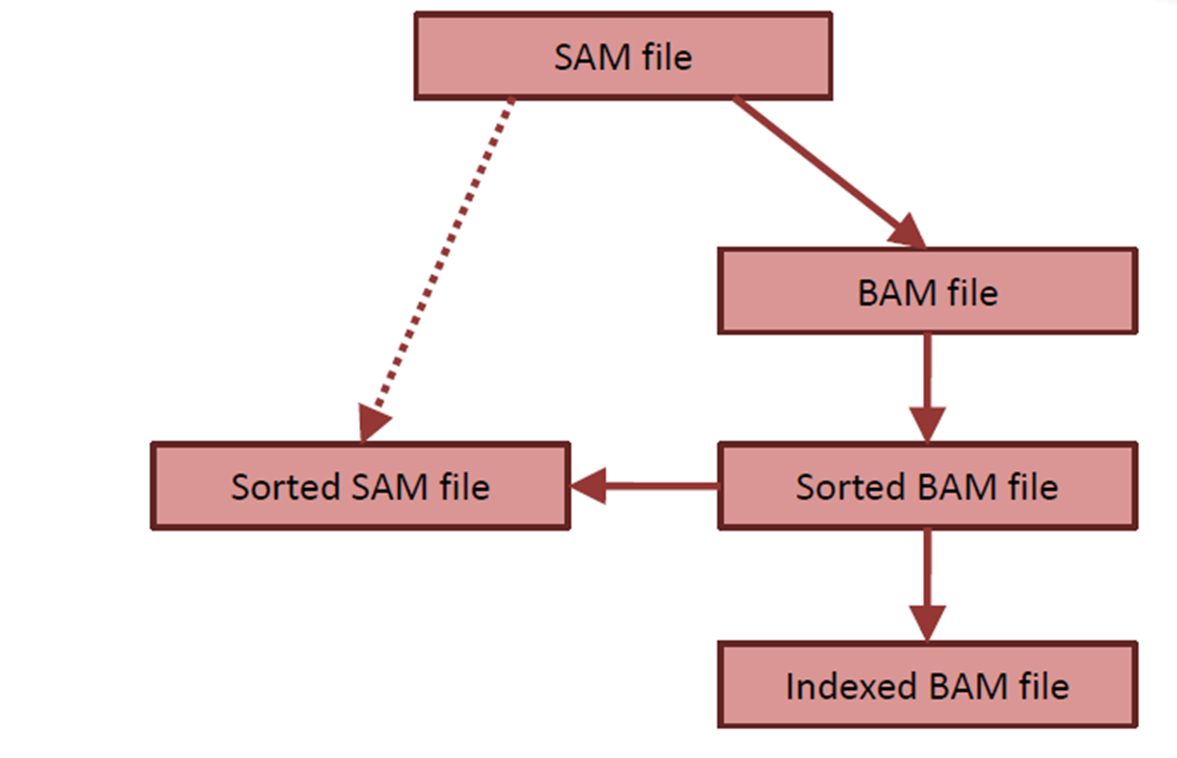
Sequence Alignment Map (SAM) format
BAM (binary SAM) is a compressed version of a SAM file
Takes up much less space, but otherwise equivalent (use it for big projects!)
samtools is a suite of programs for working with SAM/BAM files
E.g. performs SAM ←→ BAM conversion
Sorted SAM/BAM file puts alignments in order
Original order is read order, which is random
Indexed BAM file enables targeted lookup
Like a table of contents
Involves separate BAI index file

Slide 42
Alignment vs. Mapping

Slide 43
Sequence alignment vs. mapping
G |  | A |  | T |  | T |  | A |  | C |  | A
▼ |  | ▼ |  |  |  | ▼ |  | ▼ |  | ▼ |  | ▼
G |  | A |  | – |  | T |  | A |  | G |  | A
Sequence alignment is a residue-level mapping (Identifies homologous sites)
Alignment is also a sequence-level mapping (Identifies homologous sequences)
There are other ways to perform sequence-level mapping that do not require alignment
These mapping methods are sometimes referred to as pseudoalignment, and often involve looking for shared words (k-mers)
Recall from our BLAST discussion that we can find shared words very quickly through dictionary lookup (hashing)
G |  | A |  | T |  | T |  | A |  | C |  | A
| |  | | |  |  |  | | |  | | |  |  |  | |
G |  | A |  | – |  | T |  | A |  | G |  | A
G |  | A |  | T |  | T |  | A |  | C |  | A
G |  | A |  | T |  | A |  | G |  | A
These two sequences have three 2-mers in common

Slide 44
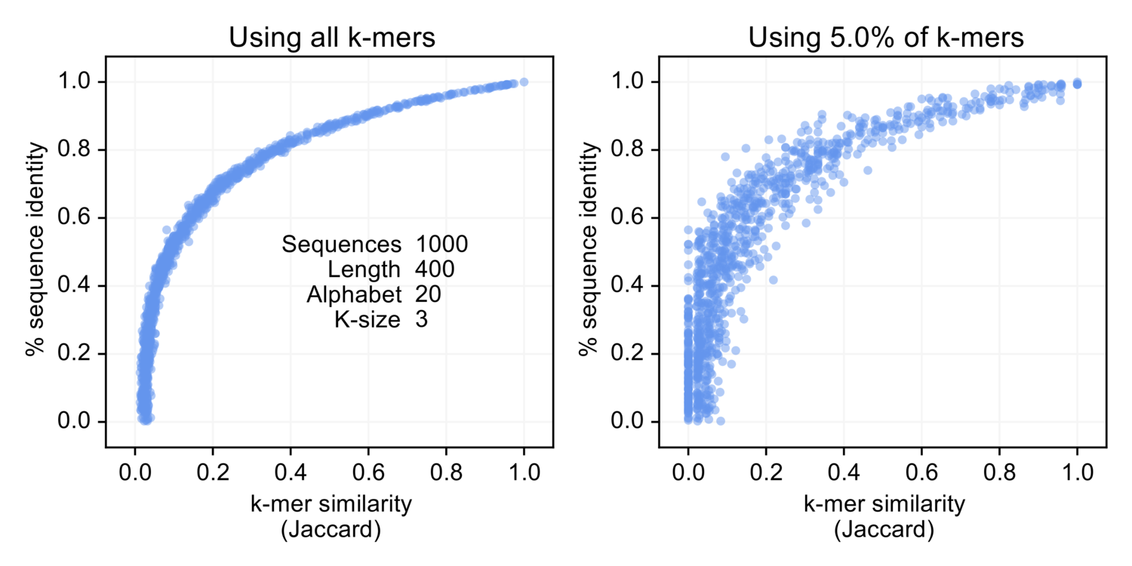
k-mer overlap is predictive for sequence identity
Texts with lots of words in common tend to be globally similar
Useful tool for detecting plagiarism even with sentence/paragraph reordering
Same principle holds for biological sequences (with k-mers replacing words)
Greater overlap in k-mers tends to predict higher alignment % identity
Works with a subset of k-mers!
Faster but approximate

Slide 45
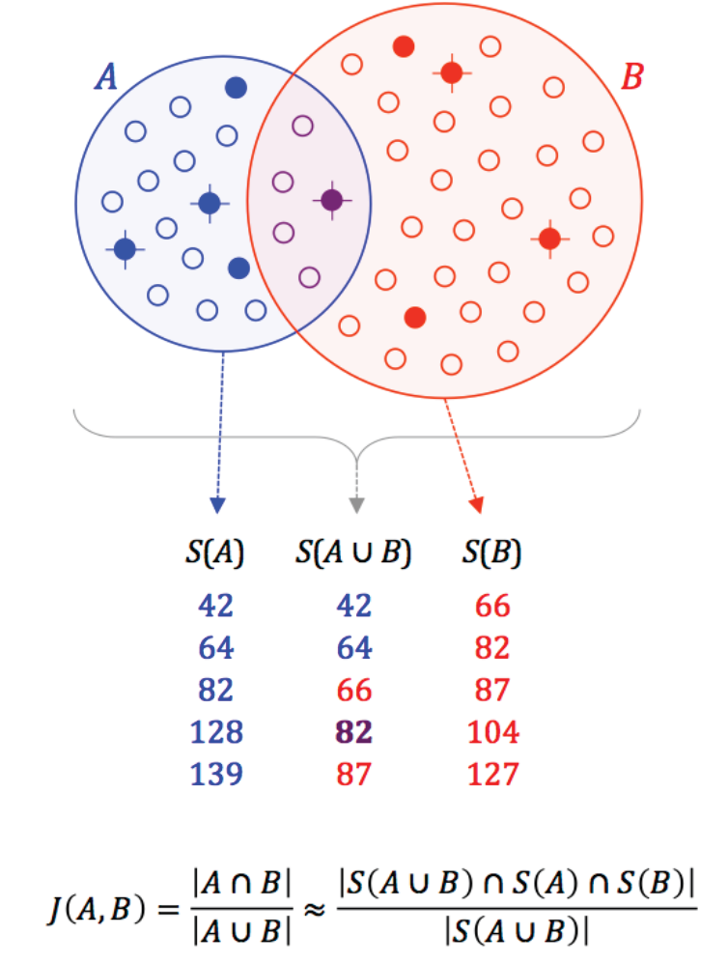
Mash/MinHash for whole-genome pseudoalignment
Mash/MinHash use this idea to compare large sequences much faster than BLAST/alignment
Works with long reads, contigs, genomes
The reduced k-mer profile of a sequence, called a sketch, can be saved for future comparisons
Another form of indexing!
Accuracy of Mash vs. alignment-based average nucleotide identity (ANI) for E. coli genomes

Slide 46
Kallisto for pseudoalignment of short reads
kallisto constructs an assembly graph for a set of input sequences (e.g. transcripts)
Another example of database indexing!
Nodes in this graph are k-mers from the original transcripts
k-mers from a sequencing read follow a path in this graph
Quick lookup through hashing
Can skip over a lot of uninformative k-mers
Need about two per read
Final output = set of transcripts that query read could have come from

Slide 47
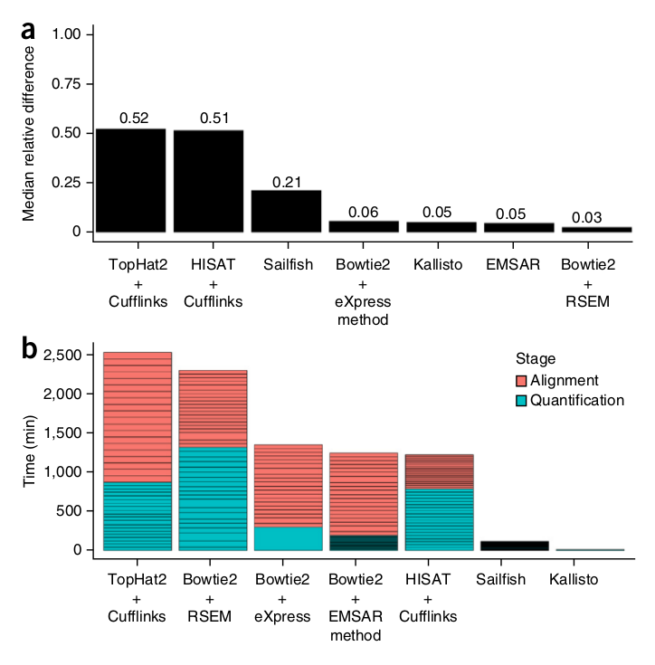
Kallisto for pseudoalignment of short reads
Mapping with Kallisto is almost as accurate as Bowtie2 and considerably faster
Accuracy here incorporates extra considerations for when a read is compatible with >1 transcript; we’ll discuss this more when we cover RNA-Seq

Slide 48
Summary
Why care about sequence comparison?
Finding optimal sequence alignments
Homology-based search with BLAST
Aligning short reads
Mapping sequences without alignment
Interpreting alignment data

Slide 49
Extra slides

Slide 50
Quantifying sequence similarity by alignment
Dot plots are a good tool for visualizing sequence homology, but they are impractical for actually building alignments
The number of possible alignments for two sequences grows very rapidly (250M options for two sequences of length 12):
mathmaticks
++++ +
mathematics
math-maticks
++++ +++++
mathematics
math-maticks
++++ +++++ +
mathematic-s

Slide 51
Optimal global alignment
 | X_{i} | → | 0 |  | 1 |  | 2 |  | 3 |  | 4 |  | 5 |  | 6 |  | 7
Y_{j} |  |  | – |  | G |  | A |  | T |  | T |  | A |  | C |  | A
↓
0 | –
 |  |  |  | ↖
1 | G
 |  |  |  |  |  | ↖
2 | A |  |  |  |  |  |  | ←
 |  |  |  |  |  |  |  |  |  | ↖
3 | T
 |  |  |  |  |  |  |  |  |  |  |  | ↖
4 | A
 |  |  |  |  |  |  |  |  |  |  |  |  |  | ↖
5 | G
 |  |  |  |  |  |  |  |  |  |  |  |  |  |  |  | ↖
6 | A
Consider two DNA sequences:
GATTACA GATAGA
An alignment is a path in this grid
 |  |  |  |  | G |  | A |  | T |  | T |  | A |  | C |  | A
 |  |  |  |  | | |  | | |  |  |  | | |  | | |  |  |  | |
 |  |  |  |  | G |  | A |  | – |  | T |  | A |  | G |  | A

Slide 52
Optimal global alignment
 | X_{i} | → | 0 |  | 1 |  | 2 |  | 3 |  | 4 |  | 5 |  | 6 |  | 7
Y_{j} |  |  | – |  | G |  | A |  | T |  | T |  | A |  | C |  | A
↓
0 | – |  | 0
 |  |  |  | ↖
1 | G |  |  |  | 1
 |  |  |  |  |  | ↖
2 | A |  |  |  |  |  | 2 | ← | 1
 |  |  |  |  |  |  |  |  |  | ↖
3 | T |  |  |  |  |  |  |  |  |  | 2
 |  |  |  |  |  |  |  |  |  |  |  | ↖
4 | A |  |  |  |  |  |  |  |  |  |  |  | 3
 |  |  |  |  |  |  |  |  |  |  |  |  |  | ↖
5 | G |  |  |  |  |  |  |  |  |  |  |  |  |  | 3
 |  |  |  |  |  |  |  |  |  |  |  |  |  |  |  | ↖
6 | A |  |  |  |  |  |  |  |  |  |  |  |  |  |  |  | 4
Let a “match” add 1 to the score…
Let a “mismatch” add 0 to the score…
Let an indel/gap subtract 1 from the score (reflects indels being less common than substitutions)
Our original alignment has a score of four
 |  |  |  |  | G |  | A |  | T |  | T |  | A |  | C |  | A
 |  |  |  |  | +1 |  | +1 |  | -1 |  | +1 |  | +1 |  | +0 |  | +1
 |  |  |  |  | G |  | A |  | – |  | T |  | A |  | G |  | A
Total = 4

Slide 53
Optimal global alignment
 | X_{i} | → | 0 |  | 1 |  | 2 |  | 3 |  | 4 |  | 5 |  | 6 |  | 7
Y_{j} |  |  | – |  | G |  | A |  | T |  | T |  | A |  | C |  | A
↓
0 | – |  | 0
 |  |  |  | ↖
1 | G |  |  |  | 1 | ← | 0 | ← | -1
 |  |  |  |  |  |  |  |  |  | ↖
2 | A |  |  |  |  |  |  |  |  |  | -1
 |  |  |  |  |  |  |  |  |  |  |  | ↖
3 | T |  |  |  |  |  |  |  |  |  |  |  | -1
 |  |  |  |  |  |  |  |  |  |  |  |  |  | ↖
4 | A |  |  |  |  |  |  |  |  |  |  |  |  |  | -1
 |  |  |  |  |  |  |  |  |  |  |  |  |  |  | ↑
5 | G |  |  |  |  |  |  |  |  |  |  |  |  |  | -2
 |  |  |  |  |  |  |  |  |  |  |  |  |  |  |  | ↖
6 | A |  |  |  |  |  |  |  |  |  |  |  |  |  |  |  | -1
Let a “match” add 1 to the score…
Let a “mismatch” add 0 to the score…
Let an indel/gap subtract 1 from the score (reflects indels being less common than substitutions)
The alternate alignment is quantitatively worse
 |  |  | G |  | A |  | T |  | T |  | A |  | C |  | - |  | A
 |  |  | +1 |  | -1 |  | -1 |  | +0 |  | +0 |  | +0 |  | -1 |  | +1
 |  |  | G |  | – |  | – |  | A |  | T |  | A |  | G |  | A
Total = -1

Slide 54
Optimal global alignment
 | X_{i} | → | 0 |  | 1 |  | 2 |  | 3 |  | 4 |  | 5 |  | 6 |  | 7
Y_{j} |  |  | – |  | G |  | A |  | T |  | T |  | A |  | C |  | A
↓
0 | – |  | 0 | → | -1 | → | -2 | → | -3 | → | -4 | → | -5 | → | -6 | → | -7
 |  |  | ↓
1 | G |  | -1
 |  |  | ↓
2 | A |  | -2
 |  |  | ↓
3 | T |  | -3
 |  |  | ↓
4 | A |  | -4
 |  |  | ↓
5 | G |  | -5
 |  |  | ↓
6 | A |  | -6
Needleman-Wunsch
global alignment algorithm
Column i, row j cell scores the alignment of the i- and j- prefixes of the two sequences
Start by considering only gaps (ridiculous alignments)

Slide 55
Optimal global alignment
 | X_{i} | → | 0 |  | 1 |  | 2 |  | 3 |  | 4 |  | 5 |  | 6 |  | 7
Y_{j} |  |  | – |  | G |  | A |  | T |  | T |  | A |  | C |  | A
↓
0 | – |  | 0 | → | -1 | → | -2 | → | -3 | → | -4 | → | -5 | → | -6 | → | -7
 |  |  | ↓ | ↘ | ↓
1 | G |  | -1 | → | 1
 |  |  | ↓
2 | A |  | -2
 |  |  | ↓
3 | T |  | -3
 |  |  | ↓
4 | A |  | -4
 |  |  | ↓
5 | G |  | -5
 |  |  | ↓
6 | A |  | -6
Each cell is filled with the best of three options, each representing an extension of a shorter alignment
Option 1 (↘)
Option 3 (↓)
G
G
G-
-G
0 + 1 = 1
-1 + -1 = -2
Option 2 (→)
-G
G-
-1 + -1 = -2

Slide 56
Optimal global alignment
 | X_{i} | → | 0 |  | 1 |  | 2 |  | 3 |  | 4 |  | 5 |  | 6 |  | 7
Y_{j} |  |  | – |  | G |  | A |  | T |  | T |  | A |  | C |  | A
↓
0 | – |  | 0 | → | -1 | → | -2 | → | -3 | → | -4 | → | -5 | → | -6 | → | -7
 |  |  | ↓ | ↘ |  | ↘ | ↓
1 | G |  | -1 |  | 1 | → | 0
 |  |  | ↓
2 | A |  | -2
 |  |  | ↓
3 | T |  | -3
 |  |  | ↓
4 | A |  | -4
 |  |  | ↓
5 | G |  | -5
 |  |  | ↓
6 | A |  | -6
Repeat this process to fill all cells of the grid, remembering which option we picked for each cell
Option 1 (↘)
Option 3 (↓)
GA
-G
GA-
--G
-1 + 0 = -1
-2 + -1 = -3
Option 2 (→)
GA
G-
1 + -1 = 0

Slide 57
Optimal global alignment
 | X_{i} | → | 0 |  | 1 |  | 2 |  | 3 |  | 4 |  | 5 |  | 6 |  | 7
Y_{j} |  |  | – |  | G |  | A |  | T |  | T |  | A |  | C |  | A
↓
0 | – |  | 0 | → | -1 | → | -2 | → | -3 | → | -4 | → | -5 | → | -6 | → | -7
 |  |  | ↓ | ↘
1 | G |  | -1 |  | 1 | → | 0 | → | -1 | → | -2 | → | -3 | → | -4 | → | -5
 |  |  | ↓ |  | ↓ | ↘ |  |  |  |  |  | ↘ |  |  |  | ↘
2 | A |  | -2 |  | 0 |  | 2 | → | 1 | → | 0 | → | -1 | → | -2 | → | -3
 |  |  | ↓ |  | ↓ |  | ↓ | ↘ |  | ↘
3 | T |  | -3 |  | -1 |  | 1 |  | 3 | → | 2 | → | 1 | → | 0 | → | -1
 |  |  | ↓ |  | ↓ | ↘ | ↓ |  | ↓ | ↘ |  | ↘ |  |  |  | ↘
4 | A |  | -4 |  | -2 |  | 0 |  | 2 |  | 3 |  | 3 | → | 2 | → | 1
 |  |  | ↓ | ↘ | ↓ |  | ↓ |  | ↓ | ↘ | ↓ | ↘ |  | ↘ |  | ↘
5 | G |  | -5 |  | -3 |  | -1 |  | 1 |  | 2 |  | 3 |  | 3 | → | 2
 |  |  | ↓ |  | ↓ | ↘ | ↓ |  | ↓ |  | ↓ | ↘ |  | ↘ |  | ↘
6 | A |  | -6 |  | -4 |  | -2 |  | 0 |  | 1 |  | 3 |  | 3 |  | 4
Repeat this process to fill all cells of the grid, remembering which option we picked for each cell
The bottom right cell contains the score for the optimal, global alignment of the two sequences

Slide 58
Optimal global alignment
 | X_{i} | → | 0 |  | 1 |  | 2 |  | 3 |  | 4 |  | 5 |  | 6 |  | 7
Y_{j} |  |  | – |  | G |  | A |  | T |  | T |  | A |  | C |  | A
↓
0 | – |  | 0 | → | -1 | → | -2 | → | -3 | → | -4 | → | -5 | → | -6 | → | -7
 |  |  | ↓ | ↖
1 | G |  | -1 |  | 1 | → | 0 | → | -1 | → | -2 | → | -3 | → | -4 | → | -5
 |  |  | ↓ |  | ↓ | ↖ |  |  |  |  |  | ↘ |  |  |  | ↘
2 | A |  | -2 |  | 0 |  | 2 | → | 1 | → | 0 | → | -1 | → | -2 | → | -3
 |  |  | ↓ |  | ↓ |  | ↓ | ↖ |  | ↘
3 | T |  | -3 |  | -1 |  | 1 |  | 3 | ← | 2 | → | 1 | → | 0 | → | -1
 |  |  | ↓ |  | ↓ | ↘ | ↓ |  | ↓ | ↘ |  | ↖ |  |  |  | ↘
4 | A |  | -4 |  | -2 |  | 0 |  | 2 |  | 3 |  | 3 | → | 2 | → | 1
 |  |  | ↓ | ↘ | ↓ |  | ↓ |  | ↓ | ↘ | ↓ | ↘ |  | ↖ |  | ↘
5 | G |  | -5 |  | -3 |  | -1 |  | 1 |  | 2 |  | 3 |  | 3 | → | 2
 |  |  | ↓ |  | ↓ | ↘ | ↓ |  | ↓ |  | ↓ | ↘ |  | ↘ |  | ↖
6 | A |  | -6 |  | -4 |  | -2 |  | 0 |  | 1 |  | 3 |  | 3 |  | 4
Trace back to find the alignment
 |  |  |  |  | G |  | A |  | T |  | T |  | A |  | C |  | A
 |  |  |  |  | | |  | | |  | | |  |  |  | | |  |  |  | |
 |  |  |  |  | G |  | A |  | T |  | – |  | A |  | G |  | A

Slide 59
Optimal global alignment
 | X_{i} | → | 0 |  | 1 |  | 2 |  | 3 |  | 4 |  | 5 |  | 6 |  | 7
Y_{j} |  |  | – |  | G |  | A |  | T |  | T |  | A |  | C |  | A
↓
0 | – |  | 0 | → | -1 | → | -2 | → | -3 | → | -4 | → | -5 | → | -6 | → | -7
 |  |  | ↓ | ↖
1 | G |  | -1 |  | 1 | → | 0 | → | -1 | → | -2 | → | -3 | → | -4 | → | -5
 |  |  | ↓ |  | ↓ | ↖ |  |  |  |  |  | ↘ |  |  |  | ↘
2 | A |  | -2 |  | 0 |  | 2 | → | 1 | → | 0 | → | -1 | → | -2 | → | -3
 |  |  | ↓ |  | ↓ |  | ↓ | ↖ |  | ↘
3 | T |  | -3 |  | -1 |  | 1 |  | 3 | ← | 2 | → | 1 | → | 0 | → | -1
 |  |  | ↓ |  | ↓ | ↘ | ↓ |  | ↓ | ↘ |  | ↖ |  |  |  | ↘
4 | A |  | -4 |  | -2 |  | 0 |  | 2 |  | 3 |  | 3 | → | 2 | → | 1
 |  |  | ↓ | ↘ | ↓ |  | ↓ |  | ↓ | ↘ | ↓ | ↘ |  | ↖ |  | ↘
5 | G |  | -5 |  | -3 |  | -1 |  | 1 |  | 2 |  | 3 |  | 3 | → | 2
 |  |  | ↓ |  | ↓ | ↘ | ↓ |  | ↓ |  | ↓ | ↘ |  | ↘ |  | ↖
6 | A |  | -6 |  | -4 |  | -2 |  | 0 |  | 1 |  | 3 |  | 3 |  | 4
Trace back to find the alignment
Noting that ties can occur!
 |  |  |  |  | G |  | A |  | T |  | T |  | A |  | C |  | A
 |  |  |  |  | | |  | | |  |  |  |  |  | | |  |  |  | |
 |  |  |  |  | G |  | A |  | - |  | T |  | A |  | G |  | A

Slide 60
Optimal global alignment
The scoring part alone is not too hard to carry out in Excel
=MAX( B2+IF($A3=C$1,1,0), B3-1, C2-1 )
match = 1
mismatch = 0
gap = -1

Slide 61
Advanced alignment scoring: affine gap scoring
Unlike point substitutions, insertions and deletions often happen in chunks:
Penalizing each individual gap as a separate event is overly harsh
Instead, use a large, negative “gap open” penalty (e.g. -4) and a smaller negative gap extension penalty (e.g. -1); this is called “affine gap scoring”
AGGAC-----TAGGCATATGGGGGACT
AGGACGCATCTAGGCATATG---GACT
-4 + -4 + -4 + -4 + -4 versus -4 + -1 + -1 + -1 + -1
AGGAC-----TAGGCATATGGGGGACT
AGGACGCATCTAGGCATATG---GACT
-4 + -4 + -4 versus -4 + -1 + -1

Slide 62
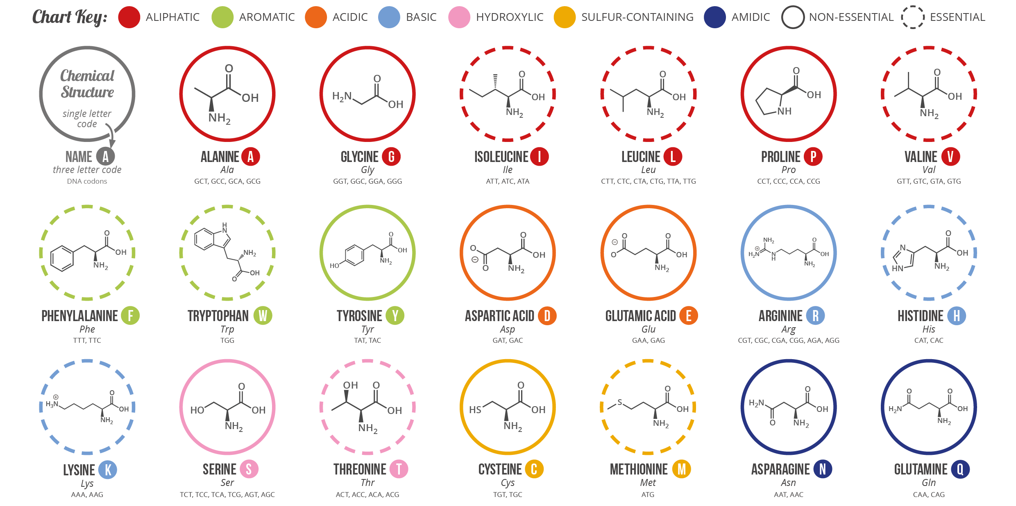
Advanced alignment scoring: amino acid similarity
Not all mismatches are equally “bad”

Slide 63
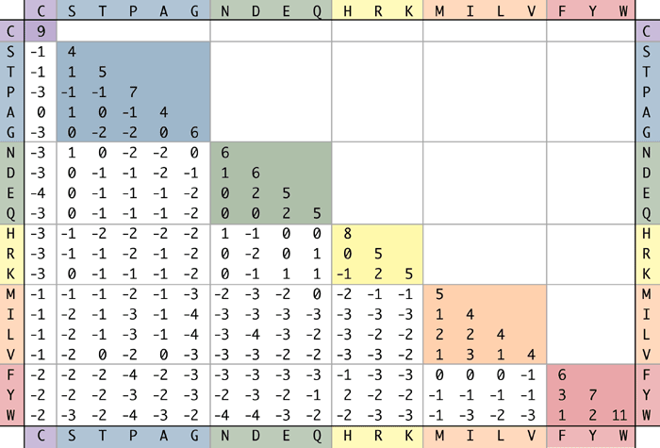
Advanced alignment scoring: amino acid similarity
BLOSUM62 scores weight AA pairs based on evolutionary similarity
(which tends to mirror biochemical similarity)
(i,j) entry reflects the log likelihood of AA_{i} aligning to AA_{j} in two sequences that are 62% identical

Slide 64
Interpreting BLAST hits (protein query / database)
 | HIGH identity | LOW identity
HIGH coverage | Your query*; Population variants; Close homologs | Distant homologs, pseudogenes
LOW coverage | Shared domain; gene fragment; gene fusion | False positive?
|| ||||| ||||
| || |

