Slide 1
Protein-protein interactions
Curtis Huttenhower (chuttenh@hsph.harvard.edu)
Eric Franzosa (franzosa@hsph.harvard.edu)
http://huttenhower.sph.harvard.edu/bst281

Slide 2
Midterm: journal club
If you have not already signed up, you are now late.
  These should already have been finalized by today.
Email instructional team with:
  Group members (2-5, names + CCed).
  Paper to present.
  ~2-4 sentence justification.
    Recent and/or high-impact quantitative biology.
  Date of presentation (March 6, 11, 13).
    3-4 presentations / day.
    First come, first served.
20 minute presentation + 5 minutes questions.
  All group members must present.
  Background, overview/results, methods, discussion/interpretation, questions.

Slide 3
Summary
Stable PPIs
  Two-hybrid
  Affinity capture / MS
Transient PPIs
  Protein modifications
  Phosphorylation
  Everything else
PPI resources

Slide 4
Stable PPIs

Slide 5
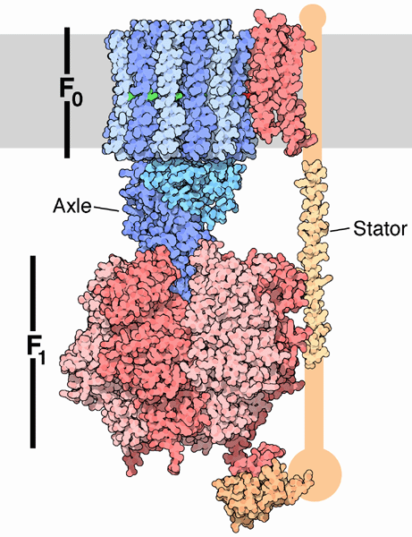
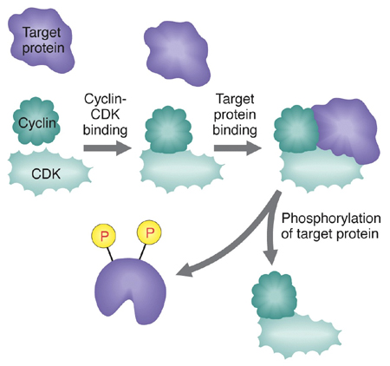
Physical Protein-Protein Interactions (PPIs)
(1) Cyclin binds to CDK and (2) the Cyclin-CDK complex binds to a target protein. These are transient interactions.
*also called
“obligate” or
“constitutive”
ATP synthase is a large, stable complex of physically interacting proteins. These are permanent* interactions.

Slide 6

Physical Protein-Protein Interactions (PPIs)
Protein A makes direct physical contact with Protein B in the cell; alternatively, A and B both interact with a third (mediator) protein, C.
10 kda
10 kda
20 kda
20 kda
30 kda
30 kda
45 kda
Gel-shift assay
A
B
A+B
A
B
A+B
A+B+C

Slide 7
Top-20 interaction screens (BioGRID Feb. 2018)
Type | Technology | Count
genetic | Negative Genetic | 525,482
physical | Affinity Capture-MS | 315,158
genetic | Positive Genetic | 172,189
physical | Two-hybrid | 122,071
physical | Affinity Capture-Western | 95,296
physical | Reconstituted Complex | 43,361
physical | Co-fractionation | 41,330
genetic | Synthetic Growth Defect | 29,188
physical | Affinity Capture-RNA | 28,757
physical | PCA | 22,514
physical | Biochemical Activity | 19,443
genetic | Synthetic Lethality | 18,509
genetic | Phenotypic Suppression | 16,989
genetic | Phenotypic Enhancement | 16,253
genetic | Synthetic Rescue | 8,700
physical | Proximity Label-MS | 8,567
genetic | Dosage Rescue | 7,024
physical | Co-purification | 6,486
physical | Co-localization | 3,879
physical | Co-crystal Structure | 2,832

Slide 8
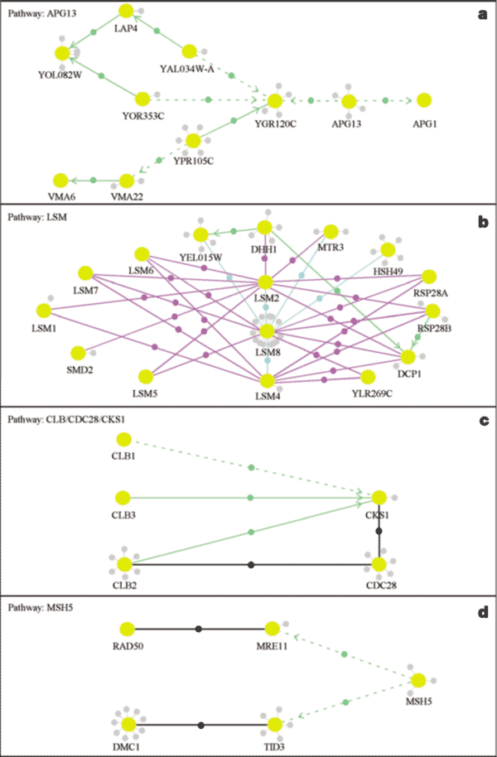

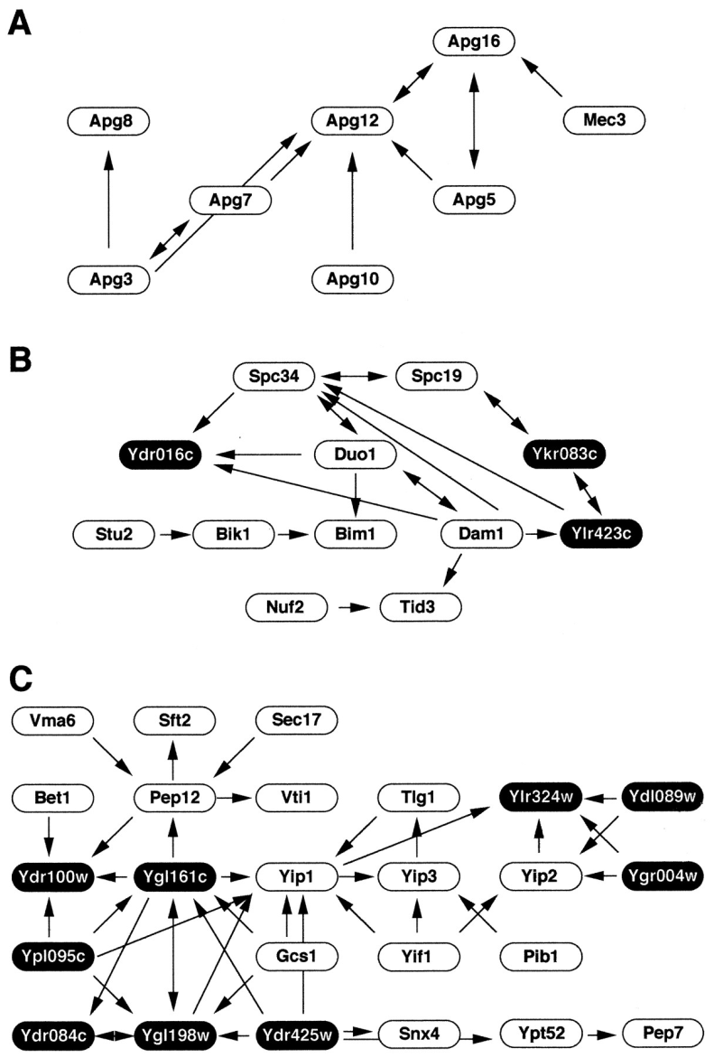
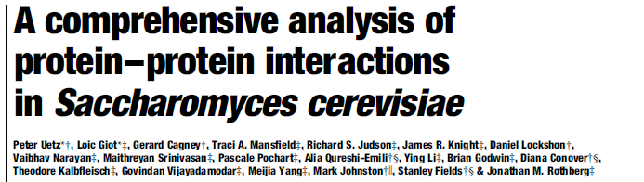
Physical Protein-Protein Interactions (PPIs)
2001
2000

Slide 9
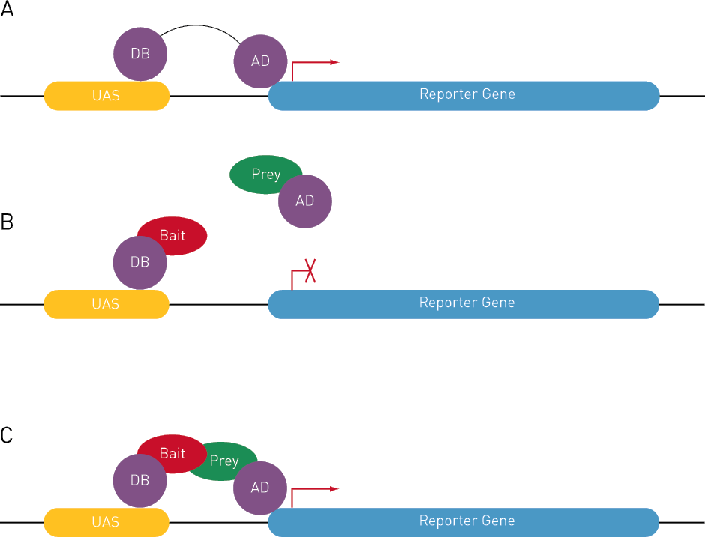
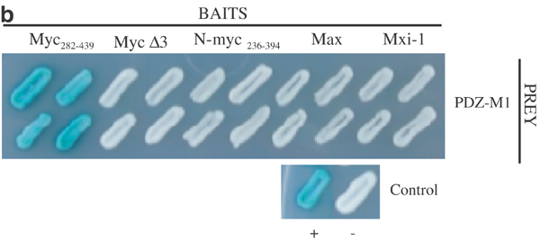
Detecting PPIs: Two-hybrid methods
Exploits independent function of protein domains in (e.g.) transcription factors
Hybridize bait protein to DNA binding domain (DB) and prey protein to transcription activation domain
Interaction “rescues” transcription and produces a signal (e.g. blue pigment)

Slide 10
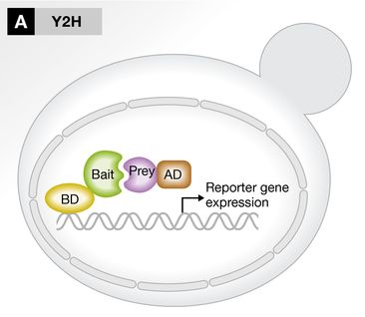
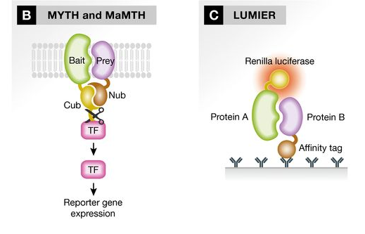
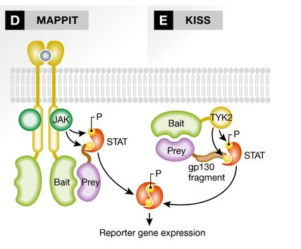
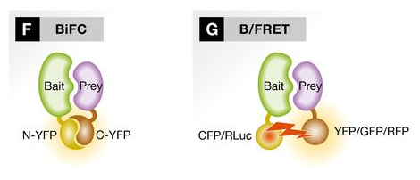
Detecting PPIs: Two-hybrid methods
Lots of variants on this idea!
(Many of them performed in yeast due to its helpful genetics and reproduction, but not limited to yeast proteins!)
Method strengths:
Scales well, sequencing-based read-outs, flexible
Method weaknesses:
Modified proteins may not reflect “wild-type” expression/interactions

Slide 11
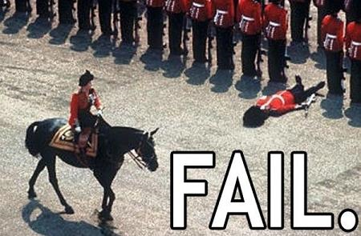
Two-hybrid strengths and weaknesses
2001
False negatives
  Must localize to nucleus (membrane proteins = bad)
  Must express and more or less function in yeast
    (Or other compatible expression/reporter vehicle)
  Fusion protein must maintain function
  Conditions must be right
False positives
  “Sticky” proteins (common!)
  Reporter autoactivation
?
20% overlap
2000

Slide 12
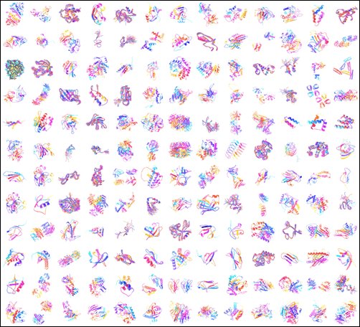
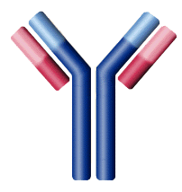

Detecting PPIs: Affinity capture
A
C
D
A
B
The cell’s contents are exposed to a surface engineered to bind a particular protein (the bait, here A). This is often done using an antibody specific to A or a tag fused to A.

Slide 13
Detecting PPIs: Affinity capture
A
C
D
A
B
The bait protein binds to the surface, bringing its various interaction partners along with it (called prey).

Slide 14
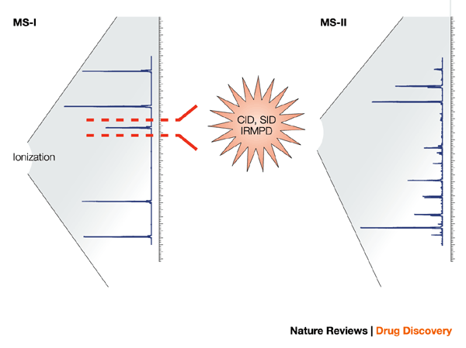
Detecting PPIs: Affinity capture
Method strengths:
Co-immunoprecipitation considered a gold standard for PPIs
Method weaknesses:
Can’t differentiate between direct and indirect (mediated) contact
A
C
D
A
B
The unbound cellular contents are then washed away.
Prey proteins pulled down by the bait are identified using prey-specific antibodies or by mass spectrometry.

Slide 15
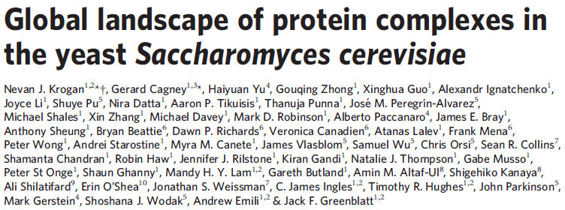
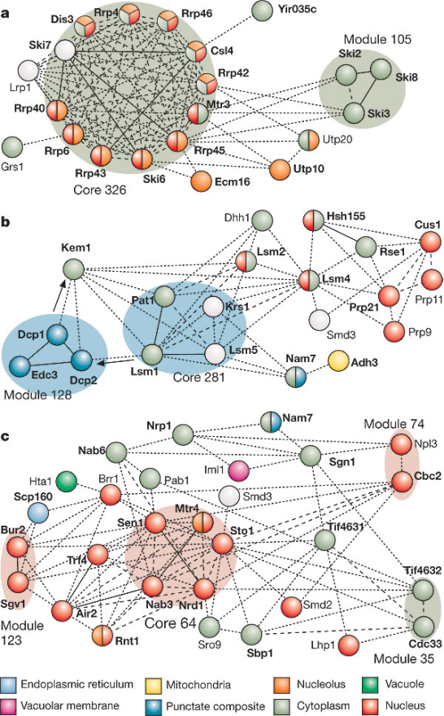
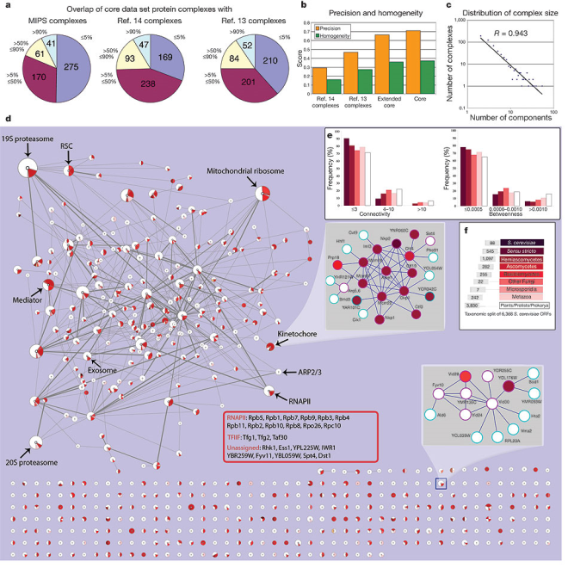
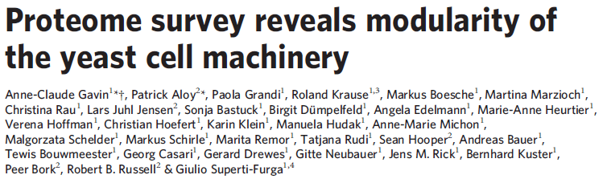
Detecting PPIs: Affinity capture
2006
2006

Slide 16
Transient PPIs
(Protein modifications)

Slide 17

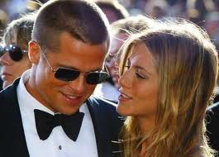

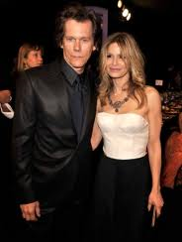
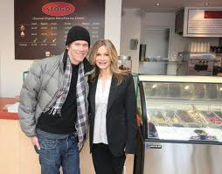
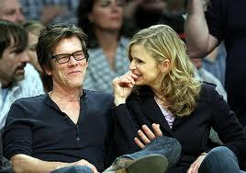
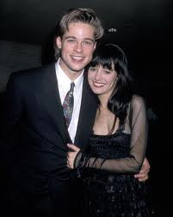

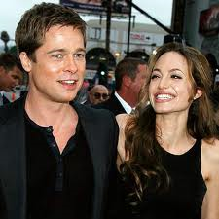
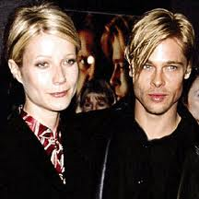
Stable vs. transient protein interactions

Slide 18
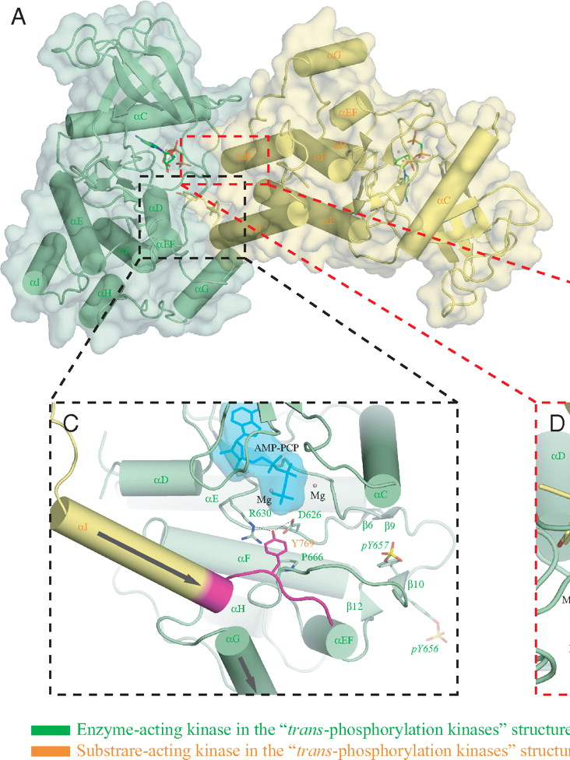
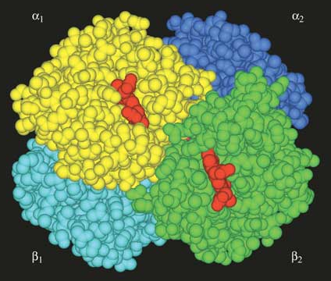
Stable vs. transient protein interactions
Structure
Information
flow
Chen 2008

Slide 19
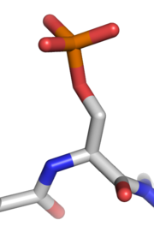
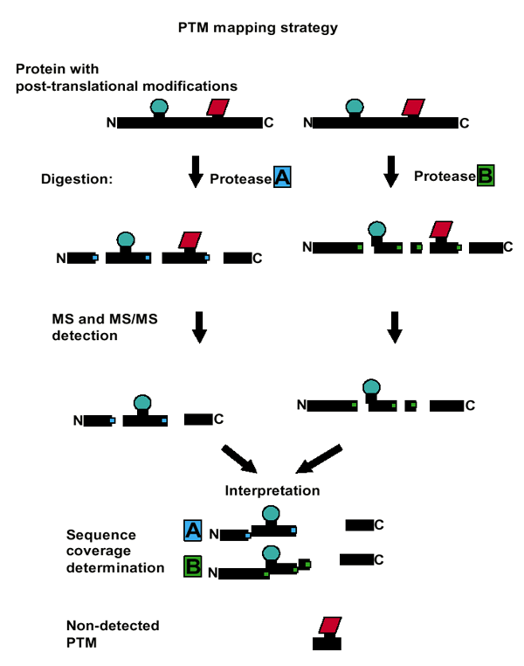
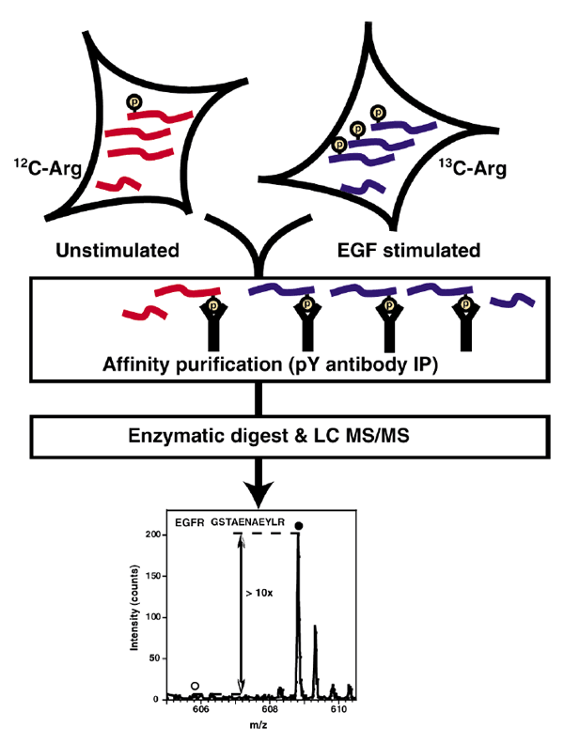
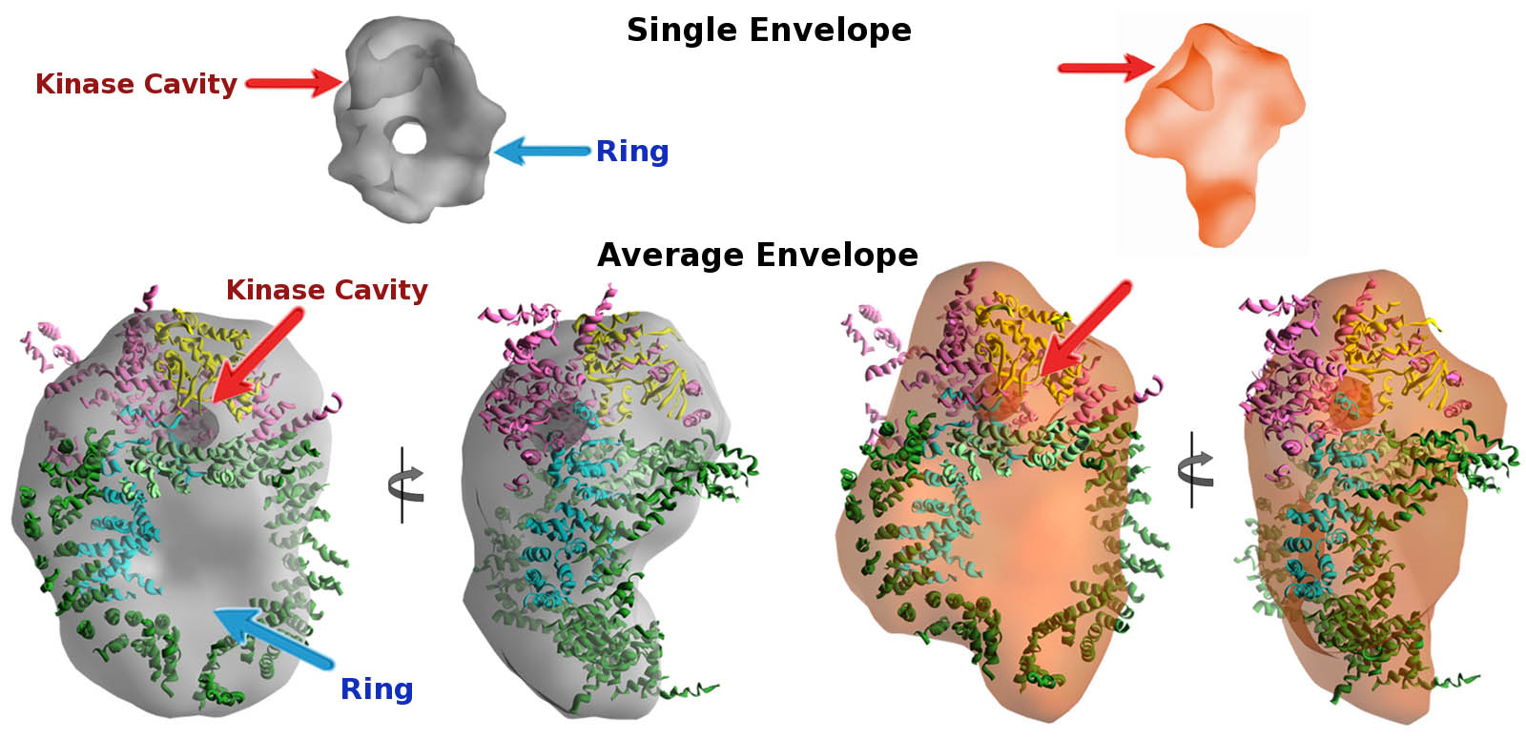
Transient interactions: phosphorylation
http://www.websters-online-dictionary.org/images/wiki/wikipedia/commons/thumb/c/cd/Phosphorylated_serine.png/180px-Phosphorylated_serine.png
Mann 2003
http://bl1231.als.lbl.gov/2010/11/03/Hammel_fig3.jpg

Slide 20
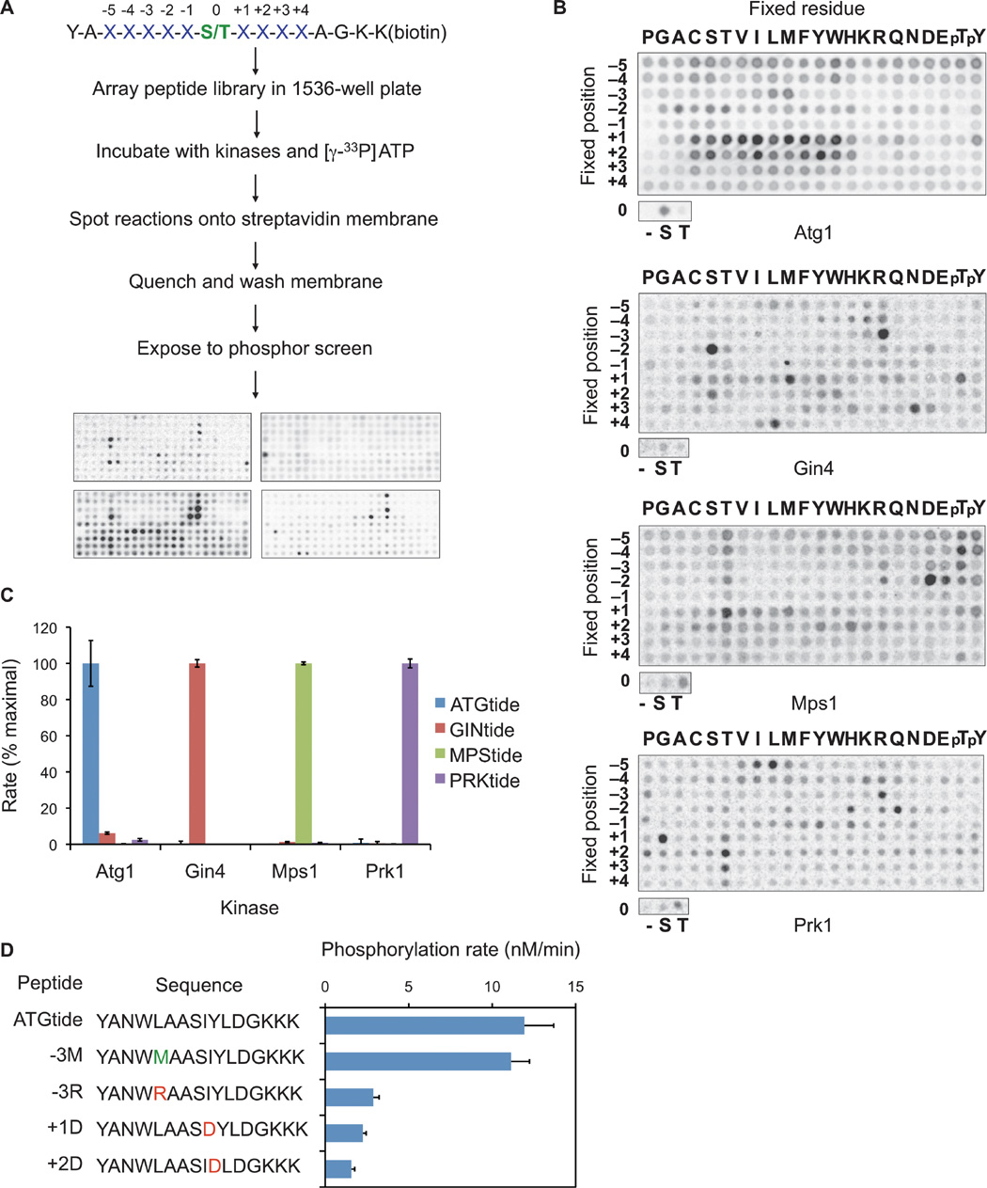
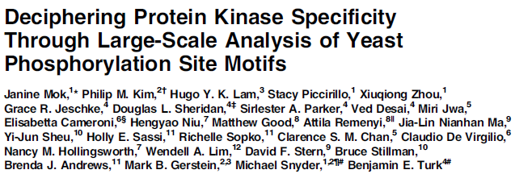
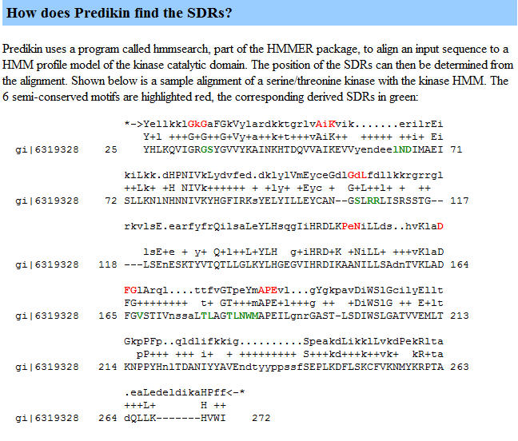
Transient interactions: phosphorylation
2010 (!)

Slide 21
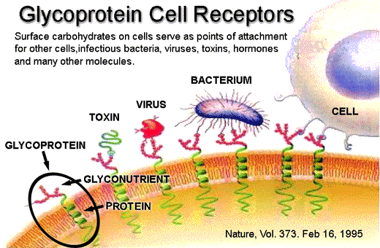
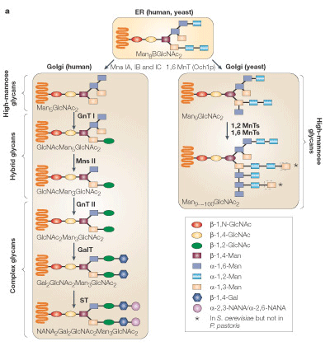
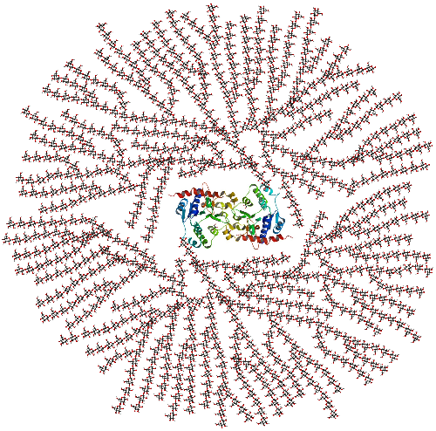
Transient interactions: glycosylation
Wildt 2005

Slide 22
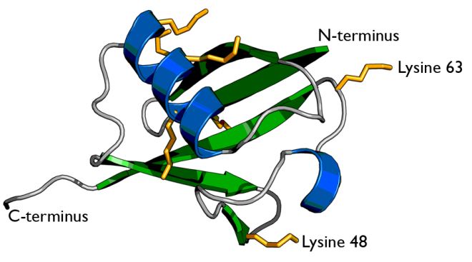
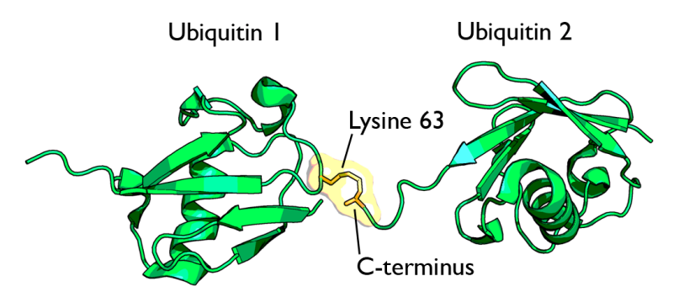
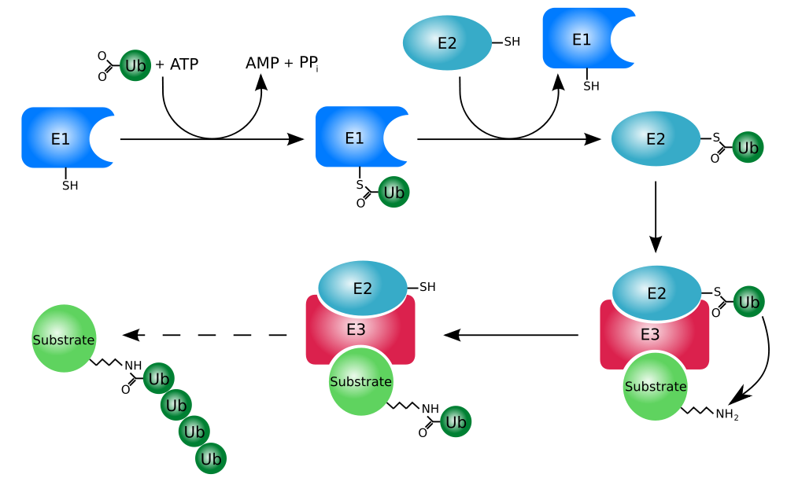
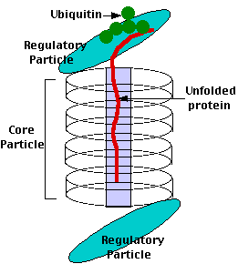

Transient interactions: ubiquitination
http://en.wikipedia.org/wiki/Ubiquitin

Slide 23
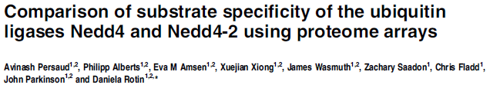
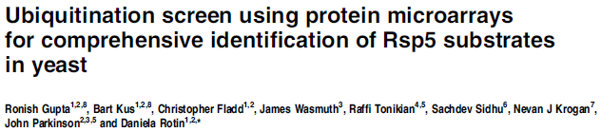
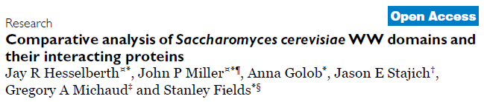


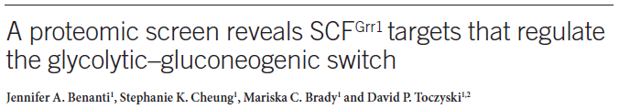
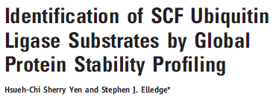
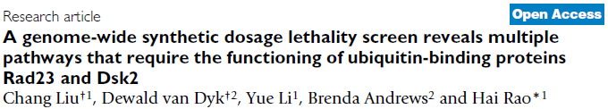
Transient interactions: ubiquitination
2009
Liu 2010
Does a known ubiquitinator
bind a substrate?
Does a substrate
acquire ubiquitins?
Does a substrate accumulate
in a proteasome mutant?
Does extra substrate hurt a
proteasome mutant?
2007
2006
2009
2008
2008
2009

Slide 24
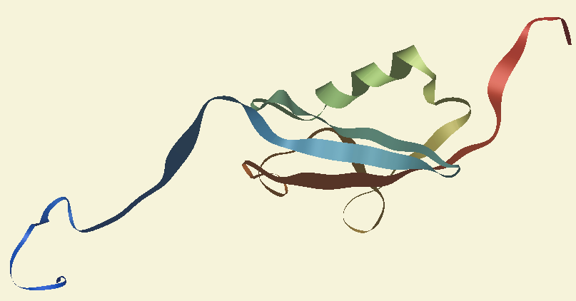
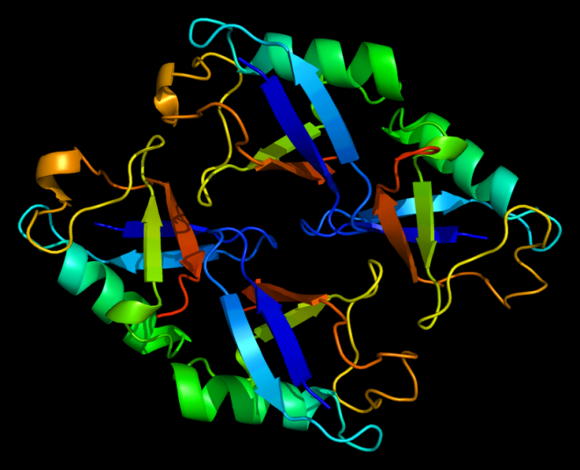


Transient interactions: sumoylation and neddylation
SUMO: Small Ubiquitin-like Modifier
NEDD8:
Neural-precursor-cell-expressed developmentally down-regulated 8
http://www.nature.com/nrm/journal/v8/n12/images/nrm2293-f2.jpg
http://www.nature.com/embor/journal/v9/n10/images/embor2008183-f1.jpg

Slide 25
PPI Resources

Slide 26








PPI databases
www.thebiogrid.org
www.ebi.ac.uk/intact
www.hprd.org
mint.bio.uniroma2.it
domine.utdallas.edu
dip.doe-mbi.ucla.edu
mips.helmholtz-muenchen.de
bond.unleashedinformatics.com

Slide 27









Protein modification databases
www.phosphopep.org
phospho.elm.eu.org
www.phosphogrid.org
www.phosphosite.org
www.phosida.de
www.cbs.dtu.dk/databases/OGLYCBASE
www.ebi.ac.uk/RESID
sumosp.biocuckoo.org
scud.kaist.ac.kr
ubiprot.org.ru
dbptm.mbc.nctu.edu.tw
www.unimod.org

Slide 28
https://canvas.harvard.edu/courses/55671/quizzes/127077

Slide 29
Summary
Stable PPIs
  Two-hybrid
  Affinity capture / MS
Transient PPIs
  Protein modifications
  Phosphorylation
  Everything else
PPI resources

