Slide 1
Genetic Perturbations &
Interactions
Curtis Huttenhower (chuttenh@hsph.harvard.edu)
Eric Franzosa (franzosa@hsph.harvard.edu)
http://huttenhower.sph.harvard.edu/bst281
Slides courtesy of Florian Markowetz (Cancer Research UK) and Chad Myers (UMN)

Slide 2
Class notes
Today’s lecture is about gene perturbations.
More generally, it concerns analyses one can do with a list of genes.
  Or a list of gene pairs (interactions).
Many final projects begin with such lists or produce them.
Questions about midterm presentations (or problem set)?

Slide 3
Summary
Single gene perturbations
  Perturbing genes
  Detecting phenotypes
  Analyzing phenotypes
  Phenotypes → networks → phenotypes
Multiple gene perturbations
  Models for epistasis
  Multiple perturbation technologies
  Genetic interaction data
  Analyzing genetic networks

Slide 4
Single Gene Perturbations

Slide 5
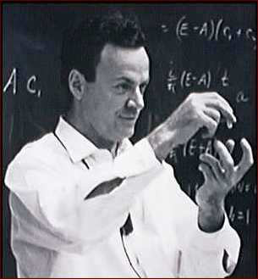
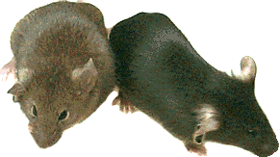
How to understand a complex system?
Richard Feynman:
“What I cannot create, I do not understand.”
Synthetic biology
Mathematical models in systems biology
Functional Genomics:
“What I cannot break, I do not understand.”
experimental interventions
gene perturbation screens

Slide 6
How to break biological systems
Small
molecules
Drugs
RNAi
Protein
Stress
Knockout
mRNA
DNA
SNPs
natural variation

Slide 7
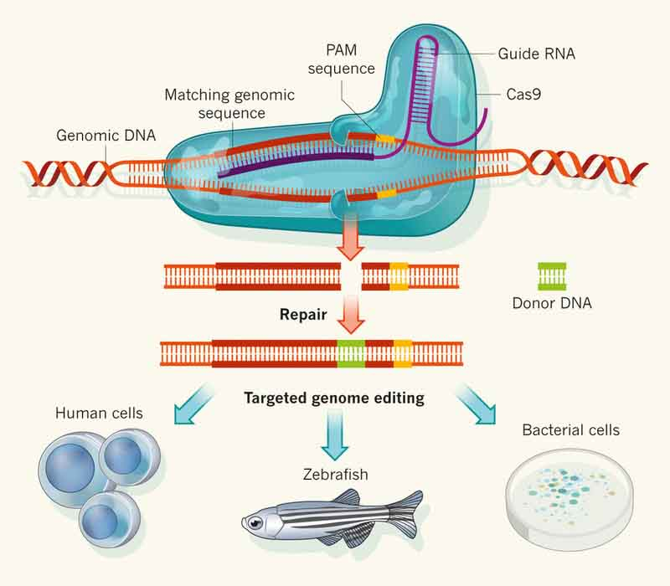
Cas9 (CRISPR associated protein 9)

Slide 8
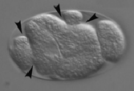
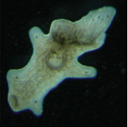
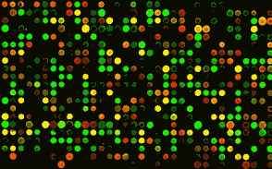
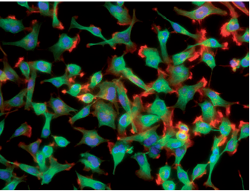
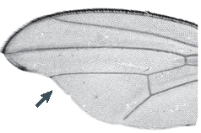
Phenotypic read-outs
Low-dimensional
phenotypes
High-dimensional phenotypes
by microscopy
or ‘omics profiles
A-
Size
Time

Slide 9
Phenotype: pathway activity
Receptors
B-
Cell membrane
A-
C-

Slide 10
Phenotype: global gene expression
B-
A-
C-
All the genes in the genome
A-
…
B-
…
C-
…
Transcriptional phenotypes by RNA-seq

Slide 11
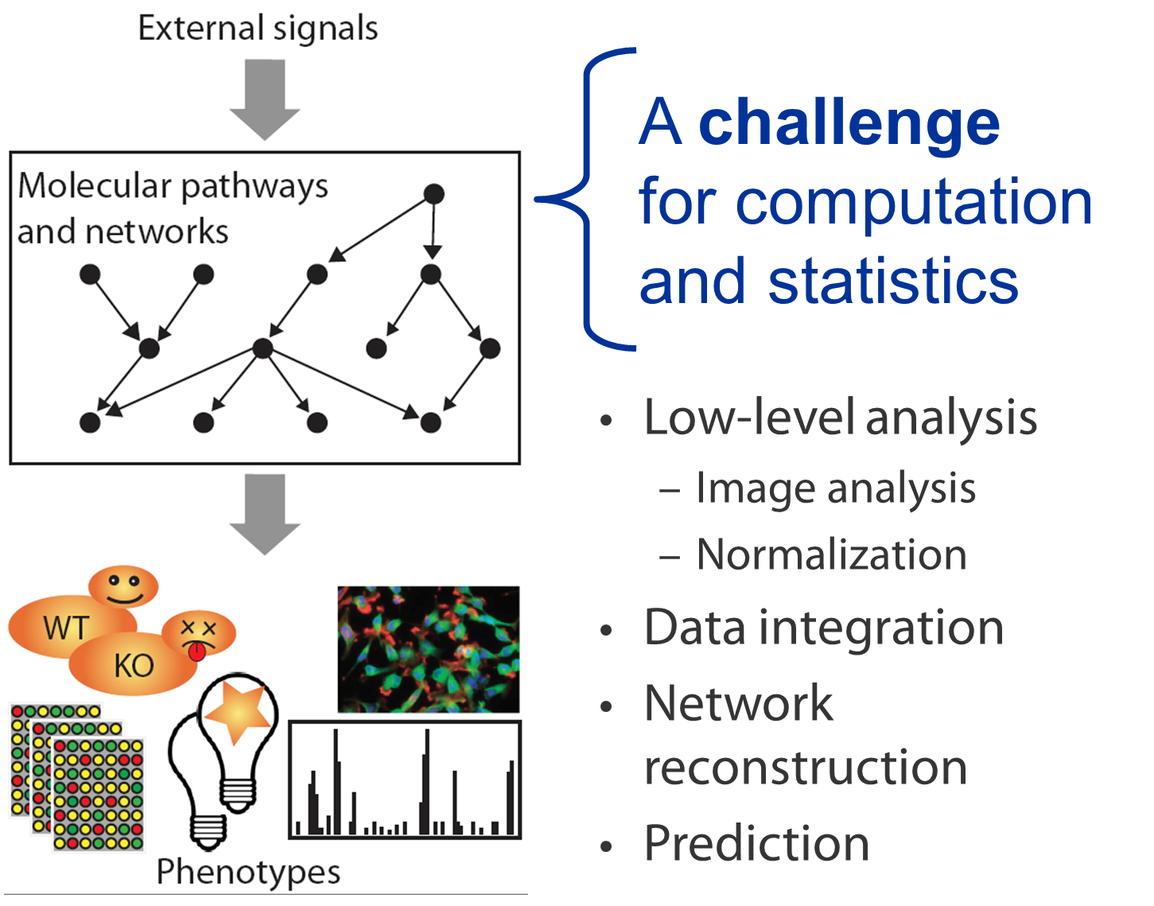
How to reconstruct the interesting stuff in the middle?

Slide 12
Downstream phenotypes carry only indirect information on networks
Pathway
Indirect information: effects are only visible at downstream reporters
No direct information
of pathways and mechanisms
Goal of computation: recover pathways/ mechanisms from observed phenotypes
B
?
D
A
C
Phenotypes
A-
Size
Time

Slide 13
Gene Set Over-Representation
Hits!
GO
Weak
Phenotype
Strong
Hits in GO term
All Hits
Hypergeometric test
Genes in GO term
All genes

Slide 14
Gene Set Enrichment Analysis
Significant trend
GO
Weak
Phenotype
Strong
No significant trend
Weak
Phenotype
Strong
Not restricted to GO, could be any collection of gene sets,
e.g. MSigDB at http://www.broad.mit.edu/gsea/
Subramanian et al. (2005)

Slide 15
Pros and Cons
Result:
p-values
(hyper-geometric or GSEA)
Gene set 1
Gene set 2
Gene set 3
Gene set 4
…
e.g.
Wnt pathway
DNA repair
Chromosome 1
Expressed in liver
Advantages:
standard analysis
comprehensive first overview
“unbiased” and “hypothesis-free”
Disadvantages:
“unbiased” and “hypothesis-free”
relies on known gene sets
can not uncover new pathways
pathway = “unconnected” gene set
soon more gene sets than genes

Slide 16
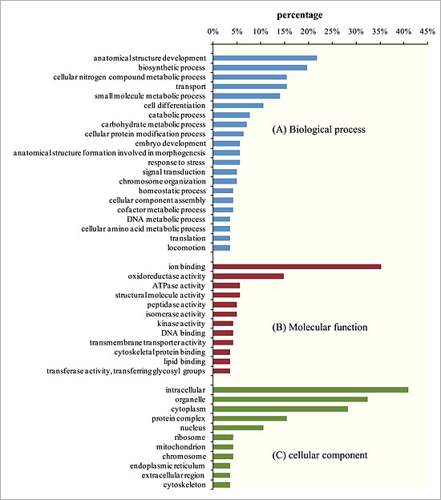
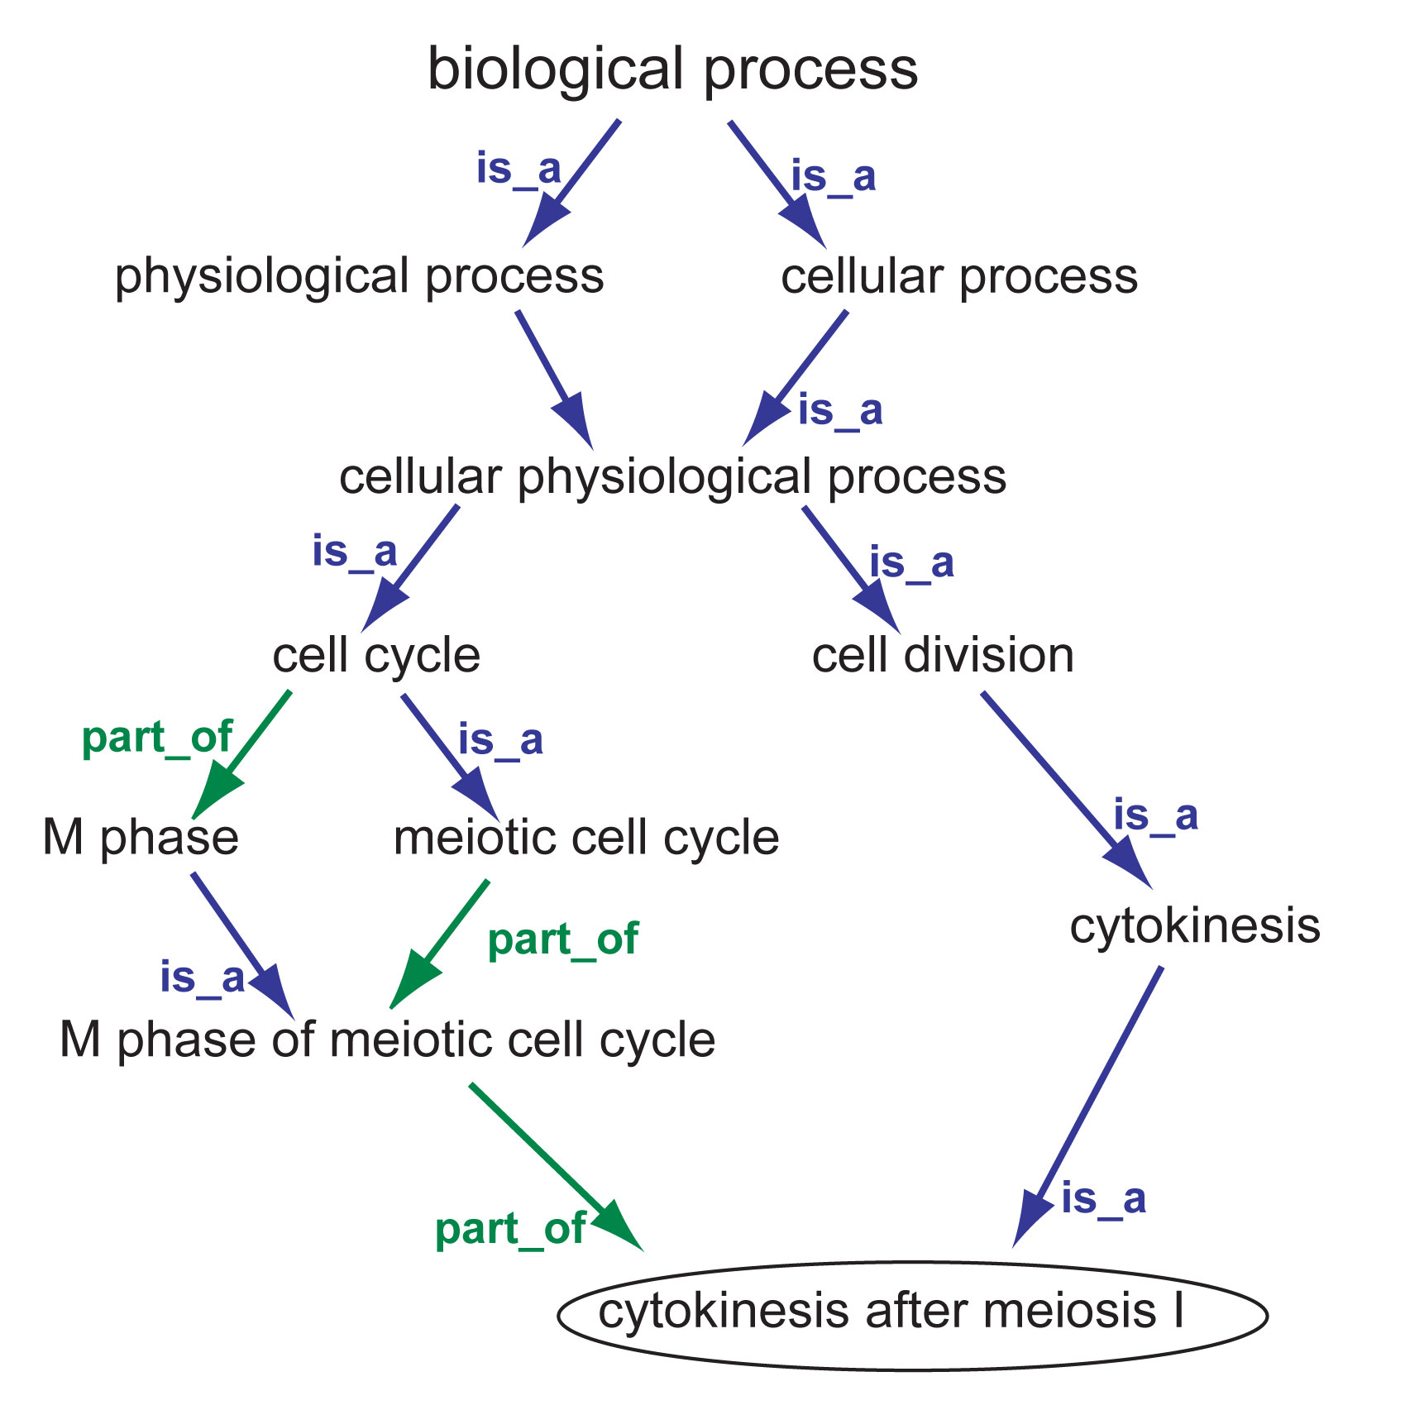
Why Gene Ontology?

Slide 17
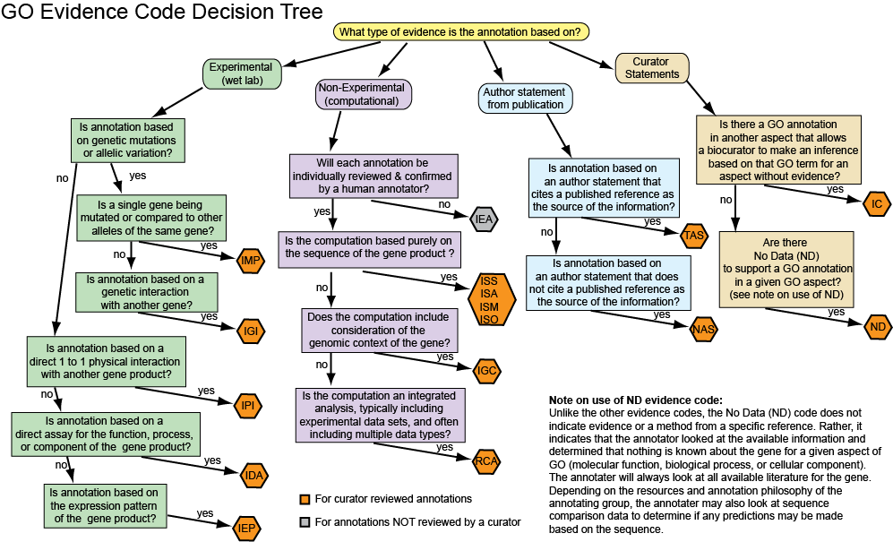
Why Gene Ontology?

Slide 18
Other ways of defining a gene set / caveats
Genes in a metabolic pathway
  Structured gene sets, must have (A and B and C) to complete the pathway
  Data sources: MetaCyc, KEGG
Genes with products in a molecular complex
  Also structured, must have (X and Y and Z) to form the complex
  Data sources: CORUM, PDB
Genes with a shared domain
  Data sources: Pfam, InterPro
Genes with a shared interaction partner
  Data sources: BioGRID, IntAct
Genes implicated in a shared disease
  Data sources: OMIM, MeSH
Be mindful of overlap between gene sets within and across databases – may not represent independent signals!
A statistically significant overlap is not necessarily biologically interesting

Slide 19
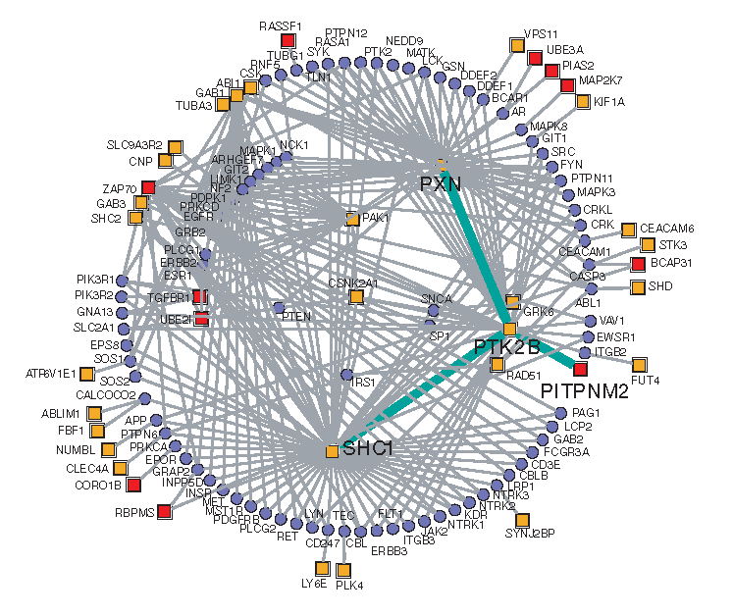
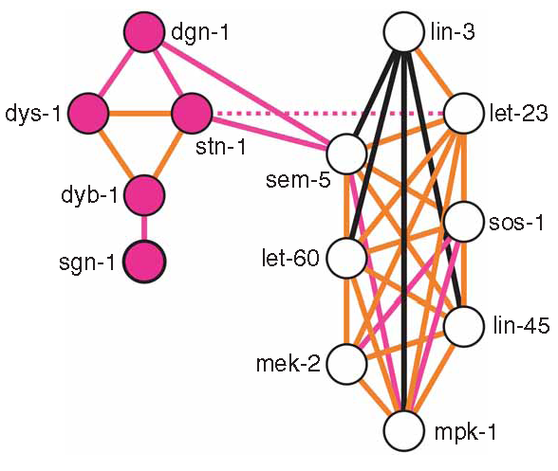
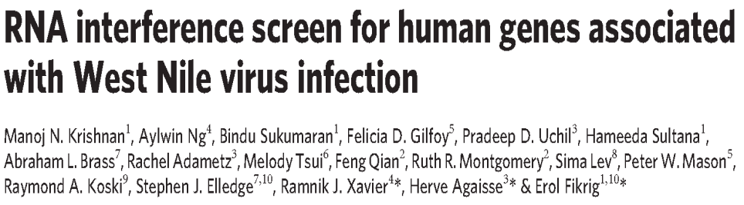
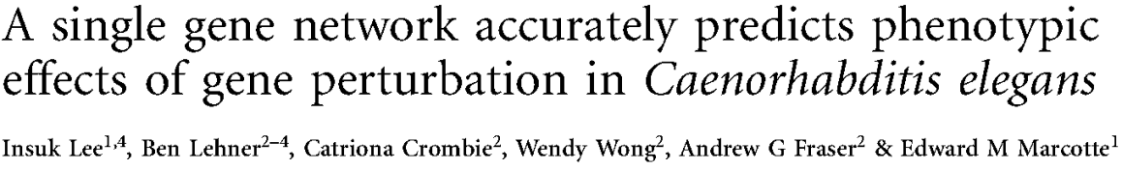
Map phenotypes to a network
Where do the hits fall in the network and what are they connected to?

Slide 20
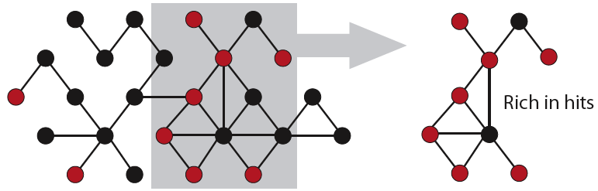
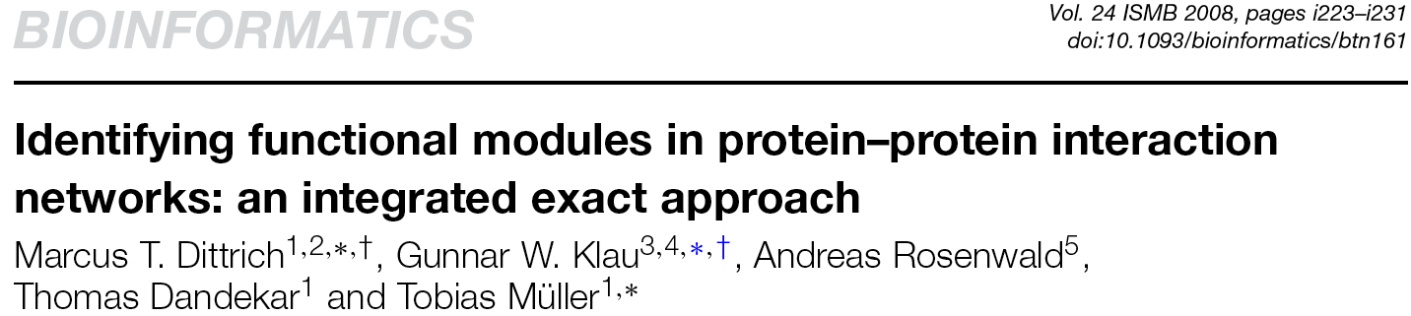
Sub-networks rich in hits?

Slide 21

Guilt by association
Guilt by association
?
Use known phenotypes in the network
Use edge weights if possible
Success depends on quality and coverage of linkage in the network
?
?

Slide 22
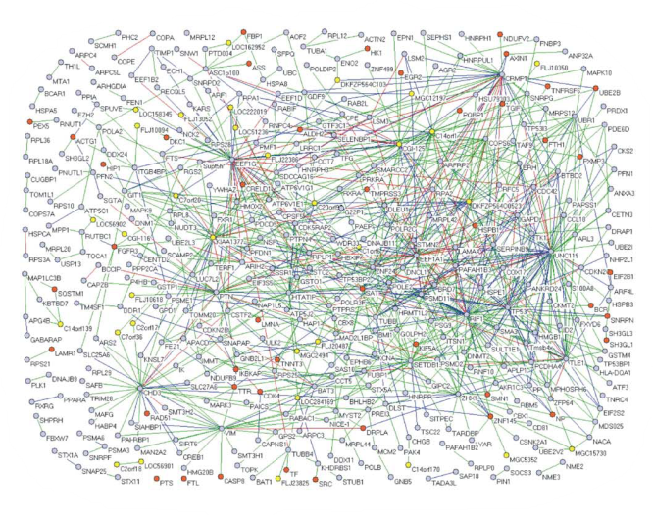
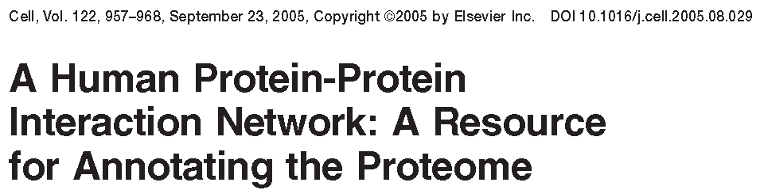

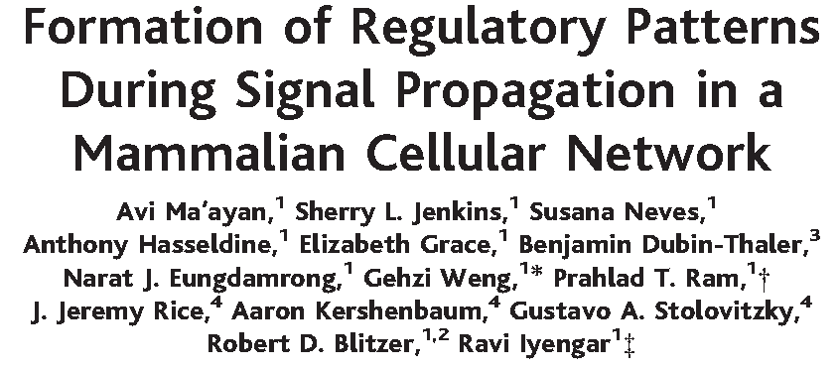
Which networks to use?
Networks from large-scale experiments
Networks from analyzing the experimental literature
Networks from probabilistic data integration

Slide 23
Software
Enrichment analysis
David http://david.abcc.ncifcrf.gov
Golem http://function.princeton.edu/GOLEM
Ontologizer http://compbio.charite.de
GSEA http://www.broadinstitute.org/gsea/
Subnetworks rich in hits
jActiveModules http://www.cytoscape.org
heinz http://bionet.bioapps.biozentrum.uni-wuerzburg.de
Subnetworks with high phenotype correlation
Matisse http://acgt.cs.tau.ac.il/matisse/

Slide 24
Cluster first, think later
Genes with similar phenotypic profiles often have similar molecular functions or act in the same pathways.
Principle for function prediction:
Guilt by association
Perturbed Genes

Slide 25
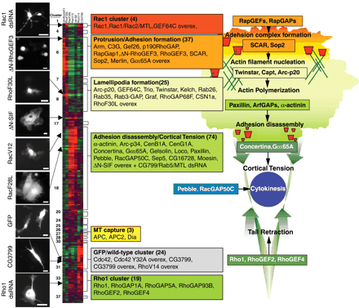
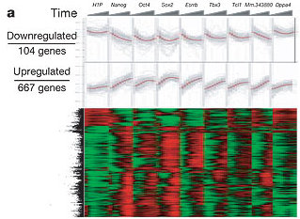
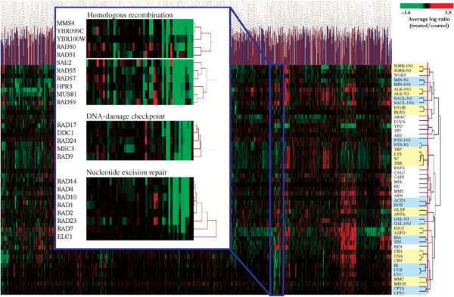
Pros and cons of clustering
Bakal et al (2007)
Brown et al (2005)
Ivanova et al (2006)
Standard analysis, almost always applicable
Global first overview
Can identify strong trends and patterns in the data
PRO
Often applied in situations where other methods would be more appropriate (e.g. supervised analysis)
NEG

Slide 26
Query-based gene ranking
Task: find genes similar to query phenotypic profile
Often addressed by clustering:
Which cluster does the query gene fall into?
Cluster 1
But:
That’s a pretty indirect way of answering the question
Cluster boundaries can be arbitrary
Genes in other clusters can also be similar to query
Better use a ranking method!
Cluster 2
Query gene
Cluster 3

Slide 27
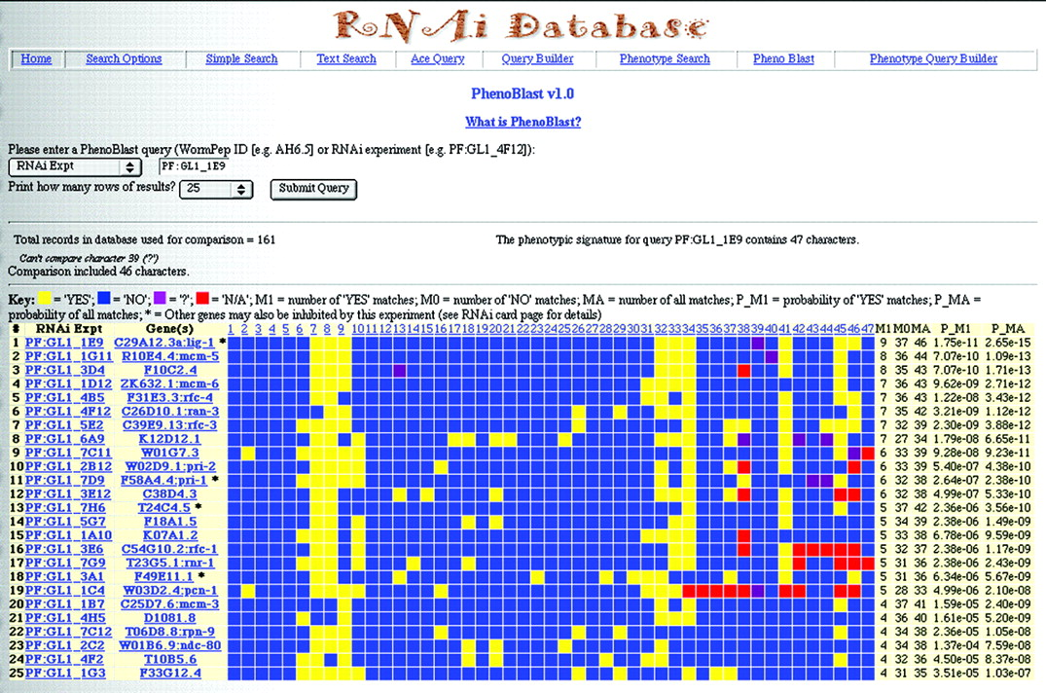
Ranking by PhenoBLAST
Rank genes by similarity to query phenotypic profile
Challenge: identify informative phenotypes, correct of ubiquity
PhenoBLAST
Gunsalus et al (2004)
Perturbed Genes
Ordered by similarity to query gene
Phenotypes

Slide 28
From clusters to pathways
Enrichment, clustering and ranking are multi-purpose methods that give a broad first overview of general patterns in the data.
Next:
graph-based and probabilistic models to infer (causal) pathway structure from phenotypic data.

Slide 29
We only see a part of the picture
Protein
mRNA
DNA
Model
A
B
C
D
E

Slide 30
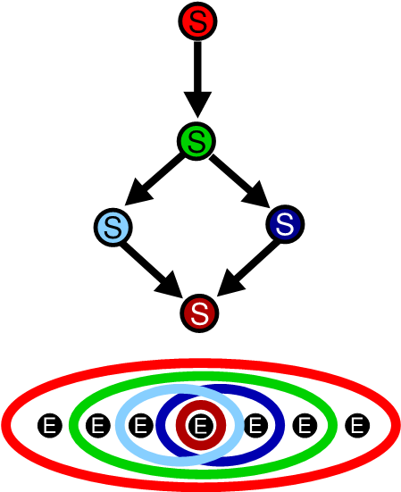
Information gap
In most cases
no direct observation of perturbation effects on other pathway components!
Components of signaling pathway which are experimentally perturbed
Inference only from observed effects on
downstream reporters.
Downstream effect reporters,
Phenotypic profiles

Slide 31
Subset structure
Kinase
TF1
TF2
TF1
TF2
Kinase 1
TF1
TF2
Kinase 2
TF3
TF

Slide 32
Nested effects models
Set of candidate pathway genes
High-dimensional phenotypic profile, e.g. microarray
INPUT
Graph representation of information flow explaining the phenotypes
OUTPUT
Phenotypic profiles
Inferred pathway
A
A B
B
C
D
E F
Gene perturbations
C D
E
F
G
G H
H
Effects
Markowetz et al (’05, ‘07), Fröhlich et al (’07,’08,’09),
Zeller et al (‘08), Markowetz and Tresch (‘08), Vaske et al (‘09)

Slide 33
Multi-gene Perturbations

Slide 34
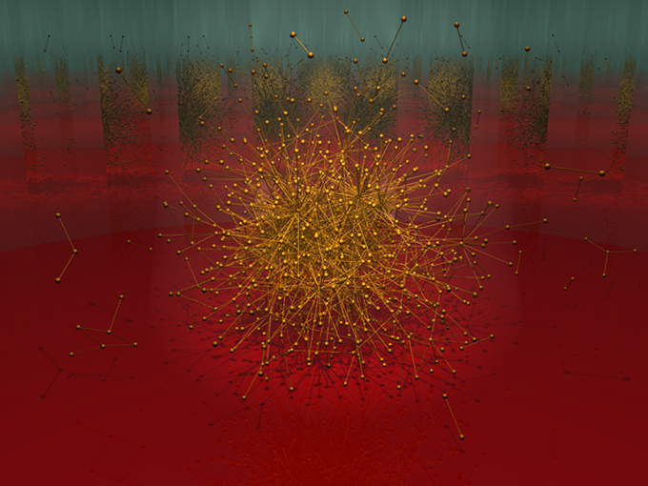
Why combinatorial perturbations?
Systems-level understanding depends on characterizing interactions among components
The human protein-protein interaction network
Stelzl et al. Human Protein-Protein Interaction Network: A Resource for Annotating the Proteome Cell, 2005.
http://supfam.mrc-lmb.cam.ac.uk/elevy/perso/elevyArt.html

Slide 35
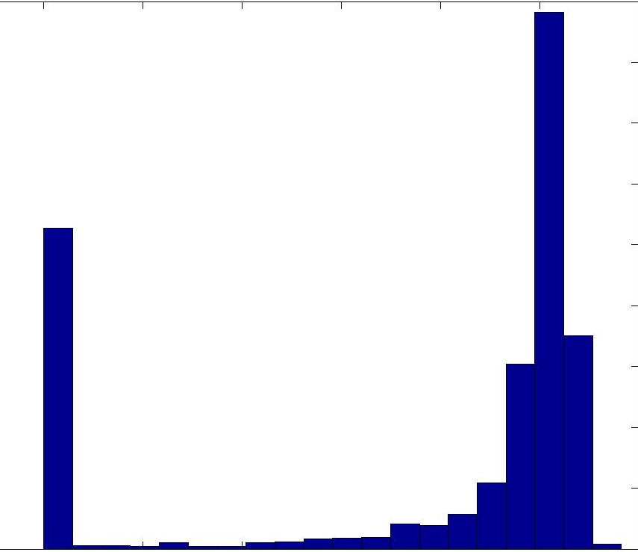
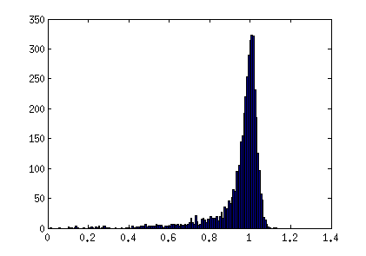
Evidence for network redundancy in yeast
Fitness of yeast deletion mutants
(~6000 different gene-level perturbations)
{
~80% can be independently deleted with no severe fitness defect!
1800
1600
1400
1200
1000
800
600
400
200
0
# of deletion mutants
Fitness of single mutant
(relative to wild-type cell)
Winzeler EA et al: Functional characterization of the S. cerevisiae genome by gene deletion and parallel analysis. Science 1999, 285(5429):901-906.

Slide 36
Does yeast only use 20% of its genome?
Seems unlikely
Hypothesis 1: 80% of genome is conditionally essential
  I.e. essential, but only under (e.g.) heat stress
  Test by evaluating essentiality in a range of conditions
Hypothesis 2: 80% of the genome has built-in redundancy
  I.e. able to tolerate the loss of system 1 because system 2 takes over
  Test by evaluating essentiality with multiple perturbations
  = looking for genetic interactions

Slide 37
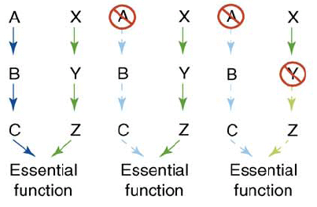
The promise: from combinatorial perturbations to network structure
Single mutant (A)
Single mutant (Y)
Double mutant (A,Y)
?
?
?
?
?
?
A
Y
AY
healthy
healthy
dead
“genetic interaction”
(synthetic lethality)
An interpretation:
MC Costanzo et al. Curr Opin Biotech (2006).

Slide 38
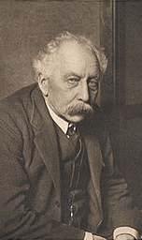
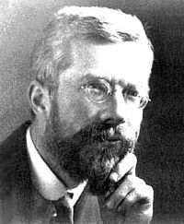
Genetic interactions: surprising phenotypes from combinations of mutations
Bateson (1909): “epistatic”– variant or allele at one locus prevents variant another locus from manifesting its effect
Fisher (1918): “epistacy”– deviation from additivity in the effect of alleles at different loci with respect to a quantitative phenotype
William Bateson
Cordell HJ. Hum Mol Genet 2002, 11(20):2463-2468
Sir R.A. Fisher

Slide 39
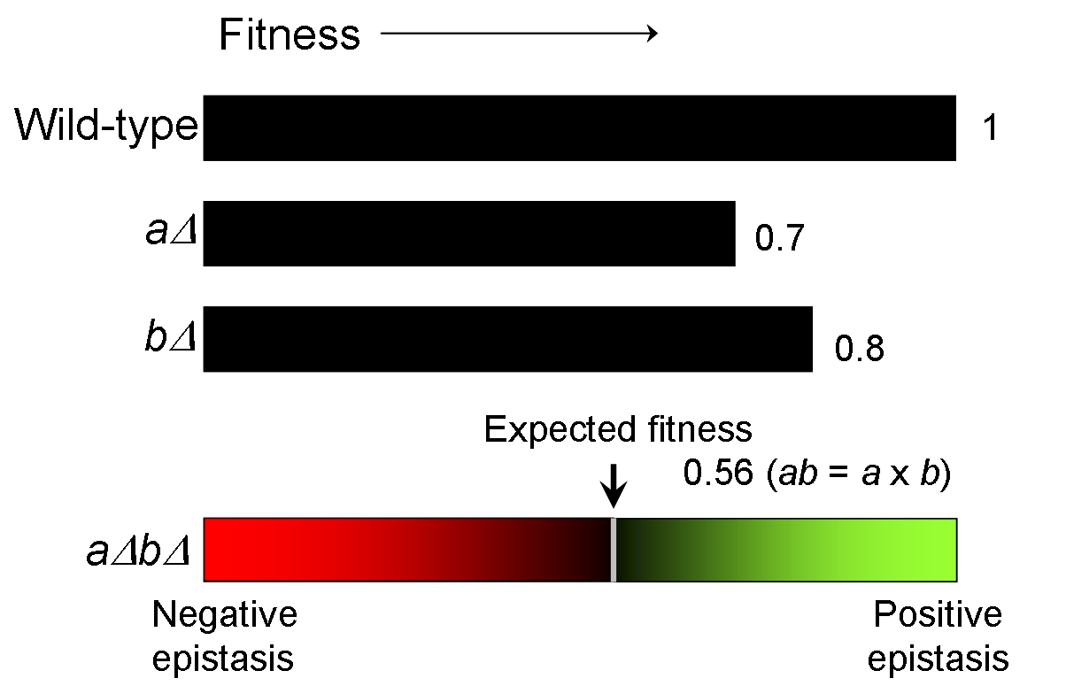
Example 1: Measuring epistasis from quantitative fitness measures (1-dimensional phenotype)
Null model:
“aggravating”
“synthetic”
“alleviating”
“antagonistic”

Slide 40
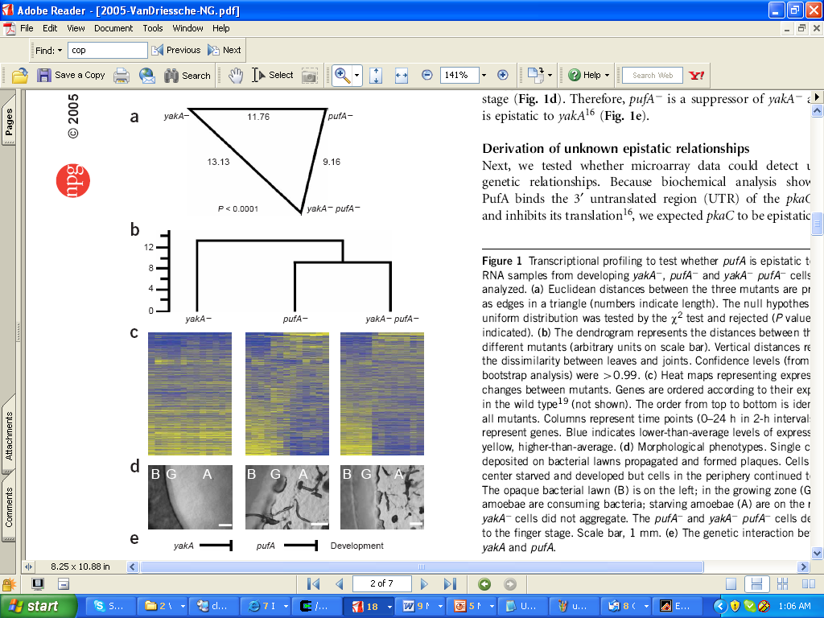
Example 2: Measuring epistasis from high-dimensional expression phenotypes
pufA single mutant profile is highly similar to pufA, yakA double mutant→ pufA is “epistatic” to yakA
(null assumption: mutant expression profiles are additive)
Van Driessche et al. Epistasis analysis with global transcriptional phenotypes. Nat Genet 2005, 37(5):471-477.

Slide 41
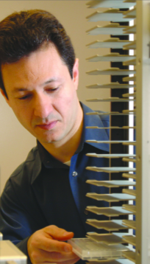
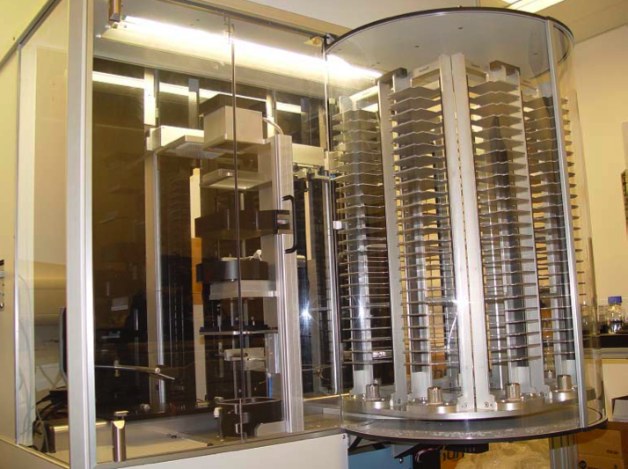
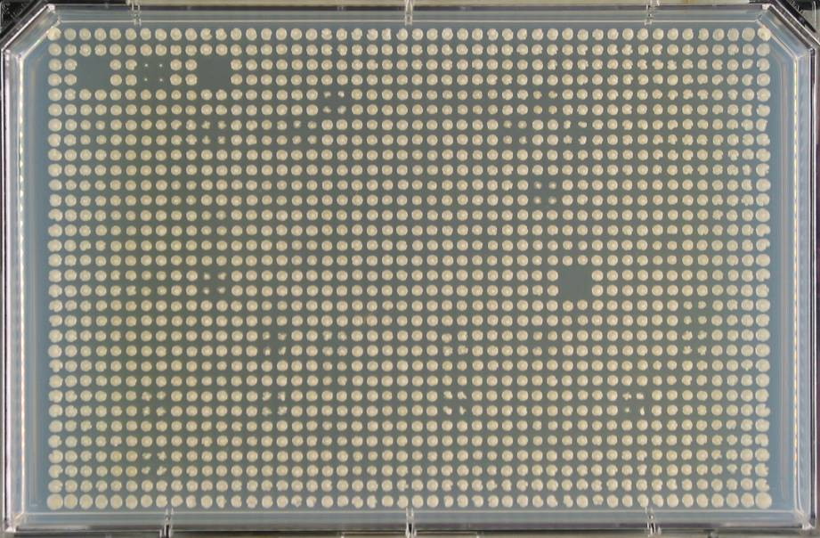
The problem with combinatorial perturbation: it’s combinatorial!
Consider yeast, ~6000 genes
~18 million pairs
~ 10¹⁰ triples
High throughput technology to the rescue!
200 genome-wide screens/month
Charlie Boone’s lab (Synthetic Genetic Array technology)

Slide 42
Overview of computational strategies for analyzing combinatorial perturbation data
Extracting functional information from interaction profiles
Relating genetic interactions to modular network structure
Beyond modular structure: defining pathway order through epistasis analysis
Predicting genetic interactions
Biological specificity

Slide 43
Overview of computational strategies for analyzing combinatorial perturbation data
Extracting functional information from interaction profiles
Relating genetic interactions to modular network structure
Beyond modular structure: defining pathway order through epistasis analysis
Predicting genetic interactions
Biological specificity

Slide 44
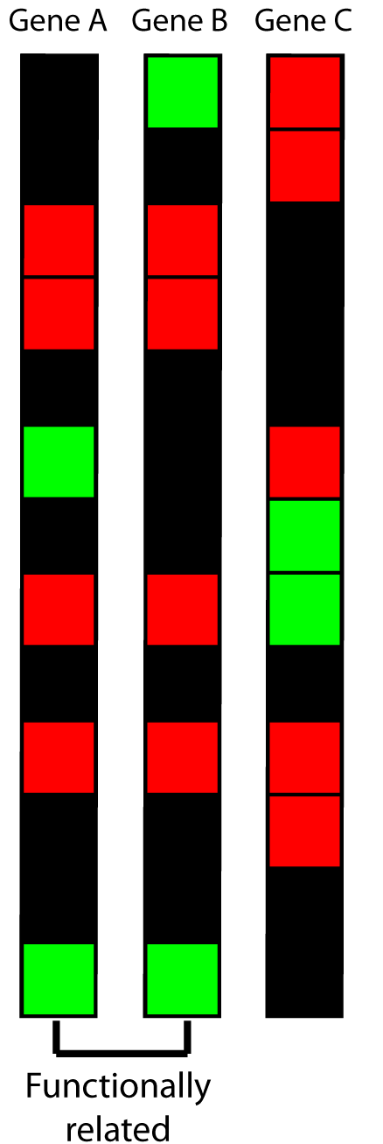
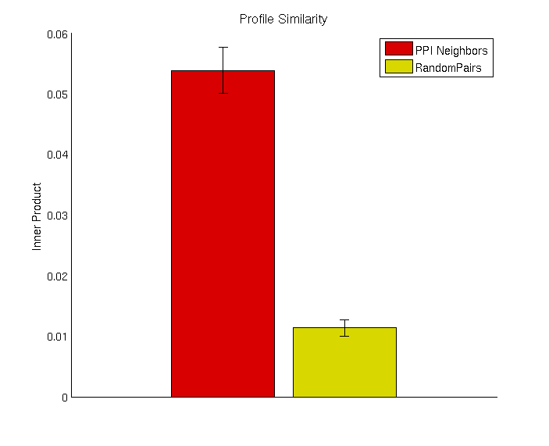
Interaction profiles are predictive of gene function
Physical interactions
Physical, protein-protein interactions (PPI)
Interactions
Avg. genetic interaction profile similarity (cosine)

Slide 45
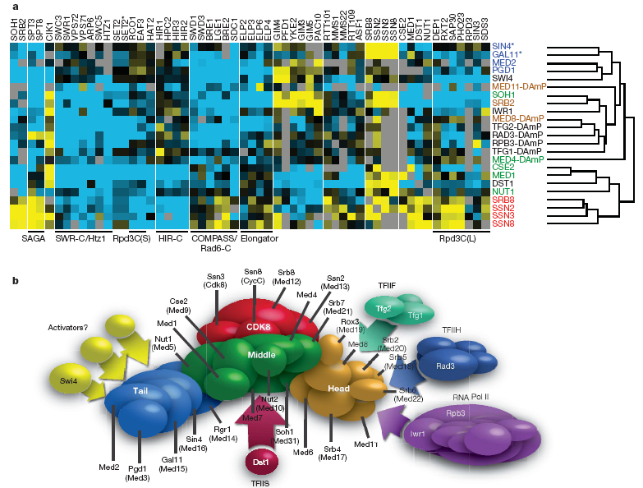
Interaction profiles are predictive of gene function
Complex co-membership
Blue: negative genetic interactions
Yellow: positive genetic interactions
Collins et al. Functional dissection of protein complexes involved in yeast chromosome biology using a genetic interaction map. Nature 2007, 446(7137):806-810.

Slide 46
Overview of computational strategies for analyzing combinatorial perturbation data
Extracting functional information from interaction profiles
Relating genetic interactions to modular network structure
Beyond modular structure: defining pathway order through epistasis analysis
Predicting genetic interactions
Biological specificity

Slide 47
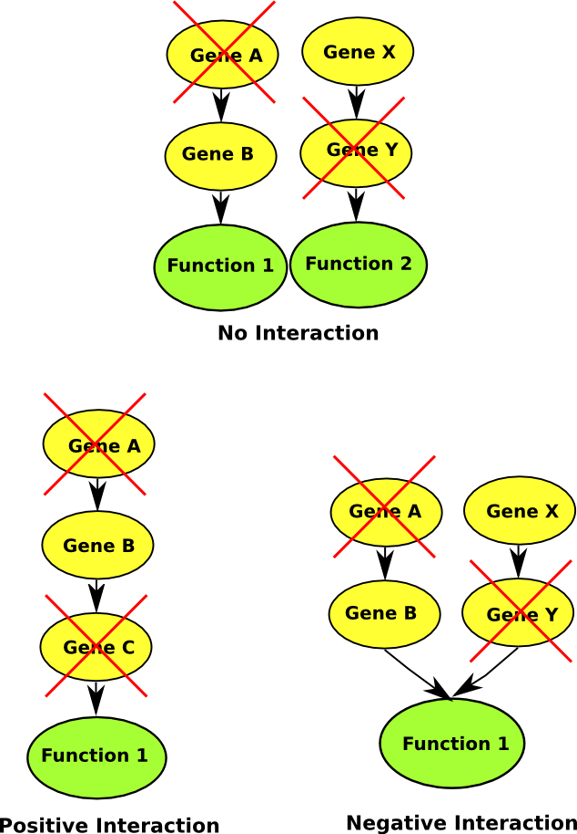
A local view of synthetic (negative) interactions
No interaction indicates unrelated
(i.e. independent) processes.
Intuitive interpretation: Synthetic (negative) interactions indicate functionally compensatory relationships
Can we find evidence for this intuitive model?

Slide 48
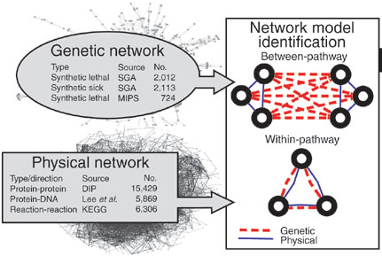
Data driven comparison of between vs. within-pathway models for synthetic interactions
Kelley R, Ideker T: Systematic interpretation of genetic interactions using protein networks. Nat Biotechnol 2005, 23(5):561-566.

Slide 49
Why do we often observe this structure?
Pathway A
Pathway B
A1
B1
A2
B2
Negative genetic interaction
A3
B3
Modularity: pathway A depends on
all three A1, A2, and A3
Redundancy: pathways A and B compensate for one another

Slide 50
Mechanistic understanding of antagonistic (positive) interactions
Positive interactions can indicate within-module/protein complex dependencies
(i.e. simultaneously required)

Slide 51
Why do we often observe this structure?
DNA homologous recombination/repair pathway
Translesion synthesis DNA repair
RAD57
RAD55
REV7
RAD52
REV1
Negative genetic interaction
RAD51
REV3
RAD54
Positive genetic interaction
Modularity: pathway A depends on all five components– any one deletion will disable the pathway
Redundancy: pathways A and B compensate for one another

Slide 52
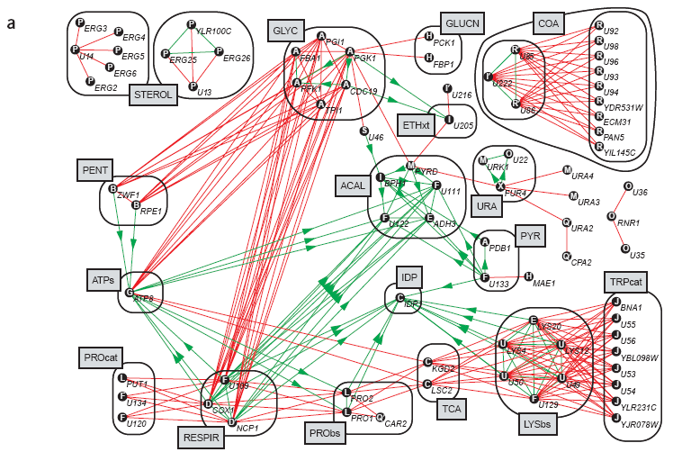
Why do we often observe this structure?
Flux balance analysis of metabolism
Within and between-pathway/module interactions are monochromatic
Segre D, Deluna A, Church GM, Kishony R: Modular epistasis in yeast metabolism. Nat Genet 2005, 37(1):77-83.

Slide 53
Overview of computational strategies for analyzing combinatorial perturbation data
Extracting functional information from interaction profiles
Relating genetic interactions to modular network structure
Beyond modular structure: defining pathway order through epistasis analysis
Predicting genetic interactions
Biological specificity

Slide 54
Classical epistasis analysis: the theory
Alleviating (positive) interactions often correspond to within-pathway, within-module interactions
Can we learn something by comparing single mutants, A⁻, C⁻ and double mutant, A⁻C⁻ ?
Basic rule:
  if the A⁻C⁻ phenotype is more similar to A⁻ → A⁻ is epistatic to C-
  (i.e. A- “covers” C-)
  Under some assumptions, we can use this to infer order of action
Input signal

Slide 55
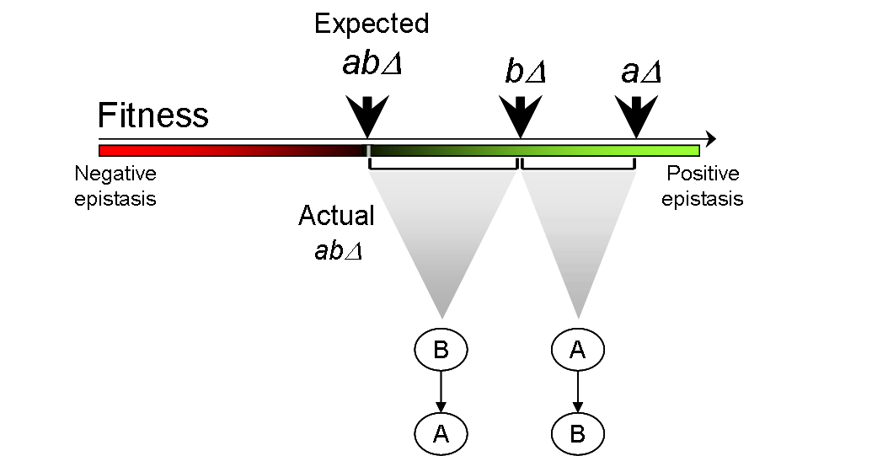
Epistasis analysis for 1-dimensional quantitative fitness phenotypes
Wild-type fitness
Example: B makes a critical metabolite,
A shuttles it to the right cellular compartment
Example: A makes a non-critical metabolite, B makes sure it doesn’t accumulate to cytotoxic levels
(assumes mutants show phenotypes in the same input signal state,
e.g. positively regulated cascades)
Avery L, Wasserman S: Ordering gene function: the interpretation of epistasis in regulatory hierarchies. Trends Genet 1992, 8(9):312-316

Slide 56
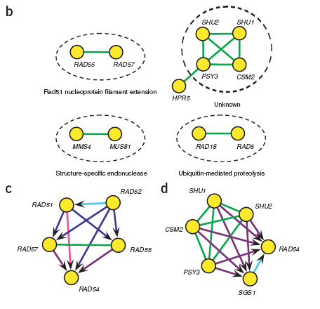
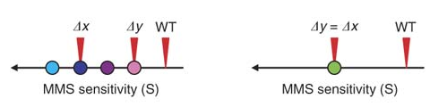
Case study: Ordering DNA repair/recombination pathways from double mutant growth rate analysis
x
y
y
x
“co-equal”
St. Onge et al. Systematic pathway analysis using high-resolution fitness profiling of combinatorial gene deletions. Nat Genet 2007, 39(2):199-206.

Slide 57
Overview of computational strategies for analyzing combinatorial perturbation data
Extracting functional information from interaction profiles
Relating genetic interactions to modular network structure
Beyond modular structure: defining pathway order through epistasis analysis
Predicting genetic interactions
Biological specificity

Slide 58
Summary
Single gene perturbations
  Perturbing genes
  Detecting phenotypes
  Analyzing phenotypes
  Phenotypes → networks → phenotypes
Multiple gene perturbations
  Models for epistasis
  Multiple perturbation technologies
  Genetic interaction data
  In-depth S. cerevisiae case study
  Analyzing genetic networks

