Slide 1
Inference and Hypothesis Testing
Curtis Huttenhower (chuttenh@hsph.harvard.edu)
Eric Franzosa (franzosa@broadinstitute.org)
Siyuan Ma (sim653@mail.Harvard.edu)
http://huttenhower.sph.harvard.edu/bst281

Slide 2
Topics
Using statistics for inference
Test statistics and p-values
Performance evaluation
Repeated tests and high-dimensional data

Slide 3
Descriptive and inferential statistics
Descriptive statistics summarize information already present in data
Inferential statistics use a sample of data to make predictions about larger populations or about unobserved/future trends

Slide 4
Probabilistic reasoning about (uncertain) data
You know that adult chickens weigh 6.2 ± 0.8 lb.
You find out that an unknown object weighs 10 lb.
⇒ You can conclude that the object is probably not a chicken.
Test statistic: weight
Null distribution
Null hypothesis: this is a chicken
Observation
p-value

Slide 5
Null distributions
The null hypothesis is a quantitative statement about what's not surprising.
Usually that results / measurements / etc. are due to chance.
e.g. There is no bias towards heads vs. tails, or gene expression is due to measurement error, or "this is a chicken."
Denoted H₀
Alternate hypothesis is everything else.
The null distribution is the distribution of the test statistic if the null hypothesis is true.
e.g. binomial distribution, normal distribution, known range of chicken weights.
For test statistic T: P(T = t | H₀).

Slide 6
p-values
The p-value is the probability of observing an equal or more extreme value of the test statistic than observed, assuming the null hypothesis.
For test statistic T, this is P(T ≥ t | H₀).
Quantifies "surprise."
Lower ⇒ observation is more unlikely ⇒ more surprised.
When the null hypothesis is true, p-values have a uniform distribution.
p-values < α (critical value) are considered "significant."
i.e. reject the null hypothesis.
α is the fraction of tests that will be significant when the null hypothesis is true.
Usually 0.05 or 0.01 for p-values.
Note that other types of significance tests are possible; more on that later...

Slide 7
An example null distribution: the z-test
If the test statistic is normally distributed under the null, then as before:
z = (x - µ) / σ
Going back to our chickens...
Adult chickens weigh 6.2 ± 0.8 lb (stdev.)
An object's observed mass is 10 lb.
z = (10 – 6.2) / 0.8 = 4.75.
P(|z| ≥ 4.75 | This is a chicken) = 2.03 × 10⁻⁶
Very unlikely to be a chicken!

Slide 8
Accepting the null(?)
Consider:
Adult chickens (still) weigh 6.2 ± 0.8 lb.
You measure an object and it weighs 6.1 lb.
Therefore you conclude that it is a chicken.
Equivalent to a high p-value:
Low p-values encourage rejection of the null hypothesis.
High p-values do not encourage acceptance of it!
"Guilty" vs. "not guilty."
An absence of evidence is not evidence of absence.

Slide 9
Statistical significance vs. biological significance
Statistically significant ⇏ biologically significant.
Something can be statistically significant, but biologically irrelevant.
e.g. when sample size is very large or uncertainty is very low.
Not statistically significant ⇏ not biologically significant.
Especially when sample size is small.
"There is no difference at the effect size we’re powered to test."

Slide 10
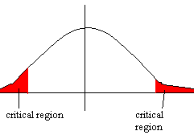
One-tailed and two-tailed tests
What observations are considered "extreme"?
One-sided/one-tail tests test whether the test statistic is higher or lower than chance
H₀ : μ≥μ₀, H_{A} : μ<μ₀
How likely is it for a gene to be this upregulated?
Two-sided/two-tail tests test whether the test statistic is equal to
H₀ : μ=μ₀, H_{A} : μ≠μ₀
How likely is it for a gene to be this differentially regulated (up or down)?

Slide 11
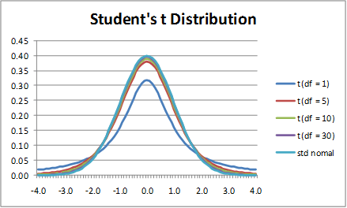
Other simple parametric tests
We just ran a hypothesis test with a normal null distribution with known mean and standard deviation.
This assumes that chicken weights are normal and we know everything about them.
Other common hypothesis tests often still assume a normal distribution...
But with unknown mean and/or standard deviation.
For example: difference in means between two normal samples.
Null distribution is “Student’s t” distribution, leading to the t-test.
Like a normal distribution, but heavier tails...
Testing Pearson correlations:
Usually H₀ : ρ=0, H_{A} : ρ≠0
tanh⁻¹(ρ) ∼ Normal ⇒ z-test
Often make very strong assumptions about the data

Slide 12
Nonparametric tests
Test statistic is insensitive to the distribution (e.g. by rank transform)
"Non-parametric t-test": Mann-Whitney U test.
Cost is decreased sensitivity (as usual).
Permutation tests.
p-value is calculated by repeated randomizations of the data.
Cost is a significant increase in computation time.
Permutation scheme not always straightforward

Slide 13
Performance evaluation
For a test to be “good”, it cannot just perform well under the null…
Imagine a test that regardless of outcome, never rejects
“Tastes like chicken!”
Also consider performance under the alternative. Possible outcomes:
 | H₀ True | H₀ False
H₀ Not Rejected | True Negative | False Negative (Type II)
H₀ Rejected | False Positive (Type I) | True Positive

Slide 14
Performance evaluation
Probability of incorrect call
False positive rate: FPR = FP/(TN+FP)
What is the false positive rate, for a hypothesis test with $α$ = 0.05?
Power: probability of detecting a true effect
TP/(TP+FN)
Also called recall, true positive rate (TPR), sensitivity
Precision: probability a detected effect is true
TP/(FP+TP)
Specificity: probability an undetected effect is false
TN/(TN+FN)
Also true negative rate (TNR)
 | H₀ | H_{A}
H₀ Not Rejected | TN | FN
H₀ Rejected | FP | TP

Slide 15
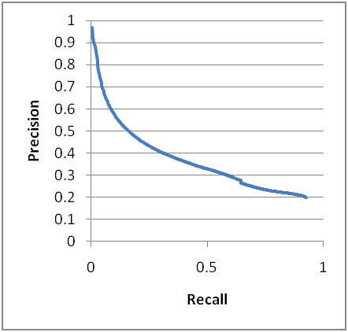
Precision/recall plots (PR)
Most tests have a parameter that adjusts their sensitivity, e.g. α.
Precision vs. recall:
Upper-right is good.

Slide 16
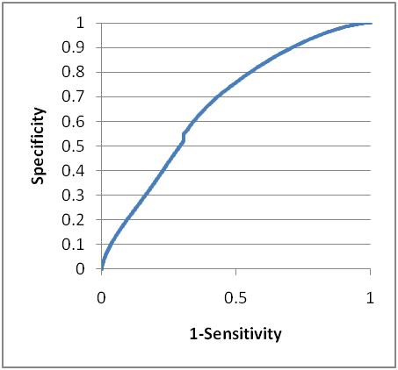
Receiver Operating Characteristic (ROC)
Sensitivity/specificity plots.
TPR vs. FPR
Upper left is good.
Well-defined behavior when guessing.
Area Under the Curve (AUC)
Perfect = 1
Random = 0.5
Perfectly wrong = 0

Slide 17
Testing many hypotheses
Recall that under the null hypothesis, p-values follow a uniform distribution over [0, 1].
Probability of rejecting of α, even if there’s no biological effect.
Consider 20,000 genes measured at once by microarray/RNA-seq.
Test each gene for differential expression.
How many false positive are expected at critical value ⍺?
What can we do?
Can change the test statistic to "maximum difference over the dataset."
Null hypothesis: "no effect for any of the features."
Can instead "adjust" the p-value to account for multiple hypothesis testing.

Slide 18
Multiple hypothesis correction
Bonferroni correction.
Multiply p-values by the number of tests.
Directly adjusts critical value to include all tests.
Very strict / conservative.
Controls the "Family-Wise Error Rate" (FWER), % of negatives expected to "succeed" by chance.
A common alternative controls the False Discovery Rate (FDR)
Controls false discovery rate (1 – Precision).
FDR q-value = (# tests) * (p-value) / (p-value rank).
Changes what the critical value means.
 | H₀ True | H₀ False
H₀ Not Rejected | True Negative | False Negative (Type II)
H₀ Rejected | False Positive (Type I) | True Positive
https://www.unc.edu/courses/2007spring/biol/145/001/docs/lectures/Nov12.html

Slide 19
A simple experiment
Create a 5,000 x 15 matrix of random values.
"Genes" and "samples"
Find gene most correlated with "Age"
Does this gene truly predict longevity?
Feature | Sample1 | Sample2 | Sample3 | Sample4
Age | 0.150953 | 0.821741 | 0.158316 | 0.898557
Gene1 | 0.801808 | 0.491848 | 0.608064 | 0.583391
Gene2 | 0.146415 | 0.922903 | 0.547641 | 0.344042
Gene3 | 0.219748 | 0.844069 | 0.39559 | 0.314302
Gene4 | 0.613934 | 0.685797 | 0.512878 | 0.986288
Gene5 | 0.322305 | 0.149985 | 0.106558 | 0.659032
Gene6 | 0.667529 | 0.508563 | 0.57018 | 0.803856
Feature | Sample1 | Sample2 | Sample3 | Sample4
Age | =RAND()
Gene1
Gene2
Gene3
Gene4
Gene5
Gene6
…
…
Pearson correlation = 0.81
p-value = 0.000252
q-value = 5000 * 0.000252 / 1 = 1.26

Slide 20
Summary
Inference lets you reason about uncertainty and unobserved data.
Test statistics, null hypothesis and distribution, and p-values.
Performance evaluation of hypothesis tests (and other things):
False positive/negative rates, power, precision, and specificity.
Precision/recall plots.
Receiver-Operator Characteristic (ROC) and the Area Under the Curve (AUC).
Repeated tests and high-dimensional data.
Bonferroni and FDR corrections.

