Slide 1
Gene expression assays: RNA-seq and microarrays
Curtis Huttenhower (chuttenh@hsph.harvard.edu)
Eric Franzosa (franzosa@hsph.harvard.edu)
http://huttenhower.sph.harvard.edu/bst281
Slide elements courtesy of:
Amy Caudy
Gavin Sherlock
Matt Hibbs
Florian Markowetz
Olga Troyanskaya
Ben Bolstad
Monnie McGee
Galaxy Training Network
Manfred Grabherr
Asa Bjorklund

Slide 2
Final project
Sign up for a final project slot by end of day next Monday!
  Leave time to iterate – rare that first proposed project is accepted without revision.
Email instructional team with:
  Group members (2-5, names + CCed) – can, but doesn’t have to be, same as midterm.
  1-2 paragraph summary of proposed project.
  Date of presentation (May 6, 8, 13, 15).
    ~3 presentations / day; first come, first served.
Any analysis project incorporating quantitative biomolecular data analysis.
  Scope must be appropriate for number of people and time – not too much, too little.
  Can be drawn from current research.
  Will submit group presentation and code+data package, individual 2-4 page writeup.
    Must include 1-2 figures and appropriate references; aim for 2 pages + citations (and overflow).
30 minute presentation + 5 minutes questions.
  All group members must present.
  Background/motivation, data, methods, results, discussion, questions/next steps.

Slide 3
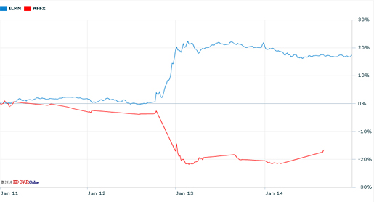
Gene expression through the ages
What is gene expression anyway?
  And why are we measuring it?
Microarrays
  These were originally developed as a sequencing technology, you know?
RNA-seq
  The reason Affymetrix stock tanked.
Single cell sequencing.
Illumina announces HiSeq 2000
2010

Slide 4
Gene expression and transcriptomics
Today we’ll discuss measures of cellular transcript pools.
  Microarrays, RNA-seq, and variants.
Referred to as gene expression studies or transcriptomics.
Good (and essentially the first) measure of functional molecular activity.
  For reasons we’ll discuss in a second.
Although as an aside, they don’t generally measure…
  Transcription rates.
  Degradation rates.
  Translation rates.
  Biochemical activity.

Slide 5
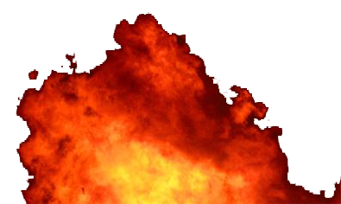
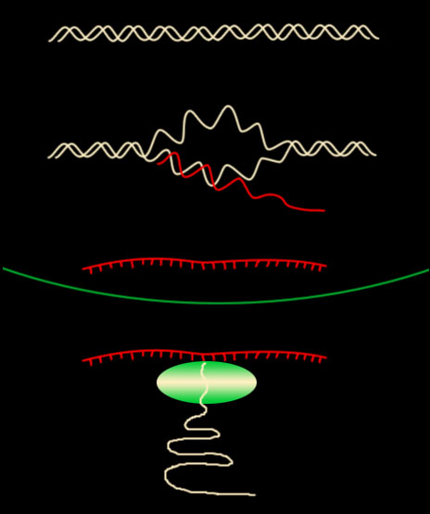
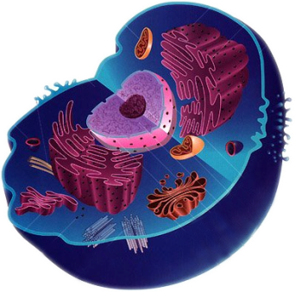
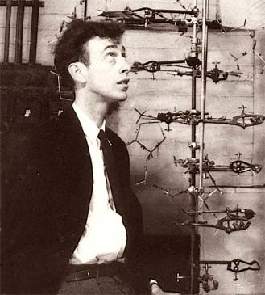
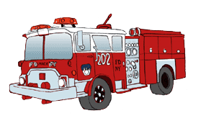

All I Really Need to Know about Biology I Learned from One PowerPoint Slide
Stimulus
Cell
DNA
T
r
a
n
s
c
r
i
p
t
i
o
n
mRNA
T
r
a
n
s
l
a
t
t
i
o
n
Proteins

Slide 6
So why measure gene expression?
Tractable, universal snapshot of cellular activity.
  Nucleotides are much easier to manipulate than proteins.
  But DNA “just” tells you what’s there, not what’s going on.
Captures biologically useful dynamics.
  DNA takes generations to change.
  RNA can be expressed or degraded in minutes.
Combinatorial.
  Captures genes responding to the same environment, even if distal.
Interpretable.
  Easy to go from a unique sequence to homologous DNA or translated protein.

Slide 7
So why measure gene expression?
Identify genes involved in a particular biological process.
  Response to nutrient, stress, environmental condition, etc. etc.
Regulatory module reconstruction.
  Who regulates who.
  Using what sequence elements.
Function prediction using guilt by association.
  Network reconstruction and analysis.
Sample classification.
  What tissues / cell types are present?
  Diagnosis: is this a case or control?
  Prognosis: what cancer subtype is this / outcome / treatment response is expected?

Slide 8
So how to measure gene expression…
…when you don’t have (cheap) sequencing?
You can get RNA out of cells of interest.
  And you can attach a fluorophore to it.
  But only to all of it at once.
    You can’t attach unique fluors to individual sequences – no way to read.
    And you can’t sequence fluors from individual nucleotides – too expensive.
You can clone reference DNA sequences of interest.
  Genes, for example, or subsequences from known genes.
  You can stick them to a chip in predetermined spots, too.

Slide 9
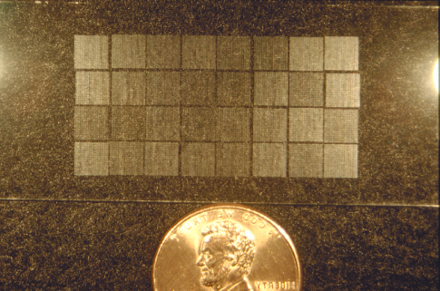
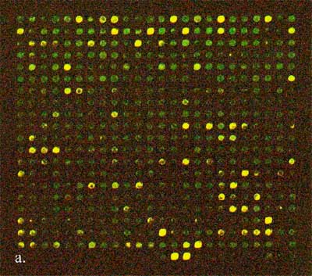
The earliest microarrays: spotted cDNA
Synthesize DNA for all genes of interest.
  Remember which pool is which!
Spot pools onto pre-recorded slide locations.
Extract RNA and fluorescently label.
  Under condition(s) of interest.
Measure how much each spot lights up.
Plus some details.
Now referred to as a two-channel spotted full length gene array.
  Jointly developed at Stanford and CSHL.
Early microarray
(18,000 probes)

Slide 10
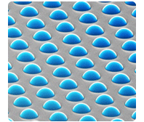
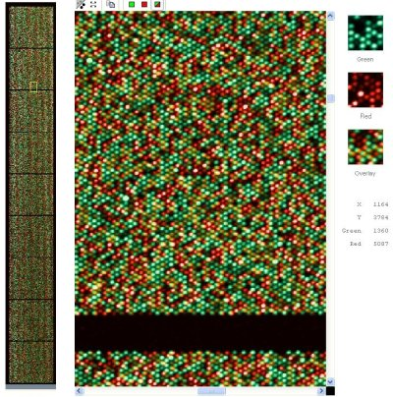
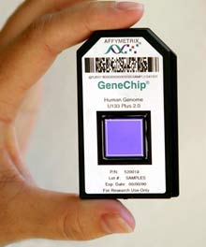
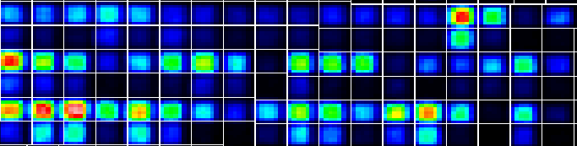
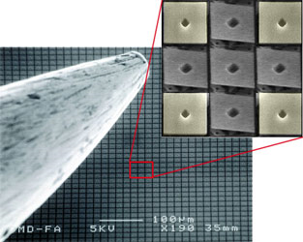
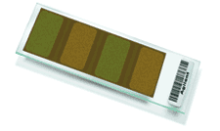
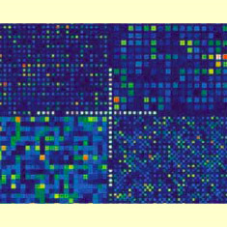
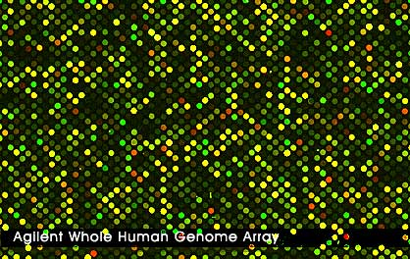
The microarray technology zoo
Illumina BeadArray
(~1M probes)
Early microarray
(18,000 probes)
Affymetrix GeneChip
(~1M probes)
Nimblegen Maskless Array
(~2M probes)
Nanostring
(~1K probes)
Agilent microarray
(~100K probes)

Slide 11
The microarray technology zoo
Very low input
  1-5ng material (!)
Sensitive
  Good dynamic range even with little material.
Precise
  Targeted to 200-800 variants of interest.
  Many standard panels available, but also easily
  customized.
Cheap ($200-400 / sample)
  Compare $400-1,000 for RNA-seq,
  with 10-100ng material.
Nanostring
(~1K probes)
https://www.nanostring.com/support/additional-resources

Slide 12
The microarray technology zoo
Single versus dual channel arrays.
  Two channels measure relative fluorescence (expression) levels.
  One channel provides “absolute” measurements (relative to universal baseline).
Probe length and synthesis method.
  Only the earliest chips used full length, cloned probes.
  Most use oligomers ~tens of nucleotides in length.
  Chemically synthesized, printed, or photolithographed.
Probe arraying technology.
  Spotting.
  Printing.
  Bead microwells.

Slide 13
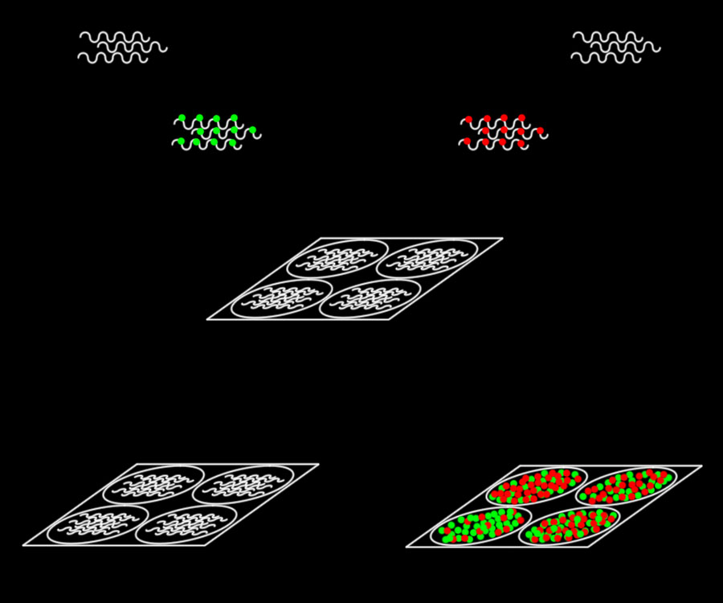

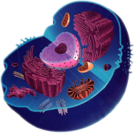
But in the end, the underlying principle’s the same
Control mRNA sample
Experimental mRNA sample
Add green dye
Add red dye
Mix
Normal
Cells
Experimental
condition X
Spot slide with gene sequences
Conditions
Genes
X
Y
Z
Hybridize
A
2
1.5
1
Scan
B
0.2
-0.1
0.15
Gene A
Gene B
C
-1
-1.5
-2
Gene C
Gene D
D
0
3
0.5

Slide 14
Making data from a physical microarray chip
Measure intensity (single channel or red/green) at each spot.
Typically multiple spots (probes) per gene (probeset).
Ratio and log.
Capture in absolute scale.
Positive: folds up.
Negative: folds down.

Slide 15
Actually making data from a microarray chip
It all seems so simple! What could possibly go wrong…
Hybridization issues.
  Cross-hybridization, variable hybridization, GC content sensitivity…
Image and signal processing.
  Segmentation, spot identification and separation, intensity (under)saturation.
Chip flaws.
  Background fluorescence, spatial nonuniformity, defects, bubbles, spot uniformity.
RNA degradation.
Contamination.
Reverse transcription efficiency.
Sequence identification and mapping.

Slide 16
Quality control of expression data
Many concepts apply to all technology types.
Typical to filter out subsets of:
  Spots (probes) or genes (probesets)
  per experiment (matrix cells).
  Genes (matrix rows).
  Experiments (matrix columns).
Seq. level
Exp. level
Gene level
Experiments 1 ... n
  Seq. level: quality of the expression measurement of one seq. in one particular experiment.
  Exp. level: quality of the expression measurement in one particular experiment.
  Gene level: quality of the expression measurement of one probe across all experiments.

Slide 17
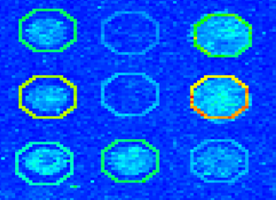
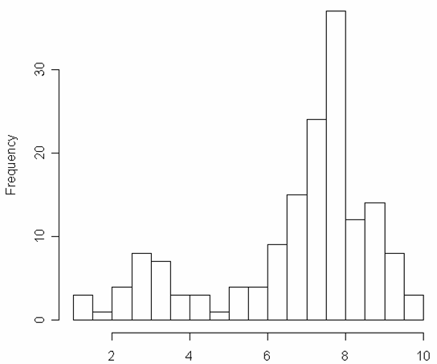
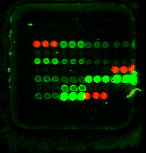
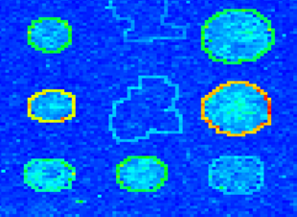
QC: spot identification
Histogram of pixel intensities of a single spot
good spot quality
NA
X
“Donuts“
poor spot quality
Mean / Median / Mode / 75% quantile

Slide 18
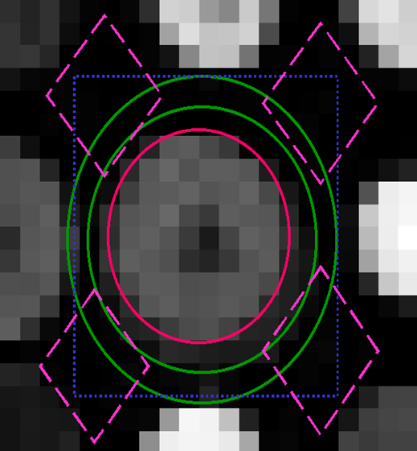
QC: local background
GenePix
QuantArray
ScanAlyse

Slide 19
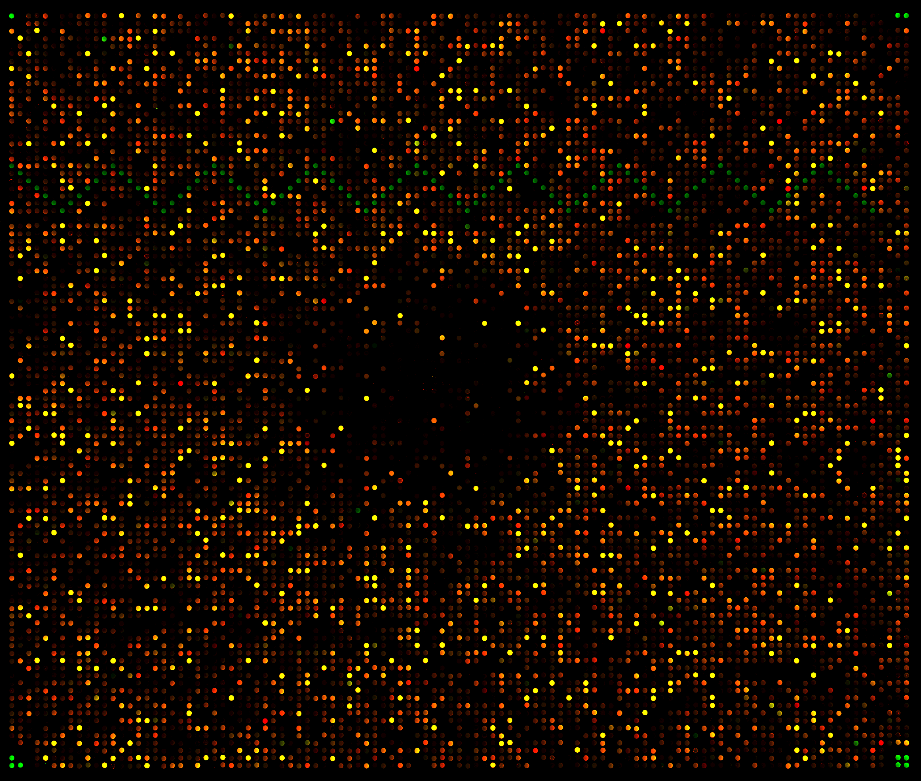
QC: spatial defects

Slide 20
Quality control of expression data
First, throw out anything too bad to be recoverable.
  Probes: bad prints, local background, scratches / bubbles / etc.
  Genes: too few / failed probes, incorrect sequence, ambiguous sequence.
  Experiments: bad array / hyb / extraction, something just plain went wrong.
Then correct or normalize everything left.
  Adjusts per-gene differences (e.g. hyb affinity, GC bias).
  Adjusts per-experiment differences (between replicates, hyb conditions, extraction).
  Adjusts per-batch differences (scanner behavior, environmental conditions, etc.)
  Critical to compare between experiments / batches!
Finally, optionally, re-impute missing values.

Slide 21
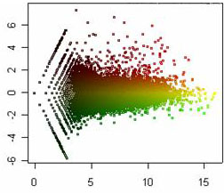
Normalization: MA plots
mRNA Samples
sample1 sample2 sample3 sample4 sample5 …
1 0.46 0.30 0.80 1.51 0.90 ...
2 -0.10 0.49 0.24 0.06 0.46 ...
3 0.15 0.74 0.04 0.10 0.20 ...
4 -0.45 -1.03 -0.79 -0.56 -0.32 ...
5 -0.06 1.06 1.35 1.09 -1.09 ...
Gene
M = log₂(cur / median)
gene-expression level or ratio for gene i in mRNA sample j
M =
Log₂(red intensity / green intensity)
or Log₂(current / median sample)
A =
average( Log₂(red intensity), Log₂(green intensity) )
or average( Log₂(median), Log₂(current) )
A = 1/2 log₂(cur * median)
For seq / single channel

Slide 22
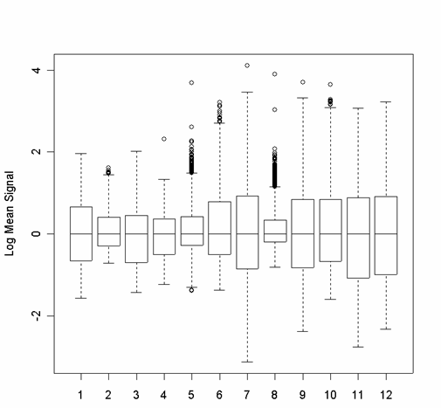
Normalization: boxplots
Median centering: assumes most genes are unchanged.
What are the biological effects / assumptions of these data normalization methods?
Quantile normalization: ensures that multiple experiments’ boxplots are (essentially) identical.

Slide 23
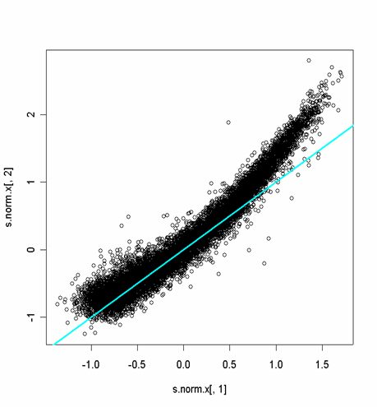
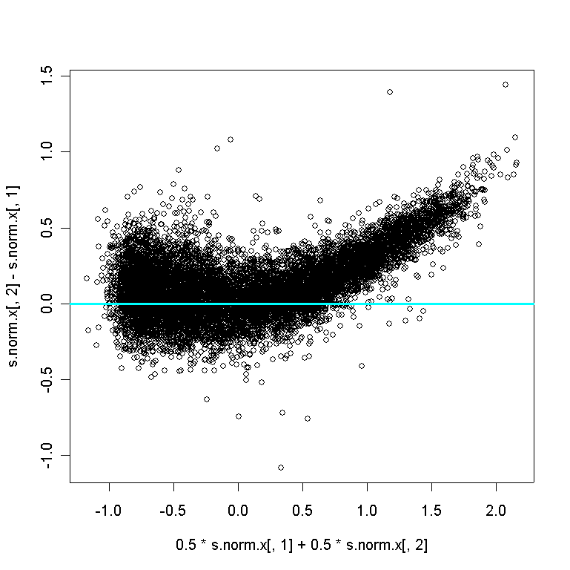
Normalization: median centering is a blunt instrument
Median centering is a global method. It does not adjust for local effects, intensity dependent effects, print-tip effects, etc.
Scatterplot of log-intensities
after median centering
MA Plot of the same data
Log cur
M = Log cur - Log median
Log median
A = (Log median + Log cur) / 2

Slide 24
Normalization: quantile / LOWESS are more accurate
Local estimate
Use the estimate to bend
the banana straight
M = Log cur - Log median
A = (Log cur + Log median) / 2

Slide 25
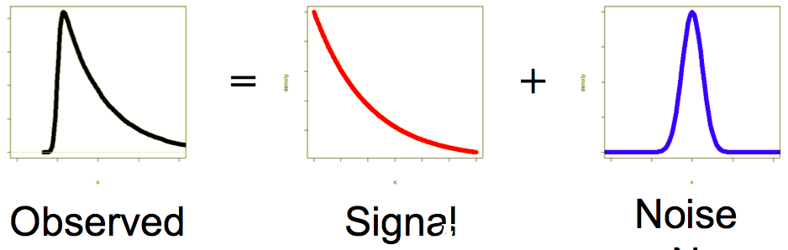
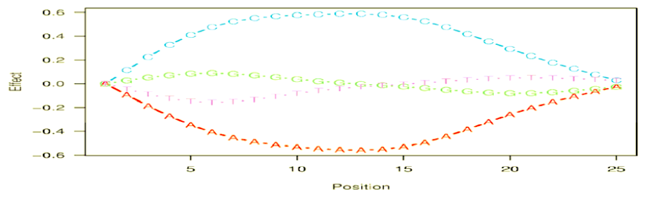
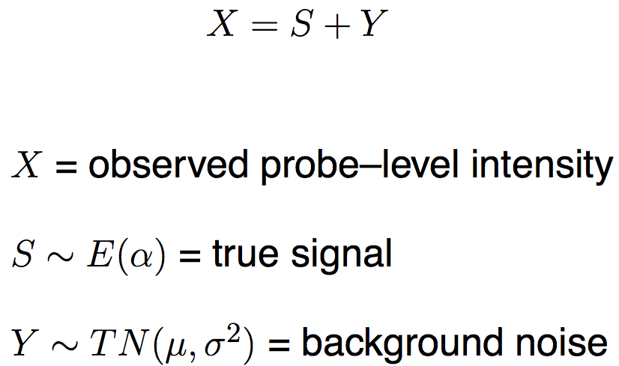
Normalization: (GC)RMA
Robust MultiArray normalization
GC-RMA adds a further component for per-base noise
(fit to empirical training data).
Hierarchical model of within- and between-probe (within-gene) noise.

Slide 26
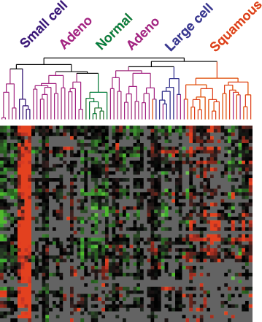
Missing value imputation
What if normalization alone isn’t enough?
  Some algorithms, like PCA, rely on a complete data matrix with no missing values.

Slide 27
Missing value imputation: k-nearest neighbors
Fill gaps with weighted sum of k nearest neighboring genes’ values in that experiment, for some definition of ”nearest” (e.g. Spearman) and “k” (e.g. 10).
Complete data
30% simulated missing values, zero-filled
30% missing values,
KNN imputed
j
j
2 | | 5 | 7 | 3 | 1
Gene X
2 |4.3| 5 | 7 | 3 | 1
Gene X
2 | 4 | 5 | 7 | 3 | 2
Gene B
2 | 4 | 5 | 7 | 3 | 2
Gene B
3 | 5 | 6 | 7 | 3 | 2
Gene C
3 | 5 | 6 | 7 | 3 | 2
Gene C

Slide 28
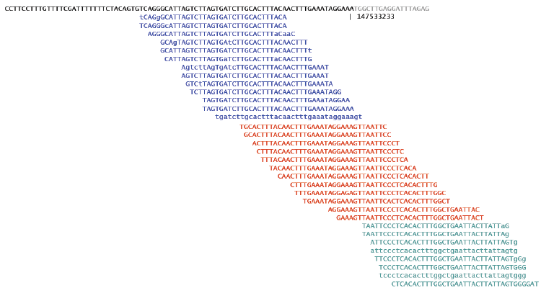
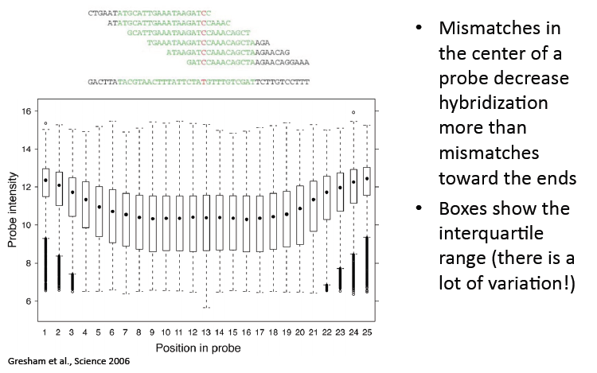
A reminder: chips aren’t just for gene expression
SNP chips use tiling arrays for variant detection
Sequencing is just a very dense tiling array!

Slide 29
https://canvas.harvard.edu/courses/55671/quizzes/128193

Slide 30
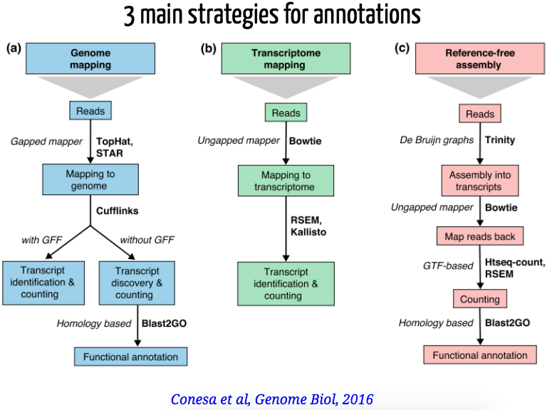
Speaking of sequencing: RNA-seq
RNA-seq is a mashup of single channel microarrays with sequencing.
  Do all your sequence-level QC like you would for DNA, not microarrays.
  Replace your fluorescence scanner with a mapper.
  Do all your gene / experiment-level QC like you would for microarrays.

Slide 31
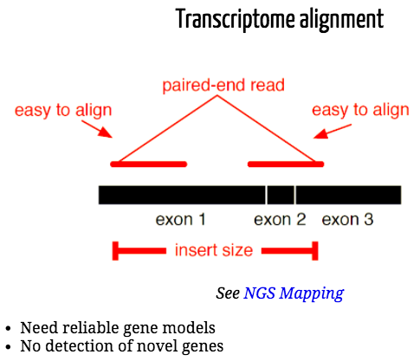
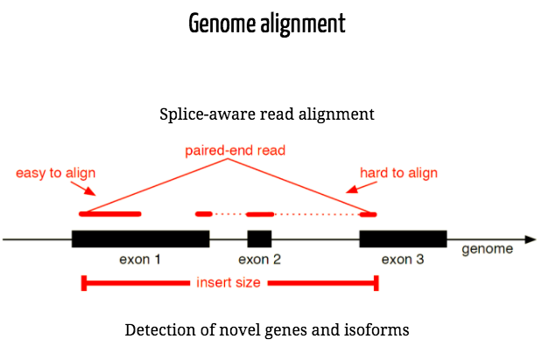
RNA-seq mapping: gaps
Aligners of short reads for RNA-seq must either have a perfect reference for all isoforms, or be smart about gaps.

Slide 32

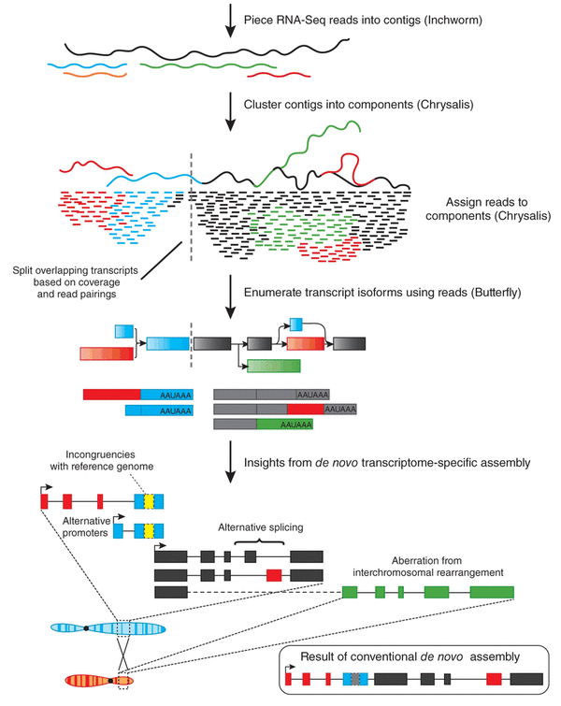
RNA-seq “mapping”: assembly
“Inchworm” performs pure k-mer short-contig assembly (pre-graph).
“Chrysalis” does the usual de Bruijn graph resolution (roughly one per gene).
One representative of several transcriptome assemblers.
“Butterfly,” rather than collapsing to contigs, enumerates consistent paths (roughly one per isoform).
Then treat this as a new reference and map reads back to quantify.
Iyer et al, NatBT 2011

Slide 33

RNA-seq quantification
Several units that all boil down to “reads per unit transcript.”
  FPKM/RPKM: Fragments or Reads per Kilobase per Million (reads).
    Normalizes for length of target gene and sequencing depth.
    Differ only in the way in which pairs (reads) versus single ends (fragments) are handled.
  CPM or TPM: Copies or Transcripts per Million (reads).
    Same normalizations, different order; results in proper %s / proportions per sample.
Most quantifiers also probabilistically reassign ambiguous reads / exons.
  Suppose you have isoforms ABC and DBE.
  Exons A and C have abundance 100, D and E have abundance 10, B has 110.
  How abundant is the isoform ABC vs. DBE?
  Real world not quite so clear – most solutions use expectation maximization (EM).

Slide 34
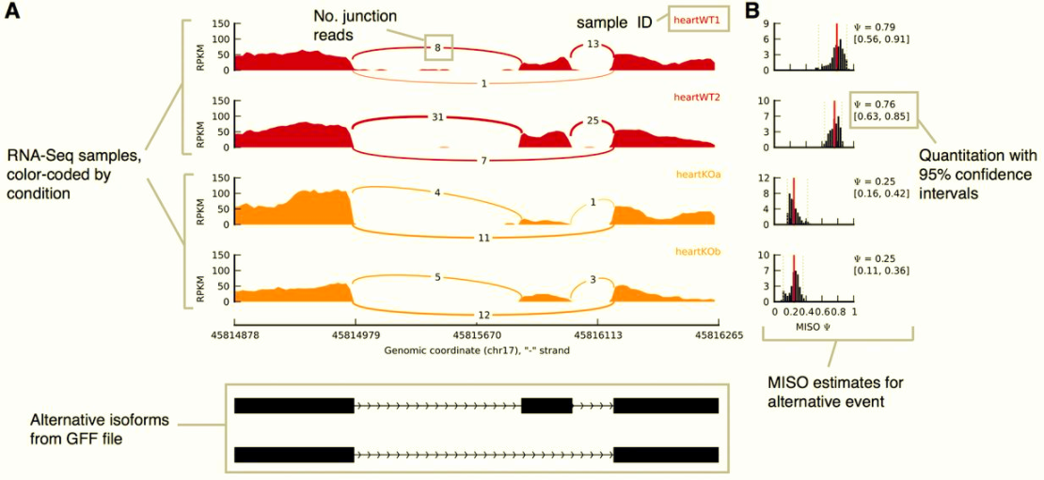
RNA-seq QC: alignment / recruitment / “sashimi” plots
Katz et al, Bioinformatics 2015

Slide 35
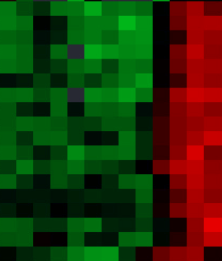
Single cell (RNA) sequencing
RNA-seq, one “experiment” per cell rather than per population / condition.
Why bother?
  Distinguish cell types within tissues / immune response / etc.
  Heterogeneity in cellular responses (stochastic expression / etc.)
  Loss of signal through population averaging (e.g. half up, half down = no signal).
RNA-seq
Conditions →
scRNA-seq
Cells →
Conditions
← Genes
← Genes

Slide 36
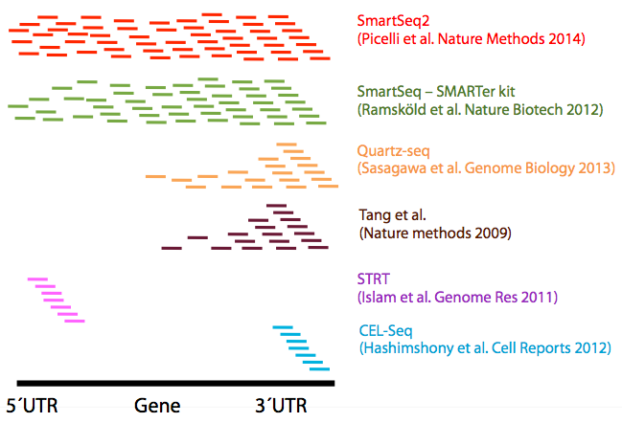
Single cell (RNA) sequencing
Protocols differ mainly in how they scrape detectable RNA out of such tiny quantities of biomaterial!
For data analysis, this translates into noise.
Technical noise:
  Amplification bias.
  Jackpotting / loss.
  Background noise.
  Cell state / size / cycle variation.
Biological noise:
  Stochasticity.
  Sparsity.
  True (vs. experimental) zeros.
  Low counts / rare events.

Slide 37
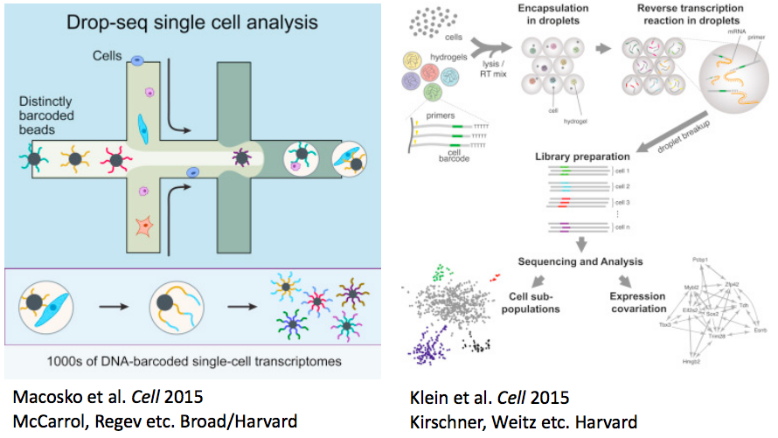
Single cell (RNA) sequencing

Slide 38
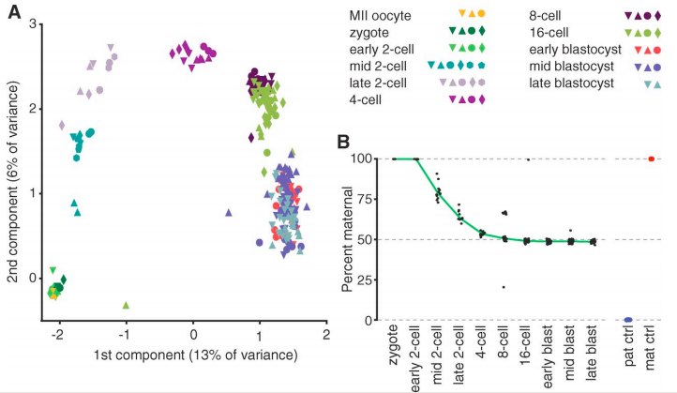
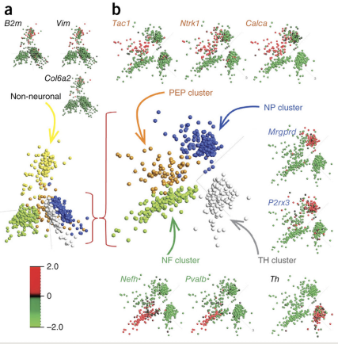
Single cell analysis: ordination
Very common to then cluster subpopulations of similarly-transcribing cells using ordination (PCA, (N)MDS, t-SNE, etc.)
Deng et al, Science 2014
Usoskin et al, NatNeuro 2015

Slide 39
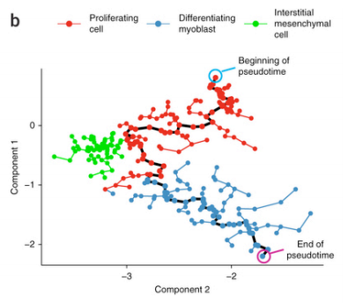
Single cell analysis: ordination
This can get interesting if you then trace temporal / developmental / differentiation paths through the ordination, which can be reprojected to generate “time” axes.
Trapnell et al, NatBT 2014

Slide 40

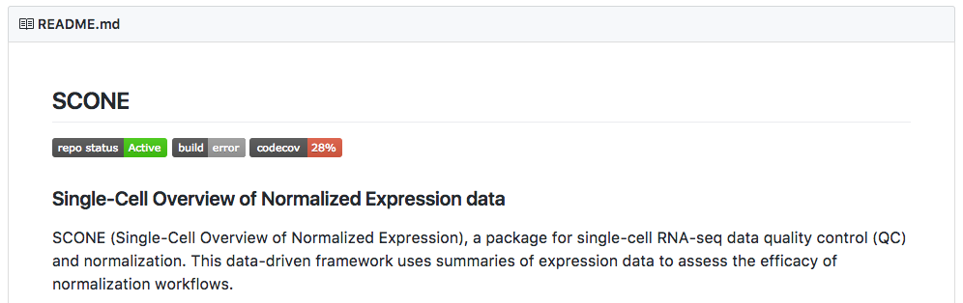
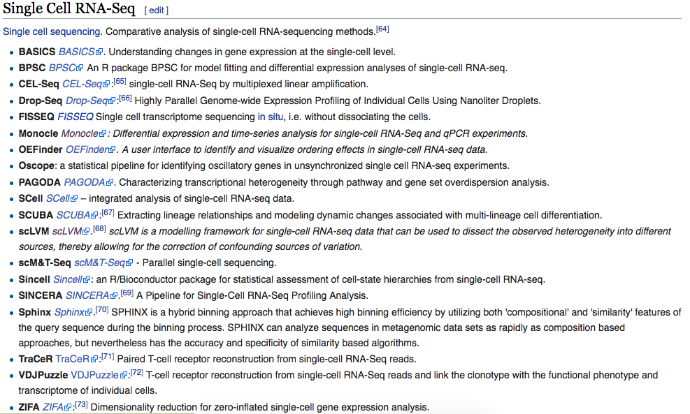
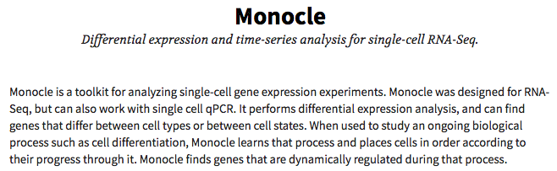
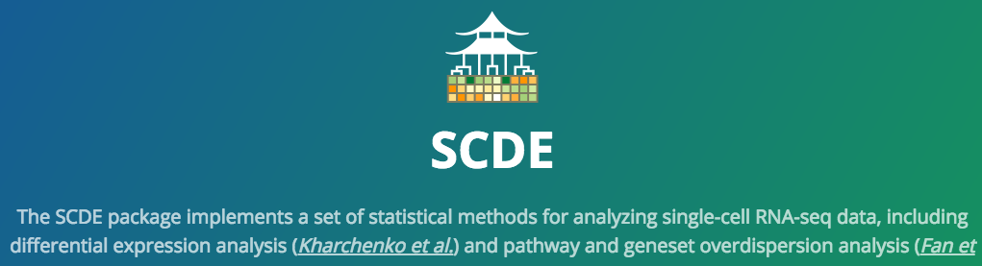
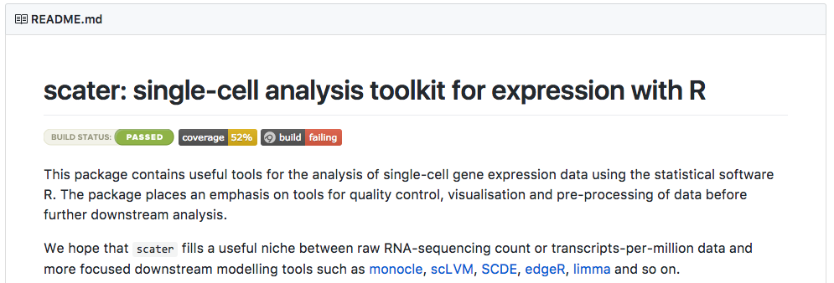


Single cell analysis: so many tools!
http://github.com/seandavi/awesome-single-cell

Slide 41











Sources of gene expression data
www.ebi.ac.uk/arrayexpress
www.ncbi.nlm.nih.gov/geo
biogps. org
www.ebi.ac.uk/gxa
portal.gdc.cancer.gov

Slide 42
https://canvas.harvard.edu/courses/55671/quizzes/128196

Slide 43
Summary
Gene expression provides a global snapshot of molecular dynamics.
Microarrays came first (originally meant for sequencing!)
  DNA sequences arrayed in known locations.
  Hybridize labeled cDNA, measure fluorescence intensity.
Quality control: throw out bad probes / genes / experiments.
Normalization: fix the ones that remain by shifting expression distributions.
Imputation: if you need to, put back good guesses for missing values.
RNA-seq looks basically like a single channel microarray.
  But quantification is done by mapping, which is usually gap-aware.
  Can be aided by de novo transcriptome assembly.
Single cell RNA-seq makes each sample a single cell.
  Introducing more technical and biological noise, but allowing cell population analysis.

