Slide 1
Gibbs Sampling – Algorithm | MOTIF DETECTION

Slide 2
Gibbs Sampling – Algorithm | MOTIF DETECTION
Start random.

Slide 3
Gibbs Sampling – Algorithm | MOTIF DETECTION
Align.

Slide 4
Gibbs Sampling – Algorithm | MOTIF DETECTION
Pick one random sequence.

Slide 5
Gibbs Sampling – Algorithm | MOTIF DETECTION
Slide (jump) to improve the alignment.

Slide 6
Gibbs Sampling – Algorithm | MOTIF DETECTION
Slide (jump) to improve the alignment.

Slide 7
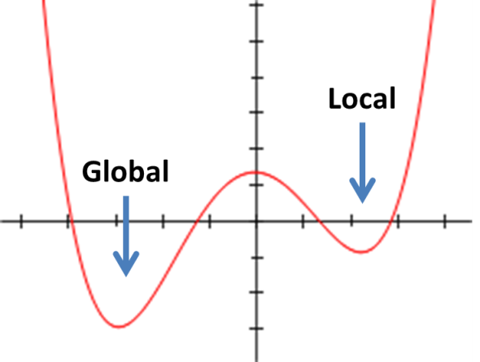
Gibbs Sampling – Algorithm | MOTIF DETECTION
Pick jump with probability proportional to improvement in score
(not necessarily global optimum).

Slide 8
Gibbs Sampling – Algorithm | MOTIF DETECTION
Eventually (hopefully) we arrive at an alignment of the real motif.

Slide 9
Gibbs Sampling – Algorithm | MOTIF DETECTION
Thus we found the original (hidden) pattern.

