Slide 1
Transcriptional regulation
Curtis Huttenhower (chuttenh@hsph.harvard.edu)
Eric Franzosa (franzosa@hsph.harvard.edu)
http://huttenhower.sph.harvard.edu/bst281
Slide elements courtesy of:
Doug Brutlag
Yechiam Yemini
Shaojie Zhang
Florian Markowetz

Slide 2
Final project
Sign up for a final project slot by end of day today!
  Leave time to iterate – rare that first proposed project is accepted without revision.
Email instructional team with:
  Group members (2-5, names + CCed) – can, but doesn’t have to be, same as midterm.
  1-2 paragraph summary of proposed project.
  Date of presentation (May 6, 8, 13, 15).
    ~3 presentations / day; first come, first served.
Any analysis project incorporating quantitative biomolecular data analysis.
  Scope must be appropriate for number of people and time – not too much, too little.
  Can be drawn from current research.
  Will submit group presentation and code+data package, individual 2-4 page writeup.
    Must include 1-2 figures and appropriate references; aim for 2 pages + citations (and overflow).
30 minute presentation + 5 minutes questions.
  All group members must present.
  Background/motivation, data, methods, results, discussion, questions/next steps.

Slide 3
Introduction

Slide 4
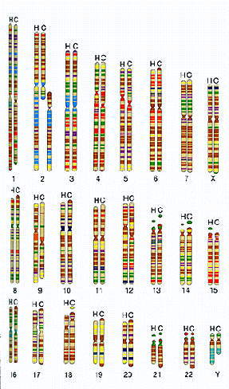
Review: Biological complexity
Biological parts lists are big
  1,000s of genes / transcript isoforms / proteins / metabolites
These numbers are dwarfed by the numbers of potential interactions
  (N choose 2) = N! / (N-2)! / 2 = N(N-1)/2 ~ N²
With more interaction choices, and interactions being
easier to “invent/rewire,” they are major drivers
of diversity in biological systems
A collection of parts and their interactions form a network
The “parts lists” between the human and chimp
genomes are very similar!

Slide 5
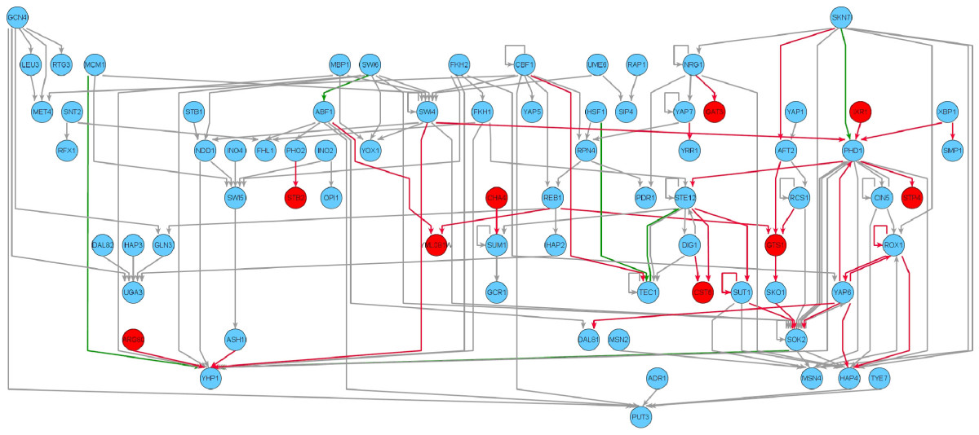
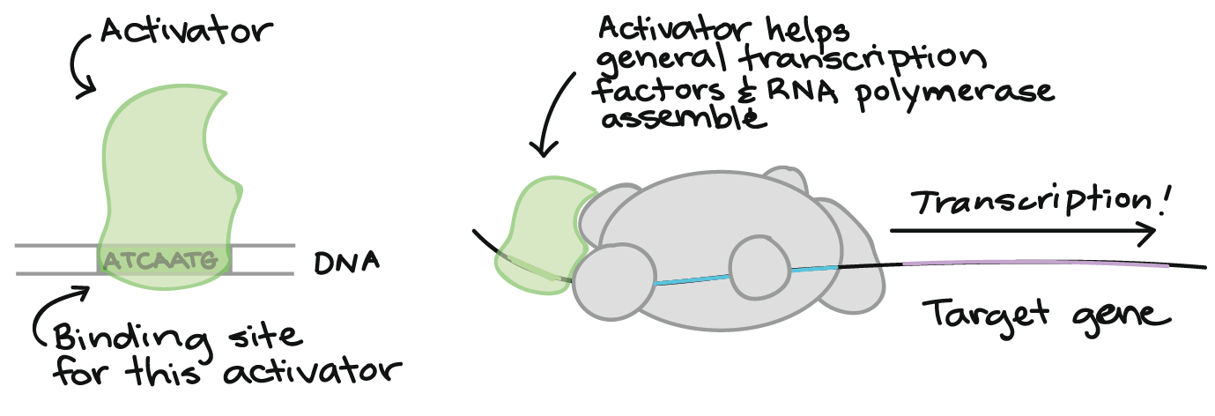
Review: Transcriptional regulatory networks
Transcription factors (TFs) bind DNA near target genes (TGs) to regulate transcription
  Edges are directed: TF regulates gene
  Edges can be activating (+) or repressing (-) (terminology: signed interaction)
TFs regulate other TFs, leading to a regulatory hierarchy
TF
-
+
TG
STOP
repressor

Slide 6
Today: Transcriptional regulation (and friends)
Transcriptional factor binding sites.
  Discovery from sequence.
  Chromatin immunoprecipitation: ChIP-*.
miRNAs.
  Post-transcriptional regulation of transcripts.
Incorporating gene expression assays.
Incorporating regulatory network models.

Slide 7
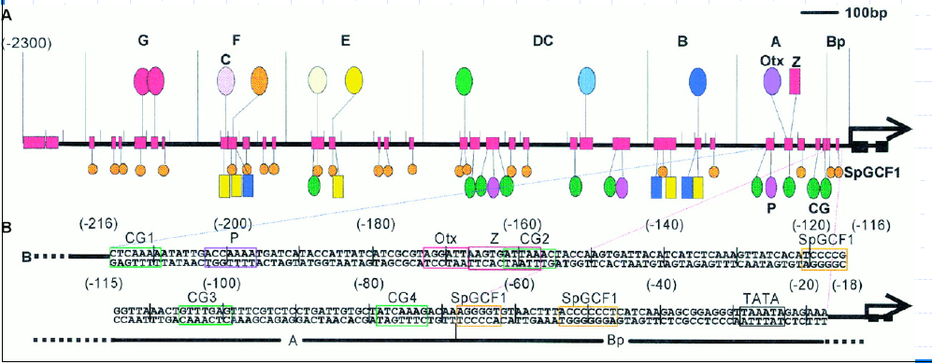
Identifying transcriptional regulatory elements
Transcriptional regulation is hard!
Hundreds of cooperating factors, dozens of mechanisms.
Cis-regulation: “inline” upstream of transcript, but still multiple kilobases.
Trans-regulation: distant, often very (10s-100s knt).
Many-to-many relationships between TFs and genes.

Slide 8
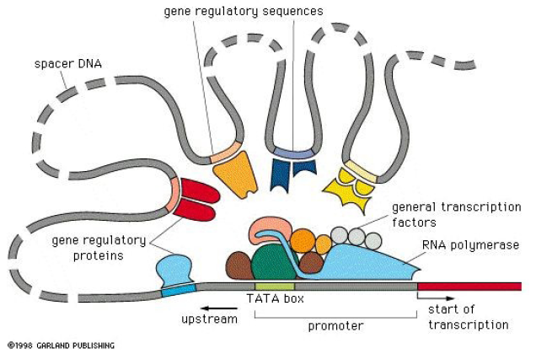
Complicated due to underlying molecular mechanisms

Slide 9
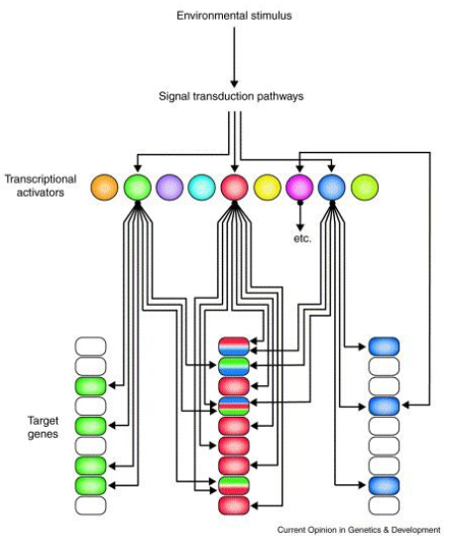
The gap between biology and model

Slide 10
Data used in regulatory network analyses
Sequence motifs.
  Seq. location or co-occurrence.
Physical binding (ChIP).
Conservation.
Coexpression.
  Particularly during perturbation or mutation/knockout.
Chromatin structure.
  *-C.
Protein-protein interaction networks.
Protein structure.
…

Slide 11
Discovering regulatory elements from primary sequence

Slide 12
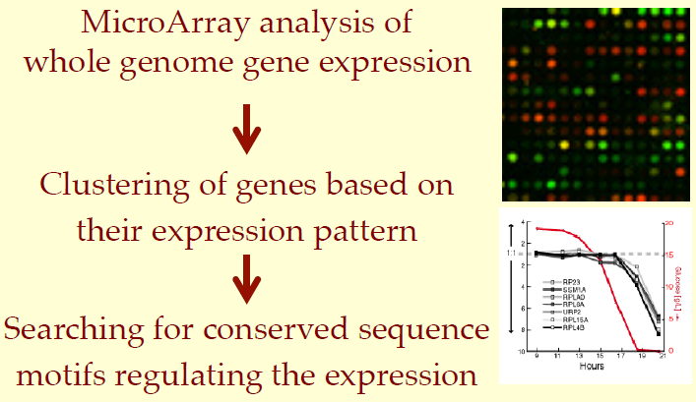
Suppose biology precisely fit the expected model

Slide 13
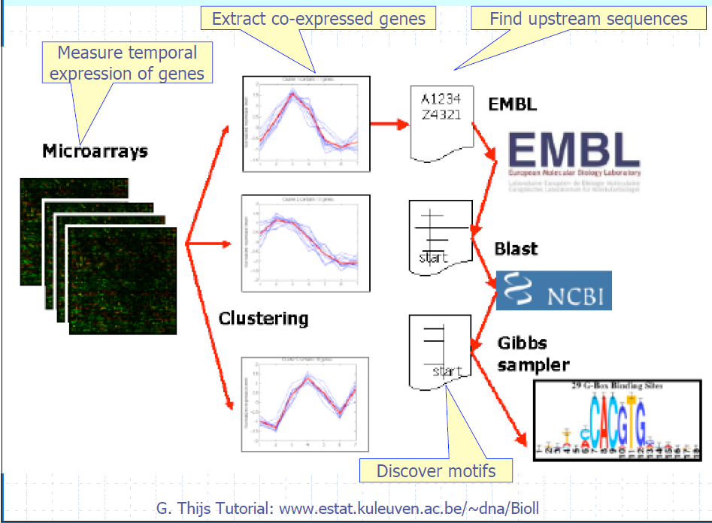
From coexpressed modules to motifs

Slide 14
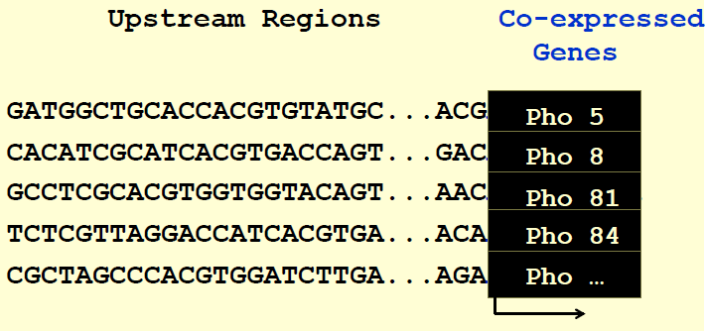
Can human beings solve the problem?

Slide 15
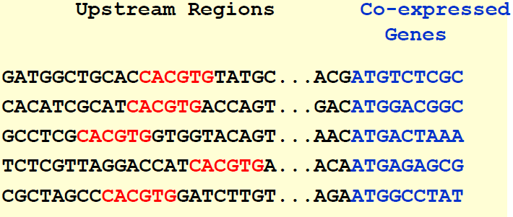
Can human beings solve the problem?

Slide 16
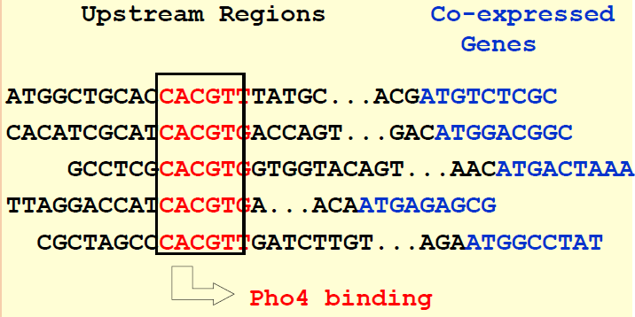
Can human beings solve the problem?

Slide 17
Motif representation

Slide 18
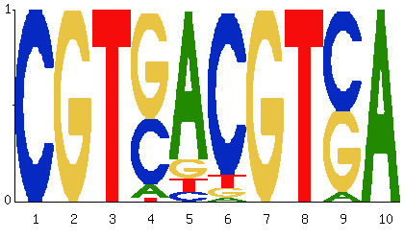
An aside: representing sequence motifs

Slide 19
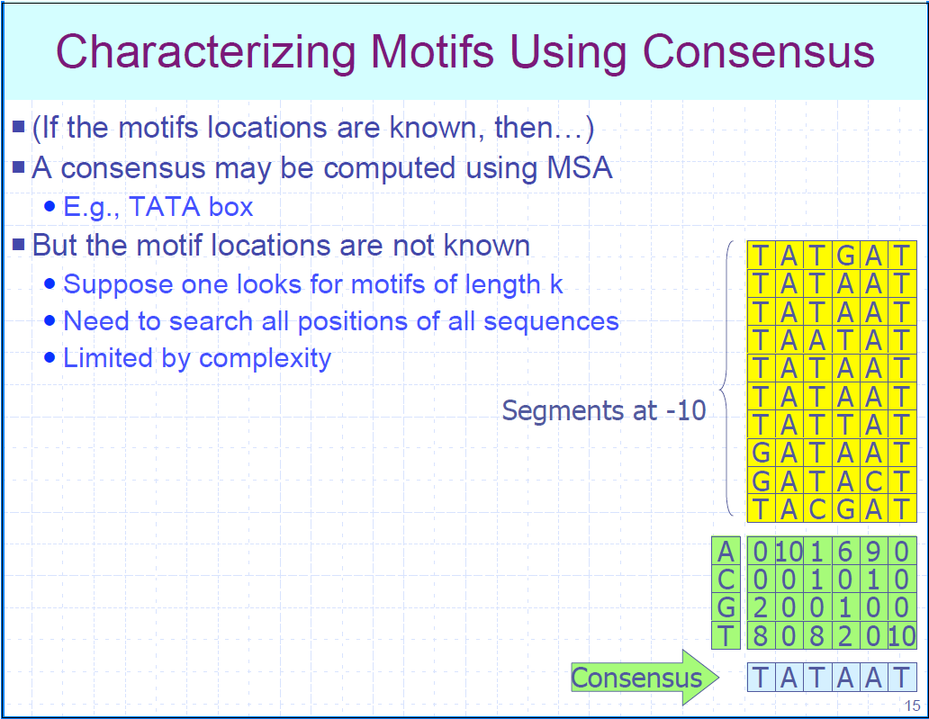
Consensus sequences
A motif represents a common pattern among a group of sequences.
  How to summarize a group of sequences?
Often useful to start with a count matrix of bases by positions.
A consensus sequence is then the most frequent base at each position.

Slide 20
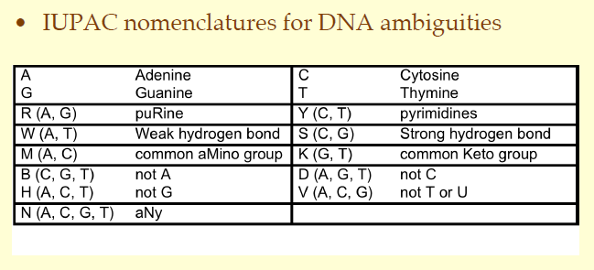
Ambiguous consensus sequences
Degenerate consensus sequences match >1 base / position.
For example:
  CRCAAAW = C, A-or-G, CAAA, A-or-T
Can be extended to allow full-on regular expressions.

Slide 21
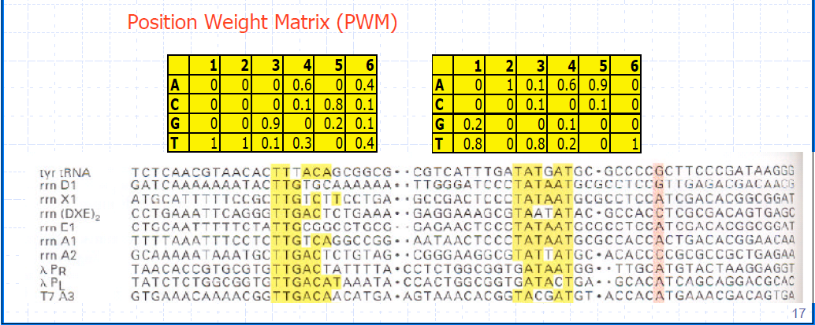
Position weight matrices
Sum-normalizing the position count matrix yields probabilities.
  Position weight matrix, PWM.

Slide 22
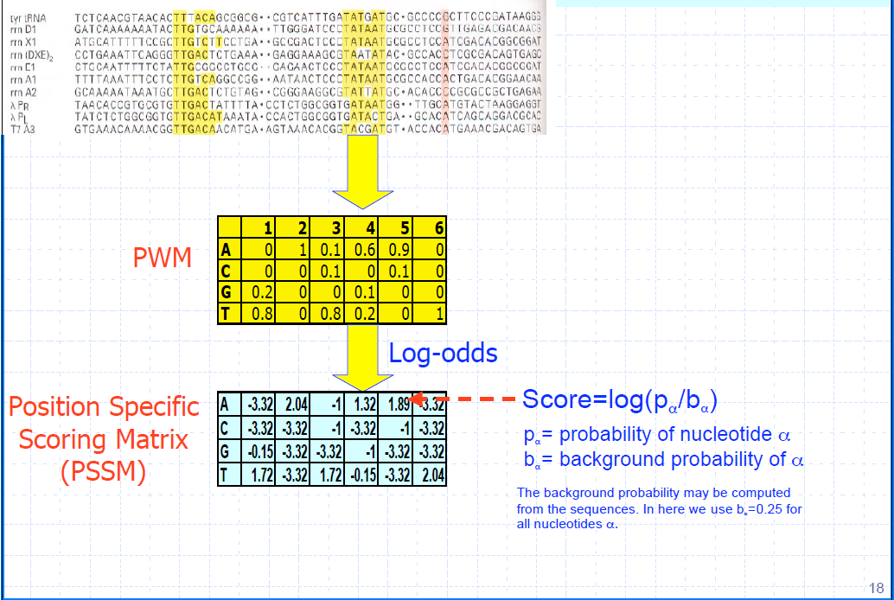
Position specific scoring matrices
Why?

Slide 23
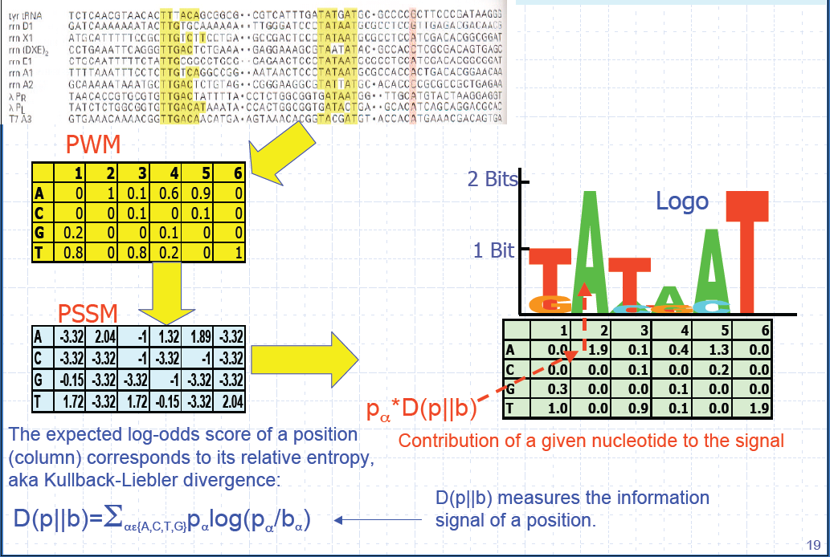
Motif sequence logos
Distance (in bits) from background.
Min = 0, max = 2.

Slide 24
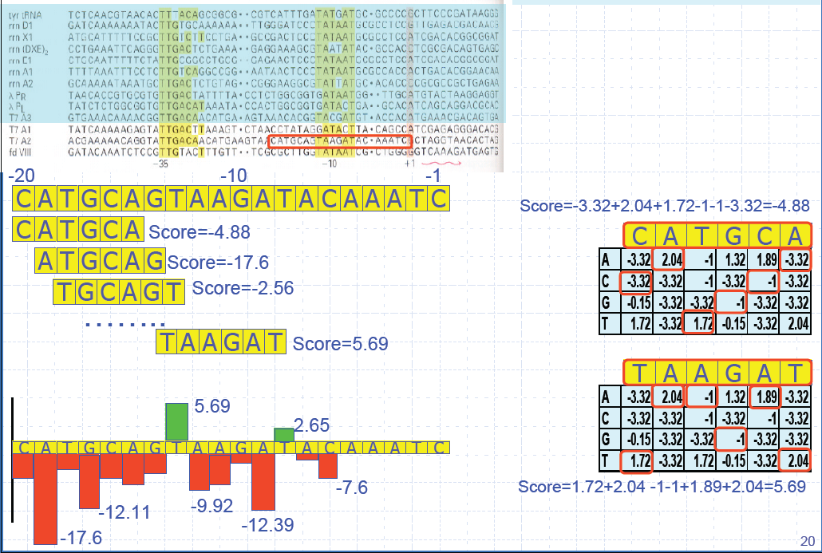
PSSMs make it easy to locate motifs in sequences

Slide 25
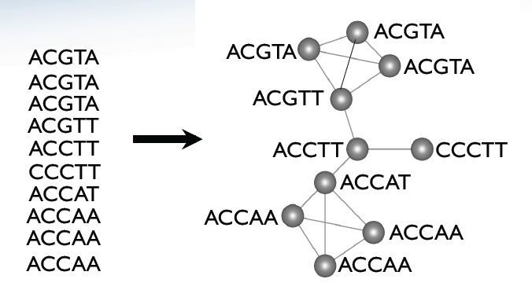
Modeling motifs (MSAs) as graphs

Slide 26
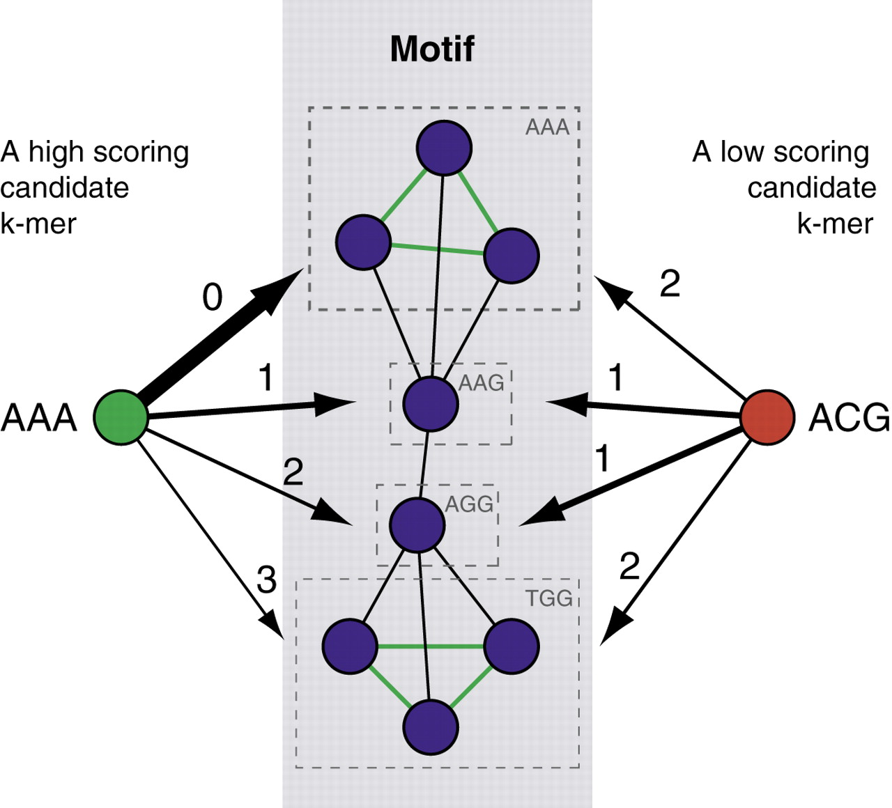


Modeling motifs (MSAs) as graphs
Gray edges represent a Hamming distance of one, green exact matches. Thickness represents weight of each match = Hamming distance of candidate-motif.
N is the total number of unique k-mers
d is the Hamming distance,
n_{i} is the number of k-mers in identity group i,
Θ_{SS} = perfect match score,
Θ_{NS(b1,b2)} = nucleotide substitution matrix,
Θ_{IK} = score of jth motif copy in group
Even though for both candidates, the average Hamming distance to the motif is the same, the high scoring candidate is an exact match to a cluster of three k-mers, which contributes the majority of its score, whereas the low scoring candidate is two mutations away from each of the clusters of three k-mers
Naughton B T et al. Nucl. Acids Res. 2006;34:5730-5739

Slide 27
Modeling motifs (MSAs) as HMMs
Bioinformatics Sequence and Genome Analysis, David W. Mount

Slide 28
Algorithms for motif discovery

Slide 29
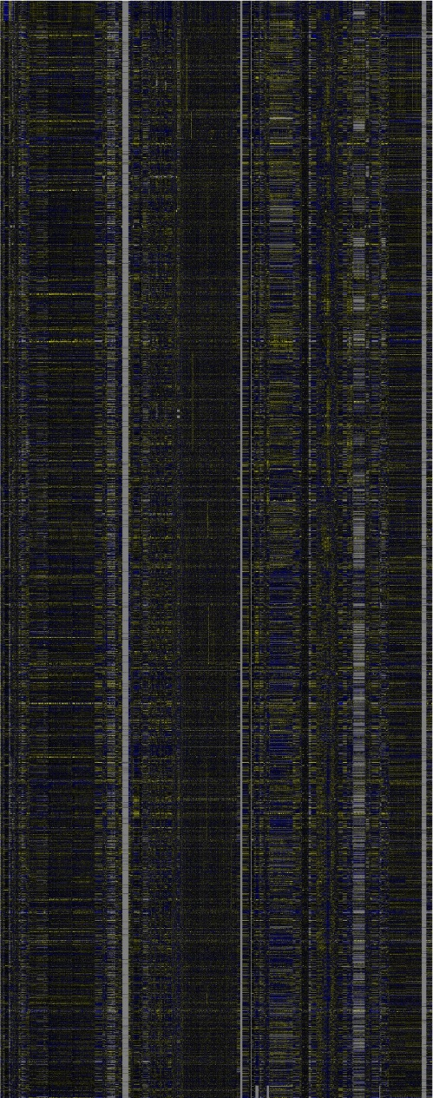
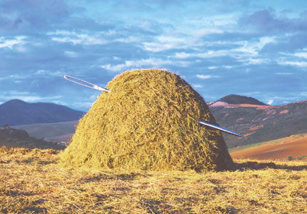
Back to business…
~2,200 conditions
100 genes
80 conditions
~6,000 genes

Slide 30
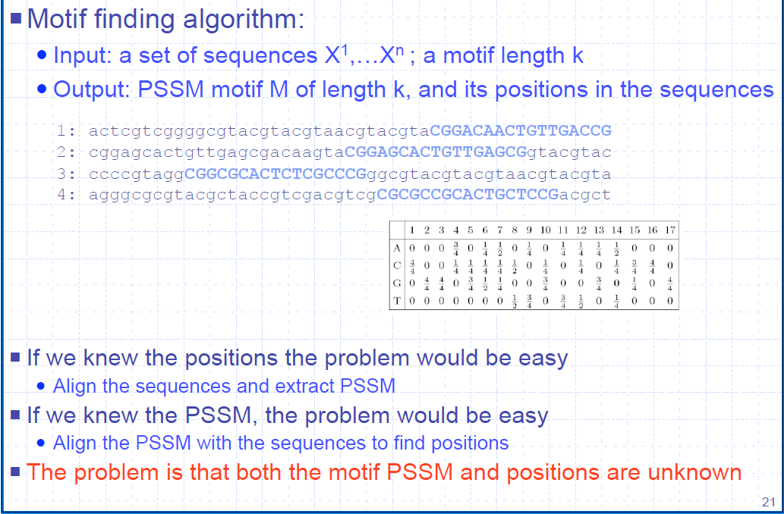
Identifying enriched regulatory sequence motifs

Slide 31
Probabilistic mechanisms for sequence model fitting
This is an instance of model fitting by parameter optimization.
Two efficient, globally optimal algorithms under the right circumstances:
  Gibbs sampling: randomly sample from parameters, proportionally to their likelihood.
  Expectation Maximization: iterate between optimizing one parameter vs. another.
Lots more to solve this kind of problem, depending on specifics:
  Markov Chain Monte Carlo (MCMC) sampling.
  Gradient a/de-scent.
  Genetic algorithms.
  Simulated annealing.
  …

Slide 32
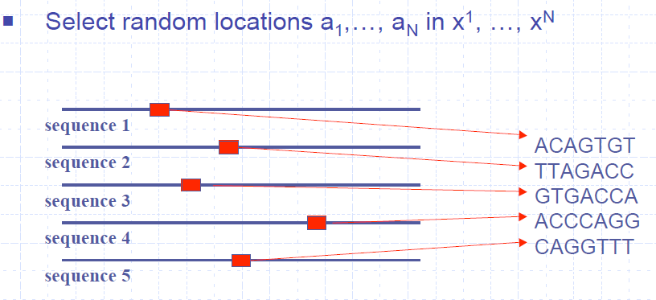
Gibbs sampling for enriched motif identification
First in Science 1993 - been around a long time!

Slide 33
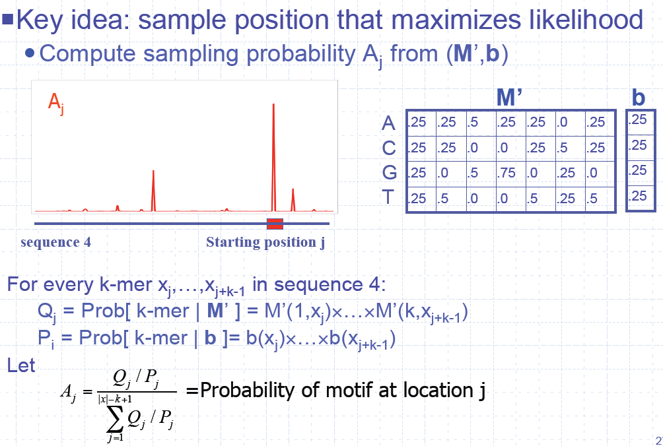
Gibbs sampling for enriched motif identification

Slide 34
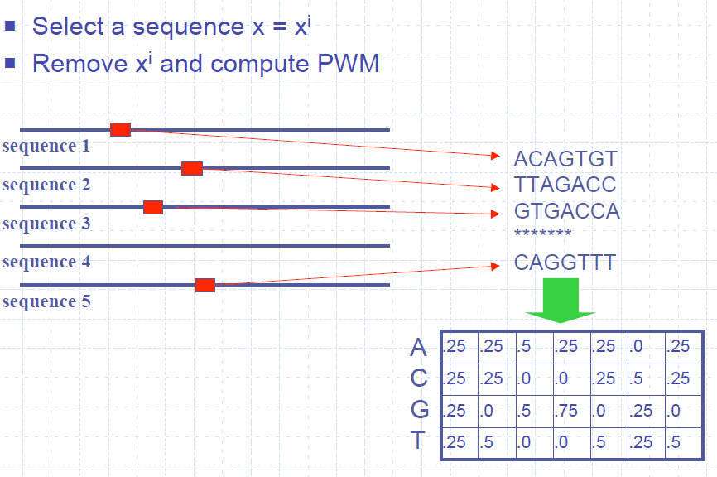
Gibbs sampling for enriched motif identification

Slide 35
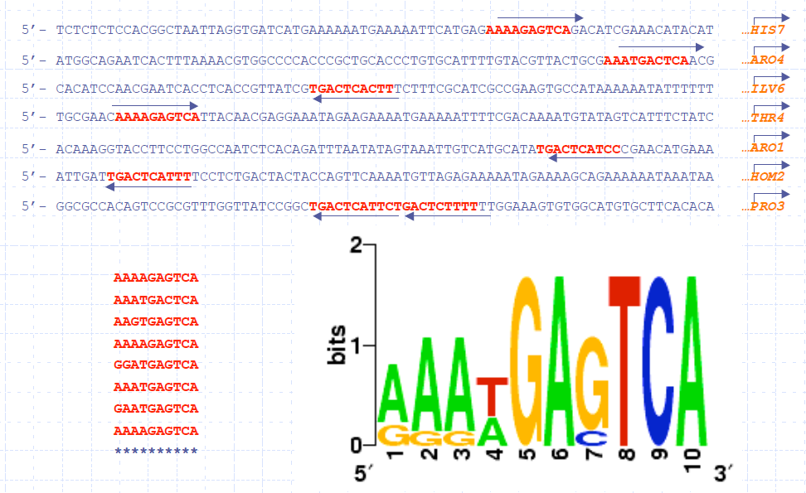
Gibbs sampling for enriched motif identification
So the algorithm in summary is:
Seed a potential motif with random subsequences from potential regulators.
Iteratively select a subsequence at random.
  Rebuild the motif without
  that subsequence.
  Scan the whole subsequence
  with the rebuilt motif.
  Re-add the “best hit” location
  to the developing motif.
Repeat until convergence
(no more changes).

Slide 36
Show alternate
Gibbs slides

Slide 37
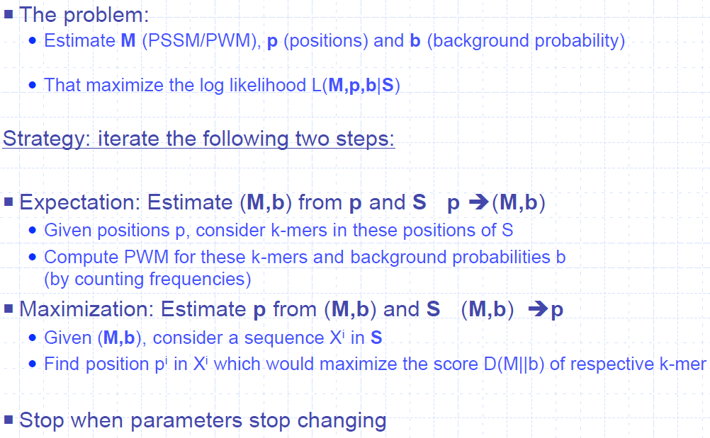
Expectation Maximization (EM) for enriched motif identification

Slide 38
Expectation Maximization (EM) for enriched motif identification
So the algorithm in summary is:
Seed a potential motif with random subsequences from potential regulators.
Iteratively:
  Build a motif from the currently selected locations.
  Rescan every subsequence and retain the best hit location within each.
Repeat until convergence (no more changes).
This one’s “only” been around since 1995.

Slide 39
Discovering regulatory elements with experimental guidance

Slide 40
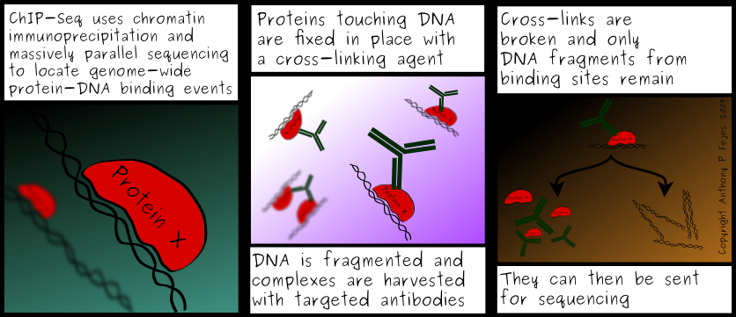
ChIP-((chip)|(seq))

Slide 41
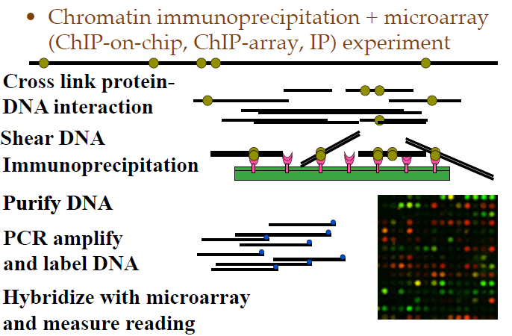
High-throughput chromatin immunoprecipitation

Slide 42
Motif discovery from ChIP-* experiments
Unlike regulatory region screening, ChIP experiments yield short, local, highly enriched sequences.
  Although still by no means noise-free; functional vs. nonspecific binding.
Design an algorithm that more efficiently, specifically identifies one or a few motifs highly enriched in ChIP-bound subsequences?
  As opposed to many motifs weakly/combinatorially enriched in regulatory regions?

Slide 43
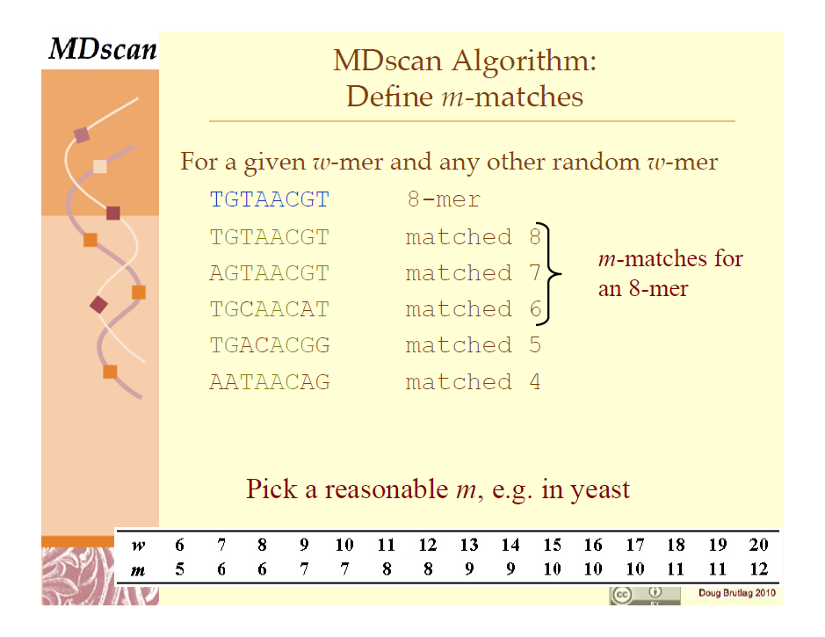
MDscan for motif identification in ChIP sequences
Liu NatBT 2002

Slide 44
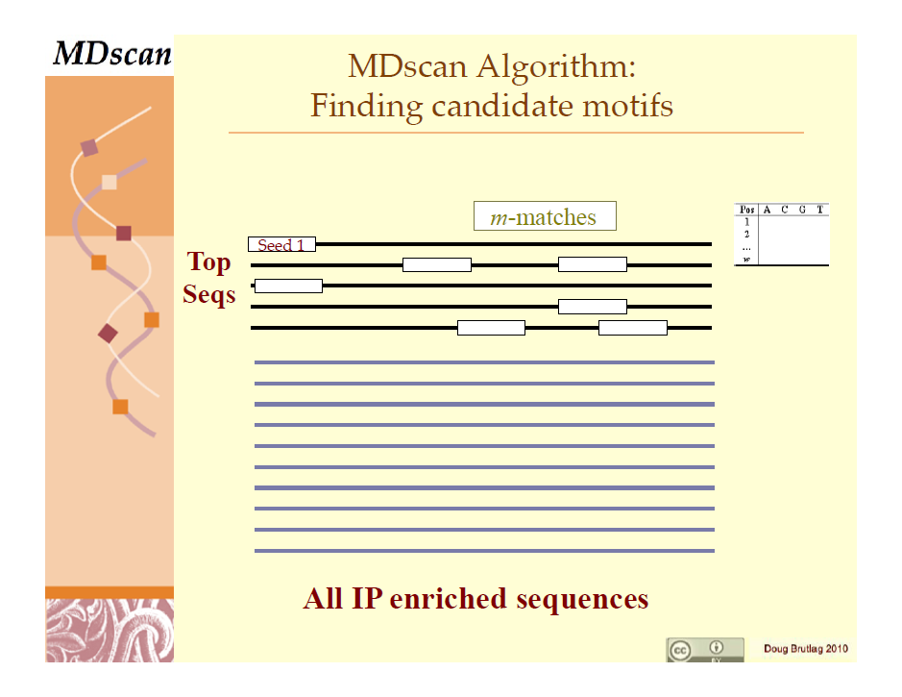
MDscan for motif identification in ChIP sequences

Slide 45
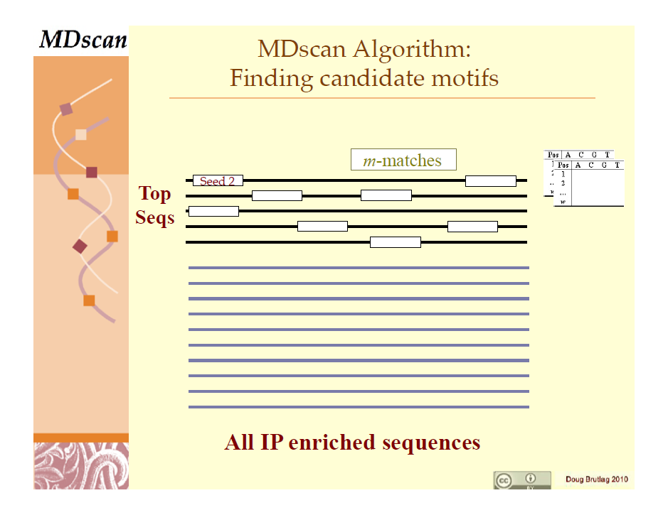
MDscan for motif identification in ChIP sequences

Slide 46
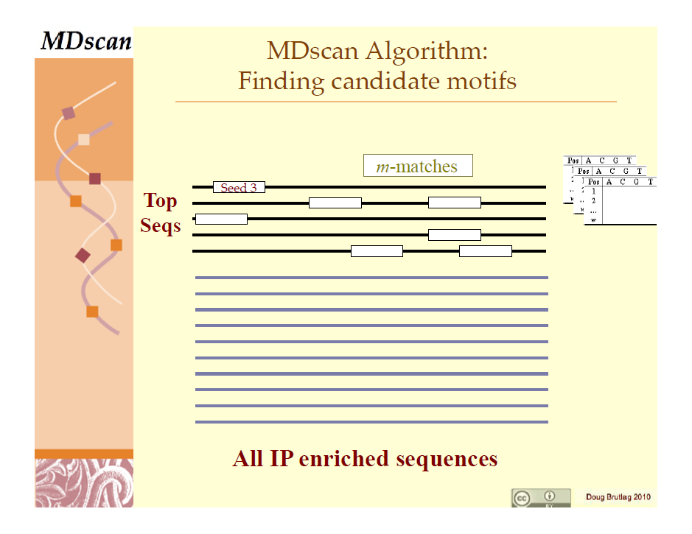
MDscan for motif identification in ChIP sequences

Slide 47
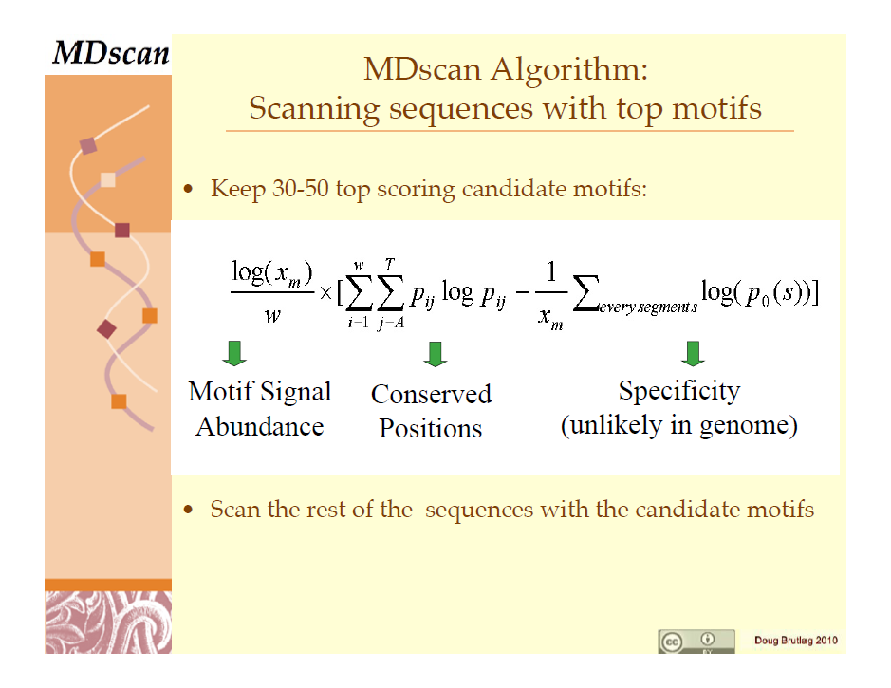
MDscan for motif identification in ChIP sequences

Slide 48
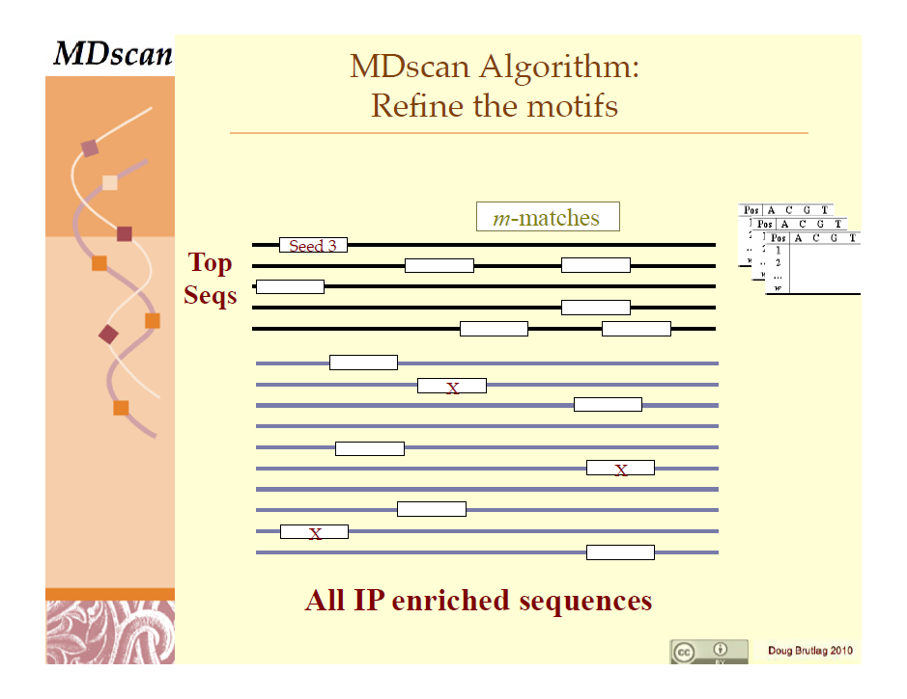
MDscan for motif identification in ChIP sequences

Slide 49
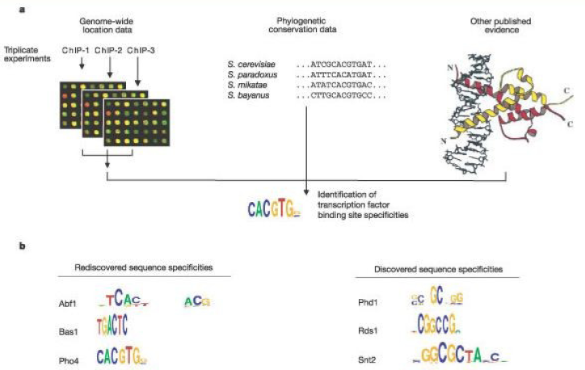
Integrating multiple data types for ChIP analysis
Early groundbreaking study in yeast regulatory network discovery by combining ChIP(-chip, at the time) with conservation and structure.
Harbison Nature 2004
McIsaac BMCBioinf 2006

Slide 50
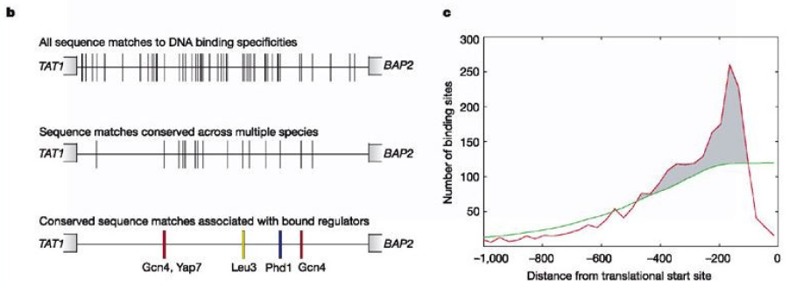
Integrating multiple data types for ChIP analysis

Slide 51
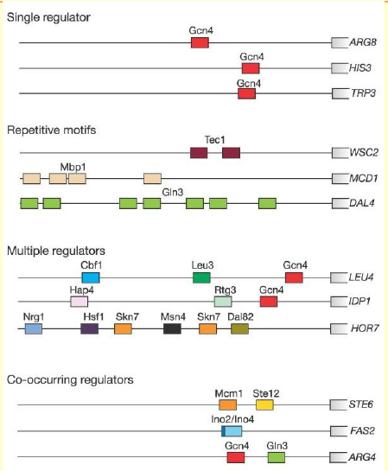
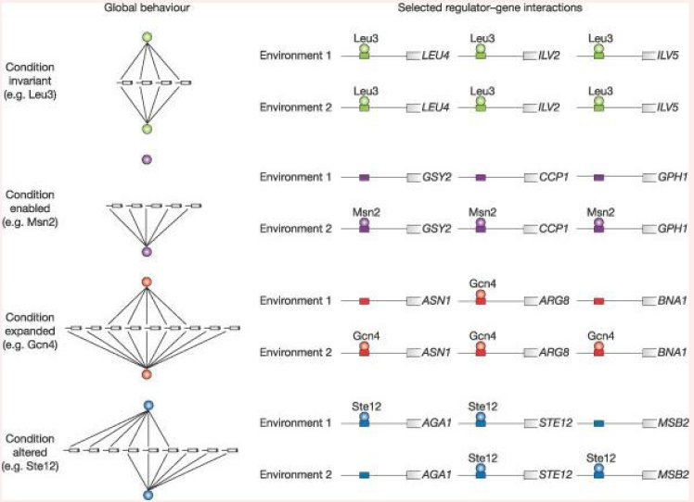
Global properties of the resulting yeast regulome

Slide 52
Canvas question time
Ask me for the passcode

Slide 53
RNA interference

Slide 54
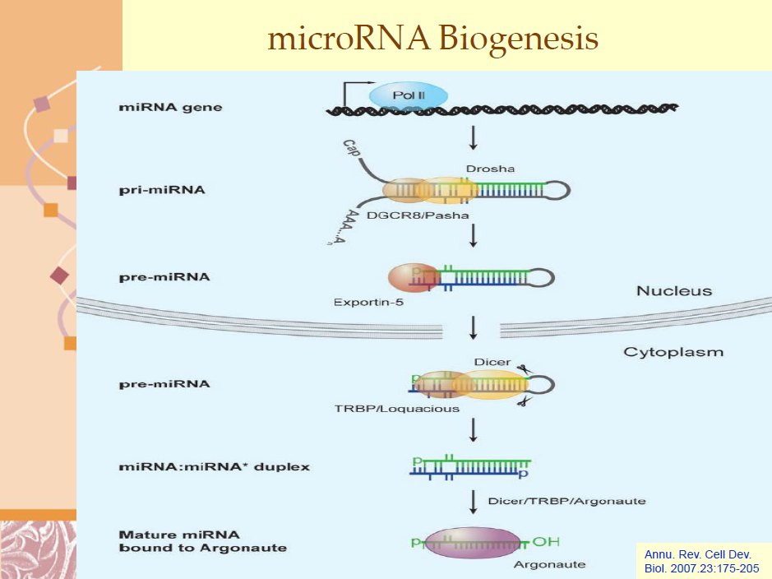
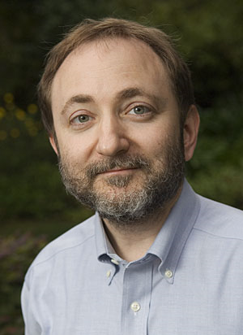
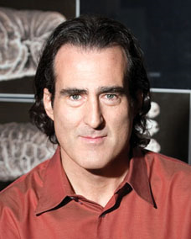
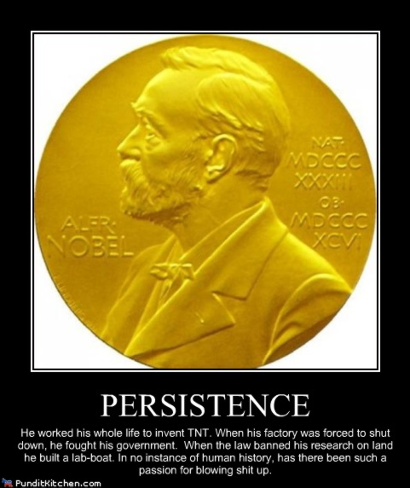
miRNA biology in one slide
Andrew Fire
Craig Mello
2006

Slide 55
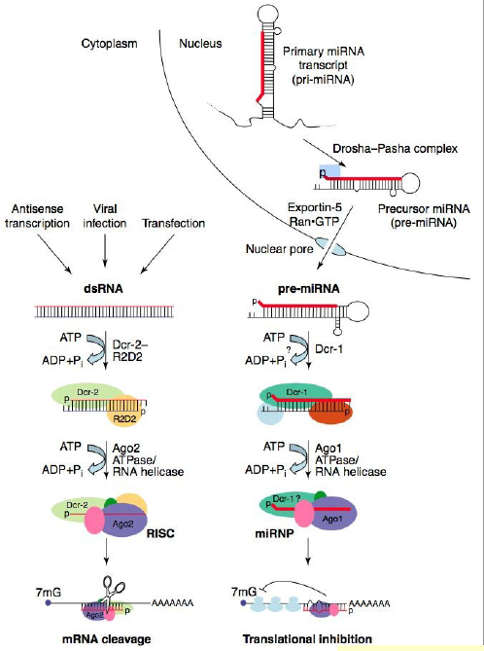
miRNA biology in one two slides
RISC loading → degradation
Ribonucleoprotein complex → translation inhibition
Filipowicz CurrOpSB 2005

Slide 56
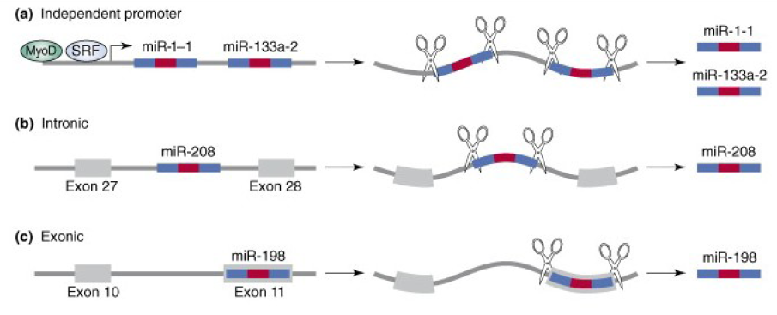
miRNA genes
Leads to two related problems in miRNA bioinformatics:
Given a genome, find miRNA genes.
Given an miRNA gene, find its targets.
Zhao TiBS 2007

Slide 57
Finding miRNA genes: MiRscan
Scan genomes to find…
  Open reading frames with…
  Short structures that fold to RNA hairpins…
  That are conserved across (closely related) species…
  Weighting additional features based on training set.
Lim Science 2003

Slide 58
Finding miRNA genes: MiRscan
All predictions (>35k)
Training set
Experimentally verified

Slide 59
Finding miRNA targets
miRNA target motifs are mostly…
  Located in 3’ untranslated regions (UTRs).
  Generally have very high complementarity to a short (7-8nt) seed.
    Often perfect in plants, less so in other organisms.
  Have structural complementarity to the rest of the miRNA (~20-25nt).
    Which can include mismatches, gaps, structural “bulges”, etc.
These are:
  Small numbers.
  Loose rules.
  Many variants.
  “Mostly” - lots of exceptions.
Easy to find lots of false positives!

Slide 60
Finding miRNA targets: RNA structure
Strategy #1 incorporates detailed RNA secondary structural modeling.
  Target must be accessible in broader molecule, not self-binding, etc.
Robins 2005

Slide 61
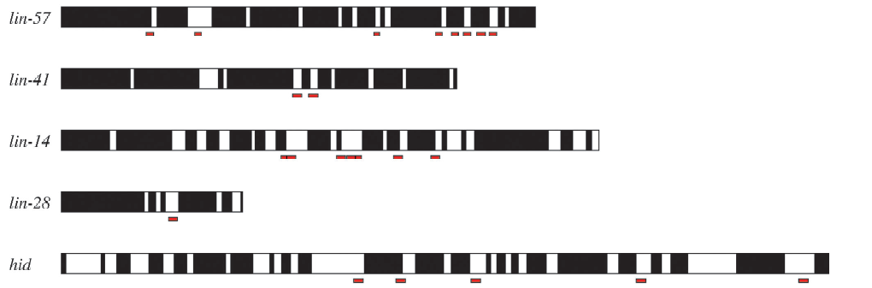
Finding miRNA targets: conservation
Streategy #2: miRNA binding targets are also evolutionarily conserved.
  And often appear in sequence clusters.
Conserved sites
miRNA targets
Stark PLoS Bio 2003

Slide 62
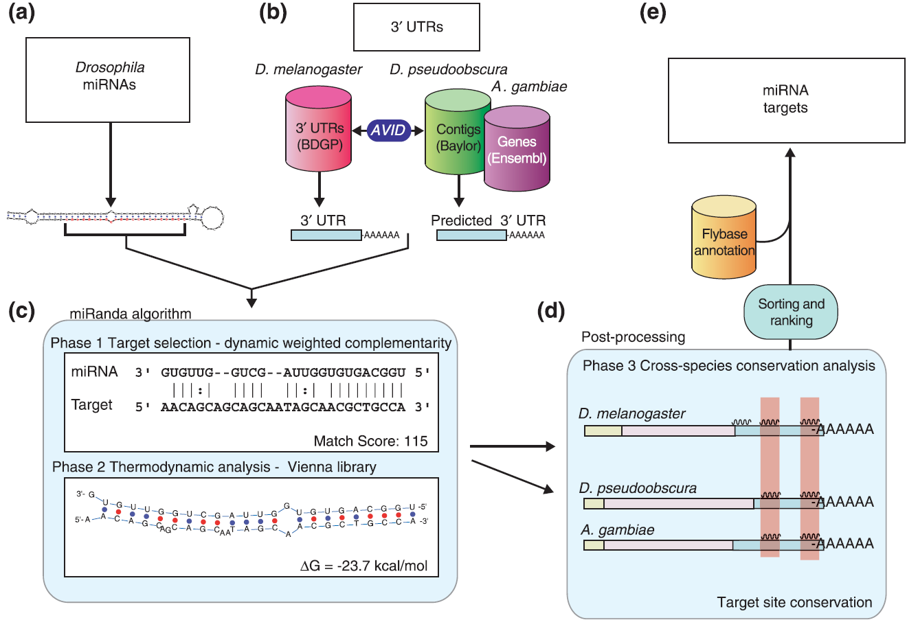
Finding miRNA targets: integration
Most target finders now use a combination of these properties.
miRanda: Enright Genome Bio 2003
TargetScan: Lewis Cell 2003

Slide 63
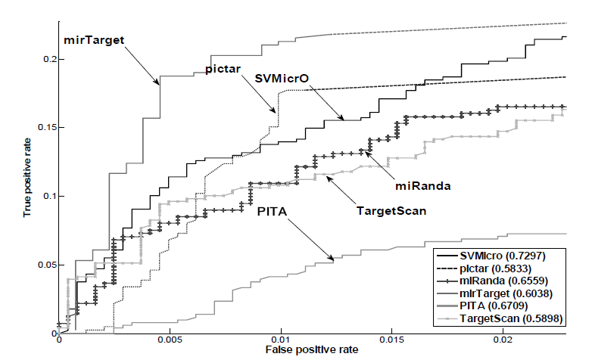
Finding miRNA targets: it’s still hard!
Positives generally true, but lots of false negatives.
Liu 2010

Slide 64
Regulatory circuit and network reconstruction

Slide 65
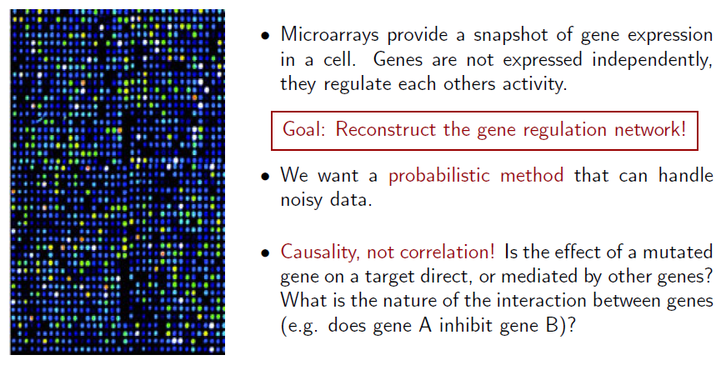
Probabilistic models for regulatory circuits

Slide 66

Probabilistic models for regulatory circuits

Slide 67

Probabilistic models for regulatory circuits

Slide 68

Bayesian networks for single cell regulatory networks
K Sachs et al. Science 2005;308:523-529

Slide 69


“Module networks” representing regulatory circuits
Segal 2003

Slide 70

Biophysical dynamical systems of regulatory circuits
Segal 2009

Slide 71










Avoiding the genome-wide network trap
Clockwise from top left:
  simulated E.coli 1 network;
  E.coli 1 inferred correlations above 50%;
  simulated E.coli 2 network;
  E.coli 2 inferred correlations above 50%;
inferred networks made using 2 bins for each gene.

Slide 72



Local regulatory network reconstruction: the Inferelator
Expression = Sum(TFBSs * Expression(TFs))
Bonneau 2006

Slide 73




Local regulatory network reconstruction: FIRE
Beer 2004

Slide 74
Tools and resources

Slide 75









Transcription factors and miRNAs
jaspar.genereg.net
www.biobase-international.com
redfly.ccr.buffalo.edu
regulondb.ccg.unam.mx
www.oreganno.org
www.cisred.org
www.abcam.com/kits/microrna-database-and-target-predictor-resources
zmf.umm.uni-heidelberg.de/apps/zmf/mirwalk2/
www.mirbase.org
www.targetscan.org
mirdb.org

Slide 76








Motif discovery
meme.sdsc.edu

Slide 77

Regulatory data and tools

Slide 78
Summary
Start planning for the final project – sign up by next Monday.
  Don’t forget to leave time for iteration!
Regulatory motif discovery from primary sequence is hard.
  Look for enriched binding sites upstream of transcribed targets.
Enrichment can be determined by different statistical optimization strategies.
  Gibbs sampling, Expectation Maximization, others.
Motifs themselves can be represented by several data models.
  Consensus sequences, degenerate patterns, position weight matrices, PSSMs, graphs…
Chromatin immunoprecipitation provides regulatory binding evidence.
  Works best when integrated with multiple data types: expression, conservation, etc.
miRNAs represent another level of post-transcriptional regulation.
  Find miRNA genes as conserved, structurally favorable ORFs.
  Find miRNA targets by complementarity, coexpression, conservation.
Finally, regulatory circuit / network reconstruction can use many different models.
  Bayes nets, linear models, dynamical systems; beware the hairball!

Slide 79
Extras

