Slide 1
Epigenetics
Curtis Huttenhower (chuttenh@hsph.harvard.edu)
Eric Franzosa (franzosa@hsph.harvard.edu)
http://huttenhower.sph.harvard.edu/bst281
Slide elements courtesy of:
Shirley Liu
GC Yuan

Slide 2
Epigenetics
Introduction to epigenetic effects
Molecular mechanisms underlying epigenetic effects
  Nucleosome positioning
  Histone modifications
  DNA methylation
  Chromatic conformation
Sequencing-based methods for epigenetic profiling
  DNA accessibility screens
  ChIP-chip and ChIP-seq (revisited)
  Bisulfite sequencing
  Hi-C (and related methods for chromatin conformation capture)

Slide 3
Introduction

Slide 4
Epigenetics: a brief primer
Changes in phenotype not caused by changes in genotype.
  Technically, lots of things are epigenetic.
Typically refers to persistent structural changes in DNA storage, not sequence.
  Often, but not always, over multiple cell divisions – sometimes in offspring.
  How DNA is packed, accessible (or not), expressed, etc.
boundless.com

Slide 5
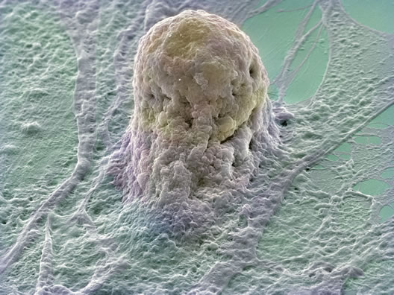
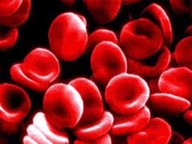
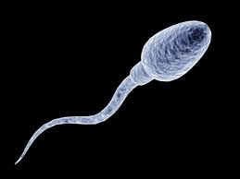
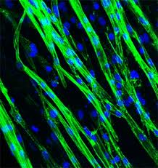
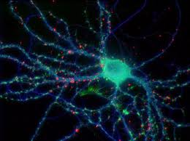
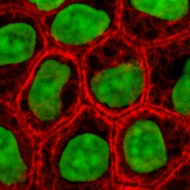
Epigenetic phenotypes: cell types
Cell type differentiation – same genome!
wallace.genetics.uga.edu

Slide 6
Epigenetic phenotypes: imprinting
Imprinting – some of this can reach offspring.
wallace.genetics.uga.edu

Slide 7
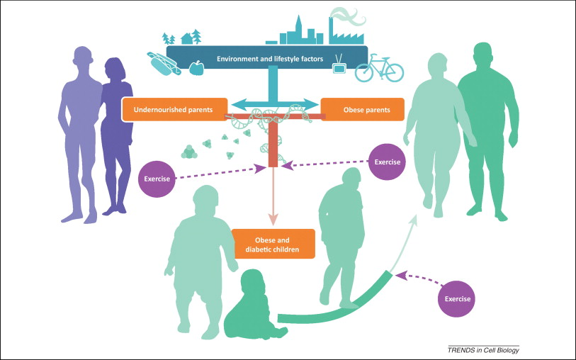
Epigenetic phenotypes: metabolism
Parents with a poor diet have children epigenetically pre-disposed for weight gain.
What’s the mechanism? Why might it be evolutionarily advantageous?

Slide 8
Chromatin structure

Slide 9
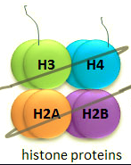
Nucleosomes and histones
Felsenfeld and Groudine 2003

Slide 10
Nucleosomes influence regulation by placement
Bell NRG 2011

Slide 11
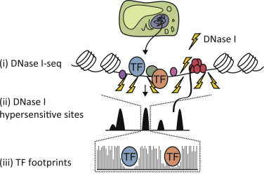
DNAse-seq reveals sensitive (open) regions
Globally exposed regions become large peaks
Locally blocked regions leave “footprints”
DNAse treatment releases fragments from open (unbound) regions which we can then sequence and map
How could we use this method to help identify TF binding sites?

Slide 12
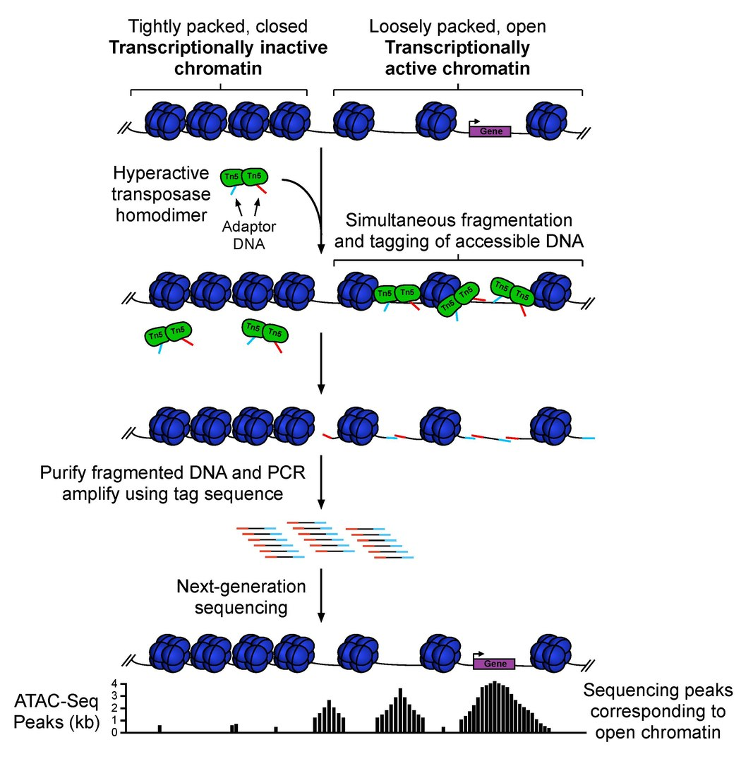
ATAC-seq is a newer, more sensitive approach
ATAC = Assay for Transposase-Accessible Chromatin
Simultaneously shear DNA while end-capping with known tag DNA, facilitating amplification before sequencing
Especially useful when working with low biomass, as in single-cell applications
What’s an advantage of amplifying and sequencing a single cell’s sensitive DNA as opposed to a population of cells?

Slide 13
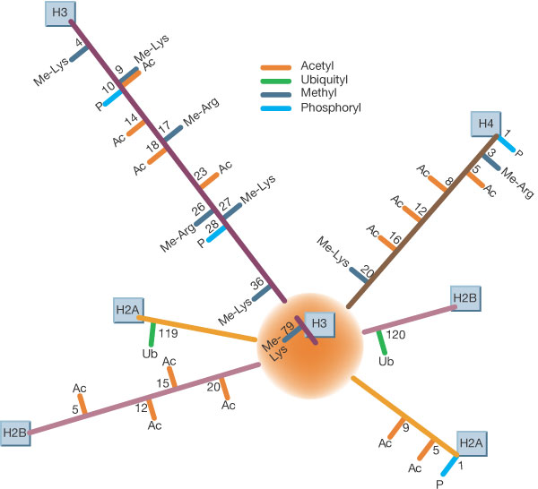
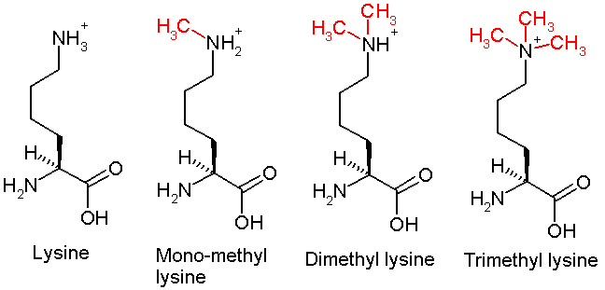
Nucleosomes influence regulation by modifications
H3K4me3 a.k.a. H3K4 trimethylation
H3 = histone 3
K4 = lysine (K) as position 4
Felsenfeld and Groudine 2003

Slide 14
Nucleosomes influence regulation by modifications
Bell NRG 2011

Slide 15

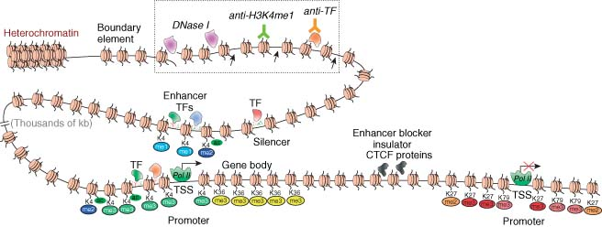
Nucleosomes influence regulation
TF
ACATGT
RNA
Modifications can change placement.
Or change conformational structure.
Or directly modify TF recruitment.

Slide 16
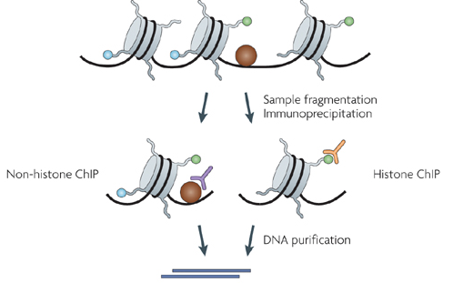
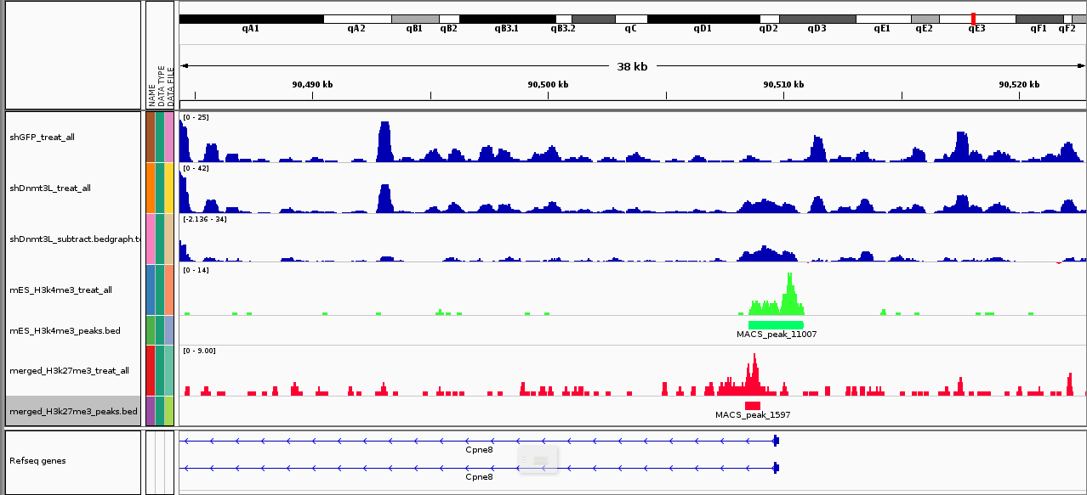
Assaying nucleosome positions by ChIP-*
biocluster.ucr.edu
Using antibodies specific to a single histone modification!
Felsenfeld 2003

Slide 17
Modeling nucleosome positions
Why don’t histones have conserved, discrete binding motifs like TFs?
Segal 2006

Slide 18
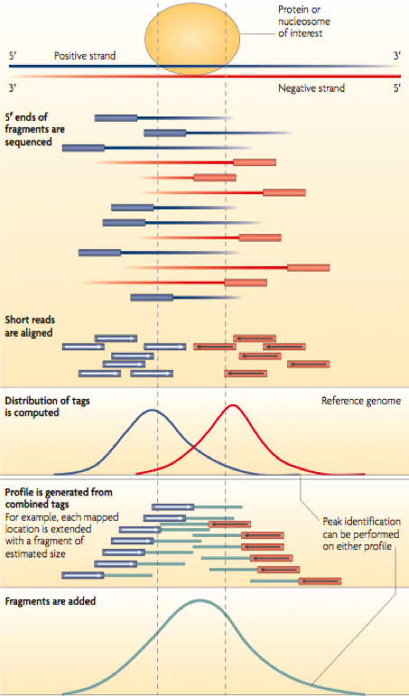
Identifying nucleosome positions
MACS (MACS2) – Liu Lab
Peakseq – Gerstein Lab
SPP – Park Lab
GEM – Gifford Lab
E-Range – Wold Lab
Peak Finder
SICER – Peng Lab
T-Picr – Pachter Lab
biocluster.ucr.edu
Park NRG 2009

Slide 19
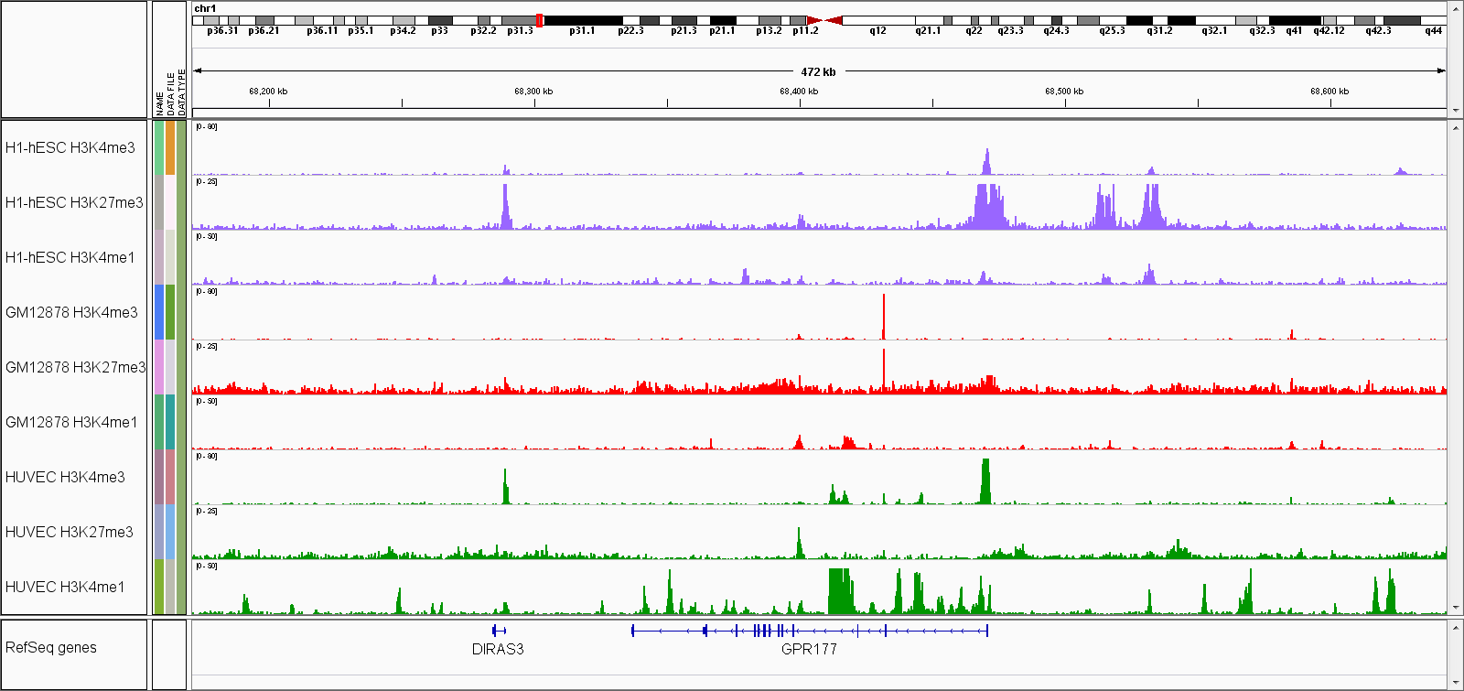
Integrating histone modification patterns
Transcription
Repression
Stem cell
Lymphocyte
Endothelial
Wnt receptor

Slide 20
Hidden Markov Models

Slide 21


Hidden Markov Models (HMMs)
A Markov model is a sequence of states that we transition through over time
The likelihood of where we’ll transition to depends only on the state we’re in
  No long-term memory
Let’s use the weather as an example...

Slide 22

Hidden Markov Models (HMMs)
Imagine that if it is sunny today, there is an 80% chance of sun tomorrow, and a 20% chance of clouds.
Similarly, if it is cloudy today, there is a 50% chance of clouds tomorrow, and a 50% chance of sun.
80%
50%
20%
50%
Today
Tomorrow
Today
Tomorrow

Slide 23
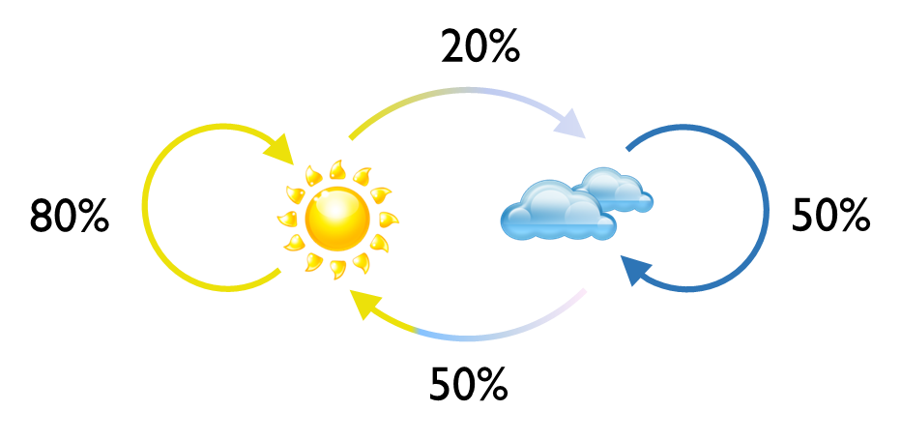
Hidden Markov Models (HMMs)
The same probabilities will take us from tomorrow into the day after tomorrow, and so forth...
This allows us to simulate a sequence of states

Slide 24
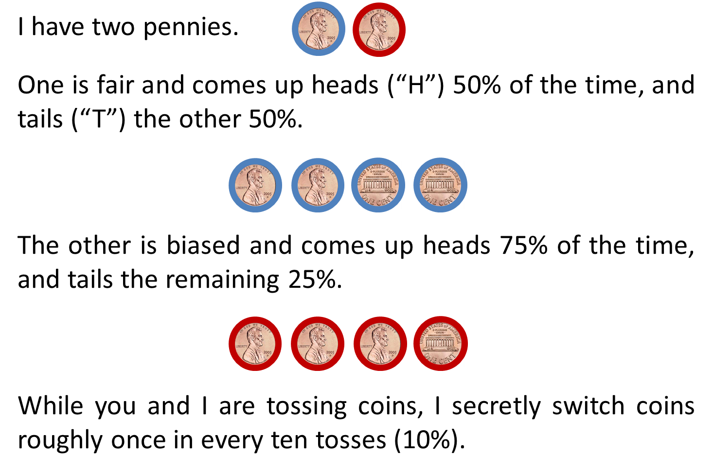
Hidden Markov Models (HMMs)
In a Hidden Markov Model, we don’t get to see the states directly
Instead, states emit information (symbols) and the frequency of these emissions varies with the state

Slide 25
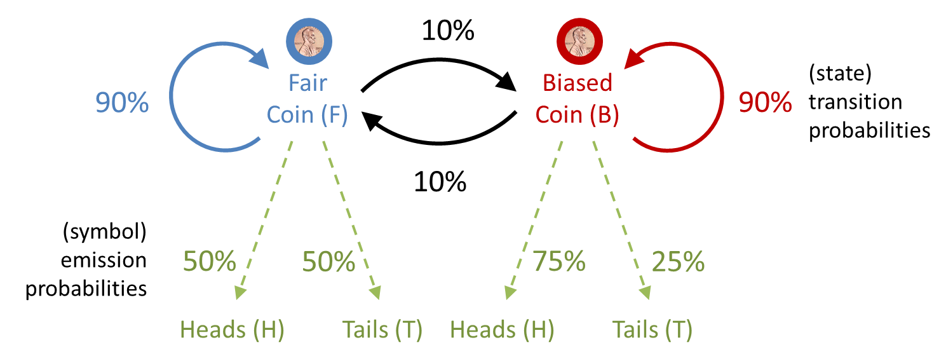
Hidden Markov Models (HMMs)
The same scenario represented as a HMM
Given a sequence of tosses, evaluate the likelihood of different sequences of states to pick the most likely one:
Emissions (flips): HTHH
States: FFBB
P(Sequence) = (0.50)(0.90)(0.50)(0.10)(0.75)(0.90)(0.75) = 0.011

Slide 26
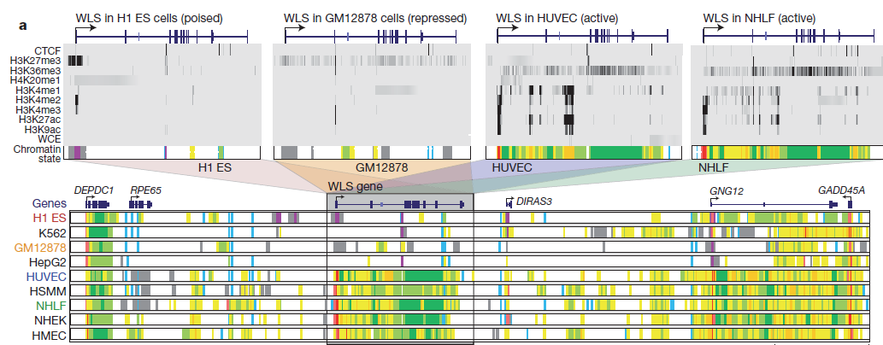
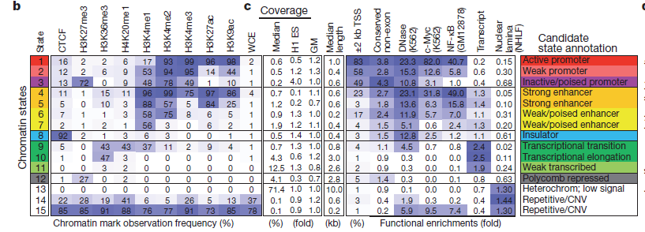
Integrating histone modification patterns
ChromHMM (Ernst Nature 2011) and related approaches treat chromatin marks as symbols emitted by an underlying (hidden) biological system in different states.
Can be trained to recognize those states given new chromatin state data.
Very useful for integrating multiple noisy measurements into a discrete biological state, e.g. “active promoter”

Slide 27
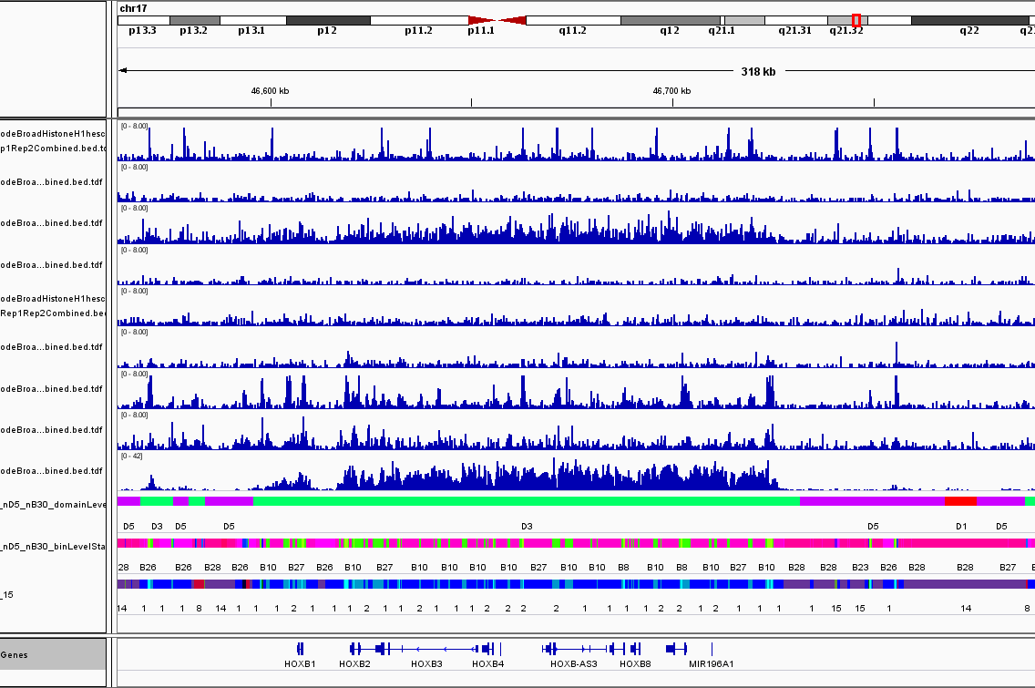
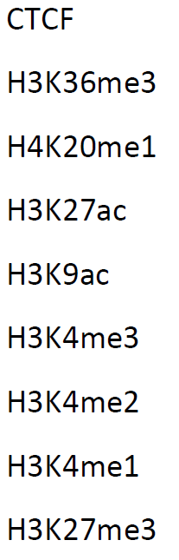
Chromatin domains
Dom
Nuc
HHMM
chromHMM

Slide 28
DNA methylation

Slide 29
DNA nucleotides can be directly modified

Slide 30
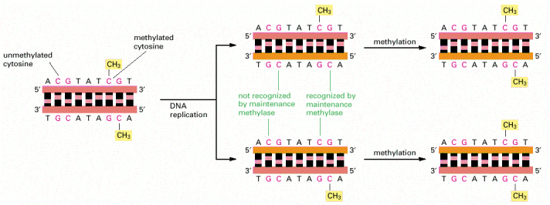
Heritable repression through DNA methylation
Occurs at CpG dinucleotides.
Maintained during replication.
Alberts MBC

Slide 31
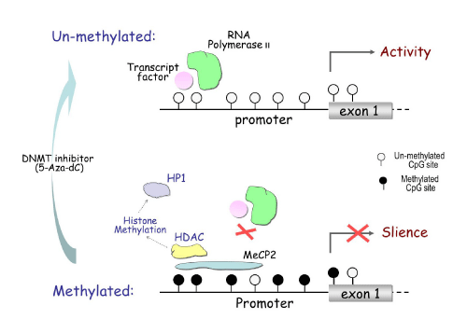
Heritable repression through DNA methylation

Slide 32
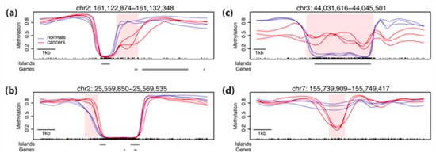
Methylation phenotypes
Dynamic during cell type differentiation
Aberrant during cancer
Irizarry NatureG 2009

Slide 33
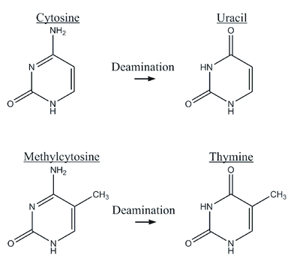
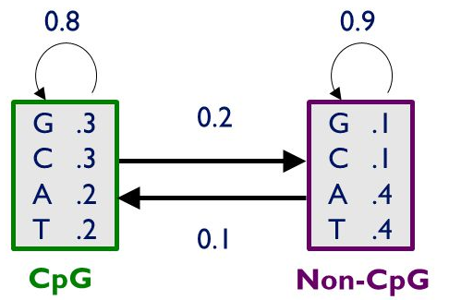
A (relevant) aside about CpG islands…
Cytosine methylation occurs throughout the genome at CpG sites
Methylated cytosines are frequently mutated to thymine residues
These mutations are more likely to fix in non-coding regions
This results in an excess of CpG sites in coding regions (“CpG islands”)
This observation is used by HMM models to find genes!
Deaminated cytosine
= uracil
= foreign
= removed
A simplified HMM for finding CG-rich regions (not necessarily CpGs)
Deaminated methylcytosine
= thymine
= DNA-like
= allowed to stay

Slide 34
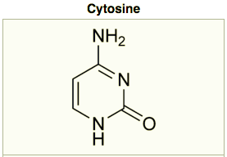
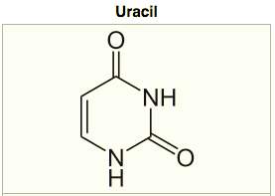
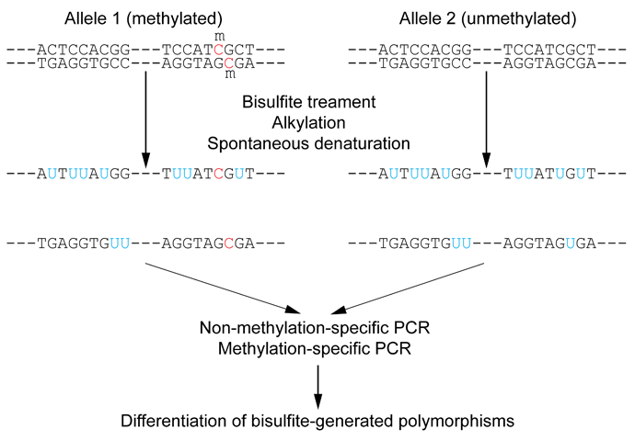
Assaying methylation
(Reduced representation) bisulfite sequencing (RRBS).
  Chemically convert unmethylated C to U (RNA version of T).
  Sequence the original and converted sequences and look for differences.
  When “reduced,” PCR-enrich for CpG-rich genomic regions first – more efficient.
Methylated DNA immunoprecipitation
(MeDIP).
  ChIP-*, but antibodies against methyl-C
  instead.
Endonuclease digestion
  Digest by methylation-sensitive, sequence-
  specific enzymes.
  Then sequence to see where cuts are.

Slide 35
Analyzing differential methylation
QC.
Mapping.
Smoothing.
Testing (hierarchical).
Hebestreit Bioinformatics 2013

Slide 36
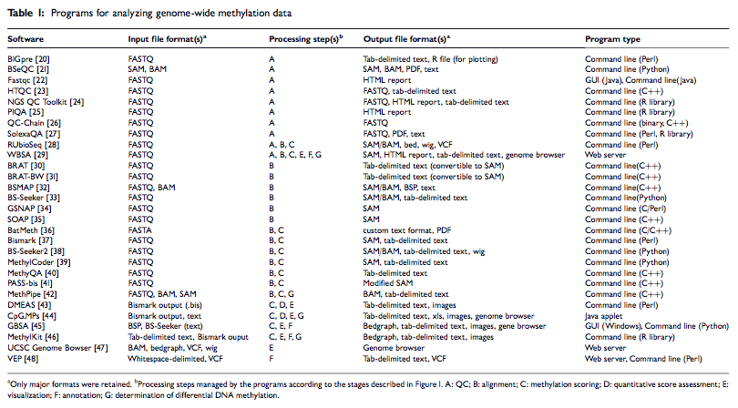
Analyzing differential methylation
Adusumali BiB 2014

Slide 37
Chromatin capture

Slide 38
CCCCCCCCCC
3C: Chromosome conformation capture (single locus pair).
  Cross-link DNA, fragment, ligate with tagged primers, unlink,
  PCR, quantify.
4C: Chromosome conformation capture-on-chip (one locus
to many).
  Cross-link DNA, fragment, circularize with tagged primers,
  unlink, PCR, quantify.
5C: Chromosome conformation capture carbon copy
(genome-wide).
  Cross-link DNA, fragment, ligate with universal primers,
  unlink, PCR, sequence.
Hi-C: Chromosome conformation capture carbon copy
(genome-wide).
  Cross-link DNA, fragment, ligate with biotinylated primers,
  sequence.

Slide 39
Distal chromatin contact mapping
Lieberman-Aiden Science 2009

Slide 40
ChIA-PET: Chromatin Interaction Analysis by Paired-End Tags
Fullwood Nature 2009
Hi-C + ChIP for your TF/protein of interest

Slide 41
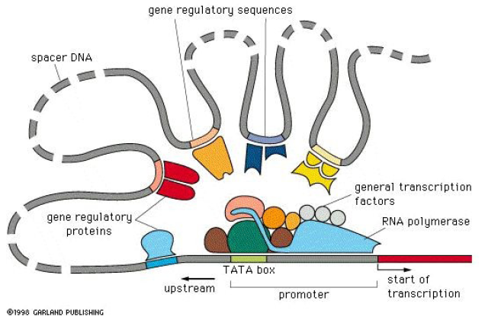
~ChIP-Seq for long-range interactions

Slide 42
Summary
Epigenetic changes are important.
  Phenotypes induced by non-sequence mechanisms.
  Sometimes also heritable.
Nucleosome positioning.
  Packs DNA into (in)accessible regions, blocks TF recruitment.
Histone modifications.
  Of the four main proteins, plus variants, side chains can be modified.
  Changes chromatin structure, activates, represses, recruits, etc.
DNA methylation at CpGs.
  Transcriptional repressive marker that’s preserved through replication.
Chromatin capture.
  Sequencing assays that link distal, contacting sequence elements.

Slide 43
Canvas question time
Ask me for the passcode

Slide 44
Extras

Slide 45
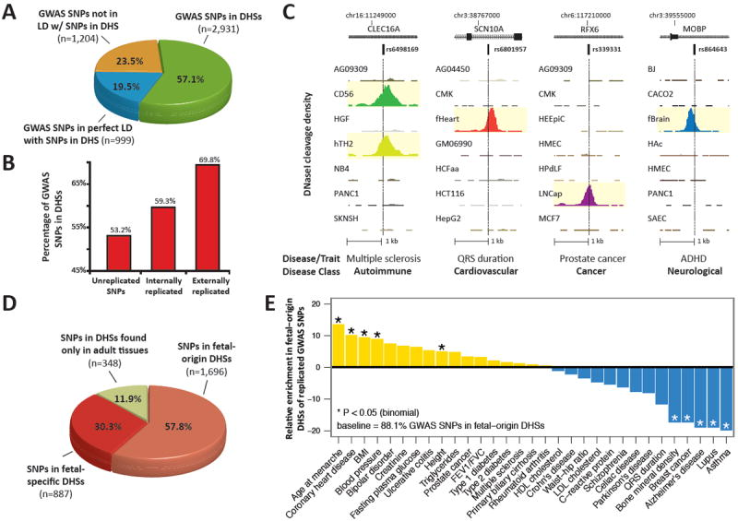
Epigenetic phenotypes
DHS =
DNAse Hypersensitive Site = exposed DNA
Maurano Science 2012

Slide 46

Integrating histone modification patterns
ChromHMM (Ernst&Kellis); Segway (Hoffman&Noble).
Both are based on hidden Markov models (HMM).
chromatin state
histone mark intensities
Assumptions
Markov property:
Independent obs:

Slide 47
Yes, they work for single cells too
Nagano Nature 2013
10 manually isolated T cells
Local (domain) structure preserved, global (inter-domain) structure variable.

