Slide 1
Metabolomics
Curtis Huttenhower (chuttenh@hsph.harvard.edu)
Eric Franzosa (franzosa@hsph.harvard.edu)
http://huttenhower.sph.harvard.edu/bst281
With slides courtesy of Julian Avila Pacheco

Slide 2
Summary
Metabolomics
Nuclear Magnetic Resonance (NMR)
Mass spectrometry (MS)
Liquid Chromatography (LC)
Quality-control procedures
Metabolite identification
Downstream analyses
Case study of the IBD microbiome
Databases
Metabolic modeling

Slide 3
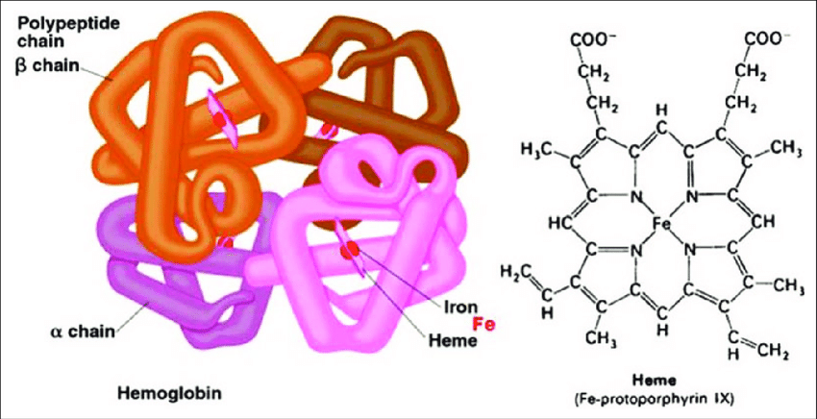
What is metabolomics?
The study of small molecules (metabolites) produced by a biological system
Small usually defined as <1 kda
Mass of glucose ~ 0.18 kda
Mass of heme ~ 0.62 kda
Mass of hemoglobin alpha ~ 16 kda
Sometimes distinguished from metabonomics
Includes other molecules in the system, e.g. food
Term more common in NMR literature

Slide 4
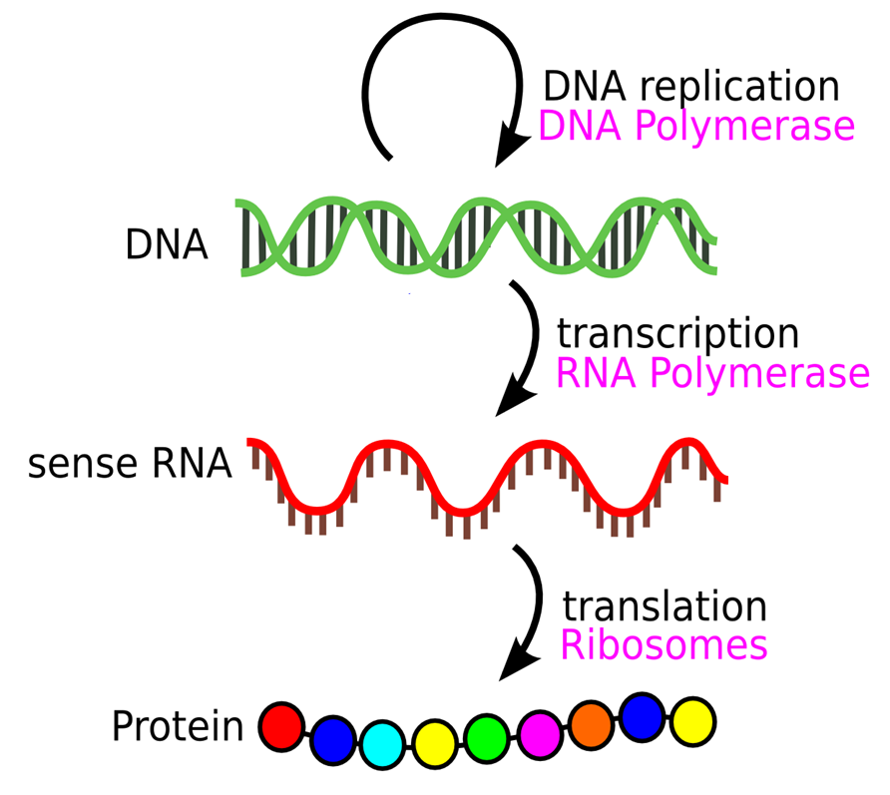
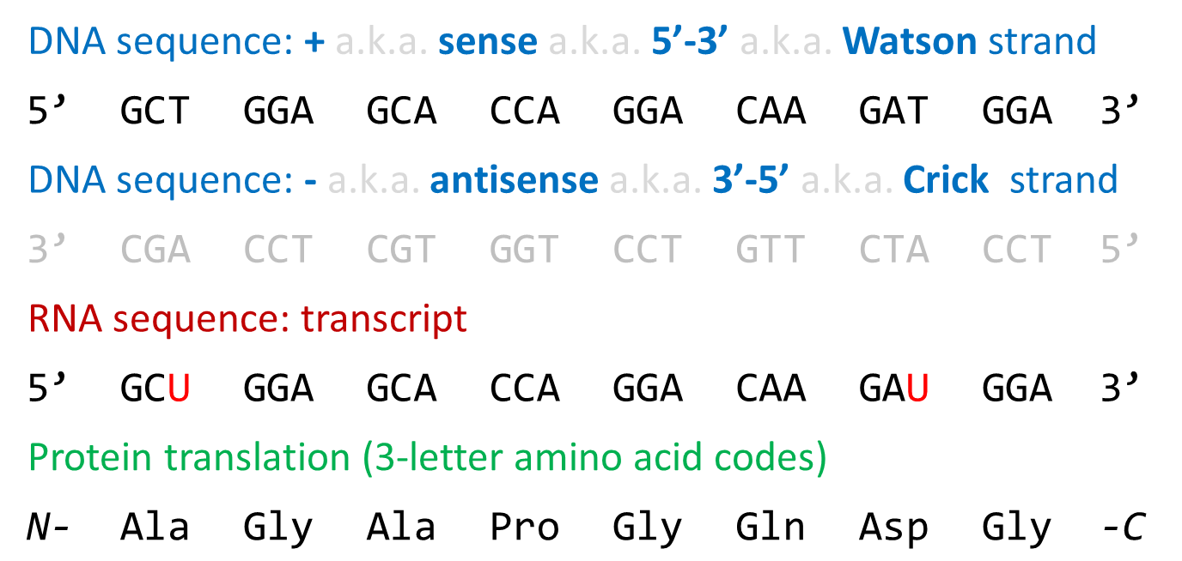
Why metabolomics is tricky (to me at least)
Only tangentially connected to central dogma
enzymes (proteins) interconvert metabolites
No direct connection to sequence
Even proteomics used sequence as a guide
Can’t rely on sequencing biology to help us
Metabolites don’t self replicate
Metabolites don’t hybridize to DNA
High-throughput gene-metabolite associations based on correlational analyses

Slide 5
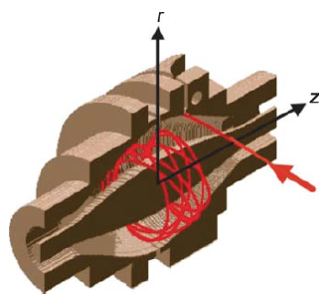
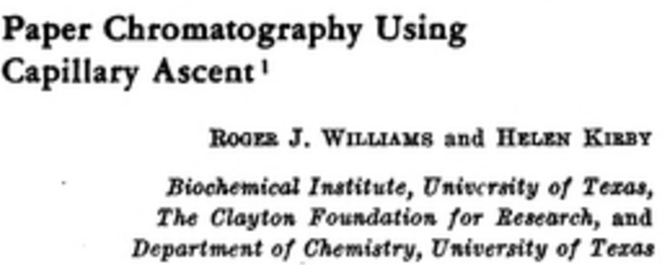
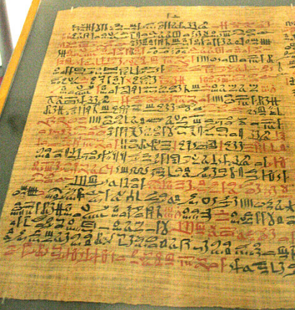
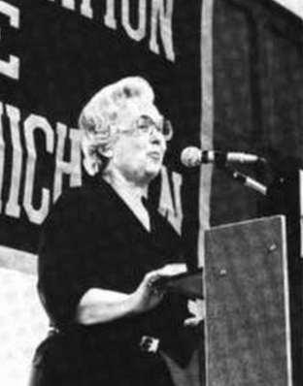
Metabolomics history
1974
Fourier
Transform
MS
1981
First
Commercial
Quad
2005
LTQ
Orbitrap™
1940
TOF MS
1979
Ion Mobility
(IM)
1950
Metabolic
Pattern
1984
LC
interfaced
with MS
1995
ESI
IM
1968
ESI
1,500 BC
“Ant test”
Testing sweetness in urine with ants
1996
Hybrid
Q-TOF
1960
Metabolic
Profile
GC
MS
1950
1980
2000
¹Thermo Electron Corporation, San Jose, CA (Makarov et al., 2006a,b; Olsen et al., 2005).
Clemmer et al., 1995 J. Am. Chem. Soc.

Slide 6
Metabolomics philosophies
Targeted metabolomics
Quantifies 10s of well characterized metabolites from a sample
Provides absolute quantification through comparisons with chemical standards
“Usual suspects”: central carbon metabolism, amino acids, nucleotides
Untargeted metabolomics
Attempts to enumerate 1,000s of unique metabolites from a sample
Only characterizing what you can, and with mixed accuracy
Usually requires multiple screens targeting different chemistries
Provides (mostly) relative abundances

Slide 7
Metabolomics technologies
Nuclear Magnetic Resonance (NMR) spectroscopy
Uses environment-specific atomic resonance (e.g. ¹H) patterns to identify compounds
Can also be used to work out molecular structures (from coupling)
Pros: Absolute, reproducible quantification; minimal sample prep; sample unperturbed
Cons: Low sensitivity (# of molecules, min. abundance); machines very expensive
Mass spectrometry (MS)
Directly measures mass/charge ratio of a metabolite
Can also be used to work out molecular structure (from fragmentation pattern)
Pros: Very sensitive and flexible; can differentiate 1,000s of metaolites
Cons: Relative quantification only; sample destroyed; complex preps

Slide 8
Nuclear Magnetic Resonance (NMR) spectroscopy

Slide 9
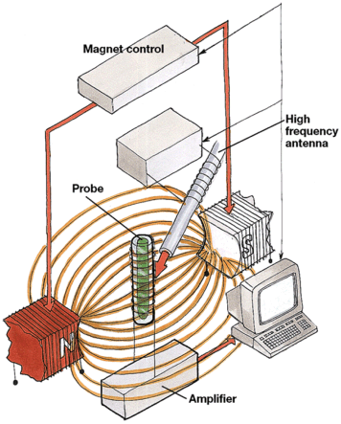
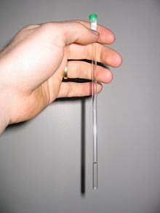
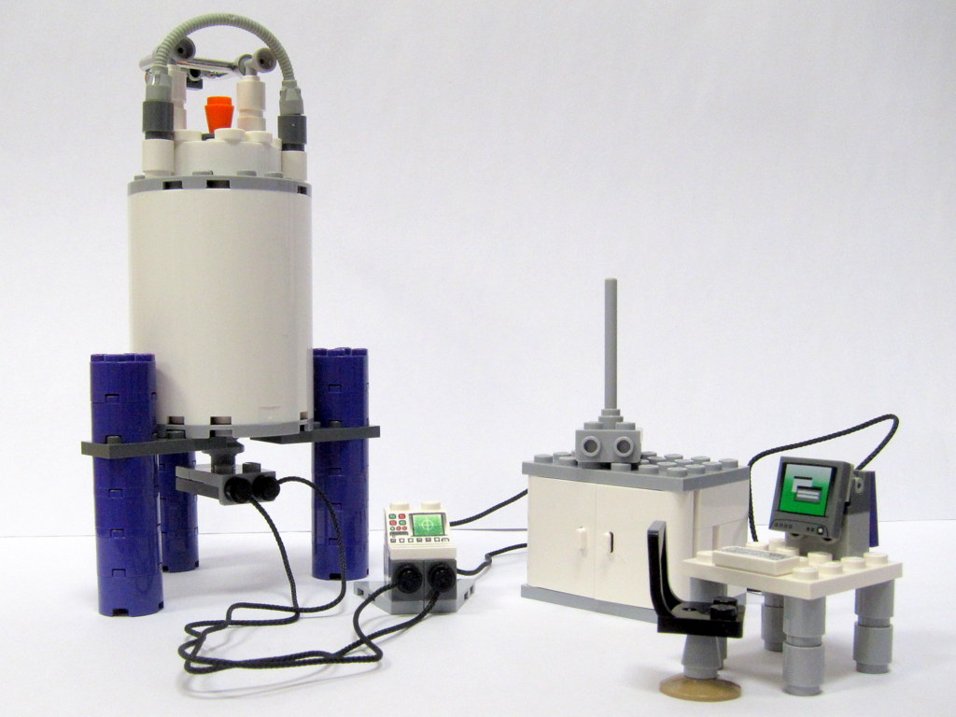
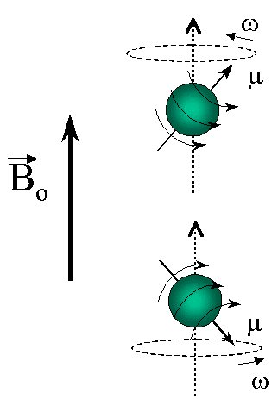
Nuclear Magnetic Resonance (NMR) spectroscopy
Certain atomic nuclei have magnetic properties
Line them up with powerful magnetic fields
Apply electromagnetic pulses, causing nuclei to resonate
Resonance produces measurable currents
Resonance frequency is environment specific

Slide 10
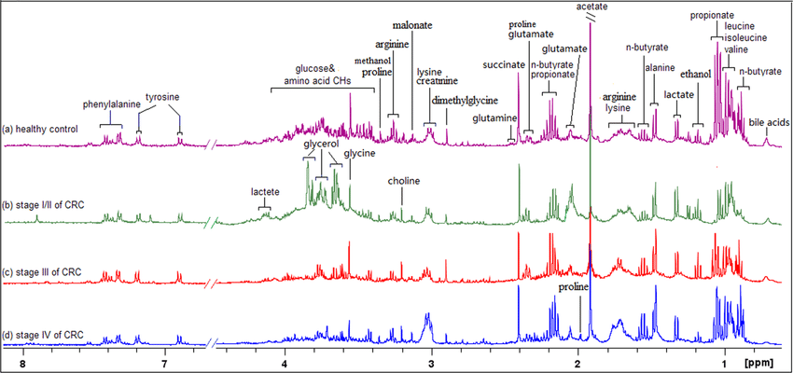
Nuclear Magnetic Resonance (NMR) spectroscopy
Example (1D) ¹H NMR spectra for patients with different stages of colorectal cancer
x-axis = resonance frequency (varies by molecule) in normalized units
y-axis = intensity ~ abundance

Slide 11
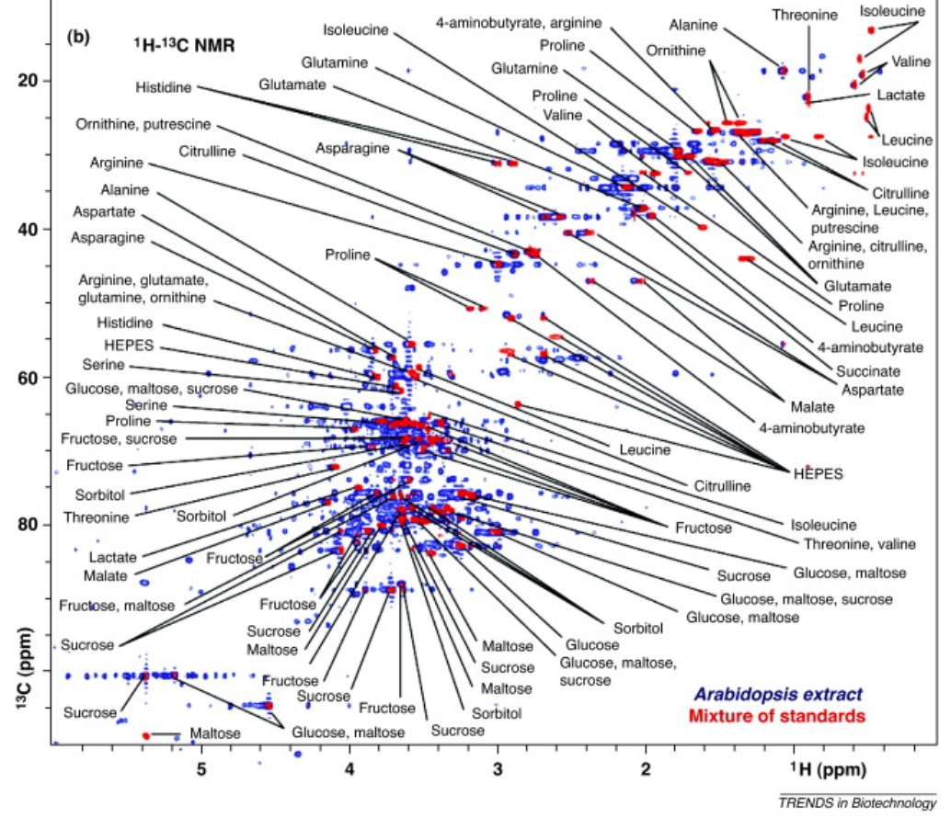
Nuclear Magnetic Resonance (NMR) spectroscopy
Example 2D NMR spectrum
x-axis = ¹H resonance frequency
y-axis = ¹³C resonance frequency
z-axis = intensity (not shown)
Similar to a 2D protein gel, the two axes provide extra resolution for distinguishing compounds

Slide 12
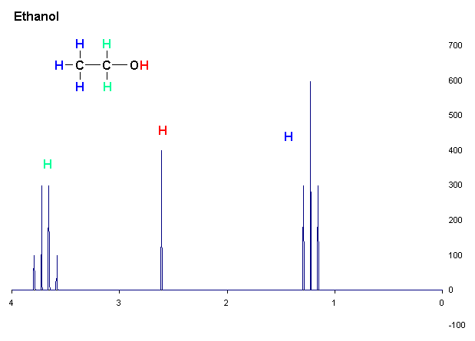
Nuclear Magnetic Resonance (NMR) spectroscopy
Each “type” of hydrogen atom produces a group of peaks
Integrated intensity the peaks indicates # of hydrogens
# of peaks corresponds to other hydrogens in their environment
Chemical shift suggests other environmental properties (e.g. shielding by other atoms)
Intensity
Chemical shift (ppm)

Slide 13
Mass Spectrometry (MS)

Slide 14
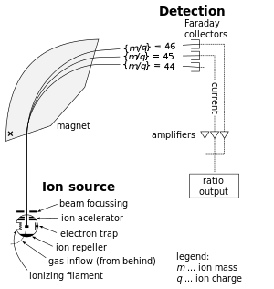
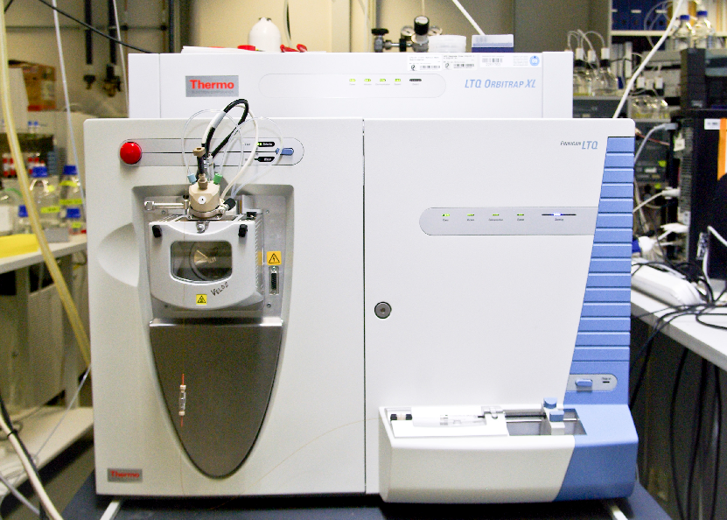
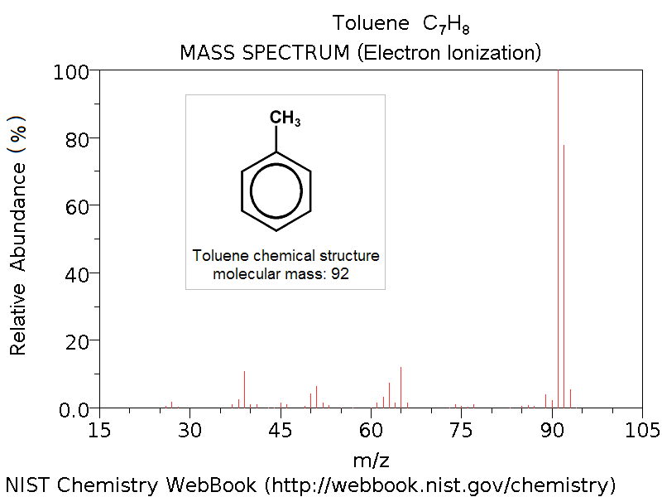
Mass spectrometry (MS)
Particles in a magnetic field will follow trajectories determined by their mass and charge
Given where a particle impacts a detector, we can work out its mass/charge ratio (m/z)
A second round of MS (MS/MS) targeting molecule’s fragments can also help reveal structural details

Slide 15
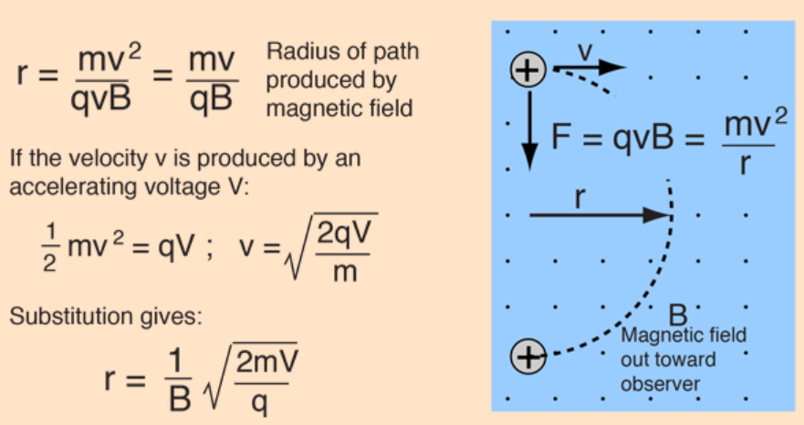
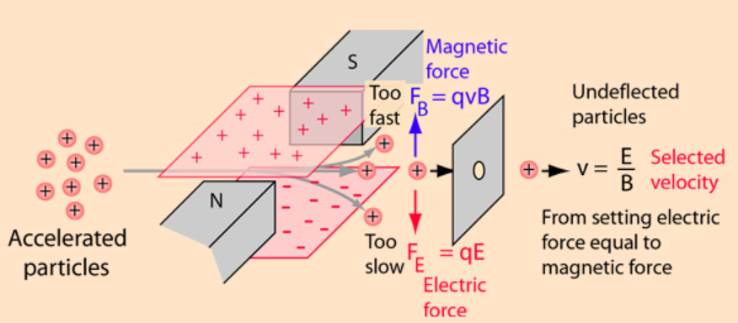
Physical principles underlying mass spectrometry
Particles enter a new magnetic field and follow curved trajectories (radius r)
Charge and accelerate some particles of interest (here, metabolites)
A velocity selector uses a balance of electrostatic and magnetic forces to isolate particles of a given velocity
Knowing velocity (v) and reading out r, we can determine mass/charge ratio
(written m/q here, a.k.a. m/z)
Source: http://hyperphysics.phy-astr.gsu.edu

Slide 16
Physical principles underlying mass spectrometry
Rather than allow variable r, which requires a big/complex detector, instead use a point detector and vary the magnetic field strength (B) until particles are detected.
Source: http://hyperphysics.phy-astr.gsu.edu

Slide 17
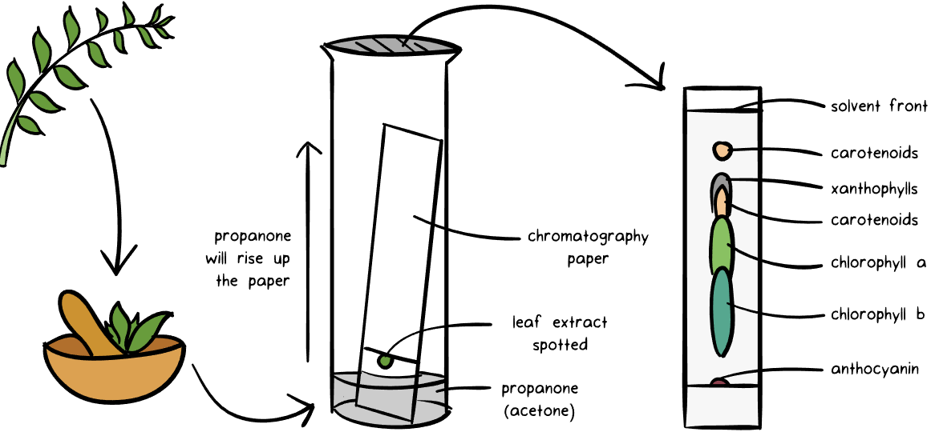
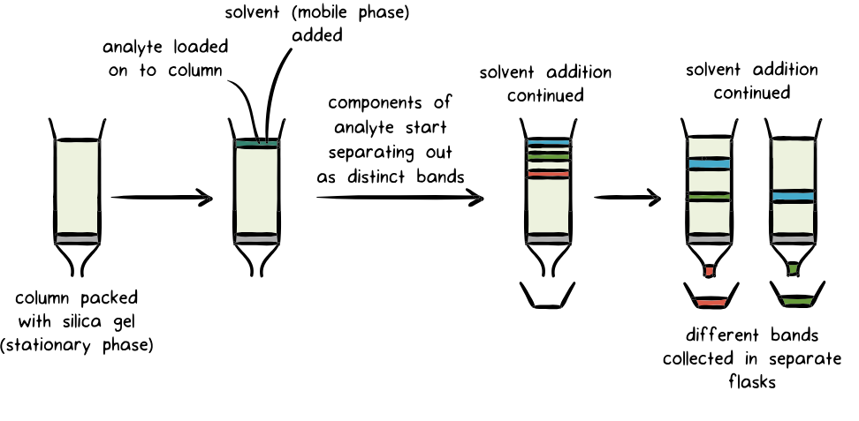
Chromatography staggers input to MS
Paper chromatography
We don’t dump a complex mixture into the MS all at once!
Chromatography techniques stagger metabolites according to chemical properties (e.g. size, hydrophobicity)
In liquid chromatography (LC), metabolites exit column after increasing retention time
Studies may use multiple columns with increasing retention of non-polar compounds (HILIC, C8, C18)
Liquid chromatography
Source: https://www.khanacademy.org

Slide 18
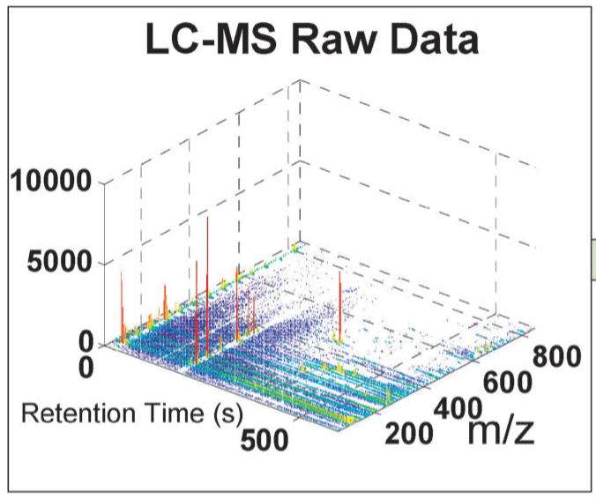
LC-MS raw data
Raw data are 3D “points” ideally corresponding to individual metabolites
Dim 1: m/z (da)
Fundamental physical quantity
Dim 2: retention time (min, s)
Varies by column, lab, day
Dim 3: intensity
Volume under the peak is proportional to abundance

Slide 19
LC-MS/MS (-MS²) raw data
If a second round of MS is performed, individual peaks from the first round are associated with additional measurements
Specifically, m/z ratios and intensity values for metabolite breakdown products
Provides more resolution to (e.g.) distinguish between isomers with the same m/z and very similar retention times

Slide 20
Quality control
Spike chemical standards into biosamples
Aids with calibration, normalization, abundance estimation
Periodically profile a reference sample (or pooling of biosamples)
Adjust for batch/run effects
Compare with dilution series of reference/pooling
Weed out unreliable molecules/establish detection limits

Slide 21
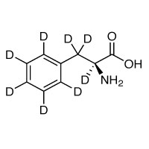
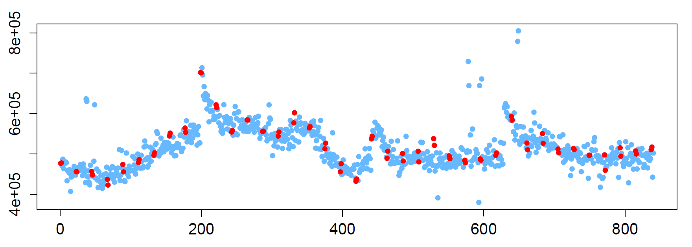
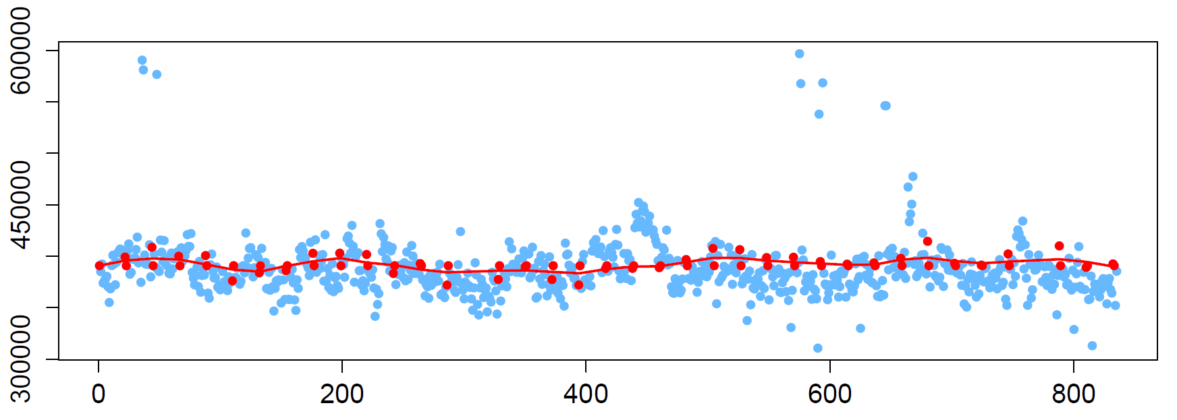
Quality control
phenylalanine-d8
phenylalanine-d8
Abundance
Spiked-in metabolite should have the same abundance in all measurements of the pooled sample
Nearest-neighbor normalization reduces technical variance
Sample number (in injection order)
phenylalanine-d8
Abundance
Sample number (in injection order)

Slide 22
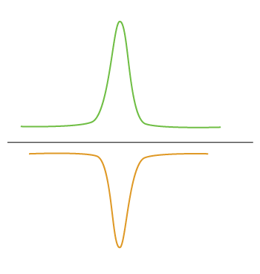
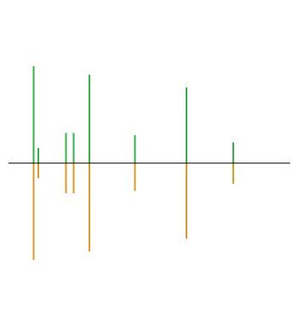
Metabolite identification
RT Match
Work out m/z and potential formulas for parent compound
Match against metabolite databases (e.g. HMDB, Metlin)
Likely to be lots of hits
Match against compound libraries
Internal RT values, known/theoretical MS² fragmentation
MS/MS Match

Slide 23
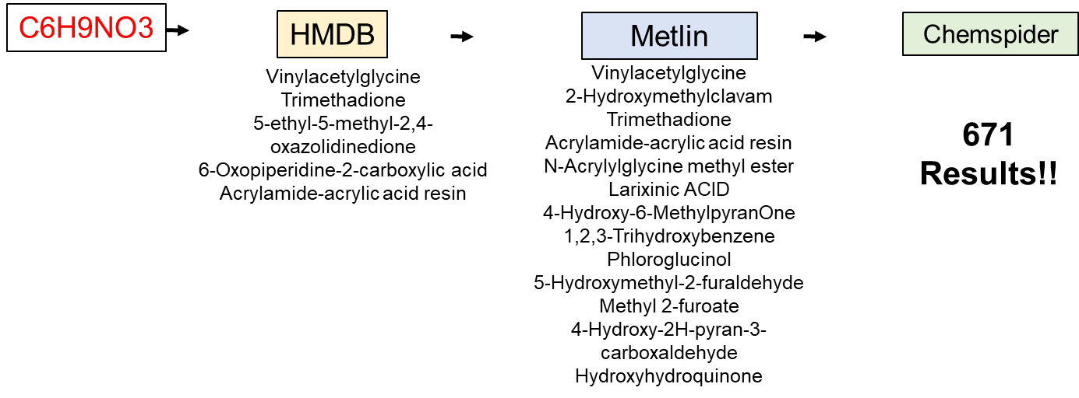
Metabolite identification
A formula alone can be very ambiguous (even worse if allowing ±1 da)

Slide 24
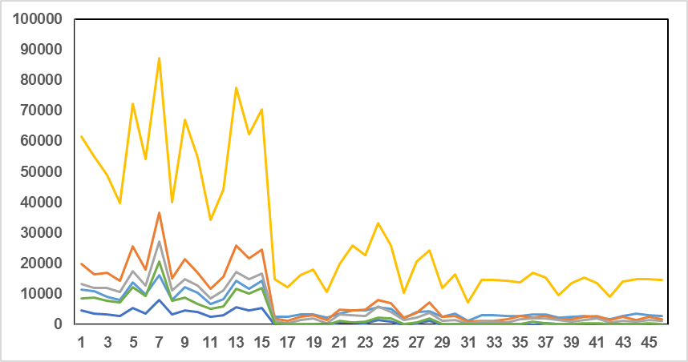
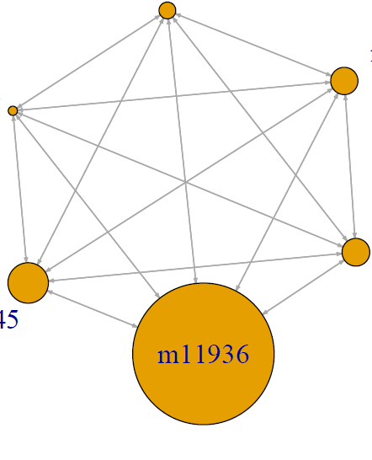
Metabolite identification
Analyze cross-sample covariation
Identify groups of related metabolites (similar to co-expression)
Transfer annotations from known to unknown metabolites (guilt-by-association)
m.z | RT | Metabolite
162.076 | 7.4 | 2-aminoadipate [M+H]+
206.0399 | 7.39 | 2-aminoadipate [M+2Na-H]+
228.0218 | 7.39 | 2-aminoadipate [M+3Na-2H]+
184.058 | 7.4 | 2-aminoadipate [M+Na]+
296.0092 | 7.39 | 2-aminoadipate [Unknwon Adduct]+
144.0656 | 7.4 | 2-aminoadipate [Fragment]+
Unknown
296.0092mz
[M-H2O+H]⁺
[M+Na]⁺
144.065mz
184.058 mz
Abundance
Pearson cor = 0.9
[M+3Na-2H]⁺
[M+2Na-H]⁺
[M+H]⁺
228.0218mz
206.0399mz
162.076mz
Parent ion
+ isotopes
+ adducts
+ common fragments
(all in same RT group)
Radius = average integrated abundance
Sample number
Brown, et al (2011) Bioinformatics 27: 1108−1112

Slide 25
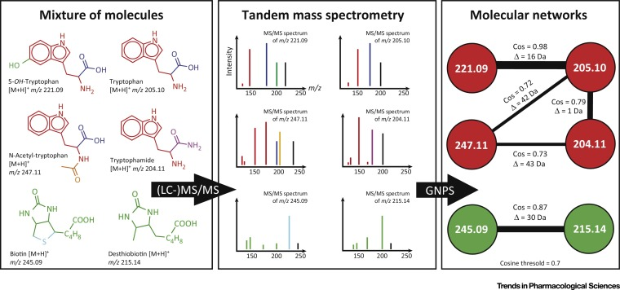
Metabolite identification
Analyze networks of similar fragmentation spectra (MS/MS only)
“Molecular Networking” by Pieter C. Dorrestein
Transfer knowledge from knowns to unknowns (more guilt-by-association)

Slide 26
Downstream Analyses
Example from my work

Slide 27
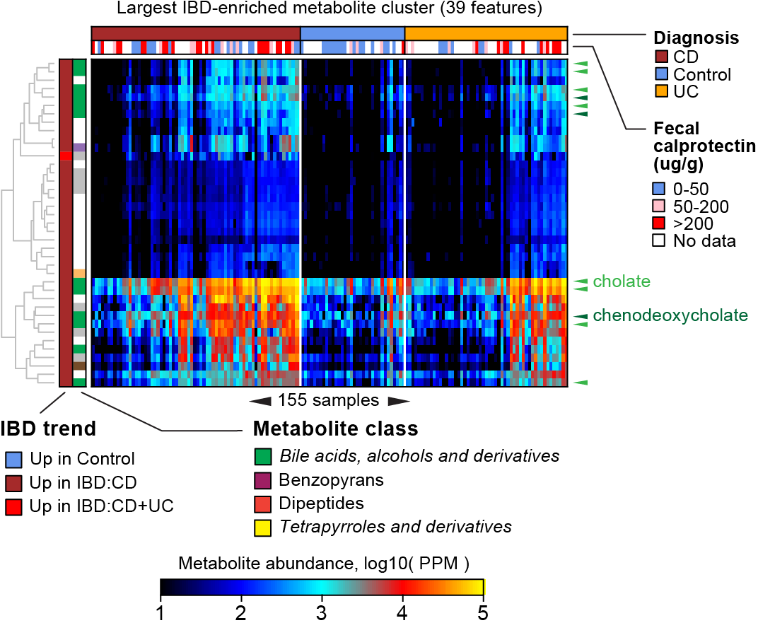
What to do with your sample-by-metabolite table?
Quality control
Normalization, outlier removal
Supervised analyses
Phenotype association/prediction
Enrichment analyses
Unsupervised analyses
Clustering samples
Clustering metabolites
Data integration
Associating metabolites with other ‘omics measurements
Do characterized metabolites associate with uncharacterized genes?
Do uncharacterized metabolites associate with characterized genes?
A common starting point in genomic data analysis:
A table of n samples (columns) and m features (rows; m ≫ n)
+ sample metadata
+ feature metadata

Slide 28
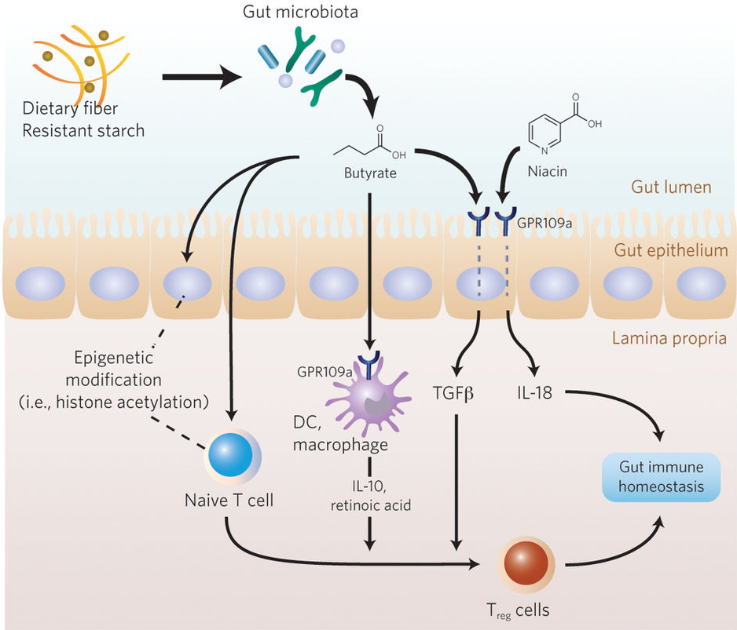
The gut metabolome as a host-microbiome interface
Dietary compounds may directly promote/hinder the growth of certain microbes
Microbes produce compounds with pro- and anti-inflammatory effects
Most of what we know comes from targeted metabolomic surveys
Potentially many microbially-derived, uncharacterized metabolites remain to be found
Adapted from Won-Jae Lee & Koji Hase, Nature Chemical Biology 10, 416–424 (2014)

Slide 29
Profiling metabolomes & metagenomes of the IBD gut
Metagenomes QC’ed by kneadData and profiled by MetaPhlAn2 + HUMAnN2
~8K measured metabolites from four untargeted metabolomics methods (different LC columns, polarity modes)
~50% had m/z matches to HMDB (we focus on their molecular subclass only, e.g. this looks like a bile acid)
~5% had m/z + RT matches to an in-house compound library (any named compounds are in this subset, e.g. this is cholate)

Slide 30
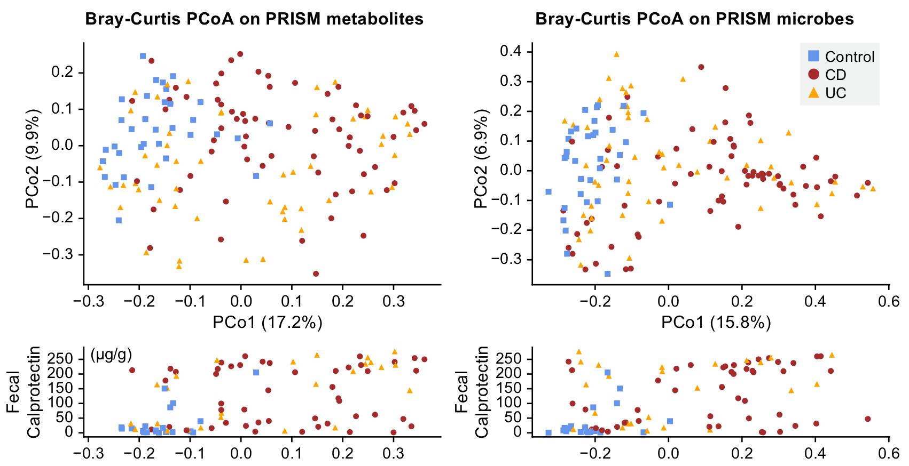
Broad ‘omics shifts correlate with host inflammation
Dominated by CD/control separation (UC is heterogeneous)
The two PCo1s were strongly correlated (r_{s}=0.66, p<10⁻²⁰)
PCo1s correlate with gut inflammation
(r_{s}=0.49 and 0.44)
PCo1s anti-correlate with Shannon diversity
(r_{s}=-0.32 and -0.57)

Slide 31
Finding differentially abundant (DA) features in IBD
Model (same for all features, sum-normalized within method):
log( feature + ϵ ) ~ diagnosis + age + abx + mesalamine + immunosuppressants + steroids
Isolate features where diagnosis:CD or diagnosis:UC coefficient had Benjamini-Hochberg (FDR) q<0.05
Save model residuals for downstream applications
Metagenomic trends (species + enzymes) consistent with previous findings
We’ll come back to these later…
Many, many DA metabolites (~2.7K of 8K)
Used “GSEA” and clustering on residuals to simplify interpretation

Slide 32
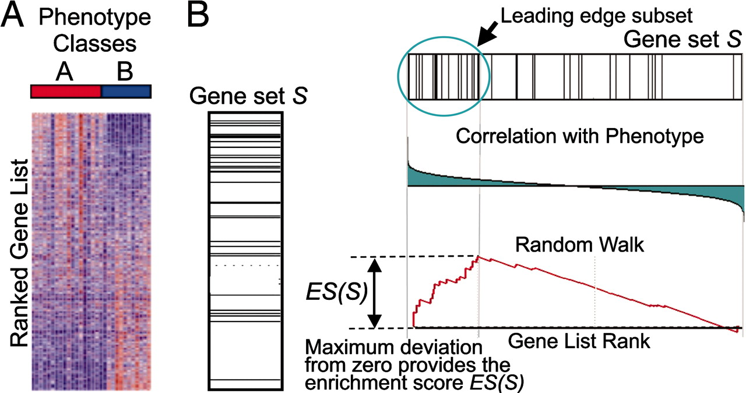
Metabolite set enrichment analysis on model results
Same idea as GSEA (Subramanian 2005): find a metabolite set (HMDB subclass) whose members’ model coefficients were distributed “unusually” among all such coefficients
(Wilcoxon test as conservative definition of “unusual”)

Slide 33
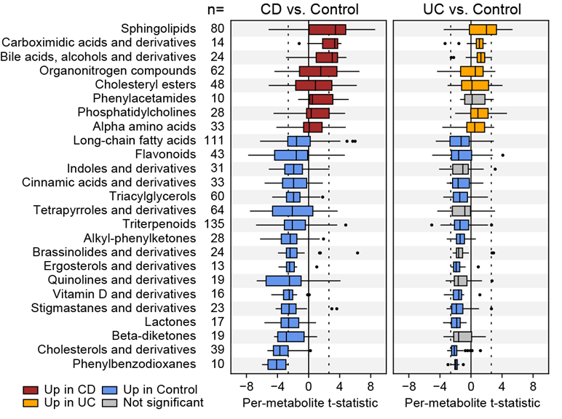
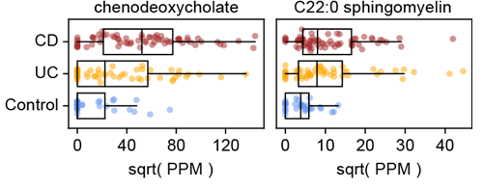
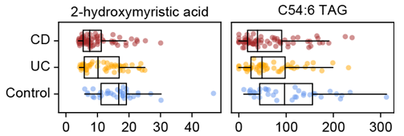
Metabolite set enrichment analysis on model results
UC trends are a weakened subset of CD trends
Sphingolipids, bile acids up
Fatty acid subclasses down

Slide 34
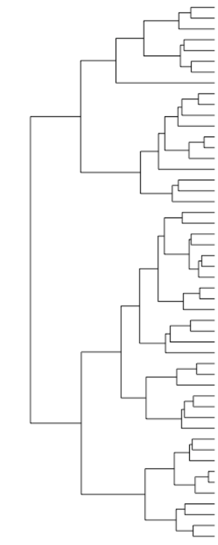
Finding clusters of co-varying, DA metabolites
Cluster DA metabolites based on residual abundance (Spearman as similarity measure)
Samples (n=155)
Model
residuals
“Cut” hierarchy to define clusters with mean similarity r_{s} = 0.7 (strongly correlated)
DA metabolites (n=2,729)
Cluster members are physicochemically similar:
→ 2.7x more similar retention times
→ 3.0x more similar mass/charge ratios
→ 15x more likely to be in same HMDB subclass

Slide 35
The largest IBD-enriched cluster (mostly bile acids)
Here, 39 bile-acid related metabolites co-vary strongly across samples
All are elevated in CD
Note substructure among UC patients, coinciding with high/low fecal calprotectin

Slide 36
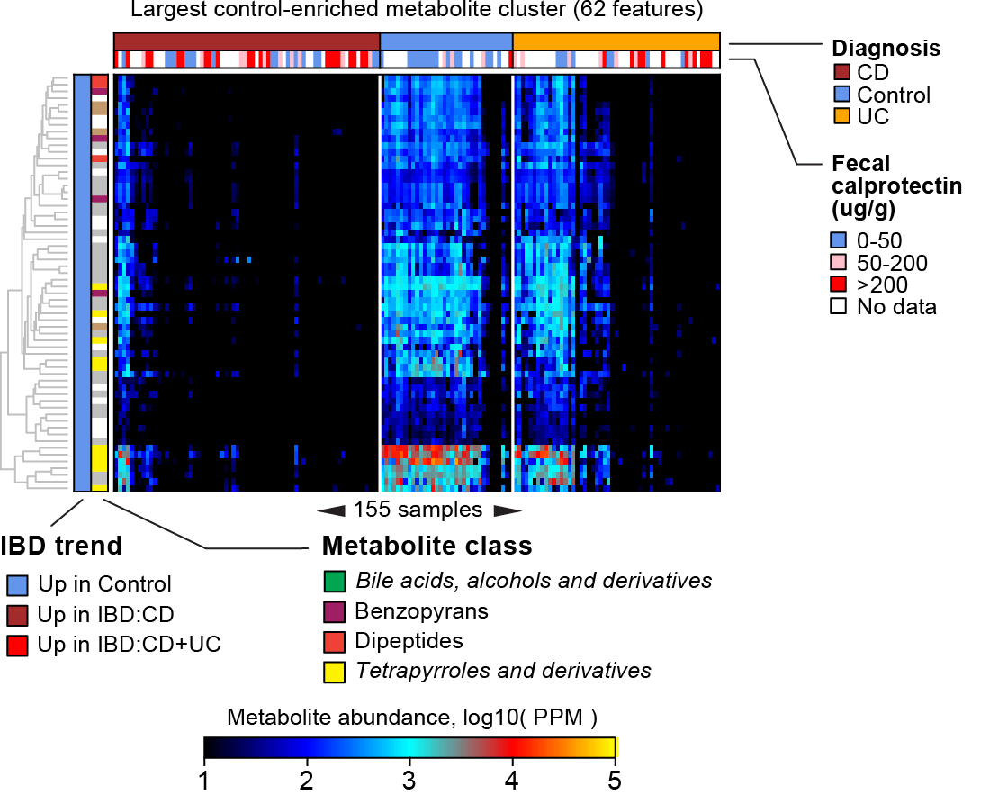
The largest control-enriched cluster (mostly unknown)
This cluster (enriched in control subjects) contains no standard metabolites
Could be enriched for uncharacterized microbially derived metabolites
Speculation: Lots of tetrapyrrole derivatives here. Vitamin B12 is a tetrapyrrole compound (but too big to be seen by these MS methods).
B12-producing bugs are depleted in IBD.

Slide 37
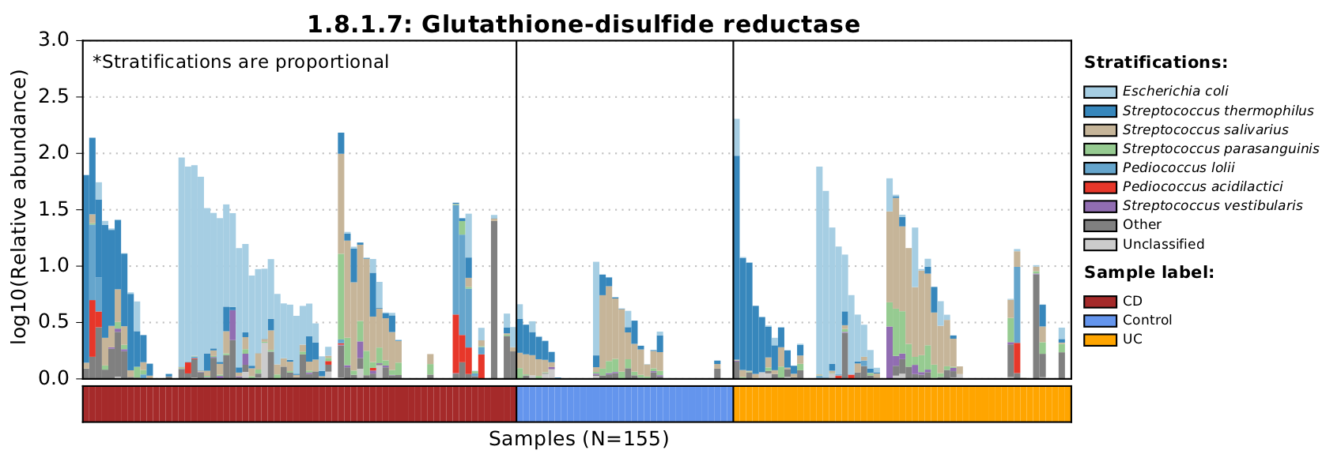
Metagenomic trends mostly follow previous findings
50 DA species, of which 35 were up in controls (reflects general loss of diversity in IBD)
DA enzymes reflect community-level responses to a more aerobic environment in IBD (e.g. response to ox. stress)
We focused on associating DA metagenomic features with DA metabolites!

Slide 38
Robust associations between metabolites & microbes
X and Y correlate incidentally due to mutual correlation with disease
Cases
Cases
Species Y
Species Y
Controls
Controls
Metabolite X
Metabolite X
Here, X and Y’s residuals correlate, suggesting that the X:Y correlation is not driven by disease
Using a linear model to subtract disease effects, the X:Y correlation vanishes
Res( Species Y )
Res( Species Y )
Res( Metabolite X )
Res( Metabolite X )

Slide 39
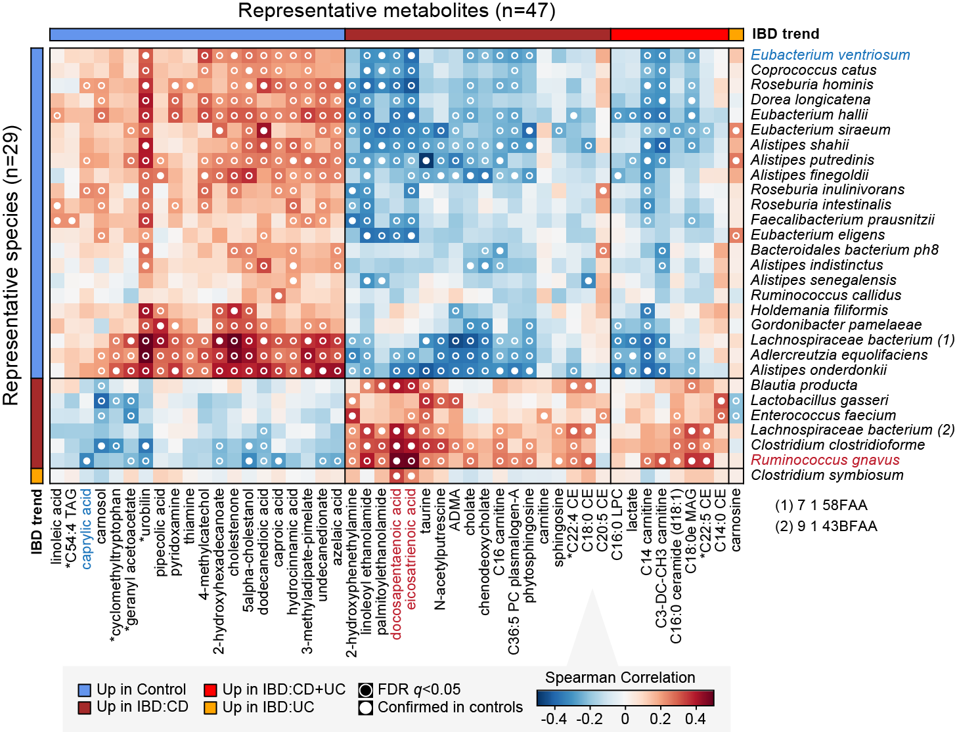
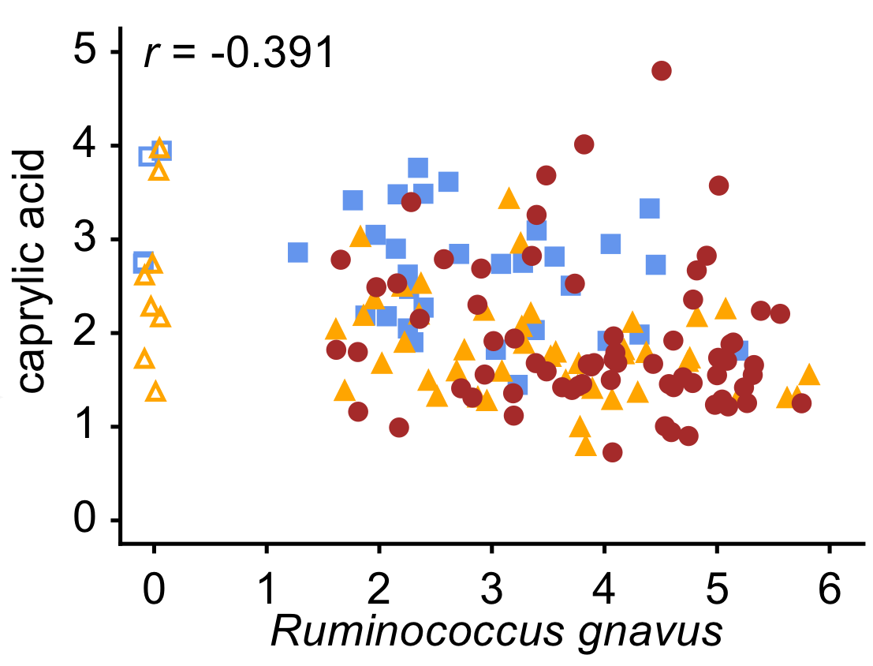
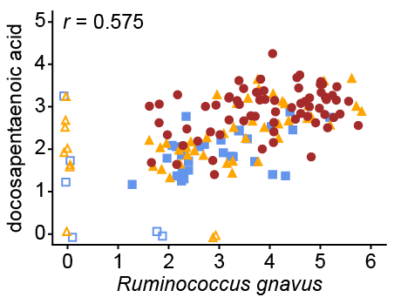
Robust associations between metabolites & microbes
log10(PPM) units

Slide 40
From associations to in vitro growth effects
Nadine
Fornelos
Test putative bug:metabolite relationships in culture
Look for changes in growth rate + carrying capacity
Some associations are confirmed in vitro!
Others not quite as convincing…
log10(PPM) units

Slide 41
Random forest prediction of IBD status
Metabolites predict IBD status well (AUC>0.9)
Predictor generalizes to new samples
Species also perform well, despite drawing on far fewer features
No marked boost in accuracy from combining metabolites and species

Slide 42
Random forest prediction of IBD type: CD vs. UC
Non-IBD controls rarely classified as IBD:CD or IBD:UC
IBD:CD rarely classified as Non-IBD control, but sometimes as UC
IBD:UC hard to get right

Slide 43
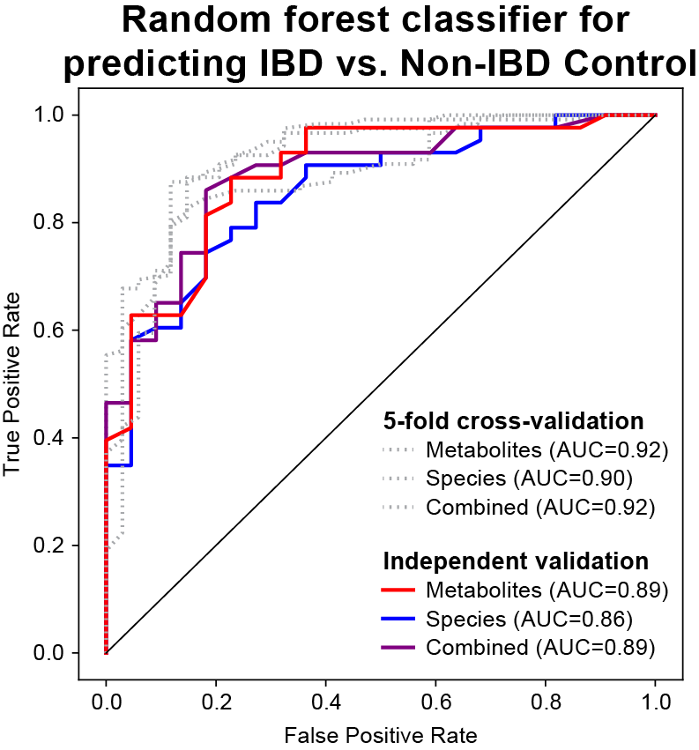
Summary of IBD metabolome application
Metabolomes broadly stratified by subject inflammation level
Putatively mechanistic microbe-metabolite associations
Microbial functional adaptations to the IBD gut agree with earlier work
Many molecular classes are differentially abundant in IBD
Some classes (clusters) are well understood, while others are largely uncharacterized
Metabolites and microbes can classify IBD status reasonably well, though subtype is harder

Slide 44
Databases

Slide 45
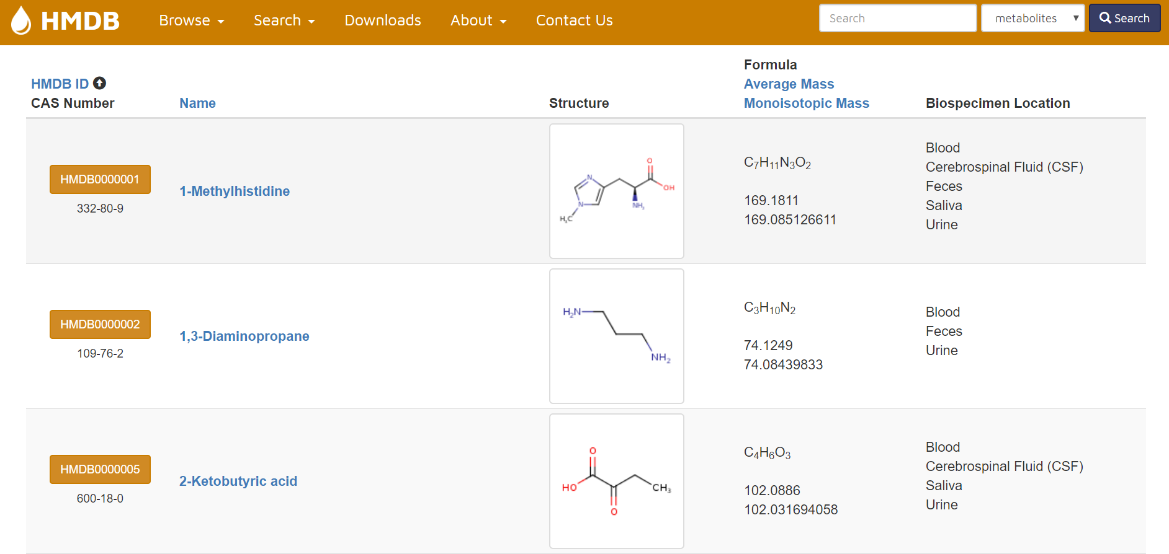
Metabolite/metabolomics databases
HMDB
The human metabolome database
http://www.hmdb.ca/
METLIN
“The original and most comprehensive MS/MS database”
https://metlin.scripps.edu

Slide 46
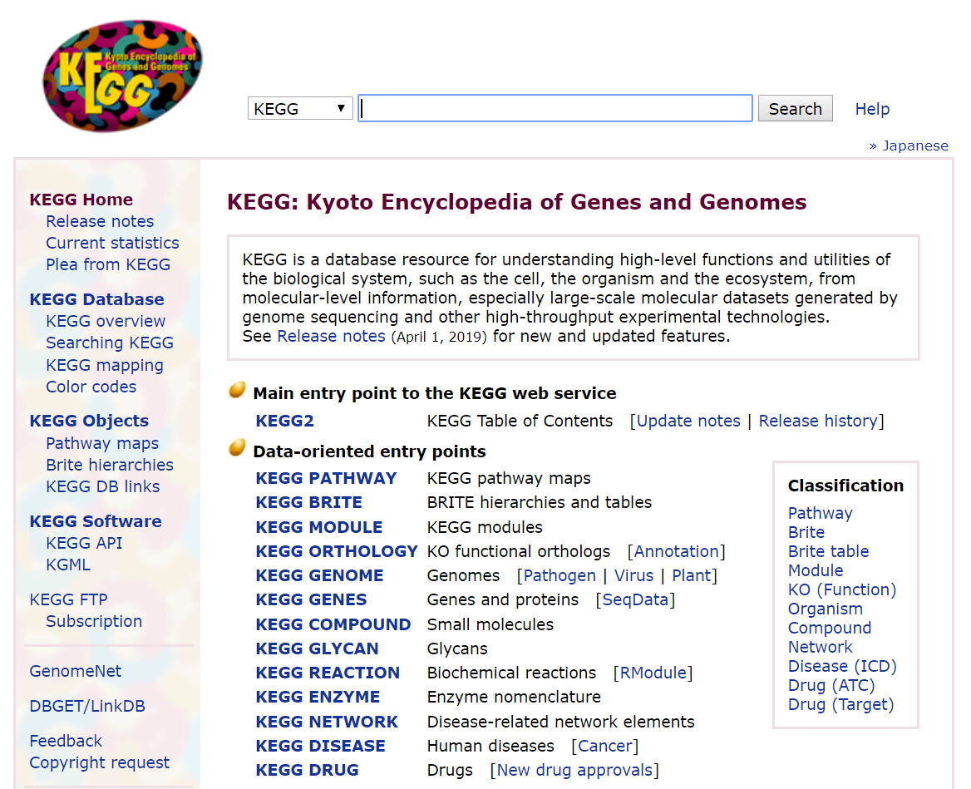
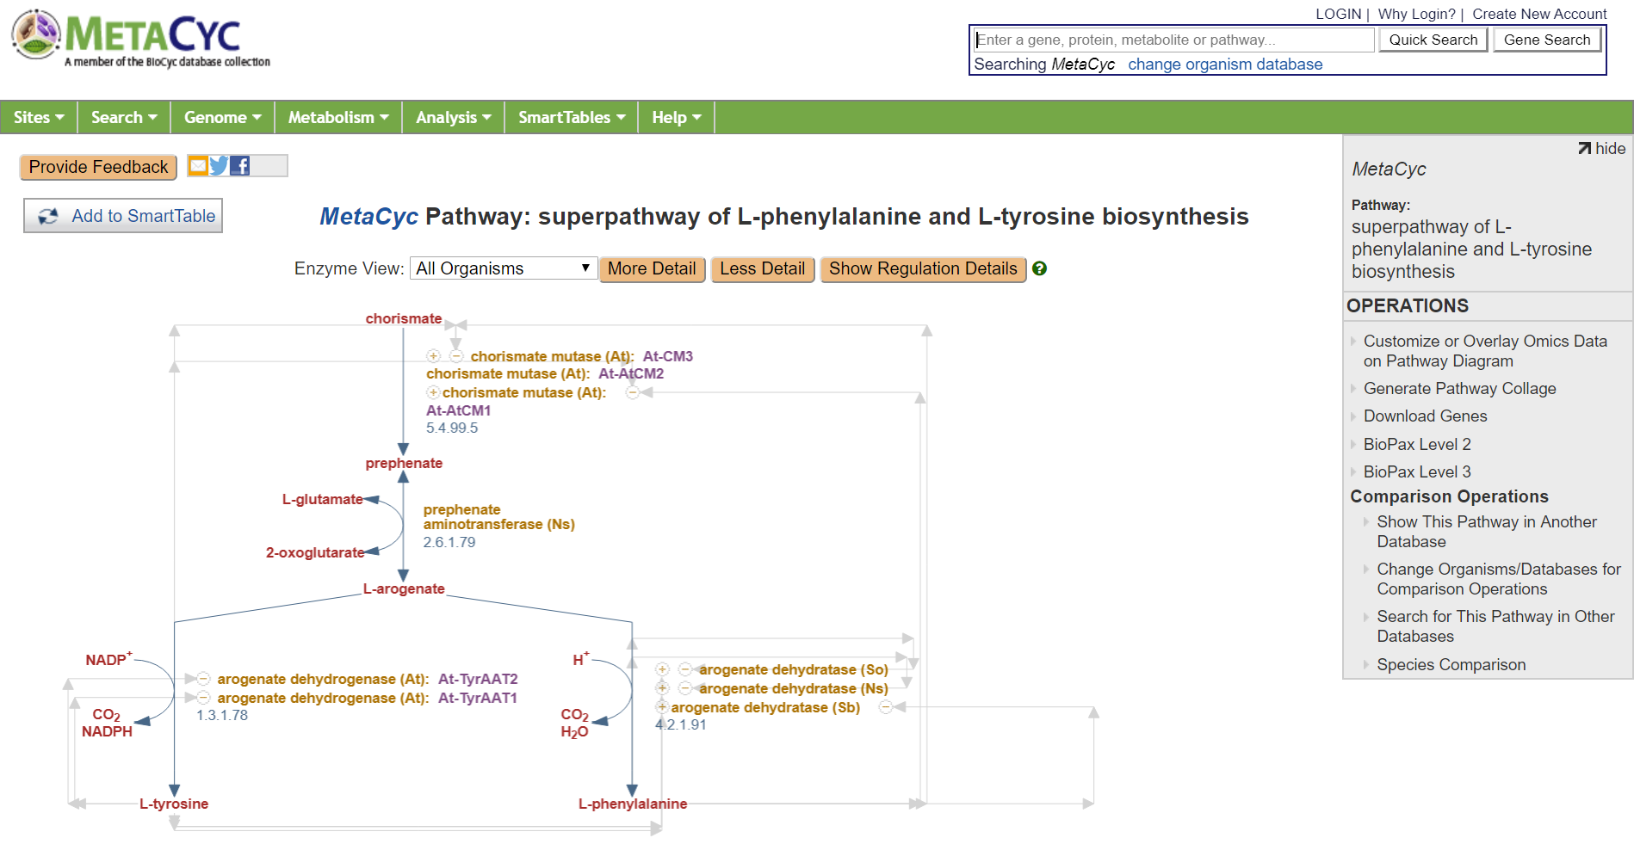
Metabolism databases
MetaCyc
https://metacyc.org/
KEGG
https://www.genome.jp/kegg/
Associate metabolites with enzymes, enzymes with pathways, enzymes with genes, genes with species…

Slide 47
Metabolic modeling

Slide 48
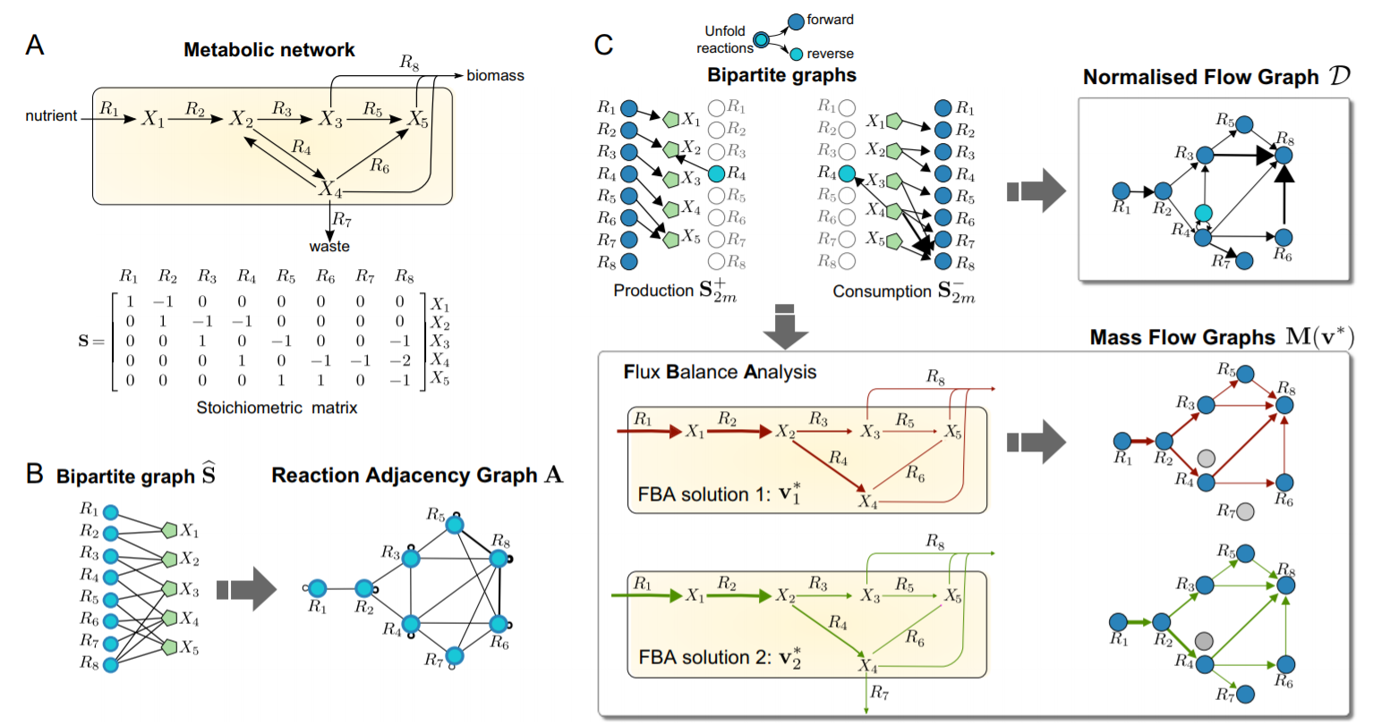
Static/steady-state models of metabolism
Source: Beguerisse-Díaz et al., npj Systems Biology and Applications (2018)

Slide 49
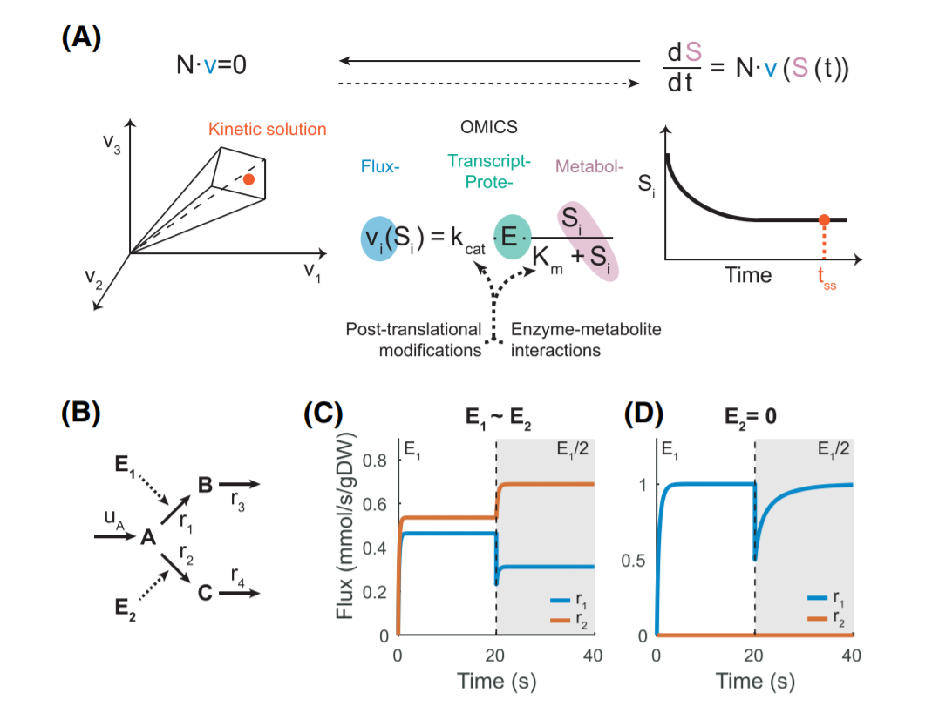
Dynamic/kinetic models of metabolism
Source: Ramon et al. Essays in Biochemistry (2018)

Slide 50
Summary
Metabolomics
Nuclear Magnetic Resonance (NMR)
Mass spectrometry (MS)
Liquid Chromatography (LC)
Quality-control procedures
Metabolite identification
Downstream analyses
Case study of the IBD microbiome
Databases
Metabolic modeling

Slide 51
https://fold.it/portal/

Slide 52
Extras

Slide 53
Canvas question time
Ask me for the passcode

