Slide 1
An overview of systems biology
Curtis Huttenhower (chuttenh@hsph.harvard.edu)
Eric Franzosa (franzosa@hsph.harvard.edu)
http://huttenhower.sph.harvard.edu/bst281

Slide 2
Systems biology
Phenotypes emergent from interactions among simpler elements
Static interactions: networks
Dynamic interactions: feedback and regulation

Slide 3
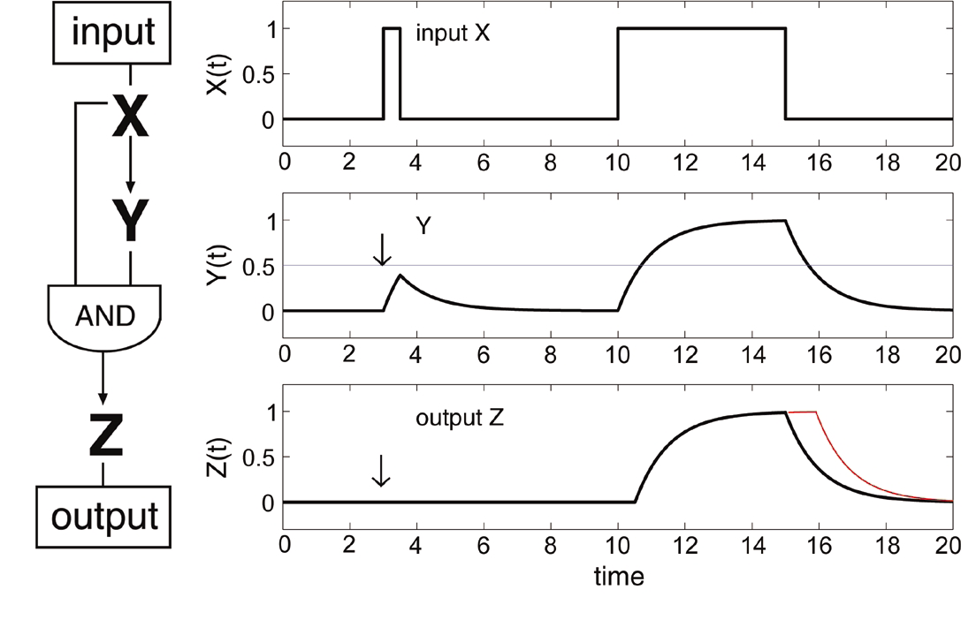
Information flow in regulatory networks
Simple interaction “circuits” can compute useful functions
These result in network motifs used repeatedly in regulatory networks
Example: the “feed-forward loop” (FFL)
The coherent (all edges activating) FFL behaves like a noise filter:

Slide 4
Network motifs
Feedback
Positive auto-regulation
Negative auto-regulation
memory
delay
speed + stability
Coherent feed-forward
Bi-fan
filter
Incoherent feed-forward
WGD and evolvability
pulse

Slide 5
Linking static network models with dynamical systems

Slide 6
Outline
Dynamic models
Model structure and notation
Defining differential equations
Interpreting differential equation models
ODEs
Applying ODE models
Perturbations and interventions
Modifying/extending models

Slide 7
Network models of processes
Interconversions between populations are one of many dynamical systems networks represent well
Nodes = populations
People, chemicals, proteins, etc.
Edges = transition rates
Infection, transformation, synthesis, etc.
Rabbits
Death
Birth
Infected
Infection
Immunity
Consumption
Suscep-tible
Recov-ered
Foxes
Susceptibility
Death
Birth

Slide 8
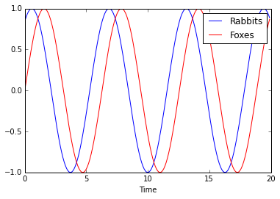
Network models of processes
In such a model, each population is a quantity that evolves over time
Thus a function with respect to time t
e.g. R(t) = sin(t + 1), F(t) = sin(t)

Slide 9
Differential equation models
Often useful to denote relationships between populations and their rates of change
Number of rabbits born depend on existing population
Newly infected individuals depends on how many healthy + how many sick already exist
Differential equations allow us to write equations about variables and their time derivatives

Slide 10
Differential equation models: SIR
SIR = Susceptible, Infected, Recovered
r_{B} = birth rate
r_{S} = susceptibility rate
r_{I} = infection rate
r_{R} = recovery rate
r_{D} = death rate
r_{D}
Infected
r_{I}
r_{R}
Suscep-tible
Recov-ered
r_{S}
r_{B}

Slide 11
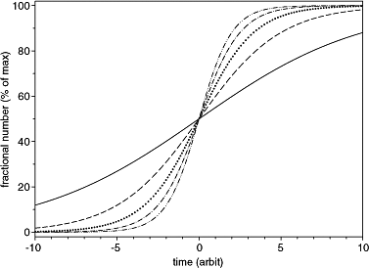
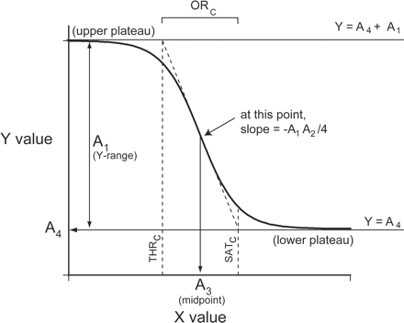
Differential equation models: solutions
The “solution” to a system of DEs is thus a set of functions that describe variables of interest
Not a single value each like standard algebra!
May be a specific, fully parameterized function
May be a family of functions that have the right shape
McDowall AJP 2006

Slide 12
Differential equation models: ODEs
Ordinary differential equations (ODEs) include a single independent variable and its derivatives
Linear ODEs are most common, in which independent variable has only linear coefficients

Slide 13
ODEs for biochemical systems
Claudio Altafini 2007

Slide 14
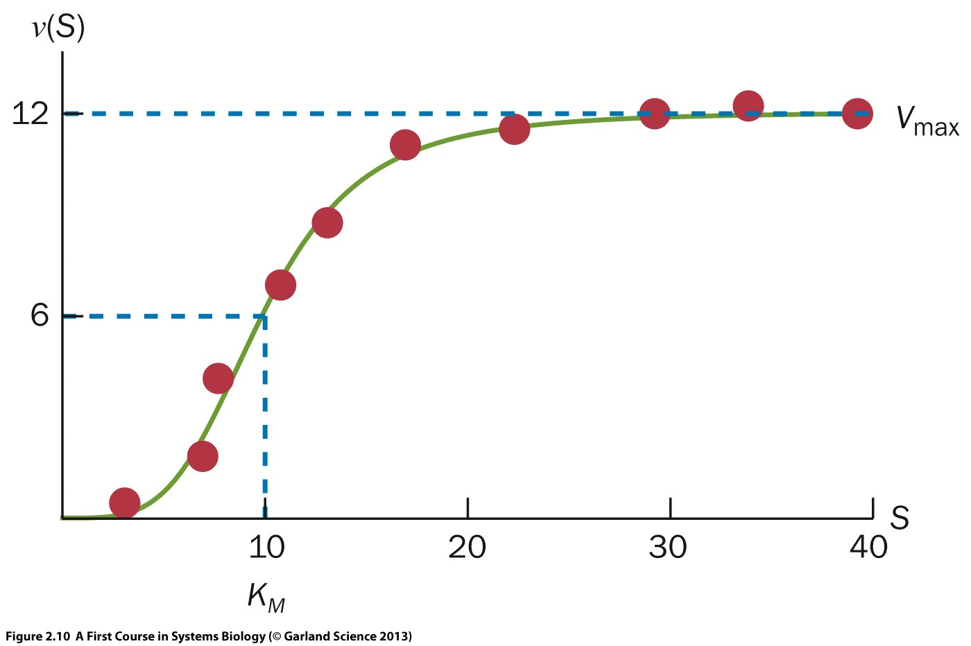
ODE parameters
We often care specifically about the parameters of an ODE model
Sometimes these are known/easily measurable
Birth/death rates in a population
Sometimes they are known within some range
Chemical conversion rates – approximately measurable
Average offspring / animal
Saturating conversion rate
Concentration at ½ V_{max}

Slide 15
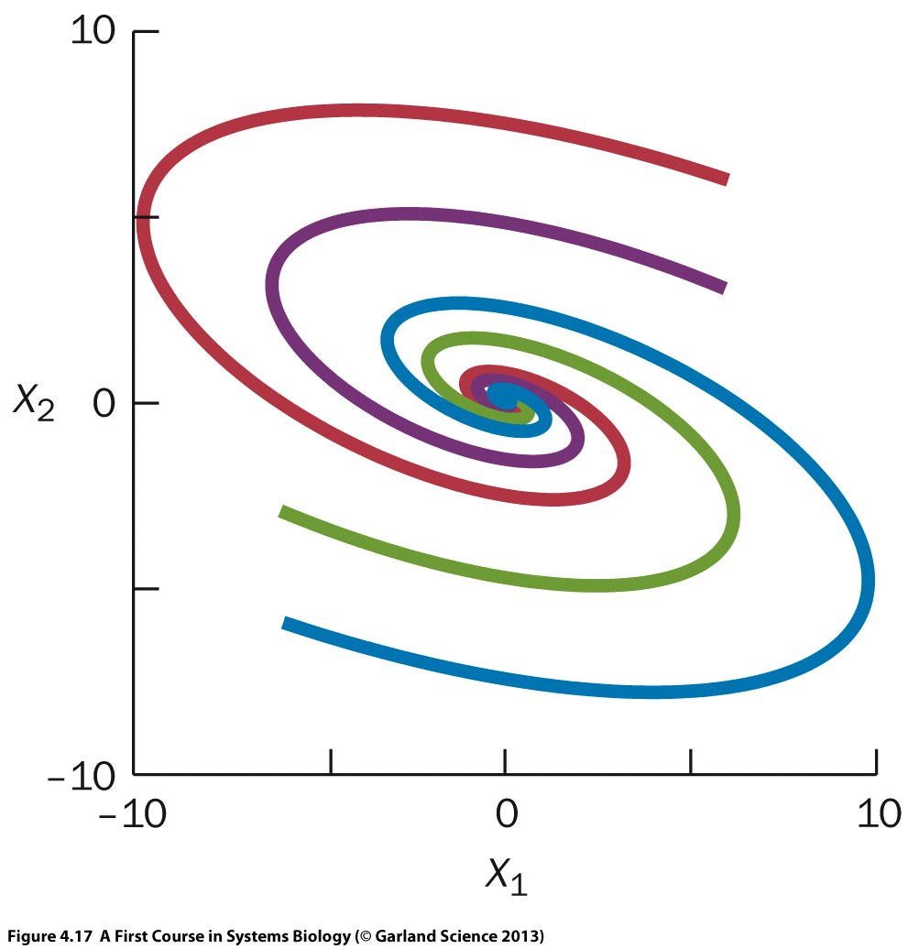
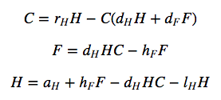
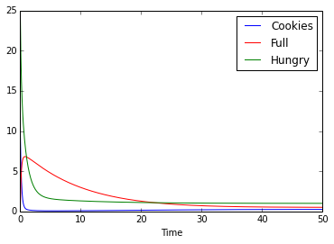
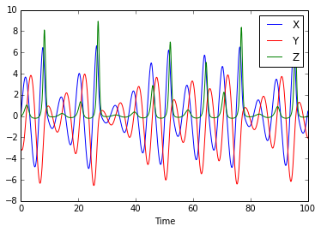
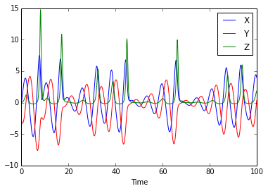
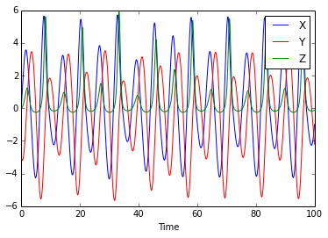
ODE parameters
Sometimes they’re unknown and can be worked around
Sometimes they’re robust to wide ranges of settings
Sometimes their precise values are critical
a=0.36, b=0.4, c=4.5
a=0.42, b=0.4, c=4.5
a=0.36, b=0.52, c=4.5

Slide 16
ODE initial values
In addition to rate parameters, ODE solutions are dependent on initial values
Also referred to as boundary conditions
Often among the most important parameters, all of the same caveats and necessities apply
Logistic map
(Discrete dynamical system)
P_{t+1}=rP_{t}(1-P_{t})

Slide 17
Fully parameterizing ODEs
Established by guesstimate or assay to fully specify model
r_{B} = birth rate
3 per unit time
r_{S} = susceptibility rate
1% per unit time
r_{I} = infection rate
0.05% per unit time
r_{R} = recovery rate
5% per unit time
r_{D} = death rate
1% per unit time
S₀= initial susceptible population
990
I₀ = initial infected population
10
R₀= initial resistant population
0
Once a model’s fully specified, how do we solve it?

Slide 18
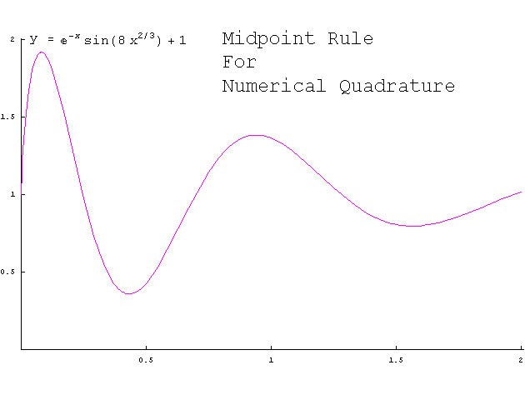
Solving ODEs
Under some circumstances, can solve analytically
Generally relies on having known functional forms for certain families of equations, e.g. exponential or sinusoidal.
Works well with power series expansion of the form $\sum_{k=0}^{∞}{c_{k}x^{k}}$
We won’t use this approach
Numerical integration = simulation
Roughly: plug in initial values and parameters, then “run” the system by executing tiny simulated time steps

Slide 19
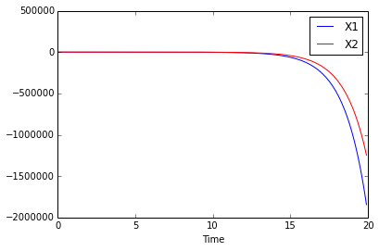
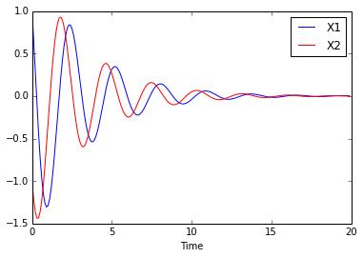
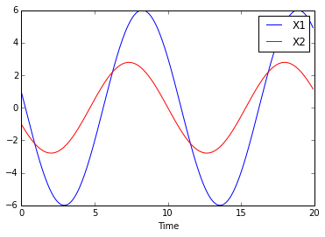
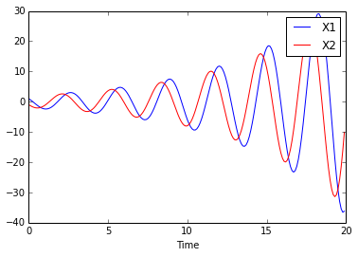
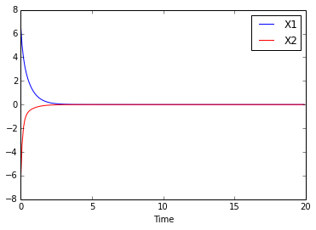
Linear ODEs
Solutions to linear ODEs combine exponential, sinusoidal, linear, and asymptotic functions
Power law at work again

Slide 20
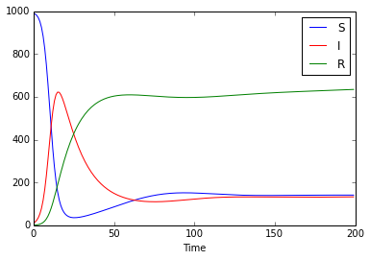
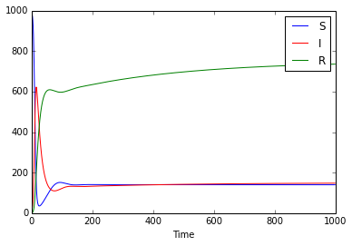
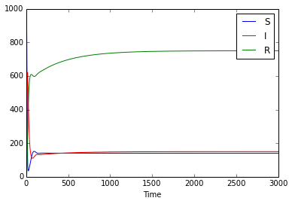
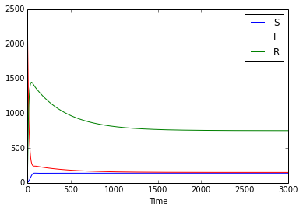
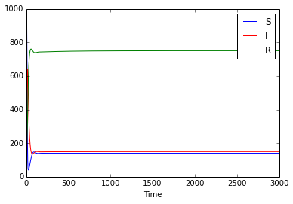
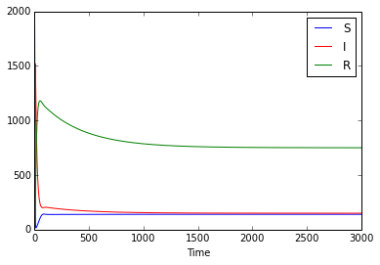
Steady state behavior
Many ODEs (especially real systems) reach a steady state: no variables changing over time
Attractor or stable steady state: same configuration reached regardless of initial conditions
S₀=990
I₀=10
R₀=0
I₀=1000
R₀=300
S₀=2000

Slide 21
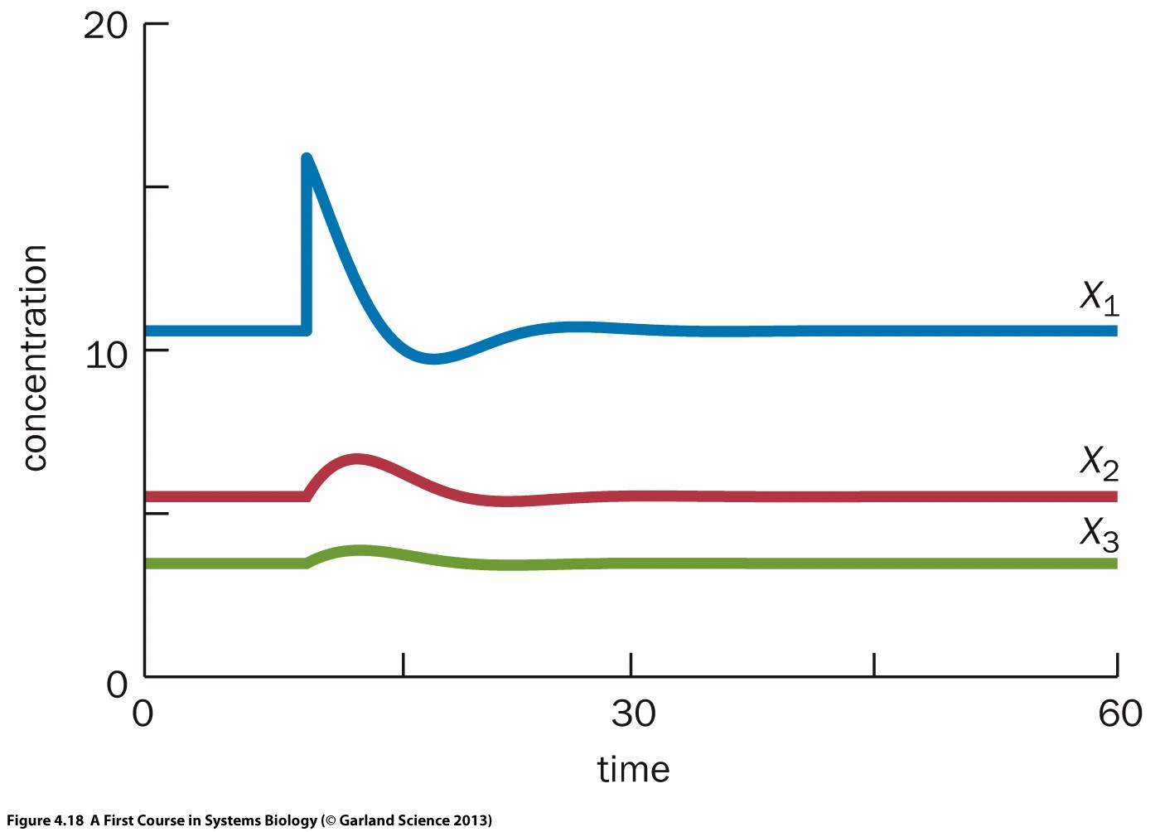
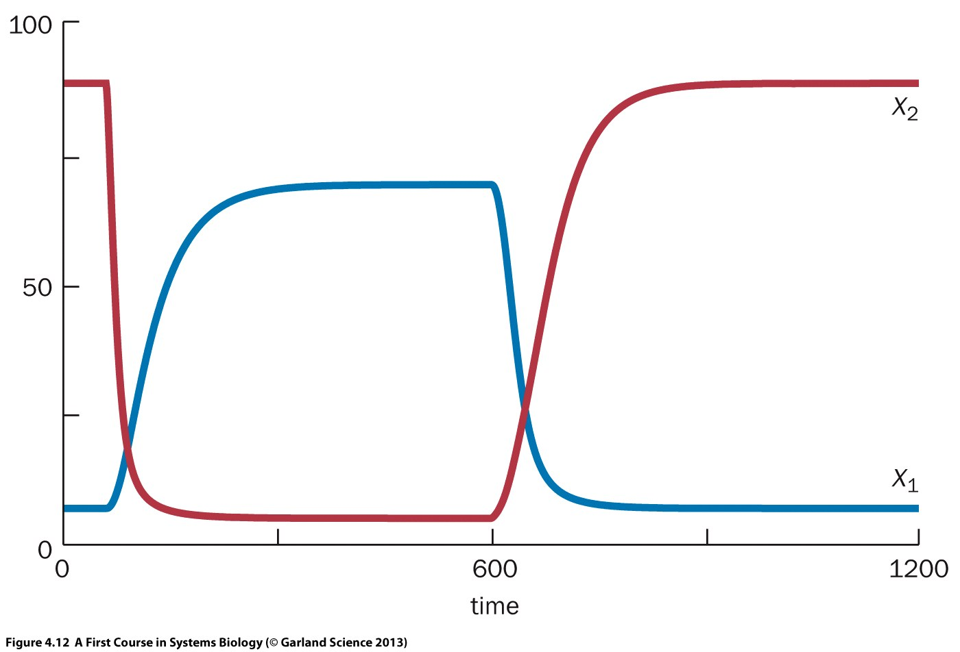
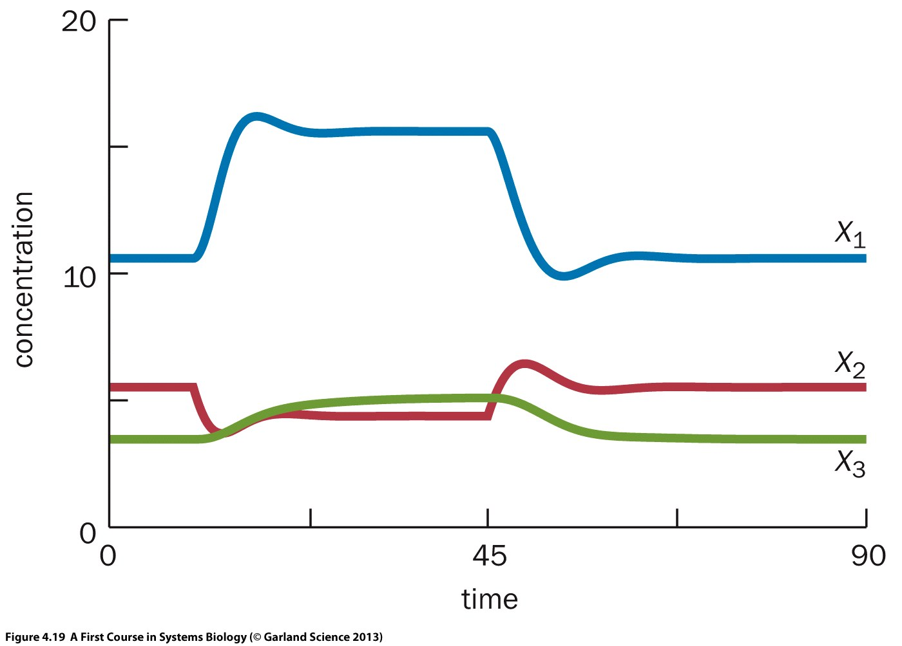
Model diagnostics: departures from steady state
Often of interest to assess model behavior after a perturbation from steady state
May return to steady state, may not – depends on system and nature of perturbation
Can stably return
Or oscillate back (overshoot)
Or change to another stable state
Or lose stability altogether
More on this later if there’s time…

Slide 22
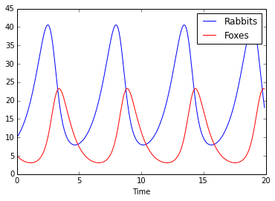
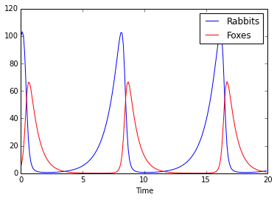
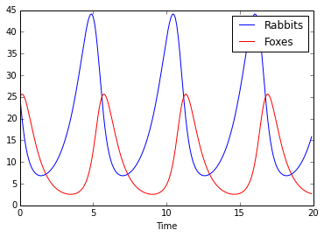
Model diagnostics: robustness to parameter values
Models may or may not be robust to parameter values
Models may or may not be robust to initial values
R=10, F=5
R=100, F=5
R=25, F=25

Slide 23
Outline
Dynamic models
Model structure and notation
Defining differential equations
Interpreting differential equation models
ODEs
Applying ODE models
Perturbations and interventions
Modifying/extending models

Slide 24
Appropriate uses of ODE models
Great for being strongly predictive
Describe entire state of a system at any time
But require a lot of prior knowledge to get right
Exact solutions and quantitation are rarely practical
Models are very sensitive to included components
Ditto parameters and initial values
Qualitative behaviorial analysis is much more fruitful
What’s the general shape of steady state?
Which perturbations matter, how much?
Which parameters matter?
How can I intervene to change outcomes of the system?
What happens if I add/remove model components?

Slide 25
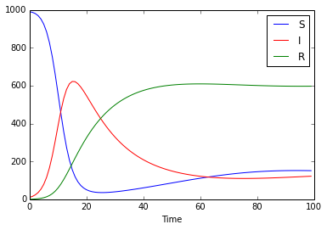
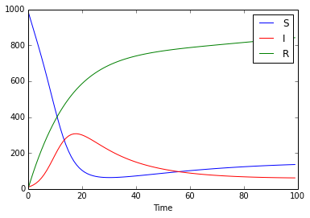
ODE example: vaccination
Vaccination as an intervention to control SIR outbreak

Slide 26
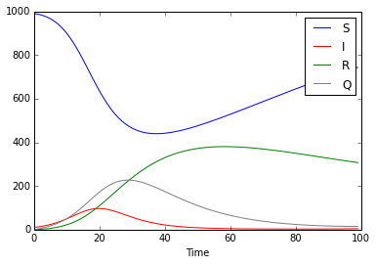
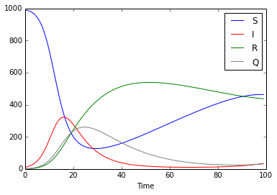
ODE example: quarantine
Quarantine as an intervention to control SIR outbreak
r_{Q}=0.25
r_{Q}=0.1

Slide 27
Evaluating overall model behavior
Can evaluate overall qualitative behavior by combining summary statistics and sampling
Choose a useful model summary
Steady state variable values
Values at a fixed time
Ratios of values of interest
Identify useful ranges of all parameters and initial conditions
Repeatedly randomly sample combinations of parameter values from across the space
Monte Carlo simulation

Slide 28
Evaluating overall model behavior
SIR over typical parameter ranges is difficult to perturb, except in the case of unusually low death rate

Slide 29
Evaluating overall model behavior
Monte Carlo (or algebraic) evaluation of model behavior answers questions like:
What combinations of parameter values lead to outcomes we like, e.g. fewer infections?
How do parameter combinations relate to outcomes of interest (such as infections)?
Are there multiple sets of qualitative behaviors, e.g. steady state vs. unbounded values?

Slide 30
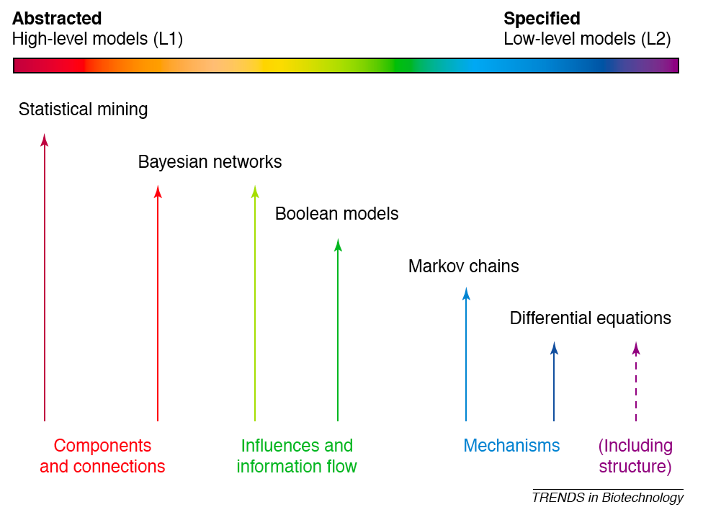
Systems biology using ODEs
Good models (and science generally!) are both simple and accurate
No models are perfect

Slide 31
Outline
Behavioral analysis of ODEs
Matrix notation for ODEs
Symbolic solution for stable states
Simulation solutions
Nonlinear ODE behaviors
Types of (un)stable outcomes
Assessing model robustness and behavior

Slide 32
Behavioral analysis of ODEs
First, a reminder of matrix notation:
Vector =
Matrix =
Addition =
Multiplication =

Slide 33
Behavioral analysis of ODEs
Thus we can write a general linear ODE:
In the two-variable case, this denotes:
Four main parameters: a_{1,1}, a_{1,2}, a_{2,1}, a_{2,2}
Two secondary parameters: u₁, u₂
Two initial conditions: X_{1,0}, X_{2,0}
What can we model with this system?

Slide 34
Applications of linear ODEs
Models two autoregulatory populations
a_{1,2}
a_{2,2}
a_{1,1}
X₁
X₂
u₁
u₂
a_{2,1}
+
-
R
TF
L
-

Slide 35
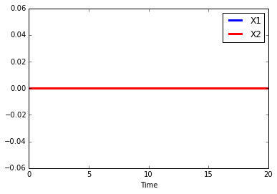
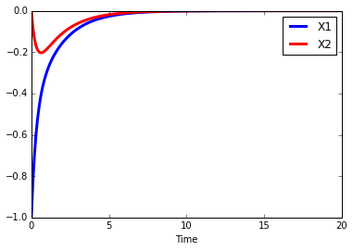
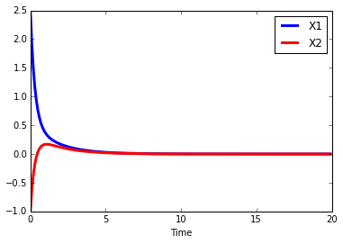
Behavior of linear ODEs
Case 1:
$$X_{1}=X_{2}$$
$$X_{1}=2X_{2}$$
X_{1,0}=0, X_{2,0}=0
X_{1,0}=2.5, X_{2,0}=-1
X_{1,0}=-1, X_{2,0}=0

Slide 36
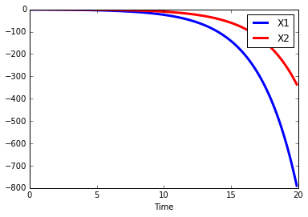
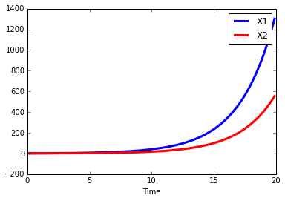
Behavior of linear ODEs
Case 2:
X_{1,0}=0, X_{2,0}=0
X_{1,0}=2.5, X_{2,0}=-1
X_{1,0}=-1, X_{2,0}=0

Slide 37
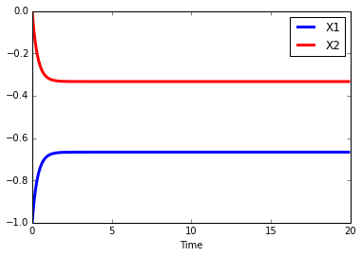
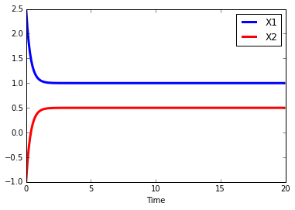
Behavior of linear ODEs
Case 3:
X_{1,0}=0, X_{2,0}=0
X_{1,0}=2.5, X_{2,0}=-1
X_{1,0}=-1, X_{2,0}=0

Slide 38
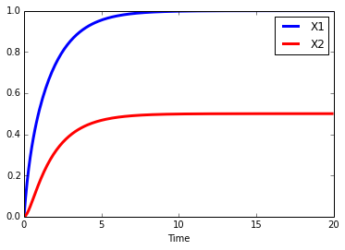
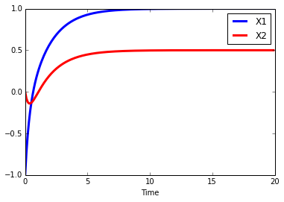
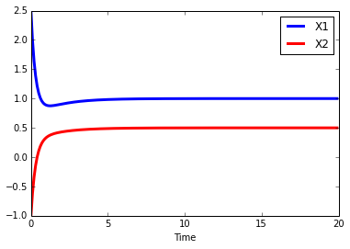
Behavior of linear ODEs
Case 4:
X_{1,0}=0, X_{2,0}=0
X_{1,0}=2.5, X_{2,0}=-1
X_{1,0}=-1, X_{2,0}=0

Slide 39
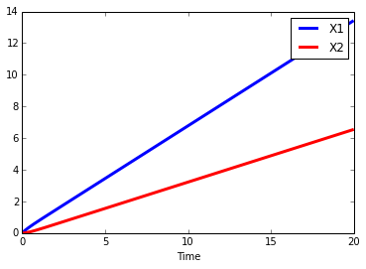
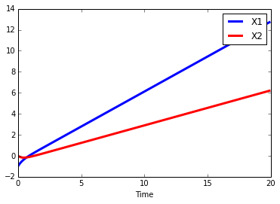
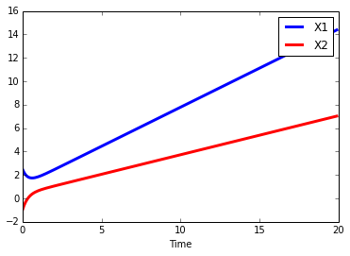
Behavior of linear ODEs
Case 5:
X_{1,0}=0, X_{2,0}=0
X_{1,0}=-1, X_{2,0}=0
X_{1,0}=2.5, X_{2,0}=-1

Slide 40
Behavior of linear ODEs
So we can get:
Stable states independent of initial values
Stable states dependent on initial values
Stable states for some initial values, not others
No stable states
How to identify these behaviors generally?
Linear systems: derivatize, set to 0, solve
Nonlinear systems: pray
Restricted classes can be solved algebraically
More often require numerical simulation / search
But simulations can easily miss stable states in sensitive systems

Slide 41
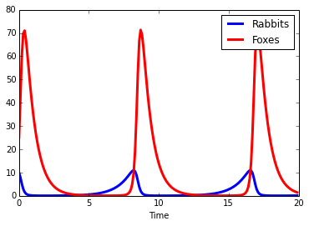
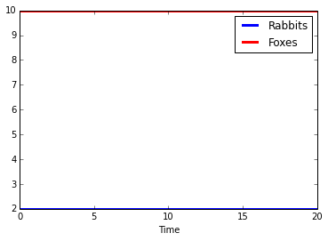
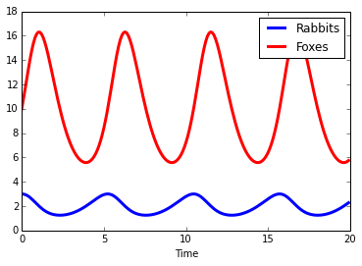
Behavior of nonlinear ODEs: Lotka-Volterra
d_{F}=1.5, c_{RF}=0.75
b_{R}=1, p_{RF}=0.1
R₀=10, F₀=25
d_{F}=1.5, c_{RF}=0.75
b_{R}=1, p_{RF}=0.1
R₀=2, F₀=10
d_{F}=1.5, c_{RF}=0.75
b_{R}=1, p_{RF}=0.1
R₀=3, F₀=10
d_{F}=1.5, c_{RF}=0.75
b_{R}=1, p_{RF}=0.1
R₀=2, F₀=9

Slide 42
Behavior of ODEs: stability analysis
In the general case, one can only assess stability landscape by simulation
But! The two-variable linear ODE case is both representative and tractable

Slide 43
Visualizing 2D ODEs
X₁
X_{1,0}=-1, X_{2,0}=0
X₂
Time
X_{1,0}=2.5, X_{2,0}=-1
X_{1,0}=1, X_{2,0}=-1

Slide 44
Stability analysis of linear ODEs

Slide 45
Stability analysis of linear ODEs
Sum of eigenvalues – decreasing when tr(A)<0, periodic when tr(A)=0, increasing when tr(A)>0
System of equations has a unique solution (steady state) only when det(A)≠0
Quadratic formula – >1 real roots when d(A)>0, one when d(A)=0, imaginary when d(A)<0

Slide 46
Stability analysis of linear ODEs: examples
X_{1,0}=1, X_{2,0}=-1
X_{1,0}=0, X_{2,0}=0

Slide 47
Outline
Behavioral analysis of ODEs
Matrix notation for ODEs
Symbolic solution for stable states
Simulation solutions
Nonlinear ODE behaviors
Types of (un)stable outcomes
Assessing model robustness and behavior

Slide 48
(Un)stable systems behavior
Linear models are generally well-behaved
Stable states, oscillations, or (exponential) growth
What about nonlinear systems?
Craziness!
Chaos
Sensitive initial conds.
Long-term aperiodic
Deterministic
Bifurcations
Lorenz system
ρ=28, σ=10, β=8/3
P
r=1.5
r=3.8
r

Slide 49
Testing model stability
Good models of the real world are generally stable
Insensitive to exact parameter values
Insensitive to exact initial conditions
(Except under special circumstances)
Can assess this by:
Bolus experiments
Changing the model structure or parameters
Screening/searching parameter space
Identifying and understanding critical points

Slide 50
Testing model stability: bolus experiments
At steady state, temporarily (typically instantaneously) modify the value of one variable
Assess subsequent dynamics – should return to steady state, smoothly or with overshoot/oscillation
Increase dependent X₁ instantaneously
Increase independent X₄ transiently

Slide 51
Testing model stability: structure
r_{D}
r_{D}
Inf.
Inf.
r_{I}
r_{R}
r_{I}
r_{R}
Susc.
Rec.
Susc.
r_{V}
Rec.
r_{S}
r_{S}
r_{B}
r_{B}

Slide 52
Testing model stability: parameter screening
Parameter screening
Simulate model with combinations of parameter values chosen from throughout plausible space
Controlled Monte Carlo simulation

Slide 53
Testing model stability: bifurcation points
Bifurcation point is a threshold past which system behaves qualitatively differently

Slide 54
Outline
Behavioral analysis of ODEs
Matrix notation for ODEs
Symbolic solution for stable states
Simulation solutions
Nonlinear ODE behaviors
Types of (un)stable outcomes
Assessing model robustness and behavior

