Slide 1
Scientific Data Visualization
Curtis Huttenhower (chuttenh@hsph.harvard.edu)
Eric Franzosa (franzosa@hsph.harvard.edu)
http://huttenhower.sph.harvard.edu/bst281

Slide 2
Summary
Why we plot
Examine data for issues / hidden behavior
Telling stories
How plots can go wrong
Ugly plots
Uninterpretable (“bad”) plots
Misleading (“wrong”) plots
The grammar of graphics
Mapping data to graphical attributes
Miscellaneous tips and tricks
References

Slide 3
Introduction

Slide 4
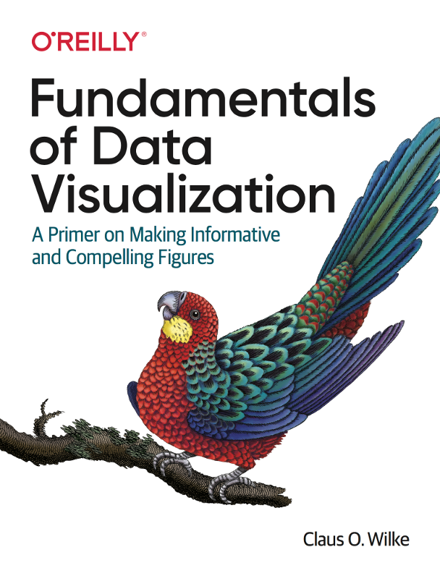
Book: Fundamentals of Data Visualization
By Claus O. Wilke
Published early 2019
Excellent, comprehensive introduction to making scientific figures
Free online version available:
https://serialmentor.com/dataviz/
Linked on Canvas
Borrowing many examples from here
Look for book cover in slide corner

Slide 5
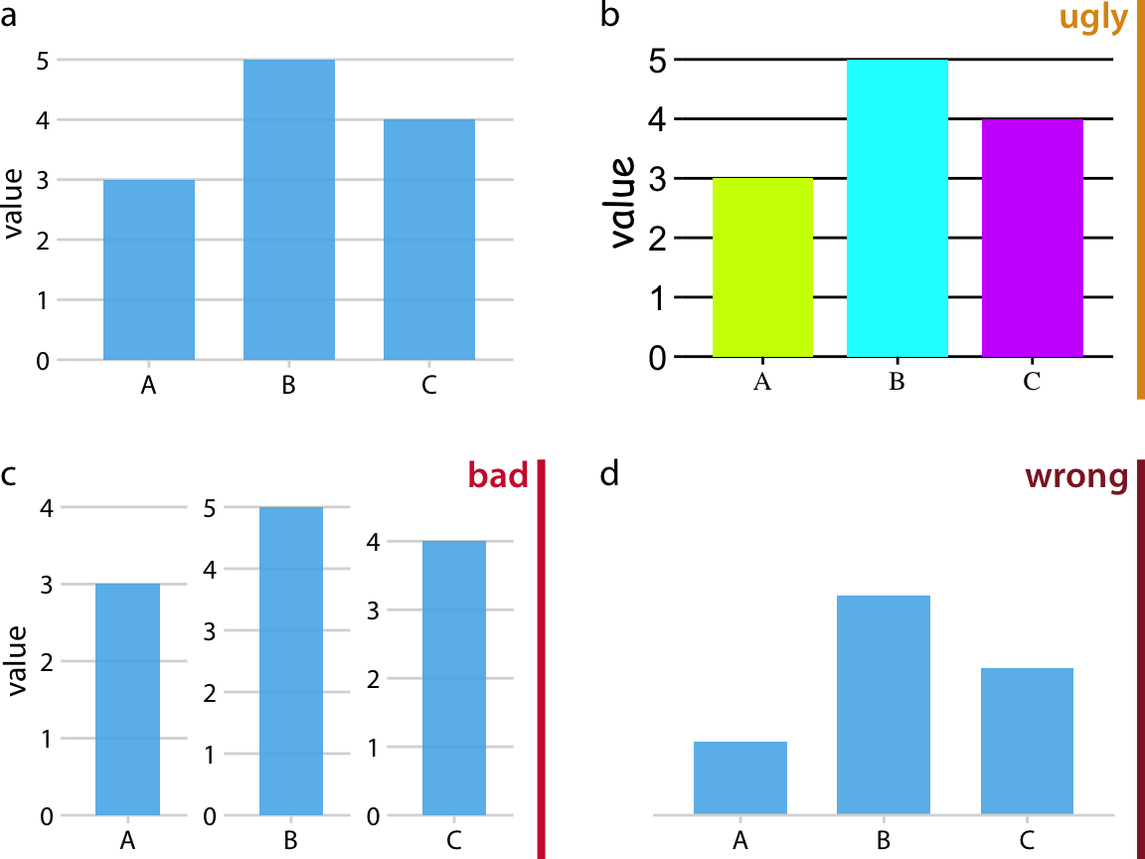
When data visualization goes ugly/bad/wrong
Fine aesthetics
Easy interpretation
Fair representation
Poor aesthetics
Easy interpretation
Fair representation
Fine aesthetics
Hard to interpret
Fair representation
OK aesthetics
Easy interpretation
Unfair representation
(bad science)

Slide 6
Why we plot:
Look at your data!

Slide 7
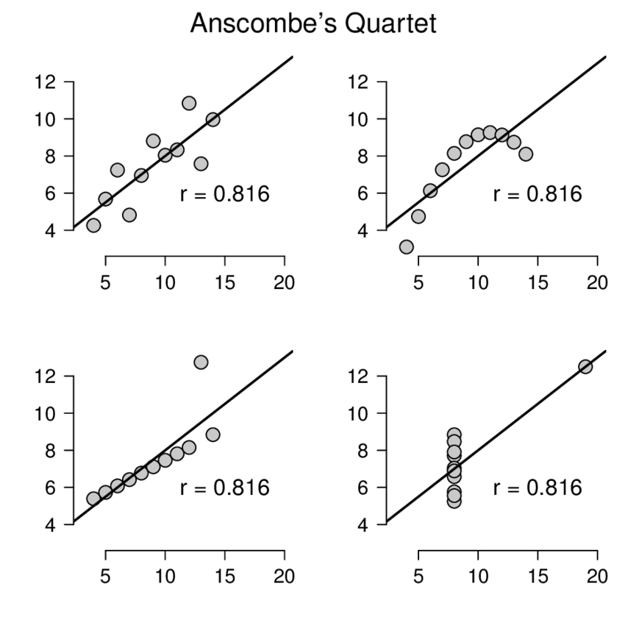
Summary trends can mask important structure
Recall Anscombe's Quartet:
Four datasets with identical (or near identical) values for many common summary statistics
The datasets clearly differ and suggest different phenomena (if they were real)

Slide 8
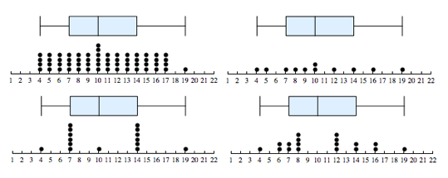
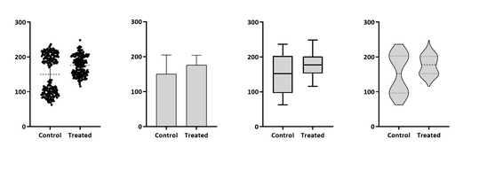
Summary trends can mask important structure
Visualize data in its rawest form possible before moving on to summary measures
Violin
Plot
Failing that, use summaries that maintain as much information as possible

Slide 9
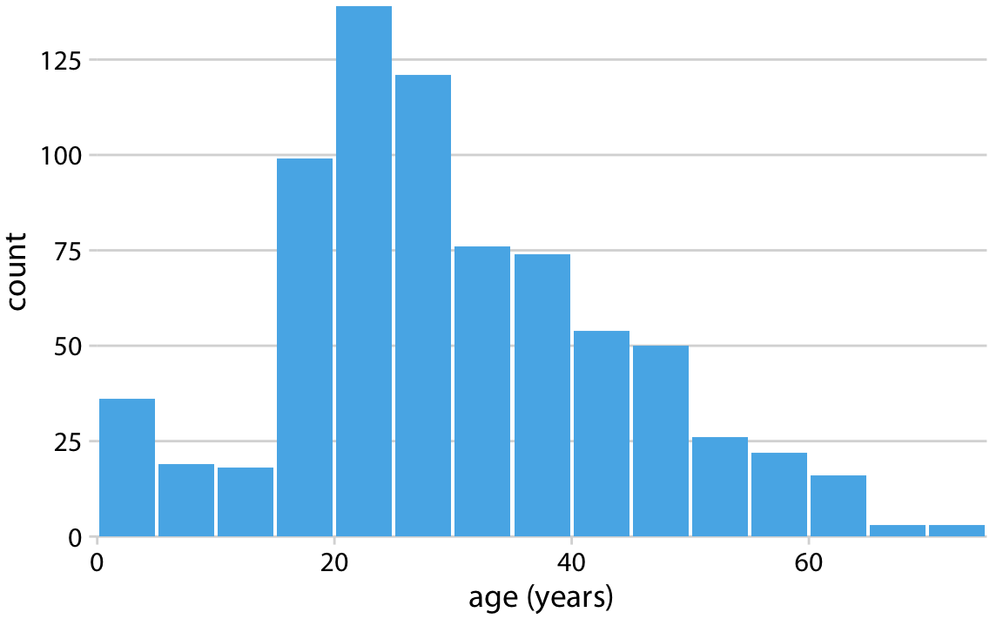
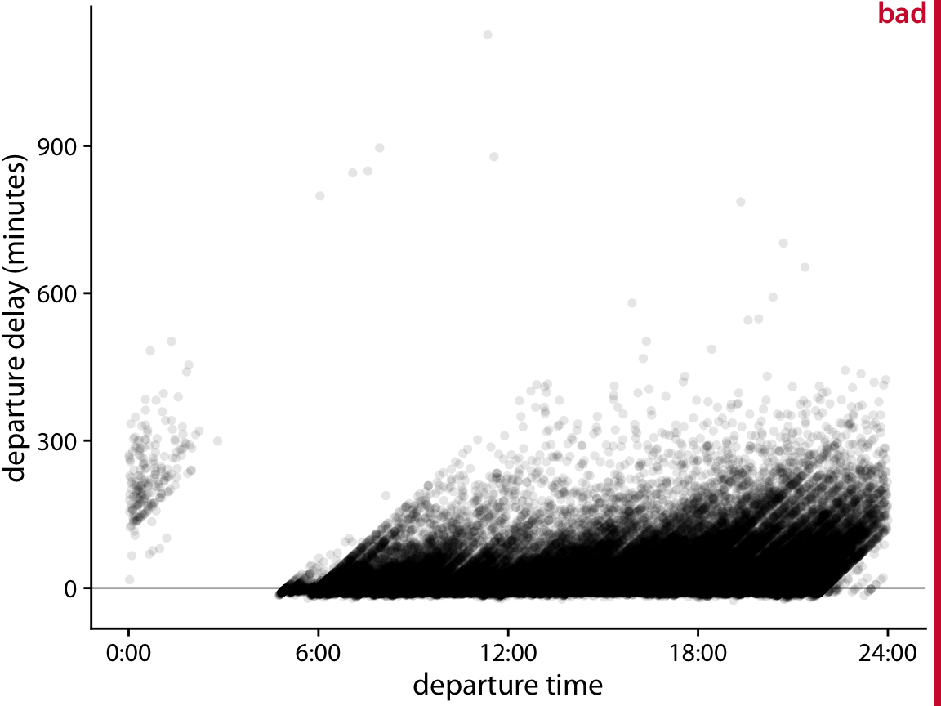
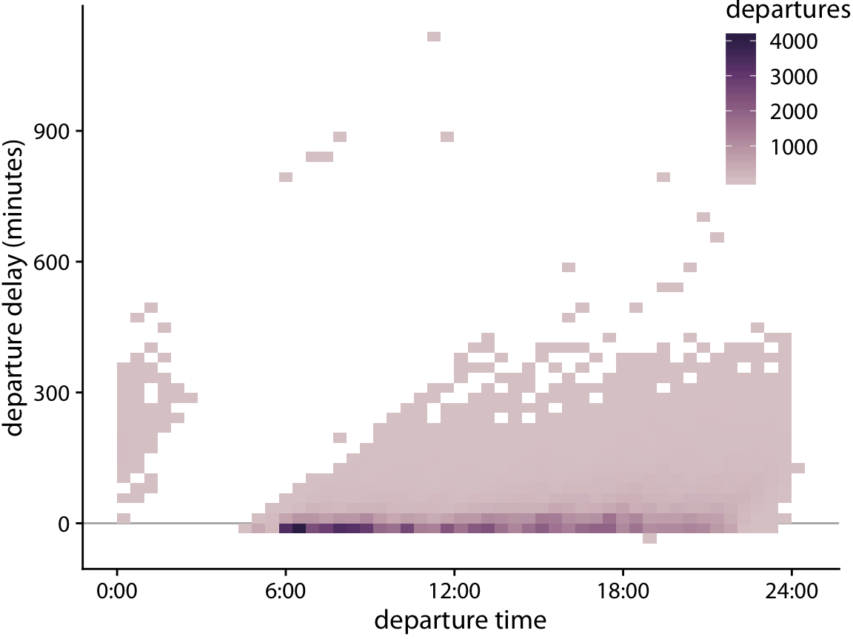
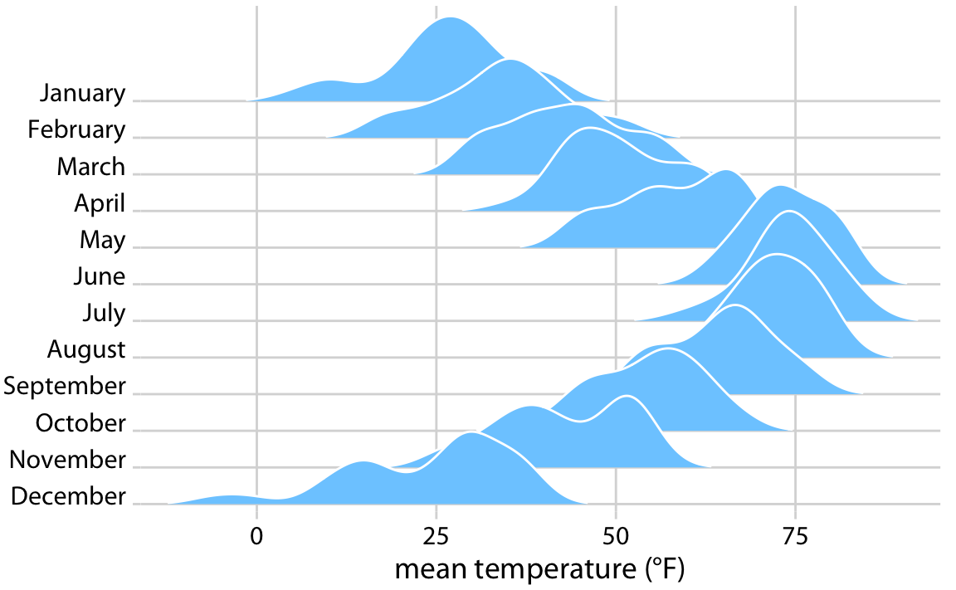
What if data are too large to view in raw form?
histograms
2D histograms
(heatmaps of counts)
Ridgeline plots

Slide 10
Why we plot:
Tell me a story

Slide 11
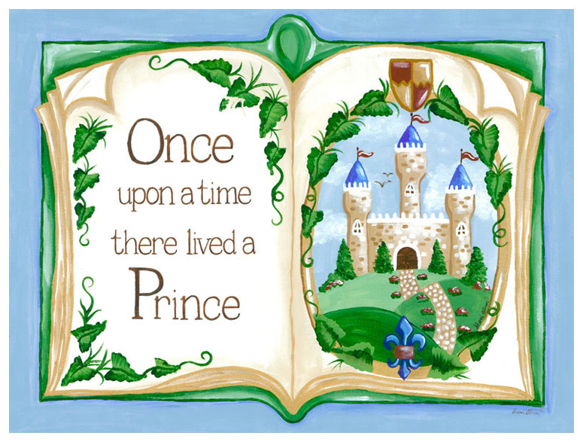
Telling stories
Plots of raw data are often for you + your team
Sometimes included in papers as “Supporting Information”
Most scientific figures are designed to tell clear stories
Those included in posters, talks, manuscripts
The story should be clear when the figure is seen out of context
Trying to tell more than one story per figure (or figure part) is tricky
How many scientists read papers:
Title → Most important summary
Authors / Journal → Subjective evaluations of quality
Abstract → Rest of the story (excluding first/last sentences of context)
Figures → Convince me that your claims were true
Methods (maybe) → How did they do this?

Slide 12
Telling stories
Stories often mirror hypotheses / statistical tests
X is associated with Y (e.g. height increases with age)
A is different from B (e.g. ibuprofen reduces fever compared to placebo)
Stories rarely involve more than three dimensions at a time
X is associated with Y when Z is true, but not when Z is false
Beyond this the stories get too complicated
Usually, there will be a clear (and common) visualization for each story type
Depending on the number and type of your variables

Slide 13
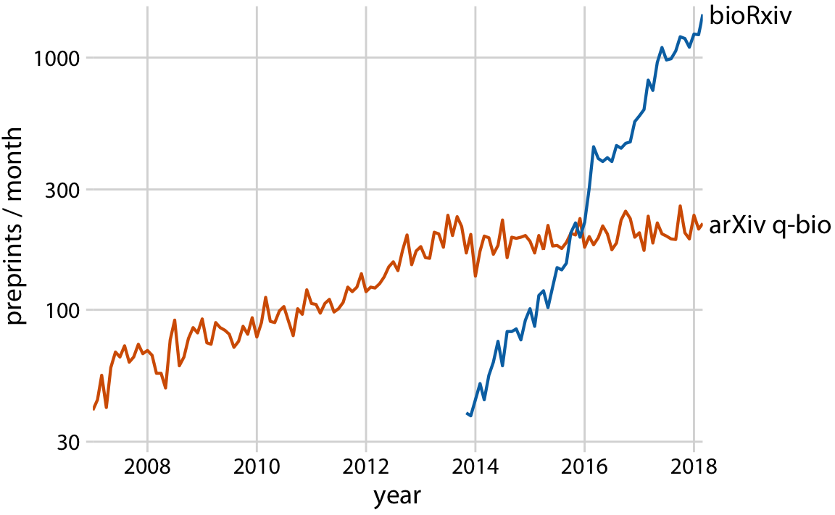
What’s the story?

Slide 14
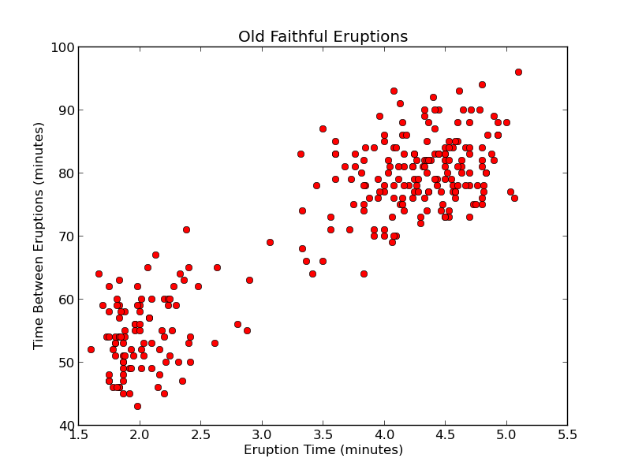
What’s the story?

Slide 15
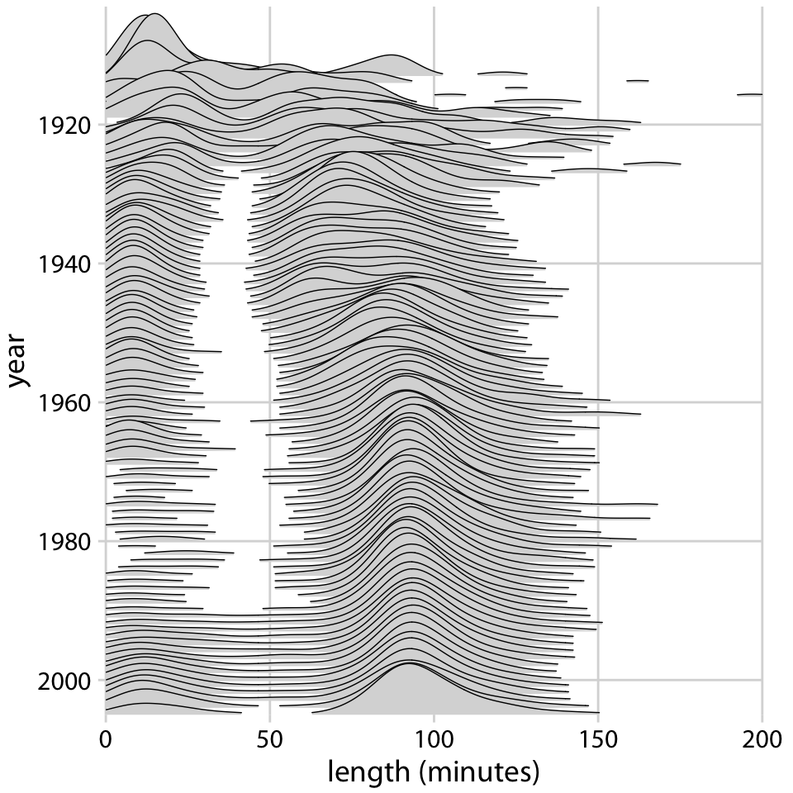
What’s the story?
movie length (minutes)

Slide 16
Mapping variables to graphical attributes

Slide 17
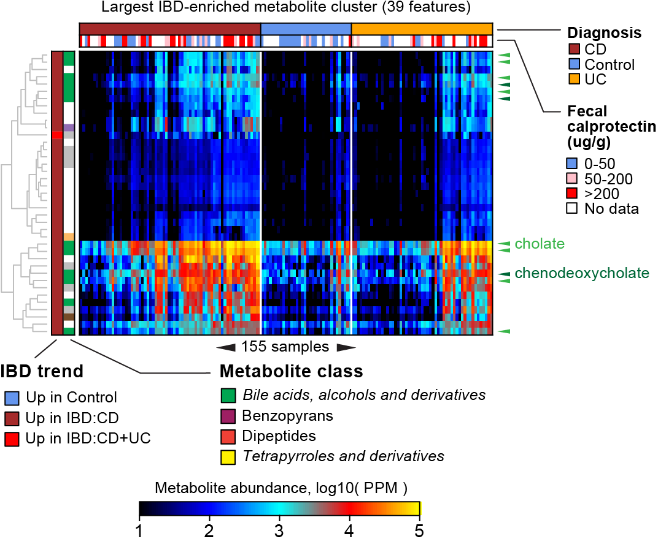
The nature of data and variables
A dataset is a collection of variables derived from discrete observations
Observation is a sample (or sampling event)
Observation is not always a unique individual (why?)
Variables come in a few common flavors:
Continuous (including proportions and counts)
“Number” data, often with units, often to arbitrary precision
Ex. Height (m) = 1.83, 1.23, 0.65, …
Categorical
“Label” data with two or more “levels”
Ex. State = Maine, Vermont, Connecticut, …
Ordinal
Categories with a meaningful order to them
Ex. Month = January, February, March, …

Slide 18
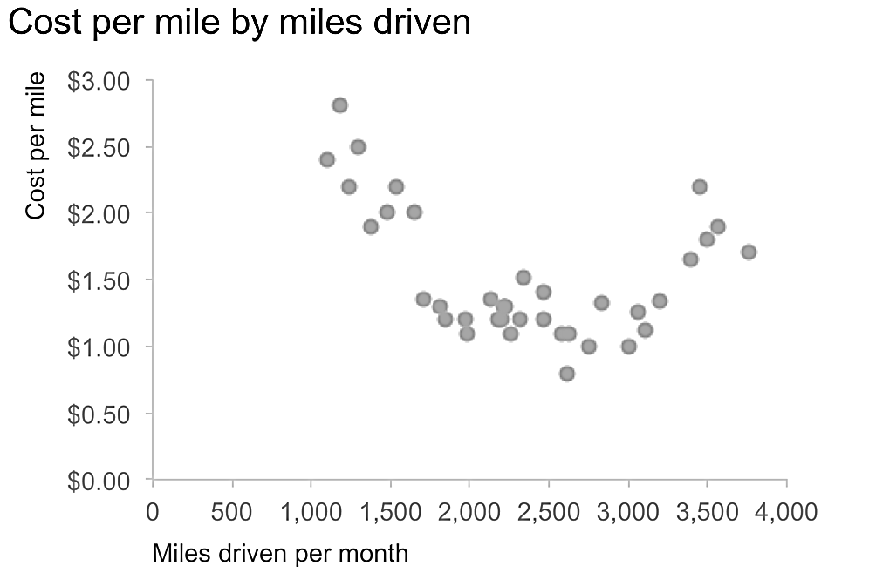
A plot maps variables to graphical attributes
A scatter plot maps:
A continuous variable to relative position along an axis
A second continuous variable to relative position along an orthogonal axis
A swarm plot maps:
A categorical variable to a position along an axis (may not be meaningful)
A continuous variable to a relative position along an orthogonal axis

Slide 19
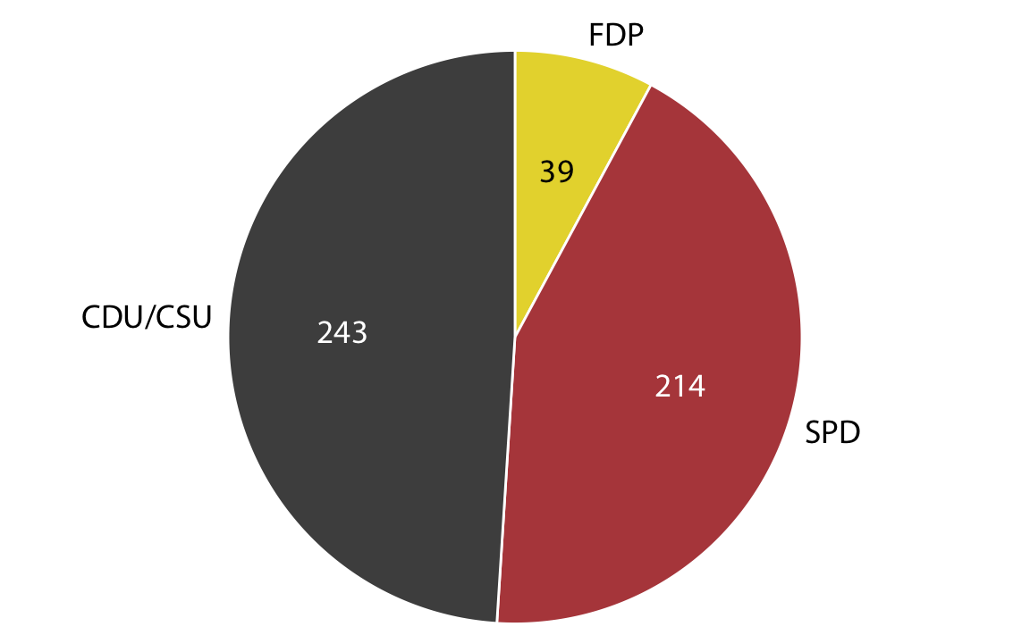
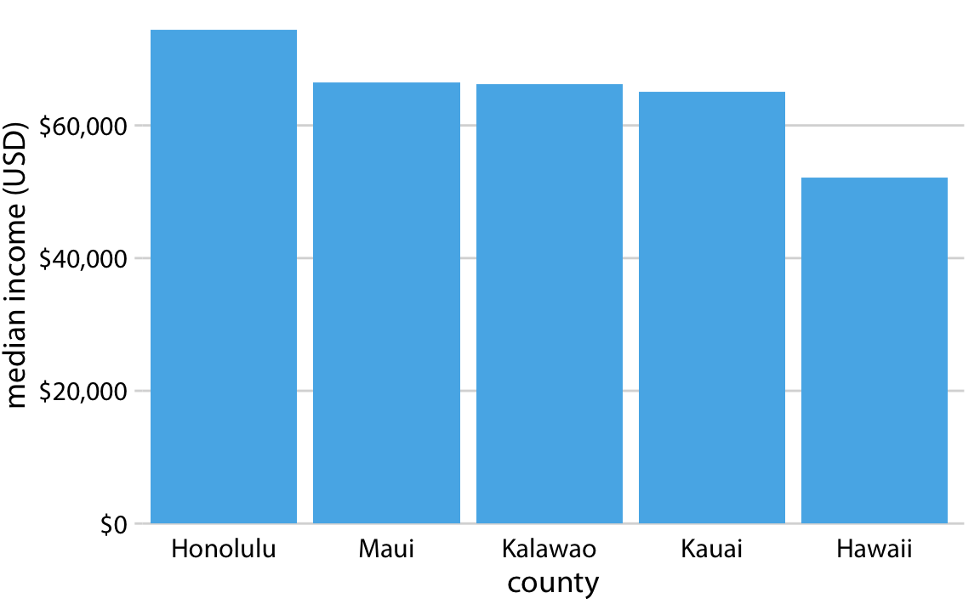
A plot maps variables to graphical attributes
A bar chart maps:
A categorical variable to a position along an axis (may not be meaningful)
A continuous variable to a length
A pie chart maps:
A continuous variable to an angle
A categorical variable to the bisector of that angle

Slide 20
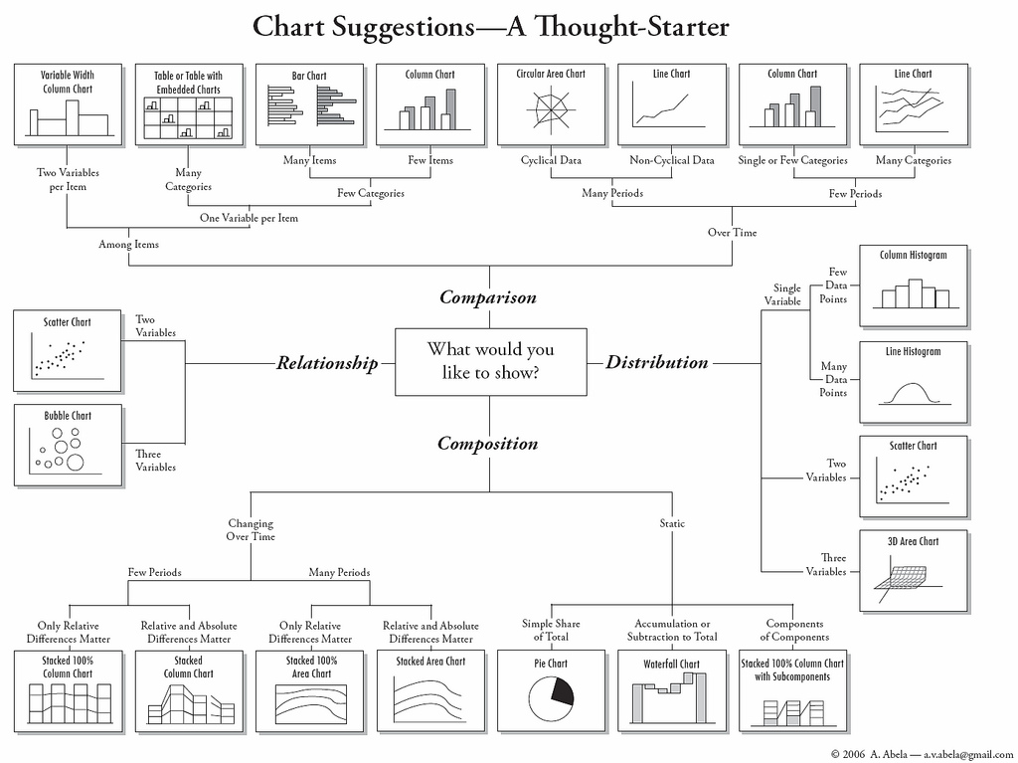
A plot maps variables to graphical attributes
Flow charts like this one are helpful for picking a type of chart based on the nature and number of your variables

Slide 21
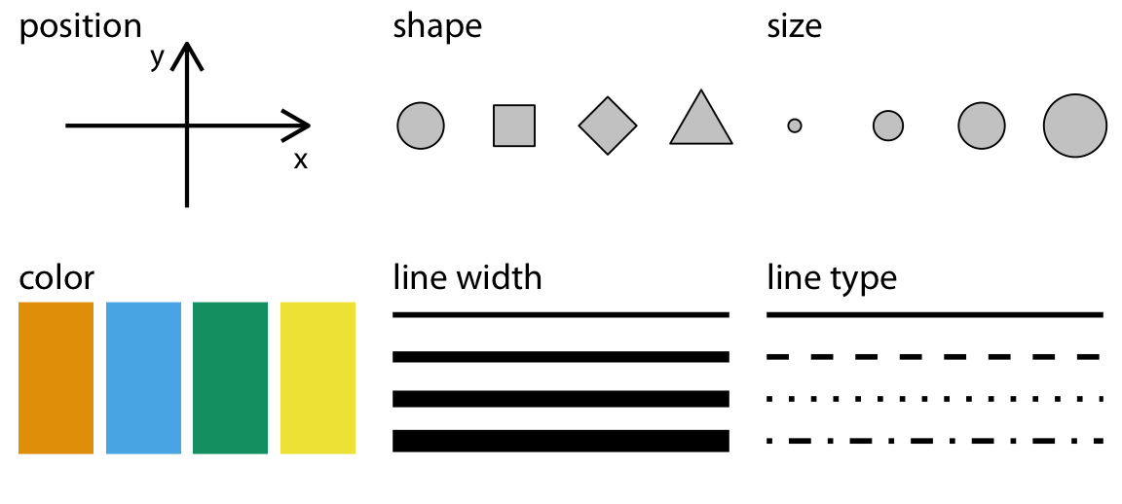
Common graphical attributes (“aesthetics”)
Continuous
Categorical (1-30 levels)
Categorical (1-5 levels)
Continuous
Categorical (1-3 levels)
Continuous
Categorical (1-10 levels)
Continuous
Categorical (1-3 levels)
Categorical (1-3 levels)

Slide 22
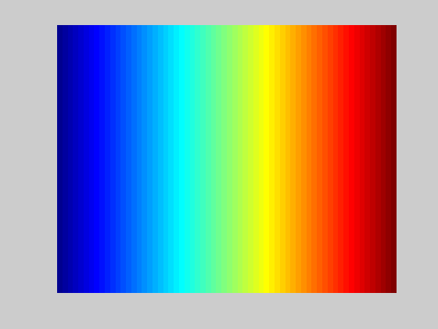
Less common attributes (examples)
Opacity
Just because you CAN doesn’t mean that you SHOULD
Rotation/angle
This is a case where standards are standards for a reason
Side number
(Usually related to ease of visual perception)
Wavelength

Slide 23
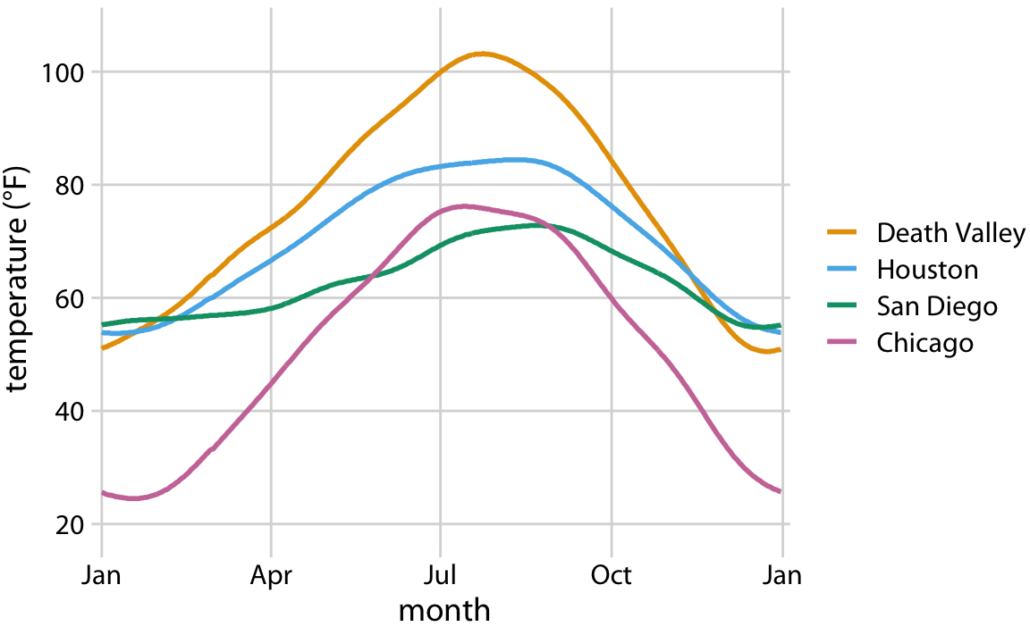
Mappings of more than two variables
Which variables (of which kinds) are mapped to which attributes?
Which is easier to interpret?
How would things change with 50 cities instead of 4?

Slide 24
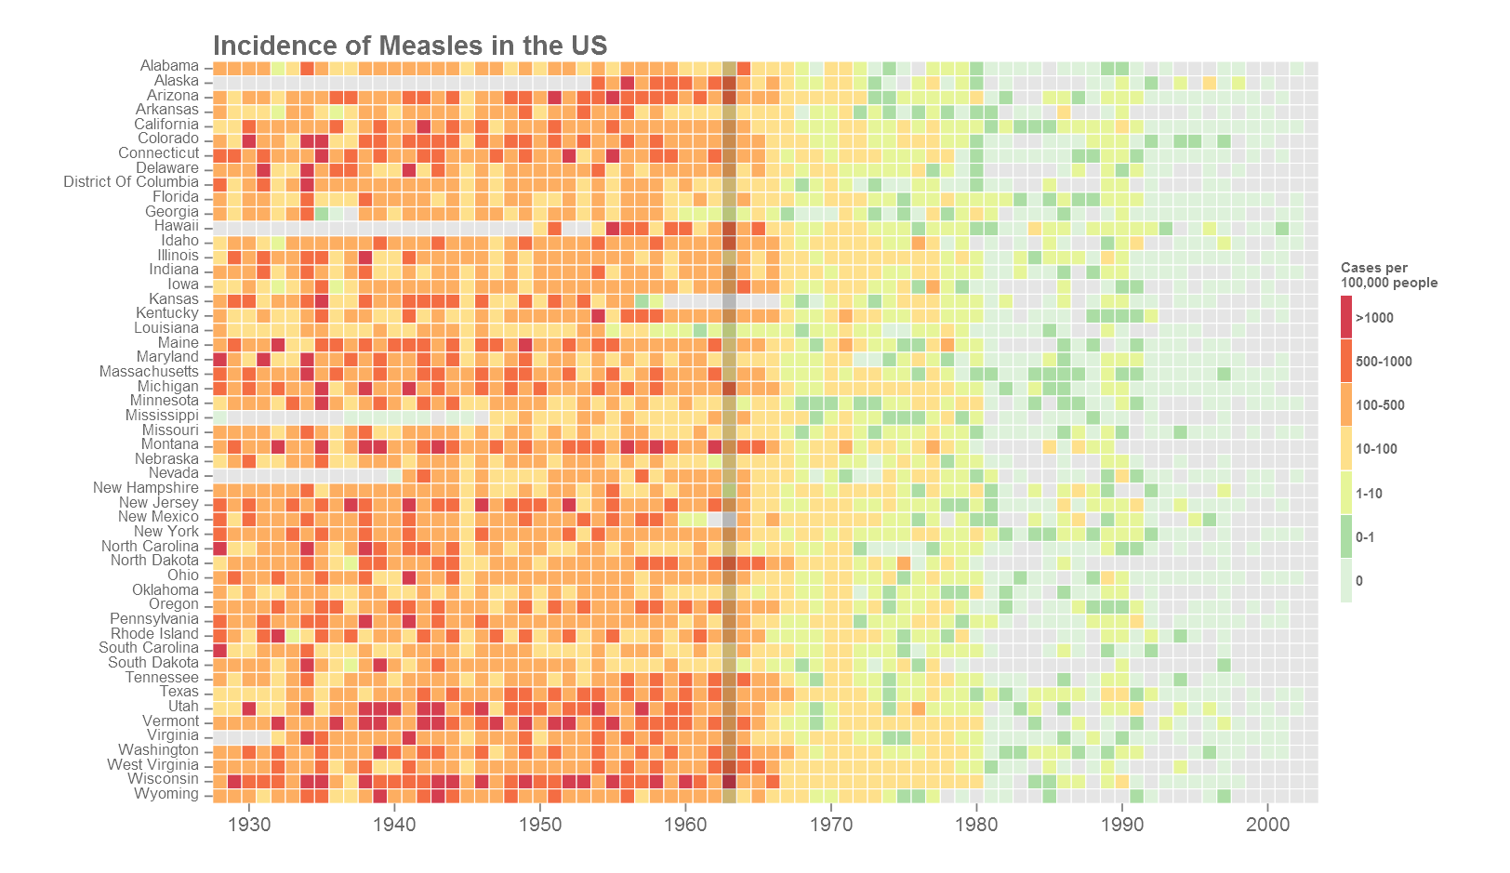
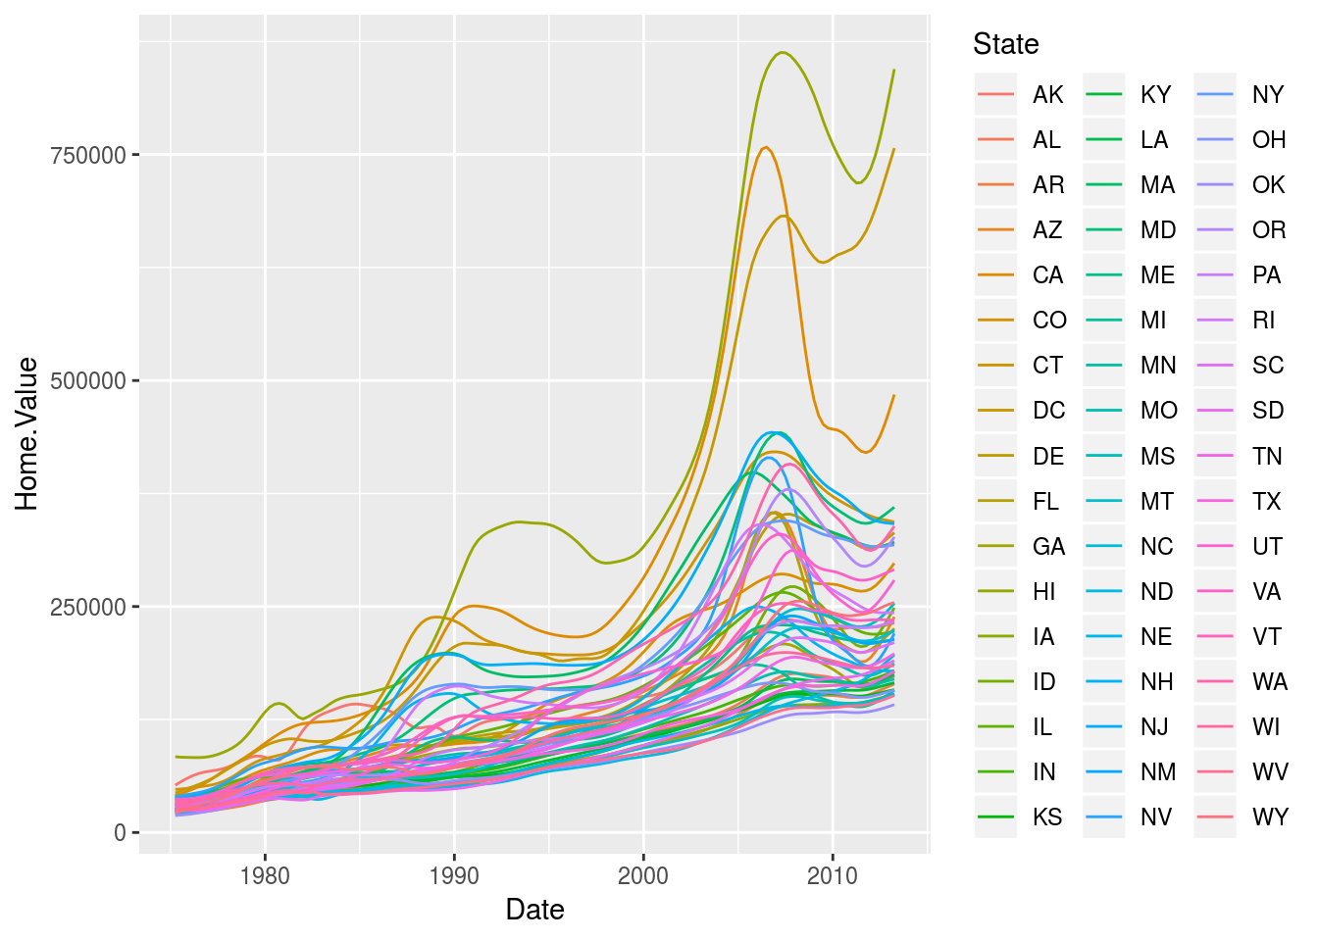
Complexity is an issue of bad design, not an abundance of data

Slide 25
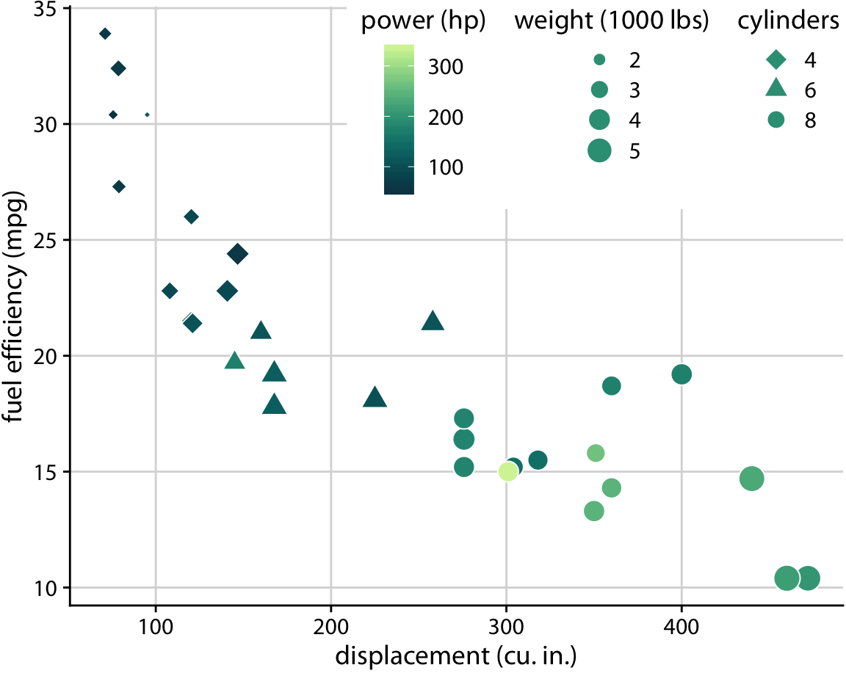
Mappings of more than two variables
Some attributes are more “obvious” than others
Differences easier to spot
Map the most important stories to obvious attributes
Position (high)
Color
Size
Shape (low)

Slide 26
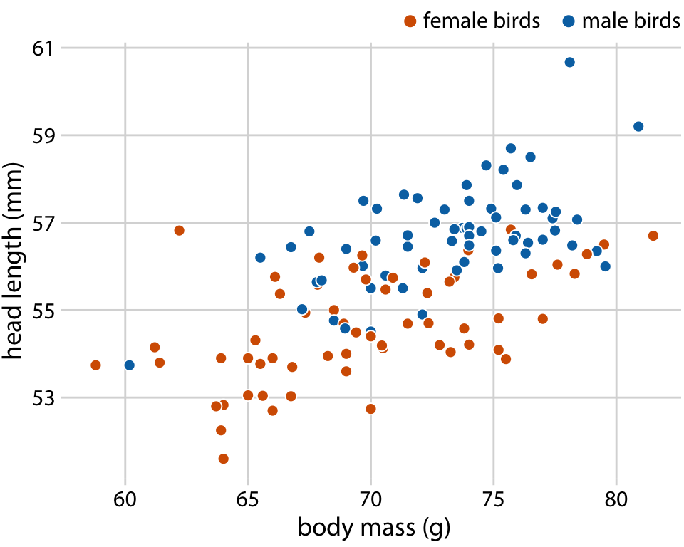
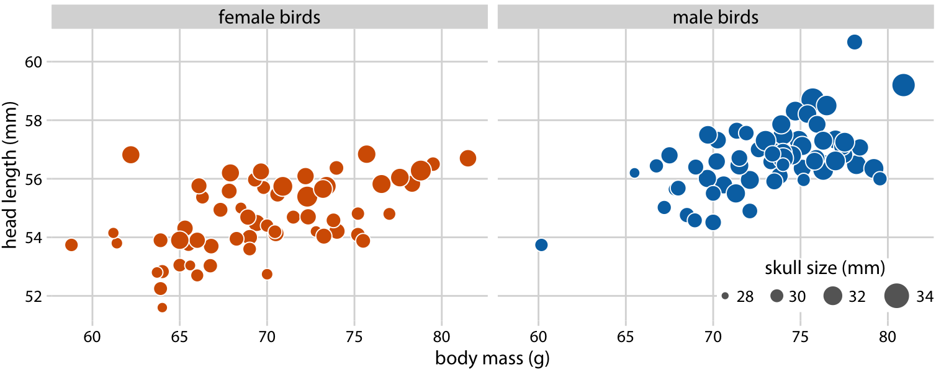
Faceting maps categorical variables over plots
The rule of small multiples: Once the reader understands a single instance of the plot, they can quickly parse many of them

Slide 27
Faceting maps categorical variables over plots
Using two dimensions of faceting (columns and rows) to visualize the accuracy of different supervised classifiers on different types of input data (from: scikit-learn)

Slide 28
Working with position and size attributes

Slide 29
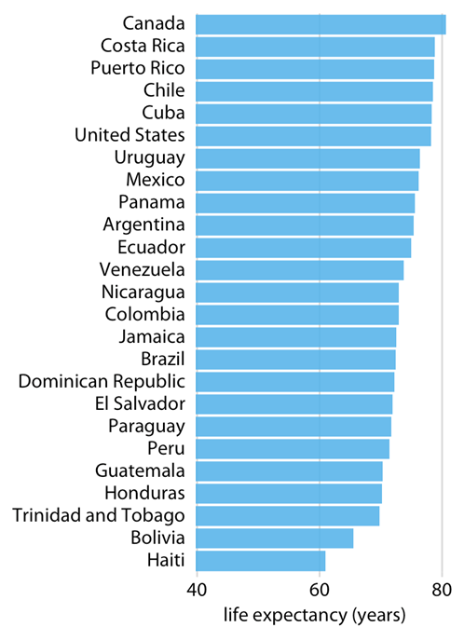
Why is this plot wrong?
What are the variables?
How are they being mapped?
Is the mapping accurate?

Slide 30
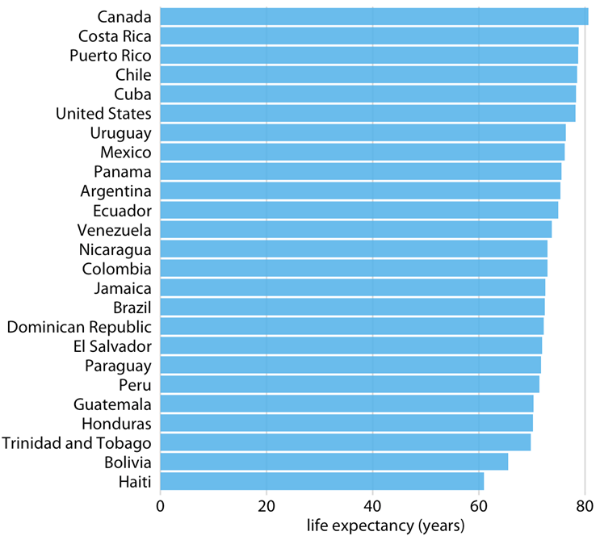
Why is this plot bad?
What are the two variables?
How are they being mapped?
Is the mapping accurate?

Slide 31
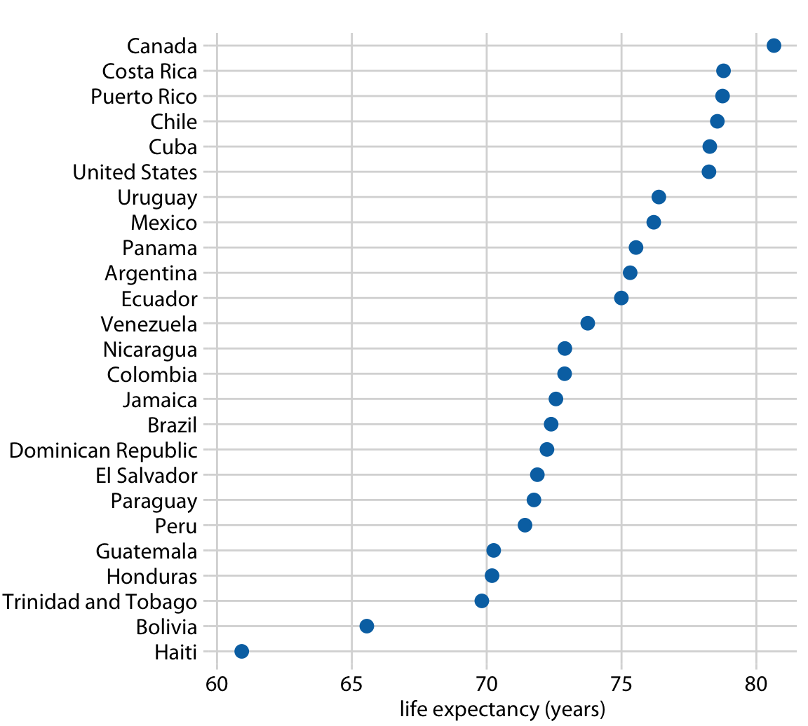
Why is this plot better?
What are the two variables?
How are they being mapped?
Is the mapping accurate?

Slide 32
Why is this plot wrong?
What are the variables?
How are they being mapped?
Is the mapping accurate?
2 cases
3 cases
4 cases
r = 1
r = 1.5
r = 2
a = π
a = 1.5²π
a = 2²π

Slide 33
Why is this plot better (but still not great)?
22
What are the variables?
How are they being mapped?
Is the mapping accurate?
Is the mapping easy to read?
2 cases
3 cases
4 cases
r = 1
r = 1.5^{1/2}
r = 2^{1/2}
a = π
a = 1.5π
a = 2π

Slide 34
Transform data to visualize across scales
Log transformation is the most common
Plotted value ~ log_{x}( data value )
Use x = 2 (log base-2) for smaller dynamic range
Use x = 10 for larger dynamic range
Can’t handle zeroes
Square-root transformation also used
Plotted value ~ sqrt( data value )
Handles zeroes, but axes can be difficult make/read
Data meriting transformation often blow up “too fast” for square root
Doesn’t just apply to position (can use with any continuous mapping)

Slide 35
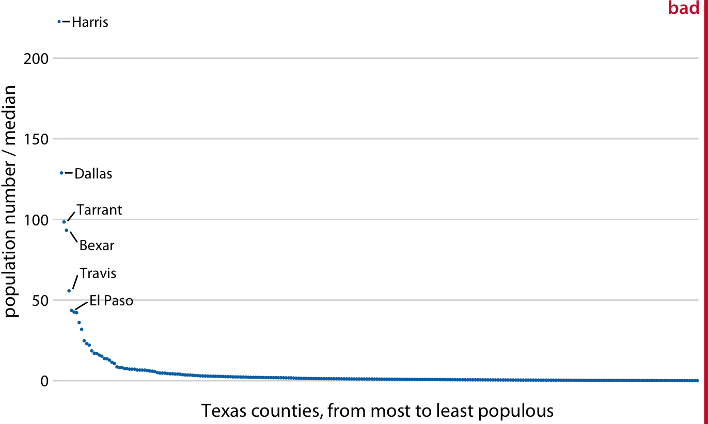
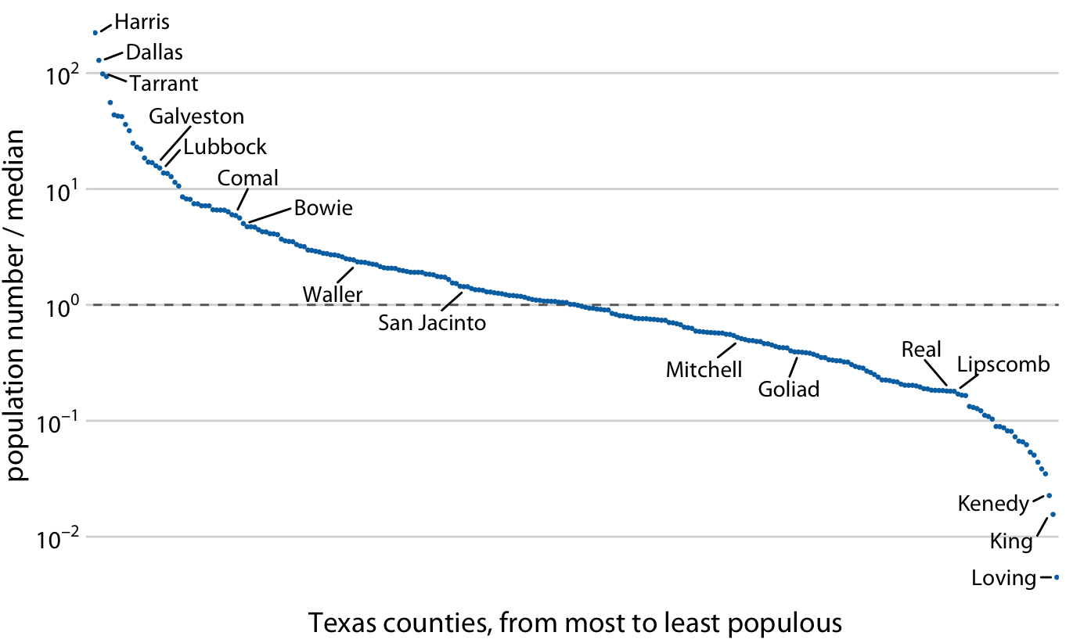
Transform data to visualize across scales

Slide 36
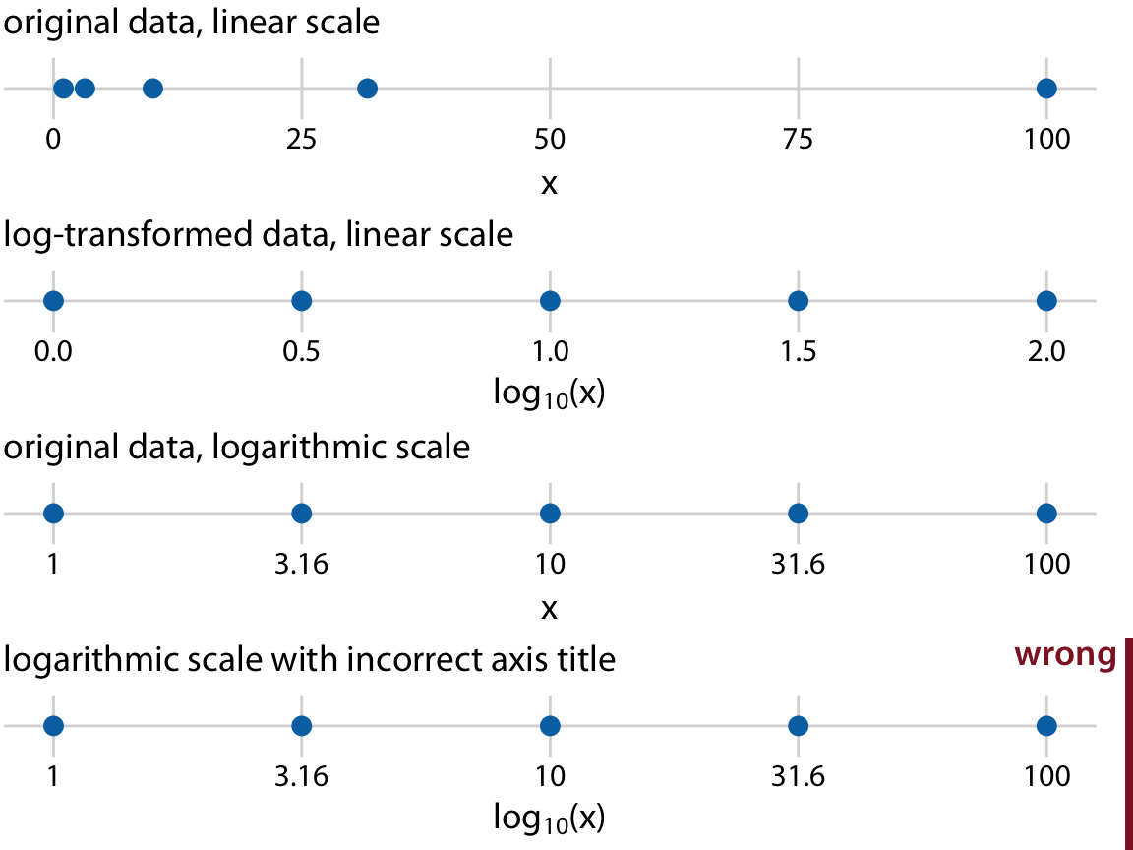
Transform data to visualize across scales

Slide 37
Working with colours

Slide 38
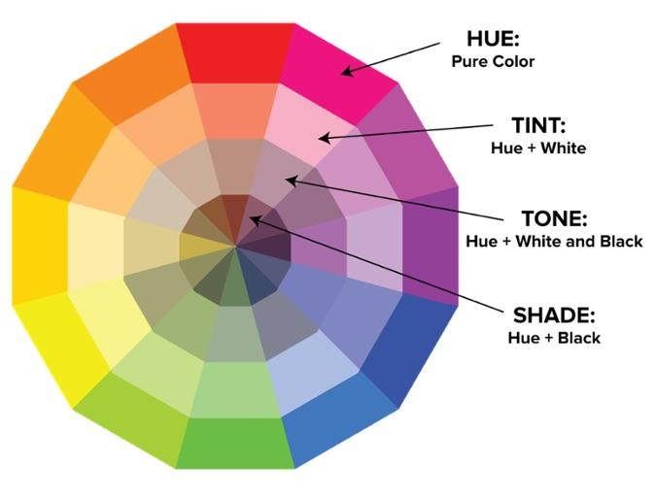
Color terms

Slide 39
Categorical colors: limit yourself
Limit yourself to 7-10 colors
If you need more, you probably need a different plot design / mapping
Reserve a couple of colors for “unknown” and “other”
Let “other” encompass all of the minor categories

Slide 40
Categorical colors: limit yourself
The goal of using color for a categorical variable is to be able to match data to its category by eye
Distinguishing close hues/tints/shades is hard
“Is that light blue or light light blue?”

Slide 41
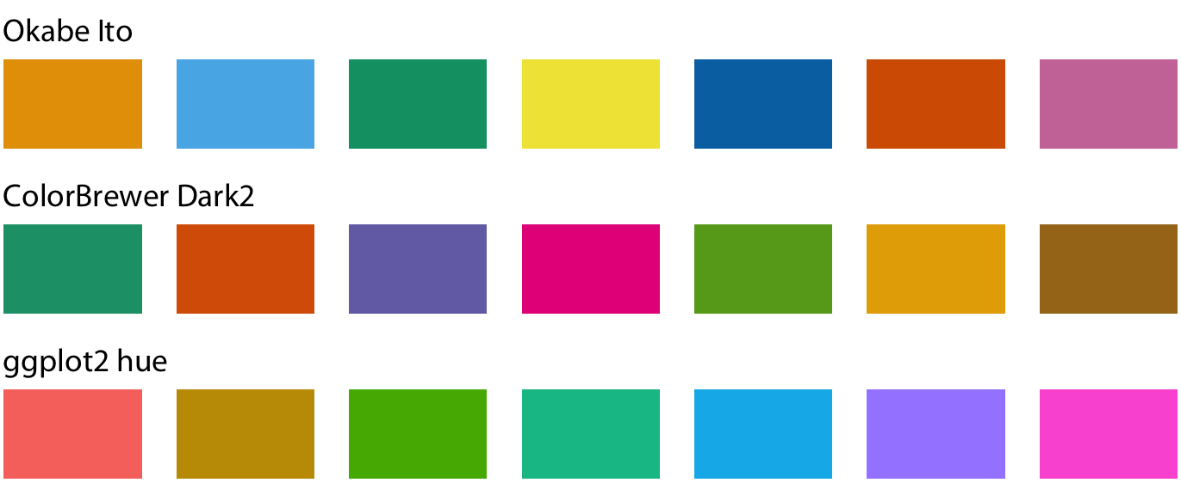
Categorical colors: use pre-defined sets
Designed to be easily distinguished and look good
Helps with staying consistent across plots

Slide 42
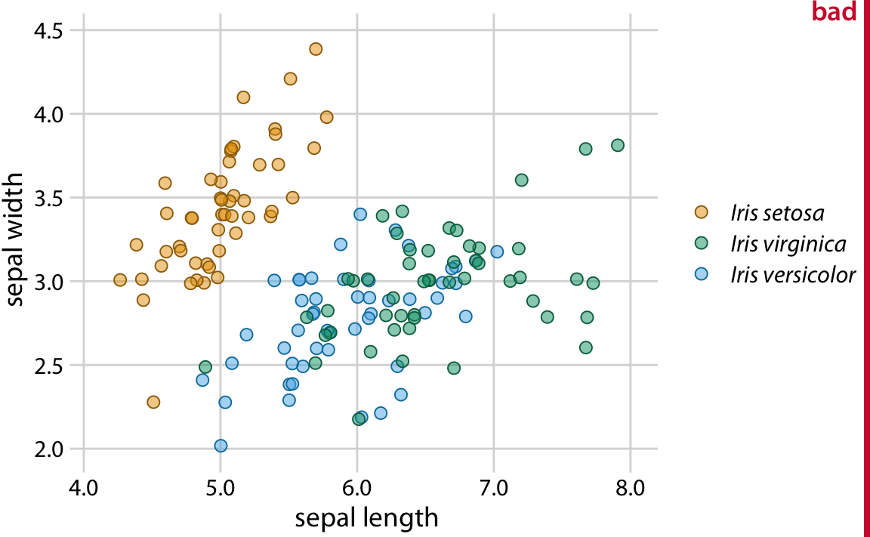
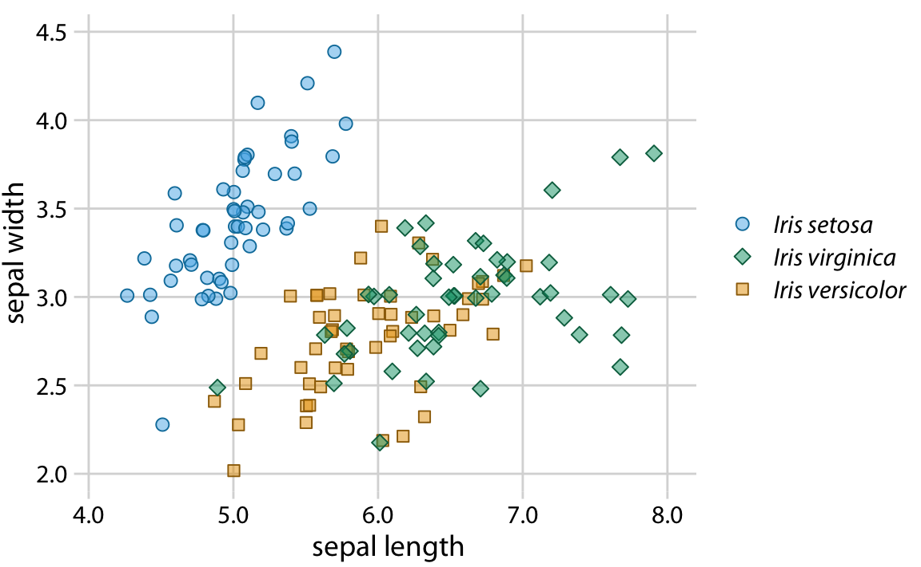
Categorical colors: redundant coding
Coding categorical variables onto two different attributes (e.g. color and shape) can help people who have a hard time distinguishing colors

Slide 43
Categorical colors: redundant coding
Coding categorical variables onto two different attributes (e.g. color and shape) can help people who have a hard time distinguishing colors
Also helps keep figure interpretable when printed in grayscale

Slide 44
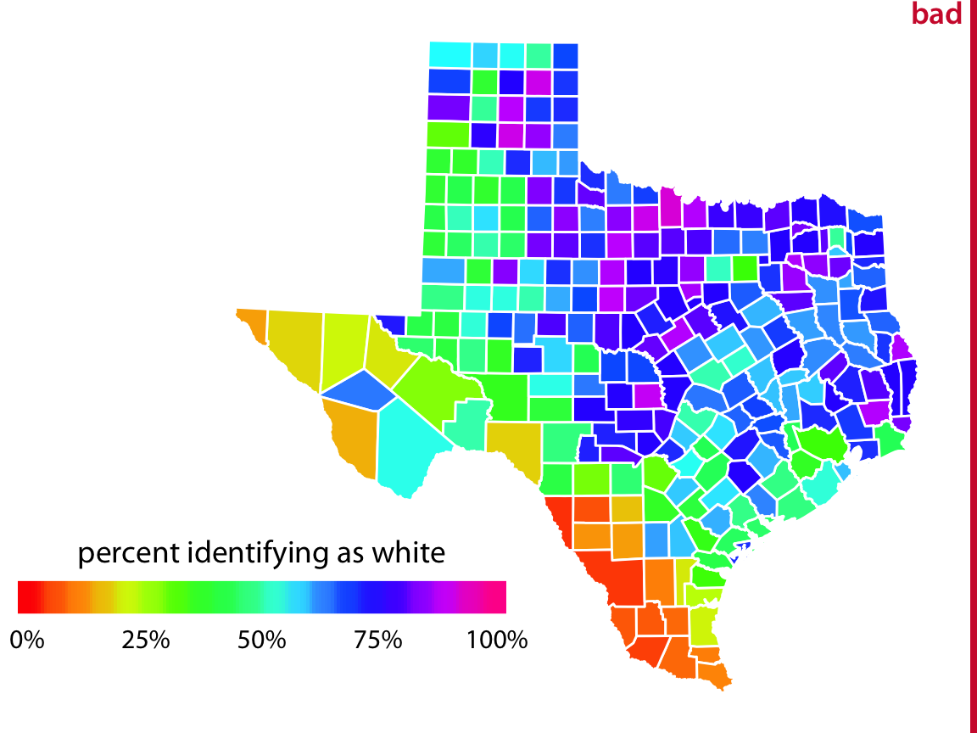
Continuous colors: don’t taste the rainbow
Mapping continuous data to hue is like mapping to wavelength
The eye/brain doesn’t interpret shorter wavelengths as higher/lower
This defeats one of the main purposes of attribute mapping

Slide 45
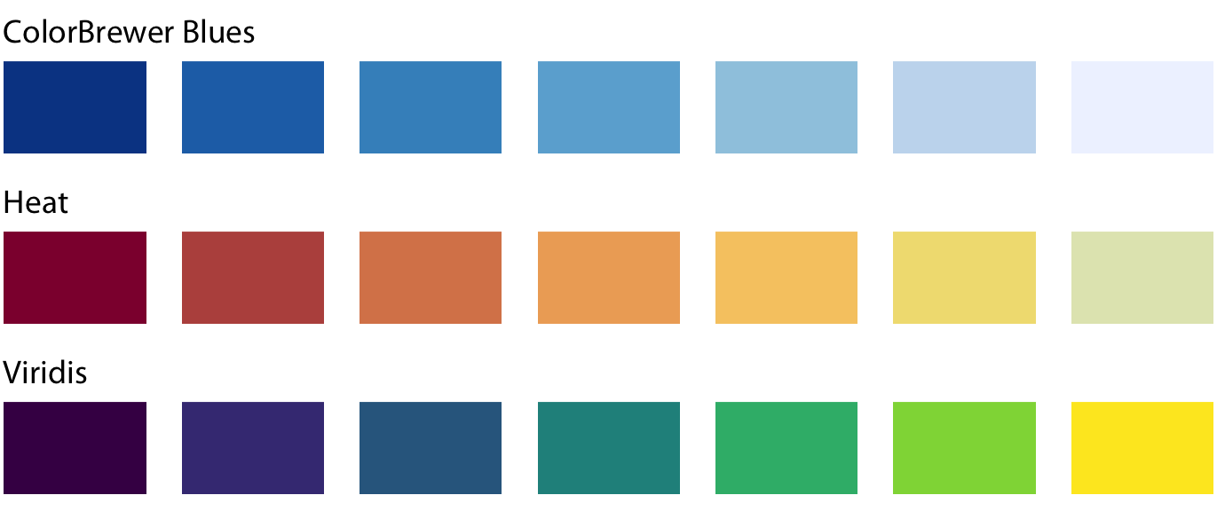
Continuous colors: use pre-defined maps
These vary at least one property other than hue
Often designed with common deficiencies in color perception in mind

Slide 46
Continuous colors: use pre-defined maps
These vary at least one property other than hue
Often designed with common deficiencies in color perception in mind
Often keep figure interpretable when printed in grayscale

Slide 47
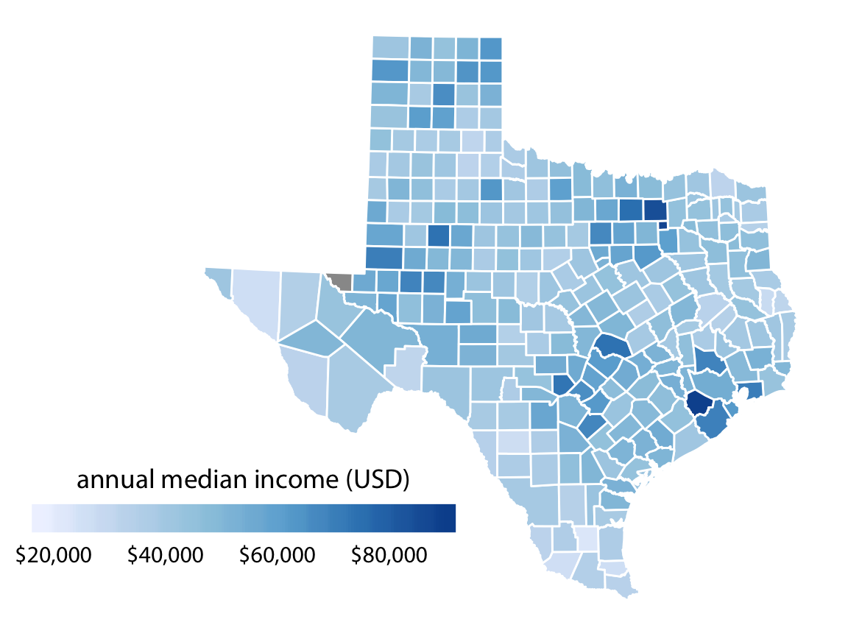
Continuous colors: use pre-defined maps
Note how much more clear the story is here:
There are a couple of counties that have much higher median income than the rest.

Slide 48
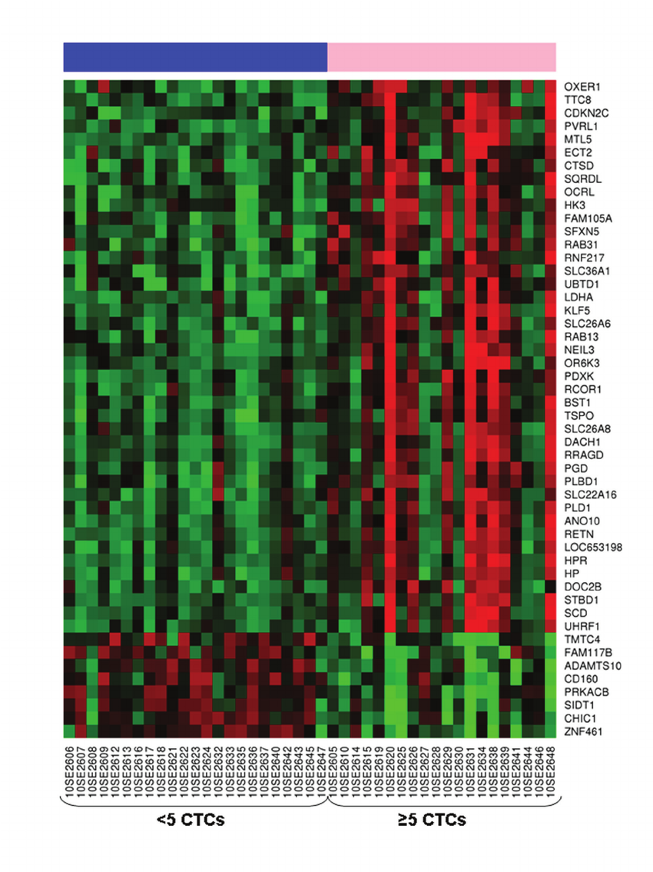
Continuous colors: diverging color maps
The classic “microarray heatmap” is one of the great tragedies of scientific data visualization
Picking green/red to represent down/up makes the figures uninterpretable to a large fraction of the population
(Personally, I associated green with “go” and red with “stop,” which makes this doubly confusing)

Slide 49
Continuous colors: diverging color maps
For data that diverge in two directions from expectation
Up-regulated vs. down-regulated
Over-enriched (enriched) vs. under-enriched (depleted)
Positive correlation vs. negative correlation

Slide 50
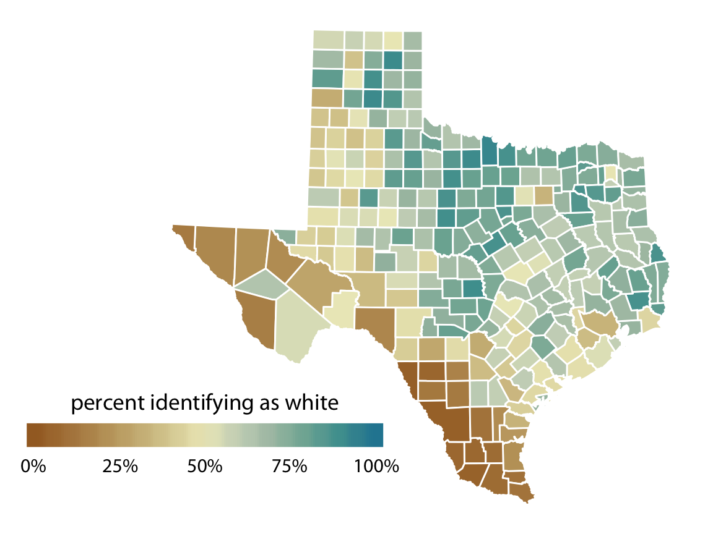
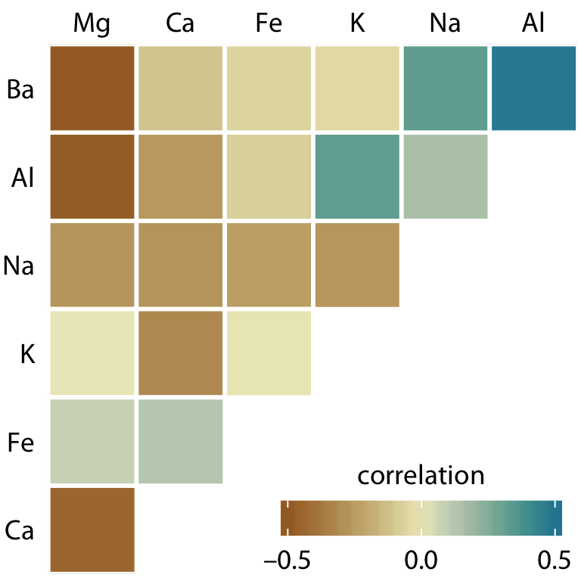
Continuous colors: diverging color maps
Always center on a meaningful value (e.g. 50% of r=0)

Slide 51
Tips for avoiding
ugly plots

Slide 52
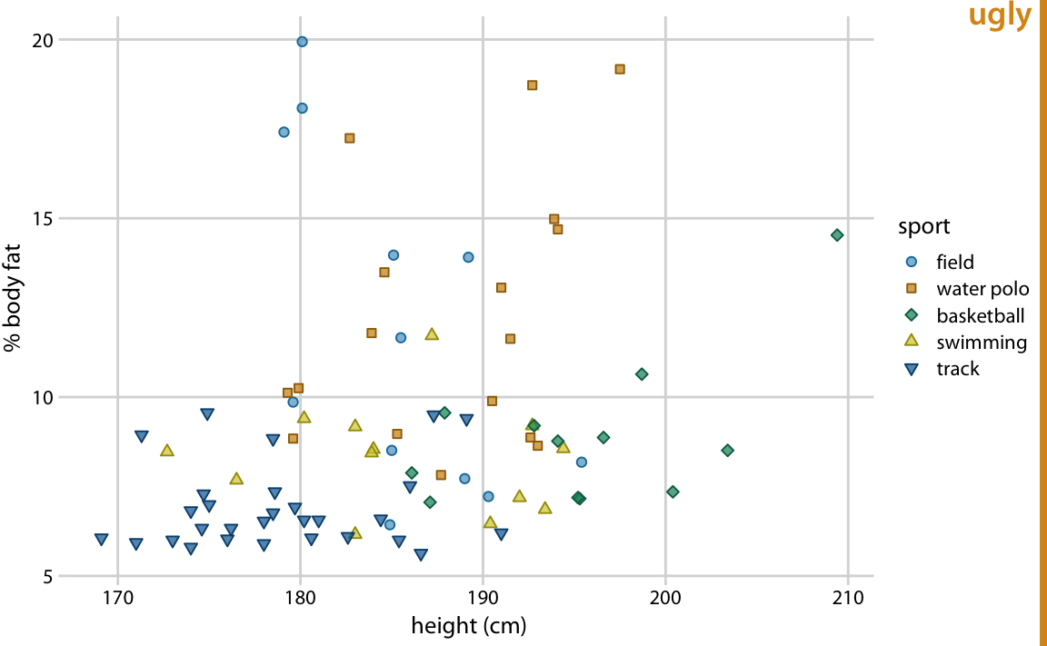
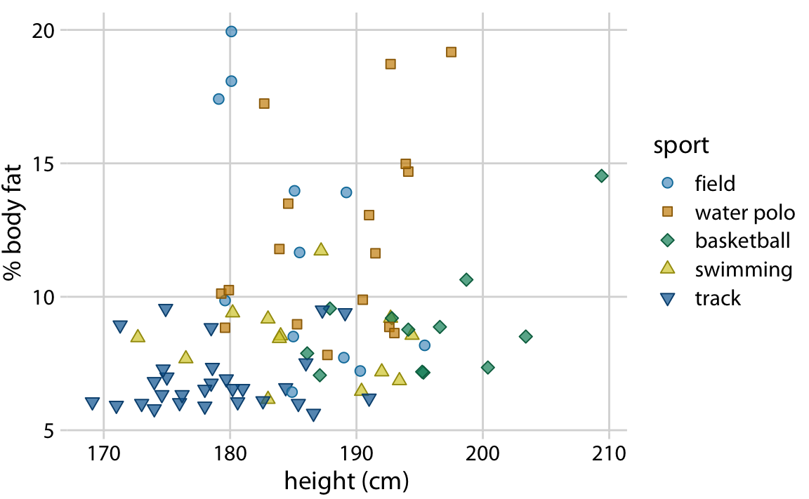
Your. Fonts. Are. Too. Small.
Biggest issue I see in evaluating figures
People design figures zoomed in on 24” monitors, but print/display on much smaller scales
Fonts should be no smaller than 6-point when scaled to fit on a page (6-7” wide)
Don’t assume software gets it right by default

Slide 53
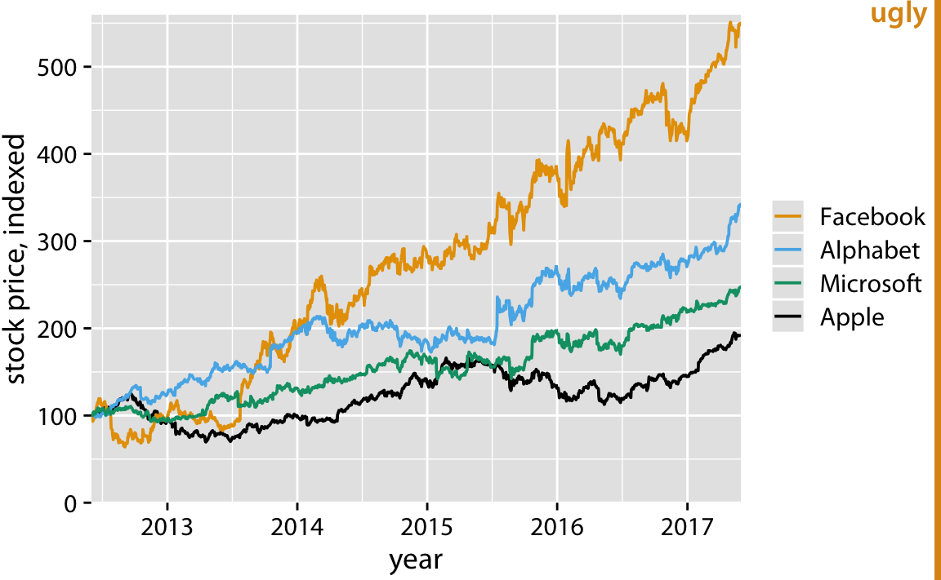
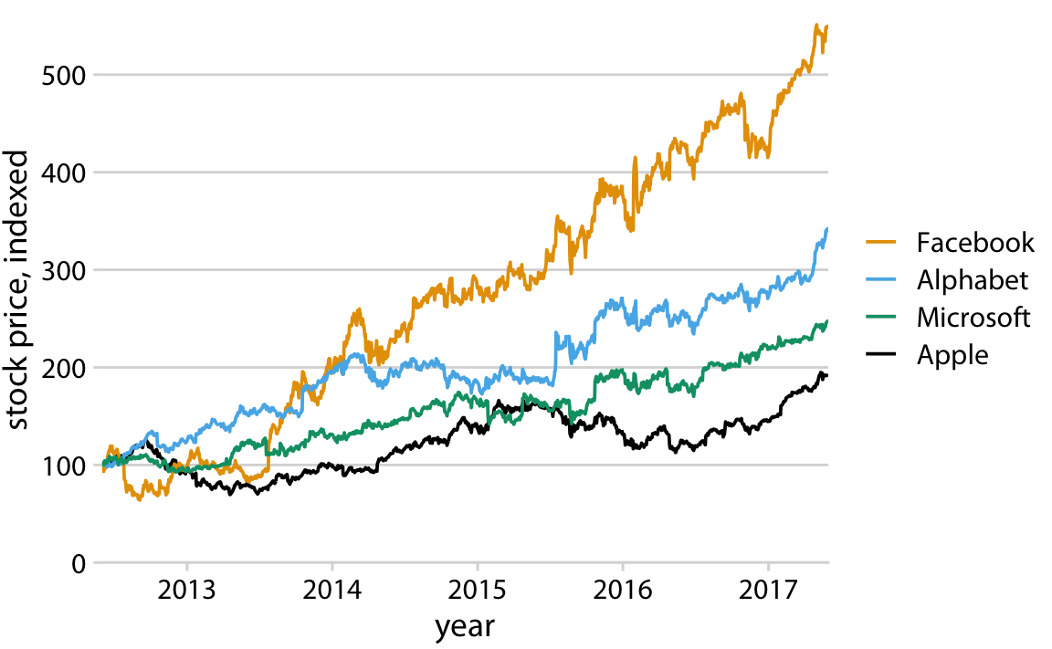
Optimize the data:ink ratio
Minimize (or avoid outright) lines and shading that don’t directly aid the reader with interpreting your data
Don’t assume software gets it right by default

Slide 54
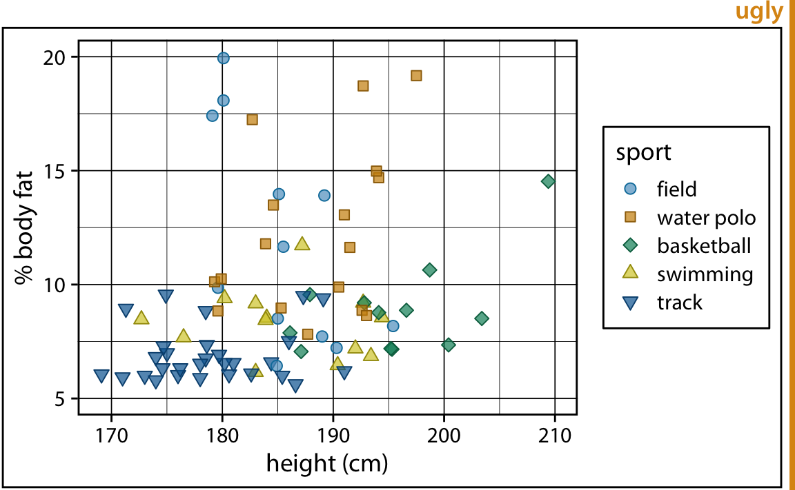
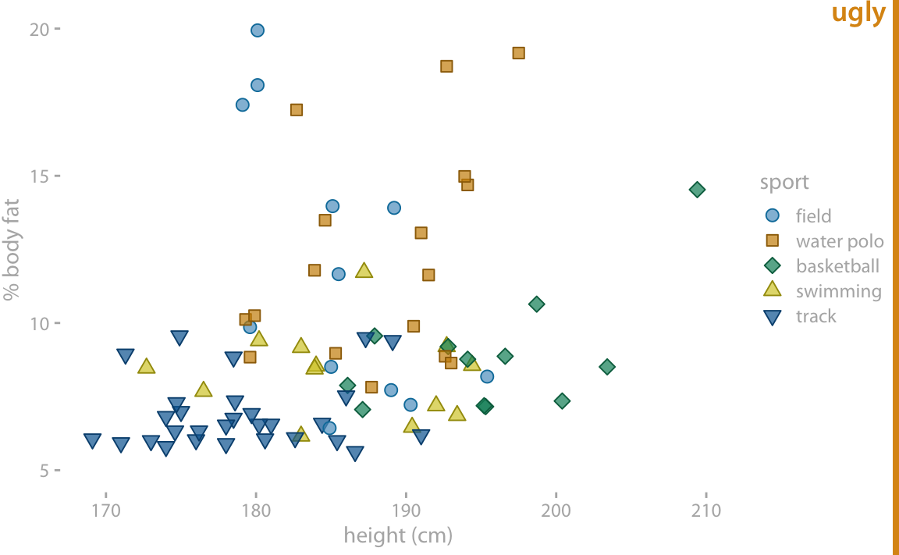
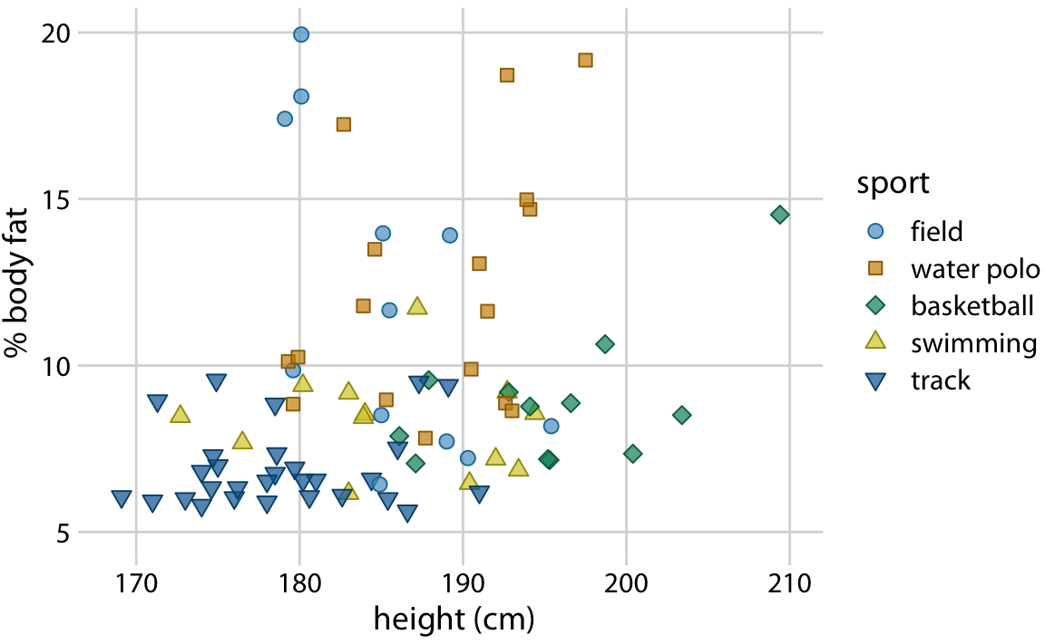
Optimize the data:ink ratio
At the same time, don’t go overboard deleting useful elements

Slide 55
Fill and organize your space
Multi-panel figures should be densely filled rectangles
If something looks like it could be aligned, it should be aligned
Good
Ugly

Slide 56
Miscellaneous tips

Slide 57
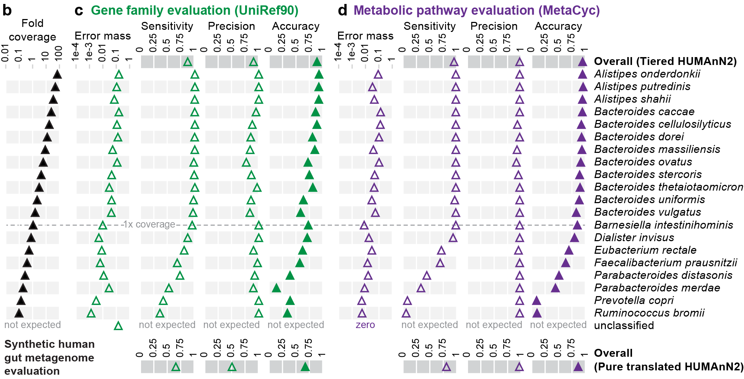
Use light shading to connect rows
I call these “iTunes bars” since that program uses them to connect song fields

Slide 58
Consider directly labeling your data
A nice alternative to a legend when you have few things to label

Slide 59
Include and label error bars
Error bars could be:
Standard deviation
Standard error
Confidence/uncertainty interval
Credible interval
These quantities have VERY different interpretations
Don’t rely on error bars for suggesting statistical significance

Slide 60
Resources

Slide 61
Tools for making plots
Plotting tools
Read in raw data and design plots
Differ in degree of automation / adherence to “grammar of graphics” philosophy
Examples (pick one and practice it)
ggplot2 (R)
matplotlib (Python)
seaborn (Python)
plotnine (Python)
Excel
Vector graphics tools
Manipulate the output of plotting tools to make polished figures
Examples (pick one and practice it)
Adobe Illustrator (Windows, Mac; not free)
Inkscape (all platforms; free)

Slide 62
Article Series: Nature Methods’ “Points of View”
Mostly by Bang Wong (with co-authors)
Series of ~30 one-page articles on various topics in data visualization

Slide 63
Book: The Visual Display of Quantitative Information
By Edward R. Tufte (“Tufte”)
A classic text in this field
Tufte has written several follow-ups

Slide 64
Book: The Grammar of Graphics
By Leland Wilkinson
Very theoretical treatment of the topic
Origin of the “gg” in “ggplot(2)”
See papers by ggplot2 creator Hadley Wickham

Slide 65
Pay attention to sources with good graphics, copy
Sadly, the vast majority of graphics in scientific publications are ugly or hard to interpret (but hopefully not outright wrong)
“Big” journals like Nature tend to be better as they employ graphics professionals to enforce good, uniform style
Many news sites (e.g. fivethirtyeight.com, nytimes.com) are putting more emphasis on powerful data graphics for story telling

Slide 66
Pay attention to sources with good graphics, copy

Slide 67
Summary
Why we plot
Examine data for issues / hidden behavior
Telling stories
How plots can go wrong
Ugly plots
Uninterpretable plots
Misleading plots
The grammar of graphics
Mapping data to graphical attributes
Miscellaneous tips and tricks
References

Slide 68
Canvas question time
Ask me for the passcode

Slide 69
Random article + figure from current Science

Slide 70
Extras

Slide 71
Categorical colors: pick the right category
What are the variables?
How are they being mapped?
What is the story?

