Slide 1
EPS 236: Lectures 1 – 2
Linear models of physical systems
…and other types of systems…
Analytical properties and applications.

Slide 2
‘
dh/dt = - h/τ ; τ = 1/k
Concentration problem (ink in a volume of water, diffusing out):
↑Units: velocity
Notes:
Rho dh/dt = - rho k h divide rho dh/dt = -k h = - h / TimeConst
Kg/m3 * m/s = kg/m2/s that’s k’P k rho h = kg/m3/m : k in s-1, if written as –k rho g h then k has units of 1/velocity; k in 1.1 has units of velocity !!!

Slide 3
1-box, impulse
1-box, with forcing
t/T*
2-box, impulse,
with 1st order decay
Notes:
D ln h/dt = - 1/tau, ln h = - t/tau dC/dt = -C (1/tau – 1/lambda) lamba = decay lifetime

Slide 4
Tracer in a 2-layer environment: Coupled 2-box problem
(closed system, mass conserved).
Notes:
Solutions by adding and subtracting: C = Total Mass ; C1 – C2 = (C1 – C2)o exp( - t * 2 k/h )

Slide 5
Solution to the initial value problem
k/h = 0.01 s⁻¹ (time unit⁻¹); initial c1=100, c2=0

Slide 6
-
Notes:
Eigenvalue equation: dC/dt = -lambda* C lambda a scalar ! C is s simple exponential

Slide 7
(for this case the eigenvectors are orthogonal, not true in general (e.g. h1 != h2)
Notes:
exp(At) = 1 + At + At^2/2! + (At)3! + … show it satisfies dY/dt = AY

Slide 9
k.h=.01 ##k/h = 0.01 s⁻¹ (time unit⁻¹)
tt=0:1000 #time vector; initial c1=100, c2=0
c1.c2=100*exp(-2*tt*k.h) #solution for (c1 – c2)
c1=(100 + c1.c2)/2
c2=100 - c1
plot(tt,c1,type="l",col="red",ylim=c(0,100),lwd=3)
lines(tt,c2,type="l",col="blue",lwd=3,lty=2)

Slide 10
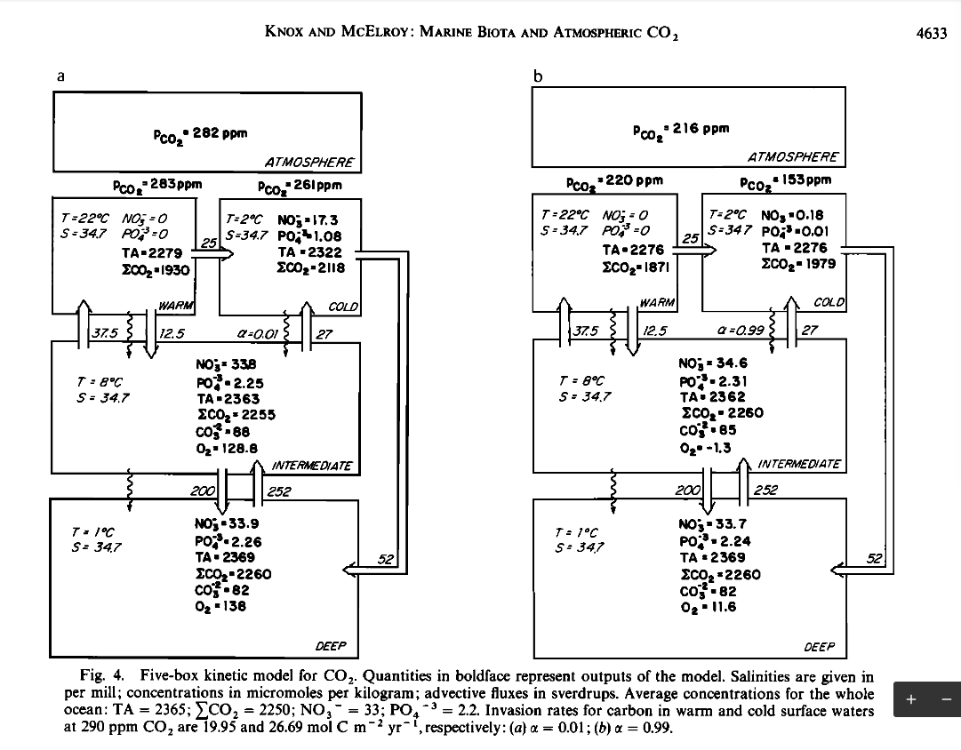
1
2
3
…
…
4
5
6
…

Slide 11
The time-dependence of any model composed of n reservoirs (boxes) and fluxes
between them given by linear functions of reservoir contents, can be written as
dx₁/dt = Σk_{1i}x_{i}
dx₂/dt = Σk_{2i}x_{i}
...
dx_{j}/dt = Σk_{ji}x_{i}
dx_{n}/dt = Σk_{ni}x_{i}
This is a familiar mathematical problem, a set of coupled, 1st-order, linear
differential equations that can be written in matrix form,
dX/dt = K*X,
where bold symbols denote matrices or vectors. For the initial value problem, where
X(t=0) = X₀, it is easy to show that the solution is given compactly as
X = exp(Kt) * X₀. (3.1)
Here is the demonstration: the function exp(Mt) of a matrix is defined in terms of a
power series analogous to exp(x), i.e.,
exp(M) = 1 + M + M²/2! + M³/3! + M⁴/4! + ....
If we differentiate exp(M) with respect to a scalar (say, t), we see that
d exp(M)/dt = exp(M) * d M/dt,
which proves the point for our case (M = K * t, K independent of t).

Slide 12
The system of coupled linear differential equations is solved efficiently using the eigenvalues and eigenvectors of the transport matrix.

Slide 17
Two-box model with loss (2 time scales)
Consider the 2-box model in which we place a radioactive gas with exponential decay time T_{d}.
dC₁/dt = ( C₂ – C₁ ) / τ – C₁/T_{d}
dC₂/dt = - ( C₂ – C₁ ) / τ – C₂/T_{d}
➔ d (C₁ + dC₂)/dt = - (C₁ + C₂)/T_{d}
d(C₂ – C₁) = -2 (C₂ – C₁)/τ - (C₂ – C₁)/T_{d}
Solutions:
(C₁ + C₂)_{t} = ( C₁ + C₂ )_{o} exp( -t/T_{d})
(C₂ – C₁) = ( C₂ – C₁)_{o} exp(- t/_{Tm}) 1/T_{m} = 2/τ + 1/T_{d}
Notes:
Could add a drain to a box with no return to simulate this case !!

Slide 19
“Time evolution operator” = X_{e} X_{e}⁻¹ exp(Kt) X_{e} X_{e}⁻¹
= X_{e} exp (Λt) X_{e}⁻¹
exp(λ₁t) 0 ….
0 exp(λ₂t) ….
…. …. ….
where Λ is the diagonal matrix of eigenvalues (λ_{i})
Green’s function: Solution of the differential equation with a delta function as the initial value. In our field it is sometimes called an “age spectrum”, representing the ensemble of transit times/transition probabilities from a given (input) location.
The Green’s function / age spectrum can be computed from the the time evolution operator, where the time dependence is construed as a lag time since the impulse/input.
The age spectrum can be measured in the atmosphere or ocean, and computed readily in models.
= X_{e}
X_{e}⁻¹
Notes:
Time evolution operators
Green's functions/impulse response: source term = delta function
Mean Age and Age spectrum ⬄ Green’s function;
Tangent linear approximations for non-linear dynamical systems; [ application to estimating global fluxes of atmospheric tracers.]

Slide 20
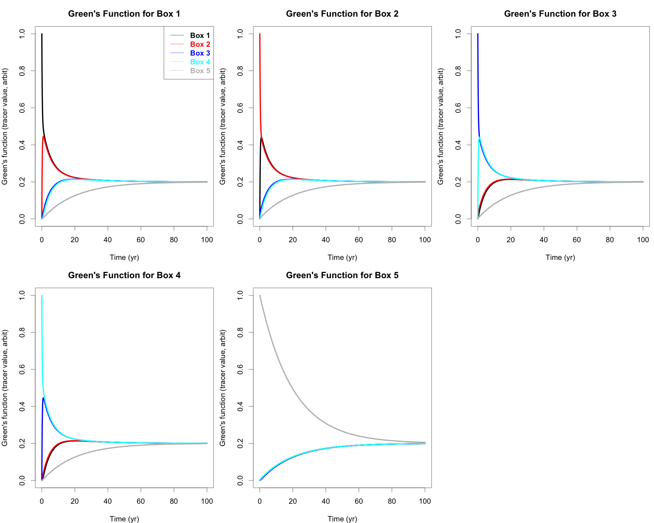
↑
↑
↑
↑
→
→
→
→
→
←
←
←
NHi NT ST SHi

Slide 21
Notes:
Create an exercise for the class to do this problem or similar. Note no diffusion in a linear system (the above problem has diffusion !)

Slide 22
Markov chain: a stochastic model for a sequence of events in which the probability of each event depends only on the state attained in the previous event. Closely linked to 1st order linear diff.eq’s.
From slide 5:
Equivalent Stochastic Model: Represent C as a population of particles (molecules, ping-pong balls, …), with C₁, C₂ the counts in each box. For time Δt (<< h/k), the probability that a single particle in box 1 transitions from 1 → 2 is k/h Δt, and the probability that it stays in 1 is 1 – k/h Δt. The
”transition matrix” (mean transition rate) is:
(1 – k/h) Δt (k/h) Δt This is the Δt << h/k
(k/h) Δt (1 – k/h) Δt approximation of the
time evolution operator of the linear model, with eigenvalues
[ 1, 1 - 2k/hΔt ] ← ( exp(-2k/hΔt) )
(Note: “1” is always the largest eigenvalue for the transition matrix, corresponding to the 0 eigenvalue of the differential equation [mass conservation].) Eigenvectors: same as in the deterministic model.
Notes:
Note: if particles disappear, Ask the class about how to represent.. {simulate with a box that has particles coming in, but none going out. –radioactivity case, for example. )
The 1 eigenvalue implies that the particles are 100% probable to stay in the bounds of the system. The stochastic matrix = columns add to 1.
The eigenvector v to the eigenvalue 1 is called the stable equilibrium distribution of A. It is also called Perron-Frobenius eigenvector.

Slide 23
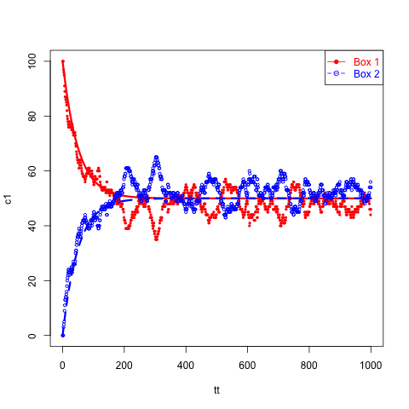
Stochastic Linear Model: 2-box model mass transfer model, as an equivalent Markov chain. What does it do?
Model pdf parameter
Box 1 -> Box 2 transition probability = k/h
Box 2 -> Box 1 transition probability = k/h
n1
(kg m⁻³)
h
(m)
k (m s⁻¹)
k (m s⁻¹)
observations
h
(m)
n2
mass_{i} = h Area n_{i}
This result is one realization (or sample) of the Markov Chain
Example: turbulent exchange of trace gases
Notes:
An example of autorgressive behavior: capacity; Two ways to learn about the model--observe the transient or the steady state

Slide 24
Stochastic Linear Model: 2-box model mass transfer model, as an equivalent Markov chain. What does it do?
Markov chain representation of this model:
Box 1 -> Box 2 transition probability = k/h
Box 2 -> Box 1 transition probability = k/h
set k/h = 0.01 1% transition prob/time
proceed step-wise, stochastically (runif)
n1
(kg m⁻³)
h
(m)
k (m s⁻¹)
k (m s⁻¹)
h
(m)
n2
mass_{i} = h Area n_{i} ; set k/h=.01
h dn1/dt = k ( n2 –n1)
h dn2/dt = k ( n1 –n2)
(n1 – n2) = d = d_{o} exp(-2k/h t)
n1 + n2 = constant
ar(x = N1) Coefficients: 0.9761 Order selected 1 (corr time = -1/log(.9761)= 41.3 (exact=50))
Notes:
degrees of freeedom. run ar() on these data; the corr time exact = 50 (s), ar estimate 41 [ AR1^n= 1/e;
This is a Markov chain (probability to stay or leave; transition rate prop to number that are in each box =prior state
NOTE this noise is process noise, there will also be PDFs for every measurement (h, ni, etc)
An example of autorgressive behavior: capacity; NOTE Two ways to learn about the model--observe the transient or the steady state

Slide 25
Coding the stochastic model of tracer in a 2-layer environment:
A “realization” of the stochastic transition problem
## R code for Markov chain representing the 2-box model
k.h.dt =0.01 # transition freq x Δt
# k/h dt= (1/τ) *Δt sampling time Δt ; transition prob no units
## A single realization with finite number of particles:
n1=100;n2=0 # number of particles, initial
N1=n1;N2=n2 # Nj accumulates solutions
for(i in 1:1000){
if(n1==0)dn1=0 else dn1=sum(runif(n1)<k.h.dt)
if(n2==0)dn2=0 else dn2=sum(runif(n2)<k.h.dt)
##runif: uniform distribution random numbers between (0,1)
n1= n1-dn1+dn2 ## new value in box 1
n2= n2-dn2+dn1 ## in box 2
N1=c(N1,n1)
N2=c(N2,n2)
}
#Notes: runif() ;
Notes:
We have seen that the problem is symmetric wrt predictors and response; and several ways that stochastic effects enter our problem; Now let's solve a very basic problem, fitting a straight line (a model!!) to data, {x ; y} <=> predictor, response; Students to solve a similar model problem, hands-on, on the website – three box symmetric. Yang Li [1] Second problem: retrieve estimates for k/h given Dt and one (then several) realizations Yang Li [2]
Better for a 2-box, because it follows individual particles, but harder to generalize. The given loop could follow the individual particles in a double loop (yuck)
np=100
khdt=.01
A1=matrix(as.numeric(runif(1000*np) < khdt ) ,nrow = np)
UU=NULL
for(k in 1:100){
u0=cumsum(A1[k,])%%2
UU=rbind(UU,u0)}

Slide 26
●
●
●
→
→
●
●
●
●
●
●
←
←
●
●
●
Notes:
Workshop item – code this model with 100 particles, k/h dt =0.01 ; also, for homework, asymmetrical limits; limit as k 3-> 1 goes to zero; (sink case); make one box sink (return flux → 0);
Code and look at both deterministic and stochastic versions; Eventually this model set will reappear in the data analysis part of the course. Workshop should be 1 week AFTER we have done the lecture.
Green’s function: with and without diffusion, (or advection). With or without a sink….

