Slide 1
String.of.Boxes
Simulations of Diffusion and Dispersion
Using 1st Order Linear Systems
Class problem #1 EPS 236 2019 Fall
L = length of the loop; Δx = L/nbox= length of each box
k.h
v_{a}
ΔC_{i}/Δt = (k.h + v_{a} )* C_{i-1} - (2 k.h – v_{a} ) * C_{i} + k.h * C_{i+1}
v_{a} has units (frac box traversed per unit time): s⁻¹
k.h has units (frac box exchanged per unit time): s⁻¹
Note: this problem is equivalent to a random walk (linear Markov chain)
Notes:
Learning outcomes for this project
Understanding the analytical properties of linear systems (the evolution operator, modes (eigenvectors, eigenvalues).
Gaining familiarity with the advection – diffusion equation and its representation in finite difference.
Developing coding, visualization, and presentation skills.

Slide 2
Relating a set of connected boxes to transport of molecules (advection – diffusion)

Slide 3
5-box example
v_{a}, advection
k.h exchange
Box 1
Box 5
Box 2
← Case: input here
Box 4
Box 3
Symmetry → only 2 decay rates + mass conservation! Symmetry is broken by advection.
Only 3 distinct eigenvectors and eigenvalues (real parts)
Notes:
Symmetry -> only 2 decay rates + mass conservation! Only 3 distinct eigenvectors and eigenvaleus

Slide 4
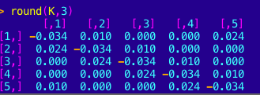
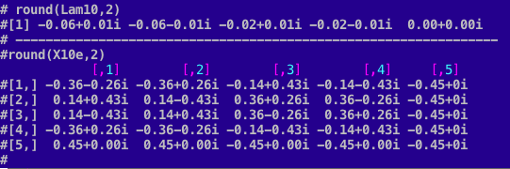
Notes:
Row: disposition into/out from a single box. Column: flows from/into a box from all other boxes.

Slide 5
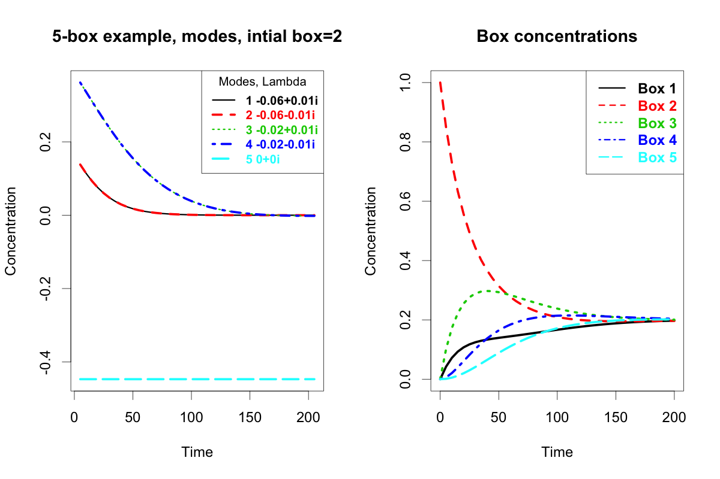

Slide 7
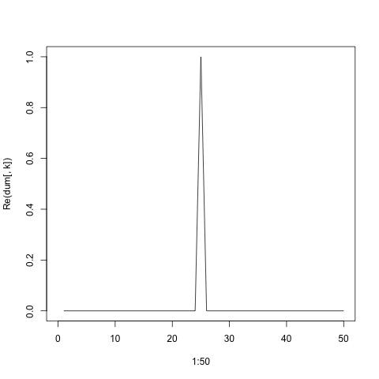

Slide 8
First class project: EPS 236 2019F.
Write a general function to represent a string of boxes connected together with two-way exchange, then apply it to some test cases. Allow for advection, and for circular connection.
Suggested Procedure:
Write down equations and code 4 boxes explicitly. by hand.
Then you know how to write the function that builds up the transfer matrix for and nbox number of boxes. Consider using a building block of a 3-element vector.
The function should compute the time evolution operator and use it to track a slug of material put into a given (selectable) box. It might be more flexible to allow any initial conditions
The function should return the Green’s function (initial input in one box) or time evolution for more complex inputs, for specified time points. It should also save or return the K matrix, eigenvalues, and eigenvectors of the K matrix.
Notes:
Assign( ) ; lists;

Slide 9
Some pointers:
You will get imaginary (pairs of complex-conjugate) eigenvalues and eigen vectors. They may be solutions to a problem very close to the exact one, but not the same as. They are good enough.
Check rowSums() and colSums() (should = 0) for your K matrix.
Develop checks on the accuracy of your solutions – are you really getting eigenvectors and eigenvalues?
As we increase the number of boxes, you would want to avoid the explicit inverse of Xe. Instead, solve the linear problem:
Xe⁻¹ %*% C₀ = solve(Xe, C₀) [R-syntax],
i.e. obtain the desired rotated vector without computing the inverse matrix explicitly. The inverse matrix can be a stiff/inaccurate computation, and it may take long.

Slide 10
Pointers (continued)
Multiplication by a diagonal matrix is very efficient ➔ the reason that the eigenvector/eigenvalue formulation is so useful (in addition giving time scales, allowing for unbiased averaging over time, etc).
Finding the eigenvectors is iterative and can be time-consuming. Consider saving the results for big matrices, using assign( ). You also want to return (or save by assign( ) ) the K matrix and its eigenvectors and eigenvalues, in addition to the solution to the initial value problem.

Slide 11
Application 1 – common to all work groups.
(a) Illustrate your results with graphs: use matplot( ) and also make a movie‡. Then one other interesting display. Do for at least 2 cases of inputs to the function.
(b) The solution to this problem is equivalent to solving the advection-diffusion equation (see extra slides); it has the form:
f(x, t) = 1/sqrt(4 π D t) exp( - (x – v_{a} t)² /( 4 D t ) )
Use an ordinary least squares fit to determine the diffusion coefficient D, for a given exchange coefficient, for a circular case, with 50 boxes, k.h= 0.01, v_{a}=.014, initially all zero except box 25.
(c) Try other cases. Let L be a distance spanned by the boxes, and nbox the number of boxes into which L is divided. If you increase nbox (to get higher resolution), you must multiply k.h by nbox² to have the same answer across the L landscape (see extra slides). If v_{a} is finite it scales by nbox. Show some comparisons.
‡An easy way to make a movie is to install the platform-independent version of ImageJ.
You must install Java first to use it. See: https://imagej.nih.gov/ij/download.html
Notes:
Describe the adv – diff equation quantitatively

Slide 12
Applications 2, 3, 4, … At least one free-wheeling application, with some nice figures to illustrate. Possibilities:
Create the comparable function for the equivalent Markov chain, explore dependence on number of particles.
Make a cube (or a pretzel – interesting!) instead of a chain (beware of accuracy limits of eigen() and solve())
Gas chromatograph. Study how a peak appears as it passes a fixed point, as a function of advection velocity.
Make one box into a “sink” – i.e. there are inflows into, but zero (or very small) outflows from, this one box.
Extra Credit (= 1 bar dark chocolate for the best submission) if you do the tunnel challenge problem on the next page.
Other creative ideas?
Products of the class project:
Each group will present their work (Powerpoint, 5 minutes).
The Powerpoint and all codes will be uploaded to the Canvas. Please ensure the codes run!

Slide 13
Tunnel Challenge
A tunnel through the Alps is 10 km long. There are sensors placed every 100m along its length. The cross section of the tunnel is 15m across and 6 m high.
Traffic is going both directions, leading to turbulence that exchanges air (k.h) in 60s between each pair of sensors. There is a wind blowing from France towards Italy at 10 km/hr.
My car is travelling from France to Italy at 100 km/hr emitting specially labelled carbon dioxide† at the rate of 50 kg/hr.
Show the concentrations of my CO₂ (kg/m³) at the sensors as my car passes through, and after I exit.
† NOTE, I actually don't own a car, but my spouse does and it is an electric car!

Slide 14
Extra Slides
The following Extra Slides show that the Strings.of.Boxes problem provides a representation of the mass continuity equation, with transport provided by advection and diffusion.
This material does not need to be used in the problem. Students are free to skip it altogether.
The slides are presented here because the advection-diffusion equation is often incorporated into atmospheric and ocean models. Students who are interested in atmospheric transport models should consider having a close look at this material. Some of it will appear again in the Modeling section of the course.
Relating a set of connected boxes to transport of molecules (advection – diffusion) 0

Slide 15
Relating a set of connected boxes to transport of molecules (advection – diffusion) 1
What is the rate (events/sec in unit volume) that molecules collide with each other ?
How far do they go on average between collisions ? ➔ Mean Free Path
Start with the "hard sphere" model of molecular collisions.
The model:
•n molecules/cm³
•Molecules are rigid, non-attracting spheres with radis r
•All molecules travel with the same speed v= (8 kT/ πm )^{½}
What volume is swept out by a molecule in 1 s ?
Cross section (area) = σ
Volume swept out in 1s is
Vol = σv
Number of collisions s⁻¹
Col.rate = σnv
Time between collisions
Δt = 1/σnv
Mean dist. between collisions
λ = v Δt = 1/σn
“Mean Free Path”

Slide 16
Relating a set of connected boxes to transport of molecules (advection – diffusion) 2
Net Flux of molecules across a surface (number cm⁻² s⁻¹)
Place all the molecules in a grid with space Δx = λ .
The number on each face of a cube is n/λ³ (or ½ that number). Compute the net flux from one face to the next.
Diffusion
Number crossing l → r (apart from factor ~2)
vn➖
Number crossing r → l (apart from factor ~2)
vn₊
Net flux in + direction (-1) v (n₊ - n➖)
(n₊ - n➖) = dn/dx Δx = λ dn/dx
Net Diffusive Flux = – λv dn/dx
The diffusion coefficient is the velocity x distance in one hop
n➖
n₊
⇓ λ ◊
x x+Δx
Advection
Advective Flux = V n_

Slide 17
Relating a set of connected boxes to transport of molecules (advection – diffusion) 3
Net Change molecules in a volume (number cm⁻³ s⁻¹)
Given by the difference between what is coming in through the left (“upstream”) surface and exiting through the right (“downstream”).
That is the x derivative of the fluxes on the previous page.
Rate of change in the volume = dF/dx (or Div F in 3-d):
dn/dt + dF/dx = <Prod/loss> = 0 (no chemistry)
dn/dt + dF/dx = V dn/dx – d/dx (D dn/dx)
This is the mass continuity equation in 1-d.
dF/dx → Div F in 3-d.

Slide 18
