Slide 1
EPS 236: Lectures 3 – 6
The 5 deadly sins of data analysis...
And how to avoid them.

Slide 2
What are some of the most common errors made by scientists and engineers analyzing and modeling atmospheric and environmental data ?
Forget/ignore the basic hypotheses underlying statistical inference from data (a.k.a. modeling your data).
Incorrectly fit a ”line” (or more complex model) to data (1): neglect the symmetry between “predictors” and “response” when assessing uncertainties the analysis
Incorrectly fit a ”line” (or more complex model) to data (2): fail to account for autocorrelation of data or predictors
Conflate standard deviation, uncertainty, and confidence intervals in an analysis (incorrectly assess/report on your data)
Not remember why an excellent and convenient way to assess uncertainties is almost always the Bootstrap or its big cousin, the Markov Chain Monte Carlo simulation
Notes:
STATE as the positive, then exhortation; 2: light bulb slide….4. from some literature, or from our sample problem ← 5. bootstrap

Slide 3
1. Statistical inference
a. Hypothetical concept – a model of the data
b. Resampling
c. Forecasting (markets; treatment effects)
d. Confidence intervals – resampling
e. Confidence intervals and variances
(Why "errors" and "uncertainty" are so confusing
to physical scientists and to non-scientists.)
2. Modeling a physical system
Resampling and forecasting
a. H atom (example where we know the PDF)
b. Emissions of natural gas from cities
What question is being asked?
What physical system is being modeled?

Slide 4
Statistical inference, resampling, and forecasts
The process we want to understand can be represented by a quantitative model.
Model of the data: Our measurements represent samples of results of this process, with “errors” (variability) that can be represented as a probability distribution (usually with zero mean = “unbiased”; a “model of the mean” may be needed…).
We can never know either the exact values of the parameters of this model, or the exact description of the probability distribution function for the “errors”.
Statistical inference provides estimates of the parameters and the pdf.
A common approach is to obtain an estimate of the likelihood that I would observe the measured values for a given set of model parameters* and pdf, and then to select as my “best estimate” the parameters* and pdf that give the maximum likelihood.
The framework is hypothetical: there exists a perfect model and a perfect probability distribution.
Our best model is an estimate, as is our set of “uncertainties”.
➔ It is possible to get wrong/biased estimates if my model of the process, or of the errors, is not correct for the system at hand.
Notes:
The "sampling" aspect is more obvious when we have the Markov model in the continuous model. In both cases I can redo the trials with the exact same setup many times and assess the variations of the results. Note in our fields, usually we can't do that !!! Wrong model: fit a straight line to curvilinear data.

Slide 5
2. Model, predictors, response; data—Symmetry
Ex. 1: Find resistance for the filament of a lightbulb, as a function of T: turn a knob to set the voltage, observe filament with a spectrometer
Set V measure spectrum→ T (absolute measurement! )
0
30
10
VVV
20
Predictor Observation Model_Param
5 ± δ v 1000 ± ε K 100 ± ε’ Ω
7 1155 110
… ... ...
aσ = 2.5x10⁻¹³ ± ε”
E = V²/R = aσT⁴
R = V²/(aσT⁴)
response predictors
σ =
But the data are reversible (invertible)/symmetric: given observed E and resistance, infer voltage: “Inverse modeling” ⬄ “causality”

Slide 6
Example 2: Analysis of a spectral line
The mean frequency provides the energy level.
The gaussian part of the line width gives the lifetime of the emitting state
The Lorentian part gives the velocity / temperature / pressure
Plot of the centered Voigt profile for four cases. Each case has a full width at half-maximum of very nearly 3.6. The black and red profiles are the limiting cases of the Gaussian (γ =0) and the Lorentzian (σ =0) profiles respectively.
Comparison of Gaussian (red) and Lorentzian (blue) standardized line shapes. The HWHM (w/2) is 1.

Slide 7

Plant et al. 2019 …

Slide 8
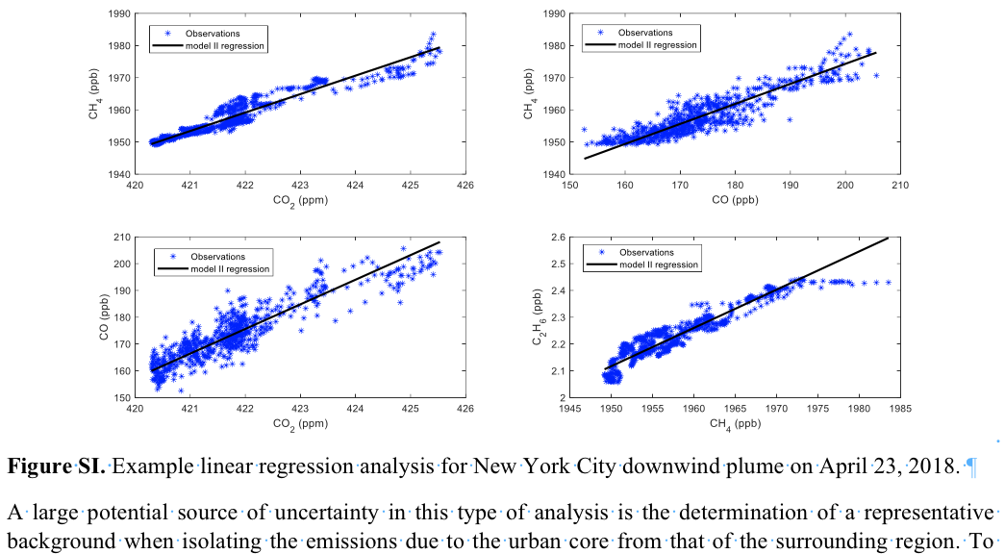

Slide 9
Fitting a model (e.g. a straight line ⬄ a model) to data:
{ Pred , Obs }
{ x_{i} , y_{i} }
Model
y = ax + b
y_{obs} = y_{true} + ε
x_{input} = x_{true} + ε’
Notes:
Insert a slide with the slope and intercept in a least squares here

Slide 10
y = ax + b Ordinary least squares
χ²(a,b) = Σ_{i} (y_{i} –a –b x_{i})²/σ_{i}² “Cost function” for (weighted)least squares problem
At its minimum, both partial derivatives of the cost function wrt a, b vanish
Then Δ = Σ_{i} 1 /σ_{i}² Σ_{i} x_{i}² /σ_{i}² - (Σ_{i} x_{i} /σ_{i}² )²
a= (Σ_{i} x_{i}² /σ_{i}² Σ_{i} y_{i} /σ_{i}² - Σ_{i} x_{i} /σ_{i}² Σ_{i} x_{i}y_{i} /σ_{i}² )/Δ
b= (Σ_{i} 1 /σ_{i}² Σ_{i} x_{i}y_{i} /σ_{i}² - Σ_{i} x_{i} / σ_{i}² Σ_{i} y_{i} /σ_{i}² )/ Δ
If all the σ_{i} are equal, they disappear and we have the more familiar
b = (Σx_{i}y_{i} – Σx_{i} Σy_{i})/(Σx_{i}² – (Σx_{i})²) = cov(x,y)/var(x)
Compare to the correlation coefficient, r
r= (Σx_{i}y_{i} – Σx_{i} Σy_{i})/ ( (Σ(x_{i} - x)² )^{1/2} (Σ(y_{i} - y)² )^{1/2} ) ≡ cov(x,y)/(σ_{x} σ_{y} )
= cov(x,y)/sqrt(var(x) var(y) )
Note that r is symmetric in x and y, but the slope b of the ordinary least squares is not (!).
Notes:
Cov(x,y) = SUM( (x - <x>)((y - <y>)) SUM (xy) -

Slide 11
θ = parameters (a,b)
P = prob we get obs data x, given (a,b)
of having produced the observations you obtained.

Slide 12
σ is usually attributed to “measurement error”, for y; no errors are attributed to x
Both usually false!!
to maximize P
minimize sum of squared residuals
Notes:
Relate to the hypothesis; NOTEϖαριανχε is not always attributable to measurement error – in our 2-box example, s is due to fluctuations of a physical process. VERY COMMON in our field !!

Slide 13
Ordinary Least Squares (OLS): “errors” all equal
Weighted Least squares (Chi-square): “Errors” may be different for different observations
OLS:
𝛘² :
So far we have not strayed from the familiar,
until we take into account variance in x!
σ_{i}² = σ_{yi}² + b²σ_{xi}² + 2 b cov(ε_{yi},ε_{xi})
←York Fit
.
.
Notes:
So far we have not strayed from the familiar!

Slide 14
But there is (almost always) also error (unresolved variance) in the predictor (x) (our “symmetry”).
Look at the relationship between the correlation coefficient ρ, and the OLS Slope (not equal!!!):
ρ = cor(x,y) ≅
symmetric
OLS Slope = ρ σ_{y}/σ_{x}
≅ r SD_{y}/SD_{x}
Why this is a YOOOGE problem
asymmetric
Notes:
note difference between rho (true corr coeff) and r, sample estimate for that!

Slide 15
An example where OLS works very well
y + ε_{y} = a + bx
x= 0:100 ; y= 1 +2*x + ε_{y}
ε_{y} = rnorm(101,2)
#create data sets, use
## lm() or lsfit()
Y
x
Notes:
NO ERROR or prob dist in x here ….! slow OLS slope decreasing with sigma x

Slide 16
… example where OLS works very well
Sample Quantiles
-4 -2 0 2 4
-2 -1 0 1 2
Theoretical Quantiles
OLS passes test for heteroscedacity (no trend in residuals)
OLS discovers noise distribution
(“error variance”)!

Slide 17
X = 1:100
#Xm meas. X, with errs
Xm= 1:100 + rnorm(100)*15
Y= 10 + 3*X
Ym=Y + 15*rnorm(100)
#Ym meas. Y, with errs
uu=lsfit(Xm,Ym)
plot(Xm,Ym)
lines(X,Y)
abline(uu,col="red")
True
OLS

Slide 18
“Type II” regressions

Slide 19
“Type II” regressions

Slide 20
Generalized Chi-square regression
Cov between errors?
Press et al., Numerical Recipes

Slide 21
Generalized Maximum Likelihood regression:
y = a + bx
specified errors in both x and y, for each predictor-observation pair.
Results in a non-linear optimization problem. Method generalized to multivariate in the YorkFit function .
+2b cov(ε_{yi},ε_{xi})

Slide 22
“York.R”:
#Universal function for finding the best straight line fit
#to data with variable, correlated errors,
#including error and goodness of fit estimates, following Eq. (13) of
#York 2004, American Journal of Physics, which was based in turn on
#York 1969, Earth and Planetary Sciences Letters
YorkFit <- function(X,Y, Xstd, Ystd, Ri=0, b0=0, printCoefs=0, makeLine=0,eps=1e-7){
#X, Y, Xstd, Ystd: waves containing X points, Y points, and their standard deviations
# WARNING: Xstd and Ystd cannot be zero as this will cause Xw or Yw to be NaN
# Use a very small value instead.
#Ri: correlation coefficients for X and Y errors -- length 1 or length of X and Y
#b0: rough initial guess for the slope (can be gotten from a standard least-squares fit without errors)
#printCoefs: set equal to 1 to display results in the command window
#makeLine: set equal to 1 to generate a Y wave for the fit line
#Returns a matrix with the intercept and slope plus their uncertainties

Slide 23
, smatr
“York.r”
χ² or fitexy() fit …
Notes:
Connections between RMA, SMA, York fit, chi-sq fit etc

Slide 24
Some basic guidelines:
Since the underlying concepts are based on the idea of a probability distribution function that attaches to all data, a data analysis should help to define the distribution, not just the mean or expected value, for each data point.
Then you should be able to use the York or similar in your analysis.
If that is not possible, it is very important to consider how various approaches affect the answers (OLS, MA, and SMA can give very different results!).
In many cases, a simple probability distribution may be unavailable, or the distribution my deviate a lot from Gaussian. Then a bootstrap may do the job (see below). The bootstrap will also require the analyst to develop well-founded error budgets.

Slide 25
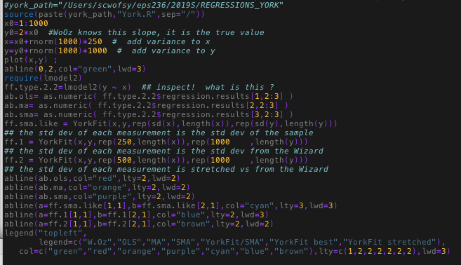
File: York_Regression_Example.r

Slide 27
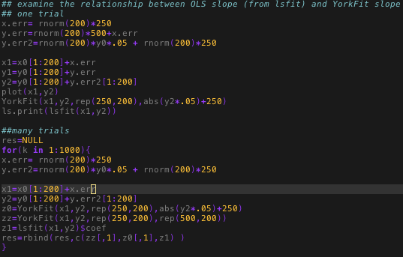

Slide 28
y1= y + ε_{y} ; y = a + b x ; x1 = x + ε_{x}
!!!!
y1
0 5 10 15 20
OLS is biased towards underestimating the slope (…the “yooge” problem)
0 5 10
x1
lmodel2( y1 ~ x1 )
Notes:
OLS is heteroscedastic on average -- residuals have a trend with data
Show the dependence of the mean slope on r / rho; introduce York regression

Slide 29
Slopes of Type I & II regressions for the model problem, resampled 1000 times (resampling errors)
MA is best, because the relationship between σ_{x} and σ_{y} is closest to MA assumptions
Regression slope Y1 on X1 – errors in both Y and X.
Notes:
Show your fits for the example problem; EXHORT the troops.; RESAMPLING concept;

Slide 30

Don’t fit OLS models to data with errors in both predictors and response;
test model fit for heteroscedacity e.g. ncvTest!

Slide 31
Ordinary Least Squares: Multiple Regressions (many predictors)

Slide 32
Overfitting: Conflating noise and signal
Y = 2 * X
Yobs=Y+3*rnorm(10)
lm (Yobs ~ X)
BIC = 43 r²=.92
Yobs ~ X + X² + X³ + X⁴
BIC = 45, r² = .95

Slide 33
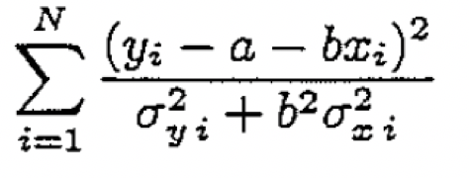
MLE cost function =
(optimized!)
(for example)

Slide 36
Using AIC or BIC
Start with a set of candidate models, all using the same data set (beware missing values).
Find the associated AIC (or BIC) values: AIC₁, AIC₂, AIC₃, ...,
If AIC_{min} is the minimum, the quantity exp((AIC_{min} − AIC_{i})/2) can be interpreted as being proportional to the probability that the ith model minimizes the (estimated) information loss.
Example: three candidate models, AIC values 100, 102, and 110.
The second model is exp((100 − 102)/2) = 0.368 times as probable as the first model to minimize information loss, either insignificant or barely significant compared to the first model.
But the third model is exp((100 − 110)/2) = 0.007 times as probable as the first model to minimize the information loss. That model can be rejected.

Slide 37
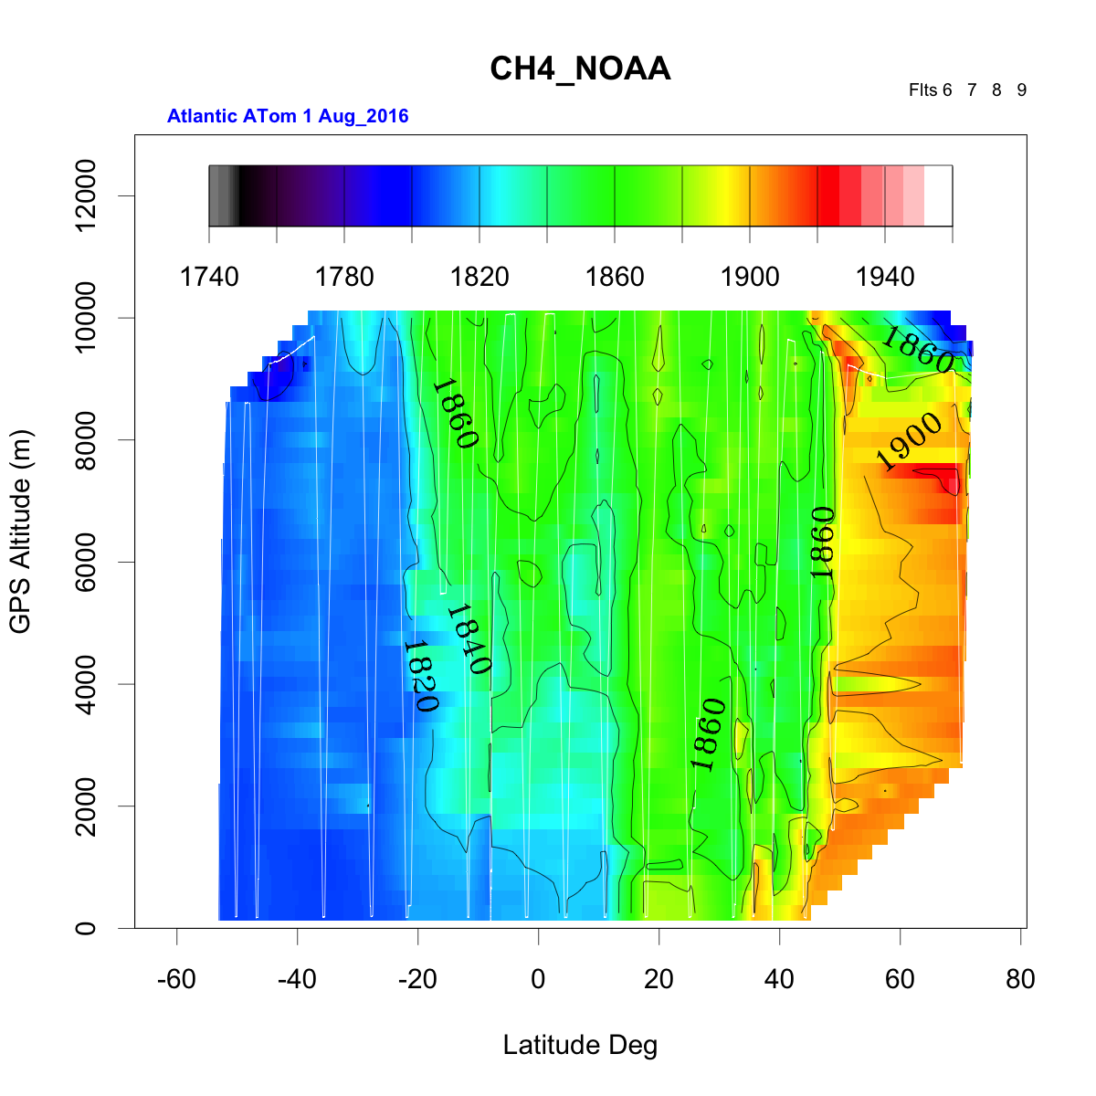
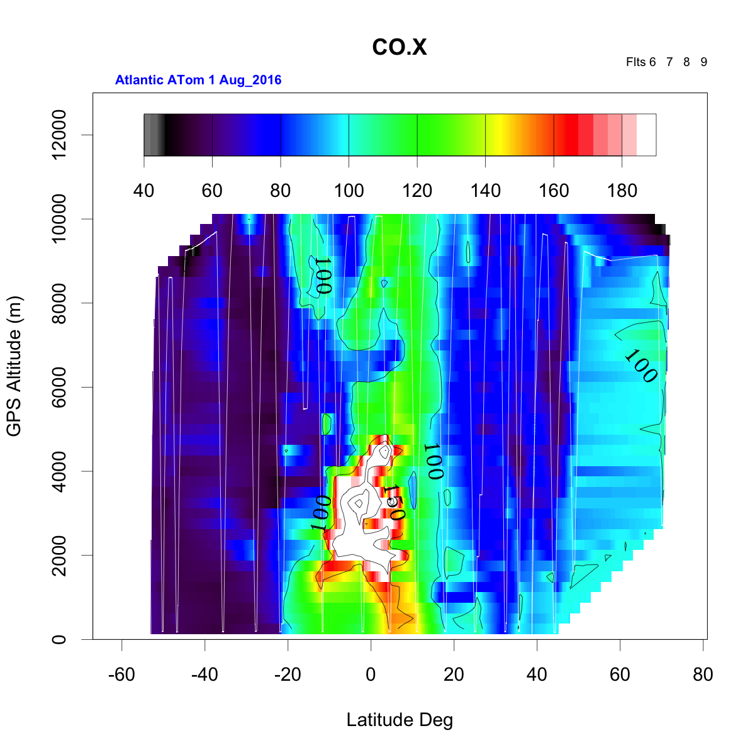
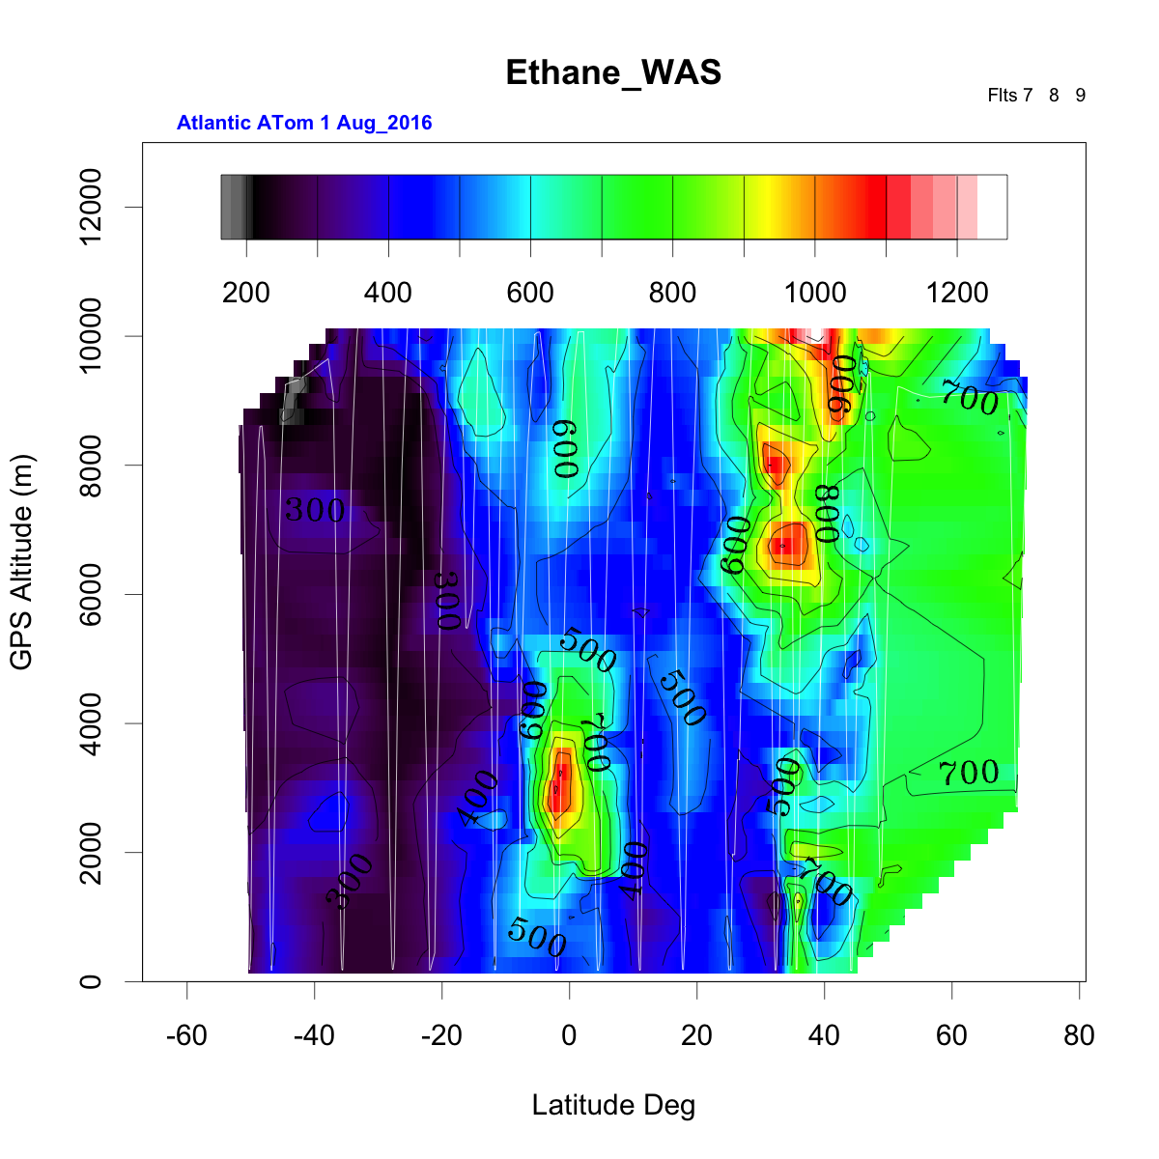
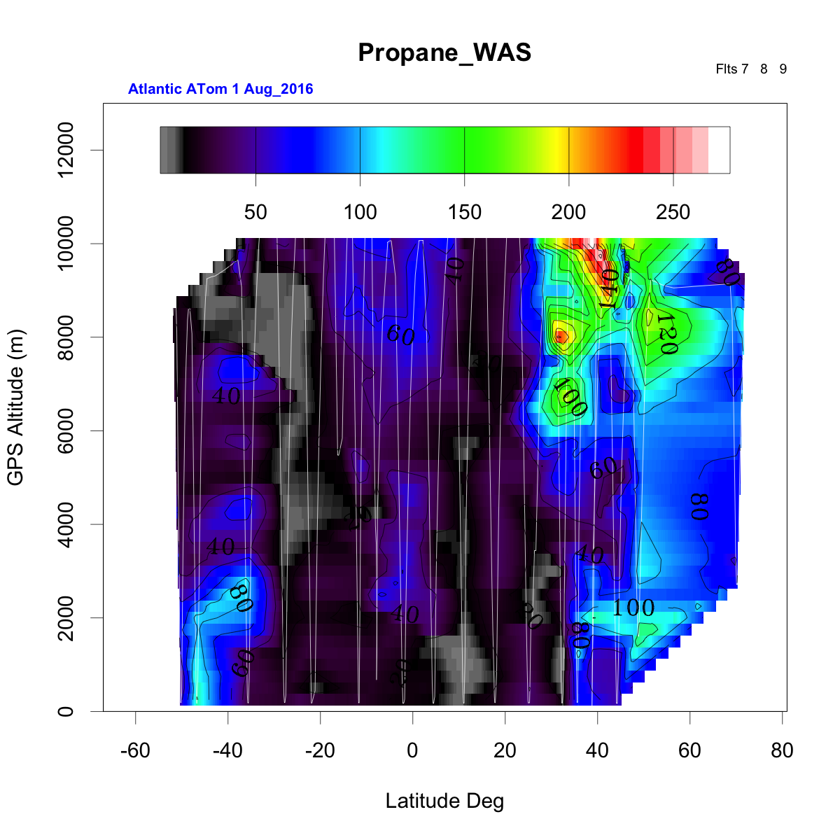
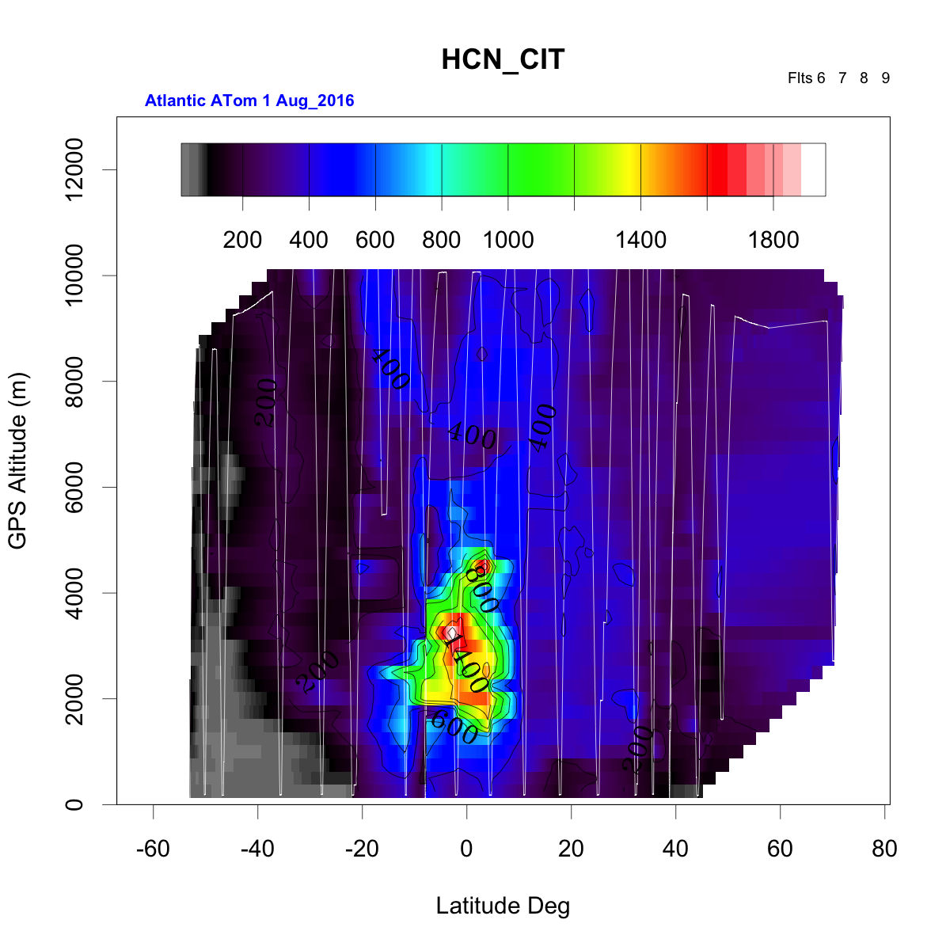
Methane Emissions from Africa in ATom:
Oil and Gas, Biomass Burning, Cities, …?
Methane
CO
Ethane
HCN
Propane

Slide 38
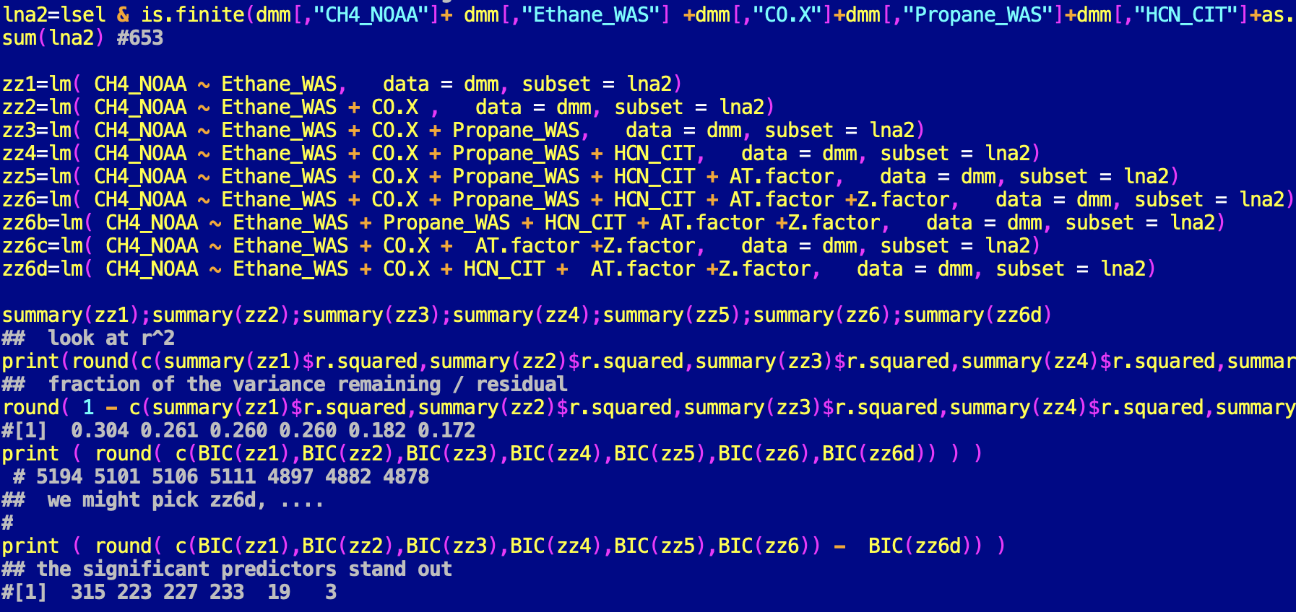
dmm data frame of ATom WAS data merged with other obs.
lsel logical selecting +/-20 degrees latitude, Atlantic

Slide 39
Regressions provide direct estimates of parameter significance and confidence intervals, once the paramaters have been chosen.
Zz6d = lm(formula = CH4_NOAA ~ Ethane_WAS + CO.X + HCN_CIT
+ AT.factor + Z.factor, data = dmm, subset = lna2)
summary(zz6d):
Estimate Std. Error t value Pr(>|t|)
(Intercept) 1.778e+03 2.984e+00 595.723 < 2e-16 ***
Ethane_WAS 6.912e-02 4.083e-03 16.930 < 2e-16 ***
CO.X 5.695e-01 6.065e-02 9.389 < 2e-16 ***
HCN_CIT -5.374e-02 6.806e-03 -7.896 1.25e-14 ***
AT.factor2 -7.355e+00 1.228e+00 -5.989 3.51e-09 ***
AT.factor3 1.354e+01 1.115e+00 12.147 < 2e-16 ***
AT.factor4 -4.454e-01 1.187e+00 -0.375 0.708
Z.factor4000 6.100e+00 1.115e+00 5.470 6.46e-08 ***
Z.factor8000 3.813e+00 9.619e-01 3.964 8.19e-05 ***
Z.factor12000 -9.479e-01 2.097e+00 -0.452 0.651
---
Signif. codes: 0 ‘***’ 0.001 ‘**’ 0.01 ‘*’ 0.05 ‘.’ 0.1 ‘ ’ 1
Residual standard error: 9.674 on 643 degrees of freedom
Multiple R-squared: 0.8269, Adjusted R-squared: 0.8245
F-statistic: 341.3 on 9 and 643 DF, p-value: < 2.2e-16
653 data points
10 parameters
Notes:
Given the data, P is the probability that the data would arise at random with the parameter value = 0 (no correlation/slope)

Slide 40
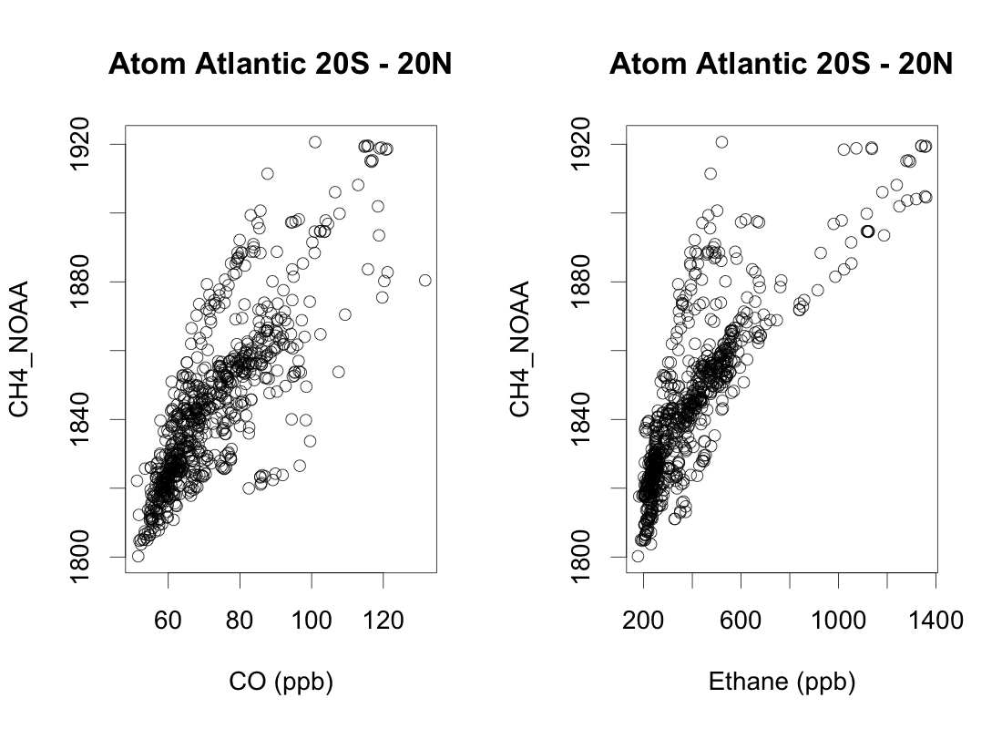
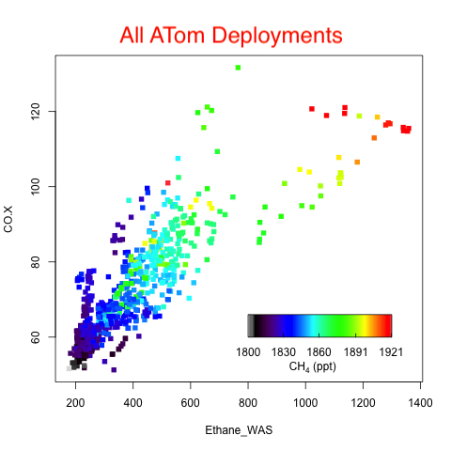

Slide 41
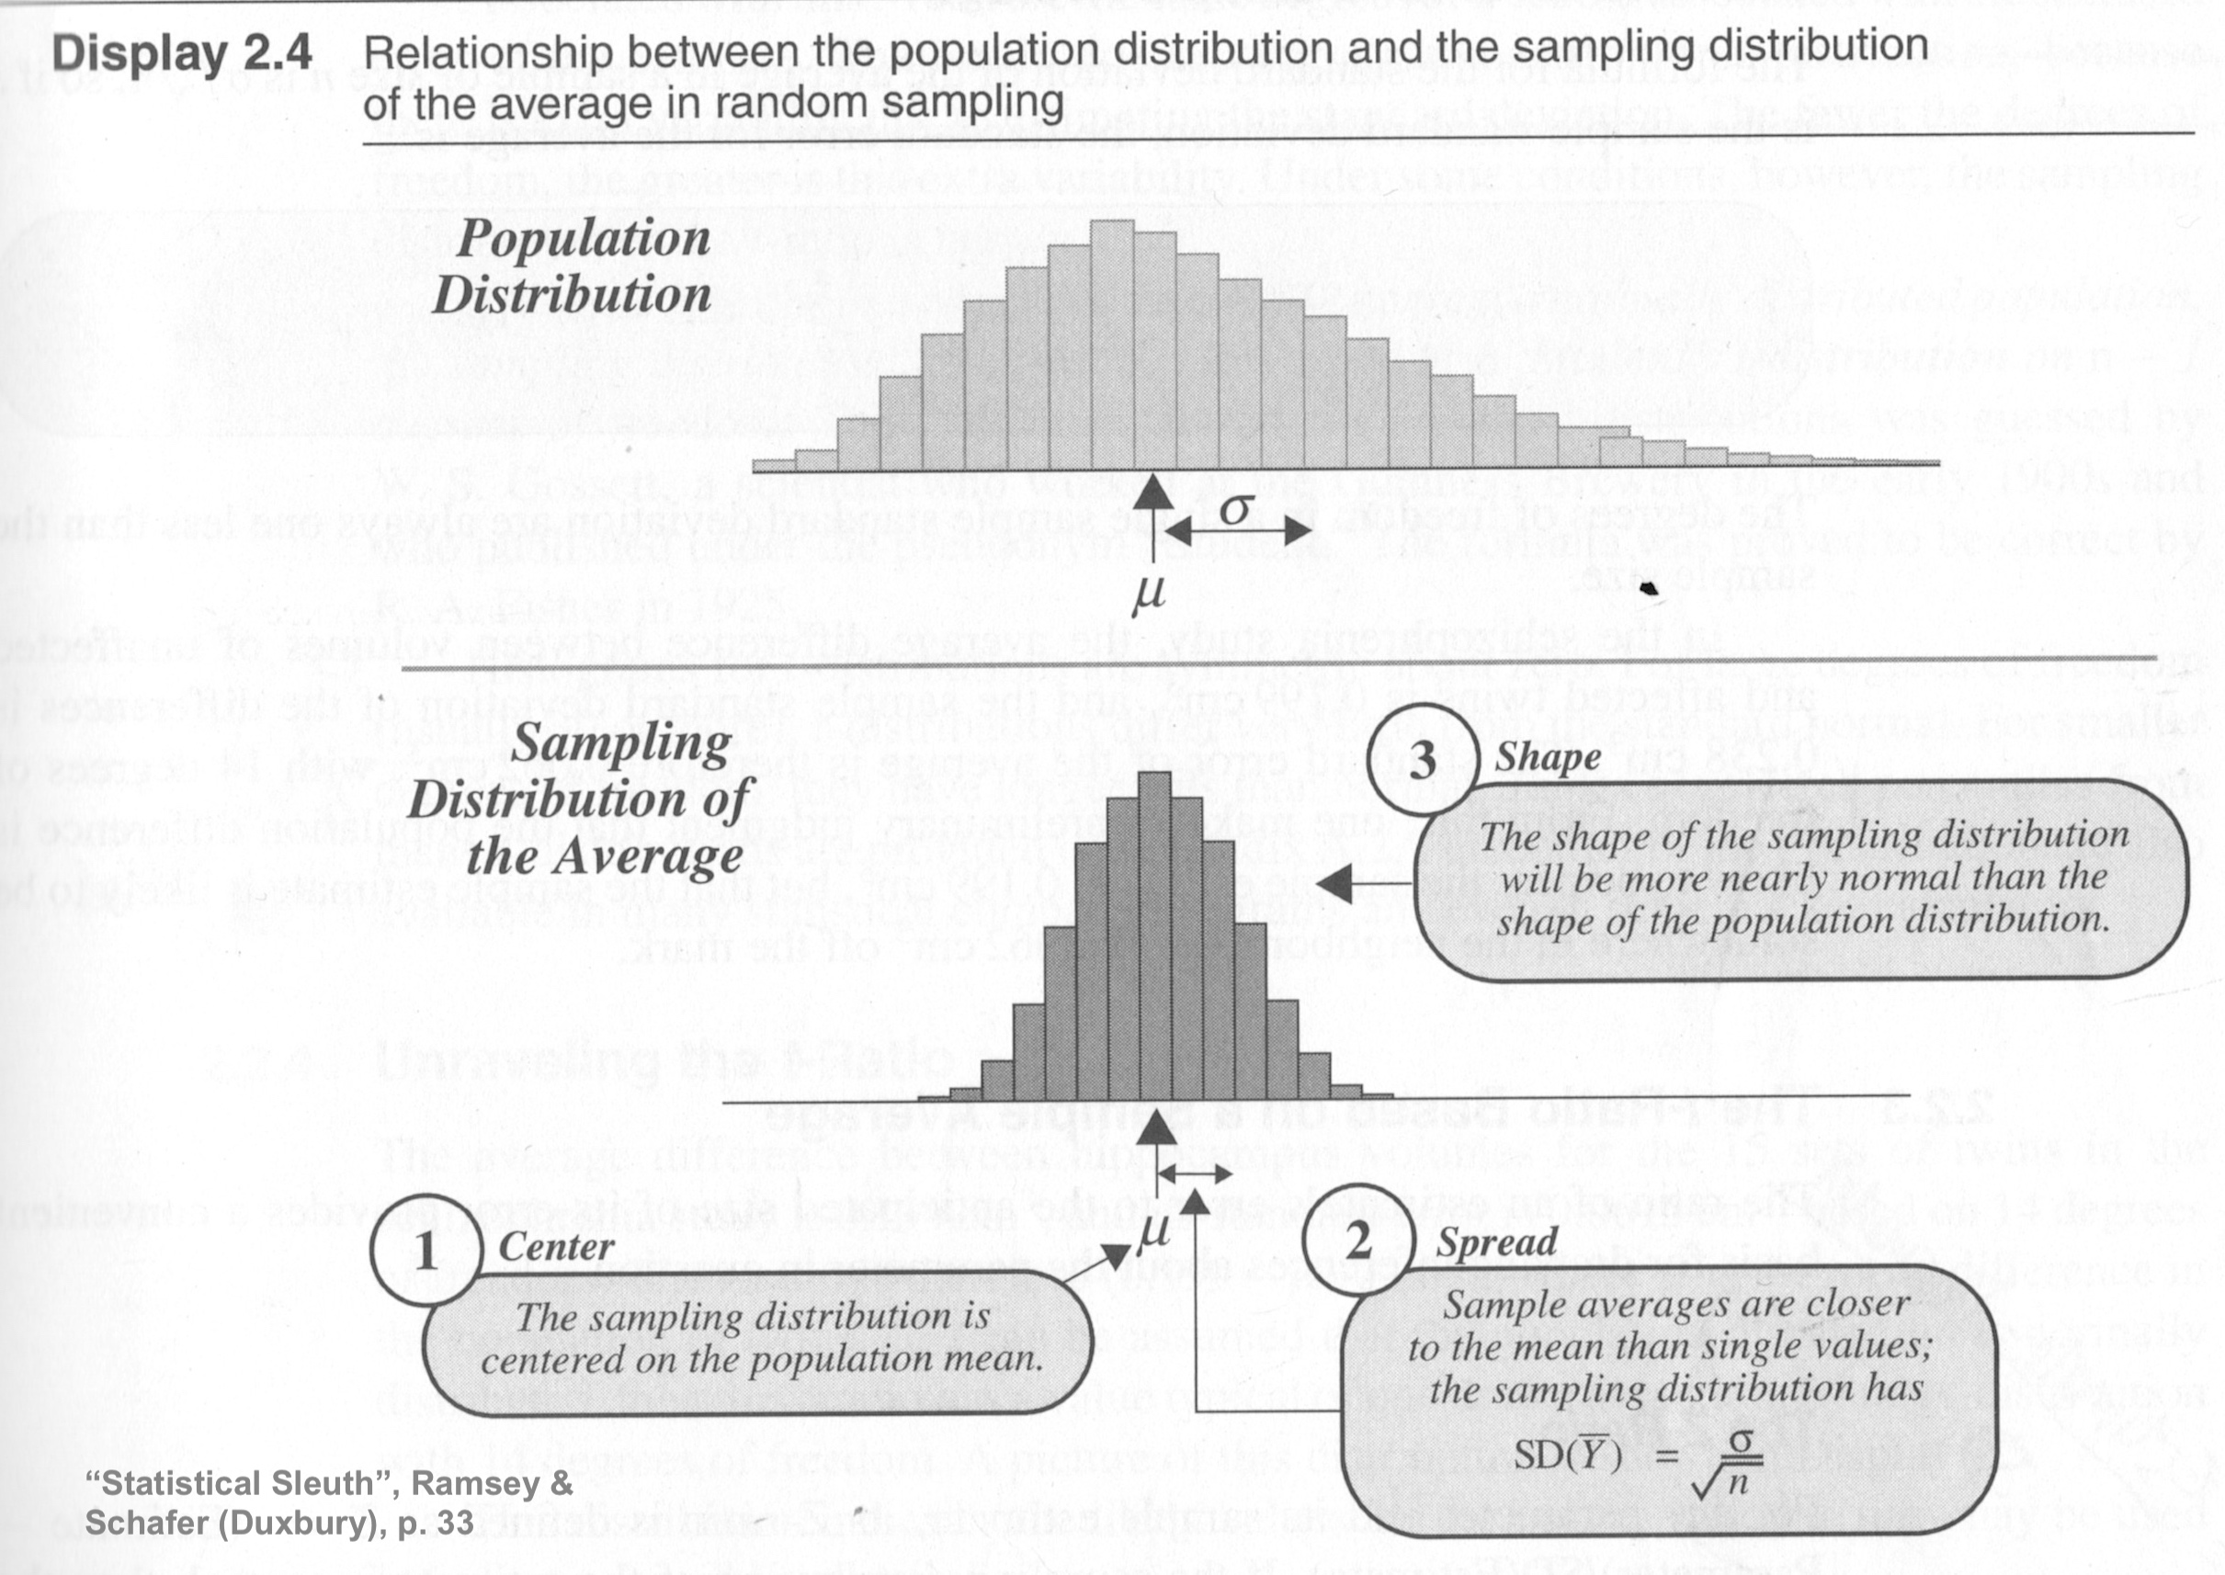
P-values and t-tests: common error estimates for fit parameters

Slide 42
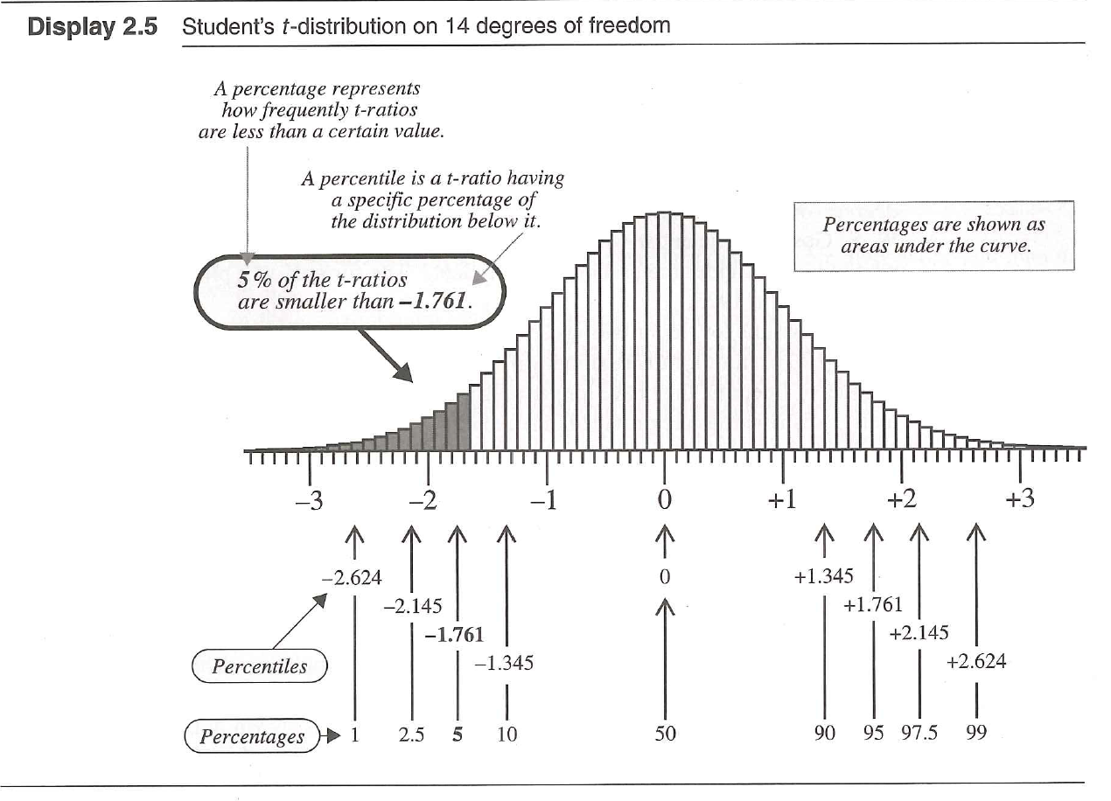
P-values and t-tests: common error estimates for fit parameters
SE(Y)= s/√n s= sample standard deviation
t-ratio = (Estimate – Parameter)/SE(Estimate)
Example: How probable is μ_{o} given the data? Est=sample mean, parameter =mean=μ
95% Confidence Interval ⬄
μ_{o} t-ratio between +/-2.145 df=14
Notes:
Resampling, normally distributed, true mean is μ_{o},,we expect sample mean to fall within the 95% CI; or, only 5% chance that, if the true mean in μ_{o}, the t-statistic will fall outside the range by chance.

Slide 43
#An example: The t-ratio for the mean of 15 points follows a Student’s t distribution with
14 = (n-1) degrees of freedom.
n7=NULL
for(k in 1:1000){
zz=rnorm(15) # same answers for runif(15,-1,1) !?!
tt=mean(zz)/(sd(zz)/sqrt(15)) # sd = sqrt(sum(zz^2)/(n)) <could be n -1 …>
n7=c(n7,tt)}
quantile(n7,probs=c(.005,.025,.05,.95,.975,.995))
# 0.5% 2.5% 5% 95% 97.5% 99.5%
# -2.937 -2.1407 -1.7531 1.7638 2.1609 3.0018
qt(c(.005,.025,.05,.95,.975,.995),df=14)
[1] -2.976843 -2.144787 -1.761310 1.761310 2.144787 2.976843
The t-statistic is wider than standard normal, approaching standard normal as df → ♾
Notes:
The general non-central t with parameters (df,Del) = (df, ncp) is defined as the distribution of T(df, Del) := (U + Del) / (Chi(df) / sqrt(df)) where U and Chi(df) are independent random variables, U ~ N(0,1), and Chi(df)^2 is chi-squared

Slide 44
Don’t overfit OLS models to data
Select the model using BIC or AIC, with predictors depending your question, and MLE principles controlling the number!

Slide 45
EPS 236 Roadmap
Linear filter model
Fitting a model to data: stochastic processes and variance; resampling; predictors and responses
Time Dependence and Analytical properties of coupled systems; eigen analysis; Class Project 1
Equivalent stochastic (Markov chain) model
Confidence intervals and t-tests
Time series analysis (Markovian) models; variance inflation, “red-shifted noise”
Confidence intervals and bootstraps (Markov chain)
Data smoothing, filtering, and filling

Slide 46
3. Analyzing and Modeling Autocorrelated Data

Slide 47
What is autocorrelation in a data set, and why is this characteristic so important in analyzing and modeling the data ?
Brief introduction to time series analysis: autoregressive, moving average filtering of noise as a key element in time series.
Variance inflation due to autocorrelation of data—”red shifted noise”.
Using arima models to extract underlying trends and signals from autocorrelated data.

Slide 48
3. First-order autoregressive (Markov) processes
Box, G. E. P., Jenkins, G. M., & Reinsel, G. C., “Time Series Analysis: Forecasting and Control” (Pearson, 1994).
Autoregressive Process (value at time t depends on previous value plus a random forcing):
Definition: z_{t} = ϕ₁ z_{t-1} + a_{t}
z: observed data; t time (discrete, evenly spaced); a random “shocks”; ϕ₁ autoregressive weight parameter (above is ar(1) process; note zero mean…)
Moving Average Process (value at t depends a random forcing plus mean of previous):
Definition: z_{t} = -θ₁ a_{t-1} + a_{t}
Both are special cases of stochastic processes with a linear filter:
Definition: z_{t} = a_{t} + Σ a_{t-j} ψ_{j}
z: observed data; t time (discrete, evenly spaced); a random “shocks”; ϕ₁ autoregressive weight parameter
∞
j=1
Relationship between φ , a_{t} and time constant and forcing in a simple linear filter,
dc/dt = - c/τ + ε_{t} : (integrate this equation from 0 to Δt)
φ = exp(-Δt/τ) or τ = Δt/log_{e}(φ) ; a_{t} = ∫_{o}^{Δt} exp(-(Δt –t)/τ ) ε_{t} dt
Notes:
compare wavelets, etc.

Slide 49
3. First-order autoregressive (Markov) processes
“autocorrelation”; “serial correlation”
Box, G. E. P., Jenkins, G. M., & Reinsel, G. C., “Time Series Analysis: Forecasting and Control” (Pearson, 1994).
Autoregressive Process (value at time t depends on previous value plus a random forcing):
Definition: z_{t} = ϕ₁ z_{t-1} + a_{t}
z: observed data; t time (discrete, evenly spaced);
a_{t} random “shocks”; ϕ₁ autoregressive parameter (above is ar(1) process; note zero mean…) Example here: < z >=0
Correlation function for lag k: ρ_{k} = φ₁ ρ_{k-1} ➔ ρ_{k} = φ₁^{k} (decays exponentially, osc if φ <0)
If E[a_{t}²] = σ_{a}² , E[z_{t}²] = σ_{z}² = σ_{a}²/(1 – ρ₁φ₁) = 1/(1 – φ₁²) : Variance increased by 1/(1 – φ₁²) compared to forcing !!!
Notes:
autocorrelation; serial correlation For Yang Li: Summary notes of a more formal nature are needed for autocorrelated data.

Slide 50
Autocorrelation (“serial correlation”) leads to larger variances in the resulting time series than the stochastic forcing:
“variance inflation”
The linear filter in a 1st order regressive model can accumulate “shocks” , and the average effect is readily computed:
z_{t}=φ₁z_{t-1} + a_{t}
= φ₁²z_{t-2} + φ₁a_{t-1}+ a_{t}
= φ₁³z_{t-3} + φ₁² a_{t-1} + φ₁a_{t-1}+ a_{t}
= Σ_{j=0} φ₁^{j} a_{t-j}
<z²> = 1 + φ₁² + φ₁⁴ + …. = 1/(1– φ₁²)

Slide 51
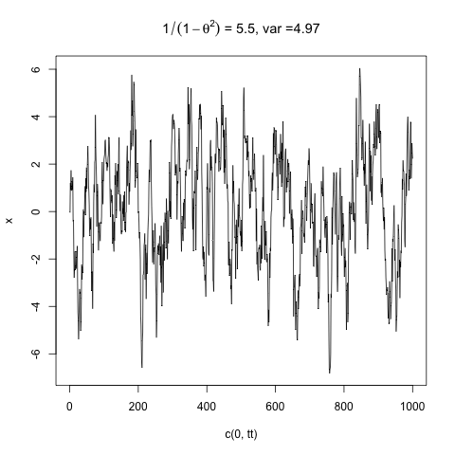
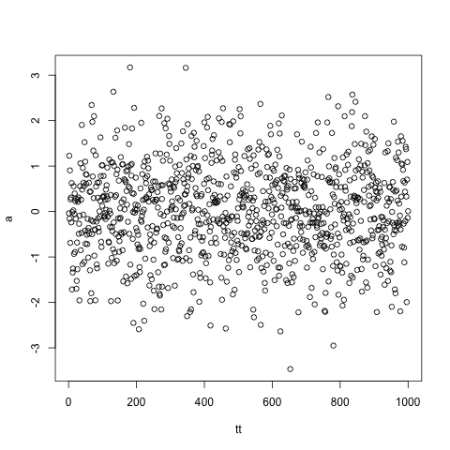
Random impulses with autocorrelation ➔ variance inflation
φ= 0.905 (τ_{decay}=10*Δt)
YY[i]=a[i]+ ϕ*YY[i-1]
1/(1 - φ²) = 5.5; var=4.97
rnorm(1000); var= 1
a = rnorm(1000)
➔
-3 0 3
-6 -4 -2 0 2 4 6
Write an R script to recreate this example:
Create an autoregressive random time series with zero mean.
Compare variances of autoregressive and forcing time series
Use the ar() function to recover the forcing.
Autoregressive Ar(1) <first order…>
Notes:
students do this! <<<<<<<<<<<<<<<<<<<<<<<<<<<<<<<<<<<<<<<<<<<

Slide 52
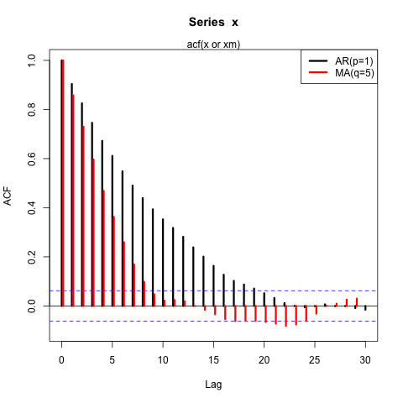
ACF function
Use acf() on your YY vector

Slide 53
How serial correlation arises in data streams
Instrumentation – finite time response, filtered output, ….
Denoising, smoothing, filtering of data
Physical or Social System – capacity (mass, capacitance); spatial scales (synoptic, continental), inertia (markets, sheep)
Temporal Forcing (Daily, Synoptic, Seasonal, …..)
Notes:
Note all the different time scales for correlation in this figure

Slide 54
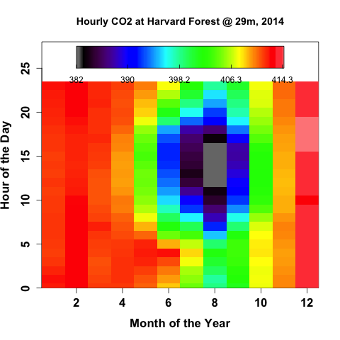
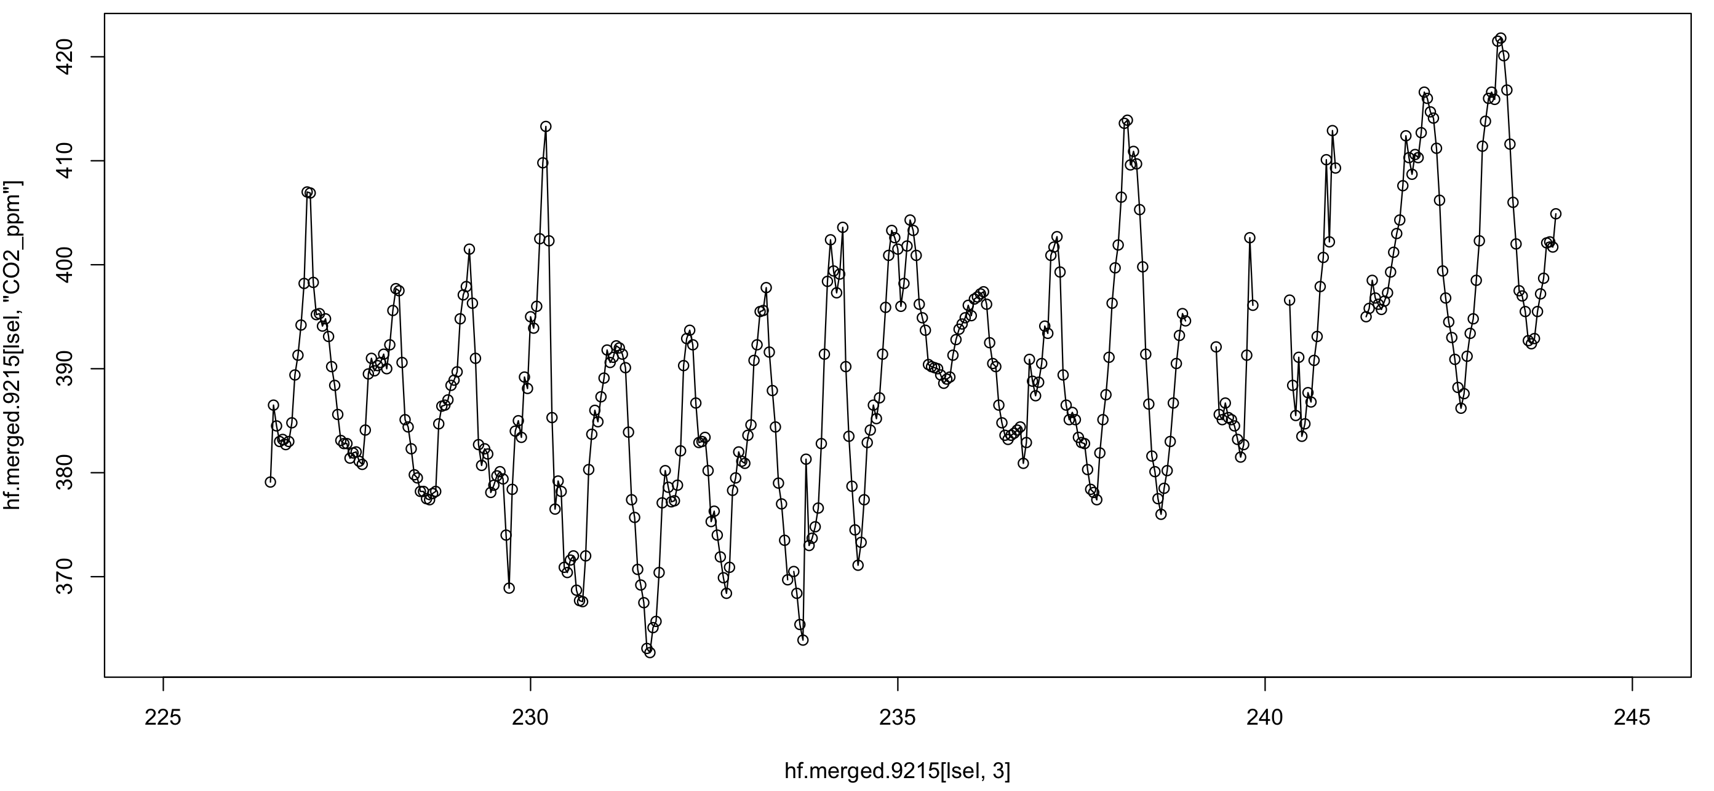
Aug. 2014 CO₂ Time series
370 390 410
225 230 235 240
Day of Year 2013

Slide 55
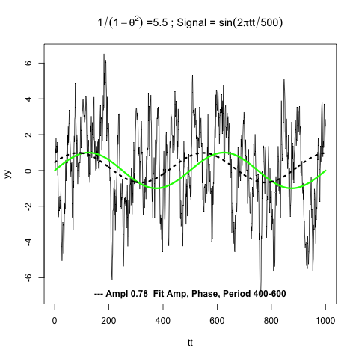
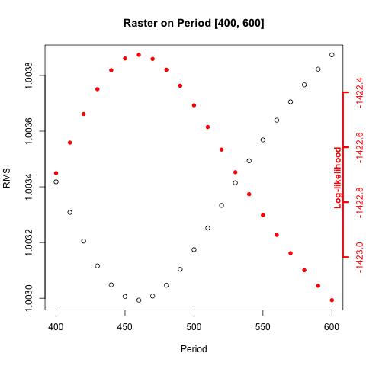
The arima(1,0,0) model determines signal with autocorrelated noise:
fits a basic model to both ar() + OLS ….
Discuss arima()
“Best” model: ar1=0.903, Ampl = 0.78 (s.e.0.4), sigma^2 (est. noise) = 1.001
Period=460, phase shift =-30.
ar1 int sin.t cos.t
ar1 1.00000 0.00609 0.00952 0.00044
int 0.00609 1.00000 -0.06123 -0.10207
sin.t 0.00952 -0.06123 1.00000 -0.05594
cos.t 0.00044 -0.10207 -0.05594 1.00000
Parameter correlation matrix
Forecasting: predict.Arima()

Slide 56
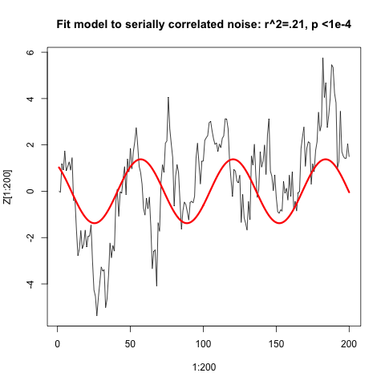
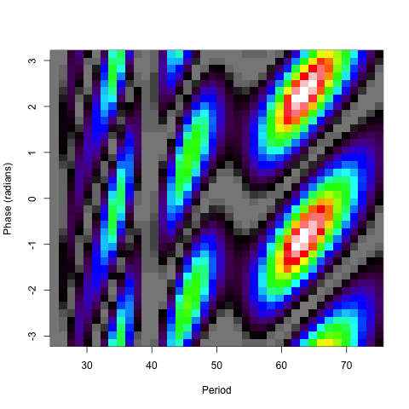
Discuss arima()
x3=sin((1:200)*2*pi/63.4-.94)
#ls.print(lsfit(x3,x[1:200]))
#Residual Standard Error=1.841 ; R-Square=0.2158
#F-statistic (df=1, 198)=54.4871; p-value=0
# Estimate Std.Err t-value Pr(>|t|)
#Intercept 0.3883 0.1302 2.9821 0.0032
#X -1.3795 0.1869 -7.3815 0.0000
arima(x = Z[1:200], order = c(1, 0, 0), xreg = x3)
#Coefficients:
#ar1 intercept x3
#0.8547 0.3848 -1.2766
#s.e. 0.0360 0.4473 0.5489
## do it again with 5x longer data record
#arima(x = Z, order = c(1, 0, 0), xreg = x33)
#
#Coefficients:
#ar1 intercept x33
# 0.9021 0.1835 -0.4675
#s.e. 0.0135 0.3203 0.3280
sigma^2 estimated as 1.003:
With 200 points, the OLS finds a decent fit and excellent p and F values. But, even with only 200 points, the arima model shows that we cannot reject the null hypothesis: “the time series is serially correlated noise, with no detectable signal”. The longer time series makes a strong case supporting the null hypothesis and it obtains good values for the ar() process.
Shorten to 100 or 200 points and run arima
F-statistic
Increase number of points and run arima
Notes:
F (will test for overall significance of a model:
1.define “Extra sum of squares” = Residual sum of squares-reduced model – residual sum of squares-full model
F-statistic = (Extra sum of squares) / (Extra degrees of freedom) / Variance-estimate-based-on-the-sample-data-full-model
F-distribution =function(num deg of freedom, denom deg of freedom) ; similar to t-test, but tells us if a group of predictors is signficant

Slide 57
The hazards of ar1() data:
There are actually fewer degrees of freedom(constraints) than you think.
The variance is inflated.
The “redshifted noise” is actually random (in phase), but shows distinct structure associated with the decorrelation time. A very long time series needed to know if it is a signal.
How to approach these problems: Test data for a null hypothesis (e.g. “the data are random correlated noise”) using ar() and arima()—efficiently estimate autoregressive model and significance.
Notes:
HEY, IS THAT THE AMO??
Describe what arima() does: fit a model with a functional form + autoregressive noise!.

Slide 58
Don’t fit models to garbage: use ar() or arima() to test data for serial correlation !

Slide 59
Assigned reading for the next lecture: “Statistical Data Analysis in the Computer Age”
Effron and Tibshirani (1991) (course website).

