Slide 1
4. Confidence intervals and errors
Estimating and interpreting
probability distributions and uncertainty
(a.k.a. “errors”)
Bootstrapping and
Markov Chain—Monte Carlo Simulations
for estimation of confidence intervals and errors

Slide 2
Assigned reading for the next lecture: “Statistical Data Analysis in the Computer Age”
Effron and Tibshirani (1991) (course website).
Also:
Download the Boston greenhouse gas data set.

Slide 3
Estimating and presenting probability distributions and uncertainty (a.k.a. “errors”)
Rigorously estimated errors are essential for data analysis.
The standard deviation (σ) measures variation of the sample.
The confidence interval (CI) estimates the “uncertainty” of the model results (parameters…).
“Uncertainty“: Range for a parameter for which the likelihood of a null hypothesis (e.g., result arose randomly) is small.
The confidence interval is often estimated using the “standard error” (from MLE) or the “student‘s t-test”. These usually assume errors are Gaussian, but give decent answers even if that is not true.
Complex (e.g. hierarcharal or sequential/chained) models require a bootstrap or its big cousin, the Markov Chain/Monte Carlo simulation.
Assigned reading for the next lecture: “Statistical Data Analysis in the Computer Age”
Effron and Tibshirani (1991). In Bootstrap…RefPpapers.pdf (course website)
Notes:
Emphasize what the SD and CI measure: *variance* vs uncertainty.
SD not an error estimate!!!

Slide 4
What is a “confidence interval” (“CI”) ?
The confidence interval is an estimate for the results that would be obtained from resampling (repeating an experiment).
If we resample an experiment many times (e.g. compute the mean or other metric of the data from each resampling trial), the x% (e.g. 95%) confidence interval encompasses x% (95%) of the results. Thus the CI encompasses the range of parameter estimates with high likelihood of arising from random resampling. Outside the CI, low likelihood!
Example 1: I want to estimate the mean temperature over a geographic area at a particular time. I measure the temperature at N points across the domain, and take the average to obtain an estimate of the mean.
If I could repeat this measurement many times, the 95% confidence interval is given the the 2.5 and 97.5 percentiles. I can only make an estimate of the true mean. But, I can’t resample the domain at a past time! I have only the N data points I first measured.
Notes:
RESAMPLING: back to our conceptual framework for statistical inference.

Slide 5
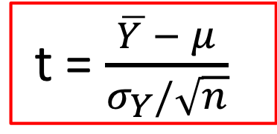
**
“Student’s t-test” ⬄ Confidence intervals
**
t = $\frac{\overline{Y }− μ}{σ_{Y}/\sqrt{n}}$
Degrees of freedom
df = n – 1
S.E. ～ σ_{Y} /n^{½} = σ _{Y}
α=0.025
α=0.025
-4 -2 0 2 4
t
The probability that all random (re)samples‡ would give Y, in the case where μ is the mean,
σ_{Y} is the standard deviation of Y, n is the number of samples, and the t-ratio has a given value on the x-axis, is given by the t-distribution. As df gets large, the t-dist → normal dist.
The 95% confidence interval is the range of μ values inside the tails shown on the left. It is the range within which the observations could arise at random “readily” (95% of the trials).
‡Resampling…results obtained by assuming distribution shape is known.

Slide 6
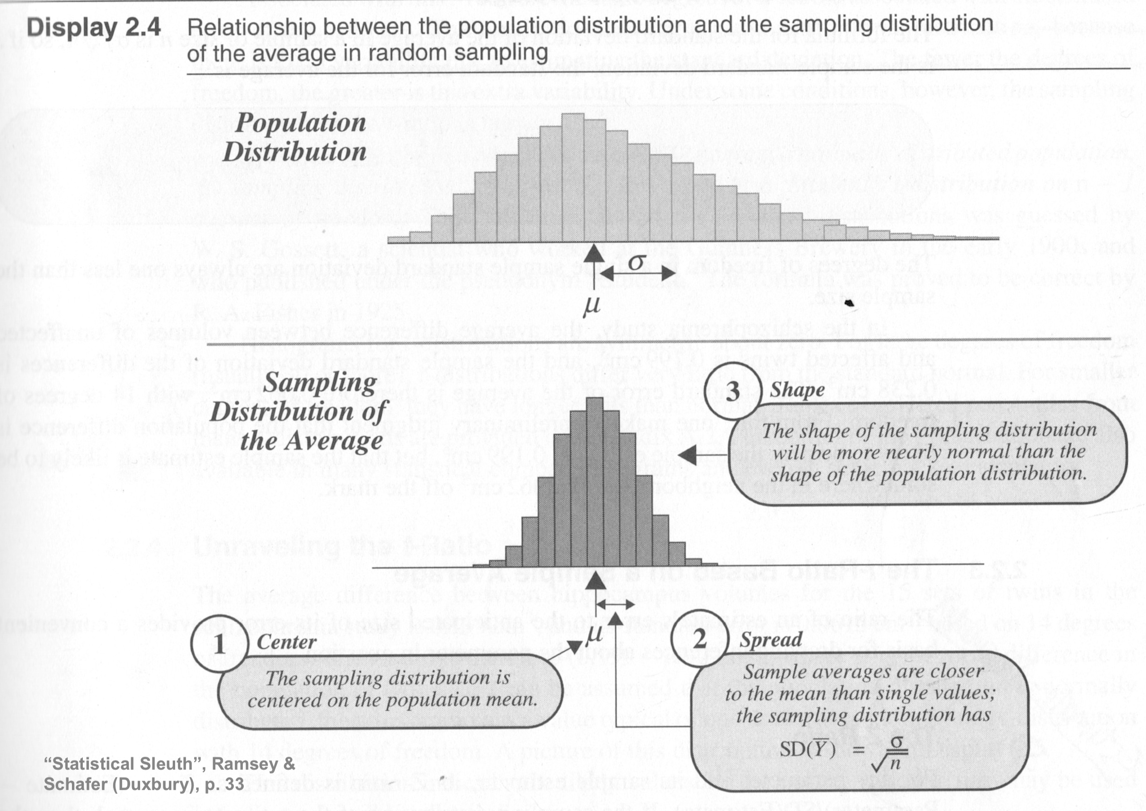
Visualizing the t-distribution arising from sampling the mean of a single population (⬄ difference in mean between 2 pop.)
1- or 2-tailed; 1- or 2-populations being sampled; <testing null e.g. μ=0>

Slide 7
Standard deviation (σ) or variance (var)
vs
confidence interval (estimated error or uncertainty)
Standard deviation measures the width of the probability distribution of your sample: estimates of σ will be refined as the sample gets larger. Estimates of the CI get smaller as the sample gets larger.
Density: rnorm(50)
Density: rnorm(1e6)
mean= - .12
CI = (-.13, .34)
range 0.5
mean= .001
CI = (-..0006,
.003)
2σ
SD=0.85
2σ
SD=1.0

Slide 8
Mean histogram of 50 samples drawn (resampled) from the normal distribution, compared to the (“true”) normal distribution
One trial
Many trials
Notes:
This is the mean histogram, not the histogram of the means

Slide 9
Example:
Estimate the mean of normally distributed data, N = 100 points, resampling the “true”
Gaussian (Normal) pdf.
“True”: mean =0
σ = 1 (std dev)
Histogram of resampled true pdf mean(rnorm(100) )
Resample 1000 times:
-.3 -0.2 -0.1 0 0.1 0.2 0.3
ZZ=NULL ; for(k in 1:1000)
ZZ=c(ZZ,mean( rnorm(100) ) ) quantile(ZZ,probs=c(.025,.975))
2.5% , 97.5% ➔ -0.20, 0.20, CI range= 0.4
Sample Mean
Notes:
This is the histogram of the means. Note how narrow it is compared to the previous slide.

Slide 10
Estimating errors using non-parametric resampling
The bootstrap method resamples the original data set, i.e. if I can’t repeat the measurements. We use its N data points to generate a large number of synthetic data sets, each also with N data points.
The procedure is simply to draw N data points at a time with replacement from each synthetic data set. Because of the replacement, we do not simply get back our original data set each time. We get sets in which a random fraction of the original points, on average 1/e ≈ 37% , are replaced by duplicated original points.
Subject the original data and the synthetic data sets to the same estimation procedure (mean; MLE/Chi-square model inversion, …) to obtain parameter estimates.
Notes:
The t-test is parametric, in effect fitting the parameters of a normal distribution. We should not do that !

Slide 11
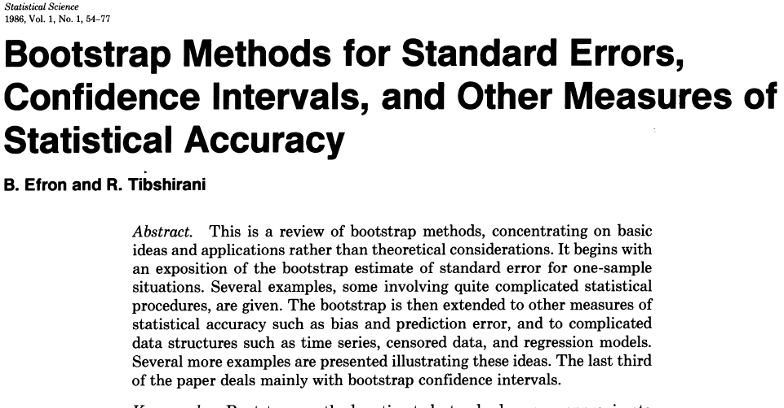
Statistical Science, 1986

Slide 12
Abstract. Most of our familiar statistical methods, such as hypoth­esis testing, linear regression, analysis of variance, and maximum likelihood estimation, were designed to be implemented on mechanical calculators. Modem elec­tronic computation has encouraged a host of new statis­tical methods that require fewer distributional assump­tions than their predecessors and can be applied to more complicated statistical estimators. These methods allow the scientist to explore and describe data and draw valid statistical inferences without the usual concerns for math­ematical tractability. This is possible because traditional methods of mathematical analysis are replaced by special­ly constructed computer algorithms. Mathematics has not disappeared from statistical theory. It is the main method for deciding which algorithms are correct and efficient tools for automating statistical inference.
10/2/19
EPS 236

Slide 13
Example:
Estimate the mean of normally distributed data, N = 100 points, using a bootstrap.
“True”: mean =0
σ = 1 (std dev)
mean of original sample
mean of true pdf
Resample 100 data 1000 times:
Zum=rnorm(100)
RR=NULL ; for(k in 1:1000)
RR=c(RR,mean(sample(Zum,100,replace=T) ) ) quantile(RR,probs=c(.025,.975))
2.5% , 97.5% ➔ -0.38 0.020 range 0.40
same range as sampling rnorm itself!
-0.4 -0.2 0 0.2
Sample Mean
Notes:
CI does include ”true” mean, but almost didn’t because our sample had notable bia relative to true

Slide 14
The set of estimated parameters will be distributed around the best estimate of the parameters from the original data (a(0)) in close approximation to the way that a(0) is distributed around a_{true} as in our simple example.

Slide 15
Markov chain – Monte Carlo concept to obtain the CI
A. Resample the underlying model: we can re-do the experiment

Slide 16
B. Resample the original data : we cannot re-do the experiment

Slide 17
Bootstrap / resampling examples and applications
Hands-on bootstrap applications
1. We have a process that produces a relationship between X and Y:
Y = 3*X
We can sample this process at integral values of X between 1 and 20, but there is uncertainty in what value of X we are sampling, equivalent to a standard deviation of 2.5 (normally distributed).
Our measurements of X are therefore given by Xobs= 1:20 + 2.5*rnorm(20)
Our measurements of Y have errors with standard deviation of 7 units.
Generate a single data set.
Use the YorkFit or York function to estimate the slope of the relationship and its confidence interval.
Generate 1000 data sets, i.e. resample the process 1000 times. Run the YorkFit or York on each and compare the quantiles of the retrieved slopes to the initial 95% Cis from the first fit.
Generate 1000 data sets by resampling the first data set with replacement, do the YorkFit or york() on each, and again estimate the slope and confidence intervals.

Slide 19
Bootstrap / resampling examples and applications
2. Find the apparent ratio of CO to CH₄ in Boston urban dome.
Question: does the relationship change seasonally? Change in a given month, 2012 – 2018 ?
#Load the Boston concentration data set (download from the website)
load(”[your path]/Boston.data.RData")
# or read.table(“[your path]/Boston.data.csv”,header=T,sep=“,”)
# these are hourly data, columns labeled STATION.GAS.mn (mn=mean, md=median, for 1 hr)
#Select a month and year e.g.
ljul=Boston.data[,”MM”] == 7
l2018 = Boston.data[,”YYYY”] == 2018 # plan the script to be able to run different months, yrs
#use lmodel2 to fit SMA slope, intercept, and CIs for CO vs CH4 at the PRU site e.g.
X = Boston.data[ ljul & l2018, “PRU.CO.mn”]
Y = Boston.data[ ljul & l2018, “PRU.CH4.mn”]
#Bootstrap the CIs by resampling the data, and running lmodel2 on each of the resampled data sets. Note: you need to extract and accumulate the int, slope results from each application of lmodel2, use for example:
uu=lmodel2(formula = Y ~ X)
Int.slope = as.numeric(uu$regression.results[3,2:3]) # a little awkward, but works
ci.s= as.numeric(uu$conf[3, 2:4]) ## not needed for the bootstrap
Notes:
Discuss the data set for the class

Slide 20
Some critical things to take away from these lectures
The basic hypotheses underlying statistical inference from data: the hypothetical “true” model or parameter value, and the equally hypothetical pure pdf that controls my sampling.
There is an underlying symmetry between “predictors” and “response”: functional relationships, errors
Autocorrelation of (among) data and predictors is endemic in our fields and has a very strong influence on results
Use central values, standard deviation, uncertainty (standard errors), and confidence intervals correctly and be explicit
The bootstrap or its big cousin, the Markov Chain Monte Carlo simulation, are incredibly useful tools for exploring the uncertainty structure of your problem. They focus on repeated simulation and resampling of your data, or your complete data-model framework.
Notes:
STATE as the positive, then exhortation; 2: light bulb slide….4. from some literature, or from our sample problem ← 5. bootstrap

Slide 21
Finis
Lectures 4 – 5
Next up:
Data conditioning, filtering, smoothing
Notes:
wrap up

