Slide 1
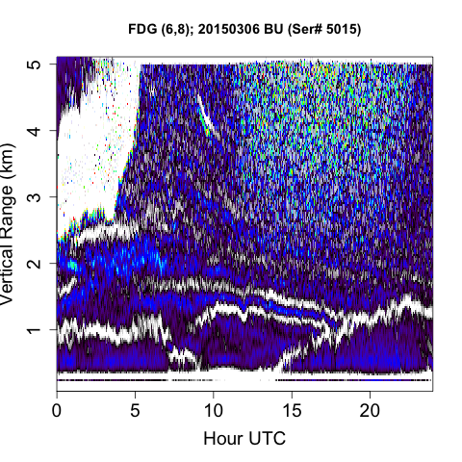
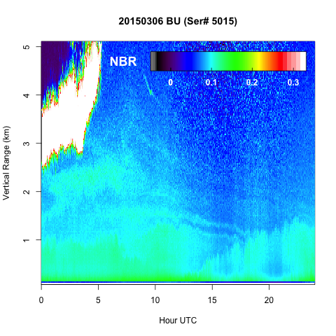
Topic 10
Introduction to wavelets
EPS 236 – Steven C. Wofsy 20191018
→
Acknowledgments: material borrowed from website of Prof. George Bebis at Computer Vision Laboratory University of Nevada (Reno); Also a figure from Wikipedia.
Notes:
Add SVD

Slide 2
[o] Wavelet Transform: Express a function (or data set) as a sum over orthonormal basis functions that are
(a) local, (b) scalable images of each other.
De-noising using a wavelet transform:
transform back keeping only lower order basis functions.
De-noising using a Wavelet Filter: Use a wavelet form to filter a function (or data set).
These are obviously the (ALMOST) same thing. The filter is similar to the projection onto one of the wavelets--any part of the frequency domain, applied in a moving window. The transform gives the discrete representation. The filter can combine wavelets to directly obtain derivatives.
Haar wavelet basis discussion

Slide 3
Wavelet and related packages in R
wavelets
LS2W
wmtsa
waveslim dwt.2d
wavethresh

Slide 4
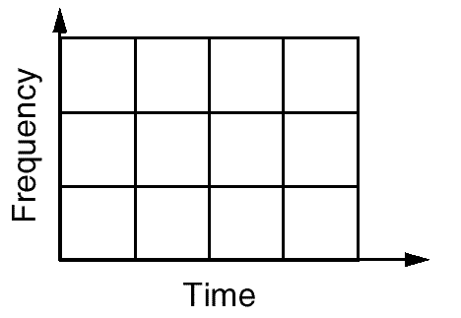
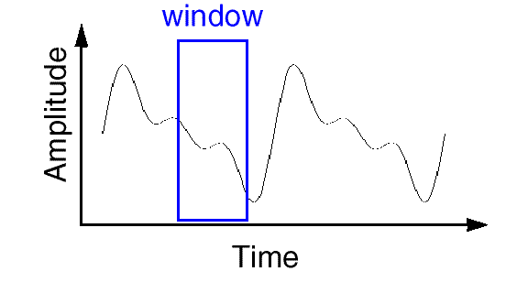
Introduction to wavelet concepts
FT (revisited)
Motivation: Fourier transforms are supremely powerful,
but have some important limitations
Time/Frequency localization depends on window size.
Once you choose a particular window size, it will be the same for all frequencies.
Many signals require a more flexible approach - vary the window size to determine more accurately either time or frequency.

Slide 5
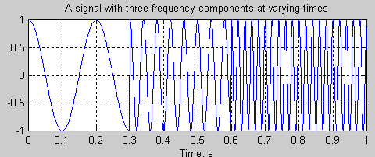
Example

Slide 6
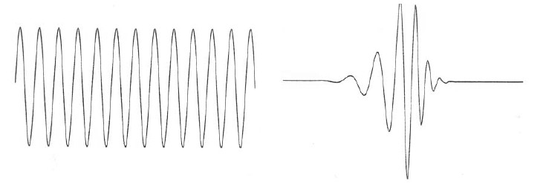
What are Wavelets?
Introduce wavelets that are localized in time/space, to address the problem that Fourier Transforms sample the entire domain, both before and after events or changes in a time series, or far removed from particular features in an image.
Wavelets are functions that sample above and below the x-axis, have (1) varying frequency, (2) limited duration, and (3) an average value of zero.
This is in contrast to sinusoids, used by FT, which have infinite energy.
Sinusoid Wavelet

Slide 7
What are Wavelets? (cont’d)
Like sines and cosines in FT, wavelets are used as basis
functions ψ_{k}(t) in representing other functions f(t):
f (t) = ∑a_{k}ψ _{k} (t)
k
Span of ψ_{k}(t): vector space S containing all functions f(t) that can be represented by ψ_{k}(t).

Slide 8

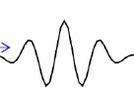
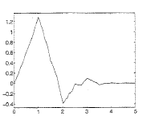
What are Wavelets? (cont’d)
There are many different wavelets:
Haar
Morlet
Daubechies
The most useful ones are very fast to compute, for the entire family of long and short ones….

Slide 9


What are Wavelets? (cont’d)
=ψ _{jk} (t)
(dyadic/octave grid)
shift k
Time Scale (1/freq) j: 2^{-j} or 1/2^{j}

Slide 10
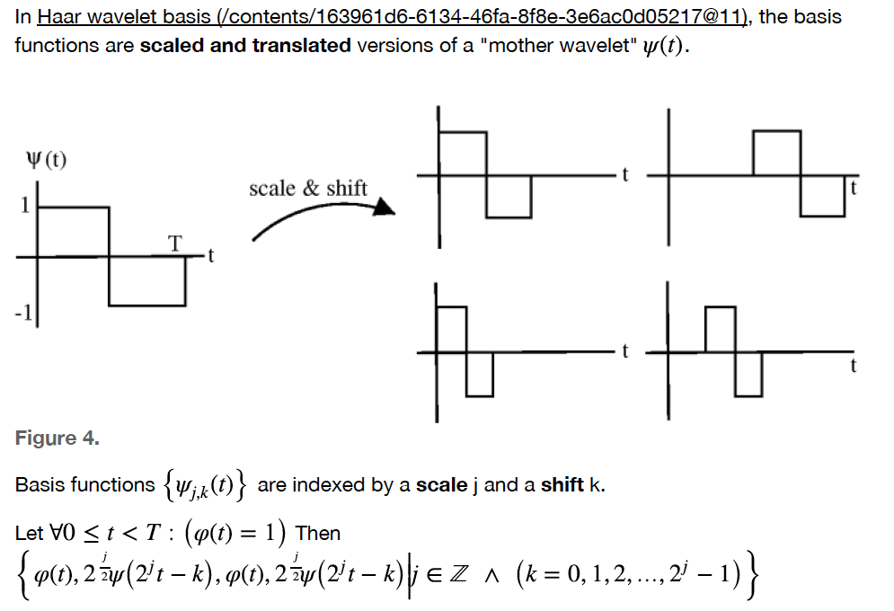

Slide 11
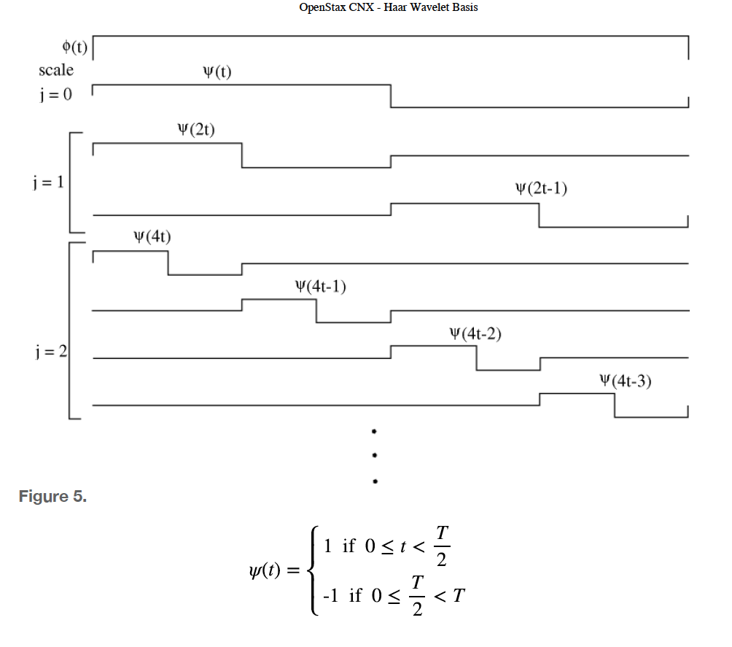
Finite mean
Zero mean
Zero mean
…..
Only these two span the domain
2^{j+1} = N

Slide 12
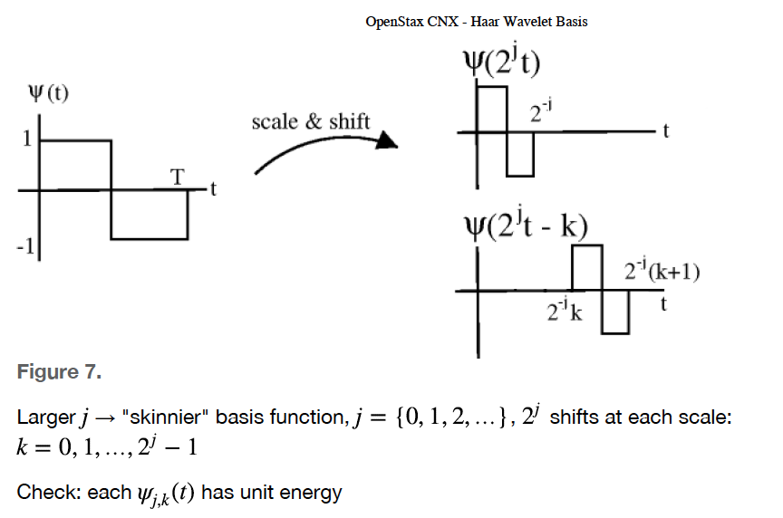

Slide 13
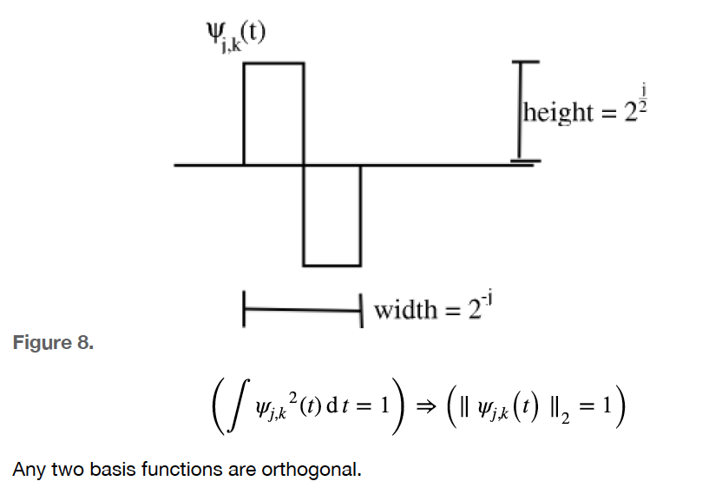
Any two basis functions are orthogonal

Slide 14
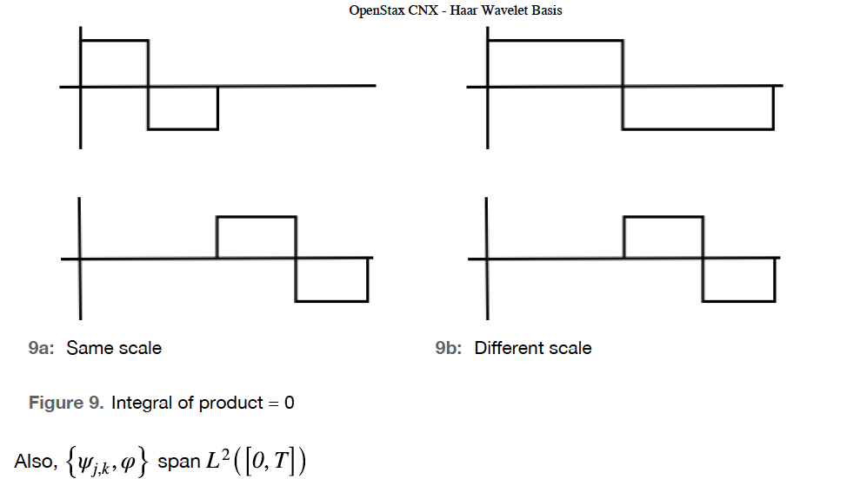

Slide 15
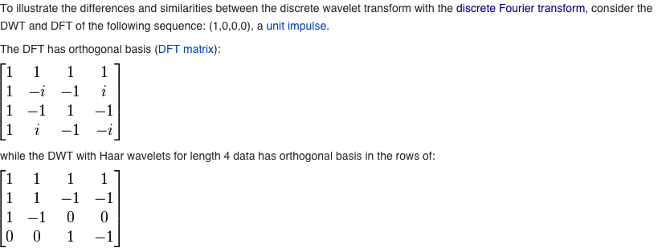
Discrete Fourier transform vs. discrete wavelet transform
The discrete Fourier transform has basis functions as below (each row).
Note that every component samples the function to be represented over
the entire domain. (example: domain of four points
Consider multiplying this basis matrix by unit impulses, (1,0,0,0), (0,1,0,0), … )
Discrete Fourier Transform (DFT) basis set matrix (each row):
The discrete wavelet transform with Haar wavelets has this basis set (each row):
Discrete Wavelet Transform (Haar example) basis set matrix (each row):
Note that the wavelets are localized. All (except the first) sum to zero. The upper basis vectors sample low frequencies and the bottom ones, high frequencies.

Slide 16
Topic 11 – Image processing – Denoising of 2-D data
See discussion in MethaneSAT_images_updated.pptx
Insert here, apply the wavelet filter

Slide 17
adimpro Polzehl and Tabelow, J. Stat. Software 19, 1-13, 2007.
biOps (build github)
tvR (total variance regularization)
akima -- 2d interpolation -- interp()

Slide 20
ppb XCH4 in grid
Total Emissions: 33 Tons/hr (45% of Lyons et al.)
Mean emission 0.5 kg/hr/km²
6 hr accumulation in the field
(conservative estimates, by ～ 1/4x)
Notes:
From: ~/METHANESAT/SAG/MEETING_20190218/Map_Meas_To_MethaneSAT_Mission_20190207_2200UTC.pptx ;
code in: ~/METHANESAT/HIRES_FIGURES_TABLE_MRS/plot.hires.r

Slide 21
Notes:
500 kg/hr is a reasonable facility detection limit for a single acquisition. 150 would be an aspiration for 20 acquisitions, persistent source

Slide 22
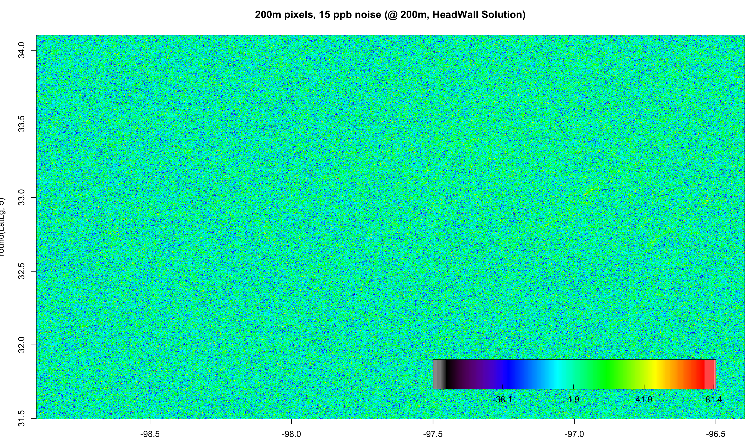
266m pixels, 15 ppb noise native pixel (HeadWall)
Equivalent to 2.8 ppb in 1.4 km
ppb XCH4 in grid
Total Emissions: 33 Tons/hr
Mean emission 0.5 kg/hr/km²
-38 2 42 81

Slide 23
Aggregation to 1.7 km grid shows the XCH4 enhancements
(15 ppb noise @ native 266m pixel, single acquisition‡
ppb XCH4 in grid
Total Emissions: 33 Tons/hr
Mean emission 0.5 kg/hr/km²
-8.3 -2.2 4 10.4 16.5
Notes:
‡Note: Mission design, 20 acquisitions per target/ 2yr; 1, 2, or 3 acquisitions each pass, priority scenes

Slide 24
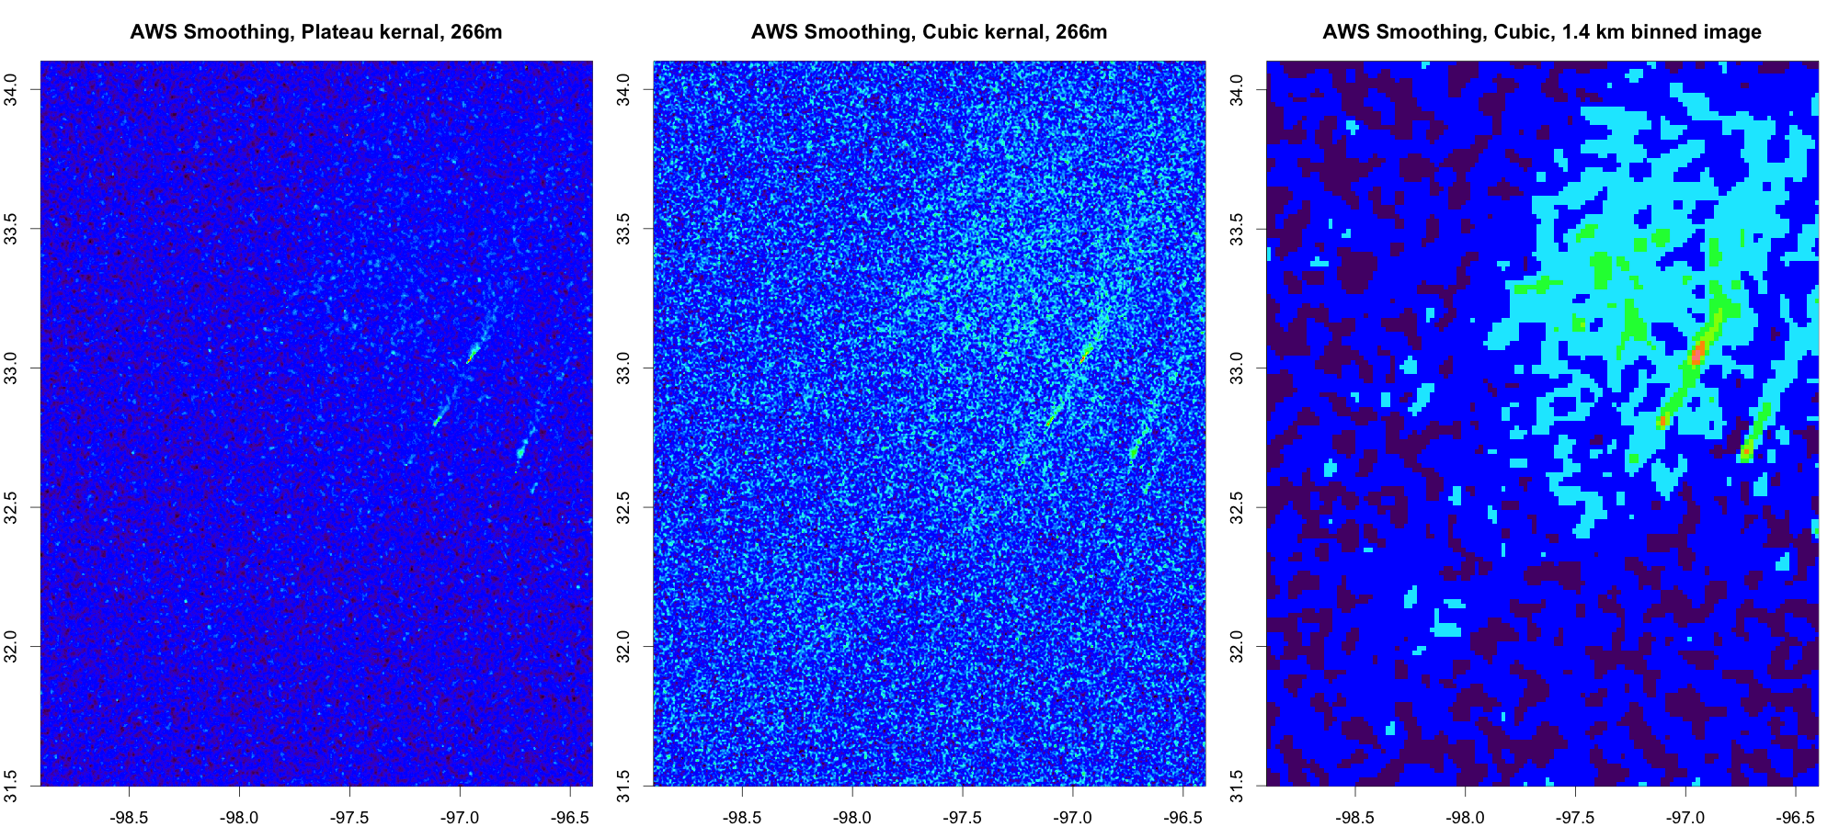
The latent image can be revealed with any number of standard image processing methods
R-code goes here
Notes:
500 kg/hr is a reasonable facility detection limit for a single acquisition. 150 would be an aspiration for 20 acquisitions, persistent source; note best point source detection is missing the area source !

Slide 25
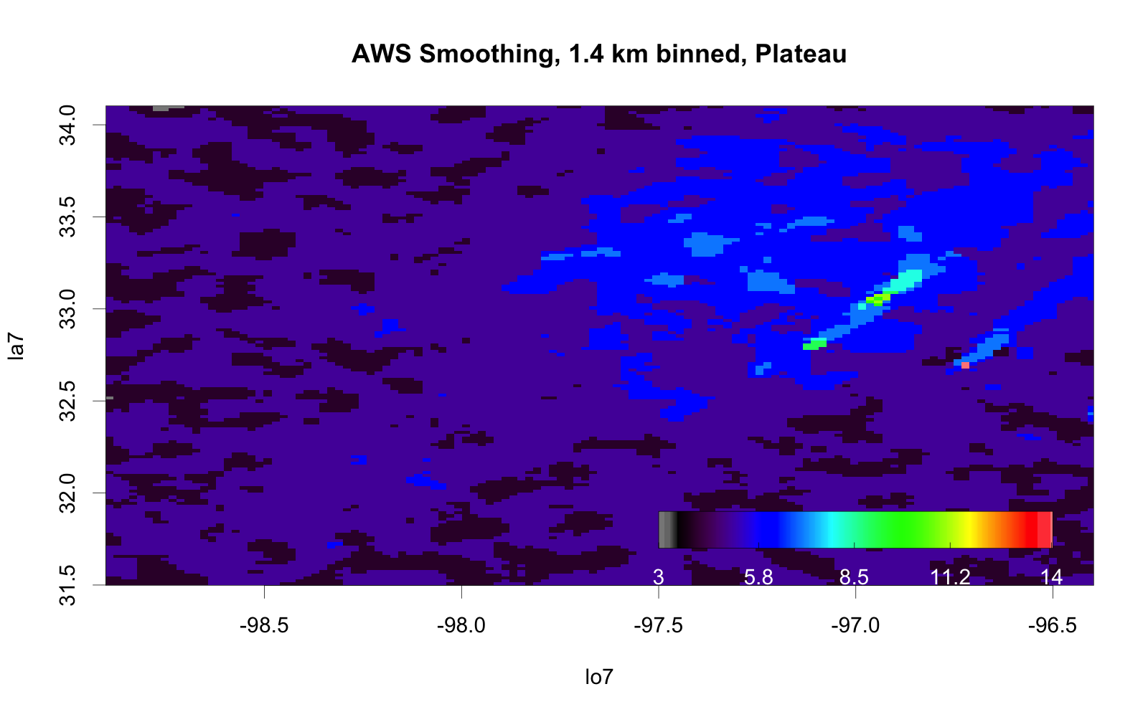
Retrieving the latent image from the 1.4 km → why it is the right aggregation for inversion

Slide 26
6.6 km grid, 15 ppb noise @ native 266m pixel
Single acquisition
ppb XCH4 in grid
-2.2 -0.3 1.7 3.7 5.6
Total Emissions: 33 Tons/hr
Mean emission 0.5 kg/hr/km²

Slide 27
Application of Wavelet Filter
Haar denoising

Slide 28
library(wavelets) ; library(LS2W) ; library(wmtsa) ; library(waveslim)
library(adimpro) ; library(biOps) ; ## relevant packages
## denoise the full noise image / get rubbish
denoise.hre=denoise.dwt.2d(HRE,wf="haar") ## wavslim package
png("Fig.HRE_1.png")
image(x=round(LonLg,5),y=round(LatLg,5),z=HRE,col=heat.285[1:280], main="HRE Original Noisy Data")
dev.off()
#
png("Fig.HRE_2_den4.png")
image(z=denoise.hre,col=heat.285[1:280],main="HRE Denoised Default Depth=4")
dev.off() # now work on the noisy 1.7 km image (ZZ)
png("Fig.HRE_1.7.png",pointsize=28,width=1600,height=1600)
par(mfrow=c(2,2),mar=c(1.2,1.2,2,.5))
image(x=lo7,y=la7,z=ZZ,col=heat.285[1:270],main="HRE Aggregated to 1.7km")
denoise.ZZ=denoise.dwt.2d(ZZ,wf="haar")
##J=4 default, very aggreated result
image(z=denoise.ZZ,col=heat.285[1:270],main="HRE 1.7 Denoised to Depth 4")
#gets much better by decreasing the depth
denoise.ZZ.2=denoise.dwt.2d(ZZ,wf="haar",J=2)
image(z=denoise.ZZ.2,col=heat.285[1:270],main="HRE 1.7 Denoised to Depth 2")
denoise.ZZ.1=denoise.dwt.2d(ZZ,wf="haar",J=1)
image(z=denoise.ZZ.1,col=heat.285[1:270],main="HRE 1.7 to Depth 1")
dev.off()

Slide 30
Singular-valued decomposition SVD
(a.k.a. Principal Component Analysis [PCA])
## Find the vectors (linear combos) that represent the values of a matrix [image] with a minimum number of components, e.g. to remove noise and visualize underlying structure.
## The matrix can be singular or non-square.....
The SVD decomposition of the matrix X as computed by LAPACK, is given by:
X = U D V',
where U and V are orthonormal matrices, V' means V^{T} (transpose and conjugated for complex input), and D is a diagonal matrix with the (non-negative) “singular” values (a.k.a. weights) D[i,i] in decreasing order (analogous to eigenvalues in the linear model). Equivalently, D = U' X V. Note that X[i,j]=Σ _{k} d[k] U[i,k] V[j, k] outer product of columns of U rows of V^{T}, with weights d[k].
By selecting the terms (rows, columns, diagonal elements) with the greatest weight, a reduced-dimension approximation to X is obtained which show the largest contributions (features!) of X.
See the script below for an example.

Slide 31
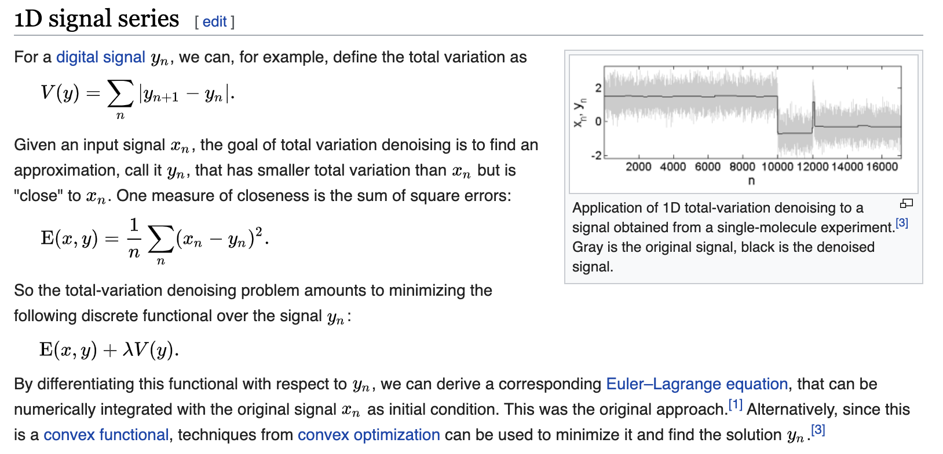
Total Variation regularization
https://en.wikipedia.org/wiki/Total_variation_denoising

Slide 32

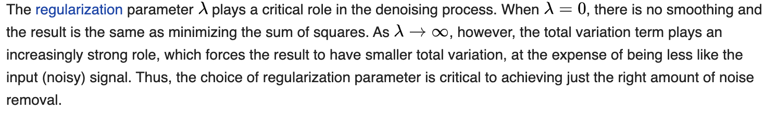
https://en.wikipedia.org/wiki/Total_variation_denoising

Slide 33
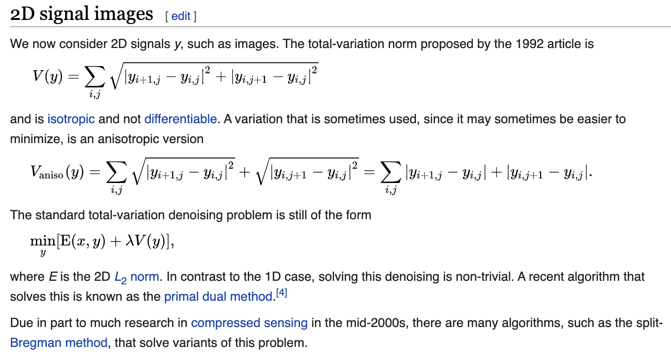
R package tvR has both 1-D and 2-D Total Variance filters
require(tvR)
Xtv=denoise2(X2)
https://en.wikipedia.org/wiki/Total_variation_denoising

Slide 34
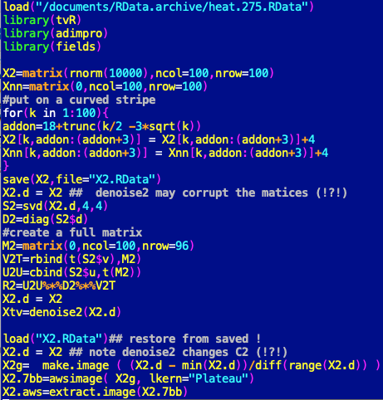
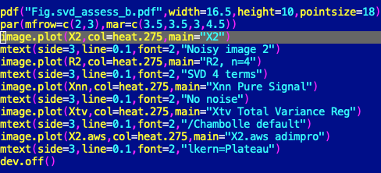
R-code to make the figure on the next slide

Slide 36
11b. Wavelet filters – 1d application to 2-d Lidar images
Extra topic
haar_coeffs=function(d){return(rep(1,2*d+1)/(2*d+1))} ##haar wavelet filter
fdh1_coeffs=function(d){return(rev( (-1)*c(rep(-1,d),0,rep(1,d)) )/(2*d+1))} ## haar wavelt 1st deriv filter
g1_coeffs=function(d=6,n.extent){
##d is dilation##returns coefficients of discrete Gauss filter, two-sided, n.extent = no. points on one side
x=( (-n.extent):n.extent)
y = exp(-1*x*x/(2*d))/sqrt(d)
return(y/sum(y)) }
fdg1_coeffs=function(d=6,n.extent){
##d is dilation
##returns coeffecients of Gauss 1st deriv wavelet filter, two-sided, n.extent = no. points on one side
x=( (-n.extent) : n.extent )
y = -x * exp(-1*x*x/(2*d)) / d
NN=sum(exp(-1*x*x/(2*d)) )
return(y/NN) }
wv.filt=function(x,d.coeffs){
#applies wavelent filter (0 or 1st derivative) to a vector x
#pad x by half the length of the filter coeffs or its full length (both sides)
n.pad=max(c(length(x),length(d.coeffs)/2+1))
X=c(rep(0,n.pad),x,rep(0,n.pad))
X.f=filter(X,filter= ( d.coeffs ), method="c",sides=2,circular=F)
res=X.f[(n.pad+1):(n.pad+length(x))]
return(res) }
Notes:
Next up: Treatment of the Barnett Shale image using wavelets, aggregation and some image processing. This section leads to a hands-on exercise *.r file

Slide 37
Application of the wavelet filter: a lidar problem.
Find the boundaries between layers of particles observed by the BU lidar over Boston
PBL

Slide 38
BU5015 Lidar retrieval 1700 UTC on 20150306

Slide 39
Discrete Gaussian Wavelet (d=6, n=8) filter
d
dilation
a.k.a. correlation length
(of the wavelet filter)
n
number of points each side (discrete, finite)
g1_coeffs=function(d=6,n.extent){
##d is dilation
##returns coefficients of discrete Gauss filter, two-sided, n.extent = # pts on each side
x=( (-n.extent):n.extent)
y = exp(-1*x*x/(2*d))/sqrt(d)
return(y/sum(y))
}

Slide 40
Gaussian Wavelet Filter
d=8 n=8 r/l d=6, n=4
Position Position

Slide 41
Comparison of Gaussian and Haar wavelets, Pspline smoothers for Lidar data

Slide 42
First derivative Gaussian wavelet filter coefficients
First derivative Wavelet Filter, d=8n n=8 r/l d=6, n=4
8

Slide 43
/2
Gaussian first deriv
Harr 1st deriv
•
•

Slide 45

Notes:
check this

Slide 46
Summary
Wavelet transforms provide localized, frequency resolved representations of 1- and 2-d data sets, allowing analysis of high-and low-frequency behavior (e.g. de-noising) in a computationally very fast and simple framework.
Wavelet filters use similar, compact, frequency-resolved mother wavelets to smooth 1- and 2-dimensional data and to directly obtain derivatives of the data with well defined smoothing. Wavelet filters are just variants of linear moving-average filters that benefit from the conceptual basis developed for the wavelet transform.
Wavelet transforms and filters are often applied to image processing problems.
Hands on exercise: fdg_lidar_example.r

