Slide 1
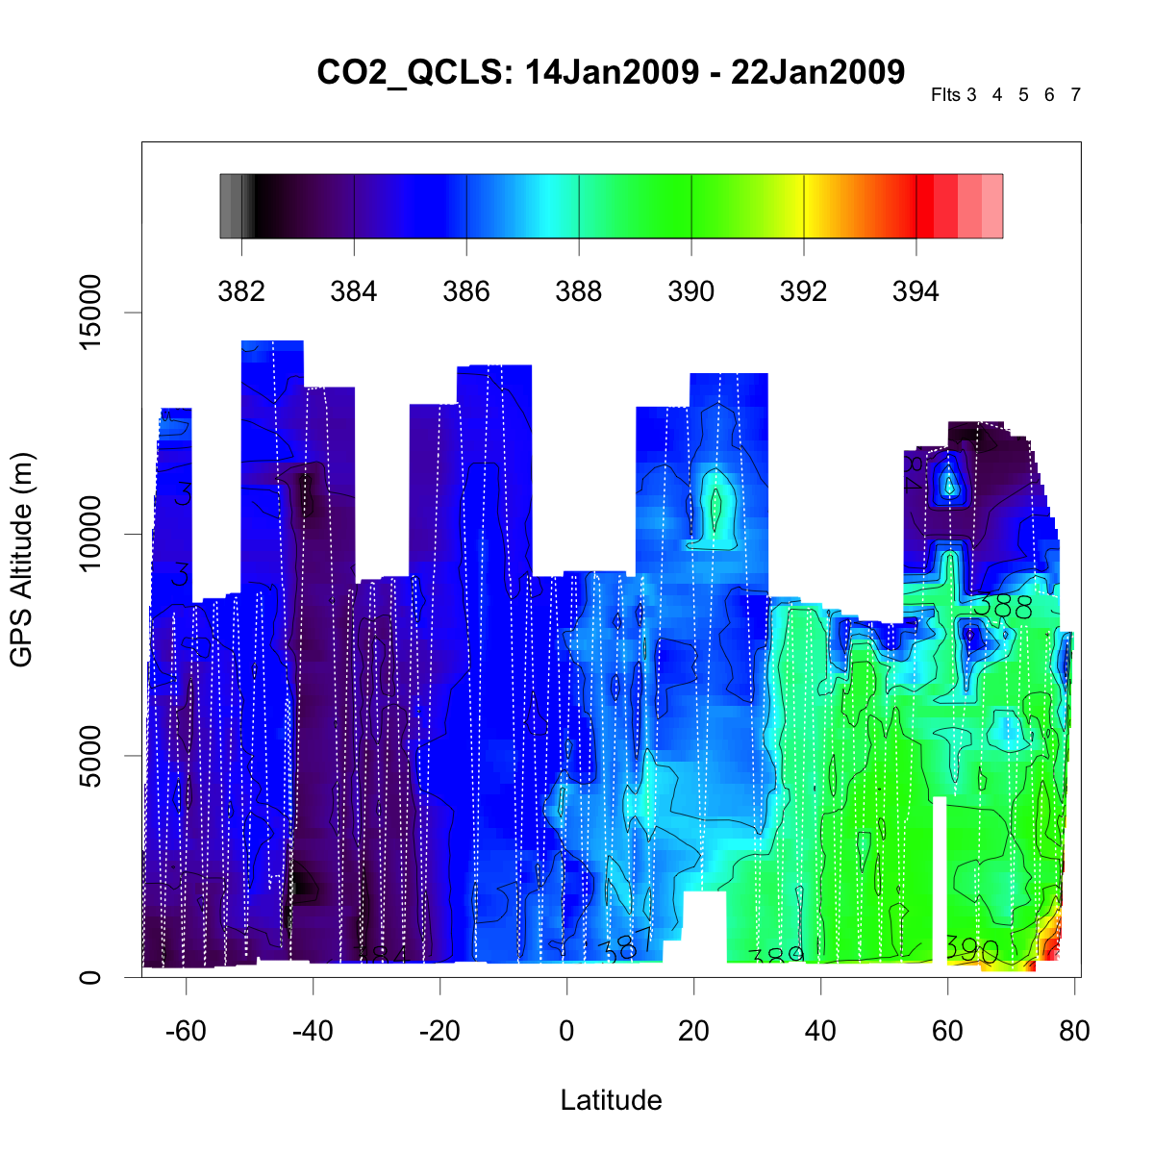
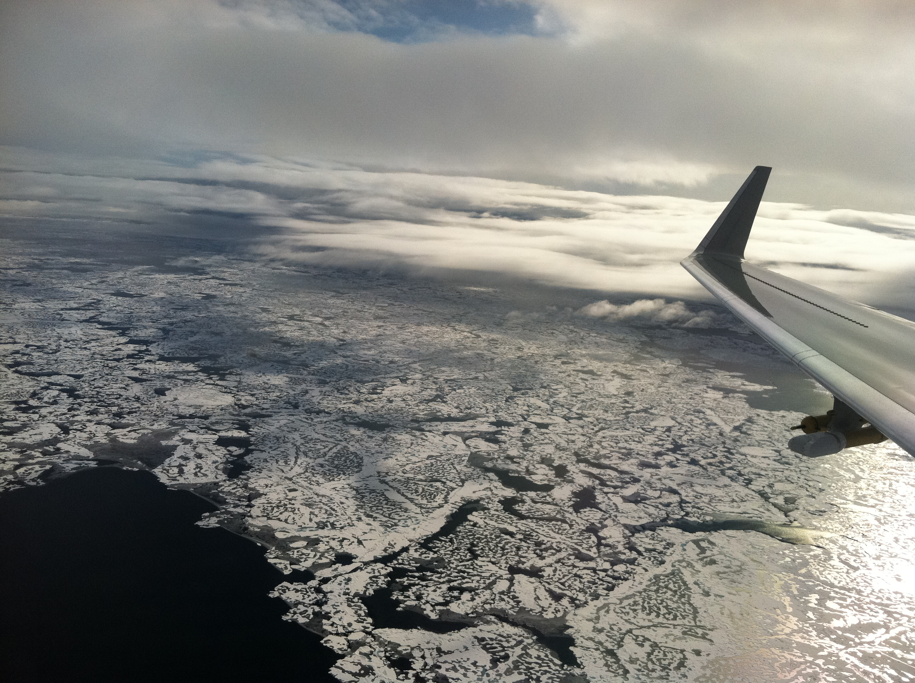
EPS 236 Fall 2019
Lecture topics 8 and 9
Data conditioning, filtering, smoothing, interpolation, regularization

Slide 2
Smoothing, de-noising, interpolation:
Fitting a model to data to de-noise, reveal signals.
Topic 8. Time series:
smoothing, filtering, rejecting outliers,
moving average, splines, penalized splines, wavelets
Seasonal decomposition and trends
Topic 9. Interpolation

Slide 3
Data smoothing, filtering, and interpolation: Merge two CO₂ data sets
HIPPO-1 Flight 3 (Arctic)

Slide 4
Compare the data graphically: Merge two CO₂ data sets
1:1
1:1

Slide 5
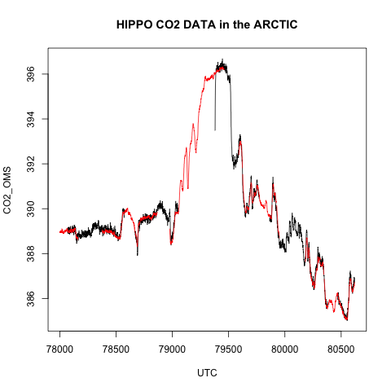
A closer look at our noisy time series data
-- OMS
-- QCLS

Slide 6
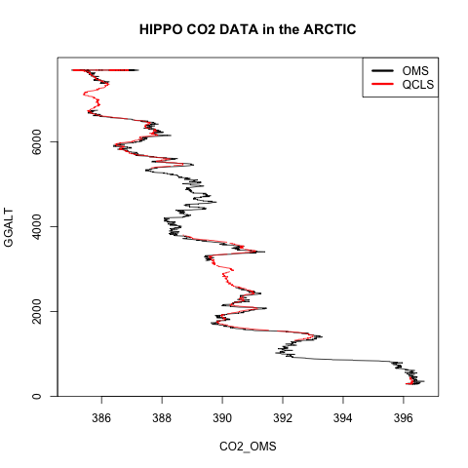
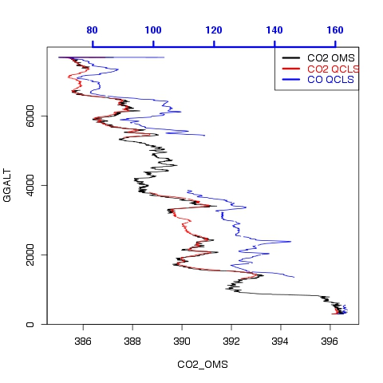
The same data plot against altitude instead of time: CO₂ – CO cor

Slide 7
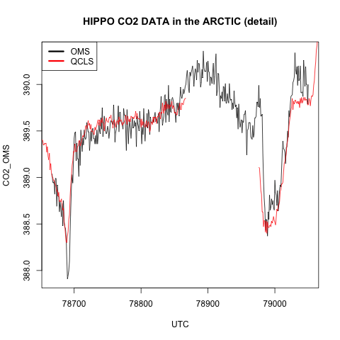
A closer look: the offsets are seen as well as differences in noise between the OMS and QCLS sensors

Slide 8
How to go about solving this problem
Visualize the data (see above)
What is the objective: obtain the best possible CO₂ data, combining the two sensors
We find:
The OMS is noisier, and it responds faster.
The QCLS has sensor-induced serial correlation.
Offsets may not be attributable, vary with time and ??.
Smoothing the data will be required to make a comparison effectively.
Smoothing will induce autocorrelation, feed-forward, peak flattening, time shifts, maybe other artifacts (e.g. common mode errors) – proceed very carefully.
Notes:
Discuss Ilsa Simpson 20 year moving average; not S-G, not loess, taper, loss of peak height etc. If you induce autocorrelation in two signals and then regress them, you are set up for common monde errors.

Slide 9
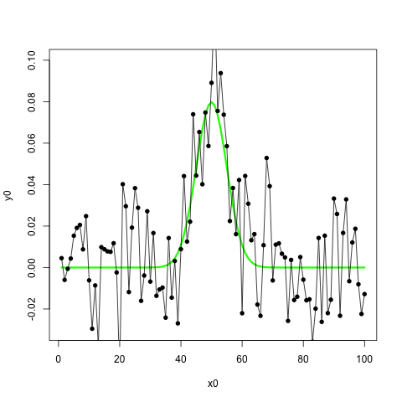
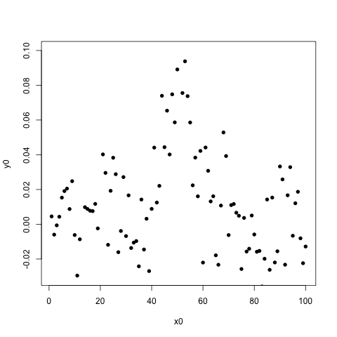
The denoising problem…for an example time series
A signal (green) with noise…..
sig=5
x0=1:100; y0=1/(sig*sqrt(2*pi))*exp(-(x0-50)^2/(2*sig^2))
plot(x0,y0,type="l",col="green",lwd=3,ylim=c(-.02,.1))
#add noise to y0
x=x0; y=y0+rnorm(100)/50
points(x,y,pch=16,type="o”)
Notes:
visualization

Slide 10
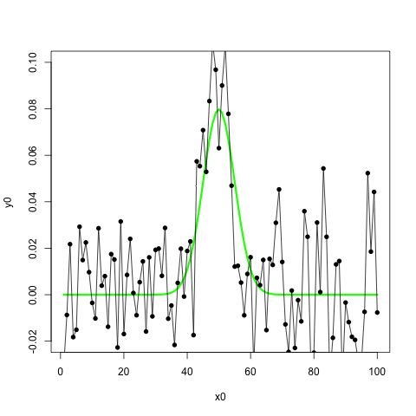
sig=5
x0=1:100; y0=1/(sig*sqrt(2*pi))*exp(-(x0-50)^2/(2*sig^2))
plot(x0,y0,type="l",col="green",lwd=3,ylim=c(-.02,.1))
#add noise to y0
x=x0; y=y0+rnorm(100)/50
points(x,y,pch=16,type="o”)

Slide 11
filter(x, filter, method = c("convolution", "recursive"), sides = 2, circular = FALSE, init)
Arguments: x: a univariate or multivariate time series.
filter: a vector of filter coefficients in reverse time order (as for AR or MA coefficients).
method: Either ‘"convolution"’ or ‘"recursive"’ (and can be abbreviated).
If ‘"convolution"’ a moving average is used: if ‘"recursive"’ an autoregression is used.
sides: for convolution filters only. If ‘sides = 1’ the filter coefficients are for past values only; if ‘sides = 2’ they are centred around lag 0. In this case the length of the filter should be odd, but if it is even, more of the filter is forward in time than backward.
circular: for convolution filters only. If ‘TRUE’, wrap the filter around the ends of the series, otherwise assume external values are missing (‘NA’).
init: for recursive filters only. Specifies the initial values of the time series just prior to the start value, in reverse time order. The default is a set of zeros.
Details: Missing values are allowed in ‘x’ but not in ‘filter’ (where they would lead to missing values everywhere in the output).
Note that there is an implied coefficient 1 at lag 0 in the recursive filter, which gives y[i] = x[i] + f[1]*y[i-1] + ... + f[p]*y[i-p] No check is made to see if recursive filter is invertible: the output may diverge if it is not.
The convolution filter is y[i] = f[1]*x[i+o] + ... + f[p]*x[i+o-(p-1)] where ‘o’ is the offset:
see ‘sides’ for how it is determined.
Value: A time series object.

Slide 12
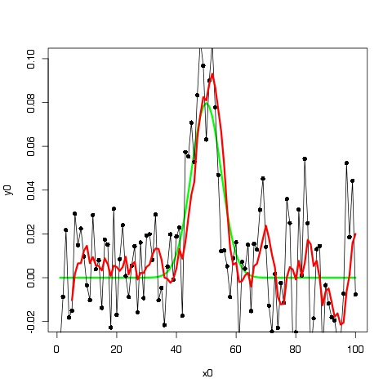
--- 5 pt moving average
(“1-sided”)

Slide 13
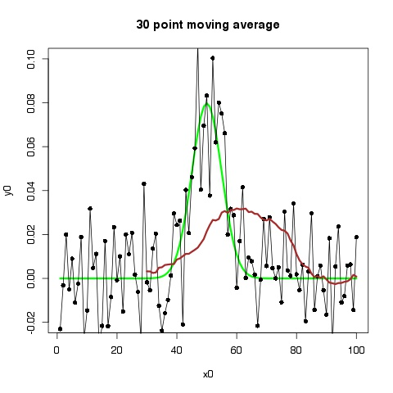
--- 30 pt moving average
Notes:
Phase shift and flattening.

Slide 14
Signal filtering is equivalent to fitting a model to the data.
Some signal filtering concepts:
● peak flattening, ● phase shift, ● tapering (at the ends),
● introduction of autocorrelation, ● red shifted noise
Types of data filtering:
Moving averages
Weighted moving averages (e.g. Savitsky-Golay)
Locally-weighted least squares (loess, lowess)
Splines, especially penalized splines
Wavelet filtering / wavelet transform
Fourier transform / digital filter

Slide 15
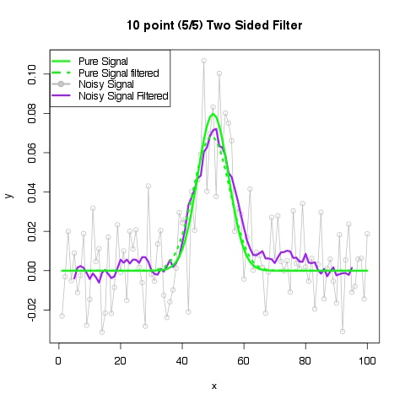
Using 11 points (centered interval always odd number)
“What is” “feed-forward”?
What happens if you want cov(A,B), and A filtered because it is noisy???
Notes:
particular example, feed forward is not too severe, but it can be; importance of signal-filtered; what happens if you want cov(A,B), and A is noisy???
The consequences of an autoreggressive filter : broadening, flattening, phase shift, variance increase (← not for moving average)

Slide 16
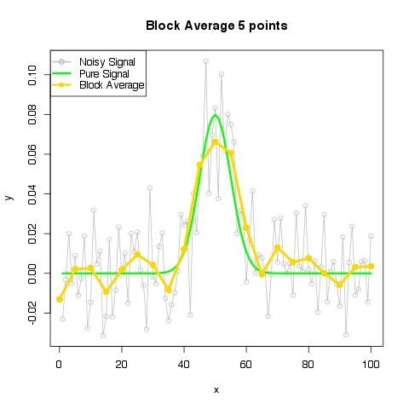

Slide 17
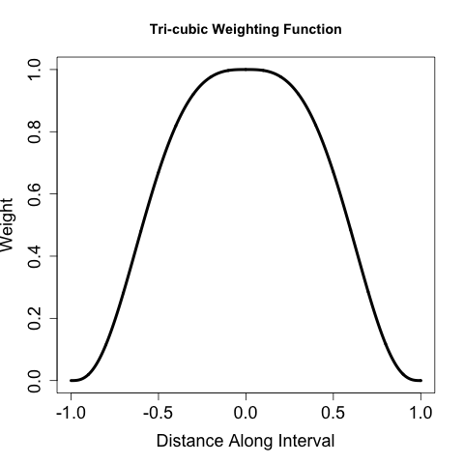
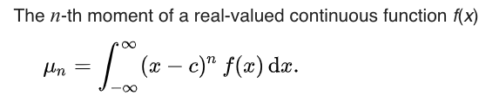
More advanced filters (curve fitting in window or similar).
Locally-weighted least-squares
(“lowess”, “loess”):
fit a polynomial (usually a straight line or
quadratic) to points in a sliding window,
accepting as the smoothed value the
central point on the line, with a taper
to capture the ends.
Points are usually weighted inversely as a
function of distance, very often tri-cubic:
(1 - |x|³)³ <in range -1,1 of the window>
supsmu is a running-line-smoother like loess,
much older code, no tri-cubic weighting
Savitsky-Golay filter: Fits a polynomial of order n in a moving window, requiring that the fitted curve at each point have the same moments as the original data to order n-1. Partakes of lowess and penalized spline features. (Designed for integrating chromatographic peaks.) Nomencature: 4.11.11.0 ( n.nl.nr.o). Allows direct computation of the derivatives. Parameters are tabulated on the web or computed.
(window; taper)
(convolution)
Notes:
We want folks to remember this! Soon for windows – Gaussian wavelet, SG, FDG

Slide 18
Savitzky – Golay filter coefficients 4.11.11.0, 4.11.11.1
Since the filter is differentiable, you can obtain the filtered derivatives or the integral of the data directly – a potentially huge advantage for some applications
Easily available on the web, in R packages “signal” and “prospectr”, and course website:
https://canvas.harvard.edu/courses/60450/files/8646067/download?wrap=1 (
https://canvas.harvard.edu/courses/60450/files/8646469/download?wrap=1 (text)
Note: reverse the 1st derivative coefficients to convolve using the R filter( ) function
Notes:
f(x) = xo + df/dx (x – xo) : S-G conserves the integral of df/dx

Slide 19
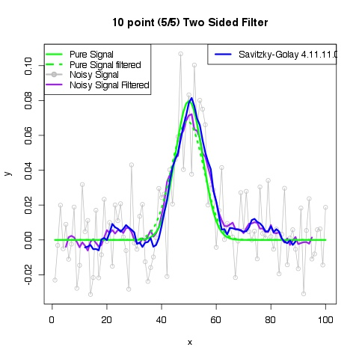

Slide 20
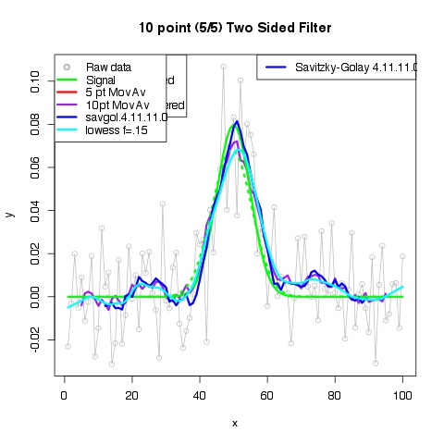
Notes:
note choices

Slide 21
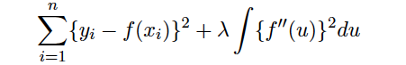
More advanced filters. these are examples of non-parametric curve fits (cf. regressions)
Splines: Splines use a collection of basis functions (usually polynomials of order 3 or 4) to represent a functional form for the time series to be filtered. They are fitted piecewise, so that they are locally determined. We choose K points in the interior of the domain (“knots”) and subdivide into K+1 intervals.
spline of order m: piecewise m – 1 degree polynomial, continuous thru m – 2 derivatives.
Continuous derivatives gives a smooth function. More complex shapes emerge as we increase the degree of the spline and/or add knots.
Few knots/low degree: Functions may be too restrictive (biased) or smooth
Many knots/high degree: Risk of overfitting, false maxima, etc
Penalized Splines add a penalty for
curvature, specifying the strength λ.
(=0, regular spline/interpolation;
= ∞, straight line, linear regression fit)
compare to Savitzky-Golay, which conserves moments vs derivatives

Slide 22
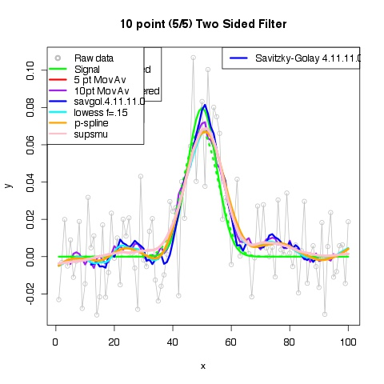

Slide 23
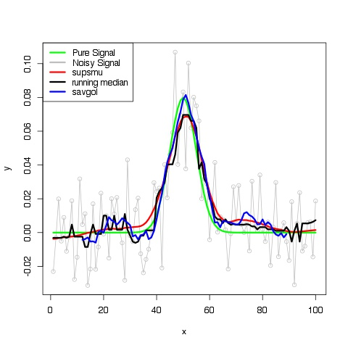
Notes:
rough! noise is reduced….

Slide 24
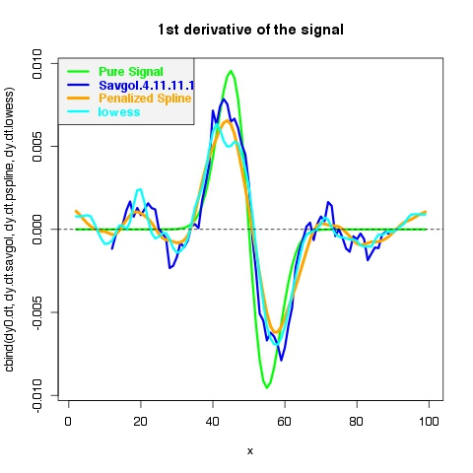
Notes:
others not worth trying….You expect attenuation, within that envelop, this is OK – penalized spline wins for smoothness/phase and savgol for amplitude

Slide 25
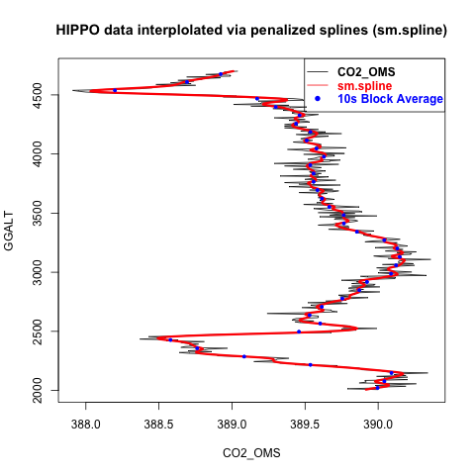
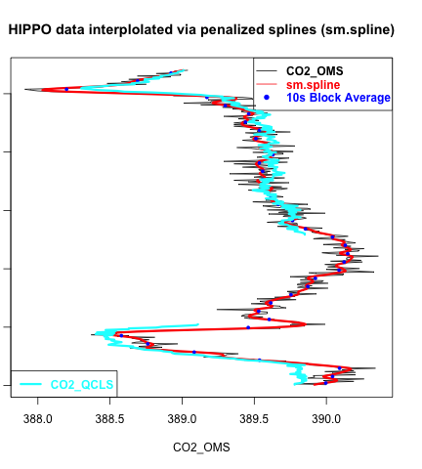

Slide 26
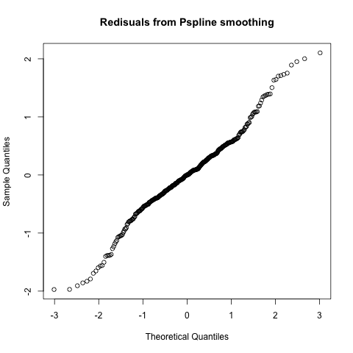

Slide 27
sig noisy_sig 10-point MA savgol.4.11.11.0 lowess pspline supsmu
0.010 0.012 NA NA 0.0117 0.012 0.0124
0.010 0.012 0.0132 0.0155 0.0117 0.012 0.0124

Slide 28
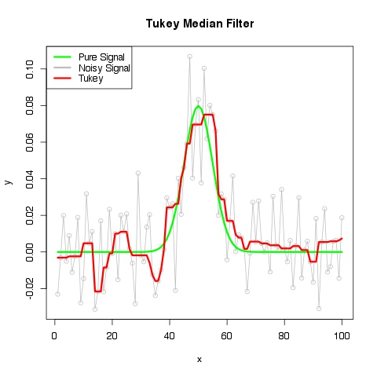

Slide 29
Wavelet filter
haar_coeffs=function(d){return(rep(1,2*d+1)/(2*d+1))}
fdh1_coeffs=function(d){return(rev( (-1)*c(rep(-1,d),0,rep(1,d)) )/(2*d+1))}
g1_coeffs=function(d=6,n.extent){
##d is dilation
##returns coeffecients of discrete Gauss filter, two-sided, n.extent = max # points on one side
x=( (-n.extent):n.extent)
y = exp(-1*x*x/(2*d))/sqrt(d)
return(y/sum(y))
}
fdg1_coeffs=function(d=6,n.extent){
##d is dilation
##returns coeffecients of continuous Gauss 1st deriv transform, two-sided, n.extent = max # points on one side
x=( (-n.extent):n.extent)
y = -x*exp(-1*x*x/(2*d))/d
NN=sum(exp(-1*x*x/(2*d)) )
return(y/NN)
}
## d = “dilation” of the wavelet filter ←→ inverse of the scale parameter in the wavelet transform
Notes:
Discuss the wavelet basis set concept briefly. Here we use the functional forms in a filtering framework.

Slide 30
#fdg_func is the 1st derivitive guassian wavelet function of a
# given abscissa x and dilation d.
fdg_func <- function(x,d){
y <- x*exp(-1*x*x/(2*d))/sqrt(d)
return(y)
}
wv.filt=function(x,d.coeffs){
#applies wavelet filter (0 or 1st derivative) to a vector x
#pad x by half the length of the filter coeffs or its full length (both sides)
n.pad=max(c(length(x),length(d.coeffs)/2+1))
X=c(rep(0,n.pad),x,rep(0,n.pad))
X.f=filter(X,filter= ( d.coeffs ),method="c",sides=2,circular=F)
res=X.f[(n.pad+1):(n.pad+length(x))]
return(res)
}

Slide 31
Examples of discrete Gaussian wavelets

Slide 32
First derivative Gaussian wavelet filter coefficients
8
Notes:
Compare to Savitzsky-Golay

Slide 33
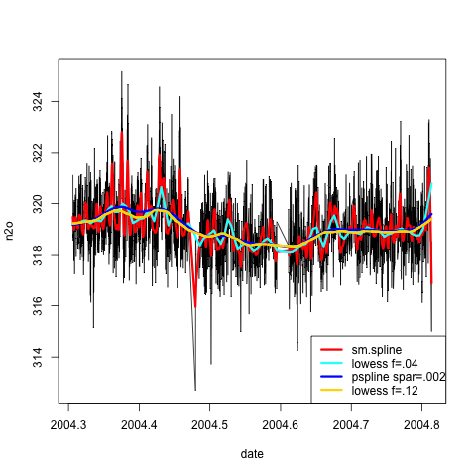
Noisy data: which filter is the “best” (for what purpose?)?
Residuals? Events ?

Slide 34
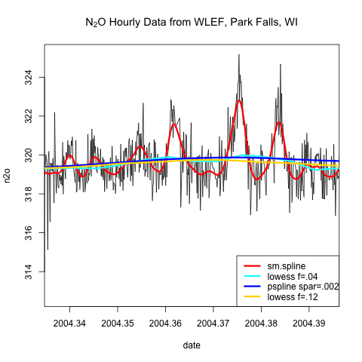

Slide 35
If spar is given:
Leave-one-out cross-validation
In the default mode, the sm.spline model is selected using “leave-one-out cross-validation”.
See article by Rob Hyndman (http://robjhyndman.com/hyndsight/crossvalidation/) for a description.
Notes:
Kalman filter

Slide 36
https://www.cs.cmu.edu/~schneide/tut5/node42.html

Slide 37
Cross-validation is primarily a way of measuring the predictive performance of a statistical model. Every statistician knows that the model fit statistics are not a good guide to how well a model will predict: high R² does not necessarily mean a good model. It is easy to over-fit the data by including too many degrees of freedom and so inflate R² and other fit statistics.
One way to measure the predictive ability of a model is to test it on a set of data not used in estimation. Data miners call this a “test set” and the data used for estimation is the “training set”. For example, the predictive accuracy of a model can be measured by the mean squared error on the test set. This will generally be larger than the MSE on the training set because the test data were not used for estimation.
Hyndman

Slide 38
Leave-one-out cross-​​validation (LOOCV)
measures accuracy as follows. Suppose there are n independent observations, y₁,…,y_{n}.
Let observation i form the i^{th} test set, and fit the model using the remaining data.
Then compute the error : e∗_{i}= y_{i} − y_{i}ˆfor the omitted observation, sometimes called a “predicted residual”. Repeat step 1 for i=1,…,ni=1,…,n.
Compute the MSE from e∗₁,…,e∗_{n} . This quantity the CV.
The best model (smoother) is the one with the minimum CV.
Minimizing CV is equivalent to minimizing the AIC.
For linear models, the LOOCV can be computed directly from the model matrix, and minimizing CV can be done in the course of model selection.

Slide 39
“Leave-one-out” CV
Source: http://robjhyndman.com/hyndsight/crossvalidation/
Minimize CV for “best” model

Slide 40
N₂O data at LEF Tower, Wisconsin

Slide 41
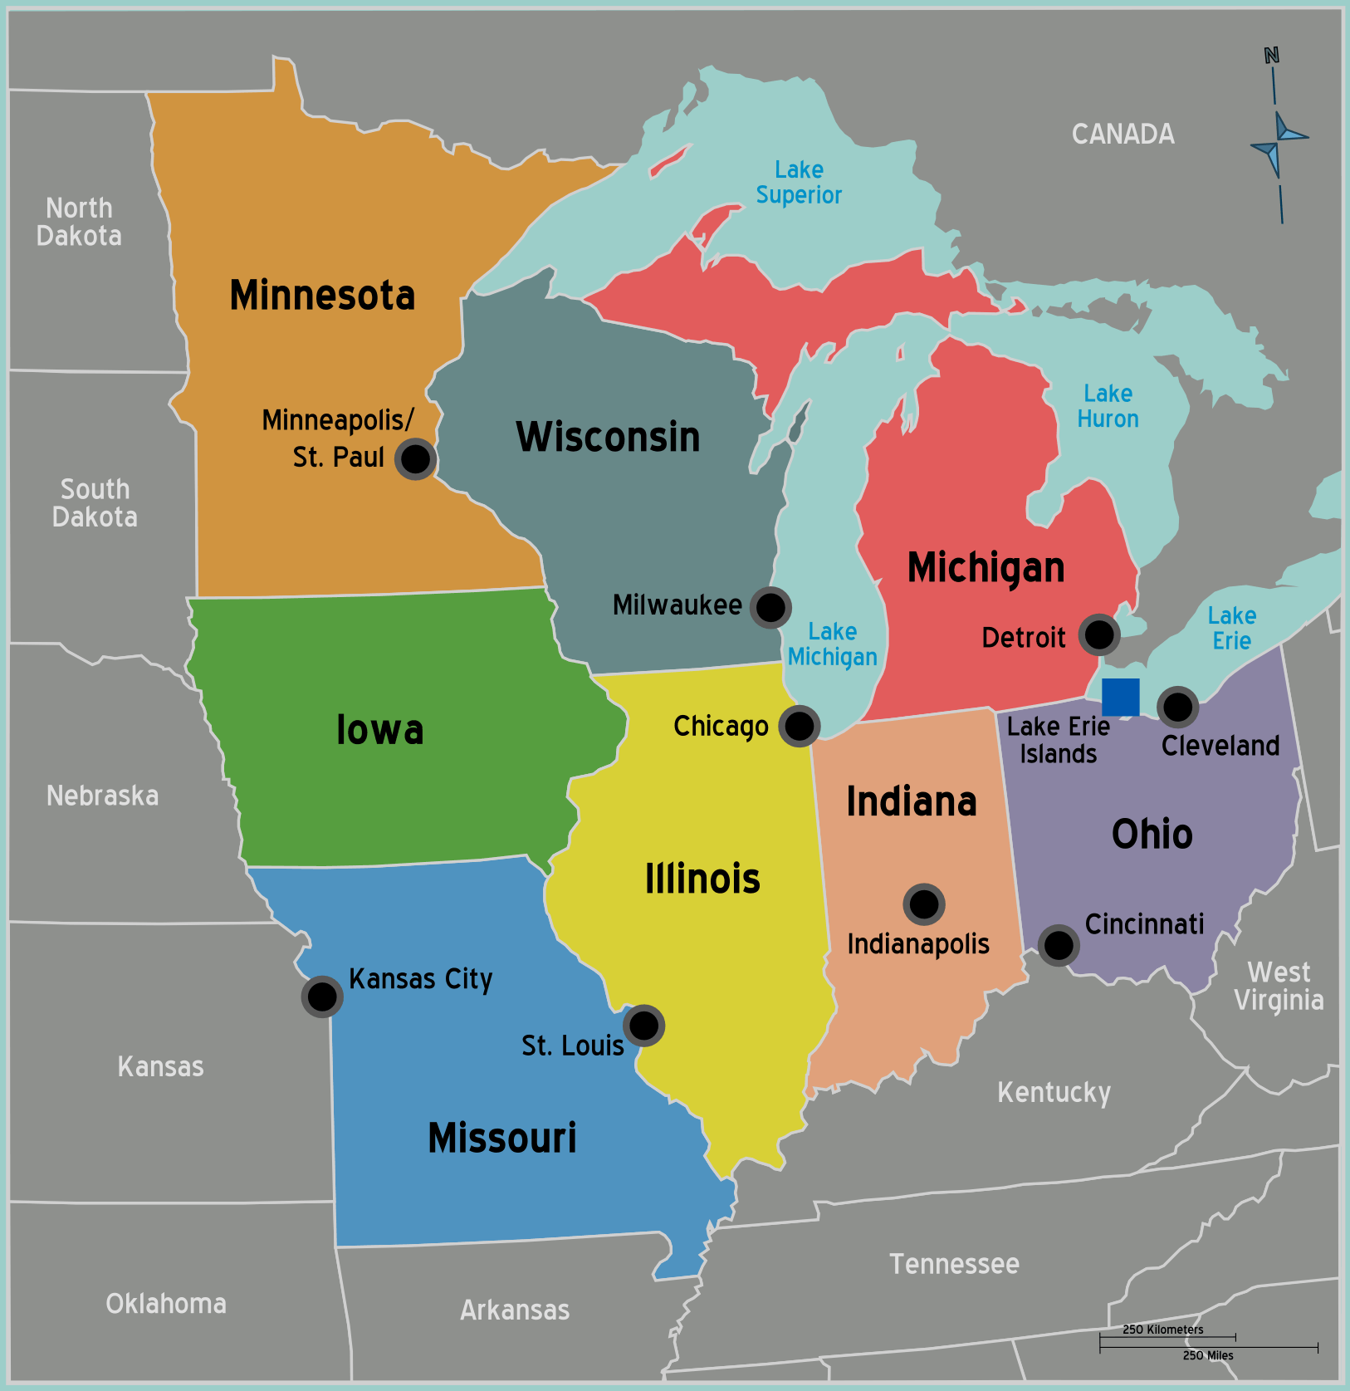
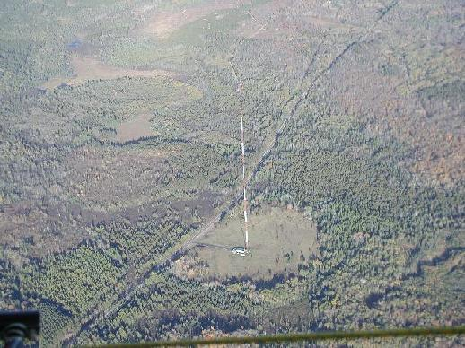
The LEF tower
LEF

Slide 42
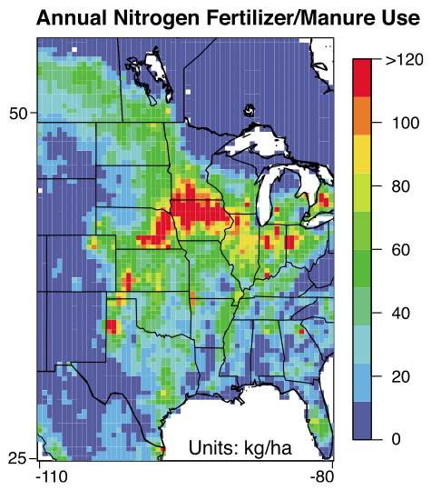
Nitrous oxide (N₂O)
- 3rd most important long-lived greenhouse gas
- Largest source from agriculture
Potter et al. 2010

Slide 43
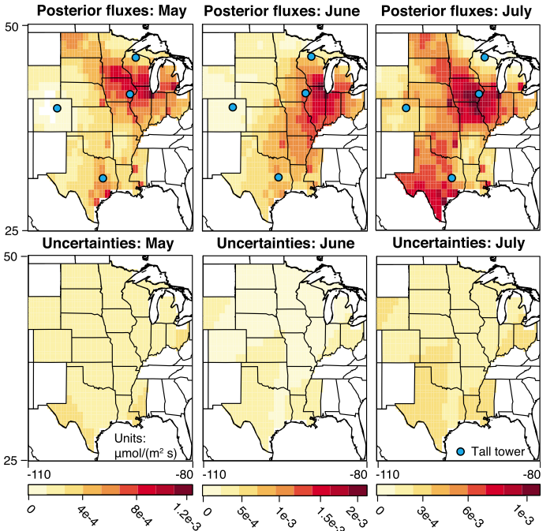
Nitrous oxide (N₂O)
μmol m⁻² s⁻¹
Miller et al. 2012

Slide 44
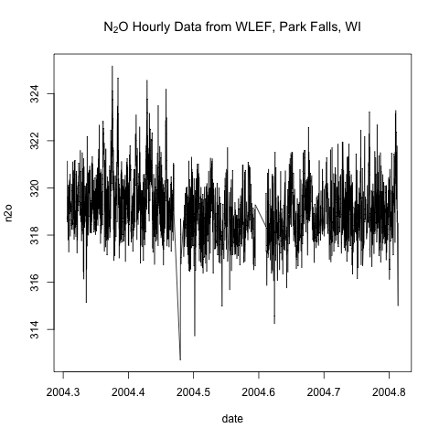
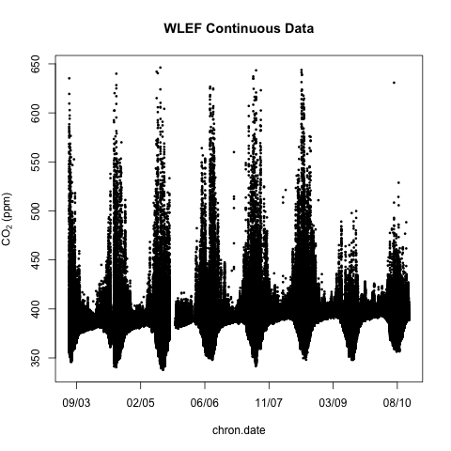
EPS 236 Workshop: 2019
Assessing different sources of variance:
Extracting Trends, Cycles, etc
by Data Filtering and Conditional Averaging.
CO₂
Measurement has low signal-to-noise ratio. Due to the long lifetime, the variations are small even near the source.
Measurement has high signal-to-noise ratio, but the system (e.g. the atmosphere) has a lot of variability.

Slide 45
Useful R functions/packages
Packages: stats, signal
Note: these packages have conflicting functions with the same name
Block averages: tapply
Moving average: filter (stats library)
Loess: loess (stats library)
smooth.Pspline (sm.spline) (pspline library)
Savitzky Golay: sgolayfilt (signal package) or
savitzkyGolay (prospectr package) (newer)
The class hands-on workshop is given in this file:
wlef_n2o_class_exercise.r
with file hirsch_2004_n2o_396m_061907.txt

Slide 46
Topic 9b. Special Application: Seasonal amplitude for CO₂ at Mauna Loa, and the celebrated increase in seasonal amplitude over time
Monthly Mean CO₂ data from Mauna Loa (downslope filtered)

Slide 47
What is the problem?
Consider a linear trend, upon which is superimposed
a sinusoidal seasonal cycle.
If we know (or assume we can specify) the parametric forms of the seasonal cycle and the trend,
We can readily decomposed the seasonal cycle and trend.

Slide 48
Weekly Mean CO₂ data from Mauna Loa (downslope filtered)
What is the problem?
We don’t know) the parametric forms of the seasonal cycle and trend, it is apparent that the seasonal cycle is not particularly sinusoidal, has noise, and has short-and long term variability. The time scales for variations in the seasonal cycle and trend are not distinct from changes
In the trend line.

Slide 49
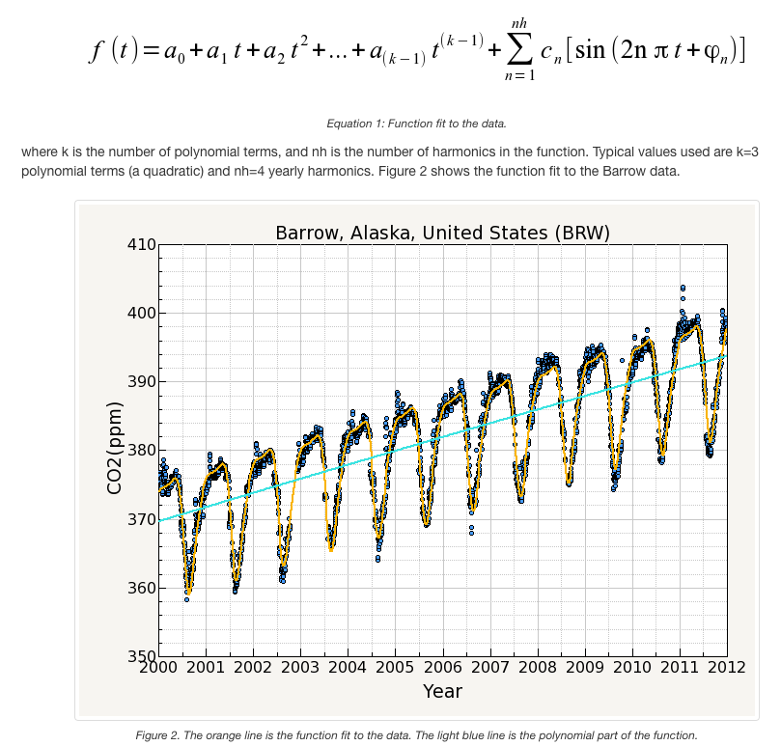
The “classic” NOAA approach:
Fit a parametric function, smooth the residuals with a FFT low-pass filter, impose simple taper, ….
Results shown
← here.
https://www.esrl.noaa.gov/gmd/ccgg/mbl/crvfit/crvfit.html

Slide 50
A linear trend, and a polyharmonic seasonal cycle,
do not readily conform to simple ideas about distinct time scales.
Y1
Y0, Y1
Y0
Y0 + Y1

Slide 51
The stl function provides an excellent way to address this problem, based on loess
stl (x, s.window, s.degree = 0, t.window = NULL, t.degree = 1, l.window = nextodd(period), l.degree = t.degree, s.jump = ceiling(s.window/10),
t.jump = ceiling(t.window/10), l.jump = ceiling(l.window/10), robust = FALSE,
inner = if(robust) 1 else 2, outer = if(robust) 15 else 0, na.action = na.fail)
x: univariate time series to be decomposed.
#
s.window: either the character string ‘"periodic"’ or the span (in lags) of the loess window for seasonal extraction, which should be odd and at least 7, according to Cleveland et al. This has no default.
#
s.degree: degree of locally-fitted polynomial in seasonal extraction. Should be zero or one.
#
t.window: the span (in lags) of the loess window for trend extraction, which should be odd. If ‘NULL’, the default is ‘nextodd(ceiling((1.5*period) / (1-(1.5/s.window))))’, #
#t.degree: degree of locally-fitted polynomial in trend extraction. Should be zero or one.
#
l.window: the span (in lags) of the loess window of the low-pass filter used for each subseries. Defaults to the smallest odd integer greater than or equal to ‘frequency(x)’ which is recommended since it prevents competition between the trend and seasonal components. If not an odd integer its given value is increased to the next odd one.
#
l.degree: degree of locally-fitted polynomial for the subseries low-pass filter. Must be 0 or
Notes:
Need to actually find and represent the Thoning approach.

Slide 52
STL:
Make a set of subseries of all of the points for a given phase(month) within the “seasonal cycle”, e.g. all of the January points, all for Feb, etc (121 subseries for monthly data).
Run loess for each of these series, with span window l.window (in lags, i.e. Δt). Average them together to get a first approximation to the smooth trend. Run loess on that approximation with span in lags t.window.
Subtract the smoothed trend from the mean of the subseries, and smooth the resulting trend residuals with loess using window s.window to get the smoothed residuals.
Subtract the (smooth trend + smoothed residuals ) from each of the subseries. Repeat with this “flattened” data, iteratively.
“robust” loess can be chosen in R to reduce sensitivity to outliers (more iterations)(Cleveland, 1979)

Slide 53
Plot of CO₂ stl decomposition for MLO
-4 0 +2
Remainder Trend Seasonal Data
320 360 400 320 360 400
-1 0 +1
| | | | | | |
1960 1970 1980 1990 2000 2010 2020
Year

Slide 54
Plot of CO₂ stl decomposition for Seasonal Component: MLO
CO₂ seasonal amplitude at MLO (ppm)
ppm

Slide 55
ar(co2.mlo.stl[[1]][,"remainder"],
order.max=6)
Coefficients:
1 2 3 4 5 6
0.19 -0.03 -0.12 -0.08 -0.08 -0.06
Check for serial correlation…in the data after removing seasonal.

Slide 56
Make a set of subseries of all of the points for a given phase within the “seasonal cycle”, e.g. all of the January points, all for Feb, etc (121 subseries for monthly data).
Run loess for each of these series, with span window l.window.
Average them together to get a first approximation to the trend. Run loess on that with span in lags t.window
Subtract the smoothed trend from the mean of the subseries, and smooth the resulting trend residuals with loess using window s.window.
Subtract the (smooth trend + smoothed residuals ) from each of the subseries. Repeat with this “flattened” data, iteratively.

Slide 57
Weekly data with penalized spline: sm.spline( ) .

Slide 58
Check for serial correlation:
The prior application of pspline injects bogus correlation

Slide 59
Instead, use the pspline filter to interpolate the missing points only.

Slide 60
CO₂ at MLO, analysis using STL:
Seasonal amplitude Trend
Monthly filled
5 5.5 6.0 6.5 7.0 7.5 8.0
Weekly filtered
320 340 360 380 400
Weekly filled
1960 1970 1980 1990 2000 2010 2020 1960 1970 1980 1990 2000 2010 2020
Stiff, unstable; errors should be bootstrapped
general trend is confirmed however. Trend: Well defined

Slide 61
10. Interpolation of 1-D and 2-D data
1-D “objective” data – curves to conserve all observed points:
Typical novice application – interpolate keeping points that you have
approx( ) linear interpolation
aspline( ) package akima (“like a hand-drawn curve”)
1-D noisy data: loess or pspline objects interpolated with predict()
find argument specifications via help(predict.loess) or
See slides 25 and 36 for examples
=================================================================================================
2-D “objective” data – curves to conserve all observed points:
akima → interp (predict within triangles) – irregular grid
bilinear – conserves ranges, mass ⬅ scale x,y
spline (smooth, highly unreliable) – scale x,y
Kriging → fit a variogram model
2-D noisy (image) data: Covered in Topics 10 and 11
loess, pspline directional image processing
Many others: Topic 11, Image Processing

Slide 62
One-dimensional and two-dimensional interpolation (regular grid)
https://en.m.wikipedia.org/wiki/Bicubic_interpolation

Slide 63
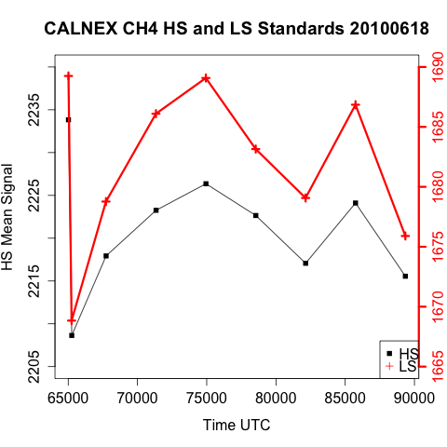
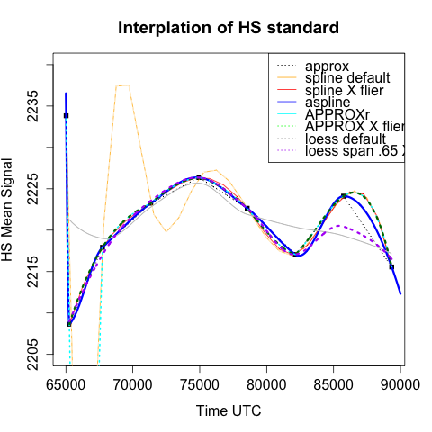
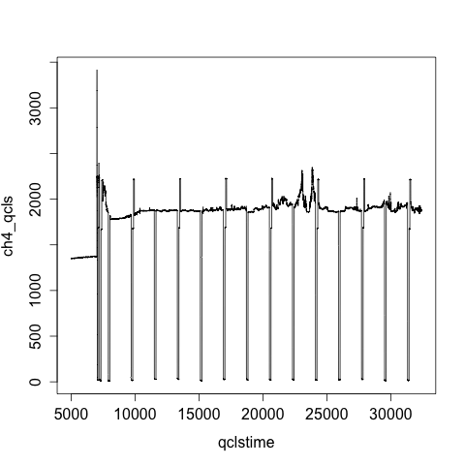
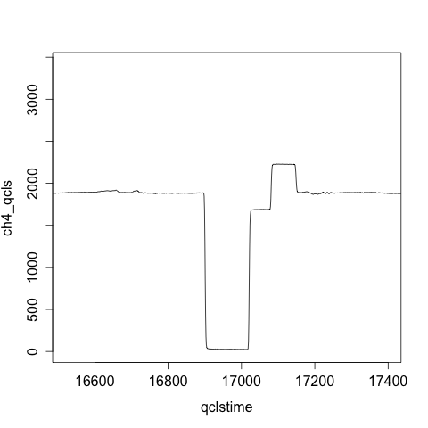

Slide 64
## Prepare a noisy signal for interpolation
x=seq(0,2*pi,2*pi/1000)
y0=sin(x)
y=y0+rnorm(1001)/2
# take out a chunk that we will interpolate
l11=x>=1.5&x<=2.5
y1=y; y1[l11]=NA
#plot the data
plot(x,y1)
# line for noise-free, gap=free data / truth
lines(x,y0,col="red")
# use sm.spline to interpolate
library(pspline)
lna=is.finite(y1)
X=x[lna]
Y=y1[lna]
XY=sm.spline(X,Y)
# look at predict with this model object
#-#help(predict.smooth.Pspline)
## note the help page is different than call
Yp=predict(XY,xarg=x)
# plot the interpolation with de-noising
lines(x,Yp,lwd=4)
## same with loess smoother/interpolator
XYL=loess( Y ~ X,span=.15)
#help(predict.loess) check the help page
#predict(object, newdata = NULL, se = FALSE,
na.action = na.pass, ...)
YLp=predict(XYL,newdata=x)
#plot the loess smoother; it is an overfit
lines(x,YLp,lwd=3,col="darkgrey")
# increase the span
XYL.3=loess( Y ~ X,span=.3)
YLp.3=predict(XYL.3,newdata=x)
# looks quite nice
lines(x,YLp.3,lwd=3,col="gold")
legend("bottomleft",legend=c(
"Data","Noise-Free Data","sm.spline, LOOCV",
"loess span=.15", "loess span=.30"),
pch=c(1,rep(-1,5)),lty=c(-1,rep(1,5)),
col=c("black","red","black","darkgrey","gold"),
lwd=c(2,rep(3,5)))
# First derivative from model matrix (pspline)
YP.1=predict(XY,xarg=x,nderiv=1)
plot(x,YP.1,type="l",lwd=3,ylim=c(-1,1))
lines(x,cos(x),col="red")

Slide 66
Recovering the (interpolated) 1st derivative (pspline)
cos(x)
predict(XY,xarg=x,nderiv=1)

Slide 67
cos(x)
predict(XY,xarg=x,nderiv=1)
diff(loess…)

Slide 68
Interpolation of 1-D and 2-D data
1-D data: predict() with loess or pspline objects
predict() : find argument specifications via help(predict.loess) or help(predict.pspline)
See slides 25 and 36 for examples
2-D data: akima → interp (predict with triangles) – irregular grid
Kriging → fit a variogram model

Slide 69
ATom cross section plot for CO
Atlantic

Slide 70

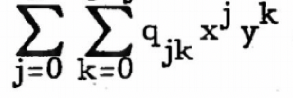
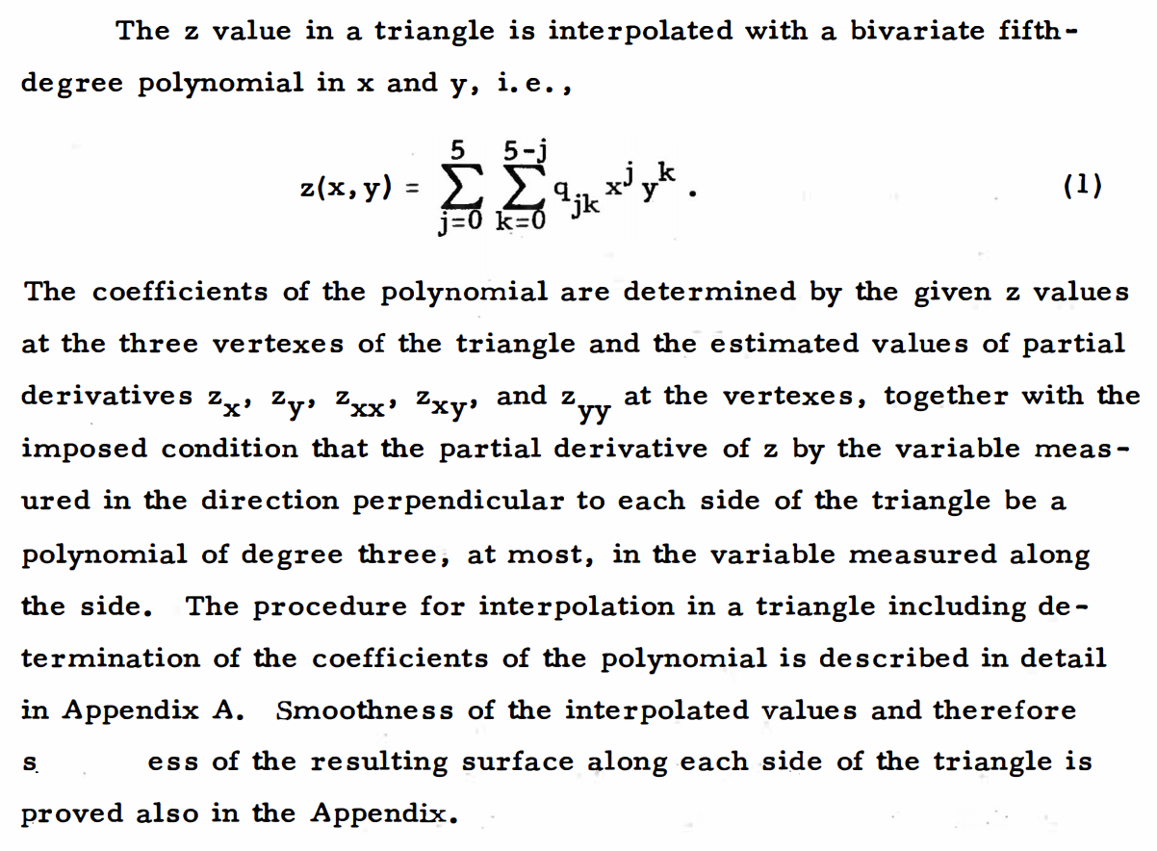
1 1
H. Akima, 1978
bilinear
fifth
smoothness

Slide 71
interp package:akima R Documentation
Gridded Bivariate Interpolation for Irregular Data
Description:
These functions implement bivariate interpolation onto a grid for
irregularly spaced input data. Bilinear or bicubic (1 - |x|³)² spline
interpolation is applied using different versions of algorithms
from Akima.
If linear is TRUE (default), linear interpolation is used in the triangles bounded by data points.
Usage:
interp(x, y=NULL, z, xo=seq(min(x), max(x), length = nx),
yo=seq(min(y), max(y), length = ny),
linear = TRUE, extrap=FALSE, duplicate = "error", dupfun = NULL,
nx = 40, ny = 40, jitter = 10^-12, jitter.iter = 6, jitter.random = FALSE)

Slide 72
Arguments: (akima interp)
x: vector of x-coordinates of data points or a
‘SpatialPointsDataFrame’ object. Missing values are not
accepted.
y: vector of y-coordinates of data points. Missing values are
not accepted.
If left as NULL indicates that ‘x’ should be a
‘SpatialPointsDataFrame’ and ‘z’ names the variable of
interest in this dataframe.
z: vector of z-coordinates of data points or a character
variable naming the variable of interest in the
‘SpatialPointsDataFrame’ ‘x’.
Missing values are not accepted.
‘x’, ‘y’, and ‘z’ must be the same length (execpt if ‘x’ is a
‘SpatialPointsDataFrame’) and may contain no fewer than four
points. The points of ‘x’ and ‘y’ should not be collinear,
i.e, they should not fall on the same line (two vectors ‘x’
and ‘y’ such that ‘y = ax + b’ for some ‘a’, ‘b’ will not
produce menaningful results). Some heuristics is built in to
avoid this case by adding small jitter to ‘x’ and ‘y’ when
the number of ‘NA’ values in the result exceeds 10%.

Slide 73
xo: vector of x-coordinates of output grid. The default is 40
points evenly spaced over the range of ‘x’. If extrapolation
is not being used (‘extrap=FALSE’, the default), ‘xo’ should
have a range that is close to or inside of the range of ‘x’
for the results to be meaningful.
yo: vector of y-coordinates of output grid; analogous to ‘xo’,
see above.
linear: logical - indicating whether linear or spline interpolation should be used.
extrap: logical flag: should extrapolation be used outside of the
convex hull determined by the data points?
duplicate: character string indicating how to handle duplicate data points. Possible values are
‘"error"’ produces an error message,
‘"strip"’ remove duplicate z values,
‘"mean"’,‘"median"’,‘"user"’ calculate mean , median or user
defined function (‘dupfun’) of duplicate z values.
dupfun: a function, applied to duplicate points if ‘duplicate= "user"’.
jitter: Jitter of amount of ‘diff(range(XX))*jitter’ (XX=x or y) will be added to coordinates if collinear points are detected. Afterwards interpolation will be tried once again.
Note that the jitter is not generated randomly unless ‘jitter.random’ is set to ‘TRUE’. This ensures reproducible result.
‘tri.mesh’ of package ‘tripack’ uses the same jitter mechanism. That means you can plot the triangulation on top of the interpolation and see the same triangulation as used
for interpolation, see examples below.

Slide 74
ATom cross section data points for CO Atlantic

Slide 75
Interpolation may require rescaling (x, y) – here by the ratio of vertical (10 km / scale height) and horizontal variations (1000 km /synoptic)
library(akima)
lna=is.finite(co.xx)
co.i0=interp(gglat[lna], ggalt[lna],co.xx[lna], xo=seq(-55,70,.15), yo=seq(0,12500,100))
co.ii=interp(gglat[lna]*100, ggalt[lna],co.xx[lna], xo=seq(-55,70,.15)*100, yo=seq(0,12500,100))
co.ii
co.i0
Latitude x 100 Latitude

Slide 76
Akima’s interp ( ) does not introduce extrema even though it uses a 5th polynomial, because of the way he computes the 2nd derivatives.

Slide 78
Interpolation with Kriging
Example of one-dimensional data interpolation by kriging, with confidence intervals. Squares indicate the location of the data. The kriging interpolation, shown in red, runs along the means of the normally distributed confidence intervals shown in gray. The dashed curve shows a spline that is smooth, but departs significantly from the expected intermediate values given by those means.
https://en.wikipedia.org/wiki/Kriging

Slide 79
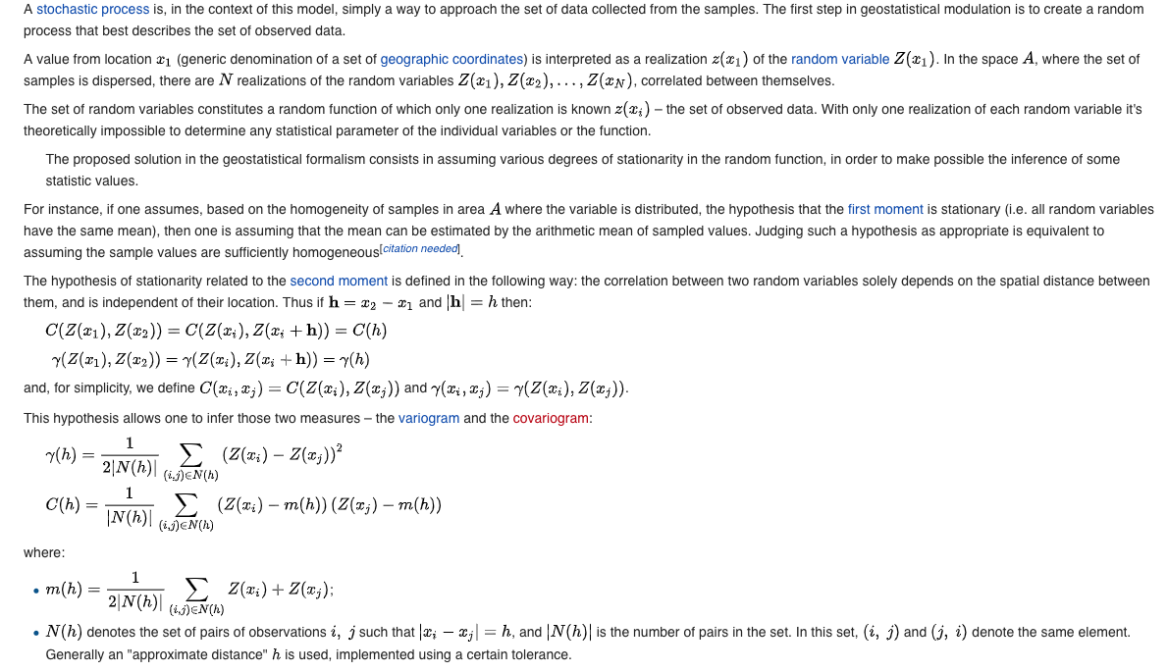
Kriging

Slide 80

#Summary:
#X Moving Average: crude, phase shift, peaks severely flattened, ends discarded <Don't use>
## Centered Moving Average: crude, peaks severely flattened, no phase shift*, feed forward >, ends discarded
## Block Averages: not too crude, not phase shifted*, no feed forward*, conserved properties*, information discarded (Maybe OK)
##Savitzky-Golay: not crude, not phase shifted*, small feed forward (localized), conserved properties, ends discarded; derivative
##locally weighted least squares (lowess/loess): not crude or phase shifted, nice taper at ends, no derivative
##supsmu: median filter, analytical properties murky, but a nice smoother for many signals; no derivative
##penalized splines: effective, differentiable; adjusting parameters tricky
##wavelet filters: can be very effective; first-derivative Gaussian excels.
#Xregular splines: either false maxima, or oversmoothed--<Don't use>
Notes:
Packages: pspline; sm; sreg (fields);

Slide 81
Summary 1-d filter and denoising methods
Notes:
Peak flattening
Edge diffusing
Rating: 1- 5 (5 best)
Centered: No phase shift; feed forward; clipped both ends;
Lagging (leading): Induced phase shift, no feed fwd, clipped one end
Convolution filters | Conserve mass (x median) | Edges clipped Regular point spacing req. | Rating
1. Simple moving average | Simple Often used | Weights: end = middle Not differentiable Regularly spaced points req. | 1-
2. Simple median | Simple Rejects outliers Conserves edges | Weights: end = middle Not differentiable; jumpy Not conserve mass | 0
3. Wavelet type: e.g. Gaussian, First Derivative Gaussi, Haar (equivalent to #1) | Easy Minimize peak flattening Center focus Direct derivative | Can adapt for irregular pts. Note: different from wavelet decomposition | 4
4. Savitsky-Golay special case of #3 | Minimize peak flattening Center focus Direct derivative Conserves def. moments Controlled, flexible | Regularly spaced points only | 4+
Binning | Conserve mass (x median) Not Clipped* | Not differentiable
5a. Block average | Simple, safe, stats defined Completely local, defined Irregular spaced points ok Good for quick/rough cut | Cell edge effects | 3+
5b. Block median | Simple, safe Completely local, defined Irregular spaced points ok Good for quick/rough cut Reject outliers | Not conserve mass Stats undefined | 3+
6. Wavelet Decomposition | Well defined Extends to 2-D | Regularly spaced points only Limited flexibility Wavelet choice→ model err | 3
Page 1 of 2

Slide 82
Fitting to functions | Full time span/not clipped Differentiable Irregularly spaced pts ok Provides interpolation | Does not conserve mass
7. Parametric | Widely used Functional form known* | Function choic → model error | 2
8. Normal Spline | Widely used Smooth | False peaks/valleys | 0
9. Penalized Spline | Smooth Elim. false peaks/valleys | "Spar" choice non-intuitive → model error | 4
Moving Window | Full time span via taper* Irregularly spaced pts ok Provides interpolation | Does not conserve mass Not differentiable
10. Loess (lowess) Similar to convolution but non-parametric | Simple to use Flexible Often effective |  | 4+
 | Special case
Seasonal Decomposition | Irregular points ok Multi-time scale Not clipped Provides interpolation | Feed forward
11a. Parametric (NOAA) | Often used Differentiable | Limited form → Model Error | 2+
11b. STL (loess) Penalized Splines could be used | Flexible, avoids model error | Window choices non-intuitive Irregular points require custom implementation | 4
ARIMA | Interpolation* ( predict() )
12. Correlated noise: ARIMA | Accounts directly for serially correlated noise | May be non-intuitive Custom implementation required for non-parametric | 3*
Page 2 of 2

Slide 83
Summary 1-d (objective and noisy data) and 2-d (objective) interpolation
1-d interpolation
Page 1 of 1

Slide 84
Notes:
Remaining: MLO decomp and arima; image processing including svd and filters; class and single projects

