Slide 1
BST272: Computing Environments for Biology
Curtis Huttenhower (chuttenh@hsph.harvard.edu)
Sagun Maharjan (smaharjan@hsph.harvard.edu)
Sharifa Sahai (sharifasahai@g.harvard.edu)
http://huttenhower.sph.harvard.edu/bst272

Slide 2
BST272: Computing Environments for Biology
Crash course in computing basics that are useful for biological (and other) data science.
From zero to basics in just a few weeks.
Assumes no nontrivial prior computing or programming background.
Mostly hands-on labs, as little lecture as possible.
Three main topics:
Command line environments, servers, grid, and cloud computing.
Python, Jupyter, and NumPy/SciPy/Pandas/Seaborn.
R, RStudio, and knitr.
Doesn’t do much biology – made to lead into BST281 (Genomic Data Manipulation) to cover that part.
Only recommended for anyone who can’t take BST273 instead.

Slide 3
Introductions
https://canvas.harvard.edu/courses/71191/quizzes/162984

Slide 4
Course overview
Location
January 7, 9, 14, 16 TR 1:00-4:00 Kresge 201
Except we’re in Kresge LL6 on Jan. 14
Instructors
Curtis Huttenhower chuttenh@hsph.harvard.edu
Office hours: 9th 11:30-12:30, 14th 4:00-5:00, SPH1 413
TAs
Sagun Maharjan smaharjan@hsph.harvard.edu
Office hours: 13th and 21st 1:00-2:00, SPH1-2 atrium
Sharifa Sahai sharifasahai@g.harvard.edu

Slide 5
Course web site
http://huttenhower.sph.harvard.edu/bst272
Redirects to standard Canvas site.
If you aren’t on Canvas that’s fine – email us now / ASAP to register.
Contains the entire calendar of topics and activities throughout the course.
All assignments and grades will be posted and submitted here.
In addition to in-class "clicker" polls.
Four in-class labs (40% total, 10% each).
Two problem sets (50% total, 25% each).
Out on Tuesday, due by end-of-day Monday.
Participation (10%).

Slide 6
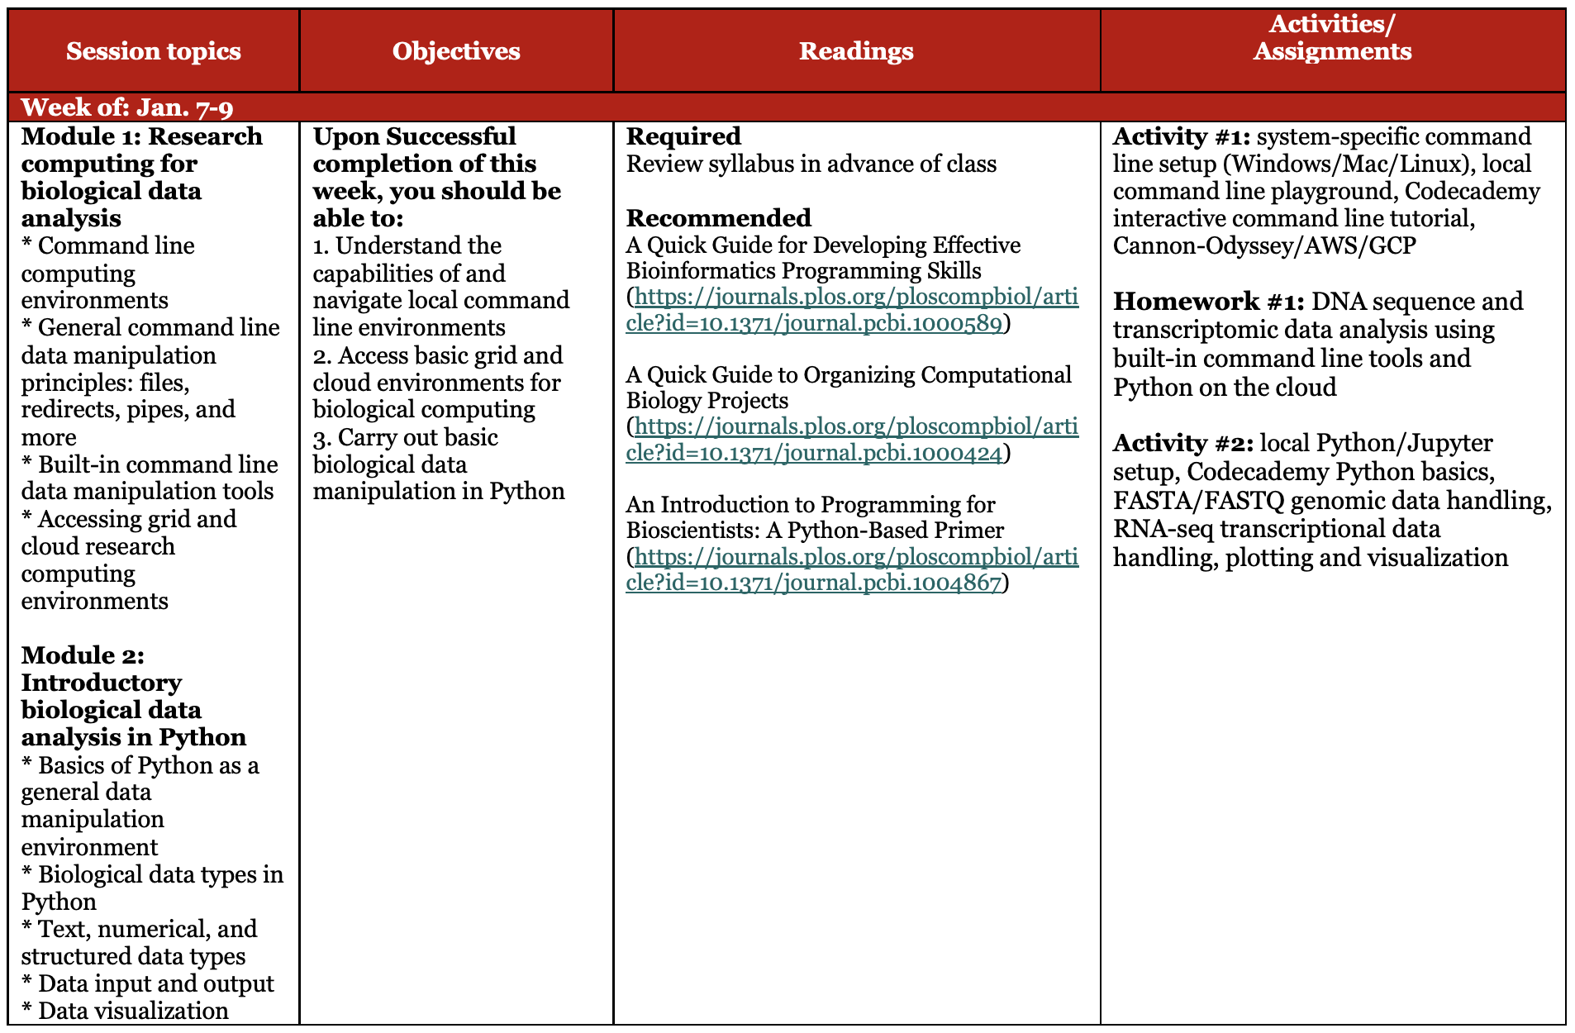
Course structure

Slide 7
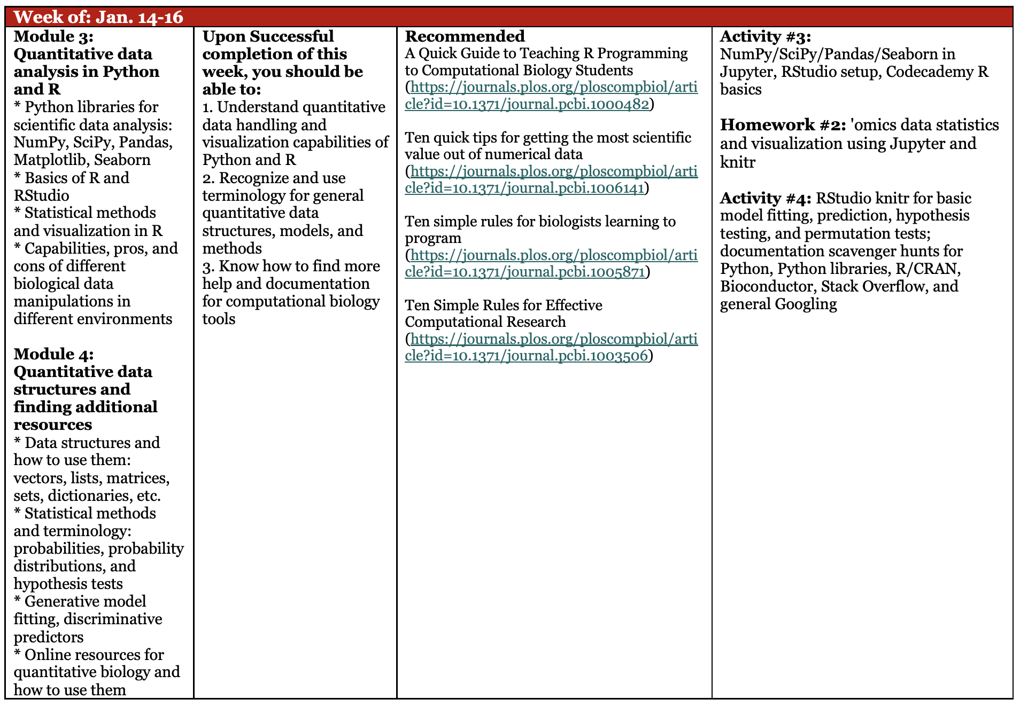
Course structure

Slide 8
Class structure
Each class is ~1/4-1/3 lecture, with the rest of the time spent on lab.
Lectures are meant to be interactive – a conversation, not a speech!
Please interrupt, ask questions, and feel free to direct discussion topics.
Particularly when they touch on your own areas of research.
Assignments and labs differ.
In-class polls are anonymous and ungraded.
Both labs and assignments have diverse individual submissions (text, code, data, etc.)
Please bring your laptops to class if at all possible.
If not, let one of us know after class.
Will be used for activities, polls.

Slide 9
Assignment and collaboration policies
Late submissions lose points geometrically:
10% the first day, 25% the second, 60% the third, 100% the fourth.
Extensions are generally fine if requested at least one day in advance.
Problem set structure and scoring is indicated within each assignment.
On problem sets, please use common sense for collaboration:
Neither specific code nor text for written answers may be shared.
Do not show them to each other, even within group members.
If you want to ask about specific code, send it privately to the instructional team.
All problem sets are submitted individually and checked for duplication.
However, we encourage discussion of questions about problem sets.
Particularly with instructional team and small groups during in-class labs.
Feel free to address questions, without sharing the specifics of individual answers.

Slide 10
Setting expectations
Most of this won’t make sense when you first see it.
Most of this won’t make sense after two weeks.
Like learning a foreign language – it takes immersion and time to sink in.
90/10: if you remember 10%, you can get 90% of your work done.
And you’ll learn how to find the rest.
The labs will be a little bit chaotic.
Most computing details don’t work the way you expect.
Most academic software doesn’t work the way it’s supposed to.
New programs never work on the first try.
It’s ok if you spend 30 minutes figuring out how to run a 30-second process.
Or figuring out how to install the program that runs it for you.
This is a new course – we’re all guinea pigs.
Talk lots, provide feedback, have fun!

Slide 12
Command line computing concepts and environments for biology
Curtis Huttenhower (chuttenh@hsph.harvard.edu)
Sagun Maharjan (smaharjan@hsph.harvard.edu)
Sharifa Sahai (sharifasahai@g.harvard.edu)
http://huttenhower.sph.harvard.edu/bst272

Slide 13
What does any of this have to do with biology?

Slide 14
Common biological data science tasks
What do you want to do with…
DNA sequences?
RNA sequences?
High-content imaging?
Single-cell sequencing?
Epigenetics?
Metabolomics?
...

Slide 15
Common biological data science tasks
Obtain data from an existing source / database / etc.
Reassign data identifiers (gene names etc.)
Find / count / sort data matching pattern X.
Visualize a relationship between data X and Y.
Test for a quantitative relationship between X and Y.
Transpose a 100 x 10M matrix.
Learn a classifier for outcome X using a combination of data Y and Z.
Automate boring task X.
Filter noise out of my experimental results.
Test for unwanted / technical / batch effects.
…

Slide 16
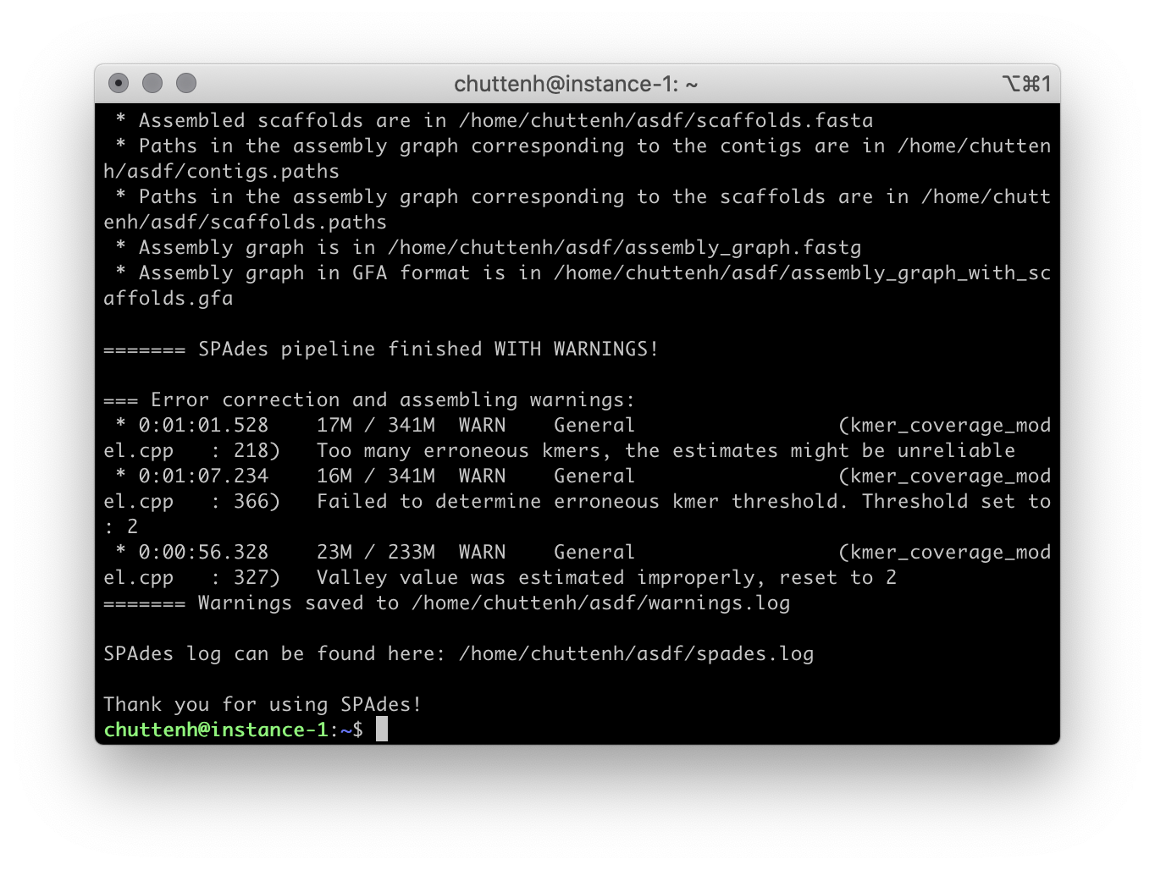
Resources in this course
Command line environments
Text-based interface for data, file, and program manipulation.
Can be used interactively or scripted.
Lots of pre-existing resources, documentation, and pre-written software.
~40-year history – extremely robust, efficient, and flexible for data manipulation.
Usually not great for complicated workflows / production software.
Python
Interpreted programming language used for scripting.
Good for data manipulation (particularly text / strings / files).
Can be used interactively (Jupyter) or automated (command line).
Reasonably fast if you’re careful – can handle big data with some grace.
Lots of pre-existing resources, documentation, and pre-written code.
Numerical computing (NumPy/SciPy/Pandas) and visualization (Jupyter/Seaborn).
Scales well from quick-and-dirty hacks to full-blown production software.
R
Interpreted programming language used for statistics.
Good for numerical analysis (particularly stats and modeling).
Can be used interactively (Jupyter) or automated (command line).
Requires caution for big data (but doable).
Lots of pre-existing resources, documentation, and pre-written code.
Can carry out extremely sophisticated quantitative tests and numerical models.

Slide 17
What’s a command line, and what does it have to do with my research?

Slide 18
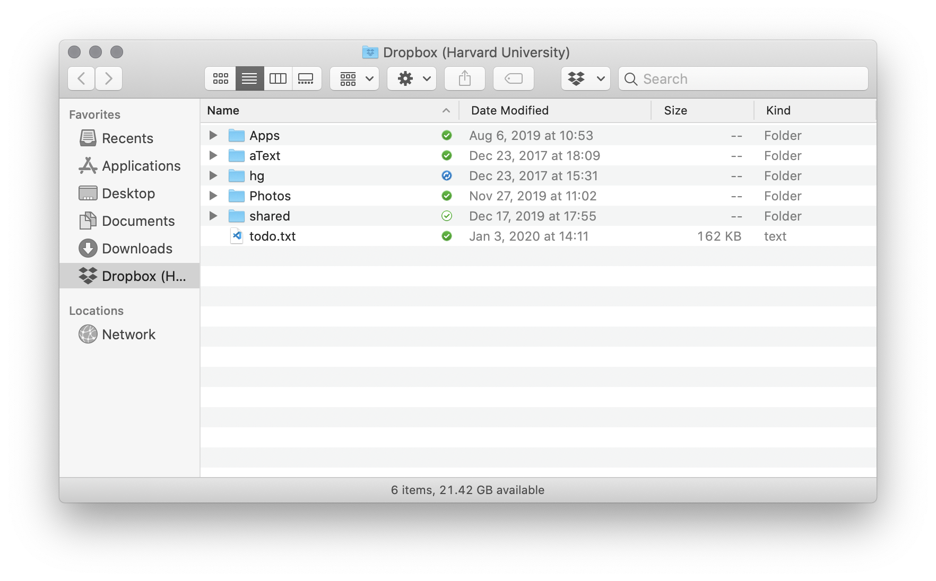
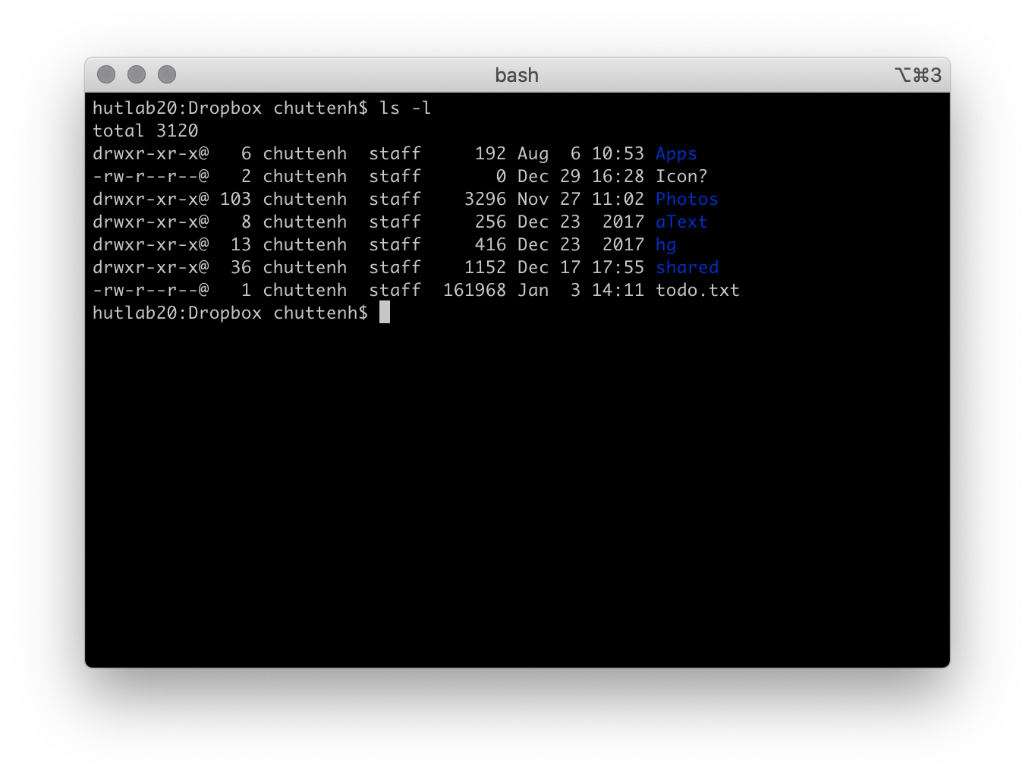

Slide 19
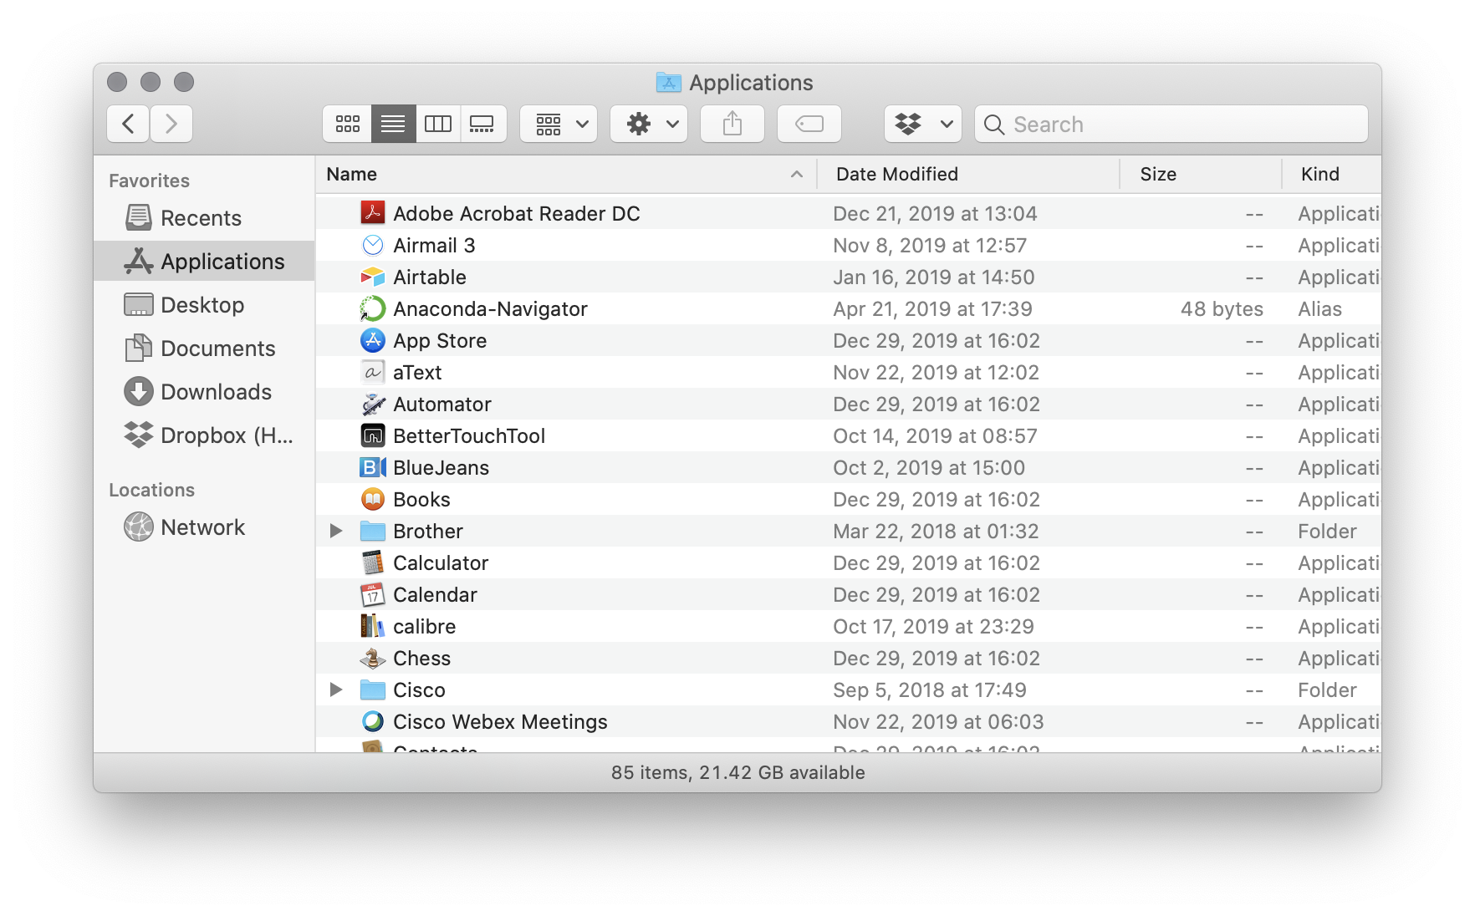
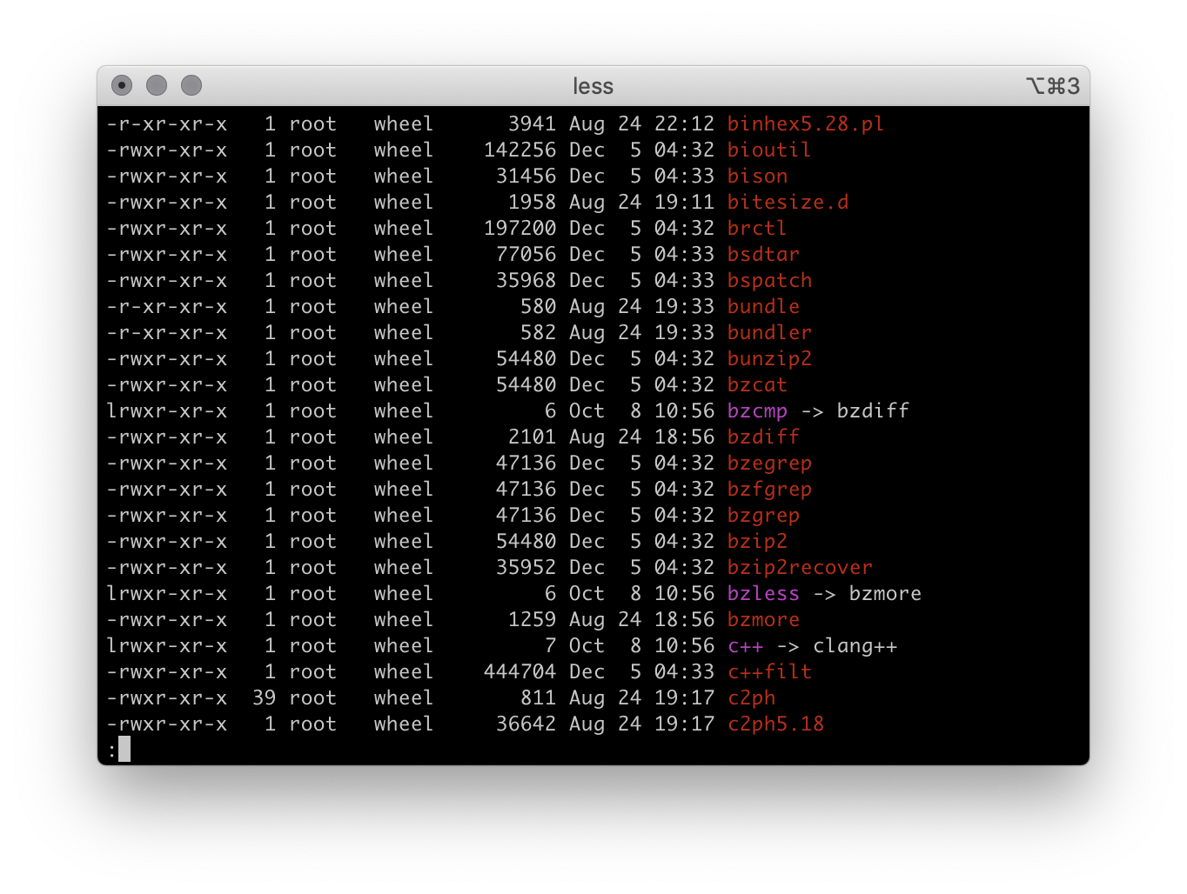

Slide 20
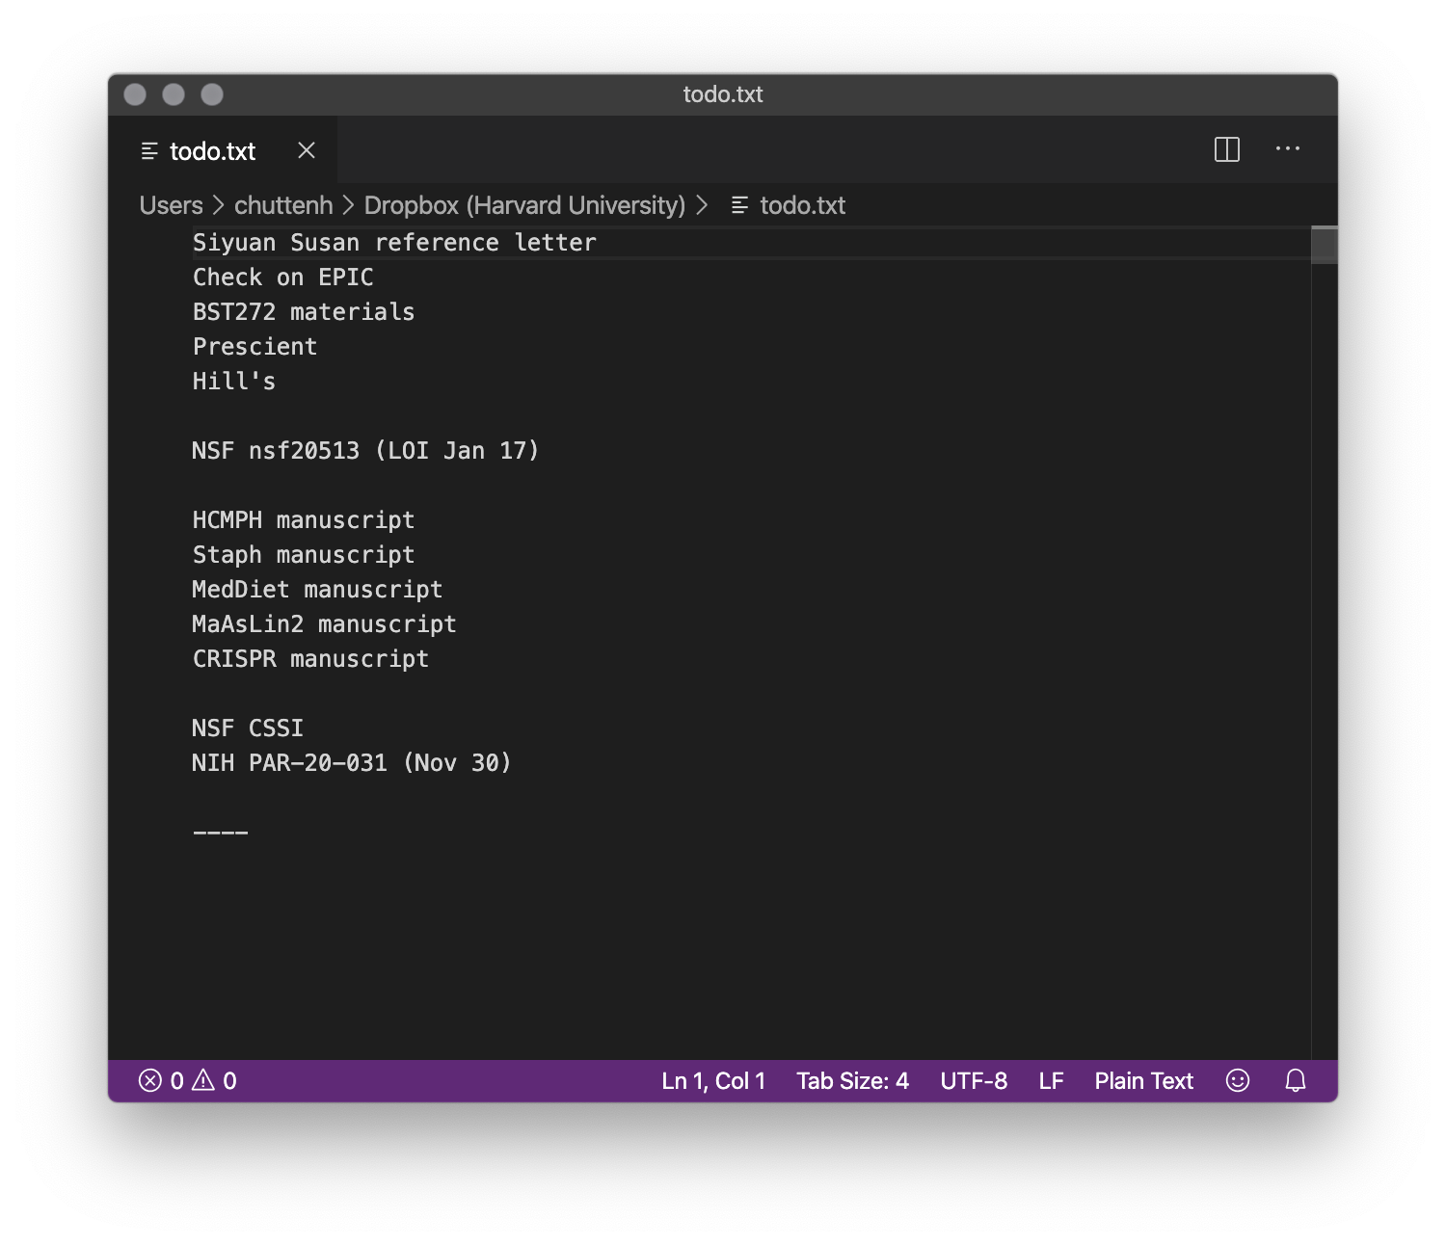
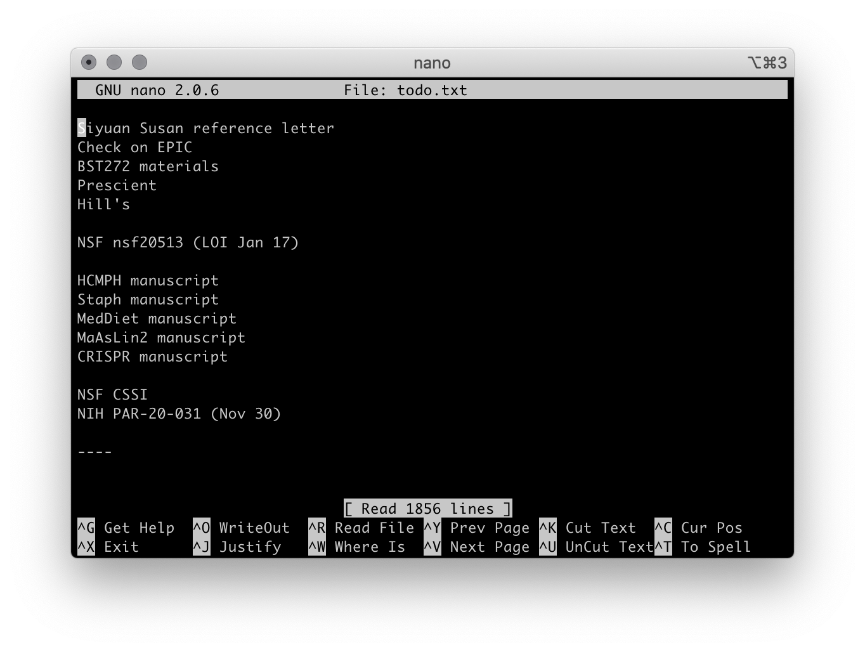

Slide 21
Why is this a useful thing?
Very efficient way to manipulate data (numbers and especially text).
Good at text searching, sorting, formatting, matching, etc.
Much much much faster than running individual tests by hand graphically.
Almost all research software is written for the command line.
Assemblers, mappers, spectral analysis software (MS), genetics / GWAS, expression data (sequencing or otherwise), epigenetics (peak calling), statistical tests…
Modular.
Most common programs are tailored to be accurate and flexible for one specific task.
Then they can be chained together in clever ways.
Automate boring / repetitive tasks!

Slide 22
Command line concepts
Each program (or executable) has a name.
Often short and inscrutable: ls, rm, mv, sed, etc…
Commands involving programs are executed by a shell.
For our purposes, most common shells are pretty similar.
But some will have slightly different syntax / capabilities / etc.
Cycles through prompting the user for input commands, running them, and handling the output.
bash is the most common shell, but you’ll also see zsh, ksh, etc.
Generally abbreviated sh

Slide 23
Command line concepts
Most programs accept arguments (or parameters) that configure behavior.
Can specify input or output files, dis/enable features, change values, etc.
These are generally preceded by one (if short) or two (if long) dashes: -
The former can be grouped together.
rm -rf * (equivalent to rm -r -f *)
ls --color=auto
spades.py -o output -1 forward.fastq -2 reverse.fastq --iontorrent
Protip: - is not the same as – if you’re copy/pasting from PowerPoint / Word…
Ditto " versus “or” and ' versus ‘or’.
Programs often accept standard input or generate standard output.
Think of these as pipes that can read or write text.
They can be connected to different sources: keyboard, file, another program.
They can be connected to different sinks: screen, file, another program.
This allows programs and files to be modularly connected to each other.
cat data.fastq | grep GCAT | sort | uniq | wc -l > hits.txt

Slide 24
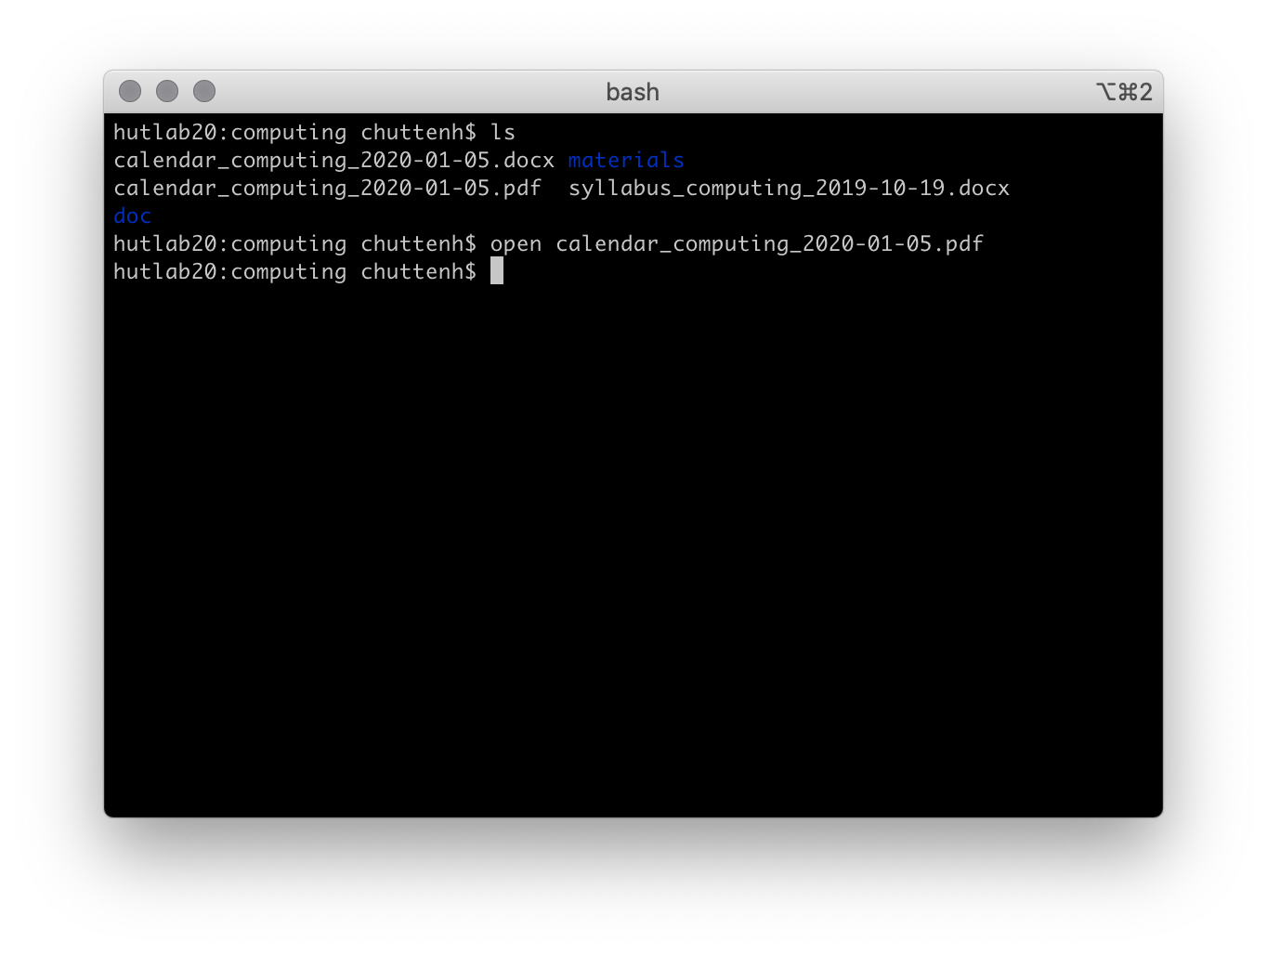
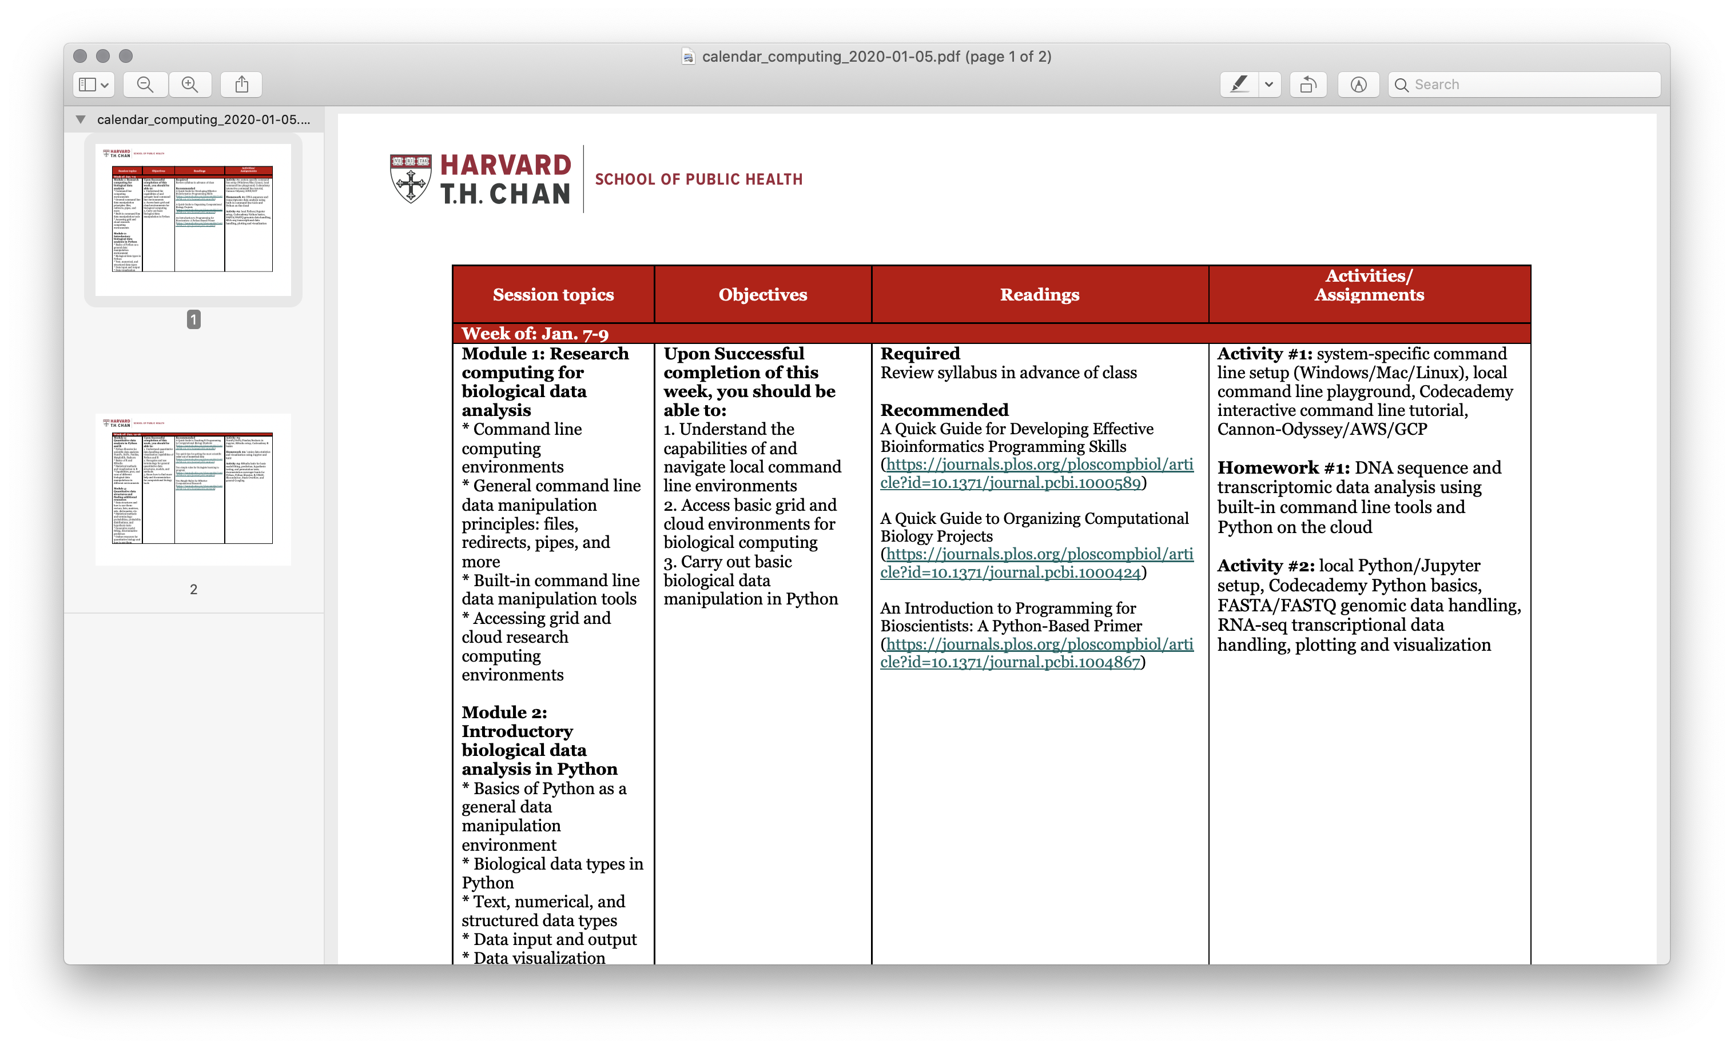
Command line concepts
What about graphics?
Command line programs can generate graphical outputs: PNGs, PDFs, etc.
Very useful for plots, publication figures, etc.
R myscript.R --output myplot.pdf
What about my normal programs?
Command line programs can call normal applications.
(On a Mac): open myplot.pdf
Or save data that you can open in a normal application.
echo "this is an example" > example.txt

Slide 25
What can I do with a command line?
Eric Franzosa

Slide 26
Path syntax
$ is used to indicate the start of a command (your prompt may look different)
$ command
You always exist in some present location (working directory) within your file system
$ pwd /Users/chuttenh
/ is the root of the file system (C:\ on Windows, typically; note the backslash)
$ ls /
A subdirectory of the root directory (separated by more /s)
$ ls /Users/
. refers to the current directory
$ wc -l ./my_file.txt $ cp /another_dir/my_file.txt . # copy file “here”
.. refers to the parent directory
$ mv ../my_file.txt .

Slide 27
*nix utilities: pwd
What does it do?
Shows the present working directory
Usage
$ pwd # prints the current directory

Slide 28
*nix utilities: cd
What does it do?
Changes the current directory
Usage
$ cd # returns to your home directory
$ cd / # changes to the root directory
$ cd .. # changes to the parent directory
$ cd some/directory # changes to a subdirectory

Slide 29
*nix utilities: ls
What does it do?
List files in the current directory
Usage
$ ls # list all files in current directory
$ ls *.txt # list all text files
Options | What does it do?
-l | List file details
-a | Include all files (including hidden / system / “dot” files, e.g. .example)
-h | Human-readable file sizes (e.g. 3.3MB vs. 3354123)
 | Lots of build in sorting options (size, type, last update, etc.)

Slide 30
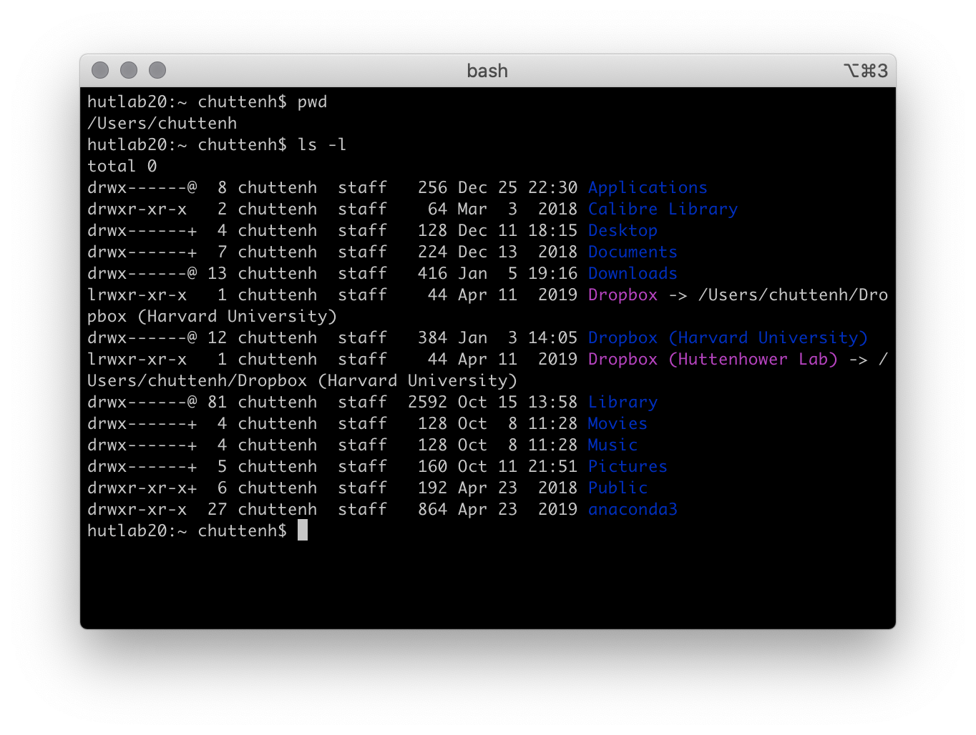
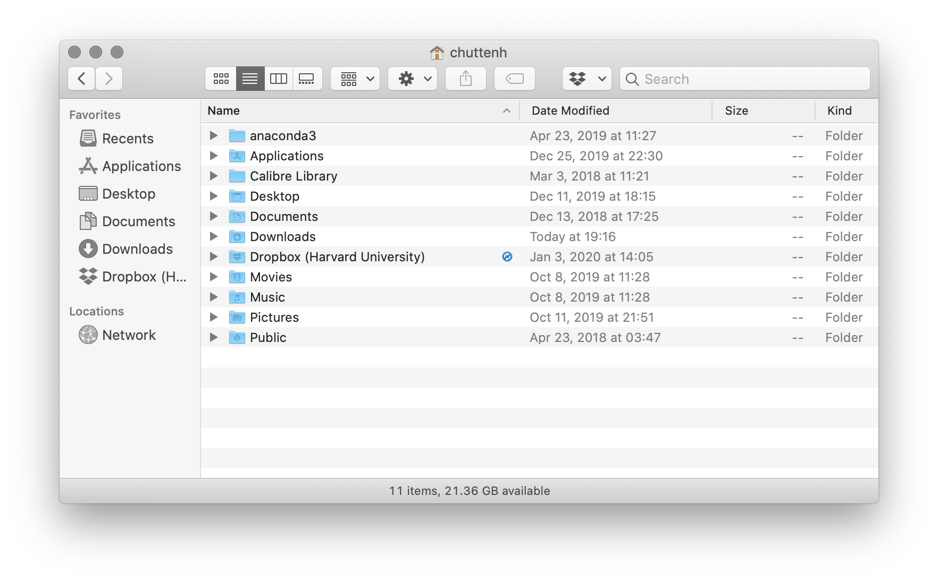
Path syntax

Slide 31
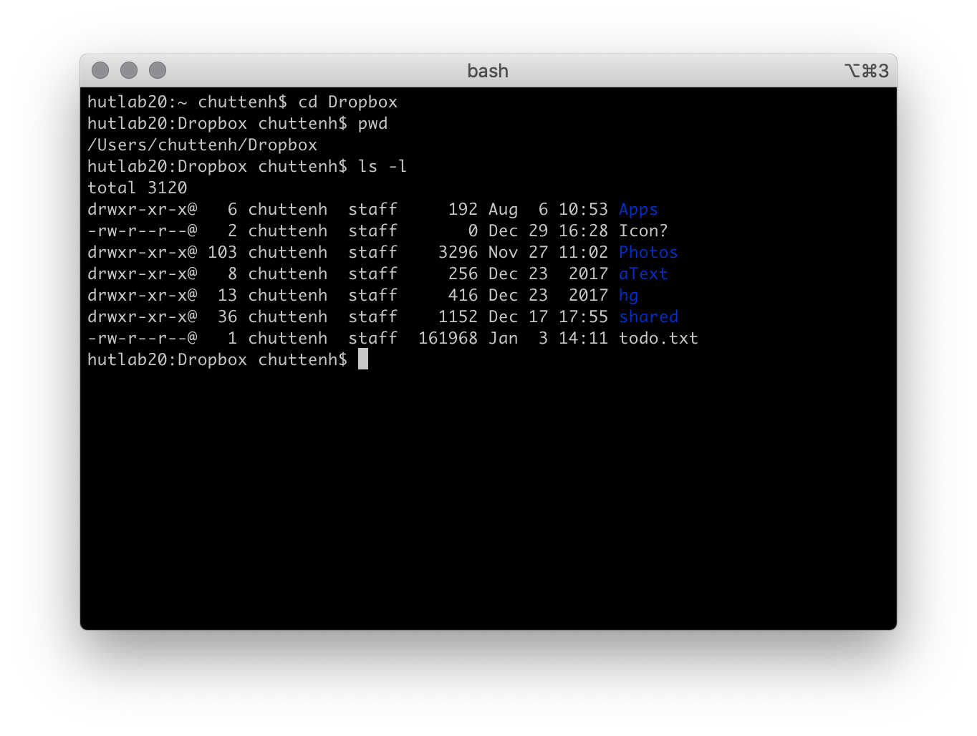
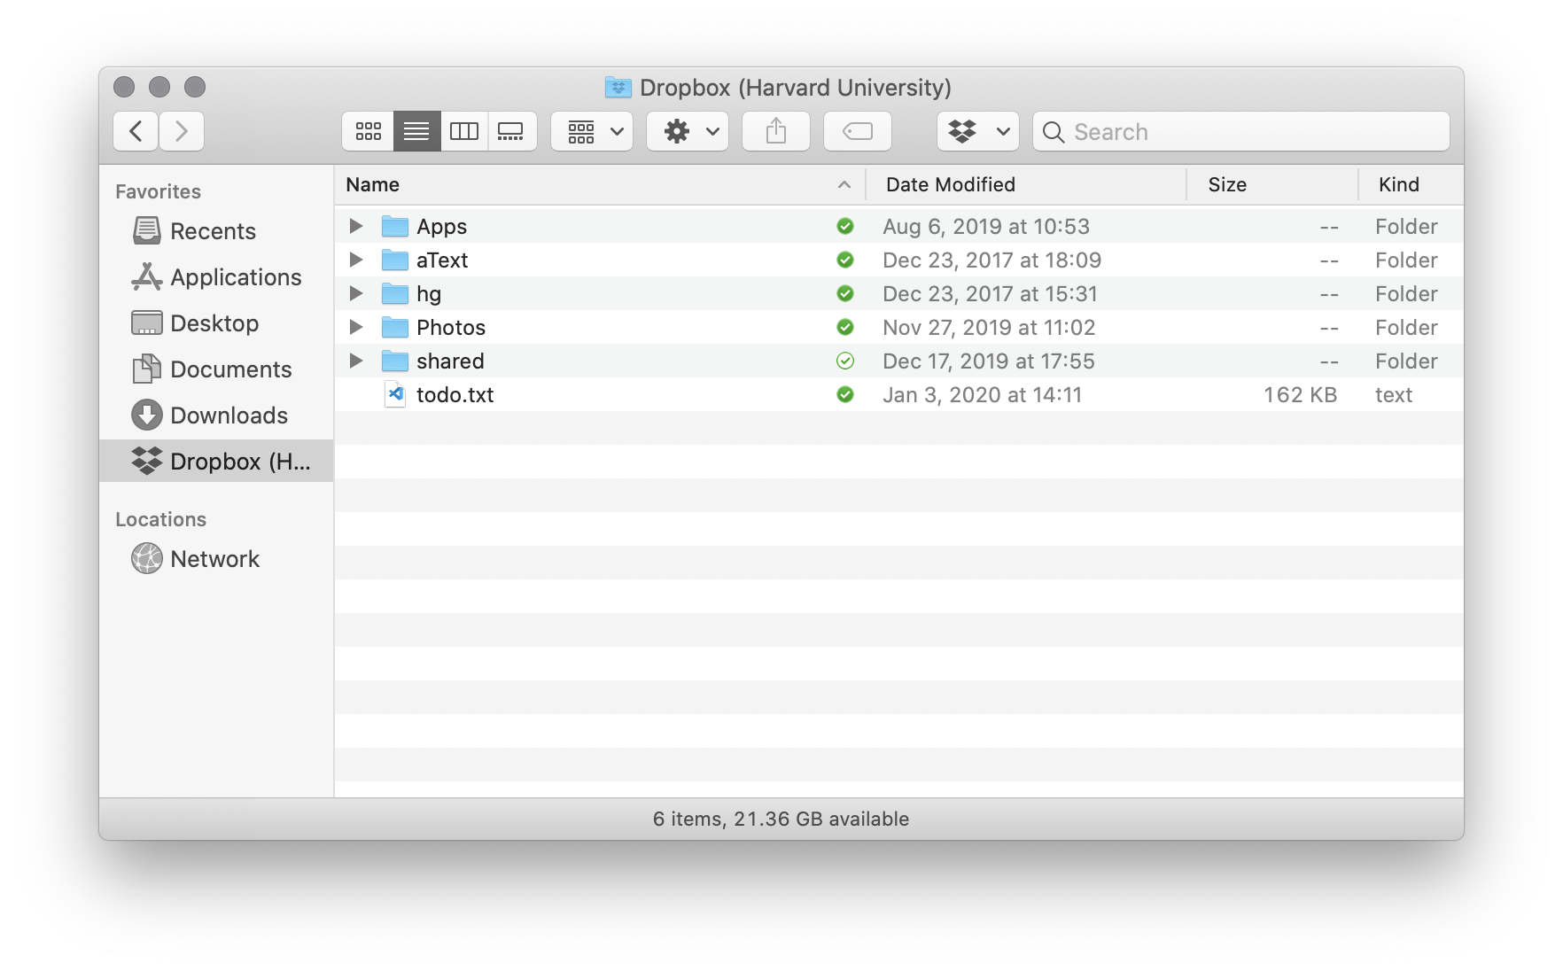
Path syntax

Slide 32
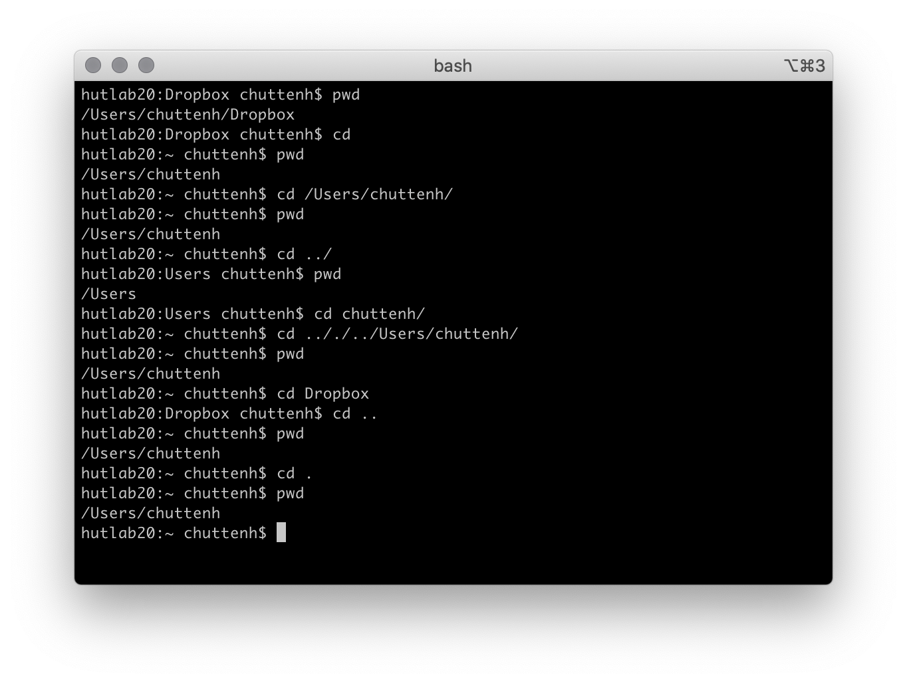
Path syntax

Slide 33
*nix utilities: man
What does it do?
Displays a manual page for another tool, detailing expected input data and optional flags
Usage
$ man less
Options | What does it do?
q | [within program] Exits the current man page

Slide 34
*nix utilities: man
LESS(1) General Commands Manual LESS(1)
NAME
less - opposite of more
SYNOPSIS
less -?
less --help
less -V
less --version
less [-[+]aABcCdeEfFgGiIJKLmMnNqQrRsSuUVwWX~]
[-b space] [-h lines] [-j line] [-k keyfile]
[-{oO} logfile] [-p pattern] [-P prompt] [-t tag]
[-T tagsfile] [-x tab,...] [-y lines] [-[z] lines]
[-# shift] [+[+]cmd] [--] [filename]...
(See the OPTIONS section for alternate option syntax with long option names.)
DESCRIPTION
Less is a program similar to more (1), but it has many more features. Less does not have to read the entire input file before starting, so with large
input files it starts up faster than text editors like vi (1). Less uses termcap (or terminfo on some systems), so it can run on a variety of terminals.
There is even limited support for hardcopy terminals. (On a hardcopy terminal, lines which should be printed at the top of the screen are prefixed with a
caret.)
Commands are based on both more and vi. Commands may be preceded by a decimal number, called N in the descriptions below. The number is used by some com‐
mands, as indicated.
COMMANDS
In the following descriptions, ^X means control-X. ESC stands for the ESCAPE key; for example ESC-v means the two character sequence "ESCAPE", then "v".
h or H Help: display a summary of these commands. If you forget all the other commands, remember this one.
SPACE or ^V or f or ^F
Scroll forward N lines, default one window (see option -z below). If N is more than the screen size, only the final screenful is displayed. Warn‐
ing: some systems use ^V as a special literalization character.
z Like SPACE, but if N is specified, it becomes the new window size.

Slide 35
*nix utilities: rm
What does it do?
Deletes (removes) a file PERMANENTLY
Usage
$ rm my_file
Options | What does it do?
-r | Force-remove a directory (will fail by default)
-f | Force file removal (use with caution!)
-i | Confirm each deletion event

Slide 36
*nix utilities: cp
What does it do?
Copy a file
Usage
$ cp my_file my_copy
Options | What does it do?
-i | Warn before overwriting a file
-r | Copy recursively (needed for copying directories)

Slide 37
*nix utilities: mv
What does it do?
Move a file to a new location (or rename a file)
Usage
$ mv my_file MY_FILE # rename my_file as MY_FILE
$ mv /my_dir/my_file . # move file “here” (.)
Options | What does it do?
-i | Warn before overwriting a file

Slide 38
*nix utilities: echo
What does it do?
Dumps its literal input arguments to STDOUT (for feeding into another program)
Usage
$ echo "this is an example" # prints the text this is an...
$ echo "this is an example" | less # shows text in less
$ echo "this is an example" > example.txt # saves text in file

Slide 39
*nix utilities: cat
What does it do?
Dumps files on disk to STDOUT (for feeding into another program)
Usage
$ cat my_file # lines of file scroll over screen
$ cat my_file | program # lines of file enter program as STDIN
$ cat *.txt | program # concatenate all text files as STDIN

Slide 40
*nix utilities: less
What does it do?
View a file or data stream with navigation options
Usage
$ less my_file
$ cat *.txt | less # ‘less’ is often used at the end of a chain
Options | What does it do?
-S | Don’t wrap long lines
←↑→↓ | Arrow keys to navigate in file (PageUp, PageDown, Home, End work too)
/ | [in program] Search for text, use n and N to see next/previous matches

Slide 41
*nix utilities: grep
What does it do?
Isolate lines of a data stream (file or STDIN) that match a pattern
Usage
$ grep pattern my_file
$ cat *.txt | grep pattern
Options | What does it do?
-P | Richer pattern options (regular expressions); more on these in a later lecture
-v | Isolate lines that DO NOT match the pattern (invert the match)
-i | Case-insensitive match
-f | Specify a file of patterns to match (slow if there are lots of options)

Slide 42
*nix utilities: cut
What does it do?
Isolate tab-delimited columns of a data stream. First column is #1 (not #0 as in Python).
Usage
$ cut -f2 my_file # isolate the 2nd column of the file
$ cut -f2,3 my_file # isolate columns 2 and 3
$ cut -f2-5 my_file # isolate columns 2 THROUGH 5
$ cut -f3- my_file # isolate columns 3 to END (python [2:] slice)
Options | What does it do?
-f | Select columns (fields)
-t'char' | Break columns on the specified character instead of tab, e.g. -t',' for .csv file

Slide 43
*nix utilities: sort
What does it do?
Sort the lines of a data stream (alphabetically)
Usage
$ sort my_file
Options | What does it do?
-r | Reverse the sort
-k N | Sort on the value of WHITESPACE-delimited column N
-t'char' | Specify the delimiter character (e.g. -t'\t' for tab)
-n | Perform a numeric sort (otherwise 10 comes before 2)

Slide 44
*nix utilities: uniq
What does it do?
Isolate the unique ADJACENT lines of a data stream
Usage
$ sort my_file | uniq # w/o sorting, non-adjacent repeats missed
Options | What does it do?
-c | Count the occurrence of each unique line

Slide 45
*nix utilities: wc
What does it do?
Counts the lines, words, and characters of a data stream
Usage
$ wc my_file
Options | What does it do?
-l | Only report line count (faster, and often all you want)
-w | Only report word count
-c | Only report character count

Slide 46
*nix utilities: head/tail
What does it do?
Stream the first/last (tail/head) lines of a data stream (default 10)
Usage
$ head my_file
$ head -n 100 my_file | tail # Stream lines 91-100
Options | What does it do?
-n N | Stream N lines instead of default 10

Slide 47
*nix utilities: column
What does it do?
“Normalize” the widths of column entries (Excel-ify your data)
Usage
$ column -t my_file
Options | What does it do?
-s'char' | Specify the delimiter character (e.g. -s'\t' for tab); default = any whitespace

Slide 48
*nix utilities: sed
What does it do?
Edit a data stream, most often used for find/replace operations
Usage
$ sed 's/find/replace/g' my_file
$ sed 's/apple/banana/g' my_file # replace all instances of “apple” with “banana”
Options | What does it do?
-i | Edit file “in place” (use with caution)
 | “find” can be a regular expression, and “replace” can use captured elements of the pattern (this will make more sense after our regular expressions lecture).

Slide 49
Chaining programs
Most programs read from STDIN and write to STDOUT
To start a chain:
cat *.txt
Useful for processing multiple files, changing the first command in the chain
grep "Hello" my_file.txt
Read file as second argument
grep "Hello" < my_file.txt
Another way to provide a single file as STDIN
Use the pipe ‘|’ to direct STDOUT of program N as STDIN of program N+1
grep "Hello" my_file.txt | sort
Can do this repeatedly
grep "Hello" my_file.txt | sort | uniq | wc -l
Dump the results to a file (OVERWRITES!)
grep "Hello" my_file.txt | sort | uniq | wc -l > hello_count.txt

Slide 50
Chaining programs
So in summary:
< assigns a file’s contents as standard input:
grep ptrn < input_file.txt
> assigns a command’s standard output to a file’s contents:
echo "quick red fox” > output_file.txt
| assigns a command’s STDOUT to another command’s STDIN:
grep ptrn < input_file.txt | sort | uniq | wc -l > output_file.txt

Slide 51
Chaining programs
patient_data.tsv
UNIQUE_ID | SUBJECT_NAME | SUBJECT_ZIP
134245 | Smith, John | 02135
102135 | Doe, Jon | 02134
... | ... | ...
What does this do?
$ cut -f3 patient_data.tsv | grep "02135" | wc -l
What does this do?
$ cut -f3 patient_data.tsv | sort | uniq | wc -l
What does this do?
$ sed "s/, Jon/, John/g" patient_data.tsv | grep ", John" | wc -l

Slide 52
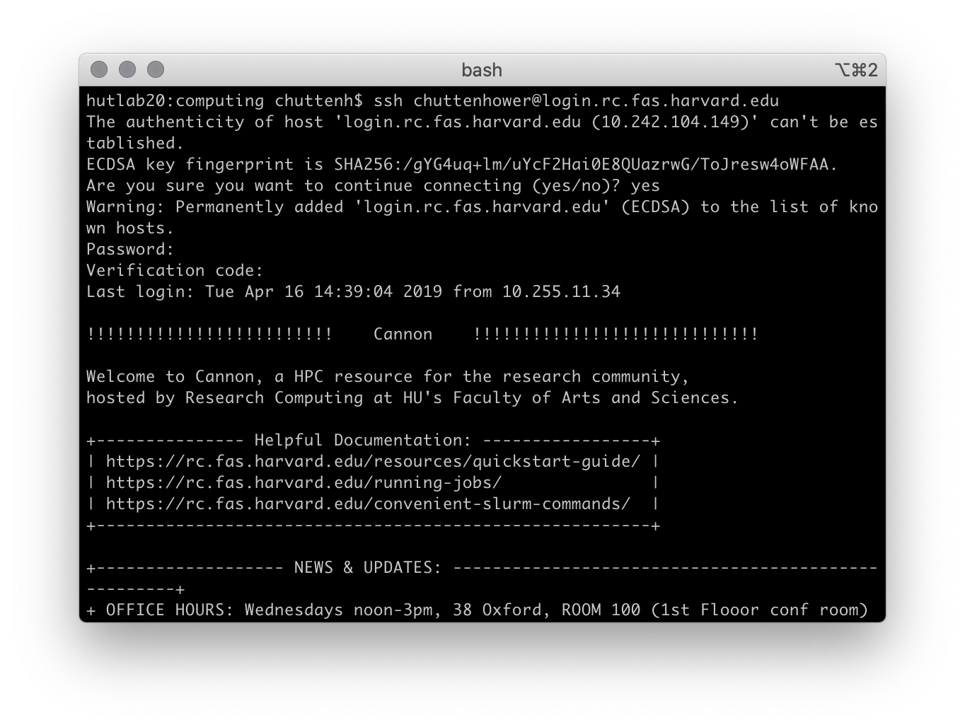
*nix utilities: ssh
What does it do?
Creates a secure shell connection to a remote machine
Usage
$ ssh username@host # connect to host as username
$ ssh chuttenhower@login.rc.fas.harvard.edu # connect to RC

Slide 53
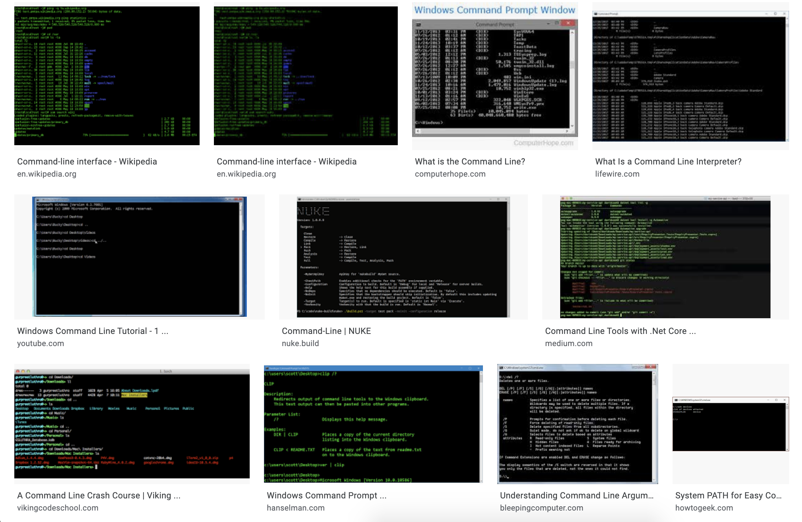
And there are lots more!

Slide 54
Where can I get a command line?

Slide 55
If you’re using Linux…
You have command lines everywhere.
And probably don’t need to be taking this class.

Slide 56
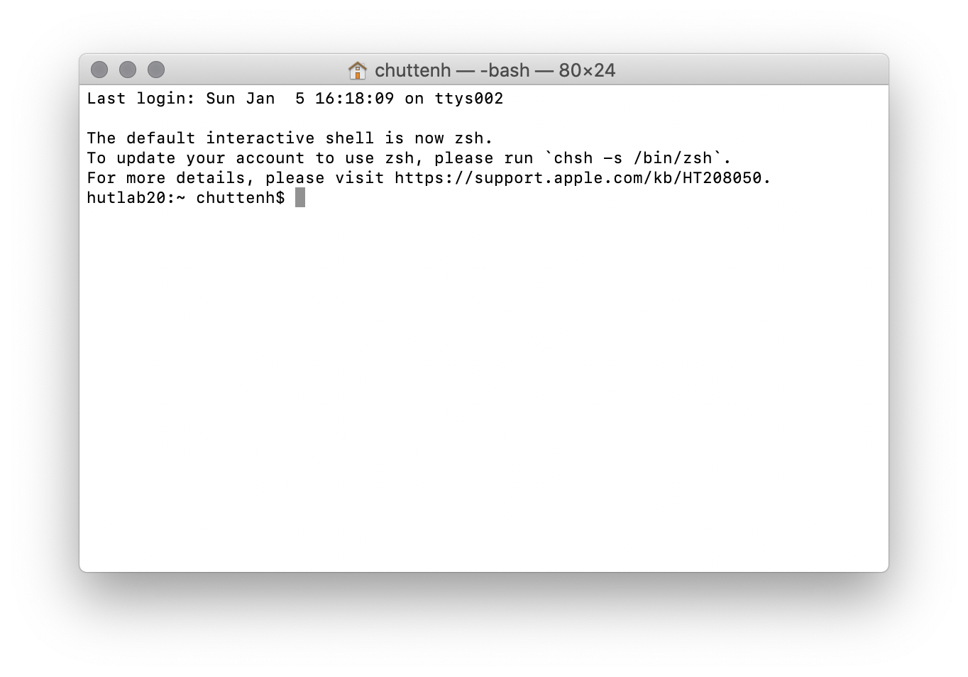
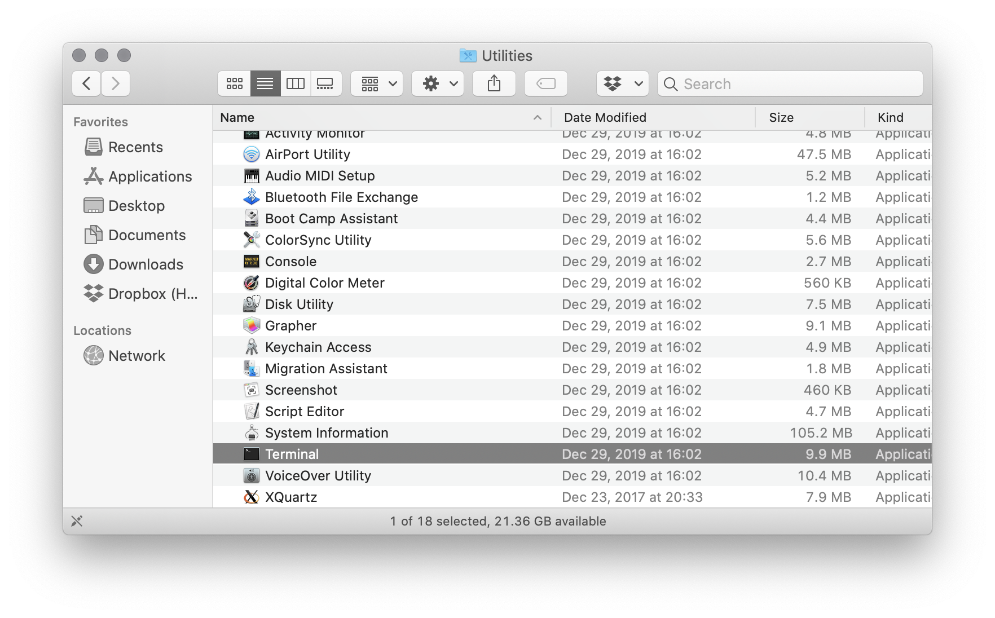
If you’re using MacOS…
Launch Applications/Utilities/Terminal
Or I prefer iTerm2 (free)
https://iterm2.com

Slide 57
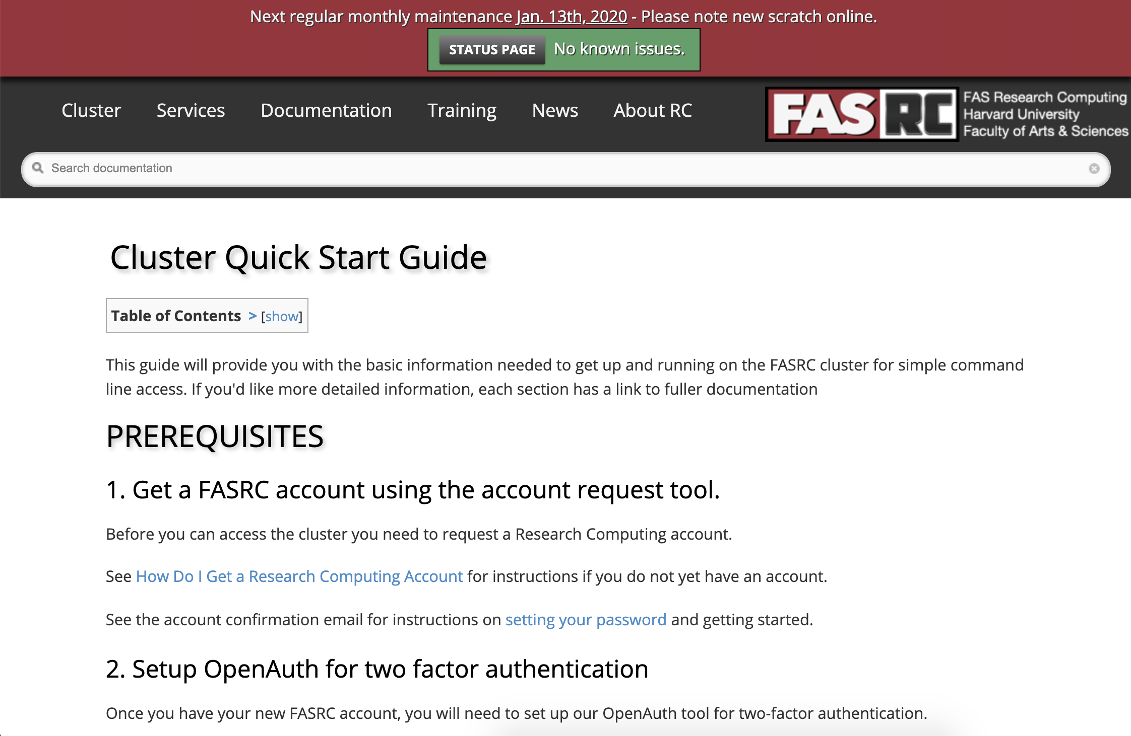
If you have a Cannon/Odyssey account…
Go here:
https://www.rc.fas.harvard.edu/resources/quickstart-guide/
And ssh using Terminal (Mac) or Putty (Windows)
https://www.chiark.greenend.org.uk/~sgtatham/putty/latest.html

Slide 58
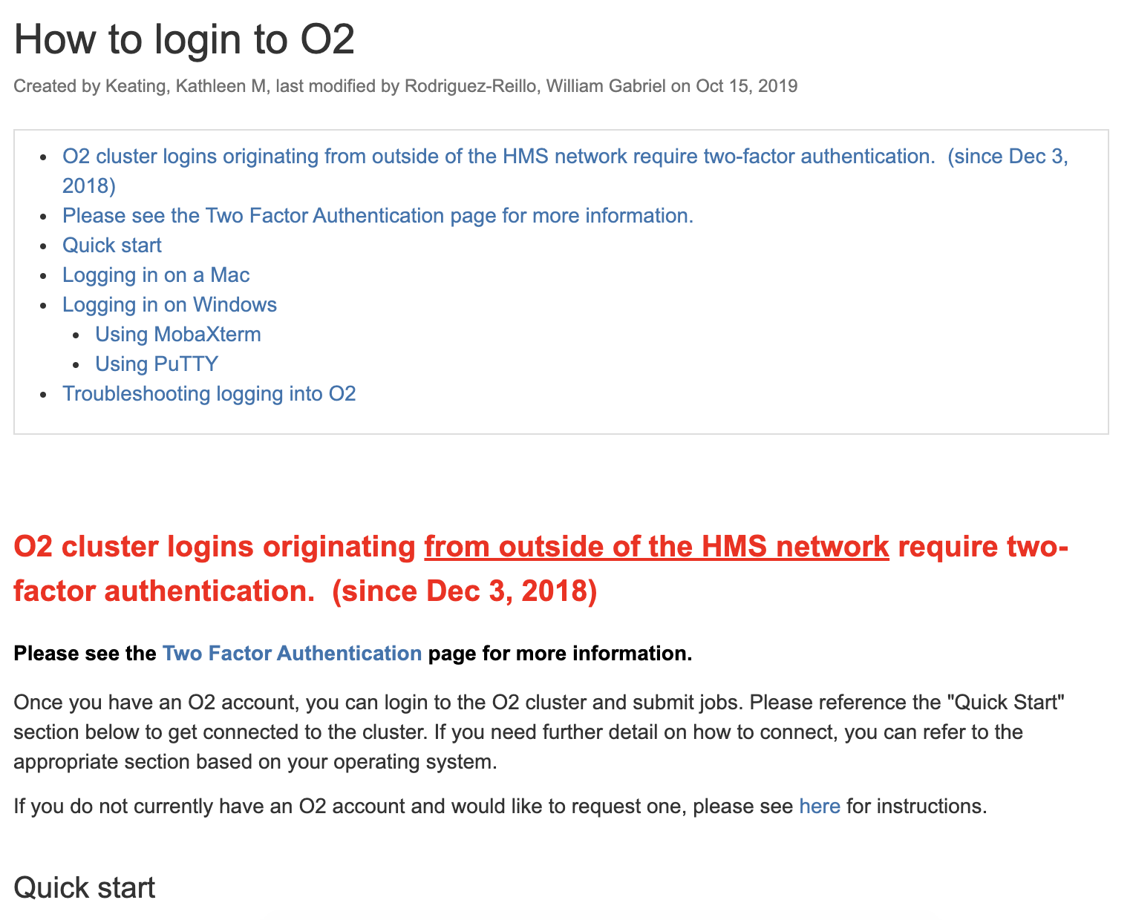
If you have an O2/Orchestra account…
Go here:
https://wiki.rc.hms.harvard.edu/display/O2/How+to+login+to+O2
And ssh using Terminal (Mac) or Putty (Windows)

Slide 59
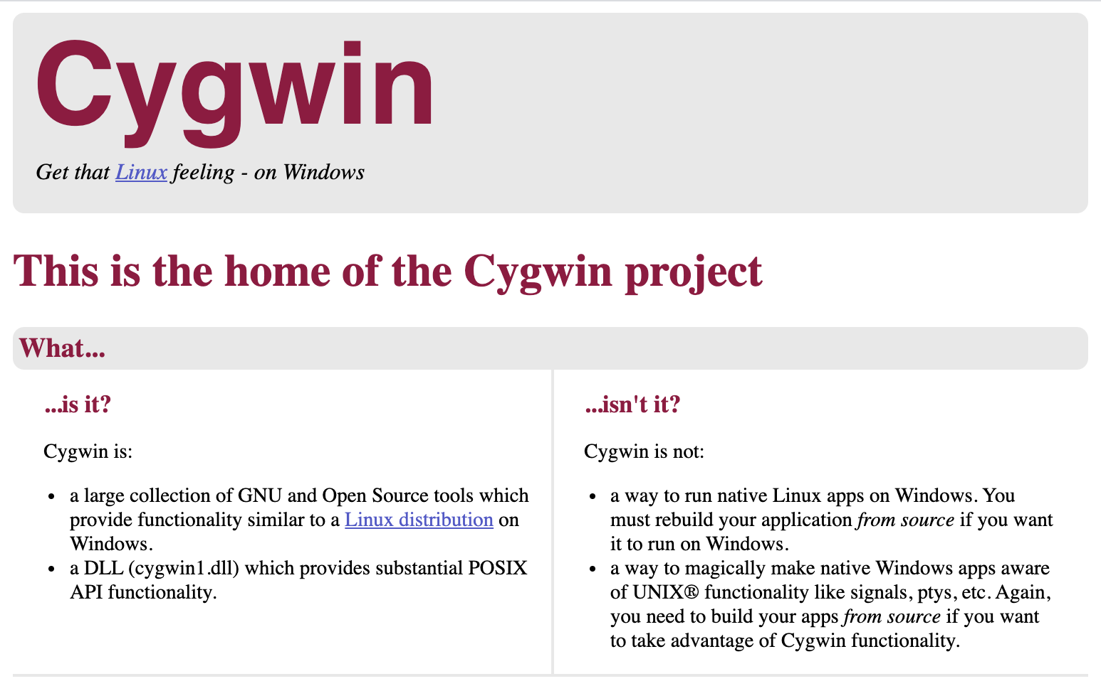
If you really want to do this on Windows…
The default Windows command line is different! But…
There’s a brutally complicated PowerShell feature that’s native:
https://docs.microsoft.com/en-us/windows/wsl/install-win10
There’s a slightly complicated, very powerful subsystem called Cygwin:
https://www.cygwin.com/
There’s a very simple, lightweight alternative called GOW:
https://github.com/bmatzelle/gow

Slide 60
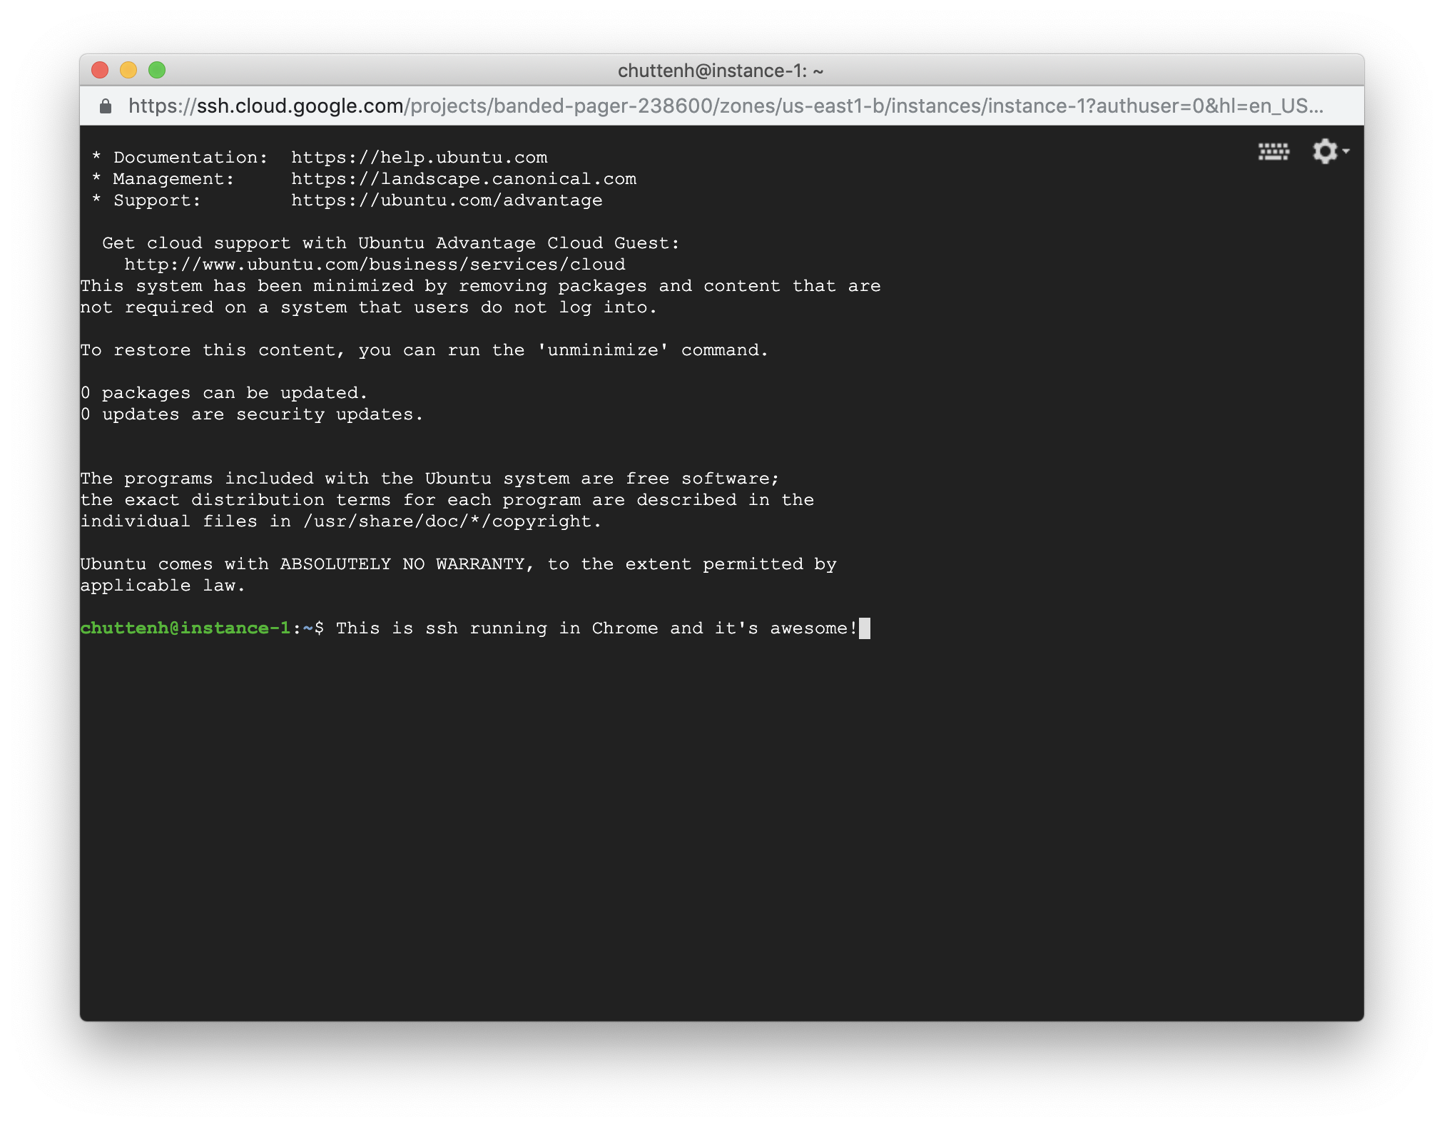
If you absolutely can’t do any of these…
…or you need it for the homework…
Talk to us about getting connected to a Google Cloud Platform (GCP) instance.
This is a web browser!

Slide 61
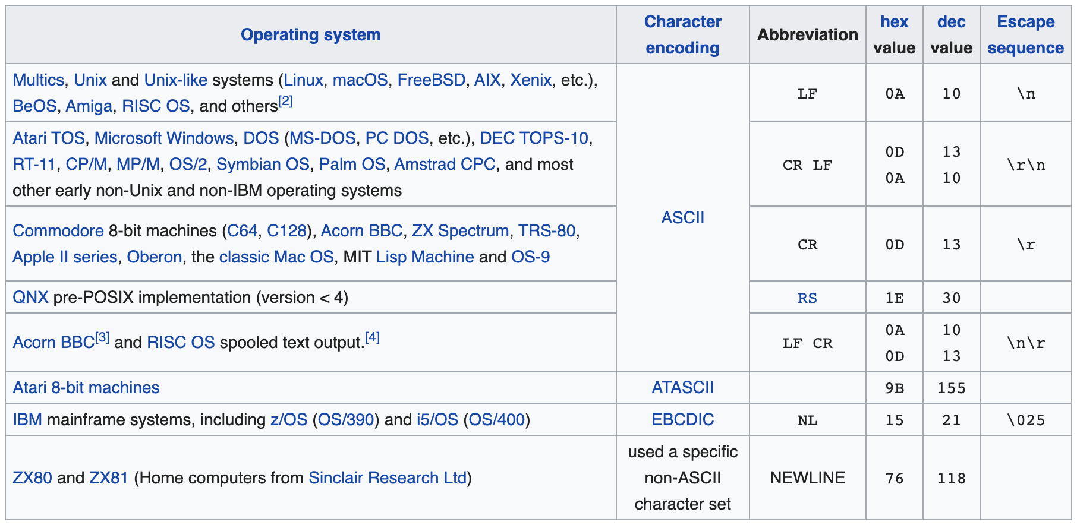
Caveat programmor
Note that there will occasionally be minor differences in behavior between different command line environments.
Or even between different versions of the same environment.
Certain commands will/won’t run, behave differently, take different arguments, etc.
Newline handling in text files is a big one.
Mac vs. DOS vs. Unix: \r vs. \r\n vs. \n
https://en.wikipedia.org/wiki/Newline

Slide 62
How can I use other peoples’ command lines?

Slide 63
Remote computing
A nice thing about text is that it’s easy to transmit over a network.
Command lines are made to be used remotely!
ssh is the main way of connecting to a remote machine.
Once connected, you can run commands just as you would if you were using that machine locally.
Don’t forget that it actually has its own separate file system, CPU, etc.!
You can transfer files back and forth using scp / sftp.

Slide 64
Grid computing
Grid or distributed computing is used to describe many (often identical) computers that can all be accessed together remotely.
Many computers that share a common network and often storage.
Can be copies of the same hardware, or heterogeneous.
Commands are typically distributed as jobs organized as batches into one or more queues.
A job is a combination of a command (executable program), parameters, data, and necessary environment.
A batch manager (or scheduler or load balancer) assigns resources (specific computers / disk space / etc.) to each job.
It can be started, stopped, and sometimes paused by the manager.
The queue can be queried or modified through additional commands.

Slide 65
Grid computing
Basic grid architecture:
One master node that runs management software.
One or more client nodes that are managed by the master and only run jobs allocated to them.
Run special software that communicates with management server.
One or more head nodes that submit jobs for scheduling.
These are what you actually interact with directly.
Users on head nodes create, submit, and manage jobs (and results).
Management software typically has great flexibility in how resources (clients) are prioritized.
One or more queues with different priorities.
Potentially heterogeneous hardware, so big jobs can be allocated to big client nodes.
Nodes with multiple cores / CPUs can be shared between multiple jobs.

Slide 66
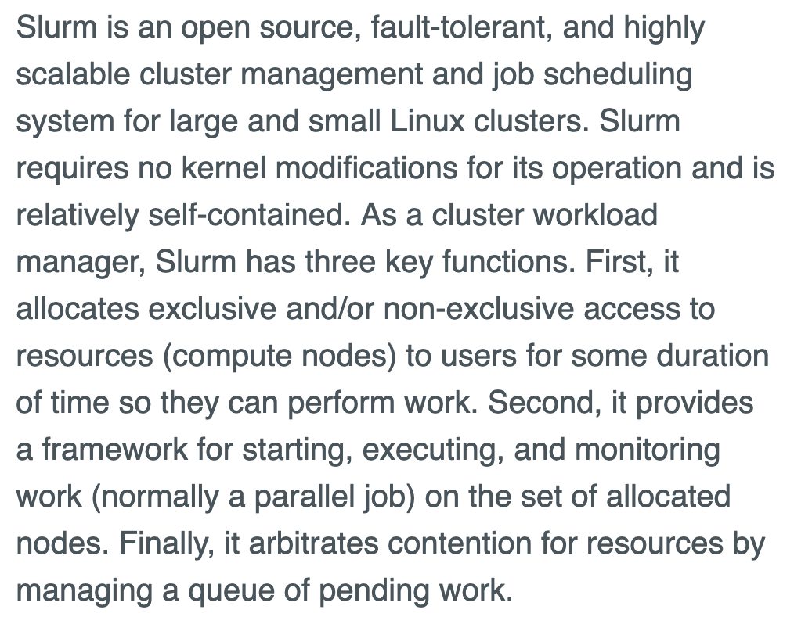
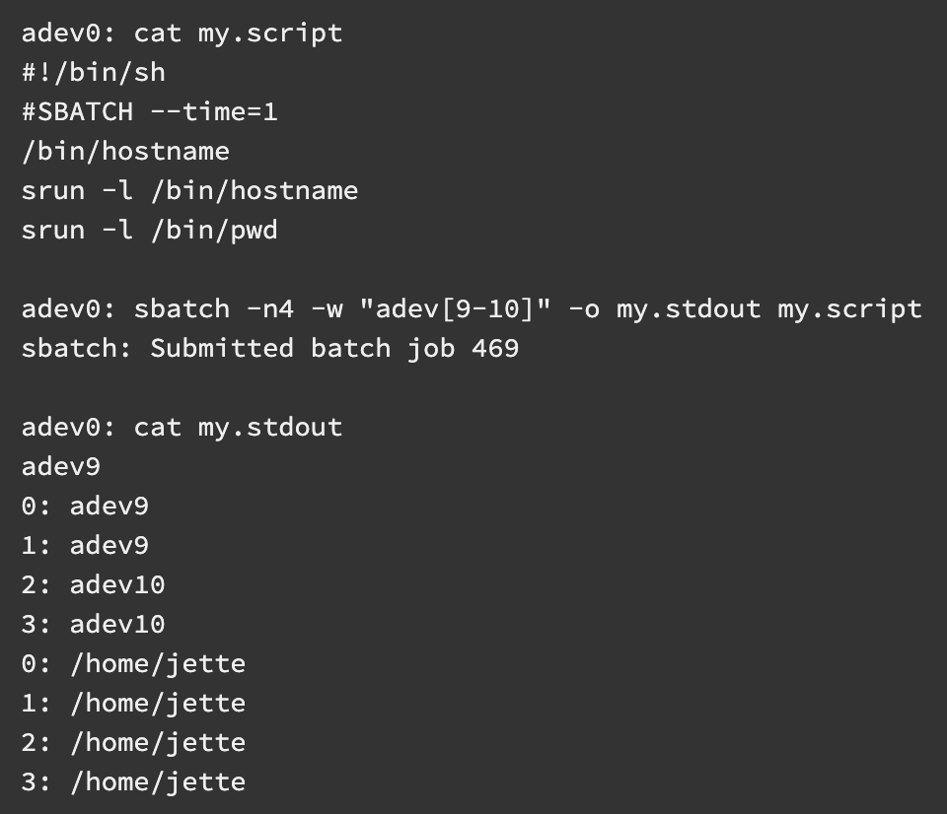
Grid job management: SLURM
https://slurm.schedmd.com
Cannon/Odyssey and O2/Orchestra both use the SLURM manager

Slide 67
Cloud computing
So what’s cloud computing?
Grossly abused phrase used to mean anything that happens online.
Colloquially can refer to:
Any remotely stored data or remotely executed services.
Hosted services, web applications, or shared documents.
Specific shared storage, computing, or service providers.
Technically, refers to:
SaaS: web / remote apps.
PaaS: SaaS limited to dev tools / APIs.
IaaS: remotely managed (potentially virtual) grids.
Here, we pretty much just care about the latter.
https://www.bmc.com

Slide 68
Cloud computing: IaaS
For our purposes, cloud computing is distributed computing where someone else owns the hardware.
By far the biggest research computing use case.
Lets you run programs using Amazon/Google’s command line.
But! Just this small change makes a big difference:
Elasticity means that you can use 10,000 computers for two hours, without needing to buy 10,000 computers forever.
When transmitting data is the bottleneck, brings computes to the data rather than vice versa.
Democratizes big computing for users that don’t have local resources.

Slide 69
Cloud computing: bringing computes to data
You have 1,000 new DNA sequences, and you want to search them all against NCBI nr.
You could either…
Download the entire nr database.
Run BLAST locally, and save the results.
Or…
Upload your 1,000 sequences to a server that already has nr.
Run BLAST there, and download the results.
This is basically SaaS, but the same principle holds for IaaS.

Slide 70
Cloud computing: elasticity
I have 1,000 jobs to run that will take 2 hours each.
I could…
Wait 2,000 hours (about three months) to run them all on my laptop. Cost = $2K, time = 2,000h.
Buy 1,000 computers, run the jobs, and then get stuck with the computers. Cost = $2M, time = 2h (plus some overhead).
Rent 1,000 computers for 2 hours each. Cost = ~$200ish, time = 2h.
https://en.wikipedia.org/wiki/Elasticity_(cloud_computing)

Slide 71
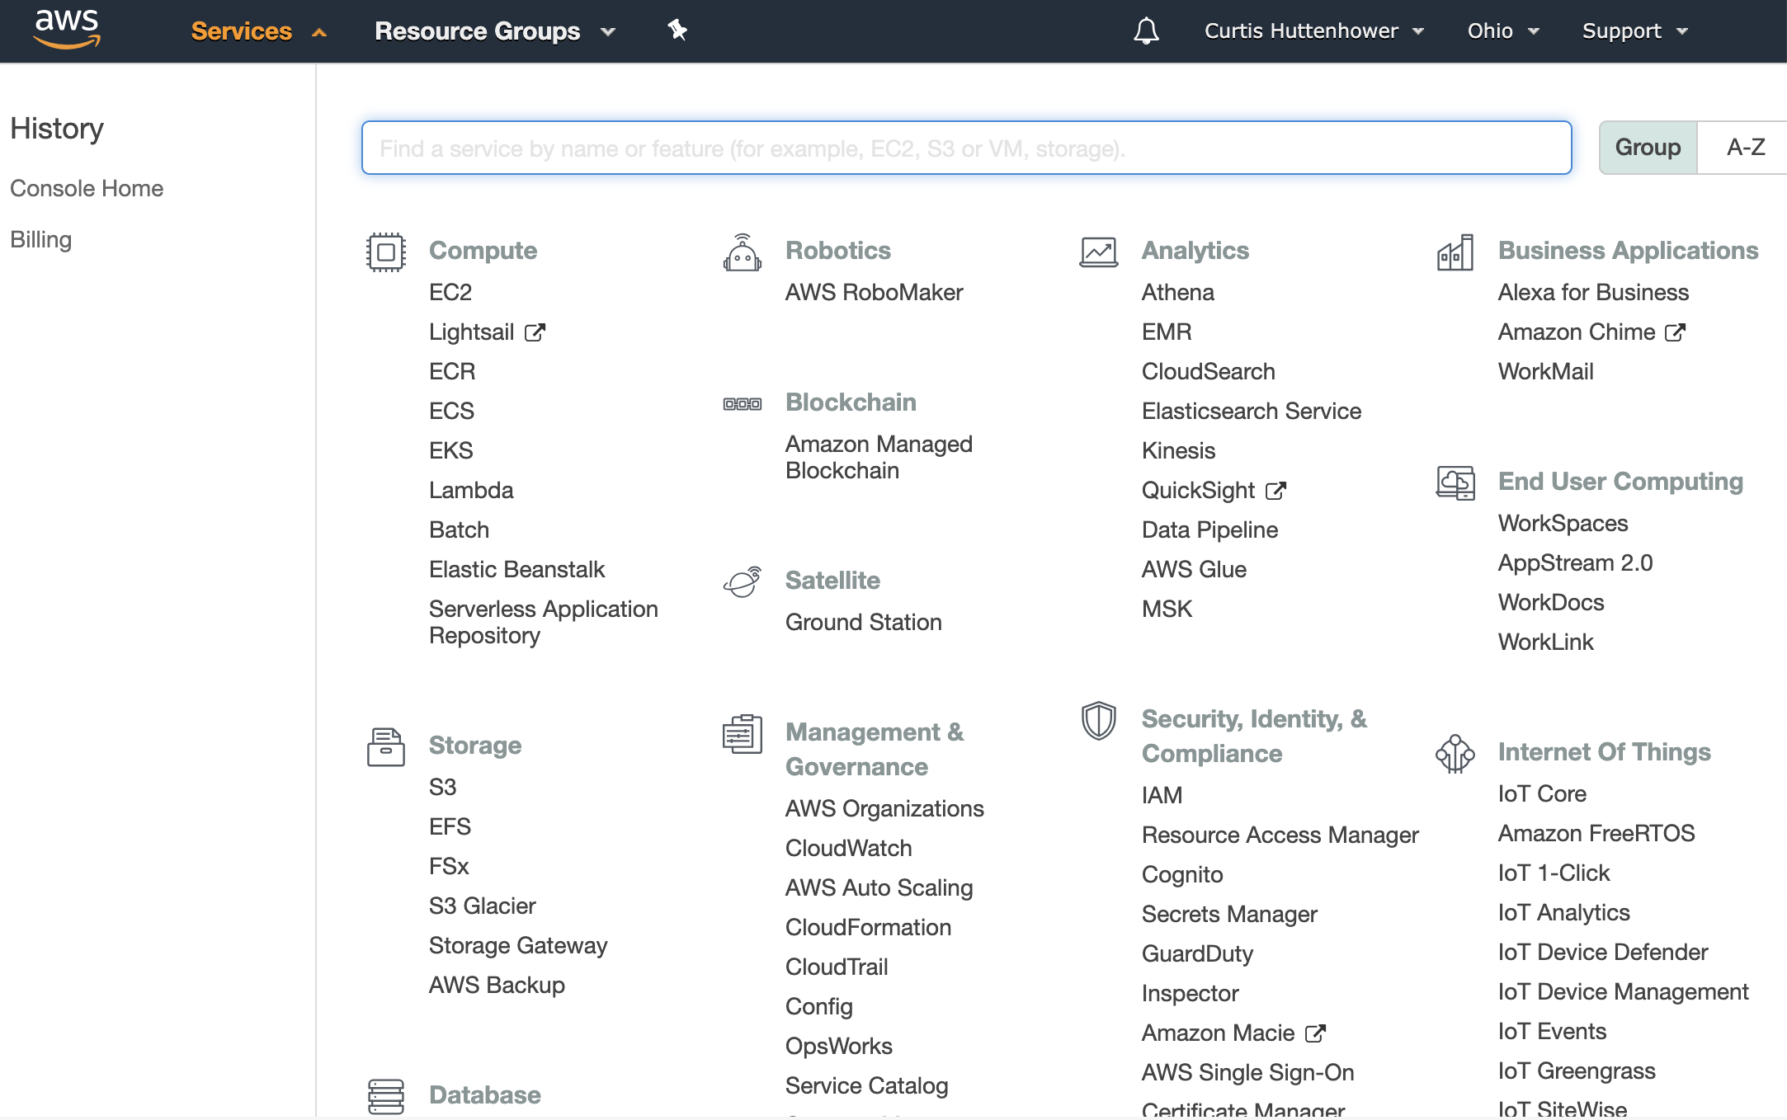
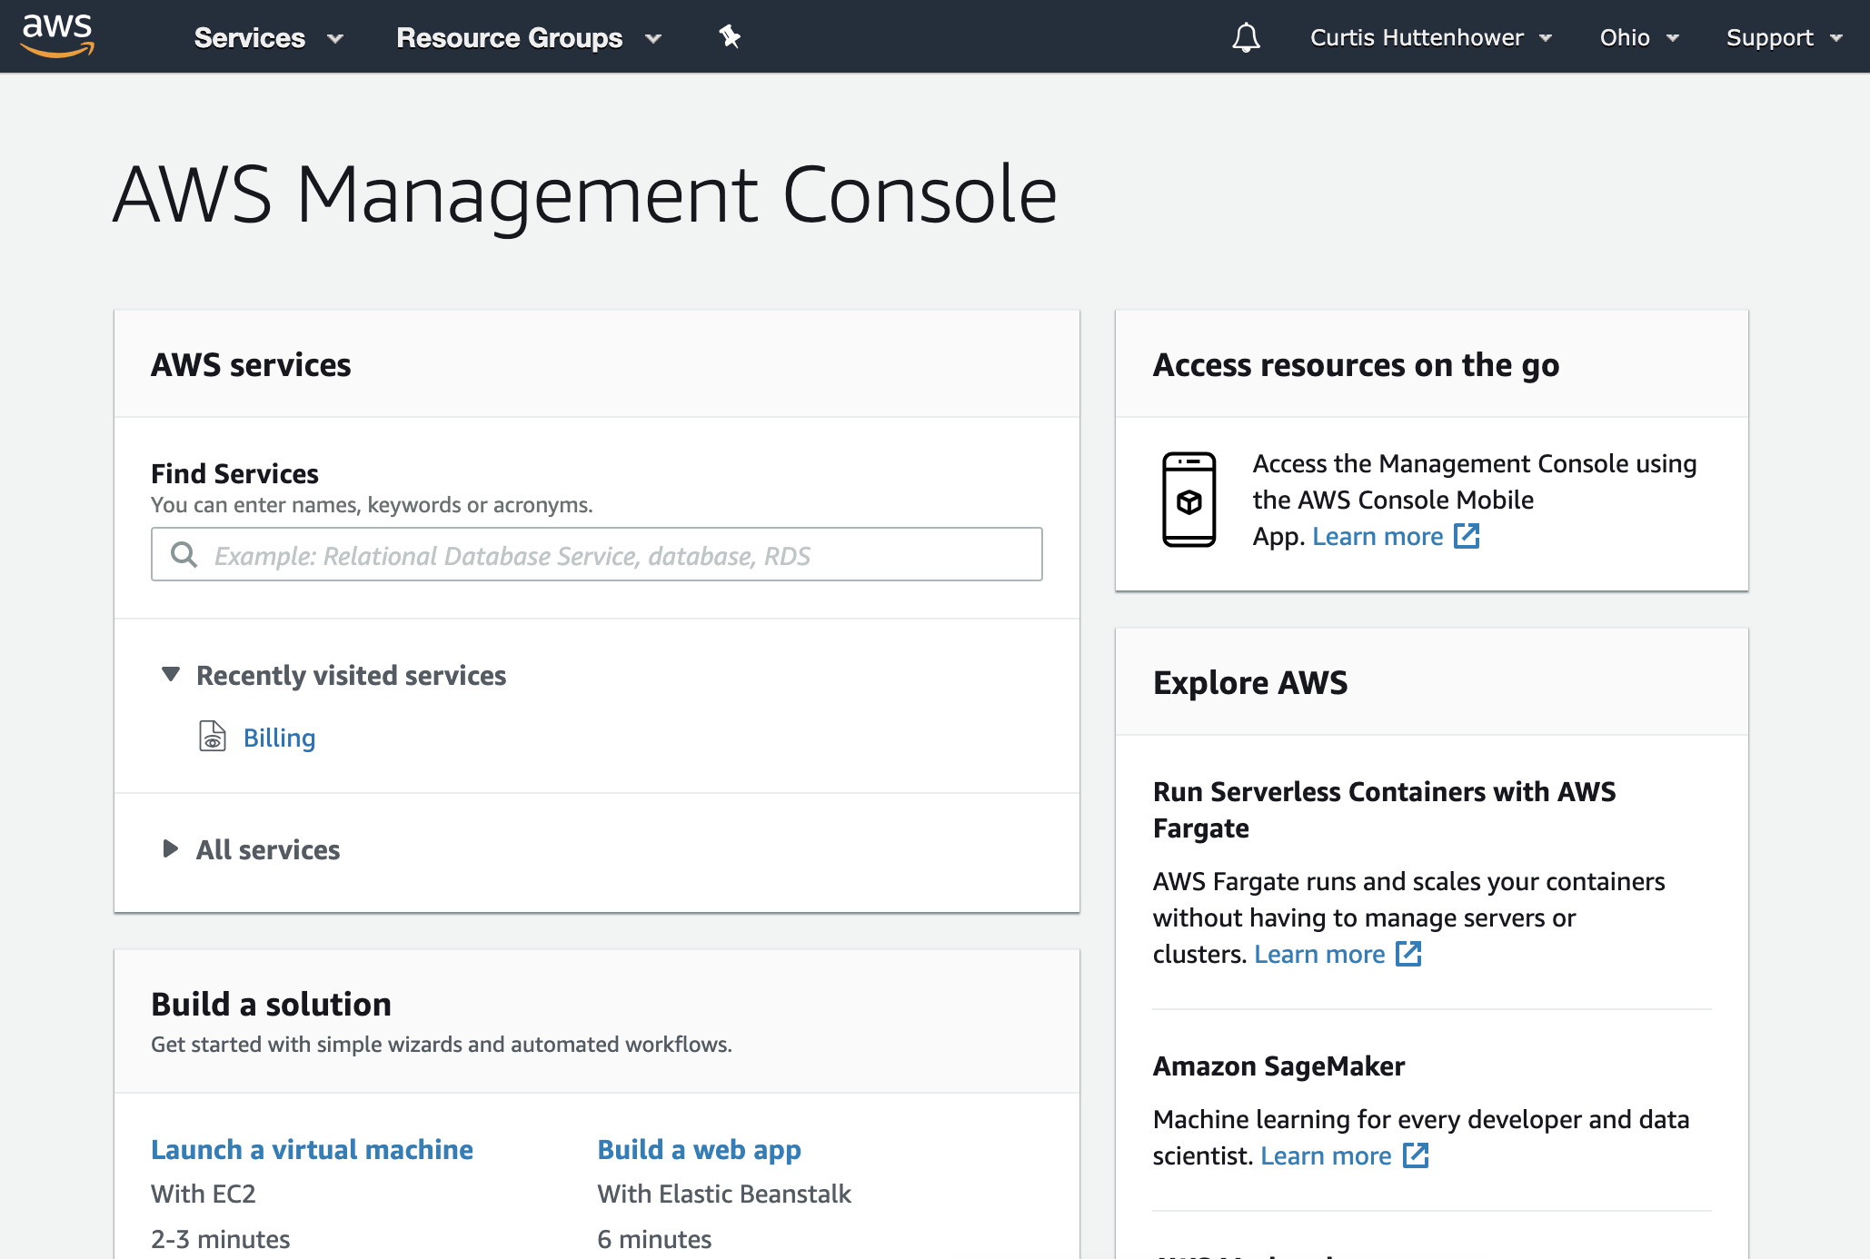
Cloud computing: Amazon
Amazon’s overall cloud platform is Amazon Web Services (AWS)
Its main services within this are:
EC2 (Elastic Compute), IaaS
S3 (Simple Storage Service), shared disk

Slide 72
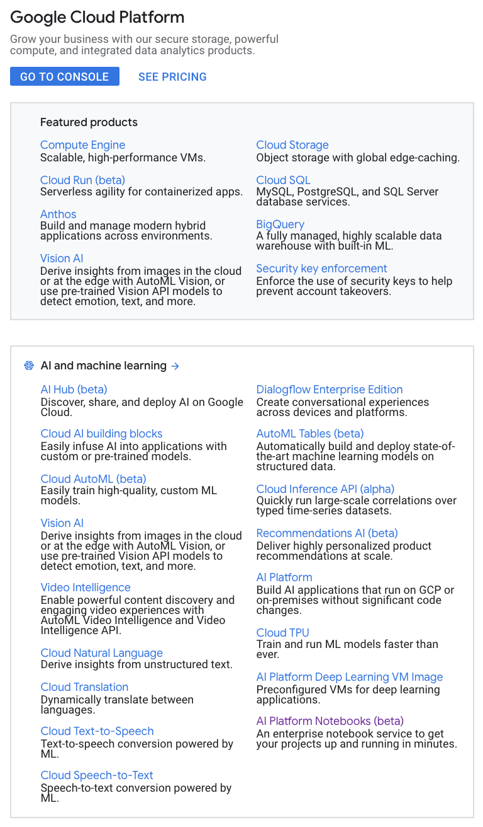
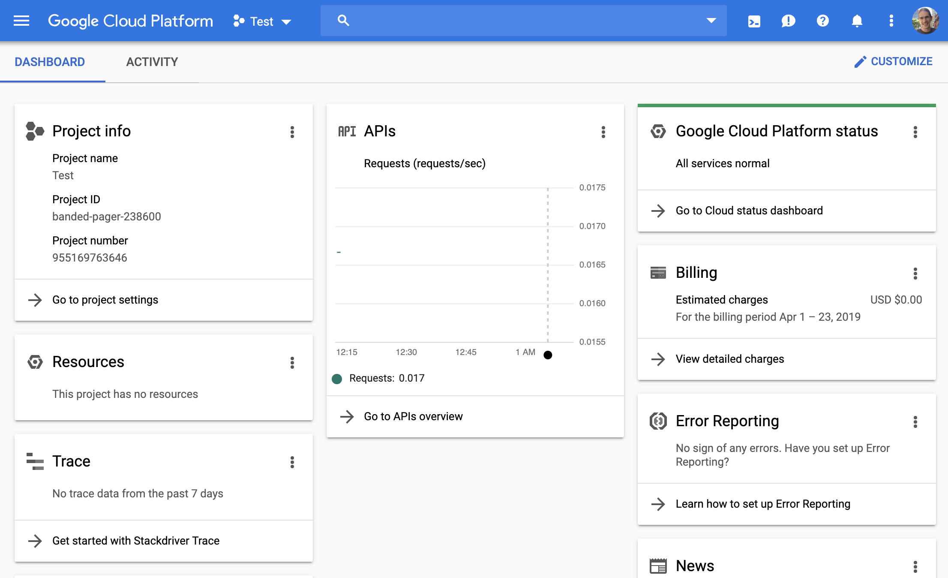
Cloud computing: Google
Google’s overall cloud platform is Google Cloud Platform (GCP)
Its main service within this is the Google Compute Engine (GCE)

Slide 73
Cloud computing: the basics
A typical cloud computing process is:
Choose a region within which to operate.
Configure a type of virtual machine (number / oomph of CPUs).
Attach VM instances to (virtual) local or network storage.
Optionally, this storage can start with a default image or container that contains a pre-specified environment with pre-installed software.
Provision those instances to run for periods of time.
Once an instance is provisioned, it can be accessed just like any remote server, either directly (ssh) or through web or otherwise managed services.
Most cloud computing is pay-as-you-go.
This can be good – see $200 example above.
This can be bad – everything costs something.

Slide 74
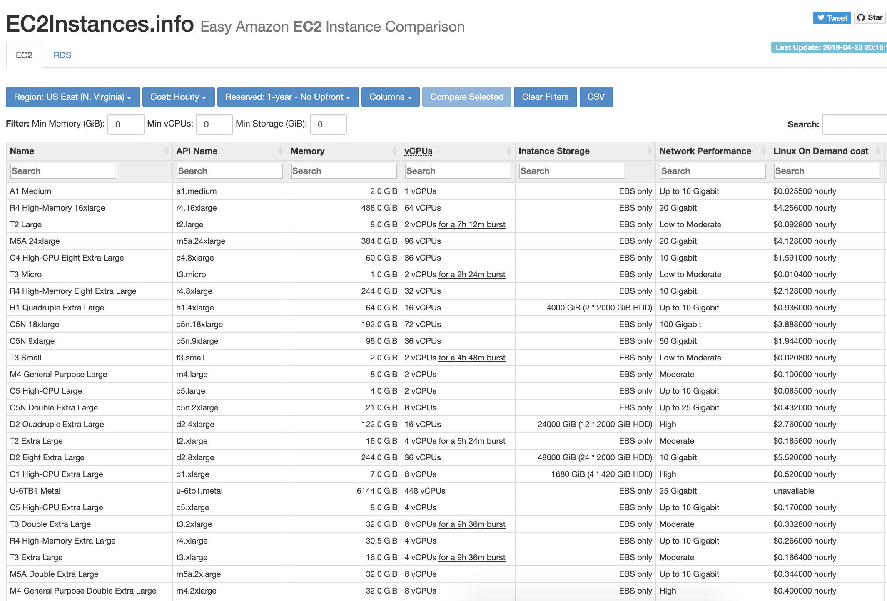
Cloud computing: the basics

Slide 75
How can I possibly remember all of this?

Slide 76
Don’t!
Google is your friend.
https://www.vikingcodeschool.com/web-development-basics/a-command-line-crash-course
https://learntocodewith.me/command-line/unix-command-cheat-sheet/
http://www.pixelbeat.org/cmdline.html
https://www.howtogeek.com/412055/37-important-linux-commands-you-should-know/
https://www.cs.cmu.edu/~213/recitations/fwunixref.pdf
https://learnpythonthehardway.org/book/appendixa.html
And more that we’ll see during the lab…

Slide 77
https://canvas.harvard.edu/courses/71191/quizzes/162985

